Slide 1
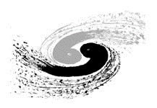

Reinforcement learning control of beam collision at IP for BEPCII
Jiaqi Fan & Jiuqing Wang
14/09/2024

Slide 2
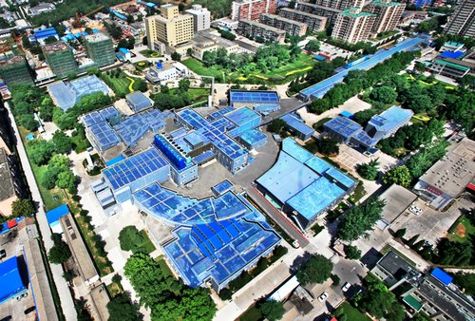
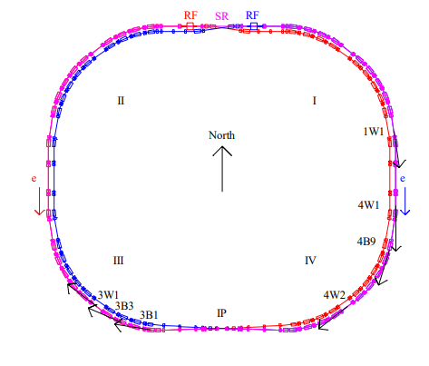
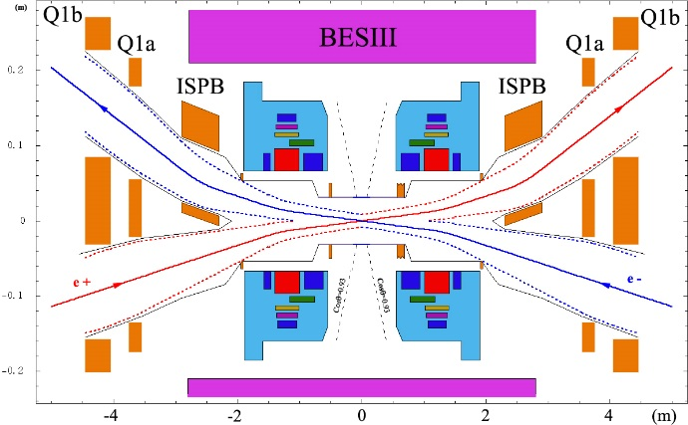
Introduction
The upgrade project of Beijing Electron–Positron Collider (BEPCII)
linear accelerator
Beijing Spectrometer(BESIII)
Storage Ring

Slide 3
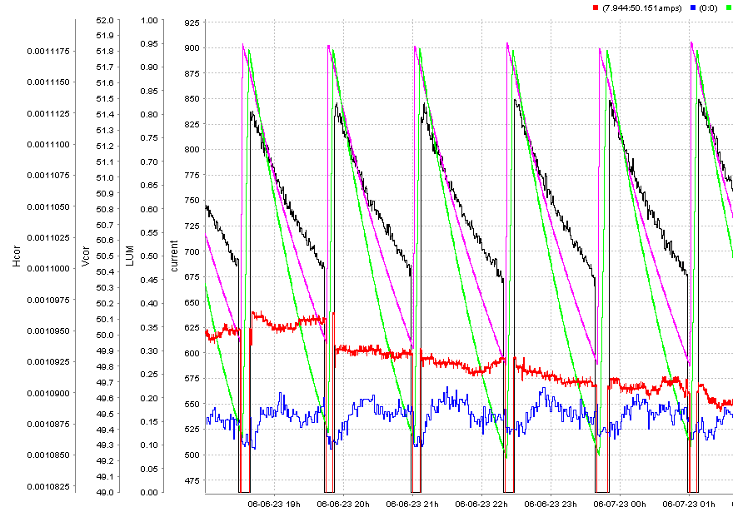
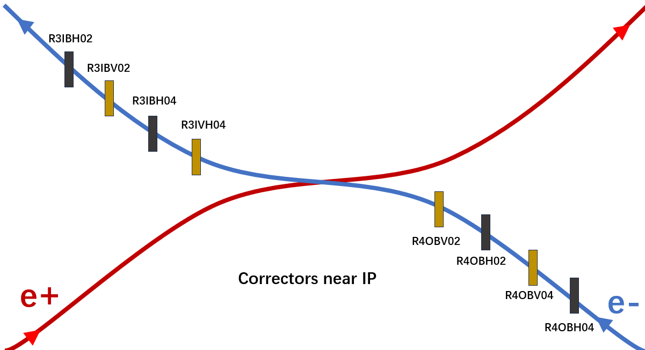
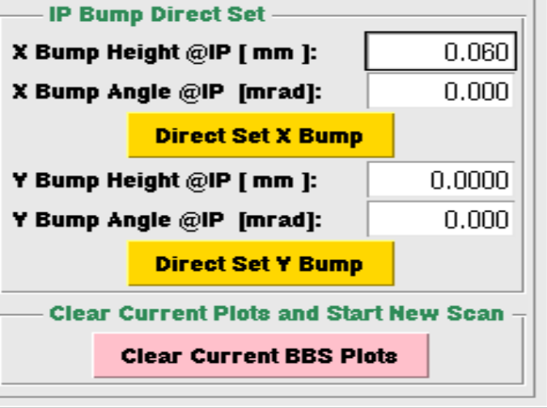
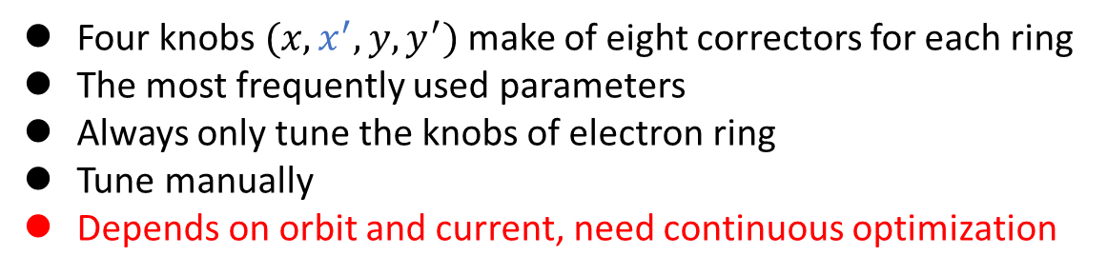

Introduction
Transverse offset in displacement and angular deviation (Offset)
A physics run
Four knobs $(x,x^{′},y,y^{′})$ make of eight correctors for each ring
The most frequently used parameters
Always only tune the knobs of electron ring
Tune manually
Depends on orbit and current, need continuous optimization
Manual operation!
Scan one by one!
Offset knobs of $e^{−}$ ring
Y plane offset
X plane Offset

Slide 4
Introduction
Control method:
Feedback Method:
  Orbit feedback (orbit-driven system)
  Absent of Global orbit feedback &
  Changing target orbit
  KEKB: based on measurements of the beam orbits around the IP. Can suppresses the luminosity loss due to the vertical orbit drift to below 1%.
Optimization Method:
  Luminosity optimization (luminosity-driven system)
  Slow response speed &
  Exploration losses
  Optimization: can only find a temporary optimal result in a dynamic environment.
  PEP-II: dithering feedback: luminosity-driven , ~3% losses on luminosity.
Reinforcement learning:
  No exploration and More efficient optimization

Slide 5
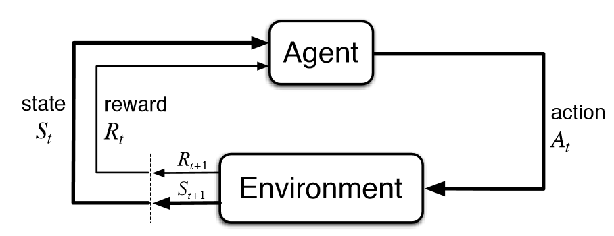
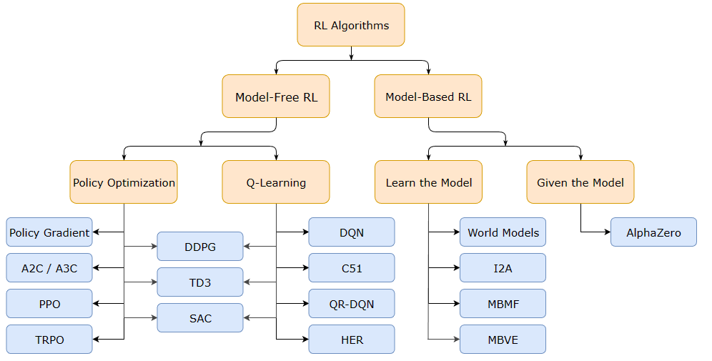
Reinforcement learning
RL: Train an Agent to make the decision of what action to take to get more reward from environment
Online consideration: easy for training
optimal
Step size
Start
Discrete action space

Slide 6
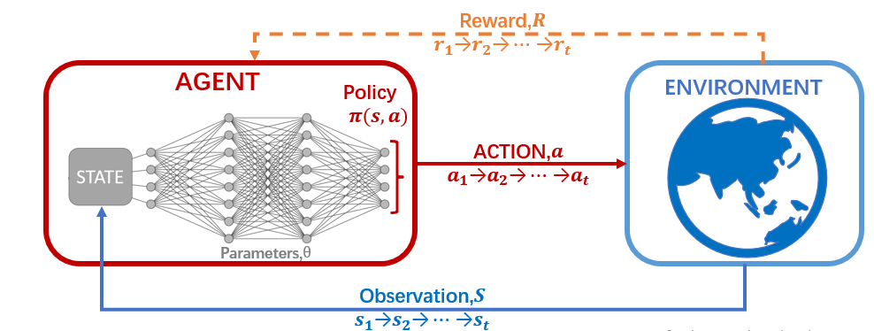
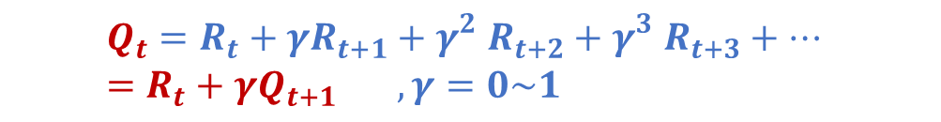
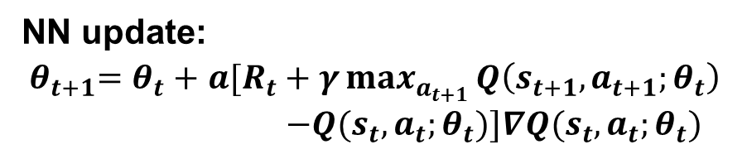
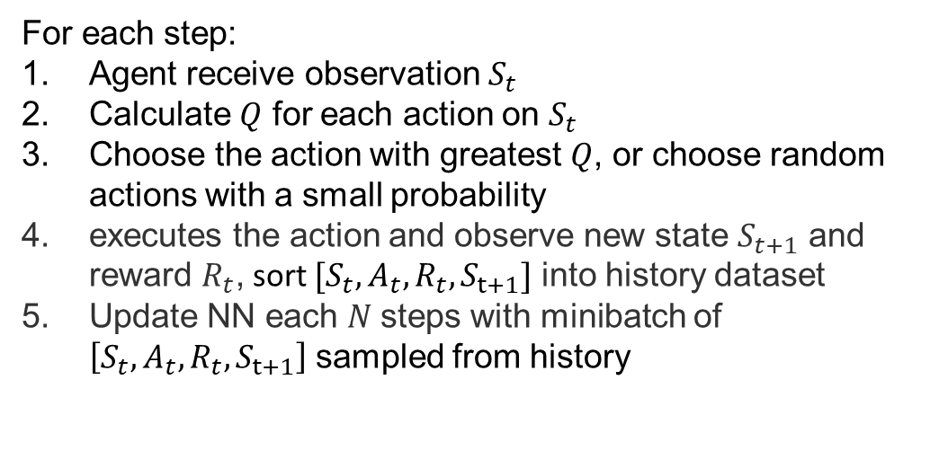
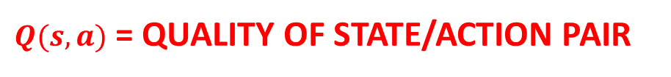
Deep Q-Network(DQN)
For each step:
Agent receive observation $S_{t}$
Calculate $Q$ for each action on $S_{t}$
Choose the action with greatest $Q$, or choose random actions with a small probability
executes the action and observe new state $S_{t+1}$ and reward $R_{t}$, sort $[S_{t},A_{t},R_{t},S_{t+1}]$ into history dataset
Update NN each $N$steps with minibatch of $\left[S_{t},A_{t},R_{t},S_{t+1}\right]$ sampled from history
$Q(s,a)$ = QUALITY OF STATE/ACTION PAIR
$$Q_{t}=R_{t}+{γR}_{t+1}+{γ_{}^{2}R}_{t+2}+{γ_{}^{3}R}_{t+3}+… =R_{t}+{γQ}_{t+1} ,γ=0\sim 1$$
NN update:
${ θ}_{t+1}=θ_{t}+$ $a[R_{t}+γ\max_{a_{t+1}}^{}{Q\left(s_{t+1},a_{t+1};θ_{t}\right)}$
$$−Q(s_{t},a_{t};θ_{t})]∇Q(s_{t},a_{t};θ_{t})$$

Slide 7

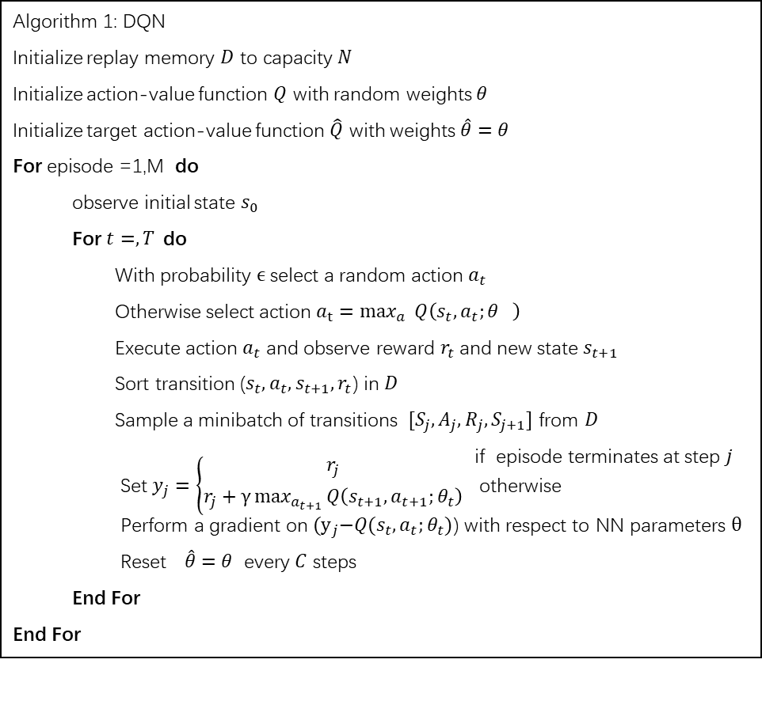
Deep Q-Network(DQN)
Algorithm 1: DQN
Initialize replay memory $D$ to capacity $N$
Initialize action-value function $Q$ with random weights $θ$
Initialize target action-value function $\hat{Q}$ with weights $\hat{θ}=θ$
For episode =1,M do
observe initial state $s_{0}$
For $t=, T$do
  With probability $ϵ$ select a random action $a_{t}$
  Otherwise select action ${a_{t}=max}_{a}^{}{Q\left(s_{t},a_{t};θ_{}\right)}$
  Execute action $a_{t}$ and observe reward $r_{t}$and new state $s_{t+1}$
  Sort transition ($s_{t},a_{t},s_{t+1},r_{t}$) in $D$
  Sample a minibatch of transitions $[S_{j},A_{j},R_{j},S_{j+1}]$ from $D$
  if episode terminates at step $j$
  Set $y_{j}=\left\{\begin{aligned}r_{j} \\ r_{j}+γ\max_{a_{t+1}}^{}{Q\left(s_{t+1},a_{t+1};θ_{t}\right)}\end{aligned}\right.$ otherwise
  Perform a gradient on${(y}_{j}−Q(s_{t},a_{t};θ_{t})$) with respect to NN parameters $θ$
  Reset$\hat{θ}=θ$ every $C$ steps
  End For
End For
How to choose parameters?
State: more parameters, more data to train
Less parameters —— ever-changing environment
[current ,offset value ,orbit value] – 18 dims
Action: [x, y, y’] → [a1,a2,a3,a4,a5,a6]
Reward: small-angle luminosity
How to train our model? Pre- training
History data of manual operation?
Data from simulation ?

Slide 8
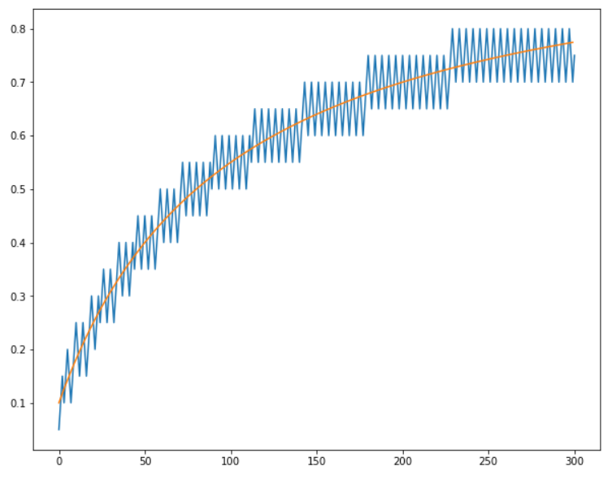
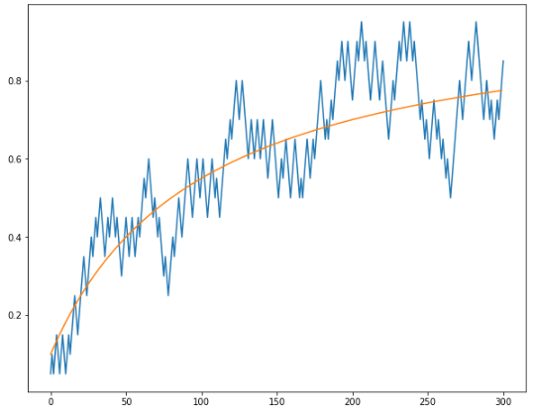
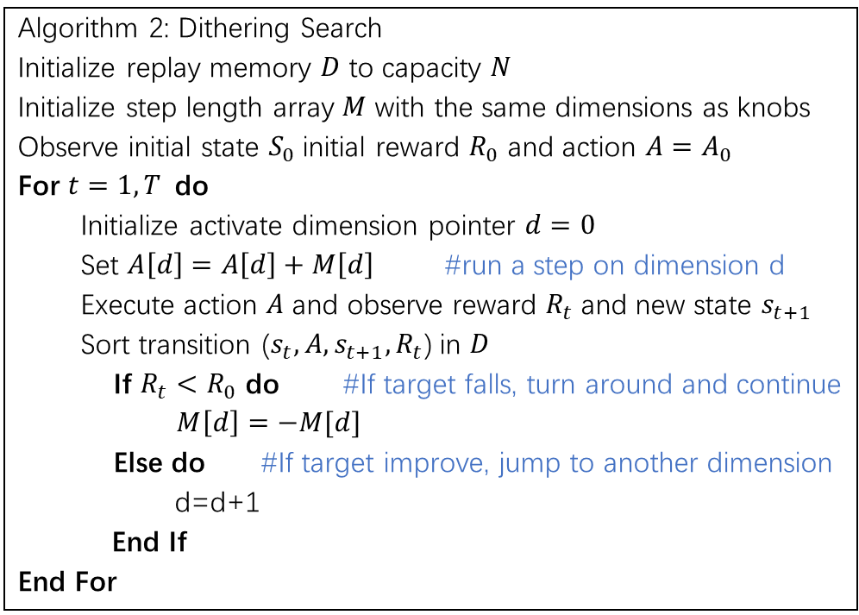
Reinforcement learning control for BEPCII
How to get perfect history data? —— Dithering search method
Algorithm 2: Dithering Search
Initialize replay memory $D$ to capacity $N$
Initialize step length array $M$ with the same dimensions as knobs
Observe initial state $S_{0}$initial reward $R_{0}$ and action $A=A_{0}$
For $t=1, T$do
Initialize activate dimension pointer $d=0$
Set $A\left[d\right]=A\left[d\right]+M\left[d\right]$ #run a step on dimension d
Execute action $A$ and observe reward $R_{t}$and new state $s_{t+1}$
Sort transition ($s_{t},A,s_{t+1},R_{t}$) in $D$
If $R_{t}<R_{0}$ do #If target falls, turn around and continue
$M\left[d\right]=−M[d]$
Else do #If target improve, jump to another dimension
d=d+1
End If
End For
Stable env
Noisy env

Slide 9
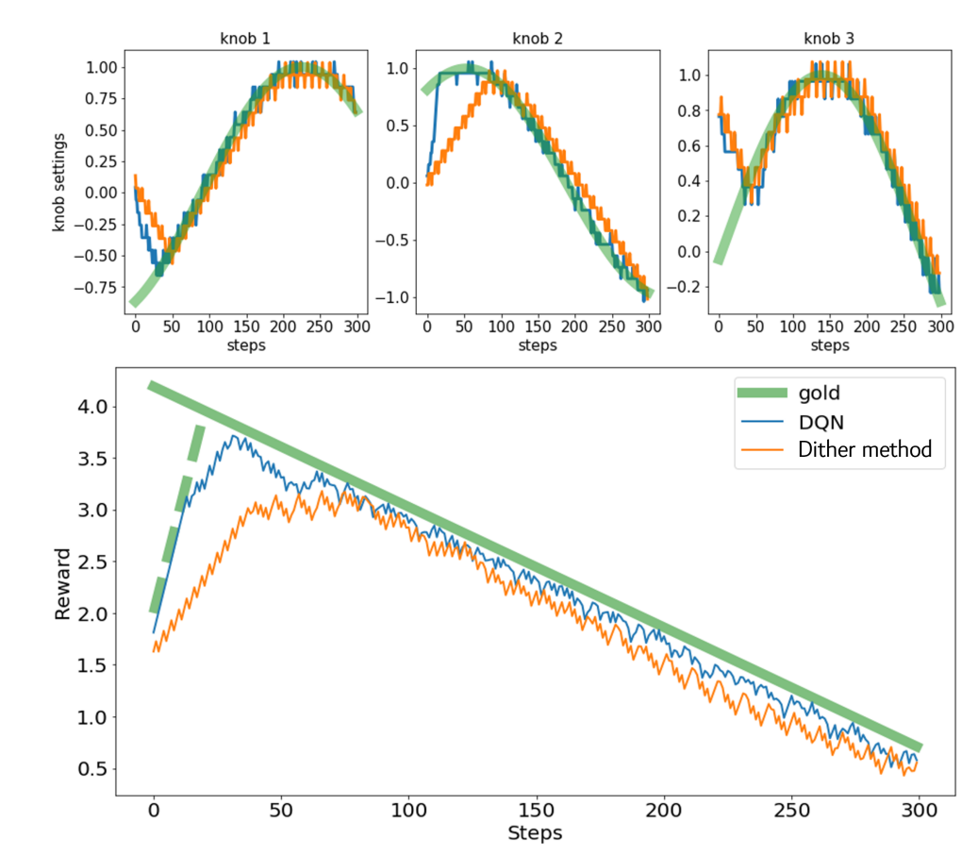
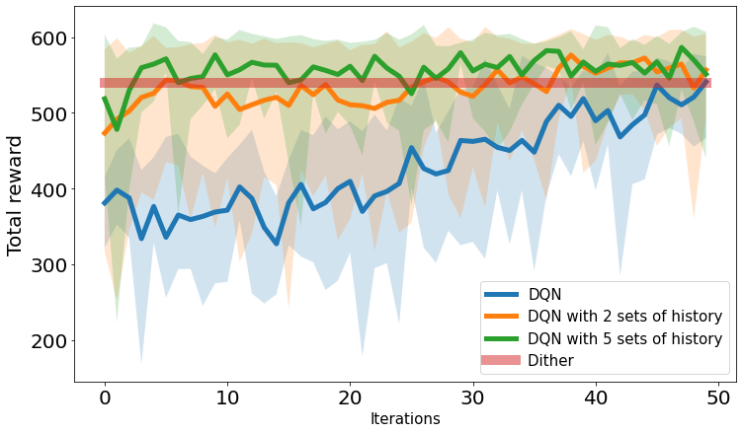
Reinforcement learning control for BEPCII
Simulation result :
DQN after pre-trained can training faster.
DQN can perform better than dither search

Slide 10
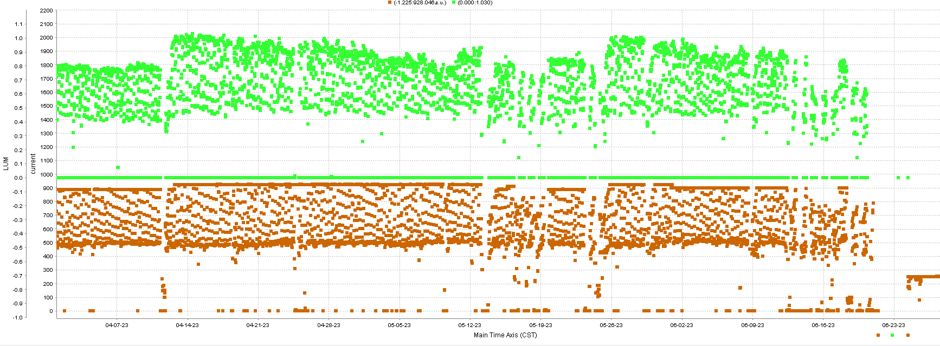
Reinforcement learning control for BEPCII
The method has been used about 8 months:
test
Use for daily operation

Slide 11
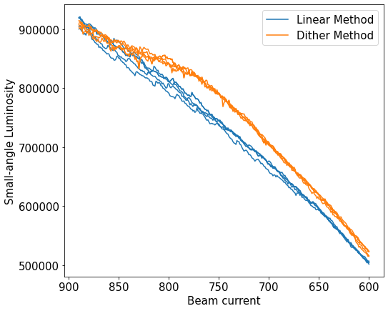
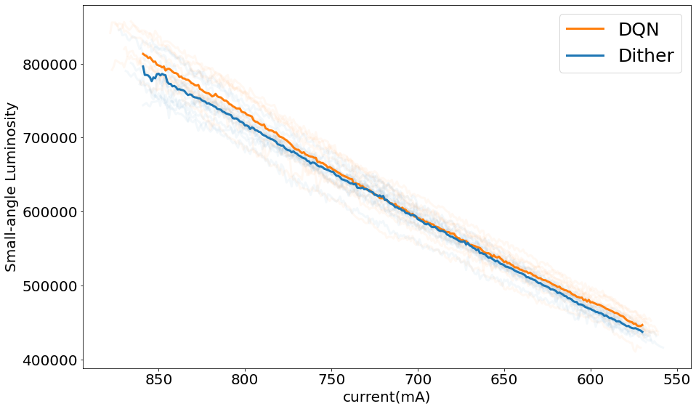
Results
Increase on Luminosity.
DQN do not perform much better than dither method
in regular operation. The statistical results indicate an improvement of approximately 1%.
Dither method make a 2-4% increase on integral luminosity compared to the always used linear method

Slide 12
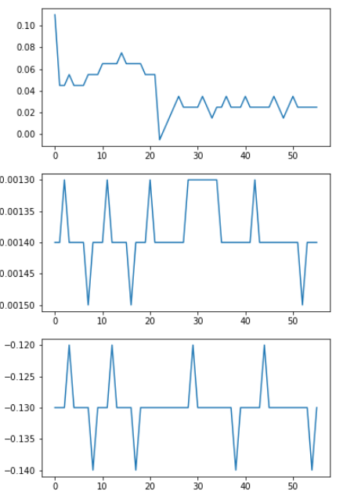
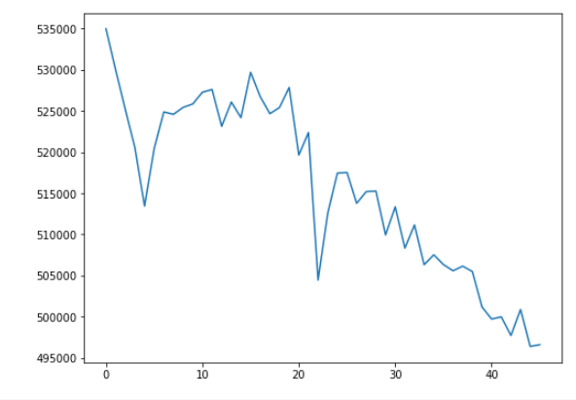
Results
Add a offset on X : -0.5
X
DQN Search: 5 steps
Y
Reward
Dithering search
Take 16 steps
Y’
step
Search every direction
Focus on X

Slide 13
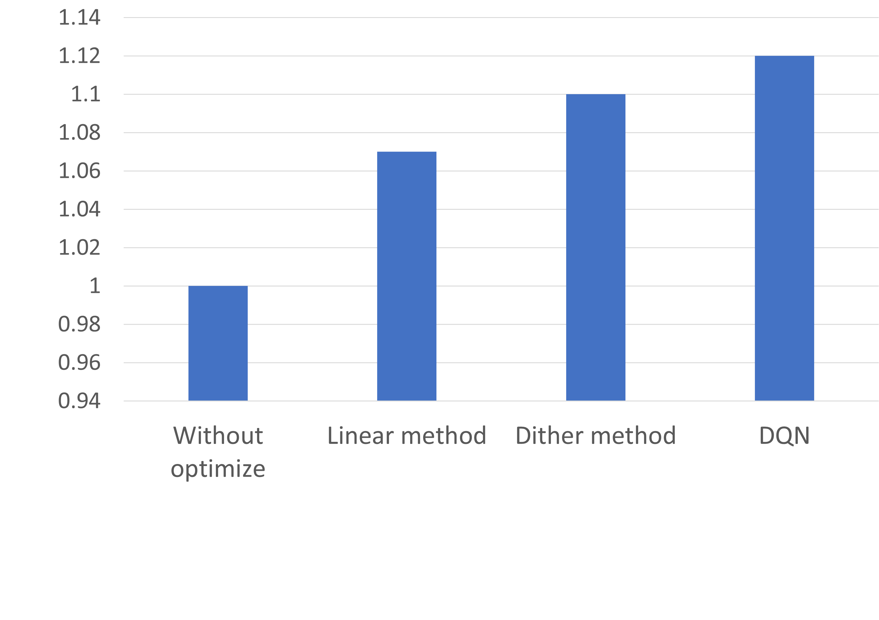
Results
Increase on Luminosity.
Variance 0.42 0.2 0.12

Slide 14
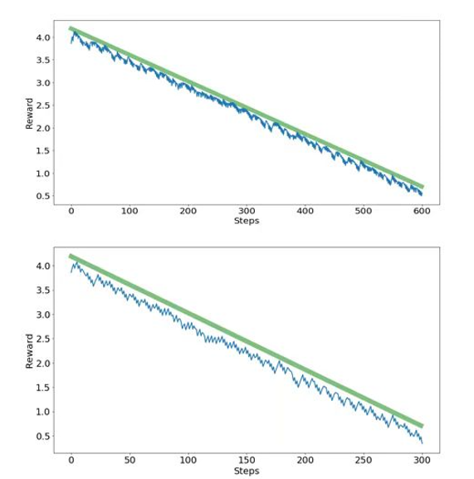
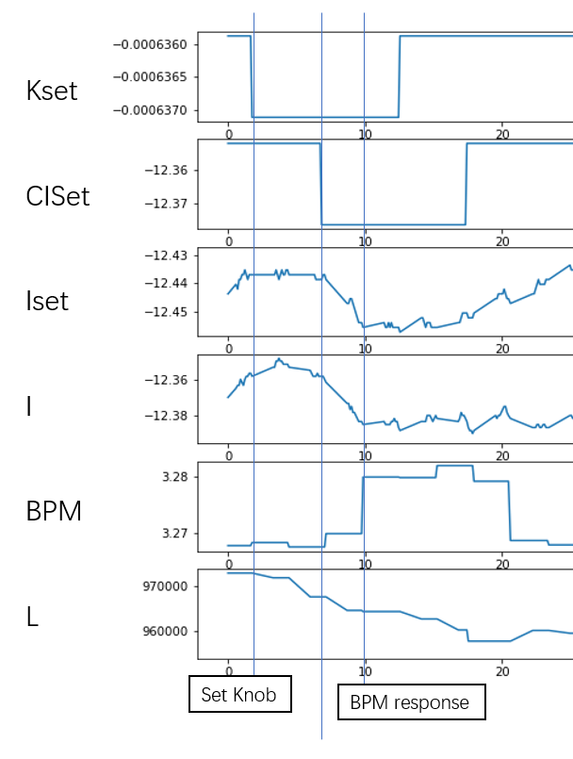
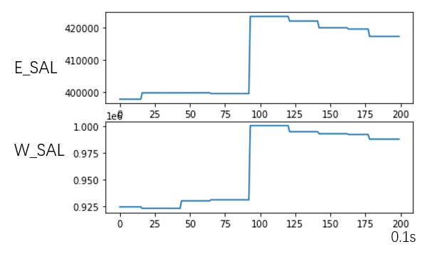
Next step
Limitations: Discreate action space response time
12s
6s

Slide 15
Next step
Faster response
Faster optimize speed
More history data
Smaller action step
(continuous action space)
More stable environment
Faster training
More luminosity optimize knobs
Higher luminosity

Slide 16
Thank you!

