Slide 1
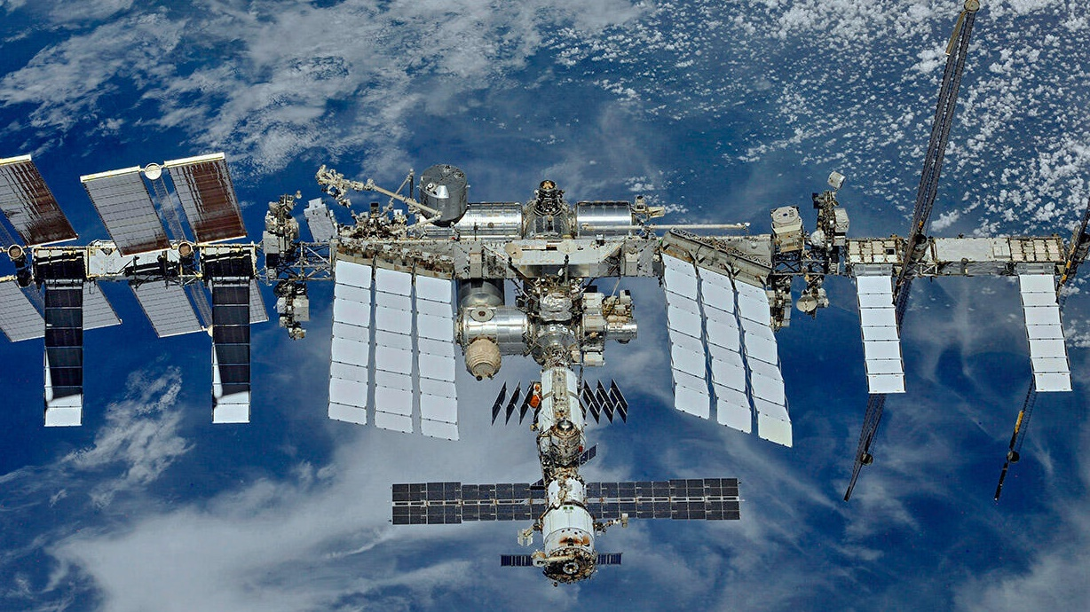
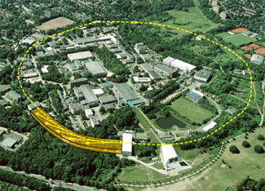
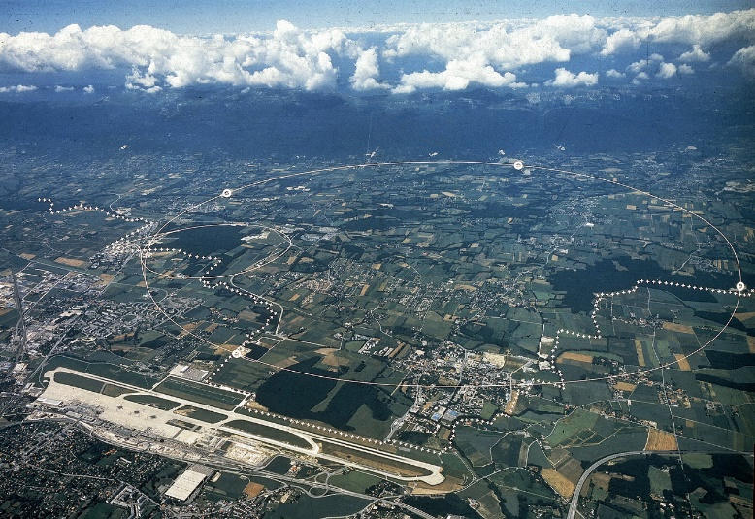
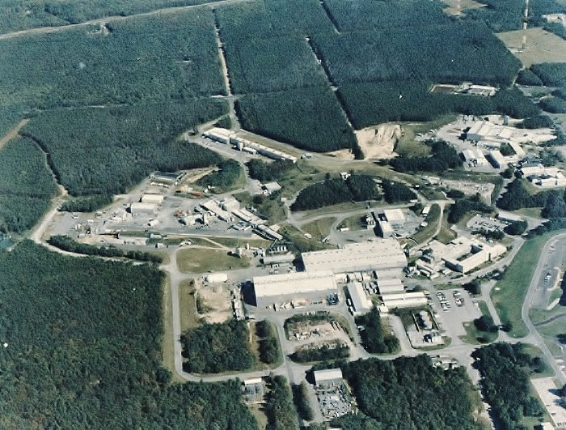


Discovery of the J Particle at Brookhaven National Laboratory
and Physics of Electrons and Positrons
AMS
Space Station
DESY
Brookhaven
CERN
Oct. 20, 2024
S. Ting

Slide 2
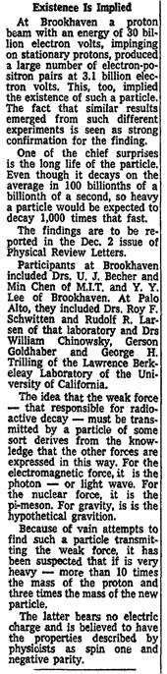
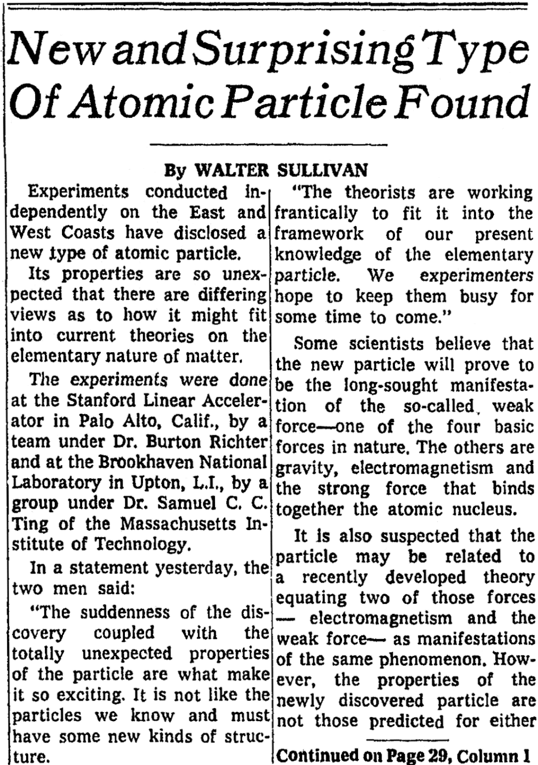
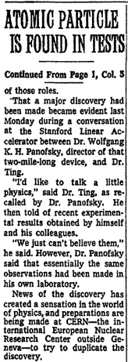
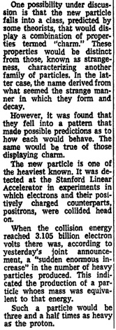
It has been 50 years since: The discovery of a new form of matter
New York Times, Nov 17, 1974, page 1.
2

Slide 3
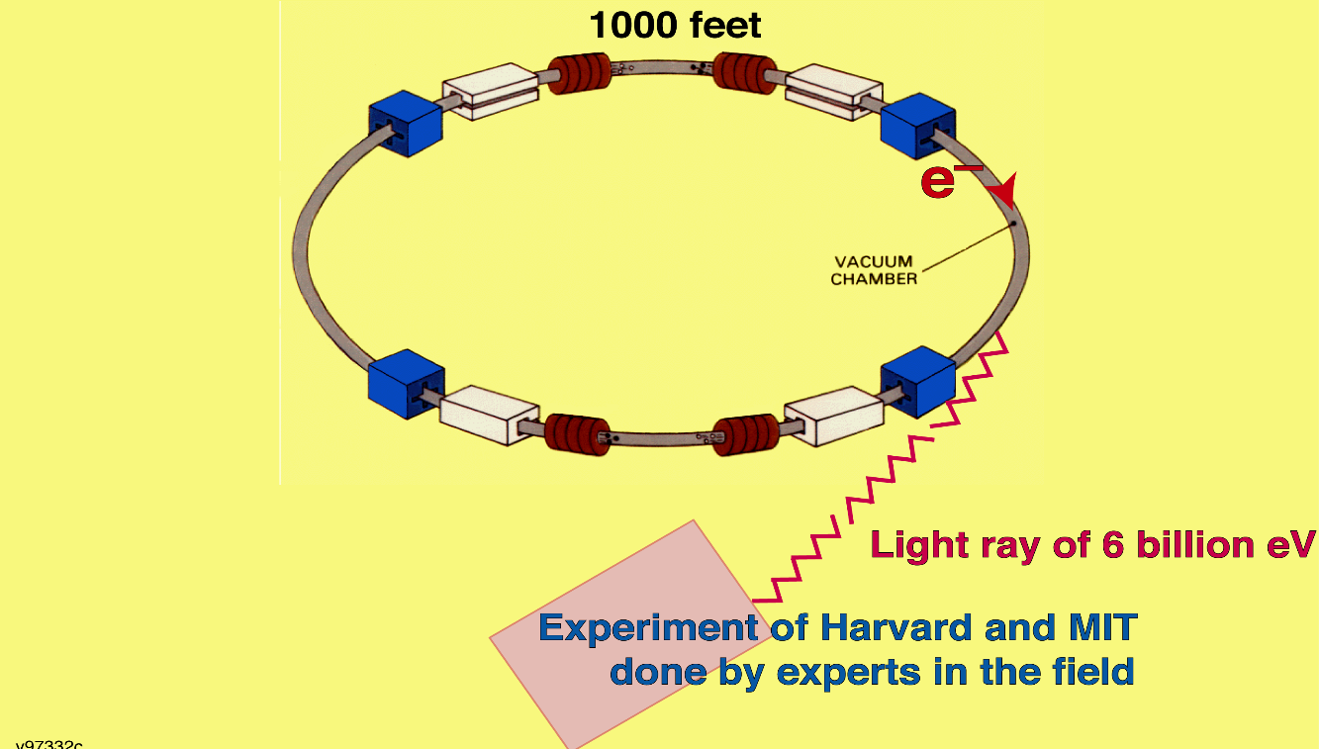




First Experiment: Measuring the size of electrons
Modern Electromagnetic Theory (QED) requires that electrons have no measurable radius (Feynman, Schwinger, Tomonaga - 1948)
The theory agreed well with all experiments until a 6 GeV electron accelerator
(CEA) provided a most sensitive measurement of the size of the electron.
The Harvard experiment was done by the world’s leading experts in the field
who had spent many years to develop the technology.
300 meters
CEA
(Harvard and MIT)
e⁺
γ
Δp
Nucleus
e⁻
Highest energy electron accelerator
Δp · Δr ≈ ħ
Harvard experiment
3

Slide 4
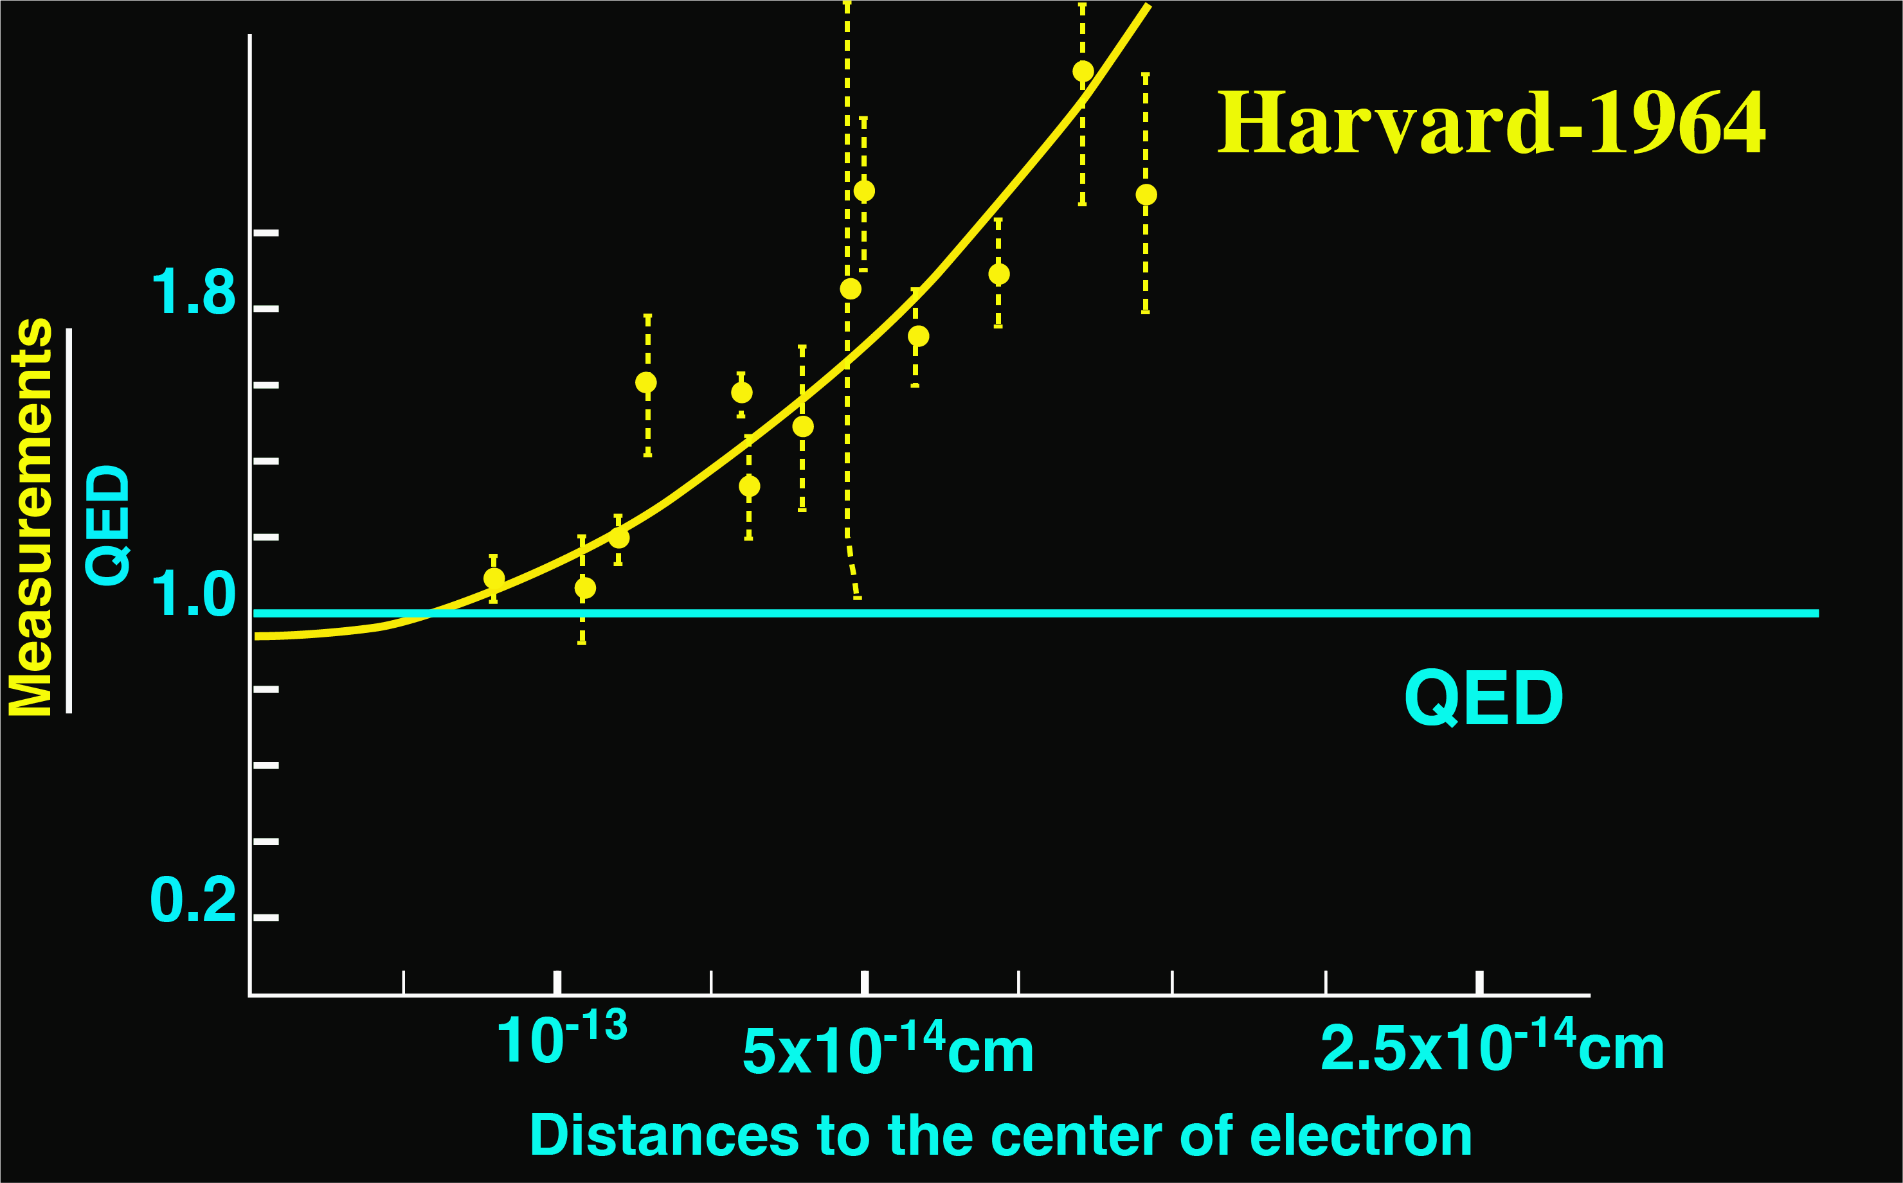
This data shows that the electron has a radius of ~ 10⁻¹³ to 10⁻¹⁴ cm.
Most importantly, this experiment was independently
confirmed by a group at the Cornell Electron Accelerator.
4

Slide 5
Since those results touch upon the foundation of Modern Physics,
I decided to perform the experiment with an independent method
At that time, I knew nothing about electron physics,
so I received no support in the U.S.
In 1965, I decided to leave Columbia University and move to
the newly built 6 billion electron-Volt electron accelerator (DESY)
in Hamburg, Germany
to re-measure the size of the electron
5

Slide 6
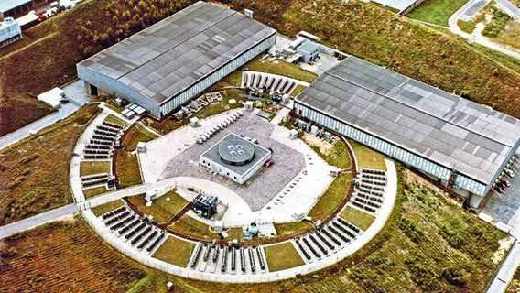
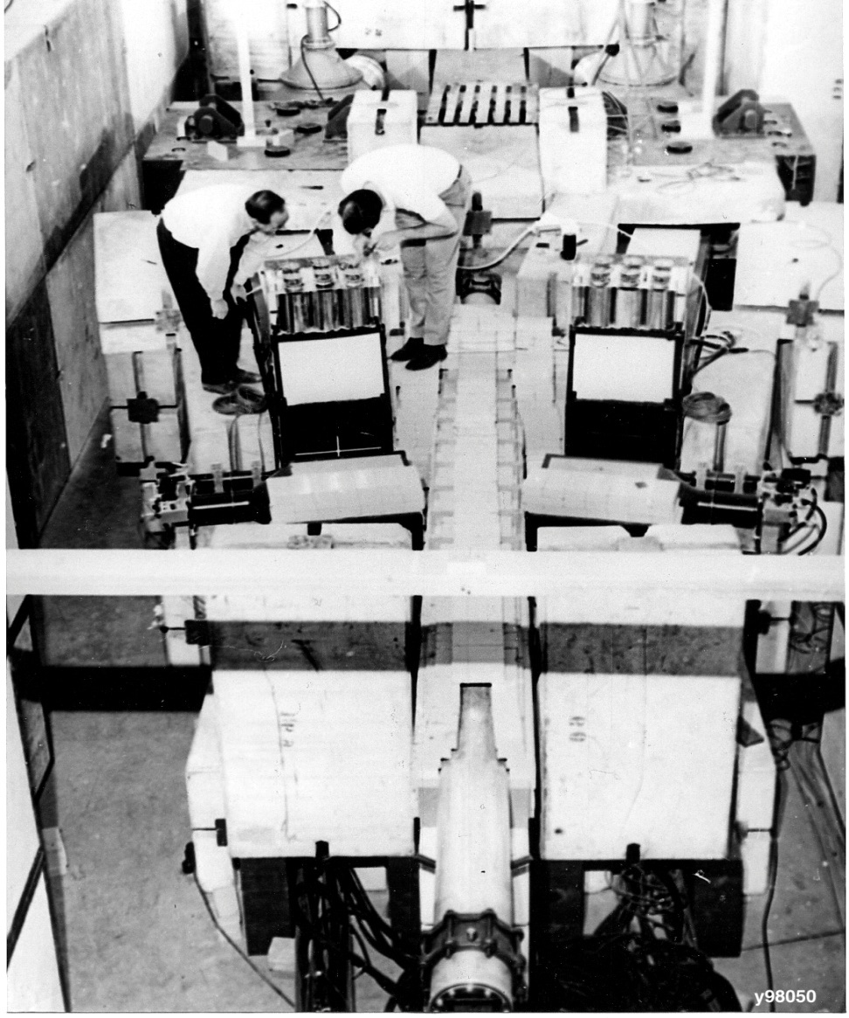
1965-1972: First set of experiments at DESY 6 GeV electron accelerator
The development of this type of
pair spectrometer
led to the J-Particle experiment.
Measuring electron-positron pairs (1966)
6

Slide 7

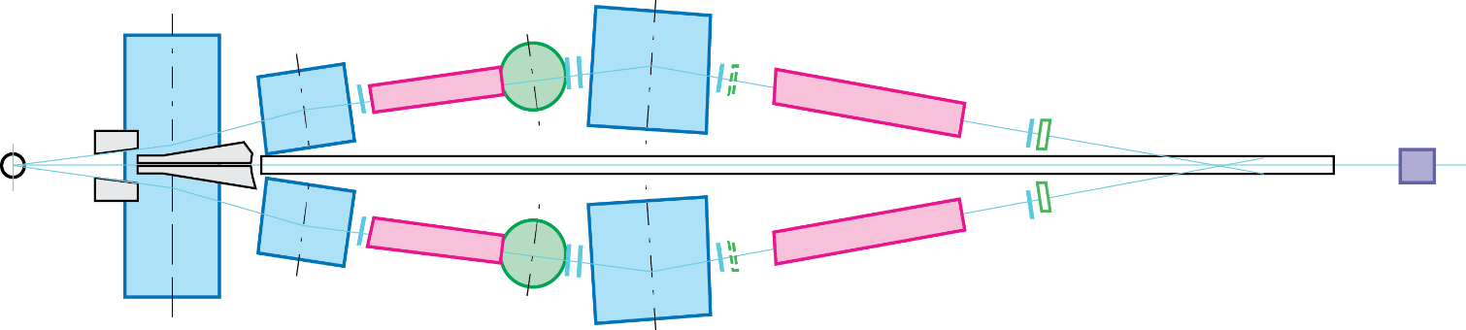
10¹¹ 𝛾/second
Experiment at DESY measuring electron-positron pairs (1966)
Target
Backgrounds
n, 𝛾, 𝜋
T
6 GeV
Unique features
None of the detectors see the target so they are not exposed to neutrons or gamma-rays backgrounds.
The acceptance is defined by counters,
not by the aperture of the magnet.
Using two Cherenkov counters separated by magnets on each arm to identify e±.
So that background e± produced from interactions in the first counter are swept away by the magnet and the e± identification of the two counters are independent.
Using Dipoles magnets and counters to measure the momentum (P).
Using calorimeters to measure the energy (E).
To reject large pion background, require E=P
Dipole Magnets
Cherenkov
Scintillation
Counters
identify electrons
measure
momentum
(P)
Cherenkov
Hodoscopes
Calorimeter
measure energy
(E)
identify electrons
PRL 18, 65 (1967)
PRL 161, 1344 (1967)
7
QM
7

Slide 8
In 1966, after 8 months, our group completed the experiment at DESY and discovered that:
The electron indeed has no measurable size: Radius < 10⁻¹⁴ cm
Measurements
QED
QED
Distance to the center of the electron
This result was first announced in 1966 at the “Rochester” conference at Berkeley
(now known as the International Conference on High Energy Physics).
On this occasion I met W.K.H. Panofsky, Dick Feynman, and I.I. Rabi.
I maintained close contact with them for many years.
8

Slide 9
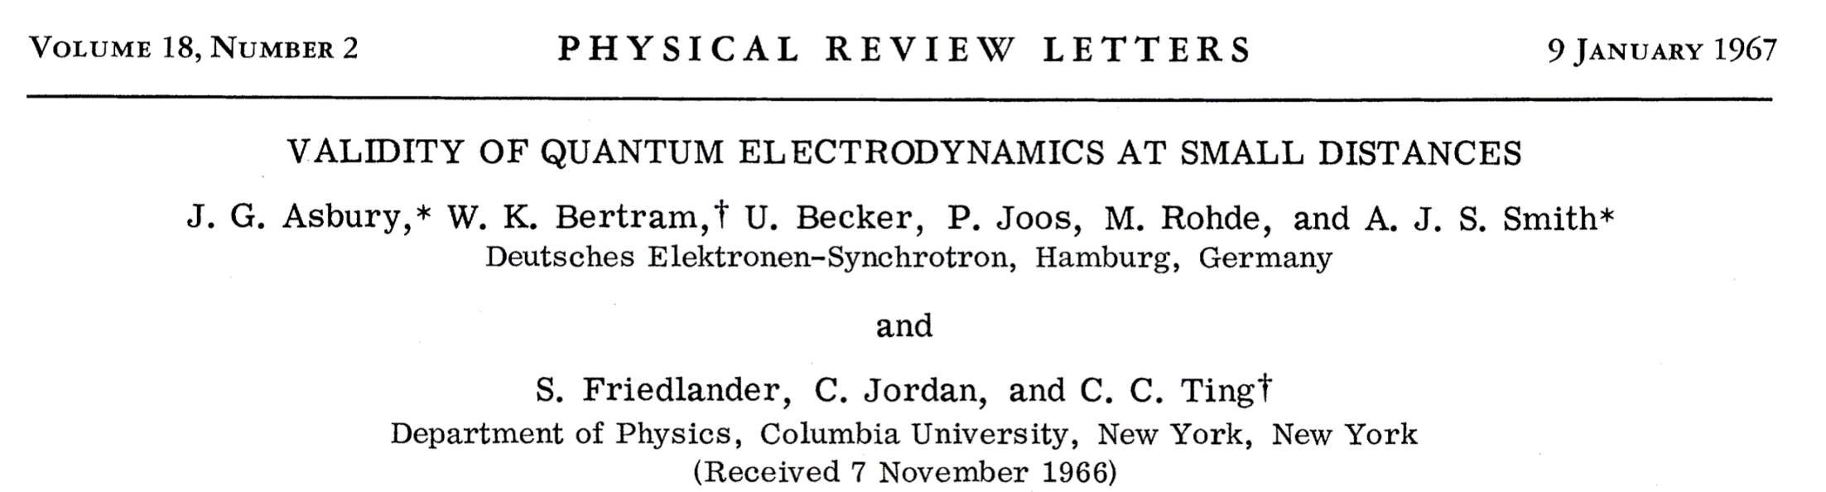
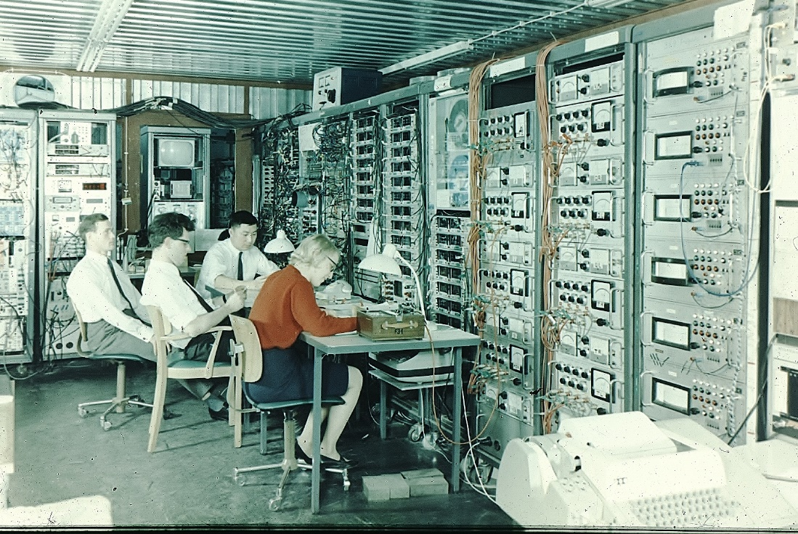
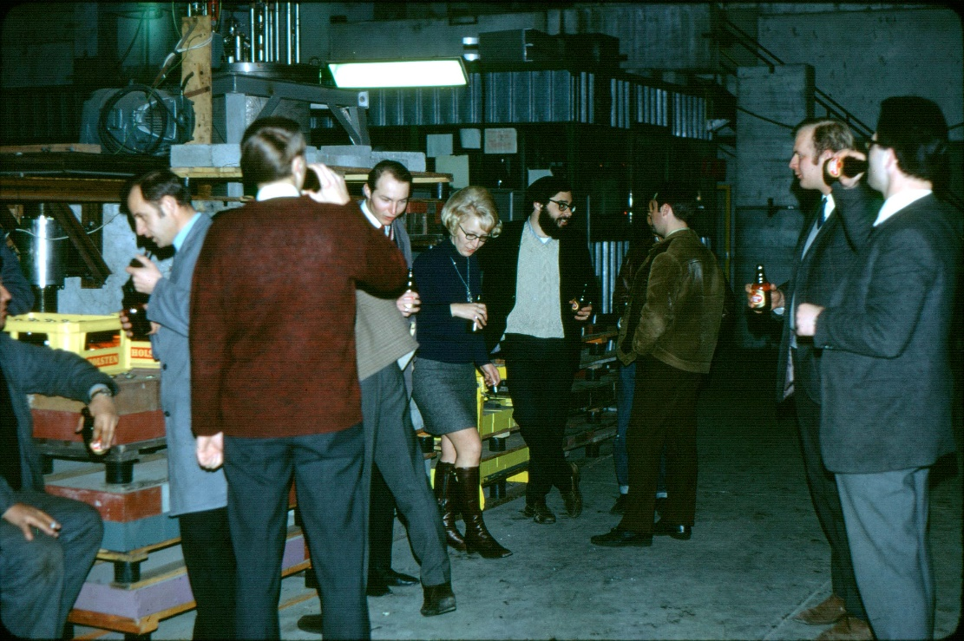
First Publication
Early Control room at DESY
with Miss I. Schulz,
Graduate Students U. Becker, and M Rohde.
The group was solely supported by DESY
9

Slide 10
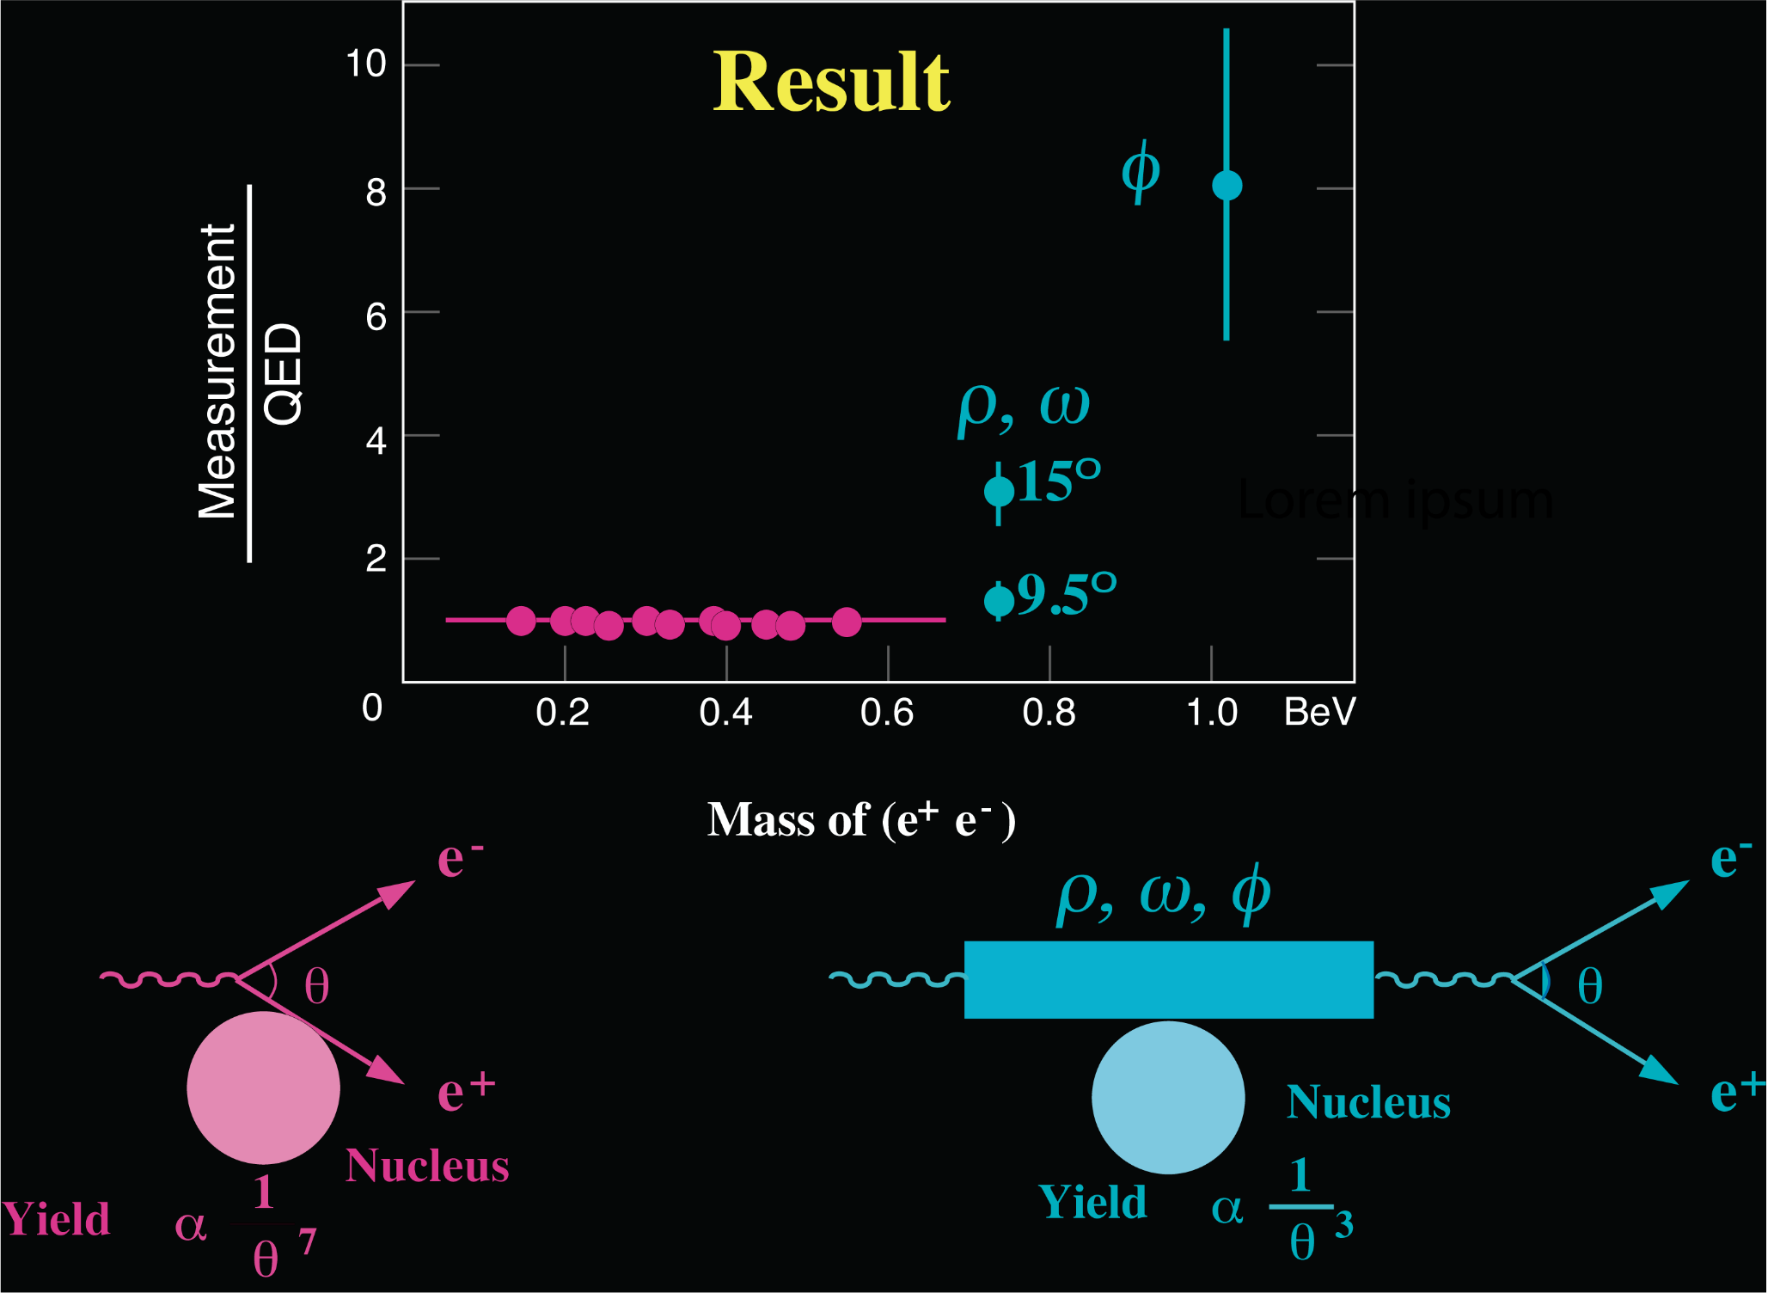
Experimental Results on Photons and Heavy Photons
Theory
QED
10

Slide 11
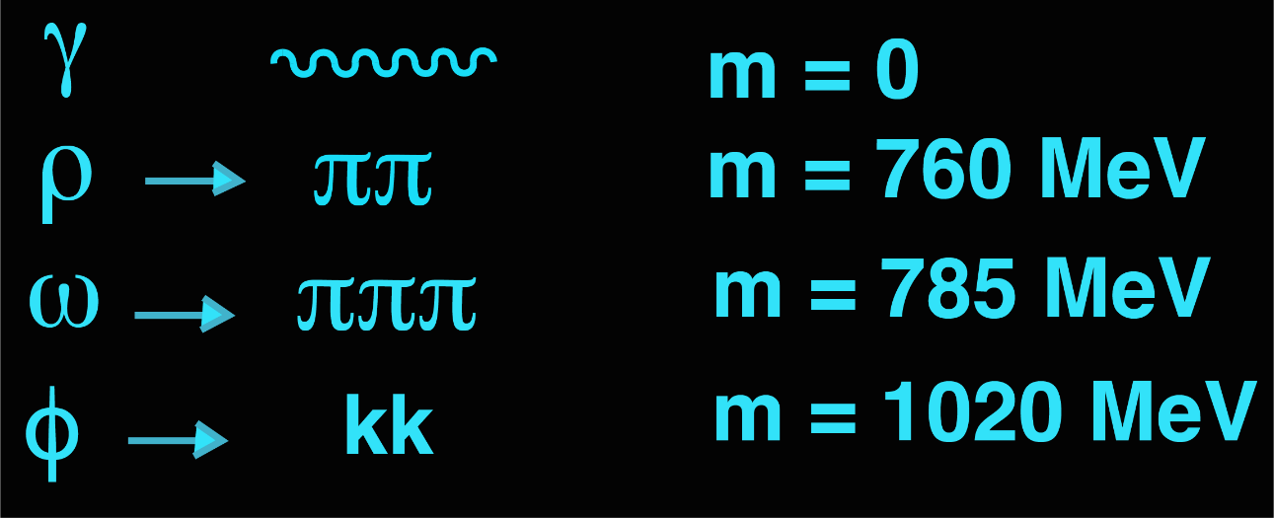

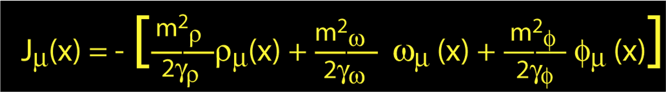
Second Experiment: Photons and Heavy Photons
Photons and Heavy Photons have the same quantum numbers
J = 1 C = -1 P = -1
This is known as the Vector Dominance Model
Experimental question: what is the relationship between Photons & Heavy Photons?
11

Slide 12
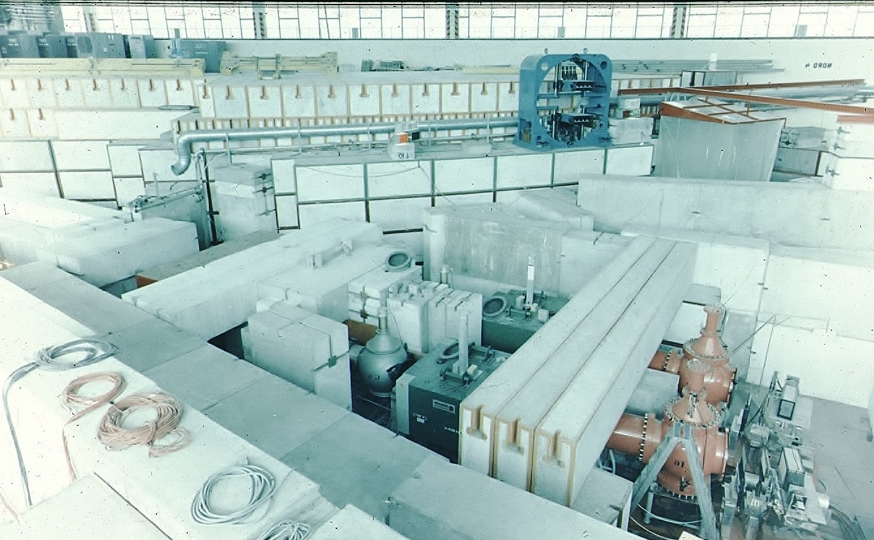
MIT Heavy Photon Experiments at DESY
with major improvements in coordinate and momentum resolution and in particle identification
Cherenkov Counter
Counter
Magnet
Cherenkov Counter
Counter
Calorimeter
12

Slide 13
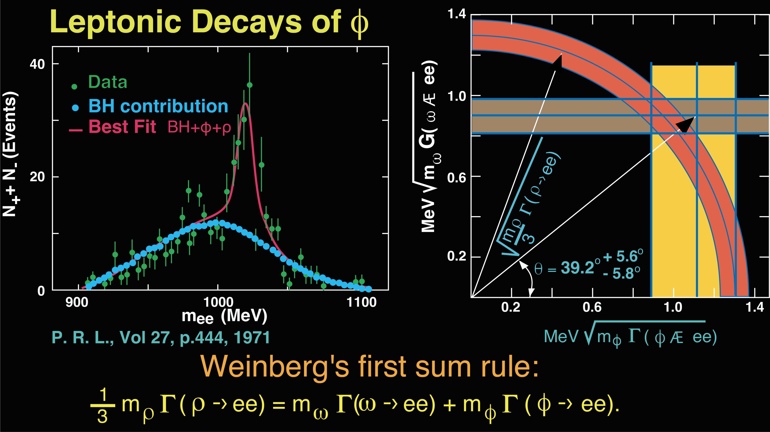
Verification of Weinberg’s first sum rule
→
13

Slide 14
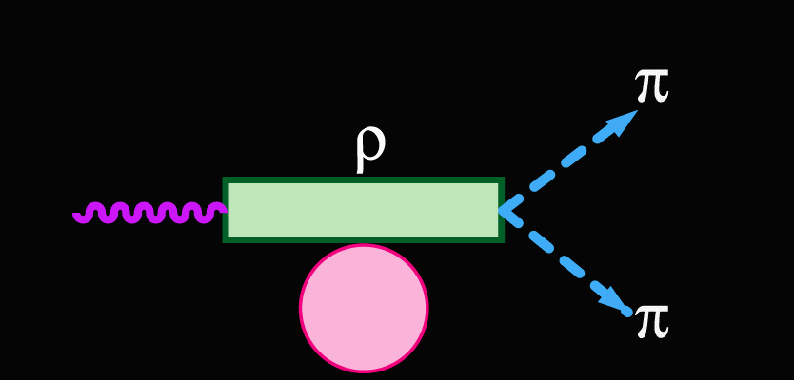
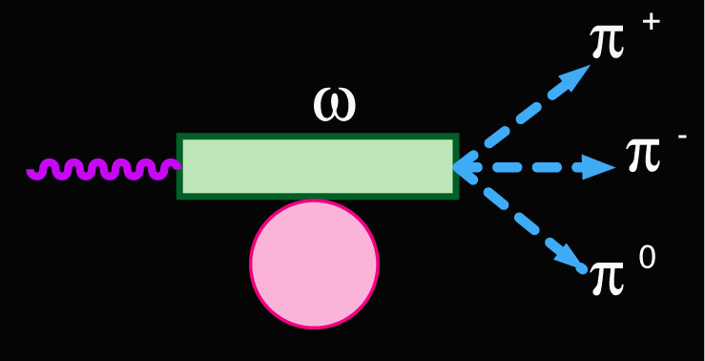
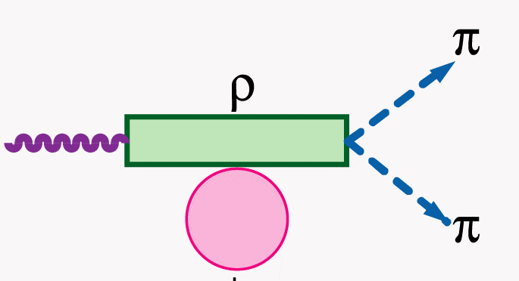
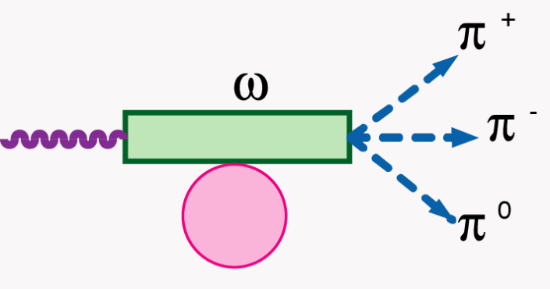
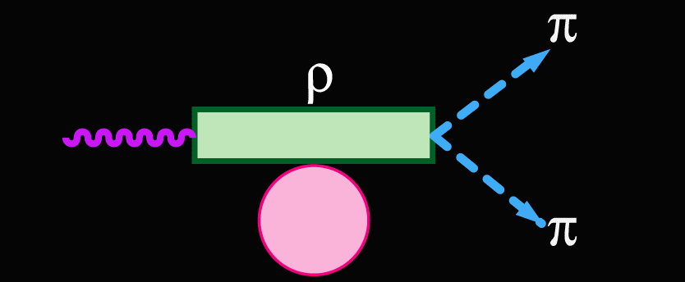
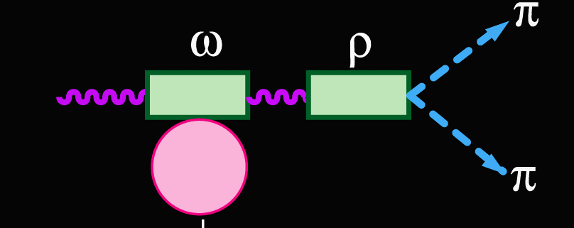
Observation of Forbidden $ω→2π$ Decays
No Interference
I = 1
I = 0
⊗
Interference
+
S. L. Glashow, P.R.L. 7, 469 (1961),
J. Bernstein and G. Feinberg, Nuovo Cimento 25, 1343 (1962)
M. Gordin, P.L. 30B, 347 (1969)
R. G. Sachs, P.R. D 2, 133 (1970) + …
J. Steinberger, P.R.L. 12, 517 (1964), BR< 0.1%
14

Slide 15
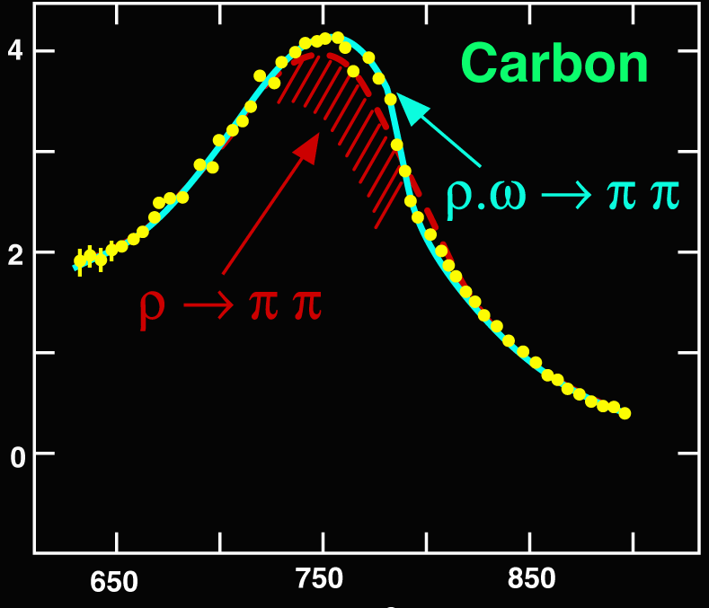
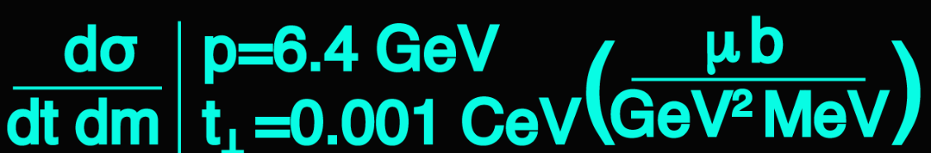

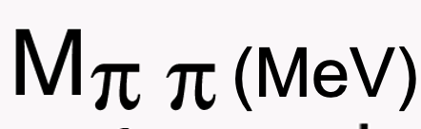
Observation of Forbidden $ω→2π$ Decays
P.R.L. 27, 888 (1971)
(MeV)
P.R.L. 27, 888 (1971)
15

Slide 16
Third Experiment: Discovery of the J particle
We learned that photons and heavy photons
are almost the same.
They transform into each other.
Question: Why should there be only three heavy photons
all at mass ~ 1 GeV?
To go to higher mass we moved to a higher energy accelerator
16

Slide 17
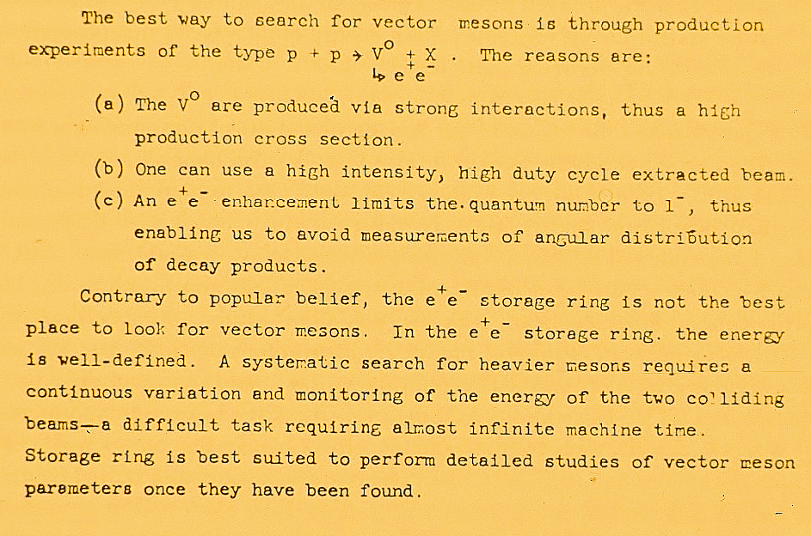
Page 4 of Proposal AGS E598 (1972) to Brookhaven National Lab
17

Slide 18
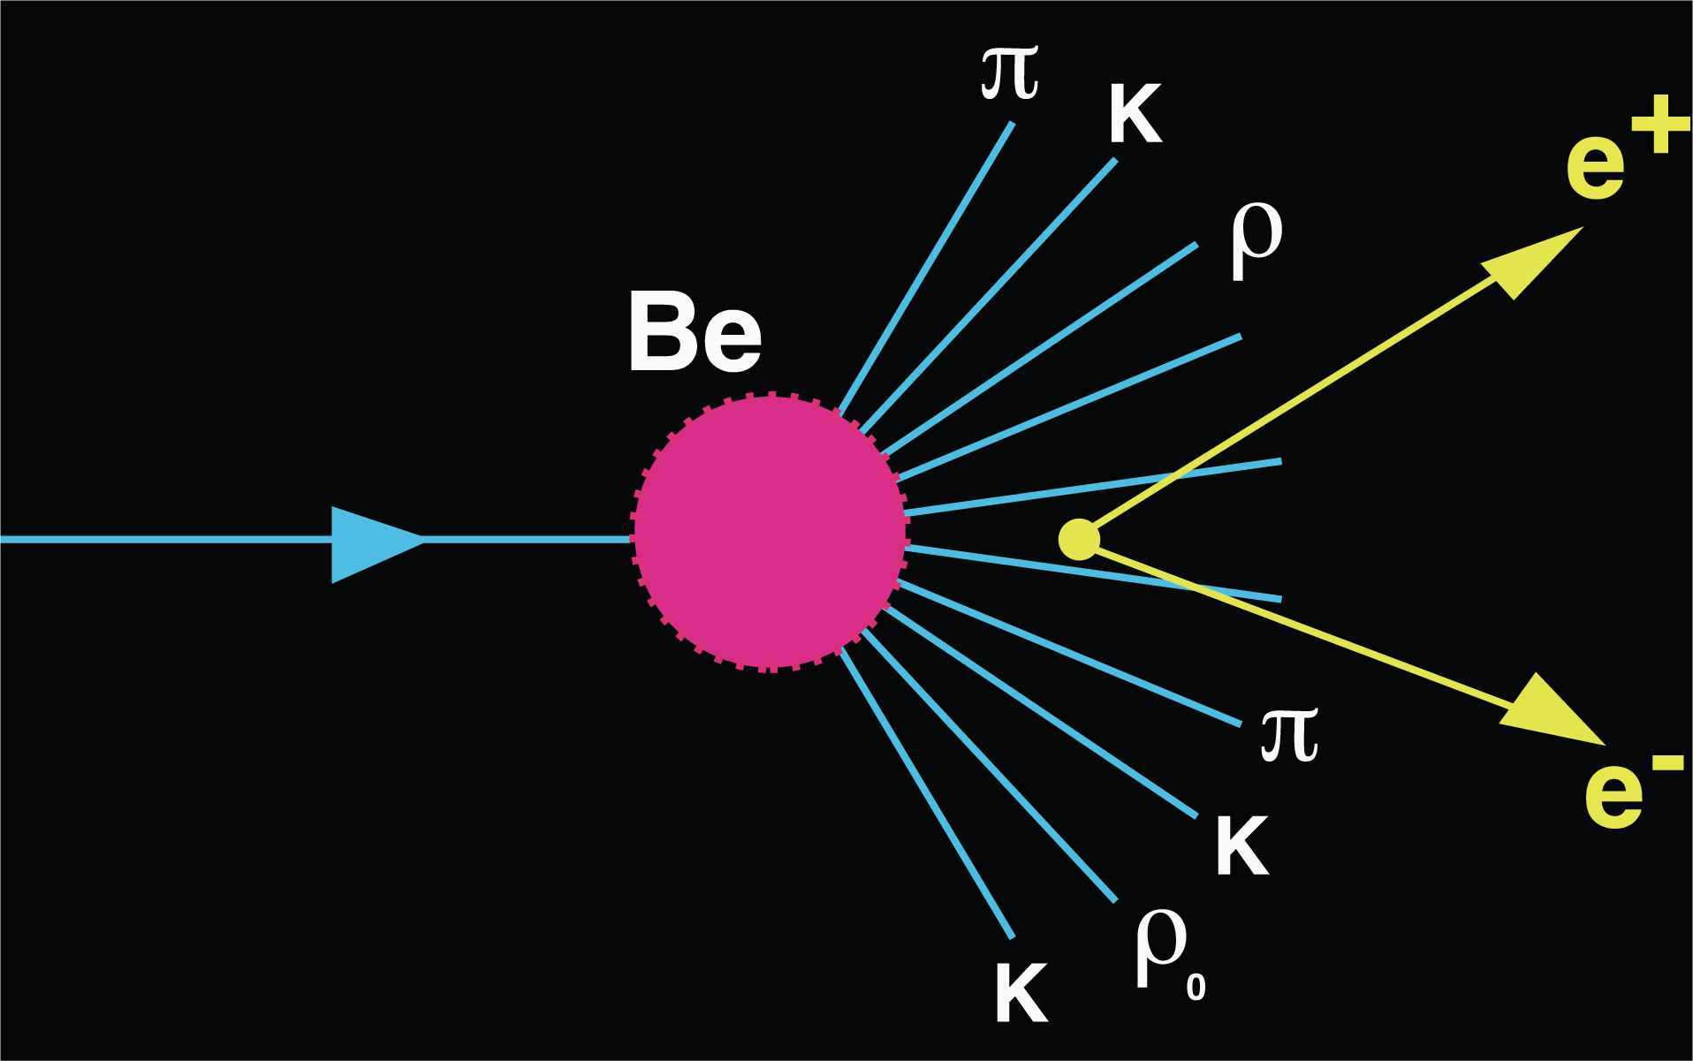

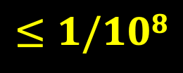
Brookhaven experiment
AGS E598
10¹² particles/sec
multiplicity
10
e⁺e⁻
10¹² protons/sec
$$≤1/108$$
10%
target
$$ππ$$
Require 1/10¹⁰ rejection
30 GeV
During a rainstorm over Beijing there are 10 billion rain drops/sec.
Try to find the one drop that is red.
18

Slide 19
This experiment was not popular
with the physics community:
  Most physicists believed that the search for heavy photons
  was not the most interesting research subject
  Few believed that such a difficult experiment could be
  carried out successfully
The proposal was rejected by most of the laboratories.
It was finally accepted by
Brookhaven National Laboratory
19

Slide 20
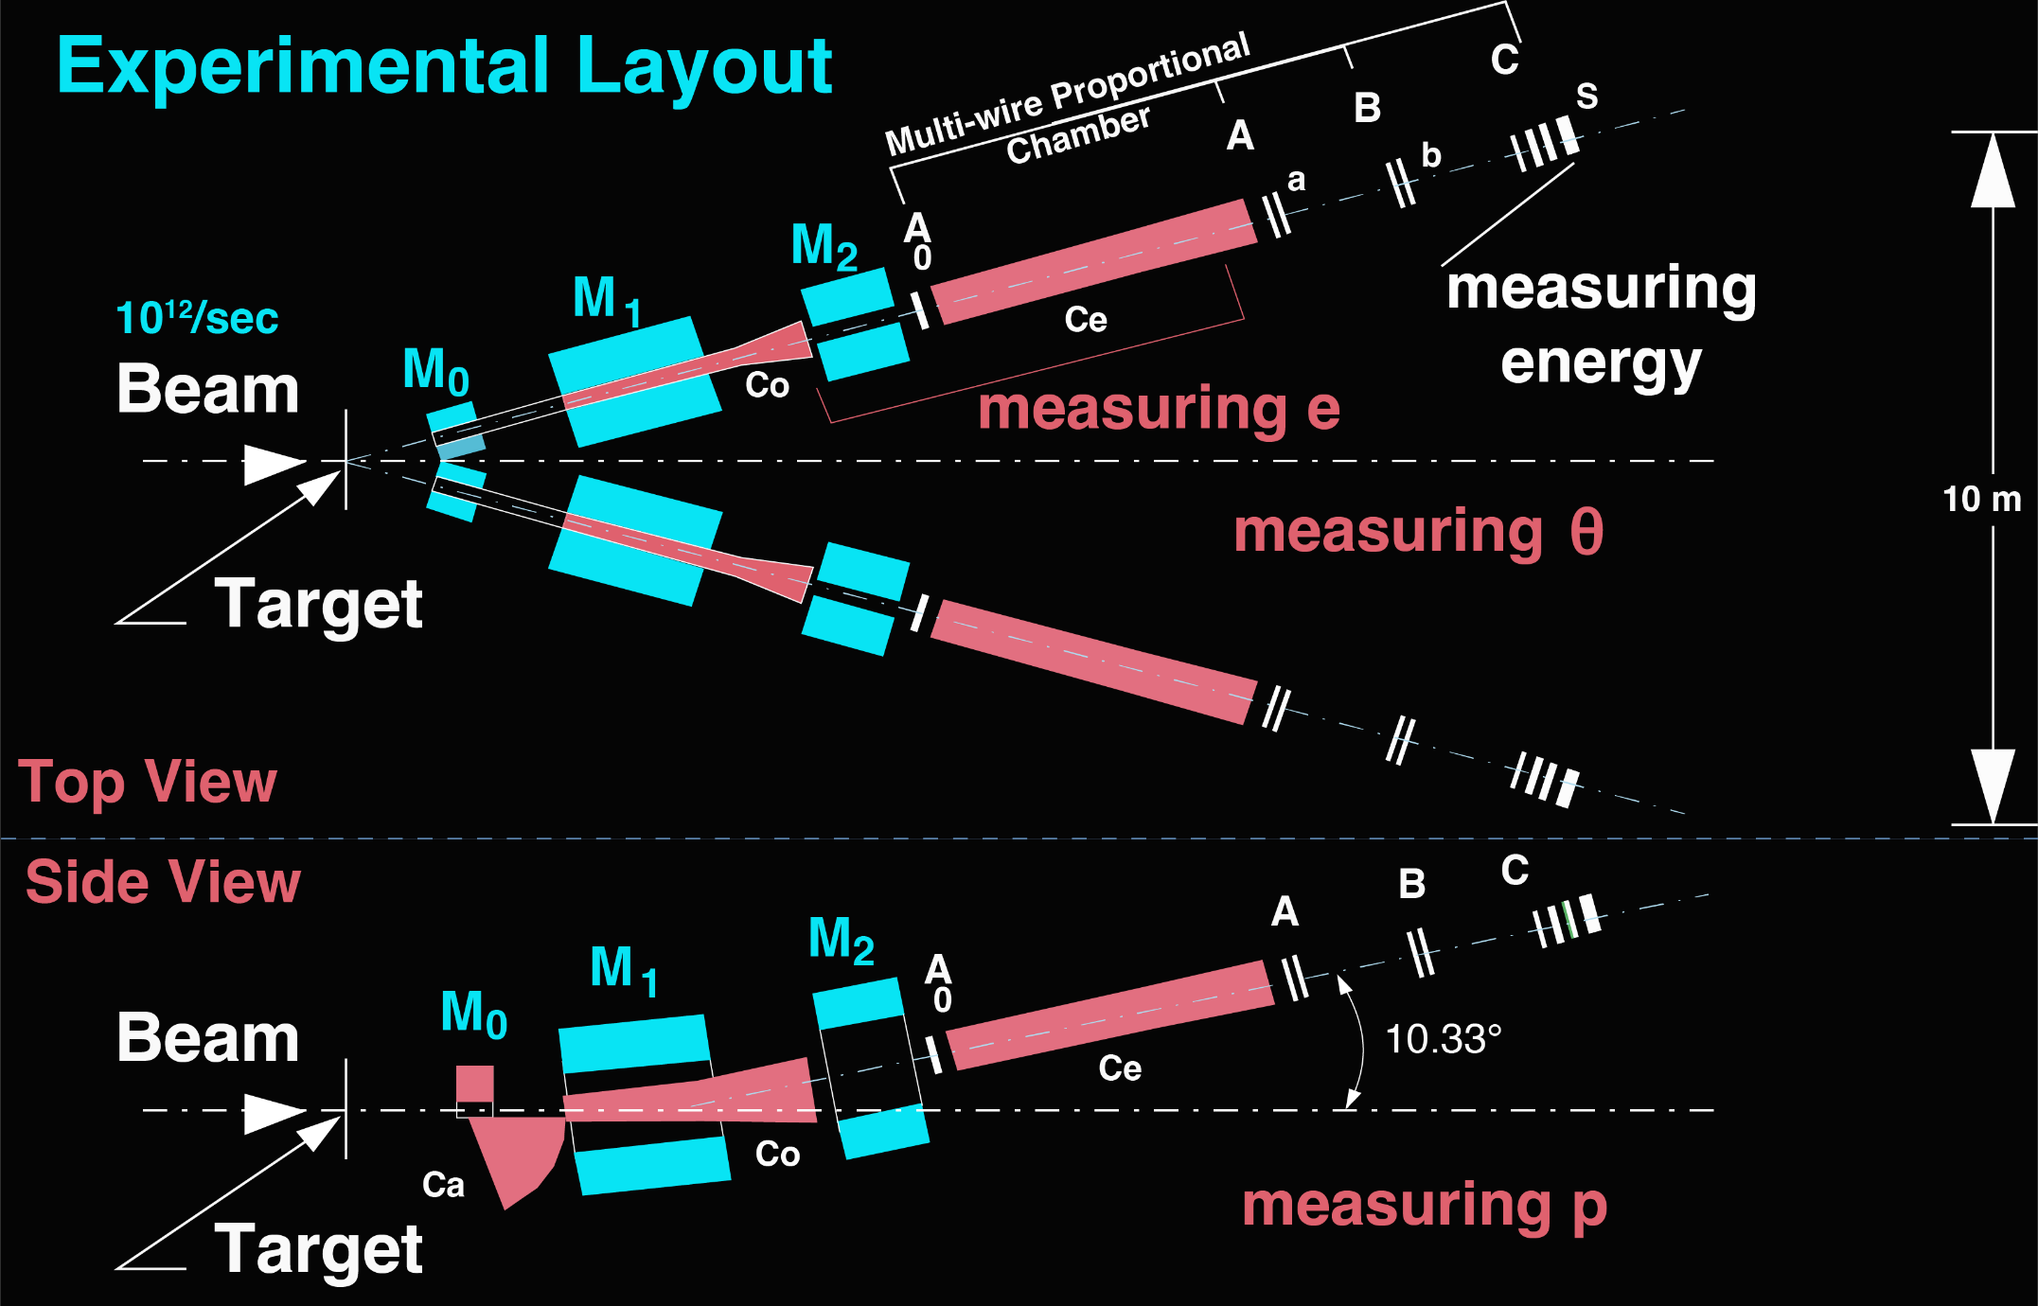
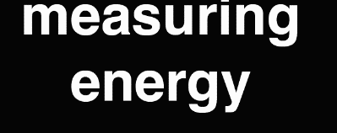
Experimental Layout
Proportional Chambers
Top View
measuring θ
C_{e}
C₀
θ
identifying e
Side View
measuring p
C_{e}
C₀
p
M₀, M₁, and M₂ are dipole magnets; A₀, A, B, and C are proportional chambers; a and b are counters;
C_{a}, C₀, and C_{e} are gas Cerenkov counters, S are shower counters.
M₀ and C_{a} measure 𝛑⁰ → e± and provide calibration of the detector with e±
The detector follows the design of the first experiment at DESY
20

Slide 21
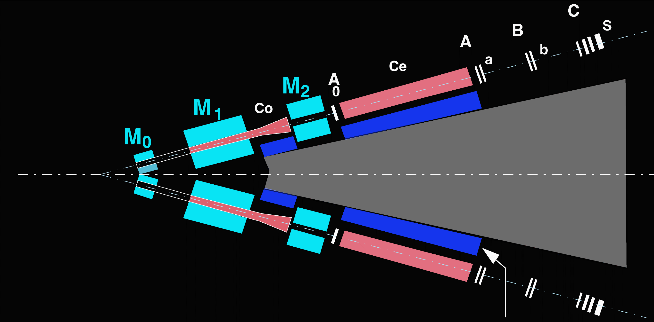
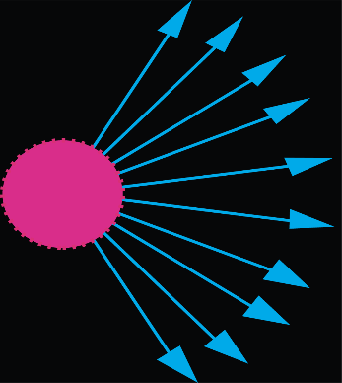
Radiation Protection
10¹²
Proton
/sec
Shielding:
10,000 tons of concrete
10¹² particles
are produced
each second
+ 5 tons of ²³⁸U
+ 100 tons of lead
+ 5 tons of soap
21

Slide 22
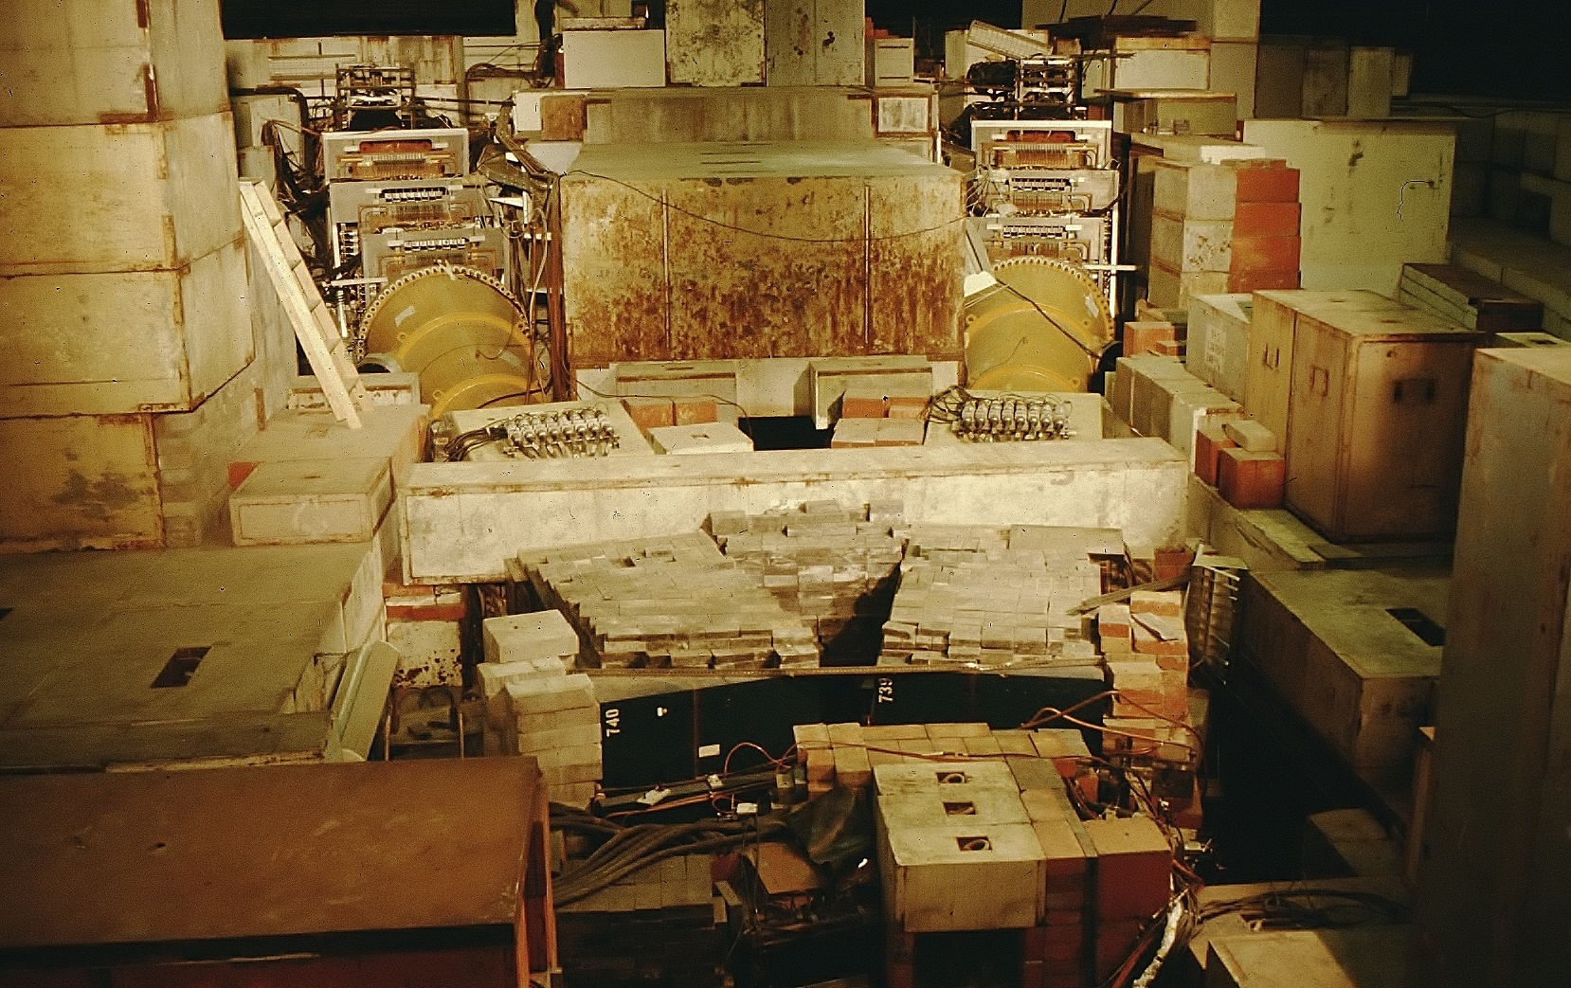
Area view of the detector with roof open
22

Slide 23
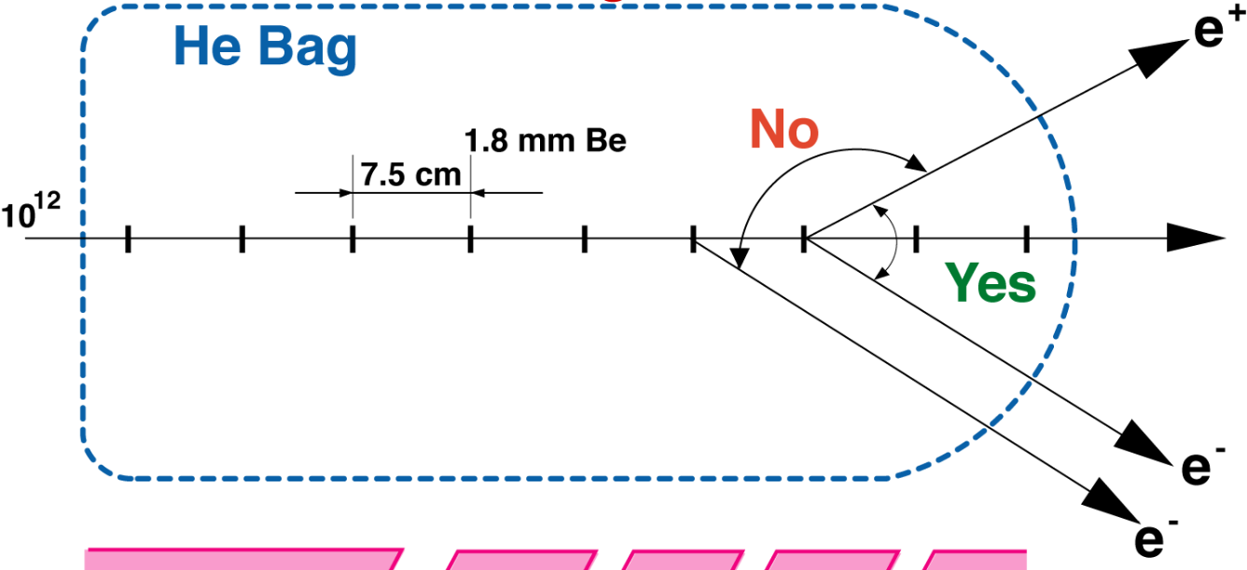
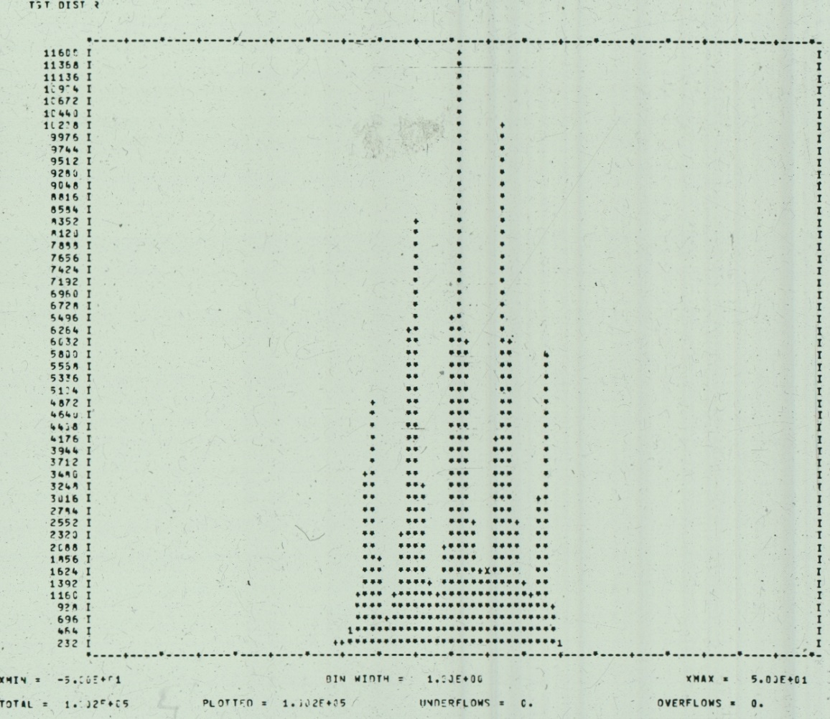
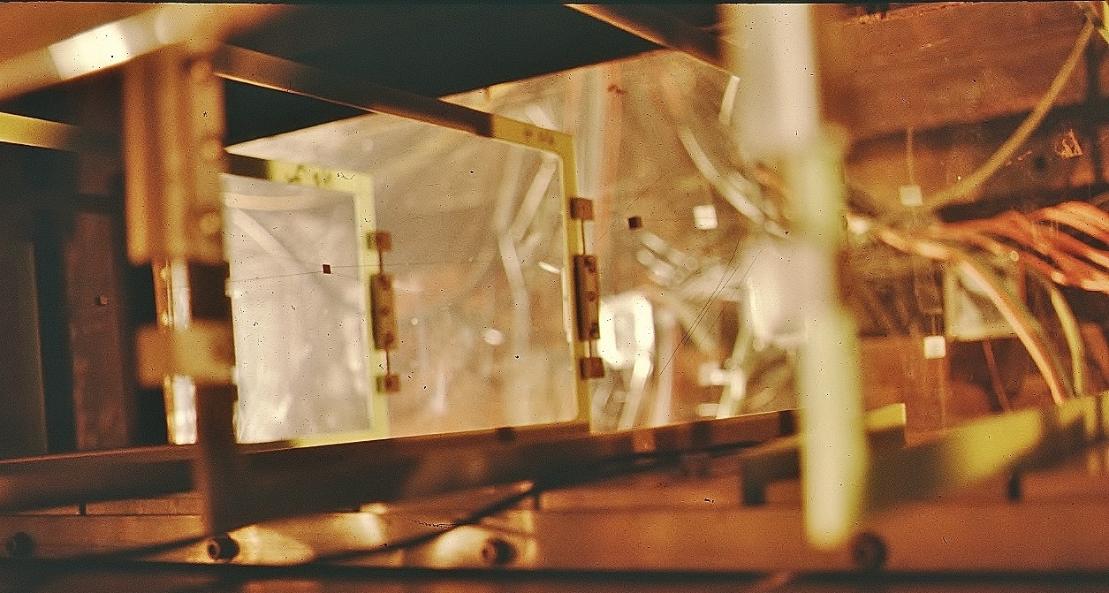
Separate thin targets to reduce the background
  Target Event distribution
23

Slide 24

The Magnets
The field is measured with 3-D Hall probe, a total of 10⁵ points.
The detector is smaller than the magnets aperture, the detector defines the acceptance.
The magnets bend charged particles to an angle such that the detectors are not exposed to photons or neutrons from the target.
e–
Detector
e–
Magnet
Neutrons, ɣ
Side view
24

Slide 25
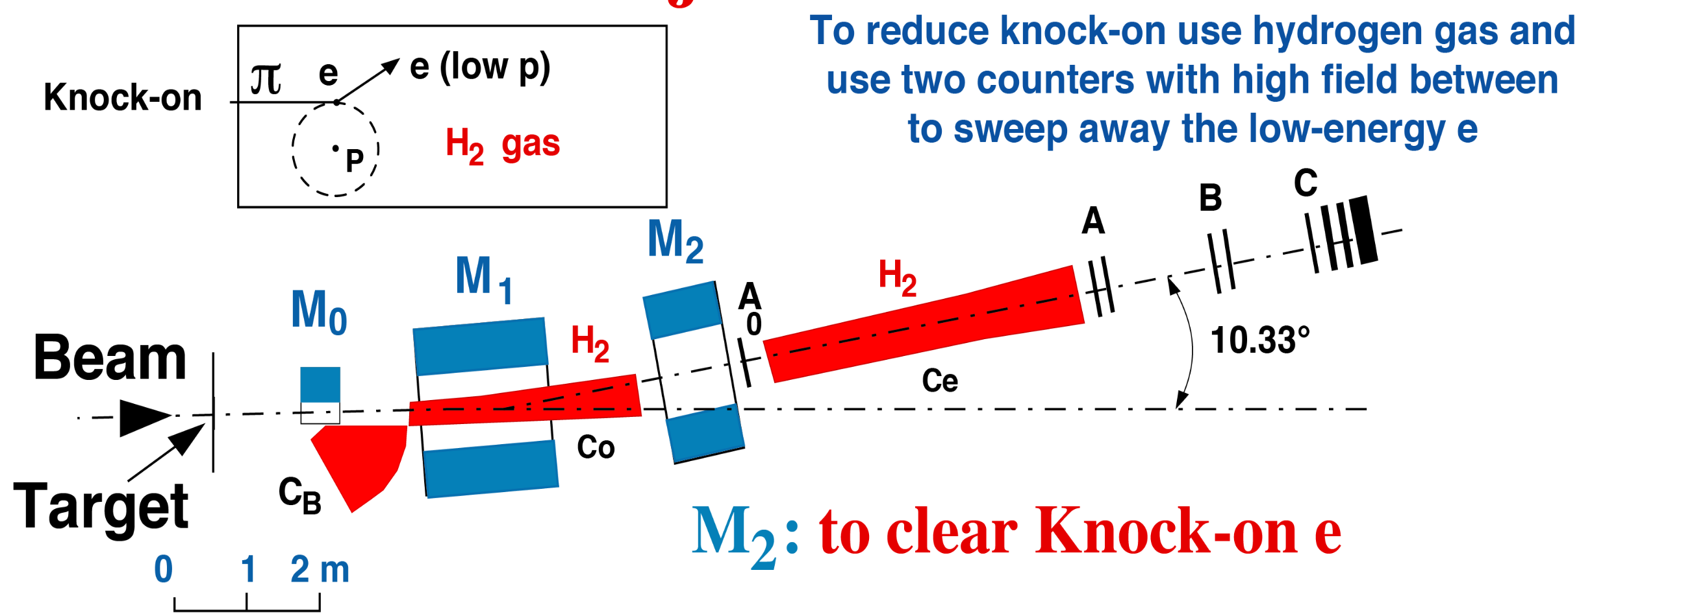
Hadron Rejection of 10¹⁰
𝝅
^{Co or Ce}
A₀
The H₂ Cherenkov counter Co in the magnet
is followed by another Cherenkov counter Ce behind the second magnet.
The separation of the two counters Co, Ce by the strong magnet M₂ ensures that the minute number of knock-on electrons produced in the first counter are swept away and do not enter the second counter
All Cherenkov counters have a black surface to reduce background from scattered light
25

Slide 26
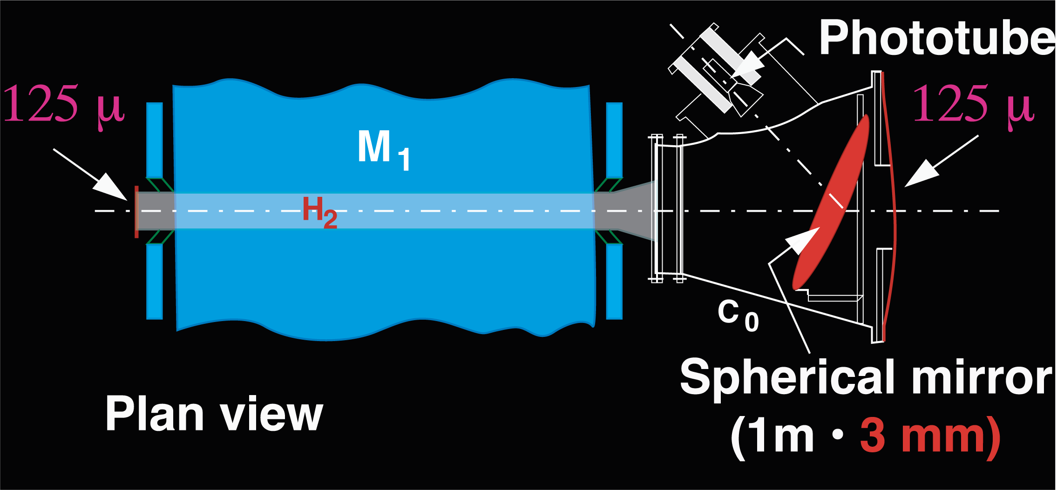
The 𝛑-e separation was achieved by four extremely sensitive Cherenkov Counters Co, Ce
125μm
125μm
The counters have minimum material.
The mirrors were made at the Precision Optical Workshop at CERN.
Designed by M. Vivargent, J. J. Aubert, and S. Ting.
26

Slide 27
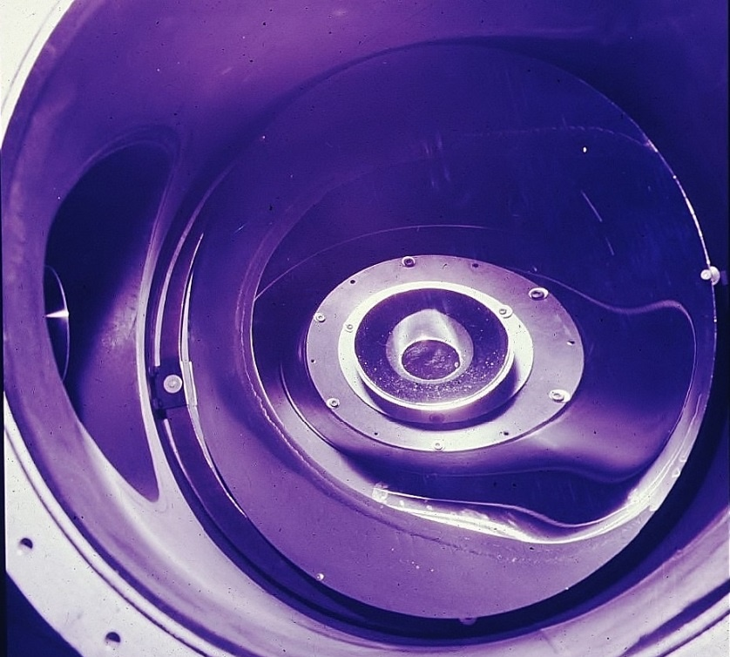
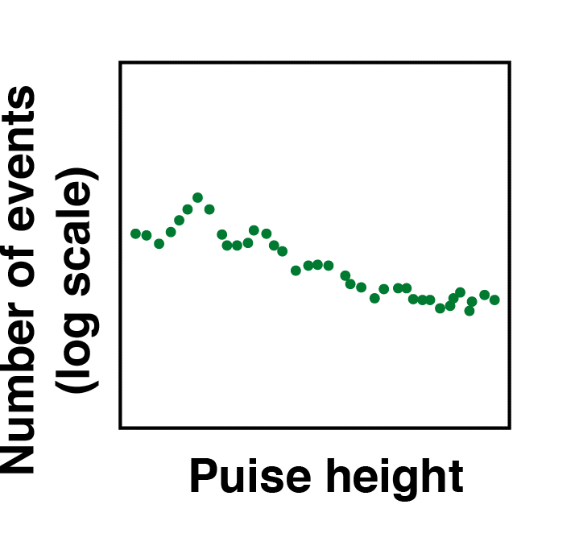
Spherical Mirror
1 photoelectron
→
2 photoelectrons
→
Pulse height
27

Slide 28
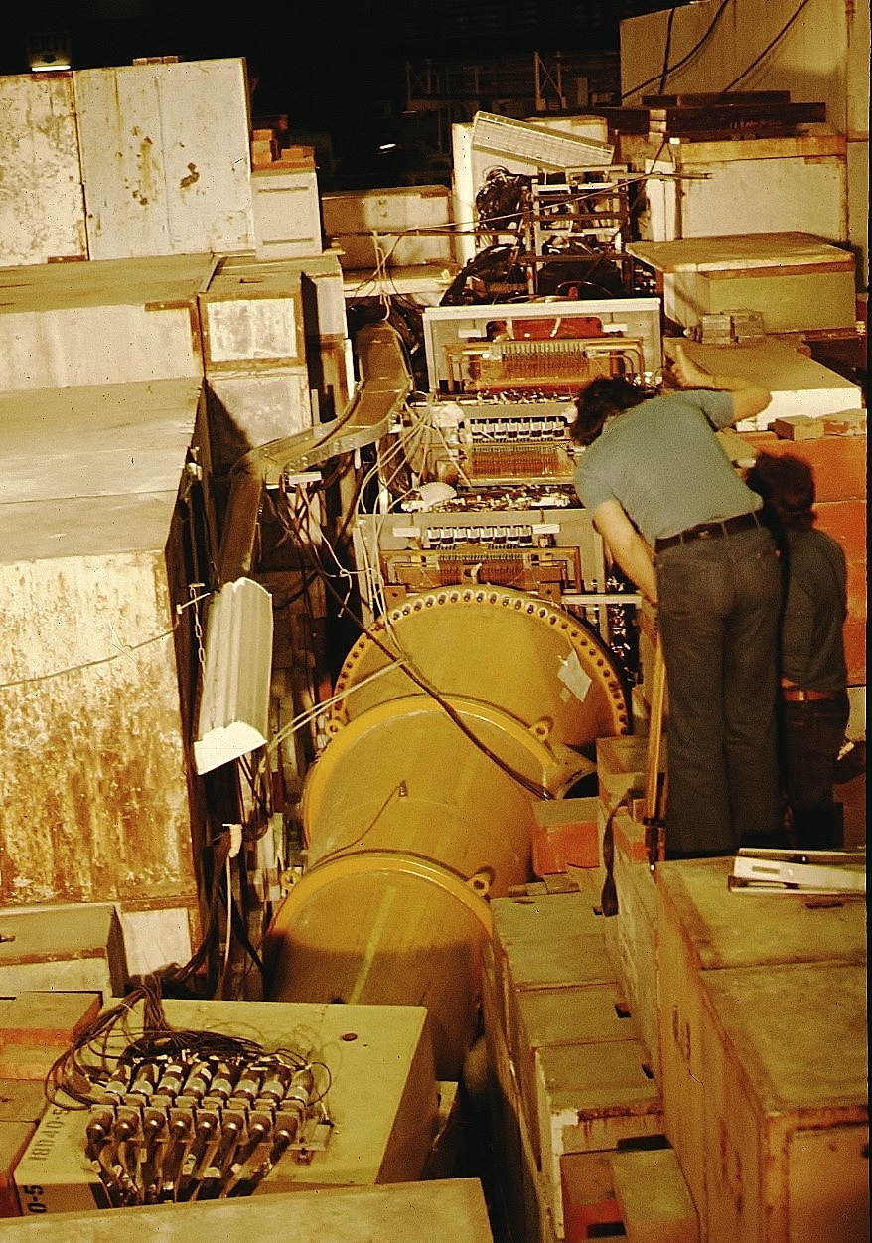
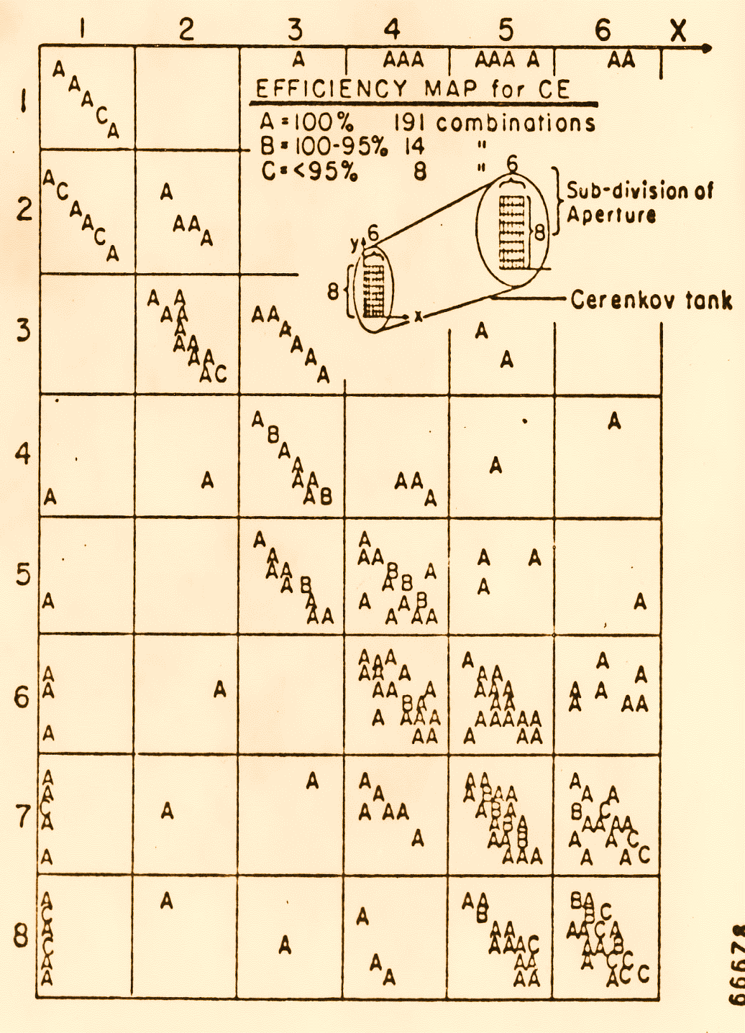
Ensure the efficiency of the Cherenkov counter is 100%
Cherenkov
28

Slide 29
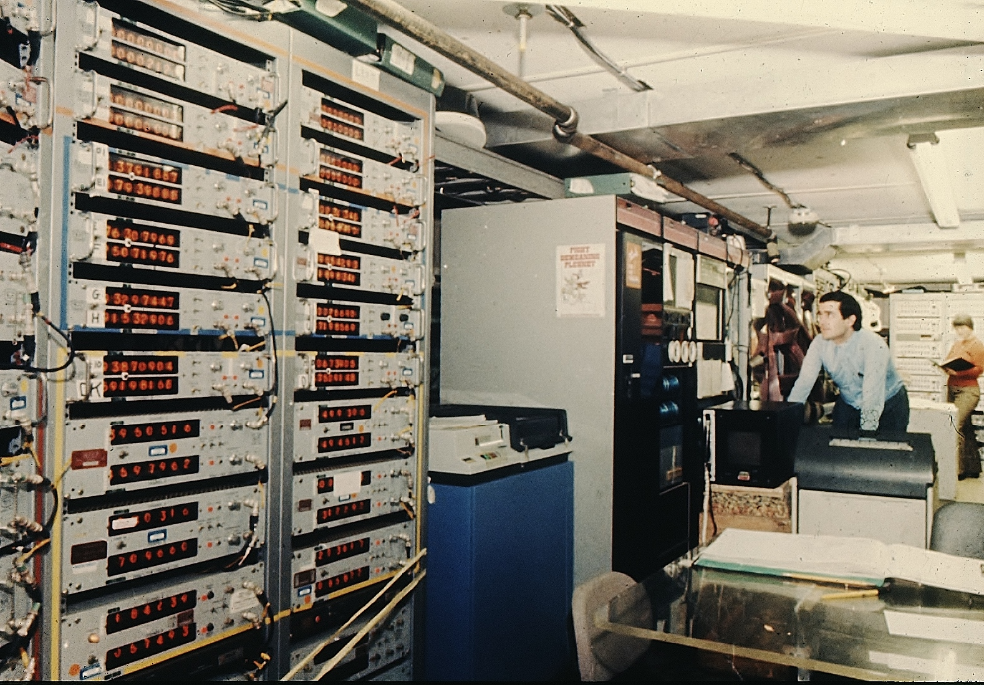
J. J. Aubert made major contributions to the success of the experiment
Professor of Physics, University of Marseille, Director-General, IN2P3, France
29

Slide 30
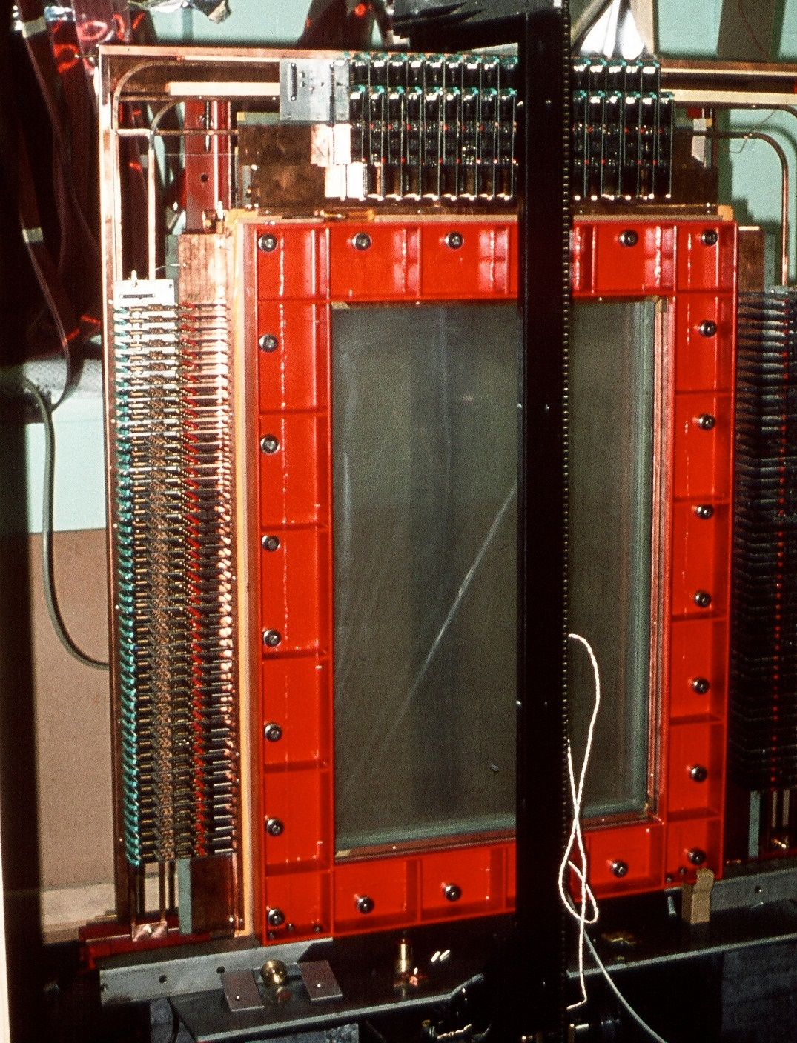
Position Detectors
designed by the
late Professor UJ Becker
To sort out multi-tracks,
the chambers
have 3 planes 60º apart
60°
a₁
a₂
b₁
b₂
a₃
b₃
a₁ + a₂ + a₃ = b₁ + b₂ + b₃
Exhibited at the Smithsonian Institute
Washington, D.C.
30

Slide 31
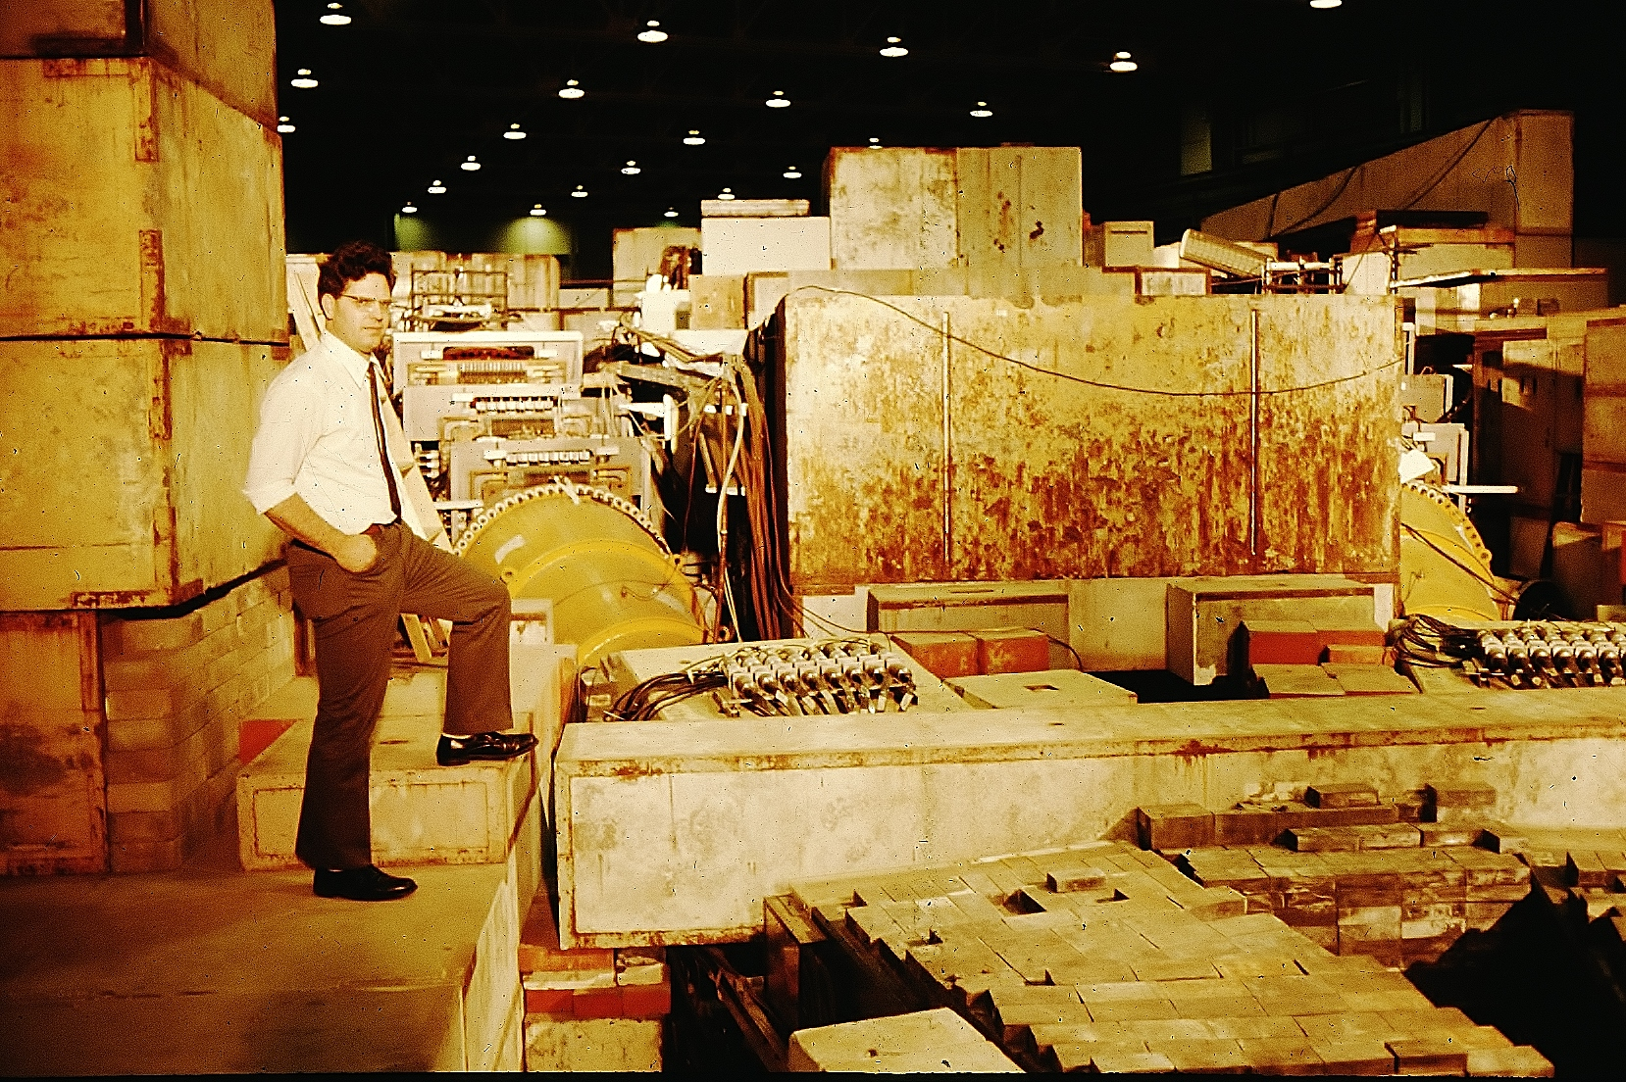
Professor UJ Becker
with precision tracker planes
31

Slide 32
During the construction of our spectrometers, and indeed during the entire experiment, I encountered much criticism. The problem was that in order to gain a good mass resolution it was necessary to build a spectrometer that was very expensive. One eminent physicist made the remark that this type of spectrometer is only good for looking for narrow resonances —and there are no narrow resonances.
The discovery of the J particle: A personal recollection
(delivered on the occasion of the presentation of the 1976 Nobel Prizes in Physics).
Rev. Mod. Phys. , Vol. 49, No. 2, April 1977
32

Slide 33

In the early summer of 1974 we took some data in the high-mass region of 4-5 GeV. However, analysis of the data showed very few electron-positron pairs.
By the end of August we tuned the magnets to accept an effective mass of 2.5-4.0 GeV. Immediately we saw clean, real, electron pairs.
But most surprising of all is that most of the e⁺e– pairs peaked narrowly at 3.1 GeV.
Rev. Mod. Phys. , Vol. 49, No. 2, April 1977
33

Slide 34

Throughout the years, I have established certain practices in the group with regard to experimental checks on our data and on the data analysis. I list a few examples:
(i) To make sure the peak we observed was a real effect and not due to instrumentation bias or read-out error of the computer, we took another set of data, at a lower (90%) magnet current. This has the effect of moving the particles into different parts of the detector. The fact that the peak remained fixed at 3.1 GeV [Fig. 12(a)] showed right away that a real particle had been discovered.
100%
90%
Rev. Mod. Phys. , Vol. 49, No. 2, April 1977
34

Slide 35
(ii) We used two completely different sets of programs to ensure that the analysis was correct. This means that two independent groups of physicists analyzed the data, starting from the reduction of raw data tapes, to form their own data summary tapes, and then performed two sets of Monte Carlo acceptance calculations, two sets of event reconstruction, two sets of data corrections, and finally, two sets of results which must agree with each other. Although this procedure uses twice as much computer time, it provides greater confidence in our results after the two independent approaches have reached the same conclusions.
One analysis group was led by U. Becker and T. Rhodes and the other by Min Chen
(iii) …
These and many other checks convinced us that we had observed a real massive particle.
Rev. Mod. Phys. , Vol. 49, No. 2, April 1977
35

Slide 36
I was considering announcing our results during the retirement ceremony for V. F. Weisskopf, who had helped us a great deal during the course of many of our experiments. This ceremony was to be held on 17 and 18 October 1974. I postponed the announcement for two reasons. First, there were speculations on high-mass e⁺e– pair production from proton-proton collisions as coming from a two-step process: p + N → 𝜋 + ⋯ where the pion undergoes a second collision 𝜋 + N → e⁺ + e– + ⋯. This could be checked by a measurement based on target thickness. The yield from a two-step process would increase quadratically with target thickness, whereas for a one-step process the yield increases linearly. This was quickly done, as described in point (iv) above.
Rev. Mod. Phys. , Vol. 49, No. 2, April 1977
36

Slide 37
Most important, we realized that there were earlier Brookhaven measurements (Leipuner et al.1975) of direct production of muons and pions in nucleon-nucleon collisions which gave the 𝜇/𝜋 ratio as 10⁻⁴, a mysterious ratio that seemed not to change from 2000 GeV at the ISR down to 30 GeV. This value was an order of magnitude larger than theoretically expected in terms of the three known vector mesons, 𝜌, 𝜔, and 𝜑, which, at that time, were the only possible "intermediaries" between the strong and electromagnetic interactions. We then added the J meson to the three and found that the linear combination of the four vector mesons could not explain the 𝜇/𝜋 ratio either. This I took as an indication that something exciting might be just around the corner, so I decided that we would make a direct measurement of this number. Since we could not measure the 𝜇/𝜋 ratio with our spectrometer, we decided to look into the possibility of investigating the e–/𝜋– ratio.
Rev. Mod. Phys. , Vol. 49, No. 2, April 1977
37

Slide 38


Qn Thursday, 7 November, we made a major change in the spectrometer (see Fig. 13) to start the new experiment to search for more particles.
Rev. Mod. Phys. , Vol. 49, No. 2, April 1977
38

Slide 39
On 6 November I paid a visit to G. Trigg, Editor of Physical Review Letters, to find out if the rules for publication without refereeing had been changed. Following that visit, I wrote a simple draft in the style of our quantum electrodynamics paper of 1967 (Asbury et al. 1967). The paper emphasized only the discovery of J and the checks we made on the data without mention of our future plans.
On 11 November we telephoned G. Bellettini, the Director of Frascati Laboratory, informing him of our results.
Rev. Mod. Phys. , Vol. 49, No. 2, April 1977
39

Slide 40






November Revolution 1974
Nov. 12
Nov. 13
Nov. 18
40

Slide 41

Members of the J-Particle Group
41

Slide 42




The unique properties of the J particle are:
1. Its lifetime is 10,000 times longer than other particles
The significance of this is similar to suddenly discovering, in a remote region of the Earth, a village where people live to be, instead of 100 years old, about 1 million years old.
2. The spectrum is similar to positronium
This implies the existence of a new kind of matter made out of a new kind of Quark-Antiquark.
Positronium transitions
J/psi transitions
from SLAC
from DESY
42
Alvaro De Rujula, Sapienza University of Rome, Sep. 23, 2024

Slide 43


The discovery of the J particle confirmed the existence of the charmed quark
predicted by S. Glashow, J. Iliopoulos, L. Maiani.
During the Summer of 1974, I had many interesting discussions
with Shelly Glashow and Luciano Maiani
43

Slide 44


Oct. 21, 1976
44

Slide 45

Attending the Nobel ceremony, Dec. 10, 1976
with M. Chen, U. Becker, J. Burger
45

Slide 46

46

Slide 47







Understanding this new form of matter:
Tau-Charm Factories in the World
Luminosity [cm⁻²s⁻¹]
By Yifang Wang
10³⁵
BEPCII
10³³
BEPC
CESRc
10³¹
DORIS I
10²⁹
VEPP-4M
SPEAR
ADONE
10²⁷
47

Slide 48
30 new hadrons discovered at BESIII from charmed meson production and decays
48

Slide 49





Electrons at Higher Energy
46 Billion Electron Volt Collider at DESY, Germany
e⁻
MARK J
Experiment
e⁺
Circumference 7km
49

Slide 50

Five decades of Collaboration with Chinese Scientists
After the Cultural Revolution, in August 1977, Chairman Deng Xiaoping suggested sending 10 scientists each year to collaborate with me. Since then, many Chinese scientists joined my team and have made contributions well recognized worldwide.
in 1978, first team of Chinese scientists joined
my MARK-J experiment in PETRA accelerator in Germany.
50

Slide 51


51
51

Slide 52



Measuring e⁺e– →𝜇⁺𝜇– forward-backward asymmetry
the earliest confirmation of electroweak theory
+
+
QED
Electroweak
P.R.L. 48, 25 (21 June 1982)
52

Slide 53


53

Slide 54


Discovery of Gluons at PETRA, Germany
jet (charged and neutral hadrons)
Physics Today, February 1980 (p.17)
jet
jet
Each jet contains charged and neutral hadrons. There are many sources of three jet events.
By measuring many three jet events, we discovered that their distribution agrees with QCD predictions.
54

Slide 55




Electron-Positron Physics at higher energies:
L3 Experiment at CERN (1982-2003)
100 GeV
Positron
100 GeV Electron
L3
CERN
L3
55

Slide 56




Important Results
2. Model independent
results on
the number of neutrinos
1. Dependence of the coupling “constants” on energy
e⁺ e– →ννγ
Nν = 2.98 ± 0.064
α ⁻¹(Q2)
Phys. Lett. B 476 (2000) 40
Phys. Lett. B 536 (2002) 217
Phys. Lett. B 587 (2004) 16
56

Slide 57

57

Slide 58


Electrons and Positrons at highest energies: AMS on the Space Station:
Charged cosmic rays have mass,
they are absorbed by the 100 km of Earth’s atmosphere
(10m of water)
The properties (±Z, P) of charged cosmic rays cannot be studied on the ground.
To measure cosmic ray
charge and momentum requires
a magnetic spectrometer in space
Cosmic Rays
100km
Atmosphere
Shower
58

Slide 59















AMS was constructed in Europe and Asia,
assembled and tested at CERN and ESA with NASA support
1
TRD
TOF
2
3-4
5-6
Tracker
7-8
TOF
RICH
9
ECAL
AMS 2026-2030
New 4+4m² Silicon Tracker Planes
Acceptance increased to 300%
59
Notes:
59
59
59

Slide 60







Unique properties of AMS:
1. Precision and redundant identification of Matter and Antimatter
e⁻
e⁺
e⁻
e⁺
2. Continuous Momentum Scale Verification
with 4 independent measurements of Pe⁺, Ee⁺,
Pe⁻, Ee⁻
The accuracy of the momentum scale is 1/(34,000 GeV)：
at 1 TeV the uncertainty is less than 3%
60

Slide 61


61

Slide 62


Latest Results on cosmic elementary particles: e+, e−, and p
Interstellar Medium
Cosmic Ray
p, He, …
Supernovae
Dark Matter
Cosmic Ray
e+, p, …
from Dark Matter
e+, p
from Collisions
Dark Matter
TRD
Upper TOF
Pulsars
Tracker
e+ from Pulsars
Lower TOF
RICH
ECAL
AMS
62

Slide 63

Low-energy positrons come from cosmic ray collisions
High-energy positrons must come from a new source
?
Cosmic Ray
Collisions
e+
Energy [GeV]
63

Slide 64


The positron flux is the sum of low-energy part from cosmic ray collisions
plus a high-energy part from pulsars or dark matter with a cutoff energy
Empirical model:
𝜒²/dof = 63/66
Pulsars or Dark Matter
Solar
Collisions
Existence of cutoff
at 99.9998% CL
e+
Dark
Matter
Cosmic Ray
Collisions
e+
Pulsars
Dark Matter
e+
Energy [GeV]
64
Notes:
Match formula colors the lines. Remove green band

Slide 65



Positron spectrum to 2030
AMS Current Data
Dark Matter (1.5 TeV)
Positrons from
Dark Matter
Positrons from
Cosmic Ray Collisions
J. Kopp, PRD 88, 076013 (2013)
Astrophysical Journal 729, 106 (2011)
AMS 2030
Dark Matter
Positrons from
Dark Matter
J. Kopp, PRD 88, 076013 (2013)
Positrons from
Cosmic Ray Collisions
Astrophysical Journal 729, 106 (2011)
200
By 2030, AMS will ensure that the high energy positron spectrum drops off quickly in the 0.2-2 TeV region and the highest energy positrons only come from cosmic ray collisions as predicted for dark matter collisions
65
Notes:
12.5 years

Slide 66



AMS Result on the electron spectrum
The spectrum fits well with two power laws (a, b) and a source term like positrons
$$Φ_{e^{−}}\left(E\right)=\frac{E^{2}}{{\hat{E}}^{2}}(C_{a }{\hat{E}}^{γ_{a}}+C_{b}{\hat{E}}^{γ_{b}}+Positron Source Term)$$
Empirical model:
𝜒²/dof = 47/67
Solar
Power law a
Power law b
6.2x10⁷ e–
Positrons
98.8% CL
99.99% CL
by 2030
Power law b
e– from collisions negligible
New sources, like Dark Matter or Pulsars, produce equal amounts of e+ and e–
66

Slide 67


Cosmic Antiprotons and Positrons
Above 60 GeV, the p and e⁺ fluxes have identical rigidity dependence
e⁺
p
1.2M p
4.2M e⁺
e⁺
e⁺
p
p
The identical behavior of positrons and antiprotons above 60 GeV
excludes the pulsar origin of positrons
60
Energy [GeV]
67
Notes:
12.5 years

Slide 68

AMS Results on Primary Cosmic Rays
Primary cosmic rays p, He, C, O, ..., Si, …, Fe
are produced during the lifetime of stars and accelerated by supernovae.
They propagate through interstellar medium before they reach AMS.
Proton
Helium
Supernova
explosion
Carbon
Nuclei fusion
in stars
Oxygen
Interstellar medium
Silicon
Iron
Measurements of primary cosmic ray fluxes are fundamental to understanding the origin, acceleration, and propagation processes of cosmic rays in the Galaxy.
68

Slide 69

Primary cosmic rays have two classes
Light elements He-C-O and Heavier elements Ne-Mg-Si
each has their own rigidity dependence
Rigidity [GV]
69

Slide 70

AMS Results on Secondary Cosmic Ray Nuclei
Secondary Li, Be, B, and F nuclei in cosmic rays are produced by the collision of
primary cosmic rays C, O, Ne, Mg, Si, …, Fe,with the interstellar medium.
Proton
Nuclei fusion
in stars
Helium
Lithium
Supernova
explosion
Carbon
Oxygen
Beryllium
Interstellar medium
Silicon
Boron
Iron
Fluorine
Measurements of the secondary cosmic ray nuclei fluxes are important in understanding the propagation of cosmic rays in the Galaxy.
70

Slide 71

Secondary cosmic rays have two classes of rigidity dependence
Li-Be-B and F
71

Slide 72

Light Nuclei 2 ≤ Z ≤ 8
He-C-O primaries compared
with Li-Be-B secondaries
Heavier Nuclei 9 ≤ Z ≤ 14
Ne-Mg-Si primaries compared
with F secondaries
Light and heavy nuclei each have two distinct classes
72

Slide 73

Abundance of elements in the Solar System
H
He
Elements in the Solar System measured from the Sun wavelength analysis and meteorites.
Solar System
Solar System
A_{O}/A_{Ne} = 4.8
Normalized to Si (10³)
AMS 10 Year 1 TV
O
AMS 10 Year [2.97-3.29] GV
C
A_{Si}/A_{S} = 2.4
A_{Fe}/A_{Ni} = 17.3
Ne
Mg
Si
S
Fe
N
Ar
Ca
Ni
Cr
Na
Al
Ti
Mn
Zn
P
K
Cl
Co
F
V
Cu
Li
B
Sc
Z
Be
O, Si, and Fe are characteristic primary cosmic rays
Li, Be, B, F, and Sc are characteristic secondary cosmic rays
73

Slide 74





Further Surprising Results:
Before AMS, taking into account the long-standing idea that C is pure primary and B is pure secondary, the (B/C) ratio has been used in models to describe cosmic ray propagation
The spectrum of carbon is the composition
of a primary flux identical to oxygen and
a secondary flux identical to boron
0.83xΦ_{O}
0.70xΦ_{B}
Carbon
Carbon
= 0.70 × Φ_{B}
Secondary flux
= 0.83 × Φ_{O}
Carbon
But C is NOT pure primary. Question: how to use (B/C) in cosmic ray models?
74

Slide 75


Primary and Secondary Composition of Cosmic Rays
Z=1
2
3
4
Hydrogen
Lithium
Secondary
Beryllium
5
6
7
8
Boron
Carbon
Nitrogen
Oxygen
9
10
11
12
Fluorine
Neon
Sodium
Magnesium
13
14
15
16
Aluminium
Silicon
Phosphorus
Sulfur
75
75
75

Slide 76

All of the measured cosmic rays can be described
by two Primary classes and two Secondary classes
Rigidity [GV]
76

Slide 77

Latest AMS Results on Heavy Antimatter
Matter is defined by its mass M and charge Z.
Antimatter has the same mass M but opposite charge –Z.
D, He, C, O …
Antimatter Star
TRD
AMS on ISS
Upper TOF
Tracker
Lower TOF
RICH
ECAL
AMS is a unique antimatter spectrometer in space
77

Slide 78



An Anti-Deuteron Candidate from ~100 million deuterons and ~10 billion protons
Bending Plane
Z
Non-bending Plane
Y
Anti-deuteron Candidate
Charge = −1.02 ± 0.05
Mass = 1.9±0.1 GeV/c²
Deuteron
Charge = +1
Mass = 1.88 GeV/c²
X
Cherenkov cone in RICH
78

Slide 79



Anti-⁴HeliumCandidate
bending plane
non-bending plane
Z
Y
Charge = −2.05 ± 0.05
Mass = 3.81 ± 0.29 GeV/c²
Cherenkov cone in RICH
⁴He: Mass = 3.73 GeV/c²
Charge = +2
X
79

Slide 80






Progress on AMS Upgrade
NASA Manifest:
February 2026
33
Canadarm
AMS
International Space Station (ISS)
80
80

Slide 81

Scientific American, May 2011
The discovery of the J particle 50 years ago opened up a new realm of physics.
Space is the ultimate laboratory. Space provides particles with the highest energies.
AMS results require the development of a new model of the cosmos.
81

Slide 83


Upgrade with new Silicon Tracker: Coordinator: J.C. Wang, IHEP,
with contributions from Weiwei Xu, SDIAT
(4+4)m²
Silicon Wafer Assembly at Beijing, May 2023
83

Slide 84




Detector Integration and Space Qualification in Italy
Assembly of Silicon ladders
Integrated Detector
Vibration tests
Thermal-Vacuum preparation
84

Slide 85

85

Slide 86




Production of 74K channels of electronics in Taiwan
Assembly
Radiation Tests
Completed Electronics
Thermal test
86

Slide 87

Extensive Training of Astronauts
in the Neutral Buoyancy Lab
at Johnson Space Center, Houston
Each EVA (Space Walk)
requires 2 astronauts
working for 6 hours on the Upgrade
It will take 4 EVAs to
complete the AMS Upgrade
AMS Mockup
87

Slide 88
Scientific American, May 2011
The discovery of the J particle 50 years ago opened up a new realm of physics.
Space is the ultimate laboratory. Space provides particles with much higher energies than accelerators. AMS results require the development of a new model of the cosmos.
88

Slide 90



Pan
Cakes
(EB)
Appelquist
ADR
Glashow
Politzer
Refe-
rences?
Eichten
Gottfried
Kinoshita
Kogut
Lane, Yan
Expe -
riment

Slide 91

The unique properties of the J particle are:
1. Its lifetime is 10,000 times longer than other particles
The significance of this is similar to suddenly discovering, in a remote region of the Earth, a village where people live to be, instead of 100 years old, about 1 million years old.
2. The spectrum is similar to positronium
This implies the existence of a new kind of matter made out of a new kind of Quark-Antiquark.
Positronium transitions
J/psi transitions
91

Slide 92

92

Slide 93


It has been 50 years since: The discovery of a new form of matter
New York Times, Nov 17, 1974, page 1.
93

Slide 94


94

Slide 95
Important Check of the Detector
Lower the magnetic field by 10%: Particles bend into different parts of the detector.
If the peak is false, it will shift away,
but it did not.
The discovery is verified.
100%
90%
95

Slide 96
Before AMS there were many results on Light Primary Cosmic Rays
(Helium, Carbon, Oxygen)
from balloon and satellite experiments
Helium
Carbon
Oxygen
96

Slide 97




AMS Results:
Unexpectedly, above 60 GV, the light primary cosmic rays have identical rigidity (P/Z) dependence.
Helium 125 Million
AMS
Carbon 14 Million
Oxygen 12 Million
97

Slide 98

Measurements before AMS of heavier primary cosmic rays
Neon, Magnesium, and Silicon
98

Slide 99
Unexpectedly, heavier primary cosmic rays Ne, Mg, Si:
have their own identical rigidity behavior but different from He, C, O.
Primary cosmic rays have at least two classes.
99

Slide 100
Secondary Cosmic Ray Nuclei
Secondary Li, Be, B, and F nuclei in cosmic rays are produced by the collision of primary cosmic ray C, O, Ne, Mg, Si, …, Fe,with the interstellar medium.
Proton
Nuclei fusion
in stars
Helium
Lithium
Supernova
explosion
Carbon
Oxygen
Beryllium
Interstellar medium
Silicon
Boron
Iron
Fluorine
Measurements of the secondary cosmic ray nuclei fluxes are important in understanding the propagation of cosmic rays in the Galaxy.
In fact, all the Lithium, Beryllium, Boron, and Fluorine
on Earth are produced by cosmic rays.
100

Slide 101


Measurements before AMS
of Lithium, Beryllium, Boron, Fluorine
101

Slide 102
Negative Charge Distribution
e⁻
p
102

Slide 103
Mass distribution of Z = −2 particles
from mass
1 to 10 GeV/c² there is no background
103

Slide 104



Current Matter and Antimatter Statistics
Events
Proton
8B
Helium
1.45B
Matter
Electron
62M
C
43M
O
36M
Li
9M
Be
4.5M
B
12M
N
11M
-1 1 2 3 4 5 6 7 8
Charge
Positron
4.2M
Anti-proton
1.2M
Events
Antimatter
Anti-Helium
anti-C
anti-O
+1 -1 -2 -3 -4 -5 -6 -7 -8
Charge
By 2030, AMS will have additional measurement points in the study of antimatter:
anti-deuterons, anti-helium, anti-carbon, and anti-oxygen.
104
Notes:
Helium

Slide 105
Unique properties of AMS:
1. Precision and redundant identification of Matter and Antimatter
e⁻
e⁺
e⁻
e⁺
2. Continuous Momentum Scale Verification
with 4 independent measurements of Pe⁺, Ee⁺,
Pe⁻, Ee⁻
The accuracy of the momentum scale is 1/(34,000 GeV)：
at 1 TeV the uncertainty is less than 3%
105

Slide 106



Unique properties of AMS:
3. Accurate and redundant measurements of e±
In cosmic rays, for every positron, there are 10 thousand protons
TRD: e⁺/p separation ：1 in 10³
TRD e⁺/p separation
TRD
P
TRD and ECAL are separated by the magnet,
e± produced from proton interacting with the detector do not enters ECAL:
ECAL e⁺/p separation
ECAL
E
ECAL : e⁺/p separation ：1 in 10⁴
E=P
106

Slide 108

Position Detectors – accuracy 1 mm
10⁴ wires, working at low voltage to prevent radiation damage
108

Slide 109


On 6 November I paid a visit to G. Trigg, Editor of Physical Review Letters, to find out if the rules for publication without refereeing had been changed. Following that visit, I wrote a simple draft in the style of our quantum electrodynamics paper of 1967 (Asbury et al. 1967). The paper emphasized only the discovery of J and the checks we made on the data without mention of our future plans.
On 11 November we telephoned G. Bellettini, the Director of Frascati Laboratory, informing him of our results. At Frascati they started a search on 13 November, and called us back on 15 November to tell us excitedly that they had also seen the J signal and obtained a 𝛤_{𝜇𝜇} / 𝛤_{total} = 0.8±0.2 keV. Their first spectrum is shown in Fig. 14(a). The Frascati Group were able to publish their results in the same issue of Physical Review Letters.
Rev. Mod. Phys. , Vol. 49, No. 2, April 1977
109

Slide 110


J decay: An Ideal Place for Gluonic Matter Searches
Gluon-rich processes
Well defined initial and final states
  - Kinematic constraints
  - Isospin and J^{PC} filters
Clean data with high statistics
  High cross sections of $e^{+}e^{−}→J/ψ, ψ^{′}$
  Low backgrounds
  high statistics samples at BESIII:
    $10×10^{9}$ $J/ψ$
    $2.7×10^{9}$ $ψ^{′}$
Good and rich physics results
beam energy: 1.0 – 2.3 GeV
1984-1988 BEPC/BES construction
1990-2004 BEPC/BES-BESII
2004-2008 BEPCII/BESIII upgrade
2009 - now: BESIII physics run
110
Glueball X(2370)
Hybrid η₁(1855)
Notes:
BESIII collected 10 B of J/psi and 2.7 B of psi’
Charmonium decays provide an ideal lab for glueballs.
They are gluon-rich
Charmonium decays have provide Well defined initial and final states. With Kinematic constraints, Isospin and JPC filters. The analysis can be much more simplified with respect to hadronic reactions.

Slide 111






Glueball-like Particle X(2370)
LQCD predictions for glueballs
arXiv:2305.04869
Glueball is a particle made of “force” (gluons)
Production: strongly favored in gluon-rich processes ⎯ J decays
Decay: flavor-blind
  $\text{No} \text{dominate} \text{mode}, SU{\left(3\right)}_{flavor} \text{symmetry} \text{expected}$
  Could be analogy to OZI suppressed decays of η_{c}, as they all decay via gluons
Scaler and tensor glueball candidates are still under debate, even though great progress have been made, thanks to BESIII
Newly identified pseudoscalar X(2370) is very promising
  J^{pc} is recently determined by Partial Wave Analysis to be 0⁻⁺
  Mass, J^{PC} and production rate consistent with LQCD predictions of the lightest 0⁻⁺ glueball
  Decay: no dominant decay, flavor symmetric, very similar to η_{c}
$$0^{++}$$
Mass(MeV)
$$2^{++}$$
$$0^{−+}$$
$${ J}^{PC}$$
PRL 132 (2024)181901

Slide 112

Hybrid candidate η₁(1855)
LQCD predictions for the Mass of $1^{−+}$ hybrid
Hybrid is a mixture of quarks and valence gluons
Signature for exotics:
  $f$orbidden for $q\overline{q}: J^{PC}={even}^{+−},{odd}^{−+}$
Previously claimed three isovector 1⁻⁺ states are still controversial
An isoscalar $1^{−+}$, $η_{1}(1855)$, has been unambiguously observed in $J/ψ→γηη′$ (>19$σ$) via partial wave analysis
Mass is consistent with LQCD calculation for the $1^{−+}$ hybrid ($1.7\sim 2.1 GeV/c^{2}$)
𝛈_{𝟏}(1855)
PRL 129 (2022) 192002

Slide 113





$J/Ψ$ Continuously Studied for 40 years at BEPC
(Beijing Electron-Positron Collider)
BES
BESII
BESIII
$J$ events: 9 million
$J$ events: 58 million
$J$ events: 10 billion
1984 1988 1995 1998 2004 2008 2030
Construction
Data taking
Upgrade
Data taking
Construction
Data taking
BEPCII
BESIII detector
BESIII Project leader: Academician Yifang Wang
113

Slide 114




Hadron Spectroscopy at BESIII
10 billion
X(1835) from $J/Ψ$ decays
58 million
Fine structures
Structure
225 million
More
structures
PRL 95 (2005) 262001
PRL 129 (2022) 042001
PRL 106 (2011) 072002
114

Slide 115

L. Lederman,
Phys. Rep. 26, 4 (1976)
see also
L. B. Leipuner et al.
PRL 34, 130 (1975)
115

Slide 116

IHEP is a founding member of the AMS experiment
Academicians
H.S. Chen
Y.F. Wang
First AMS meeting at NASA Johnson Space Center, Houston, Texas, 1994
116

Slide 117

Progress on 21 of 28 elements:
Decomposition of Primary and Secondary Cosmic Ray Fluxes
117

Slide 118

Observation of Coherent interference Pattern between $ρ and ω Decays$
(P.R.L. 25, 1373 1970)
$$ρ is a 2π resonance, ω is a 3π resonance$$
they do not interfere in the $π$ final state
118

Slide 119

Observation of Coherent interference Pattern between $ρ and ω Decays$
119

Slide 120
Unique properties of AMS:
3. Accurate and redundant measurements of e±
In cosmic rays, for every positron, there are 10 thousand protons
TRD: e⁺/p separation ：1 in 10³
TRD e⁺/p separation
TRD
P
TRD and ECAL are separated by the magnet,
e± produced from proton interacting with the detector do not enters ECAL:
ECAL e⁺/p separation
ECAL
E
ECAL : e⁺/p separation ：1 in 10⁴
E=P
120

Slide 121

Antiproton to 2030
Precision comparison of the e⁺ and p spectra
e⁺
p
e⁺
e⁺
p
p
60
Energy [GeV]
The identical behavior of positrons and antiprotons above 60 GeV
excludes the pulsar origin of positrons
121

Slide 122


Even-Z nuclei and Odd-Z nuclei have distinctly different primary and secondary composition
Carbon
Neon
Magnesium
Sulfur
Even-Z nuclei are dominated by primaries
Odd-Z nuclei have more secondaries than even-Z
122

Slide 125


Slide 126


Slide 127


Slide 128


Slide 129


