Slide 1
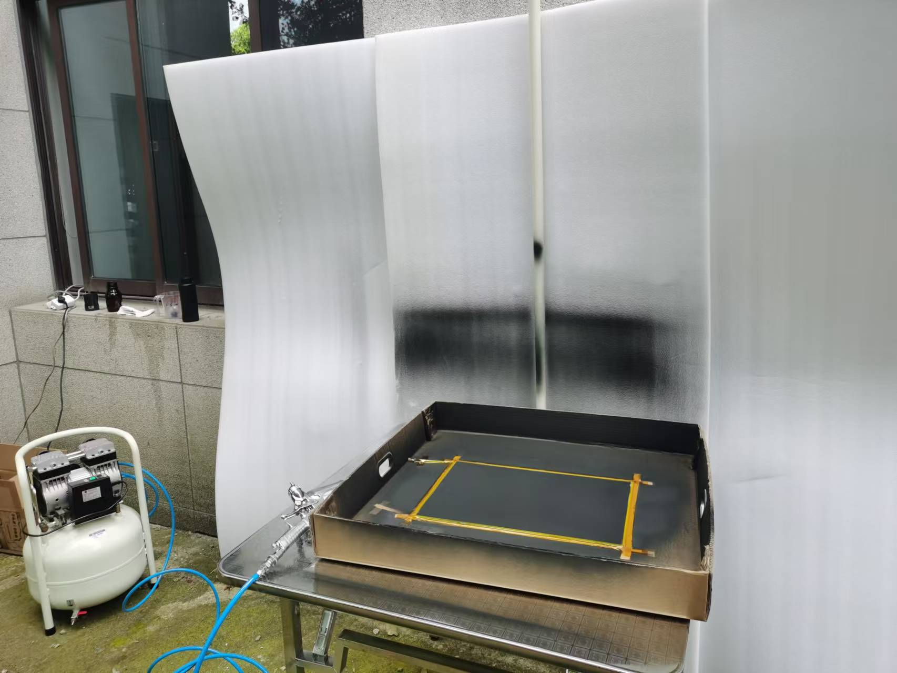
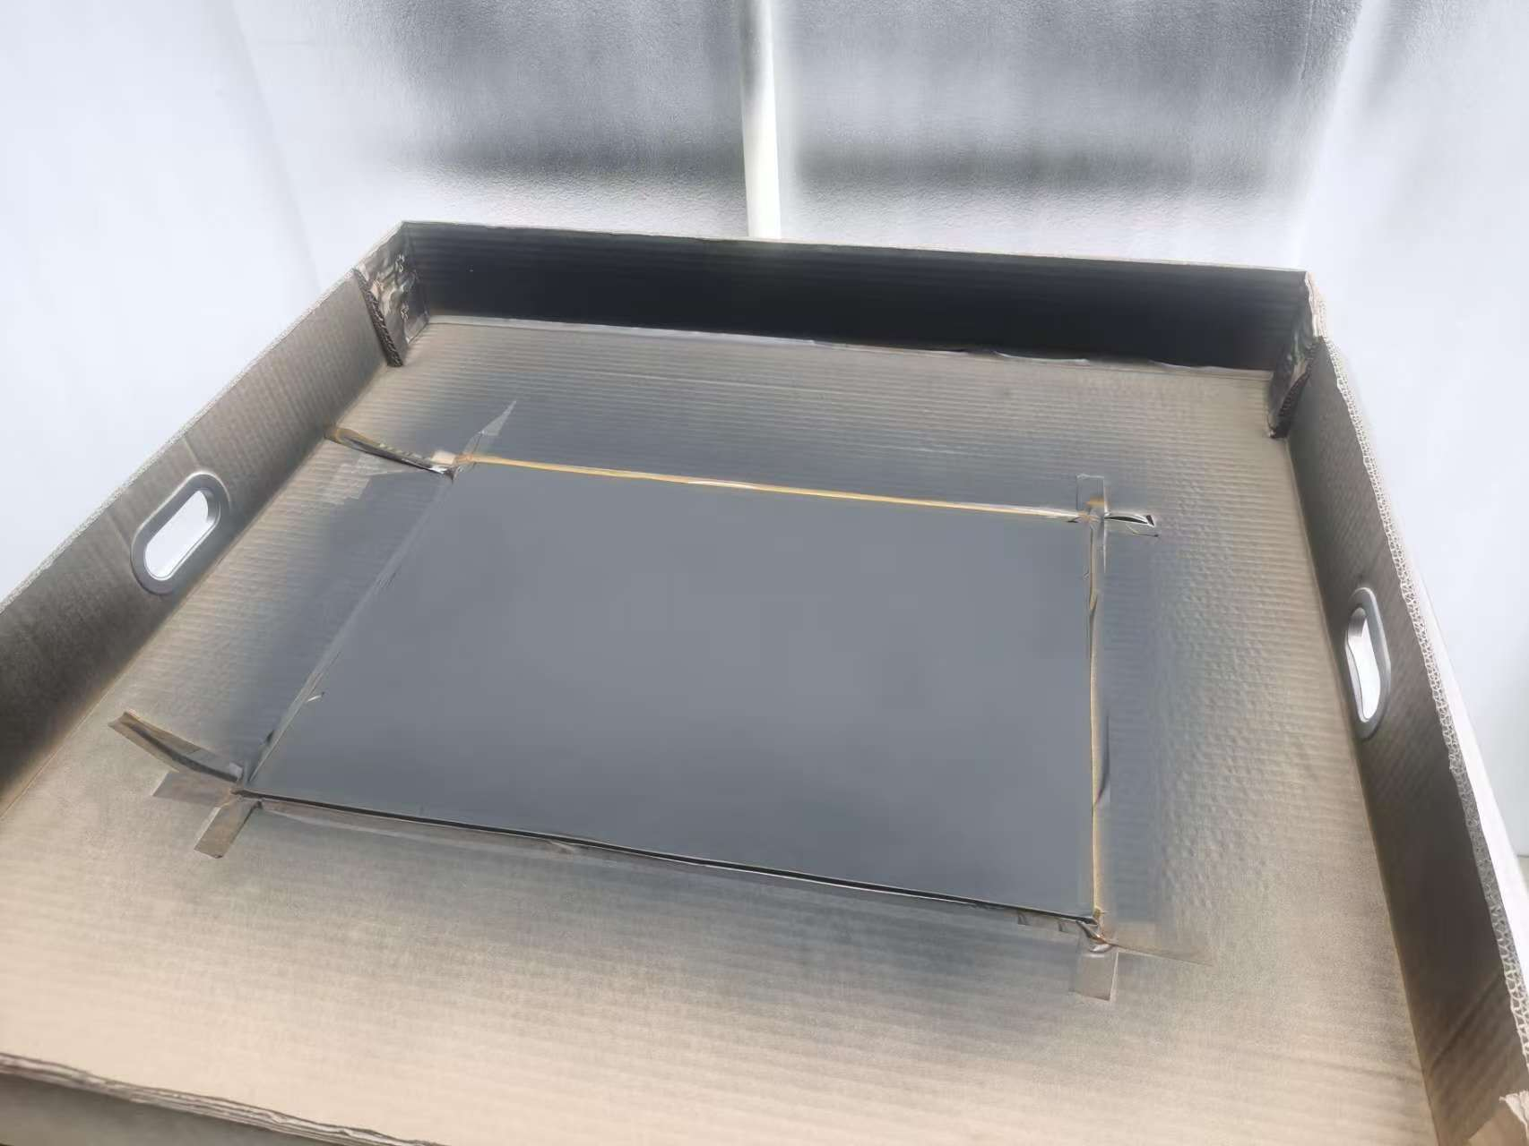
RPC prototype in SJTU
Painted the gas chamber made before
Test the surface resistivity:
7.2MΩ | 5.5MΩ | 6.4MΩ
4.0MΩ | 5.0MΩ | 5.7MΩ
Side1:
250kΩ | 110kΩ | 100kΩ
240kΩ | 130kΩ | 97kΩ
Side2:
Target: 100kΩ-1MΩ

Slide 2
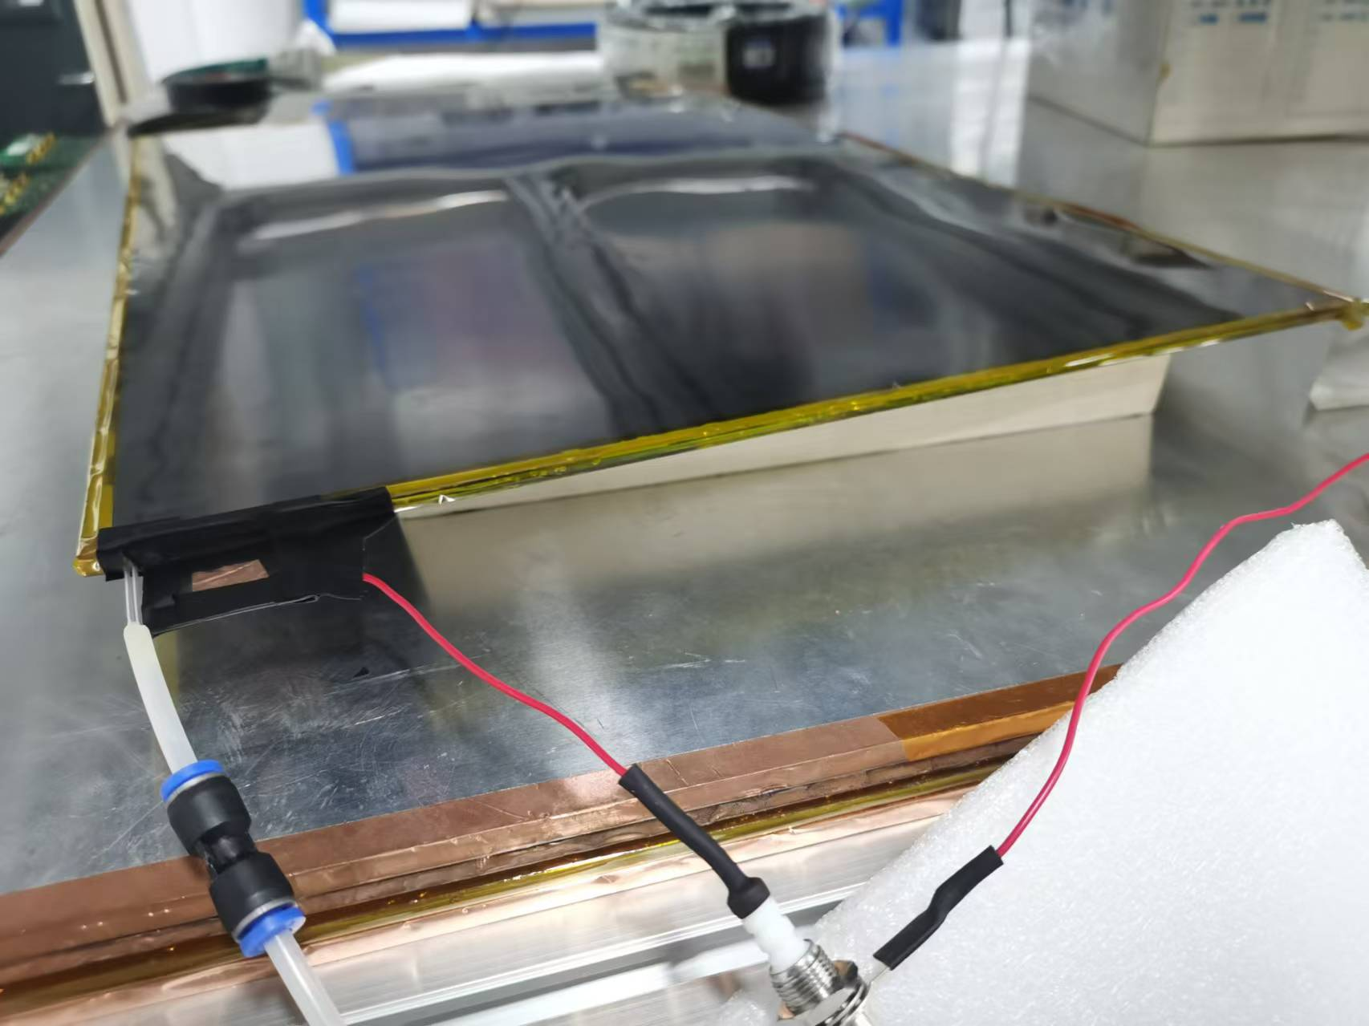
Initial HV scan
Packaged with mylar and flushed with standard gas mixture
Doing the HV scan with the standard gas mixture
Can see a exponential-like trend
Now conditioning under 6600kV

Slide 3
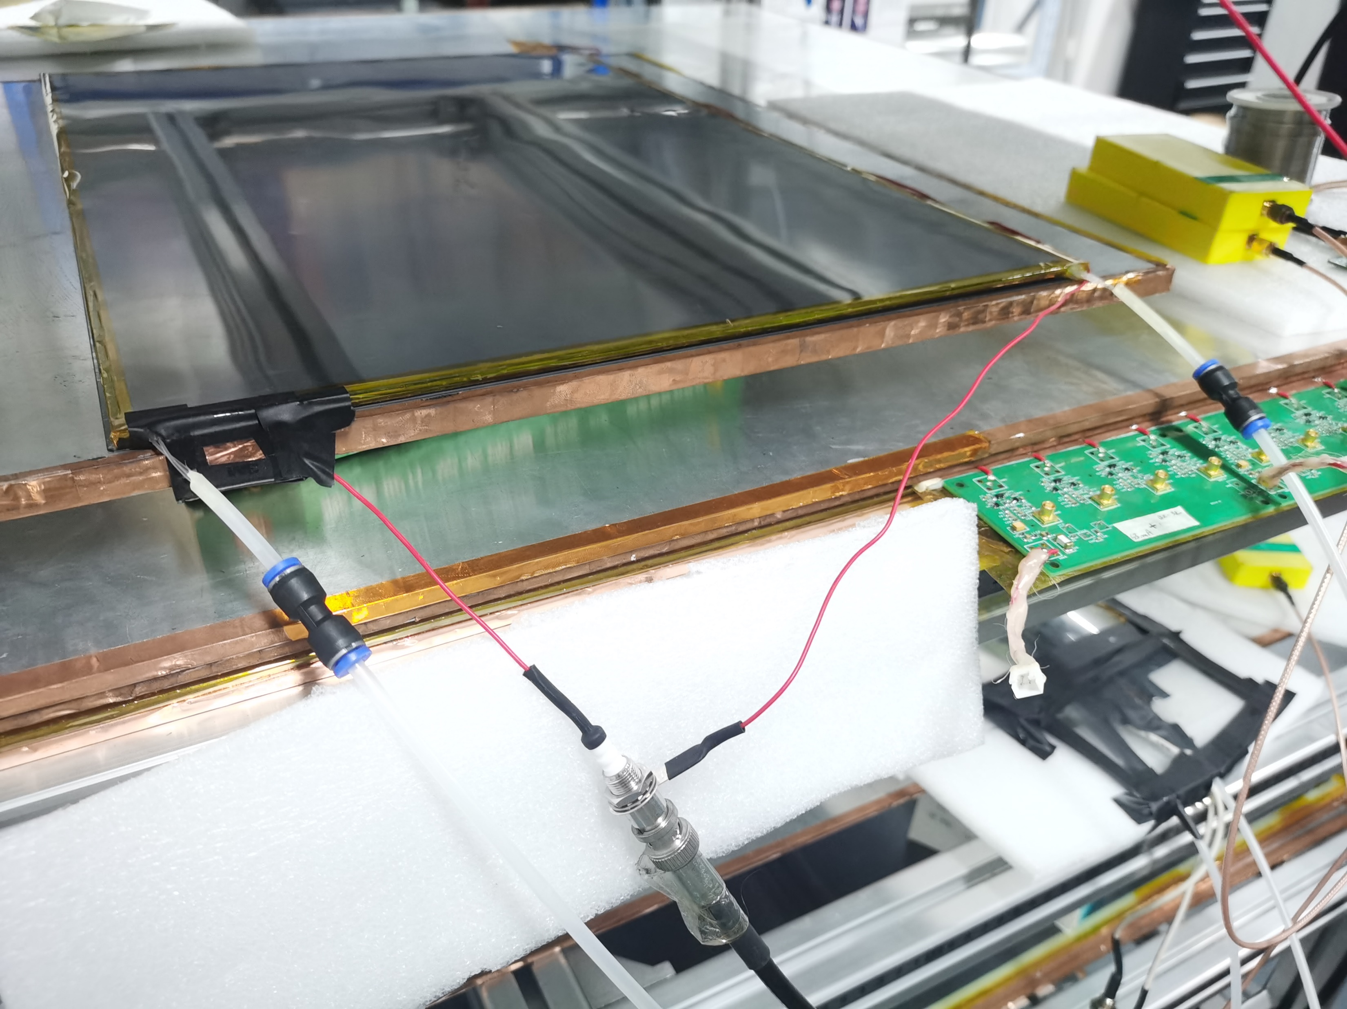
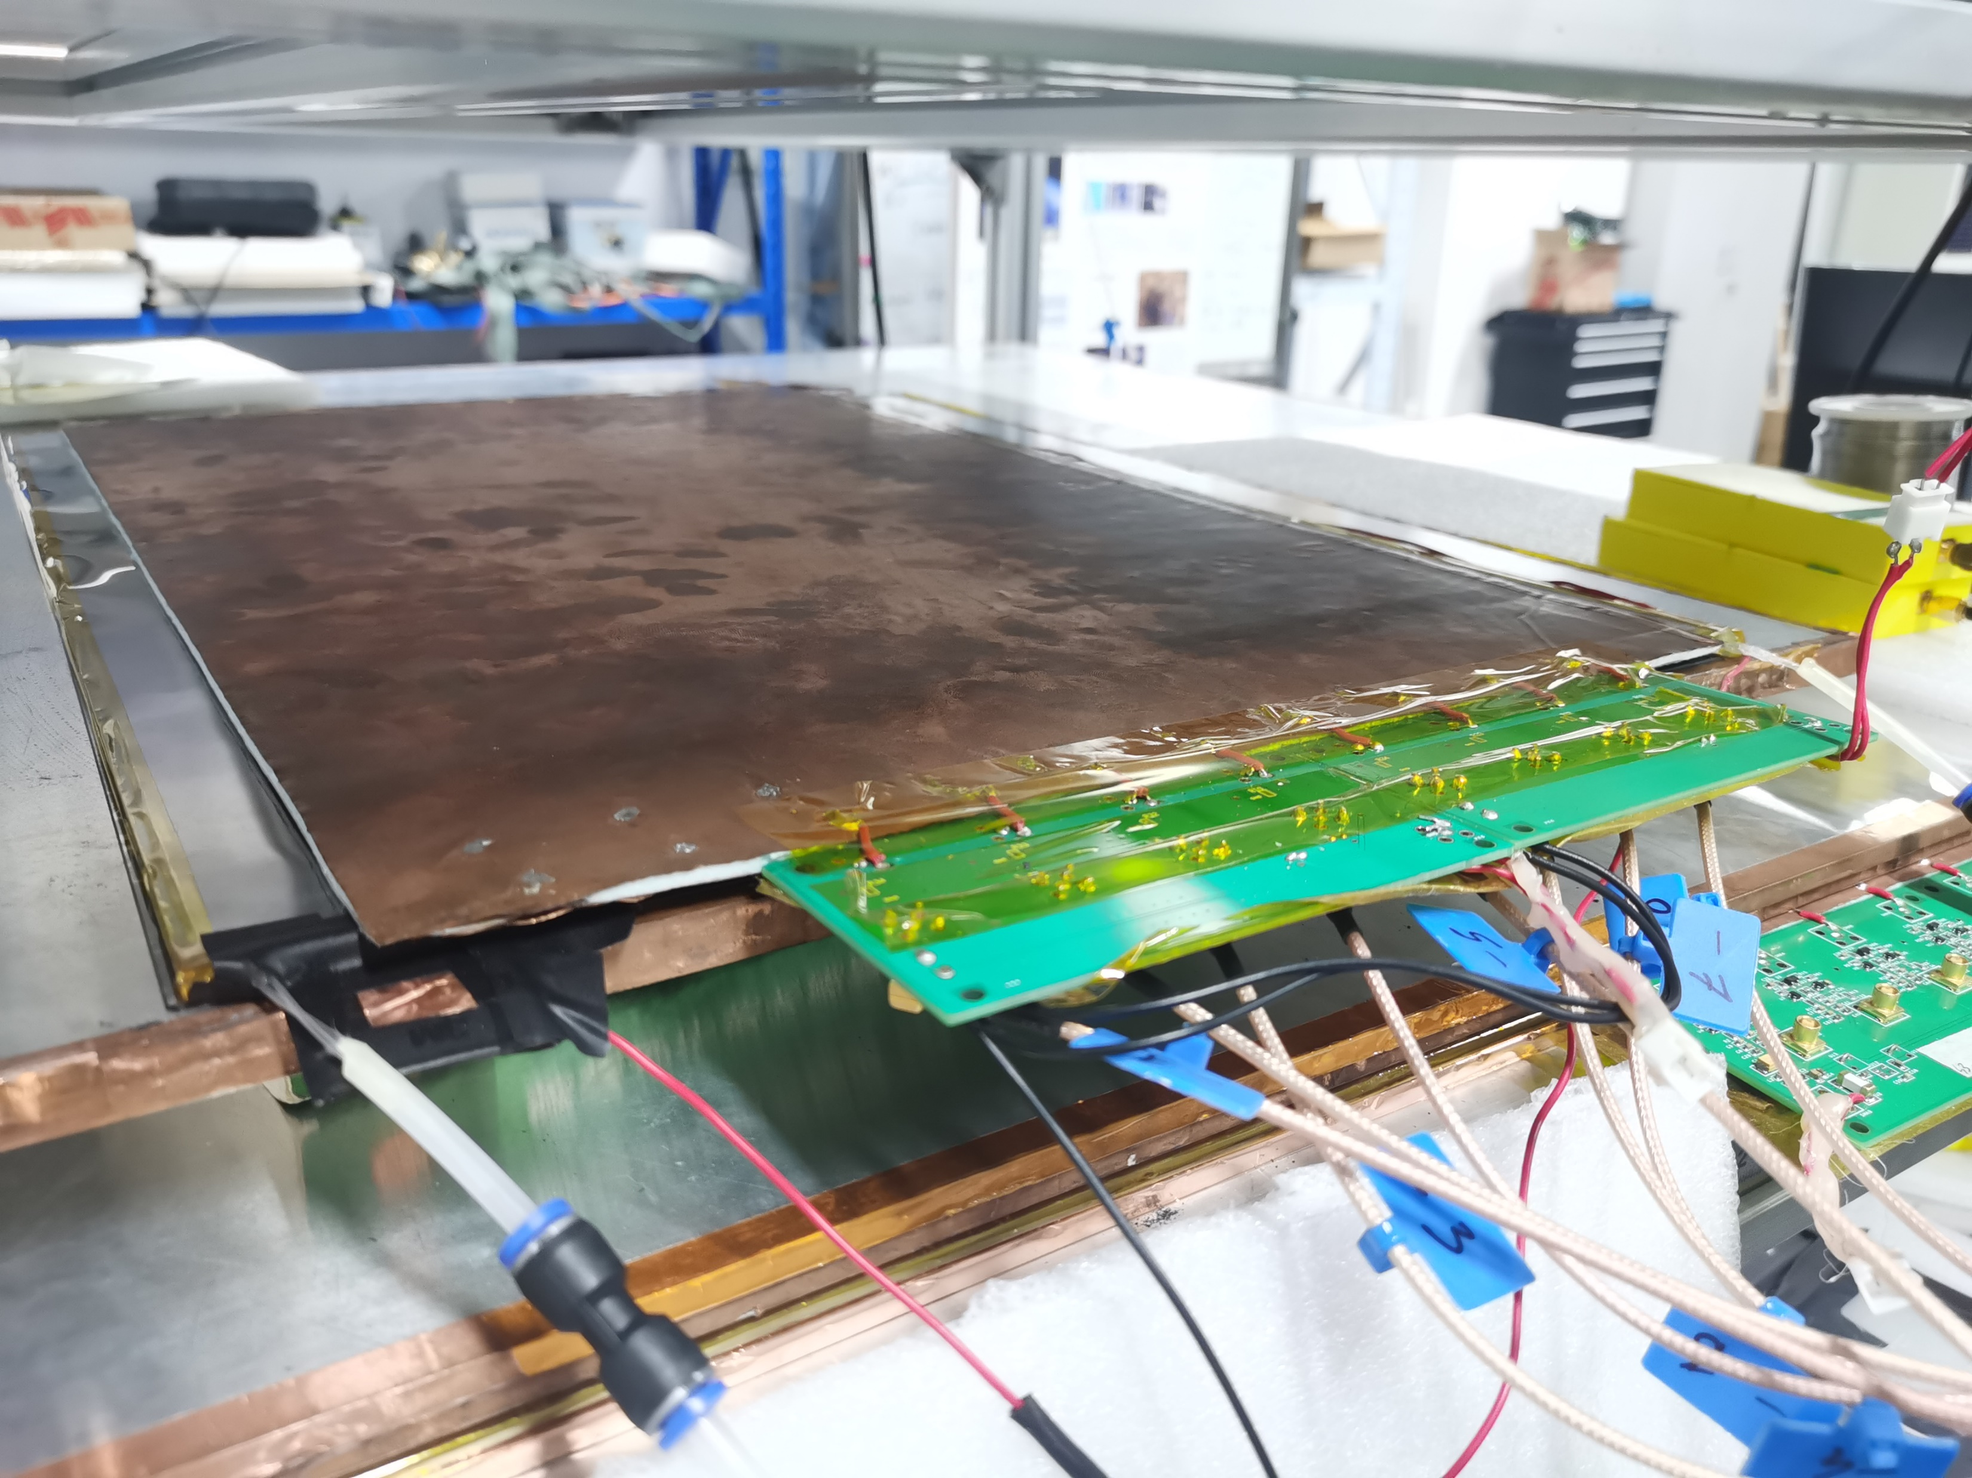
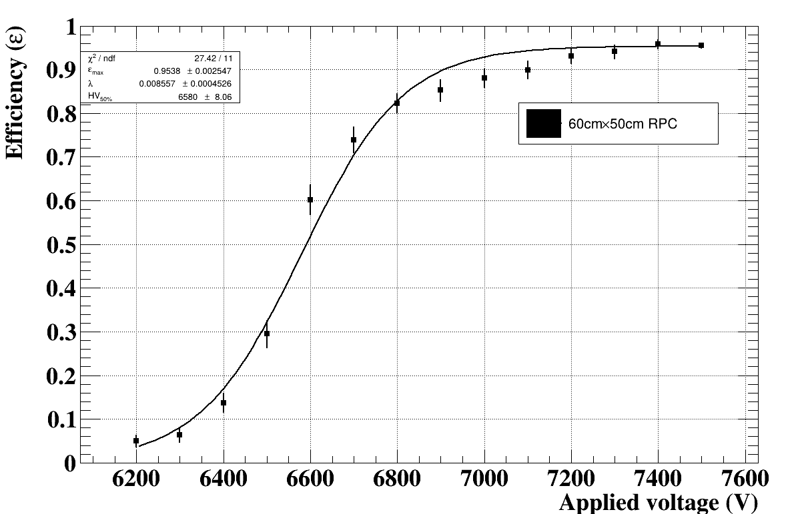
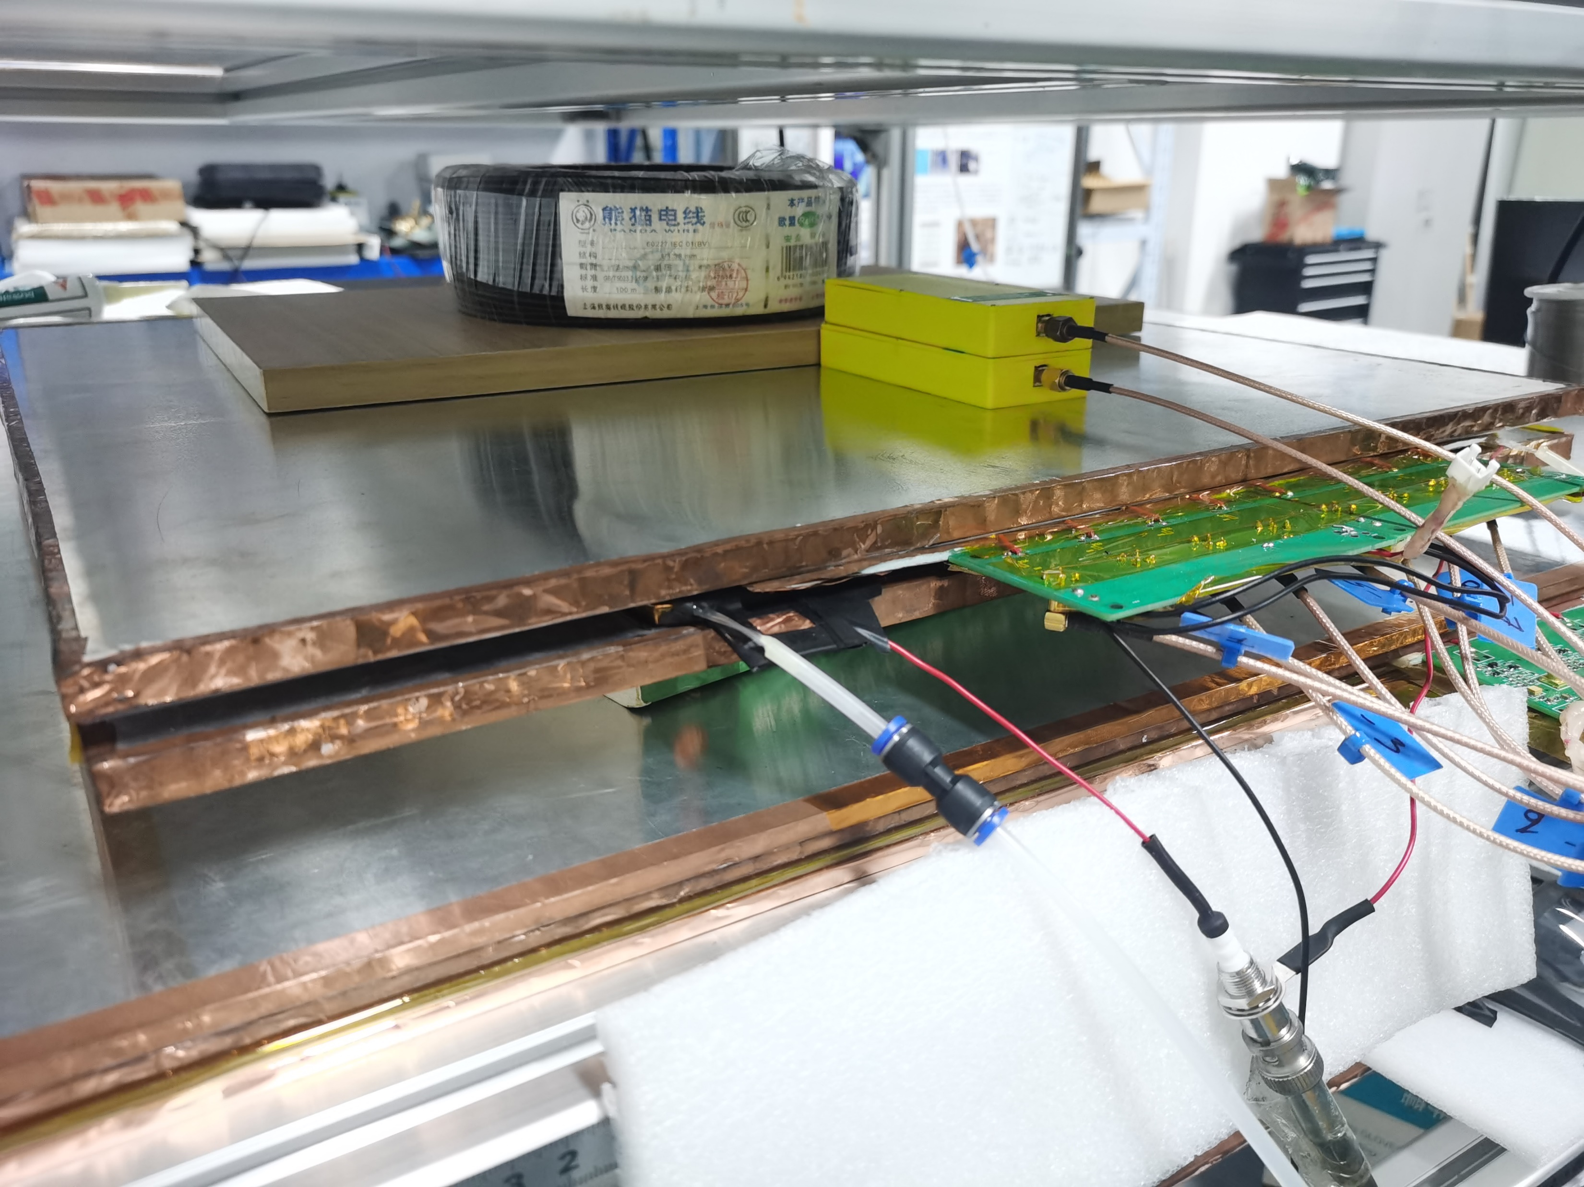
Efficiency test
Conditioning under 6600kV for ~5days
Todo:
Time resolution
Noise

