Slide 1
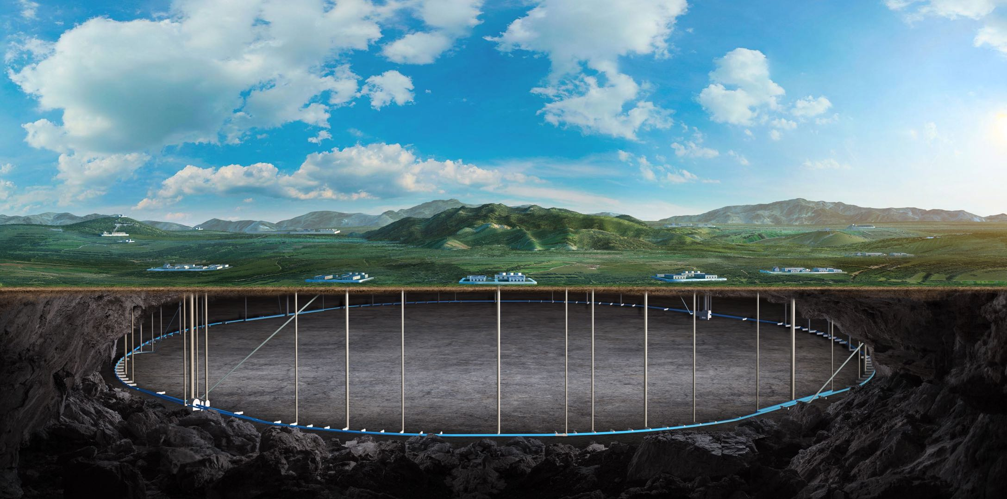
CEPC Detector Magnet
Feipeng Ning
On behalf of SC magnet Team

Slide 2
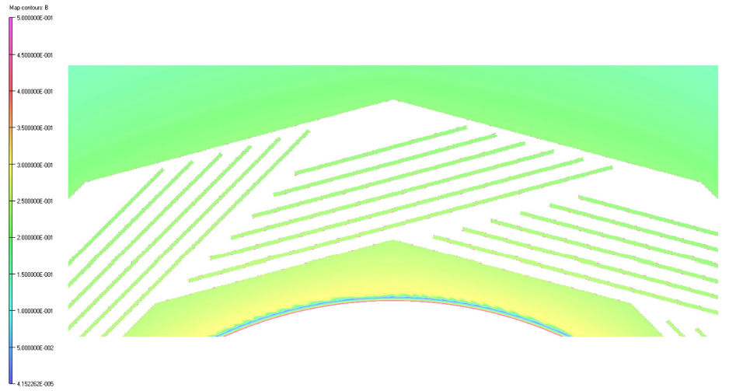
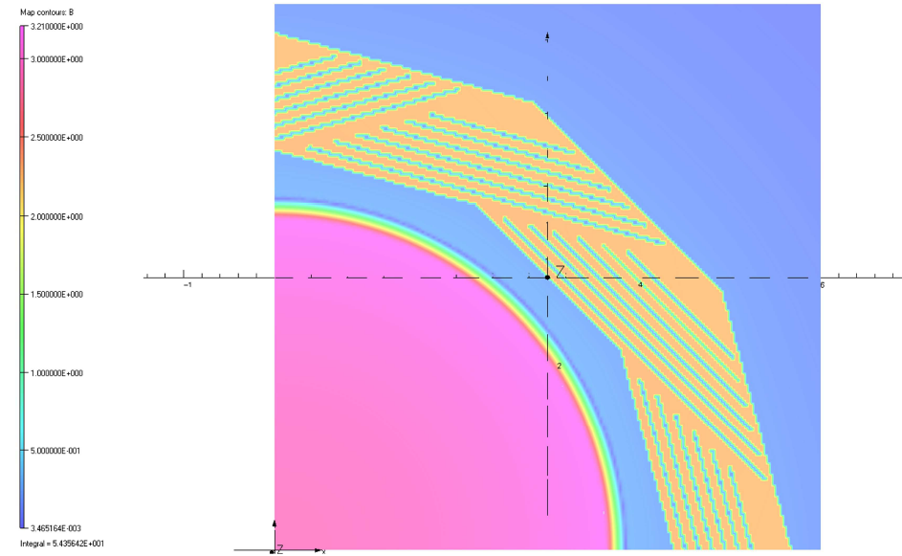
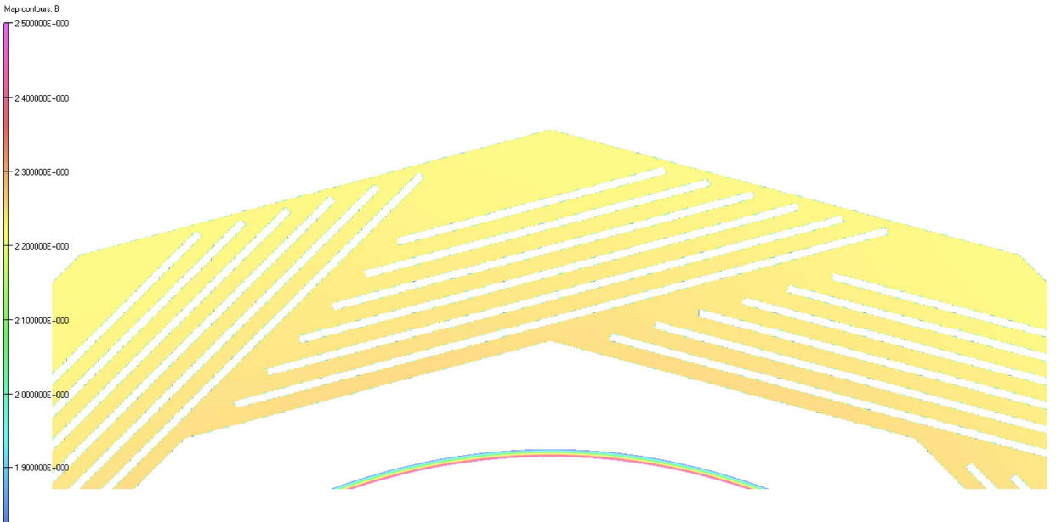
Magnetic field distribution
Magnetic field distribution of Muon detector and barrel yoke
Muon detector about 0.2-0.3 T
Z=0 m，对称面处
Barrel yoke about 2.2-2.3 T

Slide 3
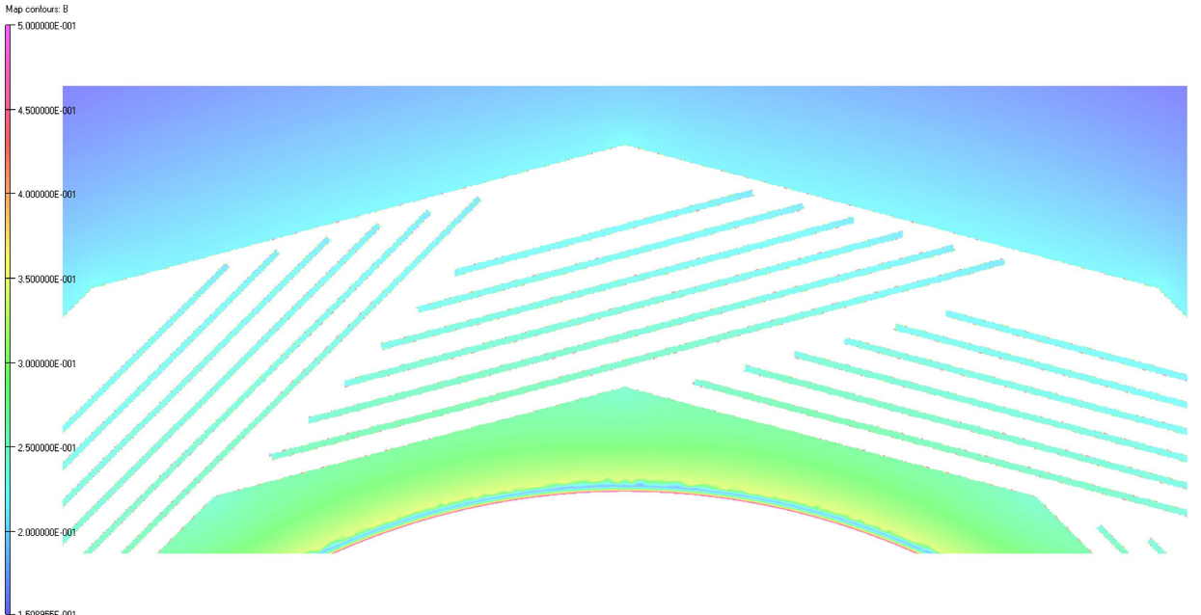
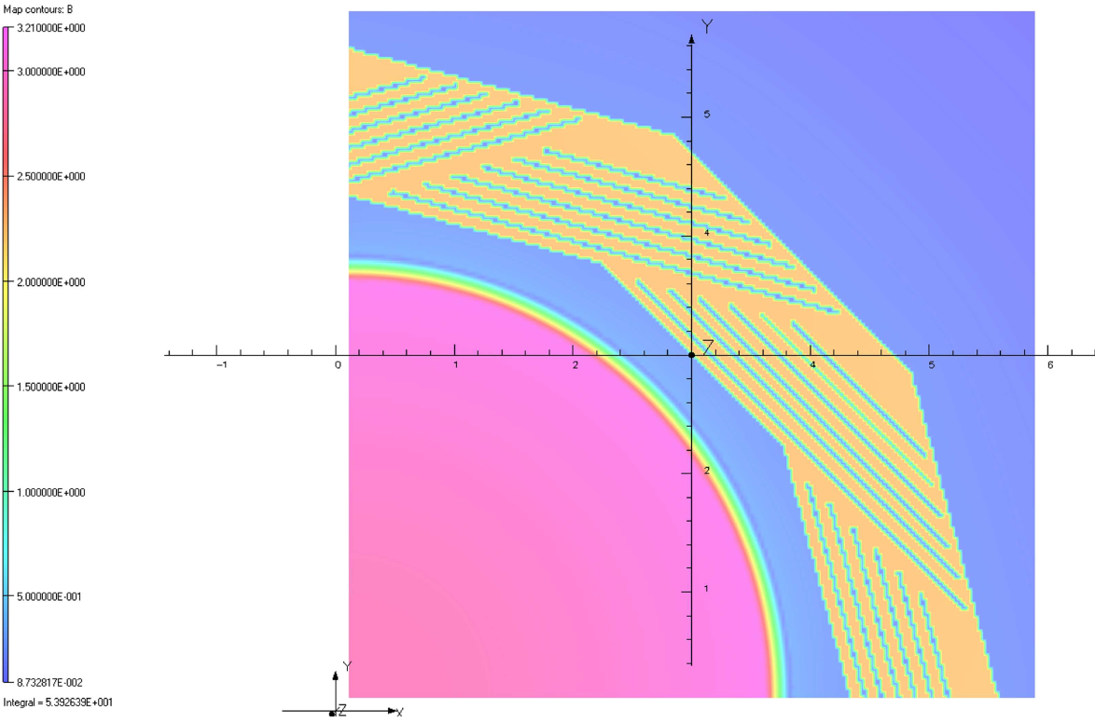
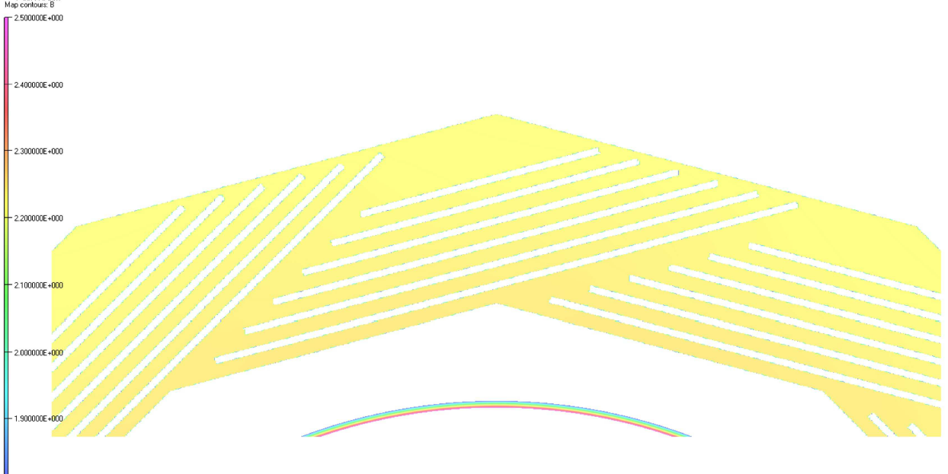
Magnetic field distribution
Magnetic field distribution of Muon detector and barrel yoke
Muon detector about 0.2-0.3 T
Z=1 m
Barrel yoke about 2.2 T

Slide 4
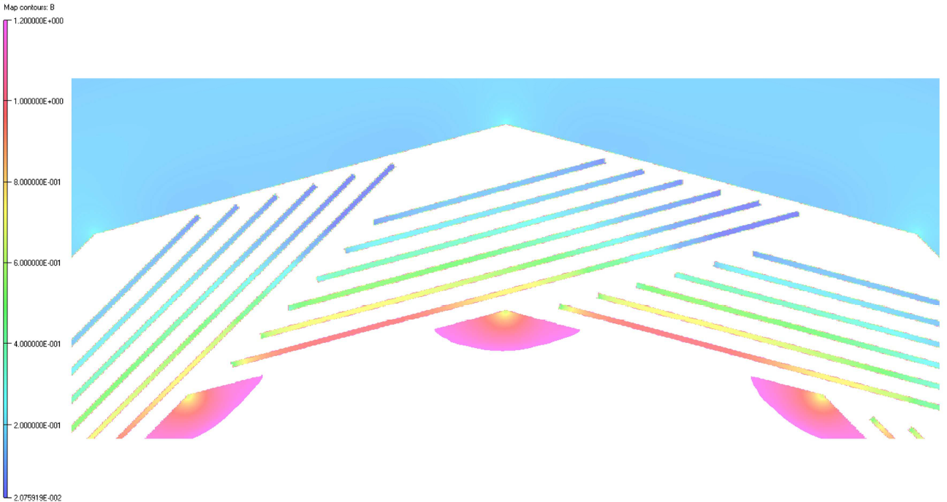
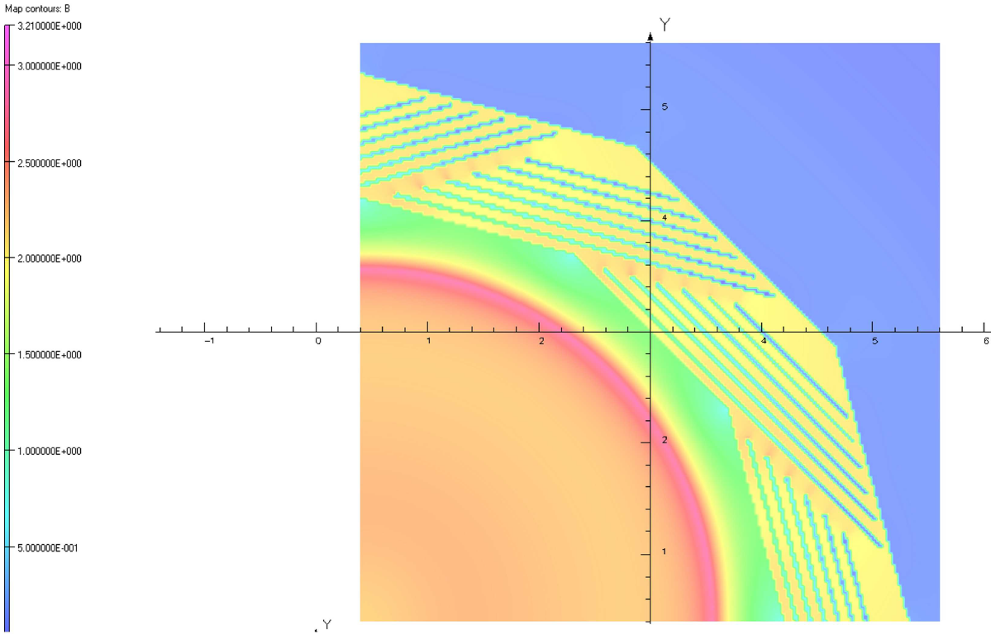
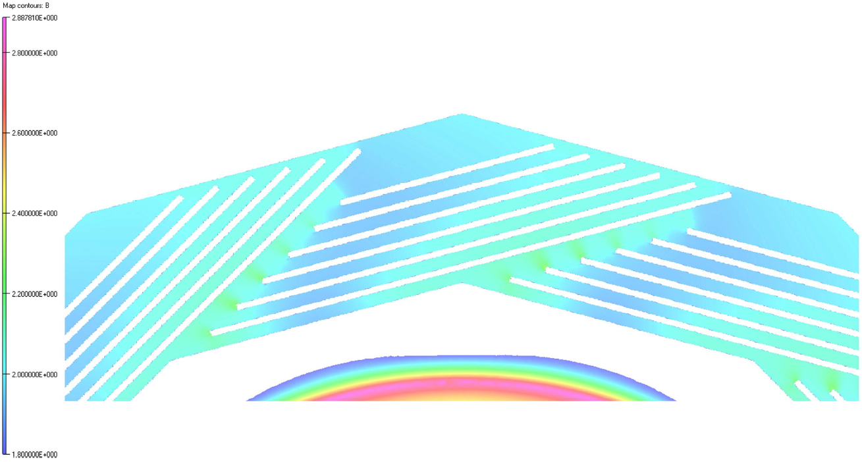
Magnetic field distribution
Magnetic field distribution of Muon detector and barrel yoke
Muon detector about 0.2-1.2 T
Z=4 m, near the end of the yoke
Barrel yoke about 1.8-2.4 T

Slide 5
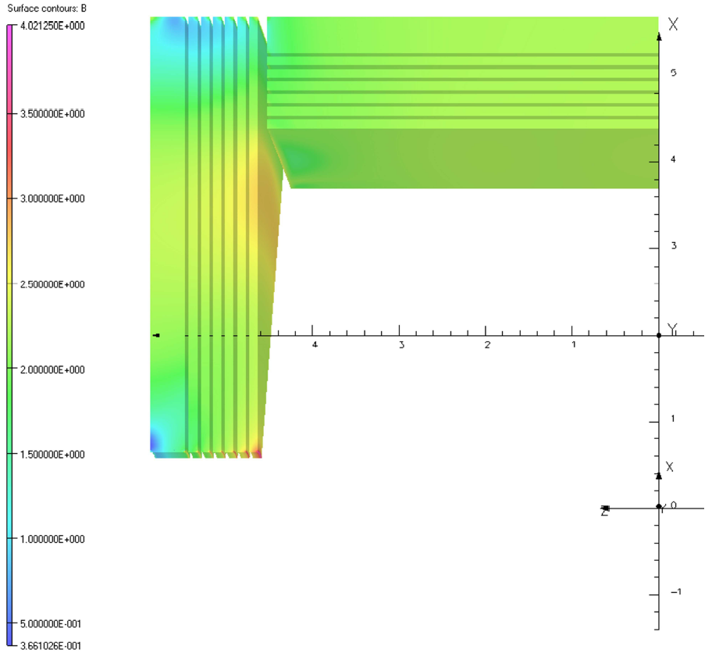
Magnetic field distribution
Magnetic field distribution on the yoke，1/24 model

Slide 6
Answers to the chair of IDRC
Why do not choose HTS?
We have not given up on the HTS scheme and have been conducting research and development on HTS. However, there are still some immature aspects of HTS, especially the defects in the quench detection scheme. Therefore, we have chosen LTS as the baseline and HTS as the backup option.

Slide 7
Answers to the chair of IDRC
Why are all the collaborating partners Chinese without any international collaborators?
The detector superconducting magnet has many large processing components, such as the 8-meter diameter, 9-meter high cryostat vacuum vessel. The most suitable solution is to produce and transport these components locally. It is very difficult and costly to have them processed abroad and then transported back to the China.
Currently, the most important component for the detector superconducting magnet is the aluminum-stabilized superconducting cable. Since 2015, the IHEP has been collaborating with enterprises on the development of aluminum-stabilized superconducting cables, which are technologically mature and cost-effective.
There are currently no suitable foreign processing units for aluminum-stabilized superconducting cables.

Slide 8
Thank you for your attention!

