Slide 1
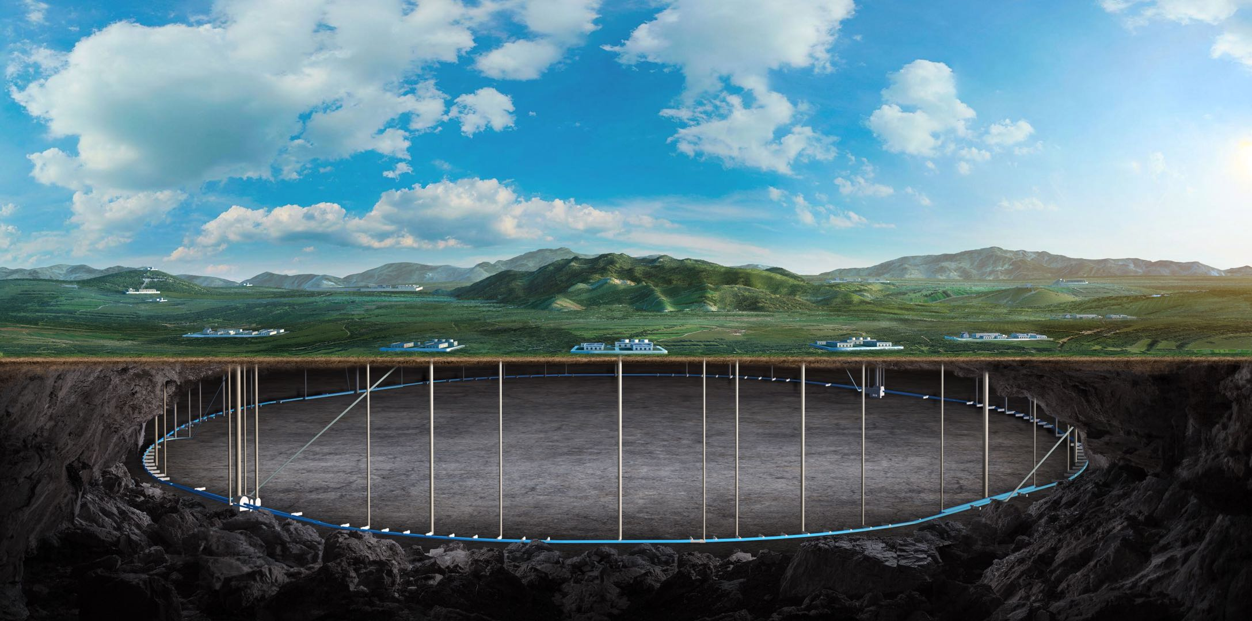
Progress of CEPC ref-TDR TDAQ
Fei Li, Jingzhou Zhao and Xiaolu Ji
On behalf of CEPC TDAQ Group
Aug. 27th, 2024, CEPC Detector Ref-TDR Meeting

Slide 2
Progress of TDAQ
Project group bi-weekly meeting(Mon. afternoon)
2024.8.26
Start to collect event types, a note “Sample generation for CEPC” in 2020.
Try analyze particle final-state features with current CEPCSW.
Survey for RDMA readout protocol development
RDMA for ATLAS FELIX (100Gb work now)
ESRF（European Synchrotron Radiation Facility)
RASHPA（(RDMA)-based acquisition system for high-performance applications
Oct. workshop talk plan
Trigger simulation and algorithm/ hardware trigger/ DAQ
DNN for BelleII L1 trigger/ FPGA based trigger algorithm development
LHCb GPU acceleration
Need 2~3 other technical talks from for foreigners

