Slide 1


Top Quark EW Coupling Precision Measurement
11/11/2024

Slide 2
Couplings Parametrization
Parameterization of tt couplings to photon and Z Boson is done in the following way :
Where :
are the SM contributions to the vertices, and non-SM form factores are : δAγ,Z, δBγ,Z, δCγ,Z describe CP-conserving interactions, while δDγ,Z parameterizes CP-violating interactions.

Slide 3
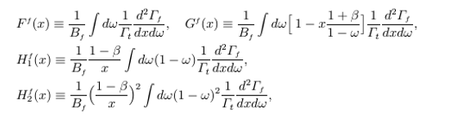

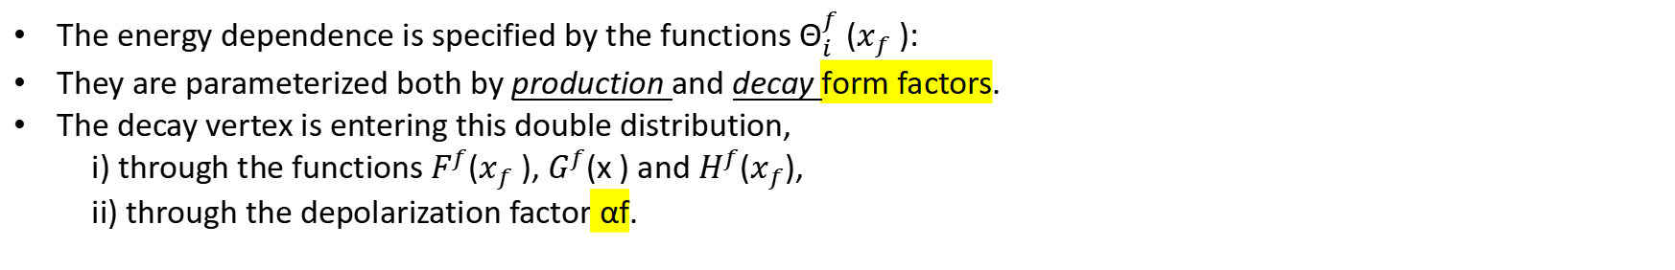
Adopting the general formula for the tt distribution dσ(s+,s−)/dΩt , we obtains the following result for the double distribution of the angle and the rescaled energy of :
The energy dependence is specified by the functions $Θ_{i}^{f}$ ($x_{f}$ ):
They are parameterized both by production and decay form factors.
The decay vertex is entering this double distribution,
i) through the functions $F^{f}$($x_{f}$ ), $G^{f}$(x ) and $H^{f}$($x_{f}$),
ii) through the depolarization factor αf.
The differential top-quark decay rates in e+e− CM frame ---->

Slide 4
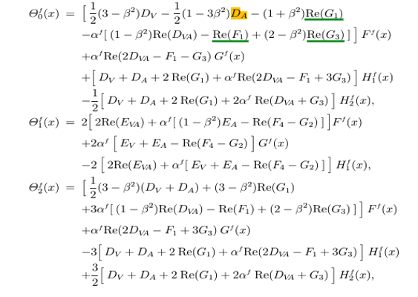
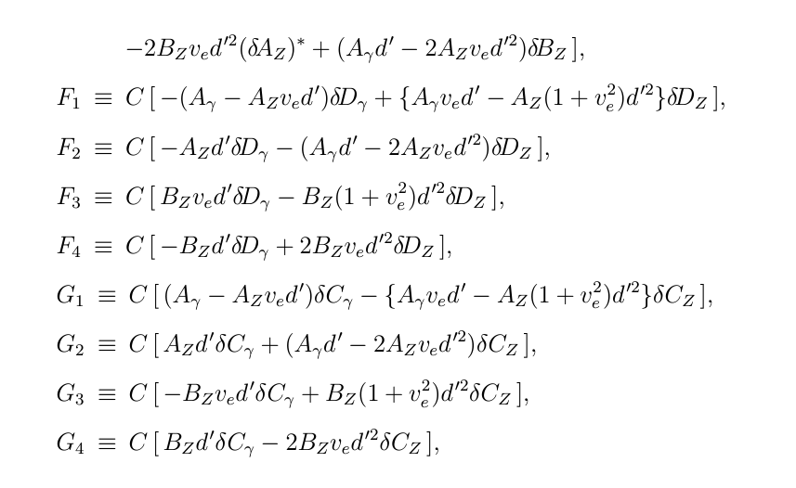
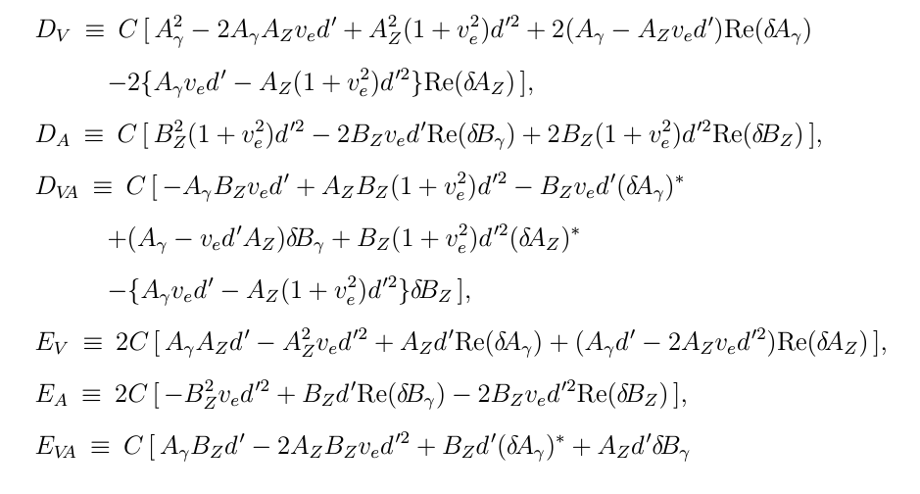
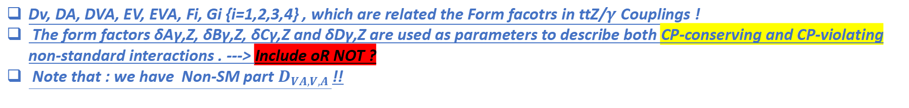
The Explicit Formula describing the energy-dependent coefficients for the angular and energy distributions :
arxiv.org/pdf/hep-ph/9911505
arxiv.org/pdf/hep-ph/9710358
Dv, DA, DVA, EV, EVA, Fi, Gi {i=1,2,3,4} , which are related the Form facotrs in ttZ/$γ$ Couplings !
The form factors δAγ,Z, δBγ,Z, δCγ,Z and δDγ,Z are used as parameters to describe both CP-conserving and CP-violating non-standard interactions . ---> Include oR NOT ?
Note that : we have Non-SM part $D_{VA,V,A }$!!

Slide 5
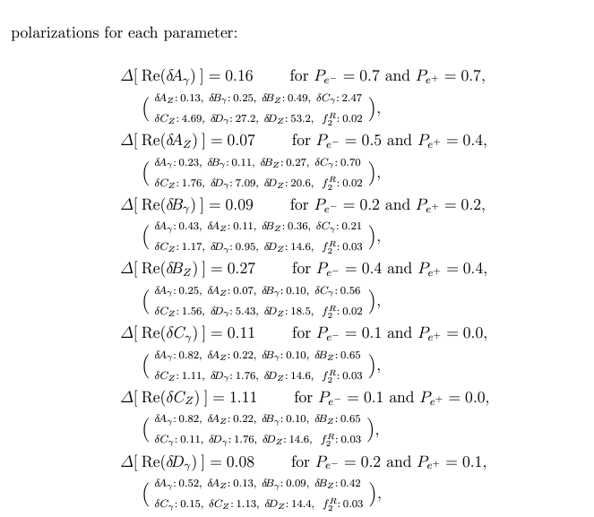
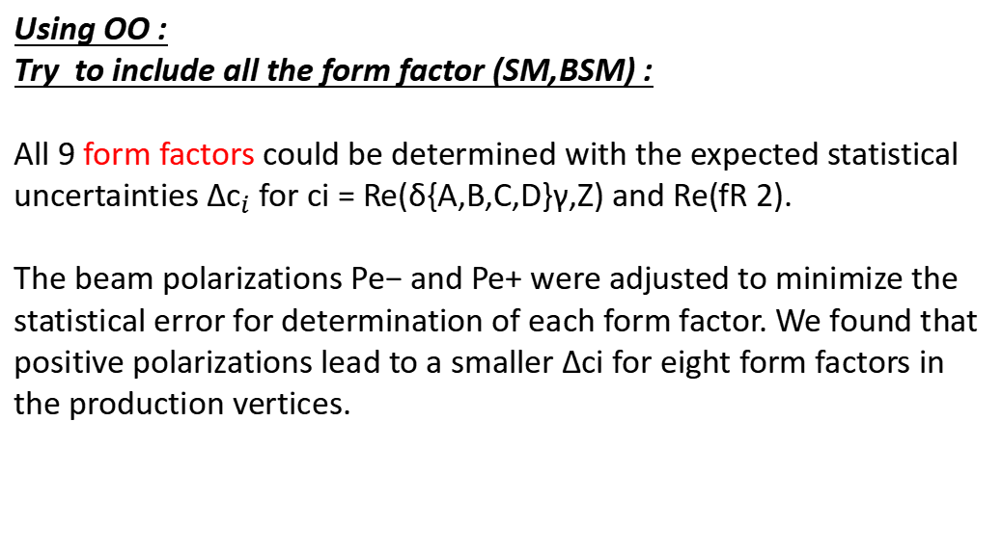
ILC case @500GeV:
Using OO :
Try to include all the form factor (SM,BSM) :
All 9 form factors could be determined with the expected statistical uncertainties ${∆c}_{i}$ for ci = Re(δ{A,B,C,D}γ,Z) and Re(fR 2).
The beam polarizations Pe− and Pe+ were adjusted to minimize the statistical error for determination of each form factor. We found that positive polarizations lead to a smaller ∆ci for eight form factors in the production vertices.
arxiv.org/pdf/hep-ph/0004223
As Example : Assumed
Derived Results : They have fixed all the non-SM parameters to be +0.05 as a reasonable example for the strength of beyond-the-SM physics (for Re(δ{A,B,C,D}γ,Z) = Re(fR 2) = +0.05).

Slide 6
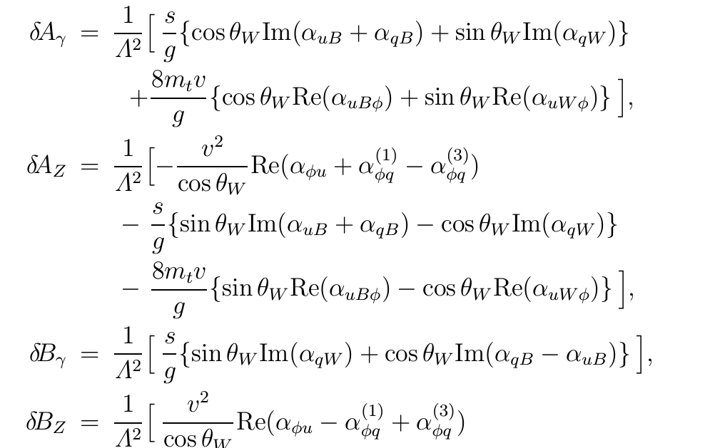
Form factors, δAγ,Z,δBγ,Z,δCγ,Z and δDγ,Z are parameterizing CP-conserving and CP-violating non-standard interactions, respectively. In the appendix, we show how they receive contributions from effective operators of dimension 6.
arxiv.org/pdf/hep-ph/9710358

Slide 7
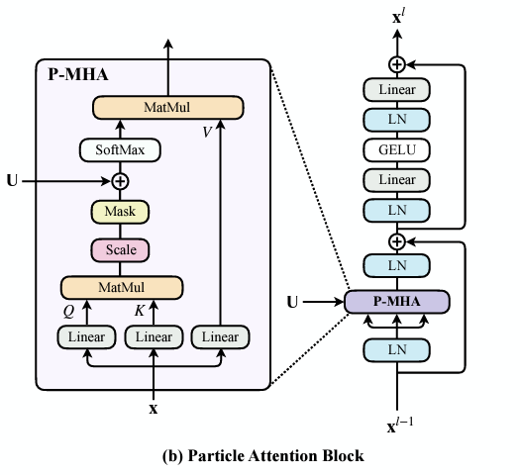
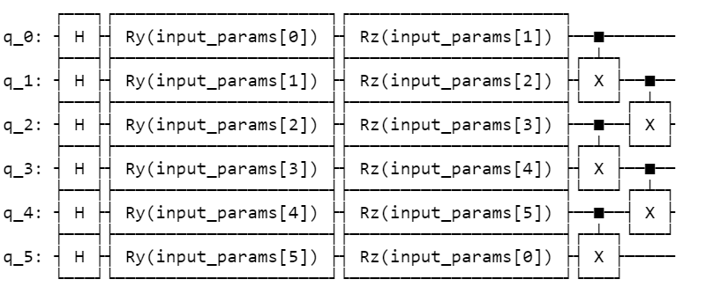
Data Encoding
- Building a Quantum linear layer : Feature Map
Solutions : - Encode Mutiple variables per qubit.
- Use MQA instead of MHA (Speed up Computation)

Slide 8
Only SM Constributions :
          arxiv.org/pdf/hep-ph/0004223

