Slide 1
Top Quark EW Coupling Precision Measurement
25/11/2024

Slide 2
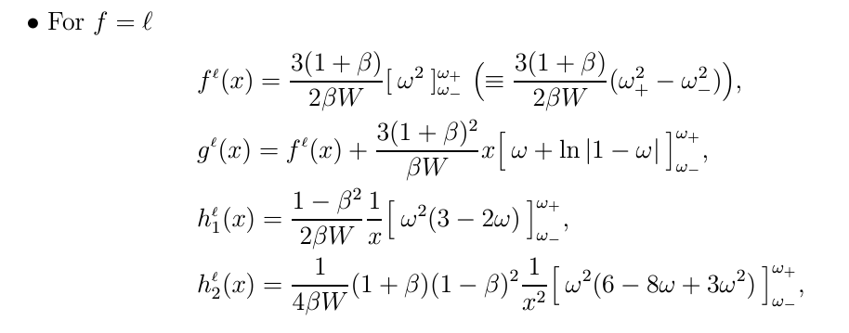
Adopting the general formula for the tt distribution dσ(s+,s−)/dΩt , we obtains the following result for the double distribution of the angle and the rescaled energy of :
The energy dependence is specified by the functions $Θ_{i}^{f}$ ($x_{f}$ ):
They are parameterized both by production and decay form factors.
The decay vertex is entering this double distribution,
i) through the functions $F^{f}$($x_{f}$ ), $G^{f}$(x ) and $H^{f}$($x_{f}$),
ii) through the depolarization factor αf ==1 for Leptons.
The differential top-quark decay rates in e+e− CM frame

Slide 3
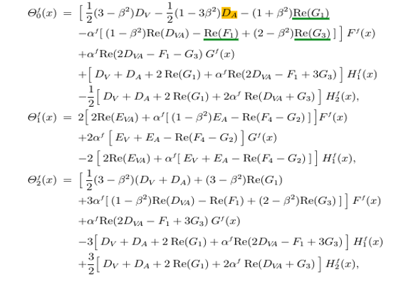
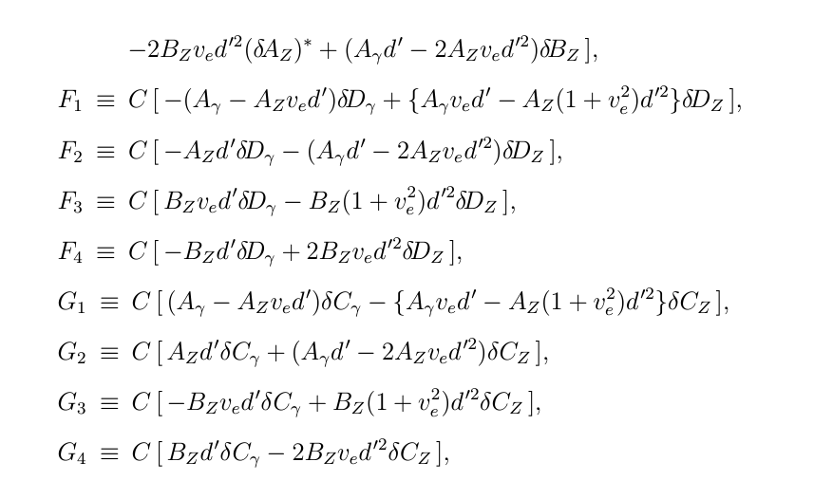
The Explicit Formula describing the energy-dependent coefficients for the angular and energy distributions :
arxiv.org/pdf/hep-ph/9911505
arxiv.org/pdf/hep-ph/9710358
Dv, DA, DVA, EV, EVA, Fi, Gi {i=1,2,3,4} , which are related the Form facotrs in ttZ/$γ$ Couplings !
FOR SM Only : ${δ\{A,B,C,D\} }_{γ,Z},fR=0 −−−−> Fi, Gi =0 ; The coefficient formulas simplify.$

Slide 4
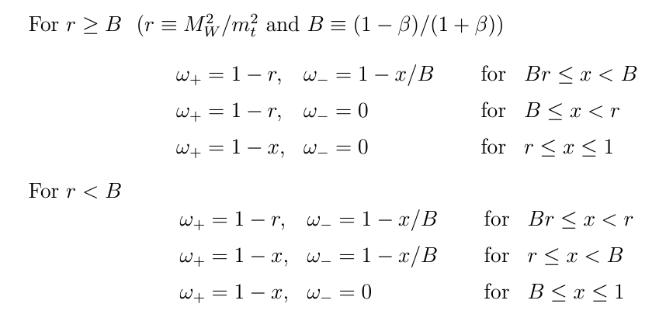
CEPC @360GeV:
Inputs :
Cases for $ω$ :
The normalized energy is given by :
Where $β$is the Top Velocity.

Slide 5
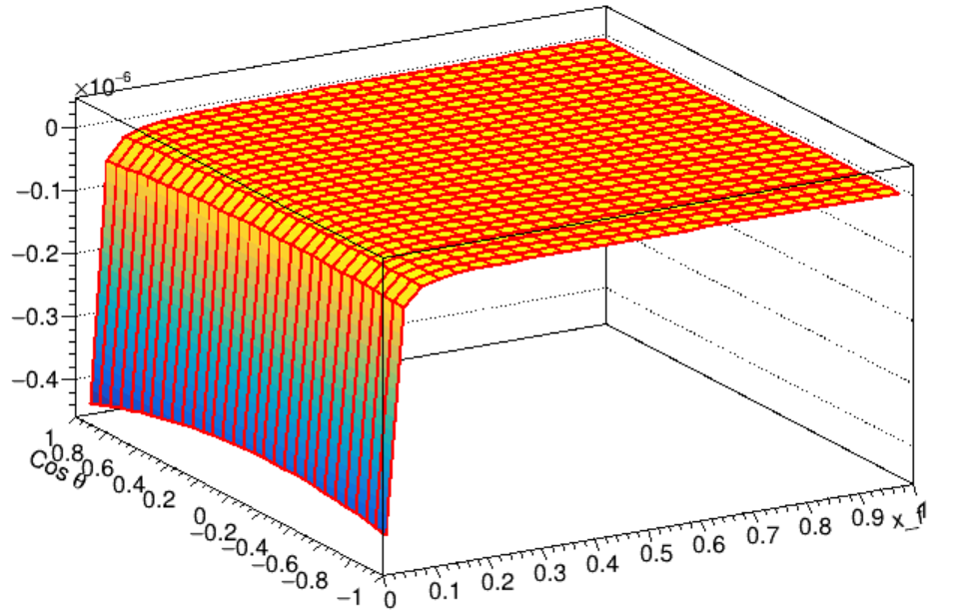
CEPC @360GeV:
- Tried to plot the 2D plot of the function in terms of the Lepton polar angle and normalized Energy :
For Truth case :
- I took the Lepton Energy.
- the B_f (branching fraction) set to 0,22 (from ILC ).
- The$\sin^{2}θ$ is set to 0.23.
- Mass of Z to 91 GeV.
- Fine structure to 0.0072973525643.

Slide 6
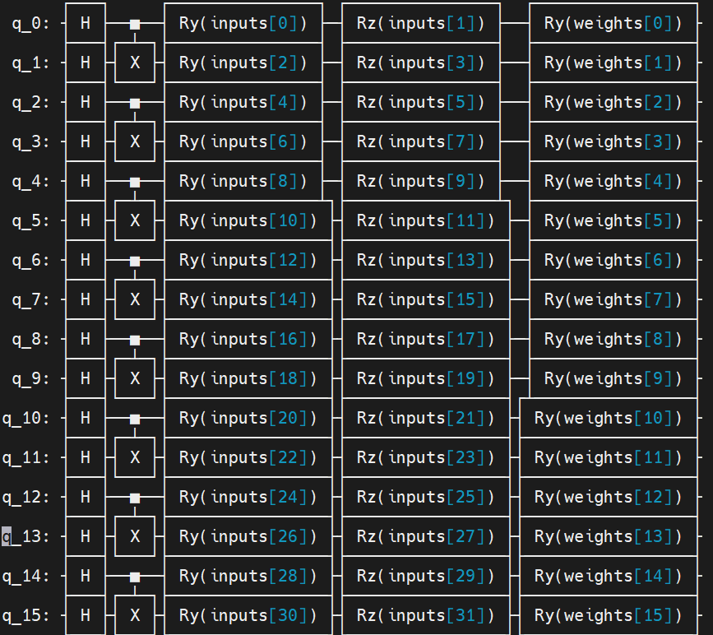
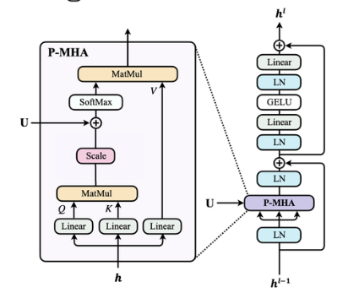
Quantum P-Transformer
- Use quantum self-attention analogs to classical ones. (Only Encoder)
- Encode 2-variables per qubit. (Based On Abdualazeem Model).
- Due to available #qubits i only used 24 qubits. (still can check to use more ?)
- Applying it to ZWW bkg :
input data : - ~16 K for training.
- ~ 16K for testing.
- No validation Data were used.
- 8 Epochs.

Slide 7
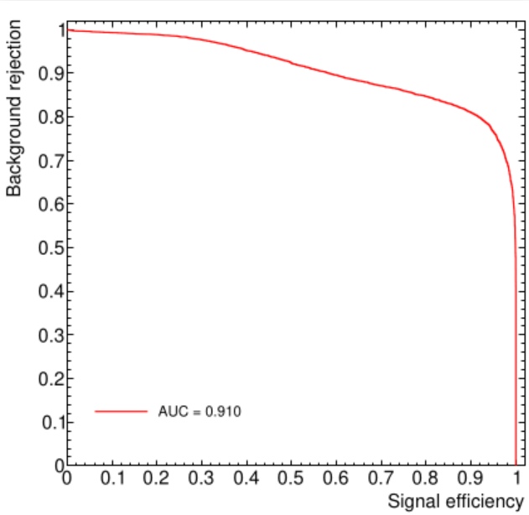
Results
- Scores For ZWW bkg :
- ROC Curve for this samples.
- Set cuts, then feed it to QparticleTransformer.
- Speed up the QSA to gain in time ~(IHEP GPUs allows !6days Only ).

Slide 8
Only SM Constributions :
arxiv.org/pdf/hep-ph/0004223

