Slide 1
CEPC CMOS Strip Tracker
Sen Zhao
On behalf of CMOS Strip Tracker Team

Slide 2
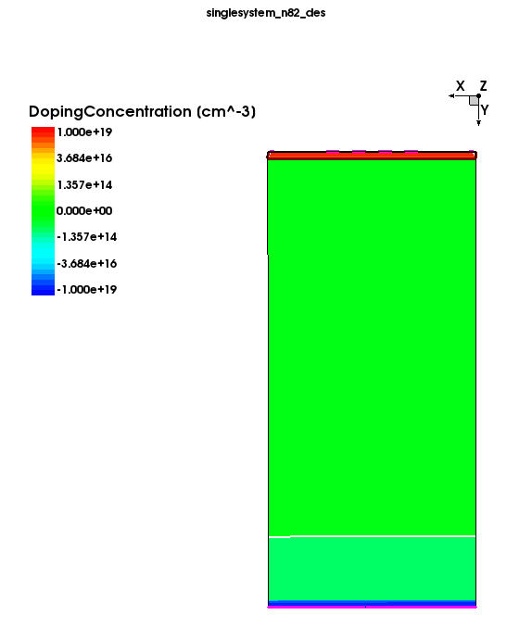
Strip Design: Passive CMOS
pitch
20 um
pad size
10 um
contact
SiO2
N layer
epi layer
350 um
Not to scale！！！

Slide 3
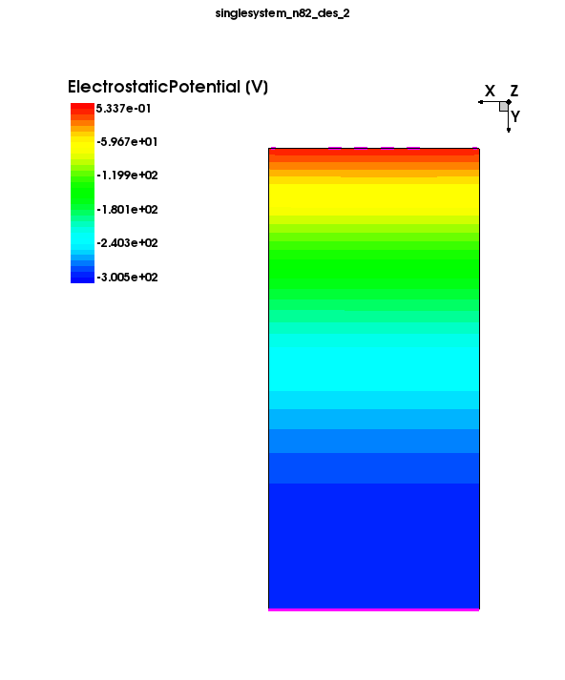
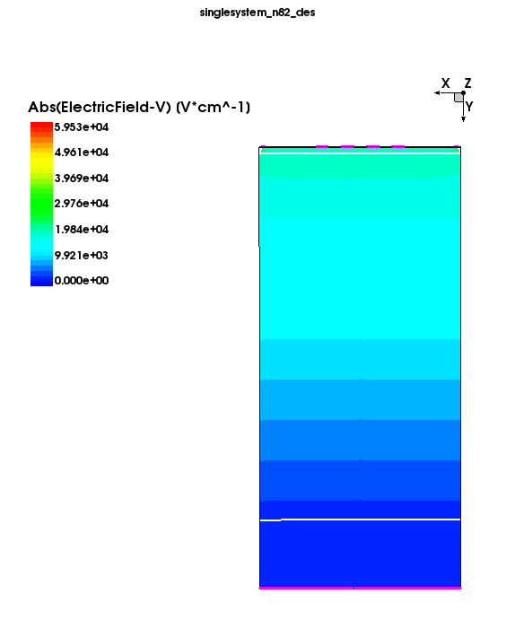
Electrostatic Potential & EField @300V

Slide 4
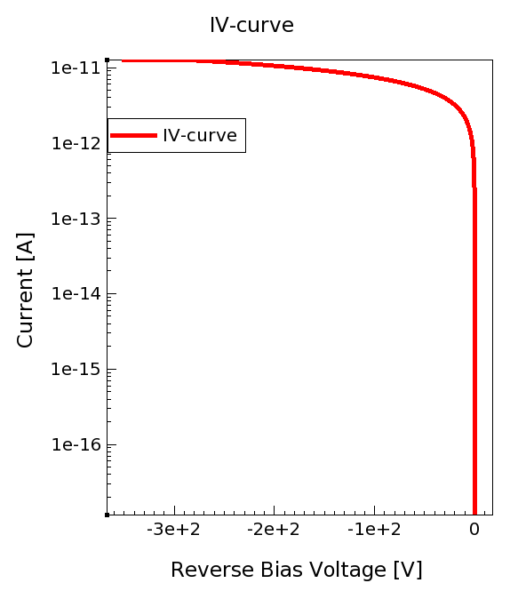
IV Curve
low leakage current at operating voltage

Slide 5
To do：
Signal response
CV

Slide 6
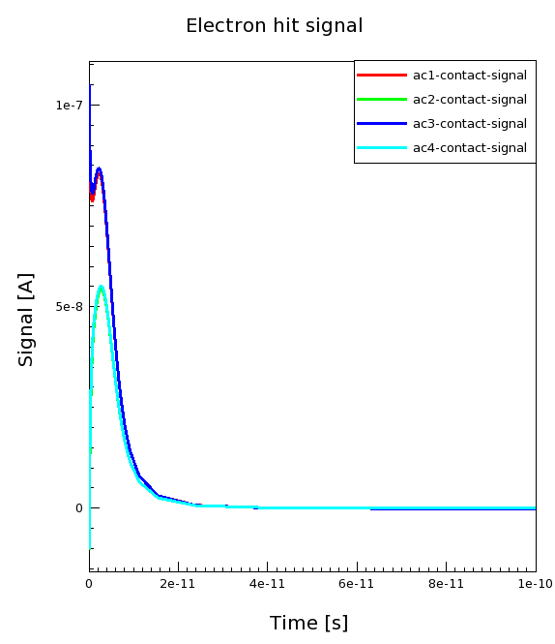
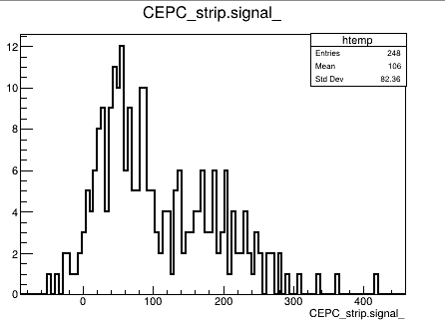
Backup：
e-
N layer
epi layer
TCAD
ALLPIX2

