Slide 1
CEPC Time of flight and outer tracker with LGAD
Yunyun Fan
Aug. 30, 2024

Slide 2
Urgent ！
Power consumption
From Xiongbo Yan at Aug. 28 (ITK+OTK meeting)
The power consumption would be 5-10 times less which means the power consumption would be similar to that of the international similar chips.
 | Per channel | Per ASIC | For ASIC area | For whole detector（barrel）
Pwer distribution | 20 mW | 2.56 W | 2.68 W/cm² ^{(ASIC area: 140mm x 15mm)} 1.71W/cm² ^{(ASIC area: 140mm x 17mm)} 1.34 W/cm² ^{(ASIC area: 140mm x 30mm)} | 0.575W/cm² ^{（dual readout）}
Possible power consumption reduction method:
1、5-10 strip using one TDC
2、occupancy is less than 10%

Slide 3
Urgent ！
Power consumption
  From Xiongbo Yan at Aug. 28 (ITK+OTK meeting)
  The power consumption would be 5-10 times less which means the power consumption would be similar to that of the international similar chips.
 | Per channel | Per ASIC | For ASIC area | For whole detector（barrel）
Pwer distribution | 20 mW | 2.56 W | 2.68 W/cm² ^{(ASIC area: 140mm x 15mm)} 1.71W/cm² ^{(ASIC area: 140mm x 17mm)} 1.34 W/cm² ^{(ASIC area: 140mm x 30mm)} | 0.575W/cm² ^{（dual readout）}

Slide 4
Hit rate estimation input for electronics
Z pole
Strip：0.1mm x 70 mm
Updated with new CEPCSW
Old one is 100K Hz/cm²
Maximum hit rate estimation
 | Hit rate （Hz/cm²） | Hit rate per ASIC（Hz） | Hit rate per strip （Hz）
Barrel | 140 | 1254.4 | 9.8
Endcap | ～35k （at 20mm ） | ～209.12k | ～2415
Cluster size：2-3 strip
Occupancy at endcap ：
  0.245% (10bit,1 µs deadtime) （worst situation，the occupancy could be less if the deadtime is smaller）

Slide 5
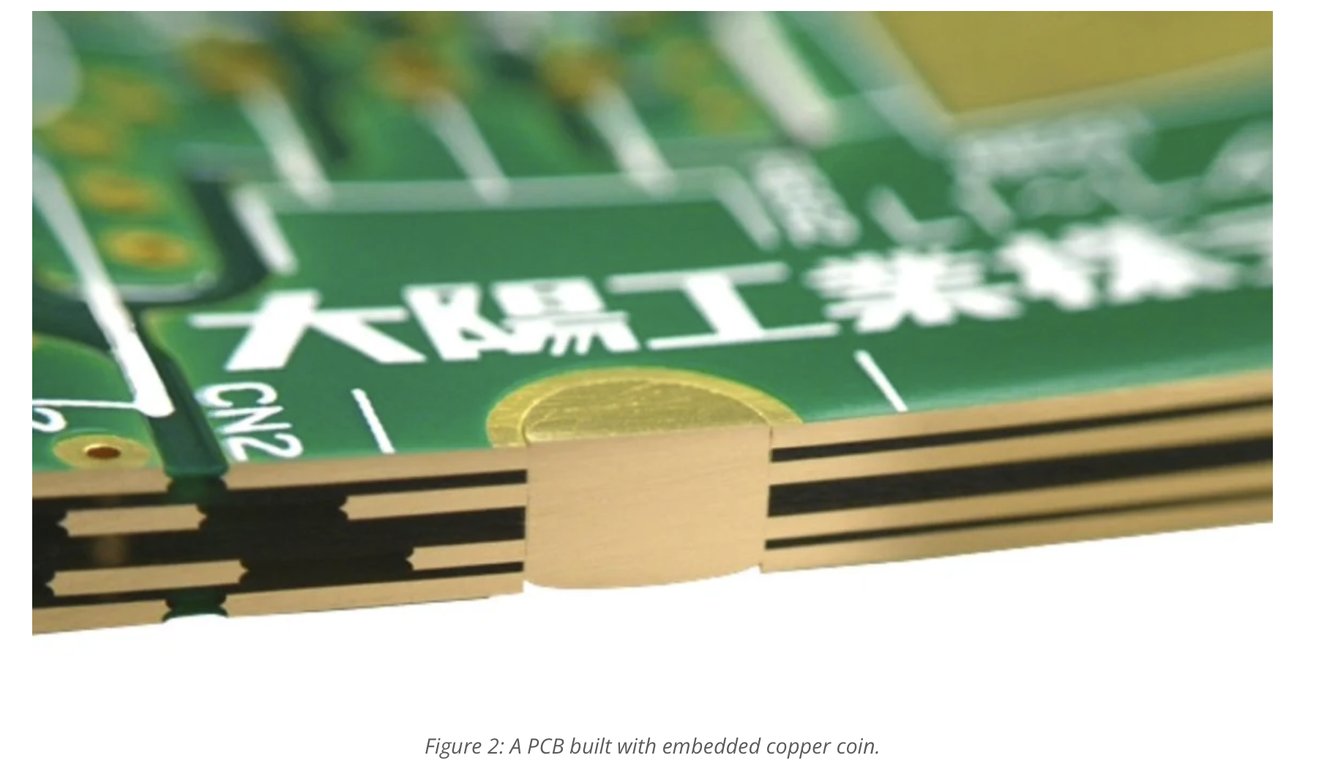
Heat sink study
PCB heat sink design should based on the standard manual
  Experiences on 1.6 mm PCB with heat sink
  Juno and AMS02 experiment applied the heat sink to cooling down
Need to know how large the heat sink is？
Who can help to do the estimation？
https://www.proto-electronics.com/blog/design-hints-high-power-pcbs

Slide 6

Update the Electronics design for the new cooling strategy
Add the Heat sink(HS) to the PCB to increase the thermal conduction ability
  help transfer the heat from the ASIC more efficiently
  Heat sink have been applied in Juno
Cooling from the ASIC surface directly like the ATLAS HGTD or ITK is not OK for us
Apply heat sink
热从柔性板测直接导入下层cooling board
Wire bonding
Flex cable
Heat sink(HS)
Candidate: Cu, graphene;
ASIC
Thermal conductor
PCB
HS
PCB
AC-LGAD
HS
Flex board
Carbon fiber board（cooling pipe）
Cooling from the surface
Cooling
Flex cable
ASIC
PCB
AC-LGAD
HS
Flex board
Carbon fiber board
From Xiongbo Yan and Yunyun Fan

Slide 7
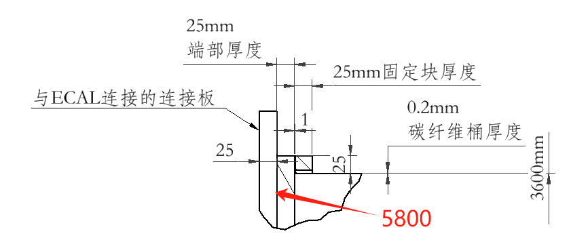
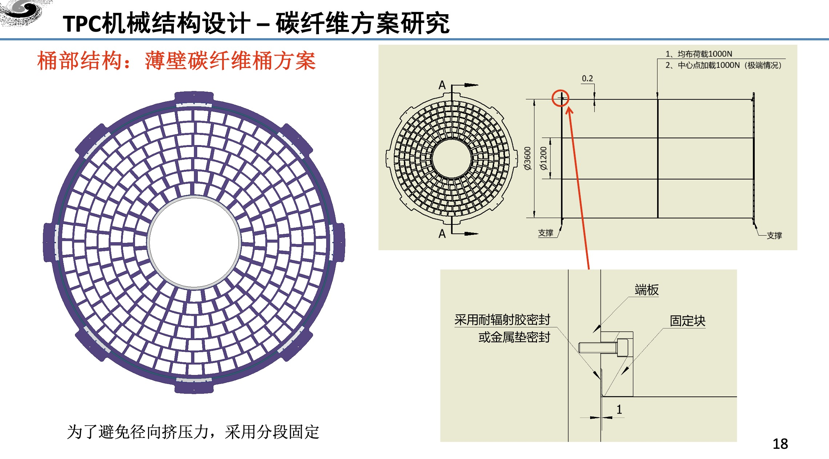
Endcap study
现有TPC设计会影响ToF（OTK）的覆盖面积
TPC设计超过自己设计边界两端各50mm，如不修改，将影响ToF桶部有效面积
设计的ECAL连接板导致OTK不能直接紧贴，影响OTK覆盖面积
Junsong Zhang

Slide 8
Endcap design
ECAL 连接板不能避免
To maintain the coverage of the ToF(OTK)
Endcap would have to increase from 1800mm to >1800 according to the width of the ECAL 连接板
ECAL 连接板厚度：25mm ，桶部LGAD全覆盖5800mm （冷管等采取侧边甩出方案）
则Endcap 区别需从1800mm增加到1815.52mm 以保证全覆盖。

Slide 9
Backup

Slide 10
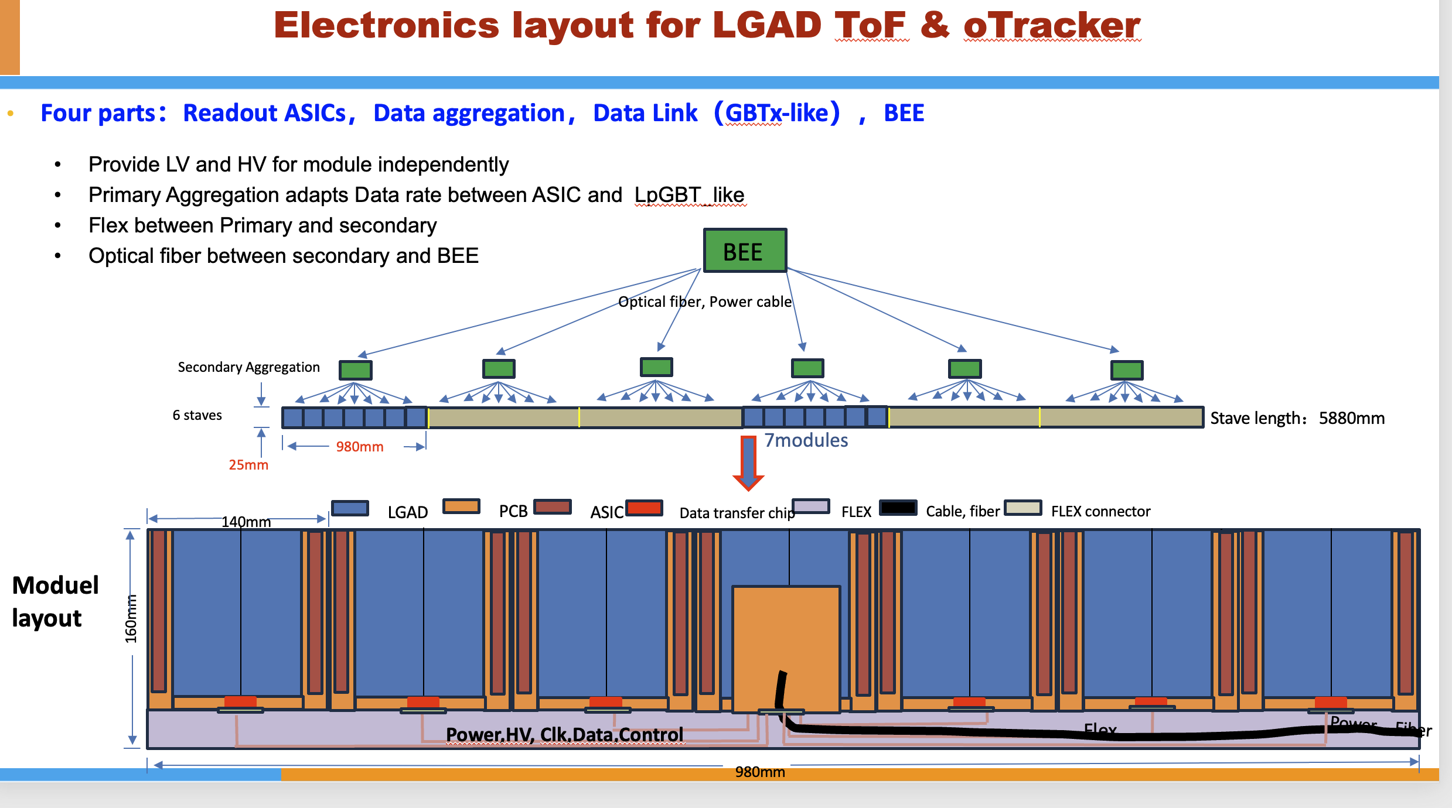
Dimension：less urgent

Slide 11
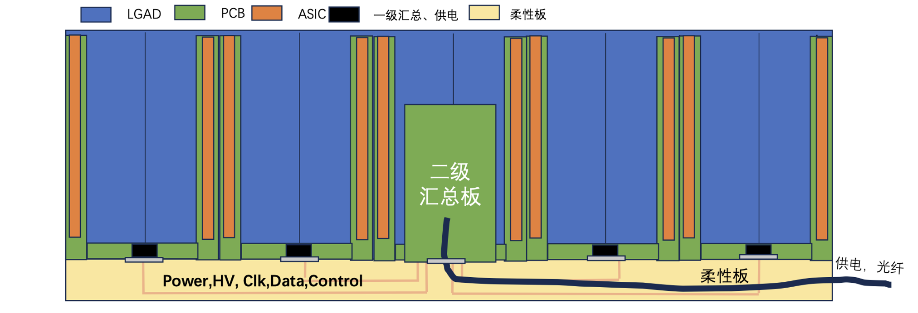
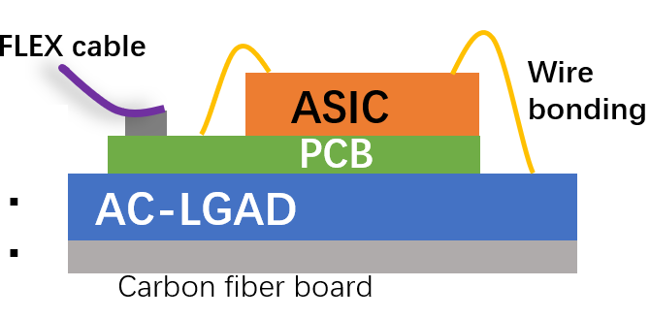
Estimate of the Electronics Thickness
Region 1
Region 4
Region 2
Region 3
The thickness of the region 1：4.6mm
  PCB：1.6 mm
  ASIC：3 mm
The thickness of the region 2:
  一级汇总供电：3 mm
  PCB：1.6 mm
The thickness of the region 3：14.6mm
  电源模块：6 mm
  光电复合电缆：5mm
  弯折走线空间：2mm
  PCB：1.6 mm
The thickness of the region 4：6 mm
  柔性板厚度：1 mm
  二级汇总电缆：5 mm （高低压供电，光纤）
Region 1
Y
Z

Slide 12
Hit rate estimation input for electronics
Z pole
Strip：0.1mm x 70 mm
Updated with new CEPCSW
Old one is 100K Hz/cm²
Maximum hit rate estimation
 | Hit rate （Hz/cm²） | Hit rate per ASIC（Hz） | Hit rate per strip （Hz）
Barrel | 140 | 1254.4 | 9.8
Endcap | ～35k （at 20mm ） | ～209.12k | ～2415
Cluster size：2-3 strip
Occupancy at endcap ：
  0.245% (10bit,1 µs deadtime)

Slide 13
Hit rate estimation input for electronics
Z pole
Strip：0.1mm x 70 mm
Updated with new CEPCSW
Old one is 100K Hz/cm²
Average hit rate estimation
 | Hit rate （Hz/cm²） | Hit rate per ASIC（Hz） | Hit rate per strip （Hz）
Barrel | 140 | 1254.4 | 9.8
Endcap | ～3k | ～26k | ～207
Cluster size：1-2 strip （most is within 1 strip）
Occupancy at endcap ：
Occupancy calculation method：

Slide 14
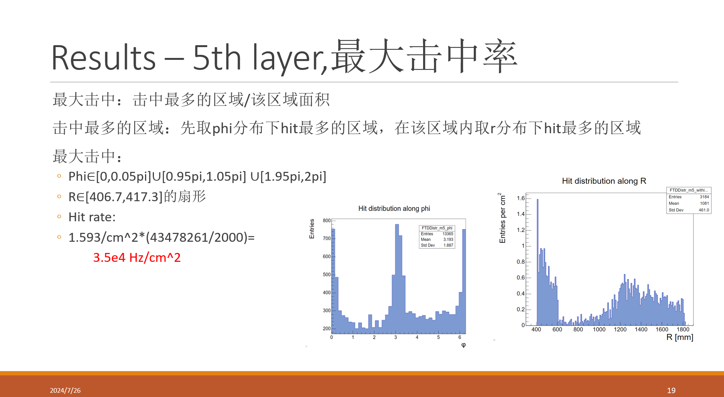

Slide 15
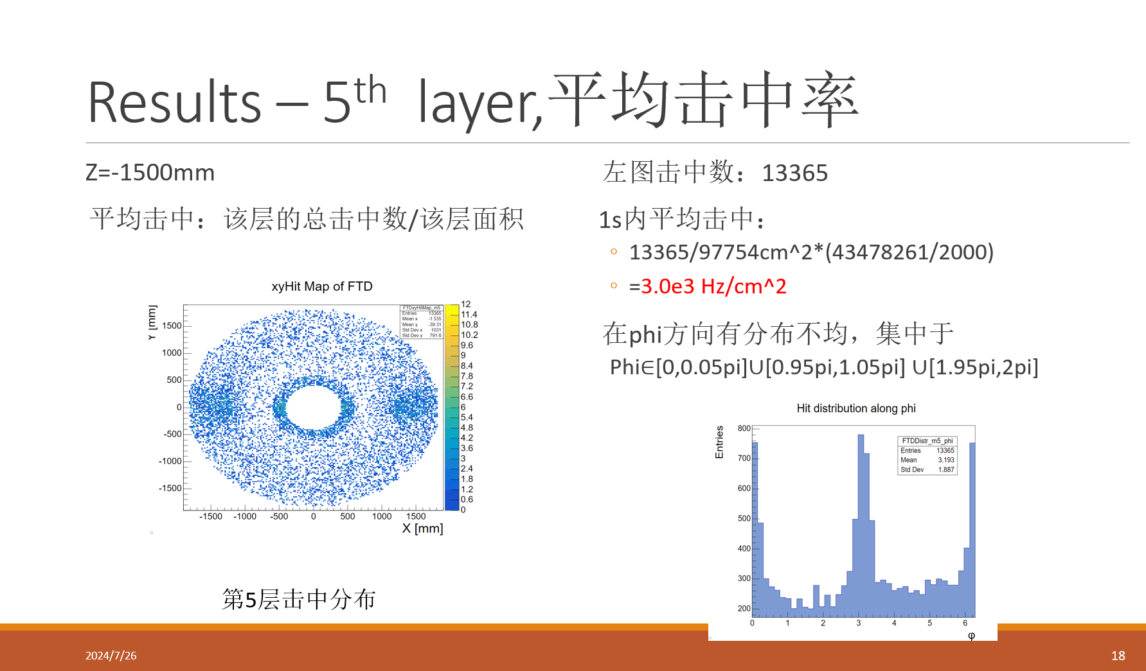

Slide 16
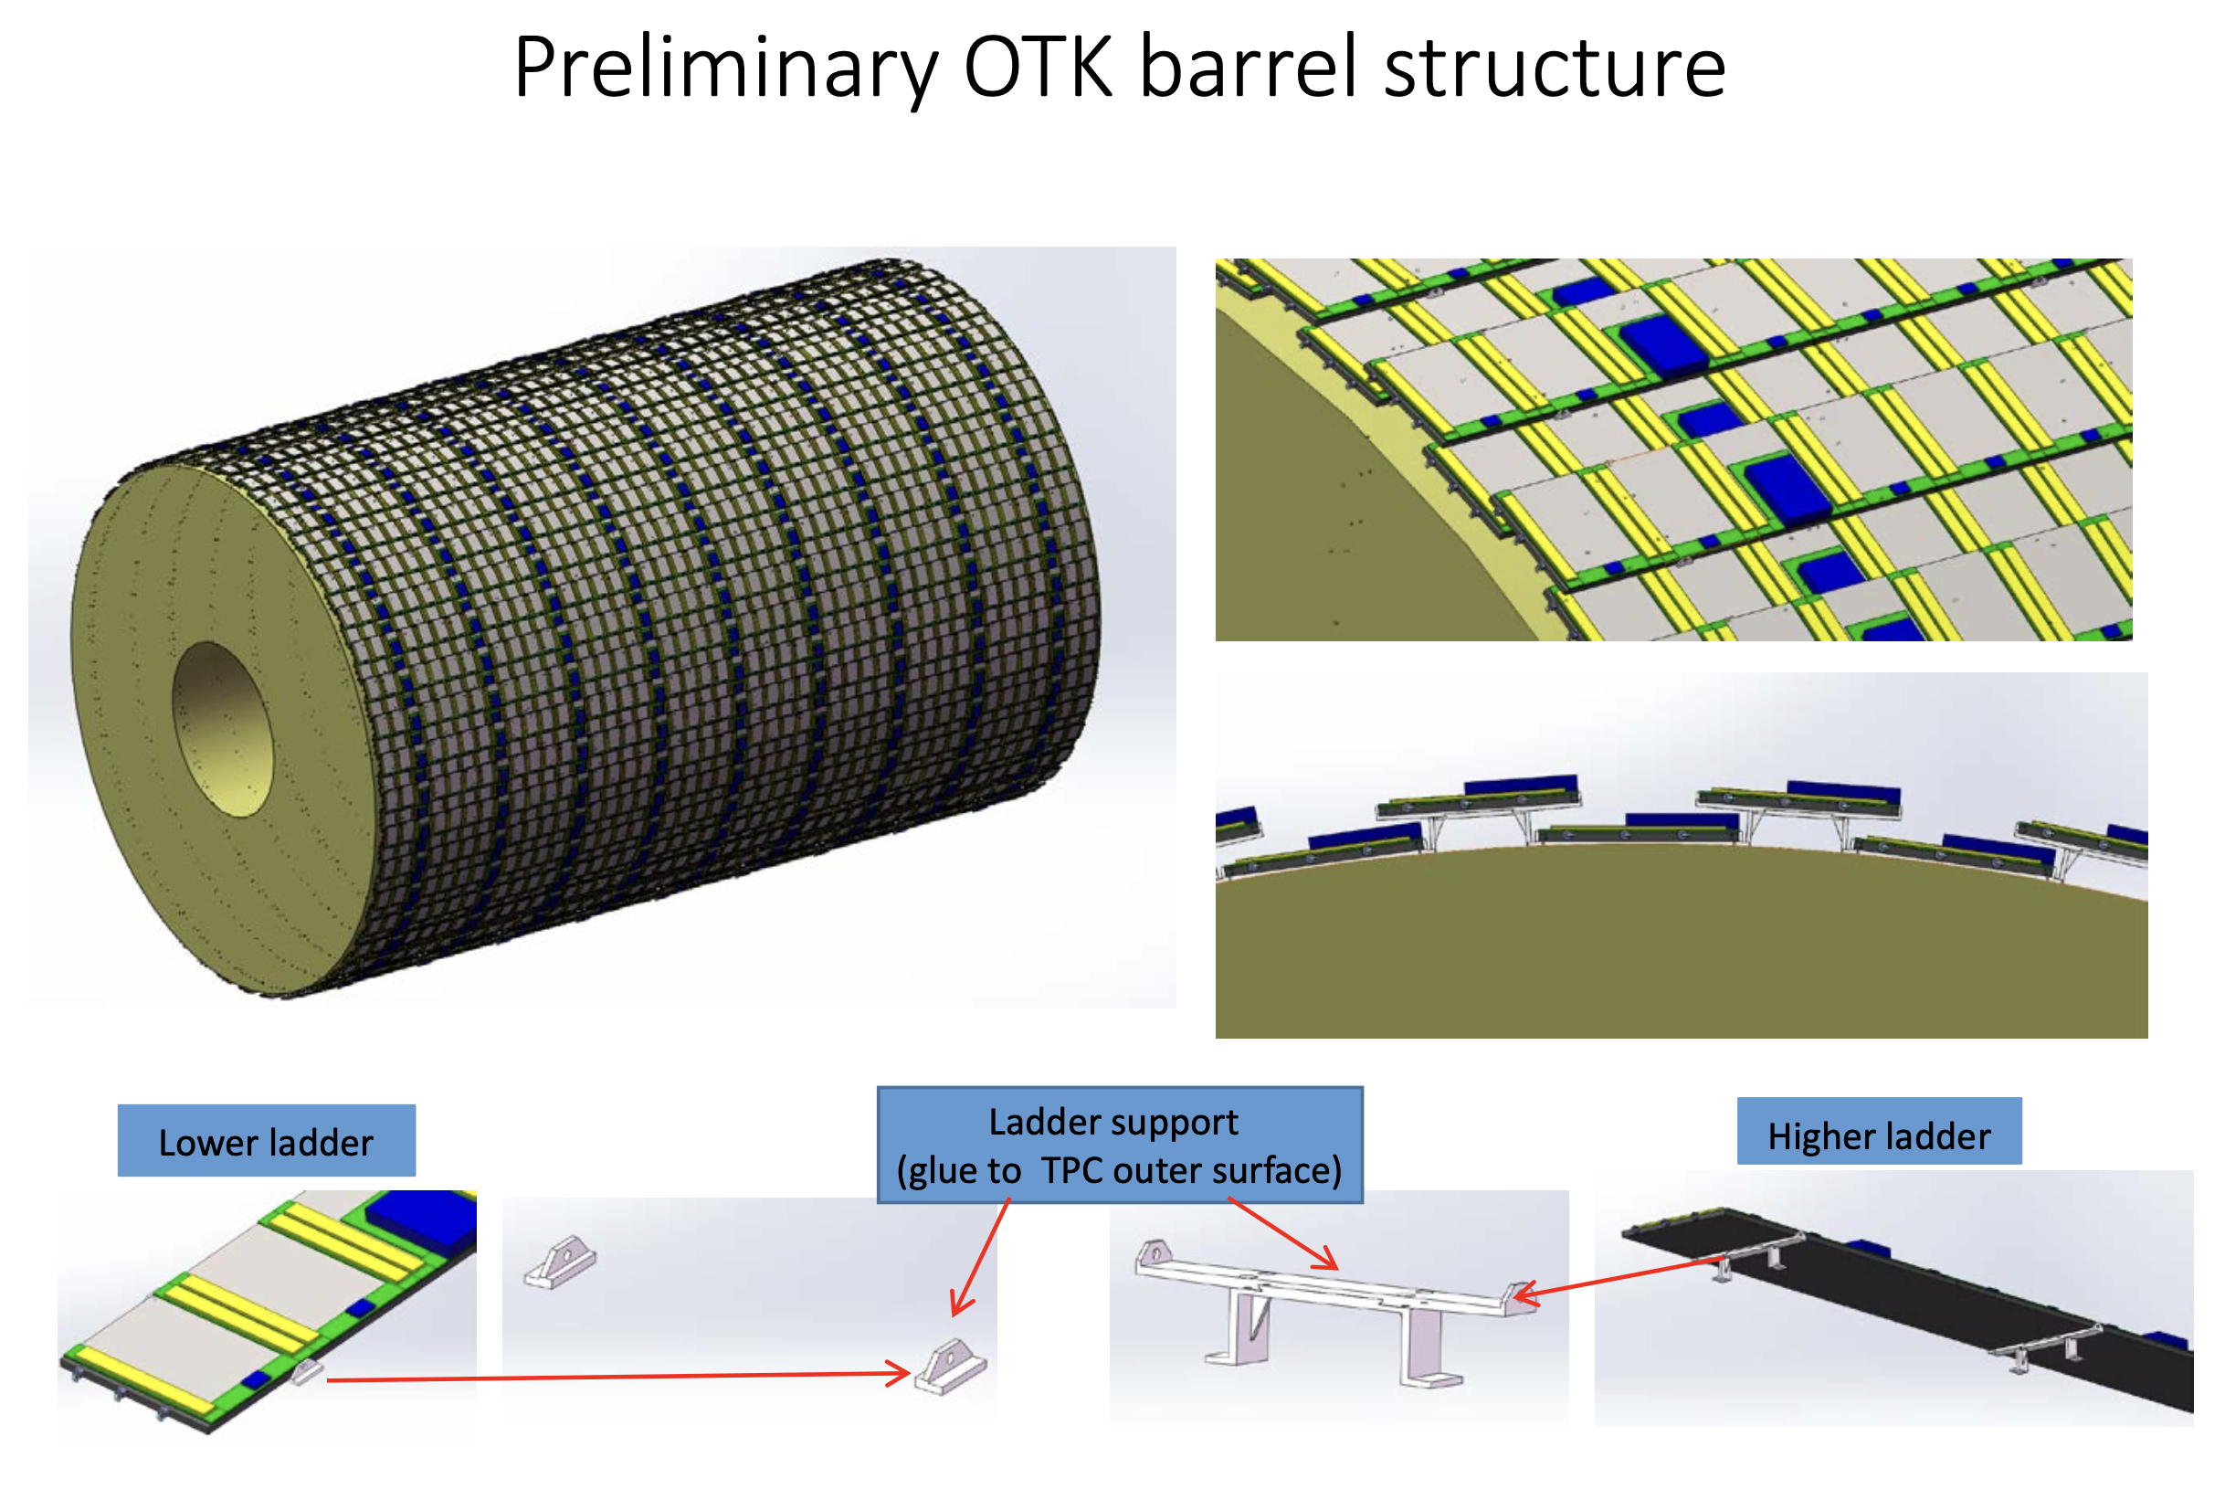

Stress analysis for the connection
Preliminary
Stick the OTK barrel directly to the TPC is OK
Result of the stress analysis showed 0.2mm TPC barrel could bear the 100kg OTK
From Jinyu Fu
From Junsun Zhang

Slide 17
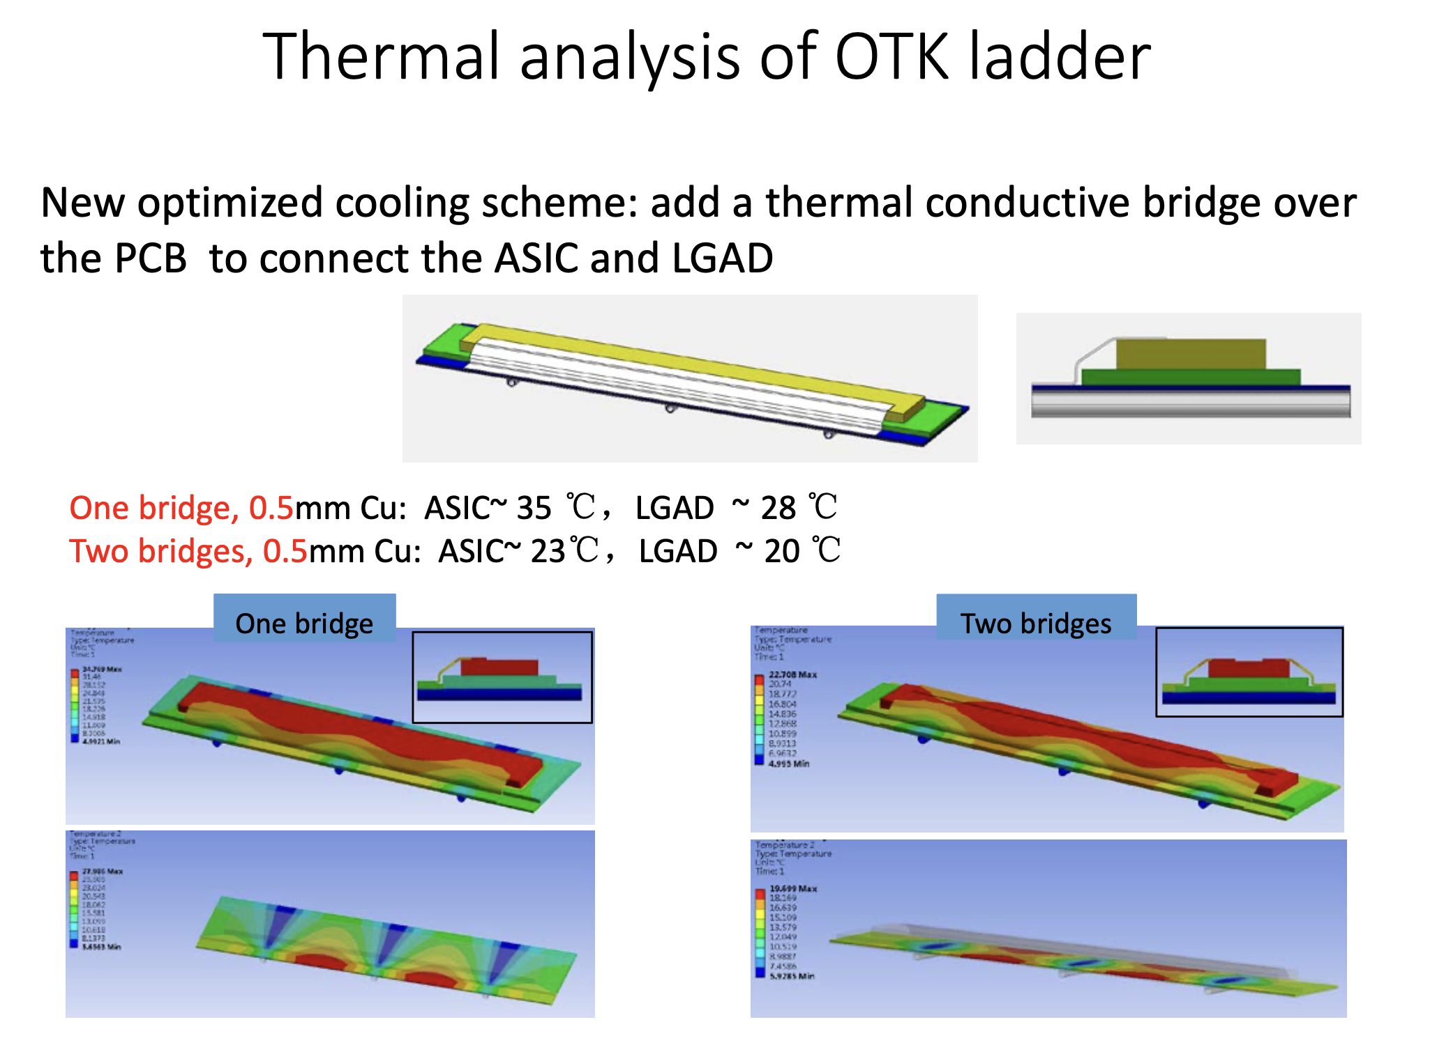
Thermal analysis results
According to previous thermal simulation, the cooling should from the ASIC sides.
 | Per channel | Per ASIC | For ASIC area
Pwer distribution | 20 mW | 2.56 W | 1.71 W/cm²
From Jinyu Fu
If could transfer the thermal from the surface of ASIC to the AC-LGAD, then the temperature of OTK ladder could be below 23 ºC. (raw simulation)
Need to continue detailed cooling
simulation to know the detailed temperature distribution with new module desgins.

Slide 18
Update the Electronics design for the new cooling strategy
Add the Heat sink(HS) to the PCB to increase the thermal conduction ability
  help transfer the heat from the ASIC more efficiently
  Heat sink have been applied in Juno
Cooling from the ASIC surface directly like the ATLAS HGTD or ITK is not OK for us
Apply heat sink
热从柔性板测直接导入下层cooling board
Wire bonding
Flex cable
Heat sink(HS)
Candidate: Cu, graphene;
ASIC
Thermal conductor
PCB
HS
PCB
AC-LGAD
Flex board
Carbon fiber board（cooling pipe）
Cooling from the surface
Cooling
Flex cable
ASIC
PCB
AC-LGAD
HS
Flex board
Carbon fiber board
From Xiongbo Yan and Yunyun Fan

