Slide 1


基于机器学习的BESIII径迹重建
袁野
20241016

Slide 2
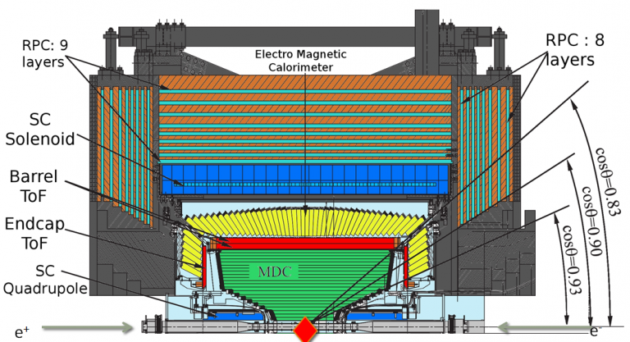
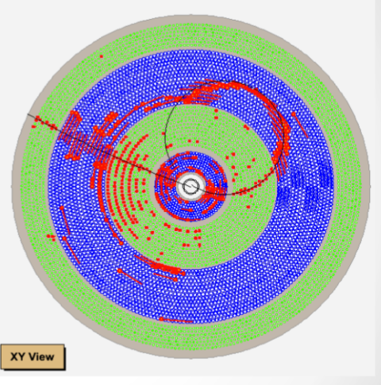
BESIII
Started physics data taking from 2009, BESIII has collected the largest electron positron collision data in the τ -charm region in the world, including
10 Billion J/ψ events, 2 Billion ψ(2S) events…
Comprehensive studies are carrying out

Slide 3
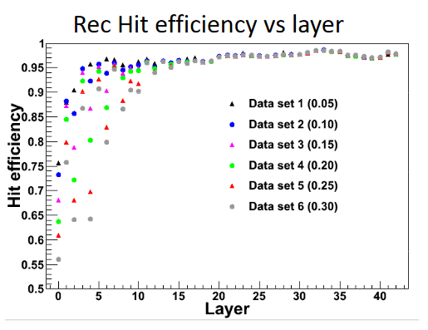
MDC tracking
Key part of reconstruction
Worse @ Low Pt, large angle
Noise dependence

Slide 4
Why Machine Learning?
More than 10 years past since first physics version of offline data processing
Continuously hard working,
continuously improving,
fruitful achivements!
But
Harder and harder…
no significant improving for a long time
It’s time to find anther way!
MDC tracking eff. Discrepancy
2% 0.5%
TOF time resolution
88ps 65ps
……

Slide 5
Noise Exclude
Full connect network: Not good
CNN : Not good
GNN：Good
Could insert before
ML tracking/Traditional tracking

Slide 6
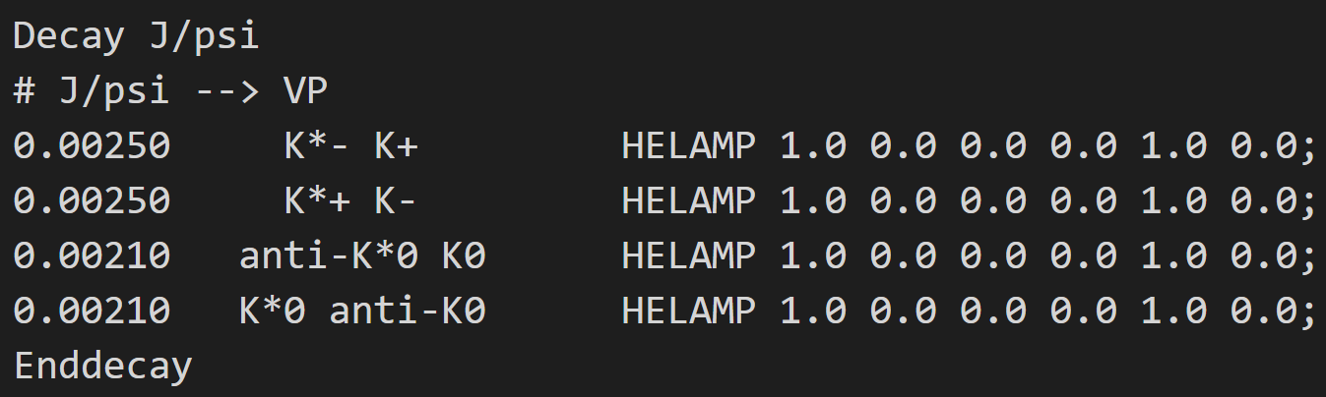
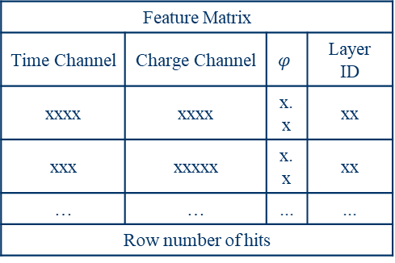
训练数据
1、使用模拟产生的10万$KK^{∗}$事例(run号：{-44760, 0, -44922})；
2、创建三个矩阵：特征值矩阵(n_hits×n_features)、关联矩阵(n_hits× n_hits) 、标签向量(n_hits)；
Feature Matrix
Time Channel | Charge Channel | $$φ$$ | Layer ID
xxxx | xxxx | x.x | xx
xxx | xxxxx | x.x | xx
… | … | ... | ...
Row number of hits
Edge Matrix
hit 0 | hit 1 | hit 2 | hit 3 | … | hit n | Row number of hits
hit 1 | 1 | 0 | -1 | … | 1
hit 2 | 0 | 1 | 0 | … | 0
hit 3 | 1 | 0 | 1 | … | -1
… | … | … | … | … | …
hit n | -1 | 0 | 1 | … | 1
Row number of hits
Feature Matrix
0
1
1
…
Row number of hits
$模型结构$
hidden dimension ×n_hits
输出
Input features
(n_hits×4)
hidden dimension ×n_hits
Edge Network
Node Network
×
n_hits ×1
Edges
n_hits ×n_hits
×
n_hits×(4+ hidden dimension )
n_hits×(4+ hidden dimension )
=
=
n_hits ×n_hits
n_hits×(4+ hidden dimension )
n_hits×(4+ hidden dimension )
n_hits×(4+ hidden dimension )
×
=
分类准确率98.4%

Slide 7
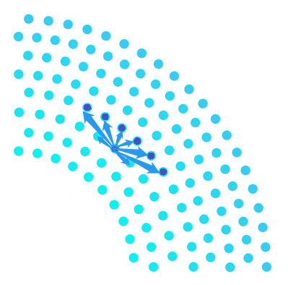

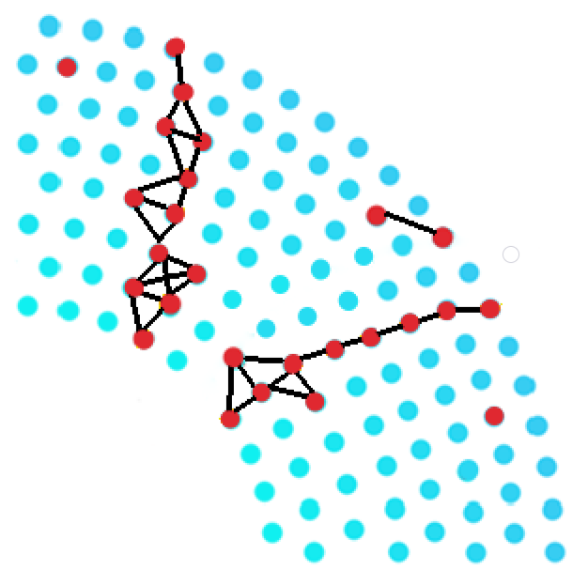
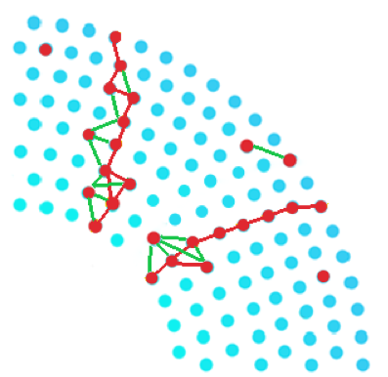
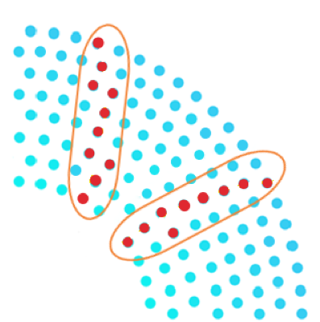
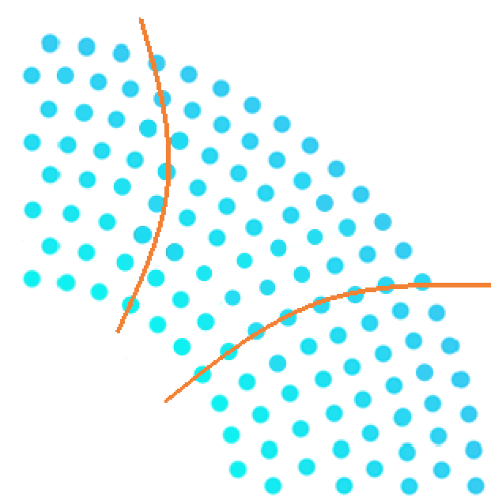
Track finding by GNN
Construct the graph based on the Pattern Map
Classify the graph edges by GNN
Cluster the selected hits
Track fitting
MDC hits produced by charged particles

Slide 8
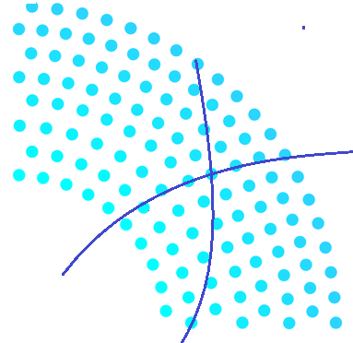
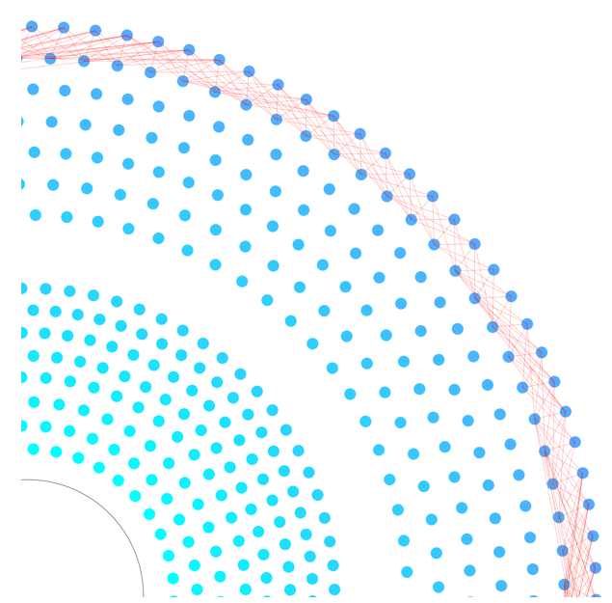
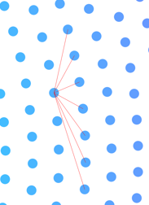
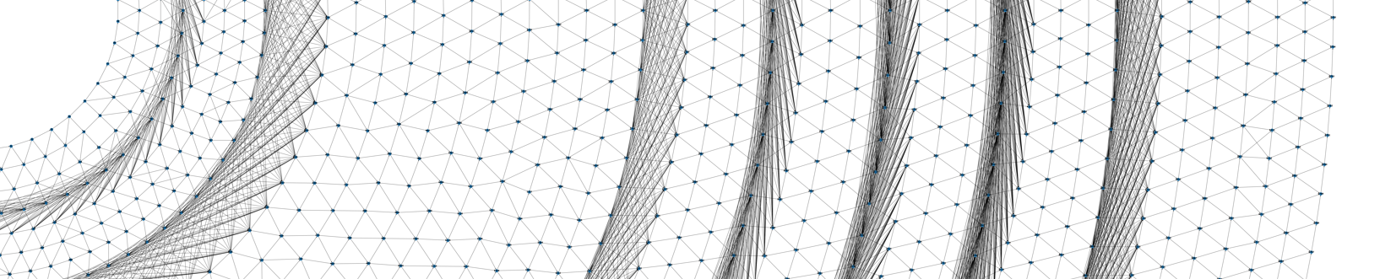
Pattern Map based on MC simulation & calculation
To reduce the number of fake edges during graph construction
Definition of valid neighbors
  Hits on the same layer
  Two adjacent sense wires on the left and right
  Hits on the next layer
  The collection of sense wires that could potentially represent
  two successive hits on a track
B
A
C

Slide 9
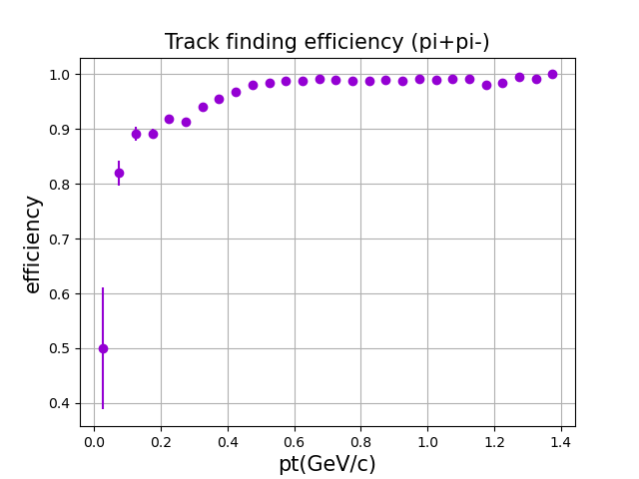
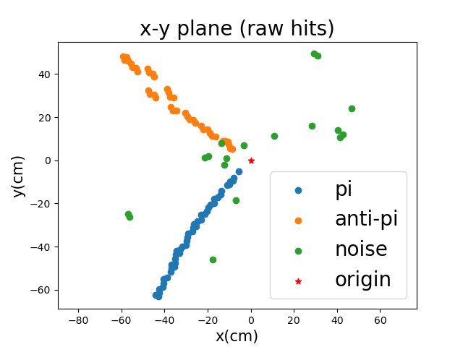

  Track finding efficiency
    track eff = $\frac{N_{rec tracks}}{N_{total tracks}}$
    Pt > 0.2 GeV/c , track eff > 90%
    Pt > 0.45 GeV/c , track eff > 98%

Slide 10
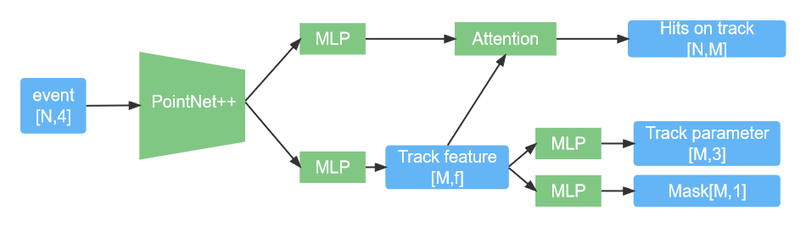
Tracking by PointNet model
  1. track index prediction for each hit (clustering)
  2. track parameters for each predicted track (fitting)

Slide 11
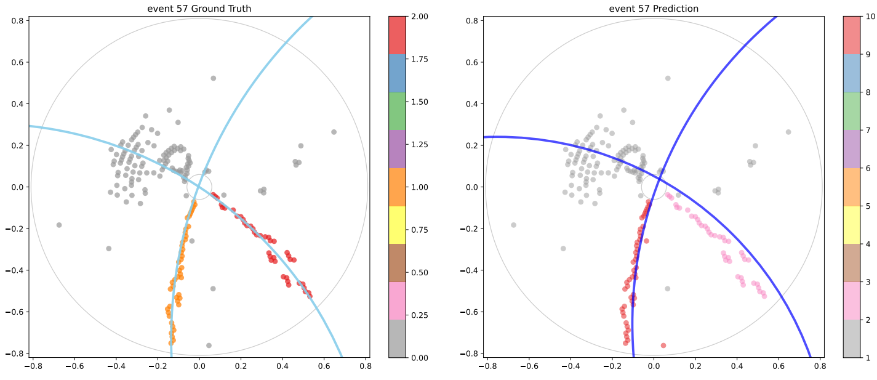
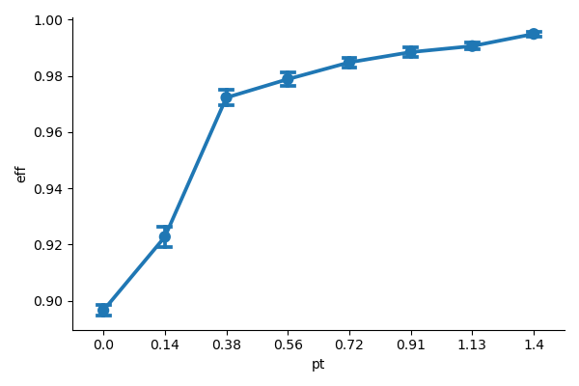
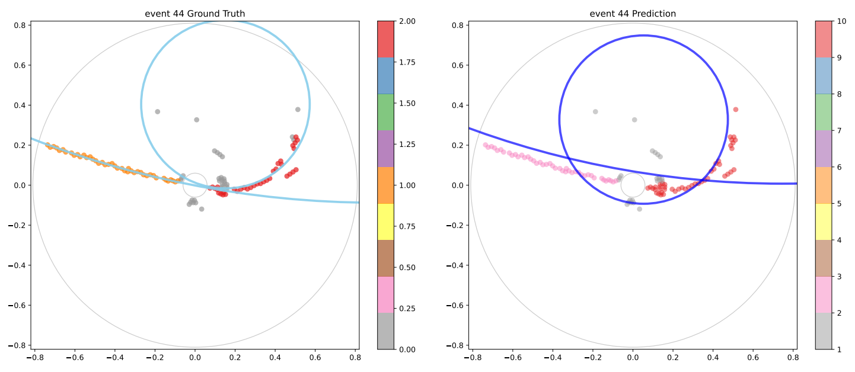
Clustering results：
Training data set: 120k events (J/ψ−>ρπ)
Test set (15k events)：
    Hit eff: 96.41%
    Hit purity: 94.7%
    Track eff: 97.17%

Slide 12
径迹数据集
基于BESIII数据
脱离探测器和物理相关背景
适用于不同机器学习方法的训练、测试和比较
避免重复劳动
公开数据集

Slide 13
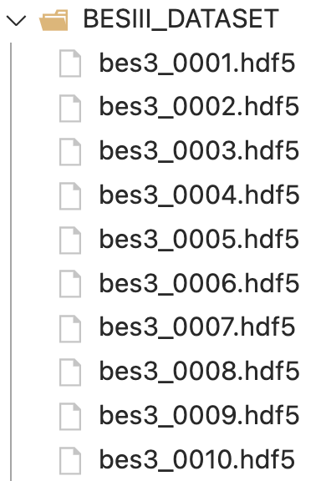
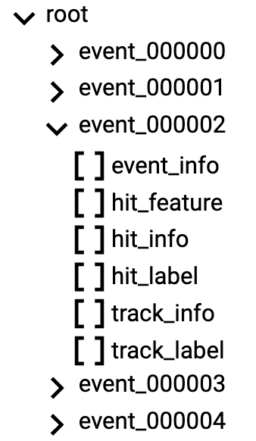
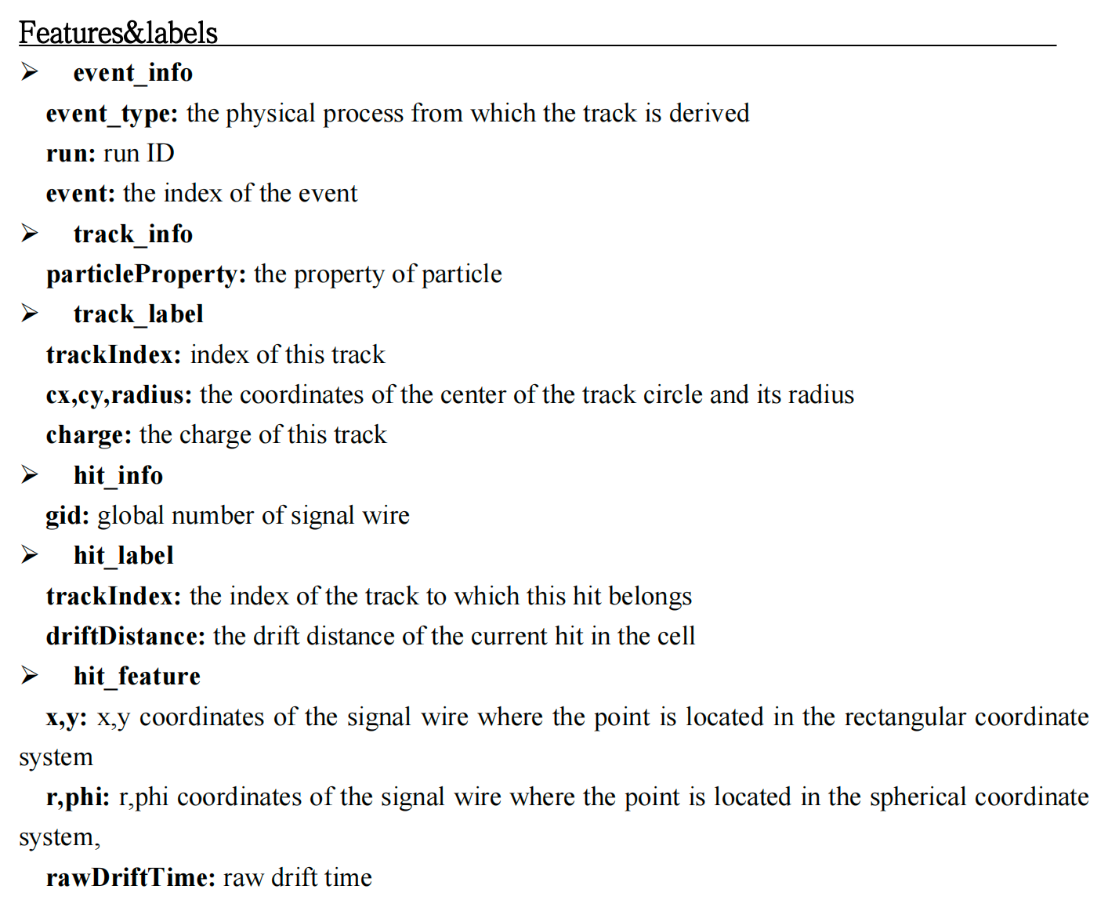
Description of dataset
The structure&format of dataset:
Description file
Features
&labels

Slide 14
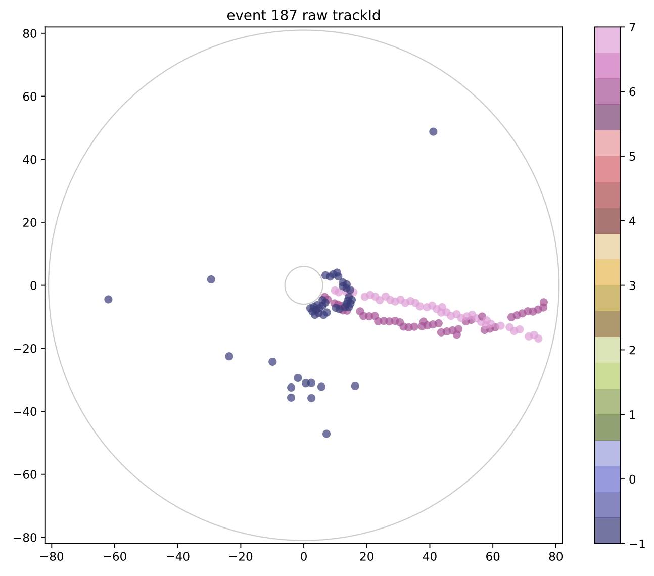
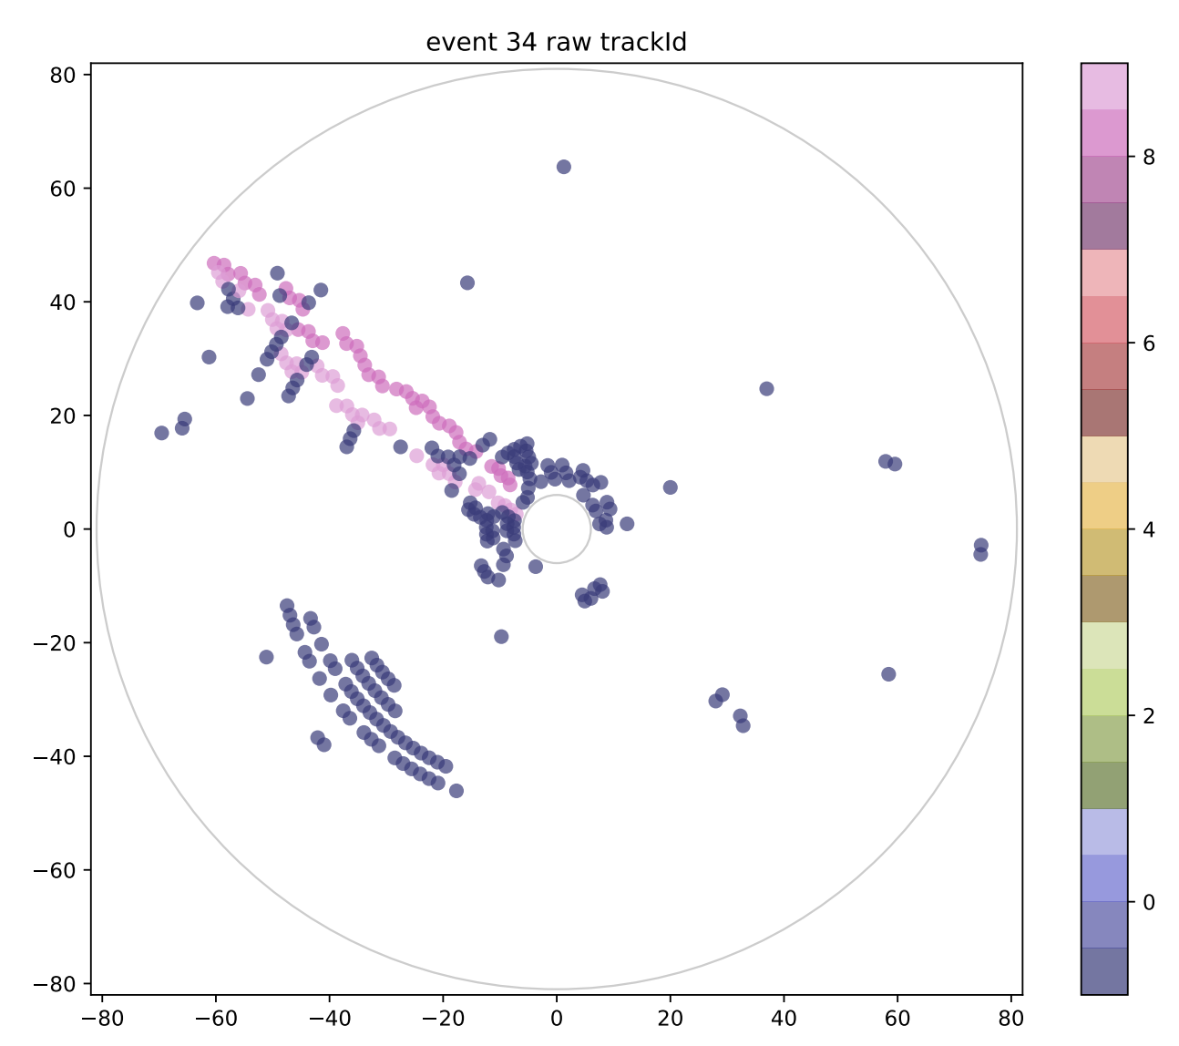
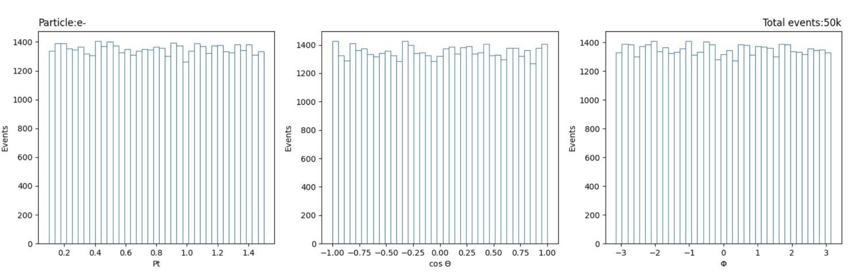
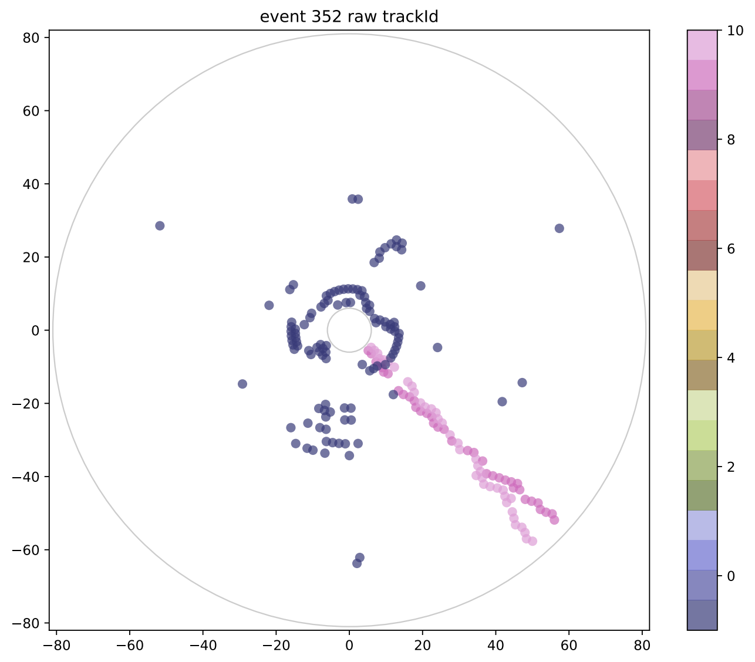
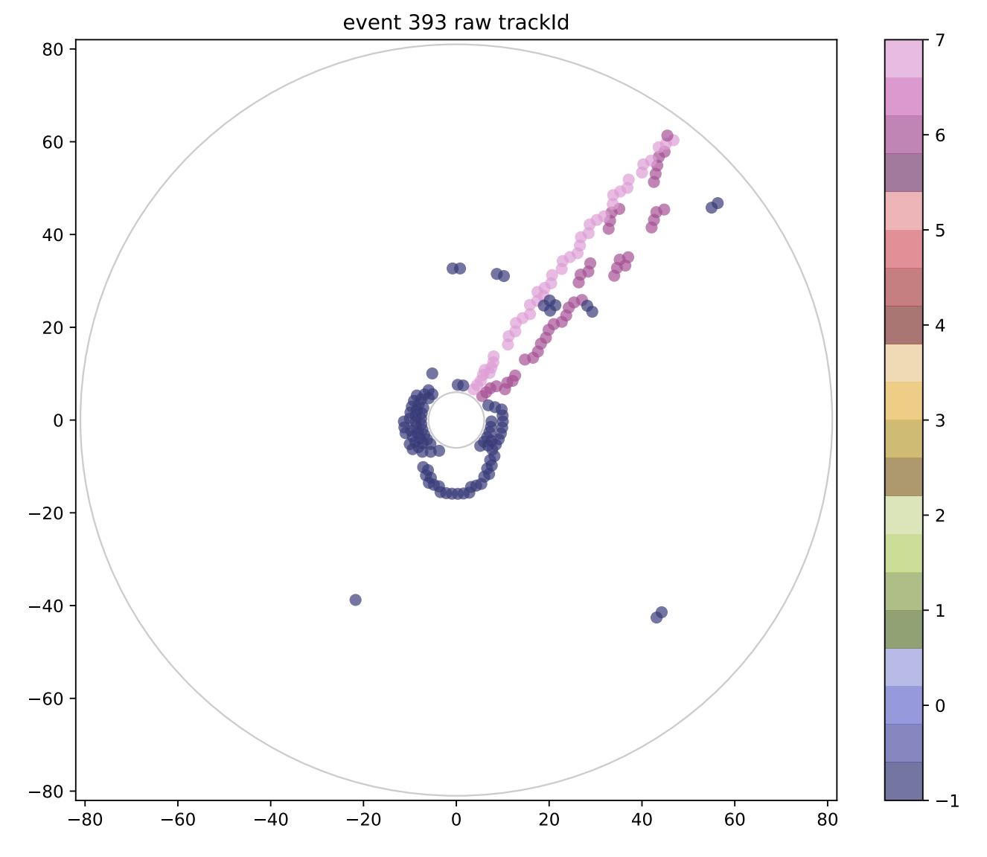
  Existing dataset MC: Single track dataset
    Total amount: 500,000 events
    flatten in Pt, cosθ, and Φ
    Links: https://ihepbox.ihep.ac.cn/ihepbox/index.php/s/k6CwLKJD8mclnxr Password：JD10Auoo
Nearby tracks dataset （special condition）
14

Slide 15
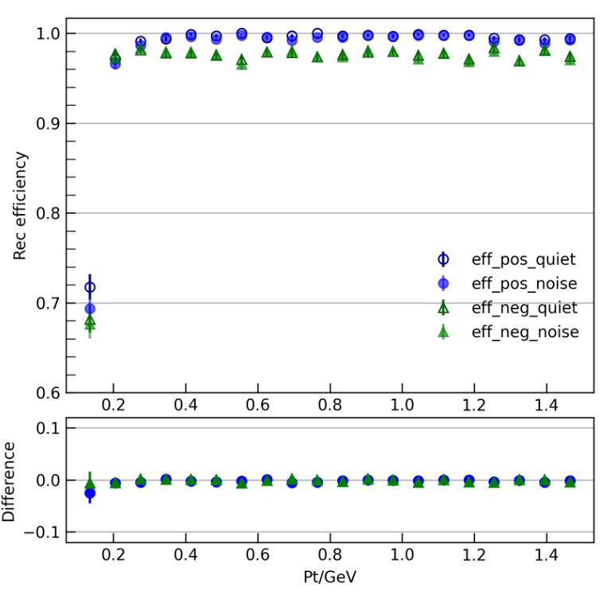
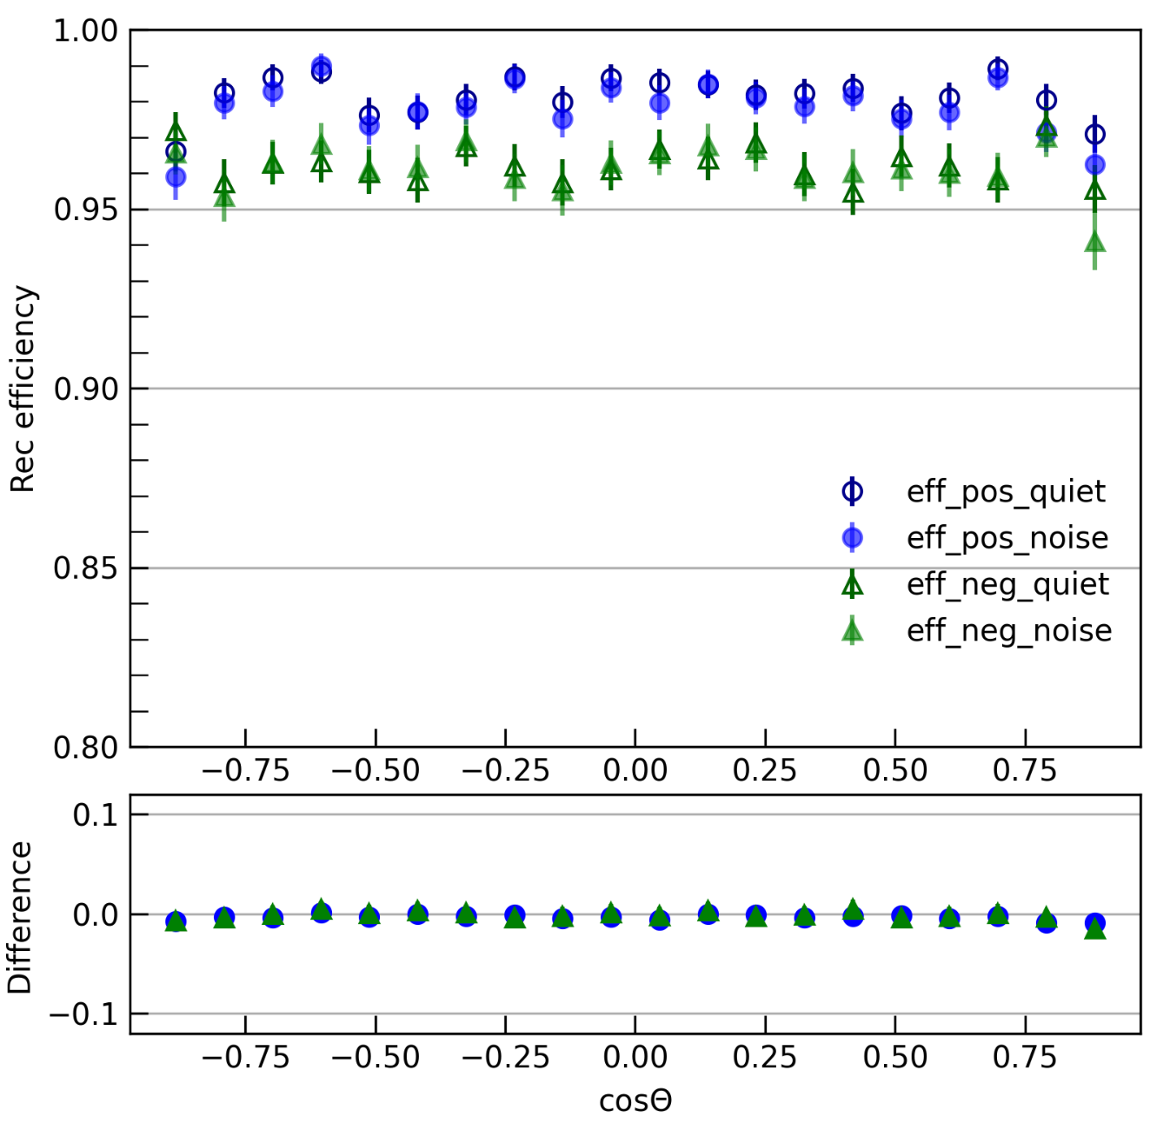
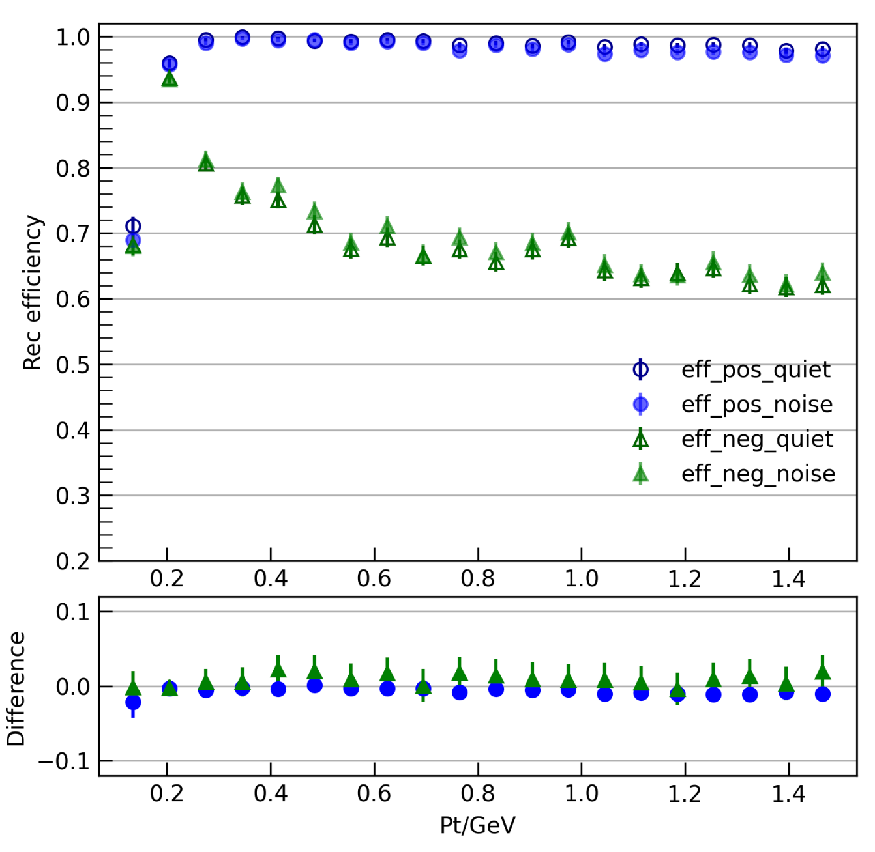
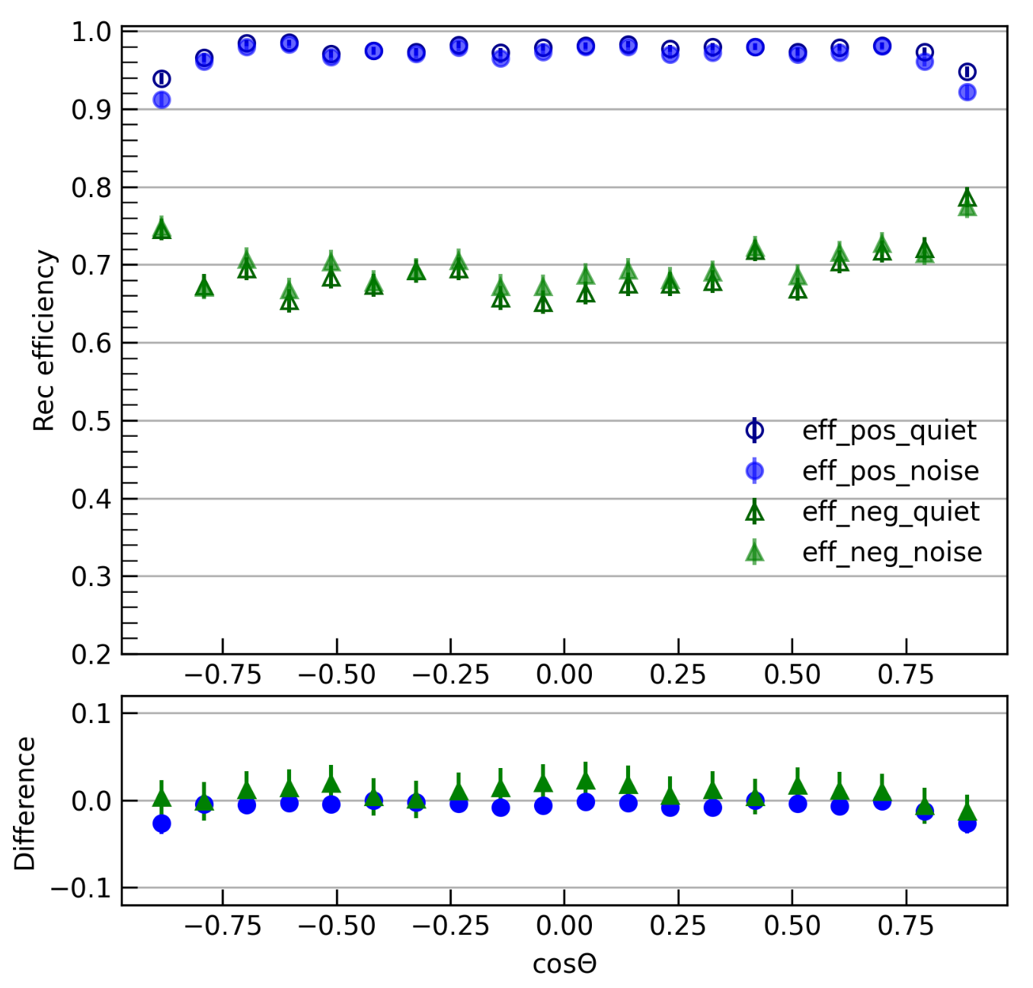
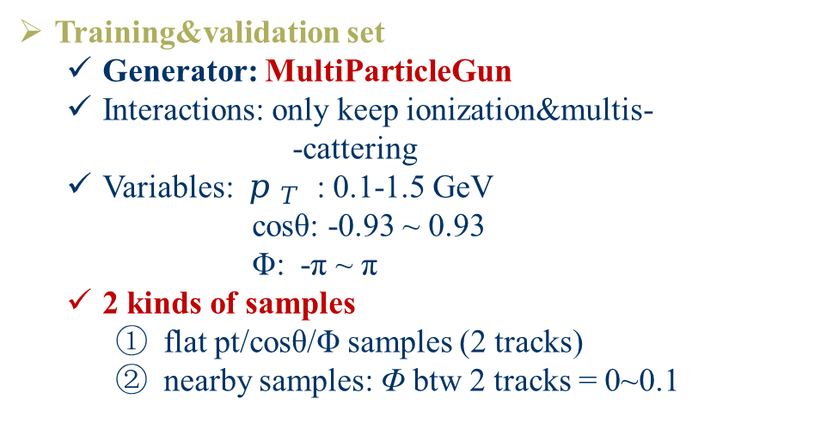
Dataset: two-track samples
Efficiency of flat samples
Training&validation set
  Generator: MultiParticleGun
  Interactions: only keep ionization&multis-
  -cattering
  Variables: $p_{ T}$ : 0.1-1.5 GeV
cosθ: -0.93 ~ 0.93
Φ: -π ~ π
  2 kinds of samples
    flat pt/cosθ/Φ samples (2 tracks)
    nearby samples: Φ btw 2 tracks = 0~0.1
Efficiency of nearby samples
Traditional reconstrcution efficiency
Samples with background VS without
background

Slide 16
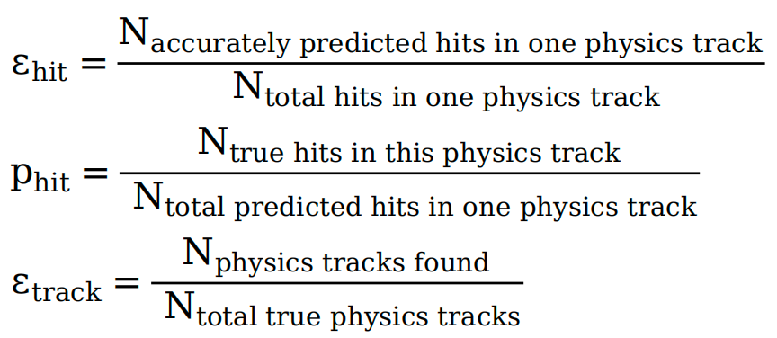
Evaluation
Provide evaluation standards:
(ɛ: reconstruction efficiency, p: reconstruction purity)

