Slide 1
The rediscovery of Zc(3900) with QSVM
邹佳恒
2024.10.16

Slide 2
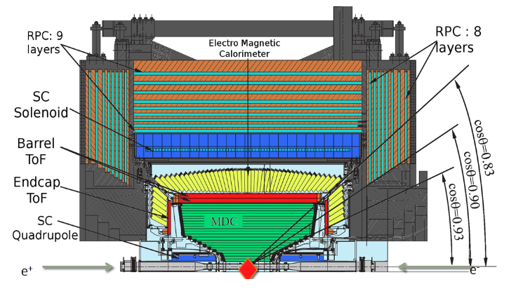
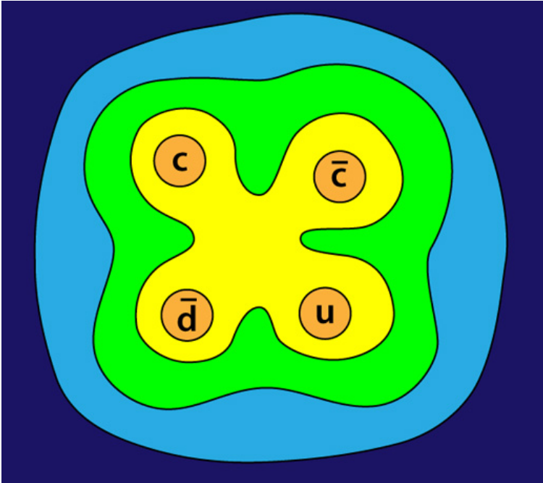
Zc(3900) @ BESIII
The BESIII experiment
  BEPCII running at a cms of 2.0-5.0GeV
  Sub-detectors: MDC, TOF, EMC, MUC
  τ-charm physics
The discovery of Zc(3900)
  Initially discovered by BESIII at 2013
  Possibly the first tetra-quark state observed in experiment
  美国物理学会《物理》2013年国际物理学领域十一项重要成果之首
  2013年度“中国科学十大进展”

Slide 3
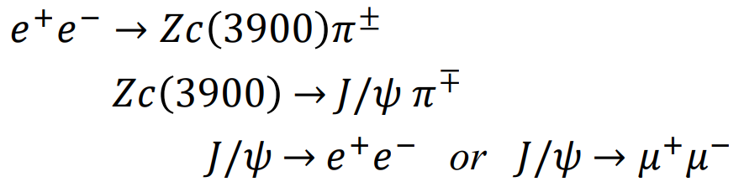
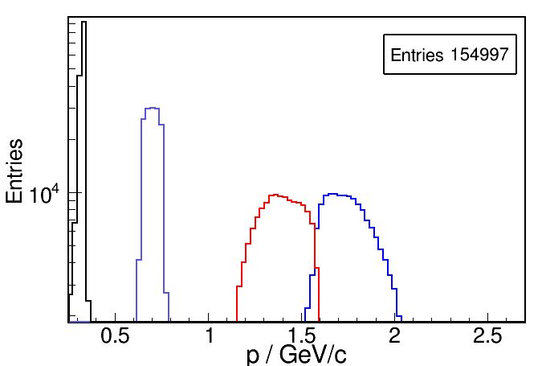
The Traditional Physics Analysis Method
Initially observed via the following decay mode with 4.26GeV data
The final state consists of 4 charged tracks
  The leptons and pions are separated clearly by the momentum
  As shown in the picture (MC data)

Slide 4
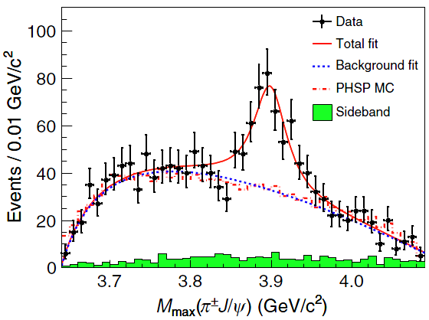
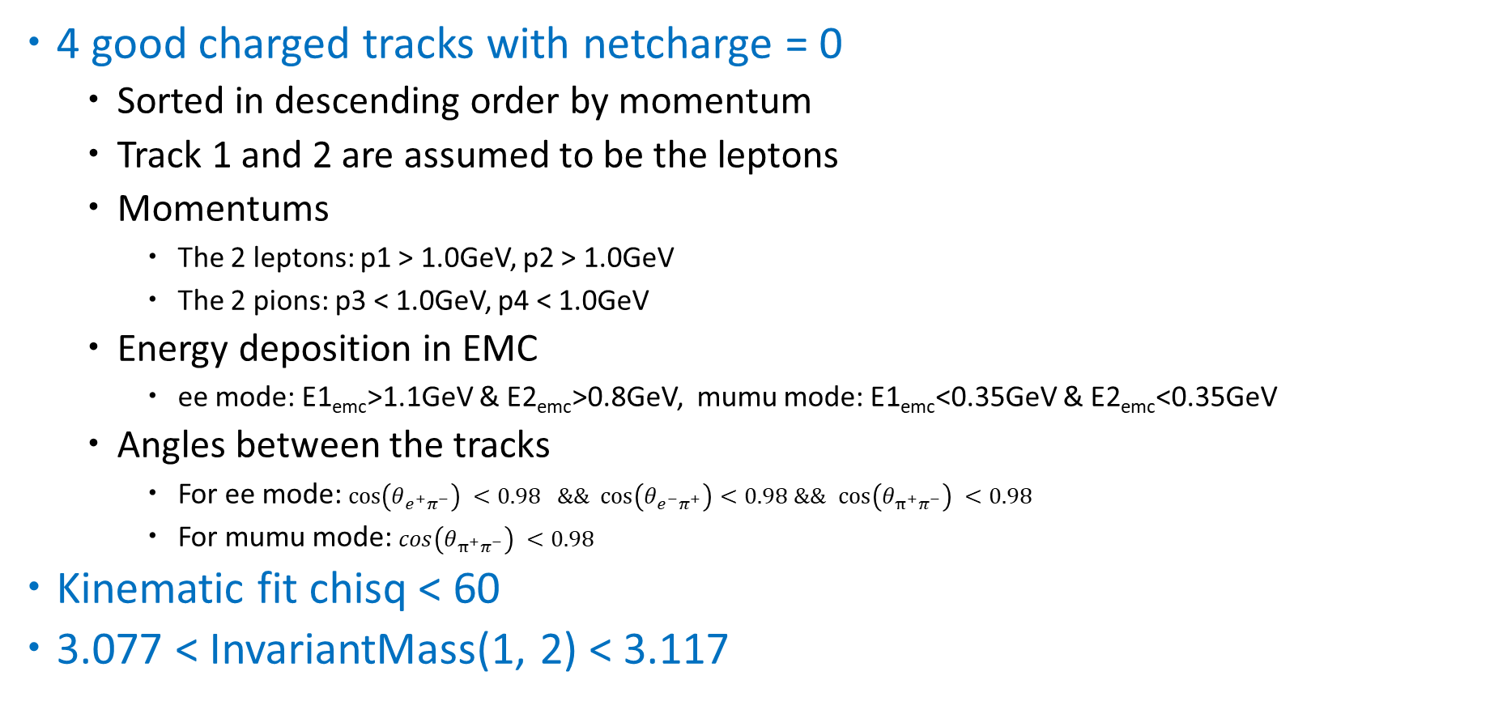
Cut-based Event Selection
4 good charged tracks with netcharge = 0
  Sorted in descending order by momentum
  Track 1 and 2 are assumed to be the leptons
  Momentums
    The 2 leptons: p1 > 1.0GeV, p2 > 1.0GeV
    The 2 pions: p3 < 1.0GeV, p4 < 1.0GeV
  Energy deposition in EMC
    ee mode: E1_{emc}>1.1GeV & E2_{emc}>0.8GeV, mumu mode: E1_{emc}<0.35GeV & E2_{emc}<0.35GeV
  Angles between the tracks
    For ee mode: $cos\left(θ_{e^{+}π^{−}}\right) <0.98 \&\& cos\left(θ_{e^{−}π^{+}}\right)<0.98$ $\&\&$ $cos\left(θ_{π^{+}π^{−}}\right) <0.98$
    For mumu mode: $cos\left(θ_{π^{+}π^{−}}\right) <0.98$
Kinematic fit chisq < 60
3.077 < InvariantMass(1, 2) < 3.117

Slide 5
Event Classification with QSVM (and SVM)
Event preselection
  4 good charged tracks with netcharge = 0
    The same as the traditional cut-based method
  Kinematic fit chisq < 200
  3.0 < InvariantMass(1, 2) < 3.2
Training dataset selection
QSVM/SVM model training and optimization
Apply the trained model to the real data
  The events after event preselection and m_{j/psi} cut
m_{J/psi} cut

Slide 6
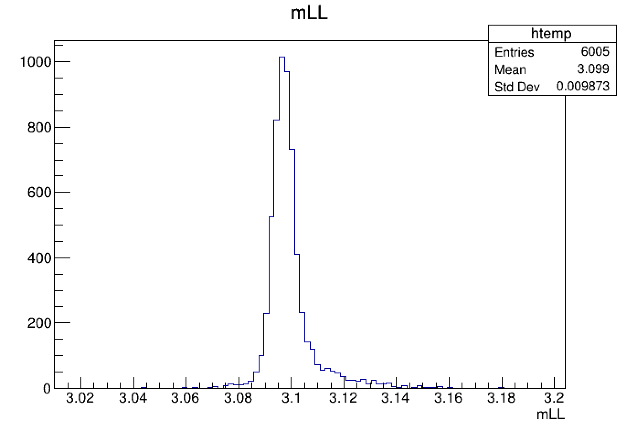
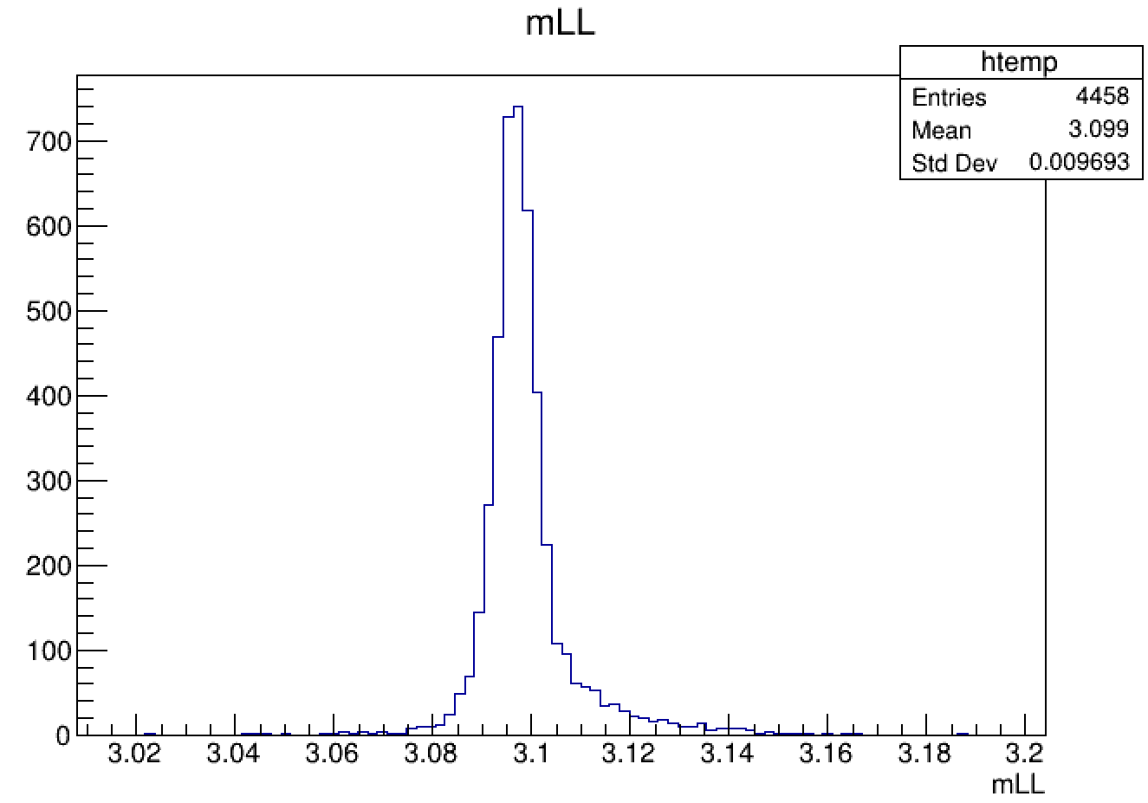
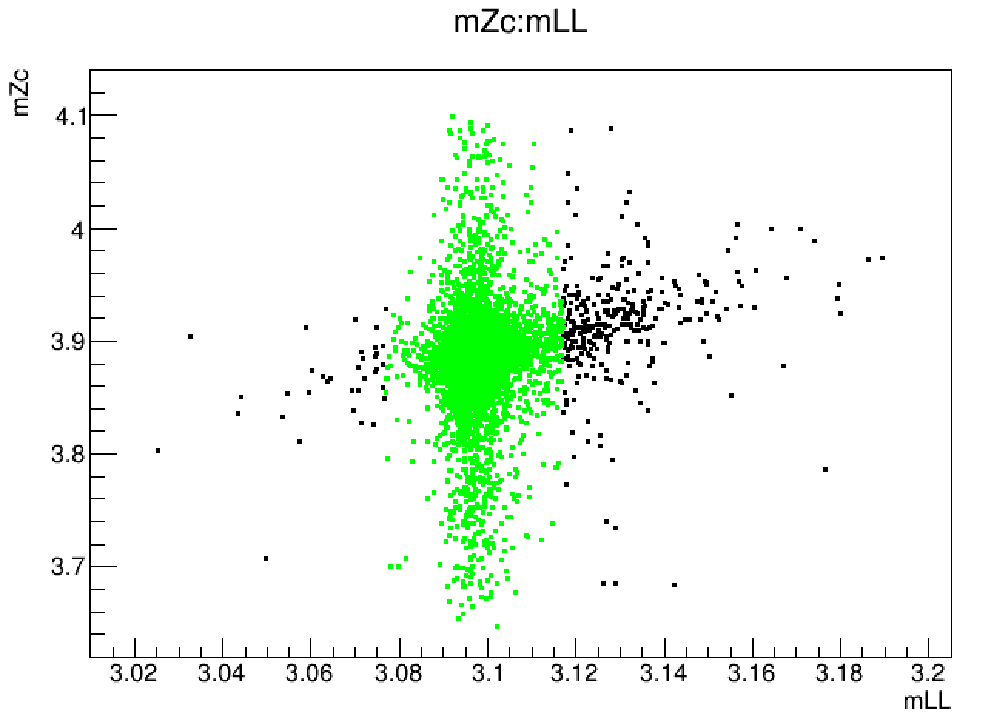
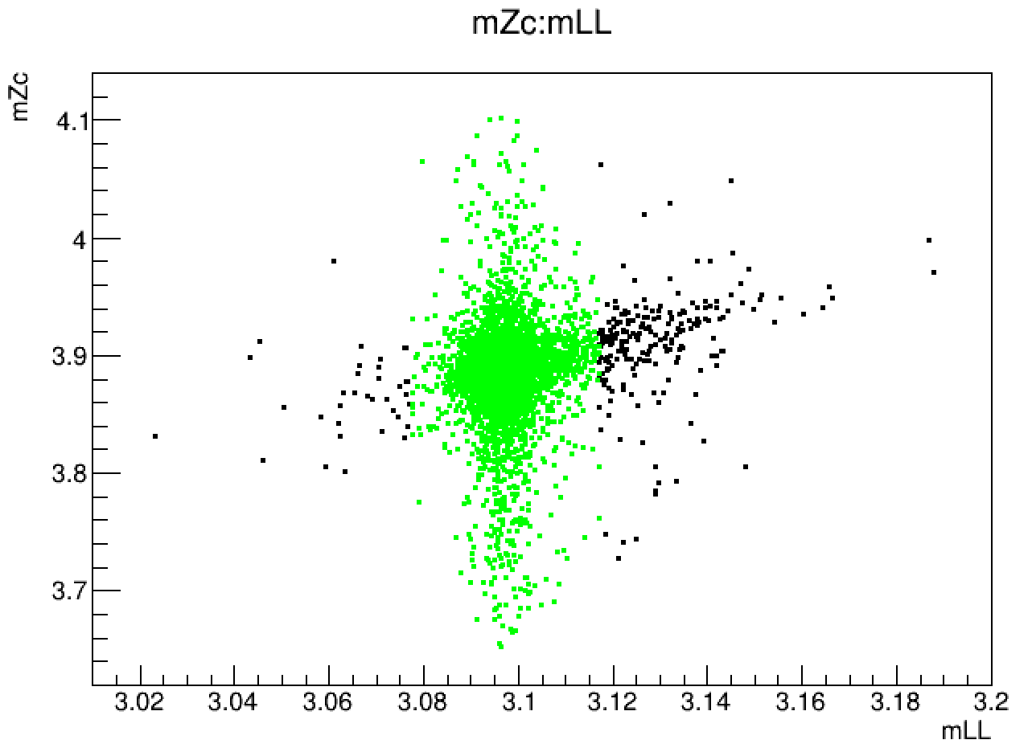
Training Dataset Selection
Signal dataset
  PHSP signal MC data that after event preselection
  Limit m_{J/psi} in the range of (3.077, 3.117) GeV
mumu
ee

Slide 7
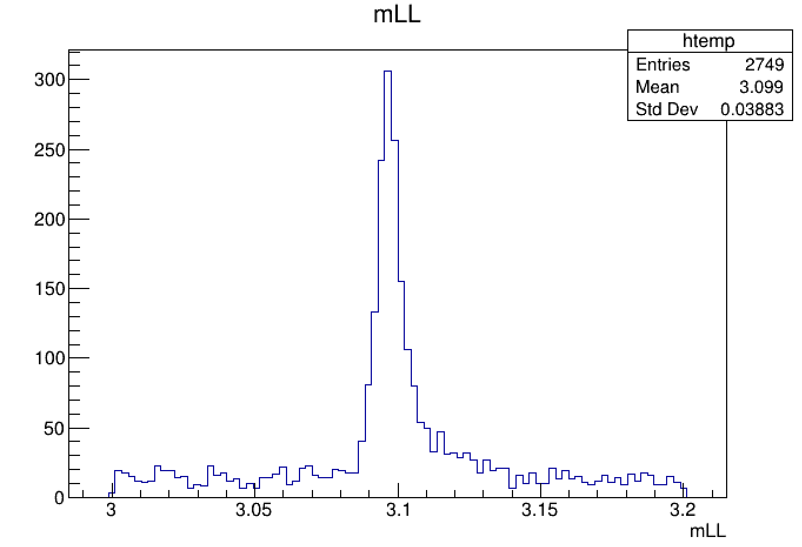
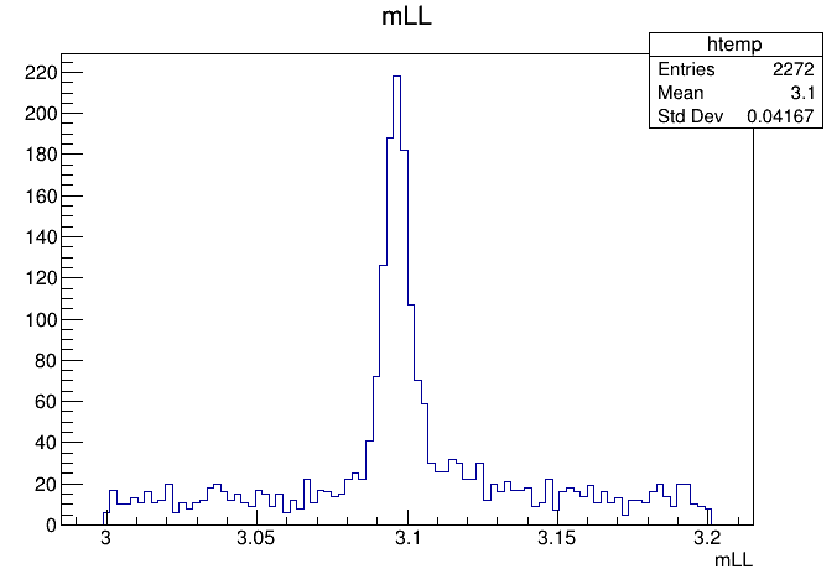
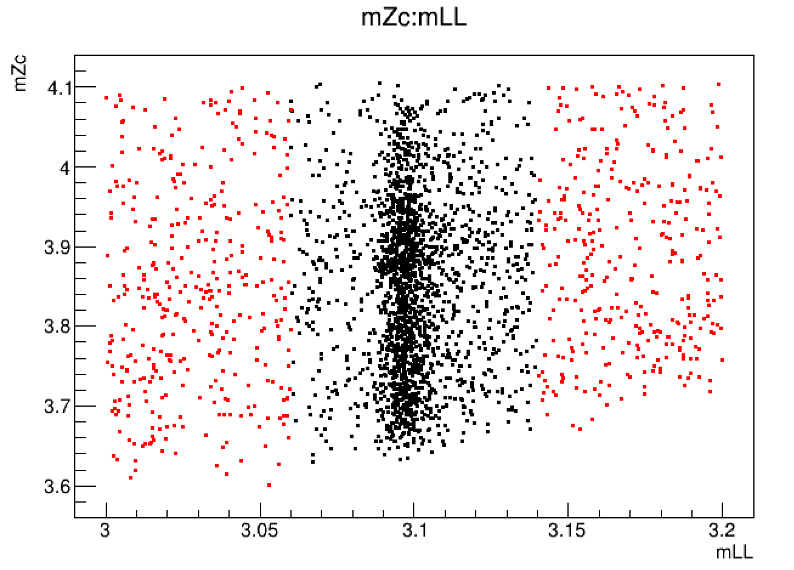
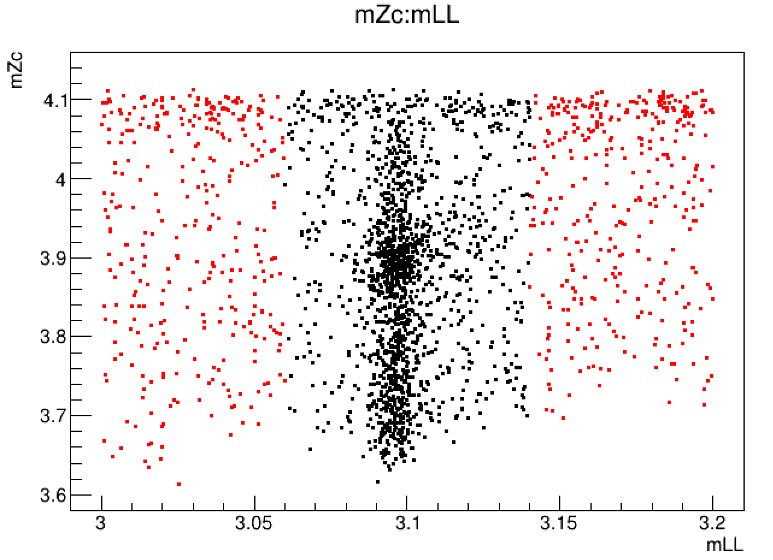
Training Dataset Selection
Background dataset
  The background can not be well described by the inclusive MC data
  The background dataset is selected from the real data that after event preselection
  Limit m_{J/psi} in the range of (3.0, 3.06) and (3.14, 3.20) GeV
mumu
ee

Slide 8
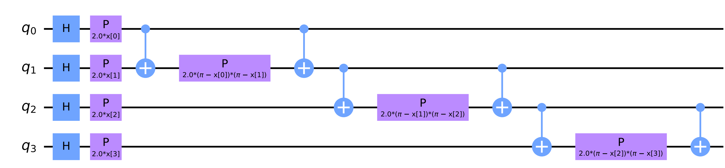
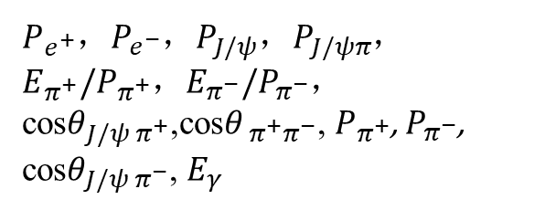
Data Features and Encoding
Totally 12 data features are considered to classify the signal and background events
The embedded ZZFeatureMap in Qiskit is used for data encoding
$P_{e^{+}}$，$P_{e^{−}}$，$P_{J/ψ}$，$P_{J/ψπ}$，$E_{π^{+}}/P_{π^{+}}$，$E_{π^{−}}/P_{π^{−}}$，cos$θ_{J/ψ π^{+}}$,cos$θ_{ π^{+}π^{−}}$, $P_{π^{+}}$, $P_{π^{−}}$, cos$θ_{J/ψ π^{−}}$, $E_{γ}$
An example of a 4 qubits ZZFeatureMap quantum circuit

Slide 9
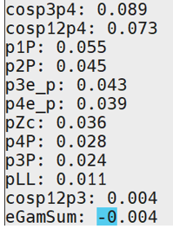
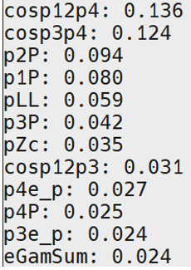
Feature Ranking
Optimize the feature set to get the best result
The ee and mumu modes are processed seperately
  The AUC is calculated respectively from 12 features to 6 features according to the ranking
  The best AUC is got with 10/8 features for ee/mumu mode
The ee mode
The mumu mode

Slide 10
The Performance of QSVM and SVM
A preliminary comparation of ROC for QSVM and SVM
  SVM with the same features as QSVM & all the 12 features
  The cut based result is also shown as a point in the picture
Plan
  Cooperate with physicists to select a more proper training dataset
  Optimize the SVM results reasonably for a fairer comparison
Thanks!

