Slide 1
LHC上强子物理与味物理实验研究进展
钱文斌
中国科学院大学
2024/12/13
29th mini-workshop on the frontier of LHC
2024/12/14
国科大 钱文斌
1

Slide 2
Outline of the talk
Introduction
Hadron physics
CKM physics
New physics hunting in flavor sector
Prospects and conclusion
2024/12/14
国科大 钱文斌

Slide 3
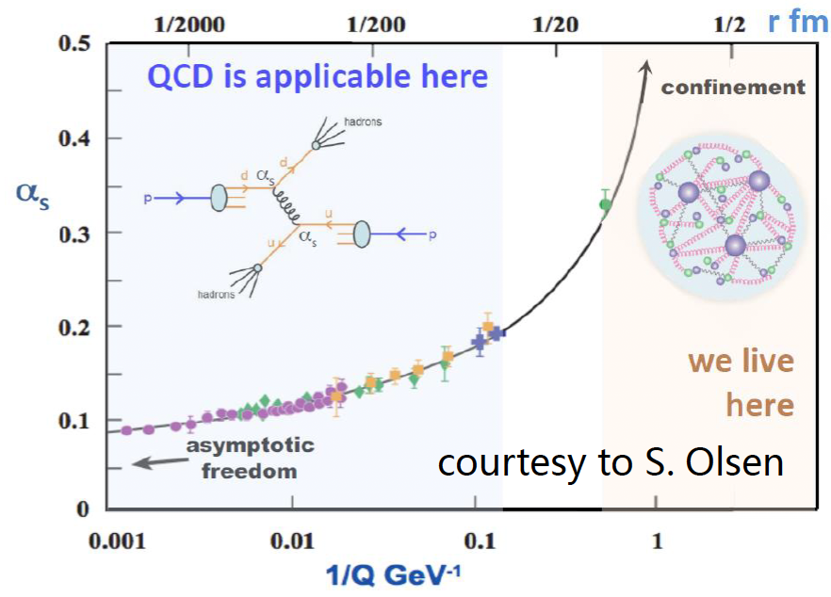
Tasks of flavor and hadron physics
SM model very successful;
Still an effective theory, many unexplained phenomena;
Most related to flavor and hadron physics
Understanding QCD at low energy
New Physics hunting
Properties of QCD confinement
Structures of hadrons
Matter and antimatter asymmetry observed in the Universe
Origin of dark matter? New particles or new forces? Flavor hierarchy
Non-perturbative!
2024/12/14
国科大 钱文斌
3

Slide 4
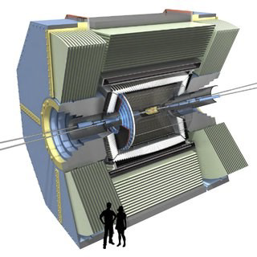
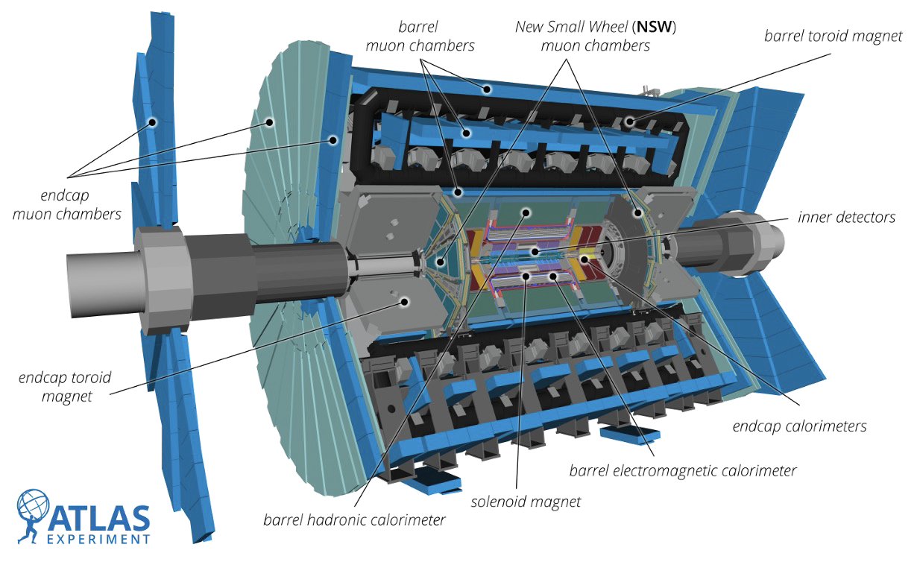
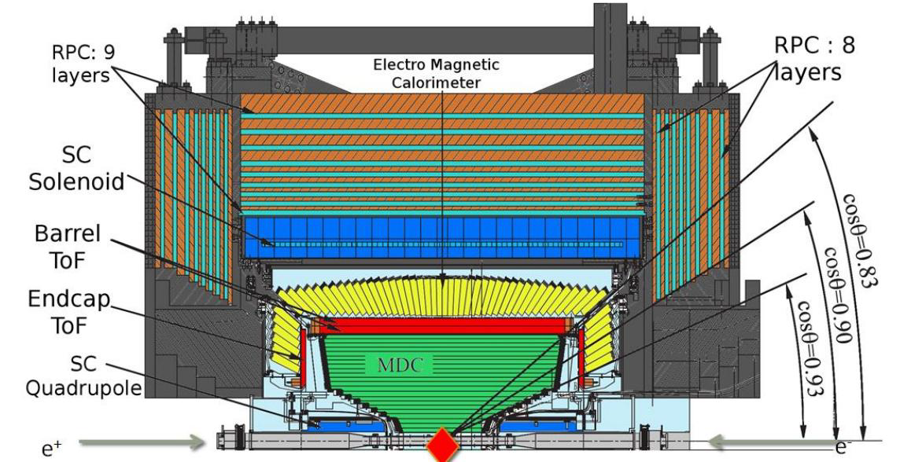
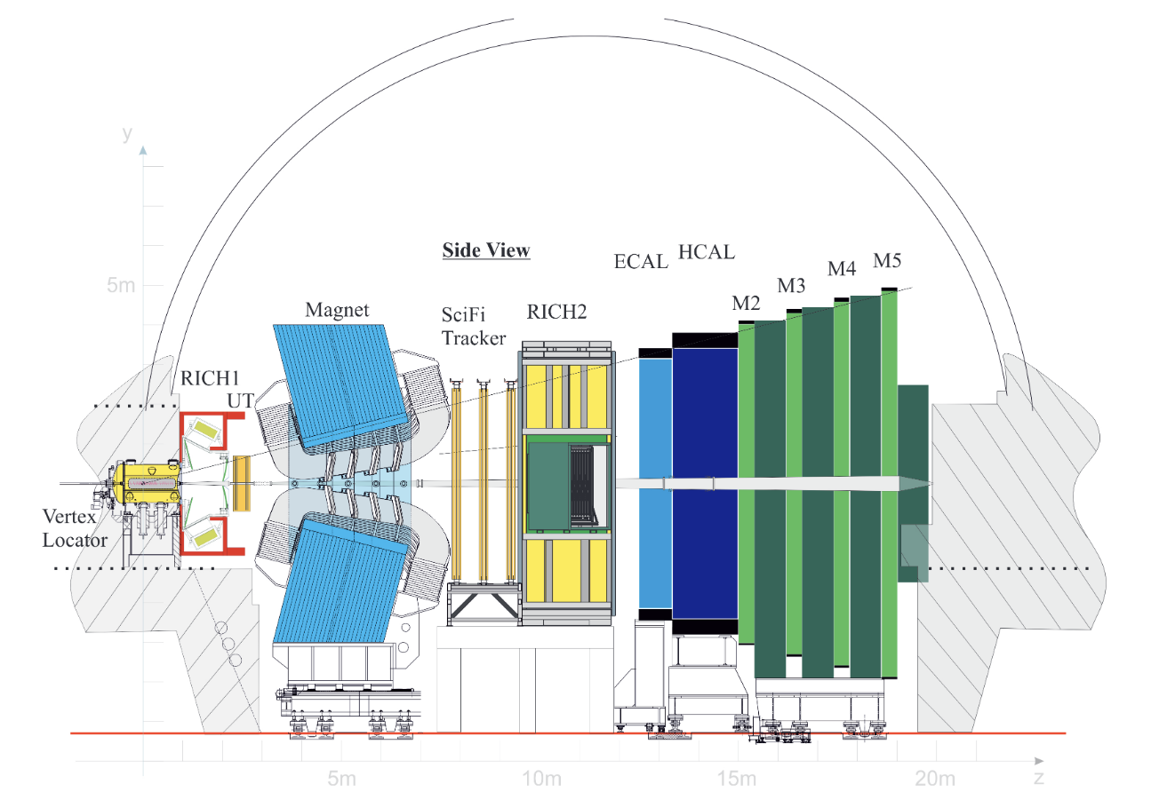
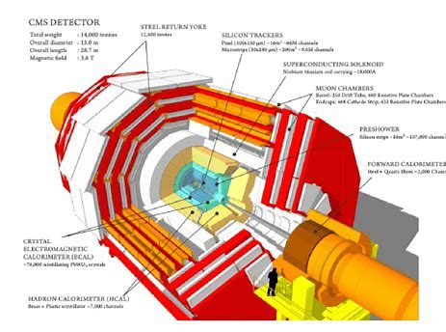
Experiments in the world
+ many dedicated experiments
Focused on LHCb experiment
2024/12/14
国科大 钱文斌
4

Slide 5
Outline of the talk
Introduction
Hadron physics
CKM physics
New physics hunting in flavor sector
Prospects and conclusion
Disclaimer: many interesting results, only a tiny fraction selected
2024/12/14
国科大 钱文斌

Slide 6
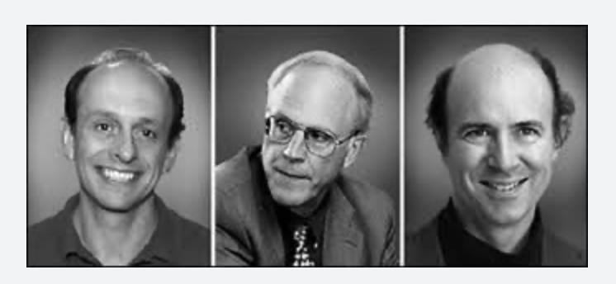
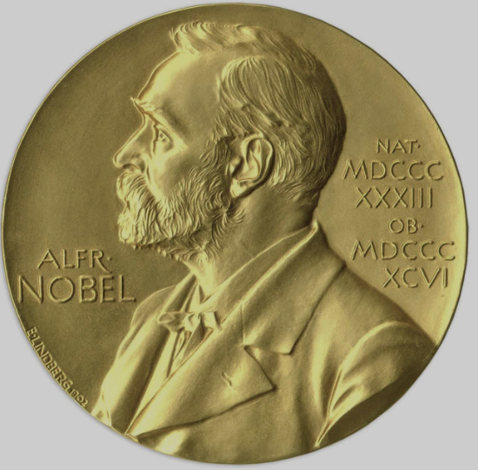
Hadron physics: colorful and tasty
QCD at low energy
Spectroscopy studies
Structure of hadrons
Hadron interaction with matter
Production and decay of hadrons
Fragmentation process into hadron
Everything related to matter
p
2024/12/14
国科大 钱文斌
6

Slide 7
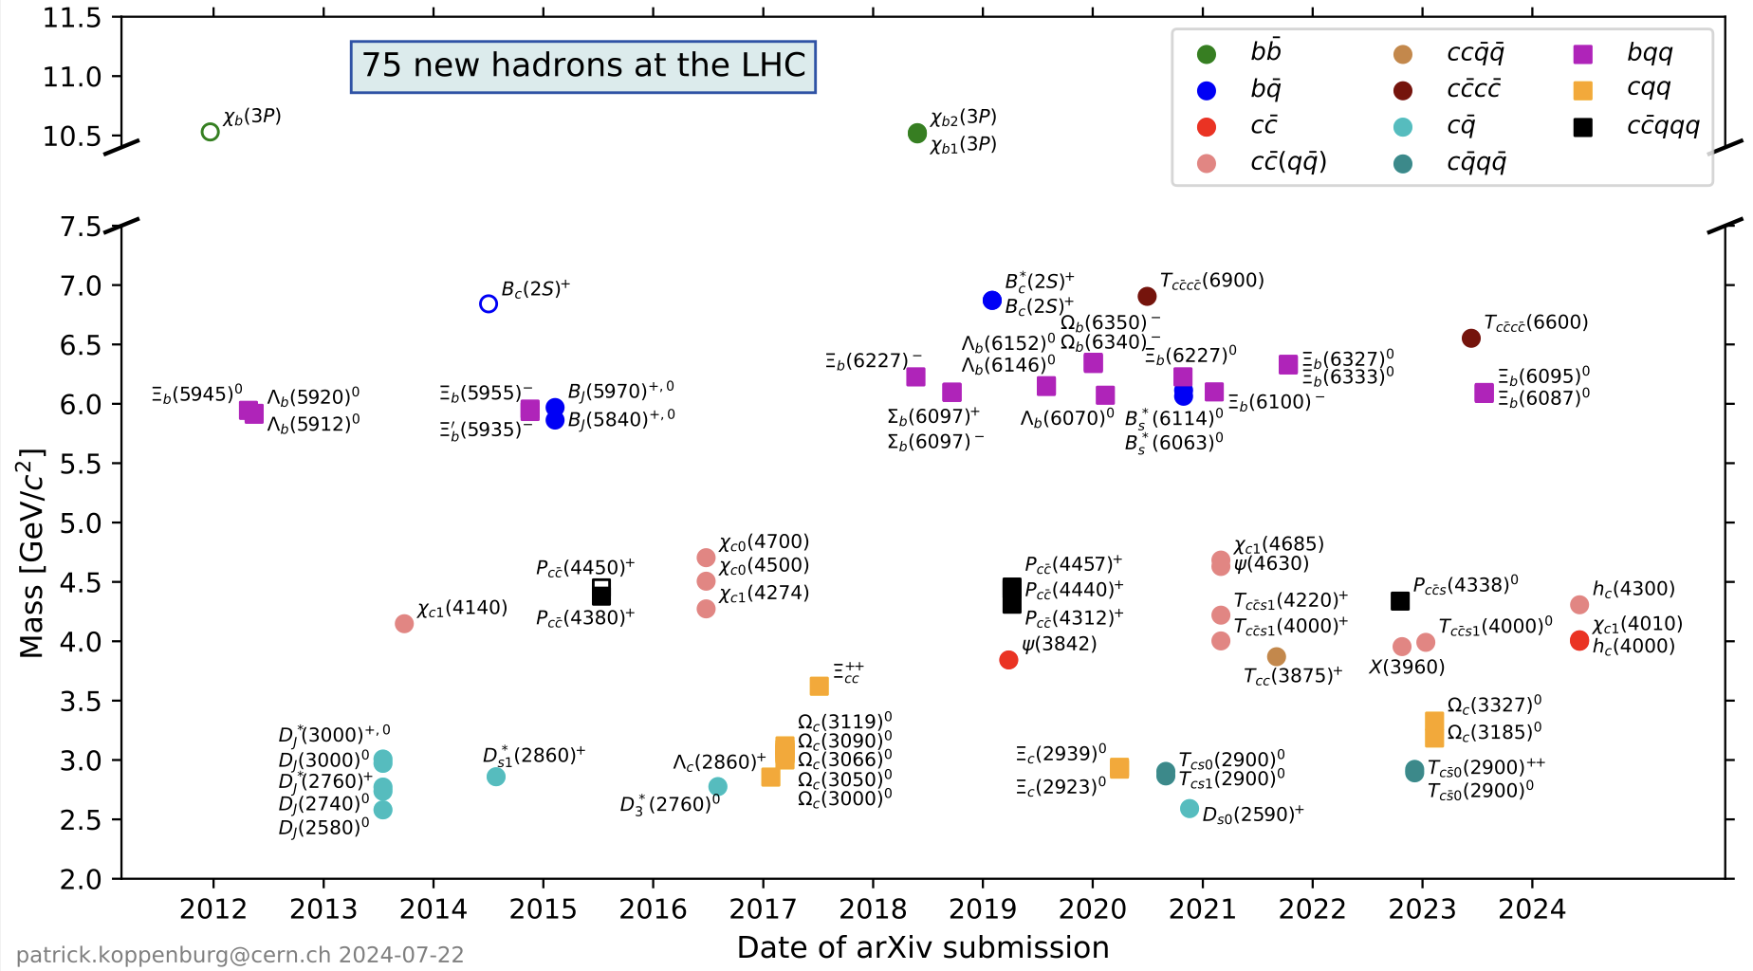
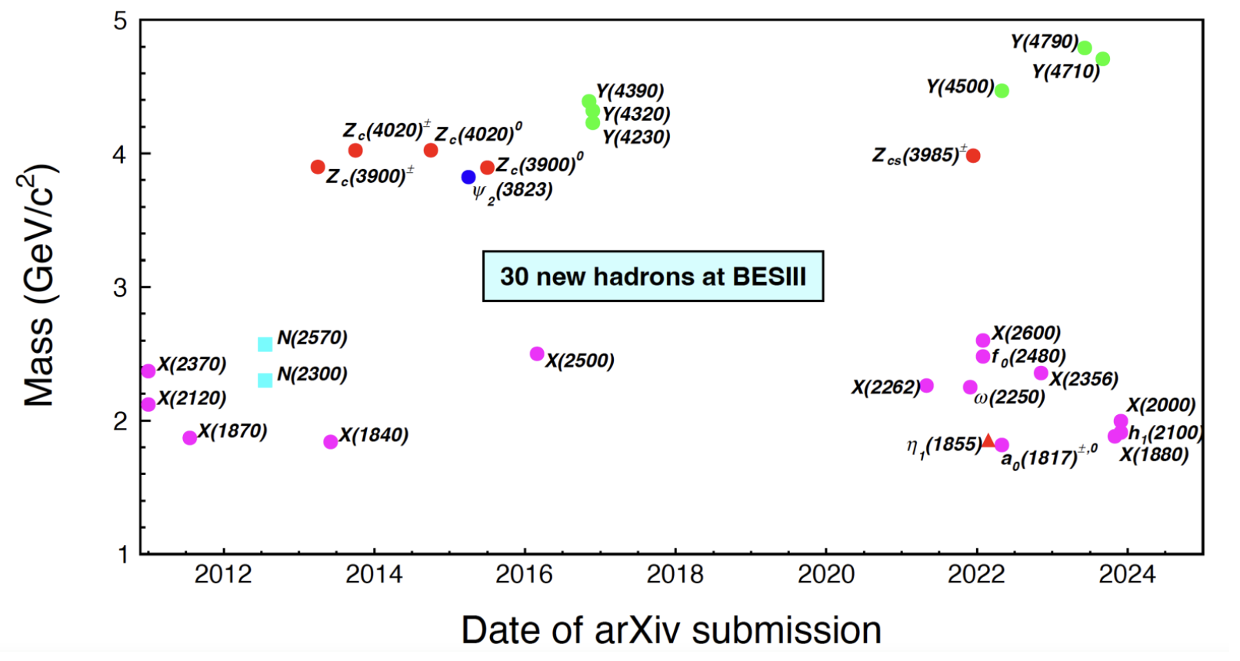
Particle zoo 2.0
Many new hadrons discovered since the discovery of $χ_{c1}(3872)$ in 2003: renaissance and revolution?
75 new hadrons
30 new hadrons
LHC (mainly LHCb)
BESIII
+ 17 new hadrons from Belle (>35 from its start)
> 20 new hadrons since 2022 (only selected ones are shown)
Many can not be explained by conventional quark model
More than 140 new hadrons
2024/12/14
国科大 钱文斌
7

Slide 8
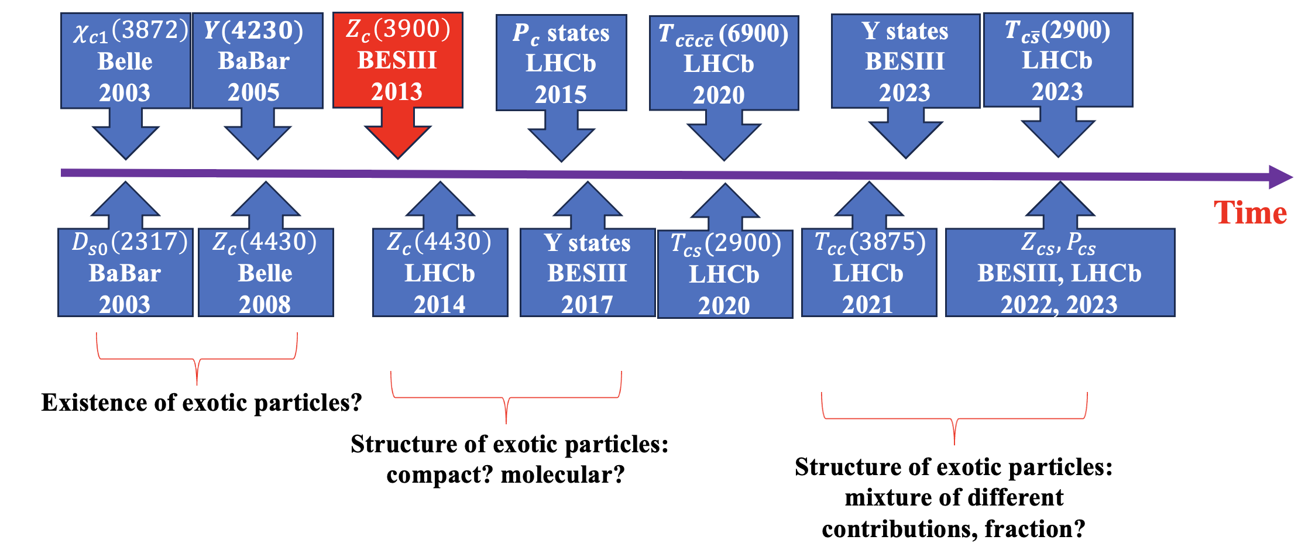
A history of understanding
$c\overline{c}(X)$+ $c\overline{s} (X)$
More states
Better understanding
Unified model for all hadrons?
$$c\overline{c}g$$
$$c\overline{c}$$
+
$$c\overline{c}qq$$
+
+
$$c\overline{c}$$
$$qq$$
+ …
Particle X =
$$cq$$
$$\overline{c}q$$
2024/12/14
国科大 钱文斌
8

Slide 9
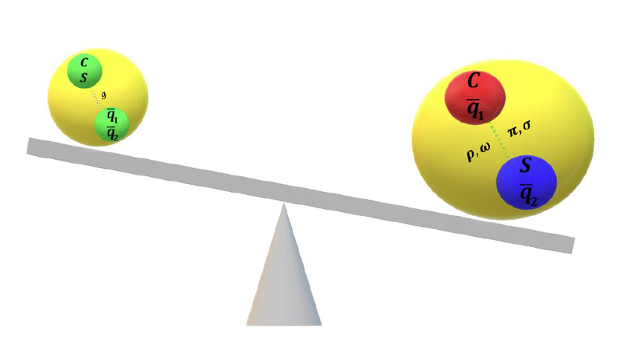
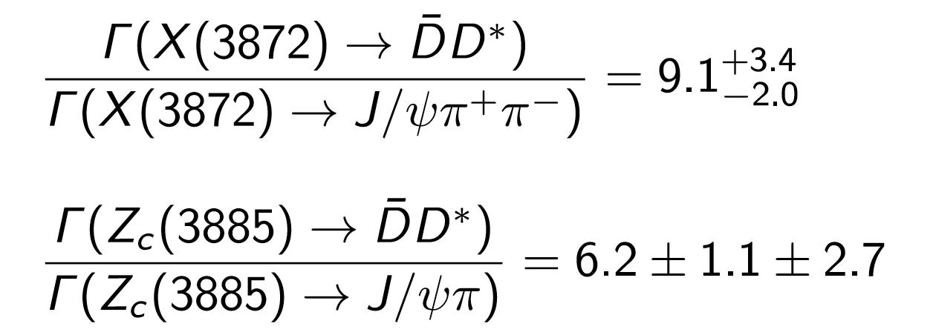
Experimental inputs
$$c\overline{c}g$$
$$c\overline{c}$$
+
$$c\overline{c}qq$$
+
+
$$c\overline{c}$$
$$qq$$
+ …
Particle X =
$$cq$$
$$\overline{c}q$$
Charm + charm + X
charmonium + X
Experimental tasks:
Discover more and understand them through production and decays
However, studies with $B→DDX$decays rather limited
2024/10/22
国科大 钱文斌
9

Slide 10
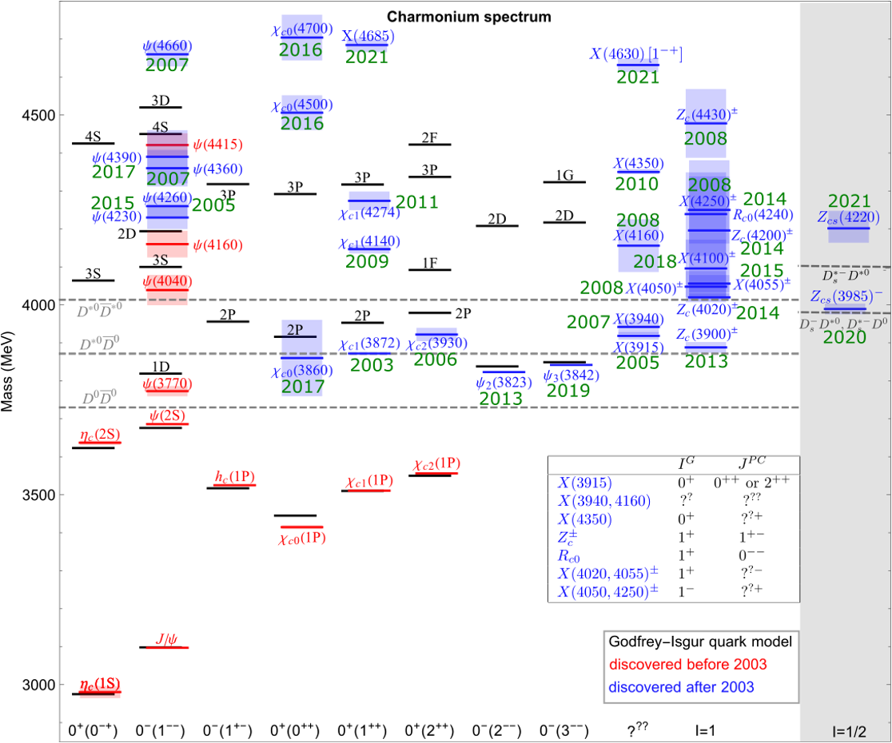
Understanding charmonium(-like) states
PRL 133 (2024) 131902
Three new states observed: $h_{c}\left(4000\right) J^{PC}=1^{+−}$, $χ_{c1}\left(4010\right){ J}^{PC}=1^{++}$, $h_{c}\left(4300\right) J^{PC}=1^{+−}$
courtesy to F.K. Guo
Filling the missing ones or adding more complexity?
2024/12/14
国科大 钱文斌
10

Slide 11
Doubly charged tetraquark and its Isospin partner
Around 4K signal events
PRL 131 (2023) 041902
PRD 108 (2023) 012017
$$B^{0}→\overline{D^{0}}D_{s}^{+}π^{−}$$
$$B^{+}→D^{−}D_{s}^{+}π^{+}$$
$$T_{c\overline{s}}^{a}{\left(2900\right)}^{0}$$
$$T_{c\overline{s}}^{a}{\left(2900\right)}^{++}$$
$$FF:\left(4.8±1.1±1.4\right)\%$$
$$FF:\left(1.96±0.87±0.88\right)\%$$
$T_{cs}^{a}\left(2900\right) \text{have} \text{quark} \text{content} c\overline{s}\overline{u}d \text{and} c\overline{s}u\overline{d}$
Two states consist with each other: isospin triplet
No other states are needed currently
2024/12/14
国科大 钱文斌
11

Slide 12
Nature of $D_{s}^{+}(2317)$ and its isospin partner
Discovered more than 20 years ago, however, its structure remains puzzling
$$\vec{s_{l}}$$
$$1/2$$
$$1/2$$
$$3/2$$
BaBar, 2006, searched in $e^{+}e^{−}→c\overline{c}+X$ @10.6 GeV, not found
Belle, 2015, searched in $B→DD_{s}^{+}π$, not found
LHCb, 2023, searched in $B→DD_{s}^{+}π$, found neutral and doubly charged $T_{c\overline{s}}(2900)$
$2900−2317=583$ MeV similar as $M\left(ψ\left(2S\right)\right)−M(ψ(1S))$: radial excitation of $D_{s}{\left(2317\right)}^{+}$
2024/12/14
国科大 钱文斌
12

Slide 13
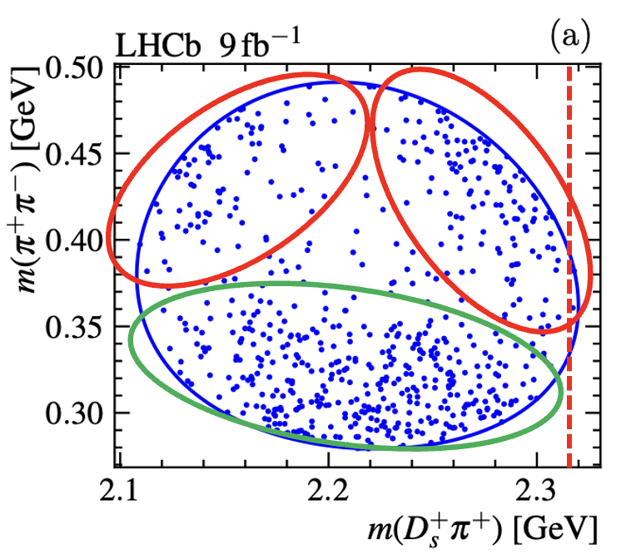
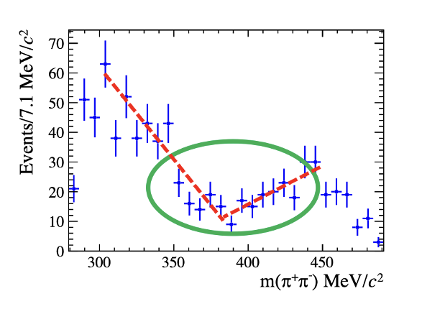
$B→D^{(∗)}D_{s}^{+}π^{+}π^{−}$, $D_{s}{\left(2460\right)}^{+}→D_{s}^{+}π^{+}π^{−}$
Interesting structures seen on Dalitz plot and projections
Very puzzling structures, rarely seen before
Two models to describe the strange shape:
$f_{0}\left(500\right)+f_{0}\left(980\right)+f_{2}(1270)$: puzzling to have large $f_{0}\left(980\right)+f_{2}\left(1270\right)$ contributions, far away from threshold; puzzling $f_{0}\left(500\right)$ mass and width
$f_{0}\left(500\right)+T_{c\overline{s}}^{++}\left(2317\right)+T_{c\overline{s}}^{0}(2317)$
2024/12/14
国科大 钱文斌
13

Slide 14
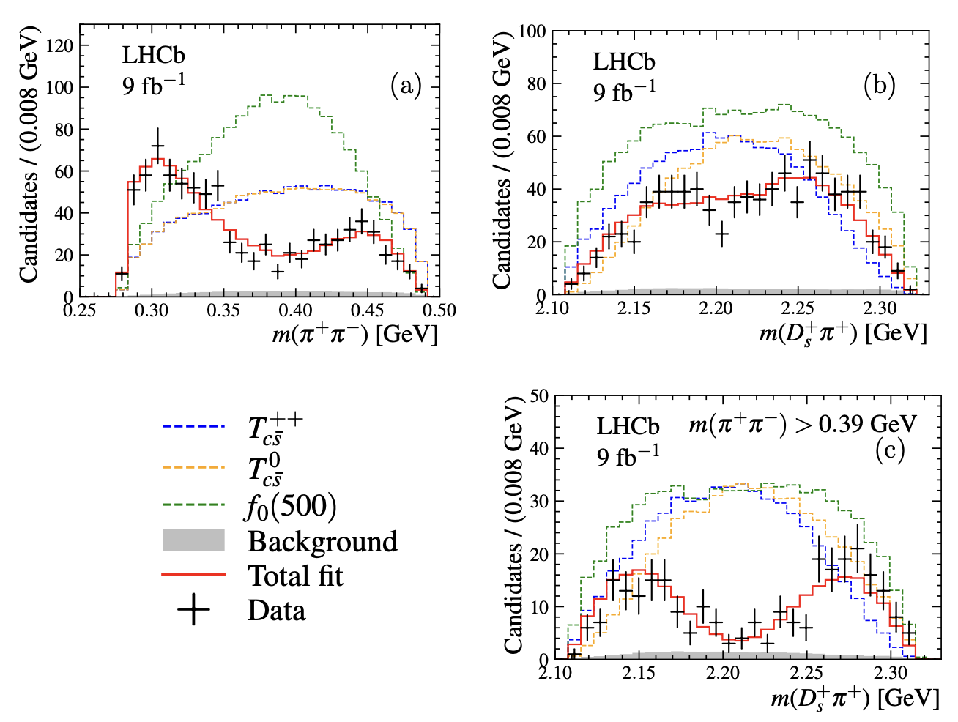
Fit results for models with $T_{c\overline{s}}$
$m\left(π^{+}π^{−}\right)∈\left[279.2, 491.2\right]$ MeV
$f_{0}\left(500\right)$ mass and width agree with other measurements
Scattering length in K-Matrix determined to be
Significance of $T_{c\overline{s}}>10σ$
Coupling, masses and widths of $T_{c\overline{s}}^{0}$ and $T_{c\overline{s}}^{++}$ fixed to be the same; if free, consistent with each other
2024/12/14
国科大 钱文斌
14

Slide 15
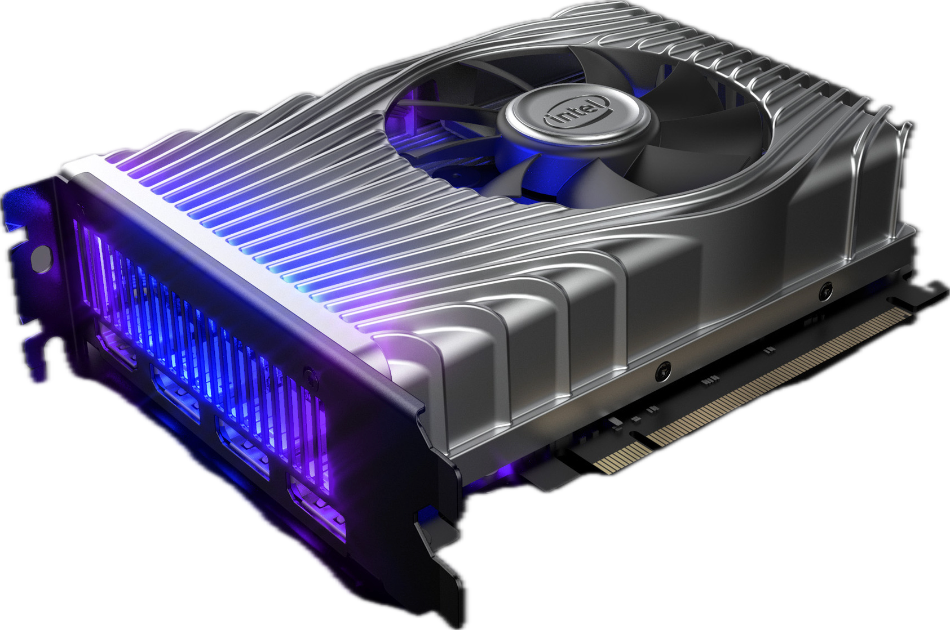
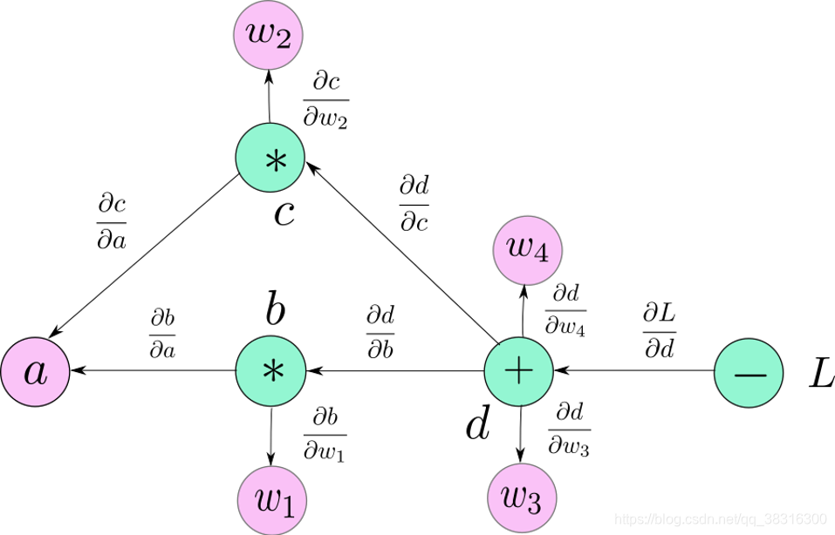
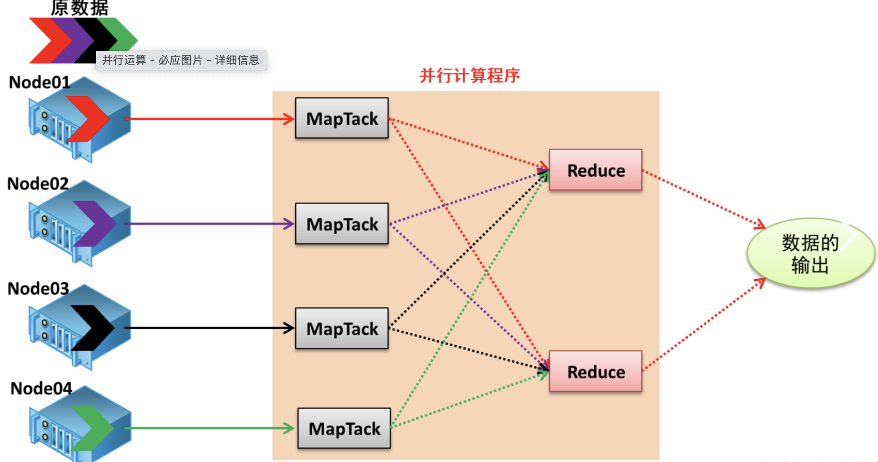
Challenges in front
Amplitude analyses: key to flavor physics
Larger and larger data size: BESIII now collects 10B $J/ψ$ sample; 10$×$ more data from LHCb (~2030); Belle II, 50$×$ Belle (~2030);
More and more complicated amplitude analyses;
Physical models：cooperation between theorists and experimentalists !
Common languages between different measurements and theorists
？
TF-PWA
https://github.com/jiangyi15/tf-pwa
2024/12/14
国科大 钱文斌
15

Slide 16
Outline of the talk
Introduction
Hadron physics
CKM physics
New physics hunting in flavor sector
Prospects and conclusion
Disclaimer: many interesting results, only a tiny fraction selected
2024/12/14
国科大 钱文斌

Slide 17
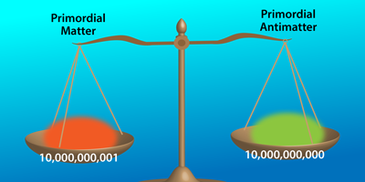
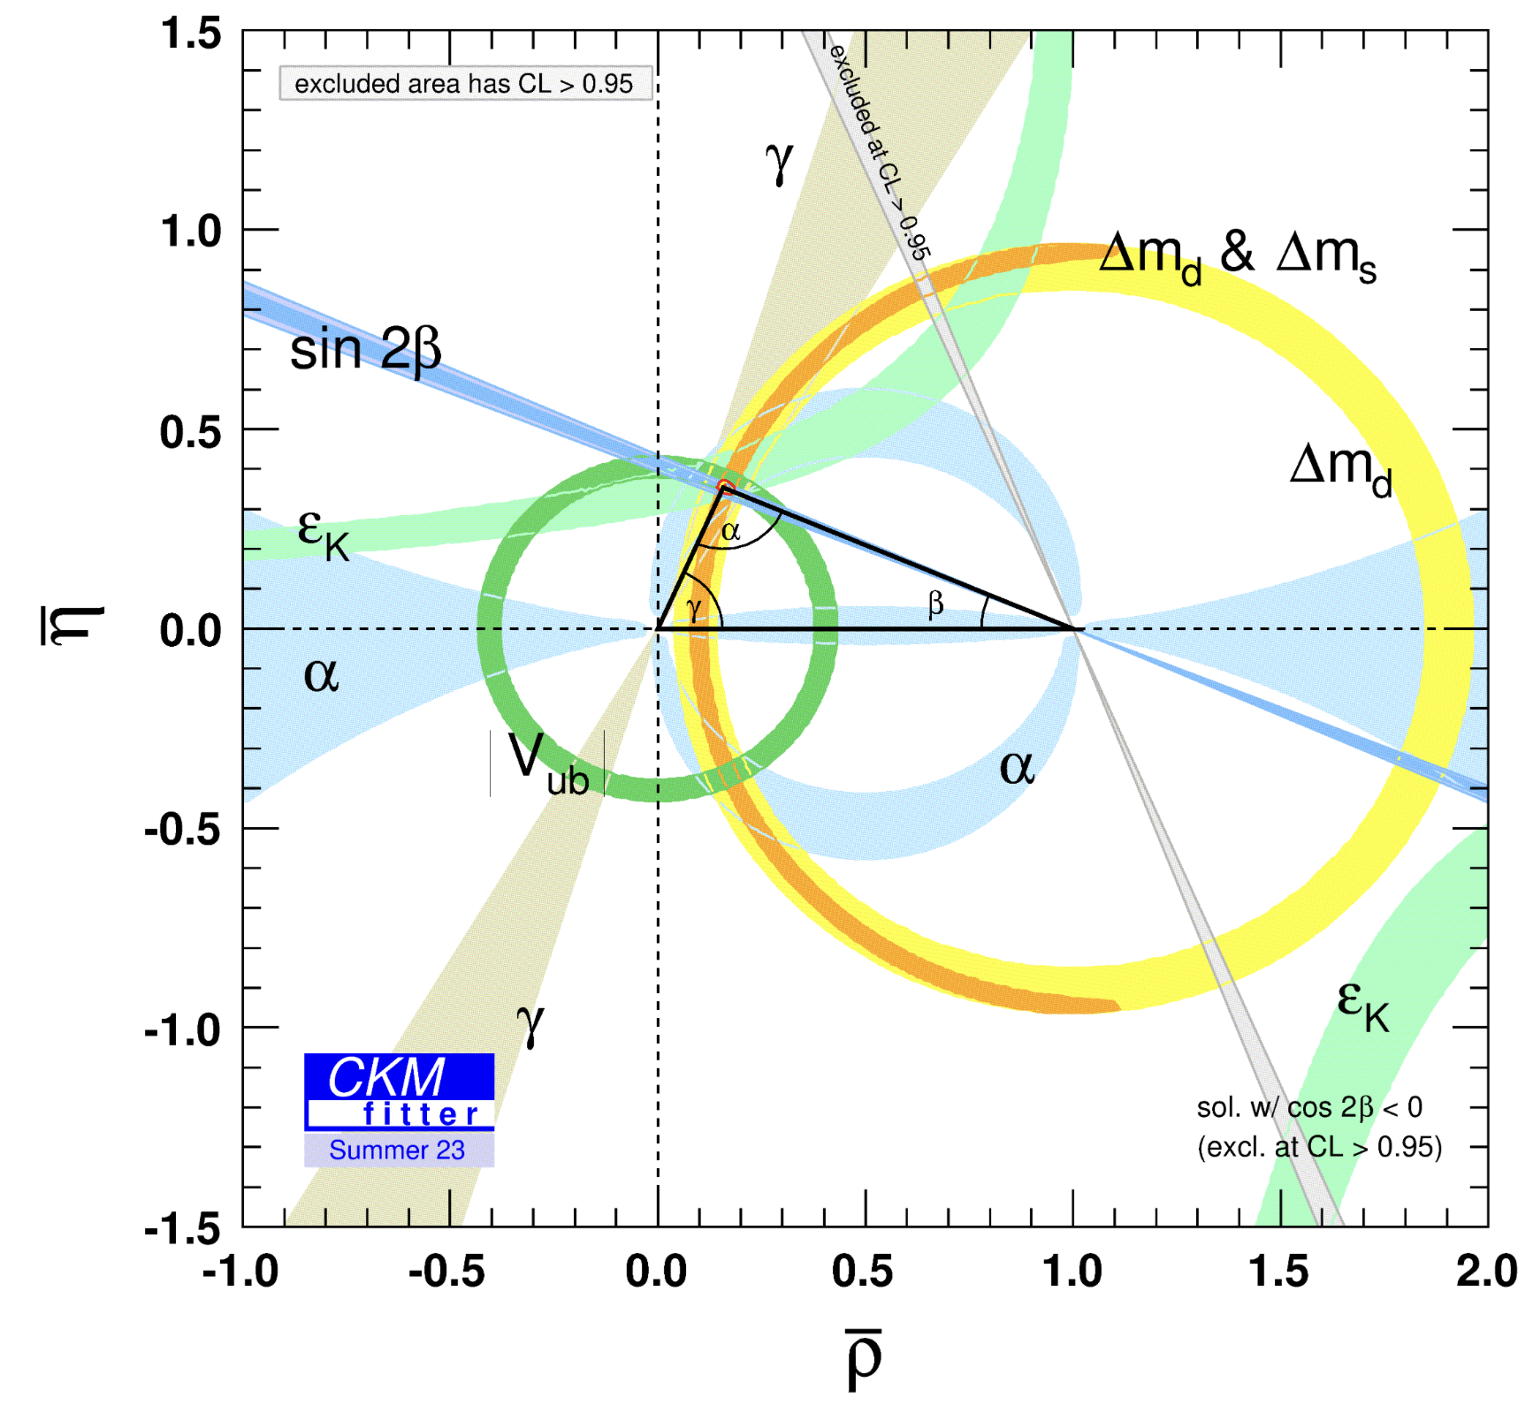
Why CKM precision test important
CKMfitter
Why three generation? Origin of mass hierarchy? Relationship between CKM elements and quark masses?
Unitarity: only requirement in SM
Mass eigenstate vs interaction eigenstate
Is current precision enough? No
Disaster for new physics searches if CKM elements not precise
$${10}^{−5}$$
$$V_{ud}V_{ud}^{∗}+V_{us}V_{us}^{∗}+V_{ub}V_{ub}^{∗}−1$$
$$=[0.00012,−0.00295] \left(3σ\right)$$
Cabbibo anomaly?
From A. Buras
2024/12/14
国科大 钱文斌
17

Slide 18
Flavor measurements
Non-perturbative
Physics of interest
Short distance + long distance
A measurement
$$A=\left(Weak\right) \left(EM\right) (QCD)$$
Precisely calculated by QED
2024/12/14
国科大 钱文斌
18

Slide 19
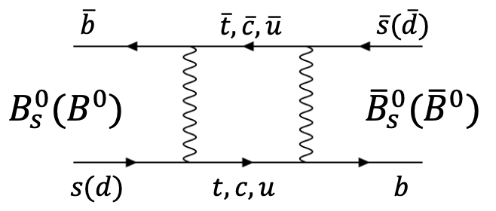
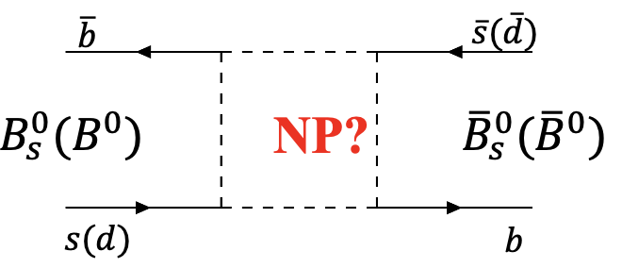
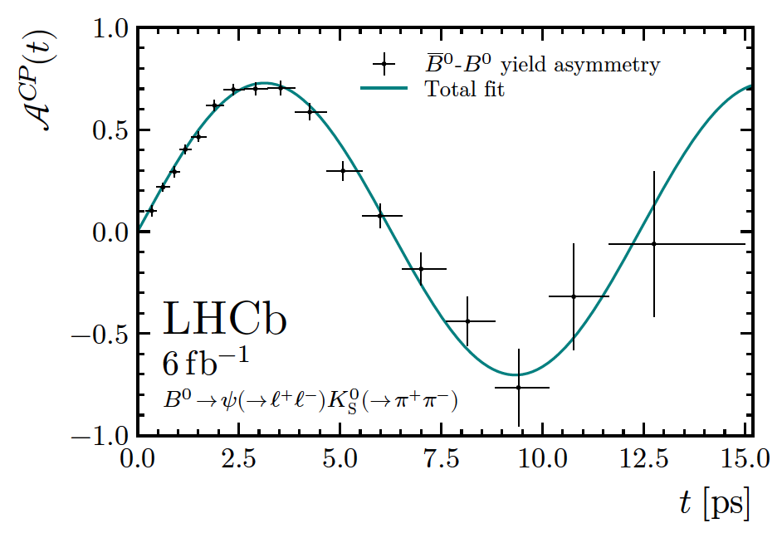
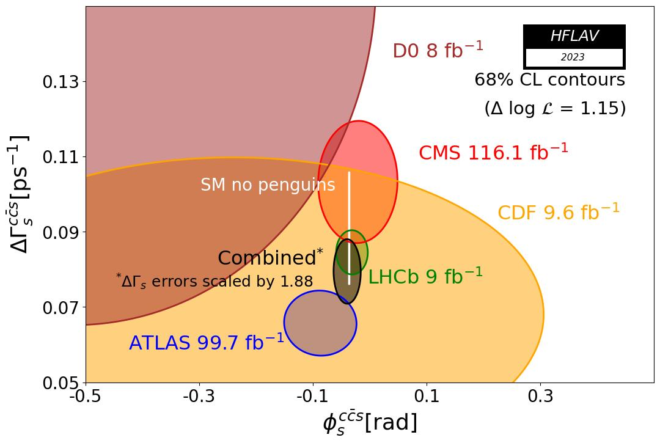
Time dependent measurements
TD measurement: Core program of B physics
$$A_{CP}= \frac{Γ\left({\overline{B}}_{(s)}^{0}\left(t\right)→f\right)−Γ(B_{(s)}^{0}\left(t\right)→f)}{Γ\left({{\overline{B}}_{(s)}}^{0}\left(t\right)→f\right)+Γ(B_{(s)}^{0}\left(t\right)→f)}= \frac{S\sin{(Δm_{q}t})−C\cos{(Δm_{q}t)}}{\cosh{(ΔΓ_{q}t/2)}+A_{ΔΓ }\sinh{(ΔΓ_{q}t/2)}}$$
$$Δm_{d}=0.5065\left(19\right)ps^{−1}$$
$Δm_{s}=17.7656\left(57\right)ps^{−1}$
$$S_{ψK_{S}^{0}}=0.717±0.013±0.008$$
$$φ_{s}=−0.039±0.022±0.006$$
Most precise determination of $\left|V_{ts}\right|$ and $|V_{td}|$
Most precise determination $sin2β$
Most precise search for NP in mixing
2024/12/14
国科大 钱文斌
19

Slide 20
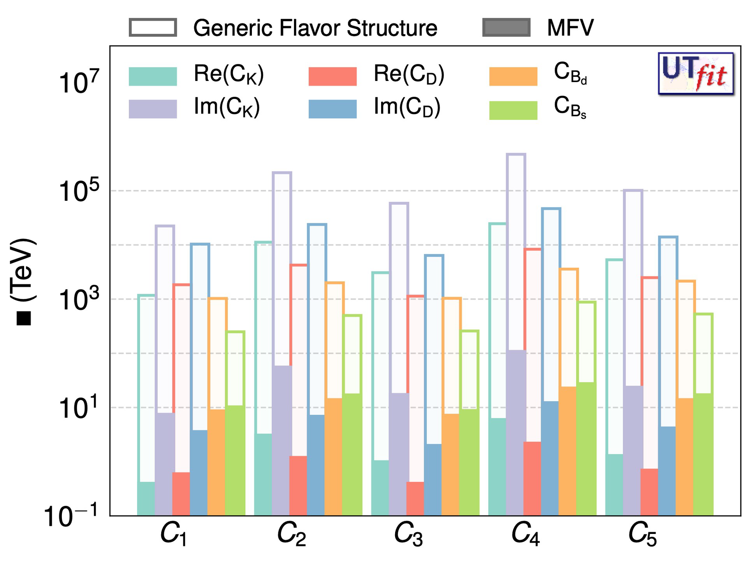
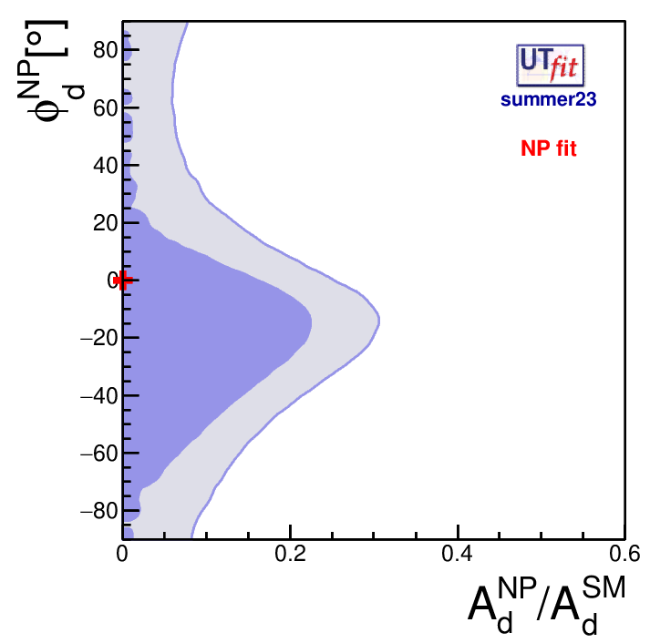
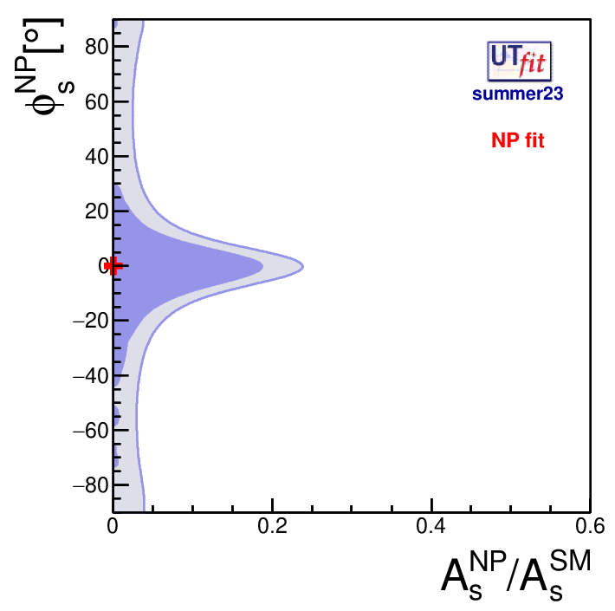
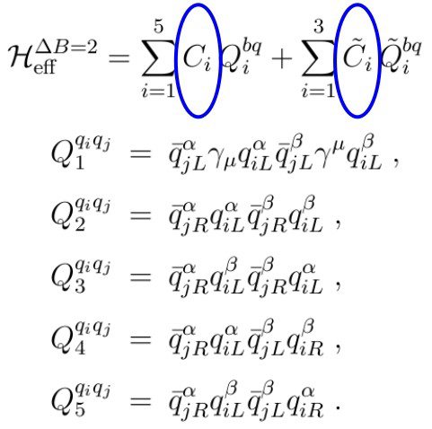
New physics in CKM: an example
UT fit
$$M_{12}^{q}=M_{12}^{SM,q} × (1+\frac{A_{q}^{NP}}{A_{q}^{SM}} e^{2i(φ_{q}^{NP}−φ_{q}^{SM})})$$
Assuming NP in $B^{0}, B_{s}^{0}$ mixing:
Ratio of NP/SM amplitudes < 20% @ 68% CL.
Sensitive to NP at level of 1~10⁵ TeV
$$C\left(M\right)=\frac{c_{NP}×F}{Λ^{2}}$$
F~ 1 (generic) or SM if NMFV
$$B^{0}$$
$B_{s}^{0}$
2024/12/14
国科大 钱文斌
20

Slide 21
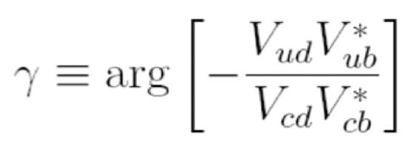
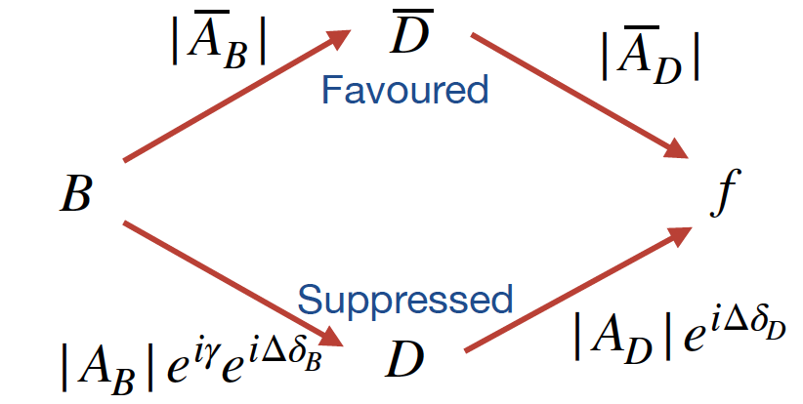
CKM angle $γ$
$b→c:$
$$\overline{A}\left(D\right):{\overline{D}}^{0}→f$$
$$r_{D}e^{iΔδ_{D}}= \frac{A_{D}}{{\overline{A}}_{D}}$$
$$A\left(D\right):D^{0}→f$$
$$D^{0}(\vec{p})$$
$b→u:$
$γ$ measurements
$$ψ\left(3770\right)$$
QC data
Charm mixing
$$\overline{D^{0}}(−\vec{p})$$
2024/12/14
国科大 钱文斌
21

Slide 22
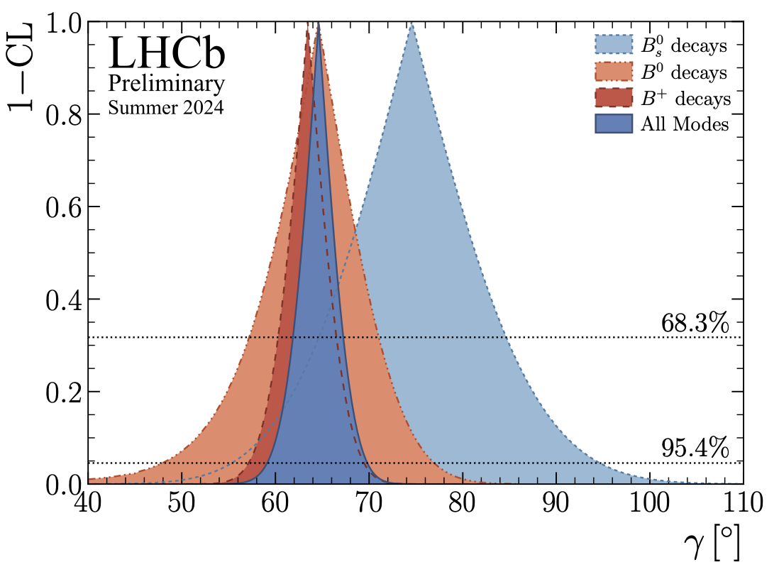
Global combination from LHCb
LHCb-CONF-2024-004
19 LHCb $B$ decay measurements + 11 $D$ decay measurements + 27 inputs from LHCb, HFLAV, BESIII and CLEO-c = 29 physics parameters of interest + additional nuisance parameters
$$γ={\left(64.6±2.8\right)}^{∘}$$
surpass LHCb design: $4^{∘}$
Belle + Belle II: $γ={\left(78.6_{−7.3}^{+7.2}\right)}^{∘}$
Previous tension between $B_{s}^{0}$ and other modes smaller, $B_{s}^{0}$ modes still with largest uncertainty
Sensitivity dominated by $B^{+}$ modes
Charm inputs crucial for $γ$ measurements
2024/12/14
国科大 钱文斌
22

Slide 23
Synergy between BESIII and LHCb (+Belle II)
Decay modes | Strategy | Quantities | BESIII status | LHCb status
$$D→K_{S}^{0}h^{+}h^{−}$$ | binned | $$c_{i}, s_{i}$$ | 3 fb⁻¹ published; 8 fb⁻¹ ongoing; | 9 fb⁻¹ published; (5$°$ VS 1$°$)
$$D→K_{S}^{0}h^{+}h^{−}$$ | Fourier | $$a_{c}^{i}, a_{s}^{i}, b_{c}^{i},b_{s}^{i}$$ | 8 fb⁻¹ ongoing; | 9 fb⁻¹ ongoing
$$D→K^{±}π^{∓}π^{+}π^{−}$$ | global and binned | $$R_{K3π}, δ_{K3π},$$ $$R_{K3π}^{i}, δ_{K3π}^{i}$$ | 3 fb⁻¹ published； New data ongoing | 9 fb⁻¹ published; (6$°$ VS 6$°$)
$$D→K^{+}K^{−}π^{+}π^{−}$$ | global and binned | $$F_{+}, c_{i}, s_{i}$$ | 16 fb⁻¹ ongoing | 9 fb⁻¹ published (MD); 9 fb⁻¹ ongoing (MI); (12$°$ VS 10$°$)
$$D→π^{+}π^{−}π^{+}π^{−}$$ | global and binned | $${F_{+}, c}_{i}, s_{i}$$ | 3 fb⁻¹ ongoing | 9 fb⁻¹ ongoing (MI); (9$°$ VS 3$°$)
$$D→K^{±}π^{∓}π^{0}$$ | global | $$R=0.792±0.033$$ | 3 fb⁻¹ published New data ongoing | 9 fb⁻¹ published;
$$D→K_{S}^{0}K^{∓}π^{±}$$ | global | $$R=0.70±0.08$$ | 8 fb⁻¹ ongoing | 9 fb⁻¹ published;
$$D→K_{S}^{0}π^{+}π^{−}π^{0}$$ | global and binned | $$F_{+}=0.238±0.017,$$ $$c_{i}, s_{i}$$ | 3 fb⁻¹ ongoing | 9 fb⁻¹ ongoing
$$D→K^{+}K^{−}π^{0}$$ | global | $$F_{+}=0.73±0.06,$$ $$c_{i}, s_{i}$$ | 8 fb⁻¹ published | 9 fb⁻¹ published;
$$D→K^{+}π^{−}$$ | global | $$δ$$ | 3 fb⁻¹ published | 9 fb⁻¹ published;
2024/12/14
国科大 钱文斌
23

Slide 24
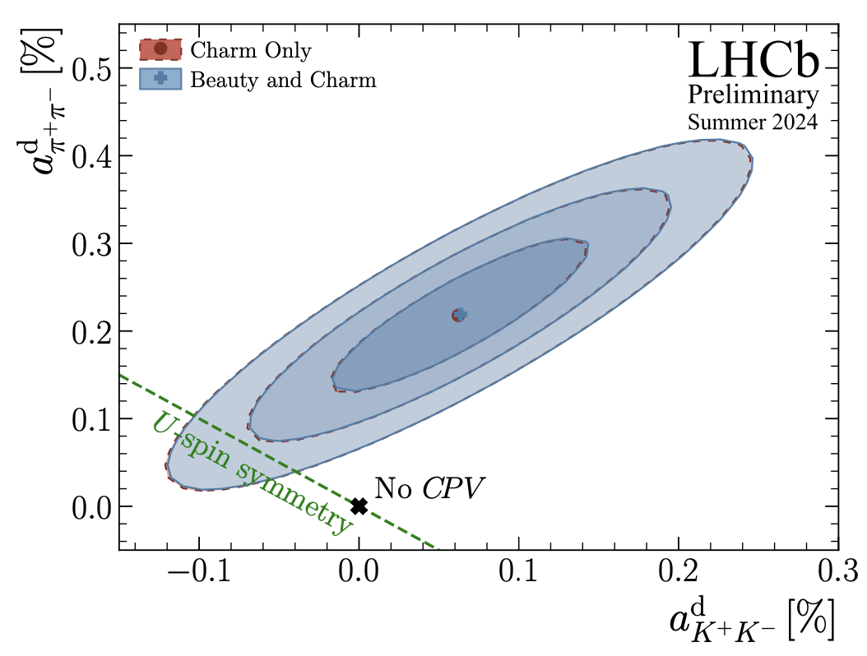
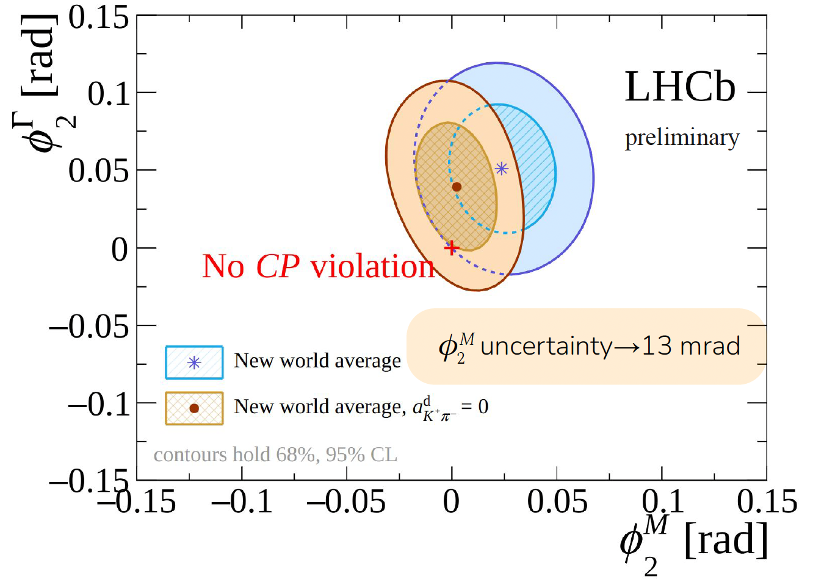
Next milestone? CPV in charm mixing?
PRL122(2019)211803
PRL131(2023)091802
CPV in charm: ~0.1%;
First observation of CPV in charm decay: $ΔA_{CP}=A_{CP}\left(K^{+}K^{−}\right)−A_{CP}\left(π^{+}π^{−}\right)=\left(−15.4±2.9\right)×10^{−3}$
Next question: when to observe CPV in charm mixing?
Precision of $φ_{2}^{M}$ down to 13 mrad, still a factor of 6 larger than SM predictions, $𝓞(2 mrad)$
With further LHCb data in upgrade I and II, CP violation in charm mixing will be established
Also, stringent search of NP in up-type meson mixing
2024/12/14
国科大 钱文斌
24

Slide 25
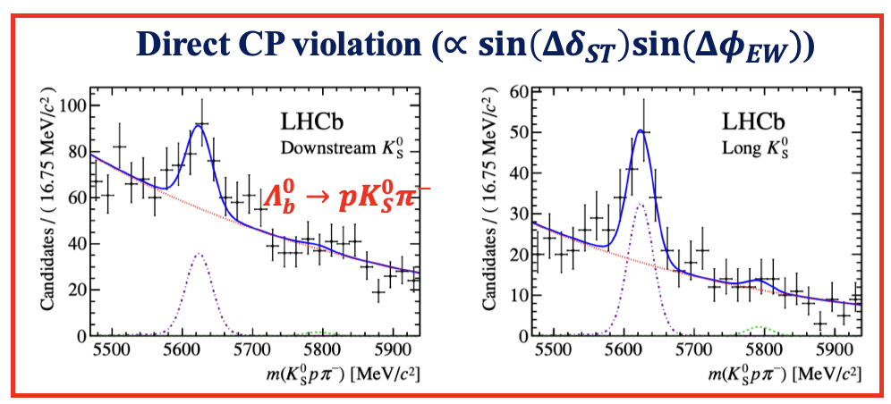
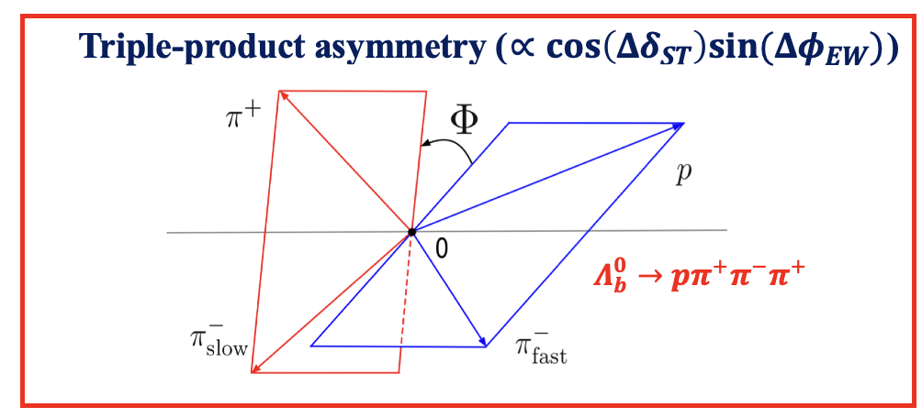
Next breakthrough? CPV in baryon decays?
JHEP04(2014)087
PRD108(2023)L011101
arXiv:2406.06118
Nature Phys.13(2017)391
CP violation not yet in baryon decays
Baryons crucial for asymmetries in Universe
$\frac{n_{B}−n_{\overline{B}}}{n_{γ}} \sim {10}^{−10}$
CPV: b baryon $𝓞(1\%−10\%)$, c baryon $𝓞(0.1\%)$, hyperon $𝓞(0.001\%−0.01\%)$
Unique chance from BESIII
$\frac{f_{Λ_{b}^{0}}}{f_{B}^{+}}\sim 1$:
Puzzling situation: similar $Λ_{b}^{0}$ production as $B^{+}$, huge significance of CPV in $B^{+}$, none in $Λ_{b}^{0}$?
Does CKM mechanism apply to baryons?
2024/12/14
国科大 钱文斌
25

Slide 26
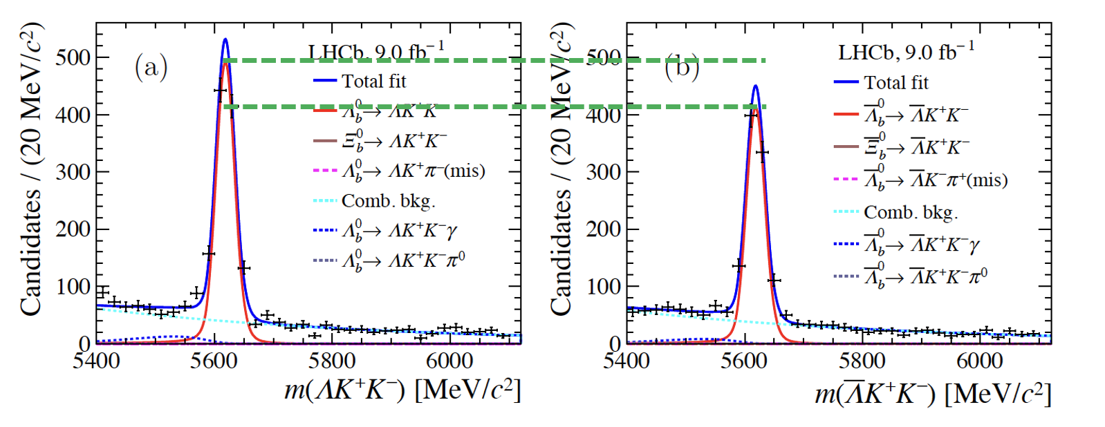
Here we come
LHCb-PAPER-2024-043
Preliminary
$$Λ_{b}^{0}→ΛK^{+}K^{−}$$
$$ΔA_{CP}=0.083±0.023±0.016$$
First evidence of CP violation, 3.1$σ$
Three body decays, need to know which resonance contributes
2024/12/14
UCAS, Wenbin Qian
26

Slide 27
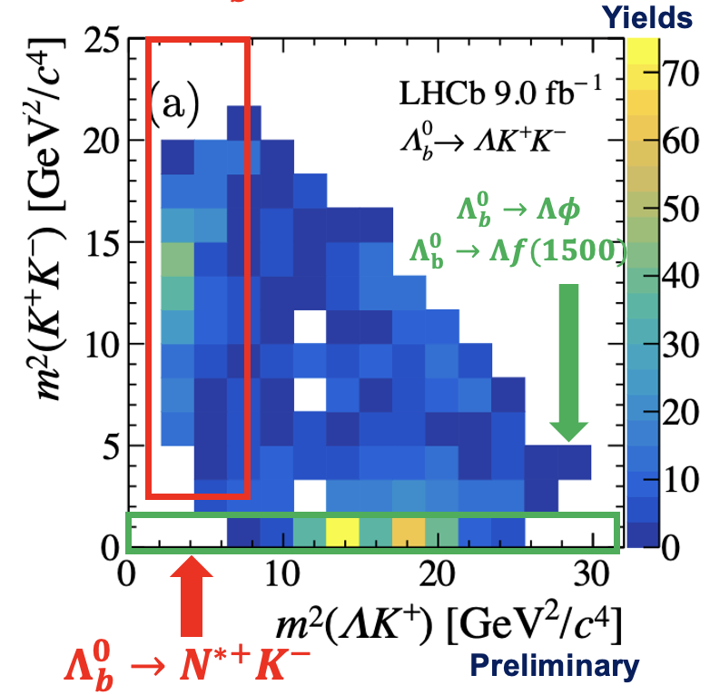
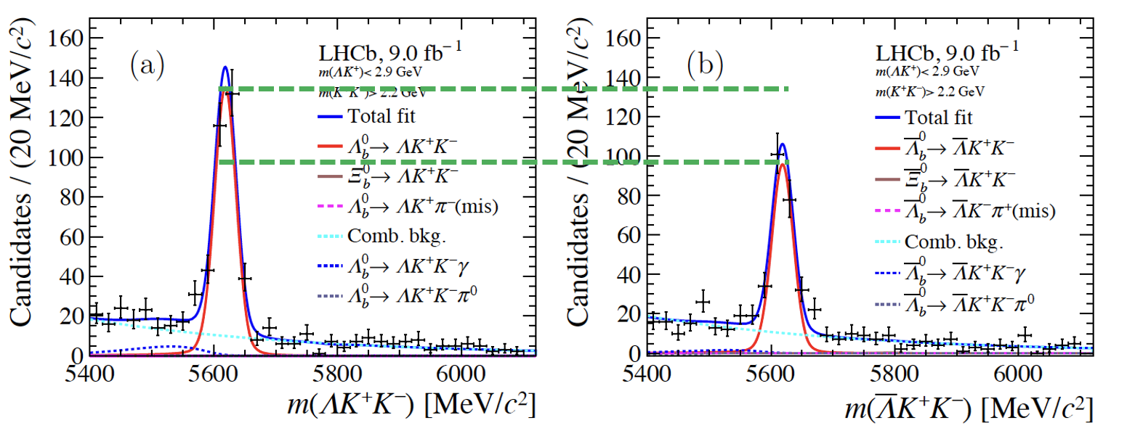
Looking into Dalitz plot ($Λ_{b}^{0}→ΛK^{+}K^{−}$)
LHCb-PAPER-2024-043
Preliminary
$$ΔA_{CP}(N^{∗+}K^{−})=0.165±0.048±0.017$$
First evidence of CP violation in local resonant region, 3.2$σ$
region
Consistent with 0 within 2.5$σ$
PRD107 (2023) 053009
$$ΔA_{CP}(Λφ)=0.150±0.055±0.021$$
Predicted CPV (resonant), ~1.5%
2024/12/14
UCAS, Wenbin Qian
27

Slide 28
What if we find 5$σ$ CP violation in baryon?
Next question: is it SM?
2024/12/14
UCAS, Wenbin Qian
28

Slide 29
What if we find 5$σ$ CP violation in baryon?
Next question: is it SM?
Answer: measuring $γ$ in baryon decays
Already some interesting work by Q. Qin et. al., PRD108 (2023) L111901
2024/12/14
UCAS, Wenbin Qian
29

Slide 30
Outline of the talk
Introduction
Hadron physics
CKM physics
New physics hunting in flavor sector
Prospects and conclusion
Disclaimer: many interesting results, only a tiny fraction selected
2024/12/14
国科大 钱文斌

Slide 31
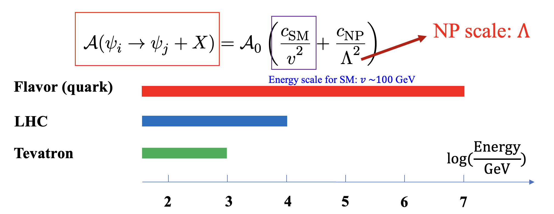
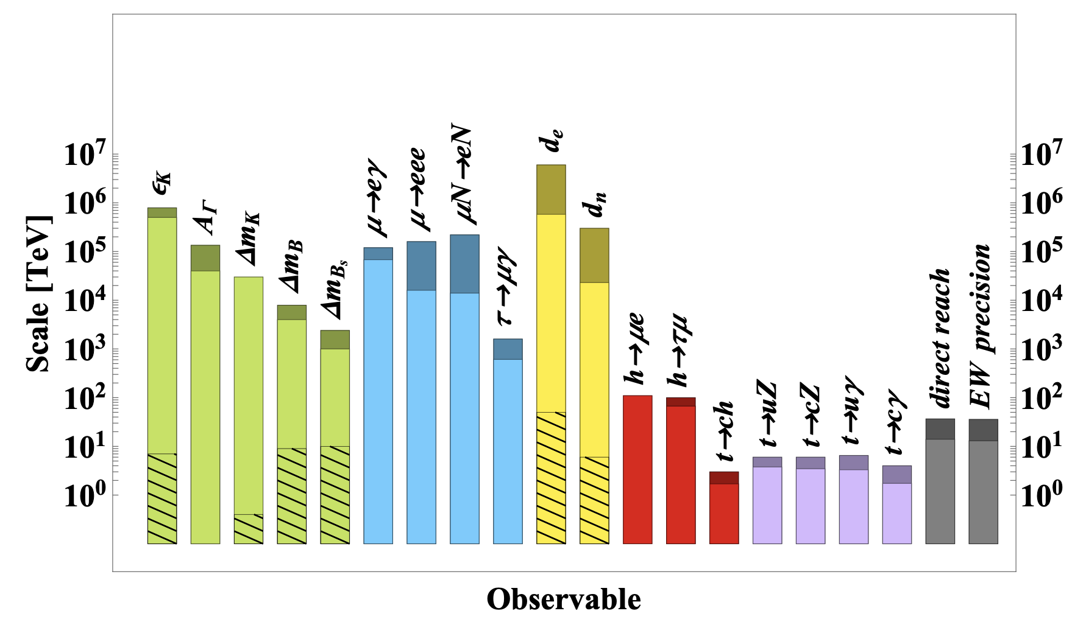
Precision measurements
arXiv:1910.11775
Sensitive to New Physics scale much higher than direct search: 1-10⁴ TeV
Statistics or precision is key for flavor program: New Physics scale, i.e. Dim = 6, $∝1/\sqrt{Uncertainty}$
Also “tasteful”, not only can tell there is New Physics, but also tell properties of New Physics based on flavor it couples to
2024/12/14
国科大 钱文斌
31

Slide 32
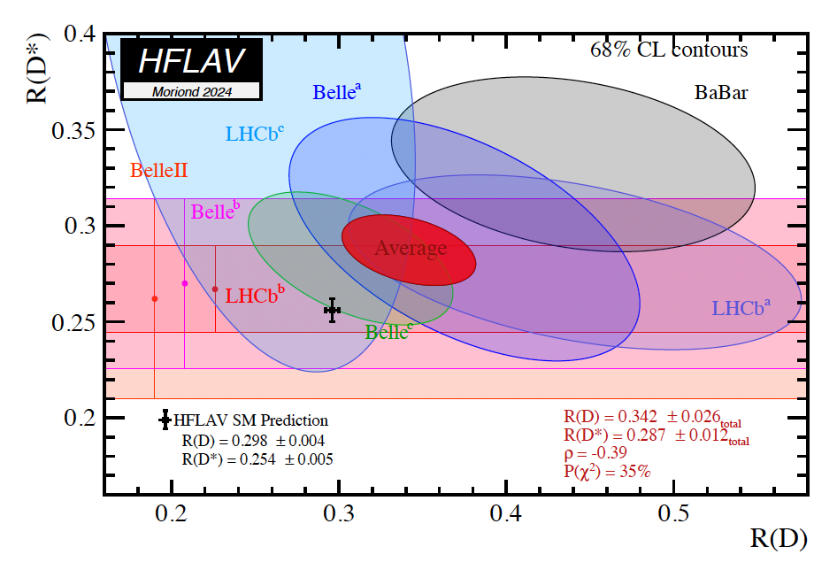
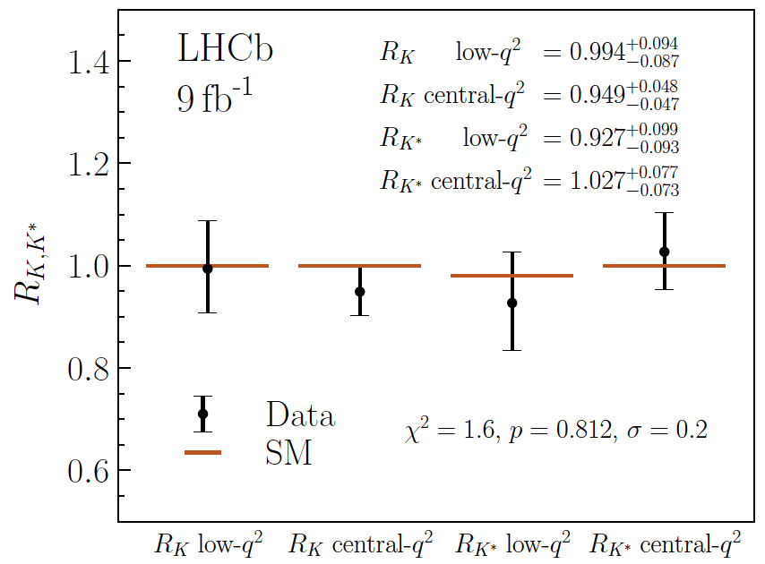
Flavor anomalies
$R\left(D\right)−R(D^{∗})$ anomaly: new physics at tree level?
$R\left(K\right)−R(K^{∗})$ anomaly: new physics at loop level?
$$R\left(D^{(∗)}\right)= \frac{ℬ(B→D^{(∗)−}τ^{+}ν_{τ})}{ℬ(B→D^{(∗)−}l^{+}ν_{l})}$$
$$R\left(K,K^{∗}\right)= \frac{ℬ(B→K^{\left(∗\right)}μ^{+}μ^{−})}{ℬ(B→K^{\left(∗\right)}e^{+}e^{−})}$$
LFU:$τ$ vs $e, μ$?
Deviation significance: 3.3$σ$
LFU violation between $e/μ$ now disappear!!!
Other $b→sl^{+}l^{−}$ measurements：still 2-3$σ$ deviation, new results consistent
Crucial: to understand charm loop contribution
2024/12/14
国科大 钱文斌
32

Slide 33
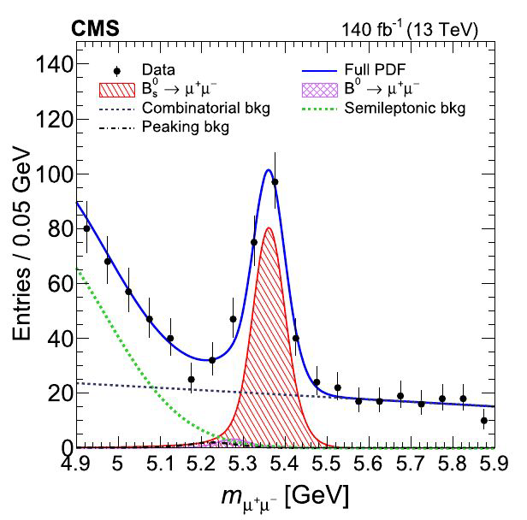
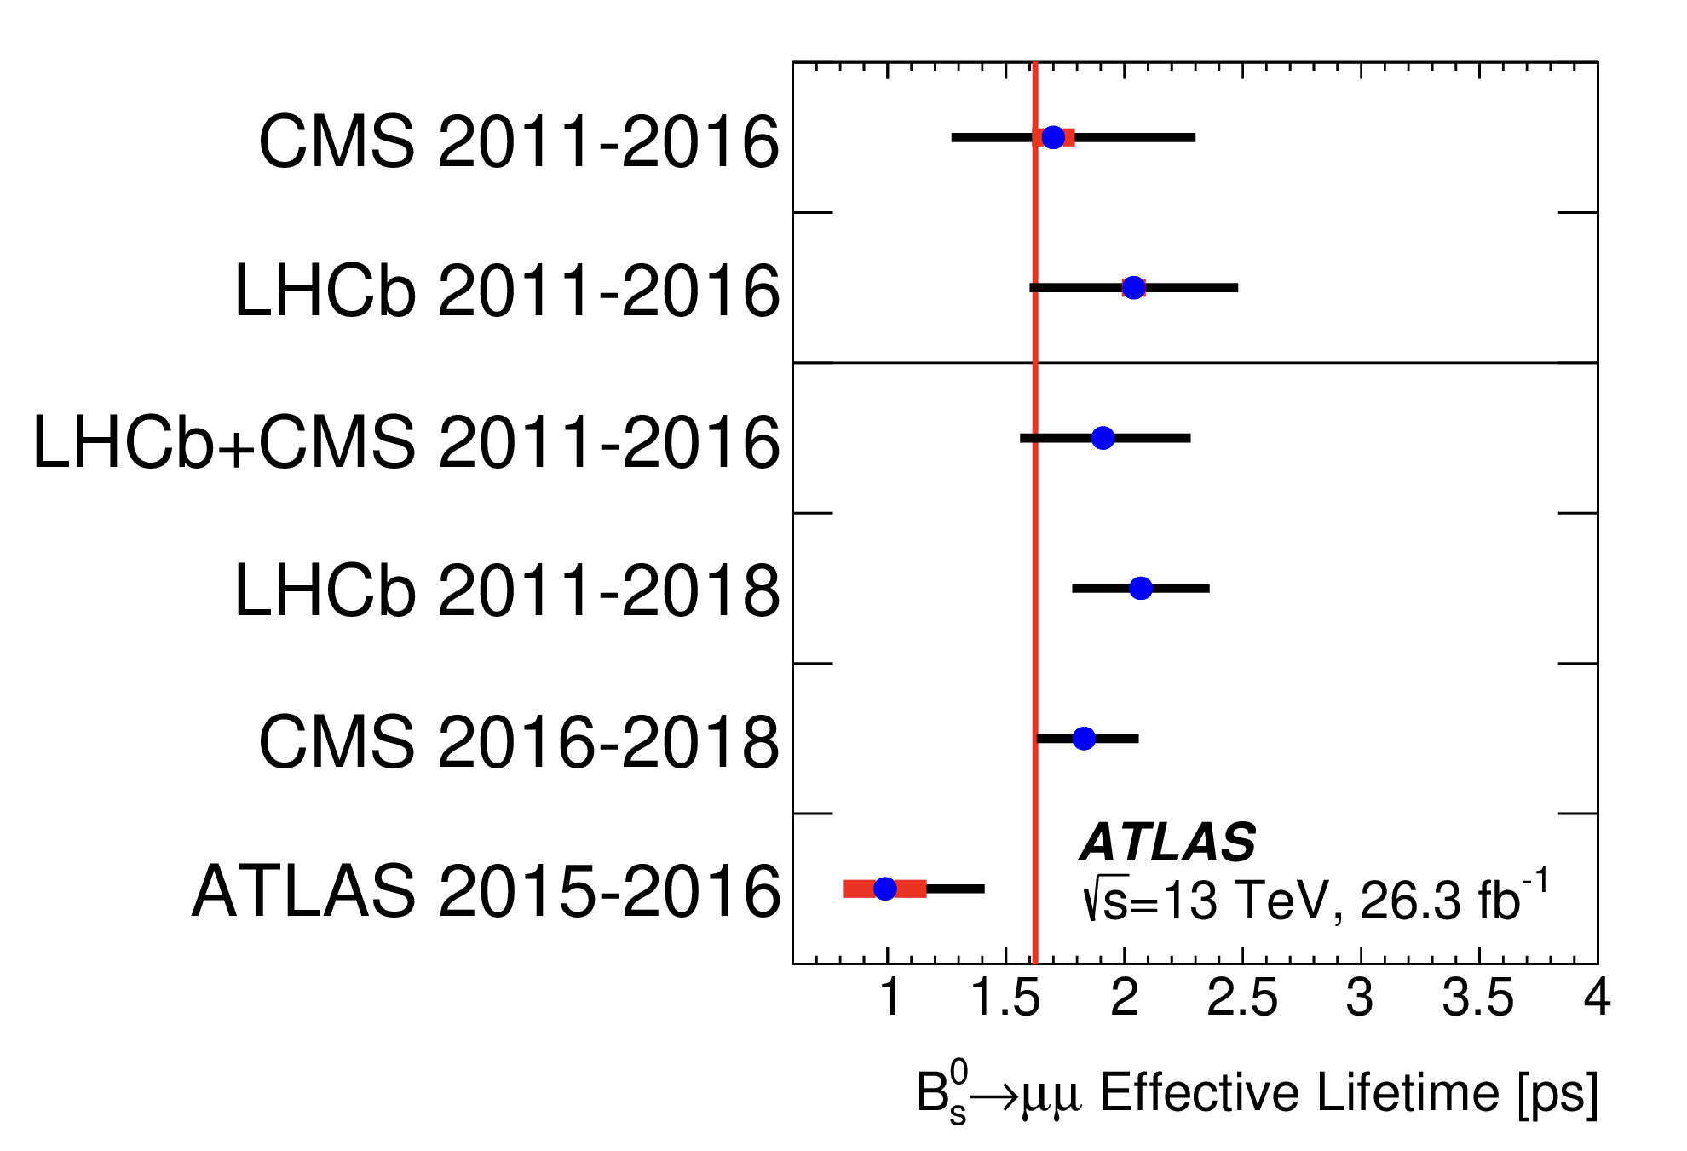
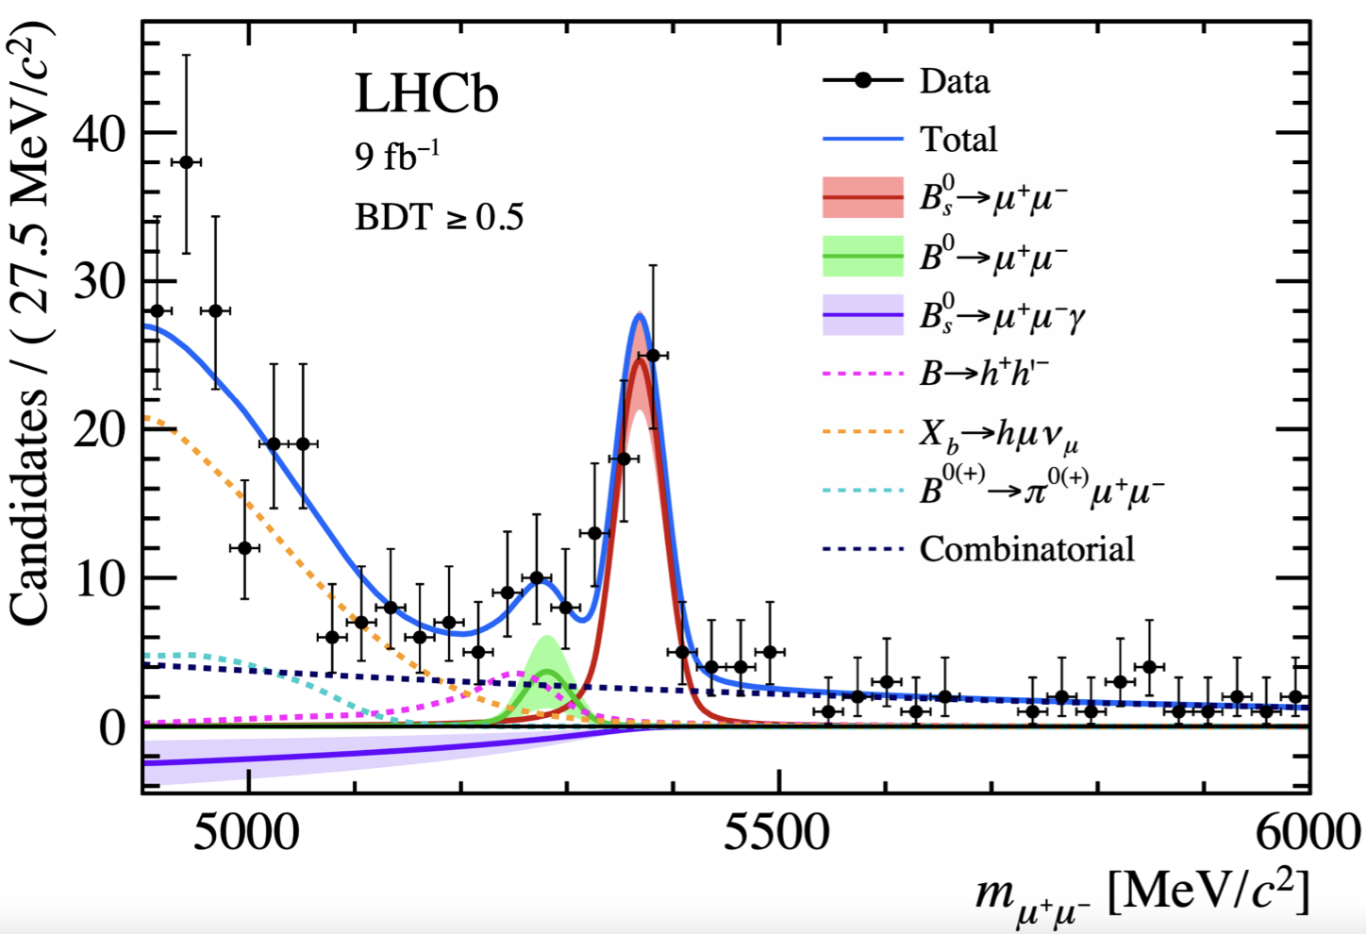
$$B_{s}^{0}→μ^{+}μ^{−}$$
PLB842(2023)137955
PRL128(2022)041801
CKM suppression + helicity suppression + loop at LO = golden mode for NP hunting
ATLAS, CMS and LHCb all join the game: branching fraction, lifetime etc.
NP may modify branching fractions
$𝓑\left(B_{s}^{0}→μ^{+}μ^{−}\right)=\left(3.34±0.27\right)×{10}^{−9}$ (Exp)
$=\left(3.66±0.14\right)×{10}^{−9}$ (SM)
Only heavier mass eigenstate $B_{s,H}$ decaying into $μ^{+}μ^{−}$, sensitive to NP with CP-even new particles
$1.624±0.009$ ps (SM)
lifetime
2024/12/14
国科大 钱文斌
33

Slide 34
Outline of the talk
Introduction
Hadron physics
CKM physics
New physics hunting in flavor sector
Prosects and conclusion
2024/12/14
国科大 钱文斌

Slide 35
Prospects
Belle II
0.4 ab⁻¹
15 ab⁻¹
50 ab⁻¹
250 ab⁻¹
2019-2022
2024-2027
Run 1
LS1
Run 2
LS1
Run 3
upgrade
2015-2018
2019-2022
2022-2025
2025-2029
2029-2032
2032-2035
2035-future
Run2
LS2
Run3
LS3
Run4
LS4
Run5-6
Phase I
Upgrade
Phase Ib
Upgrade
Phase II
Upgrade
LHCb
23 fb⁻¹
50 fb⁻¹
300 fb⁻¹
HL-LHC
CMS/ATLAS
200 fb⁻¹
3000 fb⁻¹
BESIII/super $τ$-charm/CEPC
BEPCII upgrade + running of super $τ$-charm/CEPC
2024/12/14
国科大 钱文斌

Slide 36
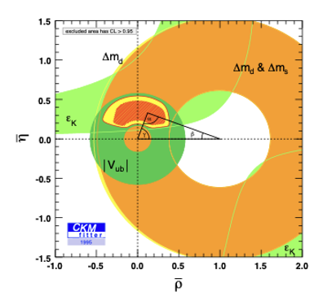
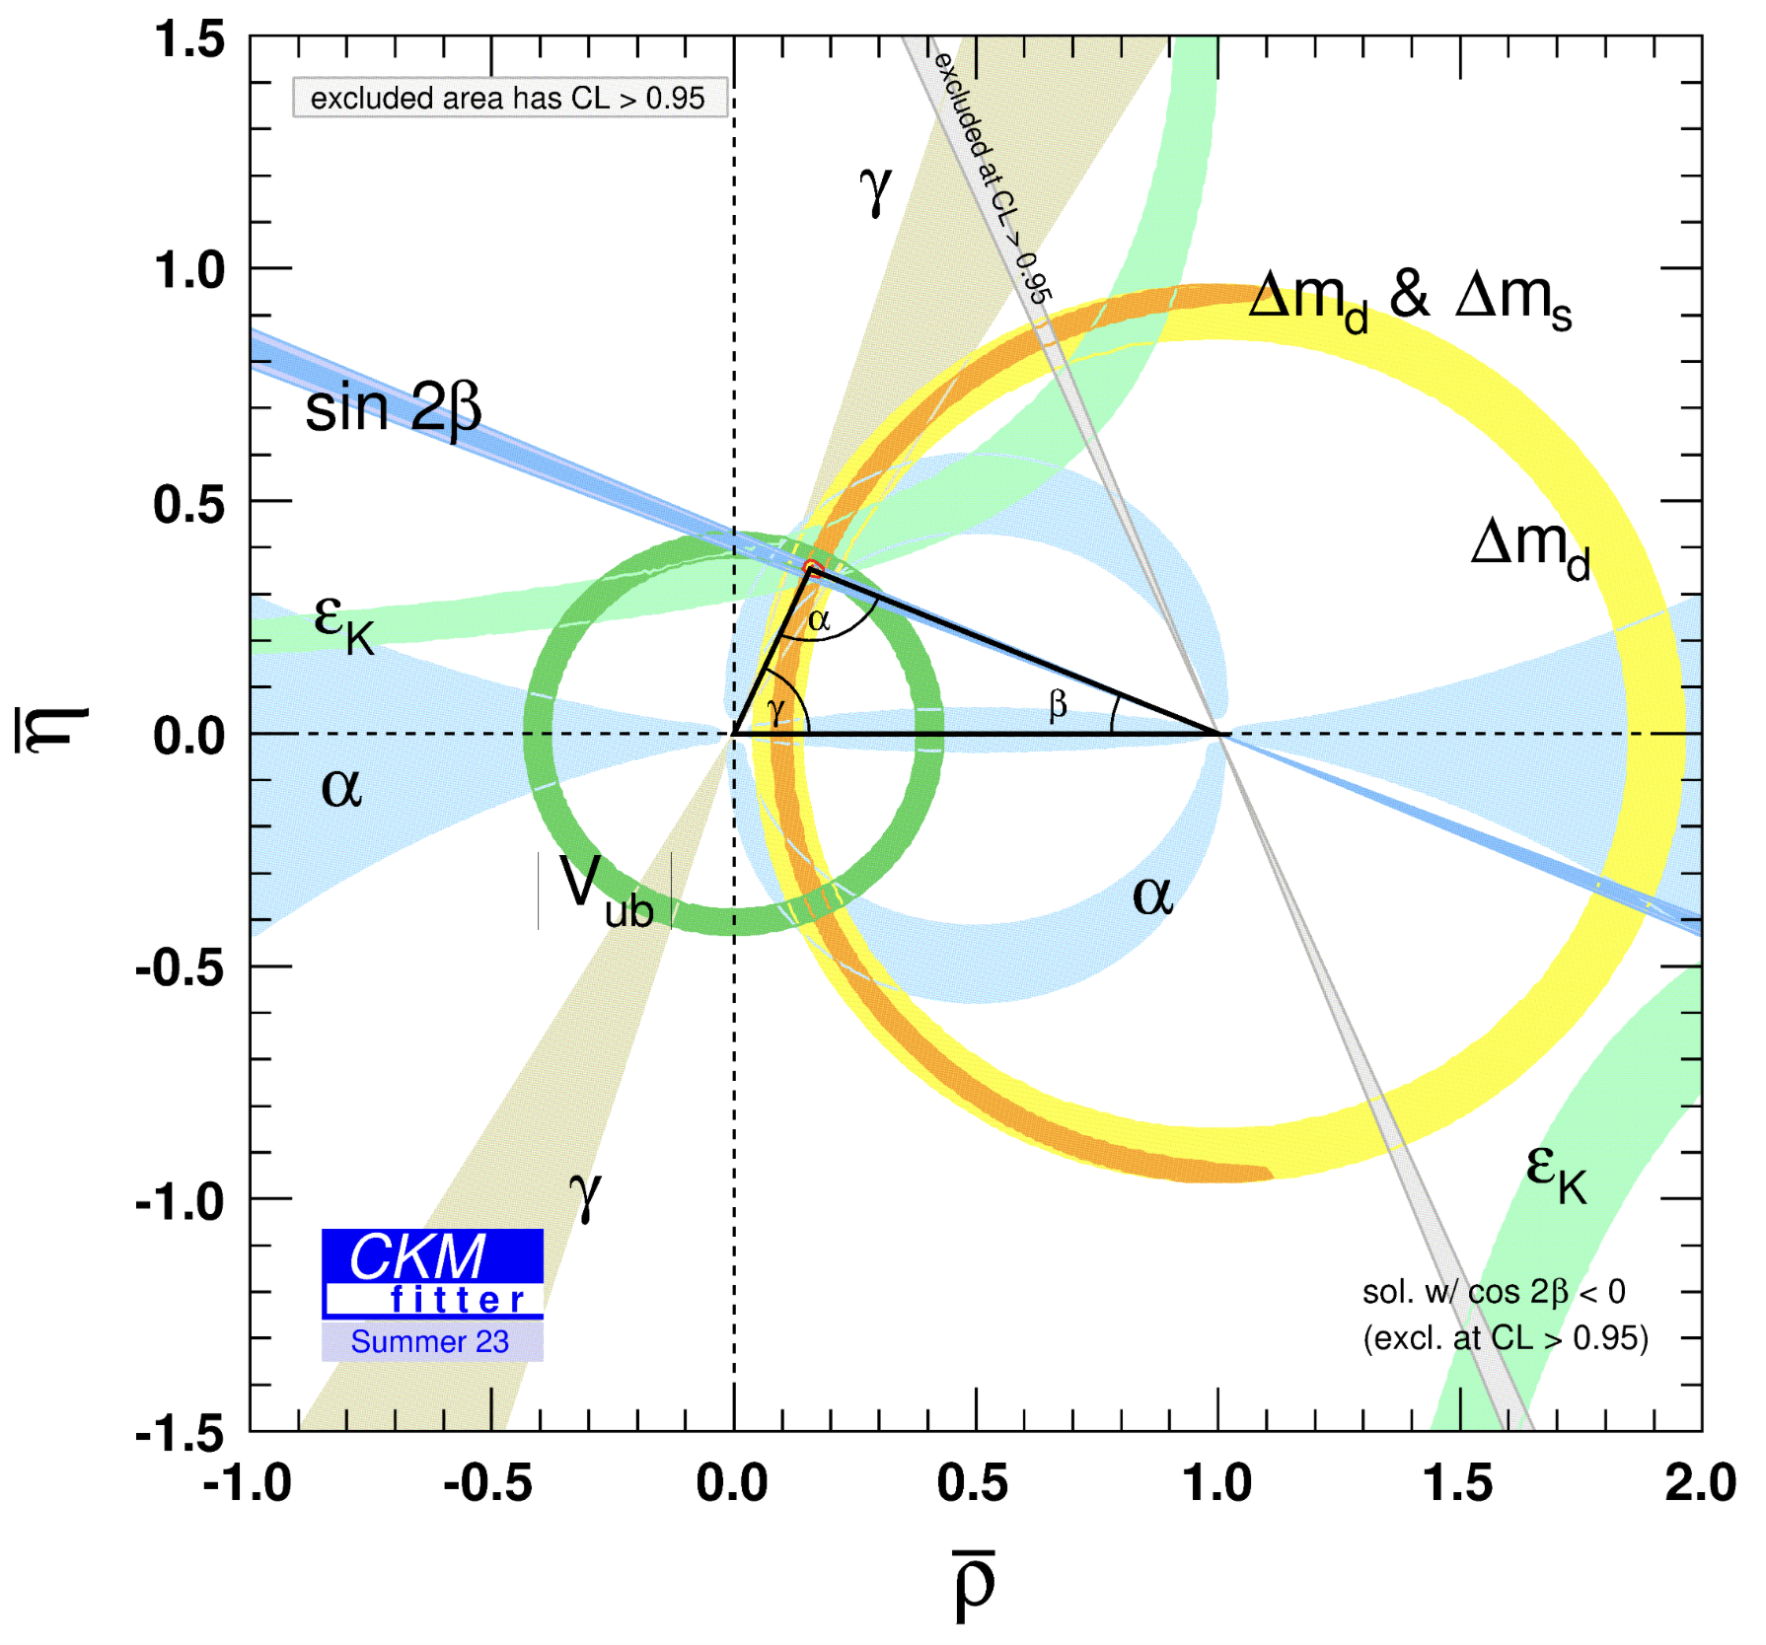
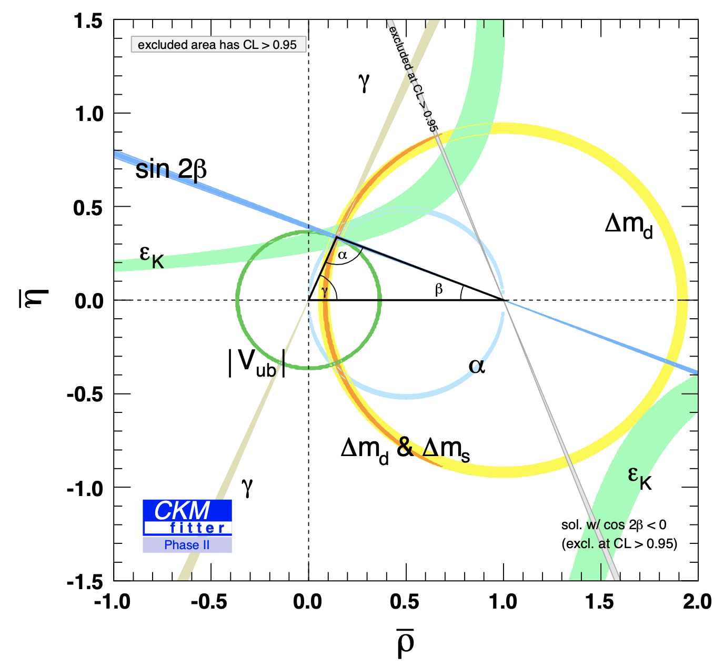
Future of flavor and hadron physics
1995
2023
2040?
Either we find NP, or we understand non-perturbative QCD
2024/12/14
国科大 钱文斌

Slide 37
Dr. Sai and others says future will be different!
Flavor experiments used AI in many aspects: flavor tagging, pattern recognition (reconstruction) and distinguishing background
Dr. Sai using AI (large language model) : publish physics results immediately after data-taking
Dr. Sai v1: http://drsai.ihep.ac.cn
Dr. Sai rediscovered $Z_{c}(3900)$ !
2024/12/14
国科大 钱文斌
37

Slide 38
Thank you for your attention!
2024/12/14
国科大 钱文斌
38

Slide 39
Open charmed exotics
PRD102(2020)112003
arXiv:2406.03156
arXiv:2405.00098
$T_{cs0}^{∗}{\left(2870\right)}^{0}$ and $T_{cs1}^{∗}{\left(2900\right)}^{0}$ with minimum quark content $cs\overline{d}\overline{u}$ seen first in $B^{+}→D^{+}D^{−}K^{+}$ decays; rediscovered in $B^{+}→D^{∗+}D^{−}K^{+}$ decays; $T_{cs1}^{∗}{\left(2900\right)}^{0}→D^{∗−}K^{+}$ not found yet
$T_{c\overline{s}0}^{∗}{\left(2900\right)}^{++}$ and its isospin partner $T_{c\overline{s}0}^{∗}{\left(2900\right)}^{0}$ with minimum quark content $c\overline{s}u\overline{d}$ and $c\overline{s}d\overline{u}$ seen first in $B^{+}→DD_{s}π$ decays; $T_{c\overline{s}0}^{∗}{\left(2900\right)}^{++}→D^{∗+}K^{+}$ not found yet
$$cs\overline{u}\overline{d}$$
$$B^{+}→D^{+}T_{cs}^{∗}$$
$c\overline{s}d\overline{u}$
$c\overline{s}u\overline{d}$
$B^{+}→D^{∗−}T_{c\overline{s}0}^{∗}{\left(2900\right)}^{++}$ not found yet
$$B^{+}→D^{∗+}T_{cs}^{∗}$$
$T_{cs1}^{∗}{\left(2900\right)}^{0}→D^{∗−}K^{+}$? ?
$T_{c\overline{s}0}^{∗}{\left(2900\right)}^{++}→D^{∗+}K^{+}$? ?
2024/12/14
国科大 钱文斌
39

Slide 40
21 years ago
First heavy exotic candidate containing $c\overline{c}$, $χ_{c1}(3872)$, opening a new field of research
In the same year, an open charmed exotic candidate, $D_{s0}^{∗}(2317)$, was also discovered
2562 citations
1002 citations
2024/12/14
国科大 钱文斌
40

Slide 41
CKM angle $γ$
Measured through $b→c$ and $b→u$ interference
$$γ$$
Tree level processes $→$ SM candle, NP normally enters loop diagrams
Loop level processes suppressed, theoretically clean, $δγ/γ$ ~ 10⁻⁷ (QCD free)
All QCD parameters (hard to calculate) obtained from experimental measurements (global fit)
2024/12/14
国科大 钱文斌
41

Slide 42
Typical example: $g−2$
PRL131(2023)161802
arXiv:2407.10913
Relative Precision
$$a_{μ}\left(FNAL\right)=116 592 055\left(24\right)×{10}^{−11}$$
$$𝓞(0.2 ppm)$$
Lepton properties, however, QCD still important (HVP, HLbL etc.)
Method developed to understand QCD (lattice, dispersive relationship)
$$+a_{μ}^{NP}$$
BESIII input
WIN-WIN SCENARIO
More in L.Y. Dai’s talk
2024/12/14
国科大 钱文斌
42

Slide 43
Importance of flavor and hadron physics
Three dedicated large detector experiments + many small experiments: flavor and hadron physics, key program of high energy physics
2024/12/14
国科大 钱文斌
43

Slide 44
Structure of $χ_{c1}(3872)$
Properties extensively studied, usually leading to different conclusions
Mass: very close to $D^{0}{\overline{D}}^{∗0}$, $m_{D^{0}}+m_{{\overline{D}}^{∗0}}−m_{χ_{c1}\left(3872\right)}=0.01±0.14$ MeV
Width: narrow width (0.1~1 MeV)
$J^{PC}$: $1^{++}$
Decay: $D^{0}{\overline{D}}^{∗0}$ (~35%), $J/ψω$ (~4%), $J/ψρ$ (~3%)
Production: $pp, p\overline{p}, B$ decays, $pP$b, PbPb
Molecular like
Charmonium like
$$c\overline{c}$$
+
$$c\overline{c}qq$$
+
$$cq$$
$$\overline{c}q$$
+
$$c\overline{c}$$
$$qq$$
$χ_{c1}(3872)$ =
Can we determine contributions of different components?
2024/12/14
国科大 钱文斌
44

Slide 45
LFV searches
No matter the results from LFU, still extremely important to search for LFV
Decay | Best upper limit (90% C.L.) | Experiment
$$μ^{+}→e^{+}γ$$ | $${3.1×10}^{−13}$$ | MEGII
$$μ^{−}N→e^{−}N$$ | $${7.0×10}^{−13}$$ | SINDRUM
$$τ^{+}→e^{+}γ$$ | $${3.3×10}^{−8}$$ | Babar
$$τ^{+}→μ^{+}γ$$ | $${4.2×10}^{−8}$$ | Belle
$$τ^{+}→l^{+}l^{−}{l′}^{+}$$ | $${(1.8\sim 2.7)×10}^{−8}$$ | Belle (II)
$$μ^{+}→{3e}^{+}$$ | $${1.0×10}^{−12}$$ | Mu3e
$$Z^{0}→e^{±}μ^{∓}$$ | $${7.5×10}^{−7}$$ | ATLAS
$$J/ψ→e^{±}τ^{∓}$$ | $${7.5×10}^{−8}$$ | BESIII
$$J/ψ→e^{±}μ^{∓}$$ | $${4.5×10}^{−9}$$ | BESIII
$$𝓑\left(μ^{+}→e^{+}γ\right)<{10}^{−54}$$
SM contributions negligible
Currently negative results
Future experiments from COMET, Mu2e, Mu3e, Belle II, LHCb, ATLAS, CMS and BESIII will further improve their strength to NP
More in X.Q. Hao’s talk
2024/12/14
国科大 钱文斌
45

Slide 46
Flavor anomalies: $b→sll$
arXiv:2405.17347
Other $b→sl^{+}l^{−}$ measurements： still 2-3$σ$ deviation, different experiments show consistent picture
$$H_{eff}\left(b→sll\right)∝C_{9}\left({\overline{S}}_{L}γ^{μ}b_{L}\right)\left(\overline{l}γ_{μ}l\right)+C_{10}\left({\overline{S}}_{L}γ^{μ}b_{L}\right)\left(\overline{l}γ_{μ}γ^{5}l\right)$$
$$H_{eff}\left(b→sγ^{∗}\right)∝C_{7}\left(\overline{s}σ_{μν}\left(m_{s}P_{L}+m_{b}P_{R}\right)b\right)F^{μν}$$
$$c_{i}=c_{i}^{SM}+c_{i}^{NP}+c_{i}^{Had.}$$
Crucial: to understand charm loop contribution
First analysis of $B^{0}→K^{∗0}μ^{+}μ^{−}$ parameterizing full q² in terms of Wilson coefficients, form factors and non-local contributions
Non-local contributions larger than assumed so far
Largest local deviation in $C_{9}$ at 2.1$σ$
Details see backup slides
2024/12/14
国科大 钱文斌
46

Slide 47
Flavor anomalies: $b→sν\overline{ν}$
$b→s$ anomaly: new physics in loop? A search for $B^{+}→K^{+}ν\overline{ν}$ from Belle II
inclusive tag
No hadronic uncertainties for charm annihilation
Sensitive to different Wilson coefficient
Evidence @ 3.5$σ$; higher than SM prediction, $(0.44±0.03)×10^{−5}$, by 2.7$σ$
$$H_{eff}\left(b→sν\overline{ν}\right)∝C_{L}\left({\overline{S}}_{L}γ^{μ}b_{L}\right)\left(\overline{ν}γ_{μ}\left(1−γ^{5}\right)ν\right)$$
$$𝓑\left(B^{+}→K^{+}ν\overline{ν}\right)=\left(2.3±{0.5}_{−0.4}^{+0.5}\right)×{10}^{−5}$$
More in X.B. Yuan’s talk
2024/12/14
国科大 钱文斌
47

Slide 48
CKM angle $α$
arXiv: 2402.17260
Isospin analysis of $B→ππ, B→ρπ$ and $B→ρρ$
Neutral particle involved, Belle II and LHCb complementary
Long waited branching fraction and $A_{CP}$ from Belle II on $B^{0}→π^{0}π^{0}$
VS
wrong tag
$$𝓑\left(B^{0}→π^{0}π^{0}\right)=\left(1.26±0.20±0.11\right)×{10}^{−6}$$
$$A_{CP}\left(B^{0}→π^{0}π^{0}\right)=0.06±0.30±0.06$$
$$ℬ\left(B^{0}→π^{0}π^{0}\right)=\left(1.59±0.26\right)×{10}^{−6}$$
$$A_{CP}\left(B^{0}→π^{0}π^{0}\right)=0.33±0.22$$
VS. world average
Branching fraction lower than WA, however still larger than pQCD and QCDF predictions
2024/12/14
国科大 钱文斌
48

Slide 49
$$\left|V_{ub}\right|, |V_{cb}|$$
Long standing tension: inclusive vs exclusive
New light shed on the issue:
inclusive
New exclusive measurements: Babar ($B→Dlν$) and Belle ($B→D^{∗}lν$) using full information
Babar: $\left|V_{cb}\right|=\left(41.1±1.2\right)×{10}^{−3}$
Belle: $\left|V_{cb}\right|=\left(41.0±0.7\right)×{10}^{−3}$
exclusive
Inclusive: $\left|V_{cb}\right|=\left(42.15±0.50\right)×{10}^{−3}$
Different form factor parameterizations (BGL and CLN) show consistent results
Simultaneous determination: inclusive and exclusive $|V_{ub}|$ using Belle data
Exclusive: $\left|V_{ub}\right|=\left(3.78±0.31\right)×{10}^{−3}$
Previous: $\left|V_{ub}\right|=\left(3.60±0.16\right)×{10}^{−3}$
Inclusive: $\left|V_{ub}\right|=\left(3.88±0.38\right)×{10}^{−3}$
Previous: $\left|V_{ub}\right|=\left(4.13±0.18\right)×{10}^{−3}$
Right direction towards solving the tension?
2024/12/14
国科大 钱文斌
49

Slide 50
Baryon states
LHC: massive production of mesons and baryons
beauty baryons (${ Ξ}_{b}^{∗−}$)
$$Ξ_{cc}^{++}$$
Charmed baryons ($Ω_{c}^{0}$)
pentaquark
Hypertriton: ${}_{Λ}^{3}{\overline{H}}$
pentaquark
2024/12/14
国科大 钱文斌
50

