Slide 1
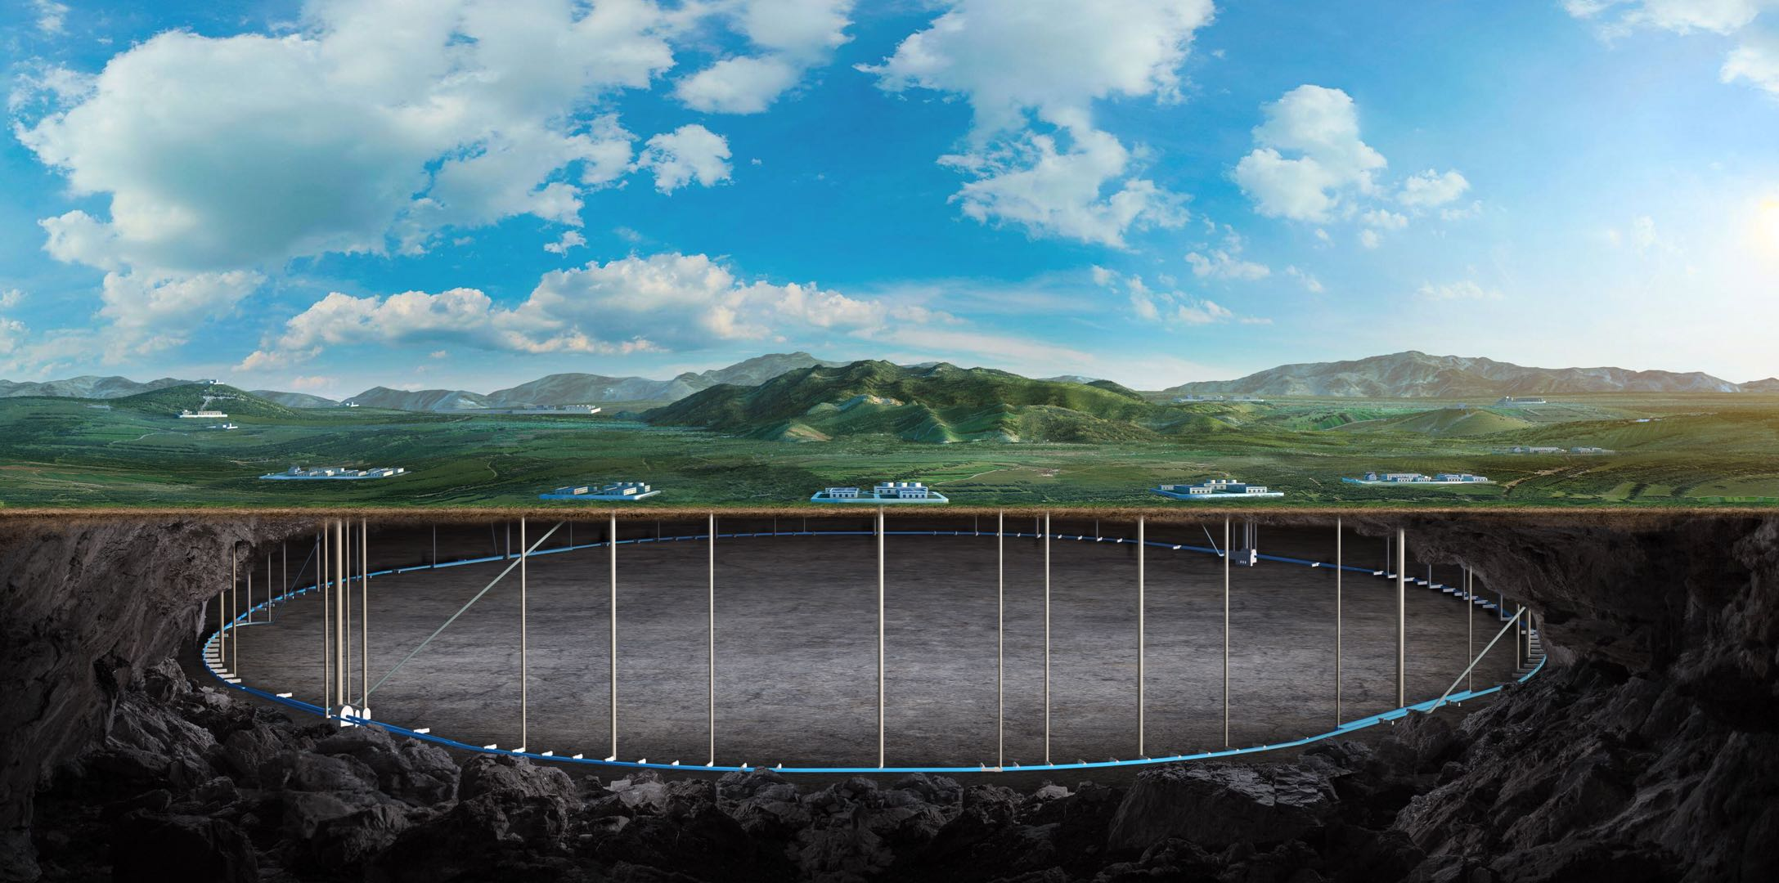
CEPC vertex Detector
Zhijun Liang
(On behalf of the CEPC physics and detector group)
Aug. 7th, 2024, CEPC Detector Ref-TDR Review

Slide 2
Vertex technologies: Cable and service
Refine the design for wire bonding and PCB

Slide 3
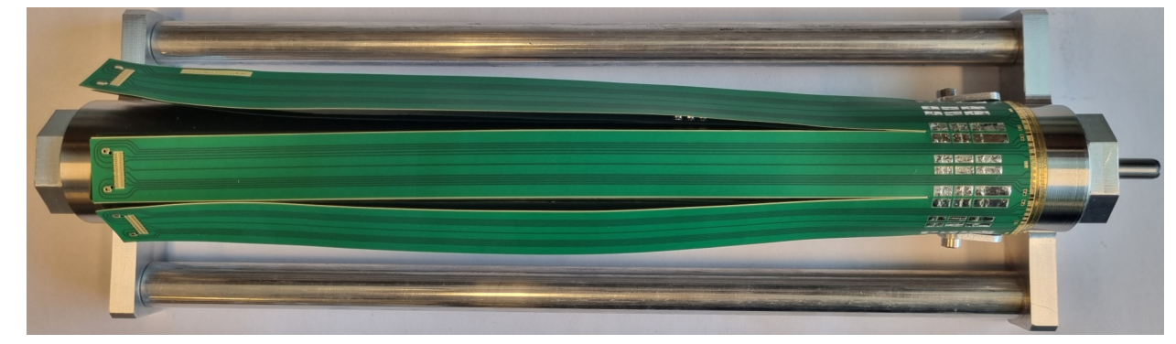
Vertex technologies: Cable and service
Refine the design space in MDI region for cable and service
All fast signal transferred into optical fiber in service region

Slide 4
International collaboration
Contacting with Jérôme Baudot, vertex group leader in IPHC/CNRS
Following the suggestion from Christine Hu
Invite Jérôme to join CEPC workshop 2024
will in-person offline discussion in PiXEL2024 in IPHC
A few talks about the CEPC vertex accepted in PIXEL2024 (Nov 18-22)

Slide 5
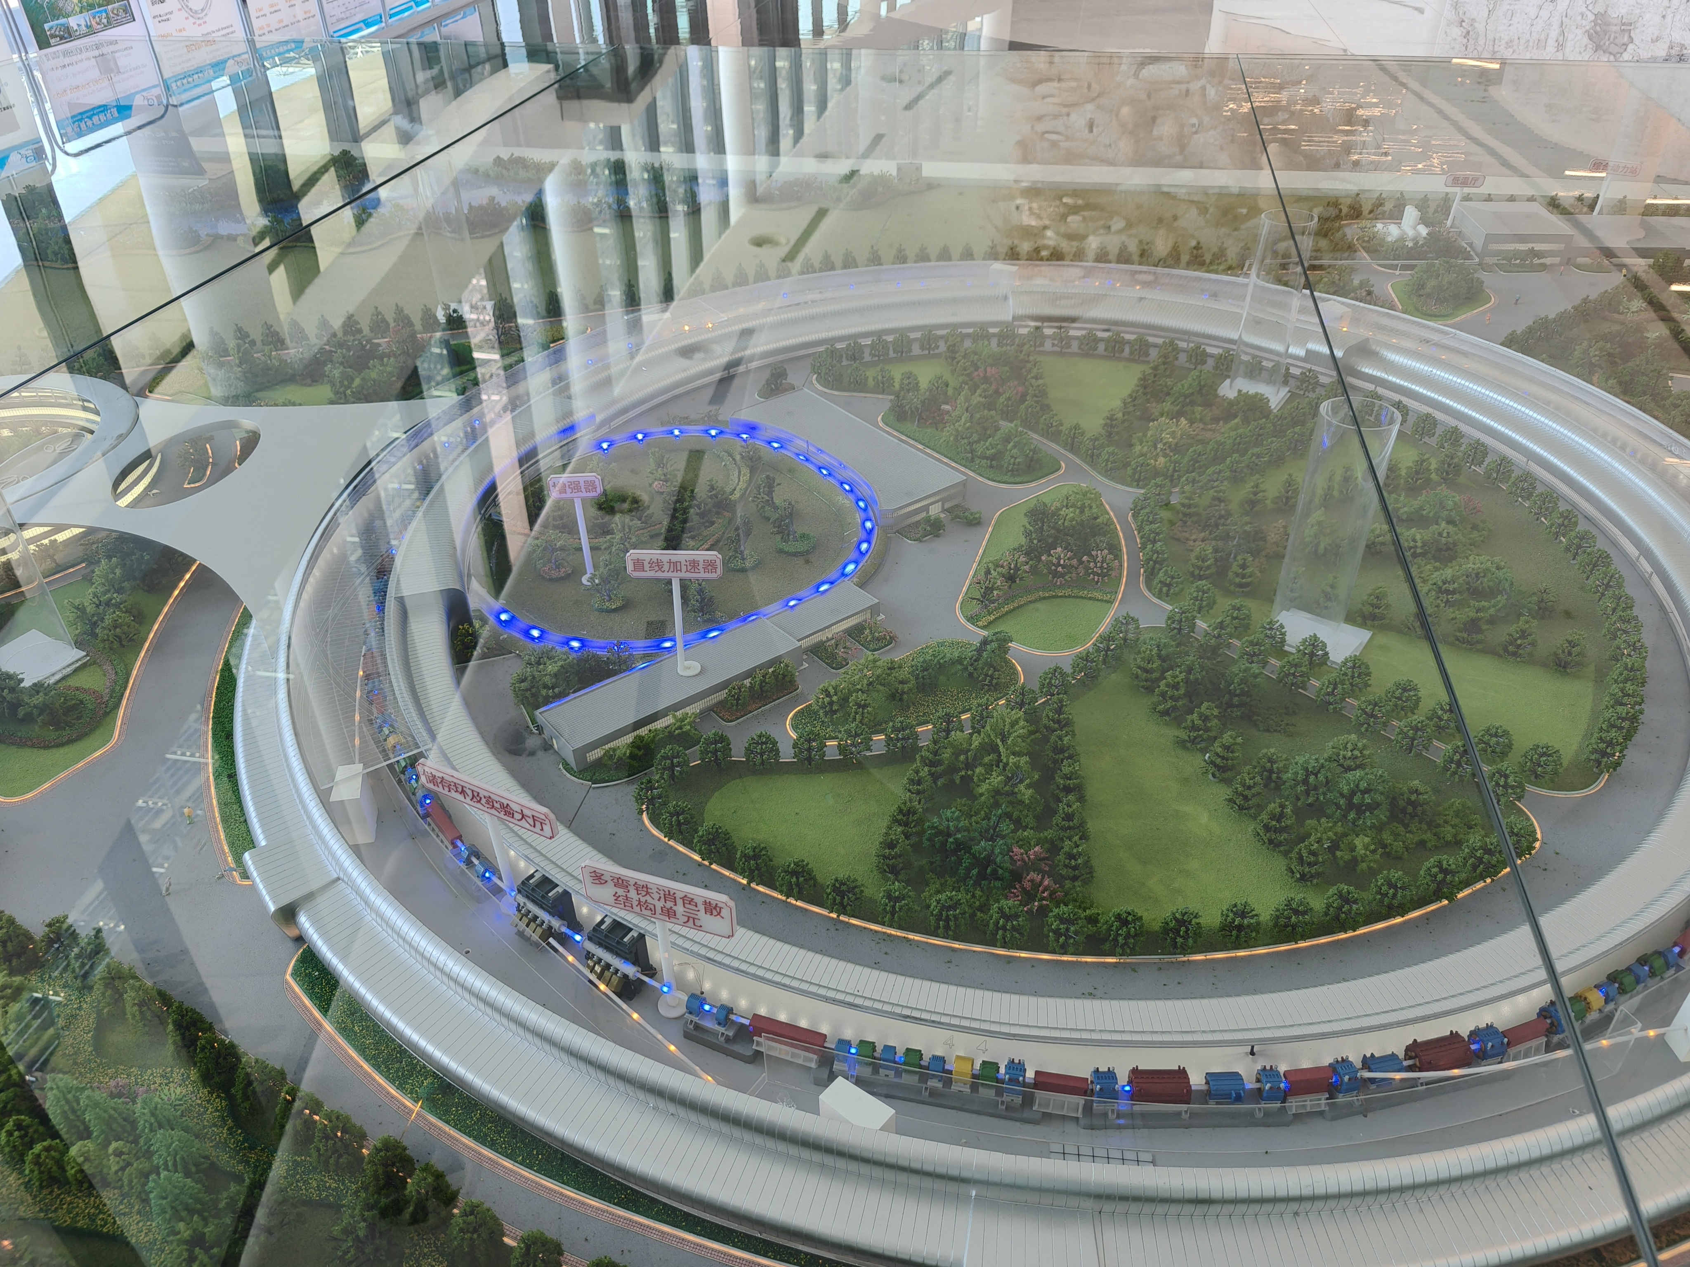
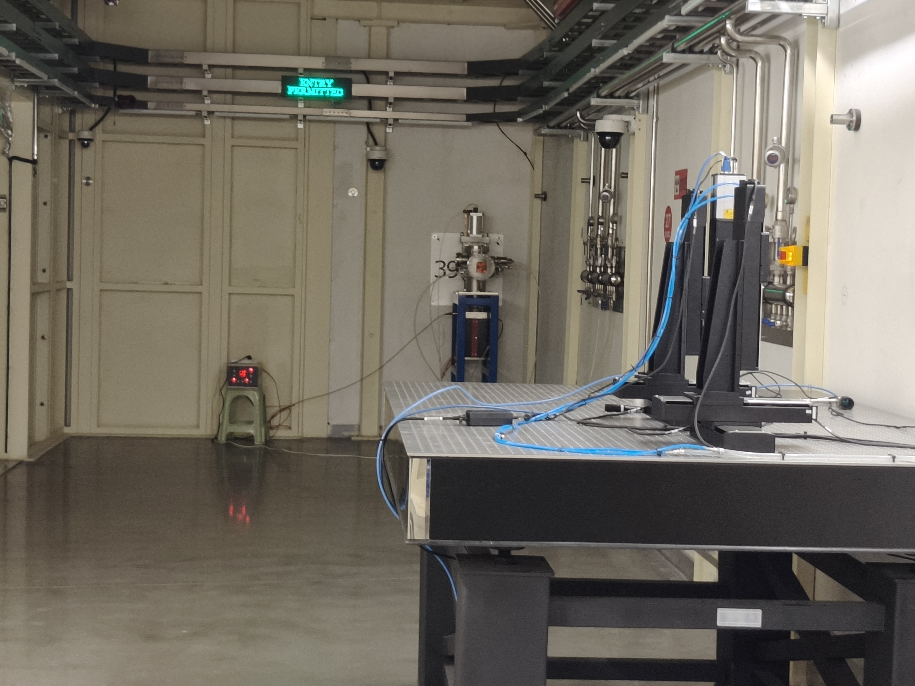
Testbeam @ HEPS
Discussed the testbeam@HEPS in CEPC day steering meeting
A visit to HEPS last Friday, Yuhui Li, Jianchun Wang, Zhijun Liang
Identified one station for testbeam for temporary solution (束测线站）
Long term solution could be building testbeam hall in booster (HEPS2)

Slide 6
Backup

Slide 7
df

