Slide 1
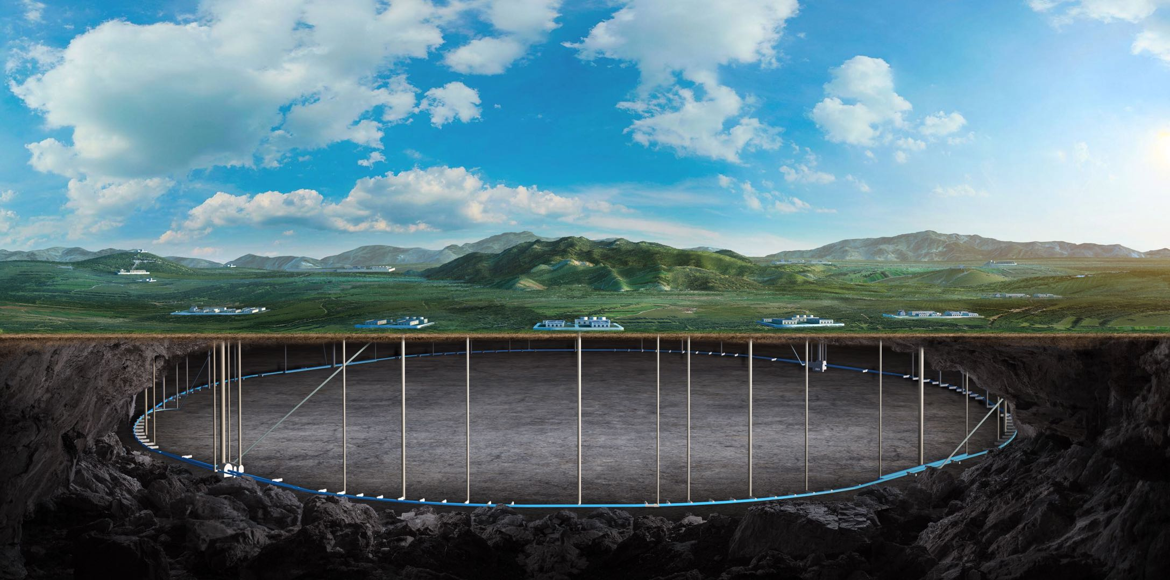
CEPC Detector Magnet
Feipeng Ning
On behalf of SC magnet Team

Slide 2
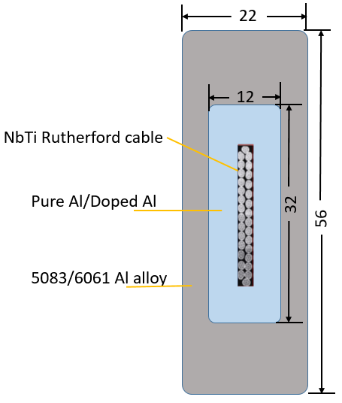
Optimize the physical design of the magnet
Optimize the physical design of the magnet
电缆结构与材料参数
电缆结构：
铌钛/铜卢瑟福电缆：2.2mm*20.5mm
中间稳定体（纯铝/掺杂铝）：12mm*32mm
加强结构（铝合金）与电缆整体：22mm*56mm
 | 纯铝 | 掺杂铝 | 铌钛超导 复合线 | 铝合金
屈服强度@4.2K | ~40 MPa | 105 MPa | > 800 MPa | >500 MPa

Slide 3
Optimize the physical design of the magnet
降温至4.2K，励磁3T，变形情况
径向 14.21mm
轴向 20.9 mm
总变形 24.8mm

Slide 4
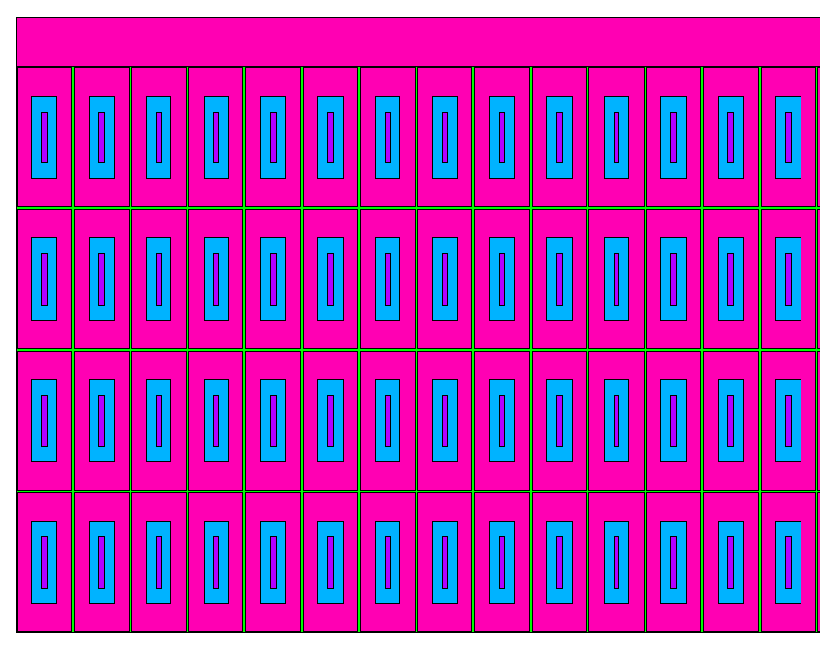
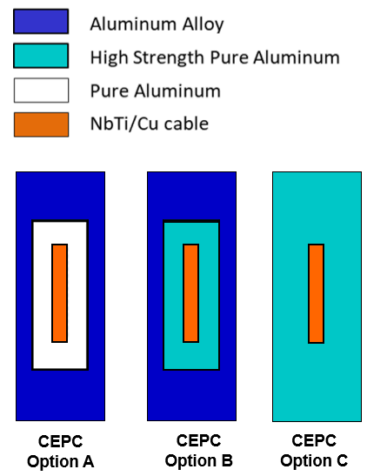
Optimize the physical design of the magnet
Optimize the physical design of the magnet
 | Option A |  | Option B |  | Option C
 | 应力 | 应变 | 应力 | 应变 | 应力 | 应变
铝稳定体 | 46.2MPa | 3.68‰ | 102 MPa | 2.28‰ | 103 MPa | 2.58‰
铌钛 | 184MPa | 1.41‰ | 223 MPa | 1.71‰ | 288 MPa | 2.21‰
加强铝 | 117MPa | 1.51‰ | 125MPa | 1.68‰ | - | -
绝缘（剪切） | 15.2MPa | 8.26‰ | 13.6 MPa | 6‰ | 14.2 MPa | 8‰
绝缘（等效） | 66.5MPa |  | 50.1 MPa |  | 66 MPa
支撑筒 | 116MPa | 1.50 | 105 |  | 126 MPa | 1.63‰
总变形 | 23.76 |  | 24.68 mm |  | 24.82 mm
Coil structure：

Slide 5
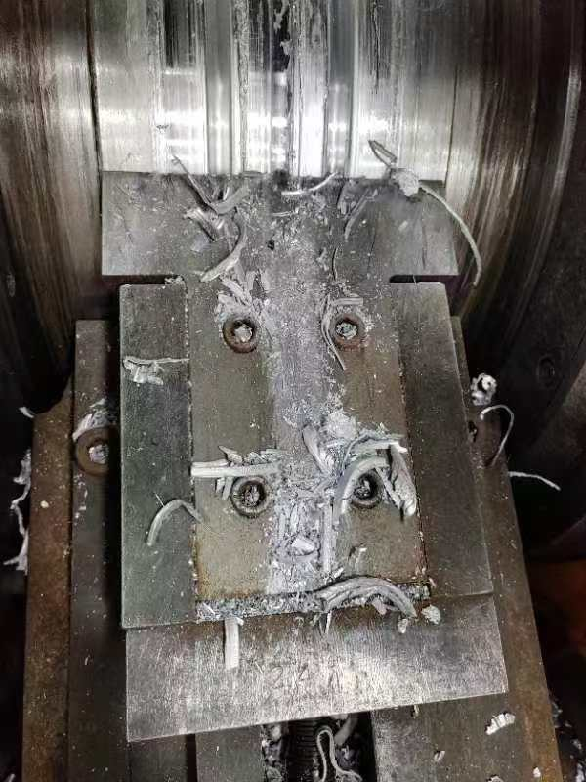
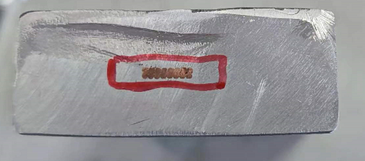
Optimize the physical design of the magnet
Optimize the physical design of the magnet
Conductor structure：

Slide 6
Optimize the physical design of the magnet
Optimize the physical design of the magnet
电缆结构：
铌钛/铜卢瑟福电缆：2.2mm*20.5mm
电缆整体尺寸：22mm*70mm/28mm*55mm
结论：电缆变窄长，整体应力更小
Material | 22mm*70mm | 28mm*55mm (n=552，Iop= 21.8kA)
Coil at 4.2 K
Aluminum | 54.9-94.3 | 54.3-95.6
SC cable | 189-246 | 190-248
Al alloy support | 3.3-24.4 | 3.27-24.7
Coil at 4.2 K, energized
Aluminum | 46.4-102 | 58.3-103
SC cable | 78.4-212 | 88.9-243
Al alloy support | 45.9-101 | 58.9-152
22mm*56mm
22mm*70mm
28mm*55mm

Slide 7
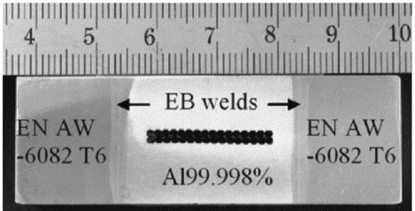
Optimize the physical design of the magnet
Further optimize the conductor structure, reduce the stress on the stabilizer.
Change the cross section of the conductor
Higher strength Al stabilizer development
Change the conductor structure
Finish the physical design before October
研究一个工艺简单，成本低的电缆结构
CMS超导电缆结构示意图，21.6*64mm²

Slide 8
Thank you for your attention!

