Slide 1
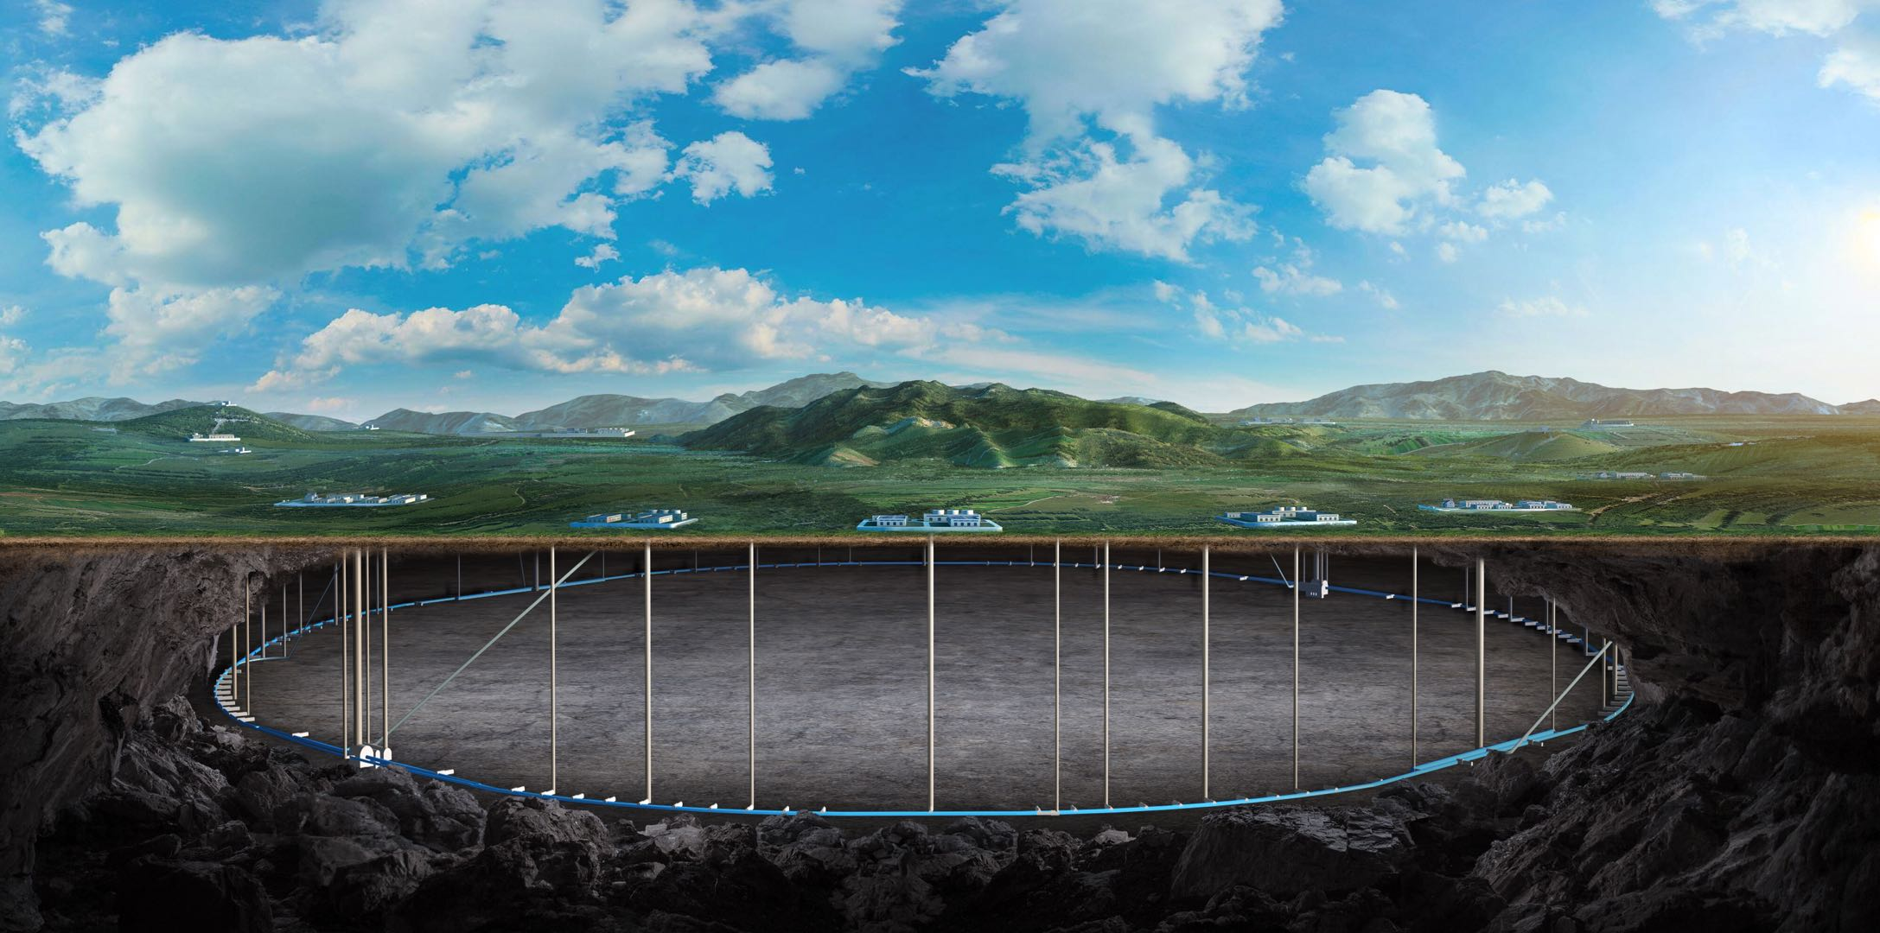
Progress of CEPC ref-TDR TDAQ
Fei Li, Jingzhou Zhao and Xiaolu Ji
On behalf of CEPC TDAQ Group
Sep. 3rd, 2024, CEPC Detector Ref-TDR Meeting

Slide 2
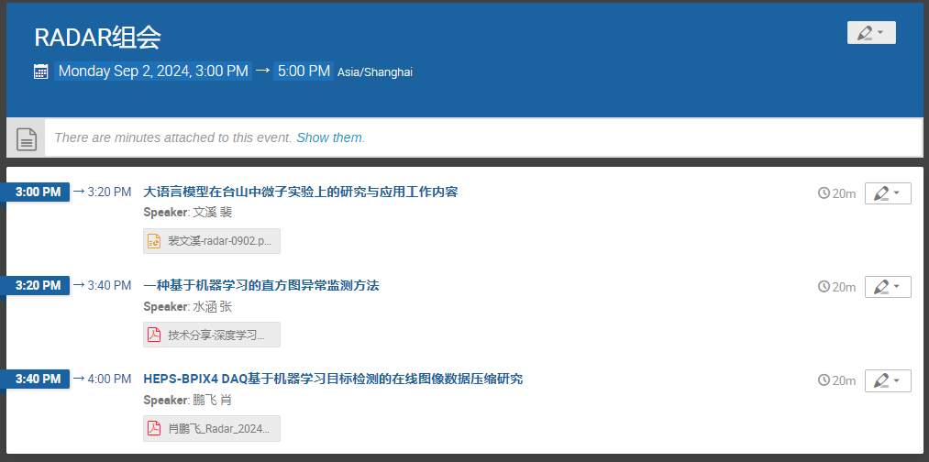
Progress of TDAQ
RADAR software bi-weekly meeting(Mon. afternoon)
2024.9.2
LLM application for chatTAO
ML for histogram anomaly detection
ML for online data compression
Oct. workshop talk plan
Plan: 3 IHEP + 3 China
Abstract: 2 talks+ 2 posters
Try to invite from ATLAS/LHCb
Project/refTDR (Thu. Afternoon)
Simulation/ L1 trigger system size assessment
IDRC: DAQ/triggering/tracking, Colin Gay, UBC,Canada
Kai chen help to invite ATLAS talk

