Slide 1
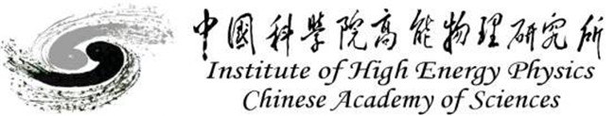
Challenge Gravitational Wave Measurement with a Novel Mössbauer Spectrometer
Huaqiao ZHANG (IHEP)
张华桥 （高能所）
collaborate with Yu Gao(IHEP), Wei Xu (IHEP)
Science Bulletin 2024; 69(18): 2795-2798
10.1016/j.scib.2024.07.038

Slide 2
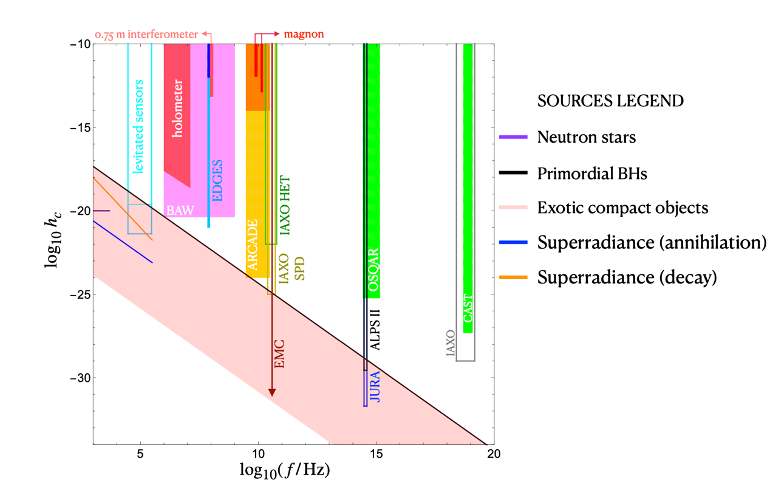
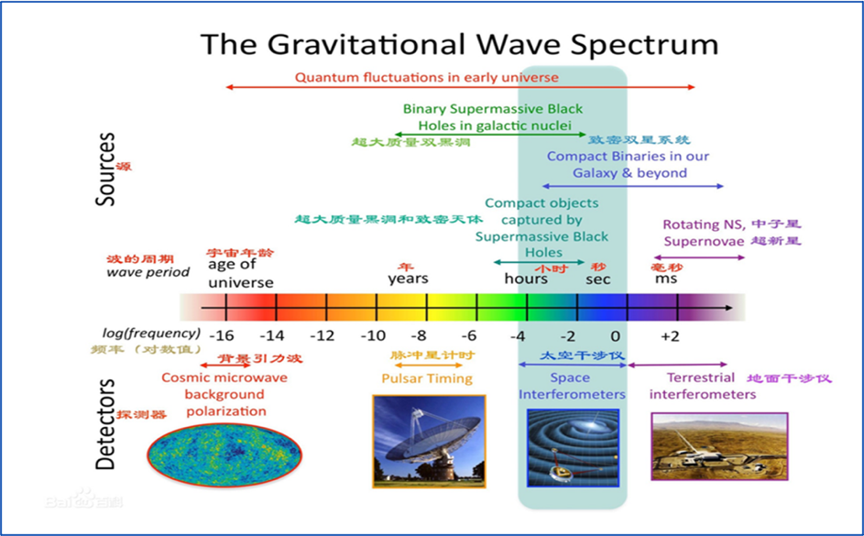
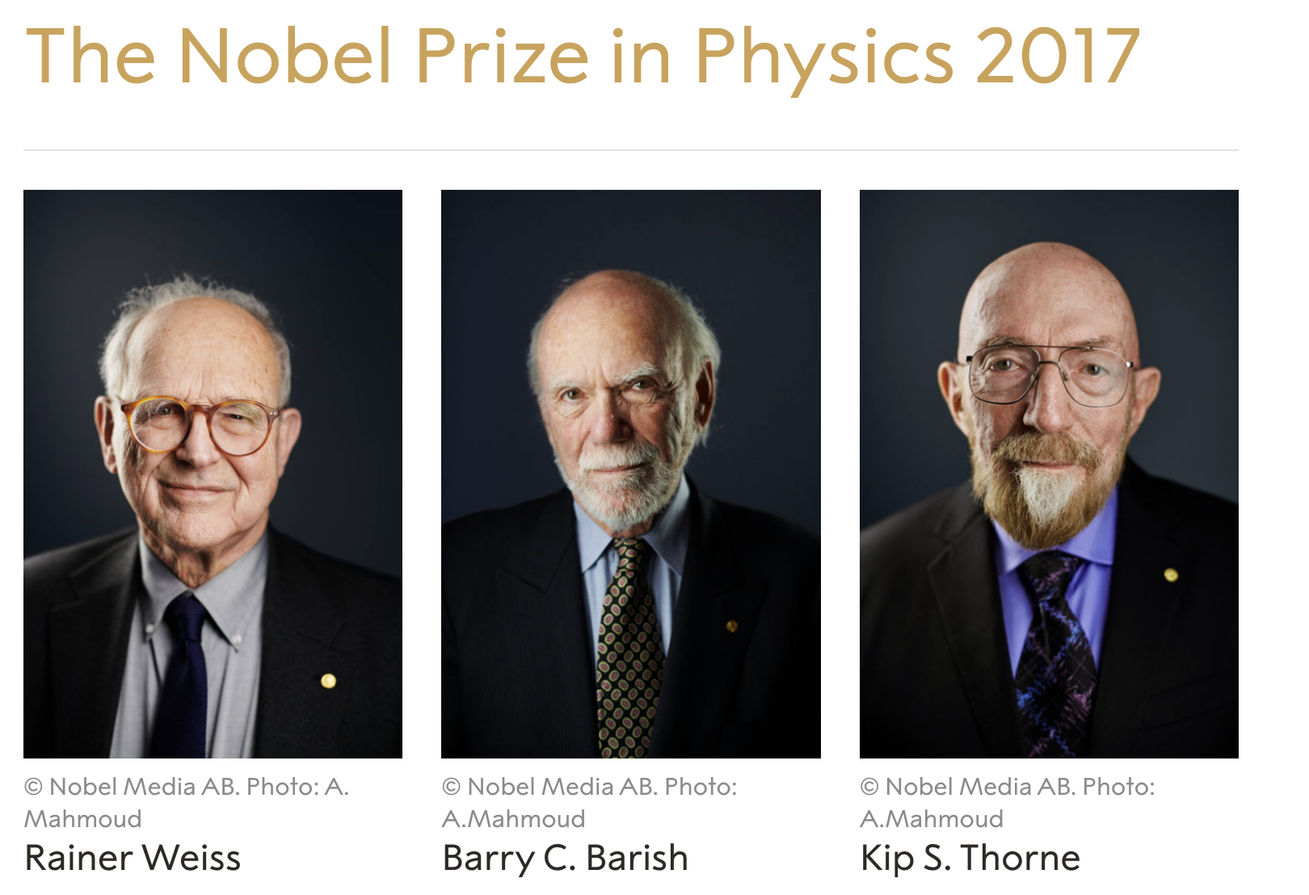
Gravitational Wave
GW： a new way to explore our universe
原初黑洞…
国内实验
阿里
PTA
(Fast)
太极，天琴
微波背景涨落
计数频率变化
激光干涉
原子干涉
Thickness of a paper over the diameter of solar system

Slide 3
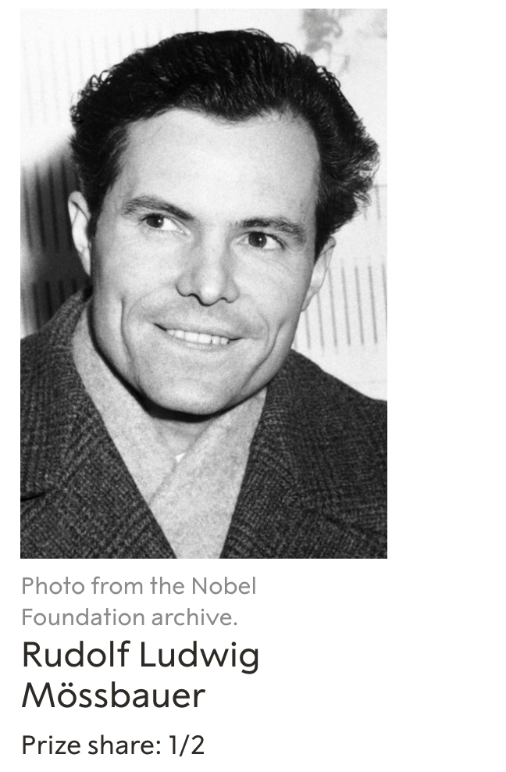

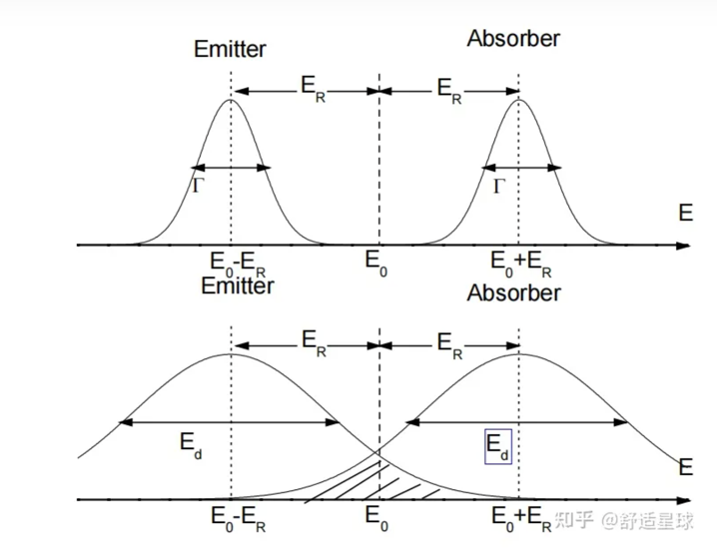
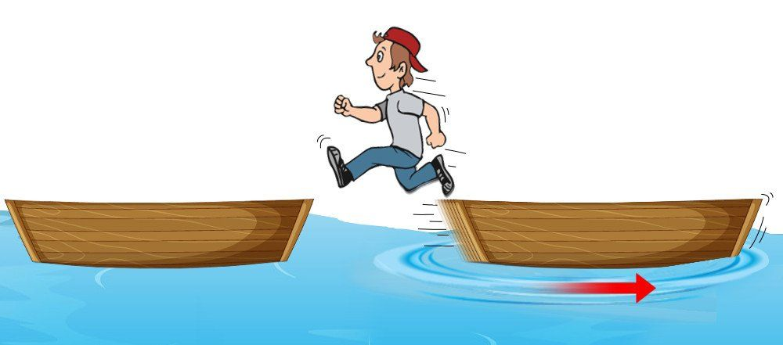
Mössbauer effect
Recoil-less emission and resonant absorption of nuclear transition photons
  Mössbauer active nucleus bound to solid state lattice
  Thermal vibration(~10¹³ Hz) much faster than nuclear transitions (lifetime ~>10⁻⁷ s)
    Effect averages to zero, no 1st Doppler broadening
    Recoil to the whole crystallite(>10¹⁴ atom)
    Without phonon excitations➔ recoil free
1961
recoil
"for his researches concerning the resonance absorption of gamma radiation and his discovery in this connection of the effect which bears his name"
Fine tune
Solid, liquid, gas

Slide 4
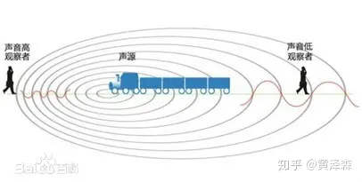
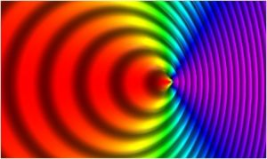
Doppler shift
Sound
Photon： E=hv
Red shift
Notes:
精密移动探针，来测量极小的能量变化

Slide 5
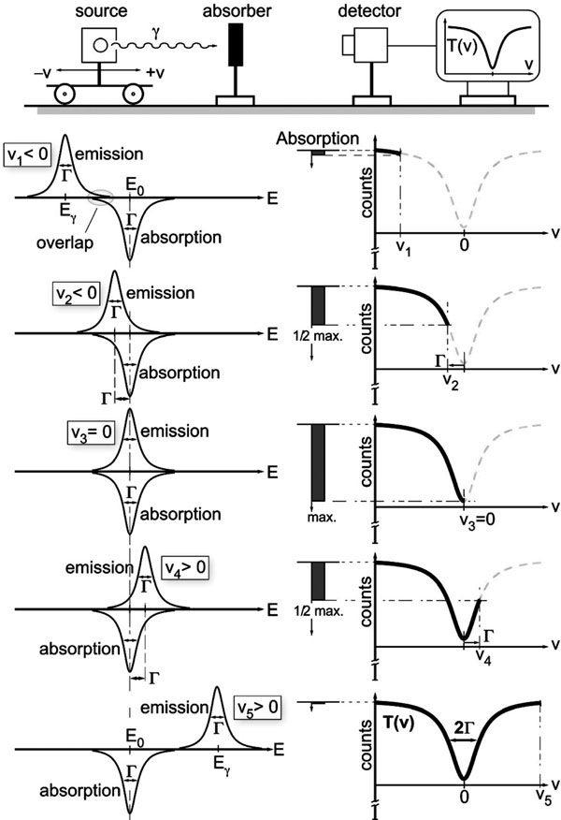
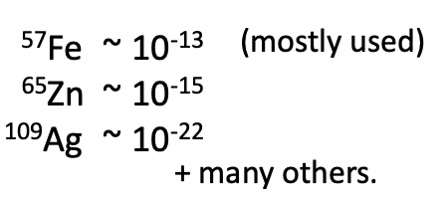
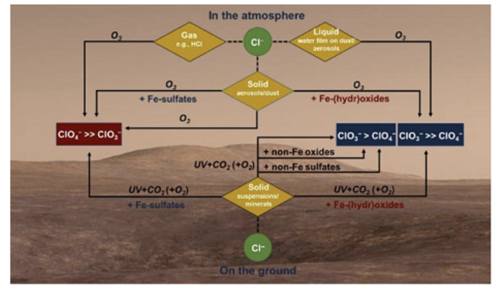
“Traditional” Mössbauer Spectrometer
Change the recoil-less emission and absorption overlap with doppler effects
Strength of recoilless nuclear resonant absorption as determined by the “overlap” of emission and absorption lines when the emission line is shifted by Doppler modulation
High accuracy of the resonant absorption width w.r.t. photon energy
Widely used in material analysis
Ex: mars
Notes:
穆斯堡尔谱仪原理
源，吸收体，计数探测器，运动控制： 简单可靠，精度高，灵敏度高

Slide 6
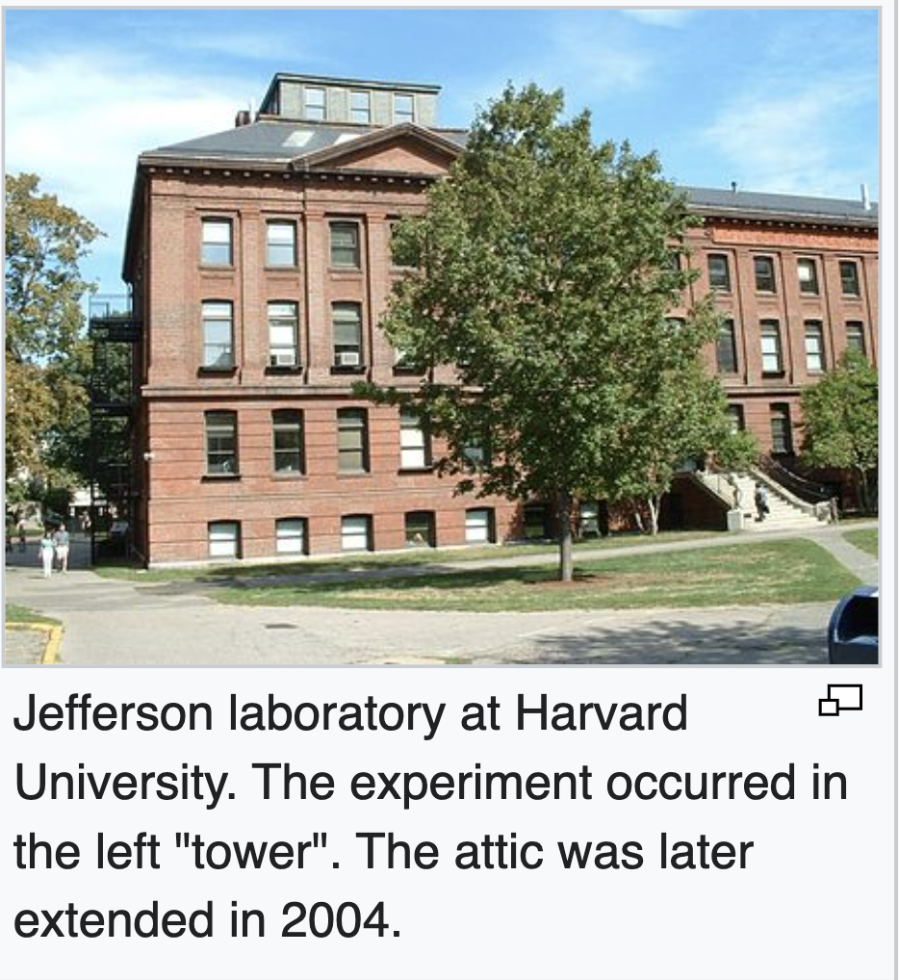
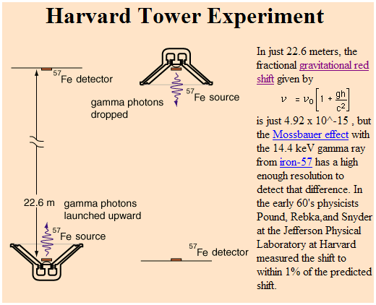

Relativity test with Mössbauer effect
Gravitational redshift test with Mössbauer effect
Pound, Rebka & Snyder (1960-1965)
Observation of a height-induced frequency shift
$ghc^{−2}\sim 4.92×{10}^{−15}$
Notes:
非常高精度测量：
QED 目前也只是在13个数量级中检验了其精度

Slide 7
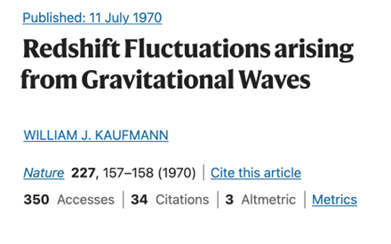
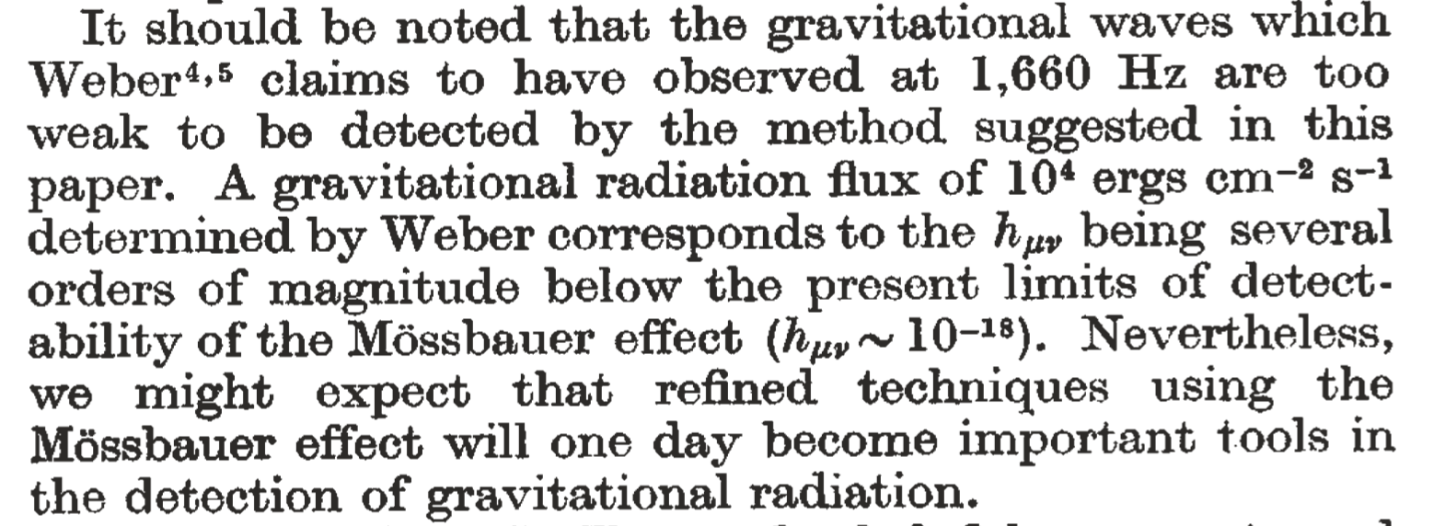
Mössbauer for Gradational Wave
Idea since 1970
  Photon frequency varies when it propagates in an un-even space-time background.
Gave way to clock-based experiments in later tests of “static” gravity.
  See K. Hentschel, Annals of Science 53, 269–295 (1996)

Slide 8
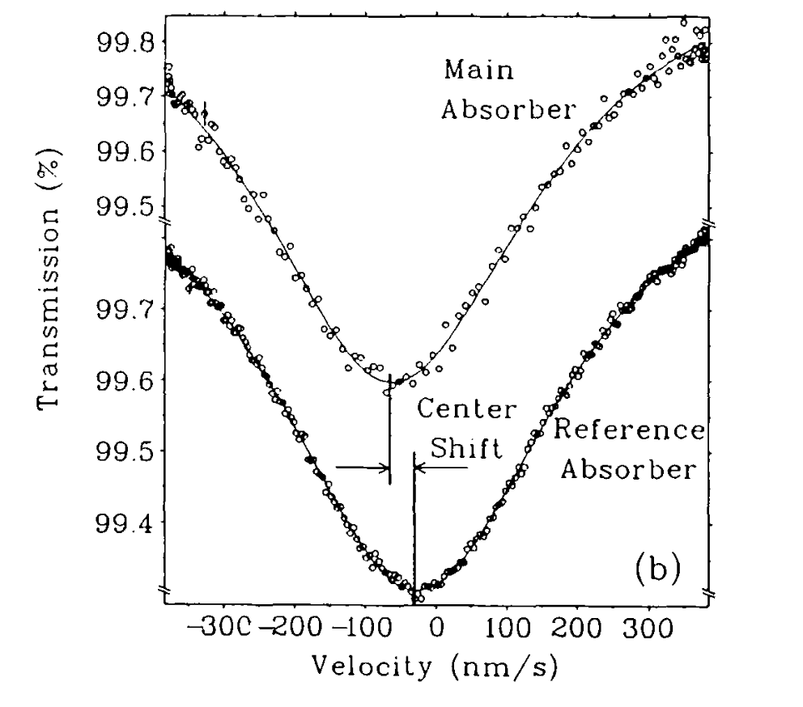
Issues in traditional Mössbauer Gravity tests
A cryogenic ⁶⁵Zn measurement
of the local g-value
(Potzel et.al. 1992)
Differential measurement
of the resonance with a
sinusoidal oscillator
  Resonance is achieved
  g-value is off, possibly
  due to various line-shifts
“such solid-state effects might be difficult ……
there might exist two exceptions. The first are null redshift experiments,
in particular measurements with stationary source and absorber”.
Can be improved with
a stationary scheme

Slide 9
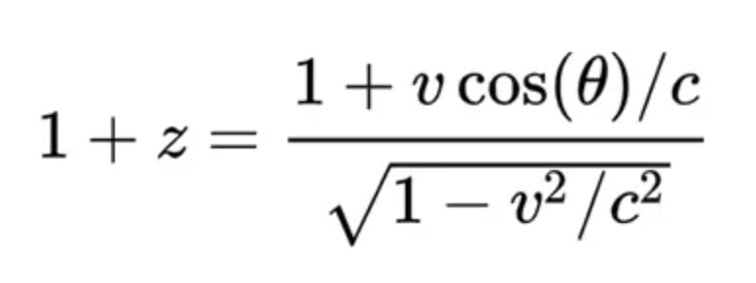
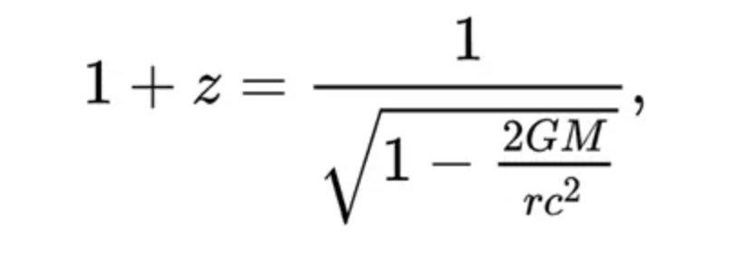
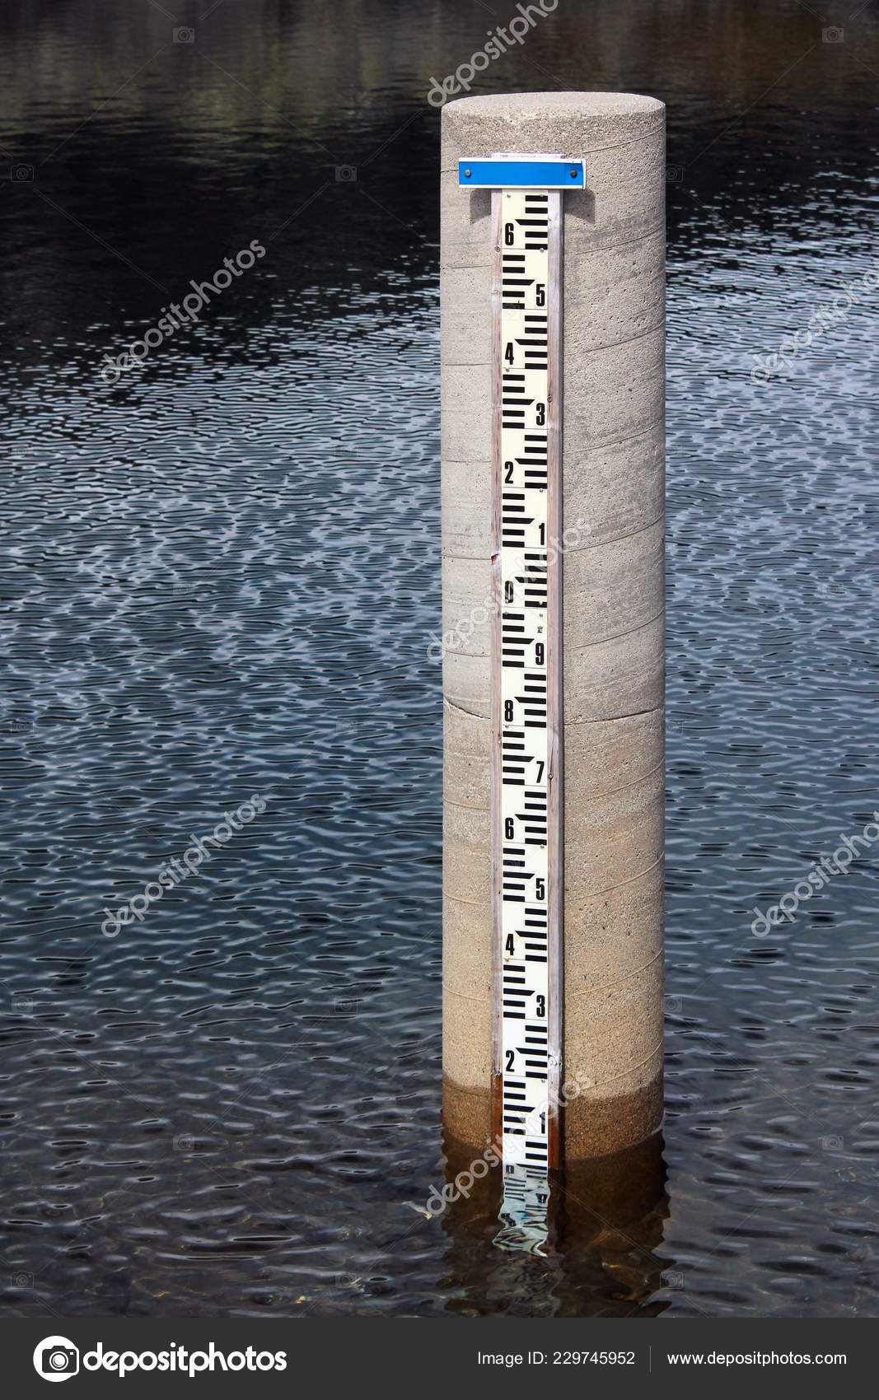
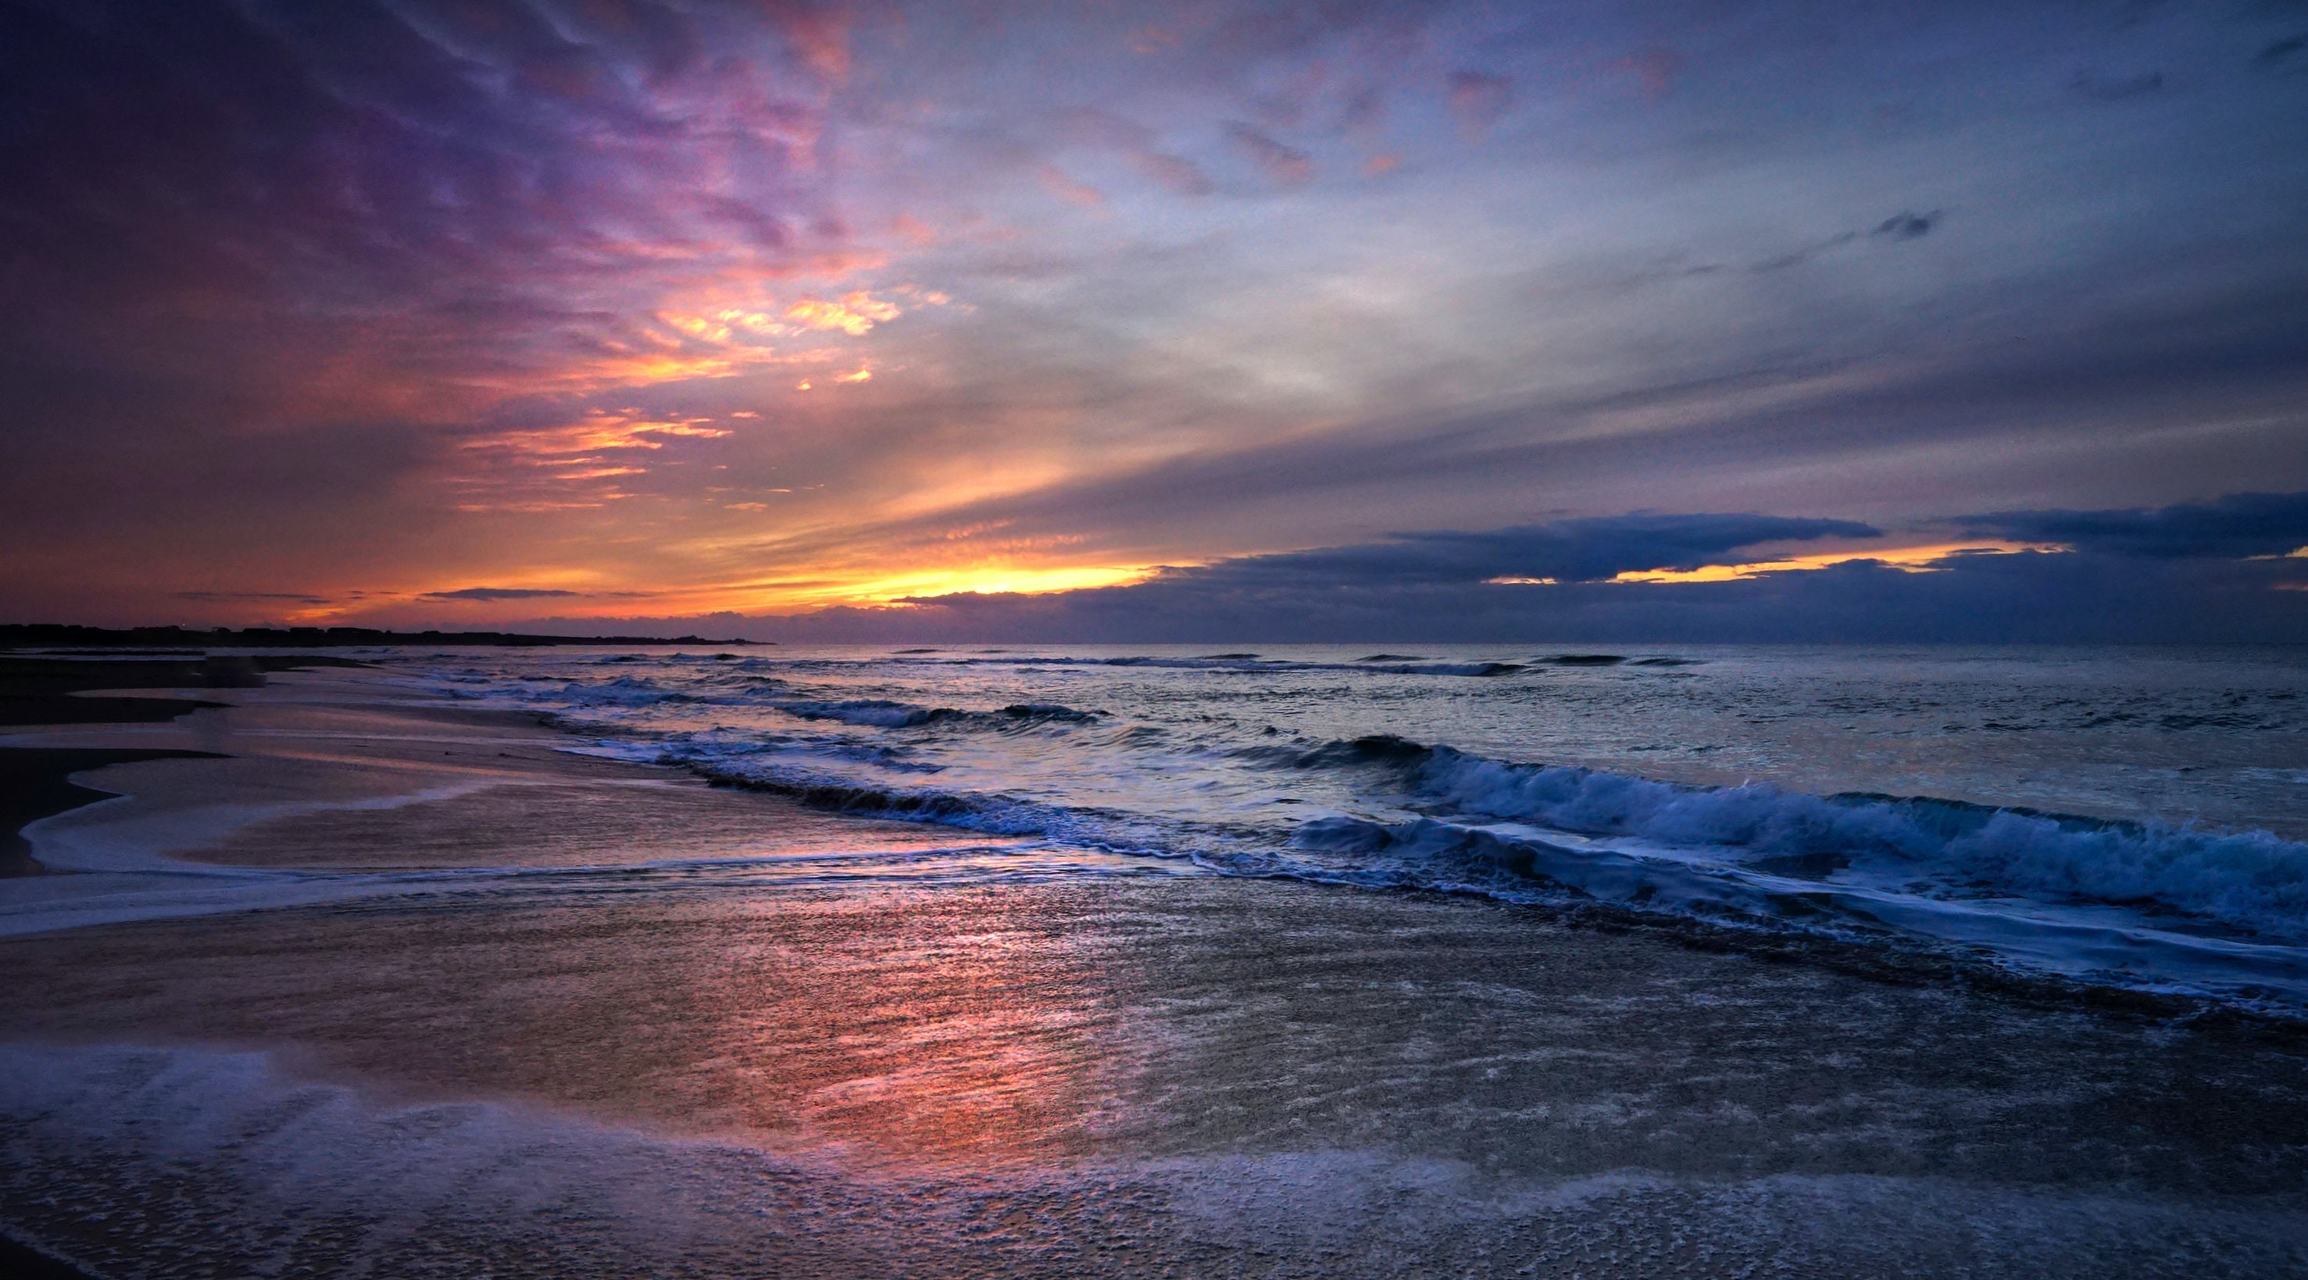

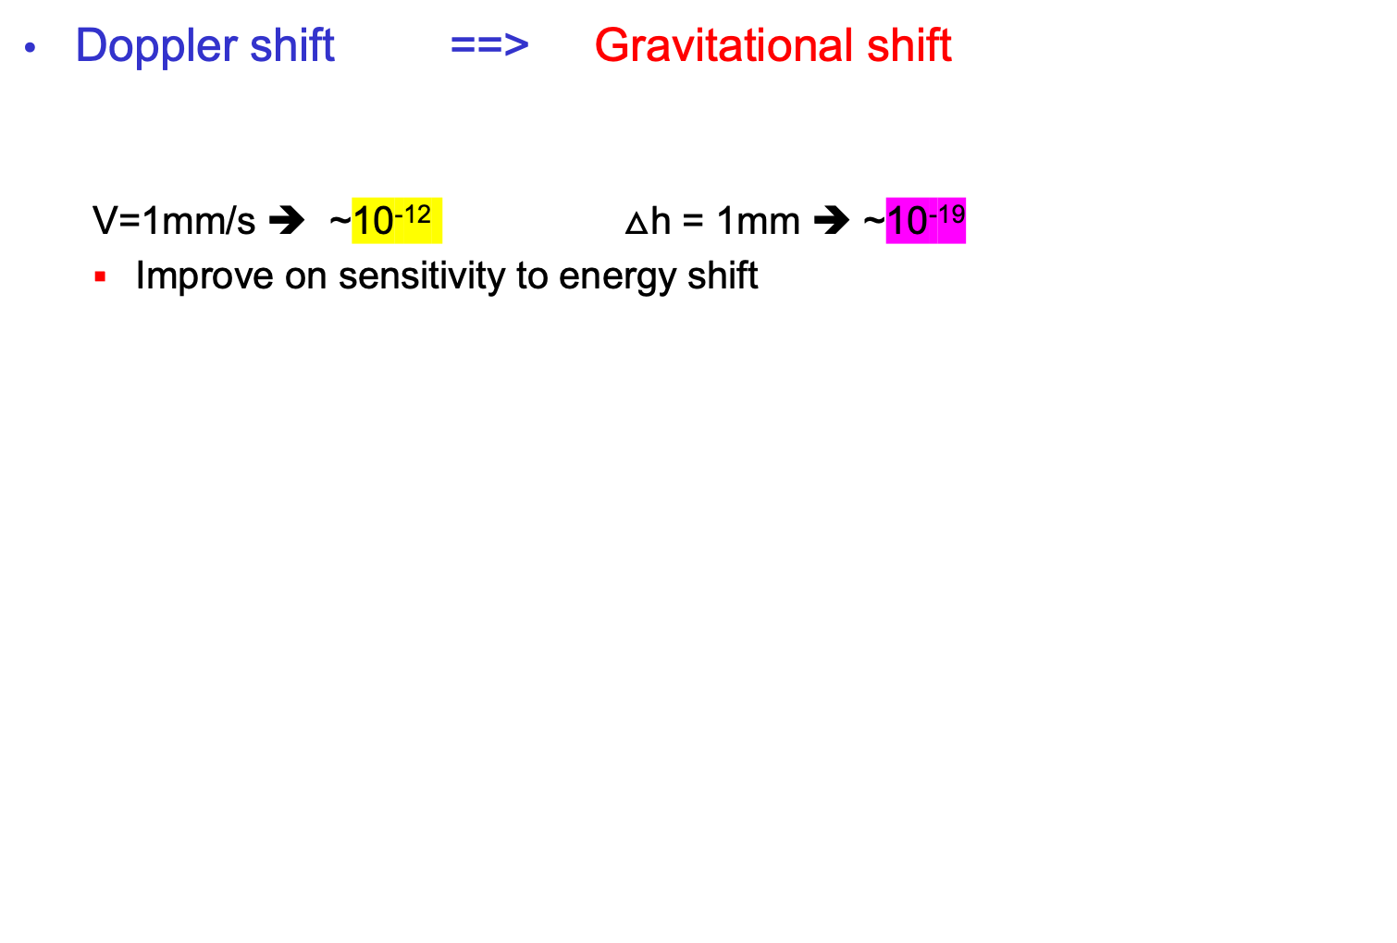

Idea of the stationary measurement
Doppler shift ==> Gravitational shift
  V=1mm/s ➔ ~10⁻¹² $△$h = 1mm ➔ ~10⁻¹⁹
  Improve on sensitivity to energy shift
$△$h<<r
$z=\frac{g}{c^{2}}∗△$h

Slide 10
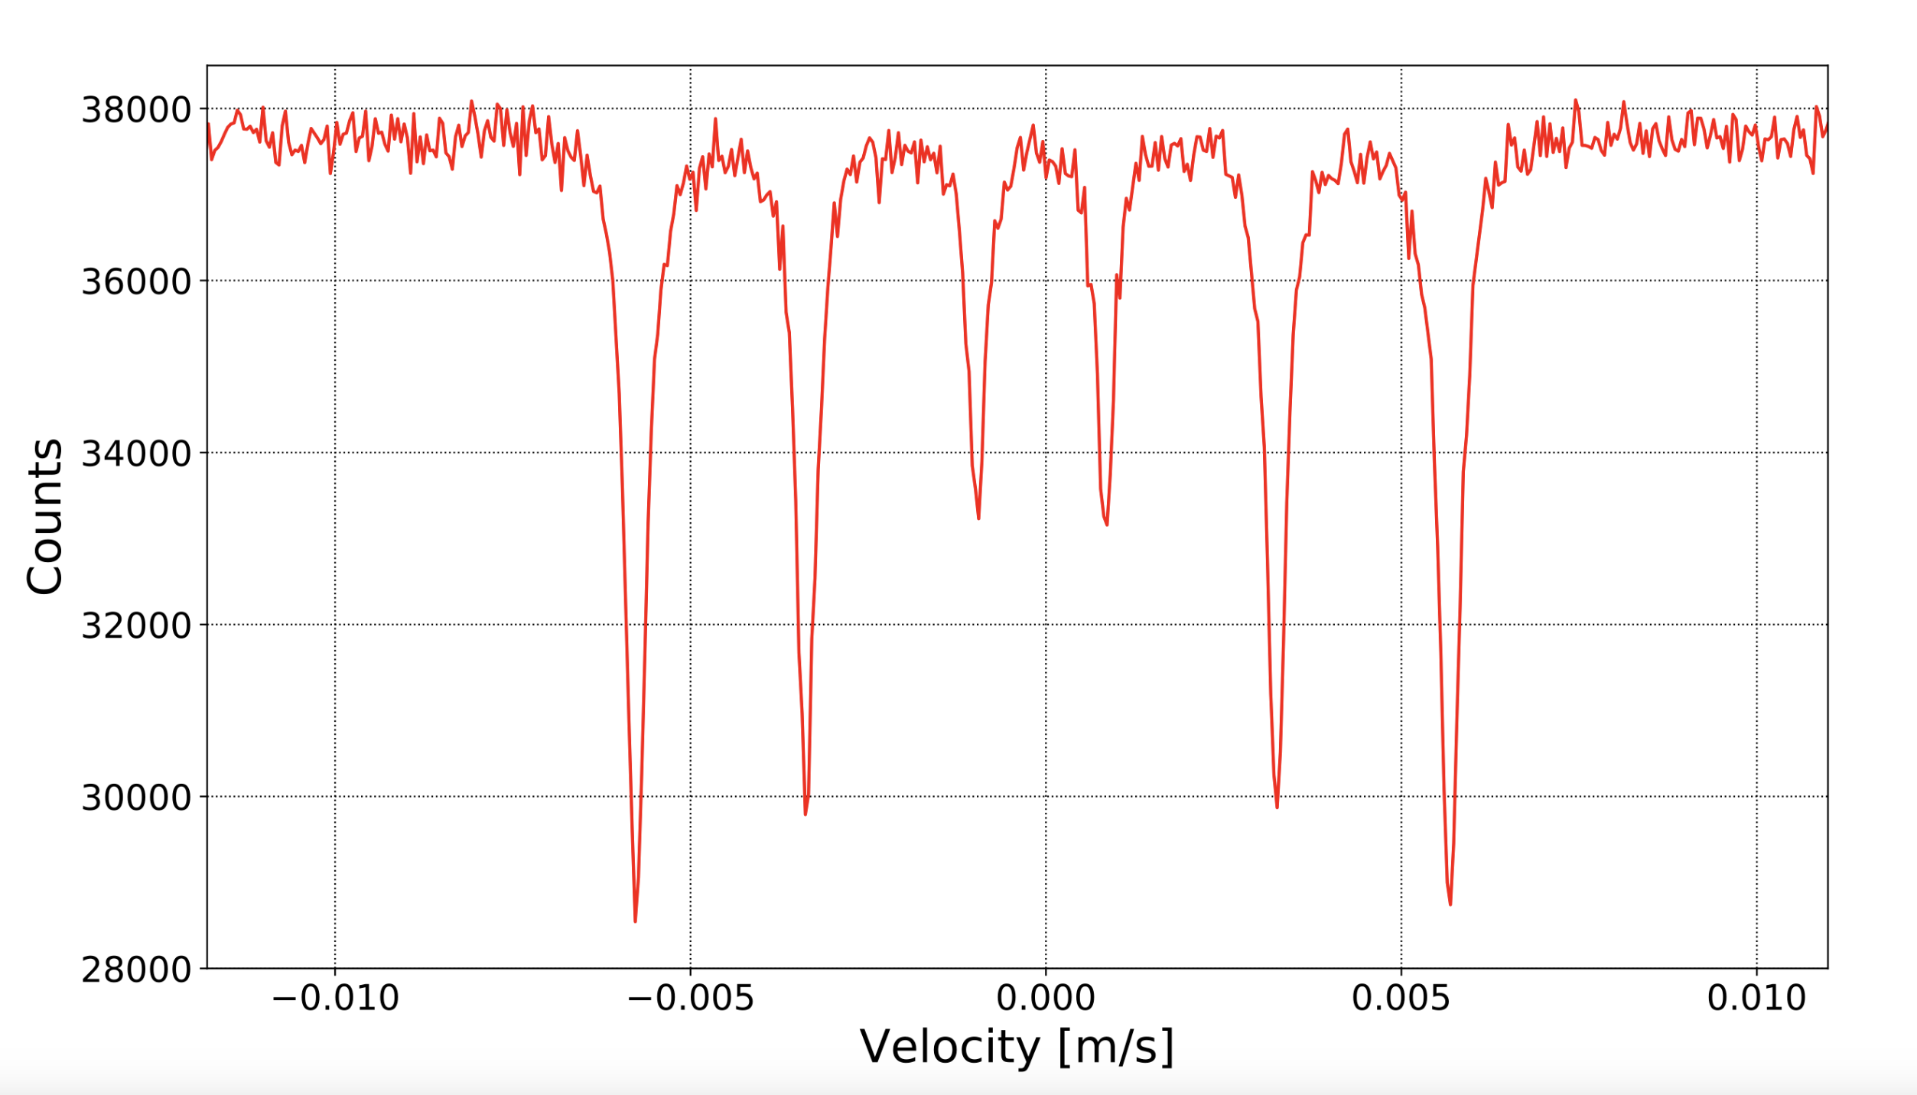
Design of a gravitational shift Mössbauer Spectrometer
Replace Doppler shift with gravitational shift
Parallel readout the resonant absorption shape
Time dependent of resonance’s height-shift instead of absolute height
Photon counters with proper Z resolution
¼ cut view
Z
Energy loss E_{R} is compensated by a slight height difference between absorber and source:
can be calibrated in advance.
--- the absolute height of resonance (Z₀) is affected by
large systematics: 2nd Doppler,
chemical composition, etc.
--- but its time-dependent shift under GW is not affected.
h
horizontal→
distance (d)
Resonance peak(s)
0
x
Radioactive source
(intensity R_{S})
-h
absorption layer

Slide 11
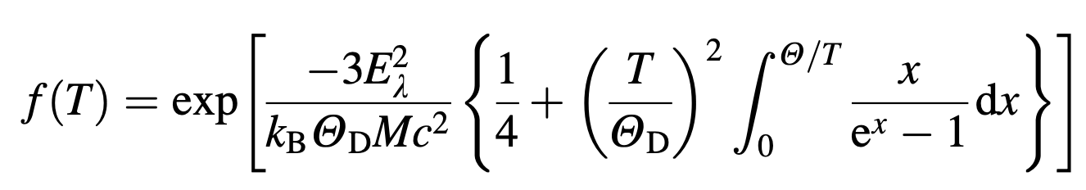
The transmission integral
Photon emission at source
  Fractional recoil-less : f_{s},
  Fractional recoiled:1-f_{s}
Photon absorption at absorber
  Mass attenuation effect: all photons
  Resonant absorption: only resonant emitted photons
The transmission integral (textbook)
  Replaced the doppler shift with gravitational shift

Slide 12
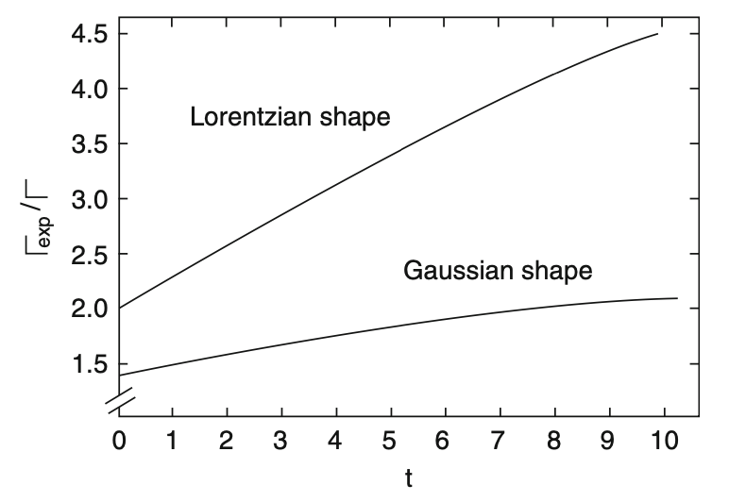
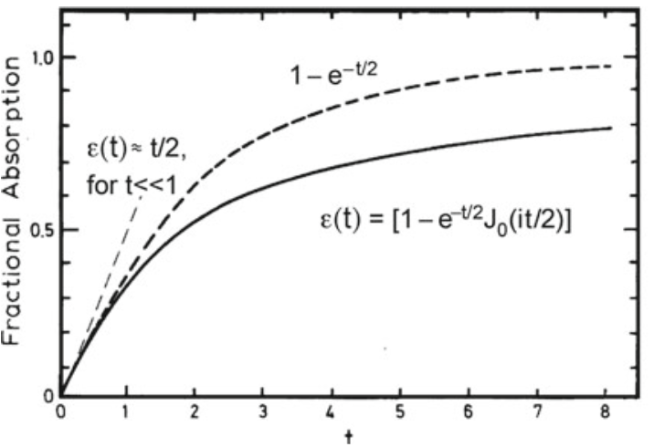
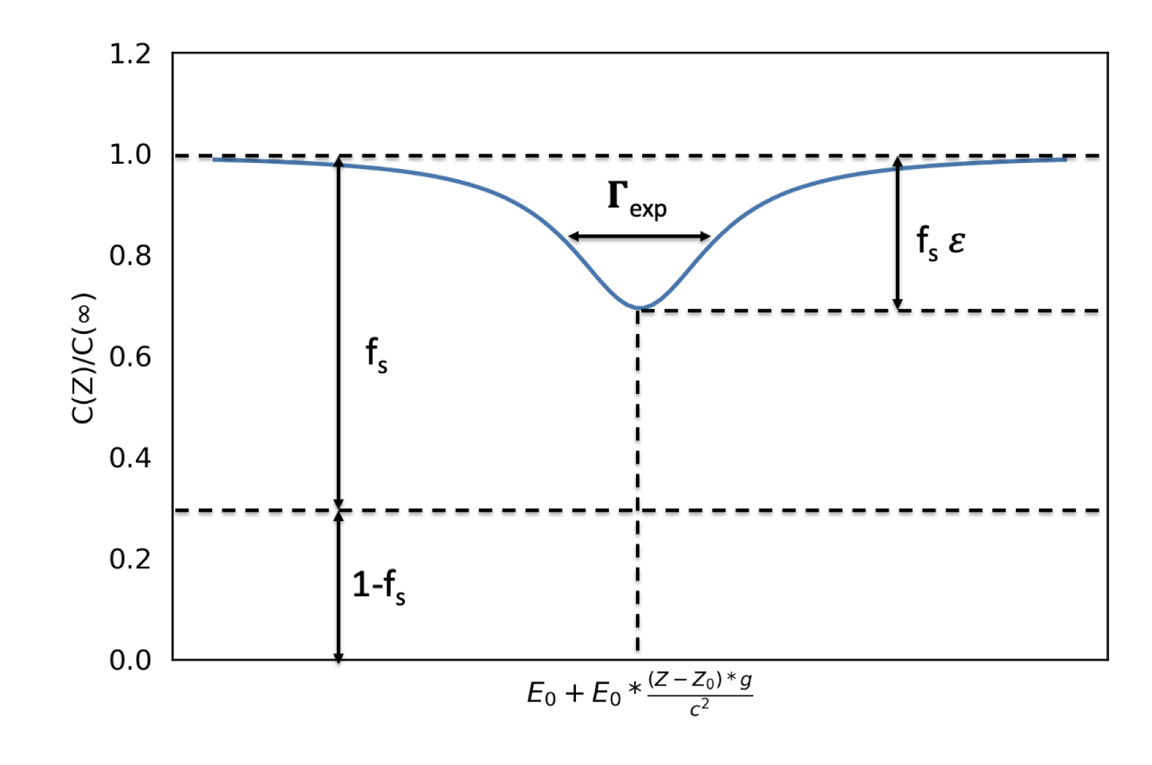
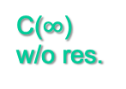
The simplified resonance line-shape
C($∞$)
w/o res.
Flux reduction due to res. absorption
Recoil-free
photons
( parameters
exaggerated
for illustration )
Recoiled photons

Slide 13
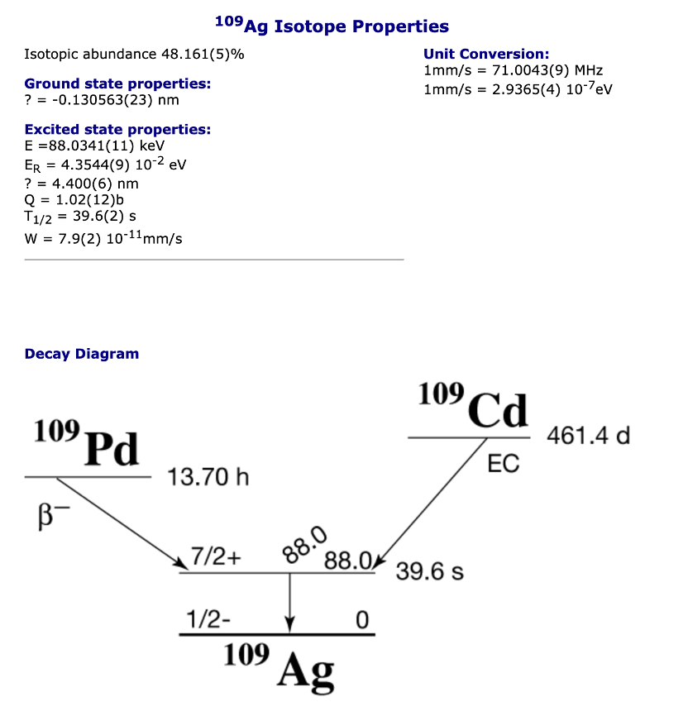
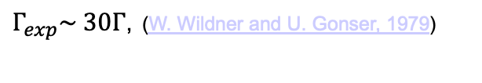
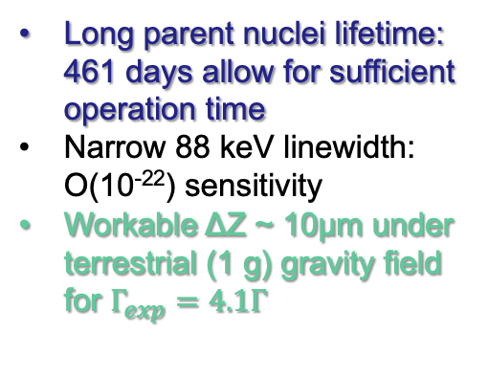
The choice of isotope source: ¹⁰⁹Ag
Long parent nuclei lifetime:
461 days allow for sufficient operation time
Narrow 88 keV linewidth:
O(10⁻²²) sensitivity
Workable ΔZ ~ 10μm under terrestrial (1 g) gravity field
for $Γ_{exp}=4.1Γ$
The quest of the ¹⁰⁹Ag resonance:
$Γ_{exp}\sim 30Γ$, (W. Wildner and U. Gonser, 1979)
Improved resonance resolution, w
broadening factors down to 16 (US)
R. D. Taylor and G. R. Hoy, SPIE 875, 126 (1988).
S.RezaieSerej, G. R. Hoy, and R. D. Taylor, Laser Phys. 5, 240 (1995).
Russian group: improvements with Grav. Effects
V. G. Alpatov, et.al. Laser Physics 17, 1067–1072 (2007).
Yu. D. Bayukov, et.al. JETP Letters 90, 499–503 (2009).
Mössbauer database (DICP, CAS)

Slide 14
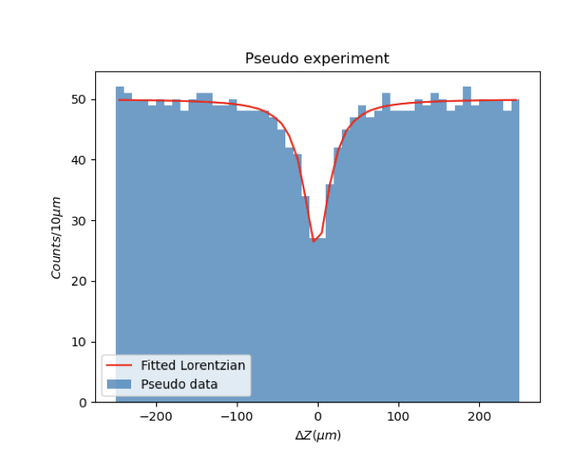
Accuracy from Pseudo experiments
Pseudo experiment simulation with reasonable parameter
  Ex: z-position resolution 10 μm, detection efficiency ~100%
  Readout frequency ~10 f_{GW}
Sensitivity extracted by fitting the resonance absorption peak
Silver alloy/compound with higher T_{deBye} helps improve f_{S}
e.g. AgB₂ has a higher T_{deBye} and f_{S} =0.2 (@ 4K)
Accuracy compatible to the accuracy needed for GW strain
Parallel measure of resonance absorption shape: fast enough for GW

Slide 15
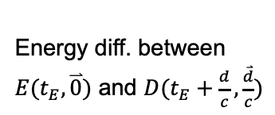
The GW signal: frequency shift
Frequency shift due to different space-time matrix for photon emission and absorption
Estabrook and Wahlquist, Gen. Relat.
Gravit. 6, 439–447 (1975);
Hellings, Phys. Rev. D 23, 832–843 (1981).
Consider a plain-wave strain perturbation
$$h\left(x,t\right)=h_{0} e^{i(ωt−k∙x)}$$
$$ds^{2}=c^{2}dt^{2}−\left[1+h\right]dx^{2}−\left[1−h\right]dy^{2}−dz^{2}$$
A particle’s 4-momentum response to GW strain
after one-way propagation:
(figure from Hellings paper)
Energy diff. between
$E(t_{E},\overset{⃑}{0})$ and $D(t_{E}+\frac{d}{c},\frac{\overset{⃑}{d}}{c})$

Slide 16
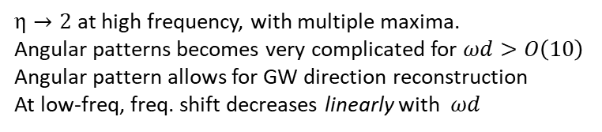
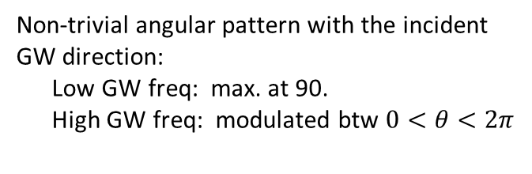

When the baseline distance approaches
to the GW’s wavelength scale, a particle
starts to see the strain difference.
Non-trivial angular pattern with the incident
GW direction:
Low GW freq: max. at 90.
High GW freq: modulated btw $0<θ<2π$
“blind directions”
Multiple directions can compensate for
others’ insensitive directions.
* Requires a perpen-
dicular h component.
* Extra complication w
baseline at high freq.
* Vanishes when (anti)
parallel to GW direction
Spin-2
$$ϕ_{pol}=0$$
Maximal shift with GW frequency:
$η→2$ at high frequency, with multiple maxima.
Angular patterns becomes very complicated for $ωd>O\left(10\right)$
Angular pattern allows for GW direction reconstruction
At low-freq, freq. shift decreases linearly with $ωd$
(optimal angle)

Slide 17
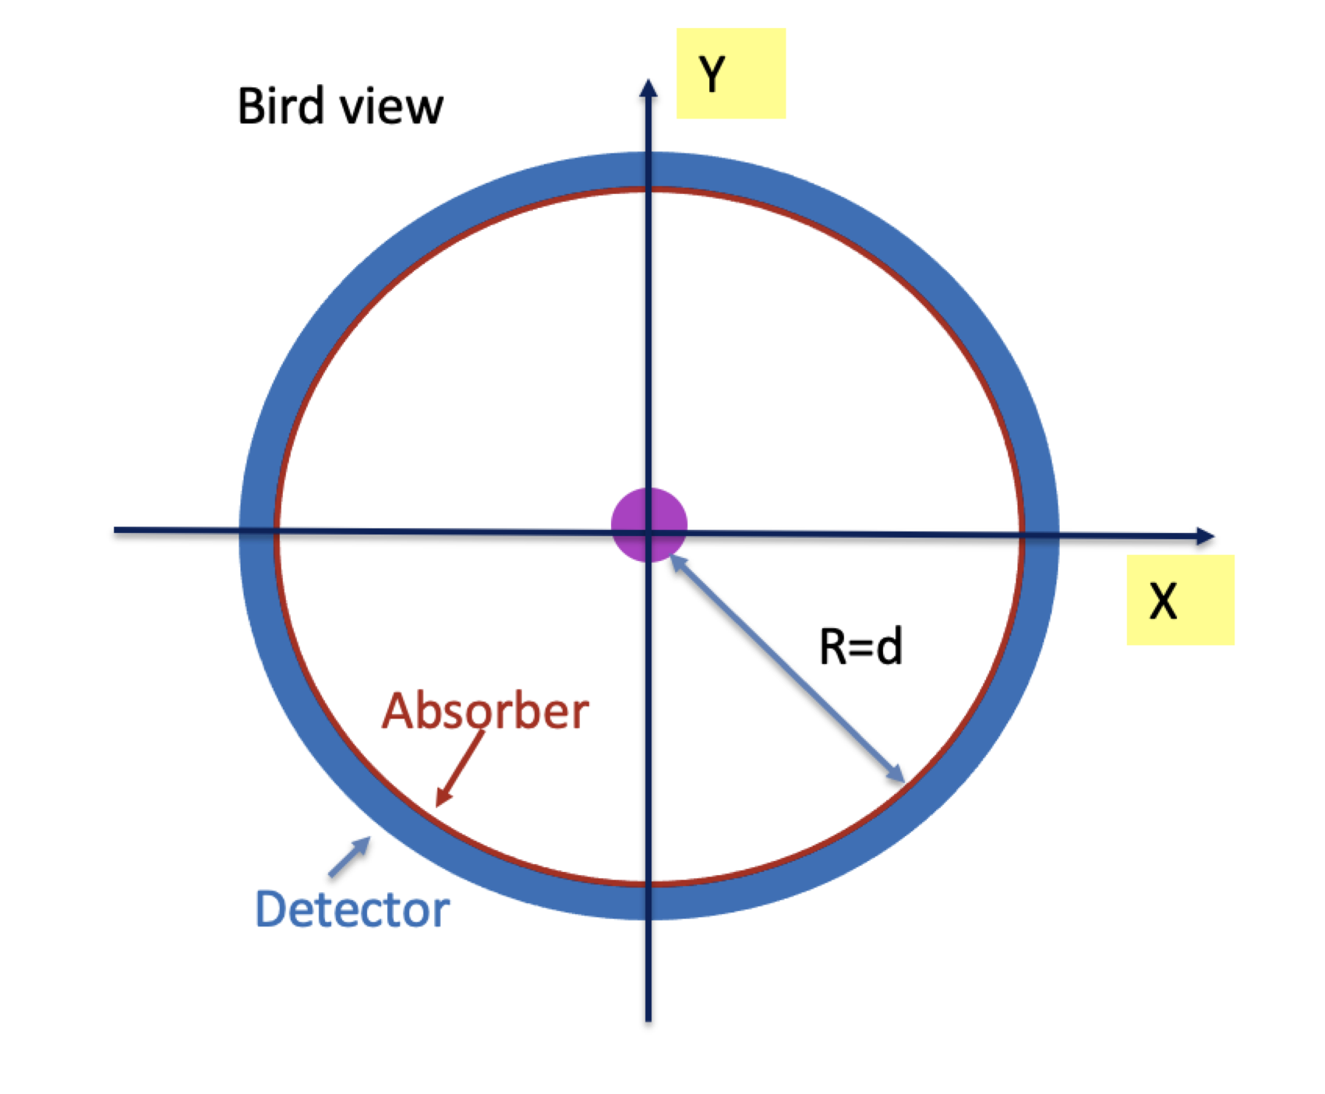
Stationary Mössbauer GW setup
Absorber+detectors are in the resonance plane around source
  At least two perpendicular directions relative to any GW incident θ angle.
  Enhance acceptance of resonances photons

Slide 18
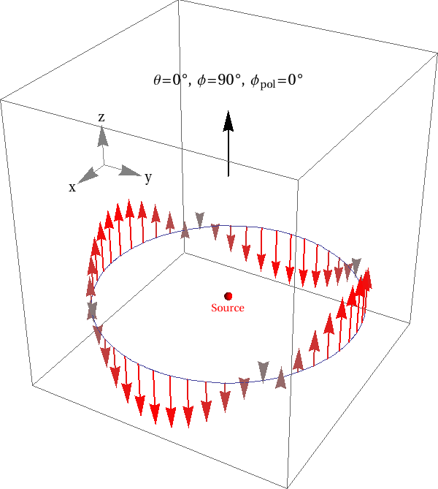
Hypothetical GW signal “seen” by our experiment
Modulation of resonance peak shifts in the ring
  Allow direction and polarization reconstruction

Slide 19
Benchmark scenarios
An estimate on the required source intensity:
(R_{S} for an isotropic source)
Benchmarks:
A: table-top experiment.
B: 10-meter radius in low-g
Beware: pars on the 2nd line
do not scale independently.
Source intensity scales
linearly with baseline length
and inversely with the local
gravitational acceleration.
Need to balance between
resonance shift length, detector
size, and practical sources.
Non-isotropic source / focusing
would immensely enhance efficiency.
Coherently repeated signals can
boost statistics: N₉₀ -> N₉₀*Q
No IC included

Slide 20
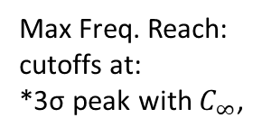
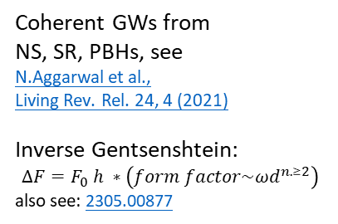

Expected sensitive on GWs
Science Bulletin 2024; 69(18): 2795-2798
A, A’ & B:
single period
A^{C}:
10⁶ periods
10¹¹ Bq.,1m
10¹³ Bq., 5m
Max Freq. Reach:
cutoffs at:
*3σ peak with $C_{∞}$,
10¹¹ Bq. 1m
* $2πfd<O(10)$
10¹⁴ Bq., 10m
Coherent GWs from
NS, SR, PBHs, see
N.Aggarwal et al.,
Living Rev. Rel. 24, 4 (2021)
Inverse Gentsenshtein:
$$∆F=F_{0} h ∗\left(form factor\sim {ωd}^{n.≥2}\right)$$
also see: 2305.00877

Slide 21
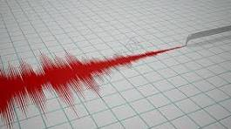
Summary
Conceptual design use Mössbauer effect for GW measurement:
  Stationary scheme （from table size to multi-kilometers）
    Measure the spatial resonance absorption peak shift.
    Allow direction and polarization reconstruction.
    Relatively small-scale setup (meter – 10 meter)
    ¹⁰⁹Ag source gives 10⁻²² strain sensitivity, long lived mother particle.
    Multiband sensitivity（Sensitive to f_{GW} > kHz）
  Possible extension on sensitivity
    low-g, focusing of photons(Laue lens)…
  Larger diameter between source and absorber:
    Aiming for lower frequency GWs
Ground based experiment
Moon based experiment?
Lagrangian point based experiment？

Slide 22
