Slide 1
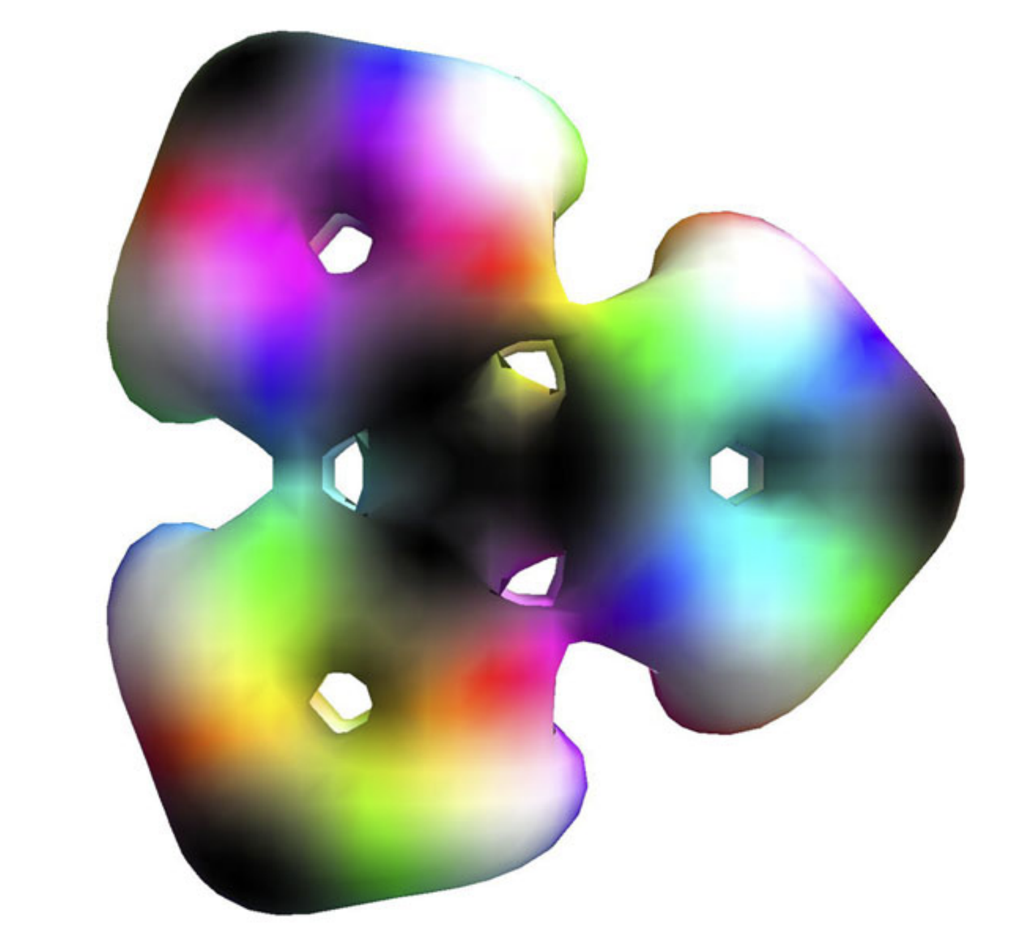
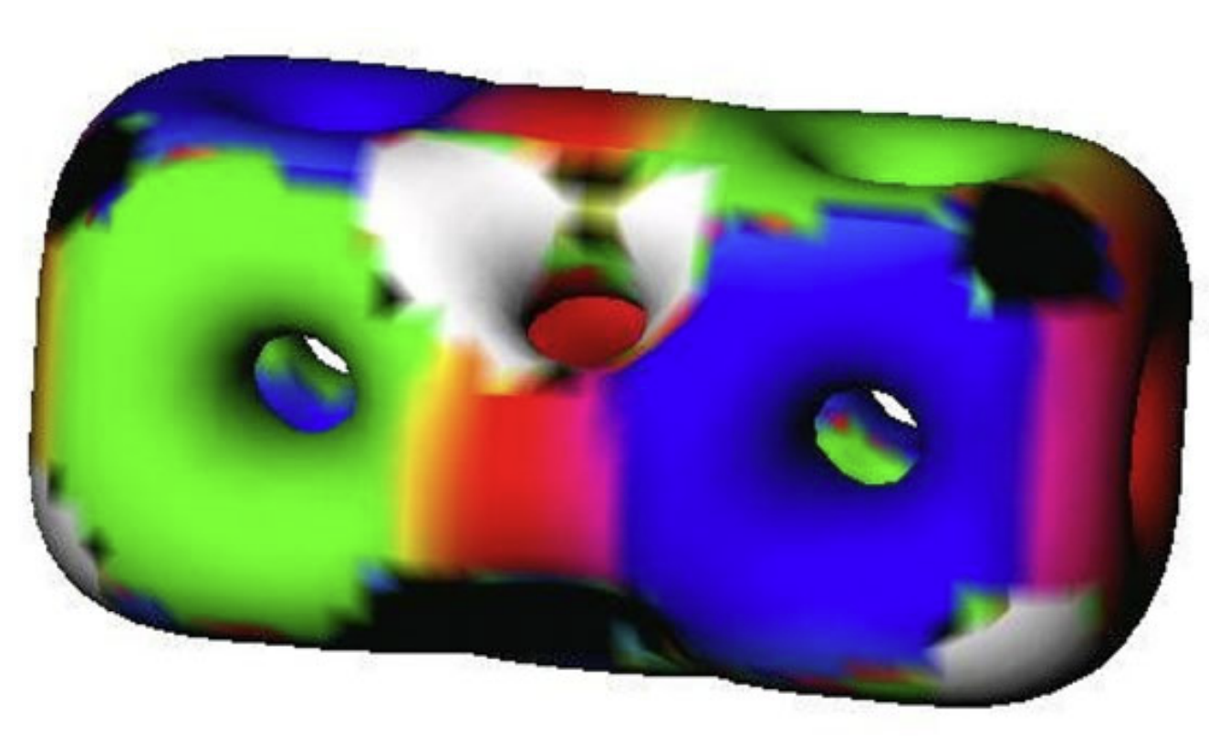
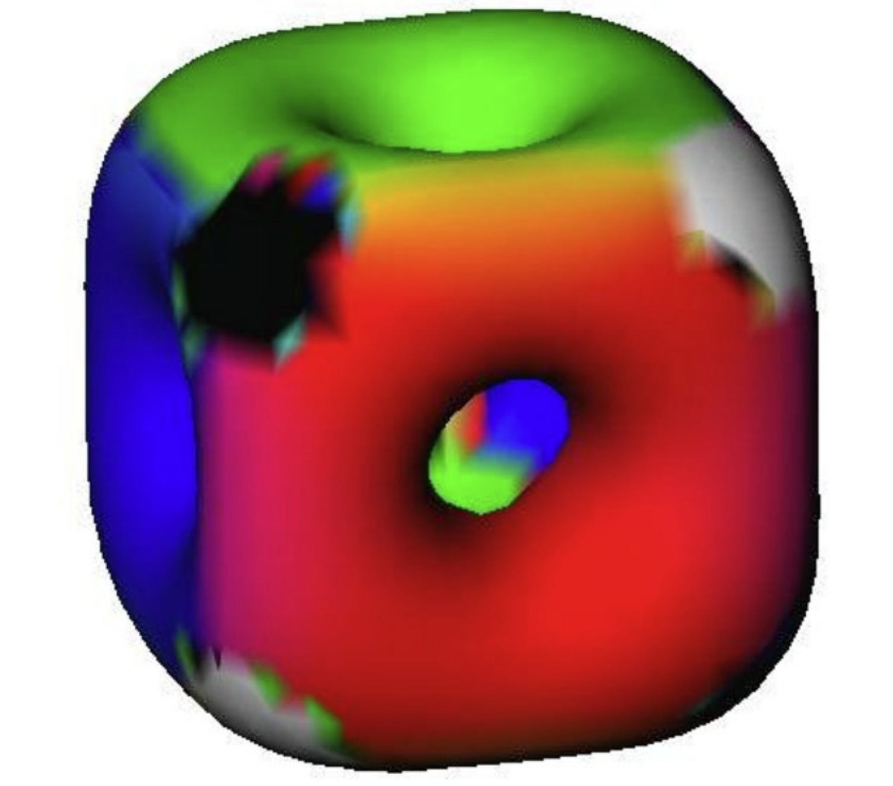

Sphaleron in the Higgs Triplet Model
周顺
(高能所理论室)
© Manton 2019
第三届高能物理理论与实验融合发展研讨会
辽宁师范大学，大连, 2024-11-02

Slide 2
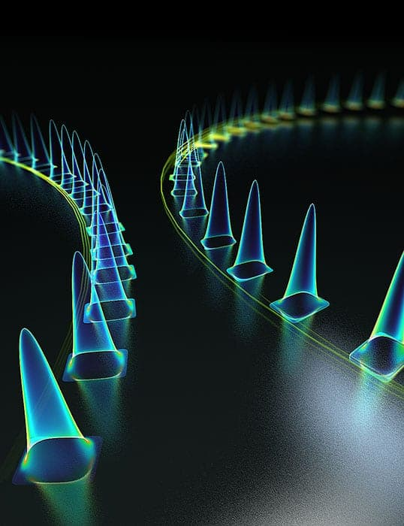
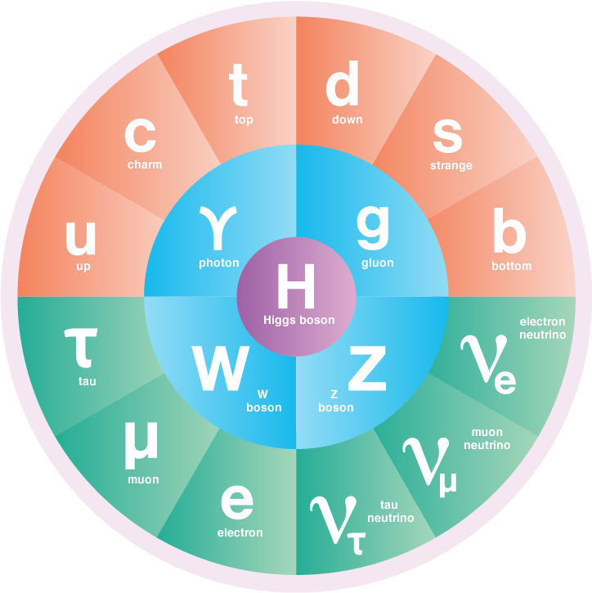
A. What is Sphaleron
The Standard Model of Elementary Particles (SM)
Herink et al., Science 356, 50–54 (2017)
Particles as the excitations of fields around the lowest energy state (i.e., the vacuum state)
Solitons as non-dispersive wavepackets observed in nonlinear optics

Slide 3
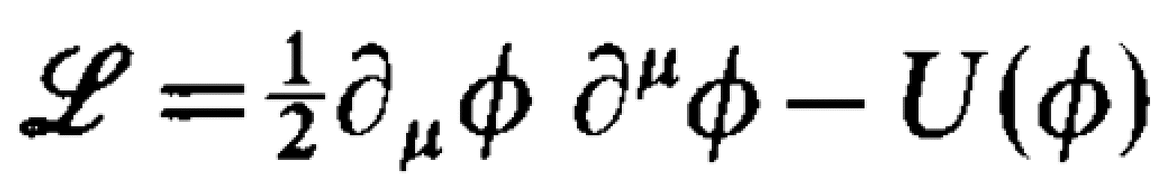
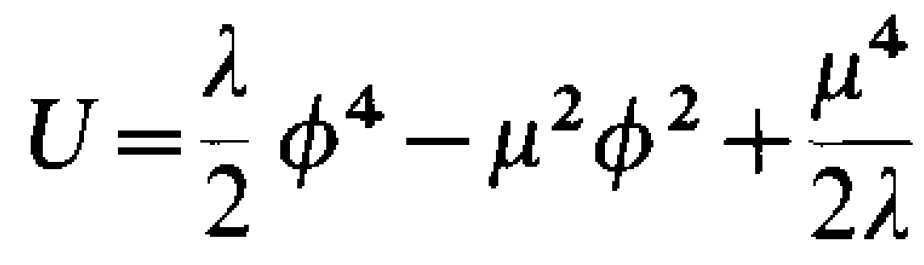
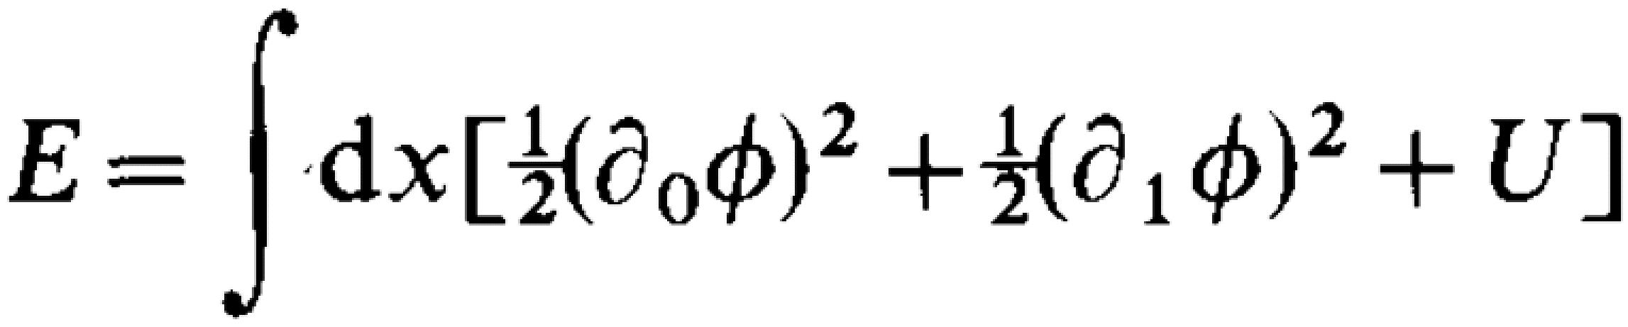
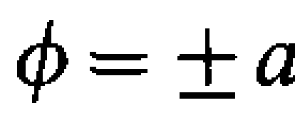
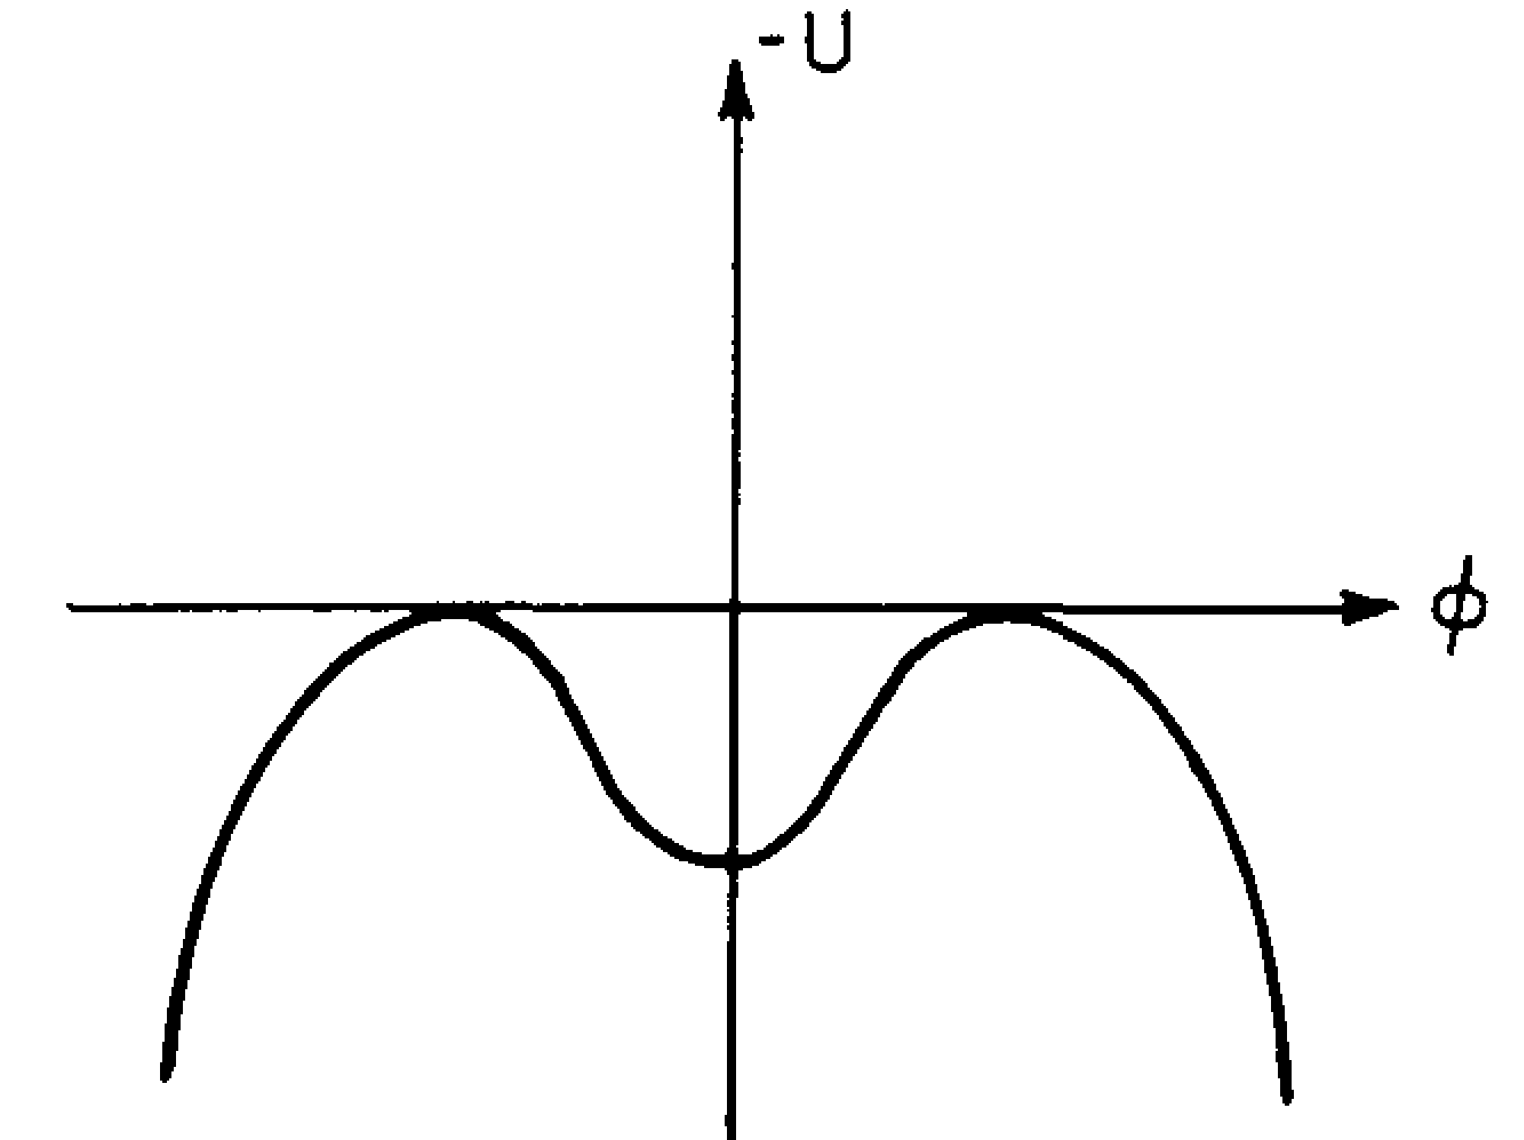
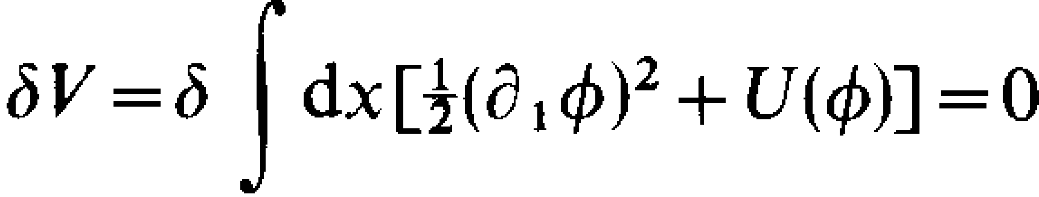
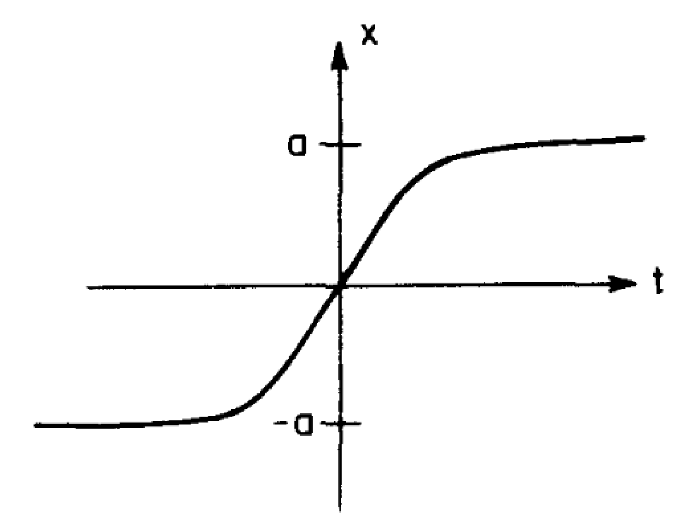
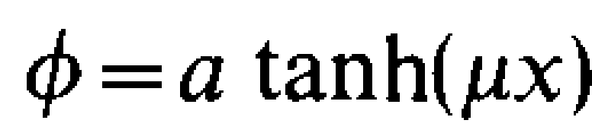
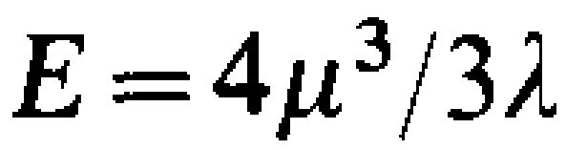




Solitons in Field Theories
Two-dimensional scalar field theory with the Lagrangian
Coleman, Aspects of Symmetry, 1985
scalar potential
and the energy of any field configuration
with positive $λ$ and $μ^{2}$
T : kinetic energy
V
$$a= μ^{2}/λ$$
Static solutions of finite energies
two ground states
$$φ$$
a massless particle described by x(t)
moving in a potential of – U(x)
-a
+a
$$x$$
field profile
finite energy
Solitons in this case called kinks

Slide 4
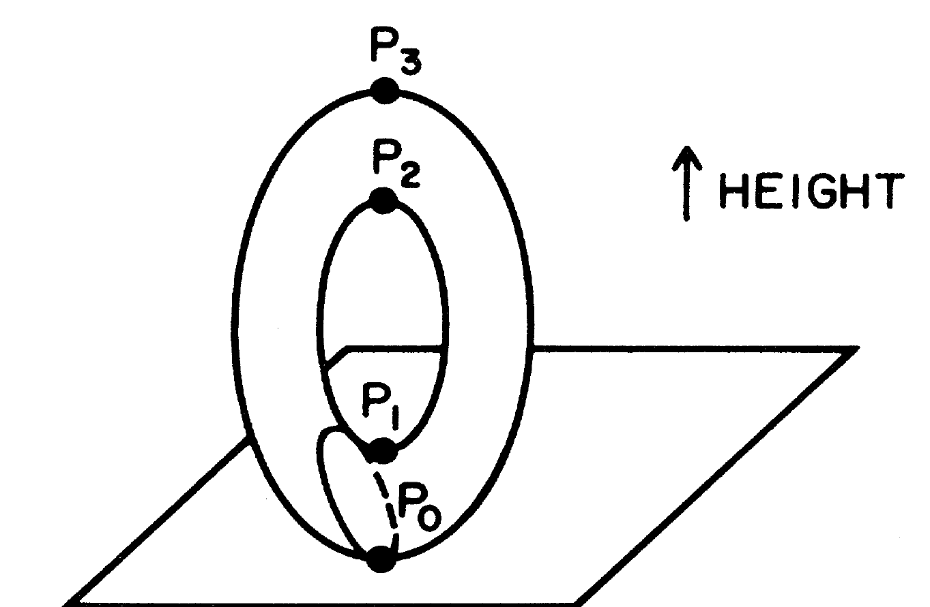
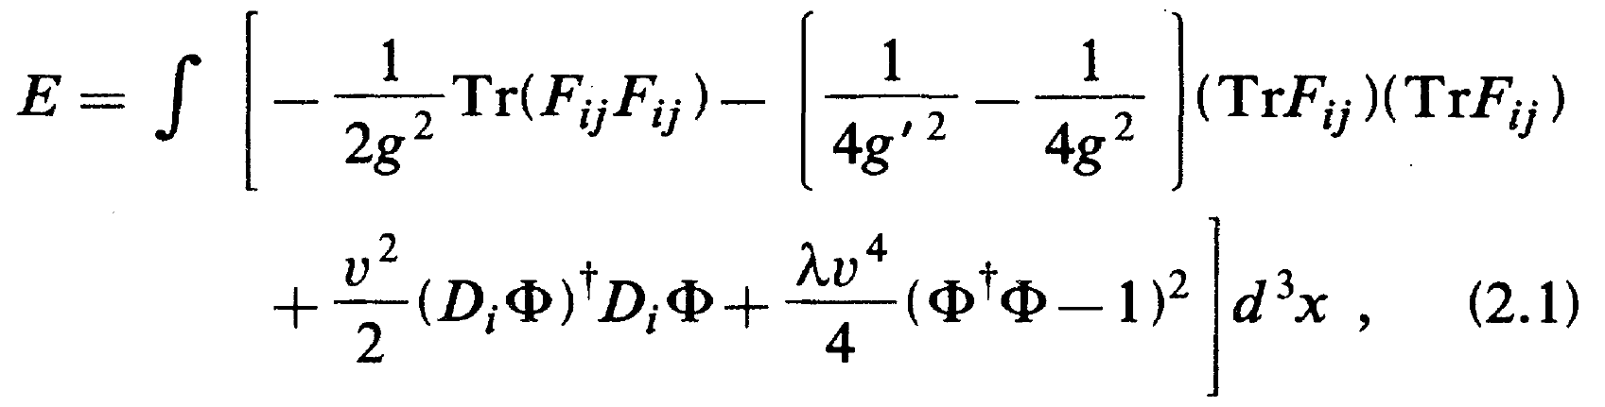

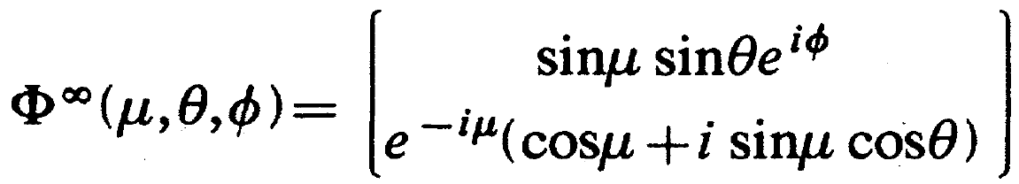
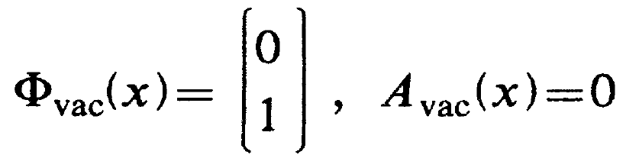
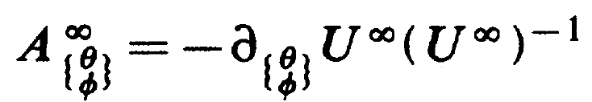
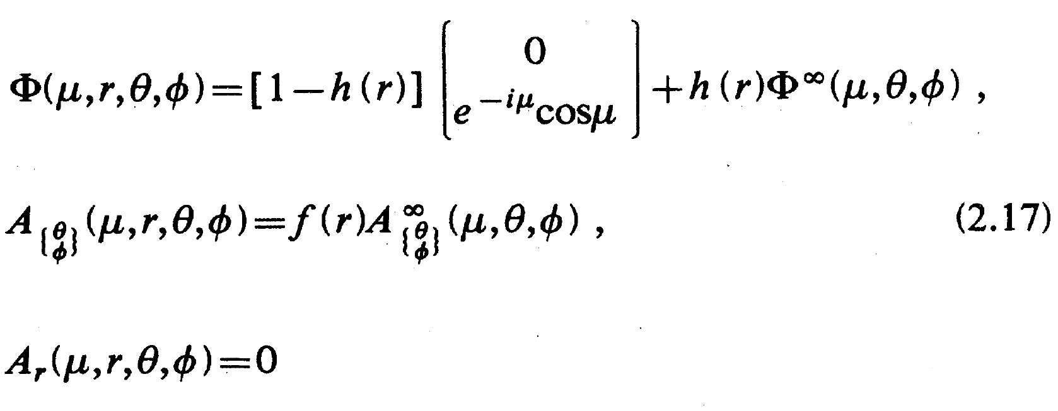
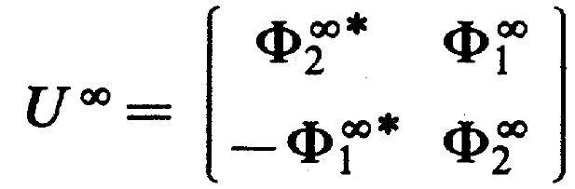

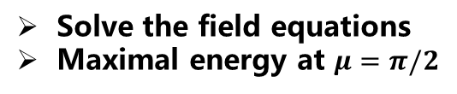
The Sphaleron in the Electroweak Theory
sphaleron in Greek: σφαλερός = unstable, ready to fall
Manton, PRD, 1983; Klinkhamer, Manton, PRD, 1984
Consider the energy of the static configurations of the Yang-Mills-Higgs system
Choose the polar gauge
Gauge transformation
Minimax method
Define the maximal height as a function of the points on the loops through P₀
For the noncontractible loops there is a minimum height at P₁
In this way one can get the saddle point
$\left\{μ, θ, φ\right\}→SU(2)$
Solve the field equations
Maximal energy at $μ=π/2$
Homotopy group Z

Slide 5

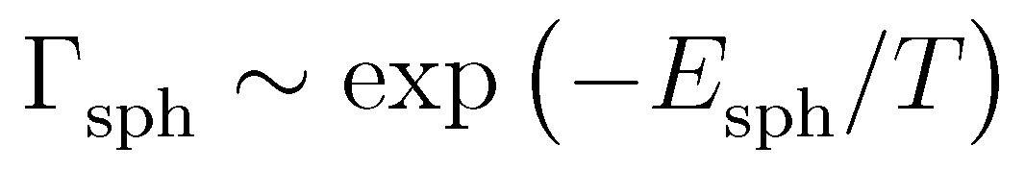
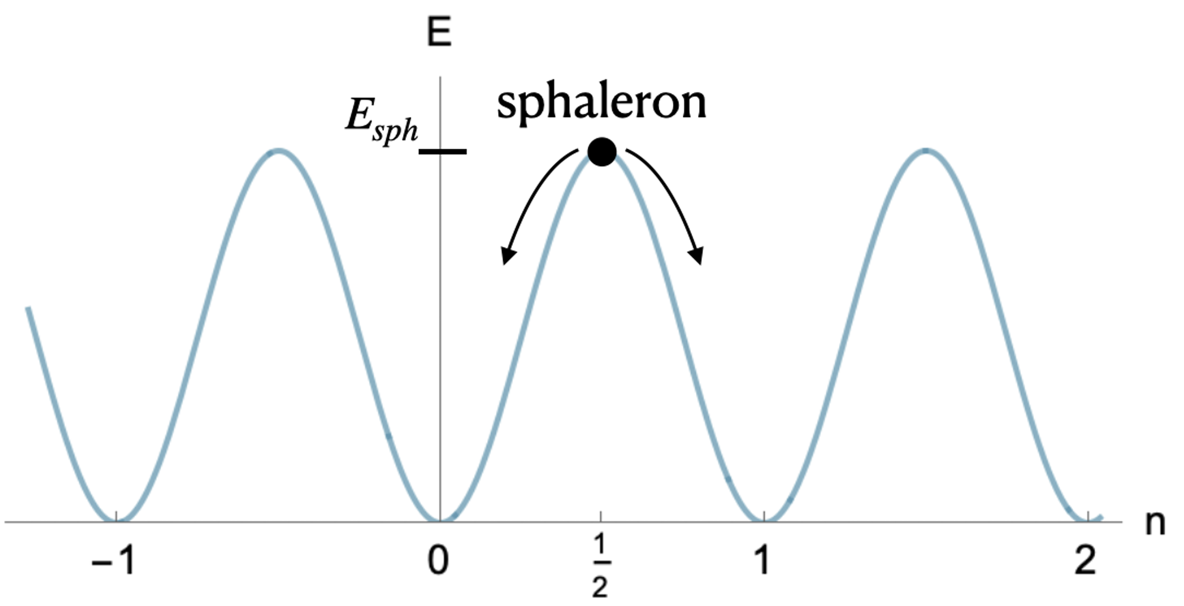
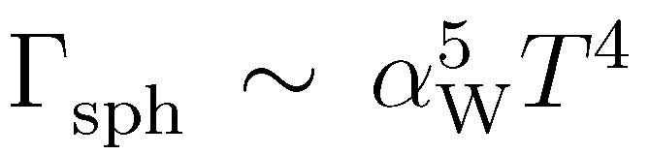
The Sphaleron in the Electroweak Theory
Hamada, Kikuchi, PRD, 2020
Boedeker, Buchmueller, RMP, 2021
B number asymmetries
‘t Hooft, PRL, 1976
Sphaleron energy
Sphaleron rate
Gannouji, 2022
L number asymmetries
Sakharov conditions
Baryon number violation
C and CP violation
Out of thermal equilibrium
Sphaleron processes in thermal equilibrium for
T > 100 GeV

Slide 6















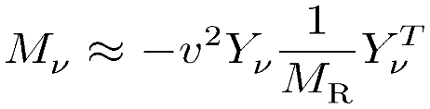
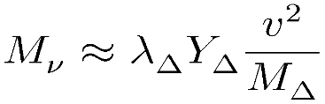

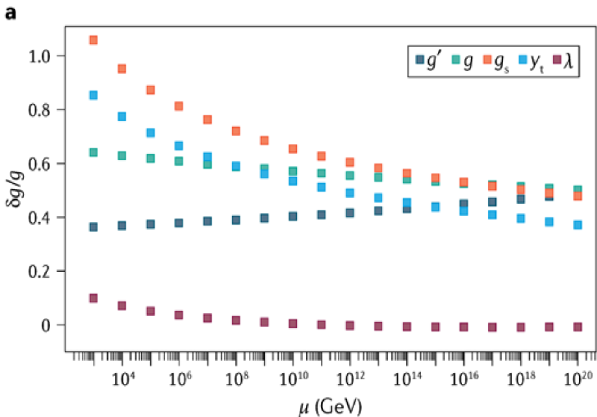
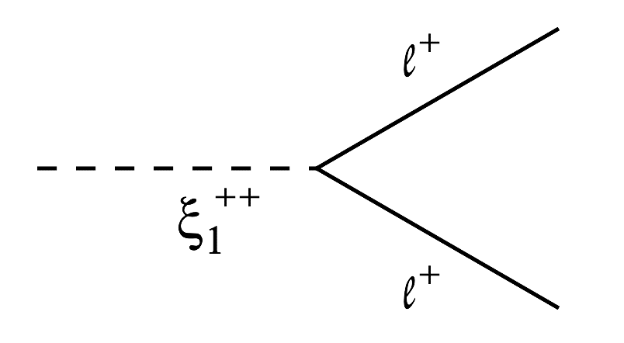
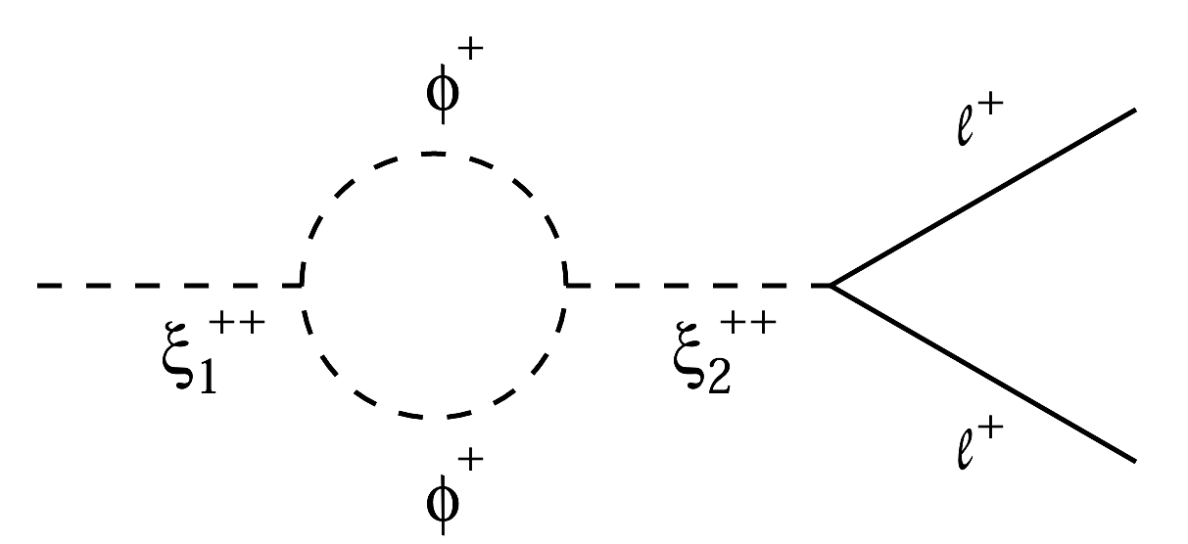
B. The Higgs Triplet Model
The Higgs Triplet Model (HTM): neutrino masses, electroweak vacuum stability, leptogenesis
Type-II Seesaw Model: SM + 1 Higgs triplet (Konetschny, Kummer 77; Magg, Wetterich 80; Schechter, Valle 80; Lazarides et al., 80; Cheng, Li 80; …)
Buttazzo et al., JHEP, 13
Ma, Sarkar, PRL, 98

Slide 7
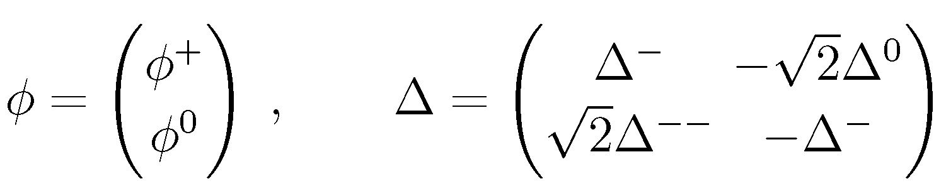
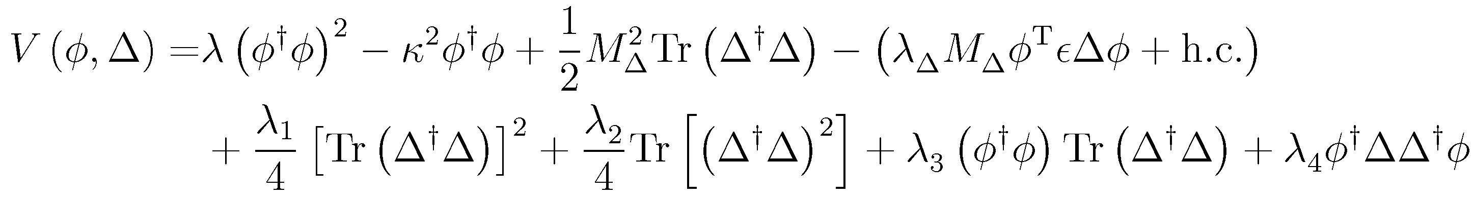
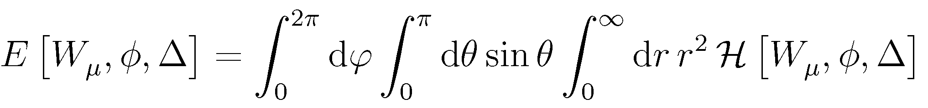
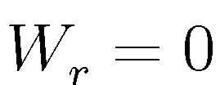
B. The Higgs Triplet Model
Theoretical setup and the sphaleron ansatz
Manton, PRL, 1983; James, ZPC, 1992
Ignore the contributions from the fermions
Omit the weak mixing angle (1% correction to the sphaleron energy)
The HTM Lagrangian
with the scalar potential
the energy density
the total energy
Choose polar gauge & spherical coordinates

Slide 8
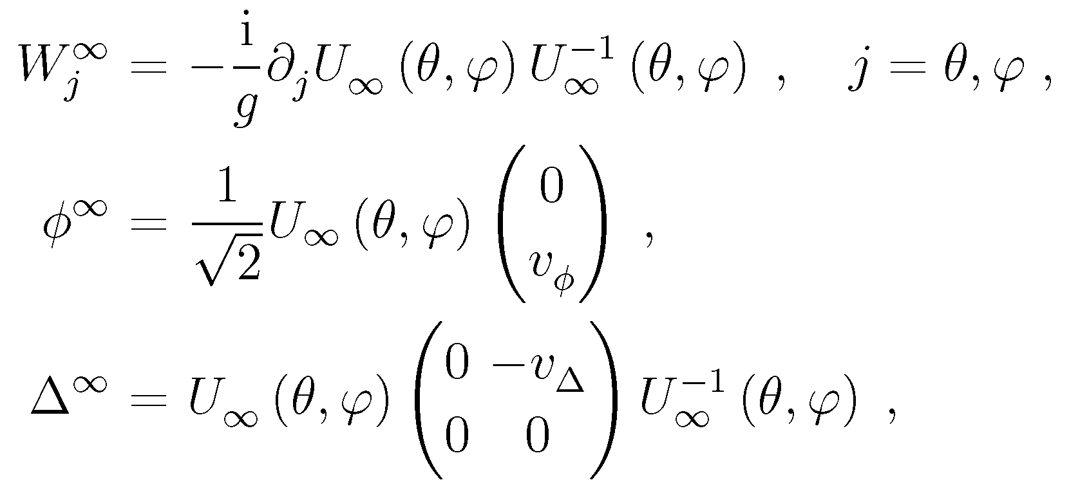
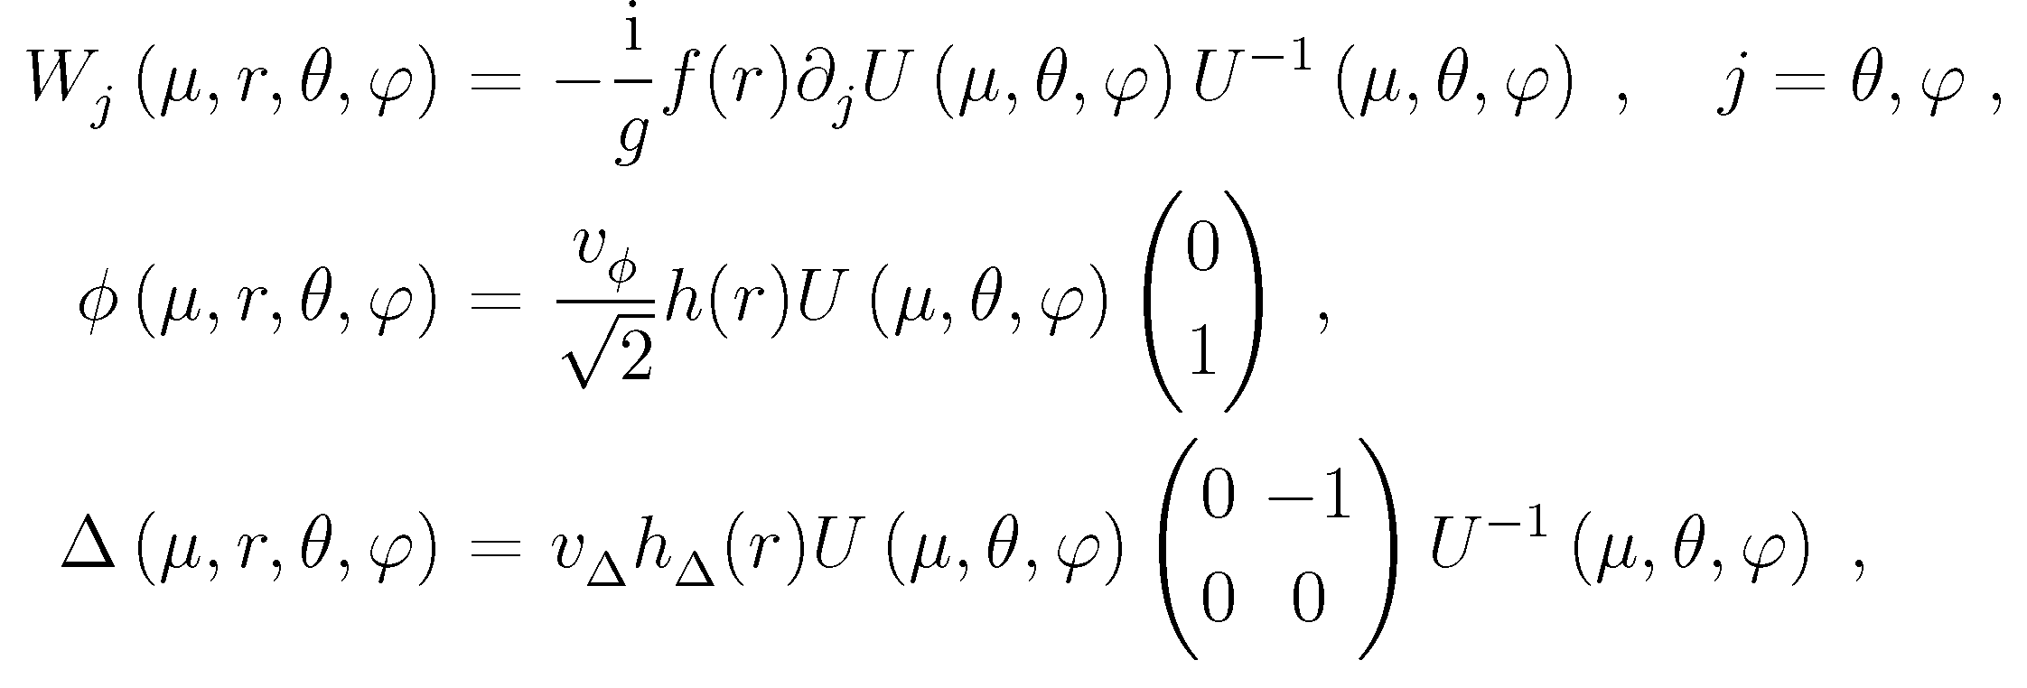
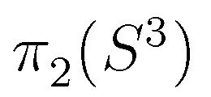
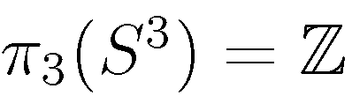
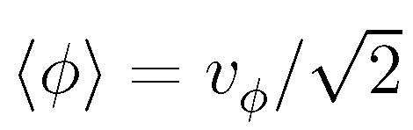
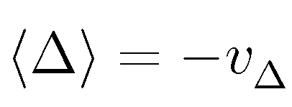
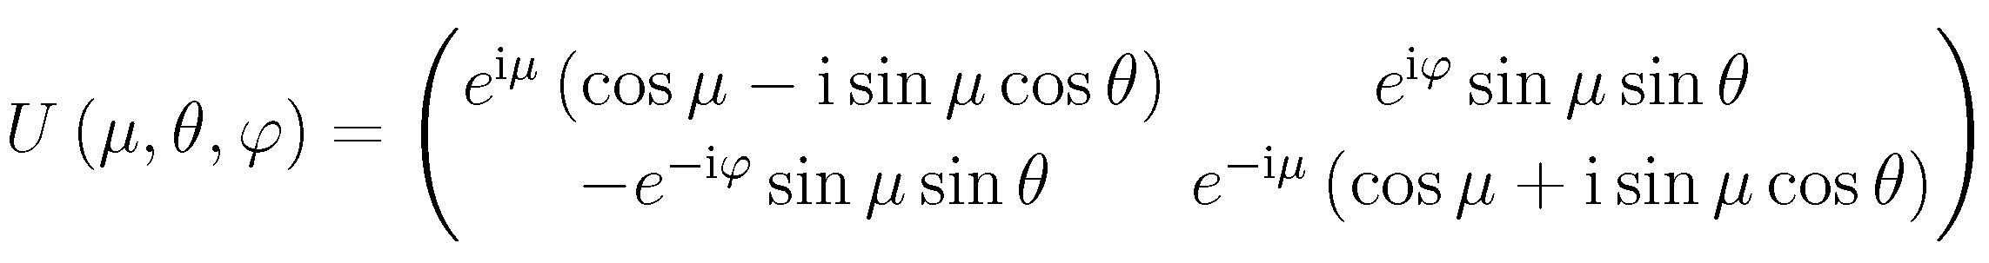
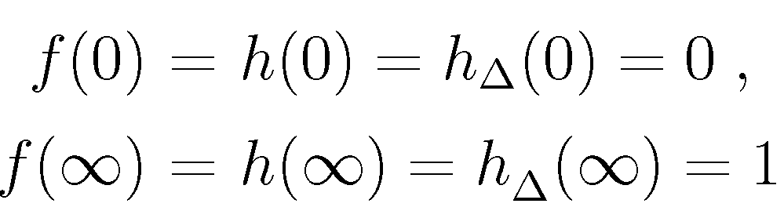
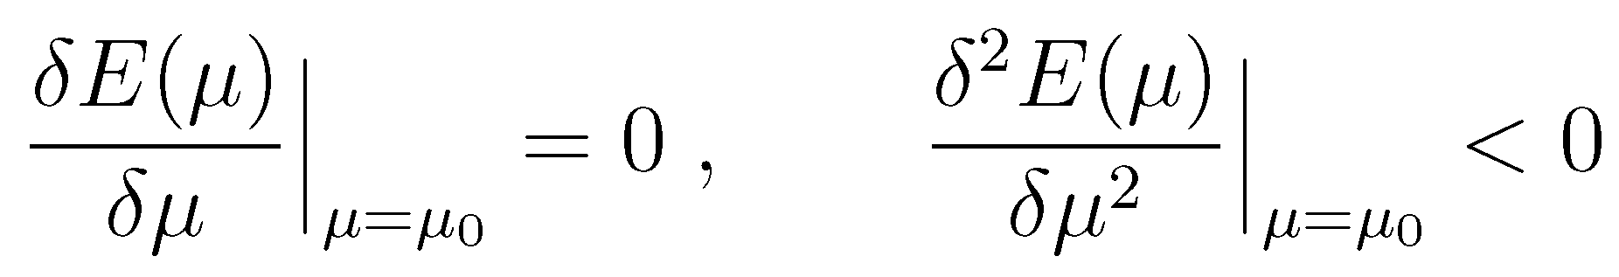
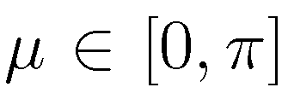

The HTM Sphaleron
At $r⟶∞$, the fields related to the vacuum configuration
A new working ansatz
Hu, Yu, Zhou, 2307.04713
Contractible loops
Boundary conditions for finite energy and smooth profiles
Construct noncontractible loops
Find the saddle point
vacuum configurations

Slide 9
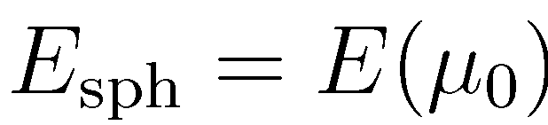
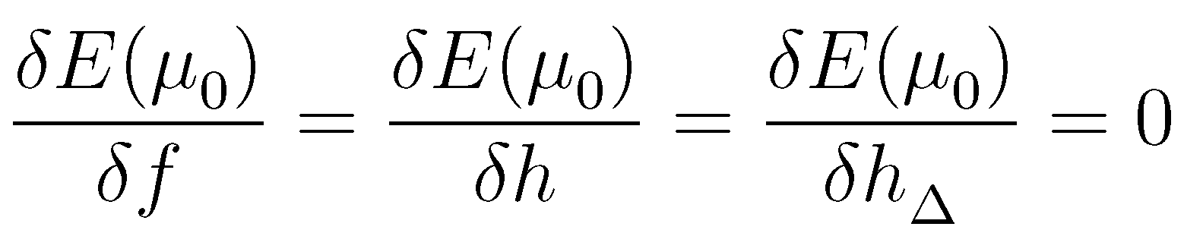
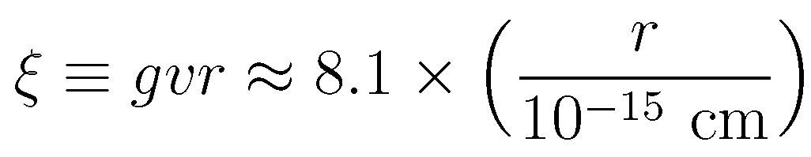

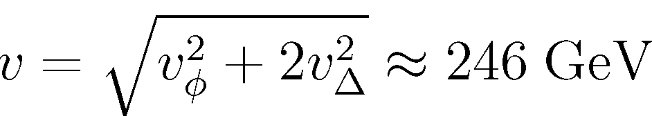
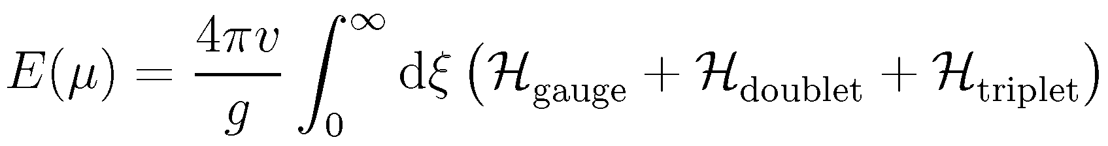
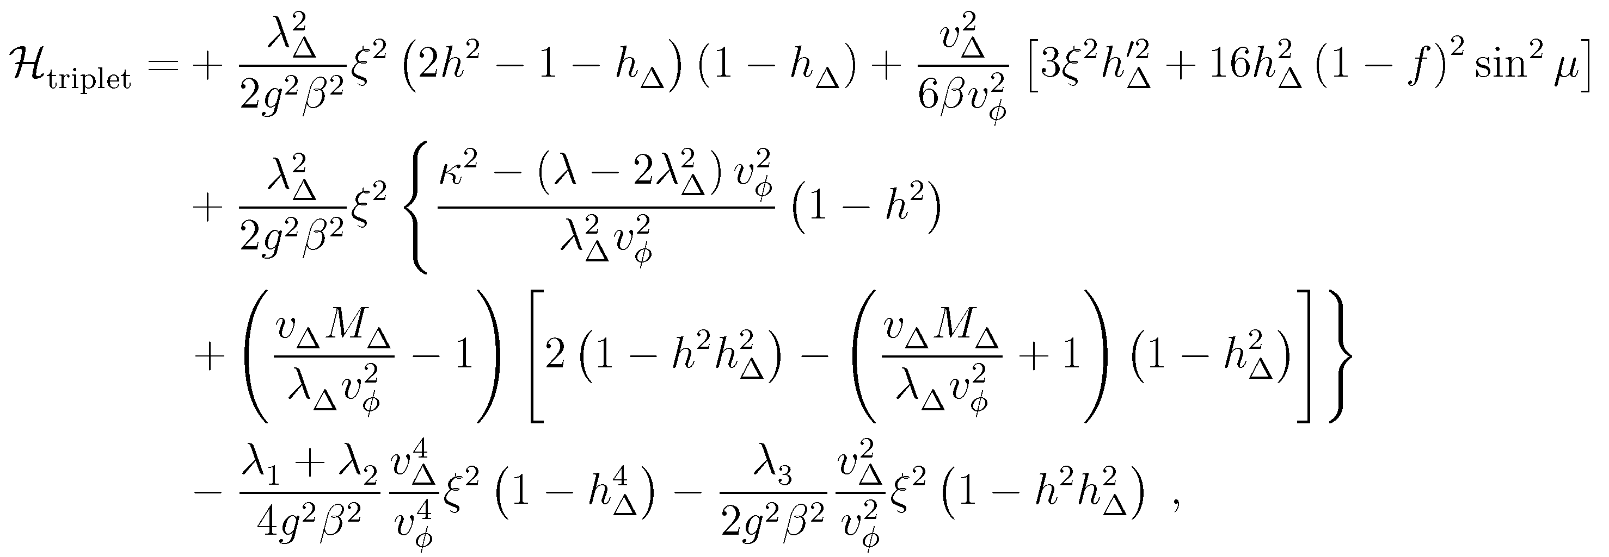



The HTM Sphaleron
Find the field equations
Introduce the dimensionless radius
Integrate out the angular parts
where the relevant energy densities are

Slide 10





The Minimal Scenario
Reduce the number of parameters: ignore all quartic terms in the scalar potential
The total energy and parameters
the SM case
The field equations to be solved
In principle the Higgs triplet could affect the sphaleron energy significantly
However current observations restrict the triplet-doublet vev ratio to be small

Slide 11









The Spectral Method
A general method to numerically solve the coupled non-linear differential equations
an arbitrary function
coefficients
a complete set of orthogonal functions
In practice the expansion must be truncated at n = N
a properly-chosen set of grid points
first derivative at x = x_{j}
Differentiation matrix

Slide 12





The Spectral Method
Choose the Chebyshev polynomials
Orthogonality
Completeness
½ for the first term
u(x) defined in [-1, +1]
Roots
differentiation matrix
Extrema
grid points

Slide 13






The Spectral Method
Validation of the method
for the SM
Sphaleron energy: rapid convergence for N > 20
Profile functions for gauge and Higgs fields
Using the spectral method, one can convert the differential equations into algebraic equations
The original functions are then reconstructed via the ordinary Lagrange interpolation formula

Slide 14



Numerical Results
Sphaleron energy: SM & HTM
Gauge and Higgs field profiles
for the SM
Negligible impact

Slide 15
Summary and Outlook
The sphaleron in the electroweak theory plays an important role in the investigations of B- and L-symmetry breaking and baryogenesis
Soliton: a static, stable and finite-energy solution to the classical field equations in the Minkowski space with a real time
Sphaleron: a static, unstable and finite-energy solution to the classical field equations in the Minkowski space with a real time
Instanton: a localized and finite-action solution to the classical field equations in the Euclidean space with an imaginary time
Klinkhamer, 2016
The sphaleron in the Higgs triplet model is carefully studied, but the energy difference from the SM is found to be small due to constraints on the ratio of triplet-doublet vevs
The correction could be as large as 30% in a contrived region of parameter space; some improvement can be made, including the sphaleron rate and finite-temperature effects
Thanks for your attention!

