Slide 1
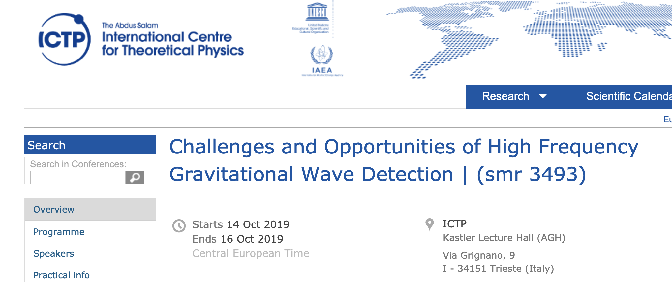
Intertwining Axion and gravitational waves, generations and detection
Nov, 02@大连
孙斯纯 （Sichun Sun）
北京理工大学/Beijing Institute of Technology
Based on:1911.04511, 2003.10527, 2206.13543, 2305.00877，2309.15069 ，2309.08407 , 2405.00490, 2406.13480
With Yu Gao(IHEP), Fei Gao (BIT), Jungsong Cang(IHEP), Junxi Duan(BIT), Chang-Yin Ji(BIT), Yugui Yao(BIT), Yiming Liu(BIT), Chu-Tian Gao(BIT), Jinneng Luo(BIT), Mingqiu Li (GUCAS &BIT), Yun-Long Zhang(NAOC), Qi-Shu Yan(GUCAS), Zhijie Zhao (GUCAS &DESY), Graham White (Southampton).

Slide 2
Outline
Blackholes and axions.
High-frequency gravitational waves (HFGW): A review
HFGW/axion detection
HFGW/axion generation: Early universe wave production, mergers, phase transition.
Pulsars for axion and GW

Slide 3
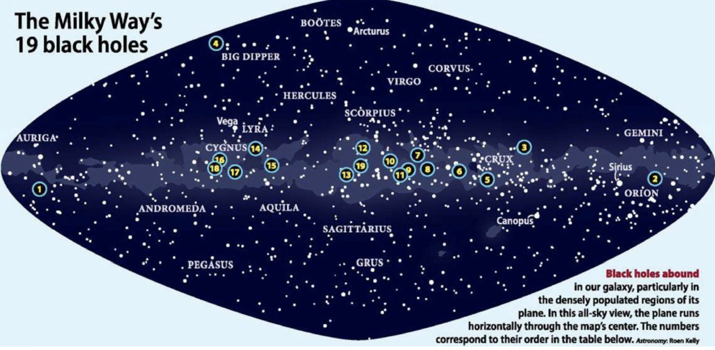

Slide 6
Video credit to:HXMT identification of a non-thermal X-ray burst from SGR J1935+2154 and with FRB 200428
C. K. Li, L. Lin, S. L. Xiong, S.N. Zhang el
Nature Astronomy volume 5, pages, 378–384 (2021)

Slide 7
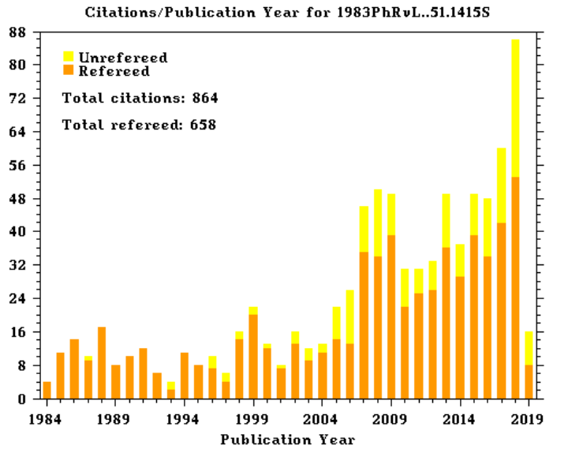
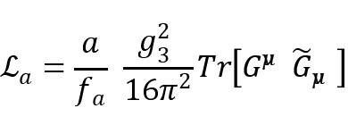
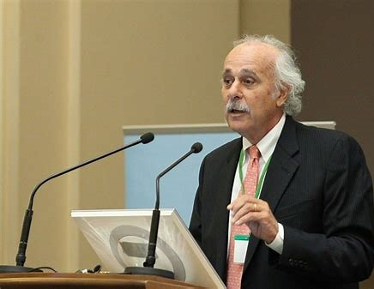
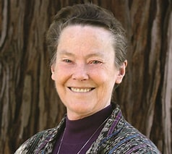
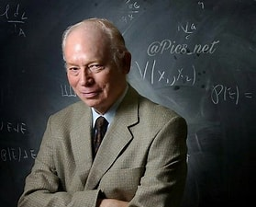
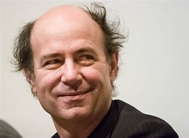
Axion: scientific importance
One very interesting dark matter candidate!
Solving strong CP problem (Fundamental symmetry)
One important particle in many beyond the
Standard Model extension
Large parameter space, tens of orders of magnitude:
m a ~ 10⁻⁵ eV, f a ~ 10¹³ GeV
Various detections with interdisciplinary fields and modern technology
Peccei-Quinn机制的 引用率走势（ADS）
Citations on the axion paper
R. Peccei
F. Wilczek
H.Quinn
S.Weinberg

Slide 8
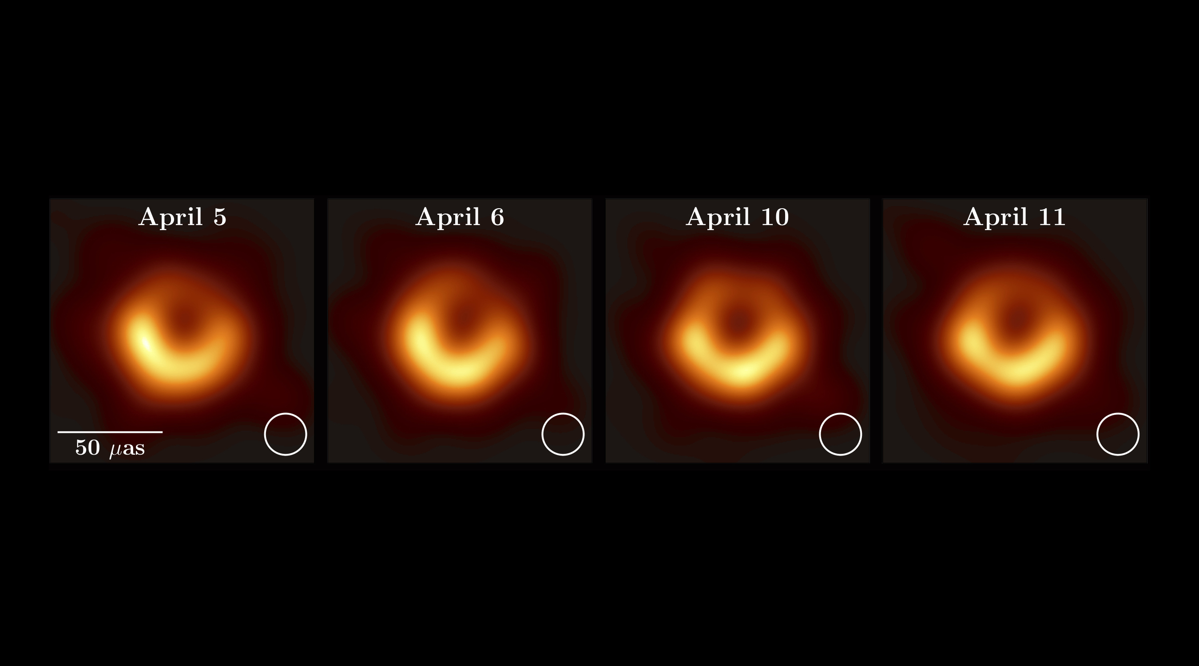
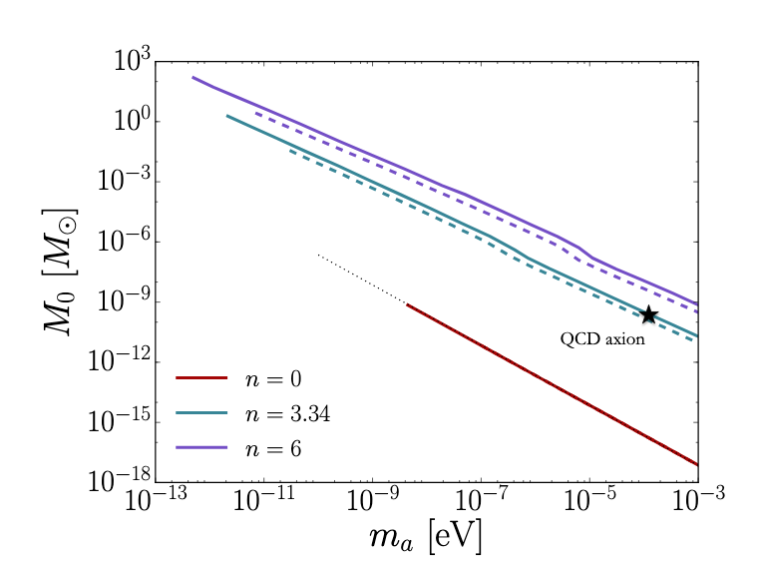
Axion clouds!
Axion stars (Boson stars, modula stars, etc).
1707.03310 by M. Fairbairn, D. J. E. Marsh, J. Quevillon and S. Rozier,

Slide 10
Black hole energy levels and gravitational waves

Slide 12
High-frequency gravitational waves detection
Inspirals
Stochastic sources
Monochromatic sources

Slide 13
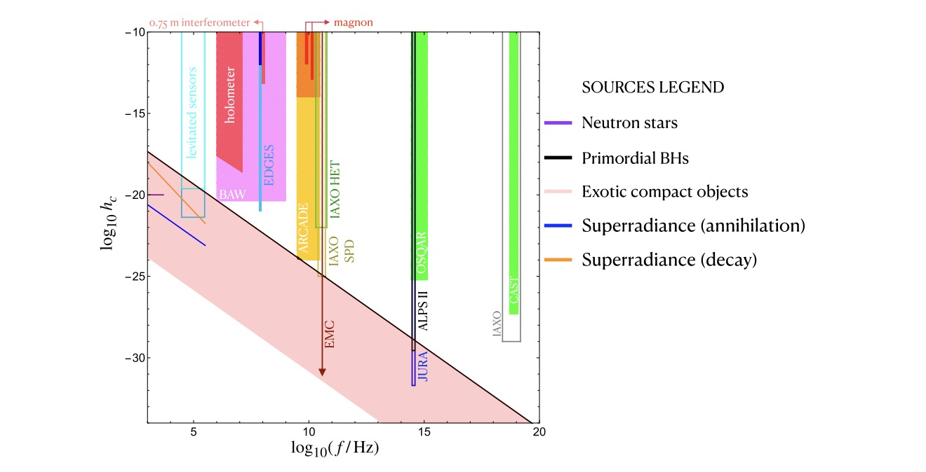
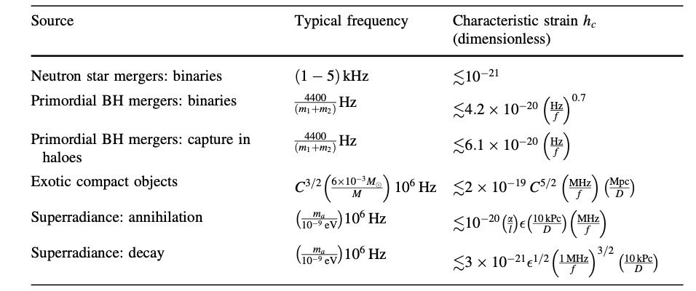
Coherent sources

Slide 14
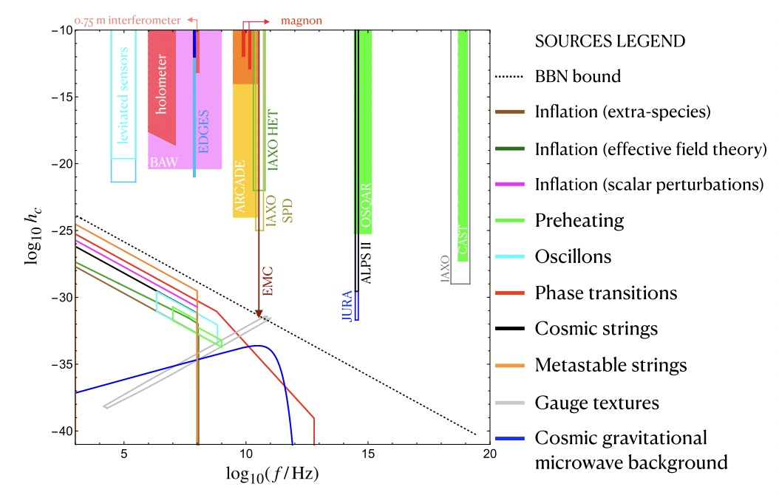
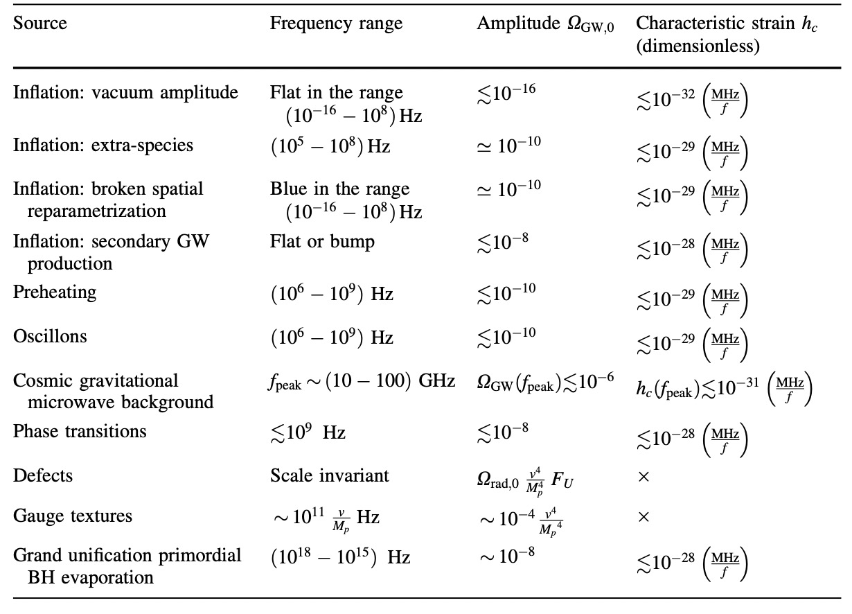
Stochastic sources

Slide 15
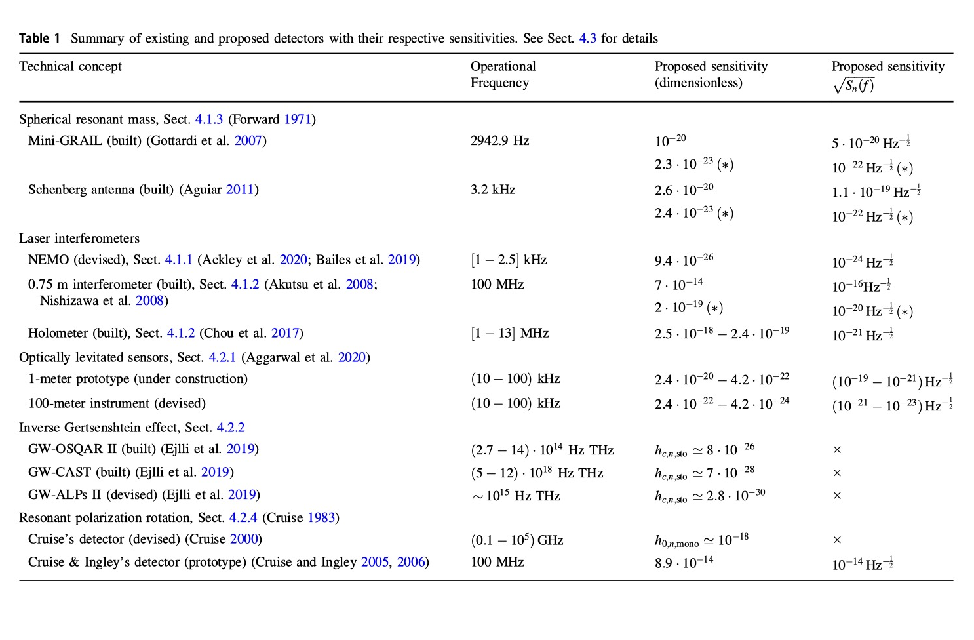
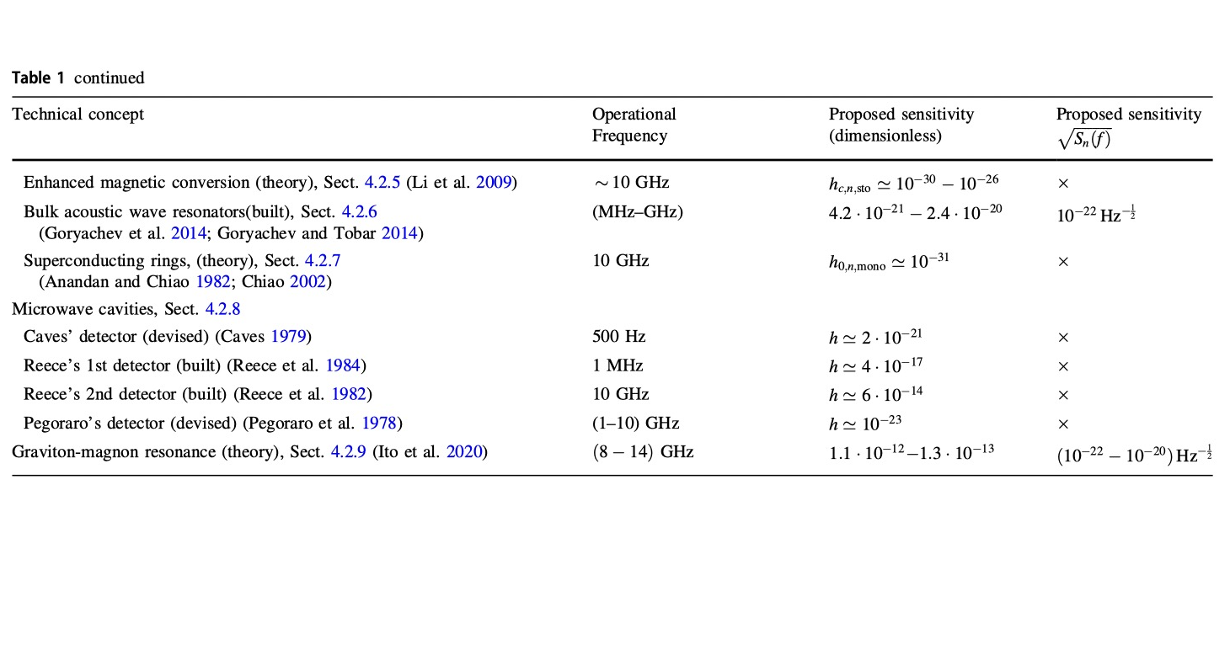

Slide 16
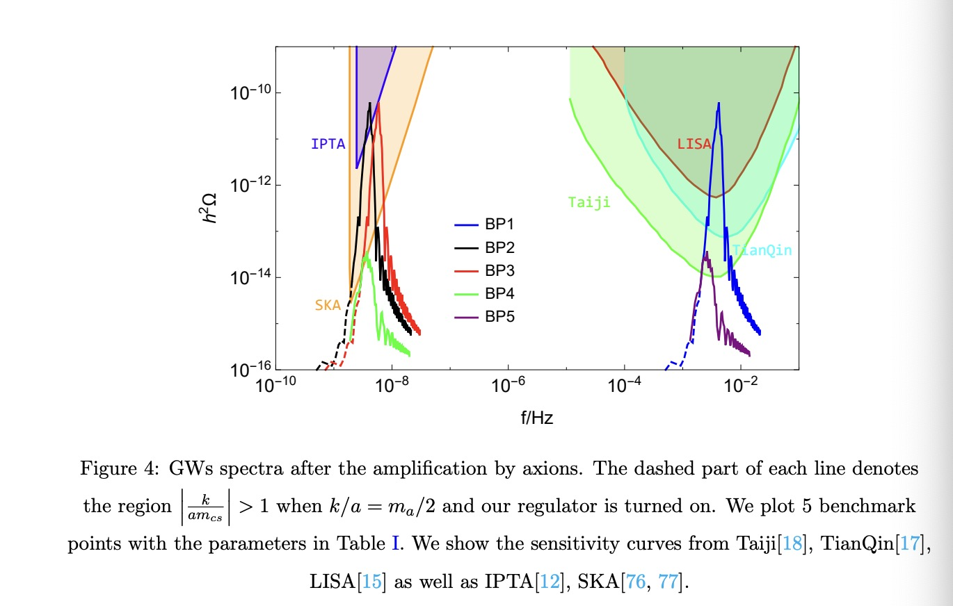
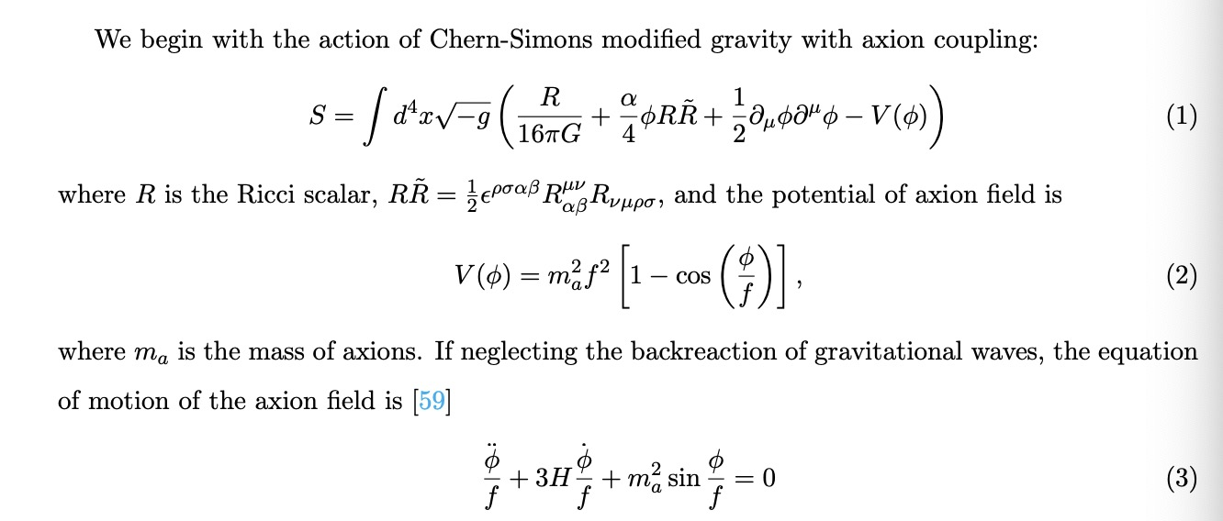
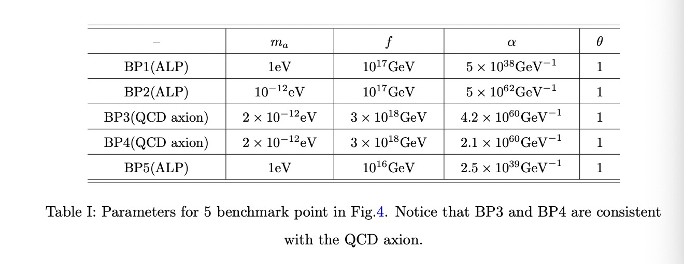
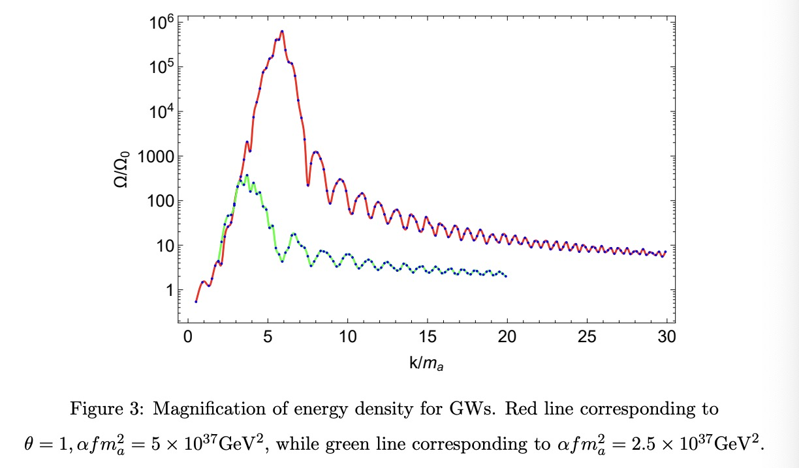
High Frequency GW from axion wave
arXiv: 2309.08407 accepted by EPJC

Slide 17
Attempts to realize the first order QCD Phase Transition in the early universe:
arXiv: 2405.00490
Large Chemical Potential:
Still within the Standard Model QCD
With different early universe large chemical potential(BSM in the other sector)
Chiral phase transition with zero mass quarks:
Probably second order……thought to be the first order before
The chiral phase transition of QCD in all massless cases with quark flavor Nf <=6 is consistent with a second-order transition at zero chemical potential from a recent lattice simulation
Our approach: Gluon condensate.
Different from a Pecci-Quinn phase transition

Slide 18
Attempts to realize the first order QCD PT in the early universe:
—-Our approach: Gluon condensate
This term corrects gluon propagator, induces a gluon condensate: an effect with pure Yang-Mills
Compared to Peccei-Quinn symmetry breaking, pseudo scalar axion as Nambu-Goldstone boson:

Slide 19
Thermal Polyakov loop as the order parameter:
At lowest non-trivial (one-loop) order in a perturbative expansion, the potential
For SU(3) YM theory

Slide 20
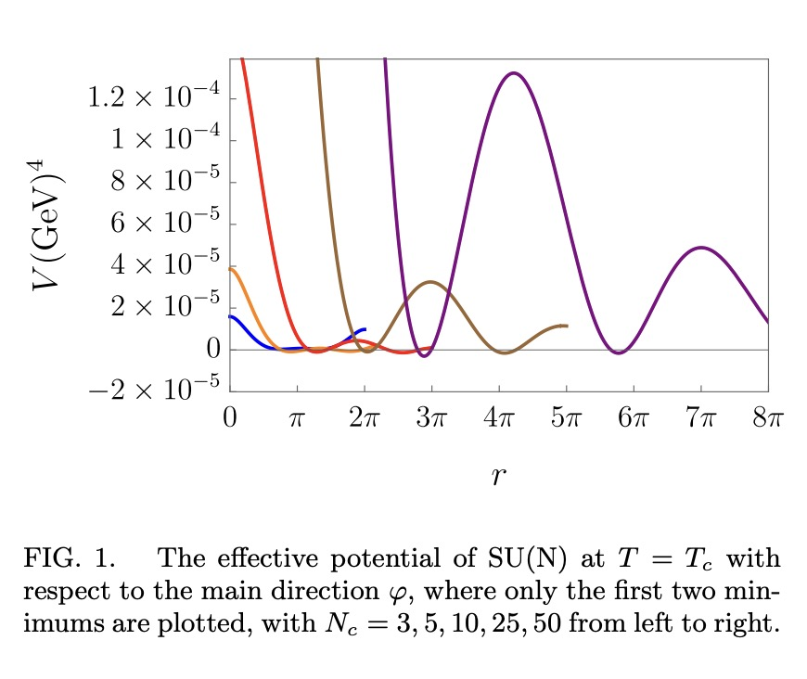
Thermal Polyakov loop as the order parameter:
Generalized to SU(Nc) theory:
From the potential form, phase transition always happens at point:
Or with the extra scalar:

Slide 21
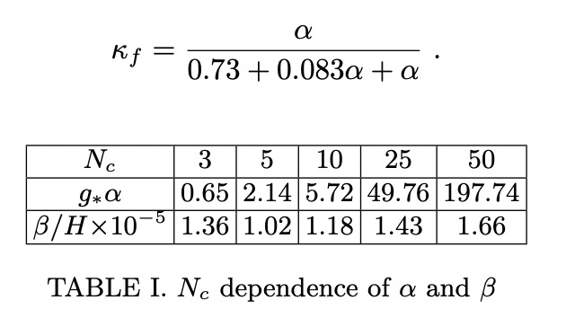
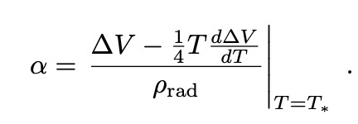
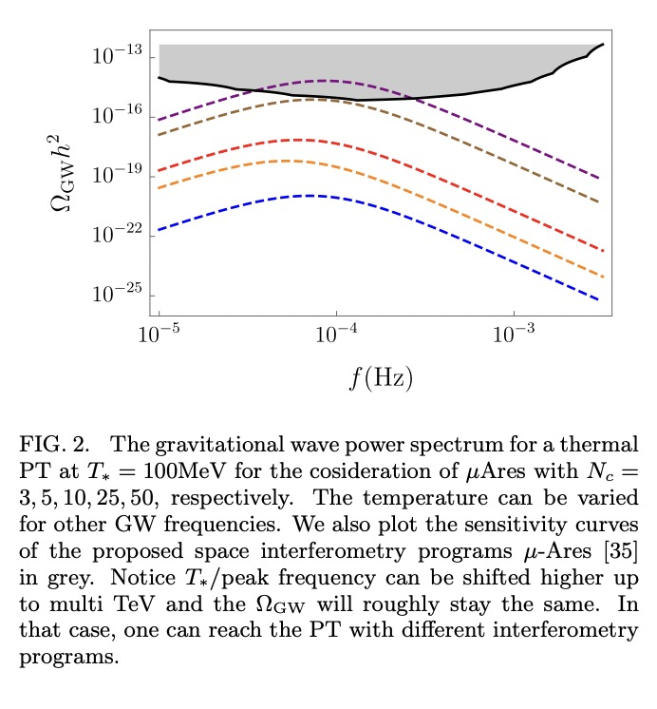
Gravitational waves production from effective potential:

Slide 22
Inverse Gertsenshtein effect ——Detecting High-frequency gravitational waves
From TT gauge to PD gauge:
See Maggiore M (2007) Gravitational Waves. Vol. 1:
Theory and Experiments. Oxford University Press.

Slide 23
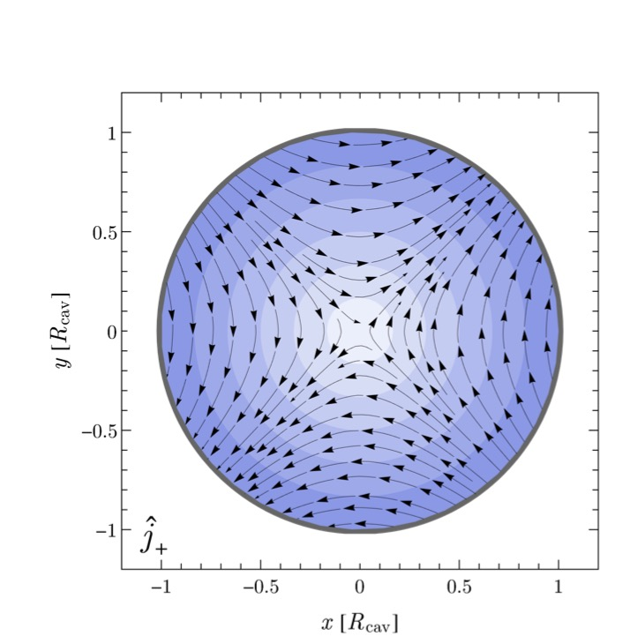
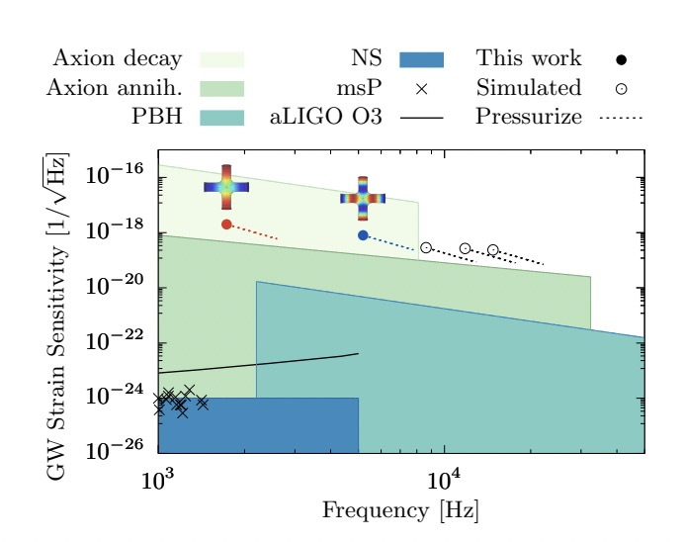
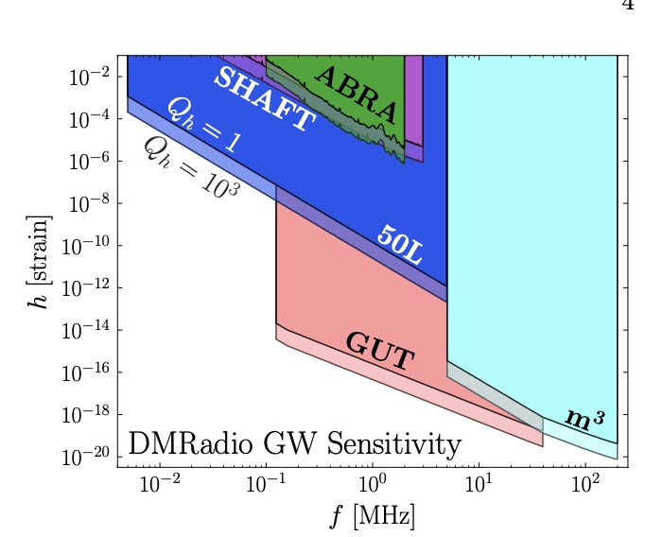
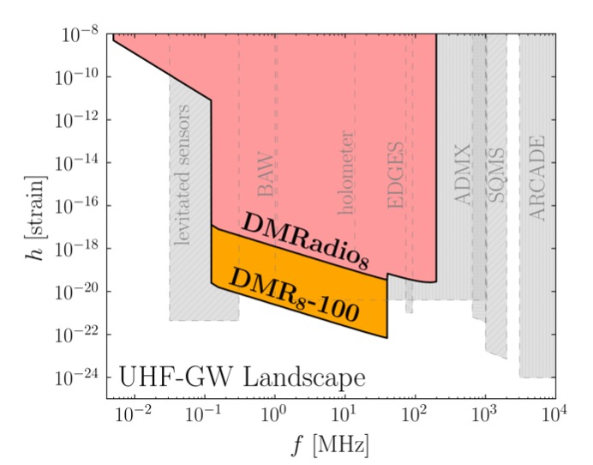
Effective current plot:

Slide 24
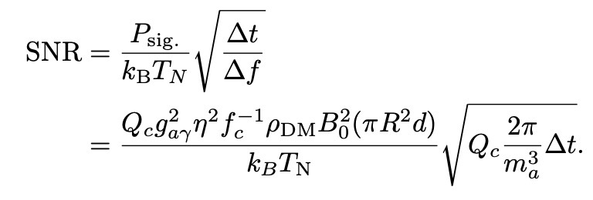
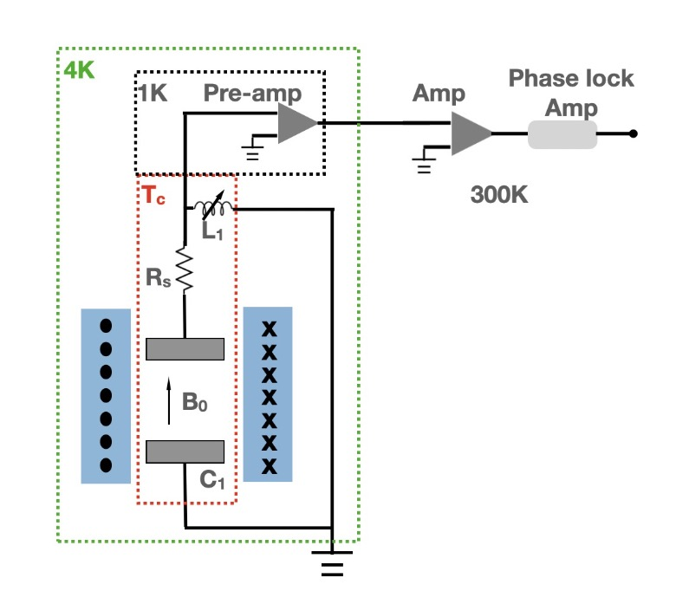
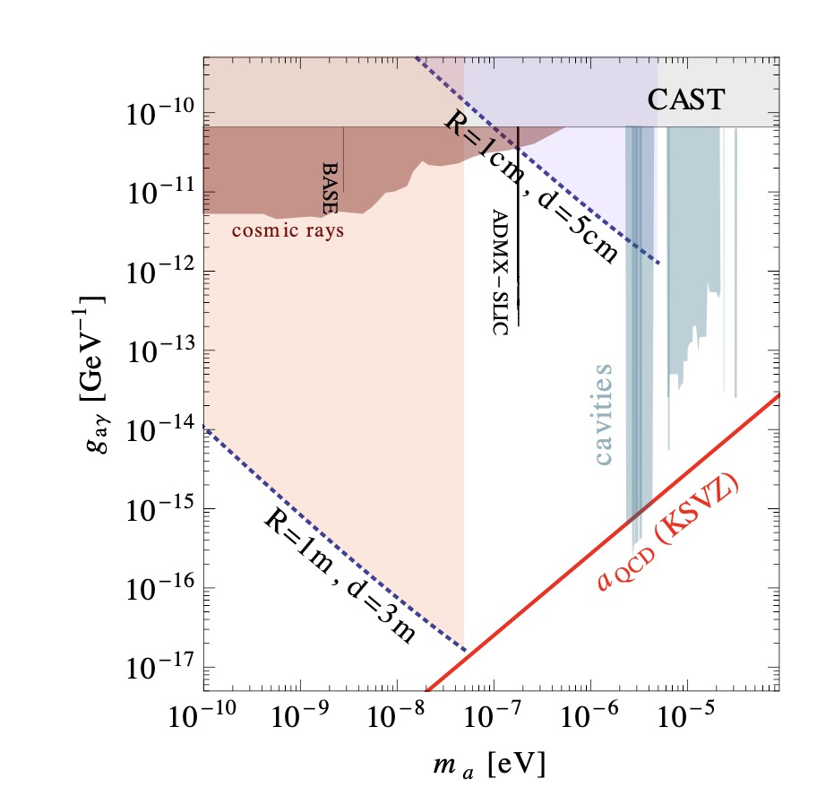
Experimental setups:
Resonant ELEctric Axion Probe(RE-LEAP)

Slide 25
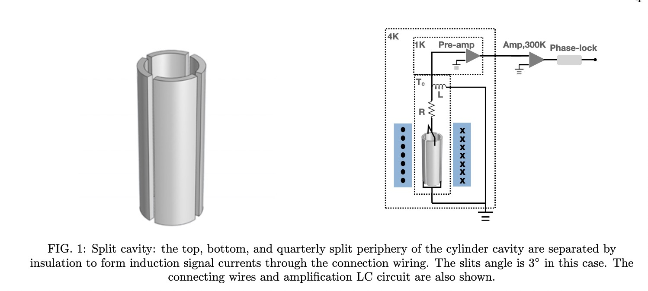
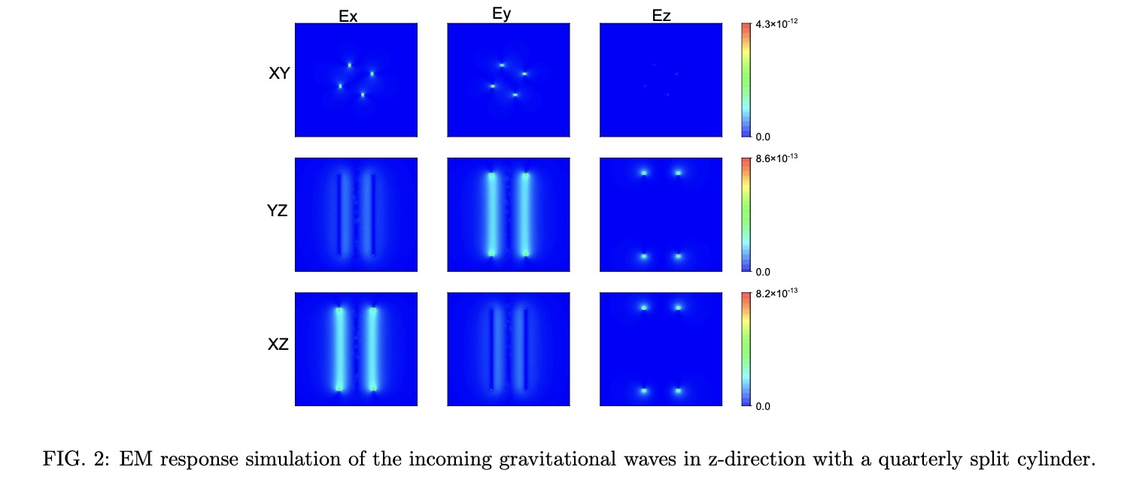
arXiv: 2305.00877,
PRD,109 (2024) 8, 084004

Slide 26
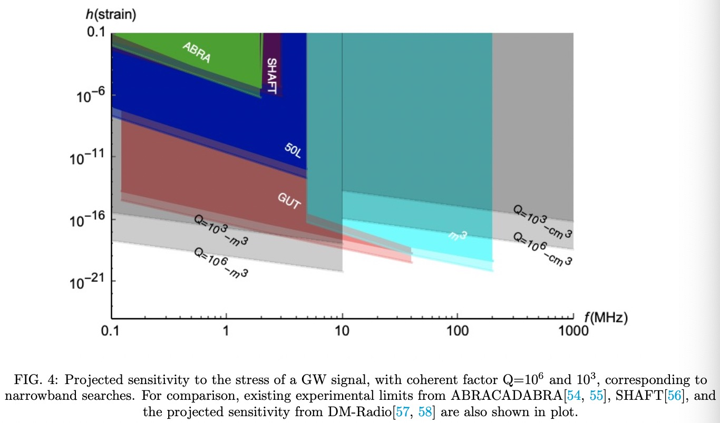
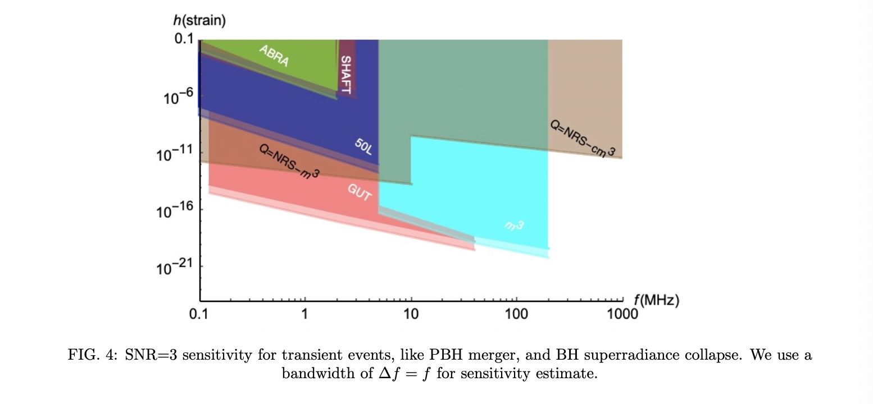

Slide 27
脉冲星计时阵列探测到了极低频引力波证据
(2023国际十大科学进展)
可能暗示了高频引力波

Slide 28
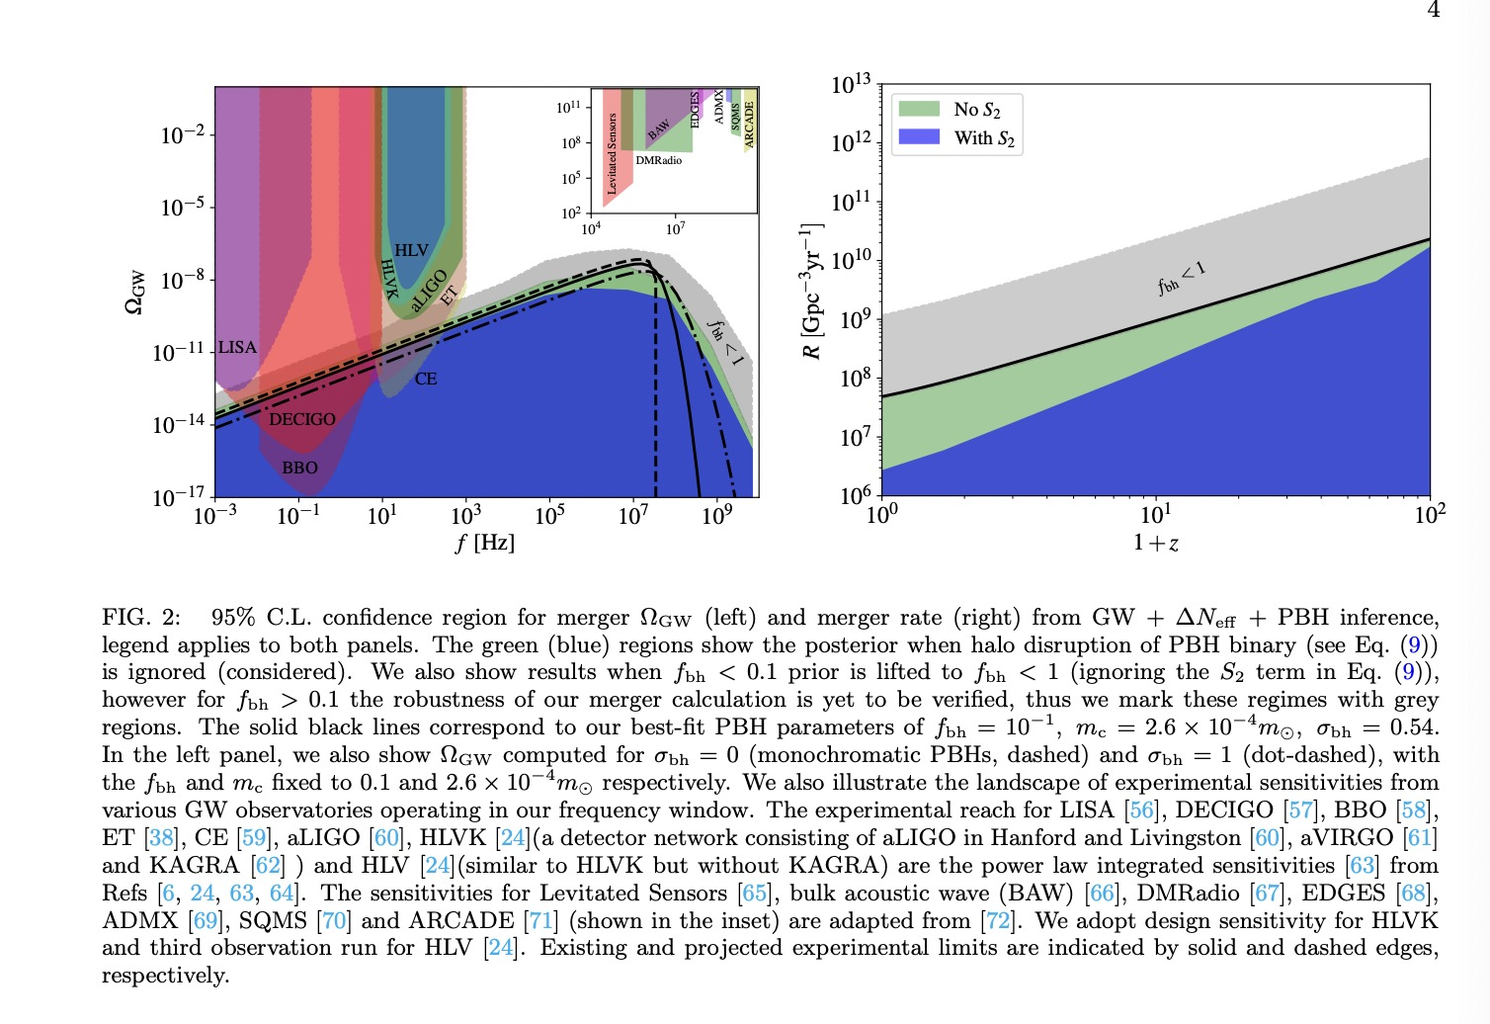
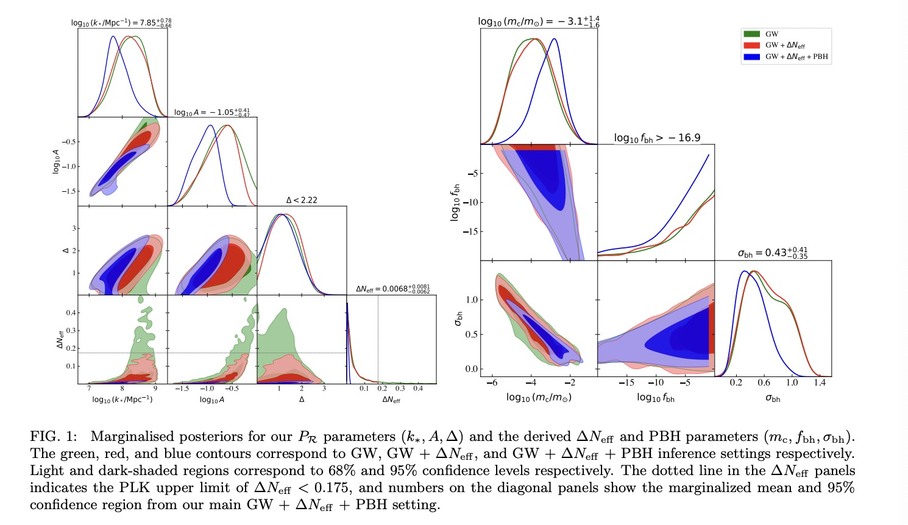
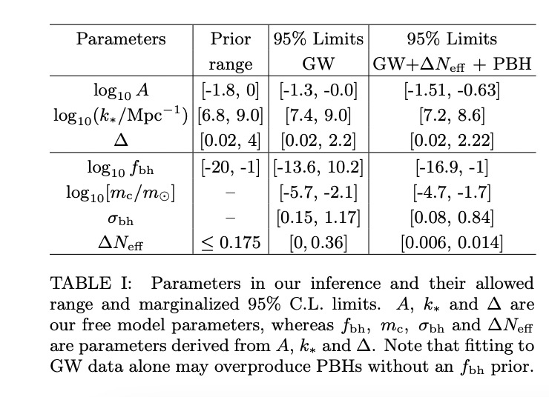
PTA(low-frequency GW) implies the primordial blackhole formation
HFGW from those primordial blackhole merger——crosslink joint analysis
arXiv: 2309.15069

Slide 29
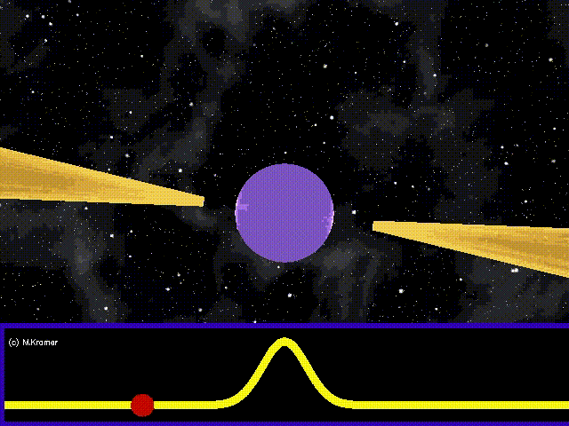
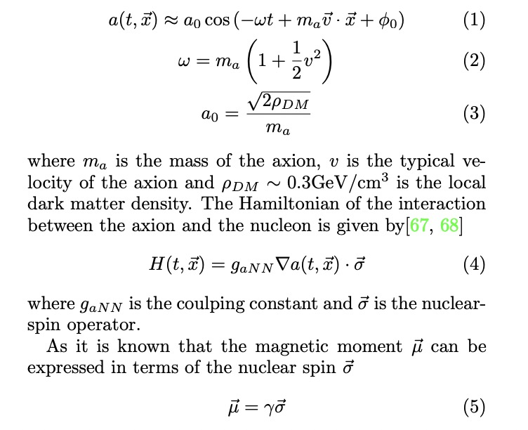
Arxiv: 2406.13480

Slide 30
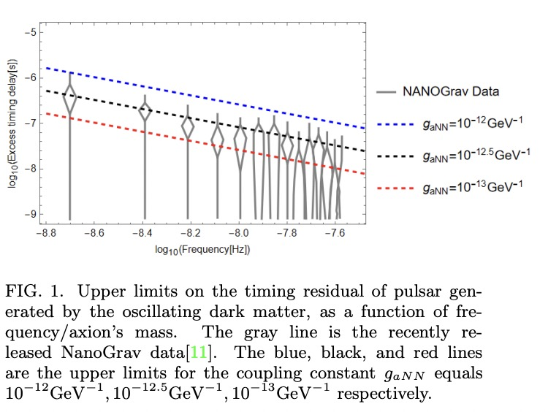
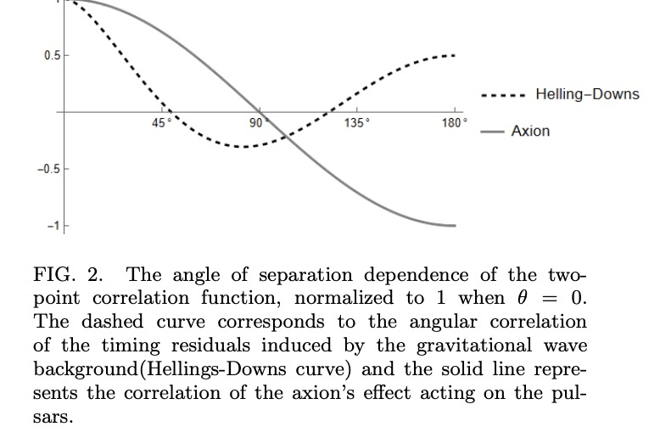

Slide 31
Summary
We have many ways to detect axion&GW.
Direct (Lab) vs indirect (through gravitational waves and PTAs!)
GW Generation:
Early universe wave production, mergers, phase transition.
Need a strong magnetic field and cryogenic technology in Lab.

Slide 32
Thank you

Slide 34
Black hole energy levels and gravitational waves

Slide 35
Resonant Electric Probe to Axionic Dark Matter 2206.13543
Axion detection communities:
Cavities:ADMX [26], HAYSTAC [27], CAPP [28],QUAX-aγ [29], TASEH [30], DANCE [31], ORGAN [32], CAST-RADES [33],
non-cavity high-frequency designs:MADMAX [34], BREAD [35], etc
lower axion masses : ADMX-SLIC [37], DM-Radio [38], BASE [39], ABRA CADARA [40, 41]

Slide 36
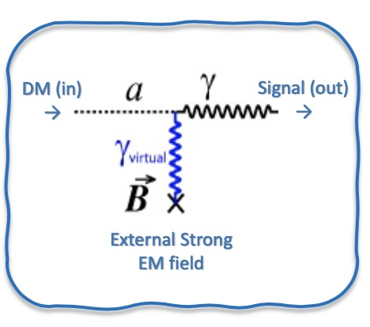
Axion modified Electromagnetism
Axion dark matter:
Axion effective charge and current satisfies:

Slide 37
Experimental setups:
Resonant ELEctric Axion Probe(RE-LEAP)

Slide 38
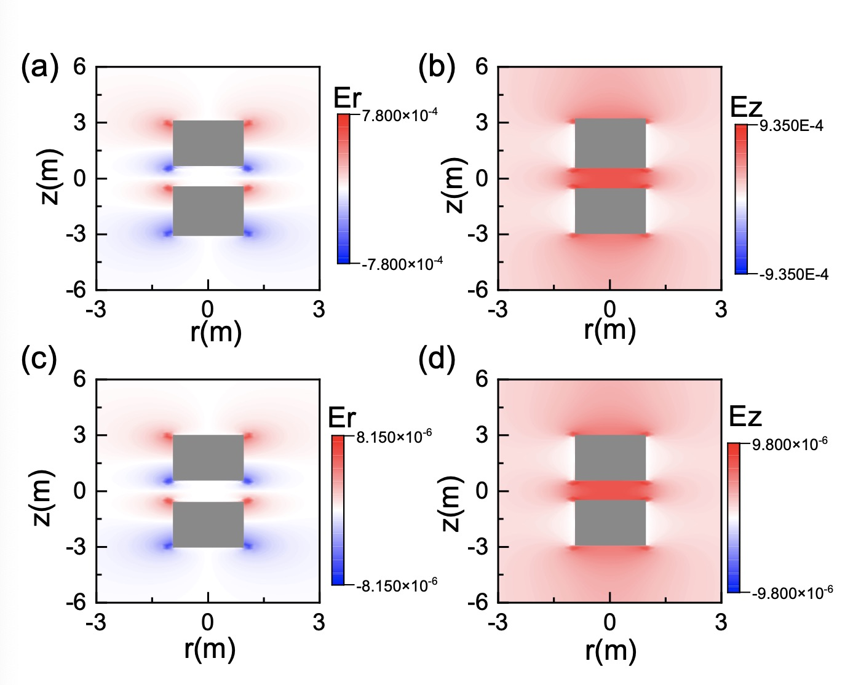
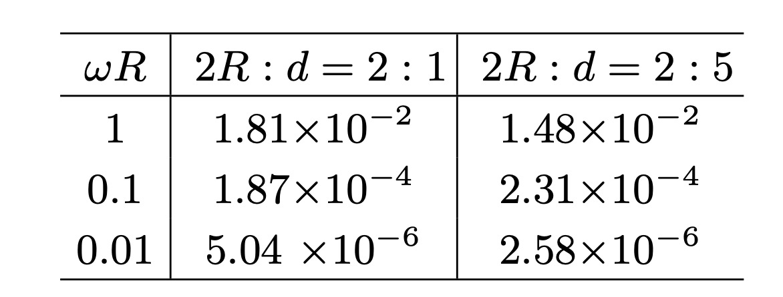
Numerical solutions:
With COMSOL Multiphysics:

Slide 39
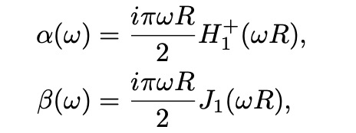
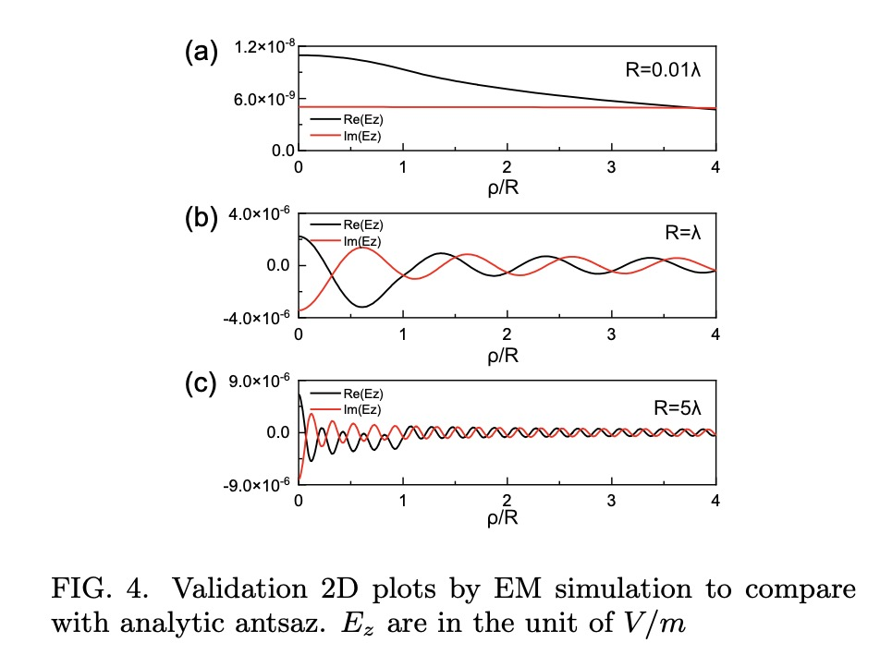
Long solenoid solutions

Slide 40
Slides credit to: Yu Gao

Slide 41
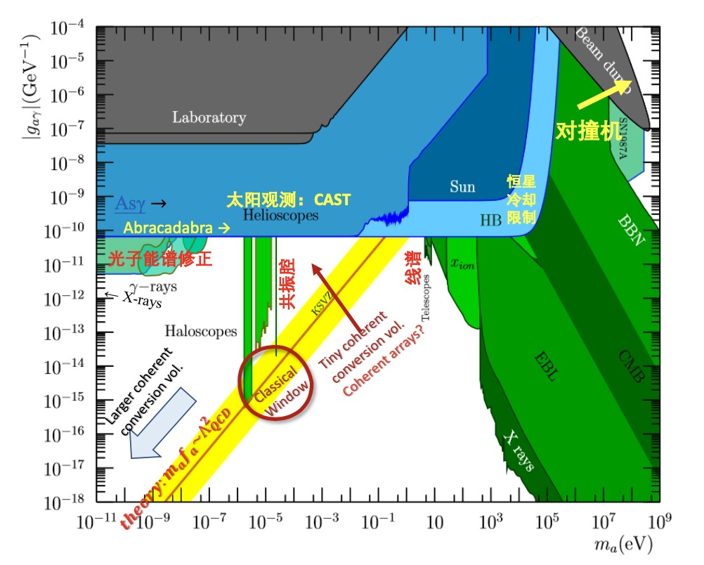

Slide 44
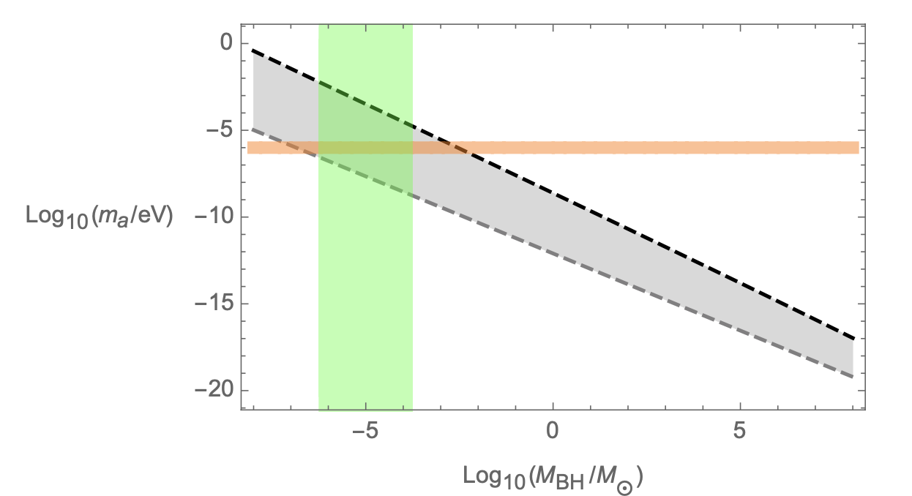
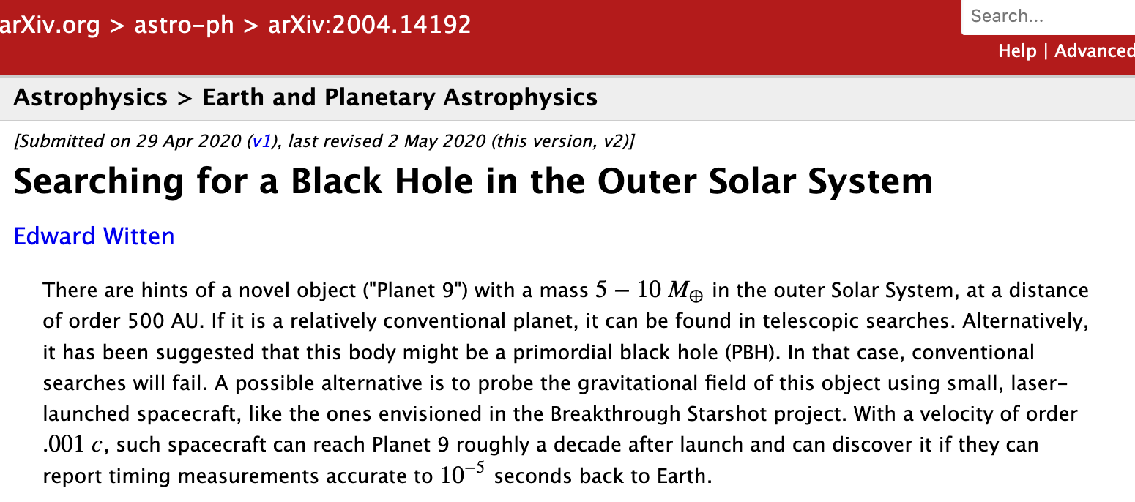
Superradiance:
Gravitationally bound “atom” with bosons (vector).
Around the black hole can emit gravitational waves for LIGO:
For primordial black hole:

Slide 46
Axion resonance
Lagrangian:
Equation of Motion:
Ansatz:
Solution:

Slide 47
Graviton-axion interaction
(Known as Chern-Simon gravity: very weakly constraint and !
Similar resonance behaviors

