Slide 1
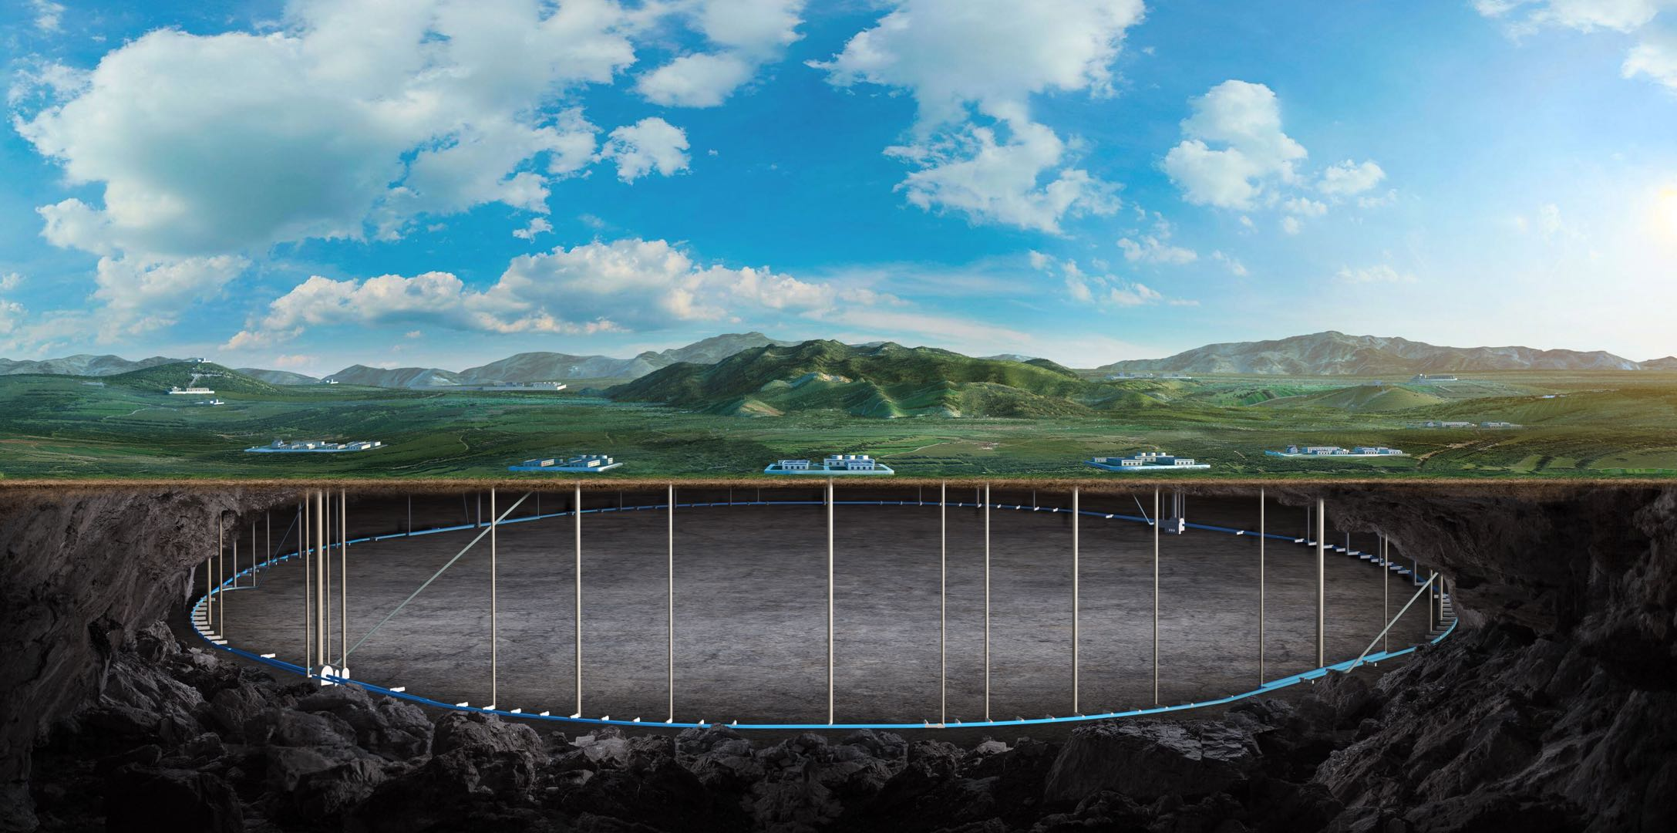
CEPC injection and extraction system EDR progresses
(including the kickers replacing electro-magnetic separators)
Jinhui Chen
On behalf of the CEPC injection & extraction team
27. Sep. 2024, CEPC Day

Slide 2
Content
Injection & extraction system EDR progress
Septum magnet
Half-sine wave kicker pulser
Alternative scheme of RF region beam separating system
Ferrite-core kicker with CW square-wave power supply
RF resonance kicker system
Summary

Slide 3
Injection & extraction system EDR progress
Lambertson Septum

Slide 4
Type and quantity of septum magnets
Lambertson magnet (LSM)with DC exciting was adopted in CEPC inj.&ext. system due to its higher reliability.
The total number of LSM is 180 sets.
No | Hardware | Type | Typical parameters |  |  |  | Unit | Number | Unit price (10,000 CNY) | Total Price (10,000 CNY)
 |  |  | Length | B | Septum | Clearance
1 | thin septa | In-vac LSM | 1.75m | 0.8T | 2mm | 20*20mm | set | 28 | 58 | 1624
2 | thick septa1 | In-air LSM | 1.75m | 0.8T | 6mm | 20*20mm | set | 148 | 25.8 | 3818.4
3 | thick septa2 | In-air LSM | 1.2m | 0.8T | 5.5mm | 50*50mm | set | 2 | 22.8 | 45.6
4 | thick septa3 | In-air LSM | 0.5m | 0.8T | 3.5mm | 30*30mm | set | 2 | 20.8 | 41.6
 |  |  |  |  |  | Total Number: | set | 180 | Total price: | 5529.6

Slide 5
Two types of Lambertson magnets for TDR
To realize thinner septum as possible, 2 novel structures of magnet were proposed:
Magnet pole
Wall of stored beam pipe
+
Wall of injected beam pipe
+
Iron septum
+
installation margins
Installation margin
Septum
thickness
Injected bunch
=
Yoke
half-in-vacuum
(for septum of 2mm)
Stored bunch
Thin septum
(IN-VAC)
Magnet pole
Installation margin
Injected bunch
SS
Half in-vacuum
Quantity:28 sets
Installation margin
Yoke
Magnet pole
Stored bunch
Installation margin
Injected bunch
embedded thin-wall vacuum chamber
(for septum≥3.5mm)
SS
Iron or
VP(FeCoV，1J22)
Thick septum
(IN-AIR)
Yoke
Traditional LSM
Stored bunch
Quantity:152 sets
in-air

Slide 6
LSM design considerations in EDR phase
What experiences and lessons can be learned from HEPS?
How to reduce the cost of magnets?
How to reduce the difficulty of magnet manufacturing, assembly and magnetic field measurement?
How to make magnets longer to decrease the magnet quantity?
1.75m -> 4m？
Vacuum achievement？
Iron-core manufacturing？
Magnetic-field measurement？

Slide 7
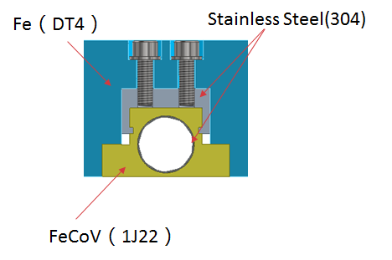
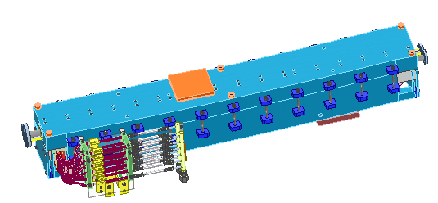
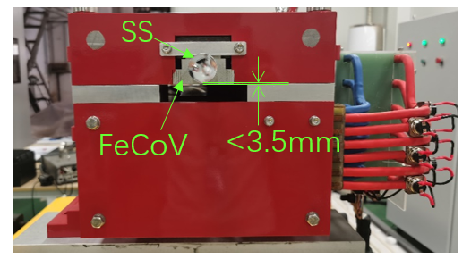
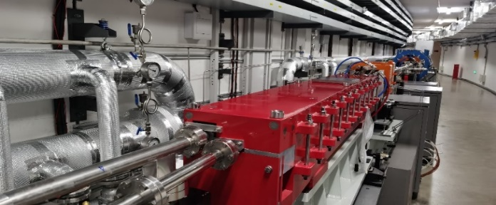
IN-Air LSM
Research status：final magnets for HEPS BST injection was applied in beam commissioning successfully last year.
BST injection LSM
BST extraction LSM

Slide 8
Experience and Lessons of in-air LSM for HEPS
FeCoV alloy（1J22）is hard to machine, the magnetic shielding blocks must segmented processing by EDM . And that, the embedded thin wall vacuum chamber for stored beam is needed.
It is difficult to control the deformation of the FeCoV blocks after 1000℃ annealing.
The seam between two materials on the magnet pole has an impact on the quality of the main field distribution and increase the leakage field.
Magnetic field measurement is difficult for the magnet with small aperture.

Slide 9
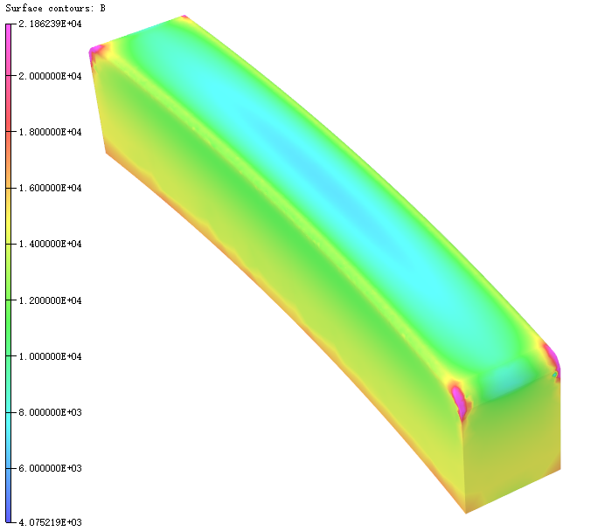
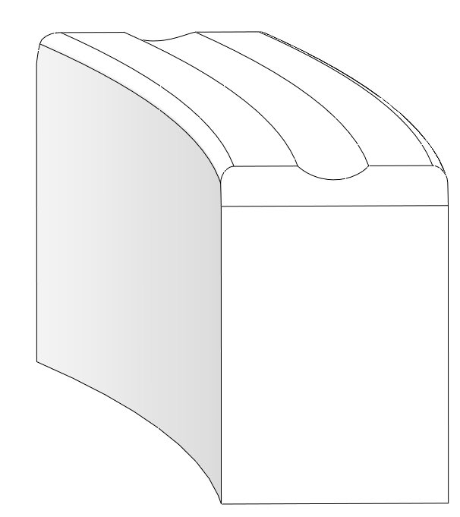
BS1LSM main field vertical field uniformity
2D model analysis: the real reason is that upper and bottom polar surface width is not symmetrical
W
D
有孔：2.75E-03
无孔：2.67E-03
ERROR:
5.83E-04
有孔：1.19E-05
无孔：4.73E-05
ERROR:
6.07E-04

Slide 10
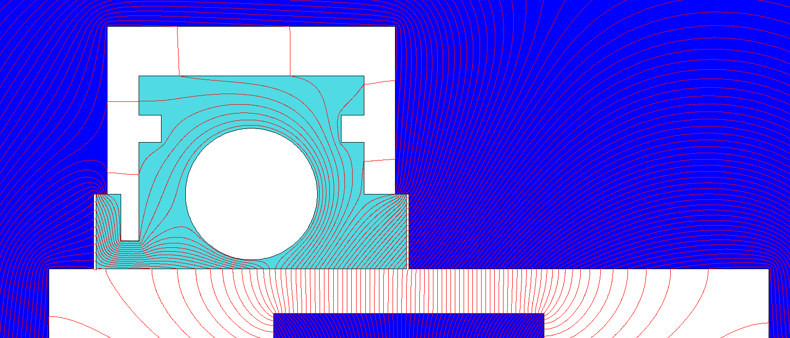
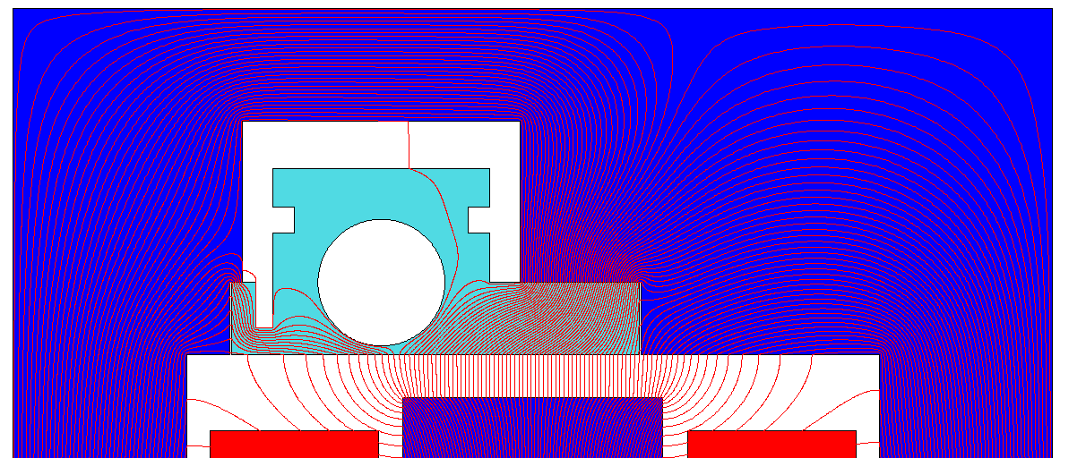
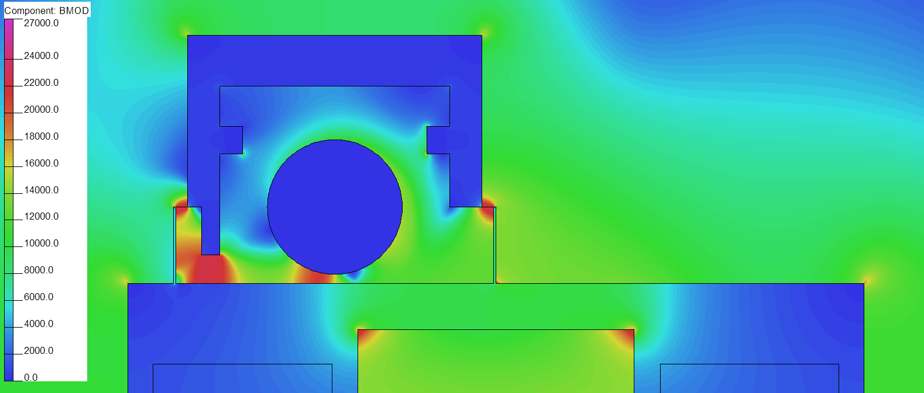
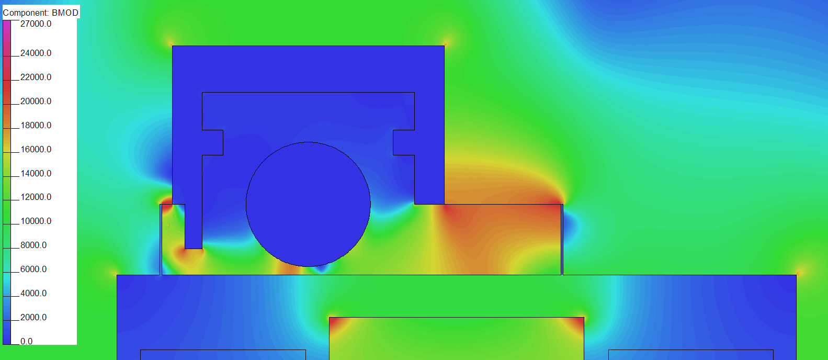
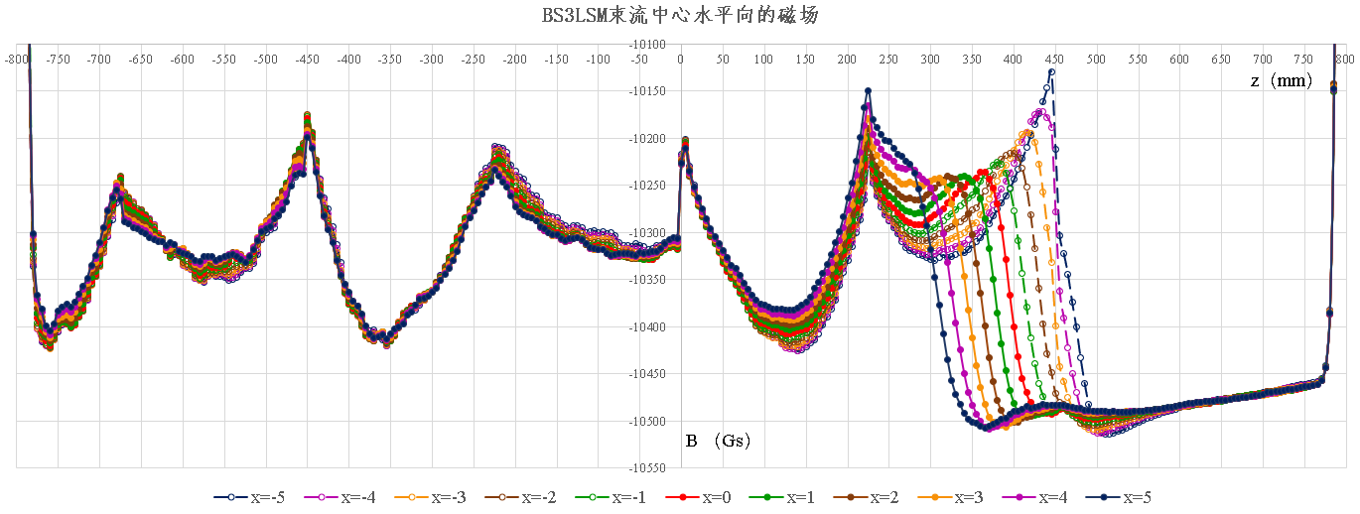
BS3LSM main field horizontal field uniformity
Measurement data display: the bad data is location at the region which injection beam track across the slot between DT4 and 1J22 block.
2D model analysis: If the overlap part is horizontal field distribution is narrow, the vertical slot between DT4 and 1J22 could significant impact the field distribution in horizontal.
Explore 25mm
0.5mm slot
0.5mm slot
Horizontal field uniformity is bad

Slide 11
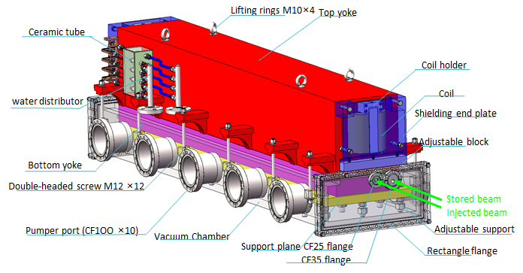
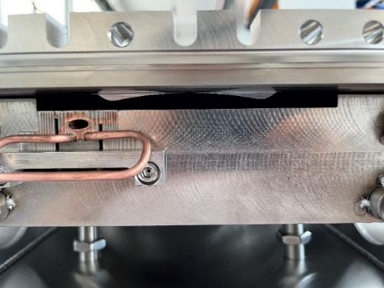
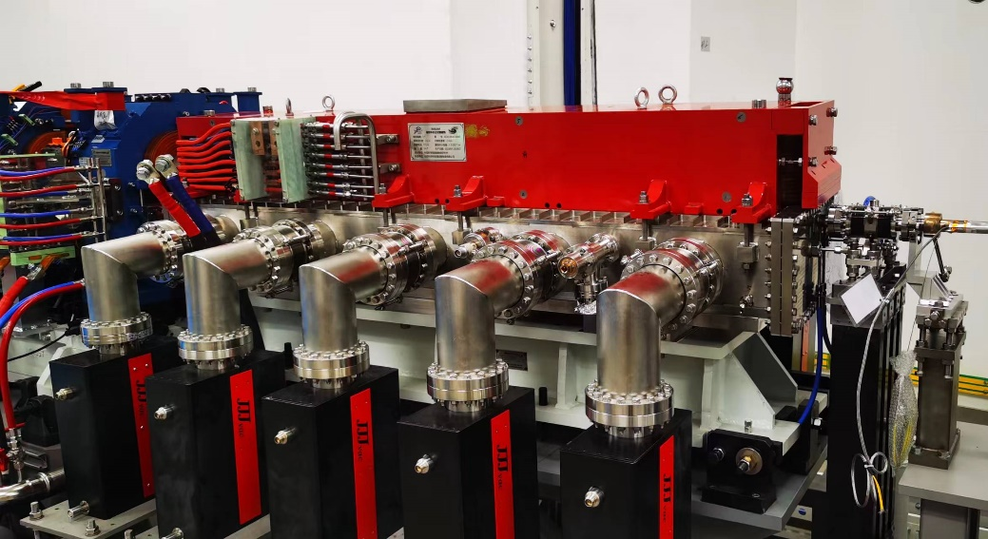
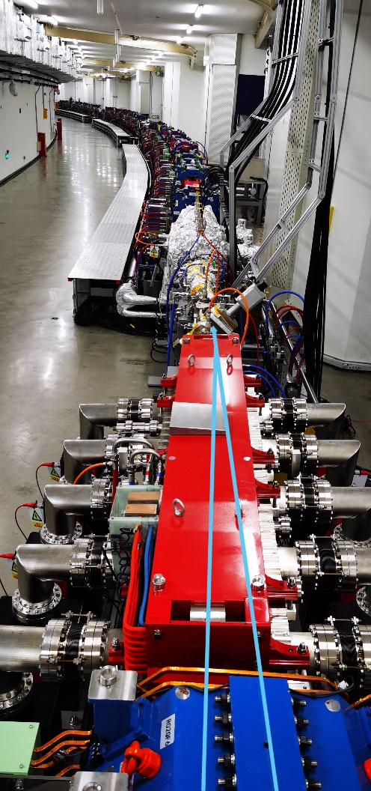
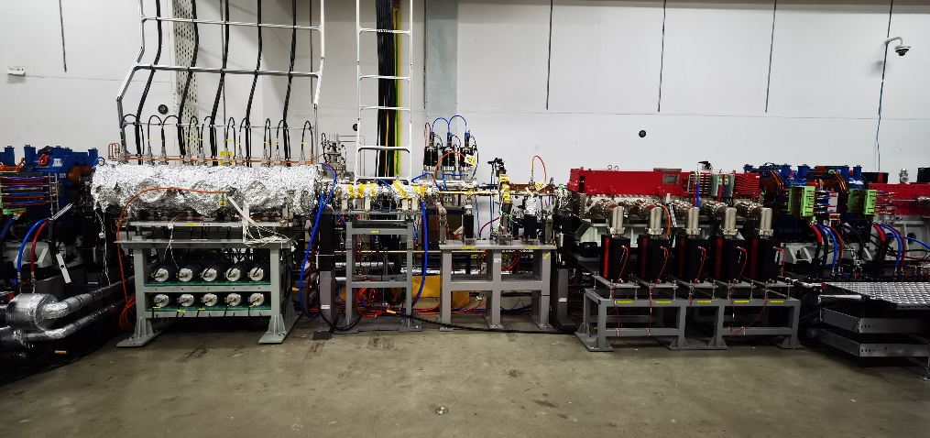
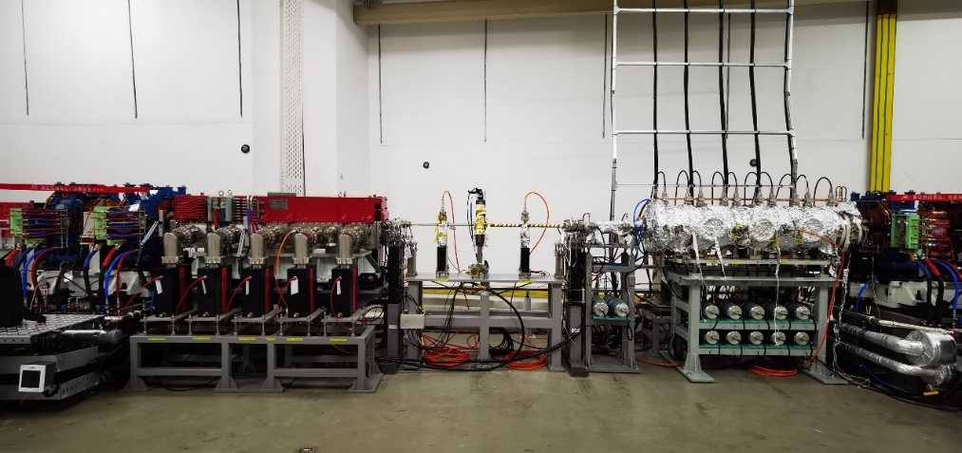
IN-Vacuum LSM
Research status：final magnets for HEPS SR was applied in beam commissioning successfully in July this year.
FeCoV
2mm
DT4
Cu
Full A:HxV=10.5mmx5mm
SR extraction LSM
SR injection straight section（R03）
SR extraction straight section（R48）

Slide 12
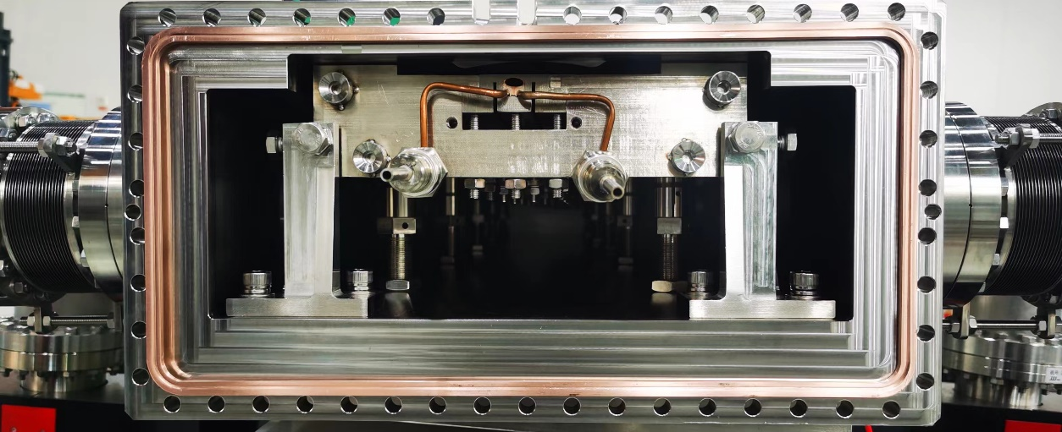
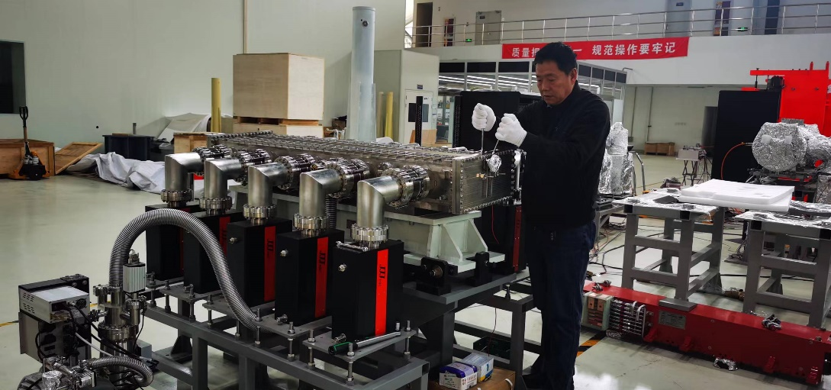
Experience and Lessons of in-vacuum LSM for HEPS
There are also difficulties in processing FeCoV alloy and magnetic field measurement
Other difficulties:
Processing, welding, and assembly of the rectangle vacuum chamber and the transition section.
Alignment of magnet in the vacuum
Rectangle flange vacuum sealing with knife-edge because of flange deformation.
Silver wire
Copper washer
一度成为HEPS的关键路线

Slide 13
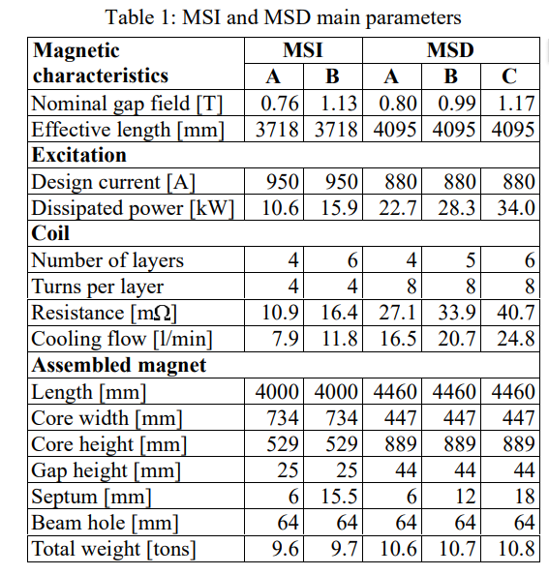
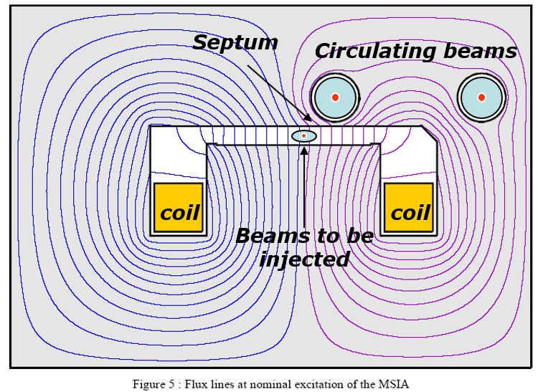
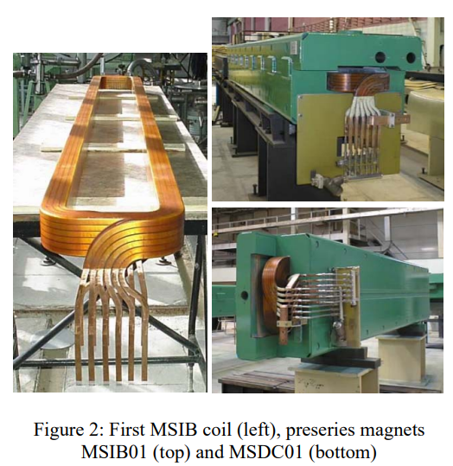
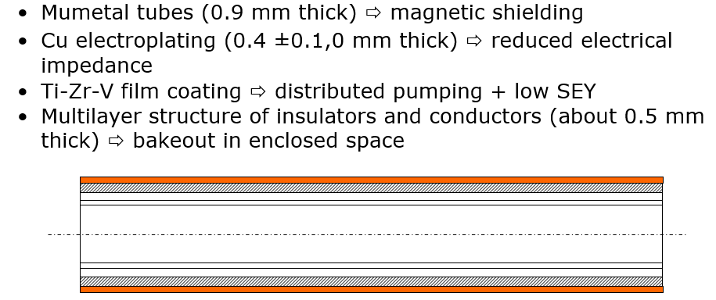
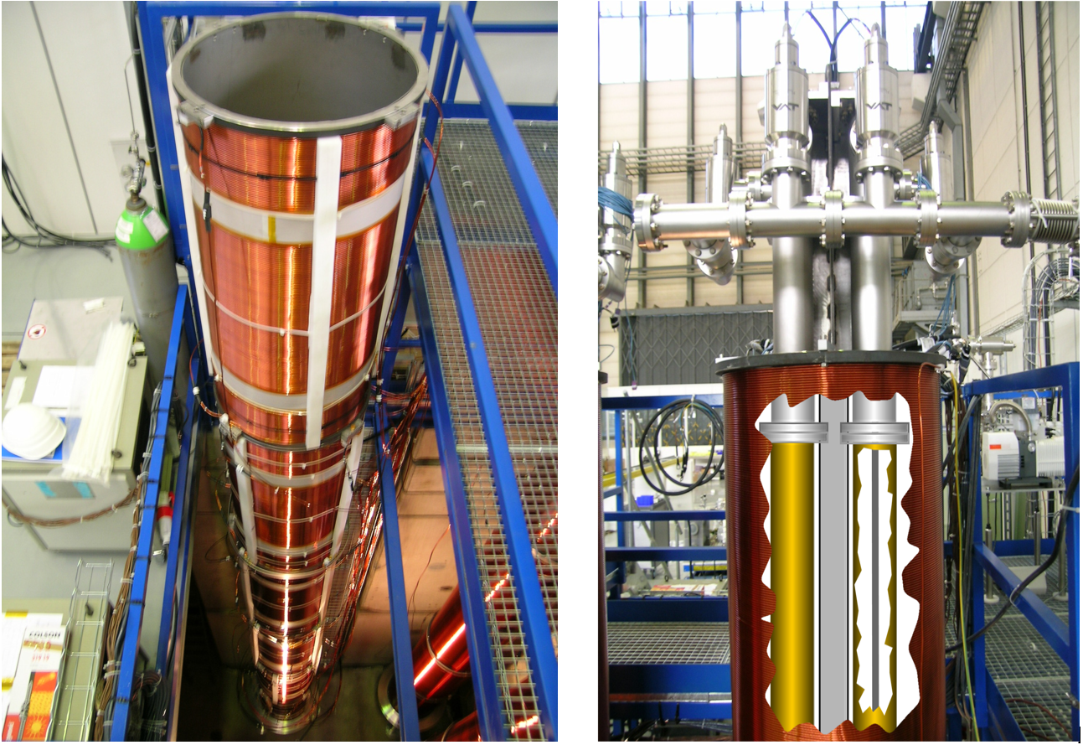
New explore：4-meter In-air LSM for LHC
4-meter Laminated iron core magnet
Magnetic shielding vacuum tube: Mumetal (domestic brand:1j77) + NEG coating
Need cooperation with vacuum system

Slide 14
Injection & extraction system EDR progress
Kickers and Pulsers

Slide 15
Type and quantity of kicker and pulser
In CEPC inj.&ext. System, there are 6 kinds of kicker and its pulser.
The total quantity of kicker and its pulser in CEPC is 100 sets, and the delay-line kicker and trapezoidal wave pulser account for largest proportion.
No | Hardware | Type | Typical parameters | Unit | Number | Unit price (10,000 CNY) | Total Price (10,000 CNY)
1 | kicker1 | delay-line dipole kicker | in-air delay-line dipole kicker, horizontal, 0.1mrad, 0.04T·m, L=1m, B=0.04T(H), inc. ion pump | set | 24 | 50 | 1200
2 | kicker pulser1 | trapezoidal wave pulser | PFN, solid-state,440~2400ns, inc. cable | set | 24 | 100 | 2400
3 | kicker2 | ferrite-core dipole kicker | in-air ferrite-core dipole kicker, horizontal,0.2mrad,0.08T·m, L=1m, B=0.04T(H)， inc. ion pump | set | 6 | 33 | 198
4 | kicker pulser2 | half-sine wave pulser | LC, solid-state,1360ns, halfsine, inc. cable | set | 6 | 31 | 186
5 | kicker3 | strip-line kicker | Strip-line kicker, vertical, 46ns, L=1m, inc. ion pump | set | 6 | 28 | 168
6 | kicker pulser3 | DSRD pulser | 46ns, ±12.5kV,DSRD pulser, inc. cable | set | 6 | 67 | 402
7 | kicker4 | slotted-pipe kicker | Slotted-pipe kicker,vertical,250ns,L=0.25m, DR beam pipe φ=30mm, inc. ion pump | set | 2 | 23 | 46
8 | kicker pulser4 | trapezoidal wave pulser | solid-state,inductive adder, 250ns, inc. cable | set | 2 | 40 | 80
9 | dilution kicker | CW full-sine | CW full-sine，L=2m，150Gauss，T=25us, total length=10m | set | 10 | 30 | 300
10 | dilution kicker pulser | CW full-sine | CW full-sine，T=25us | set | 10 | 30 | 300
11 | NLK | NLK | in-air Nonlinear kicker or pulsed sextupole, horizontal, 0.1mrad, 0.04T·m, L=1m, inc. ion pump | set | 2 | 38 | 76
12 | NLK pulser | half-sine wave pulser | LC, solid-state,0.3ms, halfsine, inc. cable | set | 2 | 15 | 30
 |  |  | Total Number: | set | 100 | Total price: | 5386

Slide 16
Design parameters of ferrite core kickers for CEPC
There are 2 kinds of kicker with ferrite core for trapezoid wave and half-sine wave pulsed system.
parameter | Unit | BST-EXT-kicker1/CR-inj-kicker1/dump （for CR off-axis inj.） | BST-EXT-kicker2/CR-inj-kicker2 （for CR on-axis inj.）
Type | - | In-air delay-line dipole kicker | In-air lumped parameter dipole kicker
Deflect direction | - | Horizontal | Horizontal
Beam Energy | GeV | 120 | 120
Deflect angle | mrad | 0.1 | 0.2
Magnetic effective length | m | 1 | 1+1
Magnetic strength | T | 0.04 | 0.04
Integral magnetic strength | T·m | 0.04 | 0.08
Clearance region(H×V) | mm | 56×56 | 56×56
Good field region(H×V) | mm | 50×50 | 50×50
Field uniformity in good field region | - | ±1.5% | ±1.5%
Repetition rate | Hz | 1k | 1k
Amplitude repeatability | - | ±0.5% | ±0.5%
Pulse jitter | ns | ≤5 | ≤5
Bottom width of pulse(5%-5%) | ns | Trapezoid：440~2420 | Half-sine：1360
Tr/Tf(5%-95%) | ns | <200 | <680
40~2000ns
1kHz
200ns
200ns
1360ns,1kHz

Slide 17
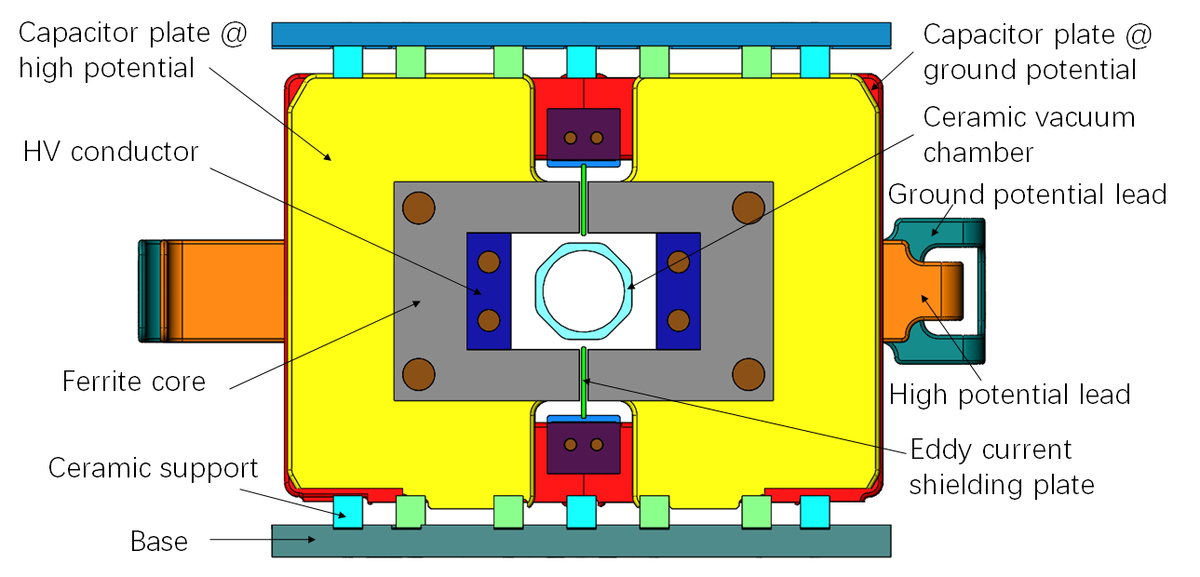
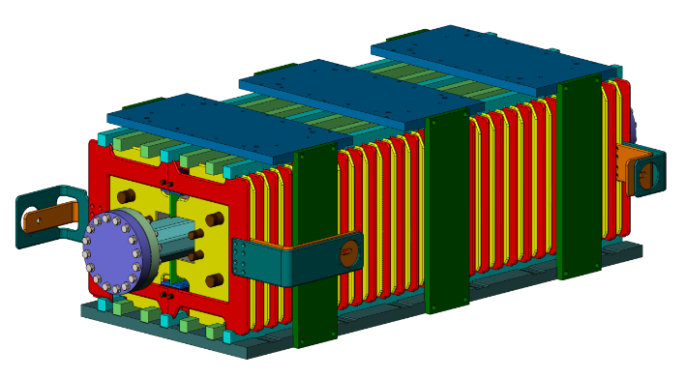
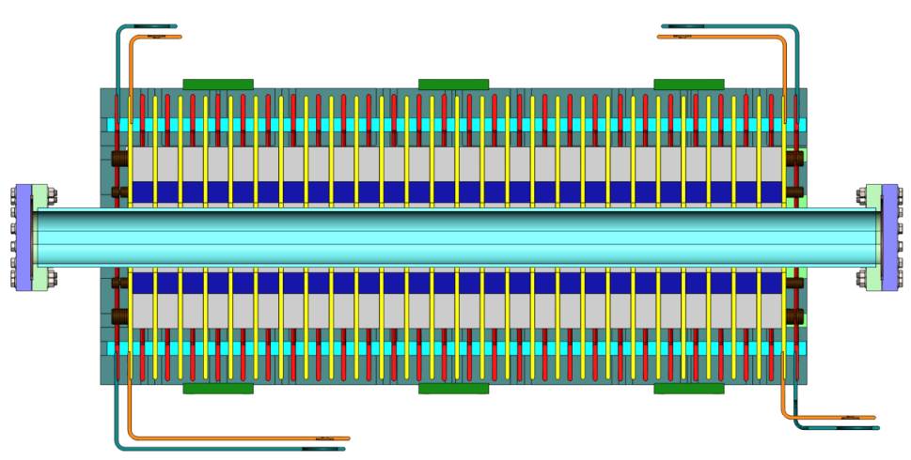
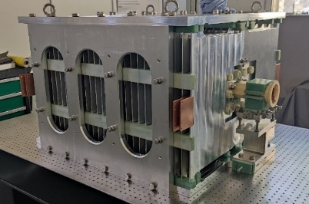
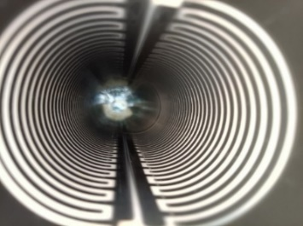
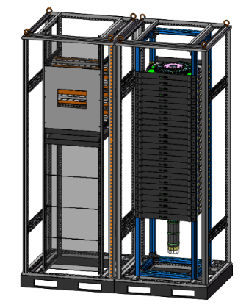
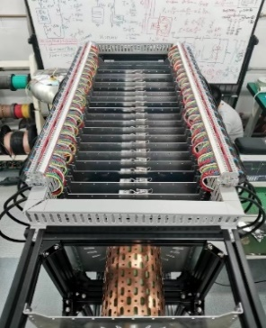
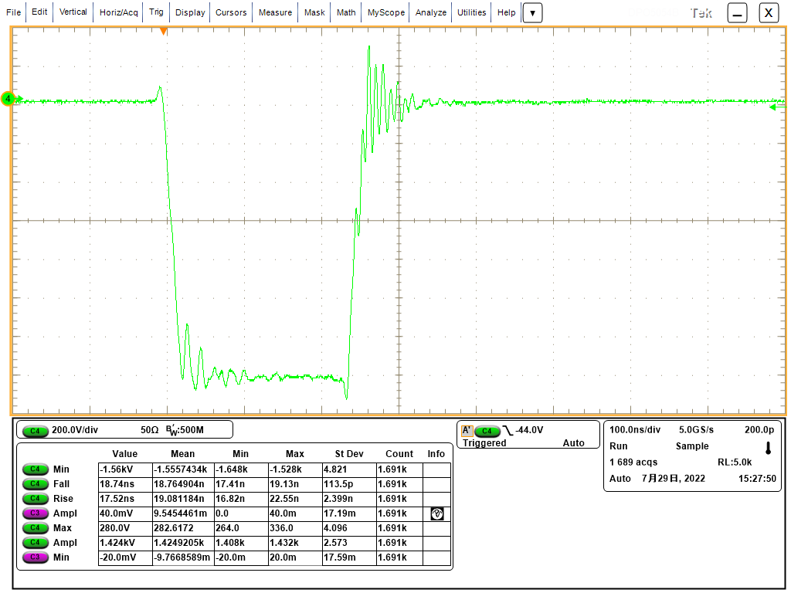
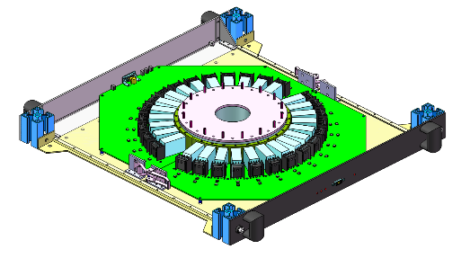
Trapezoid wave kicker system（No new progress）
40~2000ns
1kHz
Research status：
A delay-line kicker (NLK) prototype was done. But magnet characteristic impedance is a little high and volume is Large; Beam impedance issue of ceramic vacuum chamber with Ti coating is not clear
A solid-state pulser prototype based on SiC MOSFET was done. But the pulse HV dose not meet CEPC requirement yet.
200ns
200ns
Delay-line dipole kicker and pulser Parameter | Value
Aperture of magnet (mm) | 100 × 80
Longitudinal length of magnet cell (mm) | 36
Cell number of magnet | 26
Differential impedance of magnet (Ω) | 12.5
Length of magnet (mm) | 942
Total mechanical Length of magnet (mm) | 1018
Inductance of magnet cell (nH) | 56.6
Total inductance of magnet (nH) | 1471.6
Capacitance of magnet cell (pF) | 362
Total capacitance of magnet (nF) | 9.412
Magnetic strength (Gs) | 425
Exciting current of magnet (A) | 2703
Differential voltage of magnet (V) | +/-16895.5
Pulse waveform | trapezoid
Rise/fall time (ns) | 200
Flat-top width of pulse (ns) | 40~2000 adjustable
Filling time of magnet (ns) | 117.728
Rise/fall time of pulser (ns) | 80
Repetition rate (kHz) | 1
Voltage is lower
18-stage@800V：14.2kV into 10Ω

Slide 18
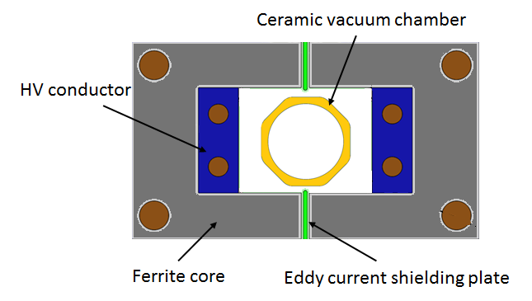
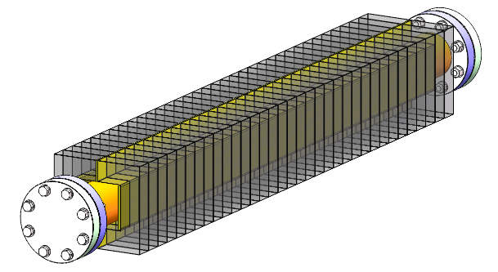
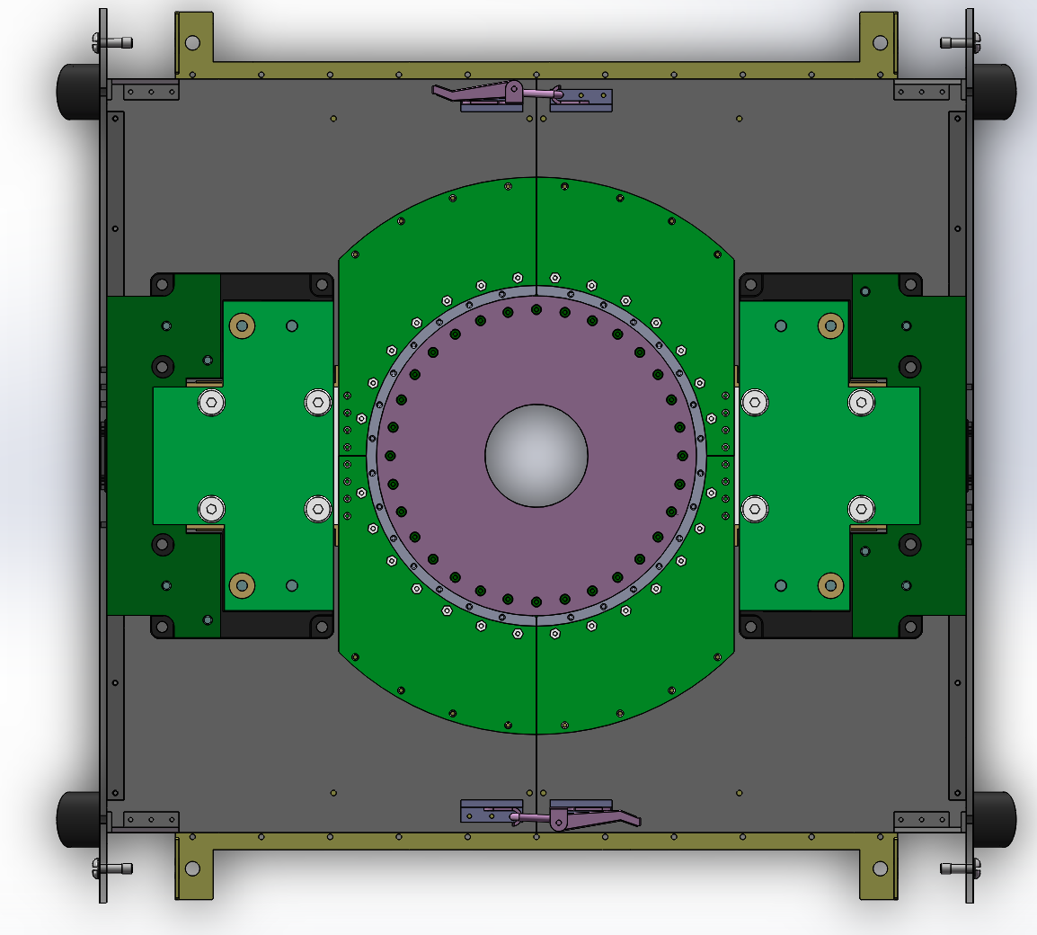
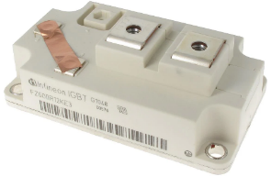
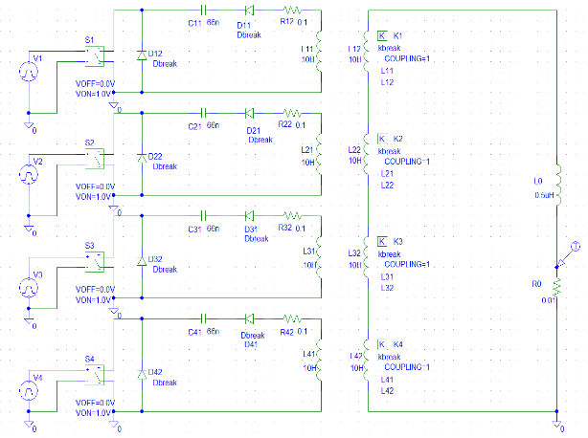
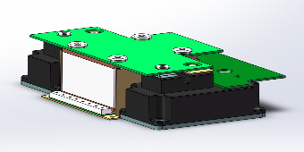
Half-sine wave kicker system
<1360ns,1kHz
Research status：
A novel solid-state pulser circuit is proposed. (LC resonance discharge with inductive-adder based on IGBT and SiC-SBD) .
The IGBT module(FZ600R12KS4: 1.2kV/1200A) is adopted for its higher performance-cost ratio.
Lumped dipole kicker Parameter | Value
Magnetic field B (T) | 0.04
Inner aperture of ceramic vacuum chamber (mm×mm) | 56×56
Ceramic vacuum chamber outer aperture (mm×mm) | 85×66
Magnet aperture w × h (mm×mm) | 100×80
Length of magnet l (m) | 1
Inductance of magnet L (μH) | 1.6
Magnet exercitation current I (kA) | 2.6
Impedance Z (Ω) | 3.7
Voltage of magnet U (kV) | 9.62
Pules bottom width τ (ns) | 1360
Repetition rate（Hz） | 1000

Slide 19
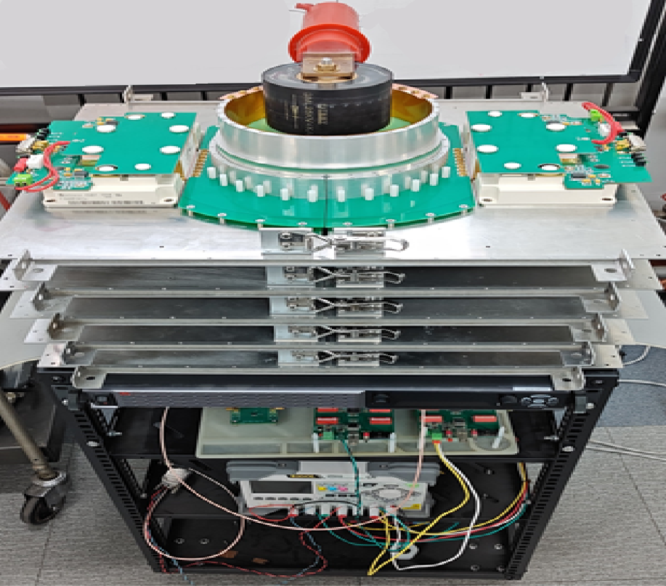
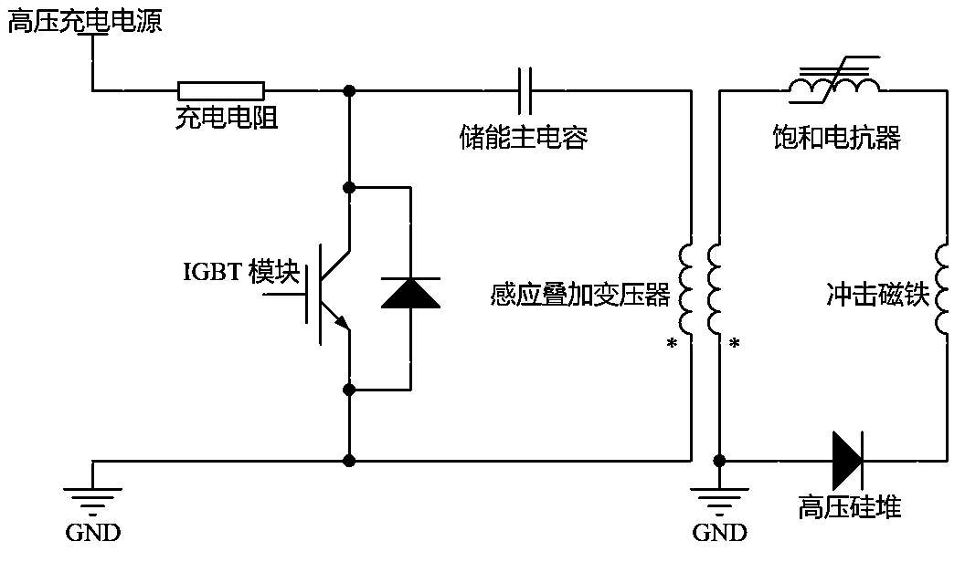
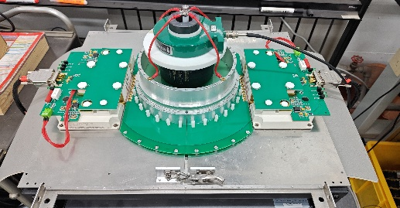
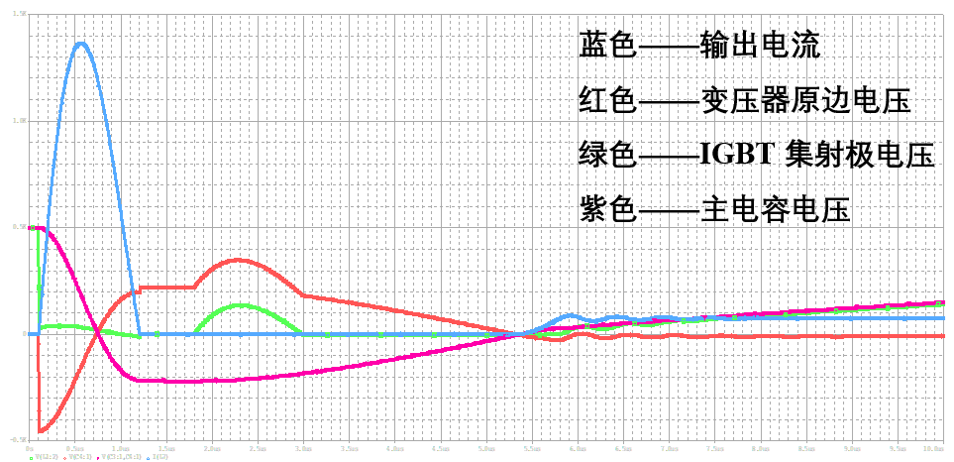
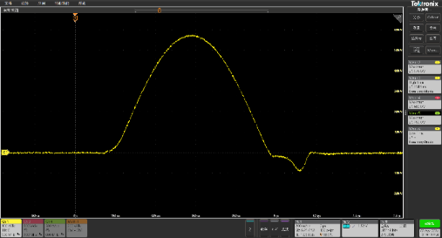
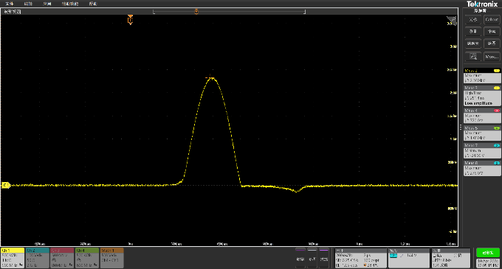
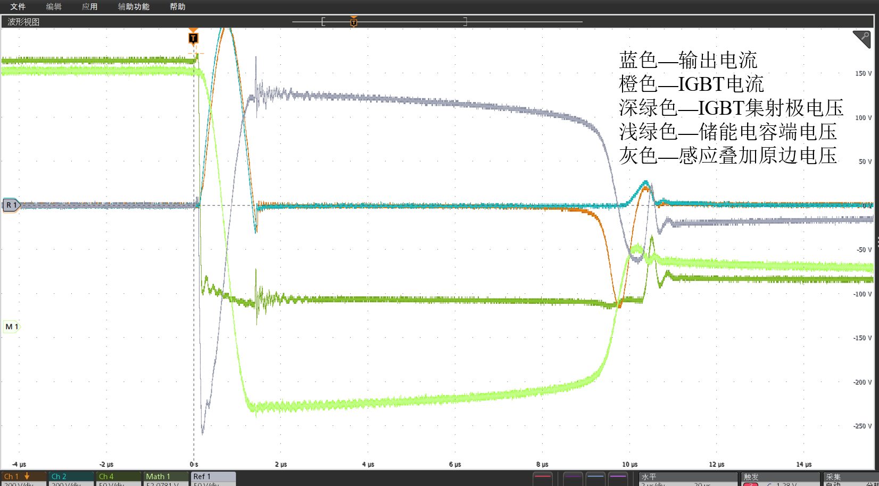
New half-sine wave kicker pulser
Principle verify circuit in condition of 5 stages was test
Load=1.3uH（Z=1.18Ω）
DC=750V
Ip=616A
Pw=715ns
Load=90nH（z=0.44Ω）
DC=1000V
Ip=2340A
Pw=250ns
f=1kHz（CW）
P=1kW

Slide 20
Alternative scheme of RF region beam separating system

Slide 21
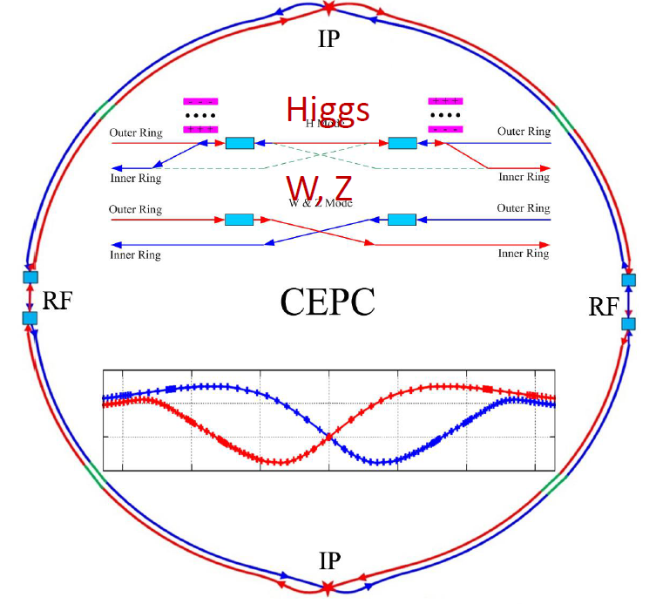
Alternative scheme of RF region beam separating system
Motivations：The adverse issues of DC HV as high as hundred kV and beam impedance of the electrostatic separator are inevitable
The alternative scheme was proposed first in 2019. Similar idea was found in ILC head-on-collision option scheme*（EPAC2006，TESLA-scheme is electrostatic-separator）.
In Higgs mode，e- /e+ beams only fill half ring respectively. So, it is possible to separate beams by kickers.
Compared with static-electrical separator, kicker magnet is stronger and contributes lower beam impedance.
4 sets of kicker locate at both sides of RF region, K1 and k4 applied for e+ beam,K2 and K3 applied for e- beam;
The waveform of kicker pulsers is square wave with duty cycle of 50%, pulse width of 165 us and frequency of 3.03 kHz;
The phase difference between K1 (K3) and K2(K4) is π.
k1
k3
k2
165us
165us
k4
k1
165us
k2
k3
k4
CW=3.03kHz, 50%
RFC
RFC
 | Kicker | Septa
Integrated strength BL [T*m] | 0.1624 | 1.4
Strength B [Guass] | 203 | 1000
Effective length Leff [m] | 8 | 14
Half width of good field region Hgf/Vgf [mm] | 10.1/3.8 @ 5E-4 | 18.9/3.8 @ 5E-4
Half width of beam stay clear Hbsc/Vbsc [mm] | 9.6/3.6 | 9.2/3.6
Septum width width [mm] | - | 10
K2
K1
Yiwei Wang
k1
DC septas
Last e+ Bunch
First e- Bunch
Top view
kickers

Slide 22
Ferrite-core kicker with CW square-wave power supply
The bandwidth of fast corrector power supply for HEPS is 1kHz
CW HF（3kHz） square-wave power supply
Circuit topology：Multi-level technology
Feedback control：digital control
Kicker magnet preliminary design：ferrite core，in-air，ceramic vacuum chamber with metallic coating
Parameters | Kicker
Integrated strength BL [T*m] | 0.1624
Strength B [Guass] | 203
Total effective length Leff [m] | 8
Size of core window w×h [mm] | 90×70
Length of a piece of magnet [mm] | 1000
Exciting current [A] | 1131
Inductance of magnet of a piece of magnet [μH] | 1.6
Width of pulse[μs] | 165
Frequency[Hz] | 3.03k
Rise/fall time of [μs] | 1
Voltage of coil [kV] | 1.8
Flatness of pulse flat-top | ?
Long term stability of amplitude of square-wave | ? 40ppm

Slide 23
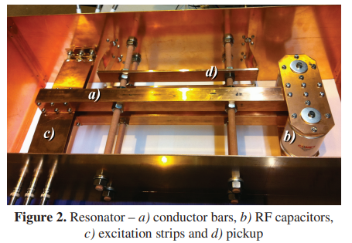
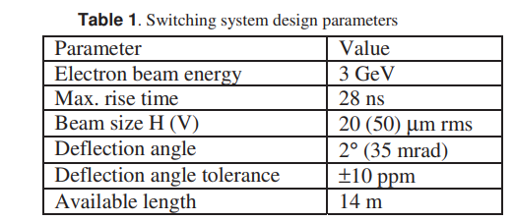
Resonance kicker scheme
680ns
165us
165us
Swiss FEL beam separating system

Slide 24
Resonance kicker system preliminary design
Frequency of CEPCRF system:650MHz
Bunch spacing in Higgs mode: 680ns
Kicker system fundamental frequency: 1.5MHz+3.3KHz
Resonance frequency: 15MHz (650MHz/43.3, 1.5MHz*10, to ensure that every bunches receive the same kick angle)
Power source: Solid-state amplifier based on MOSFET
Low-level control: to achieve amplitude and phase stability controlling
165us
(242bunch)
680ns，1.5MHz，duty cycle:50%
680ns
C=225pF
Z=$\sqrt{\frac{L}{C}}=47$Ω
L=0.5uH
165us
165us

Slide 25
Summary
This year, the injection team was mainly dedicated to HEPS and BIIU projects, and the R&D of CEPC EDR has just started.
Some key technologies have been validated on HEPS successfully and the experiences and lessons can be learned from HEPS.
The design of LHC septum magnet has important reference significance for CEPC.
Good results were obtained from new half-sine wave kicker pulser circuit test.
The preliminary designs of ferrite core kicker with square-wave power supply and resonance kicker system for RF region beam separating system has been initiated.

Slide 26
END
Thank you for attentions!

Slide 27
Backup

Slide 28
List of all type of hardware
No | Hardware | Type | Typical parameters | Unit | Number | Unit price (10,000 CNY) | Total Price (10,000 CNY)
1 | kicker1 | delay-line dipole kicker | in-air delay-line dipole kicker, horizontal, 0.1mrad, 0.04T·m, L=1m, B=0.04T(H), inc. ion pump | set | 24 | 50 | 1200
2 | kicker pulser1 | trapezoidal wave pulser | PFN, solid-state,440~2400ns, inc. cable | set | 24 | 100 | 2400
3 | kicker2 | ferrite-core dipole kicker | in-air ferrite-core dipole kicker, horizontal,0.2mrad,0.08T·m, L=1m, B=0.04T(H)， inc. ion pump | set | 6 | 33 | 198
4 | kicker pulser2 | half-sine wave pulser | LC, solid-state,1360ns, halfsine, inc. cable | set | 6 | 31 | 186
5 | kicker3 | strip-line kicker | Strip-line kicker, vertical, 46ns, L=1m, inc. ion pump | set | 6 | 28 | 168
6 | kicker pulser3 | DSRD pulser | 46ns, ±12.5kV,DSRD pulser, inc. cable | set | 6 | 67 | 402
7 | kicker4 | slotted-pipe kicker | Slotted-pipe kicker,vertical,250ns,L=0.25m, DR beam pipe φ=30mm, inc. ion pump | set | 2 | 23 | 46
8 | kicker pulser4 | trapezoidal wave pulser | solid-state,inductive adder, 250ns, inc. cable | set | 2 | 40 | 80
9 | dilution kicker | CW full-sine | CW full-sine，L=2m，150Gauss，T=25us, total length=10m | set | 10 | 30 | 300
10 | dilution kicker pulser | CW full-sine | CW full-sine，T=25us | set | 10 | 30 | 300
11 | NLK | NLK | in-air Nonlinear kicker or pulsed sextupole, horizontal, 0.1mrad, 0.04T·m, L=1m, inc. ion pump | set | 2 | 38 | 76
12 | NLK pulser | half-sine wave pulser | LC, solid-state,0.3ms, halfsine, inc. cable | set | 2 | 15 | 30
13 | thin septa | In-vacuum Lambertson | Lambertson,vertical,DC,L=1.75m,B=0.8T,Septum=2mm, mainfield clearance=20*20mm, 13mrad, 5.22T·m,inc. ion pump | set | 28 | 58 | 1624
14 | thick septa1 | In-air Lambertson | Lambertson,vertical,DC,L=1.75m,B=0.8T,Septum=6mm, mainfield clearance=20*20mm, 13mrad, 5.22T·m,inc. ion pump | set | 148 | 25.8 | 3818.4
15 | thick septa2 | In-air Lambertson | Lambertson,horizontal,DC,L=1.2m, B=0.8T, Septum=5.5mm, mainfield clearance=50*50mm, 45mrad, 0.92T-m,inc. ion pump | set | 2 | 22.8 | 45.6
16 | thick septa3 | In-air Lambertson | Lambertson,horizontal,DC,L=0.5m,Septum=3.5mm, DR beam pipe φ=30mm,inc. ion pump | set | 2 | 20.8 | 41.6
17 | septa power supply | DC power supply | DC switch power supply, inc. cable | set | 28 | 12.5 | 350
18 | local control system1 |  | PLC，touch screen，oscilloscope | set | 16 | 10 | 160
19 | local control system2 |  | PLC，touch screen，oscilloscope | set | 2 | 5 | 10
20 | Field measurement devices1 | hall | Hall point measurement system for Lambertson | set | 2 | 160 | 320
21 | Field measurement devices2 | inductive coil measurement | inductive coil measurement system for kicker | set | 1 | 10 | 10
 |  |  |  |  |  | Total cost： | 11765.6
 |  |  |  |  |  | Toal cost with installation fee(3%)： | 12118.568

Slide 29
谐振腔式kicker方案

Slide 30
谐振kicker磁铁方案
RESONANT KICKER SYSTEM FOR HEAD-ON-COLLISION OPTION OF LINEAR COLLIDER*

Slide 31
高重复频率窄脉冲kicker电源方案
自由电子激光的束流分配系统上有类似的kicker电源设计。
优点：效率更高，脉冲电源的充能元件体积更小。匹配放电电路，按照10ns/10kV/50Ω计算，终端电阻上的平均功率是：16.7kW. 谐振放电电路，能量可以回收
特点：重复频率高达1.5MHz，商业的半导体开关器件MOSFET和特殊DSRD开关工作频率已达到这个量级。为HEPS研发的strip-line kicker10ns快脉冲电源测试结果显示，可以工作在1MHz。
难点：高重复频率下如何解决脉冲幅度一致性和稳定性的问题。需要研究快速充电技术和补偿控制技术。
CW=3.03kHz,50%
165us
165us
165us
理想波形：
165us
(242bunch)
242,1.5MHz
680ns，1.5MHz，占空比50%
实际波形：

Slide 32
商业谐振式高频电源

Slide 33
Manpower and funding requirements

Slide 34
Research Team
Team member in TDR phase : 11 persons
Researcher: Jinhui Chen
Associate-researcher: Lei Wang, Lihua Huo, Yuwen Wu, Hua Shi
Engineer: Guanwen Wang, Peng Liu, Xiaolei Shi
Post-doctor: Guanjian Wu, Zilin Chen
Doctoral-graduate-student: Xinzhe Zhai
Problems：
Team members are from several groups
All people is part-time: HEPS (first half of this year), BEPCII-U(second half of this year), CSNSII
Some people are leaving
Need at least 25 FTEs in future construction phase

Slide 35
Funding and manpower requirements
R&D item | Budget (X10000CNY) | Man power（FTEs）
Lambertson magnet | 45 | 1 （霍丽华、吴官健、吴煜文）
Delay-line Kicker | 45 | 2 （王磊、吴官健）
Kicker pulser | 80 | 2（翟心哲、王冠文、陈锦晖）
Resonance kicker | 80 | 2（王磊、吴官健、霍丽华、施华）
Resonance power supply | 80 | 2（陈锦晖、翟心哲、王冠文、刘鹏）
Bumper magnet（6kHz） | 20 | 1（霍丽华）
Continue square wave power supply | 30 | 2（刘鹏、？）
total | 380 | 12

