Slide 1
CEPC collimator number optimization
Xiaohao Cui
CEPC Day, 2024/09/27

Slide 2
1. Why we need collimators in CEPC
Energy Stored in the machine
 | Higgs | W | Z | ttbar
Energy (GeV) | 120 | 80 | 45.5 | 180
Bunch Number | 268 | 1297 | 11934 | 35
Bunch Charge (nC) | 20.8 | 21.6 | 22.4 | 32
Energy/bunch (kJ) | 2.5 | 1.73 | 1.02 | 5.76
Energy/beam (MJ) | 0.67 | 2.24 | 12.17 | 0.2

Slide 3
1. Why we need collimators in CEPC
Collimation systems need to :
Suppress experimental backgrounds
Protect the machine from unexpected beam loss
Protect important elements, RF cavities, detectors,…

Slide 4
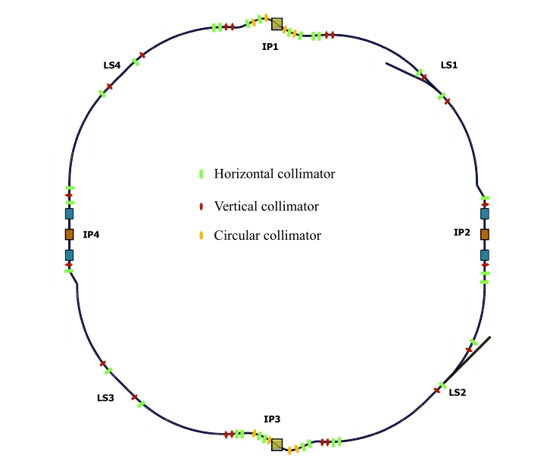
2. Previous CEPC collimator status
Wang Yuting did many studies.
58 collimators added in one ring

Slide 5
2. Previous CEPC collimator status
3 horizontal collimators in each RF section
2 vertical collimators in each RF section
2 horizontal collimators in each straight section
2 vertical collimators in each straight section
4 horizontal collimators in each IP section
5 circular collimators in each IP section
16 MDI collimators

Slide 6
2. Previous CEPC collimator status
With all these collimators, beam loss under control for RF and magnet failures.

Slide 7
2. Previous CEPC collimator status
Problems for previous collimators:
1. Large impedance
2. small collimator radius
3. Non-optimized collimator position

Slide 8
3. Optimization on number of collimators
1. horizontal Betatron collimator
2. momentum collimator
3. vertical collimator

Slide 9
3. Optimization on number of collimators
After some simulation and optimization: reduced to 34 collimators in one ring
16 MDI collimators:
8 horizontal betatron collimators in straight sections
4 momentum collimators
6 vertical collimators

Slide 10
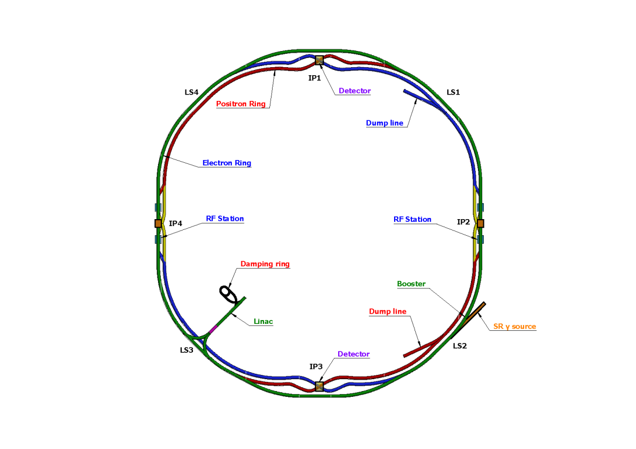
3. Optimization on number of collimators
for H betatron collimator
for momentum collimator
for vertical collimator

Slide 11
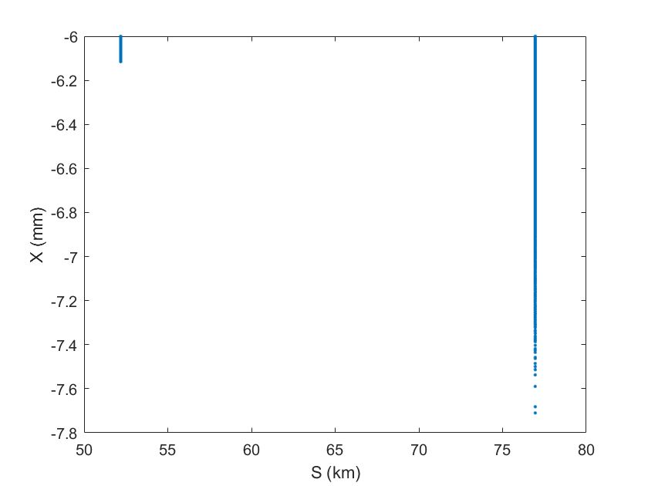
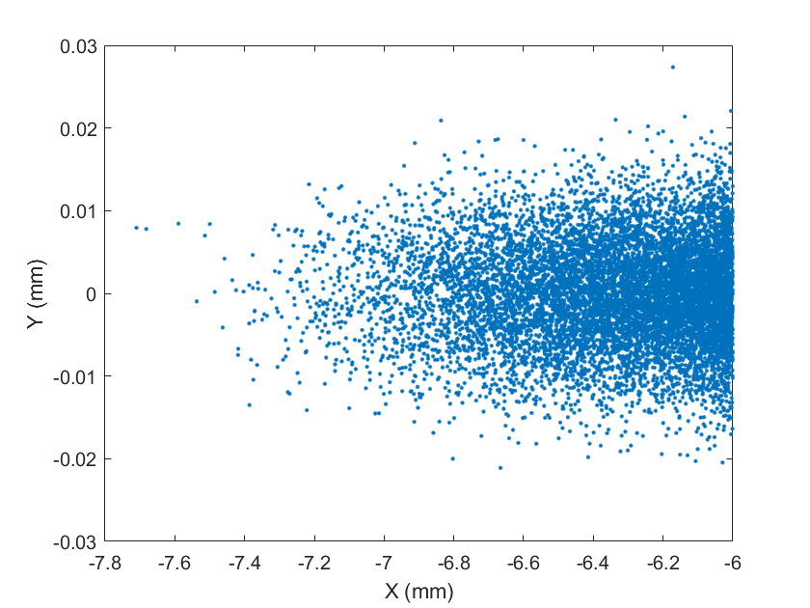
3. Optimization on number of collimators
RF failure:

Slide 12
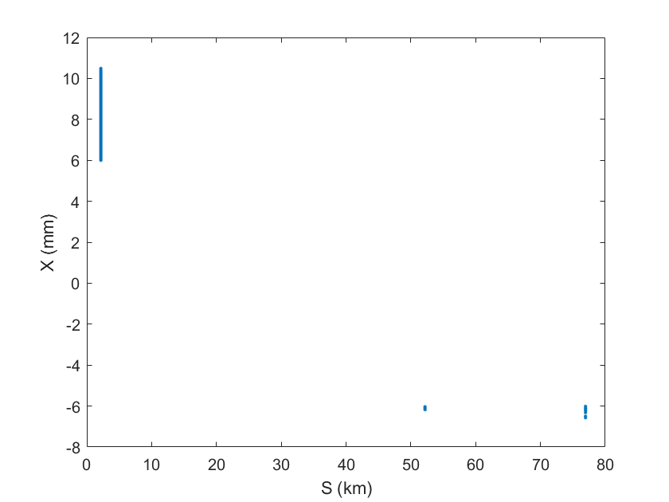
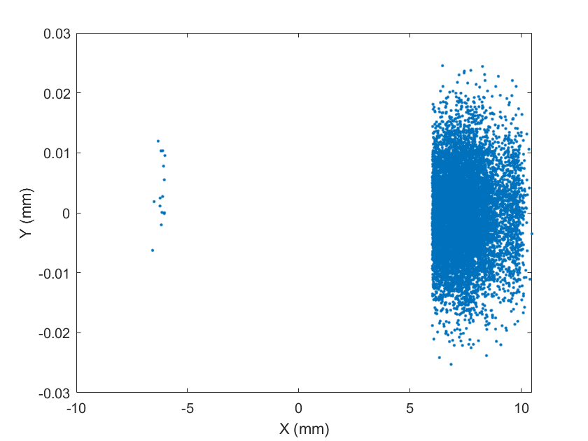
3. Optimization on number of collimators
Dipole failure:

Slide 13
4. Future works
More simulations
More optimizations on the position and aperture of collimators
Considerations on the experimental backgrounds
Other beam loss scenarios
Fluka simulation for secondary particles

Slide 14
Thank You

