Slide 1
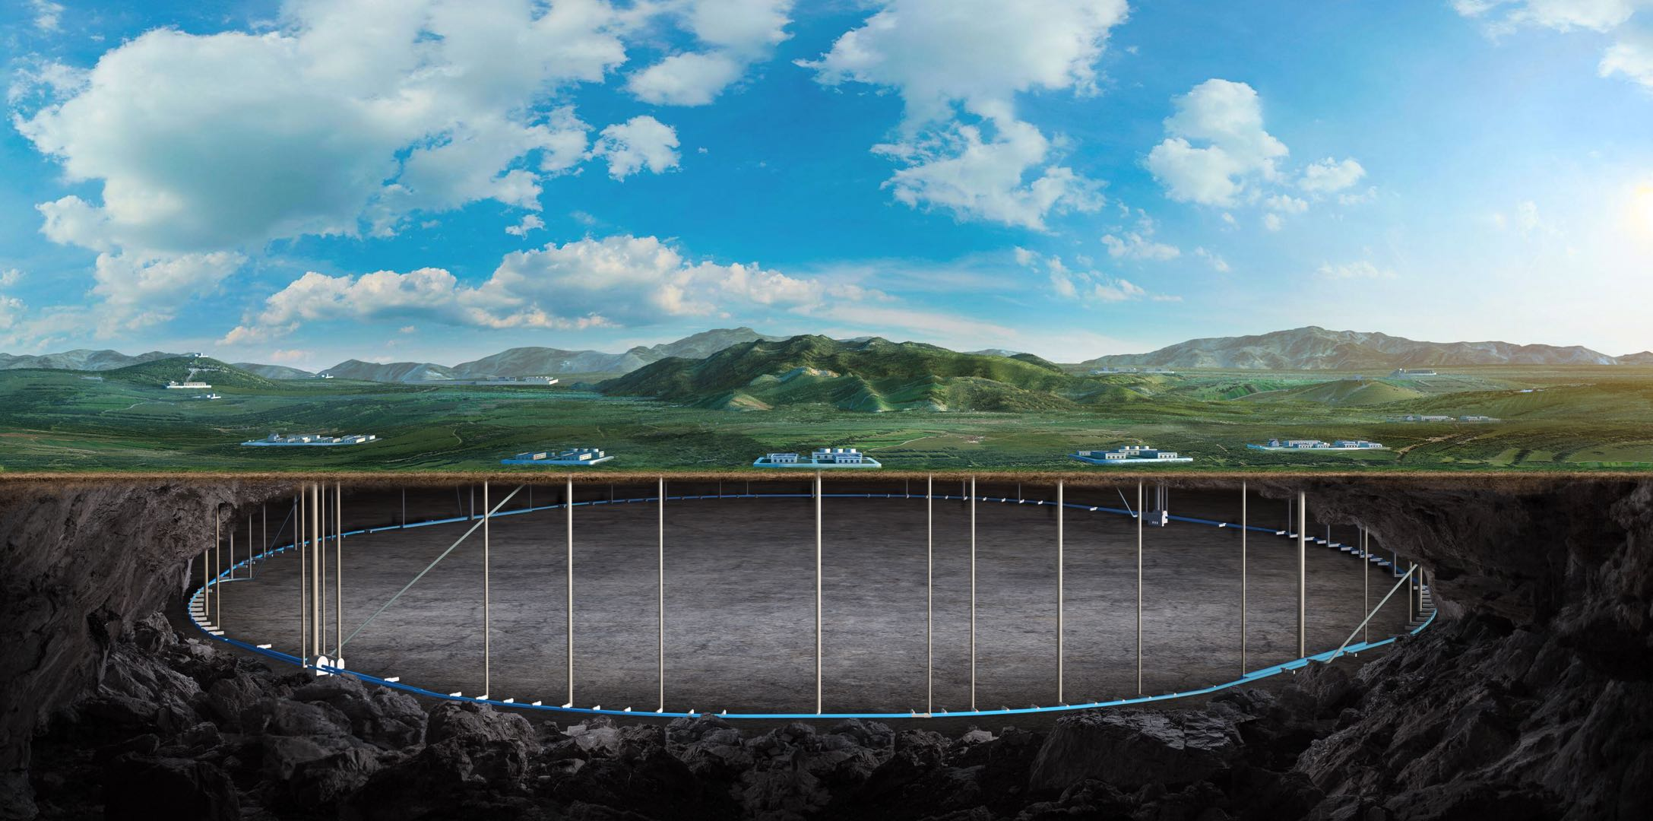
Circular Electron Positron Collider
CEPC luminosity limitations coming from impedances
Na Wang, Yuan Zhang
Institute of High Energy physics
CEPC day, 8-11 Sep. 2024

Slide 2
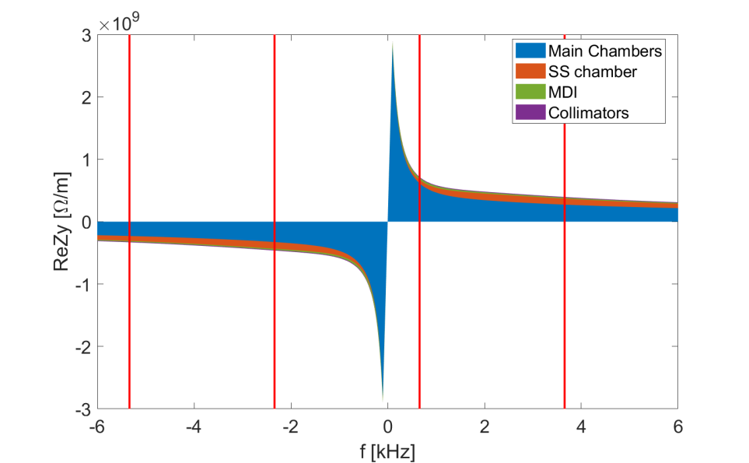
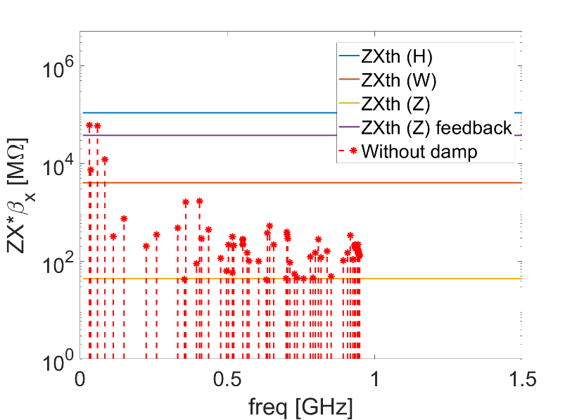
Overview on luminosity limitations from impedance
宽带阻抗 → 相空间畸变/质心振荡→ 单束团流强阈值
窄带阻抗 → 多束团耦合振荡→ 限制总流强
对撞亮度
（束流能量损失→发热）
Impedance budget
Z||/n, mΩ | 16.5
k_{y}, kV/pC/m | 64.2
 | Higgs | W | Z | ttbar
Single bunch threshold (Long) Z||/n [mΩ] | 6.5 | 4.1 | 0.7 | 14.4
Single bunch threshold (Trans) k_{y} [kV/pC/m] | 69.7 | 40.2 | 12.4 | 109.8
Longitudinal distortion
Luminosity limitations
TMCI unstable
Growth time of 1.7ms-> harsh requirement on feedback
HOMs (eg. Electroseparator)
n=11615
n=11618
n=11616
n=11617

Slide 3
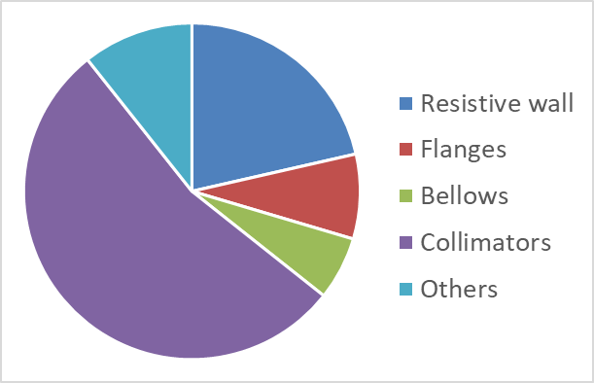
Limitations from transverse broadband impedance
Impedance increased by a factor of 2~3, mainly due to the collimator impedance
First estimation shows single bunch current limitation for W/Z, some safety margin reserved for Higgs.
Shows limitations for Z luminosity reach (with FB, ξ and asymmetry tune): beam-beam unstable at low bunch population (np=3e10-7e10), then stable collision up to 12e10 (with luminosity of 80e34 cm⁻²s⁻¹), with even higher intensity, a dynamical luminosity of around 80e34 cm⁻²s⁻¹ will be reached → However, luminosity is further limited by boot strapping.
Possible mitigations
Possible optimization on the machine protection & collimation design?
Nonlinear collimator as adopted in SuperKEKB → will introduce additional nonlinear effects to the lattice
Search for new mitigation strategies ?
Parameter [unit] | Higgs | Z | W | tt
Beam energy E_{k} [GeV] | 120 | 45.5 | 80 | 180
L_{max}/IP (10³⁴cm⁻²s⁻¹) | 5 | 115 | 16 | 0.5
Design bunch Population [10¹⁰] | 13 | 14 | 13.5 | 20
TMCI threshold [10¹⁰] | 16 | 4 | 10 | /
Impedance contributions:

Slide 4
Outline of this work
Impedance evolutions
Impedance optimization of the collimators
Benefit from reduction of collimator quantity
HOM damping of the Electro-separators
Updates on luminosity simulations
Based on previous impedance model, further studies on instability mitigations
Luminosity limitation updates concerning the updated impedance model with reduced collimator quantity

Slide 5
Impedance optimization of collimators
从优化collimation系统设计角度减少collimator数量
降低collimator结构阻抗
减小taper角度
根据Collimator随gap的依赖关系，选择合适的beta函数
与lattice结合，降低collimator的阻抗贡献
Review on nonlinear collimator proposed in SuperKEKB

Slide 6
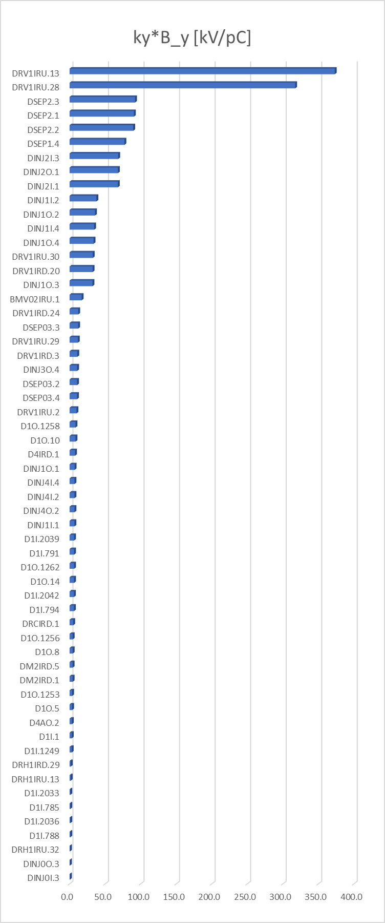
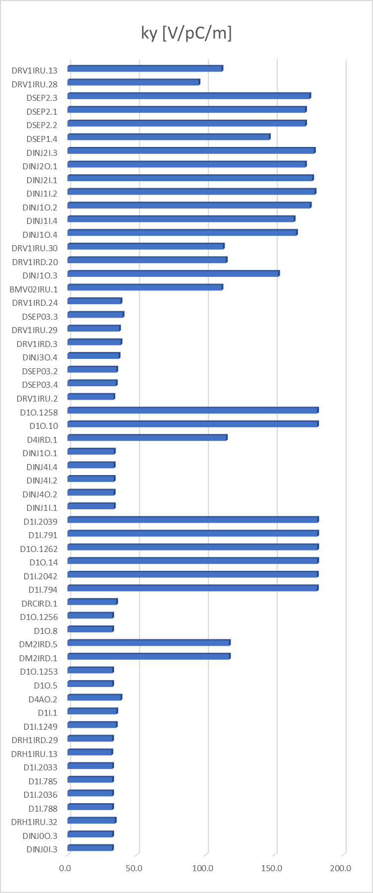
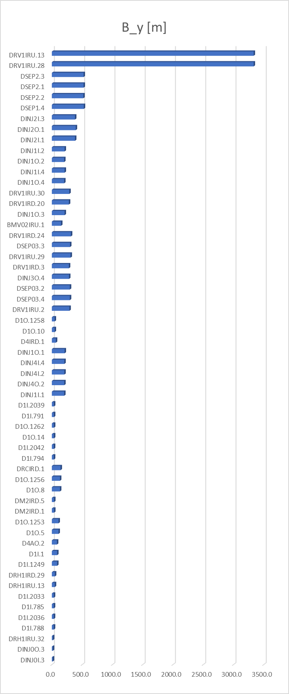
Collimator impedance contributions
Dominant contributors to vertical impedance:
Vertical/circular collimators with high vertical beta function

Slide 7
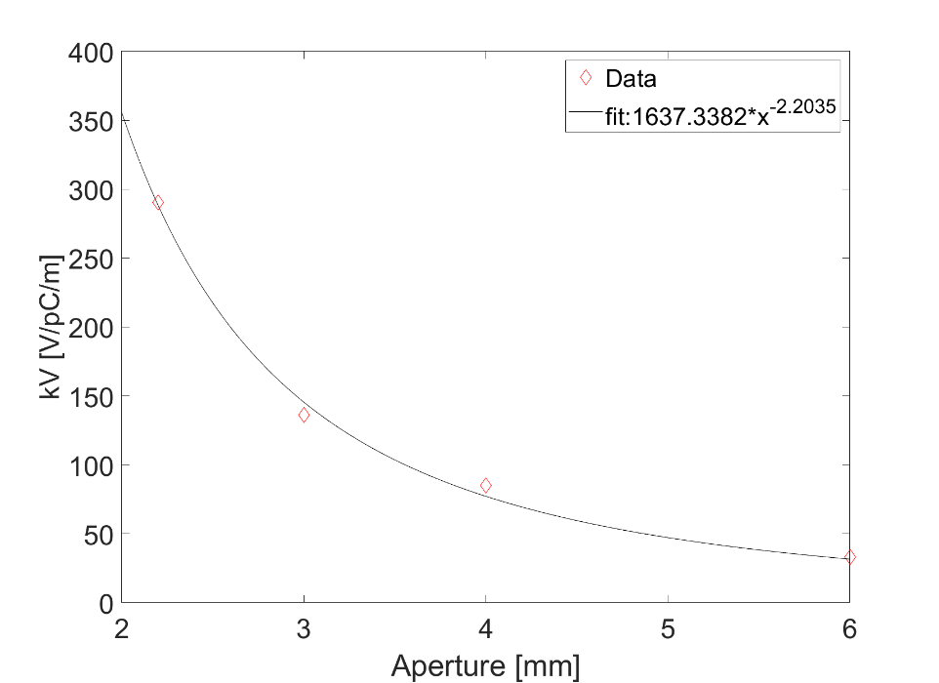
Dependance of collimator impedance on beta function
Collimation design usually chose location with high beta function to have large beam size and high collimation efficiency ⇒ with large collimator aperture ⇒ Lower impedance & high beta function weighting
Simulation model of half gap=3mm/4mm has been updated from WuLei
$Aperture∝\sqrt{βε}$
k_{y}$∝β∗$kV
Aperture [mm] | kV [V/pC/m] | kH [V/pC/m]
2.2 | 290.5 | 43.7
3 | 136.2 | 21.6
4 | 85.2 | 15.9
6 | 33.1 | 8.4
kH and kV are not weighted by beta function
kV: kick factor in the direction of jaws

Slide 8
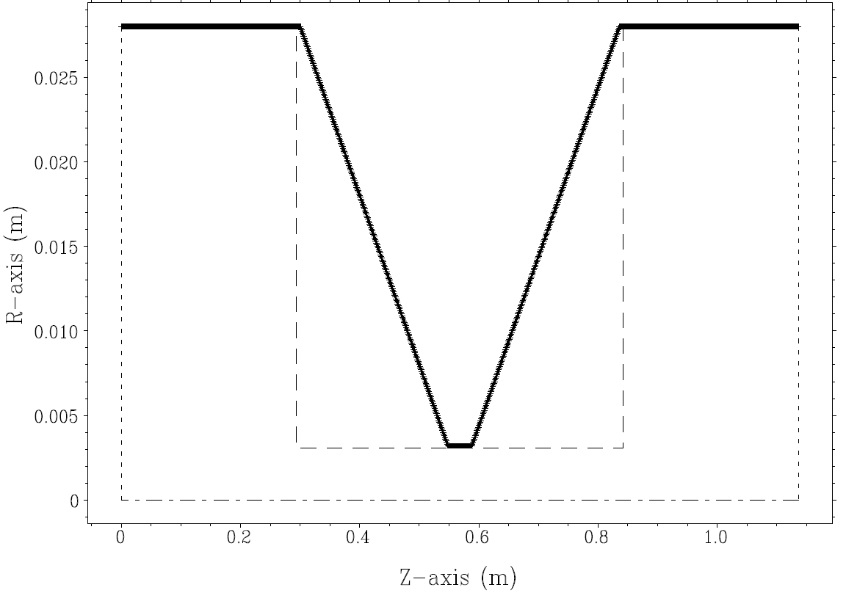
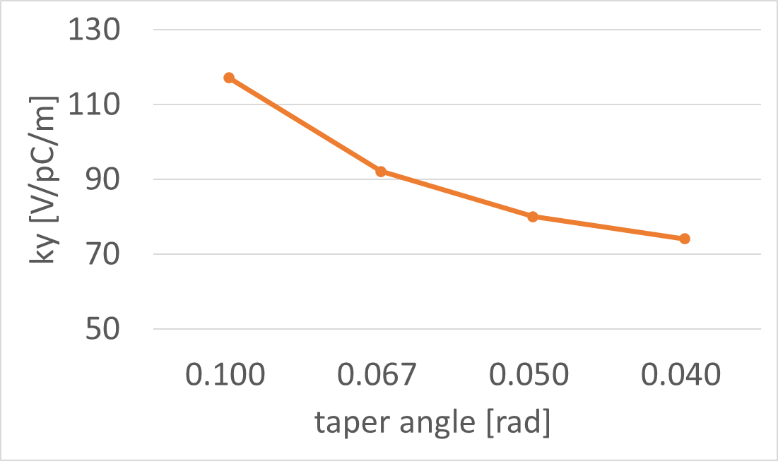
Impedance reduction of collimators
Circular collimator
By decreasing the taper angle, the impedance of circular collimator can be reduced by 20%
taper angle

Slide 9
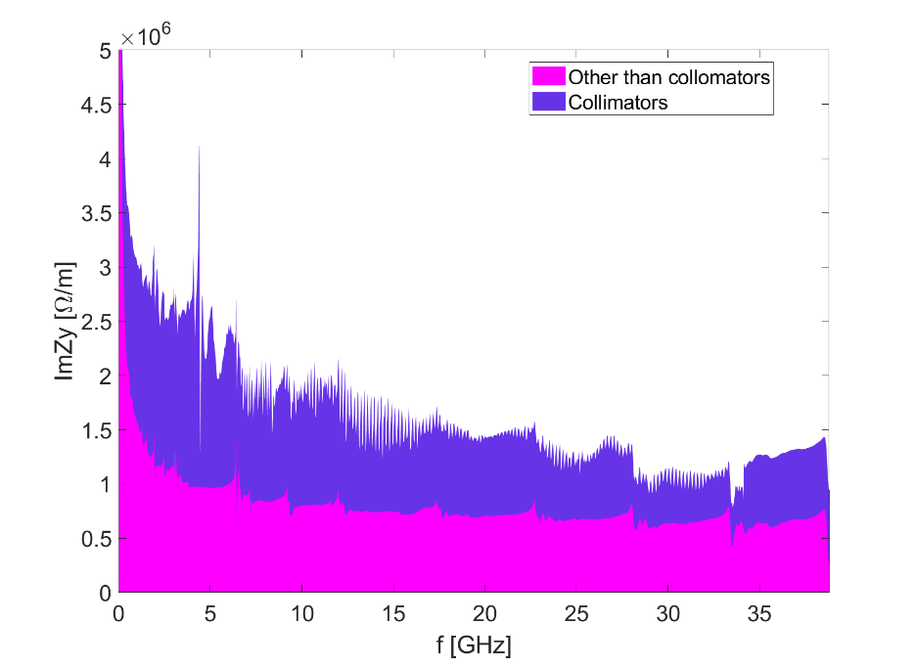
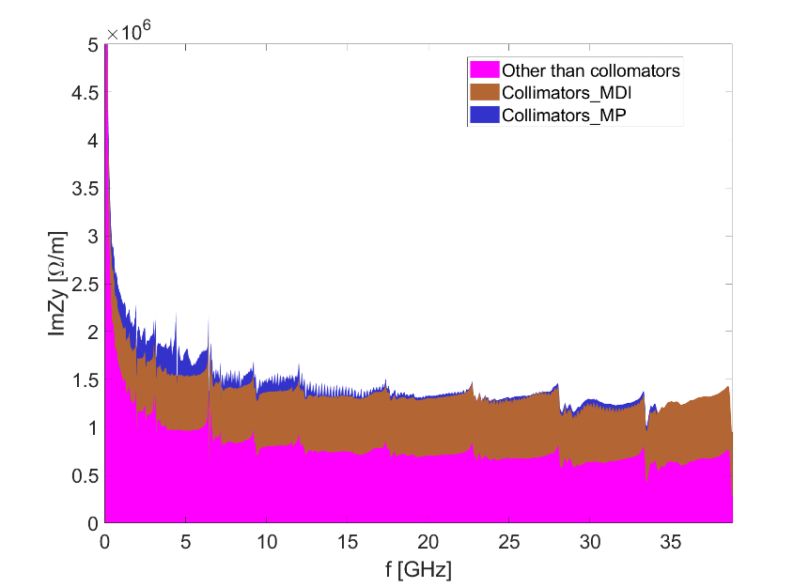
Benefit from reduction of collimator quantity
Previous design
16 MDI collimator (aperture 3.09~3.43mm)
42 MP collimator (aperture 3~4mm)
New design
16 MDI collimator (aperture 3.09~3.43mm)
12 Horizontal MP collimator (aperture 6mm, β_{y,ave}=180/120m)
6 Vertical MP collimator (aperture 3mm, β_{y,ave}=190m)
Impedance budget
k_{y,coll}, kV/pC/m | 34.5
k_{y,total}, kV/pC/m | 64.2
Previous design
New design
Impedance budget
k_{y,coll}, kV/pC/m | 21.1
k_{y,total}, kV/pC/m | 50.8

Slide 10
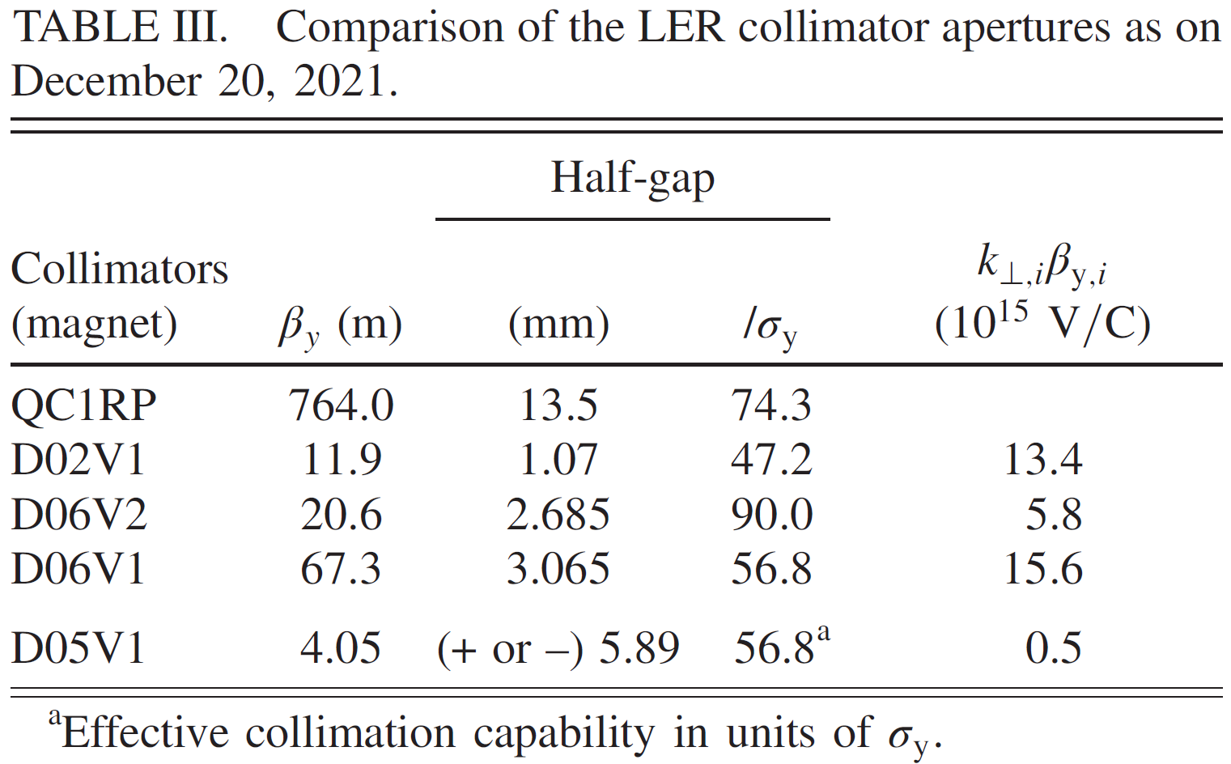
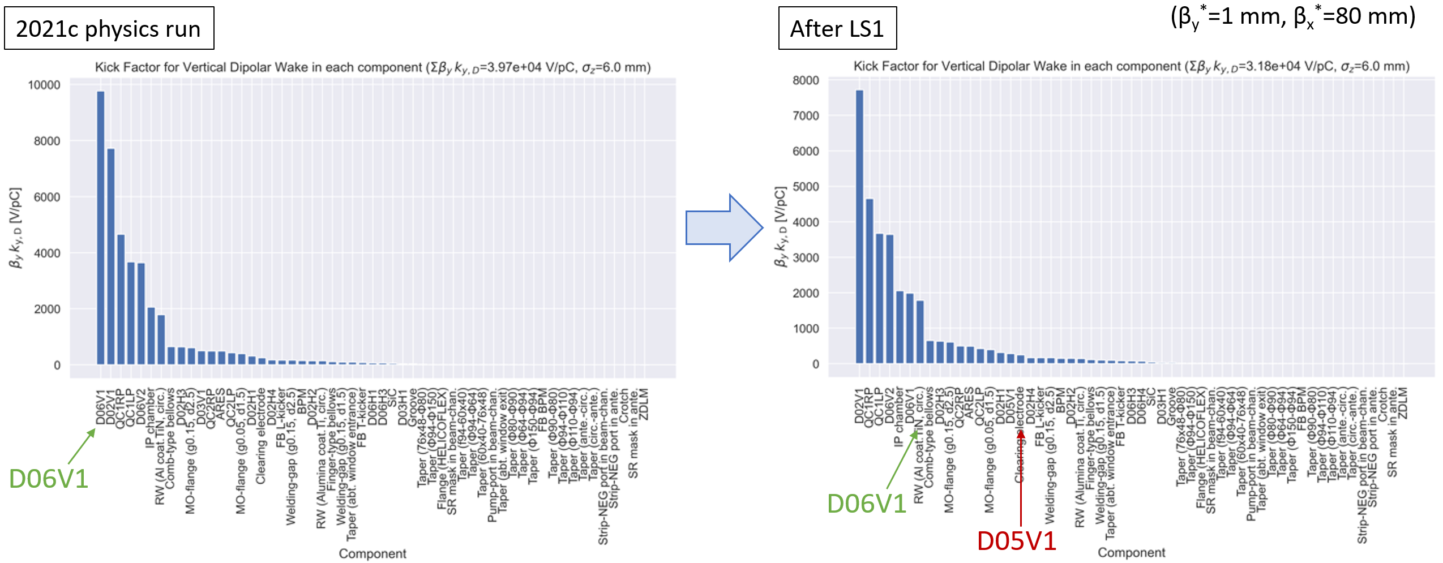
Nonlinear collimator proposed in SuperKEKB
M. Tobiyama, IPAC 2024, WEZD1
S. Terui, PRAB 27, 081001 (2024)
Installed a nonlinear collimator at OHO straight section
Replaced damaged collimator heads with copper coated Titamium/carbon
Relocated several collimators to improve the beam-cut efficiency

Slide 11
Nonlinear collimator proposed in SuperKEKB
M. Tobiyama, IPAC 2024, WEZD1
Constraints of NLC:
less efficient in background reduction from the injection
Increased radiation in the OHO experimental hall when closing the D05V1 gap

Slide 12
Collimator impedance
Previous impedance
 | k_{y,coll}, kV/pC/m
IR_C | 15.7
IR_H | 1.1
MP_H | 2.1
MP_V | 15.6
Total | 34.5
20%
Reduce taper angle
90%
Reduce collimator quantity, increase collimator gap
70%
Reduce collimator quantity
Possible reduced impedance
 | k_{y,coll}, kV/pC/m
IR_C | 12.6
IR_H | 1.1
MP_H | 0.2
MP_V | 4.1
Total | 18.0
Collimator impedance can be reduced by ~50%
Total impedance can be reduced by ~25%
Possible further impedance reductions with proper beta function or employing nonlinear collimators

Slide 13
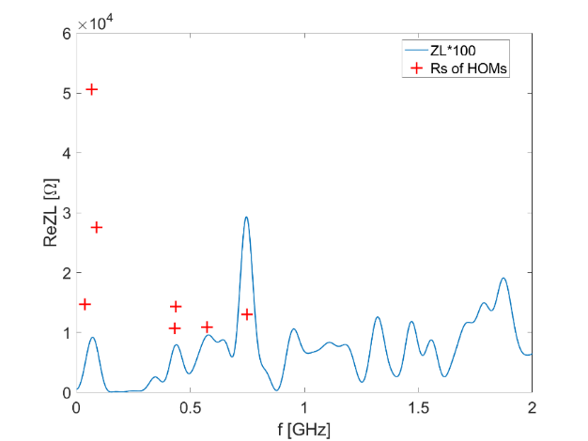
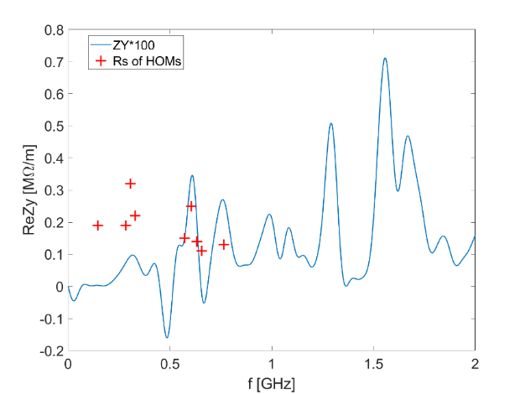
Impedance optimization of Electro-separator
Main impedance issues
High heat load
Horizontal HOMs
 | Higgs-30MW |  | Z-30MW
 | with ZL | with ZL&BB | with ZL | with ZL&BB
Beam current [mA] | 16.7 | 16.7 | 803.5 | 803.5
Bunch length [mm] | 3.0 | 4.1 | 6.0 | 8.7
kloss [V/pC] | 1.7 | 1.4 | 1.0 | 0.8
Ploss per beam [W] | 590 | 486 | 18045 | 14436
High power loss deposition can induce：
High voltage arcing/breakdown
Burning of energy absorbing resistors
Increased outgassing which would raise the electron background in the experiments
Dominant longitudinal modes: f₁=66.6MHz (R_{s}=50.6kΩ), f₂=87.7MHz (R_{s}=27.5kΩ)
Dominant horizontal modes: f₁=32.2MHz (R_{s}=15.3MΩ/m), f₂=59.4MHz (R_{s}=14.7MΩ/m)
Dominant vertical modes: f₁=306MHz (R_{s}=0.3MΩ/m), f₂=604MHz (R_{s}=0.3MΩ/m)
Above the transverse CBI threshold for Z ($fReZ_{||}$<650kΩ⋅GHz, $ReZ_{y}$<0.9MΩ/m)
Longitudinal (left) and vertical (right) impedance with HOMs below 1GHz

Slide 14
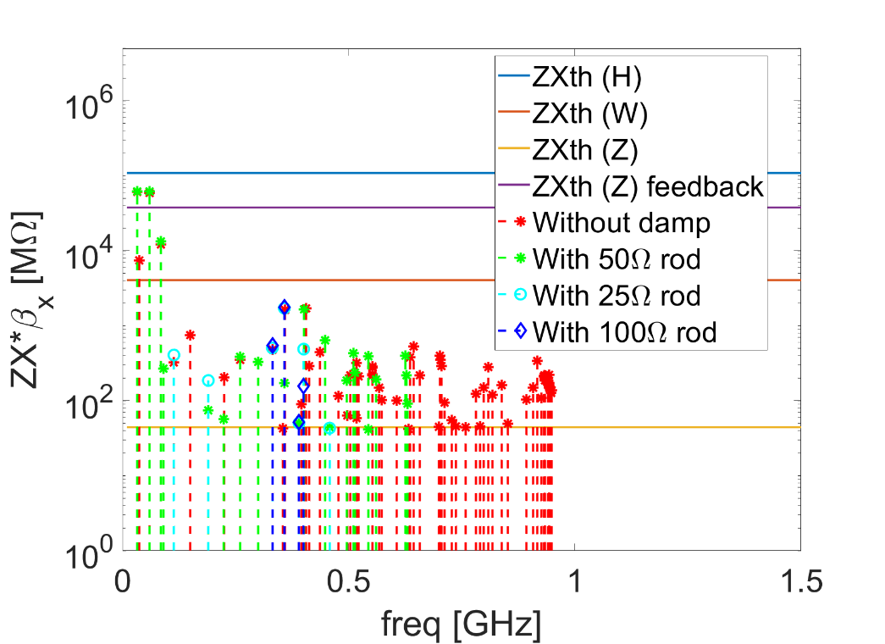
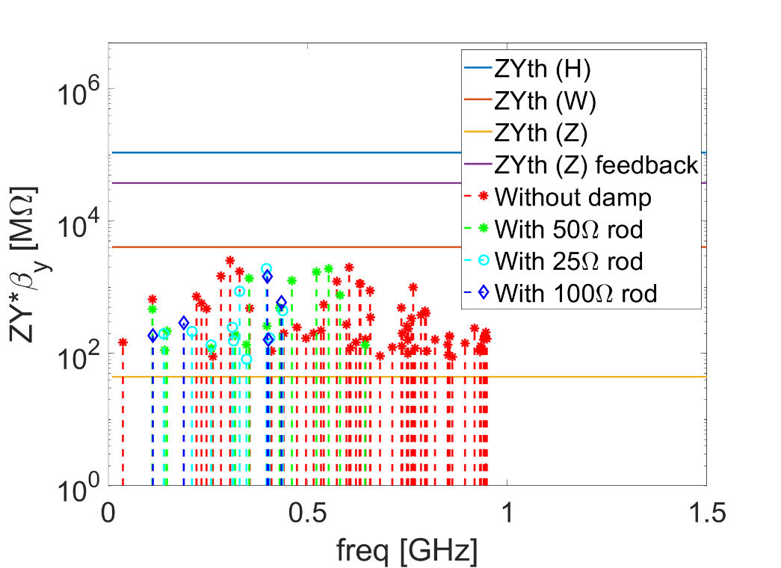
Impedance optimization of Electro-separator
Fritz Caspers (CERN) proposed to use metal rods to damp the HOMs
With feedback damping of 1ms, there are two modes unstable.
Preliminary simulations show effective damping of the HOMs with rods, without obvious increase on heat load.
There are several modes above the Z threshold of SR, but can be easily damped with feedback.
水平
垂直

Slide 15
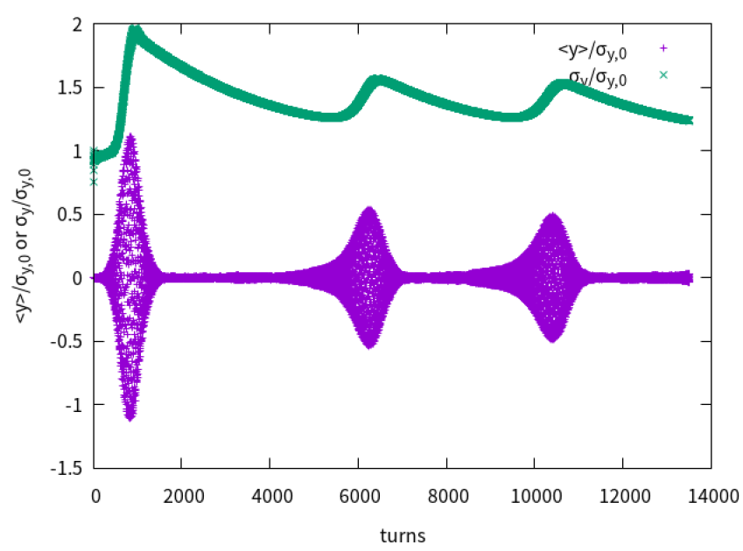
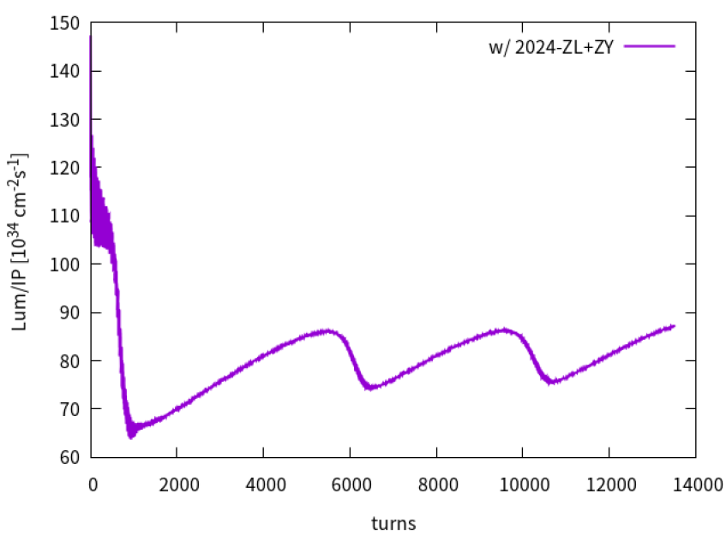
Luminosity simulations
Yuan Zhang
垂直方向的对撞稳定性@Z
考虑纵向阻抗
考虑垂直方向阻抗
Resistive feedback + 垂直色品
Damp rate ~ 0.05, Qy’~10 (半环)
Beam-beam + ZT 的复合效应导致的 TMCI 太强，对撞无法稳定
不稳定性导致质心振荡和尺寸增长
尺寸增长后，束束作用减弱，TMCI 减弱，然后尺寸开始减小
尺寸减小后，束束作用增强，TMCI 增强，然后质心振荡和尺寸增长
w/o FB, Qy’=10
w/o FB, Qy’=10

Slide 16
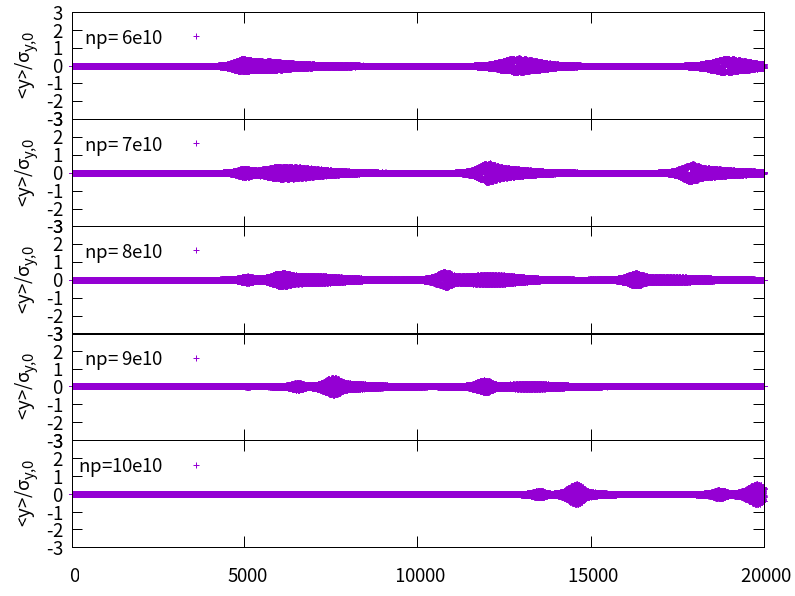
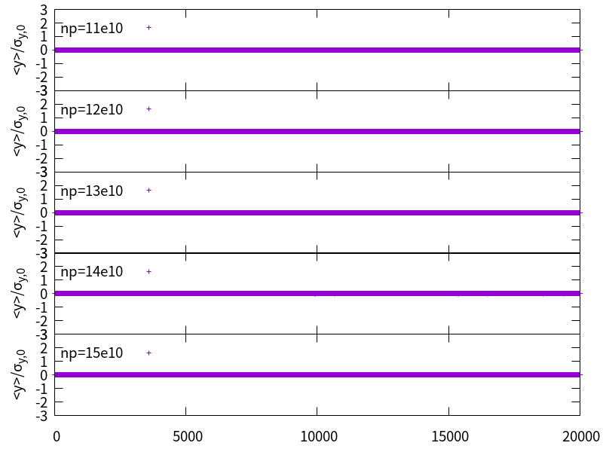
Vertical, resistive damp=0.03, Qy’=5
Yuan Zhang
np=5-10e10对撞不稳定

Slide 17
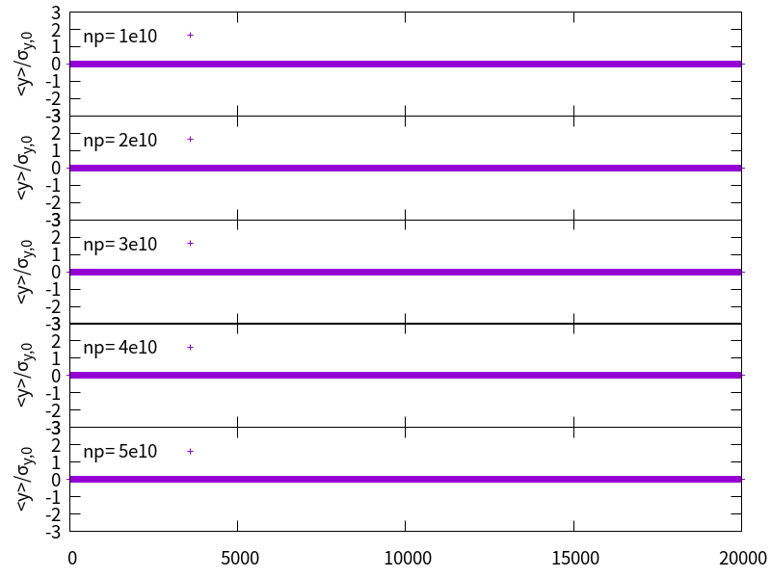
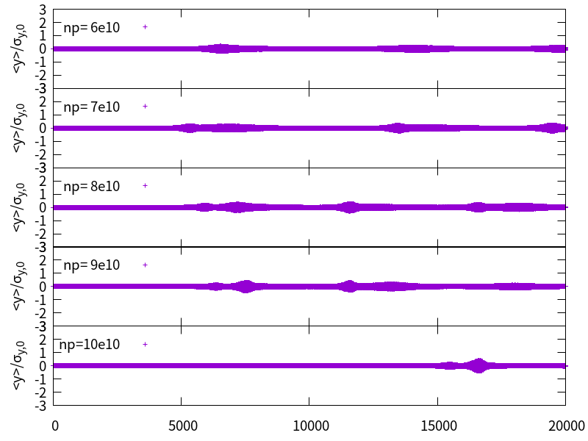
Vertical, resistive damp=0.05, Qy’=5
Yuan Zhang
np=6-10e10对撞不稳定，振荡幅度减小

Slide 18
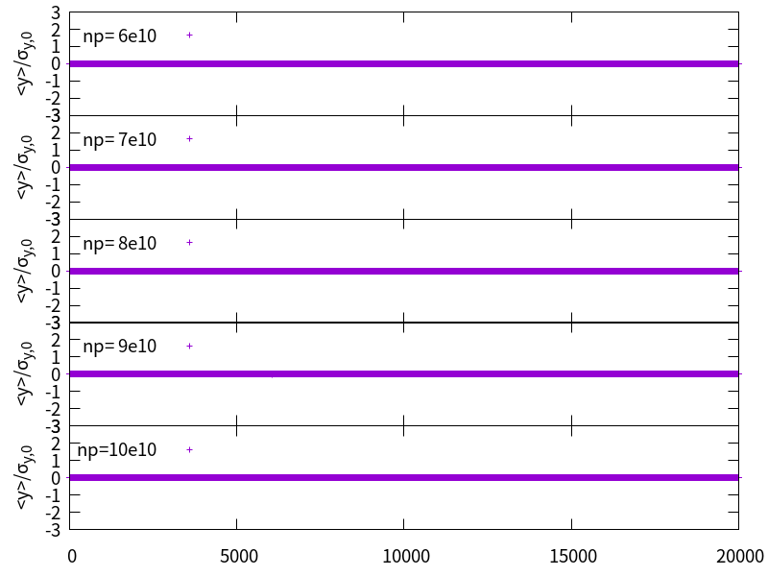
Vertical, resistive damp=0.05, Qy’=10
Yuan Zhang
对撞稳定

Slide 19
Summary
Impedance reduction from the optimization of the collimator structure and decreasing the collimator quantity are investigated
Collimator impedance can be reduced by ~50% and total transverse broadband impedance can be reduced by ~25%, possible further impedance reductions with selected beta function or employing nonlinear collimators should be investigated, accompanied by iteration with the design of the machine protection.
HOM damping of the Electro-separators is studied → a damping scheme with coaxial rods are applied and proved to be effective in damping the modes.
Updates on luminosity simulations
Based on the previous impedance model, further studies on instability mitigations shows that the beam-beam can be stable at design parameter of Z with strong feedback and high chromaticity (damp rate ~ 0.05, Qy’~10, half ring)

Slide 20
Thank you for your attention!

Slide 21
Main beam parameters (30MW)
Parameter [unit] | Higgs | Z | W | tt
Beam energy E_{k} [GeV] | 120 | 45.5 | 80 | 180
L_{max}/IP (10³⁴cm⁻²s⁻¹) | 5 | 115 | 16 | 0.5
Emittance (H/V) [nm/pm] | 0.64/1.3 | 0.27/1.4 | 0.87/1.7 | 1.4/4.7
Beam current [mA] | 16.7 | 803.5 | 84.1 | 3.3
Bunch number | 268 | 11934 | 1297 | 35
Bunch Population [10¹⁰] | 13 | 14 | 13.5 | 20
Momentum compaction α_{p} [10⁻⁵] | 0.71 | 1.43 | 1.43 | 0.71
Bunch length σ_{z} (natural/total) [mm] | 2.3/4.1 | 2.5/8.7 | 2.5/4.9 | 2.2/2.9
Energy spread (natural/total) [10⁻⁴] | 10/17 | 4/13 | 7/14 | 15/20
Betatron tune ν_{x}/ν_{y} | 445.10/445.22 | 317.10/317.22 | 317.10/317.22 | 445.10/445.22
Synchrotron tune | 0.049 | 0.035 | 0.062 | 0.078
Radiation damping [ms] | 44/44/22 | 816/816/408 | 150/150/75 | 14/14/7
Design queries
Small α_{p}
Short natural σ_{z}
Slow damping at low E_{k}

