Slide 1



CEPC MDI SC magnet cryostat design and IR region beam pipes
Xiangzhen Zhang, Xiaochen Yang
2024.09.27
Cryogenics Group, Accelerator Research Center
Institute of High Energy Physics(IHEP)

Slide 2
Content
Introduction
Weight optimization of the cryostat
Temperature field of beam pipes
Current leads design for MDI SC magnet
Summary

Slide 3
  1. Introduction
In CEPC, there are two combined-function Superconducting magnets in MDI
Each combined-function magnet includes double aperture high gradient quadrupole (Q1a, Q1b, Q2) and anti-solenoid, around each side of the IP point.
The cryostat is used to provide the cryogenic environment for SC magnets, which is below 5.0 K.
ITEM | Q1a | Q1b | Q2 | Anti-solenoid
Central field gradient (T/m) | 142.3 | 85.4 | 96.7
Cooling type | LHe | LHe | LHe | LHe
Operating current (A) | 780 | 650 | 770 | 1300
Magnetic storage energy (KJ) | 16.7 | 15.2 | 32.1 | 730
Cross section parameter (mm) | Φ40~61 | Φ52~78 | Φ62~88 | 70 sections
Magnet mechanical length (m) | 1.23 | 1.23 | 1.53 | 5.1
Net weight (Kg) | 25 | 32 | 43 | 302
Total weight of magnets (Kg) |  |  |  | 402
From Yingshun Zhu

Slide 4
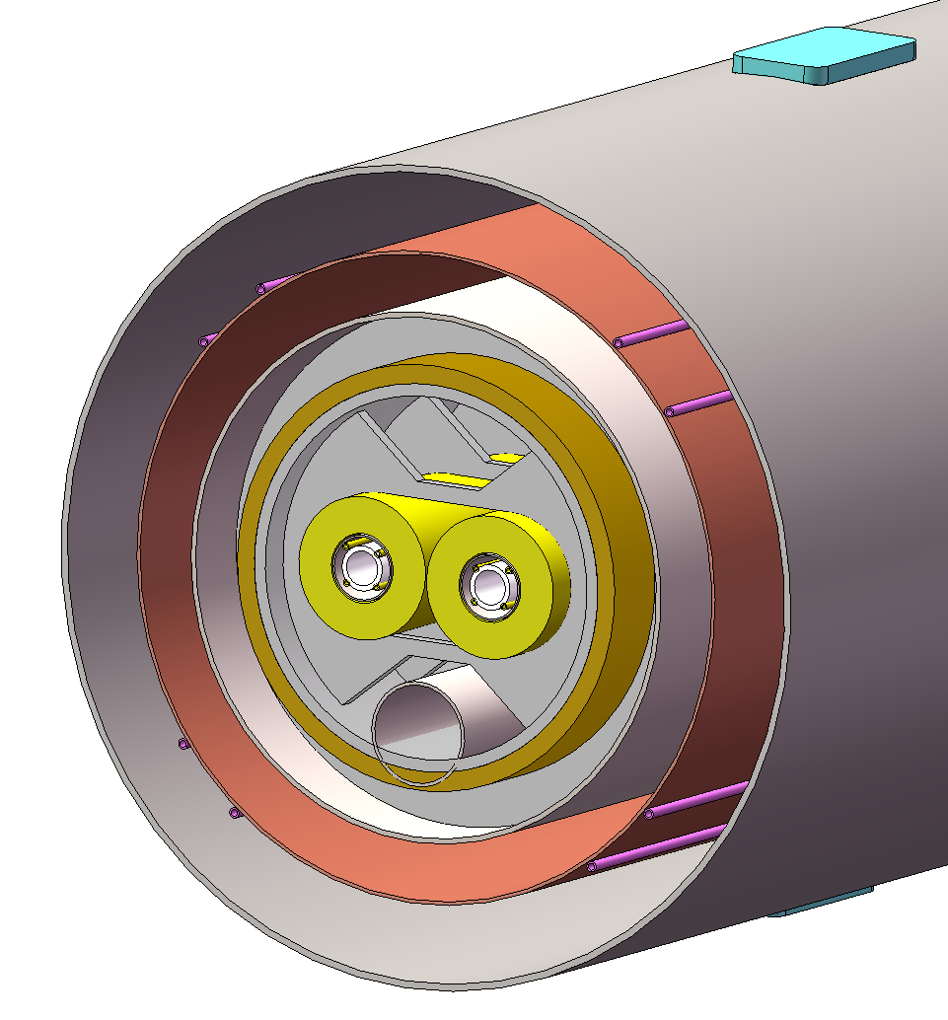
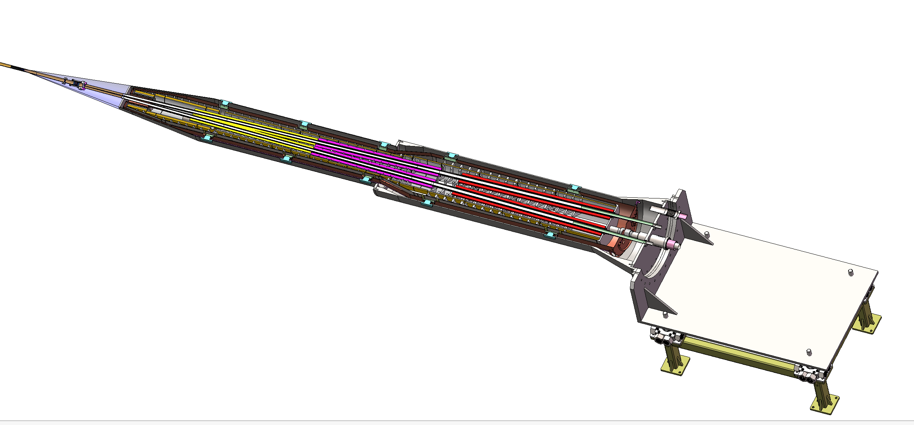
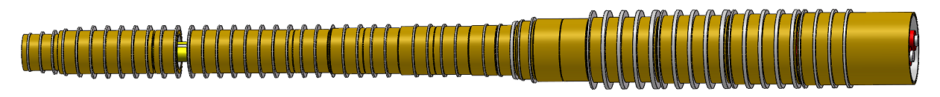
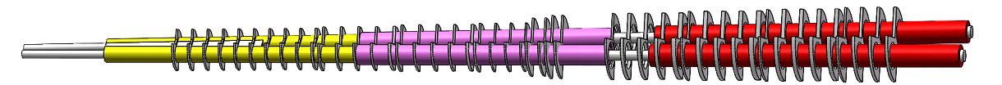
  1. Introduction
Cryostat of SC magnet
The superconducting magnets Q1a,Q1b and Q2 are supported on the inner wall of the solenoid.
The anti-solenoid is supported by a ring on the inner wall of the helium tank.
Vacuum
Thermal shield
1985mm
LHe tank
1915mm
Support
Anti-solenoid
2885mm
Anti-solenoid
Q1a
Beam chamber
Q1a
Q1b
Q2
Notes:
标注尺寸

Slide 5
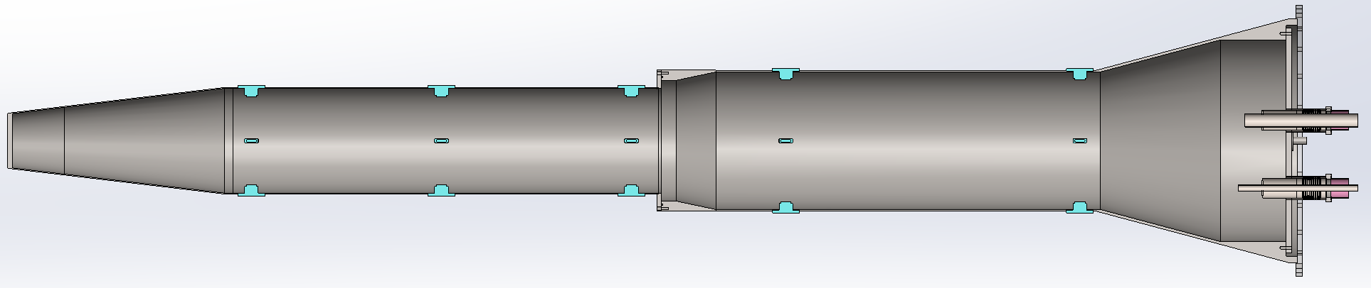



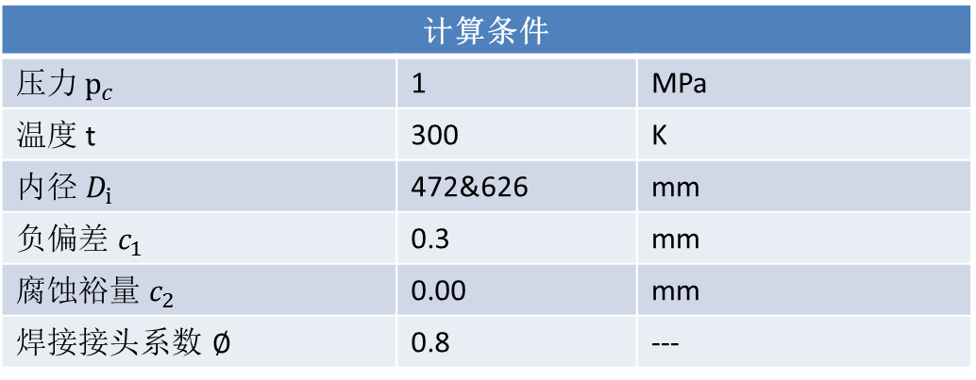
2. Weight optimization of the cryostat
根据GB/T 150.3-2011钢制压力容器厚度的计算
Vacuum vessel
计算条件
压力${ p}_{c}$ | 1 | MPa
温度 t | 300 | K
内径 $D_{i}$ | 472&626 | mm
负偏差 $c_{1}$ | 0.3 | mm
腐蚀裕量 $c_{2}$ | 0.00 | mm
焊接接头系数 $∅$ | 0.8 | ---
计算厚度：$δ=\frac{{ p}_{c}D_{i}}{2\left[σ\right]∅−{ p}_{c}}=2.96/3.93$
名义厚度：$δ_{n}=4/6$
有效厚度：$δ_{e}=δ_{n}$- $c_{1}$- $c_{2}=3.7/5.7$
950mm
1915mm
2885mm
472mm
626mm
4mm
6mm
Materials: S304
Weight: 1184kg
Notes:
标注尺寸

Slide 6
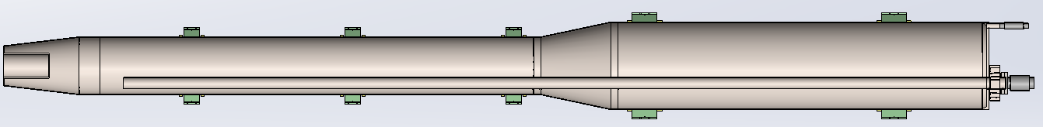



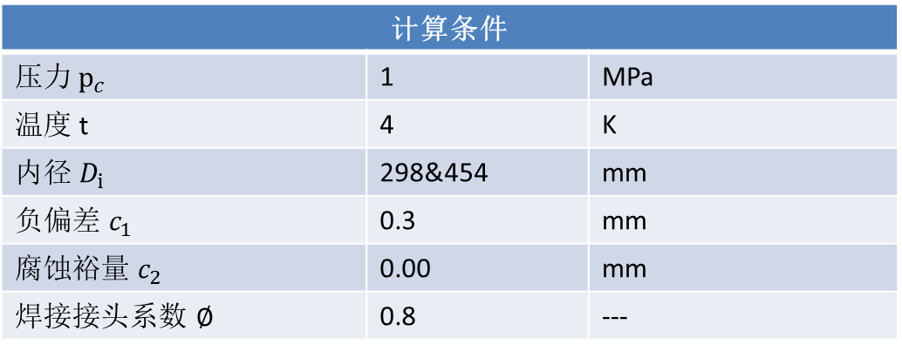
2. Weight optimization of the cryostat
根据GB/T 150.3-2011钢制压力容器厚度的计算
Helium tank
计算条件
压力${ p}_{c}$ | 1 | MPa
温度 t | 4 | K
内径 $D_{i}$ | 298&454 | mm
负偏差 $c_{1}$ | 0.3 | mm
腐蚀裕量 $c_{2}$ | 0.00 | mm
焊接接头系数 $∅$ | 0.8 | ---
计算厚度：$δ=\frac{{ p}_{c}D_{i}}{2\left[σ\right]∅−{ p}_{c}}=1.4/2.19$
名义厚度：$δ_{n}=3$
有效厚度：$δ_{e}=δ_{n}$- $c_{1}$- $c_{2}=2.7$
2800mm
2300mm
298mm
454mm
3mm
3mm
Materials: S316L
Weight: 195kg
Notes:
标注尺寸

Slide 7
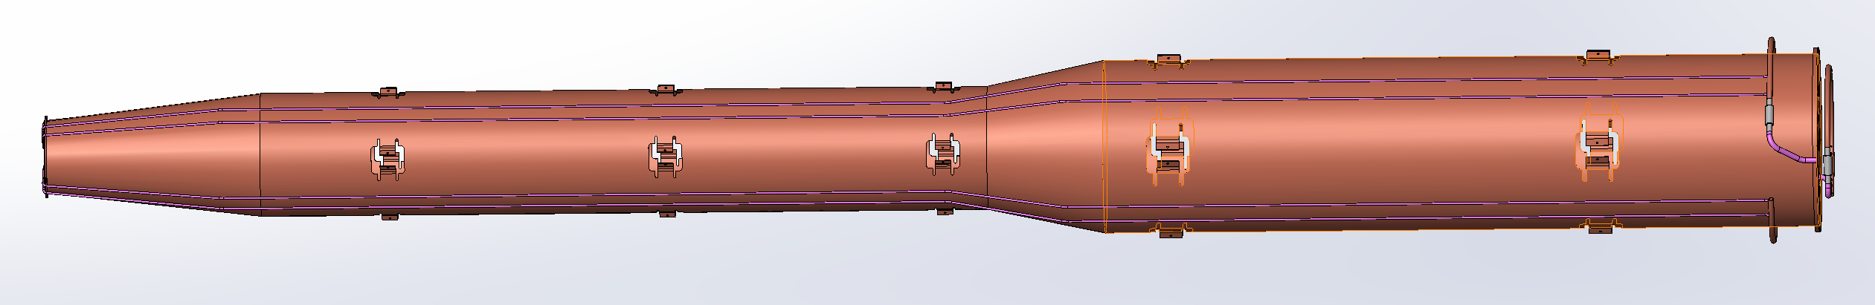
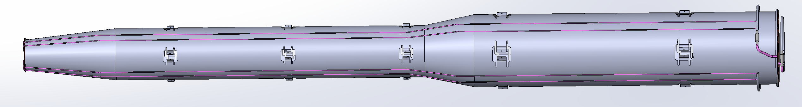
2. Weight optimization of the cryostat
Materials: Copper
Weight: 148kg
Materials: Aluminum
Weight: 43kg
Thermal shield
Notes:
标注尺寸

Slide 8
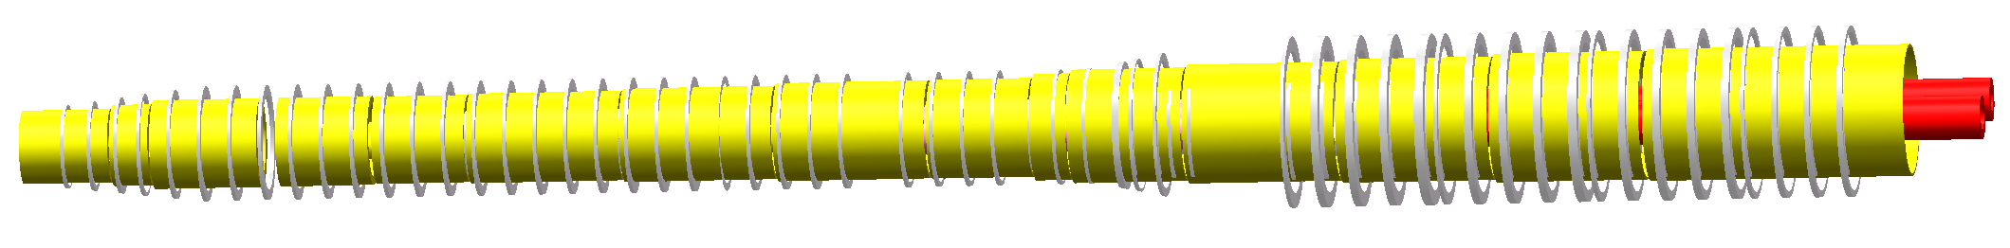
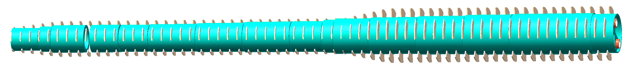
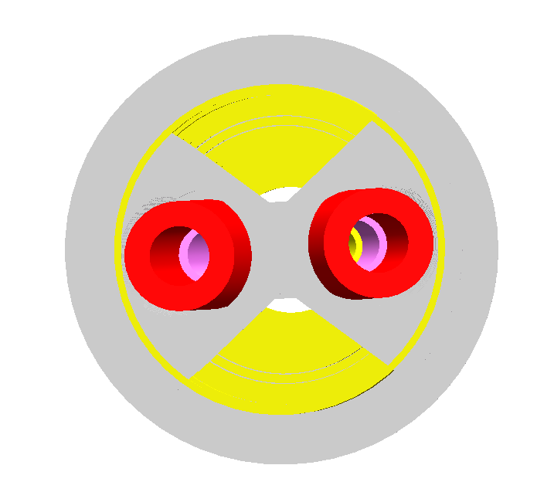

2. Weight optimization of the cryostat
Skeleton supports Weight: 142kg
Skeleton supports Weight: 92kg
Support of SC magnet
Notes:
标注尺寸

Slide 9
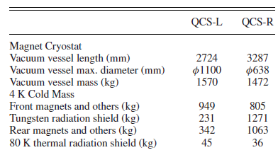
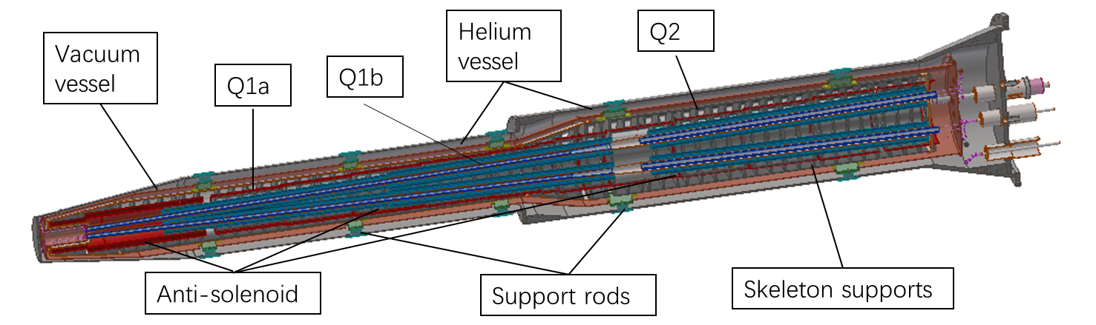
2. Weight optimization of the cryostat
Items | Weight (kg) | Main materials
Vacuum vessel | 1184 | SS
Helium Vessel | 195 | SS
Thermal shield and pipes | 43 | Aluminum
SC quadrupoles | 100 | Copper & Aluminum
Anti-solenoids | 302 | Copper & Aluminum
Skeleton supports | 92 | Aluminum
Liquid Helium | 90 | Liquid Helium
Total weight | 2006
Cryostat length: 5.75 m
Total weight: 2.006 ton
SuperKEKB
Notes:
标注尺寸

Slide 10
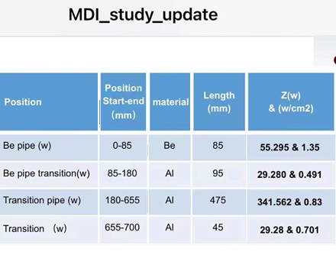
3. Temperature field of beam pipes
IP 附近束流管
From Quan Ji and Yudong Liu
右图为高能所刘瑜冬老师提供的热量，单边总热量455.4W；
计算时考虑余量，按单边总热量600W计，即各处热量乘以1.31747；
束流管热量加载
位置 | 单边总量 | 两边总量 | 面积 | 热流密度
mm | W | W | m2 | W/cm2
0~80 | 72.85 | 145.70 | 0.0100519 | 1.449
80~175 | 38.58 | 77.15 | 0.0119348 | 0.646
175~700 | 488.57 | 977.15 | 0.0843314 | 1.159
全部合计 | 600 | 1200
Notes:
标注尺寸

Slide 11
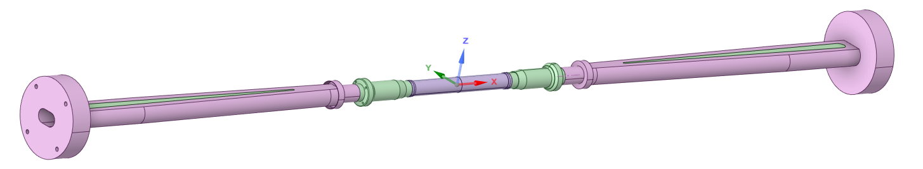
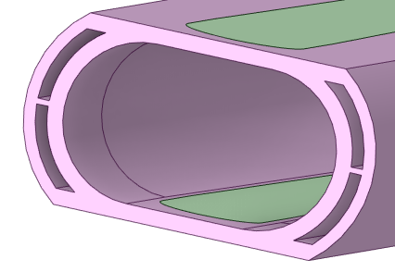
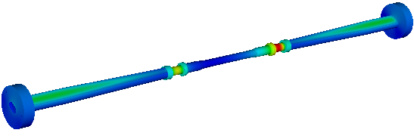


3. Temperature field of beam pipes
IP 附近束流管
铍板
A
A’
A-A’剖面
中心铍管：
4个进口，4个出口
冷却介质：水或1号电火花油
入口温度：16℃
入口流速：0.8m/s (1.1L/min)
层流
外延铝管：
2个进口，2个出口
冷却介质：水
入口温度：16℃
入口流速：1m/s (3.4L/min)
湍流，下进上出
换热要求：外铍管温度小于20℃
最高温度位置
冷却介质: 油
冷却介质 : 水
束流管整体温度分布
最高温度: 26.7℃
最高温度: 31.1℃
Notes:
标注尺寸

Slide 12
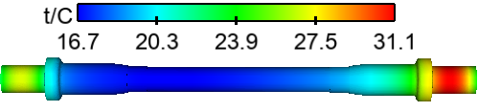
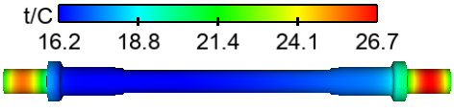
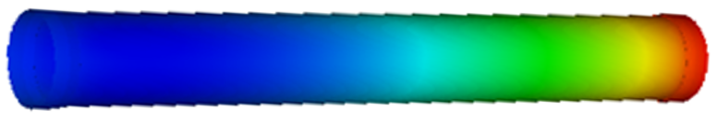
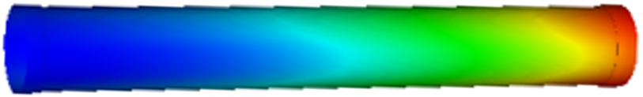
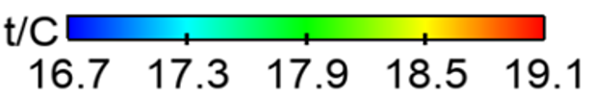

3. Temperature field of beam pipes
IP 附近束流管
冷却介质 : 油
冷却介质 : 水
Δt=2.4 ℃
Δt=1.0 ℃
ΔP=37.3 kPa
连接处
ΔP= 21kPa
外铍管温度云图
外铍管温度云图
油冷：温度满足要求！
水冷：温度满足要求！
采用水冷效果更好！
Notes:
标注尺寸

Slide 13
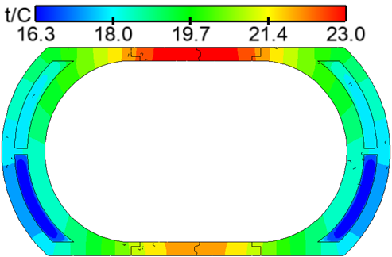
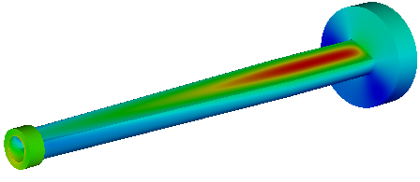


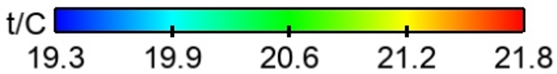
3. Temperature field of beam pipes
IP 附近束流管
外延铝管温度云图
外延铝管截面温度云图(x=585mm)
上铍板温度
铍板温度云图
下铍板温度
Notes:
标注尺寸

Slide 14
3. Temperature field of beam pipes
恒温器处束流管
热负荷：Synchrotron radiation
Region | ttbar |  | Higgs |  | Z
 | SR heat load | SR average power density | SR heat load | SR average power density | SR heat load | SR average power density
0~780mm | 0 | 0 | 0 | 0 | 0 | 0
780mm~805mm | 11.88W | 132W/cm² | 23.04W | 256W/cm² | 11.8W | 131.1W/cm²
805mm~855mm | 27.53W | 152.9W/cm² | 53.39W | 296.6W/cm² | 27.4W | 152.2W/cm²
855mm~1.9m(Q1a entrance） | 2.22W | 0.59W/cm² | 4.32W | 1.15W/cm² | 2.2W | 0.59W/cm²
Q1a（1900-3110）1210 | 1.69W | 0.38Wcm² | 3.28W | 0.75W/cm² | 1.68W | 0.38W/cm²
Q1a~Q1b（3110-3190） | 11.8W | 40.97W/cm² | 22.92W | 79.58W/cm² | 11.75W | 40.8W/cm²
Q1b（3190-4400） | 2.04W | 0.47W/cm² | 3.96W | 0.91W/cm² | 2.03W | 0.47W/cm²
Q1b~Q2(4400-4700) | 36.6W | 33.9W/cm² | 71.04W | 65.8W/cm² | 36.4W | 33.7W/cm²
Q2(4700-5900) | 3.74W | 0.69W/cm² | 7.26W | 1.34W/cm² | 3.72W | 0.69W/cm²
Notes:
标注尺寸

Slide 15
3. Temperature field of beam pipes
恒温器处束流管
热负荷：HOM & Resistance wall
Position | Position Start-end（mm） | material | Length (mm) | Higgs(w) & (w/cm²) | W (w) & (w/cm²) | Z(w) & (w/cm²) | ttbar（w） & (w/cm²)
Be pipe (w) | 0-85 | Be | 85 | 1.13 & 0.021 | 5.587 & 0.105 | 55.295 & 1.35 | 0.31 & 0.005
Be pipe transition(w) | 85-180 | Al | 95 | 0.61 & 0.01 | 2.950 & 0.049 | 29.280 & 0.491 | 0.172 & 0.007
Transition pipe (w) | 180-655 | Al | 475 | 6.99 & 0.017 | 34.48 & 0.085 | 341.562 & 0.83 | 1.958 & 0.005
Transition （w） | 655-700 | Al | 45 | 0.62 & 0.015 | 2.95 & 0.071 | 29.28 & 0.701 | 0.172 & 0.004
RVC bellow（w） | 700-780 | Cu | 80 | 0.52 & 0.007 | 2.532 & 0.034 | 25.002 & 0.337 | 0.14 & 0.002
Transition on Y-crotch | 780-805 | Cu | 25 | 0.16 & 0.007 | 0.785 & 0.032 | 7.822 & 0.316 | 0.05 & 0.002
Y- crotch (w) | 805-855 | Cu | 50 | 0.33 & 0.005 | 1.572 & 0.024 | 15.626 & 0.241 | 0.091 & 0.002
Quadrupole pipe(w) | 855-1100 | Cu | 245 | 1.58 & 0.005 | 7.735 & 0.024 | 75.594& 0.24 | 0.434 & 0.002
Total | 0-1100 | - | 1100 | 12.0 &0.011 | 58.594 &0.056 | 580.46 & 0.56 | 3.331 & 0.003
Notes:
标注尺寸

Slide 16
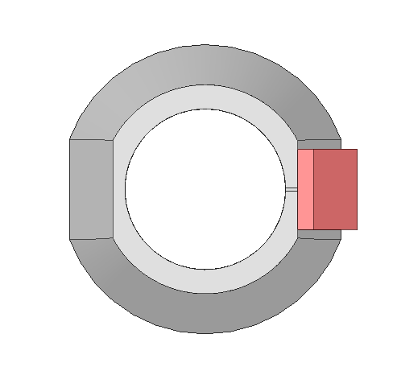
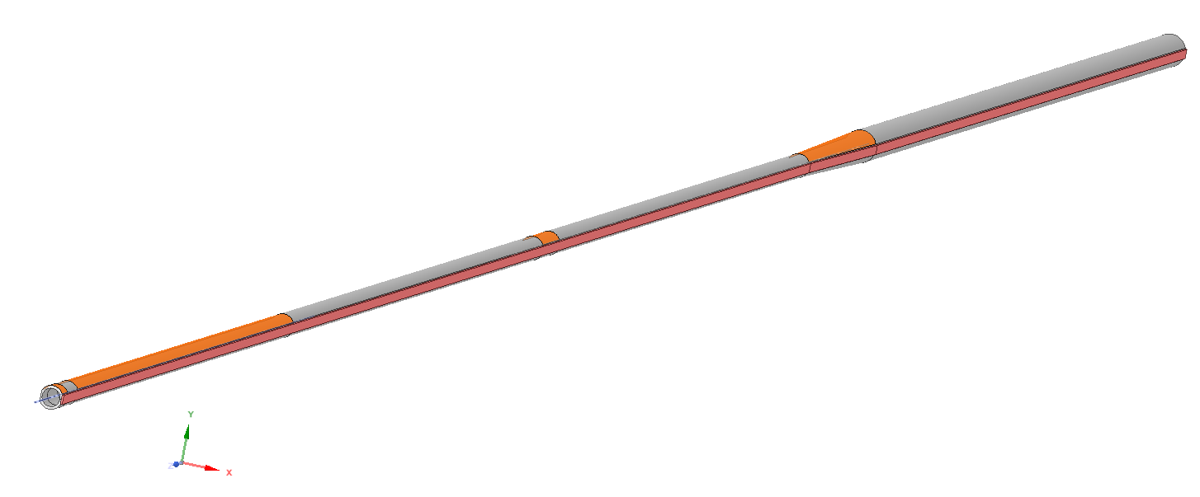
3. Temperature field of beam pipes
恒温器处束流管
计算边界条件
Q2
辐射光（Higgs）：
作用宽度0.36mm
水冷管道
1.34 W/cm²
Q1b~Q2
-- 6200mm
Q1b
65.8 W/cm²
0.91 W/cm²
Q1a~Q1b
Q1a
79.58 W/cm²
出口
0.75 W/cm²
1.15 W/cm²
296.6 W/cm²
256 W/cm²
水冷：1.5m/s，2mm*10mm流道；16℃（289K）
780mm--
入口
Notes:
标注尺寸

Slide 17
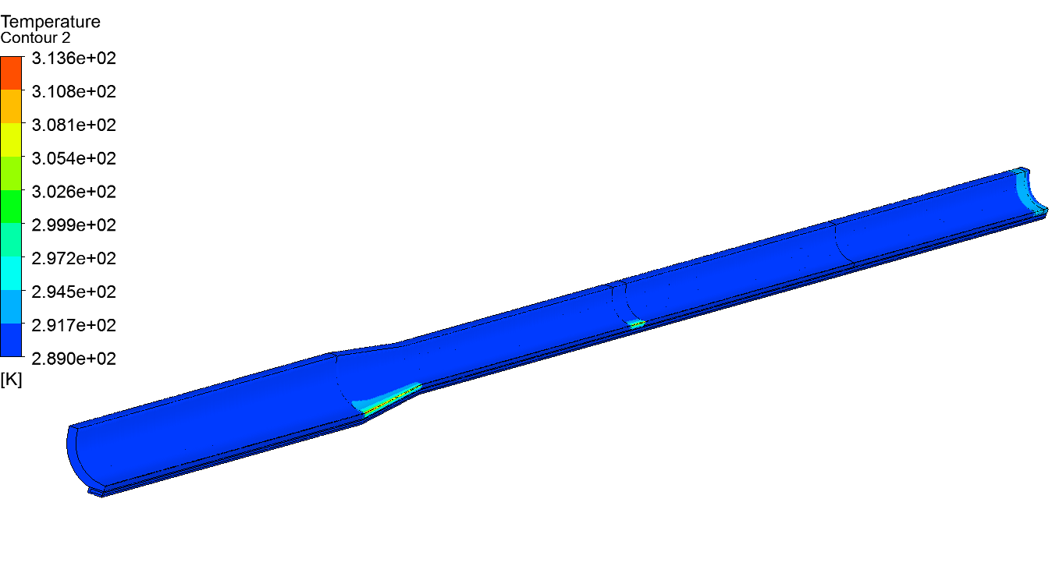
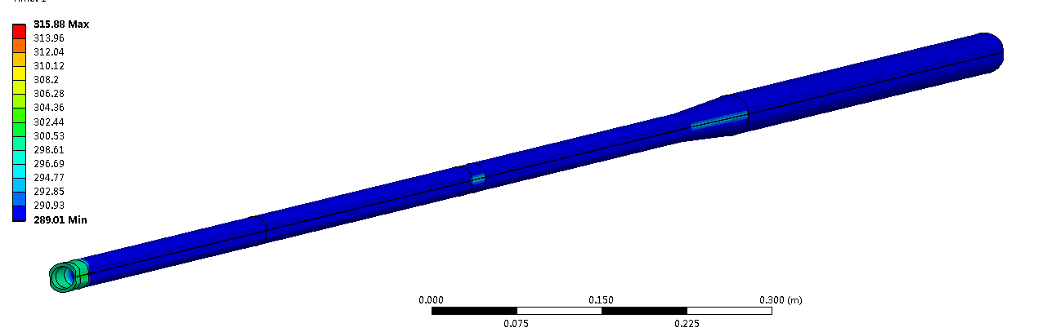
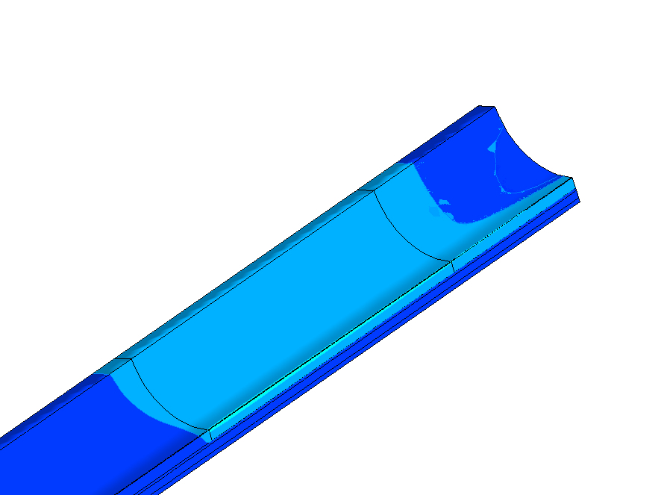
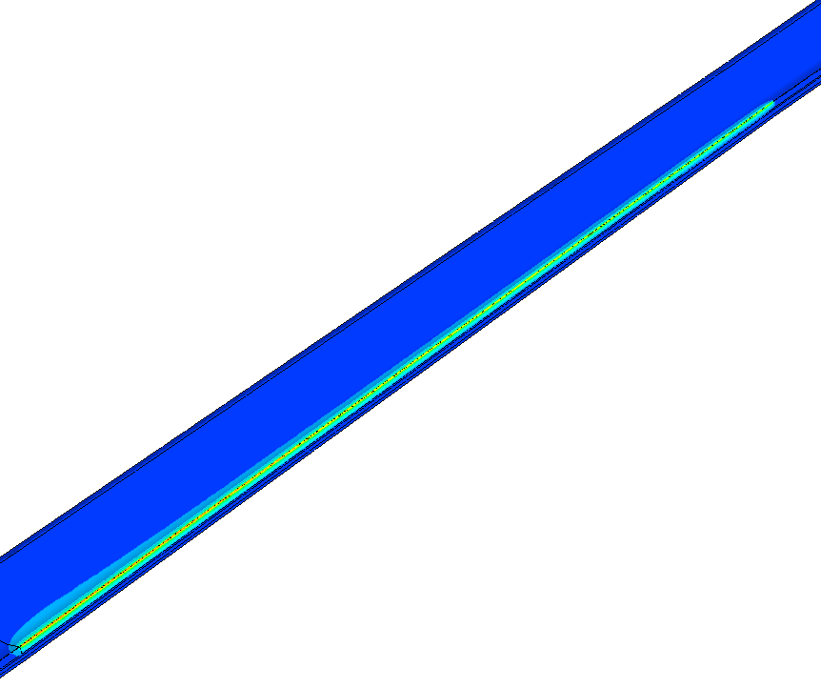
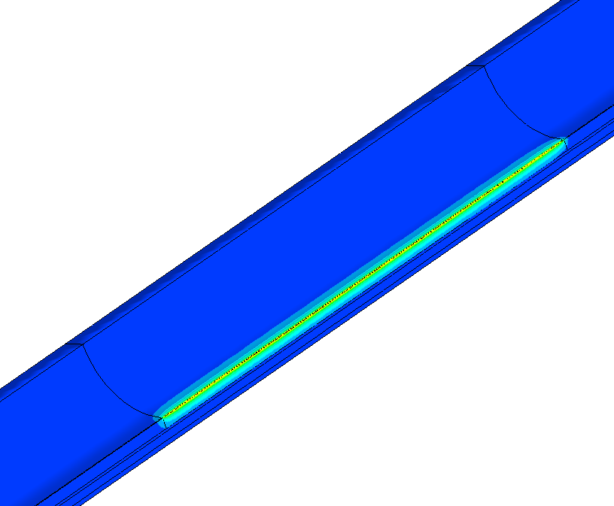
3. Temperature field of beam pipes
恒温器处束流管
真空盒温度
Thermal 校核计算（315K）
Q1b~ Q2；
Q1a~ Q1b ；
780-805mm；
805-855mm
温度云图
Notes:
标注尺寸

Slide 18
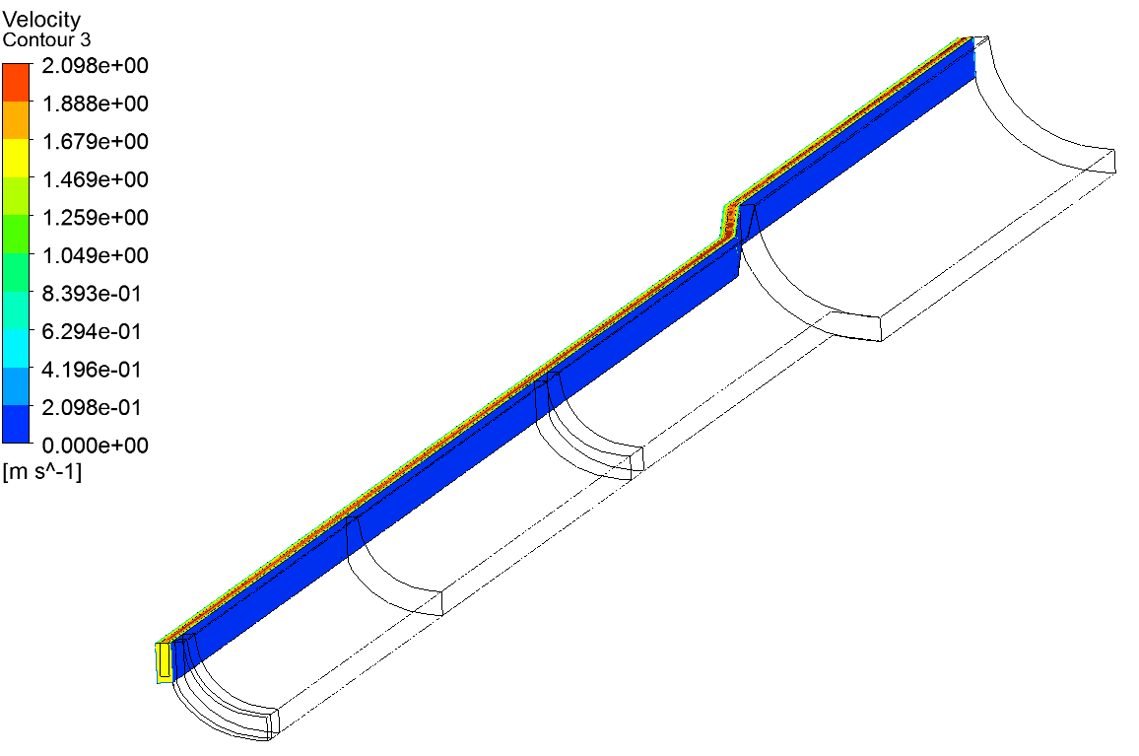
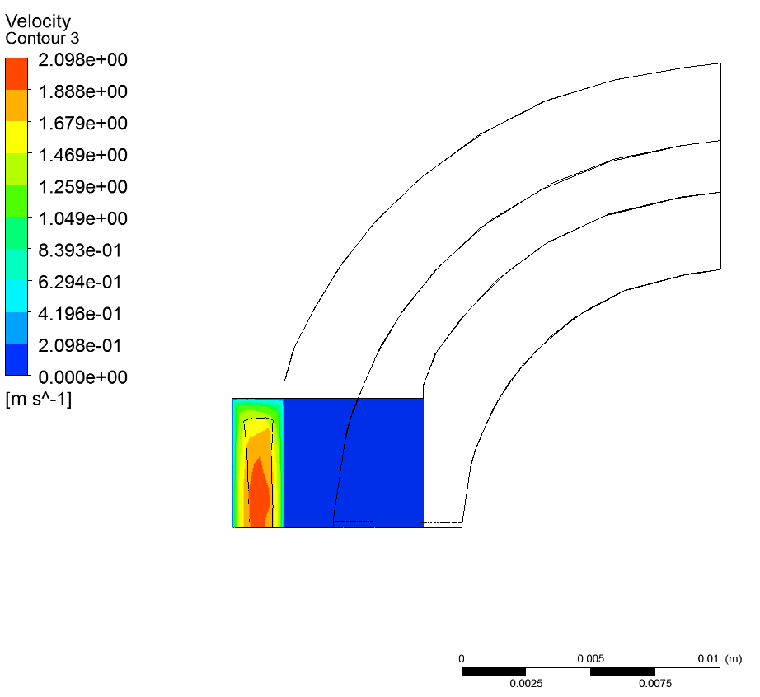
3. Temperature field of beam pipes
恒温器处束流管
水冷速度场
冷却水速度场
中心水流速度在2.1m/s
压差损失1.5bar
冷却水截面速度
Notes:
标注尺寸

Slide 19
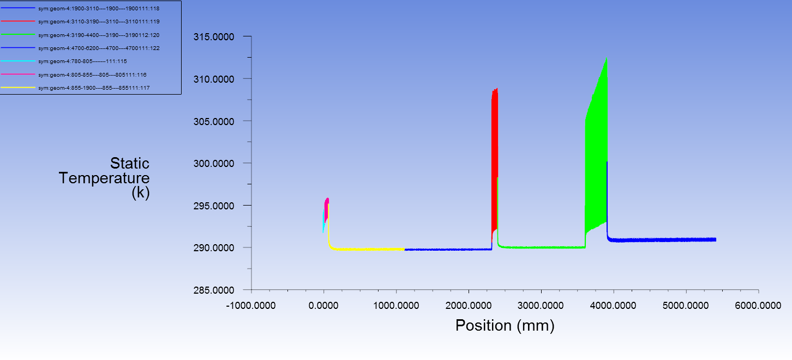
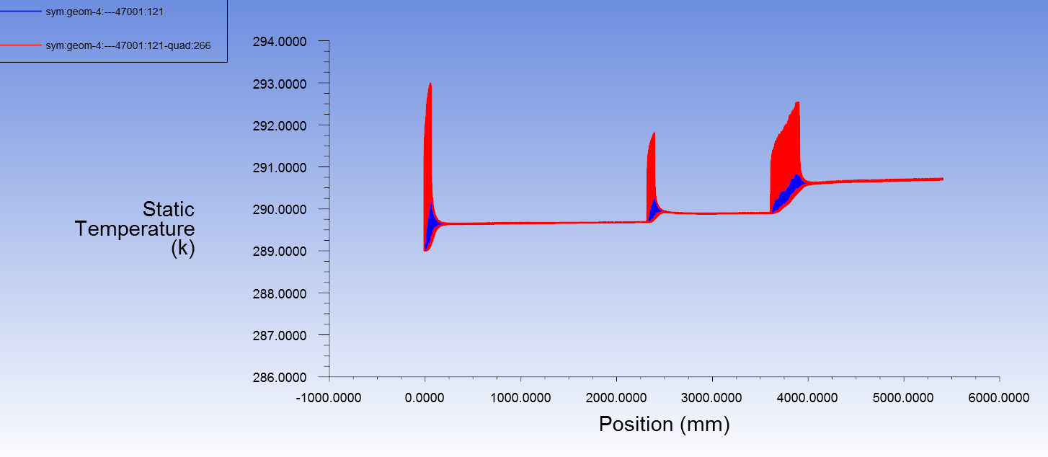
3. Temperature field of beam pipes
恒温器处束流管
沿程的温度场分布，几个位置温度升高较明显；真空盒温度，最高313K（40℃），冷却水温度，最高293K，出口291K。
Q1a~ Q1b ；
Q1b~ Q2；
780-805mm；
805-855mm
真空盒温度
水冷：温度满足要求.
温升~1.5℃.
冷却水温度
Notes:
标注尺寸

Slide 20
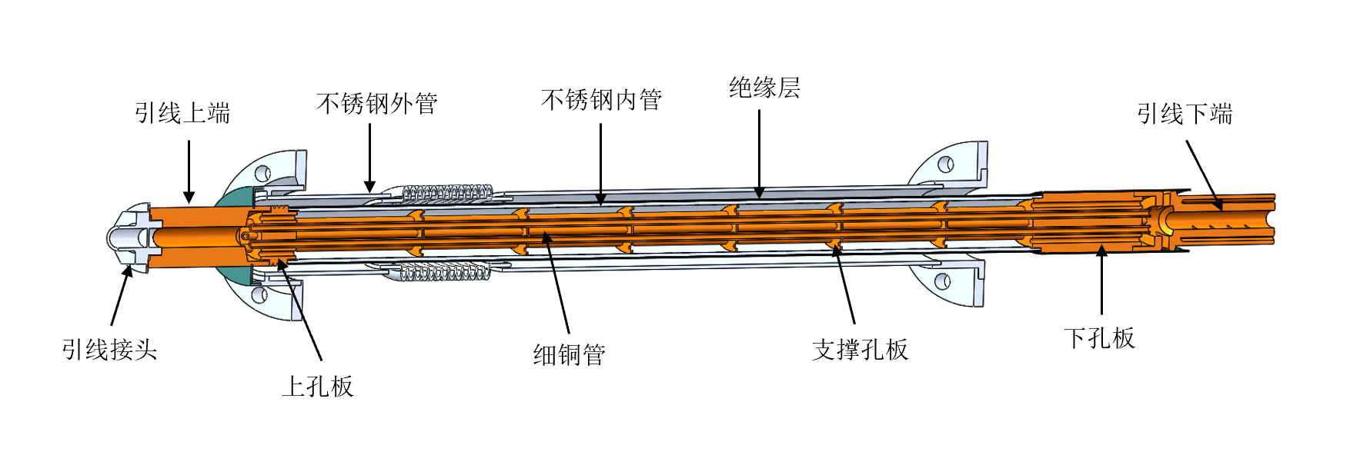
4. Current lead design for MDI SC magnet
MDI superconducting anti-solenoid magnet need to develop 1.3 kA level current leads;
The traditional pure copper leads are not easy to meet the requirements, and the current feasible solution is to use binary current leads based on high-temperature superconductivity;
The superconducting wire welding resistance optimization, safe protection and low-temperature insulation and other issues are considered;
Current lead in BEPC2
Current lead in KIT
Notes:
标注尺寸

Slide 21
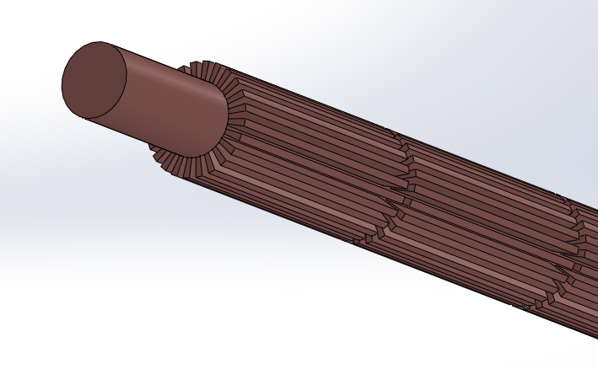
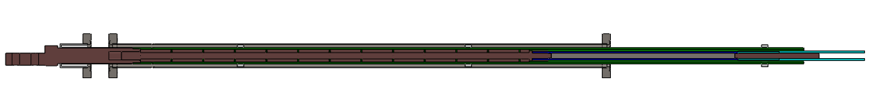
4. Current lead design for MDI SC magnet
HTS current lead
2KA HTS current lead cooled by helium gas
高纯无氧铜
高温超导+分流器
低温超导
 | 1300A电流引线 |  | 800A电流引线
引线段 | HTS | 铜引线 | HTS | 铜引线
冷却 | 5K氦气迫流 | 5K氦气迫流 | 5K氦气迫流 | 5K氦气迫流
结构 | Bi-2223银金高温超导带 | RRR40的高纯无氧铜 | Bi-2223银金高温超导带 | RRR40的高纯无氧铜
长度mm | 390 | 619 | 390 | 619
截面 | 12层 | 直径20mm，翅高5mm | 6层 | 直径20mm，翅高5mm
工作温区 | ＜60K | ＜60K-300K | ＜60K | ＜60K-300K
载流A | 1500+ | / | 900+ | /
低温漏热 | ＜0.15 | / | ＜0.1 | /
氦气g/s | / | 预估＜0.1 | / | 预估＜0.05
New heat exchange method
Current leads cooled by liquid nitrogen or helium are designed based on Bi-2223 high-temperature superconductor and high-purity copper;
With the help of numerical simulation, for the cooling of the copper section is designed; An enhanced heat transfer scheme is proposed；
Notes:
标注尺寸

Slide 22
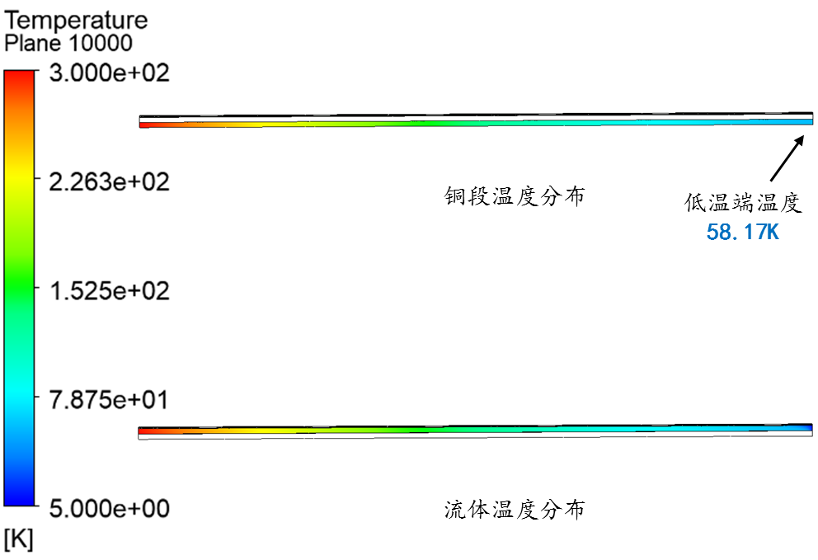
4. Current lead design for MDI SC magnet
计算得到铜的温度场，在0.06g/s氦气流量下，可满足要求。工艺更简单，流量可更小，绝缘更容易实现。
序号 | 项目 | 描述
1 | 载流能力 | 77K最大1800A @AS1，900A @SCQ。
2 | 铜段加工 | 翅片铜柱，工艺简单可靠，并大幅缩短制作周期。
3 | HTS | 有效提高铜段低温端温度，极低漏热，使得低温超导处的温度容易控制。
4 | 电绝缘 | 室温陶瓷，沿程G10套管，综合耐压可达1000V+。
5 | 低温漏热 | 大幅减小，小于一元引线情况的1/10。
二元电流引线的技术特点：
Notes:
标注尺寸

Slide 23
Summary
Design status of cryomodule:
The cryostat weight has been optimized to be approximately 2.0 tons.
The temperature field of the beam pipe has been calculated and checked, which meets the requirement.
Binary current leads have been designed initially for the SC magnets.
Works to be done:
Optimization of the cryostat and cooling system.
Thermal and mechanical analysis; (quench protection, energy storage , supports )
Measurement requirements; (temperature/pressure/BPM)
Initial consideration of processing and manufacturing technology;

Slide 24
Thanks for your attention!

