Slide 1
Material Budget Caculation

Slide 2
Method
Radiation length (X0)
B: material budget (fraction of X0)
L: thickness
X0: radiation length of certain material
Could quantify material budget with xxx% of X0
Total material budget could be simply calculated with:

Slide 3
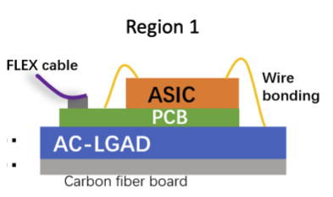
Results for normal case
Layer | Material | Radiation length(mm) | thickness(mm) | Material Budget(X0)
ASIC | Silicon | 93.6 | 3 | 0.03205
PCB | FR-4 | 174 | 1.6 | 0.009195
AC-LGAD | Silicon | 93.6 | 0.5 | 0.005342
Carbon fiber board | Carbon fiber | 237 | 0.2 | 0.000844
Total |  |  |  | 0.047432

Slide 4
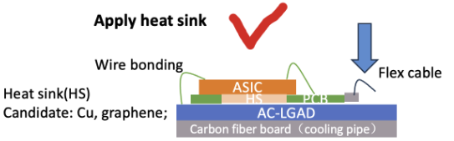
Results with heat sink(copper)
Layer | Material | Radiation length(mm) | thickness(mm) | Material Budget(X0)
ASIC | Silicon | 93.6 | 3 | 0.03205
Heat sink | Copper | 14.36 | 1.6 | 0.11142
AC-LGAD | Silicon | 93.6 | 0.5 | 0.005342
Carbon fiber board | Carbon fiber | 237 | 0.2 | 0.000844
Total |  |  |  | 0.149658

Slide 5
Results with heat sink(aluminum)
Layer | Material | Radiation length(mm) | thickness(mm) | Material Budget(X0)
ASIC | Silicon | 93.6 | 3 | 0.03205
Heat sink | Aluminum | 88.9 | 1.6 | 0.017998
AC-LGAD | Silicon | 93.6 | 0.5 | 0.005342
Carbon fiber board | Carbon fiber | 237 | 0.2 | 0.000844
Total |  |  |  | 0.056235

