Slide 1
Group Meeting
2024.09.06

Slide 2
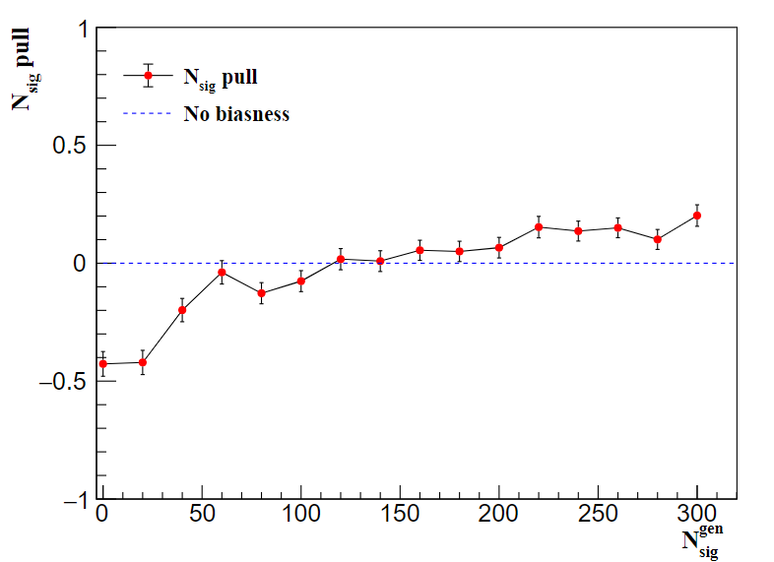
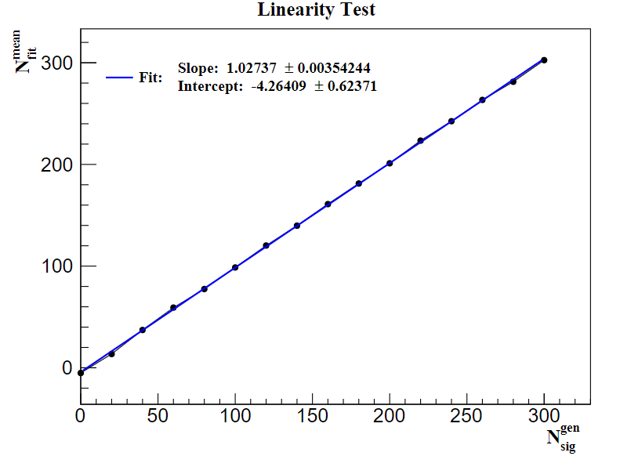
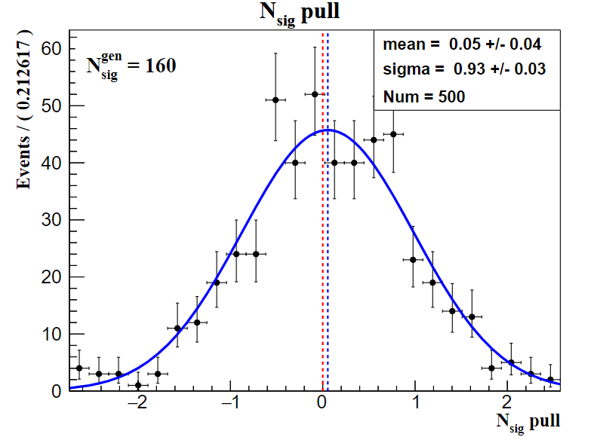
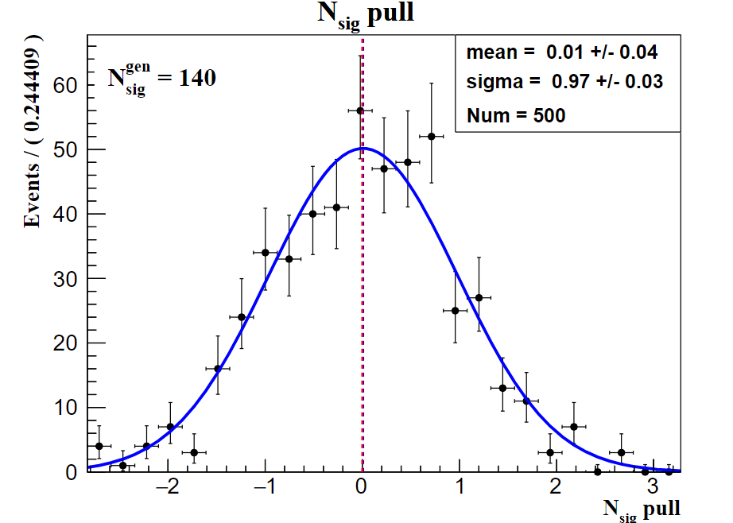
Linearity Test
( Expected signal yield : 153, range 0 – 300, step 20 )
error bars : uncertainty on the pull mean

Slide 3
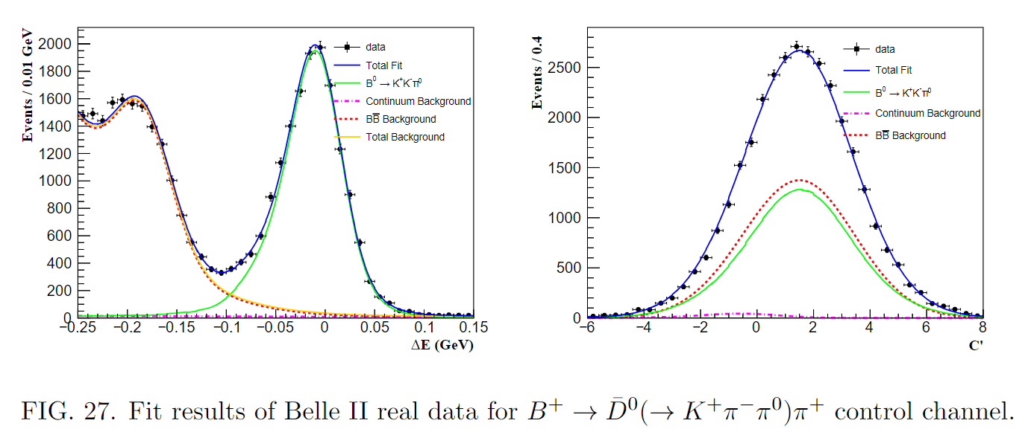
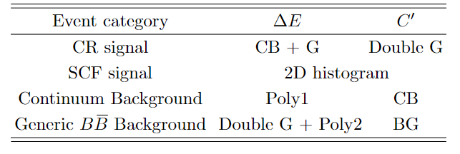
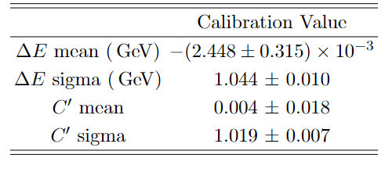
Control Channel
PDFs used to model the $∆E$and $C′$ distributions
Calibration Values

Slide 4
Control Channel
$N_{sig}$ $= 14555 ± 129$
$N_{B\overline{B}}=$ $\left(387 ±6\right) ×{10}^{6}$
$f^{+−}=\left(51.4 ±1.2\right)\%$
$ℬ\left({\overline{D}}^{0}→K^{+}π^{−}π^{0}\right)=\left(14.4 ±0.6\right)\%$
$ε_{rec}=\left(5.66 ± 0.02\right)\%$
$r_{PID}=\text{0.949}$
Br = $(4.71 ± 0.20) × {10}^{−3}$
${Br}_{PDG}$= $(4.61 ± 0.10) × {10}^{−3}$

Slide 5
Backup

Slide 6
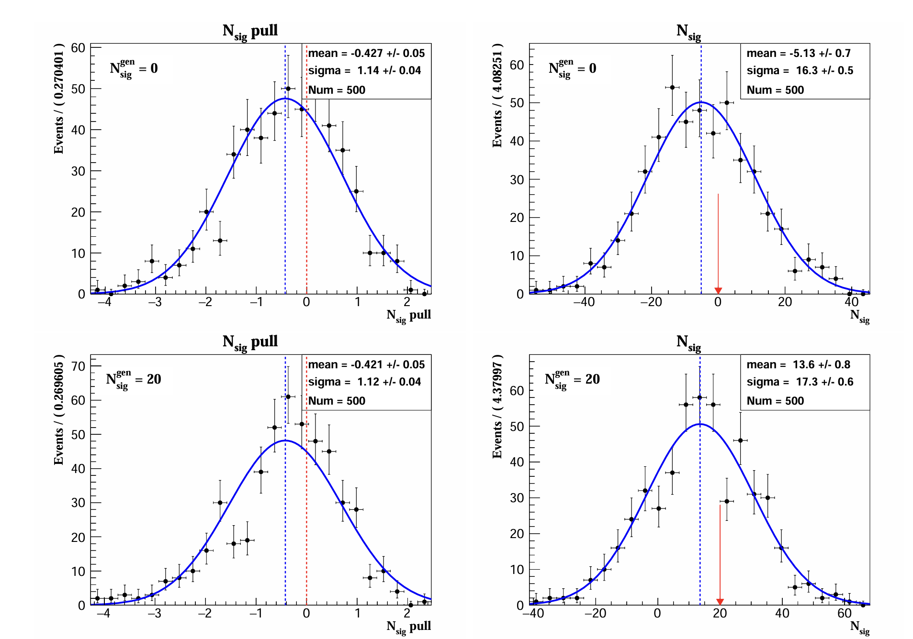
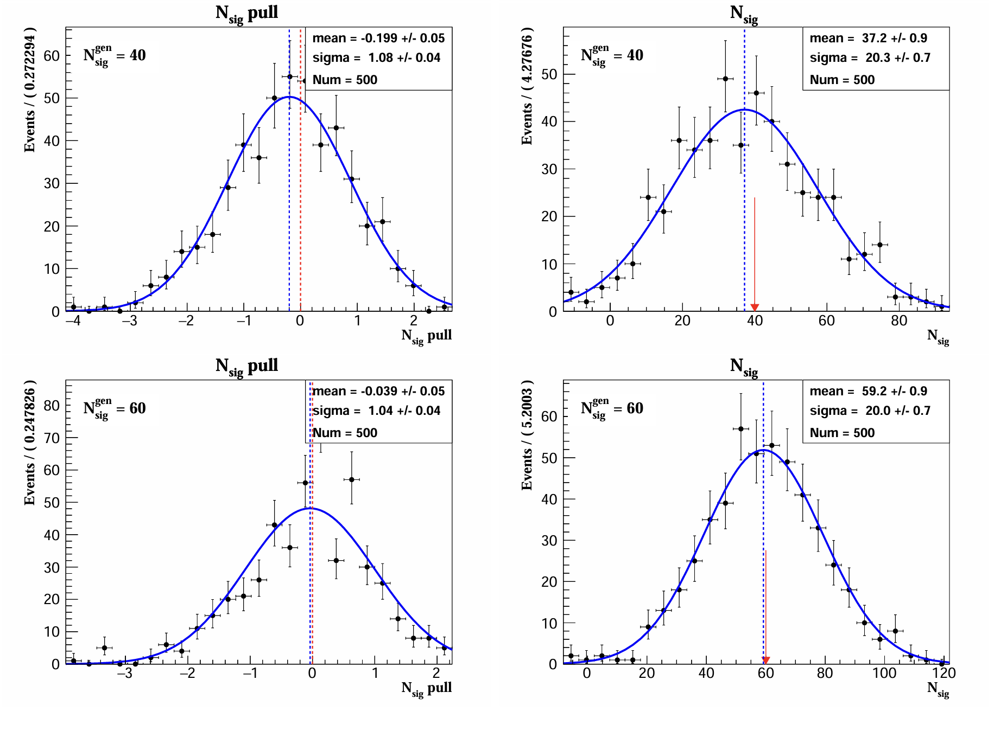

Slide 7
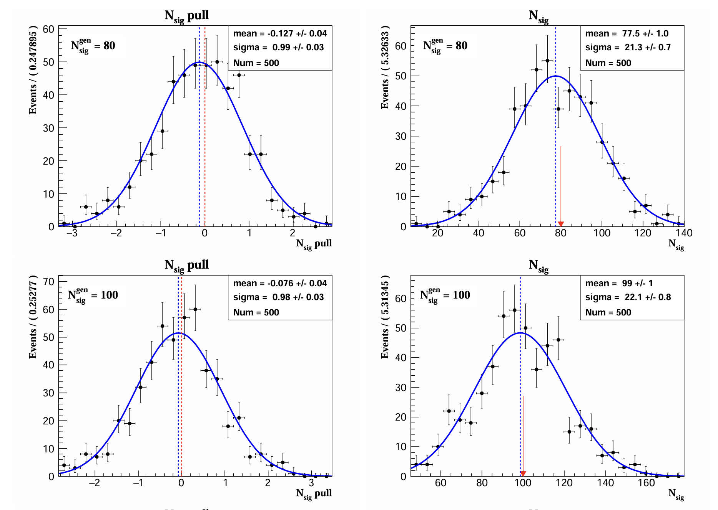
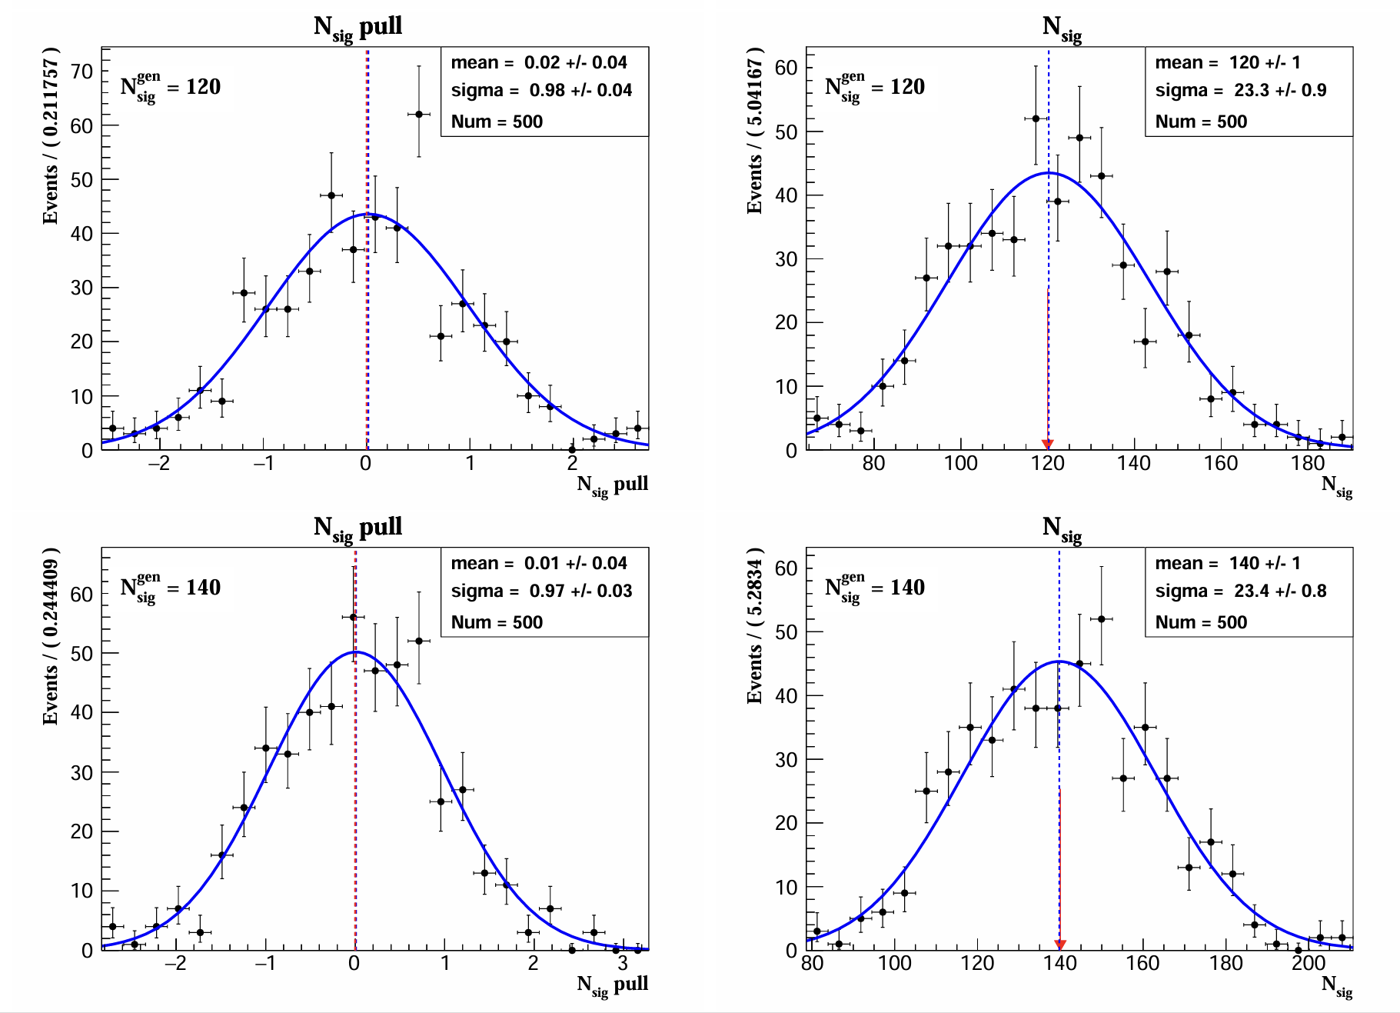

Slide 8
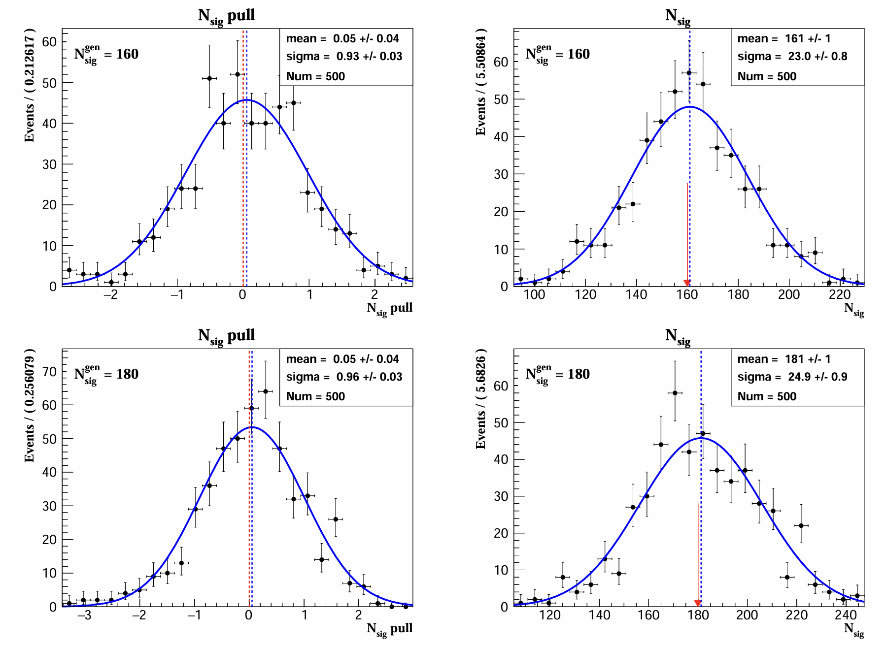
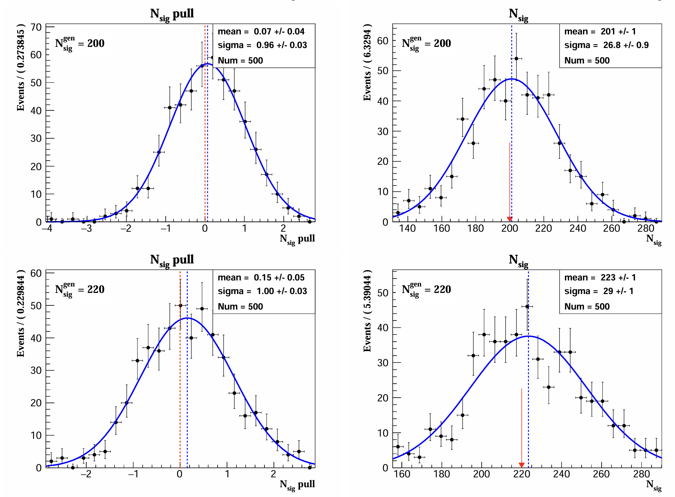

Slide 9
