Slide 1
Measurement of CSNS Back-n Neutron Beam Profile with Micromegas Detector
Yang Li
CSNS / IHEP, CAS
31st International Seminar on Interaction of Neutrons with Nuclei
Dongguan, China, 26th–30th May 2025

Slide 2
Contents
CSNS Back-n Beamline
Measurement of Beam Profile with Micromegas Detector
Result
Summary

Slide 3
CSNS Back-n Beamline
(unit: m)
Distance from spallation target
Endstation-1: ~55 m; Endstation-2: ~70 m
Neutron energy
Thermal to 300 MeV
Neutron flux
10⁷ n/cm²/s @100 kW proton beam power

Slide 4
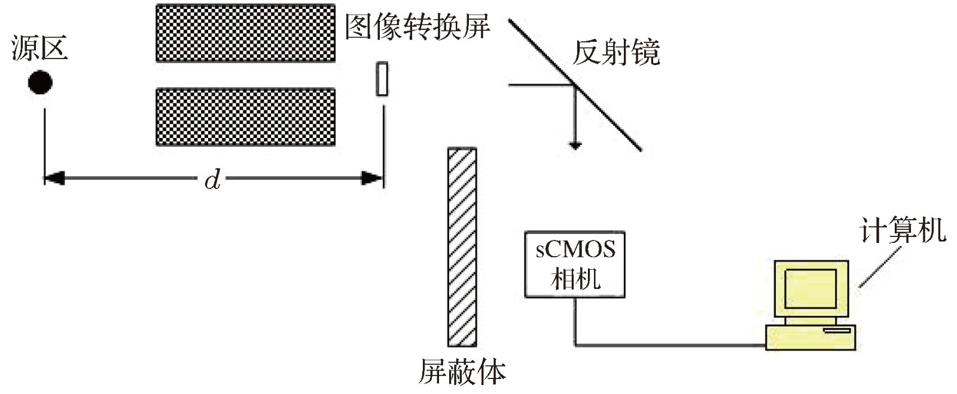
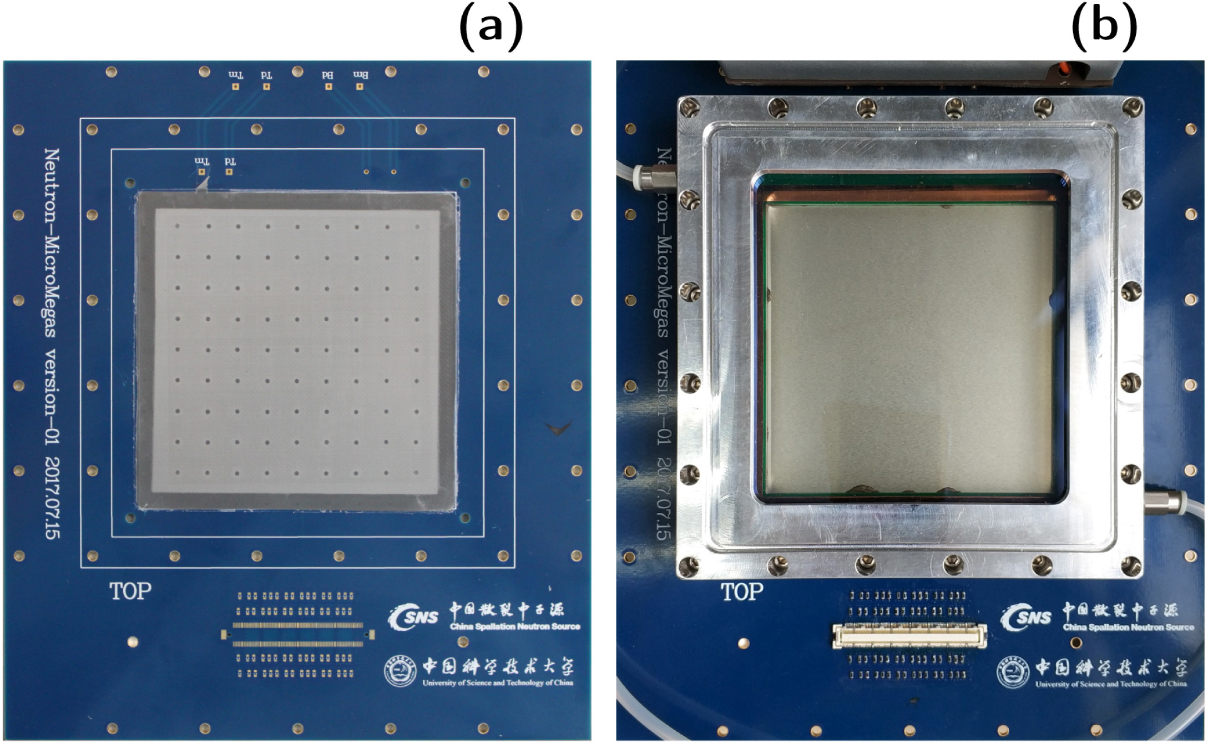
Measurement of Back-n Beam Profile
Converter
Source
Reflector
Neutron beam profile is one of the key properties of Back-n
Measured when Back-n started commissioning in 2018～2019, by a scintillator-CMOS detection system [DOI: 10.7498/aps.68.20182191]
PC
Shielding
Meanwhile, a beam profile monitor based on Micromegas (micro-mesh gaseous structure) detector was developed by CSNS and University of Science and Technology of China (USTC)
Good 2D spatial resolution
Fast timing capability

Slide 5
Micromegas Detector
To detect neutrons, they must be converted into charged particles via nuclear reactions, e.g. ¹⁰B(n, α)⁷Li, ⁶Li(n, t)⁴He.
Neutron converter of this work: B_{nat}, 1 μm thick, attached to the cathode facing the drift gap
The mesh-anode amplification gap (where electron avalanches occur) is manufactured with the thermal bonding method [https://doi.org/10.1016/j.nima.2020.164958] developed by USTC.
Drift gap: 5 mm
Amplification gap: 100 μm
Active area: 90×90 mm²
Mesh and anode plane separated by insulating pillars (2 mm in diameter)
Readout PCB of 2 mm thick

Slide 6
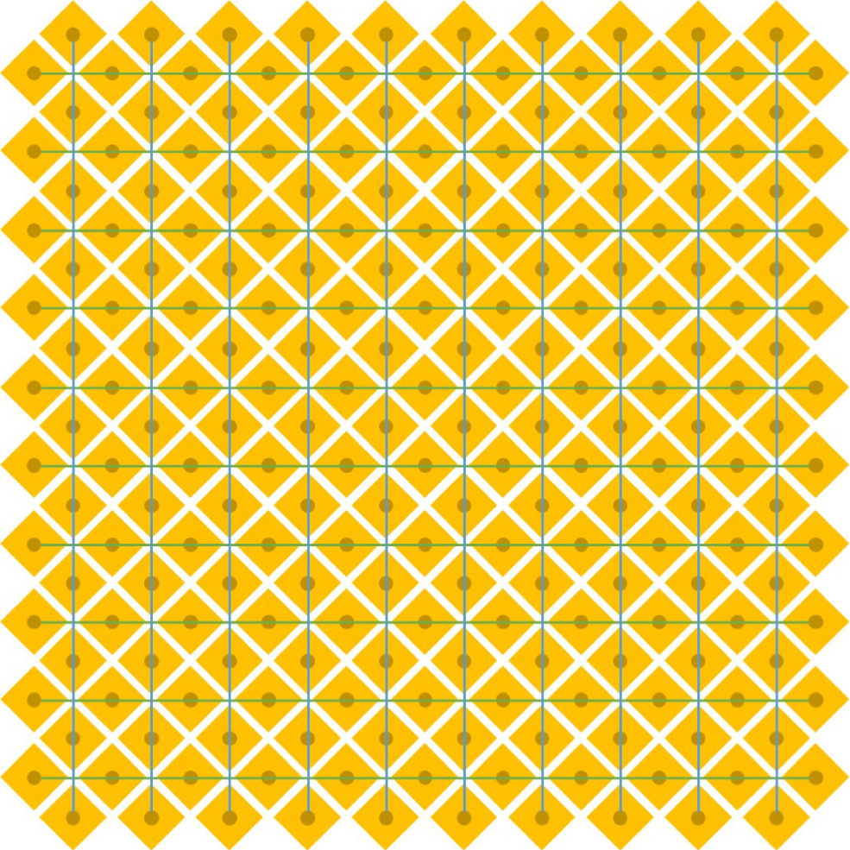
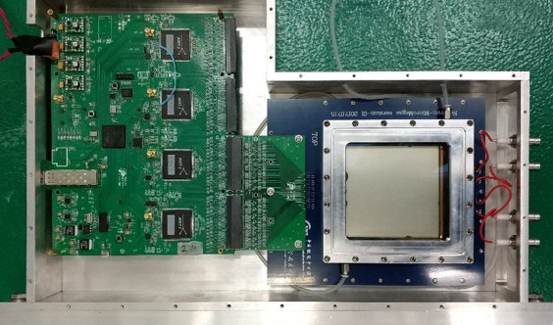
Micromegas Detector
2D readout structure has been designed to reconstruct the 2D position using strip coincidences
64 strips (1.5 mm pitch) in each direction
Each readout strip capacitively coupled to a charge amplifier, corresponding to one readout channel
Goals of this 2D readout scheme:
  Mitigate the unequal charge sharing between the two strip layers that occurs in conventional XY detectors
  Minimize the material budget of the detector
Front-end readout electronics
  Two AGET chips, 128 channels
  512 sampling points, sampling frequency 3–100 MHz
  12-bit ADC

Slide 7
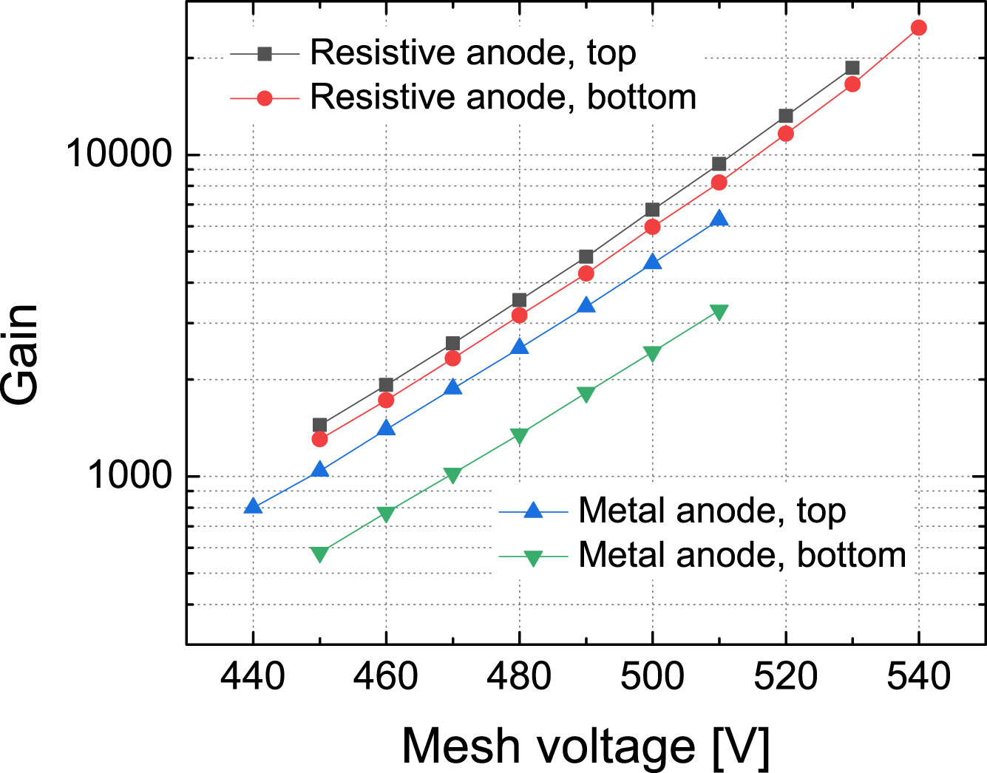
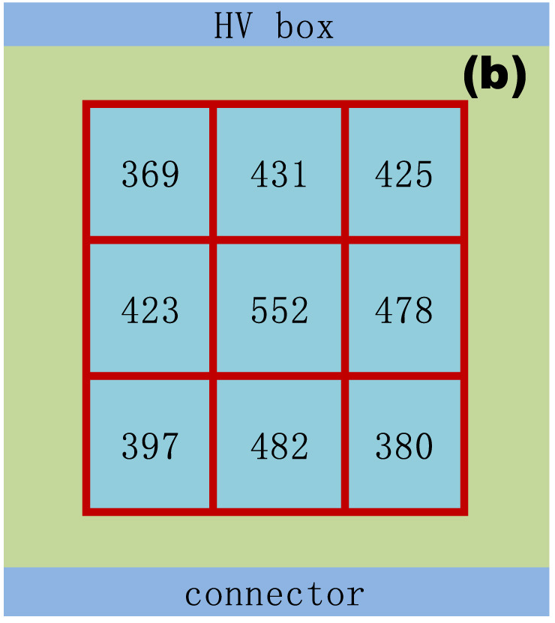
Detector Performance Test with X-rays
Collimated ⁵⁵Fe X-ray source (E_{Kα}=5.9 keV, E_{Kβ}=6.5 keV) was used to test the detector gain, gain uniformity, and energy resolution.
Energy resolution (FWHM) 37% at 5.9 keV
  Gap between the anode pads is 0.1 mm – comparable to the amplification gap length – the effects of the electric field inhomogeneities near the edges of the pads are nonnegligible.
  This leads to considerable gain variations and consequently deteriorates the energy resolution.
The number in the cell indicates the position of ⁵⁵Fe dominant peak (in units of ADC)
gain uniformity ~ 13%

Slide 8
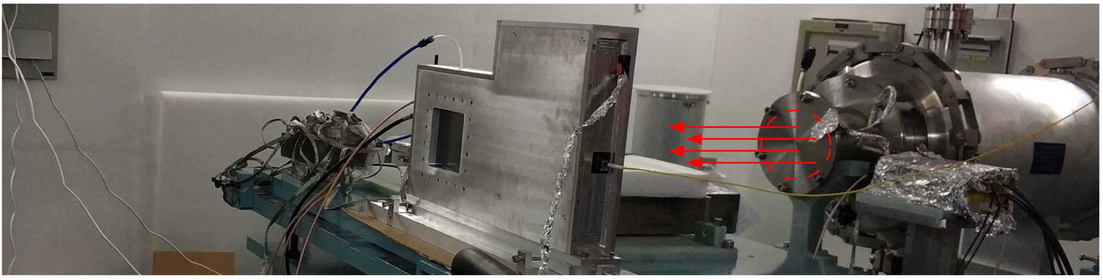
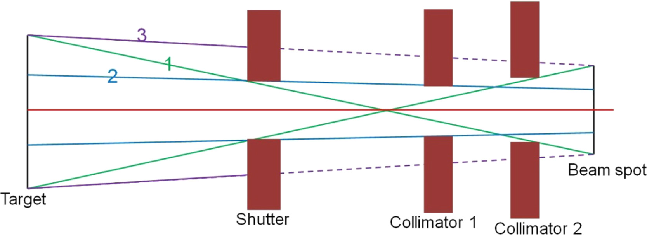
Measurement of Back-n Beam Profile
Measured at Back-n ES#1 (56 m)
20 kW proton beam power, 25 Hz
Detector gas:
  90% Ar and 10% CO₂ at atmospheric pressure
Micromegas detector
Neutron beam
Configuration of collimation aperture
⌀50 mm for Shutter, ⌀50 mm for Collimator-1
Beam spot size at ES#1 expected to be about ⌀ 50 mm according to MC simulation
Data collection time
Physics data collection time about nine hours
Dedicated run with neutron shutter being closed to collect data for pedestal correction (230 s)

Slide 9
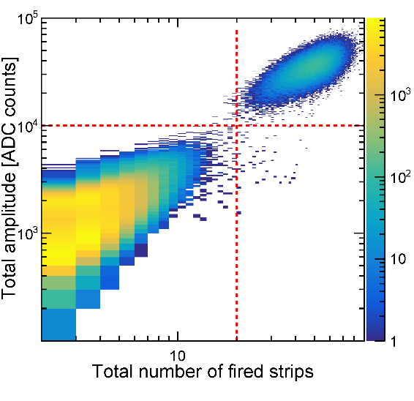
Data Analysis
Event selection
Signal of strip with S/N > 5
Fired strips should be consecutive, ensuring a continuous ionization of the gas when the charged particle traverses the drift gap
γ-flash events
Background rejection
Dominant background: γ-flash
Using total number of fired strips and sum of amplitudes of all fired strips to discriminate γ-flash from neutron events
Neutron events

Slide 10
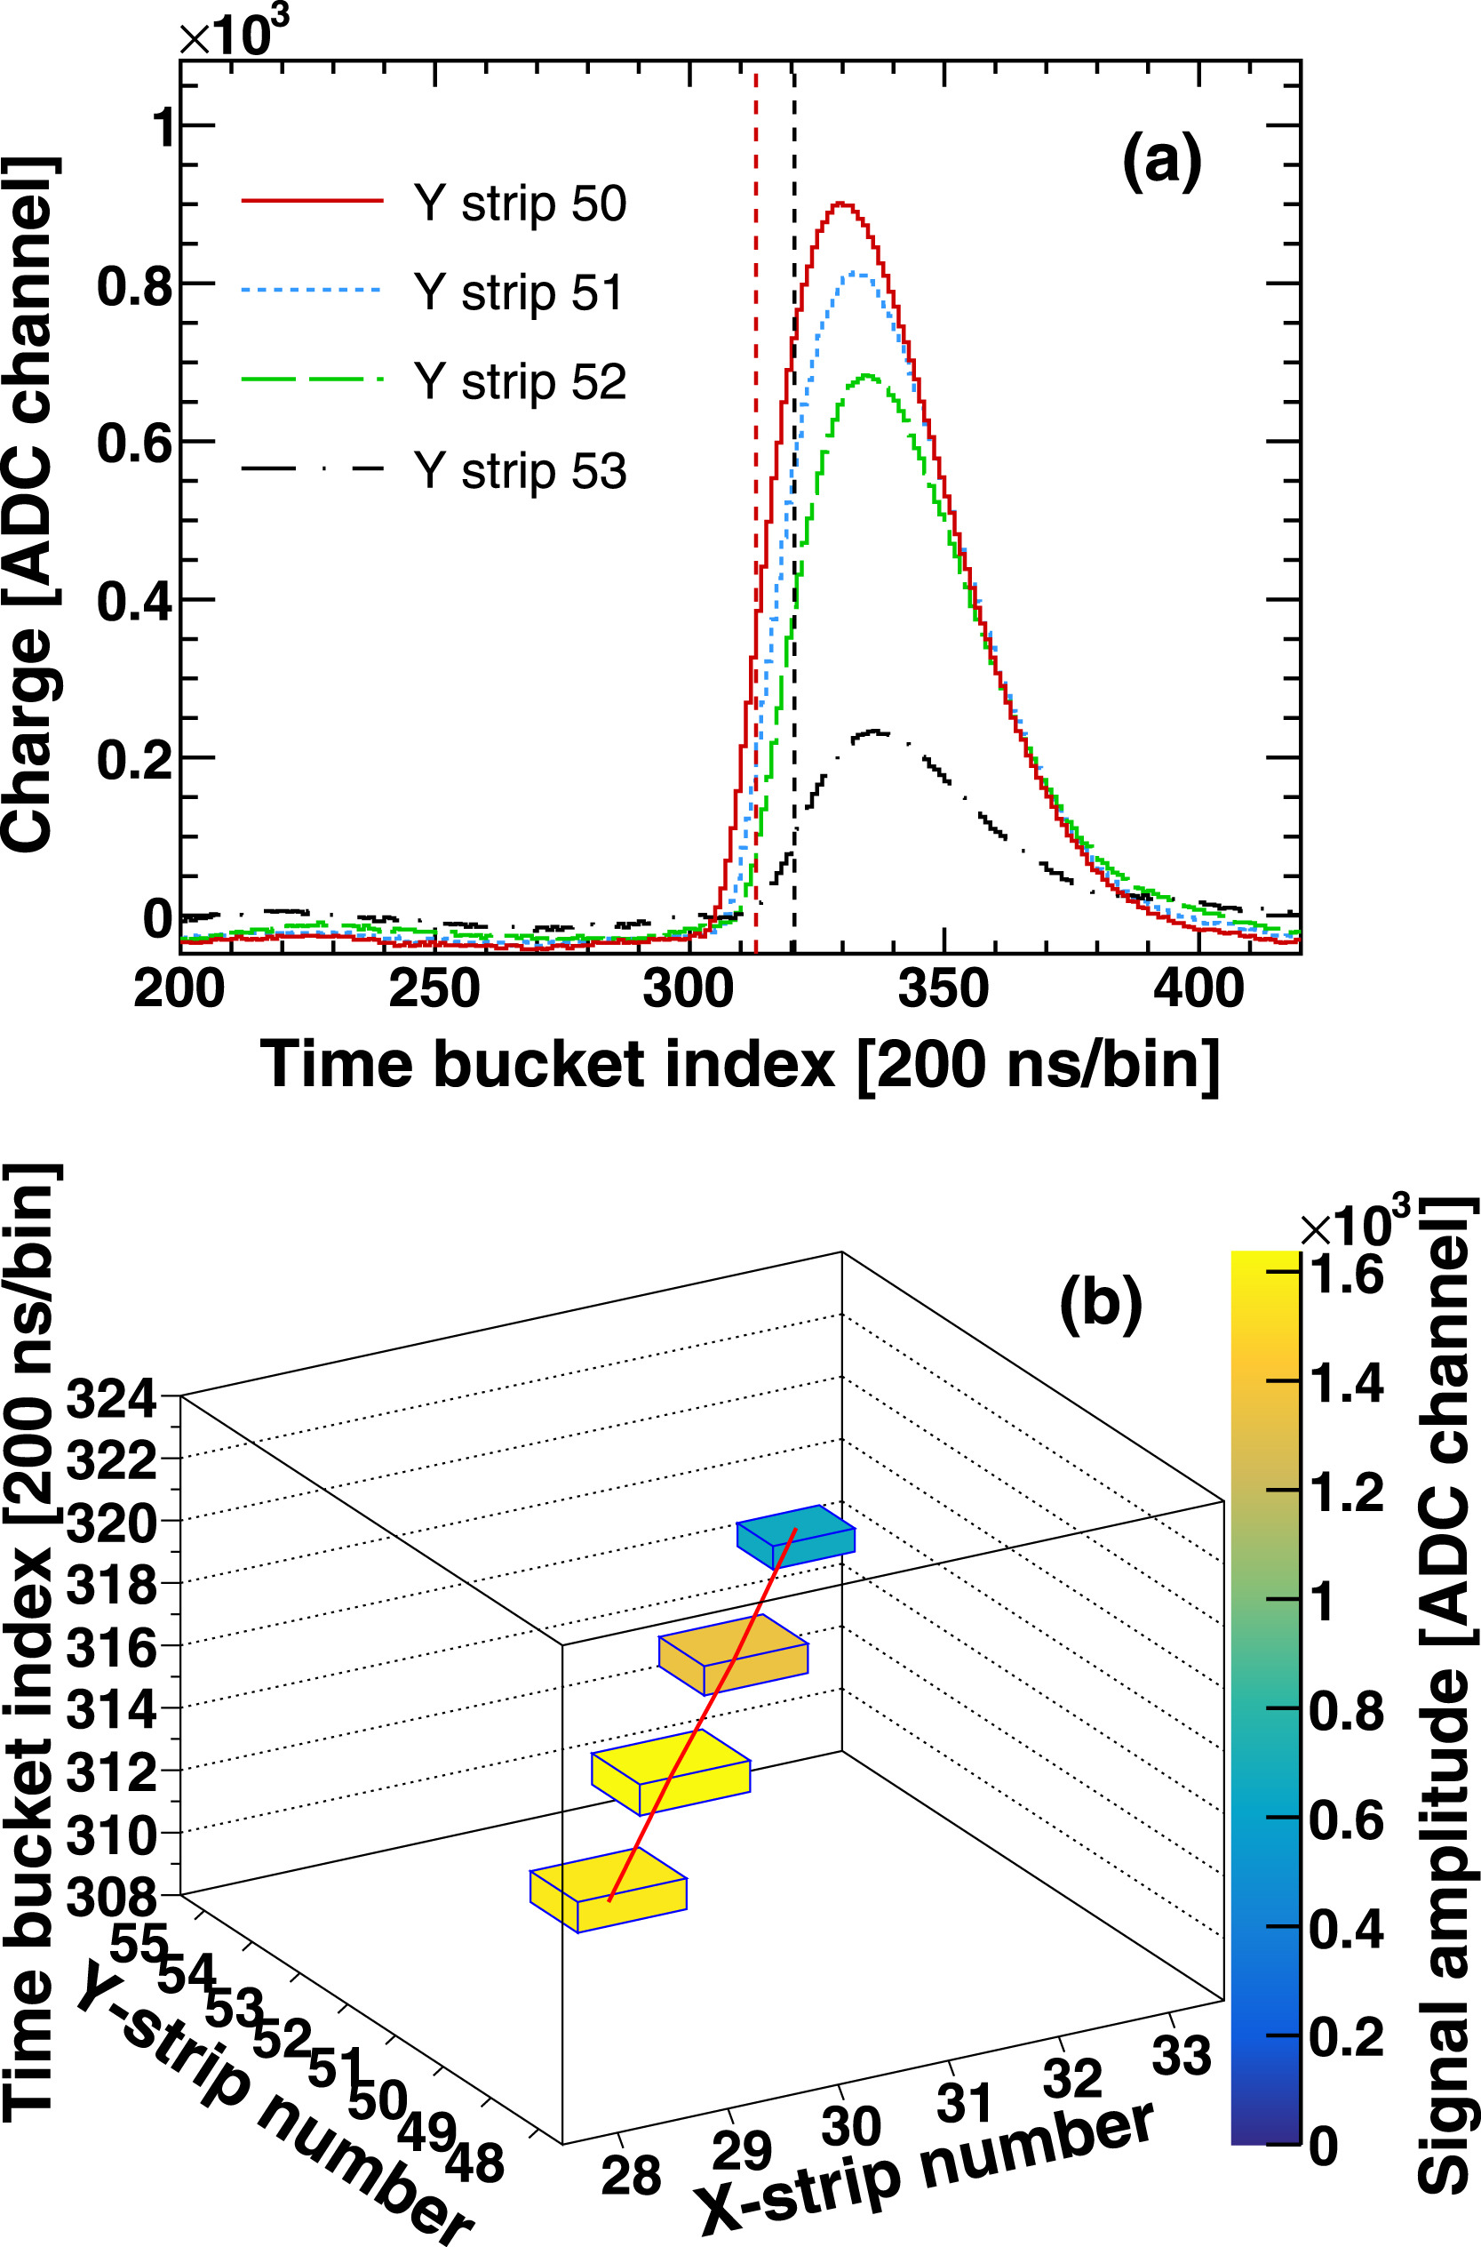
Beam Profile Reconstruction
Experimental data
After event selection and background rejection, clean neutron events are obtained for beam profile reconstruction.
Reconstruction method: Micro Time Projection Chamber (μTPC)
  Fit the leading edge of the waveform to obtain relative time information of each fired strip
  Use the positron of the latest strip as an estimation of the neutron interaction position
Fermi–Dirac function
Time bucket index [200 ns/bin]

Slide 11
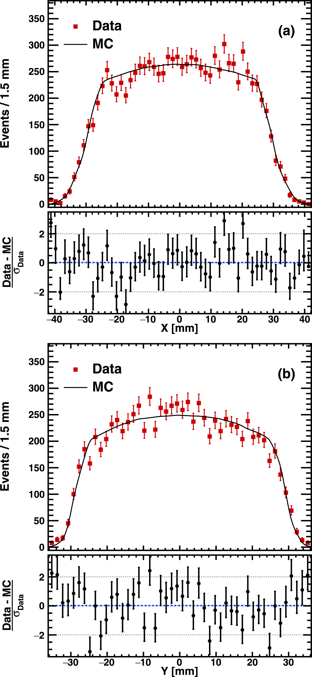
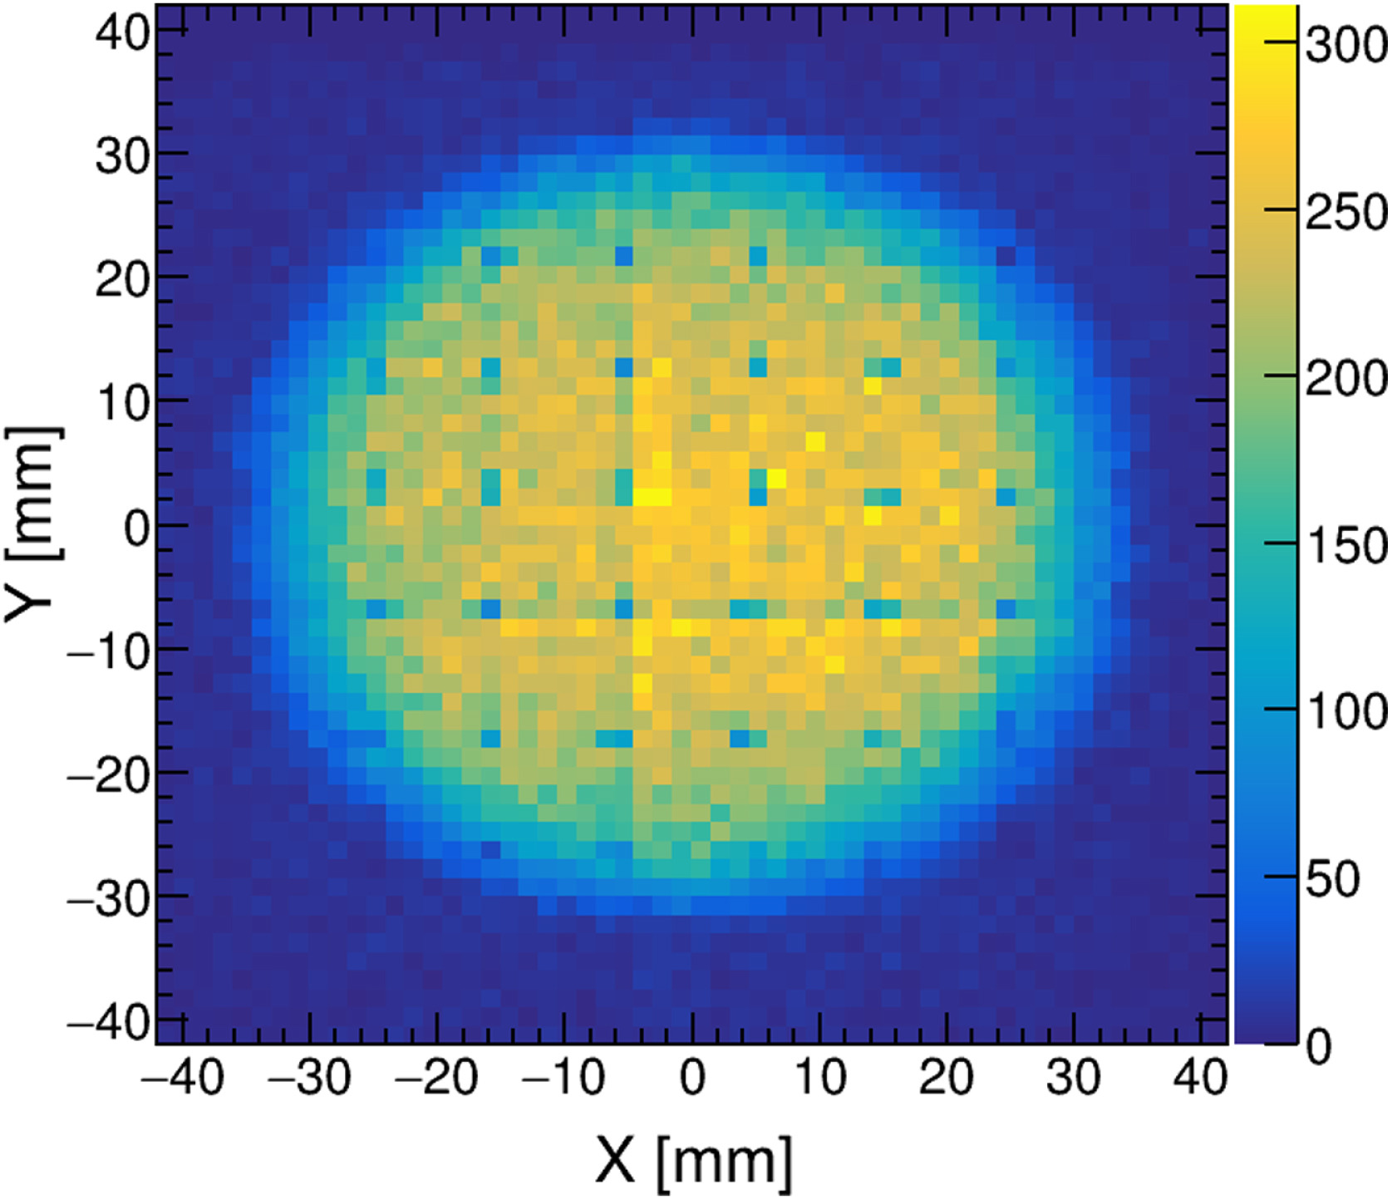
Result
Data/MC comparison
2D profile of Back-n white neutron beam at ES#1 measured by Micromegas detector
[https://doi.org/10.1016/j.nima.2020.163407]
Bin width 1.5 mm
Shaded dots correspond to the pillars (⌀2 mm) between the mesh and anode plane

Slide 12
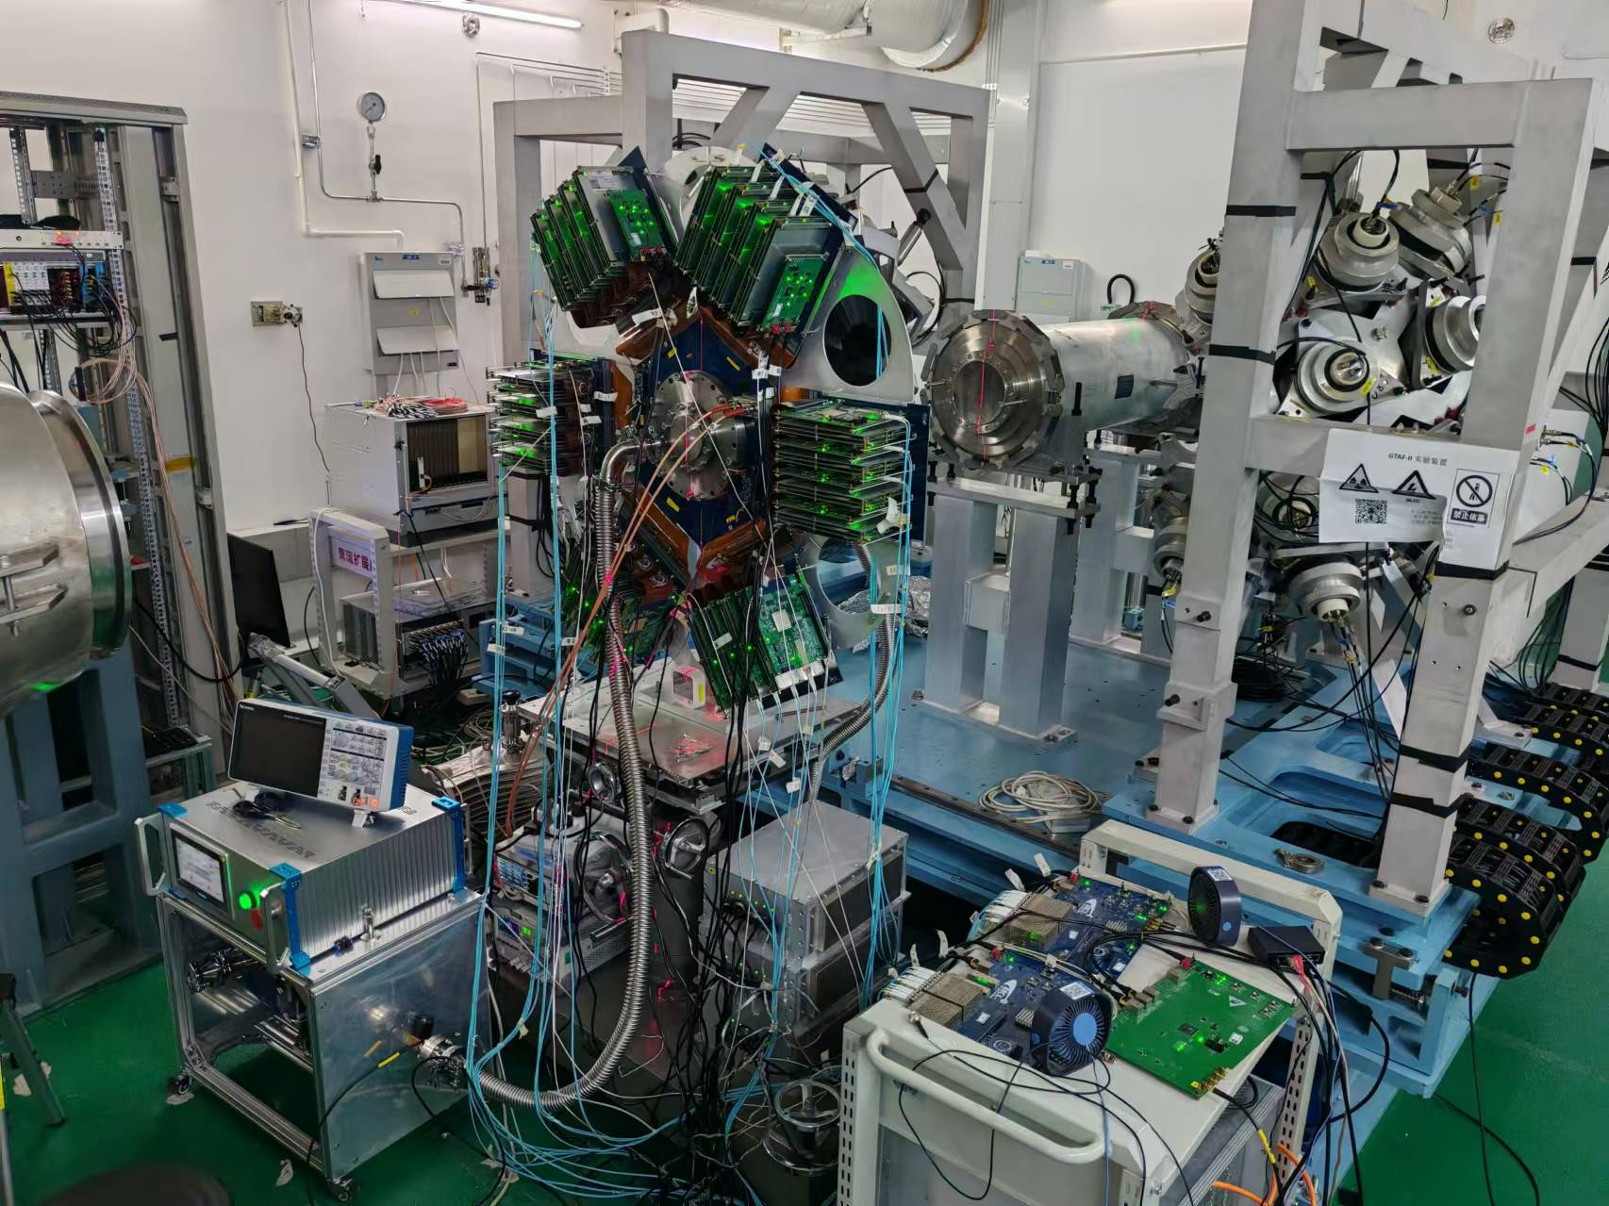
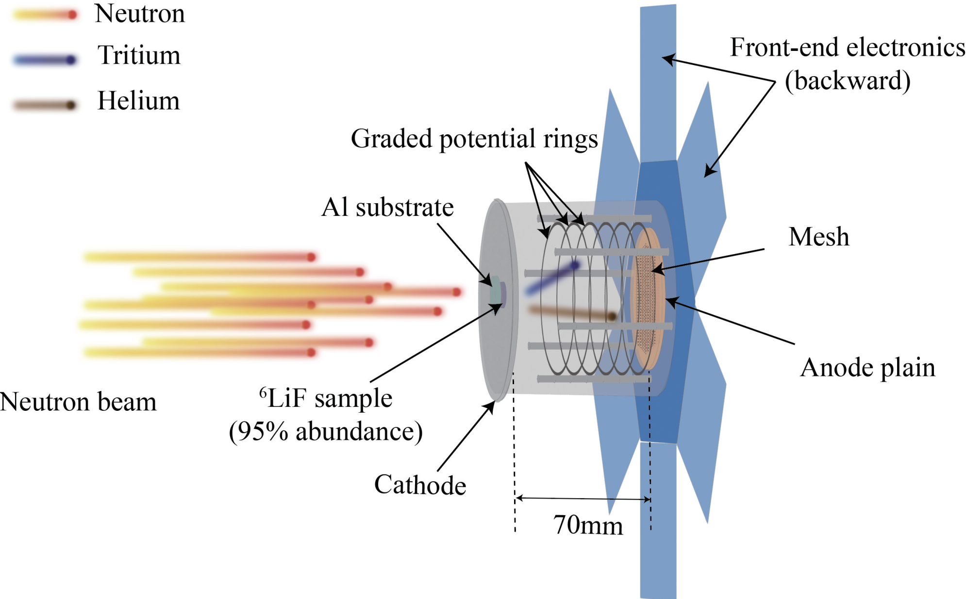
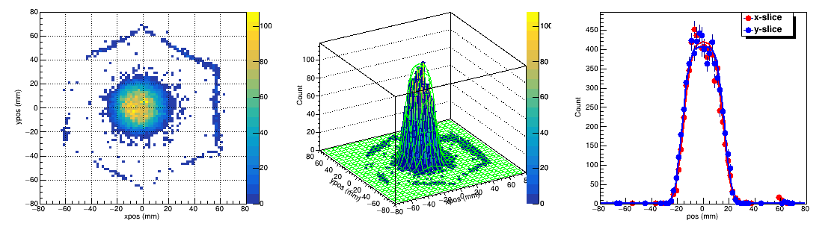
Other Beam Profilers at Back-n
Multi-purpose Time Projection Chamber (MTPC)
Developed for cross section measurement of neutron-induced light-charged particle emission and fission reactions
⌀30 mm beam profile at ES#2
Preliminary
Preliminary
Preliminary
Courtesy: Dr. Han Yi from CSNS

Slide 13
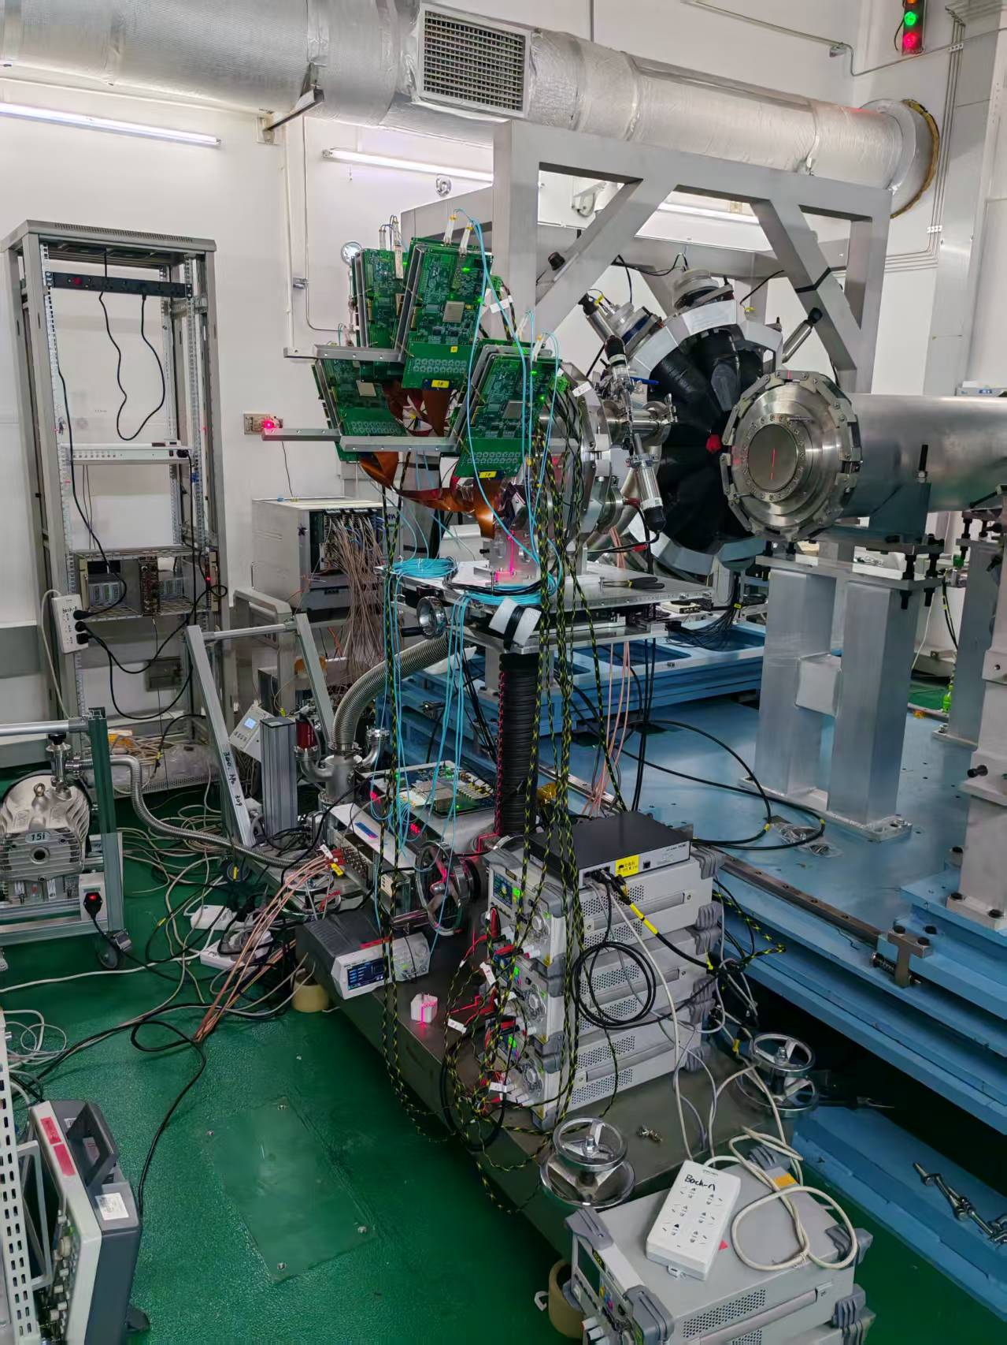
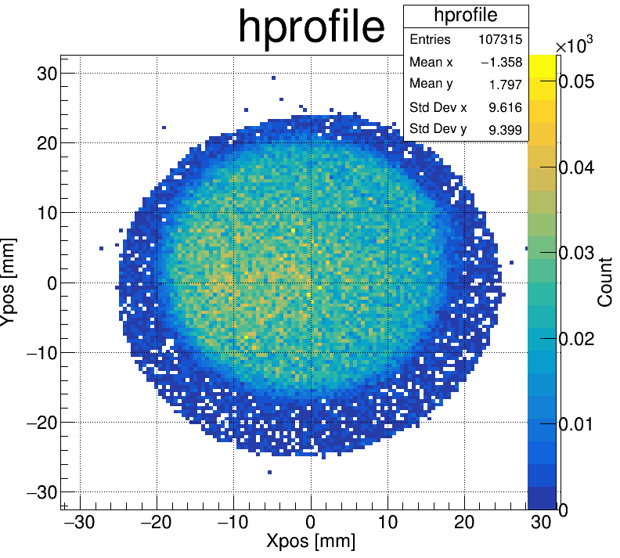
Other Beam Profilers at Back-n
¹⁰B-doped Micro-Channel Plate detector (B-MCP)
Developed for neutron resonance imaging
⌀30 mm beam profile at ES#2
Preliminary
Courtesy: Dr. Han Yi from CSNS

Slide 14
Summary
Developed a Micromegas-based neutron detector for 2D beam profile measurement of CSNS Back-n beamline
Utilized μTPC method for accurate neutron beam profile reconstruction
Achieved good agreement between data and simulation
Other advanced detectors at Back-n, such as MTPC and B-MCP, which are designed for dedicated physics experiments, exhibit the capability to measure (neutron-energy-dependent) beam profiles

