Slide 1
Experimental Infrastructure of FLNP for Research
Egor Lychagin
Joint Institute for Nuclear Research

Slide 2
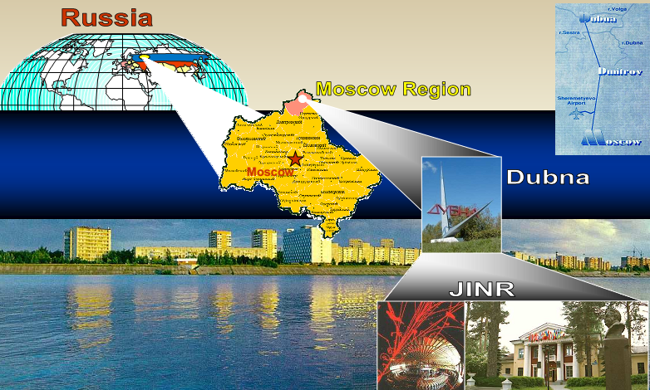


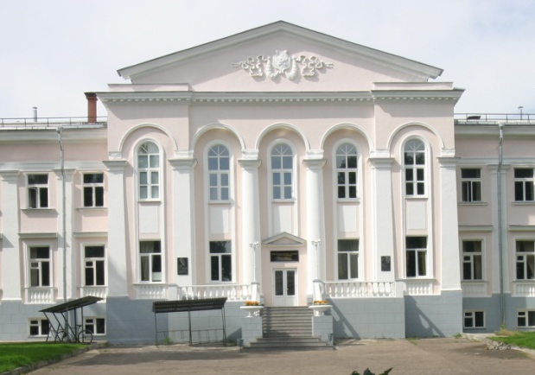
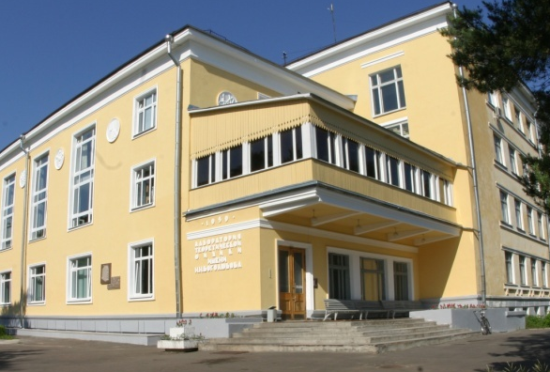
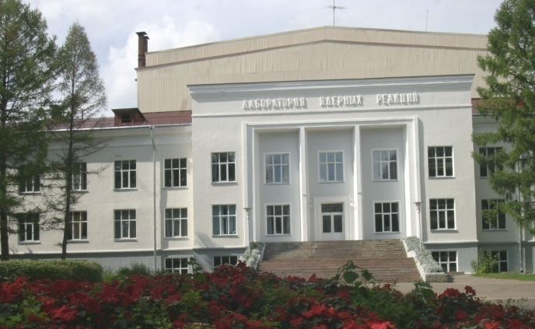
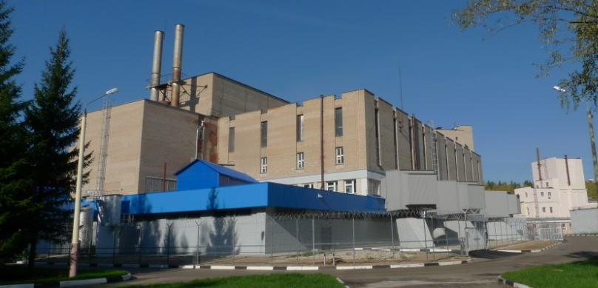
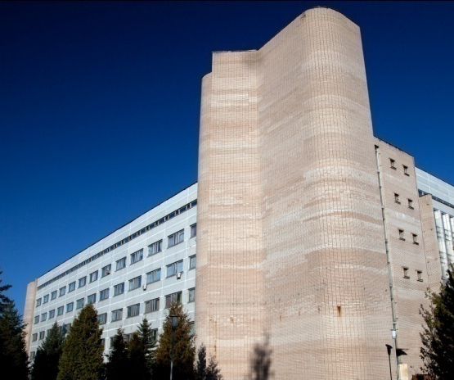
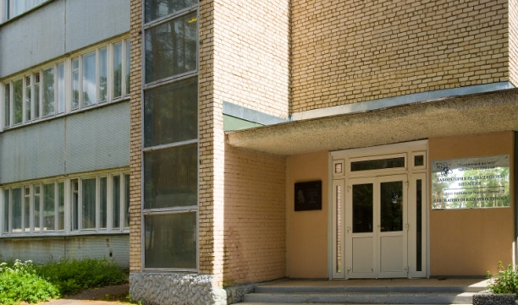
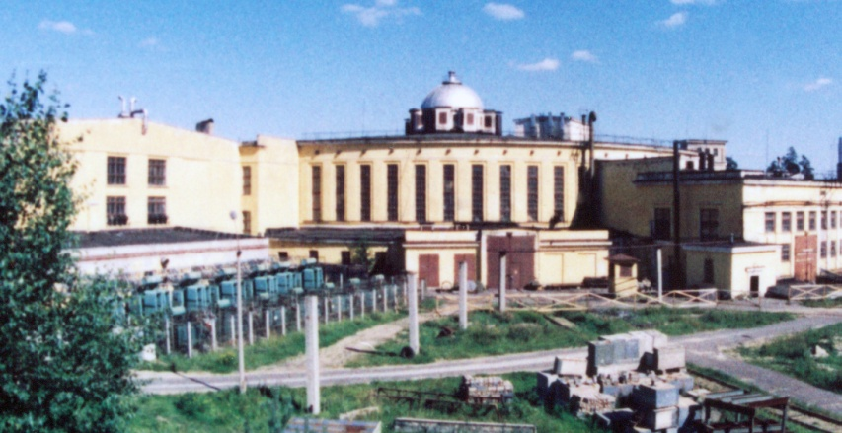
The Joint Institute for Nuclear Research
an international intergovernmental
organization
15 Member States:
Armenia Cuba Kazakhstan Slovakia
Azerbaijan DPRK Mongolia Uzbekistan
Belarus Egypt Romania Vietnam
Bulgaria Georgia Russia
Associate Members:
Germany, Hungary, Italy, Serbia, The Republic of South Africa
JINR comprises 7 Laboratories, each being comparable with a large institute in the scale and scope of investigations performed
Frank Laboratory of Neutron Physics
prepared by Dr. D. Chudoba

Slide 3
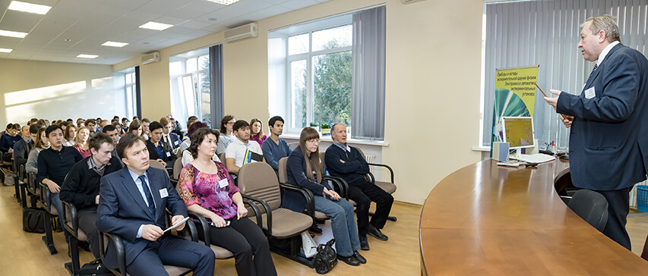
FLNP staff breakdown (2024):
Total | 557
Scientists | 202
Engineers and specialists | 152
Workers | 171
Administrative staff | 32
Average age – 48.1 years
Women – 27 %
Doctors – 29 persons
PhD – 108 persons
Foreigners – 96 persons
THREE MAIN SCIENTIFIC DEPARTMENTS of FLNP:
Department of nuclear physics (139 persons)
Department of Neutron Investigations of Condensed Matter (99 persons)
Department of Spectrometers Complex IBR-2 (51 persons)
+ Raman spectroscopy sector (10 persons)
+ Sector of a new source and complex of moderators (26 persons)

Slide 4
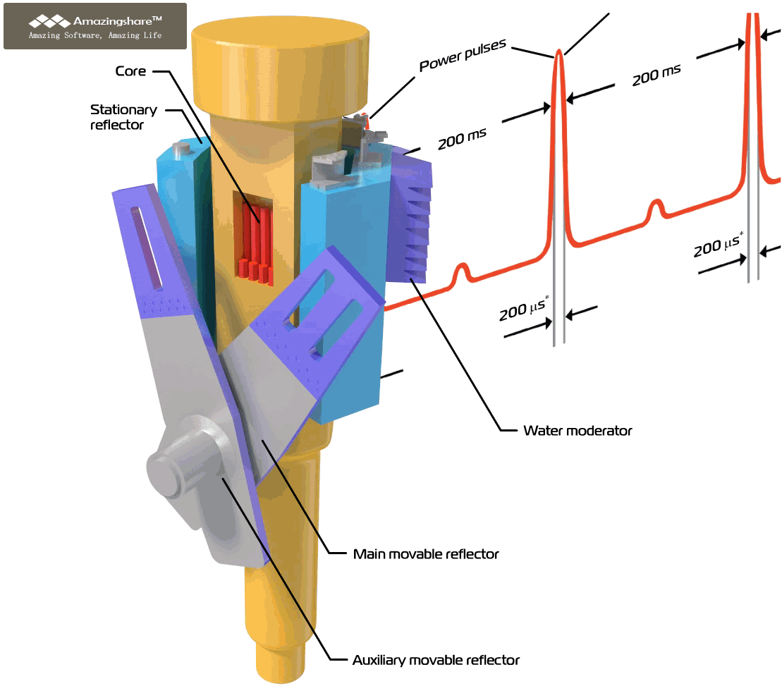
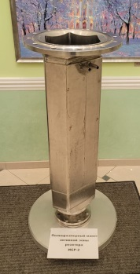
IBR-2 Pulsed Reactor
https://flnp.jinr.int/en-us/main/facilities/ibr-2
Operating since 1984
Average power, MW | 2
Fuel | PuO₂
Pulse repetition rate, Hz | 5
Pulse half-width, µs: fast neutrons thermal neutrons | 200* 340
Rotation rate, rev/min Main reflector Auxiliary reflector | 600 300
Background, % | 7.5
Thermal neutron flux density from the surface of the moderator Time average Burst maximum | ~10¹³ n/cm² s ~10¹⁶ n/cm² s
Deep modernization was carried out in 2006-2010
V_{AC}<20 l
October 16, 2021 - February 17, 2025 – reactor shutdown
Resumption of operation was done in March 2025
* at reactor power of 2MW
prepared by Dr. D. Chudoba

Slide 5
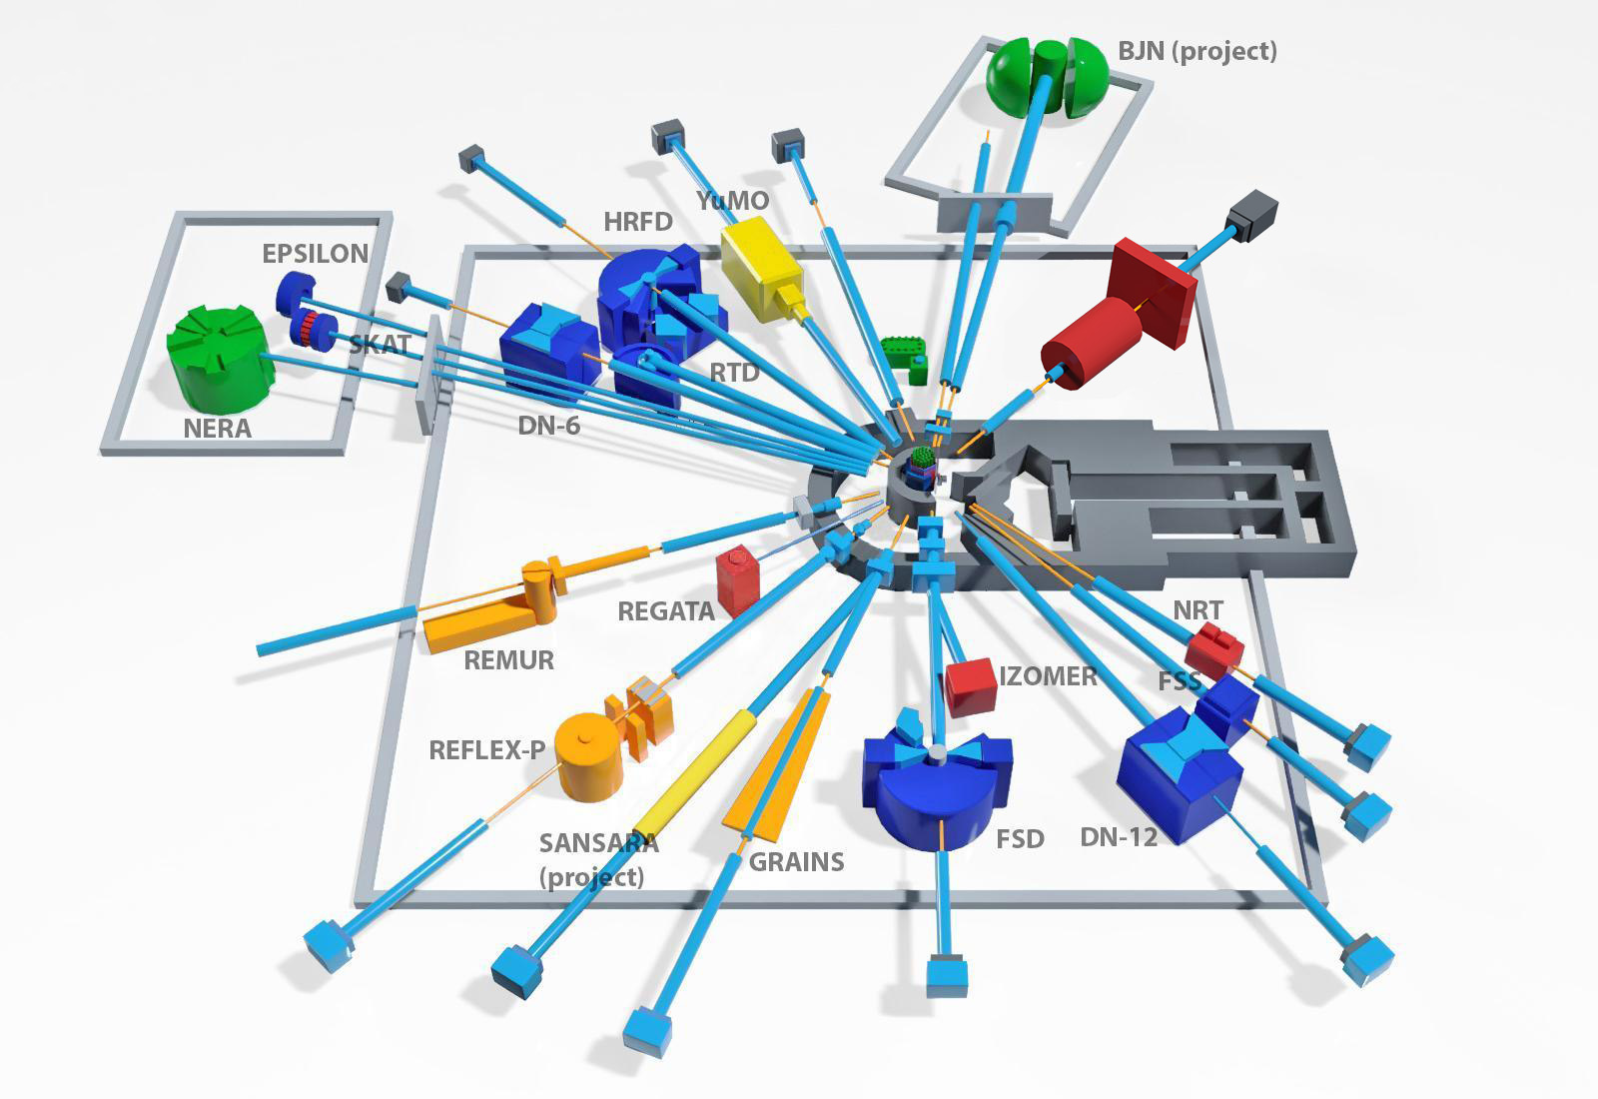
Neutron Instruments
14 INSTRUMENTS INCLUDED IN USER PROGRAM
Diffraction:
HRFD
RTD
DN-6
EPSILON
SKAT
DN-12
FSD
Small-Angle
YuMo
Reflectometry:
GRAINS
REMUR
REFLEX
Inelastic scattering:
NERA
NAA:
REGATA
Under construction:
SANSARA – small angle + imaging (2026)
BJN – inelastic scattering (2027)
Parameters of the instruments could be found at
https://flnp.jinr.int/en-us/main/facilities/ibr-2
Length of neutron guides – up to ~30 m in the experimental halls and up to ~100 m in two pavilions.
Typical neutron flux density on the sample – ~10⁶ cm⁻²s¹ (up to 4 x 10⁷ cm⁻²s¹)
NRT (neutron imaging) is included in the User Program in the second half of 2025

Slide 6
FLNP User Program
Who can apply for beam time?
Scientists from any country of the world
can apply for beam time.
Scientists from member states of JINR
get additional financial support.
Distribution of the beam time
In the FLNP JINR the neutron beam time at the high flux pulsed IBR-2 reactor is distributed between internal users (FLNP) and general science community (GSC) in the ratio of
35% (internal proposals)
55% (external regular proposals)
10% (external urgent beam time requests)
https://ibr-2.jinr.int
I. Regular access applications
 | First round | Second round
Period for proposal submission | September 1 - October 15 | March 1 – April 15
Experiments time | 1 half-year | 2 half-year
II. Fast access applications
NO DEADLINE
Submission – via FLNP scientific secretary
https://flnp.jinr.int/en-us/main/your-experiment-at-flnp

Slide 7


FLNP User Program
The proposals are evaluated by Experts Committees (technical and scientific) and beam time for experiments is granted upon possibility of technical implementation and scientific merit of the proposal.
Scientific Experts Committees:
Nanosystems and Soft Matter (YuMO, GRAINS, REFLEX, REMUR)
Atomic and Magnetic Structure
(RTD, DN-6, DN-12, SKAT, EPSILON, FSD, HRFD)
Lattice and Molecular Dynamics (NERA)
Neutron Activation Analysis (REGATA)
Detailed information could be found at:
Sidorov N.E., Chudoba D.M., Gorshkova Yu.E., Kochnev P.O., Sadovsky D.A. “User program for the neutron source reactor IBR-2 (FLNP JINR)” Physics of Particles and Nuclei Letters, ISSN 1547-4771, 2024, Vol. 21, No. 3, pp. 553–559.

Slide 8



Neutron scattering in condensed matter physics
https://flnp.jinr.int/en-us/main/science/condensed-matter-physics
Search for new properties of crystals, liquids, nanosystems
Study of materials with new properties promising for engineering, energy, biology and pharmacology
Study of structure and deformations of materials for solving problems of materials science, archeology, geology
Study of dynamics (phase transitions, diffusion, changes in magnetic fields) at the microscopic level in molecular crystals, nanostructured materials, biologically active materials, etc.
Study of cultural heritage objects
https://flnp.jinr.int/images/Books/Main_page/culture_en.pdf
https://flnp.jinr.int/images/Books/Blue_books/LifeSciencesBook.pdf
https://flnp.jinr.int/images/box-slider/MaterialsScienceBook.pdf

Slide 9

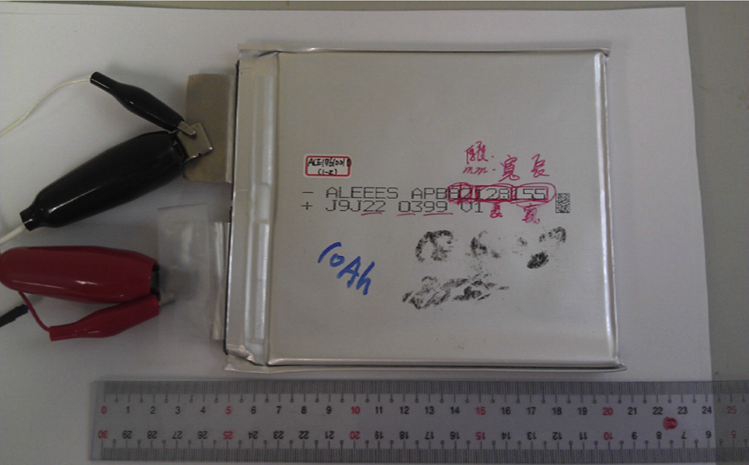
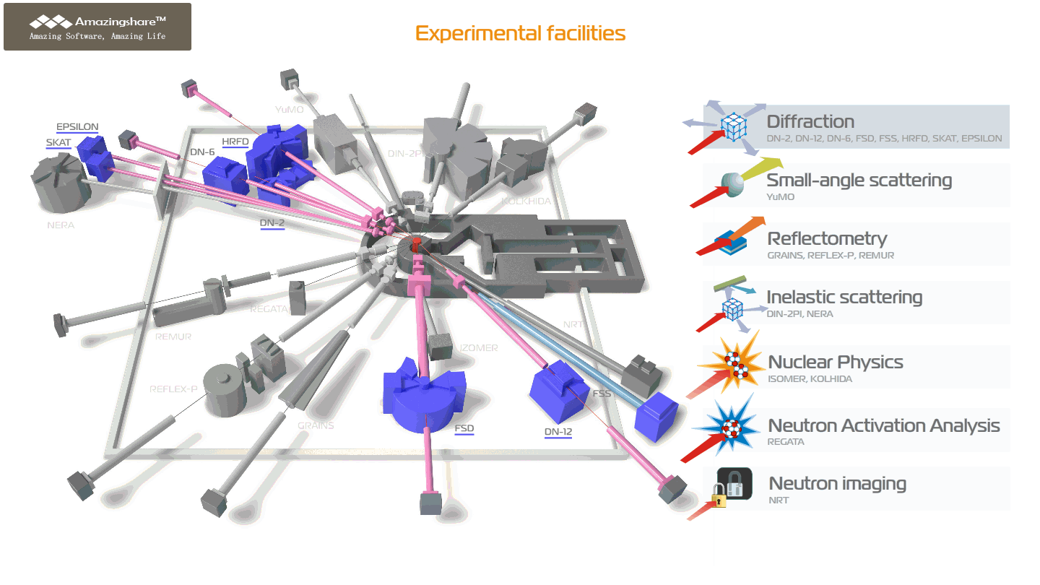
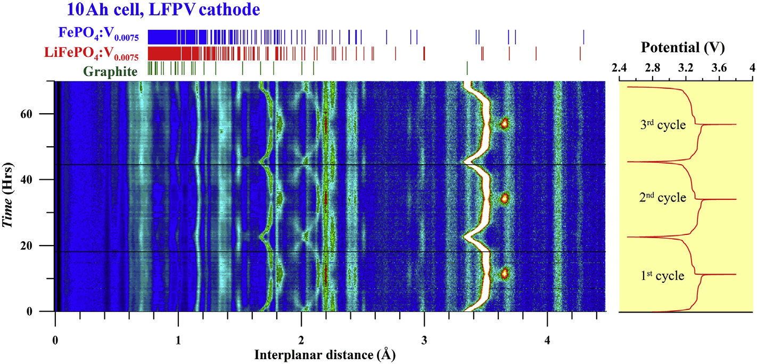
Neutron scattering in condensed matter physics
Diffraction
Crystal and magnetic structure of novel materials under ambient and extreme conditions
Real-time studies of Li-based accumulators
Phase transitions of H-based storage alloys
Crystallographic texture of metals, rocks and biological objects
Strain measurements in structural materials
2D van der Waals magnetic materials
Diffractometers equipped with Fourier choppers to achieve high resolution at short beamlines with long pulse of the reactor

Slide 10
Experimental possibilities of IBR-2 spectrometers complex спектрометров
Spectrometer, Instrument | Applications | Basic parameters | Specific features
Neutron diffraction
HRFD | Investigations of crystalline and magnetic structures of polycrystalline samples, as well as their microstructure under external influences | High resolution mode: d_{hkl} range – 0.4 - 5 Å, resolution Δd_{hkl}/d_{hkl} ≈ 0.0015 Medium resolution mode: d_{hkl} range – 0.5 - 14 Å, resolution Δd_{hkl}/d_{hkl} ≈ 0. 015 Temperature range: 5 - 1350 К | Sample volume: 0.1÷4 cm³
RTD | Analysis of crystalline and magnetic structures of materials, investigation of biological samples, kinetics of chemical reactions, structural and magnetic phase transitions in real time mode, diffuse scattering in defective crystals | d_{hkl} range: 0.6 – 30 Å, resolution Δd_{hkl}/d_{hkl} ≈ 0.01 Temperature range: 2.5 - 1400 К | Minimum sample volume: polycrystal – 0.3 cm³, single crystal – 0.1 mm³. Characteristic spectrum measurement time in real time mode – from 1 s to 10 min (depending on sample volume)
DN-6 | Determination of parameters of atomic and magnetic structure of functional materials under ultra-high pressures and low temperatures | d_{hkl} range: 1.0 – 12 Å, resolution Δd_{hkl}/d_{hkl} ≈ 0.025 Pressure range: 0 - 9 GPa (high-pressure cells with sapphire anvils), 0 - 35 GPa (high-pressure cells with diamond anvils) Temperature range: 5 - 300 К | Investigations of microsamples with a volume of about 2-3 mm³ (high-pressure cells with sapphire anvils), 0.05-0.1 mm³ (high-pressure cells with diamond anvils)
DN-12 | Determination of parameters of atomic and magnetic structure of functional materials under high pressures and low temperatures | d_{hkl} range: 1.0 - 12 Å, resolution Δd_{hkl}/d_{hkl} ≈ 0.02 Pressure range: 0 - 5 GPa (high-pressure cells with sapphire anvils) Temperature range: 15-300 К | Investigations of microsamples with a volume of about 2-3 mm³ (high-pressure cells with sapphire anvils)
FSD | Non-destructive testing of internal mechanical stresses in industrial products, study of mechanical properties, deformations and microdeformations in crystalline materials | d_{hkl} range: 0.5 - 4 Å, resolution Δd_{hkl}/d_{hkl} ≈ 0.0023 Testing machine LM-29 for in situ sample studies under external load (up to 29 kN) and high temperatures (up to 800°С) | Scanning of residual stresses in bulk samples with a minimum gauge volume of 2х2х2 mm Linear size of samples – up to 0.3 m
SKAT | Measurements of crystallographic texture in specimens of structural materials, as well as geological and biological samples | d_{hkl} range: 0.7 - 5 Å, resolution Δd_{hkl}/d_{hkl} ≈ 0.005 | Sample volume: 8÷100 cm³
Epsilon | Investigation of stresses, strains, and textures in geological, metallic, and ceramic samples | d_{hkl} range: 0.7 - 6.5 Å, resolution Δd_{hkl}/d_{hkl} ≈ 0.004 Uniaxial compression machine with F_{max} = 100 kN (150 MPa) | Sample volume: 2÷42 cm³
Operation of three instruments (HRFD, FSD and EPSILON) for external users is temporarily suspended due to technical reasons.

Slide 11
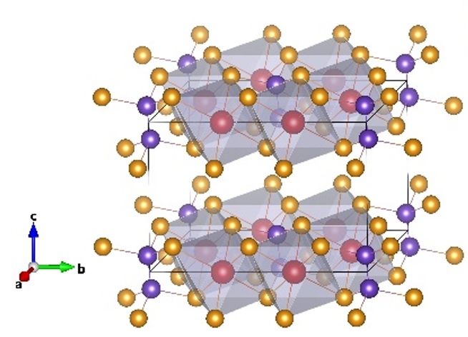
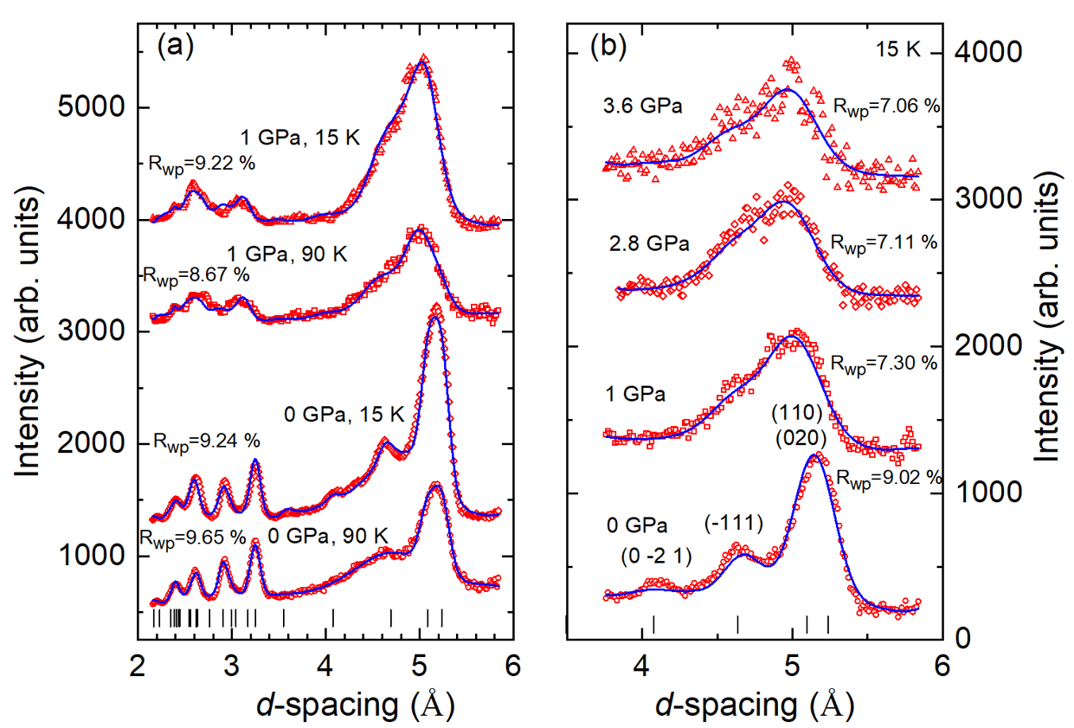
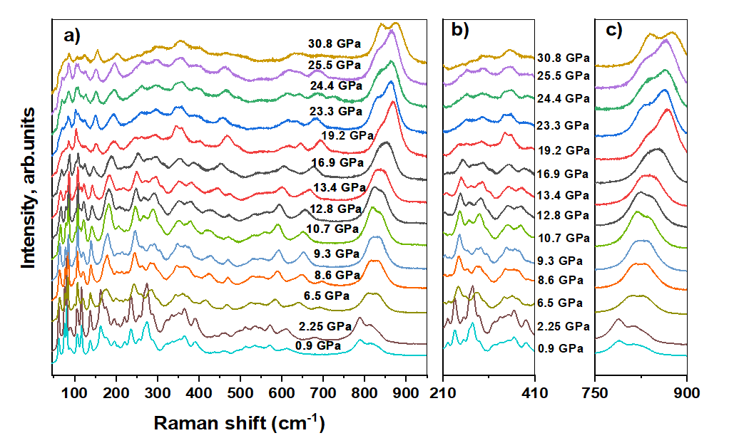

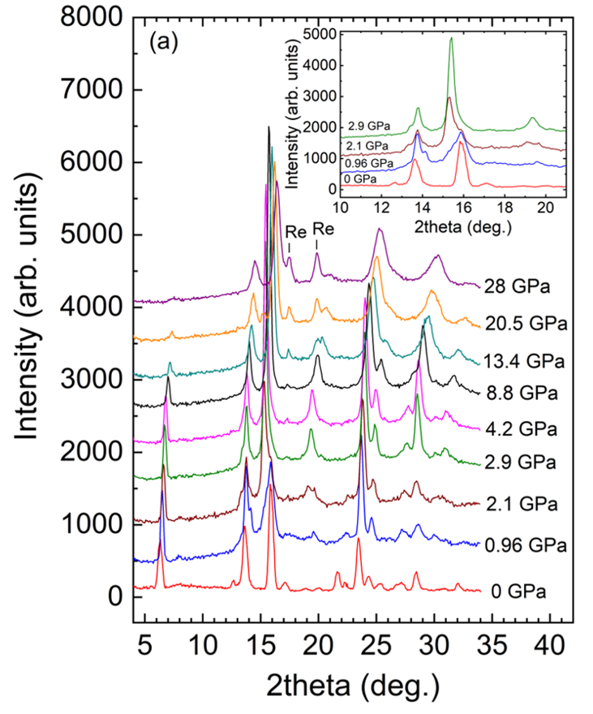
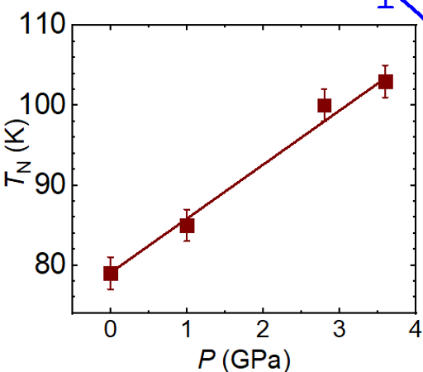
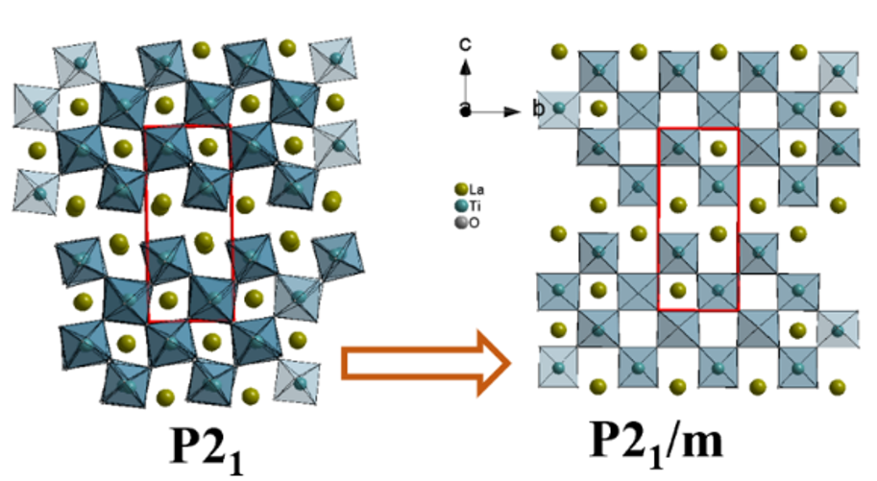
НЭОНИКС
Scientific highlights
High-Pressure Effects on Structural and Magnetic
Properties of van der Waals Antiferromagnet MnPS₃
Pressure-Induced Ferroelectric – Paraelectric Phase Transition in R₂Ti₂O₇ (R=La, Pr, Nd)
The layered titanates demonstrate one of the highest known ferroelectric Curie temperatures (T_{C} > 1400 °C) and piezoelectric behavior with high coercive field (Eg > 45 kV/cm)
Monoclinic crystal structure of MnPS₃
Neutron diffraction patterns of MnPS₃ at high pressures and selected temperatures
Raman spectra of La₂Ti₂O₇ at high pressures
X-ray diffraction patterns of MnPS₃ at high pressures
X-ray diffraction patterns of La₂Ti₂O₇ at high pressures
Pressure behavior of the Neel Temperature
Structural re-arrangement caused by the ferroelectric – paraelectric phase transition in R₂Ti₂O₇ at high pressures
D.P. Kozlenko, O.N. Lis, N.T.Dang et.al, Phys. Rev. Materials 8, 024402 (2024)
A.G.Asadov, D.P. Kozlenko, S.E. Kichanov, E.V.Lukin et.al, Journal of Alloys and Compounds 1003, 175461 (2024), Solid State Sciences 156, 107676 (2024)
Notes:
This slide contains research examples. The first one presents the results of a comprehensive study of the behavior of two-dimensional van der Waals crystals under high pressure in a wide temperature range using neutrons and X-rays. As a result of the research, a model was proposed that explains the behavior of magnetic states in the class of MPS3 compounds (M is a transition metal) under pressure. The second example is the results of systematic studies of the crystal structure and vibrational spectra of layered perovskite-like titanates La2Ti2O7, Nd2Ti2O7 and Pr2Ti2O7 at high pressures up to 30 GPa using neutron, X-ray diffraction and Raman spectroscopy. Based on the experimental data obtained, a general structural mechanism of the pressure-induced phase transition in perovskite-like layered titanates was proposed.
Проведены исследования влияния высокого давления на кристаллическую и магнитную структуру функциональных материалов. Открытие графена инициировало активный поиск двумерных магнитных материалов с похожей структурой и необычными свойствами. Одними из наиболее обещающих являются слоистые двумерные ван-дер-ваальсовы магнитные системы, демонстрирующие широкие возможности контроля и управления магнитными свойствами вплоть до предела монослоя и новые физические явления. Изучена кристаллическая, и магнитная структура ван дер вальсова антиферромагнетика MnPS₃ с помощью метода нейтронной дифракции в диапазоне давлений до 3.6 ГПа и температур 15 – 300 К, а также рентгеновской дифракции в диапазоне давлений до 28 ГПа и комнатной температуре. При давлениях выше 1 ГПа наблюдался изоструктурный фазовый переход в новую моноклинной фазу, сопровождающийся значительным уменьшением параметров решетки и степени моноклинного искажения, а также аномальным барическим поведением ряда колебательных мод. При этом симметрия антиферромагнитной (АФМ) структуры остается неизменной во всем исследуемом диапазоне давлений. Рассчитано изменение параметра обменного взаимодействия между ближайшими соседями при воздействии высокого давления. На основе анализа конкурирующих межплоскостных и внутриплоскостных магнитных обменных взаимодействий с учетом результатов ранее проведенных в НЭО НИКС исследований предложена модель, объясняющая барическое поведение магнитных состояний в классе соединений MPS₃ (М – переходный металл) под давлением.
Слоистые перовскитоподобные титанаты с общей формулой R₂Ti₂O₇ ( R = La, Ce, Pr или Nd) демонстрируют одни из максимальных температур Кюри возникновения сегнетоэлектричества, ярко выраженные пьезоэлектрические и сегнетоэлектрические свойства, превосходные характеристики диэлектрической проницаемости. Необычность физических свойств перовскитоподобных титанатов обусловлена особенностями их кристаллической структуры – так называемой Карпи-Гали фазы (the Carpy-Galy phase), в которой кислородные октаэдры TiO₆ формируют искаженные кристаллические слои, разделенные между собой топологически искаженными рядами редкоземельных элементов. Предполагается, что взаимная ориентация кислородных октаэдров в кристаллической структуре слоевых перовскитоподобных материалов играет значительную роль в формировании их сегнетоэлектрических свойств. В настоящее время влияние термодинамических параметров (высокого давления, температуры) на кристаллическую структуру и физические свойства титанатов A₂Ti₂O₇ остается недостаточно изученным. Исследования структурного поведения данных соединений при воздействии высоких давлений представляет высокую актуальность для установления взаимосвязи между структурными параметрами и физическими свойствами, а также, поиска новых структурных модификаций данных материалов, свойства которых могут существенно отличаться от исходных. Проведены систематические исследования кристаллической структуры и вибрационных спектров слоистых перовскитоподобных титанатов La₂Ti₂O₇, Nd₂Ti₂O₇ и Pr₂Ti₂O₇ при высоких давлениях до 30 ГПа методами нейтронной, рентгеновской дифракции и рамановской спектроскопии. Во всех исследованных перовскитоподобных титанатах La₂Ti₂O₇, Nd₂Ti₂O₇ и Pr₂Ti₂O₇ при высоких давлениях выше 14 ГПа обнаружен структурный фазовый переход из сегнетоэлектрической (симметрия P2₁) в параэлектрическую (симметрия P2/m ) фазу, который сопровождается аномалиями в барических зависимостях как параметров кристаллической структуры, так и вибрационных мод этих соединений. На основе полученных экспериментальных данных предложен общий структурный механизм индуцированного давлением фазового перехода в перовскитоподобных слоевых титанатах. Показано, что степень разупорядочения титанового слоя, изменяющаяся при фазовом переходе за счет изменения ориентации кислородных октаэдров относительно кристаллографических осей, является важным параметром, контролирующим свойства слоистых титанатов, и ее увеличение приводит к подавлению сегнетоэлектрического состояния в исследуемых титанатах при высоком давлении.
На этом слайде примеры исследований. Первый представляет результаты комплексного исследования поведения двумерных ван-дер-ваальсовских кристаллов по высоким давлением в широком диапазоне температур с использованием нейтронов и рентгеновского излучения. В результате исследований предложена модель, объясняющая поведение магнитных состояний в классе соединений MPS₃ (М – переходный металл) под давлением. Второй пример – результаты систематических исследований кристаллической структуры и вибрационных спектров слоистых перовскитоподобных титанатов La₂Ti₂O₇, Nd₂Ti₂O₇ и Pr₂Ti₂O₇ при высоких давлениях до 30 ГПа методами нейтронной, рентгеновской дифракции и рамановской спектроскопии. На основе полученных экспериментальных данных предложен общий структурный механизм индуцированного давлением фазового перехода в перовскитоподобных слоевых титанатах.

Slide 12
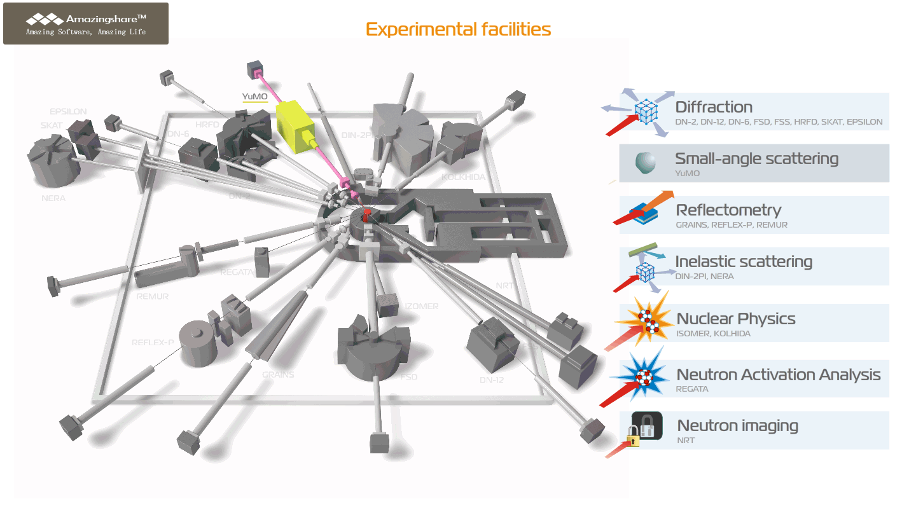
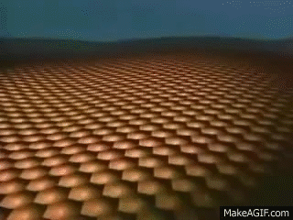
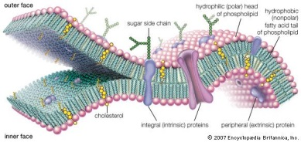
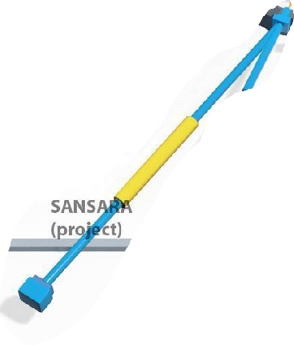
Neutron scattering in condensed matter physics
Small Angle Scattering
Small Angle Scattering
BLSs
SULVs
EULVs
Structural organization and aggregation of nanoparticles and composite systems
Interactions of nanoparticles with bio-macromolecules
Nanopores for magnetic and biomedical applications
Applications | Basic parameters | Specific features
Determination of sizes, shapes, spatial correlations of particles, agglomerates, pores, as well as fractal dimension in nanomaterials, biological objects, polymers, colloidal solutions | Q-range: 7x10⁻³ - 0.5 Å⁻¹ Temperature range: 10-180°С | Characteristic particle size that can be identified: 1-500 nm Minimum sample volume: 500 µl Characteristic sample size is up to 1.4 cm in diameter
Notes:
Periodic nanoporous silica (PNS) with its perfect regular structure, biocompatibility, thermal stability and durability, and high specific surface is very promising material from the application point of view.
We have prepared series of nanocomposites, where PNS serves as a matrix in which nanoparticles of Gd2O3 or Fe2O3 are embedded. Such materials have already exhibited extraordinary large magnetocaloric effect [1] and applicability as contrast agents for MRI [2], while their utilization for targeted drug delivery is currently being examined. In this, the detailed information on the structure of as prepared nanocomposites is essential for understanding and tailoring their properties.
We have examined our PNS by means of small angle neutron scattering (SANS) and we proposed theoretical model assuming general features of the inner structure of the composite. By fitting the model to experimental data we are able to obtain information on matrix (size, shape and mutual distance of pores) as well as on size distribution and concentration of nanoparticles embedded in the pores. Hence, the combination of SANS experiments along with our model application appears to be suitable and effective tool for the revelation of inner structure of these kinds of nanocomposites.
Исследования модельных мембран при доклинической болезни Альцгеймера проводились с использованием малоуглового нейтронного рассеяния. Результаты показали, что разрушение мембран происходит из-за включения отдельных пептидов бета-амилоида, а не крупных фибрилл, которые изначально предполагались в качестве причины заболевания. SANS впервые продемонстрировал это разрушение мембран экспериментально.
Studies of model membranes in pre-clinical Alzheimer's disease were performed using Small-Angle Neutron Scattering. The results showed that membrane disruption occurs due to the incorporation of individual amyloid-beta peptides, rather than the large fibrils that were originally proposed as the cause of the disease. SANS has demonstrated this membrane disruption experimentally for the first time.

Slide 13
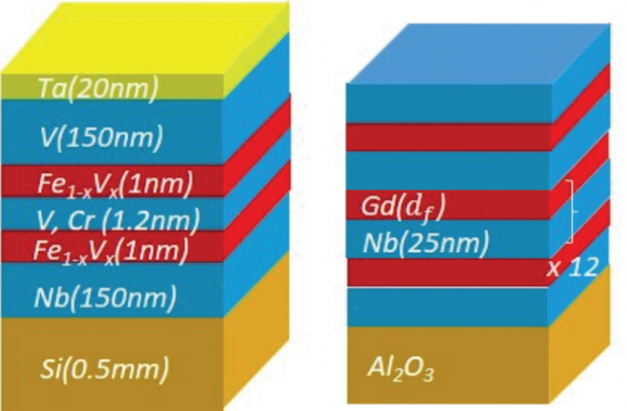
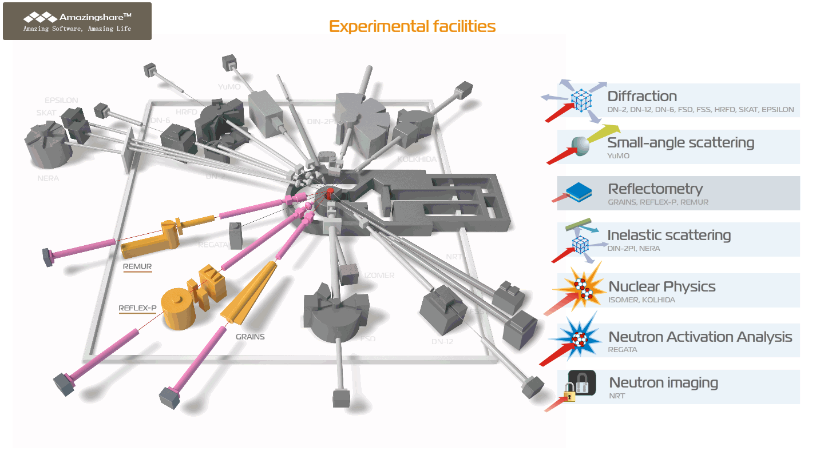
Neutron scattering in condensed matter physics
Reflectometry
Thin films and surfaces
Surface adsorption of magnetic nanoparticles
Superconducting and magnetic properties of the complex layered heterostructures
Spectrometer, Instrument | Applications | Basic parameters | Specific features
REMUR | Determination of parameters of magnetic and superconducting heterostructures, nonmetallic thin films | Q-range: 0.001 - 2 nm⁻¹, resolution ΔQ/Q ≈ 1 % Temperature range: 1.5 - 300 К Magnetic field on the sample: up to 1.5 T | Minimum surface area of ​​the sample – 5x5 mm², thickness of layers accessible for research – 0.5-500 nm, roughness – ~1 nm
REFLEX | Determination of structural parameters of thin-film nanostructures | Q-range: 0.01 - 1.3 nm⁻¹, resolution ΔQ/Q ≈ 1 - 15 % Temperature range: 1.5 - 300 К Magnetic field on the sample: up to 0.5 T | Minimum surface area of ​​the sample – 20x20 mm², thickness of layers accessible for research – 2-500 nm, roughness – ~3 nm
GRAINS | Determination of structural parameters of interfaces with “soft” and liquid media | Q-range: 0.05 - 1.0 nm⁻¹, resolution ΔQ/Q ≈ 5 %. Temperature range: 10 - 150°С | Minimum surface area of ​​the sample – 5x5 cm, maximum interface thickness – 100 nm, roughness – up to 5 nm (at a thickness of 100 nm)

Slide 14
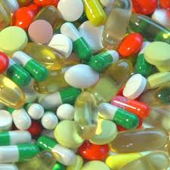
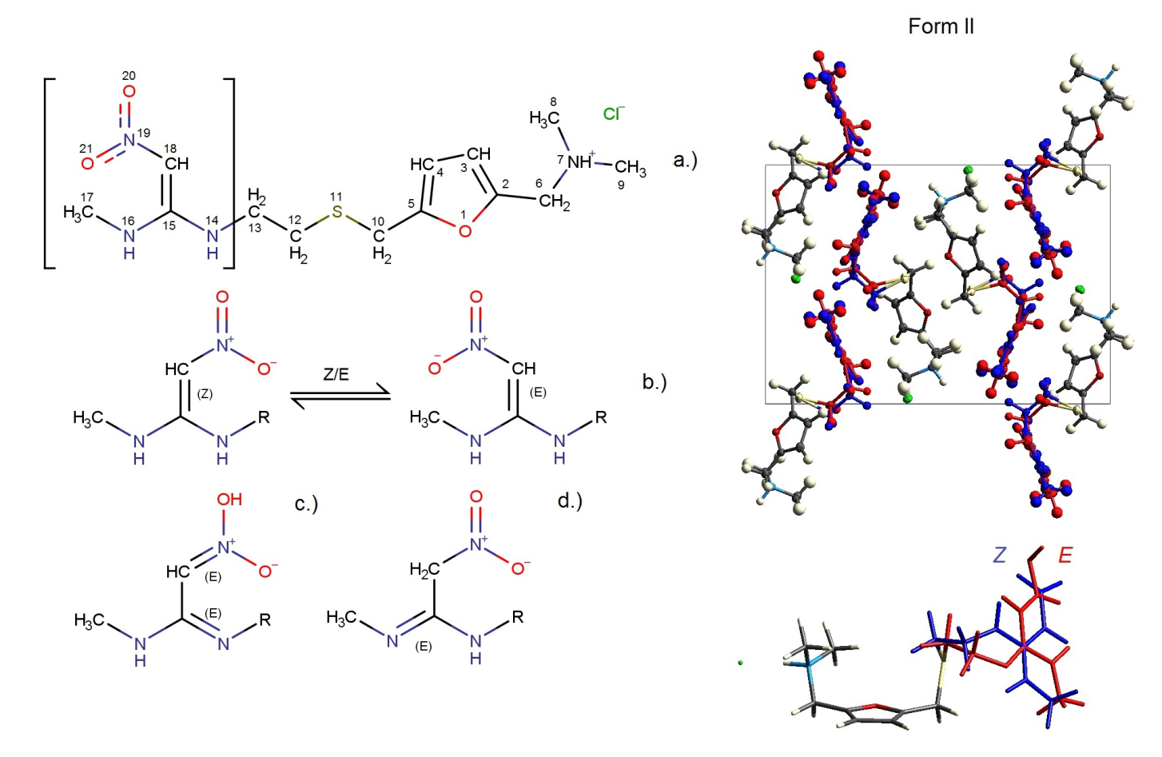
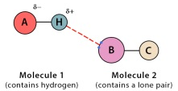
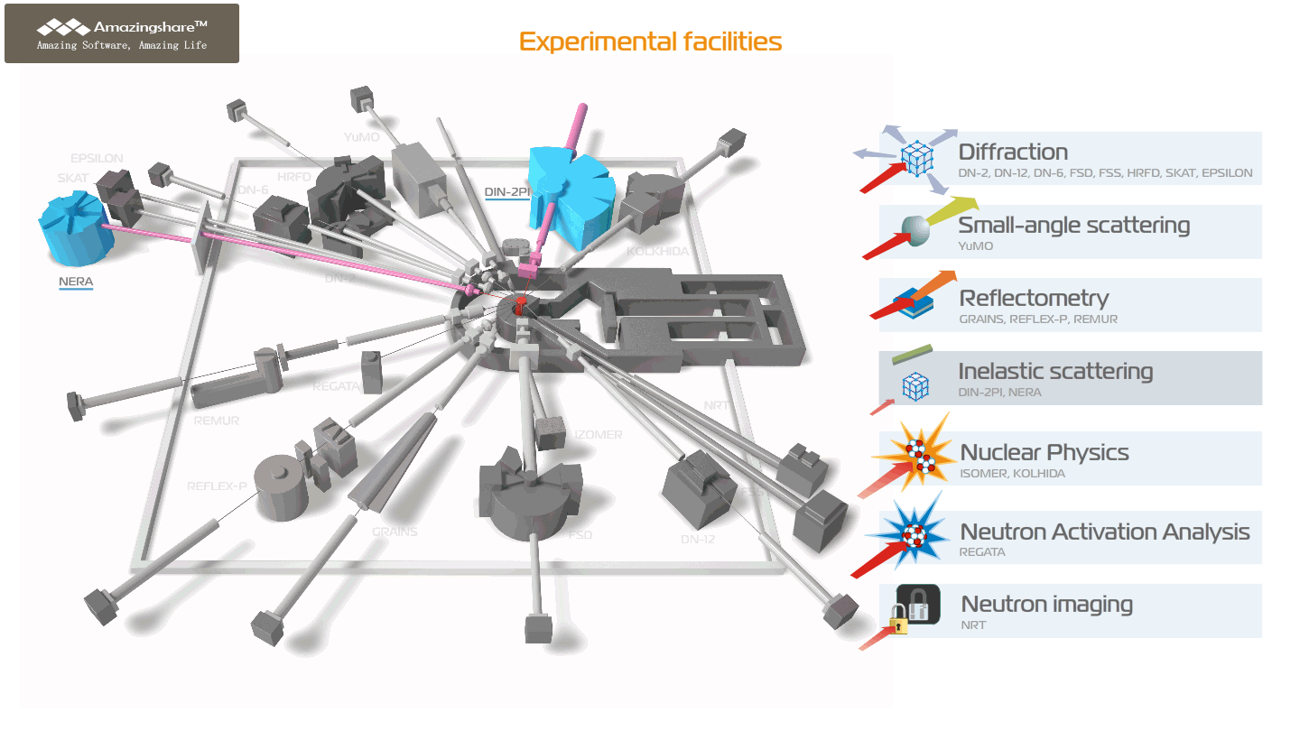
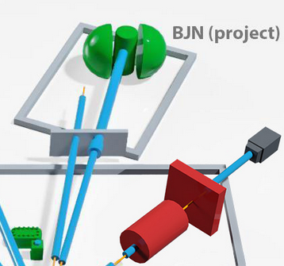
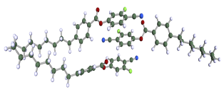
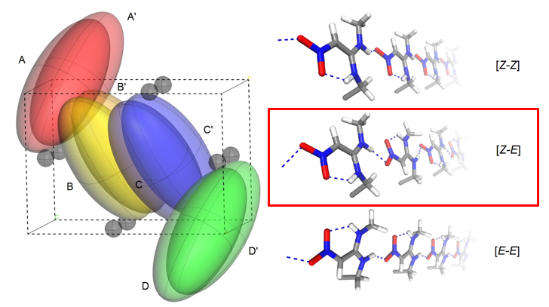
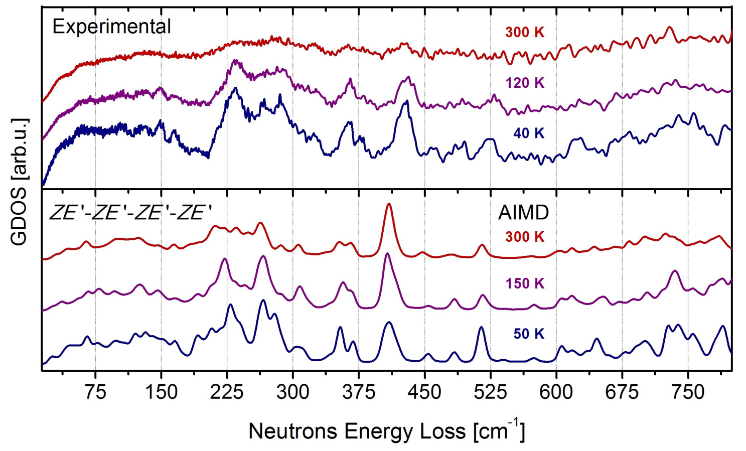
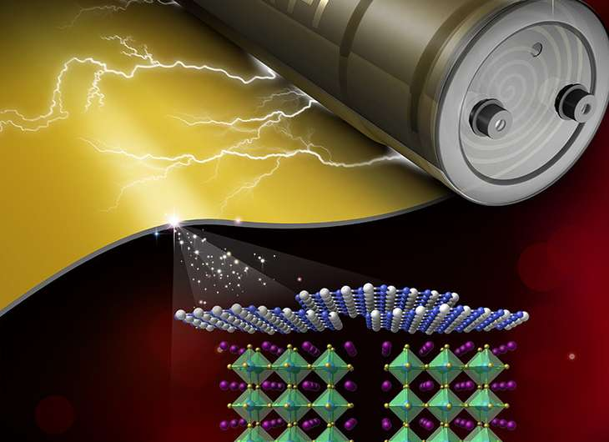
Neutron scattering in condensed matter physics
Inelastic Scattering
Molecular structure and dynamics
Isomeric forms of drugs
Drug delivery systems
Applications | Basic parameters | Specific features
Investigation of atomic and molecular dynamics of hydrogen-containing compounds, including pharmacological substances, analysis of the effect of phase polymorphism | Energy transfer range: 1 - 160 meV Resolution ΔE/E ≈ 2- 4% Temperature range: 4 - 300 К | Sample volume is about 4-5 cm³

Slide 15

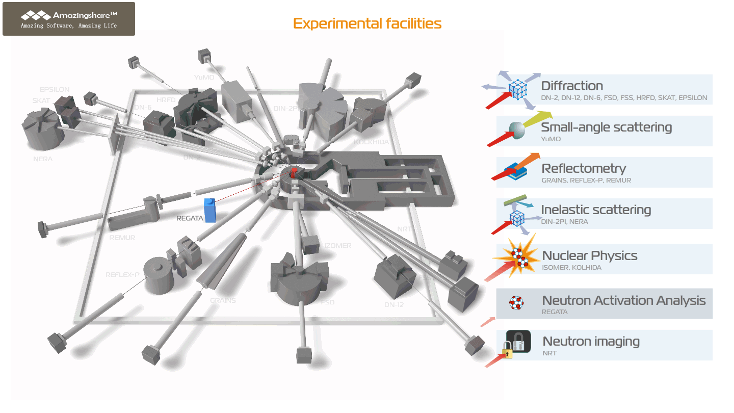

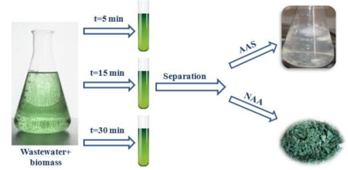






Nuclear analytical method
Neutron Activation Analysis
Elemental composition analysis of air, water, and soil or objects of cultural heritage
blood
brain
liver
lungs
kidneys

Slide 16

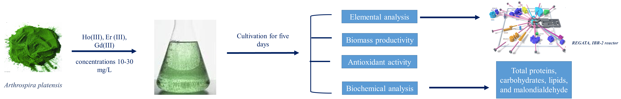
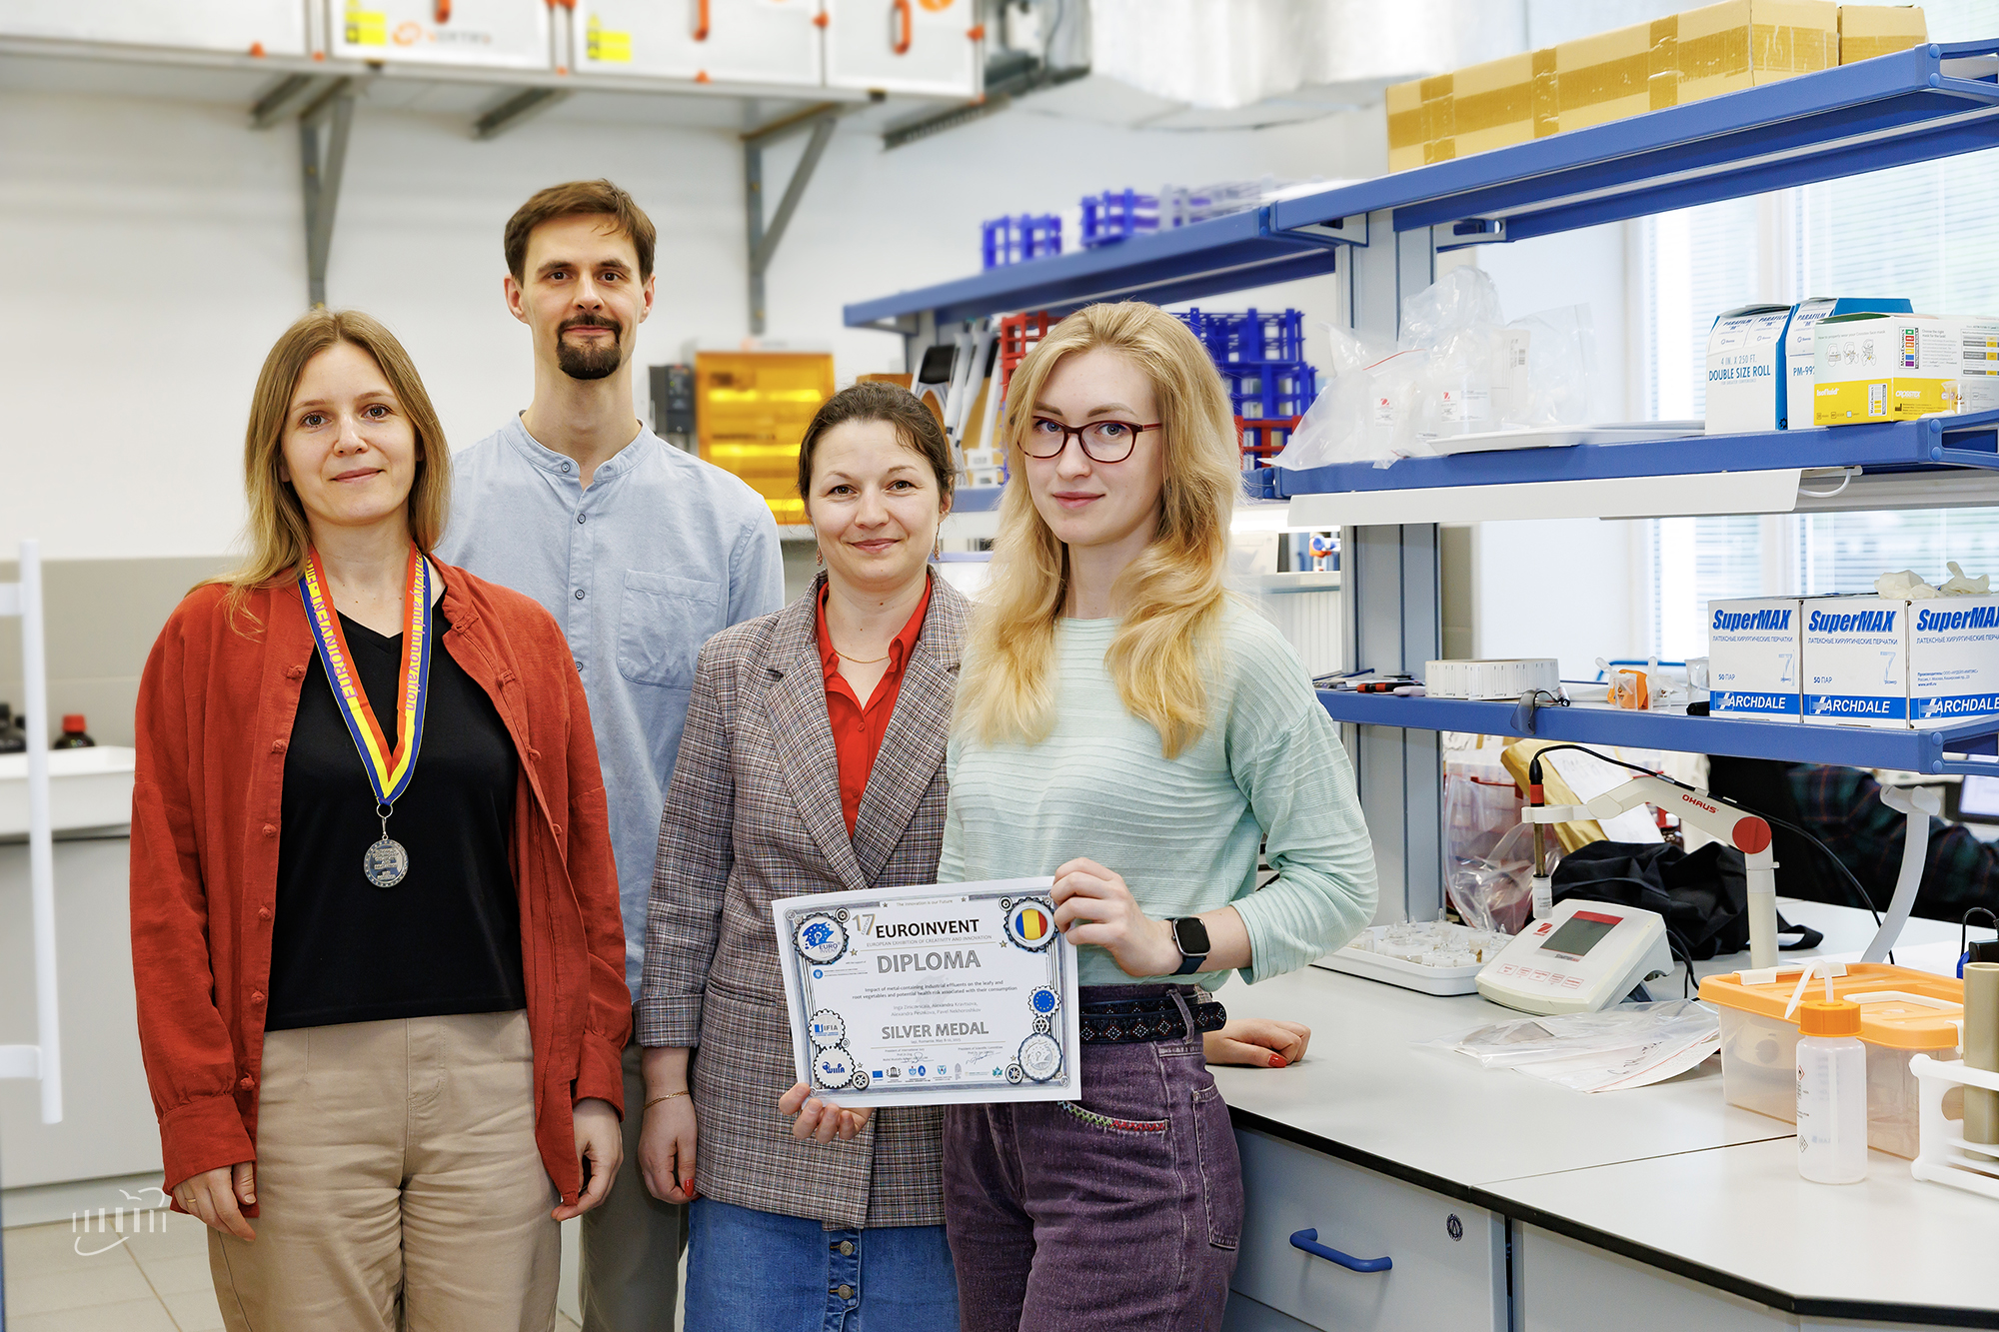
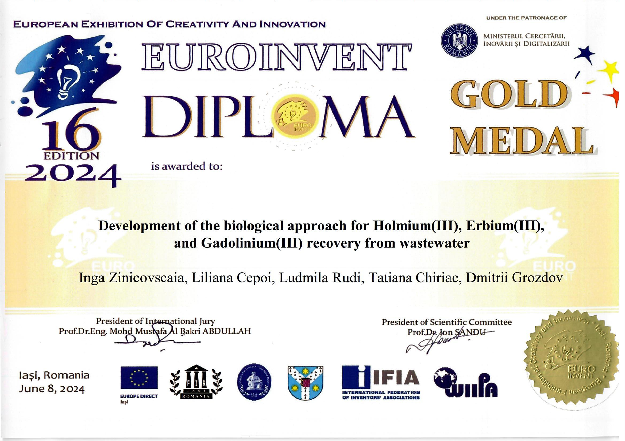
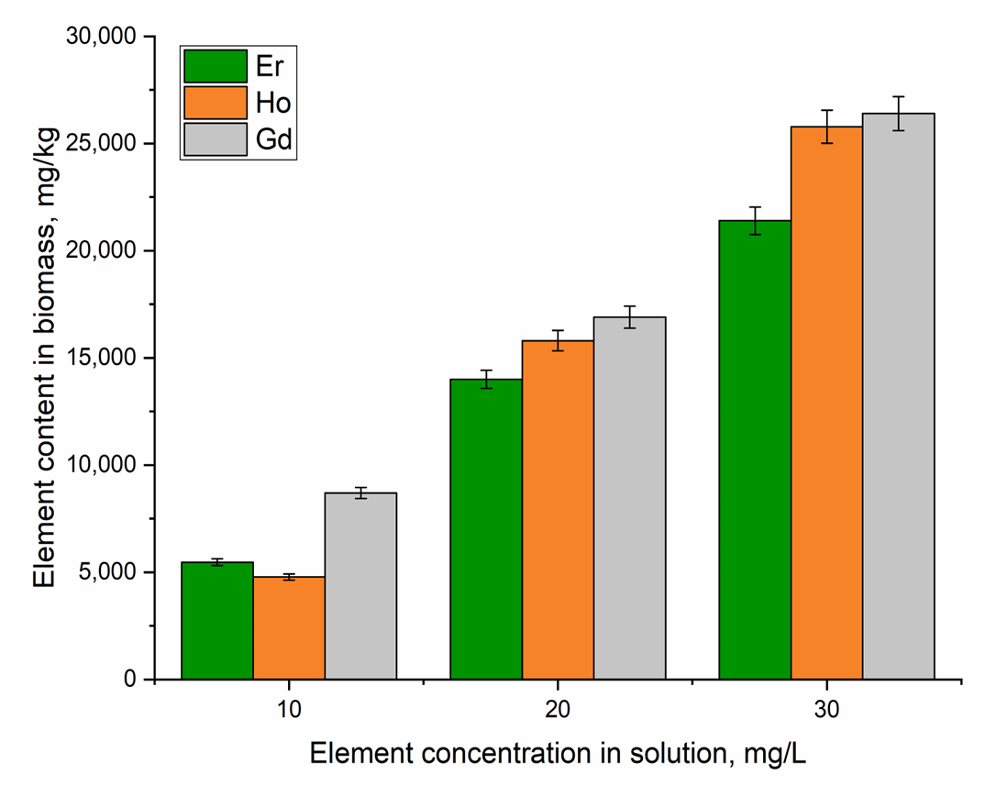
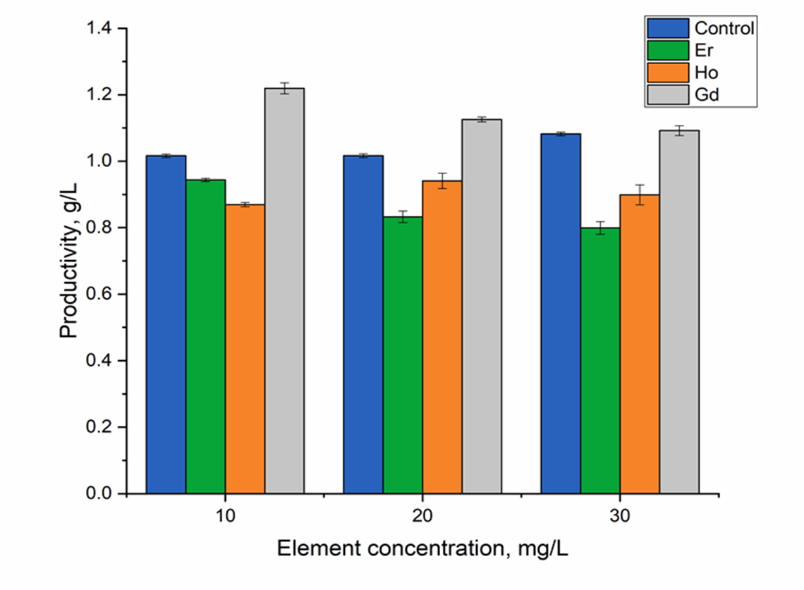

ОЯФ
Scientific highlights
Development of the biological approach for rare earth elements recovery from wastewater
EUROINVENT-2024
Uptake of Er, Ho, and Gd by spirulina biomass cultivated in a medium supplemented with REEs.
Effects of rare earth elements on spirulina productivity
I. Zinicovscaia et al. Microorganisms, 12, 122. (2024)
Notes:
Оценено поглощение гадолиния (одного из наиболее изученных редкоземельных элементов), гольмия и эрбия (двух менее изученных элементов) цианобактерией спирулиной. По результатам нейтронно-активационного анализа спирулина продемонстрировала относительно высокую аккумуляционную способность к изученным ионам металлов, которая изменялась в в следующем порядке: гадолиний > гольмий > эрбий. Сохранение продуктивности биомассы на уровне контрольной биомассы свидетельствует об удовлетворительном физиологическом состоянии культуры в условиях контакта с потенциально токсичными элементами и подтверждает ее биоремедиационную способность. Работа была отмечена золотой медалью на международной выставке изобретений, которая проходила с в июне 2024 года в Яссах, Румыния

Slide 17

FLNP offers a large suite of equipment for comprehensive study of samples by complementary techniques
It includes:
Xeuss 3.0 X-ray scattering station;
X-ray Diffractometer EMPYREAN
(PANalytical);
Coherent Anti-Stokes Raman Spectrometer
Raman spectrometers;
IR and UV spectrometers;
RFA;
ICP-MS
Chromatography System
NGC Quest™ 10 Plus
AFMs
…etc.
https://flnp.jinr.int/images/box-slider/Laboratory_Equipment_DNICM_FLNP_JINR_2021.pdf

Slide 18
Main activities in the field of nuclear physics with neutrons:
Investigations of the neutron induced nuclear reactions:
fundamental symmetries;
highly excited states of the nuclei;
nuclear fission;
nuclear data.
Investigations of the fundamental properties of the neutron, ultra-cold neutrons:
tests of quantum mechanics;
search for new type of interactions;
neutron lifetime measurement.
Applied and methodical research:
neutron activation analysis and others nuclear technics for isotope analysis;
neutron in space;
Ion beam analysis:
IREN developing.

Slide 19
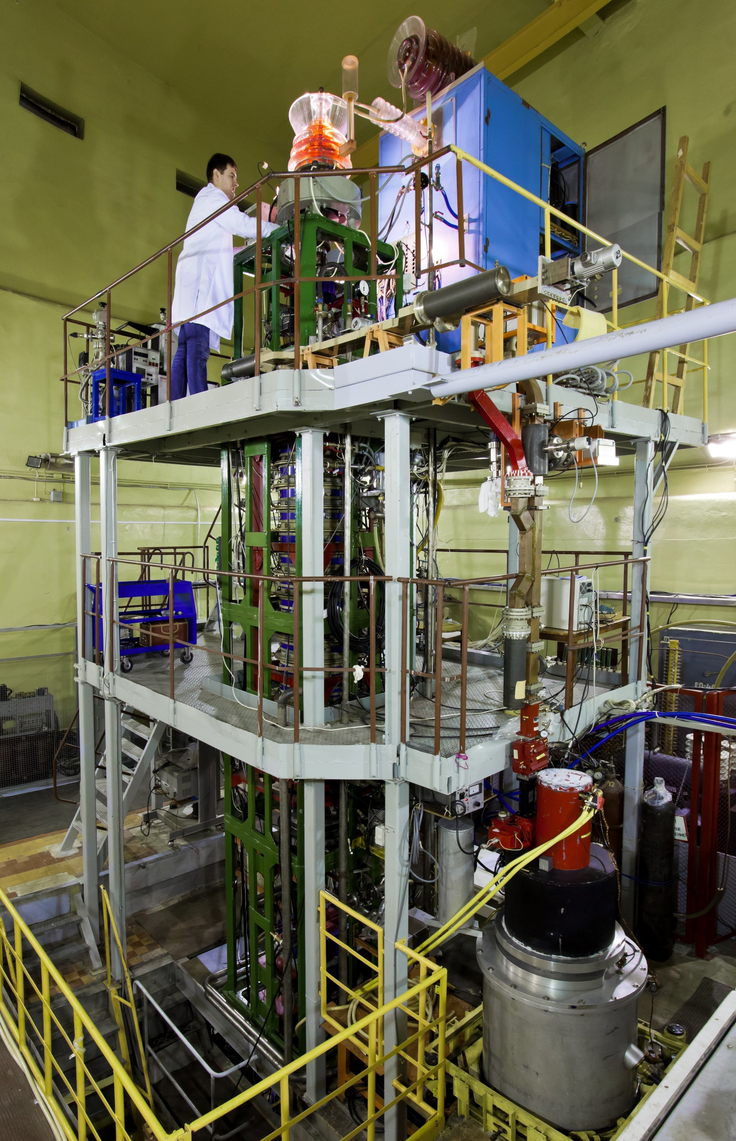
Source of resonance neutrons IREN based at lineal electron accelerator
https://flnp.jinr.int/en-us/main/facilities/iren
The linear electron accelerator LUE-200 used as a driver for the intense resonance neutron source IREN. The accelerator is positioned vertically. It consists of a pulsed electron gun, an accelerating system, microwave power sources based on 10-cm klystrons with modulators, a focusing-beam transport system, a diagnostics system with a broadband magnetic spectrometer and a vacuum system.
Peak current (A) | 3
Repetition rate (Hz) | 50
Electron pulse duration (ns) | 100
Electron energy (MeV) | 110
Beam power (kW) | 1.5
Multiplication | 1
Neutron intensity (n/s) | ~3x10¹¹
1200 hours/year

Slide 20
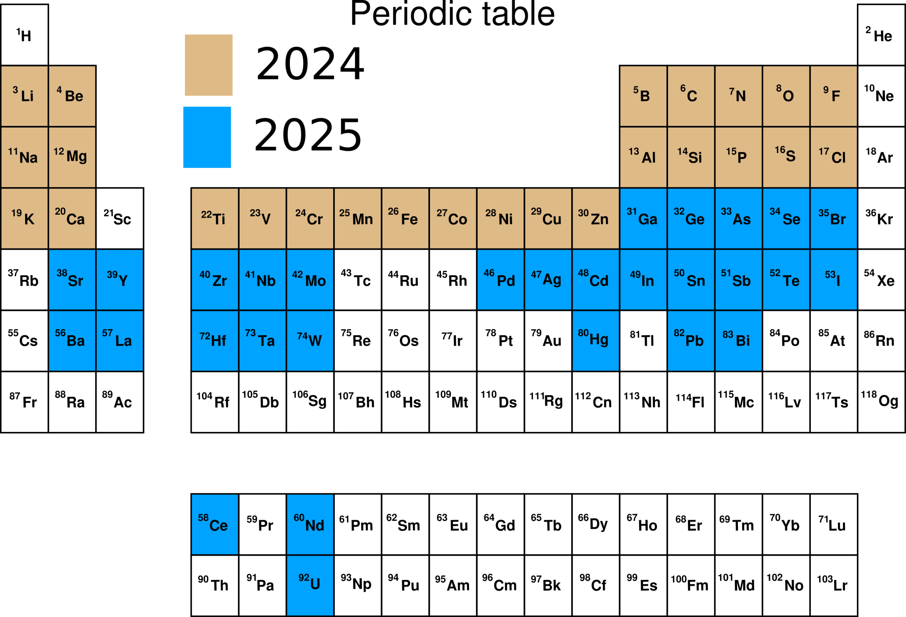
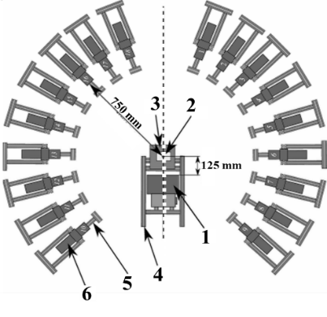
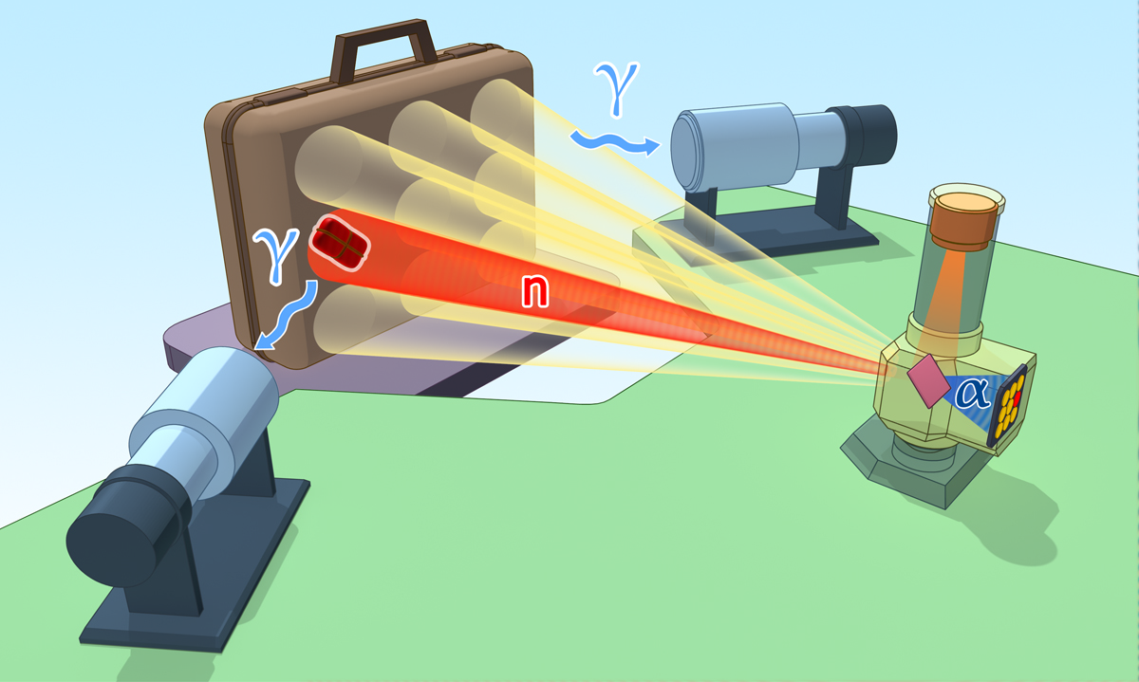
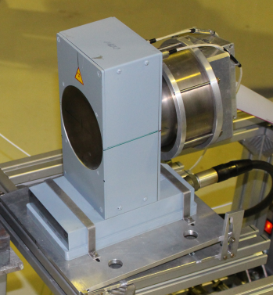
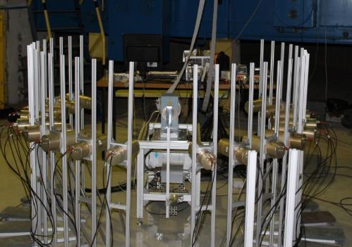
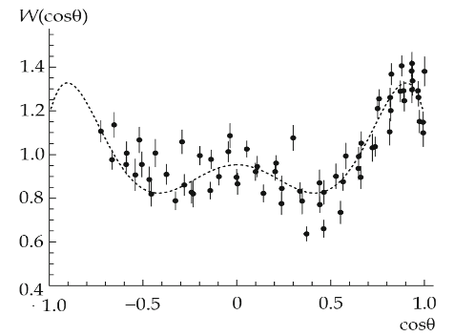
  D-T generator for tagged neutron technique (TANGRA Project)
https://flnp.jinr.int/en-us/main/facilities/tangra-project-en
In 2024 γ-ray emission cross sections for light elements was measured: B, C, N, O, F, Na, Mg, Al, Si, P, S, Cl, K, Ca, Ti, V, Cr, Mn, Fe, Co, Ni, Cu, Zn, Sn.
yield up to 10⁸ c⁻¹
Set of NaI(Tl) detectors
Set of BGO detectors
Set of LaBr detectors
Set of detectors based on different plastics
HPGe detector
Gamma-spectra and angular distributions of gamma ray have been measured in inelastic neutron scattering reactions for 20 nuclei.

Slide 21


EG-5
https://flnp.jinr.int/en-us/main/facilities/eg-5
Electrostatic Van de Graaff accelerator, was built in 1965.
The installation remains in demand today.
The characteristics of EG-5 Accelerator:
Energy region | 0.9 – 3.5 MeV
Beam intensity for 𝐻+ | 30 μA
Beam intensity for 𝐻𝑒+ | 10 μA
Energy spread | < 500 eV
Number of beam lines | 6
600 hours/year
Plan of modernization 2023-2026:
Before modernization | After modernization
Terminal voltage - 2,5 MV Beam current – 100nA Ion Energy – 2,5 MeV | Terminal voltage - 4,1 MV Beam current – 50-100mkA Ion Energy – 4,1 MeV

Slide 22







EG-5
Fast neutron reactions
Ion Beam Analysis & complementary methods
Gas Target D(d,n)³He
        Neutron flux – 5 10⁷ n/s sm²
        - Max. neutrons energy - 5,5 ± 0,1 MeV
Solid-state target
¹H + ⁷Li - ⁷Be + n
⁷Li
        Neutrons flux – 5 10⁷ n/s sm²
        - Energy region – 20 – 800keV
The elemental composition of multilayer systems, isotopic composition, stoichiometry of films.
Optical, electronic and electrical properties using complementary methods (ellipsometry voltammetry impedance spectroscopy).
E
20keV
800keV
3.3MeV
5,1 MeV
Quasi-monochromatic neutrons in a wide range of energies

Slide 23









Development of neutron instruments elements :
Neutron detectors:
gaseous and scintillator neutron detectors;
development of the technology of thin film B₄C coverage;
detector electronics.
Tools for instrument development and optimization:
simulation of instruments;
sample environment systems
software.
Developing of cold moderators:
developing of exist moderators' cryogenic system ;
developing of methane-based moderator.

Slide 24











Neutron scattering in condensed matter physics
Inelastic Scattering
BJN (Bajorek-Janik-Natkaniec) spectrometer
One of the top five in the world
New inelastic neutron scattering spectrometer in inverse geometry
1962 HOPG plates
The total solid angle coverage of the BJN spectrometer would be 5.8 Sr.
Prototype
The overall luminosity of the BJN spectrometer could be enhanced by up to 150 times relative to NERA.
https://flnp.jinr.int/en-us/main/facilities/materials/bjn-project

Slide 25






New back scattering detector
Experimental site for neutron detector production
New large aperture ZnS scintillator detector system covering scattering angles range 2θ = 133-175°, installed at the HRFD diffractometer.
Spattering machine for B₄C coverage
Ferry Vatt company, Kazan, Russia
Max. coverage square 400х1200 mm²
Modern equipment and engineer systems
Ω, sr2
The surface of scintillator S > ${\text{10} m}^{2}$
The approximate length of fibers L=36000 m
Photomultipliers : 216

Slide 26
Thank you for attention
and
we invite you to joint research

