Slide 1
Review of Recent Activities on the Tagged Neutron Method at FLNP JINR
Yuri Kopatch
for the TANGRA collaboration

Slide 2
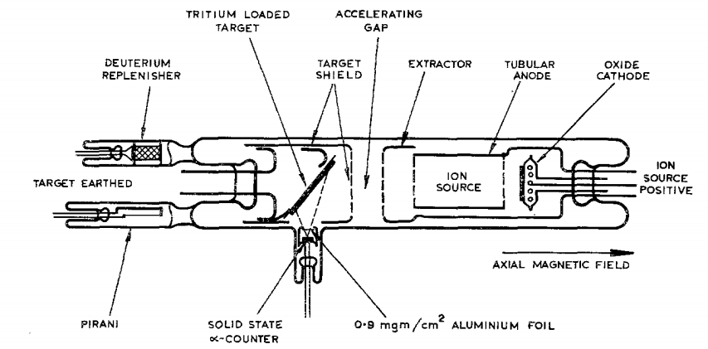
The Tagged Neutron Method or Associated Particle Technique
H. H. BARSCHALL, I . ROSEN, R. F. TASCHEK, J. H. WILLIAMS, Rev. Mod. Phys., V. 24, 1 (1952): Since neutrons arise only from nuclear reactions, there always exist at the time of their formation one or more charged particles associated with each neutron. In some cases a one-to-one correspondence exists between neutron and charged particle, and the counting of these charged particles with known efficiency determines the associated neutron flux.
D+D → He³+n+Q
D+T → He⁴+n+Q
J.D.L.H. Wood, A SEALED-OFF 14 MeV NEUTRON SOURCE INCORPORATING A SOLID STATE ALPHA-PARTICLE DETECTOR, Nucl. Instr. Meth., pp.49-52, Jan.-Feb. 1963.

Slide 3
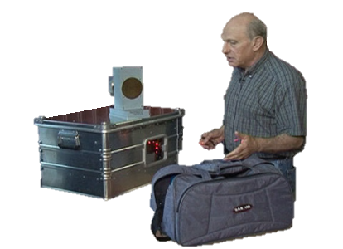
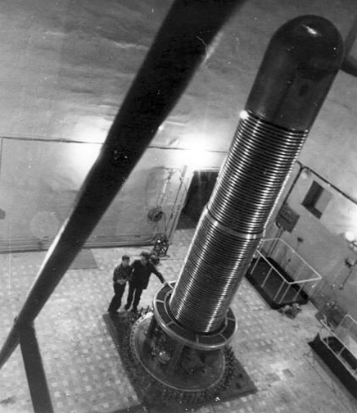
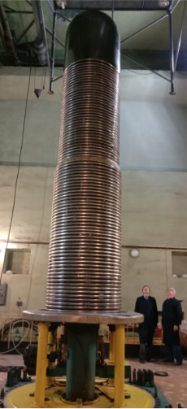

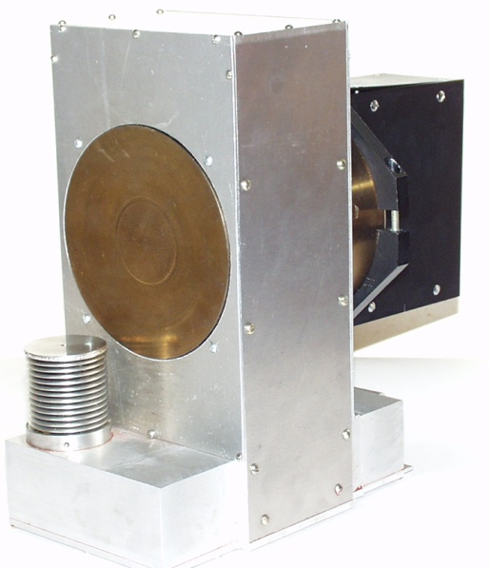
Development and Applications of the
Tagged Neutron Method at JINR
At the end of 1990th V.M.Bystritsky and M.G.Sapozhnikov proposed to study the tagged neutron method using the Van de Graaff EG-5 electrostatic accelerator at FLNP. The first experiments were started in 1999.
The first installation had a tritium target of 1.7 curie, a single-channel alpha detector based on ZnS and a gamma detector made of a NaI(Tl) crystal with a diameter of 200 mm.
~5 m
An important stage in the development of the TNM was the creation of a portable neutron generator, which was carried out by the N.L. Dukhov All-Russian Research Institute of Automatics, Moscow (VNIIA) in 2003, according to the technical specifications developed at JINR.
~30 cm

Slide 4
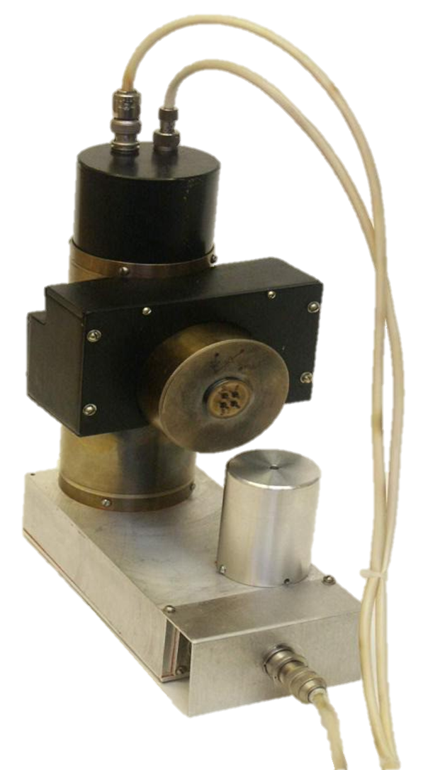
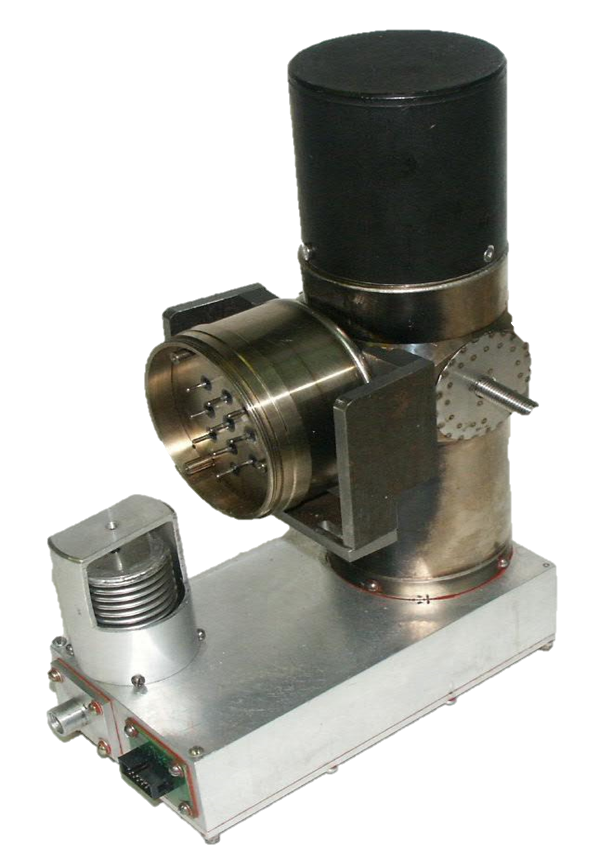
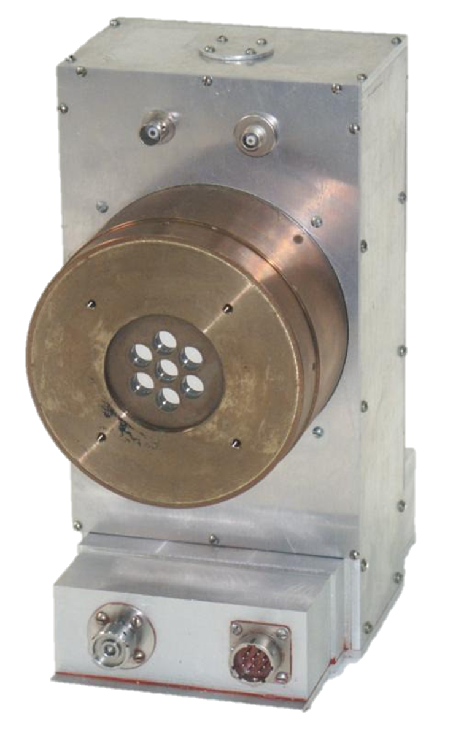
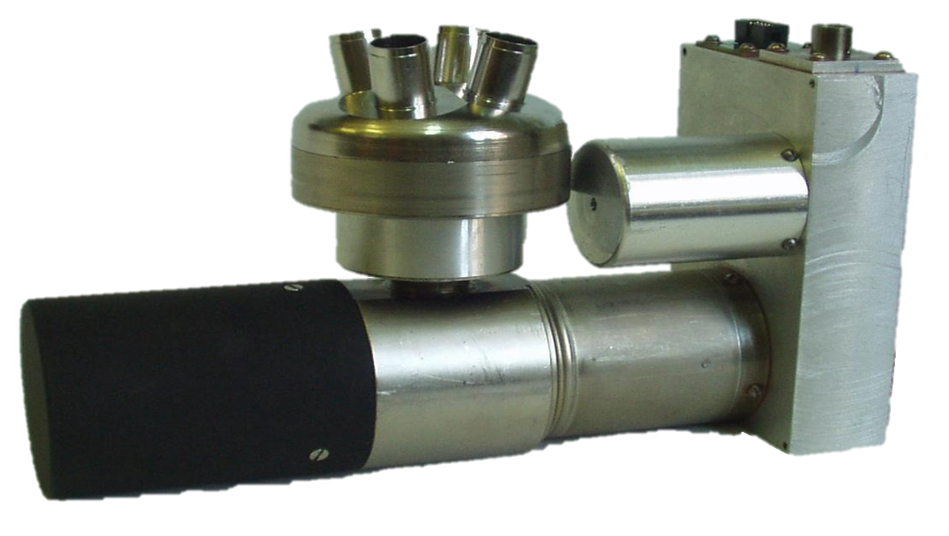
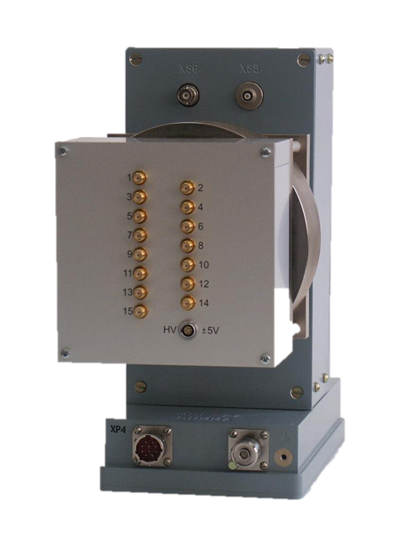
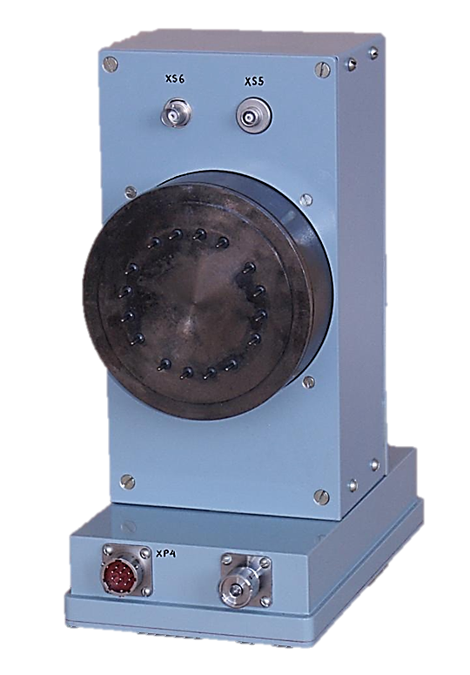
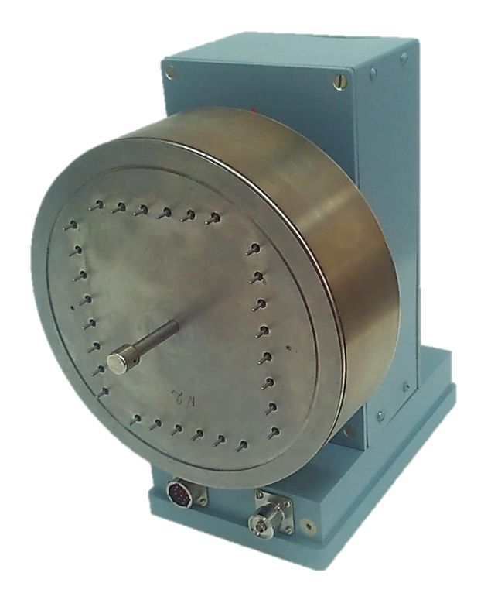
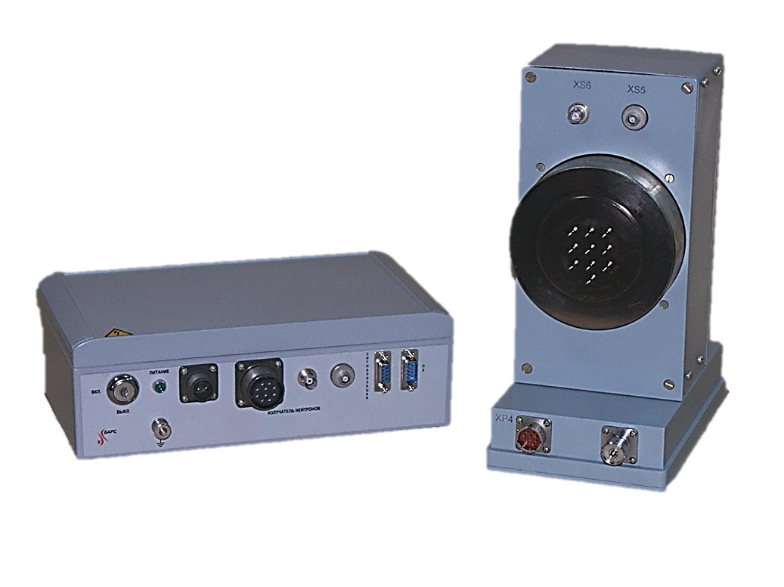
Portable VNIIA ING-27 n-generators

Slide 5
Neutron generators
Some characteristics of commercial neutron generators
Type of NG | Metherial of α-detecor | Number of tagged beams | Pixel size (mm) | Distance between pixels (mm)
Sodern, Euritrack | Si | 64 | 5.8 | 0.2
API-120 | YAP | 256 | 3 | -
ING-27 | Si | 9 | 10 | 1
ING-27-64 | Si | 64 | 6 | 1
ING-27-256 | AsGa | 256 | 4 | 0,1
Main characteristics:
Maximal intensity ~5⋅10⁷ с⁻¹
Neutron energy 14.1 MэВ
Neutron radiation mode steady-state
Operation time ~800 hours
Produced by
N.L. Dukhov All-Russian Automation Research Institute

Slide 6
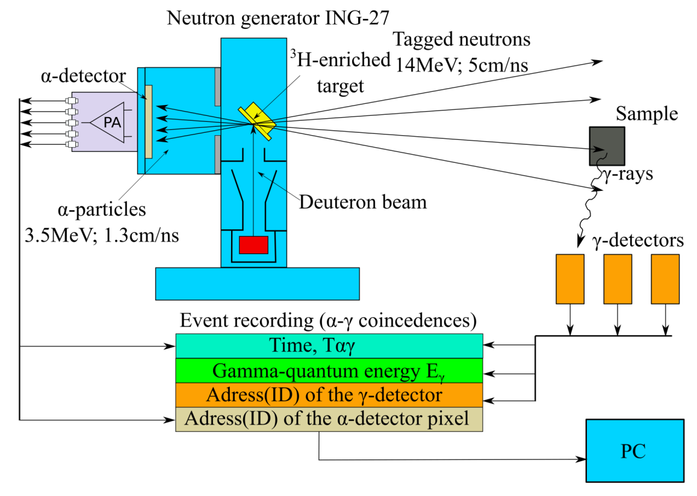
The Tagged Neutron Method with ING-27 compact neutron generators
D + T → ⁴He (3.5МeV) + n (14.1МeV)
The 14.1 MeV neutron is tagged in time and direction by detecting the associated α-particle released in the opposite direction.
Main advantages of the method:
significantly reduced background
direct measurement of the neutron flux
position sensitivity
possibility to select time-correlated events using coincidences

Slide 7
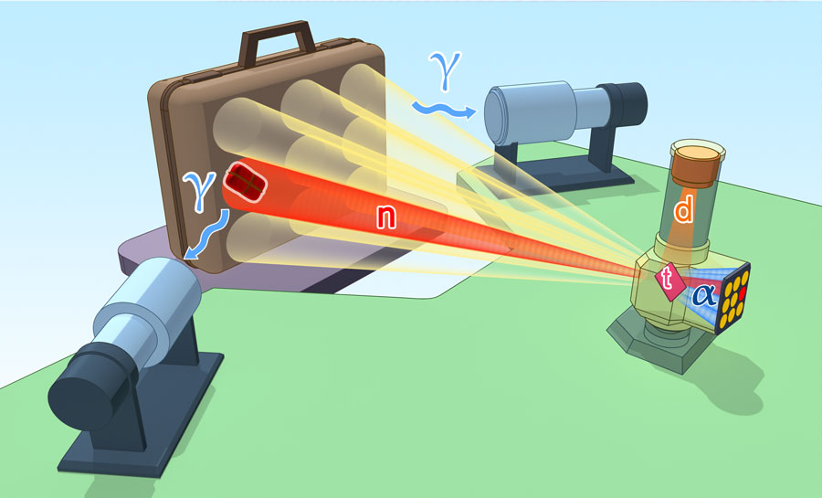
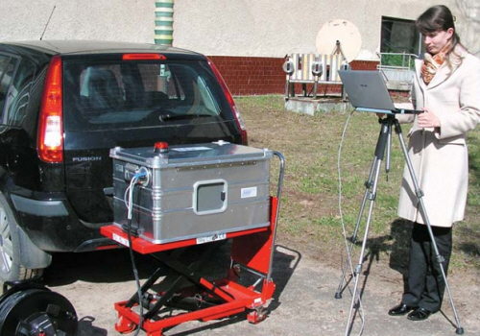
Application of the TNM: detection of hazardous substances
DVIN-1 is a portable system designed for detecting concealed explosives in inspected objects.
The DVIN-1 analyzes the elemental composition of substances and can identify over 30 explosive materials. The key advantage of DVIN-1 over gas analyzers is its ability not only to detect the possible presence of explosives but also to pinpoint their exact location within the inspected object.

Slide 8
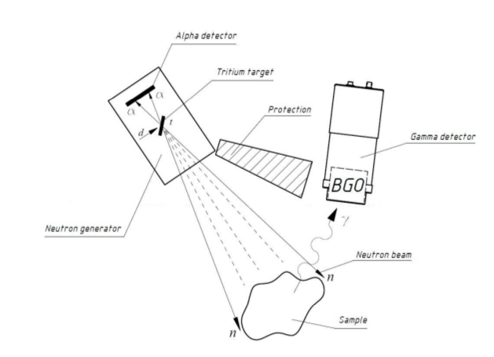
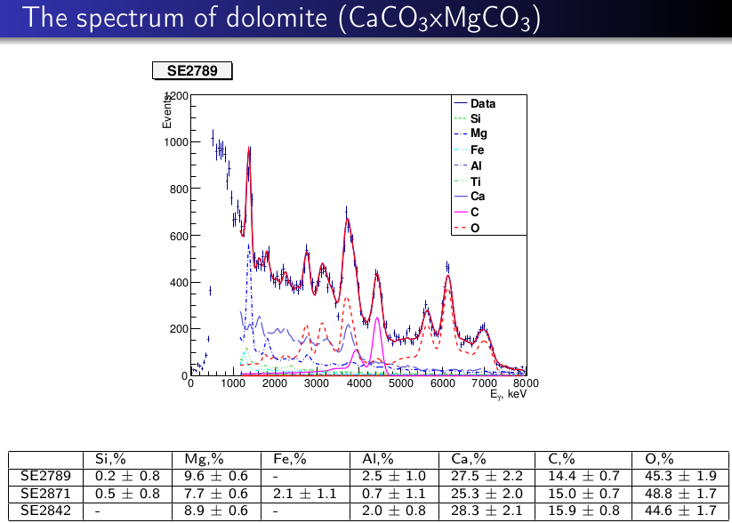
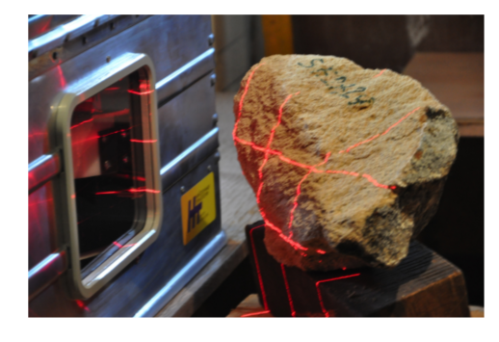
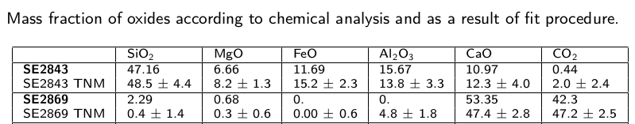
Application of the TNM: elemental composition of minerals
Decomposition of the spectrum from dolomite (CaCO₃xMgCO₃)
V.Yu. Alexakhin et al, reported at ISINN-23, Dubna (2015)
V.Yu. Alexakhin et al, preprint of JINR (2015)

Slide 9
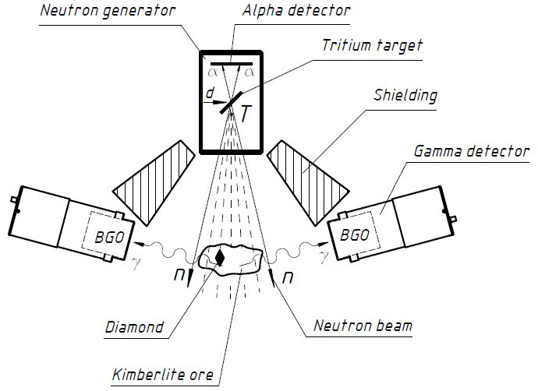
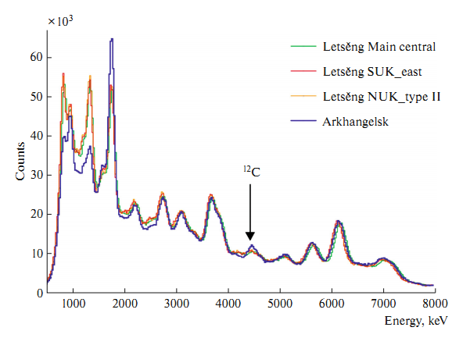
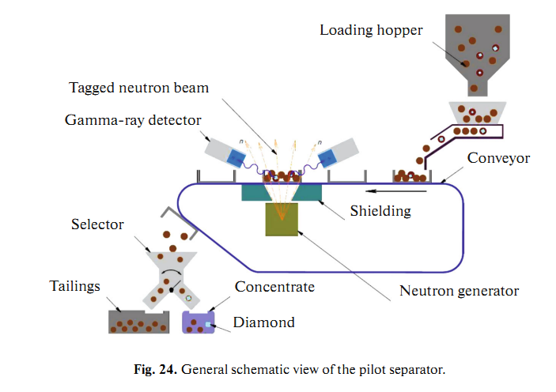
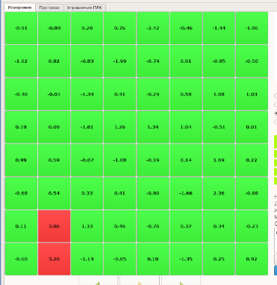
Application of the TNM: Search for large diamonds in kimberlite ore
Design of an ore separator
Kimberlite ore is irradiated by 14.1 neutrons from the neutron generator.
Characteristic γ-ray spectra are measured by the BGO detectors and analyzed separately for each ING-27 voxel.
The condition for finding the diamond is a local excess of the count rate for gamma-rays with energies ~4.43 MeV (characteristic line of carbon)
• Separator productivity 1060 kg/h.
• Minimum diamond size 8 mm.
• False detection probability 3%.
Yu.N. Rogov et al, reported at ISINN-24, Dubna (2016)

Slide 10
Project TANGRA @ JINR: TAgged Neutrons and Gаmma RAys
Development of the tagged neutron method for determining the elemental structure of matter and nuclear reactions research
Main participants:
JINR (FLNP, VBLHEP, DLNP, LRB), Dubna, Russia
N.L. Dukhov All-Russian Automation Research Institute, Moscow, Russia.
Lomonosov Moscow State University, Moscow, Russia.
INRNE, Bulgarian Academy of Sciences, Sofia, Bulgaria
Institute Ruđer Bošković, Zagreb, Croatia
BHU Varanasi, India
LLC DIAMANT, Dubna, Russia

Slide 11
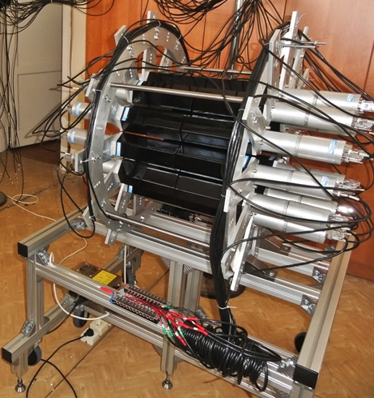
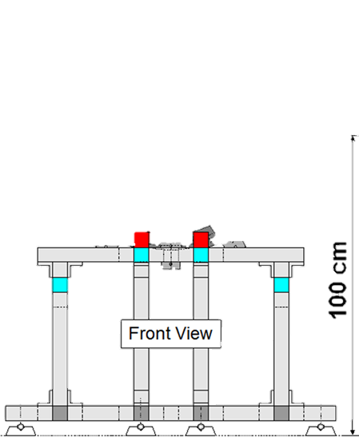
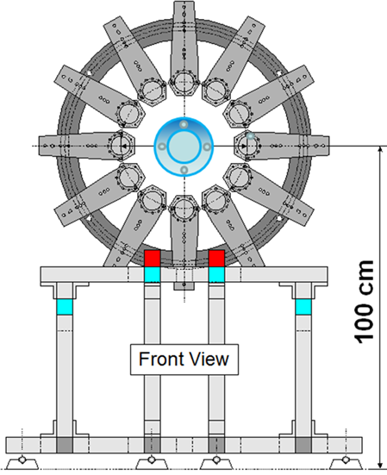
Multi-detector gamma-ray spectrometry system “Romashka”

Slide 12
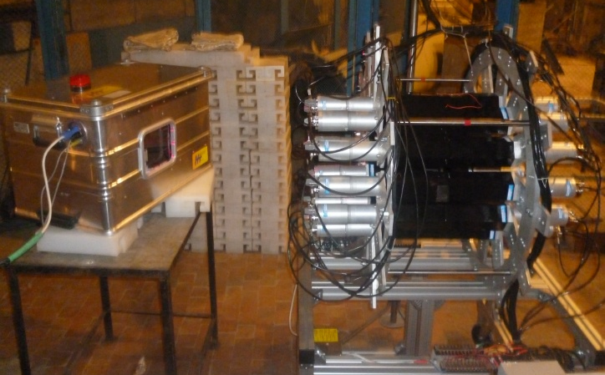
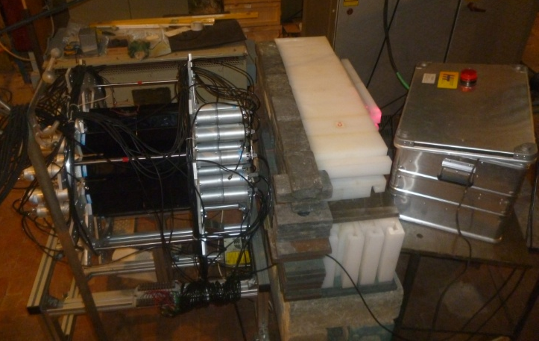
Using gamma-ray detector system “Romashka” with TNM

Slide 13
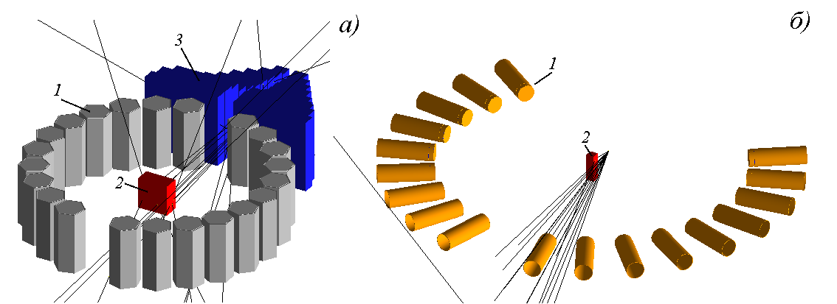
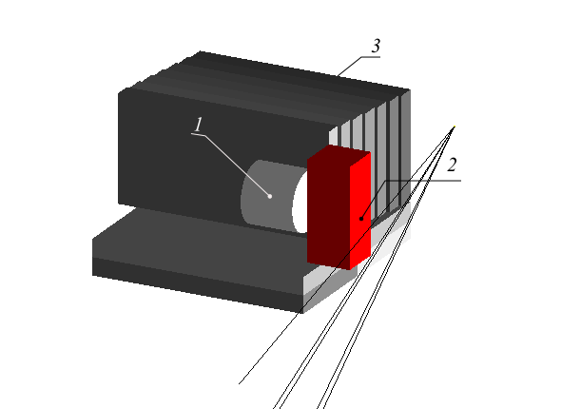
Various configurations of gamma-ray detectors
в)
Shielding
Detectors
Sample
22 NaI(Tl) detectors 18 BGO detectors 1 HPGe detector

Slide 14
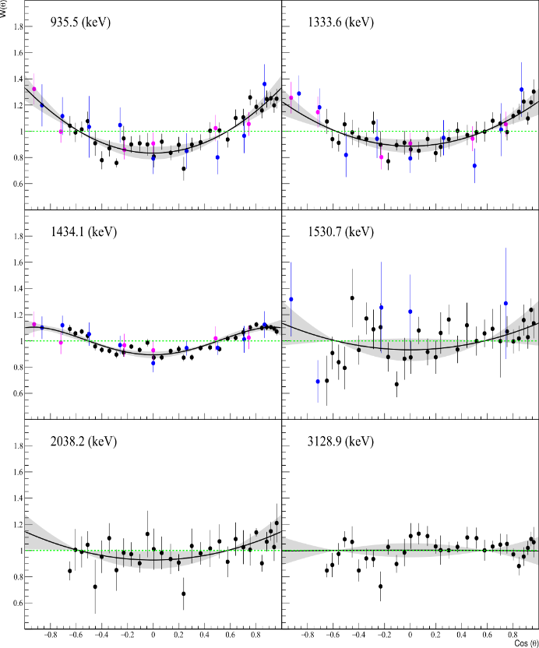


Angular distributions of γ-rays from inelastic scattering of 14.1 MeV neutrons
Angular distributions of γ-rays are the normalized differential cross sections:
Eγ (keV) | Ref. | a₂ | a₄
935.5 | Our work | 0.34 ± 0.02 | *
 | Abbodanno1973 | 0.35 ± 0.09 | *
 | Oblozinsky1992 | 0.27 ± 0.06 | *
1333.6 | Our work | 0.23 ± 0.02 | *
 | Abbodanno1973 | 0.41 ± 0.09 | *
 | Oblozinsky1992 | 0.30 ± 0.05 | *
1434.1 | Our work | 0.16 ± 0.01 | -0.06 ± 0.02
 | Abbodanno1973 | 0.18 ± 0.05 | -0.06 ± 0.07
 | Oblozinsky1992 | 0.13 ± 0.03 | 0.03± 0.04
1530.7 | Oblozinsky1992 | -0.12 ± 0.31 | *
 | Our work | 0.14 ± 0.05 | *
2038.2 | Our work | 0.15 ± 0.04 | *
3128.9 | Our work | 0.01 ± 0.03
Angular distributions of γ-rays for chromium

Slide 15
Table of gamma-ray yields for chromium
E_{γ} (keV) | Reaction | J_{i}^{P} (E_{i}, keV) | J_{j}^{P} (E_{j}, keV) | Y_{γ}, %
 |  |  |  | Our work | [42] | [3]
124,4 | ⁵²Cr(n,p)⁵²V | (141,6) | (17,2) | 2,4 (0,5)
226,3 | ⁵⁰Cr(n,p)⁵⁰V | (226,2) | (0) | 3,0 (0,6)
320,1 | ⁵²Cr(n,d)⁵¹V | (320,1) | (0) | 2,2 (0,8) |  | 1,8 (0,1)
567,0 | ⁵²Cr(n,n')⁵²Cr | (4039,2) | (3472,2) | 5,0 (0,9)
600,2 | ⁵²Cr(n,n')⁵²Cr | (4015,5) | (3415,3) | 10,0 (1,6)
645,7* 647,5* | ⁵²Cr(n,p)⁵²V ⁵²Cr(n,n')⁵²Cr | (793,5) (3415,3) | (147,8) (2767,8) | 8,5 (1,0) |  | 8,9 (0,3)
704,5 | ⁵²Cr(n,n')⁵²Cr | (3472,2) | (2767,8) | - |  | 5,4 (0,2)
744,2* 749,1* | ⁵²Cr(n,n')⁵²Cr ⁵²Cr(n,2n)⁵¹Cr | (3113,9) (749,1) | (2369,6) (0) | 12,3 (1,5) | 16,3 (2,9) | 9,1 (0,3) 5,4 (0,2)
783,3 | ⁵⁰Cr(n,n')⁵⁰Cr | (783,3) | (0) | 4,2 (0,5)
791,3 | ⁵²Cr(n,2n)⁵¹Cr | (4563,0) | (3771,7) | 2,9 (0,5)
834,9 | ⁵⁴Cr(n,n')⁵⁴Cr | (834,9) | (0) | 3,1 (0,4)
848,2 | ⁵²Cr(n,n')⁵²Cr | (3615,9) | (2767,8) | 7,3 (0,5)
935,5 | ⁵²Cr(n,n')⁵²Cr | (2369,6) | (1434,1) | 33,5 (0,8) | 26,9 (3,8) | 30,3 (1,2)
1164,6 | ⁵²Cr(n,2n)⁵¹Cr | (1164,6) | (0) | - |  | 4,6 (0,2)
1246,3* 1247,7* | ⁵²Cr(n,n')⁵²Cr | (3615,9) (4015,5) | (2369,6) (2767,8) | 5,8 (0,9) |  | 5,0 (0,2)
1289,5 | ⁵³Cr(n,n')⁵³Cr | (1289,5) | (0) | 3,3 (0,7)
1333,7 | ⁵²Cr(n,n')⁵²Cr | (2767,8) | (1434,1) | 26,4 (0,8) | 22,1 (4,0) | 26,2 (1,0)
1434,1 | ⁵²Cr(n,n')⁵²Cr | (1434,1) | (0) | 100 | 100 | 100
1530,7 | ⁵²Cr(n,n')⁵²Cr | (2964,8) | (1434,1) | 6,8 (0,6) | 9,5 (3,0) | 5,1 (0,2)
1727,7* 1730,4* | ⁵²Cr(n,n')⁵²Cr | (3161,7) (4100,0) | (1434,1) (2369,6) | 5,7 (0,7) |  | 3,3 (0,1)
2038,2 | ⁵²Cr(n,n')⁵²Cr | (3472,2) | (1434,1) | 1,7 (0,5)
2257,7 | ⁵²Cr(n,n')⁵²Cr | (4627,3) | (2369,6) | 1,1 (0,5)
2337,6 | ⁵²Cr(n,n')⁵²Cr | (3771,7) | (1434,1) | 2,1 (0,6)
3128,9 | ⁵²Cr(n,n')⁵²Cr | (4563,0) | (1434,1) | 2,0 (0,7)

Slide 16
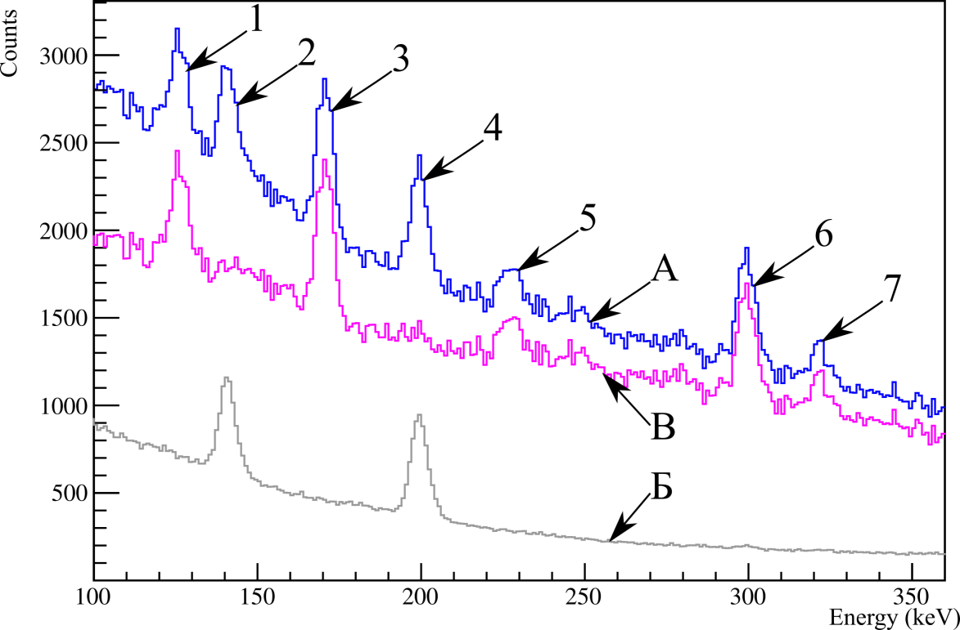
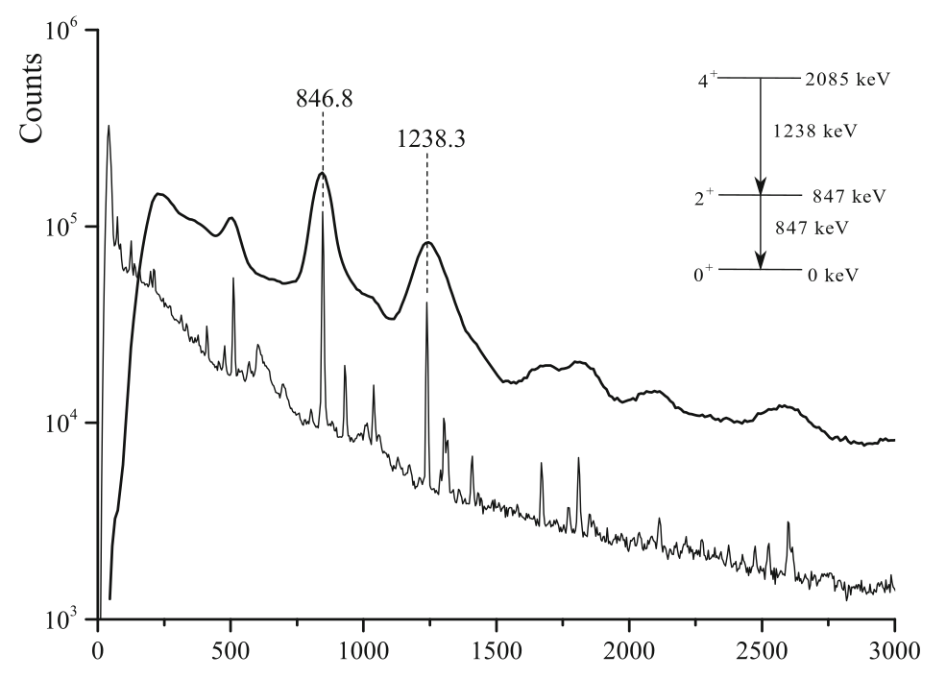
TNM with high resolution gamma spectrometry
BGO
HPGe
– energy spectrum in the coincidence window
– random background in the same coincidence window
– Pure spectrum after background subraction

Slide 17
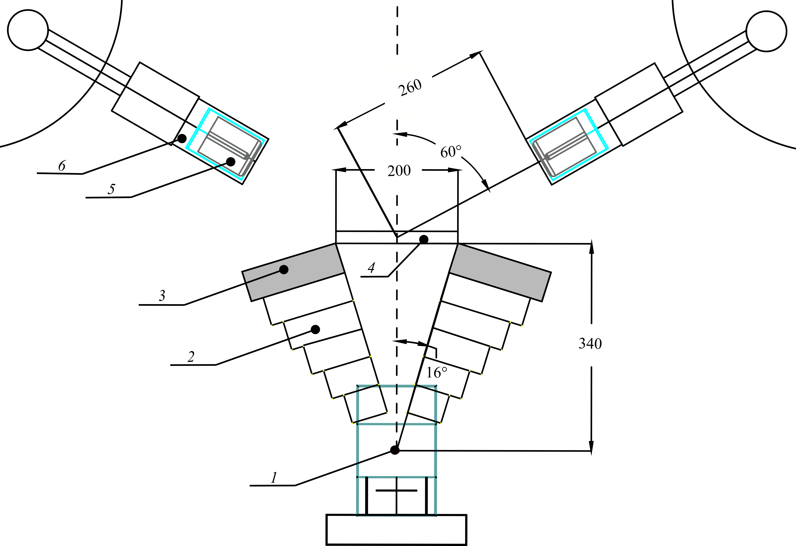
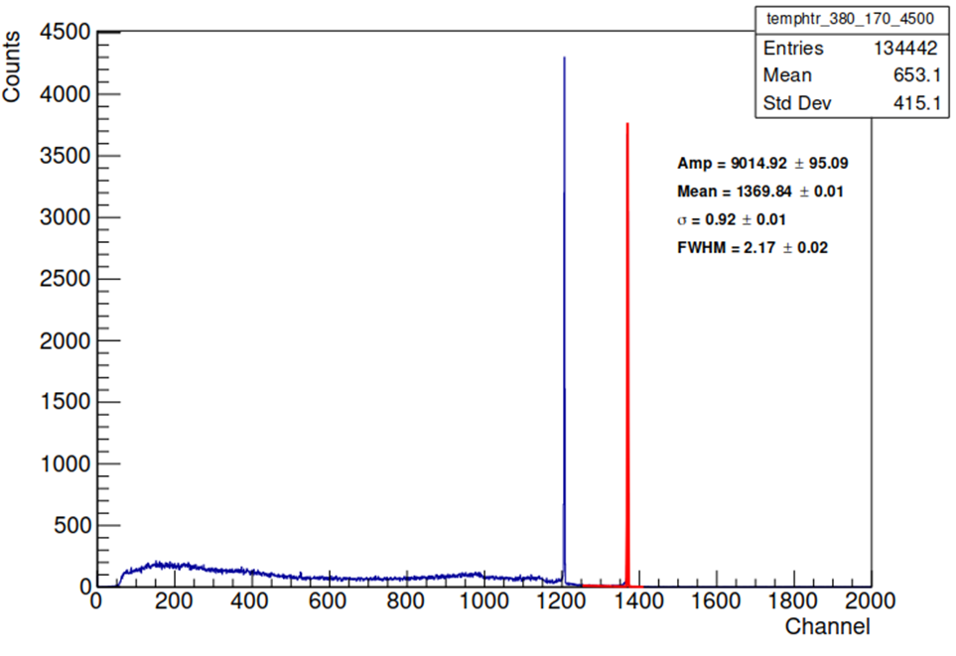
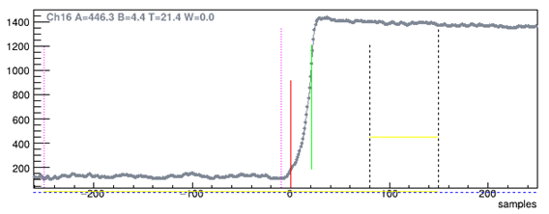
Developing and optimizing signal processing techniques
for the TANGRA project experimental setups
How?
See report of P. Kharlamov at ISINN-31

Slide 18
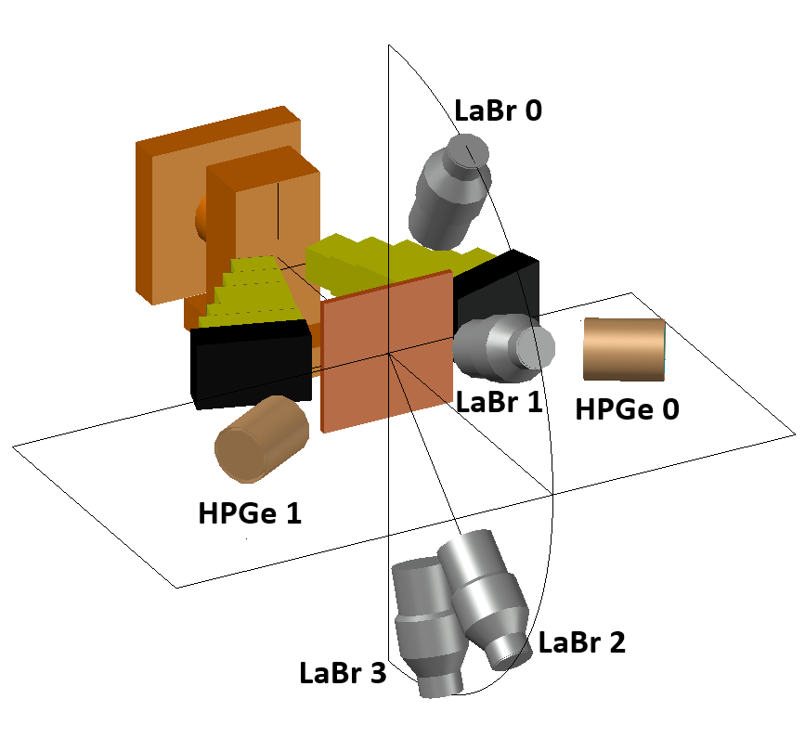
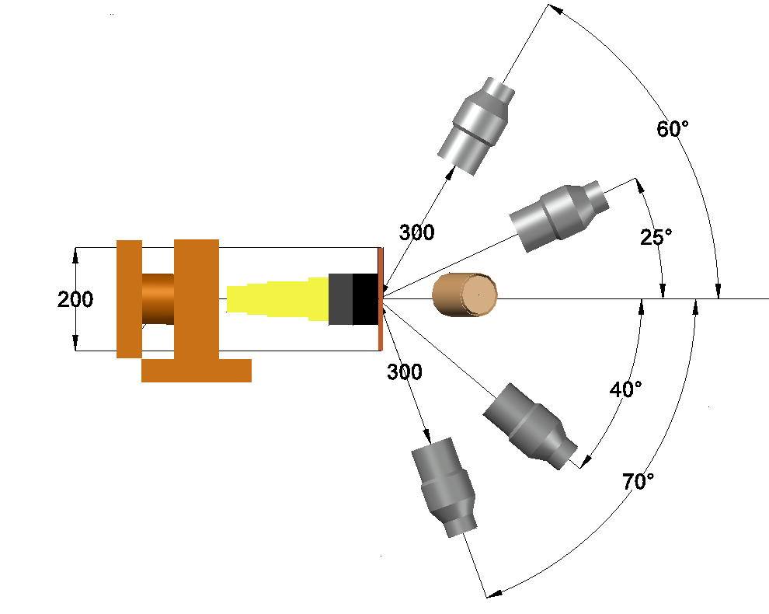
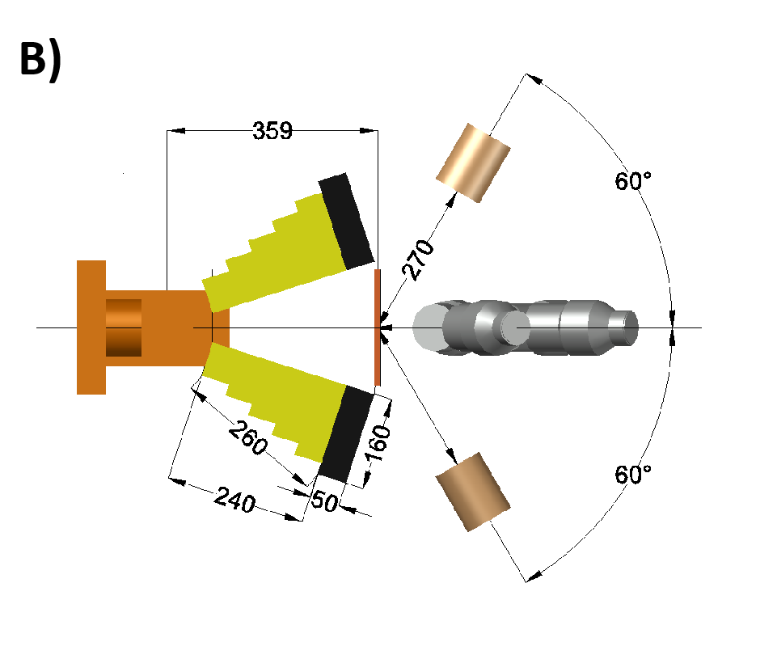
New experimental setup
A)
4
Side view
View from above
Setup for measurement of differential cross sections of γ-ray emission. Includes 2 HPGe and 4 LaBr₃ detectors. The geometry is optimized using Geant4.
See report of D. Grozdanov at ISINN-31

Slide 19
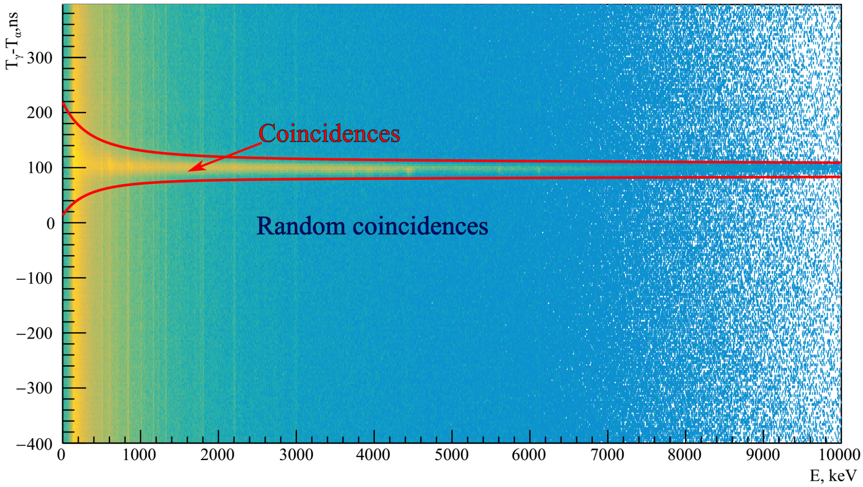
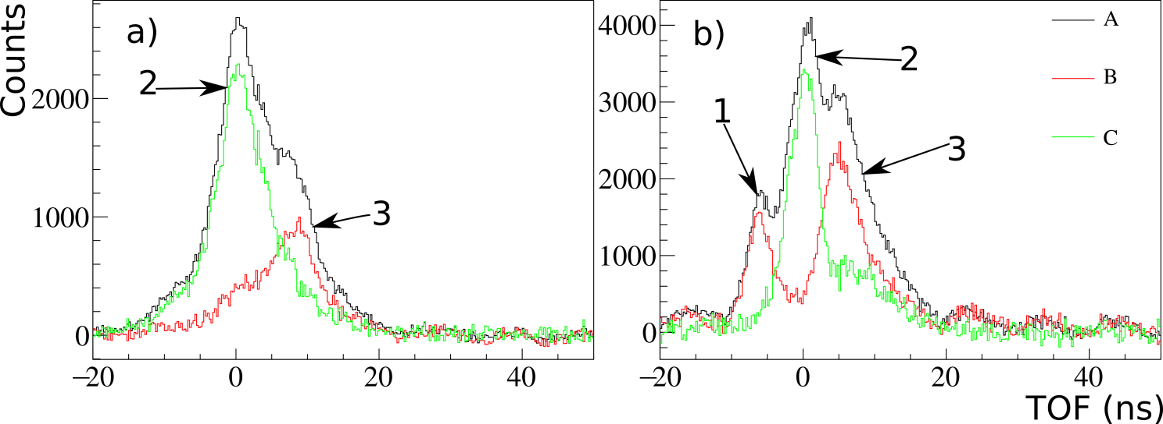
Data analysis:
Diagram energy (E_{γ} ) – the time between the registration of a γ–quantum and its corresponding α-particle (T_{γ} - T_{α} ) formed as a result of reactions in the sample, with a highlighted coincidence window.
Example of time spectra (in the energy window of about 1 – 2 MeV) for HPGe detector a) and LaBr detector b).
Where: A – With sample, B – Without sample, C – Difference.
1 – is γ-from (Fe – Pb) - Collimator, 2 – γ from sample, 3 – is scattered neutrons
See report of D. Grozdanov at ISINN-31

Slide 20
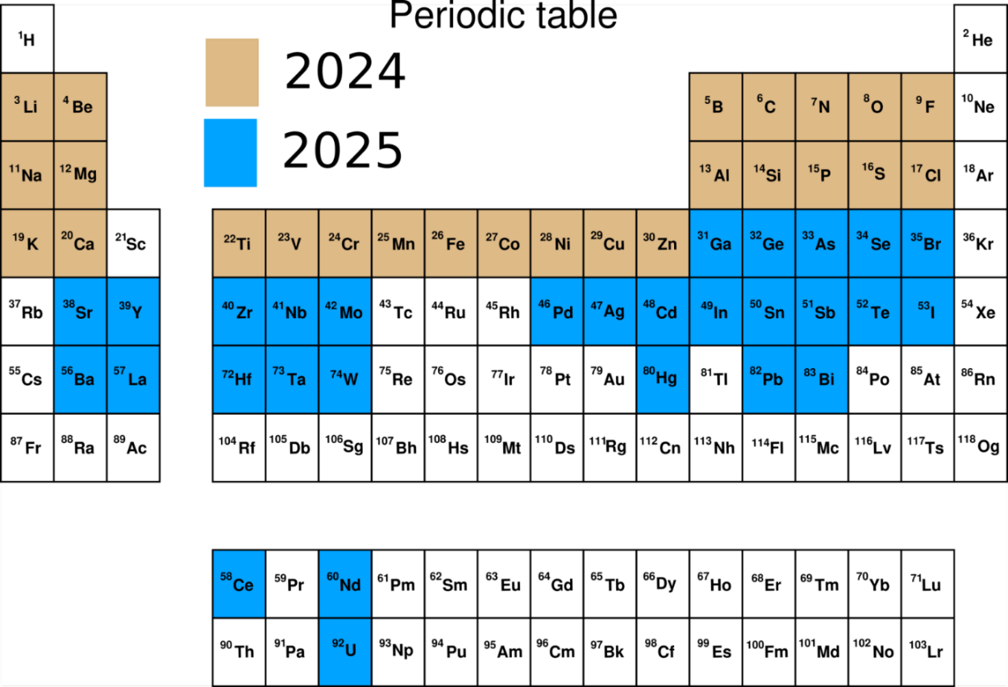
Differential cross sections of gamma-ray emission:
current and expected results

Slide 21
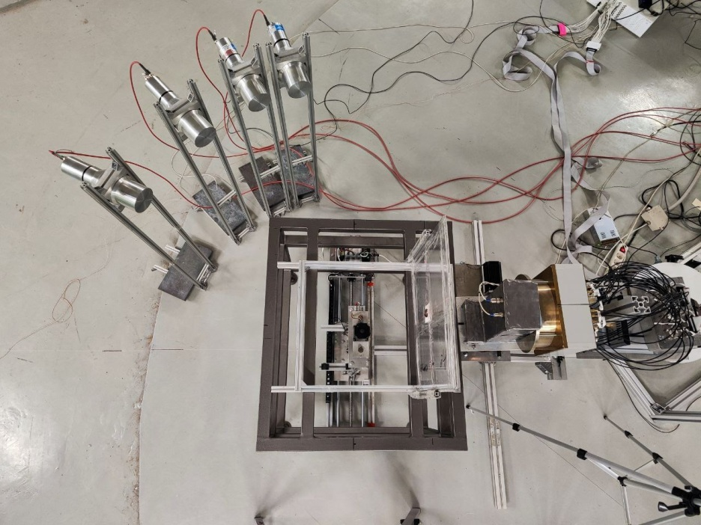
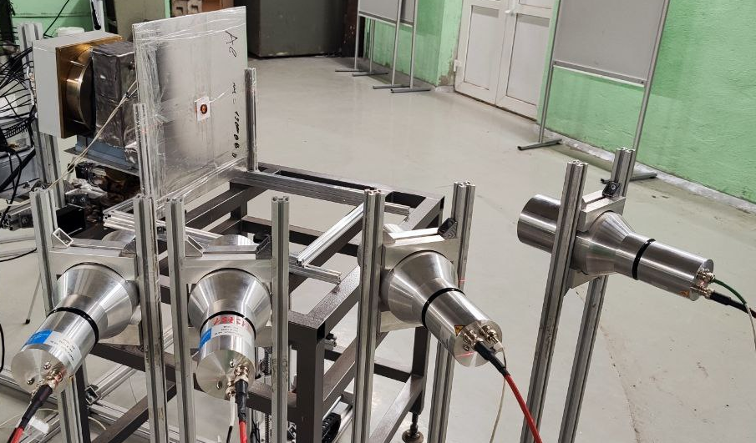
Determination of the efficiency of the detector sysmem. Analysis of chlorine neutron capture experiment for efficiency calculation validation
LaBr₃
Sample + point gamma source
LaBr₃
LaBr₃
LaBr₃
LaBr₃
Sample + point gamma source
See report of C. Hramco at ISINN-31

Slide 22
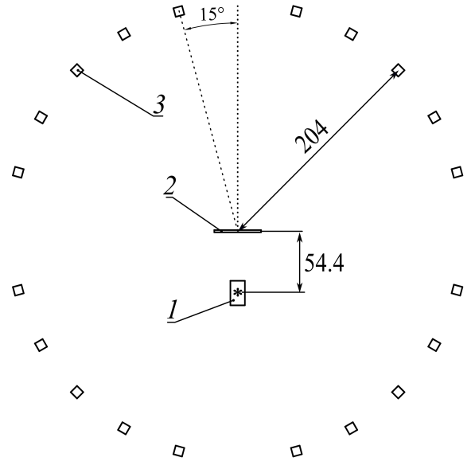
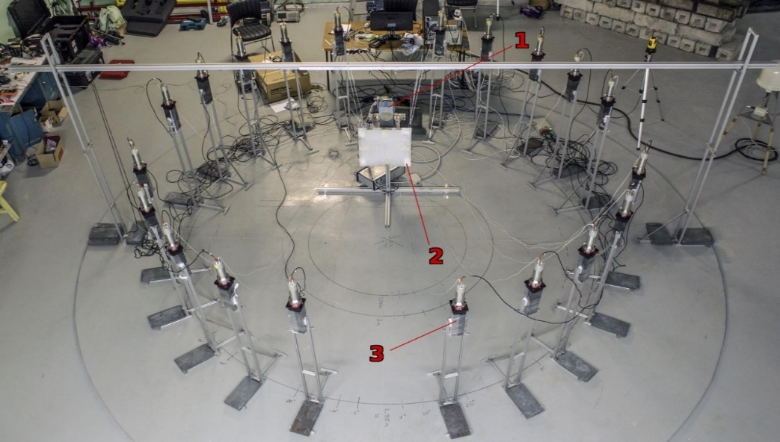
Measurement of differential cross sections of neutron scattering on 12C
Scheme of the experimental setup with plastic detectors for measuring angular distributions of the scattered neutrons. 1 – ING-27 neutron generator, 2 – irradiated carbon sample, 3 – one of the 20 plastic detectors used in the registration system.
Neutron source: ING-27 generator
Sample: graphite block, 44 cm x 44 cm x 2 cm
Neutron detectors: polyphenyltoluene scintillators

Slide 23
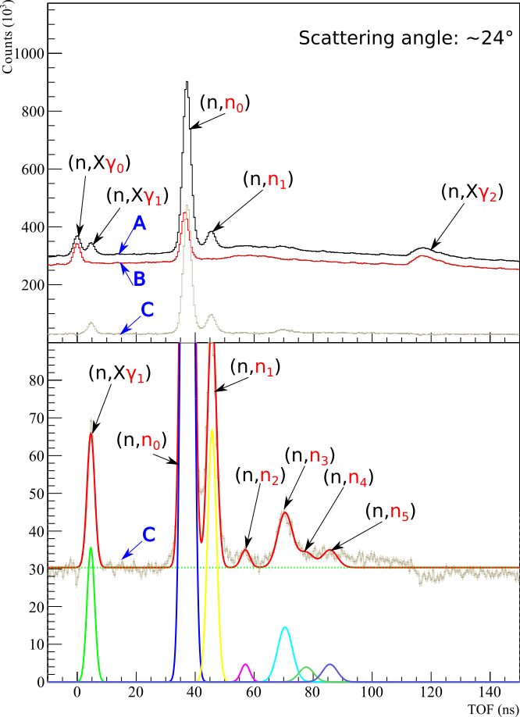
Measurement of differential cross sections of neutron scattering on 12C
Examples of the time-of-flight spectra obtained. Peaks are labelled with source reaction, registered particle is painted red.
A – is measurement with target (¹²C), Time ~ 48h;
B – is measurement without target (Background), Time ~ 28h,
C – Net spectra (without background)
(n,Xγ₀) – γ from ING-27
(n,Xγ₁) – γ from target (¹²C)
(n,Xγ₂) – γ from the opposite wall
(n,n₀) - elastic scattering
(n,n₁) - inelastic scattering to the 1 excited state of ¹²C 4.44MeV
(n,n₂) - inelastic scattering to the 2 excited state of ¹²C 7.65MeV
(n,n₃) - inelastic scattering to the 3 excited state of ¹²C 9.64MeV
(n,n₄) - inelastic scattering to the 4 excited state of ¹²C 10.30MeV
(n,n₅) - inelastic scattering to the 5 excited state of ¹²C 10.84MeV

Slide 24

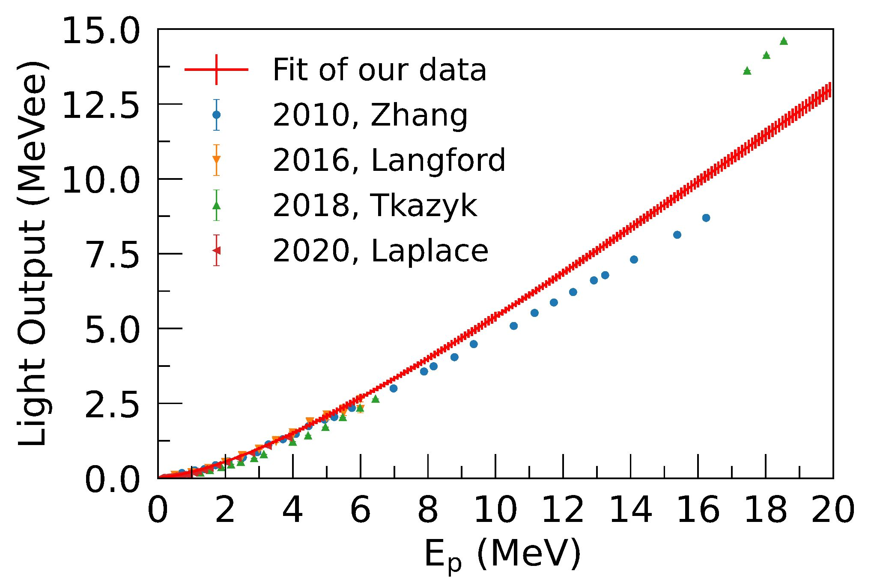
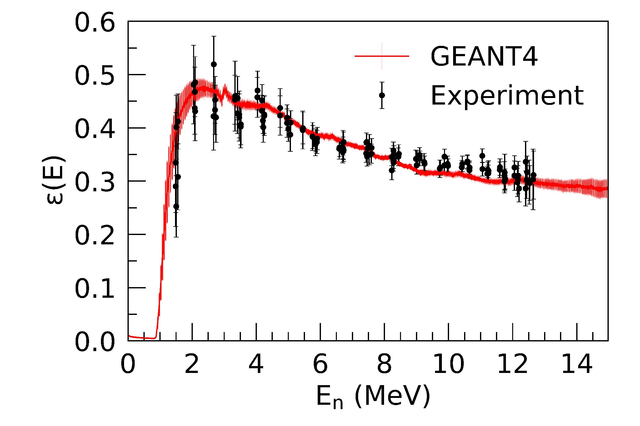
Characterization of an EJ-200 plastic scintillator array for experiments with 14-MeV tagged neutrons
The measured light output function for protons in comparison with other datasets
The experimental setup consisting of 20 plastic EJ-200 scintillators
The measured efficiency values vs the GEANT4 simulation
The new approach based on the tagged neutron method has been implemented to characterization of the organic scintillator based detectors. It was based on scattering of neutrons on carbon and hydrogen nuclei.
The light output functions for protons and α-particles were measured
The detection efficiency was experimentally measured relative to the the standard of the cross section of the elastic scattering of neutrons on hydrogen
The results obtained has been used to calculate the cross section in the experiments on investigation of the neutron emission
See report of P. Prusachenko at ISINN-31

Slide 25



Experimental and theoretical study of (n-n′-γ) angular correlations
10 long (1 m) plastic scintillator detectors with 2 PMT made by EPIC CRYSTALL
Detectors are placed at angles from 15° to 135° with step 30°
2 long detectors are placed above and below the target
(n′,γ) correlations are important for:
Understanding the reaction mechanism
Testing the theoretical predictions
Checking for nuclear forces invariance for n and p
See report of P. Filonchik at ISINN-31

Slide 26

Investigation of triple (n-n′-γ) correlations: theoretical description
See report of P. Filonchik at ISINN-31

Slide 27

THEORETICAL DESCRIPTION OF ANGULAR DISTRIBUTION OF GAMMA RADIATION OF NEUTRON-NUCLEAR REACTION PRODUCTS
See poster of A. Andreev at ISINN-31

Slide 28



Determination of carbon concentration in soil using the tagged neutron method
BGO detectors
distribution of reactions by depth
C
Carbon concentration is determined by the amplitude of the characteristic 4.44 MeV gamma-line.

Slide 29






NAS: Neutron Analyzer of Soil
Chemical analysis
NAS

Slide 30

Conclusions
The tagged neutron method (TNM) is an effective tool for studying the reactions of fast neutrons with nuclei, which makes it possible to successfully implement a program for measuring differential cross sections of neutron scattering and γ-ray production, as well as a program for the application of the TNM for non-destructive elemental analysis.

Slide 31
Acknowledgements:
Grozdanov D.N, Prusachenko P.S., Fedorov N.A., Tretyakova T.Yu., Pampushik G.V., Andreev A.V., Skoy V.R., Hramco C., Filonchik P.G., Kharlamov P.I., Barabanov A.L., Ruskov I.N., Sapozhnikov M.G., Rogov Yu.N., Alexakhin A.Yu., Razinkov E.A., Borisov D.N., Negovelov S.I.
Supported by the RSCF grant 23-12-00239

Slide 32
Thank you for your attention!

