Slide 1


INTRODUCTION TO NEUTRON ACTIVATION ANALYSIS AT THE IBR-2 REACTOR, FLNP JINR
Inga Zinicovscaia
inga@jinr.ru/zinikovskaia@mail.ru
¹Frank Laboratory of Neutron Physics, JINR, 6 Joliot-Curie Str., 1419890, Dubna, Russia, ²Horia Hulubei National Institute for R&D in Physics and Nuclear Engineering, 30 Reactorului Str. MG-6, Bucharest - Magurele, Romania

Slide 2
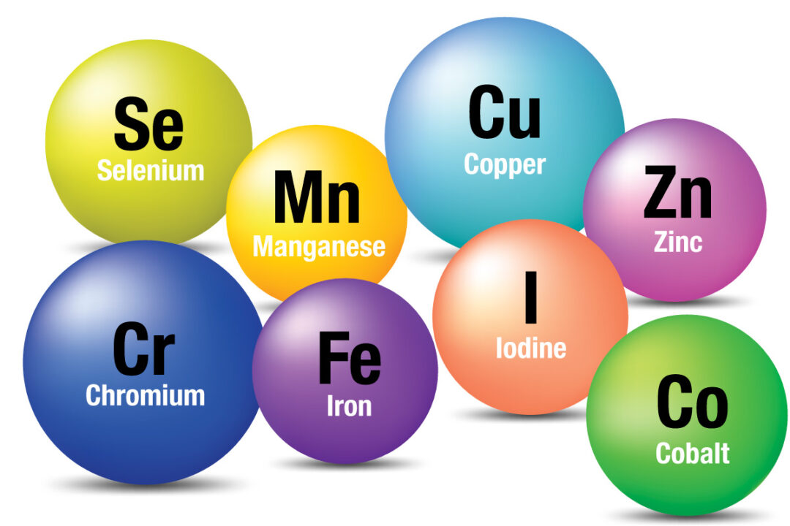
Elemental analysis
geology
environment
materials science
forensics
archeology
nanotechnology

Slide 3
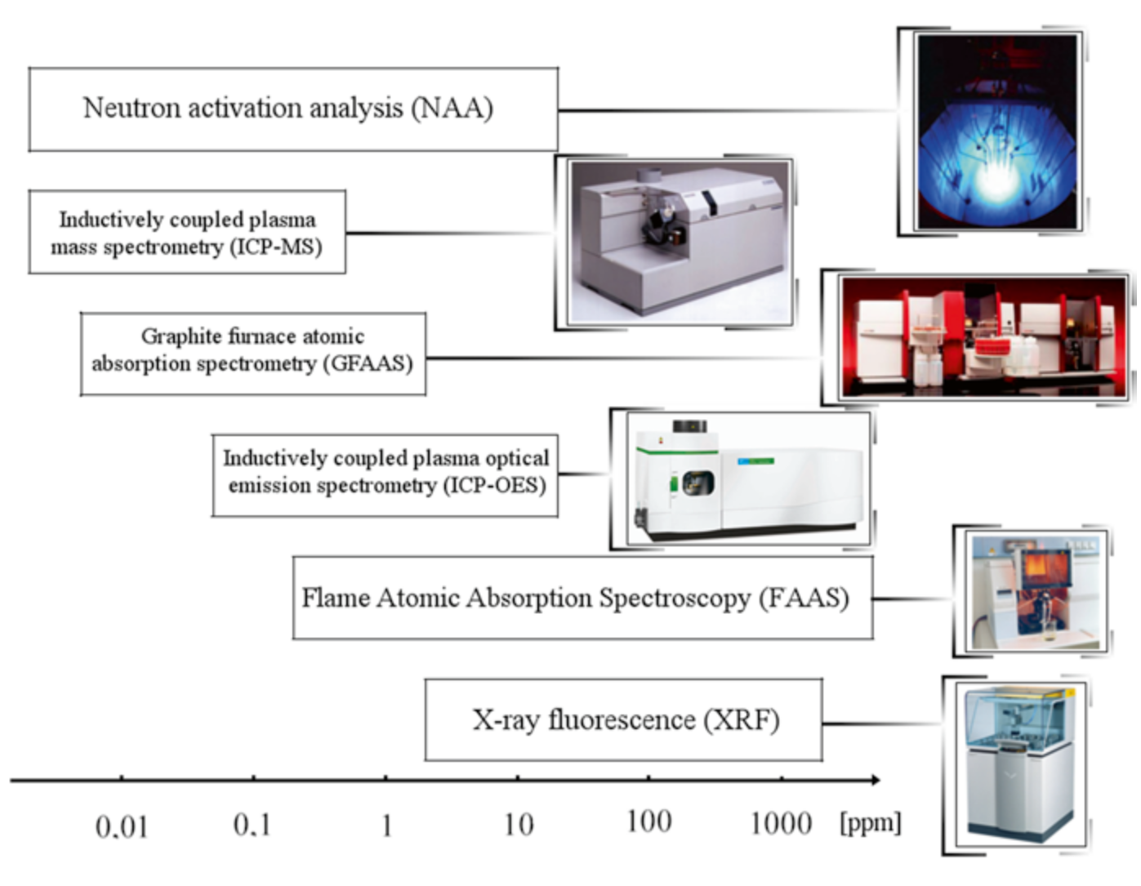
Analytical techniques applied for element analysis

Slide 4
Comparison of elemental analysis techniques
Method | Detectable elements | Sensitivity*
ICP-OES/MS/SFMS | Li to U | ppm to ppt
NAA | H to U | ppm to ppt
AAS | Mainly metallic elements, up to 70 elements | ppm
CHNOS | C, H, N, O, S | 0.05–0.1 wt%
XRF | Be to U | 10 ppm–1 at%
SEM-EDX | All except H, He, and Li | 0.1–1 at%
ERDA | H to U | 0.1–0.5 at.%
RBS | Be to U | 0.1 at%
https://measurlabs.com/blog/elemental-analysis-applications-and-method-comparison/

Slide 5
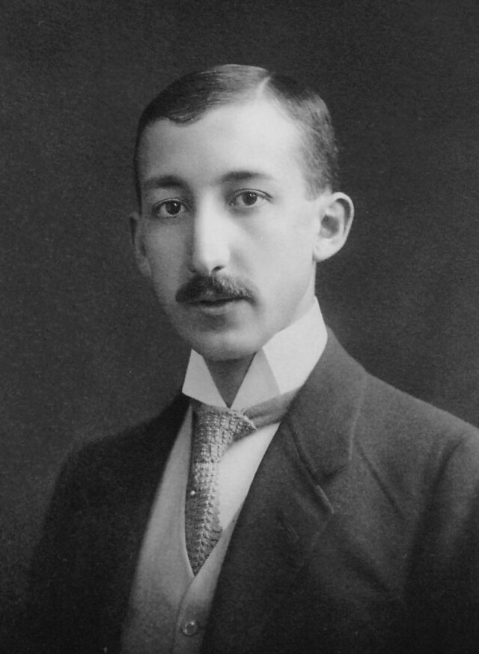
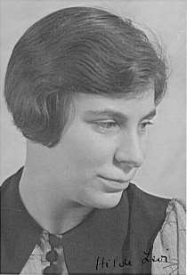
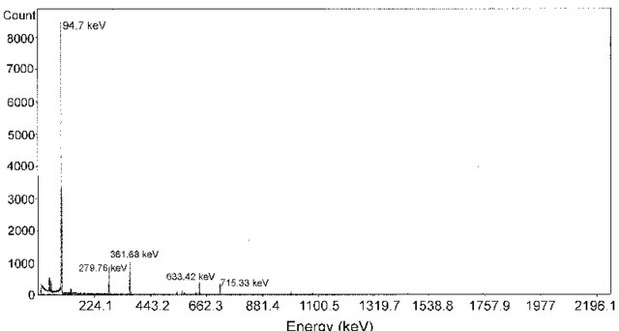
Neutron activation analysis
Neutron activation analysis was first developed by G. Hevesy and H. Levi in 1936. They used a neutron source (226Ra + Be) and a radiation detector (ionization chamber) and promptly recognized that the element Dy (dysprosium) in the sample became highly radioactive after exposure to the neutron source.
⁴He+⁹Be→¹²C+¹n
Gamma spectrum of dysprosium-165
George de Hevesy
Hilde Levi
G. Hevesy, Hilde Levi, The Action of Neutrons on the Rare Earth Elements, Det. Kgl. Danske Videnskabernes Selskab, Mathematisk-fysiske Meddelelser XIV, 5 (1936) 3–34

Slide 6
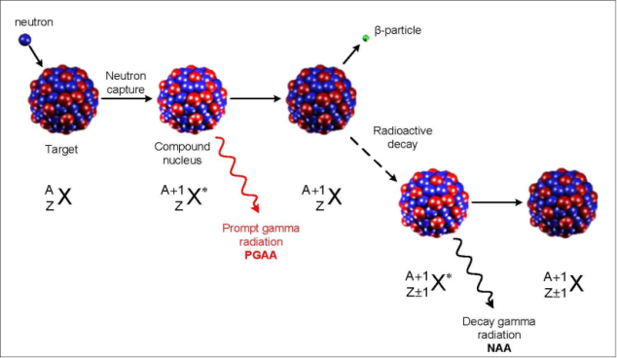
Diagram illustrating the process of neutron capture by a target nucleus followed by the emission of gamma rays
The most common reaction occurring in NAA is the (n,γ) reaction, but also reactions such as (n,p), (n,α), (n,n′) and (n,2n) are important.

Slide 7
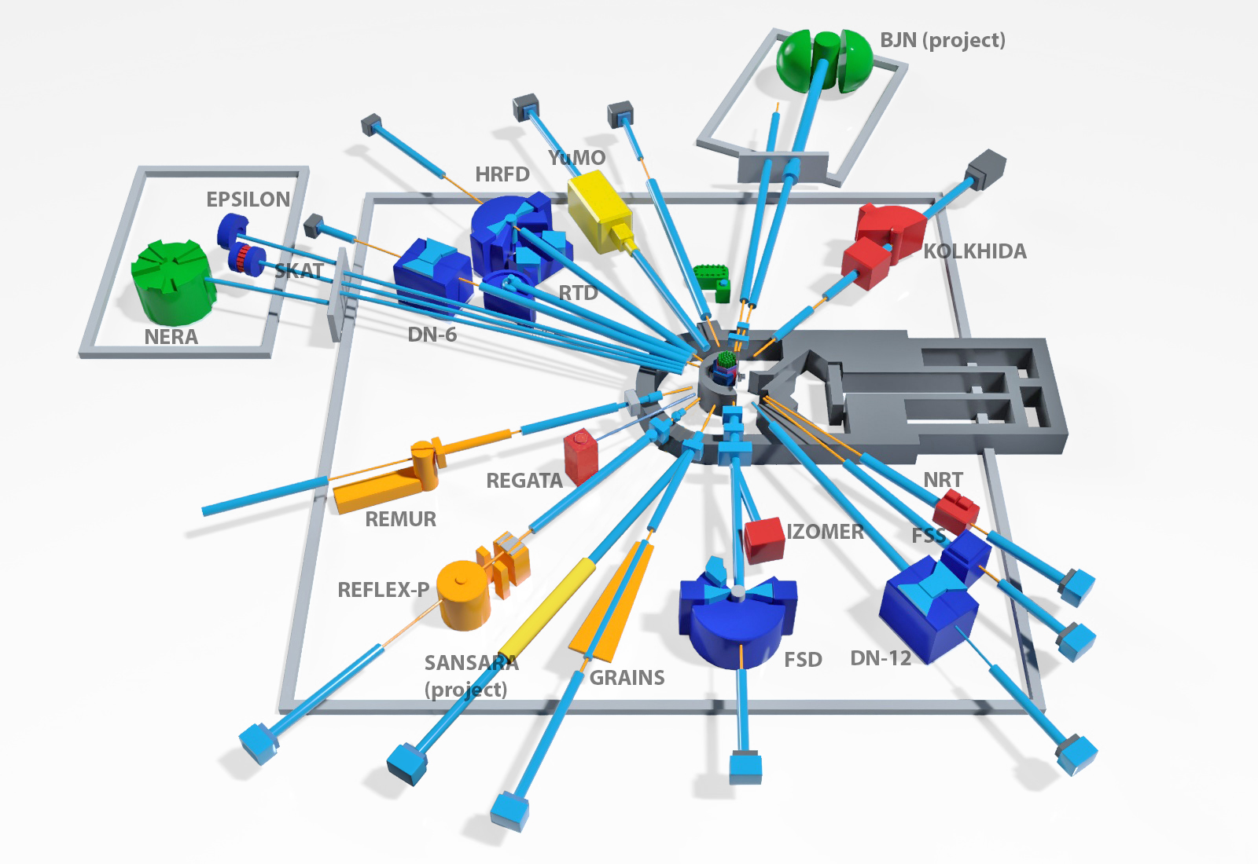
Reactor and Radioanalytical complex REGATA

Slide 8
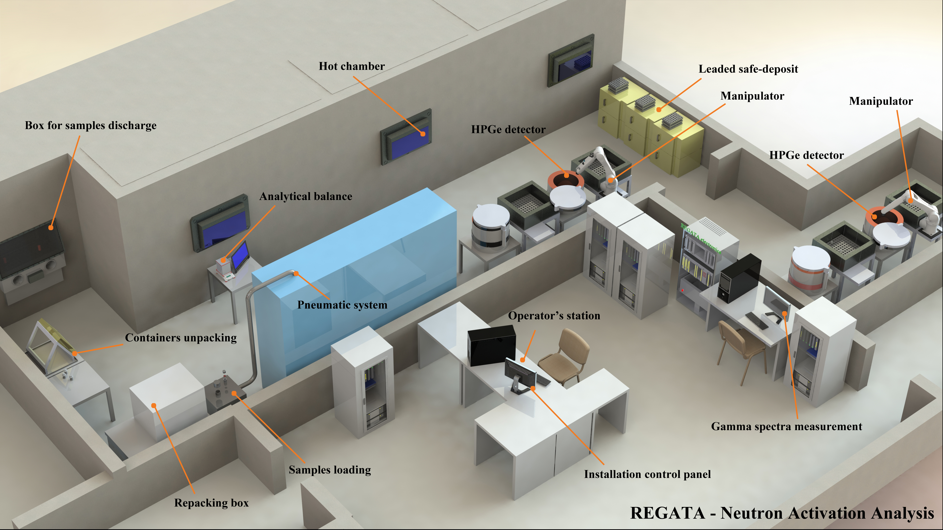
Reactor and Radioanalytical complex REGATA
2 channels for irradiations, one with Cd shield.
Thermal neutrons flux: ~ 10¹² n/cm^{2.}s
Resonance neutrons flux: ~ 10¹¹ n/cm^{2.}s

Slide 9
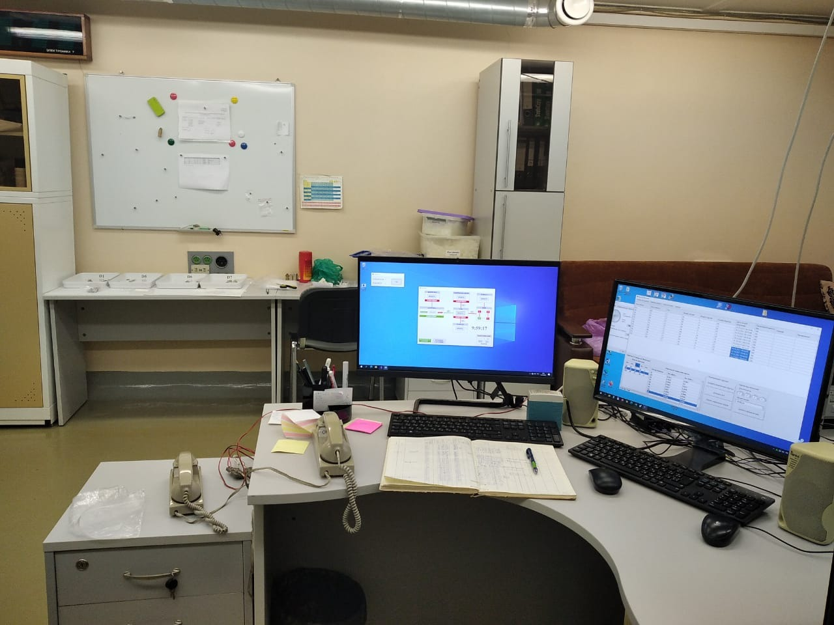
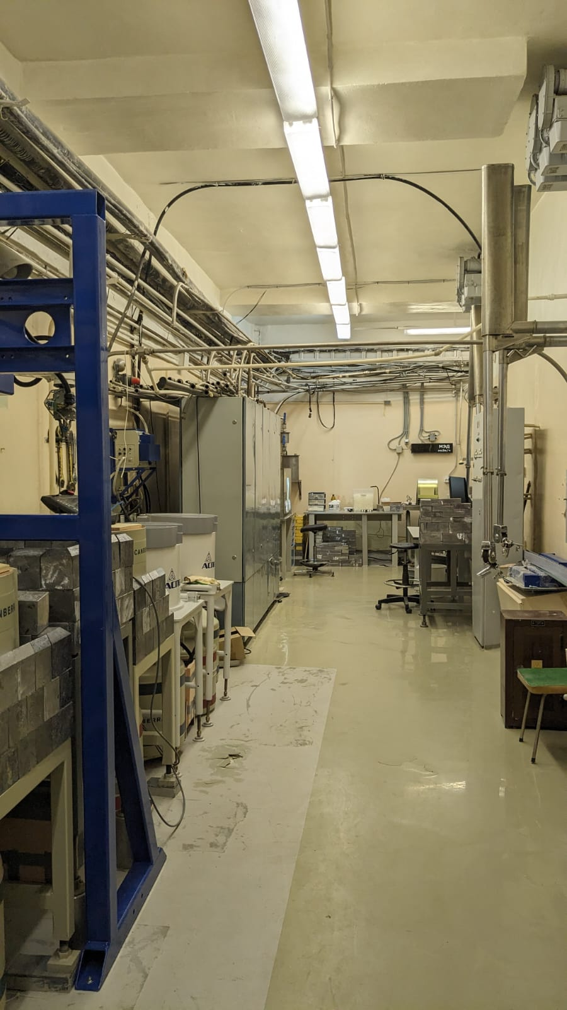
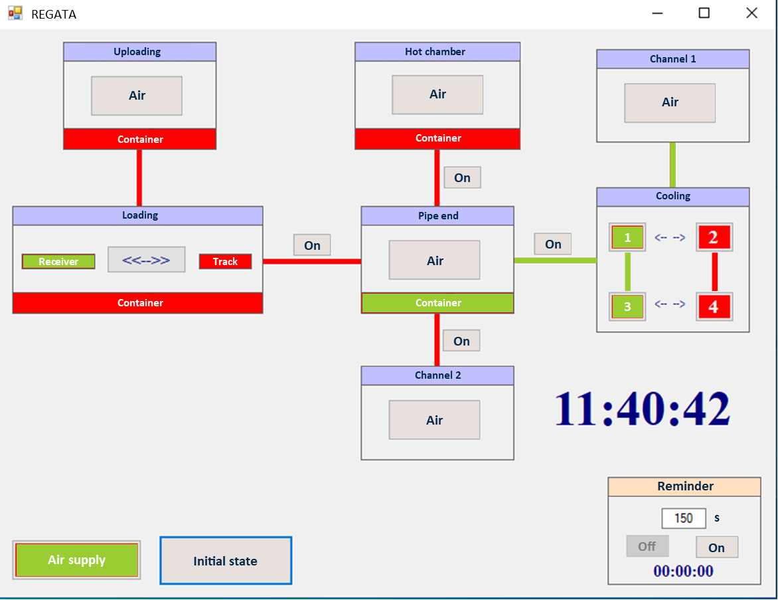
Regata Control program interface

Slide 10
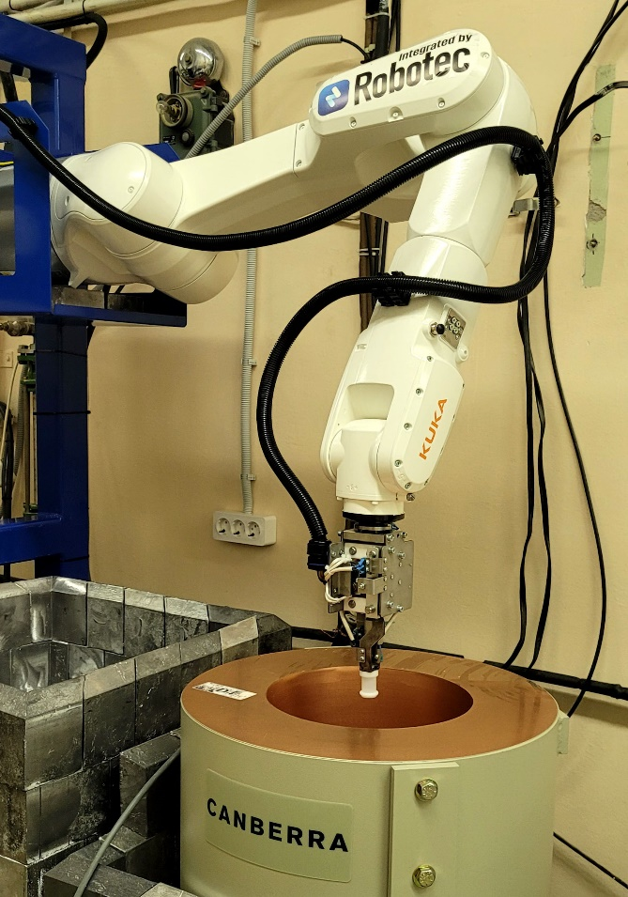
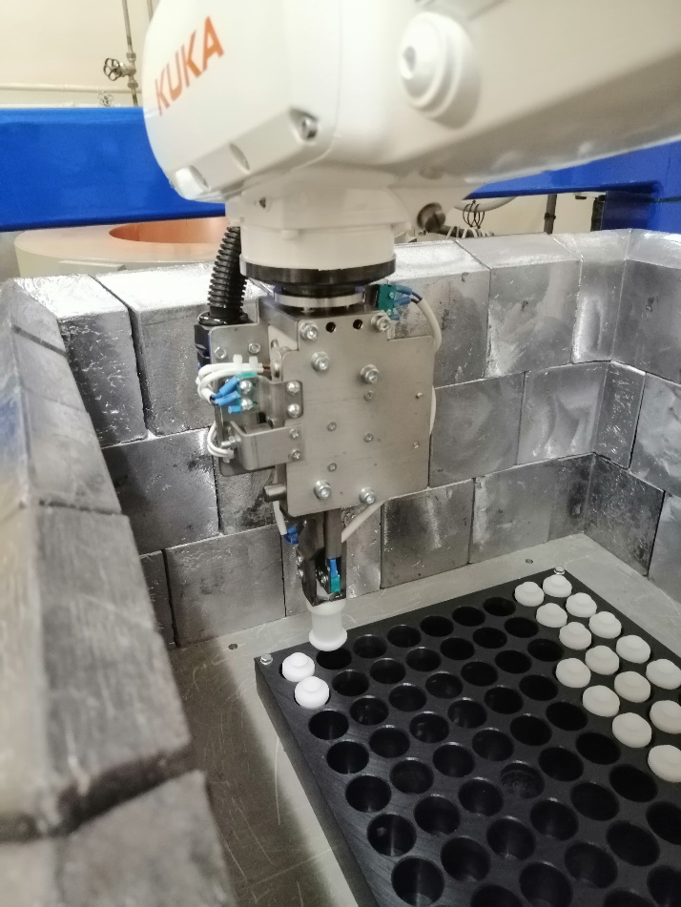
Left photo: KUKA KR 10 R1100 manipulator mounted on a stand. Right photo: Manipulator gripper and cassette holder with containers

Slide 11
Procedures of samples irradiation
Short irradiation
Long irradiation
Mg, Al, Si, Cl, I, Ti, V, Cu, Mn, Ca, S and Dy
Na, K, Sc, Cr, Fe, Co, Ni, Zn, Ga, As, Se, Mo, In, Sn, Br, Rb, Sr, Zr, Sb, Cs, Ba, Ag, Cs, La, Ce, Sm, Tb, Hf, Ta, Nd, Nb, Y, Yb, W, Re, Ir, Hg, Au, Th and U
Irradiation channel: Ch 2 (full neutron spectrum)
Weight of samples: 0.05-0.5 gram
Irradiation time: 1- 30 min
Irradiation channel: Ch 1 (Cd- screen, epithermal and fast neutrons)
Weight of samples: 0.05-0.5 gram
Irradiation time: 3- 5 days
Cooling -3.5 days/ Repacking
First measurement- 30 min, directly after repacking
Cooling time – 20 days after the end of irradiation/ Second measurement – 2.0 hours

Slide 12
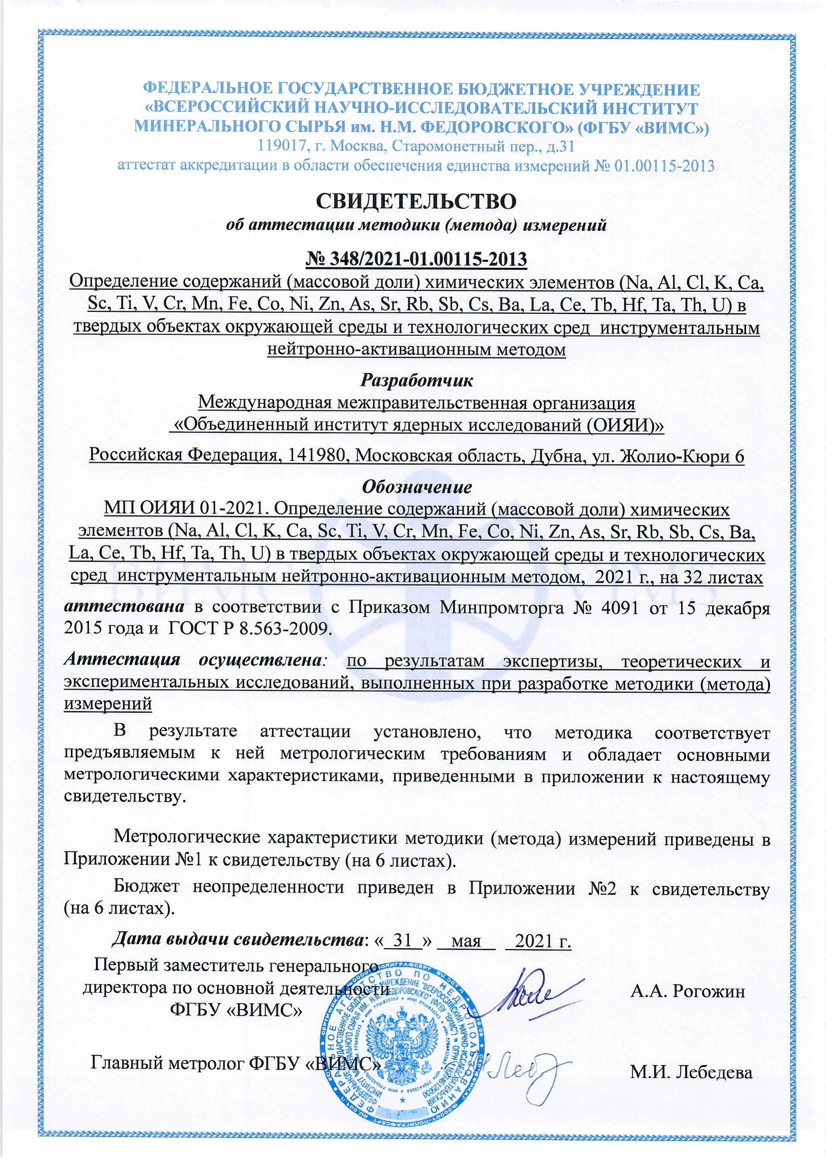
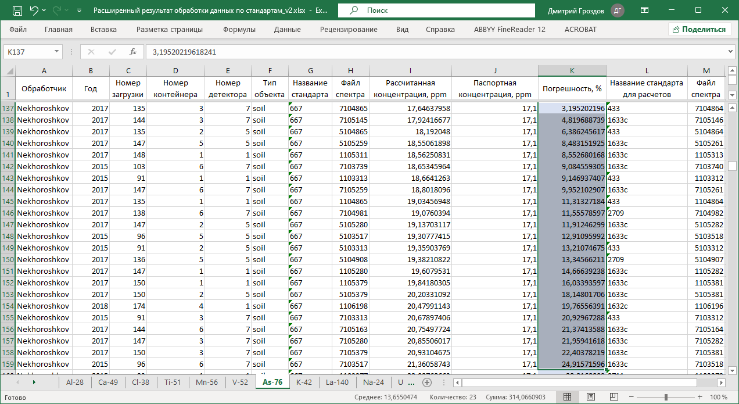
Certification of the methodology of INAA
.
Показатель | Диапазон измерений, млн⁻¹ (мг/кг) | Показатель внутрилабораторной прецизионности в относительных единицах σ_{Rл}, %
Na | 100-1000 | 26,0
 | 1000-40000 | 11,5
 | 40000-500000 | 3,86
Al | 1000-500000 | 19,3
Cl | 1000-5000 | 11,2
K | 1000-3000 | 20,5
 | 3000-30000 | 14
 | 30000-100000 | 8,08
Ca | 1000-15000 | 18,8
 | 15000-35000 | 11,4
 | 35000-400000 | 10,1
Sc | 1,0-50 | 11,4
Ti | 100-1000 | 17,9
 | 1000-10000 | 15,3
 | 10000-20000 | 6,78
V | 10,0-50 | 17,3
 | 50-500 | 13,6
Cr | 10-100 | 27,2
 | 100-500 | 15,6

Slide 13
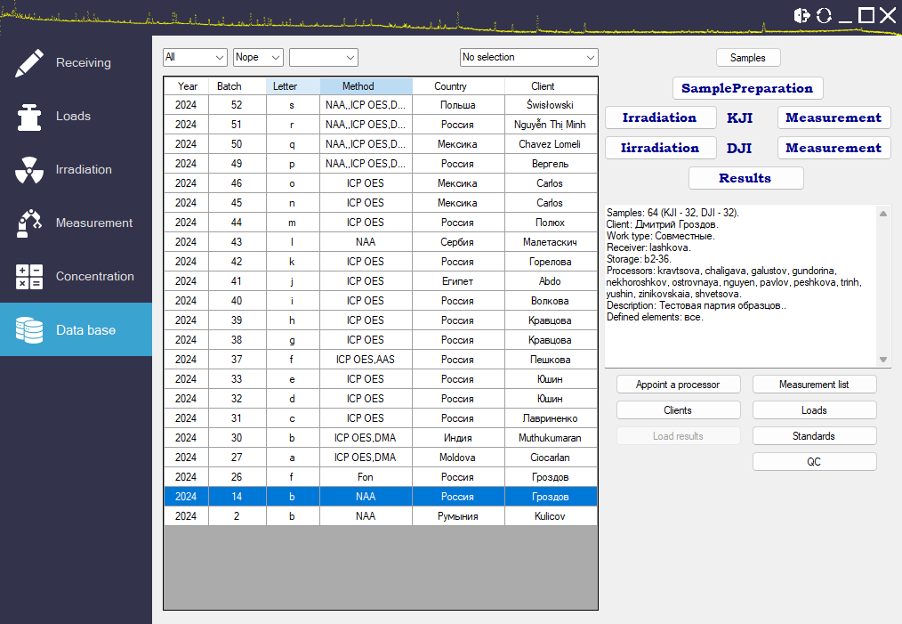
Software of the SNAAPI

Slide 14

  Scientific directions

Slide 15
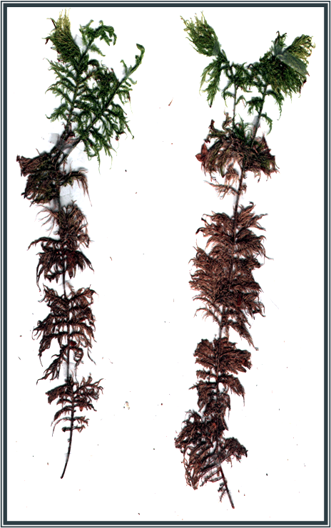

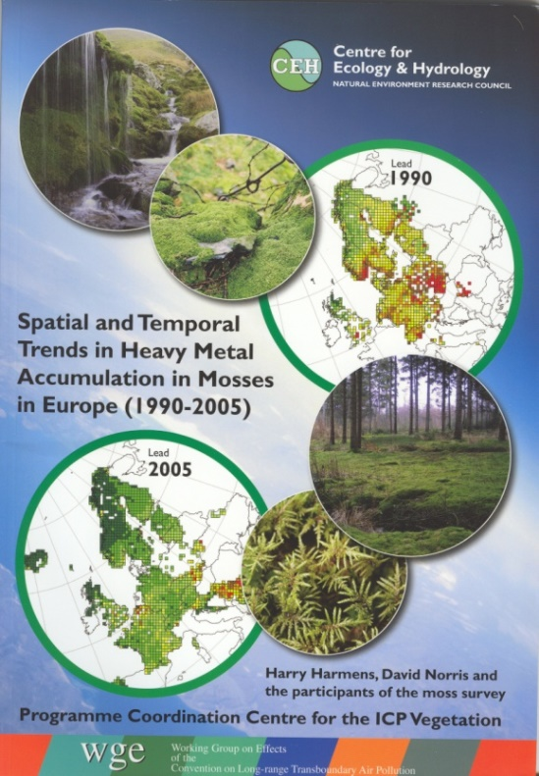
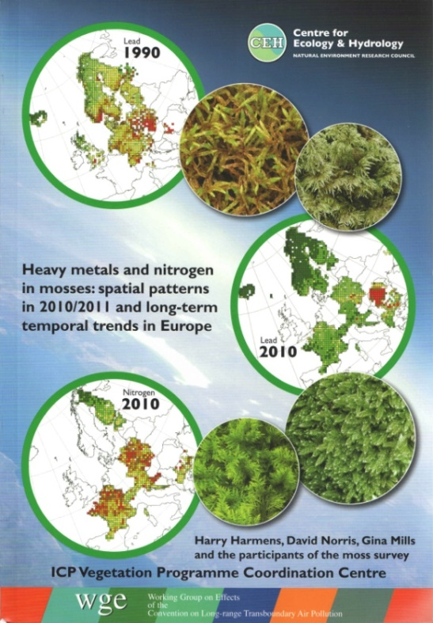
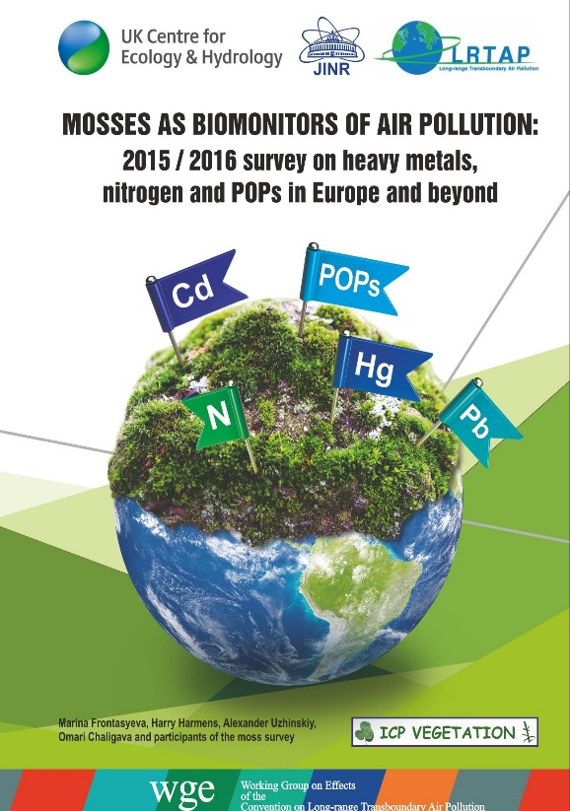
Passive biomonitoring
UNECE
CONVENTION ON
LONG-RANGE TRANSBOUNDARY
AIR
United Nations Economic Commission for Europe
International Cooperative Programme on Effects of Air Pollution on Natural Vegetation and Crops
Working Group on Effects - 1981

Slide 16
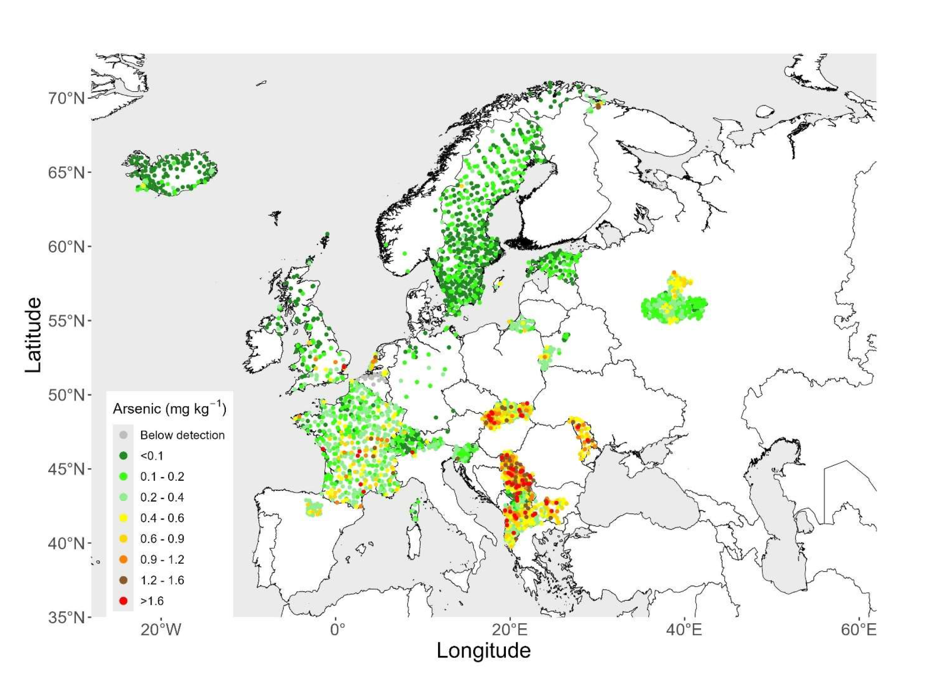
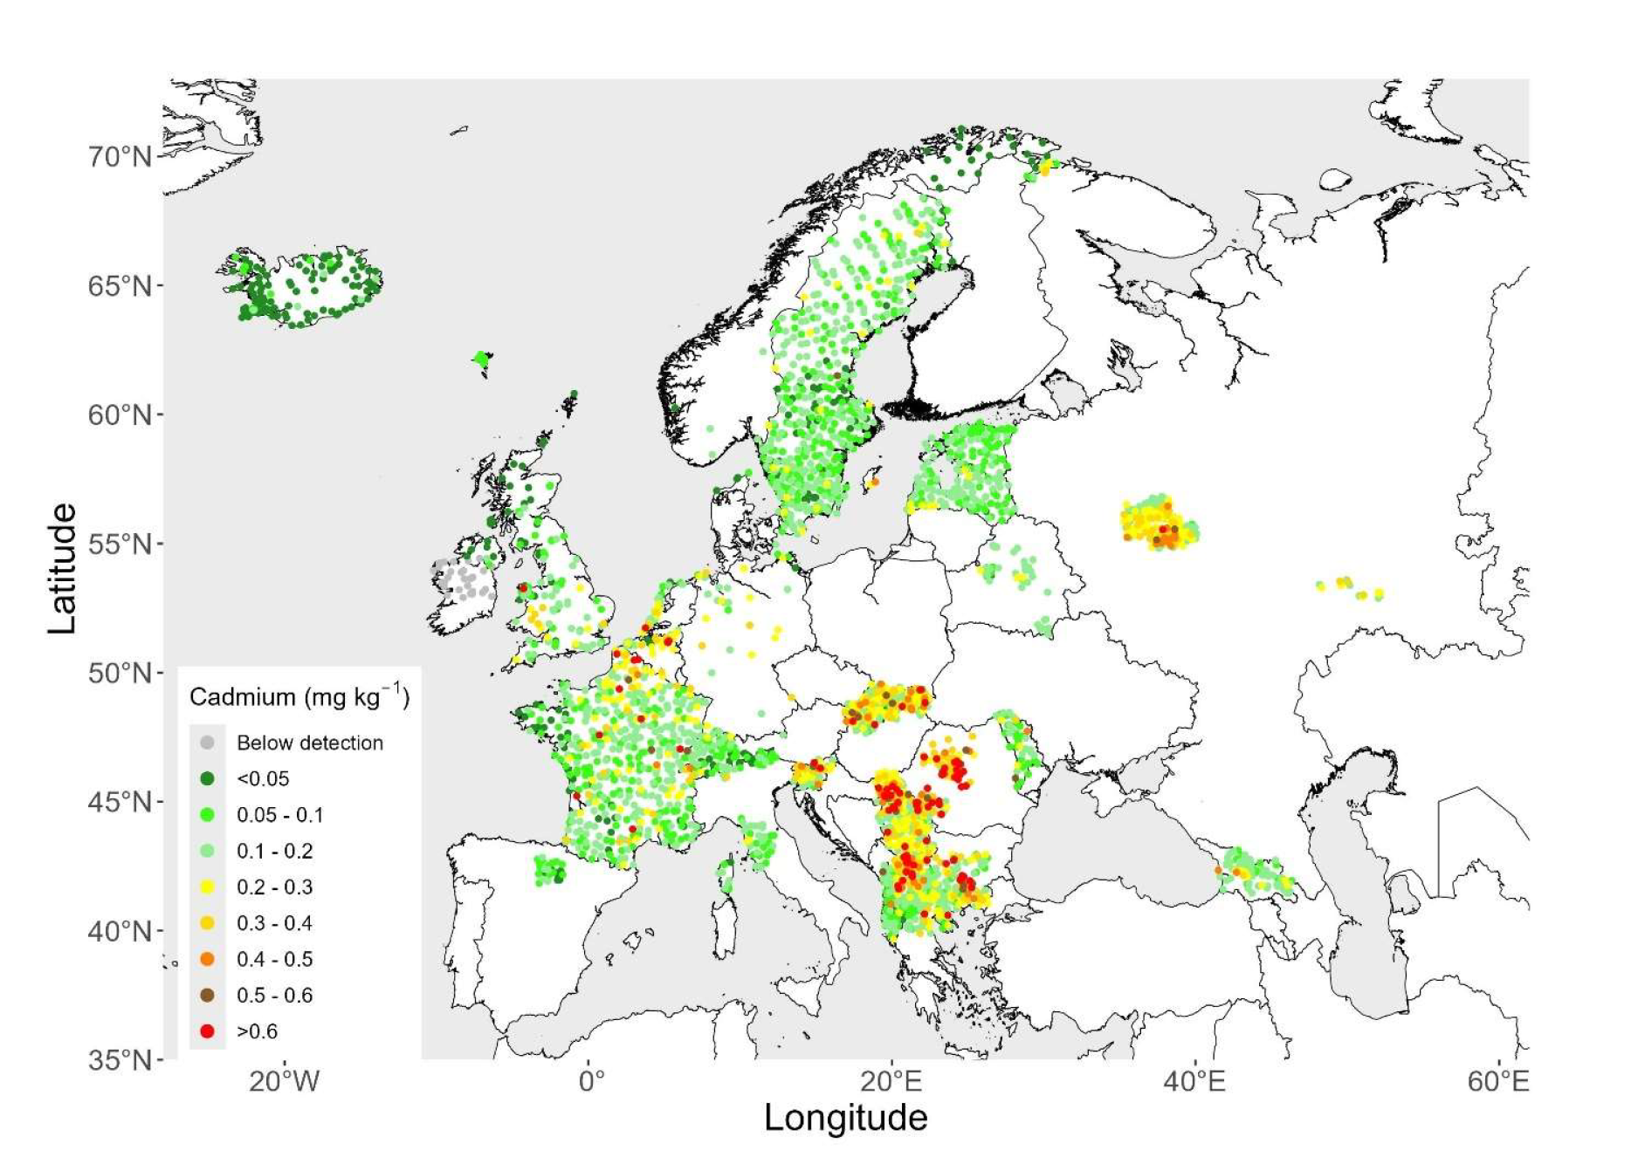
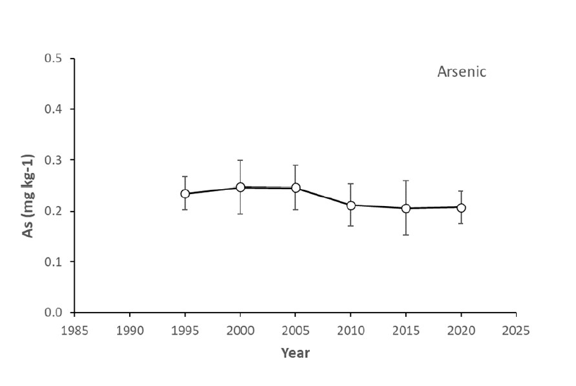
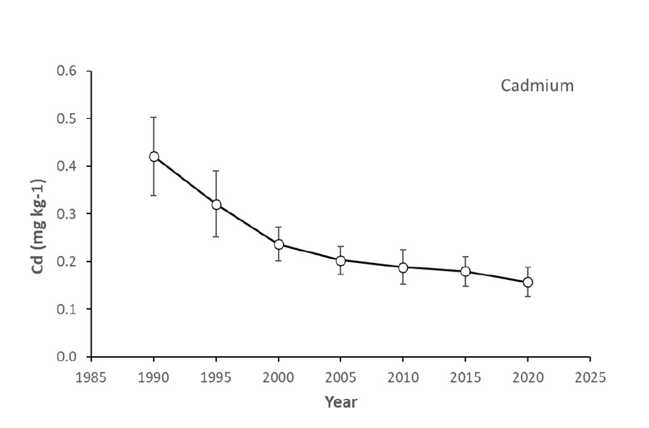
As
Cd
2020/2022
3300 sampling sites
10.9%
61.5%

Slide 17
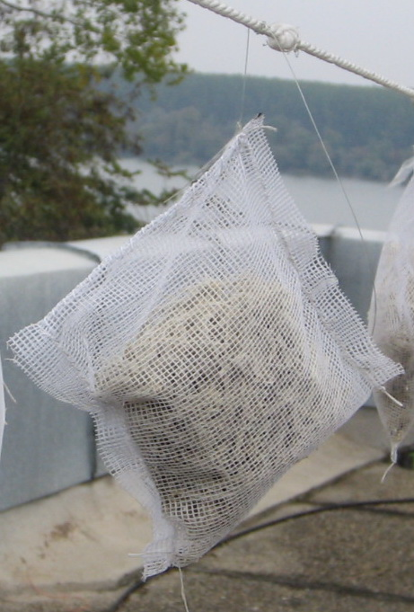
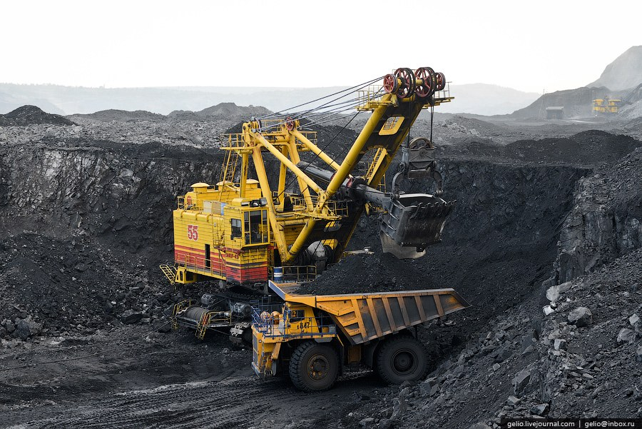
Active biomonitoring
Map of samples exposure in Kemerovo region
Content of the elements in exposed moss samples compared to control

Slide 18
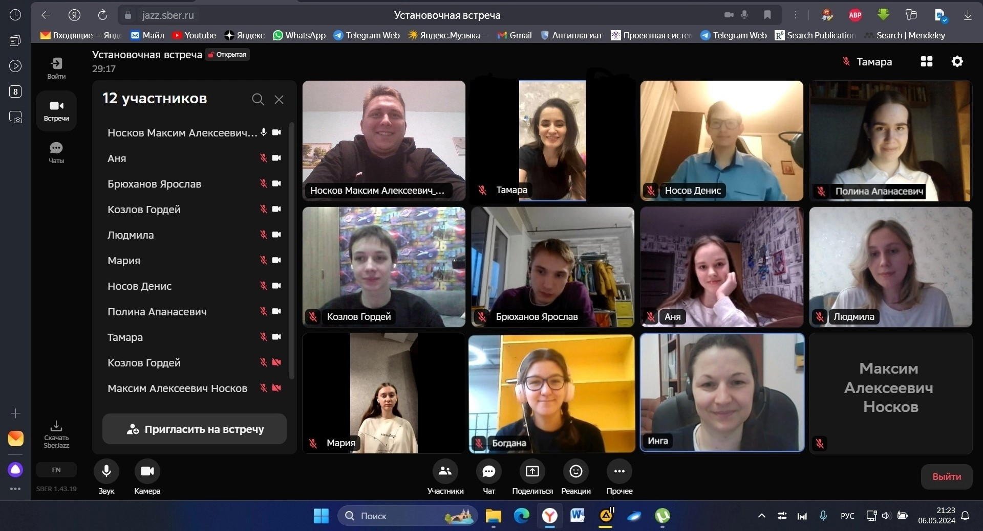
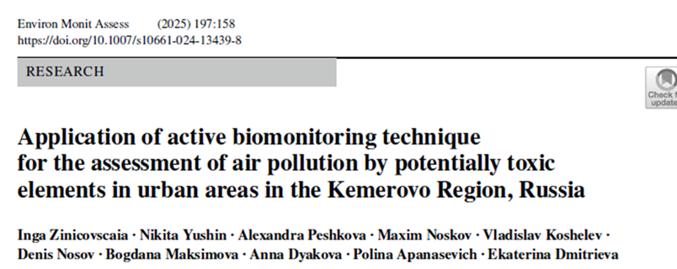

Slide 19
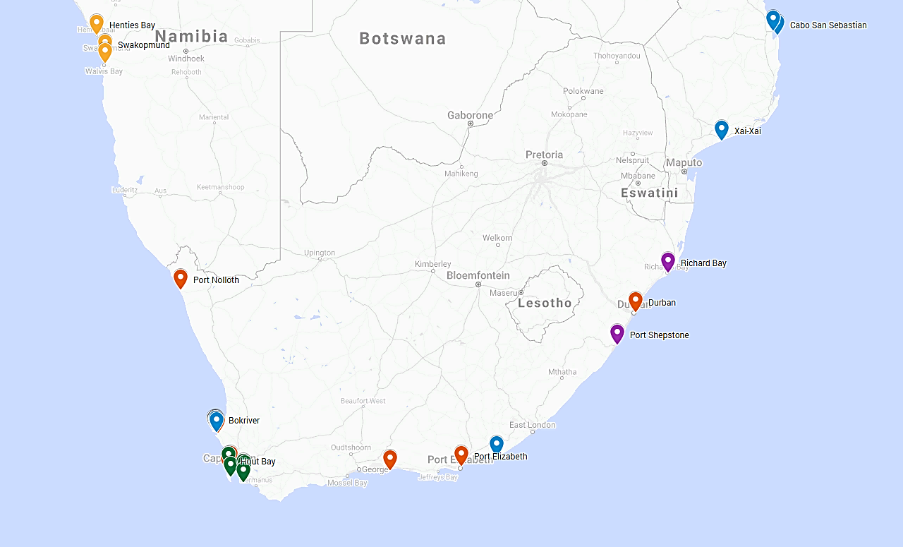
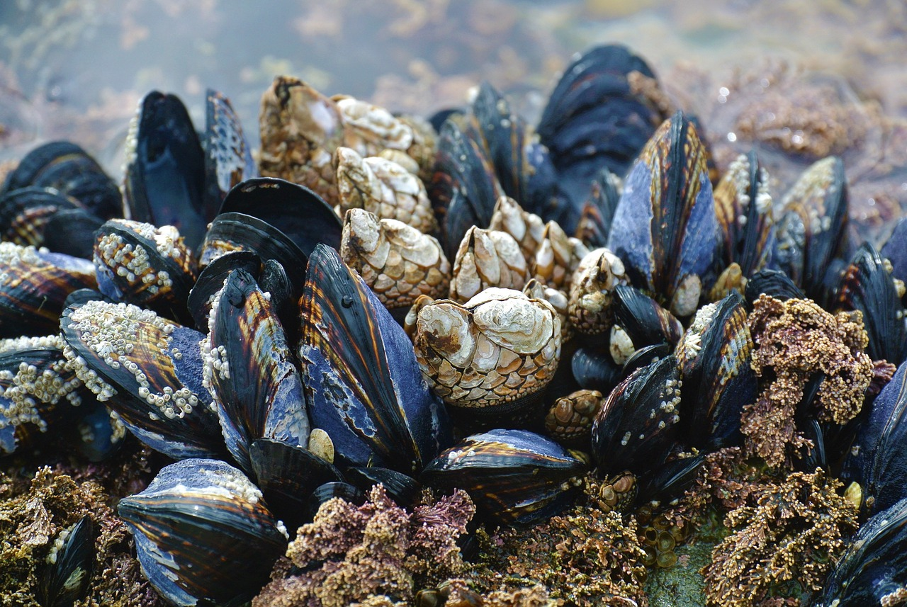
Assessment of water pollution
Namibia
Mozambique
25 stations along South Africa
KwaZulu-Natal
Saldanha Bay
Cape Town
Eastern Cape

Slide 20
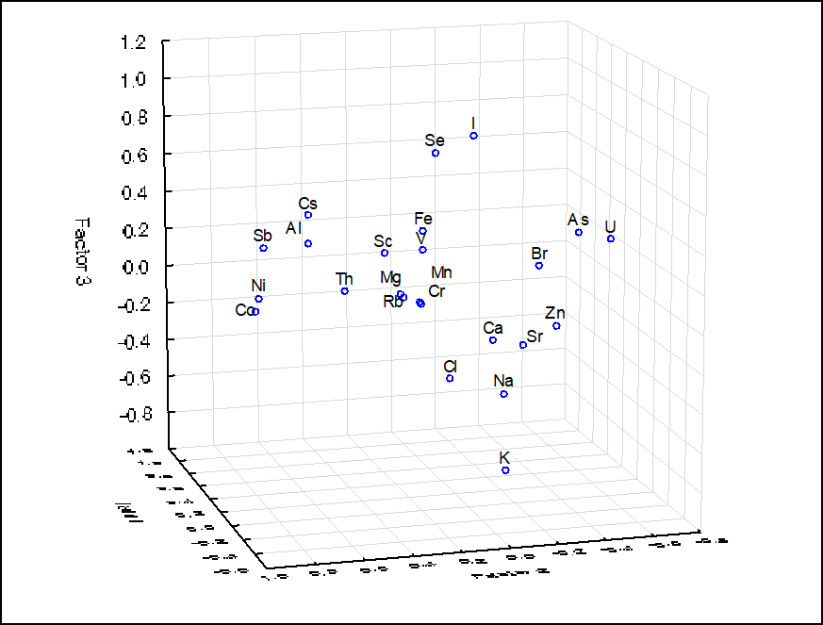
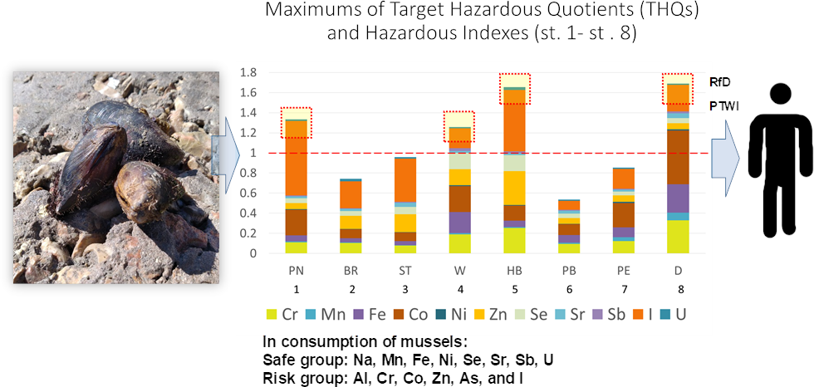
Al, Sc, V, Cr, Mn, Fe, Co, Th -terrigenous
Na, Mg, K, Cl, As, Br, I - water salinity
Co, Ni, Sb, U - anthropogenic
Ca, Sr - deposition into shell and its construction
Na, Mg, Ca, As, Br, Sr, Cs - terrigenous (resuspension of bottom sediments)
East Polluted stations (harbors at eastern coast of South Africa)
Hazard indices (THQ
and HI)

Slide 21
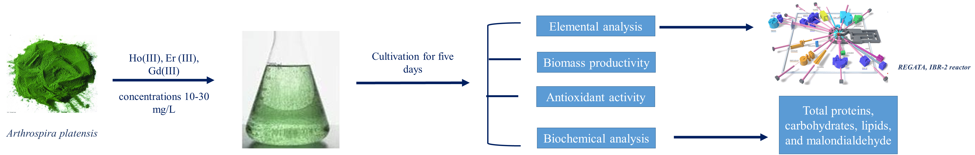
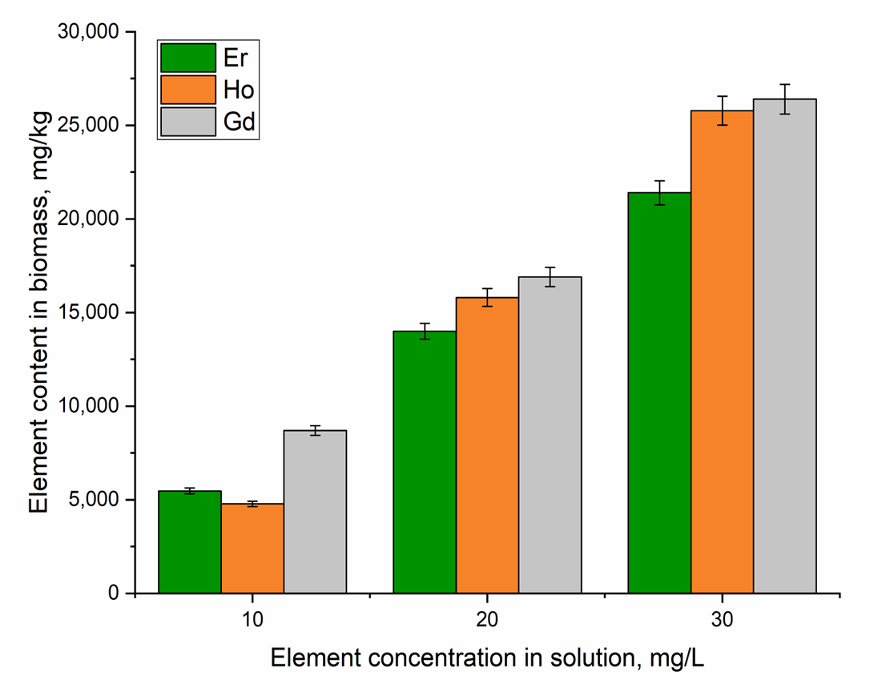
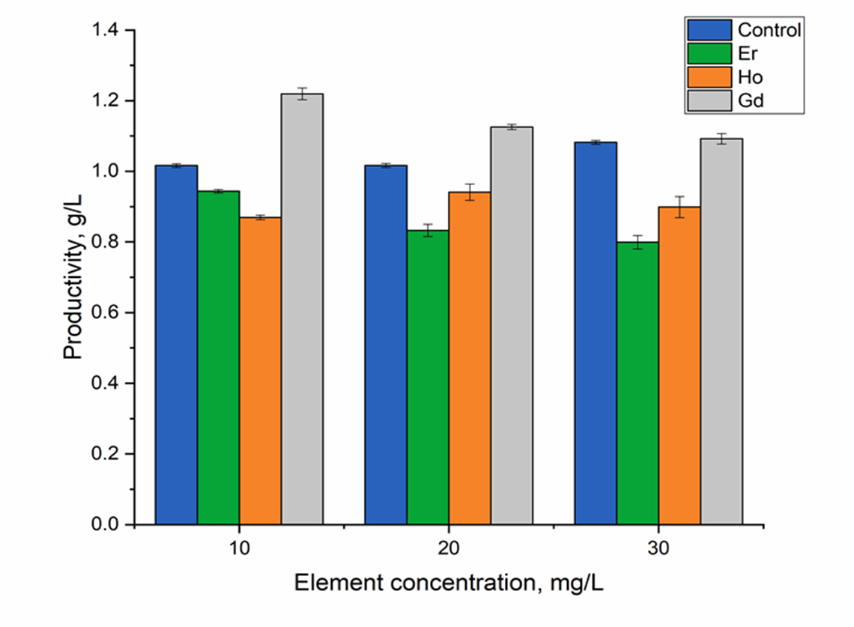
Wastewater treatment
Uptake of Er, Ho, and Gd by spirulina biomass cultivated in a medium supplemented with REEs.
Effects of rare earth elements on spirulina productivity

Slide 22
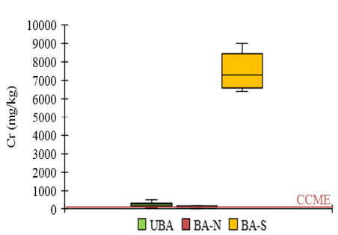
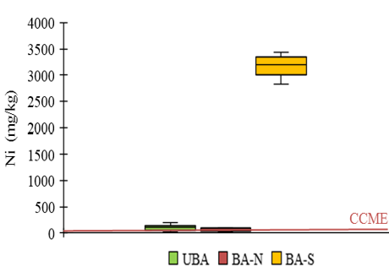
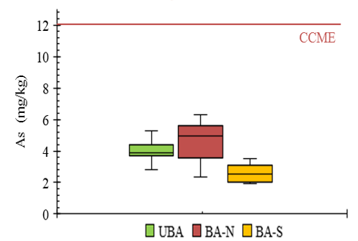
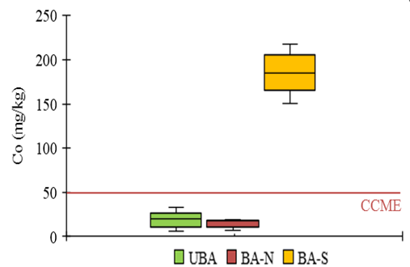
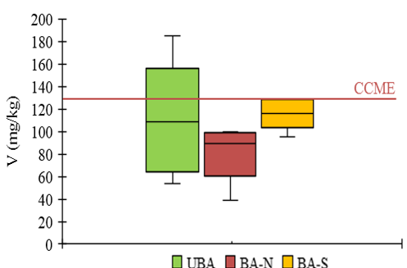
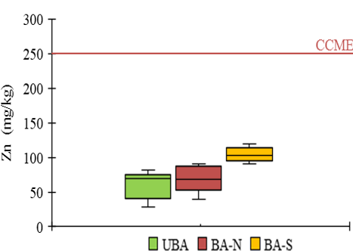
  Assessment of soil pollution
Location of the Kumluca wildfire (a), soil sampling from the study area according to different fire severity levels and aspects (b)
Element concentrations in unburned and
burned soils

Slide 23
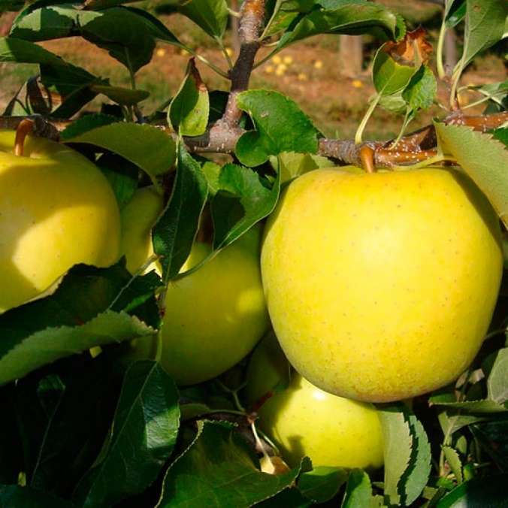
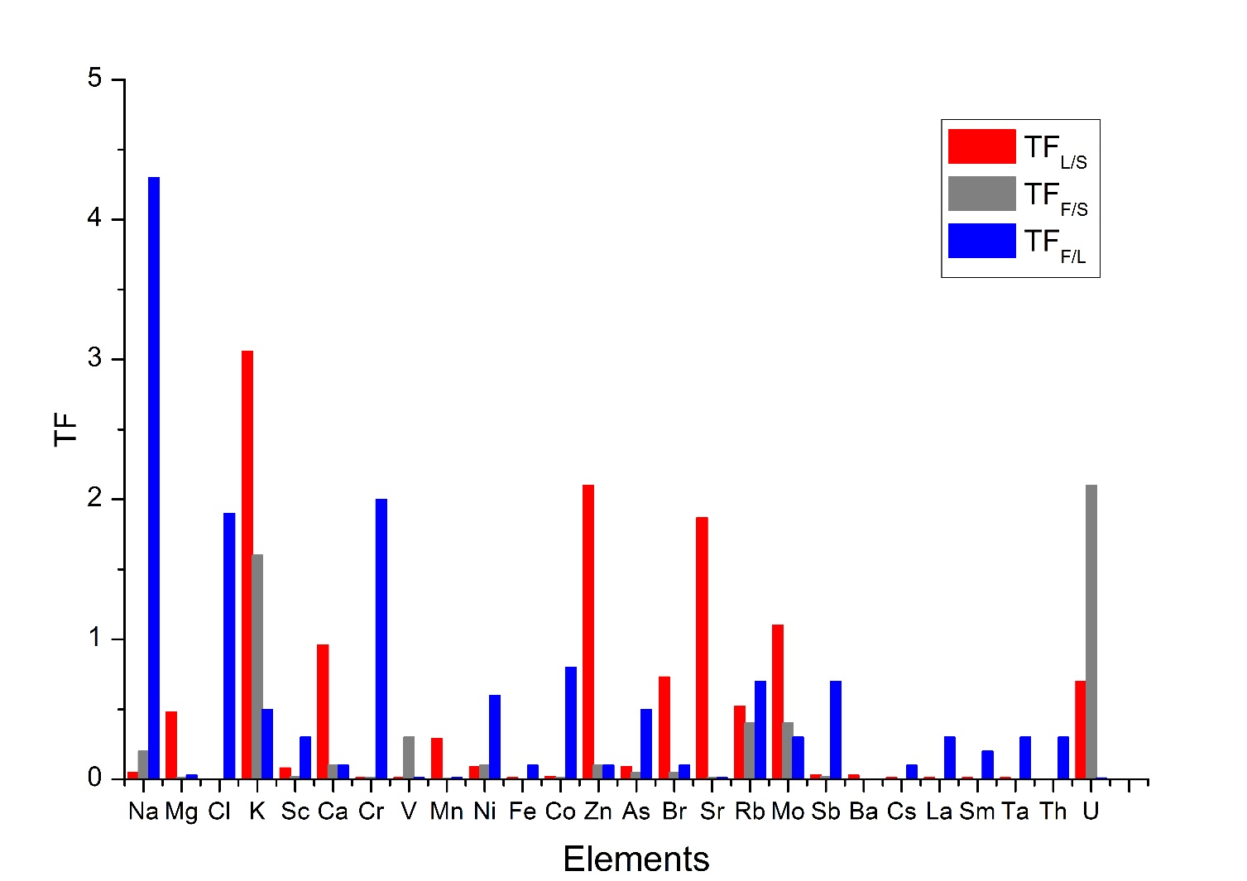
  Control of quality and safety of foodstuffs
Apples
Transfer factors in system soil-leaf-apple
Leaves-soil: K (TF_{L/S}=3.1), Zn (TF_{L/S}=2.1), Sr (TF_{L/S} =1.9), and Mo (TF_{L/S} =1.1) and Ca (TF_{L/S}=0.96).
Fruits-soil: K (TF_{F/S}= 1.6) and U (TF_{F/S} = 2.1).
Fruits- leaves: TF> 1.0 was obtained for Na, Cl, and Cr.
Estimated daily intake of metal (DIM) and potential health hazards (HQ) from fruit
 | Apple |  |  | Plum |  |  | Grape
Element | C mg/kg f.w. | DIM, mg/day | HQ, mg/kg/day | C mg/kg f.w. | DIM, mg/day | HQ, mg/kg/day | C mg/kg f.w. | DIM, mg/day | HQ, mg/kg/day | R_{f}D, mg/day
Cr | 3.9 | 1.2 | 0.01 | 0 | 0 | 0 | 0.48 | 0.1 | 0.004 | 105
Co | 0.5 | 0.1 | 0.05 | 0.7 | 0.2 | 0.07 | 0.6 | 0.2 | 0.06 | 3
Fe | 78 | 23 | 0.4 | 151 | 45 | 0.75 | 8.8 | 2.6 | 0.04 | 10-60
Mn | 8.1 | 2.4 | 0.5 | 2.2 | 0.6 | 0.1 | 1.7 | 0.5 | 0.1 | 0.5-5.0
Ni | 6.7 | 2.0 | 1.4 | 1.4 | 0.4 | 0.3 | 1.8 | 0.2 | 0.2 | 1.4
V | 0.6 | 0.2 | 0.1 | 0 | 0 | 0 | 1.3 | 0.4 | 0.3 | 1.8
Zn | 33 | 9.9 | 0.7 | 25 | 7.5 | 0.5 | 6.4 | 1.9 | 0.1 | 15

Slide 24
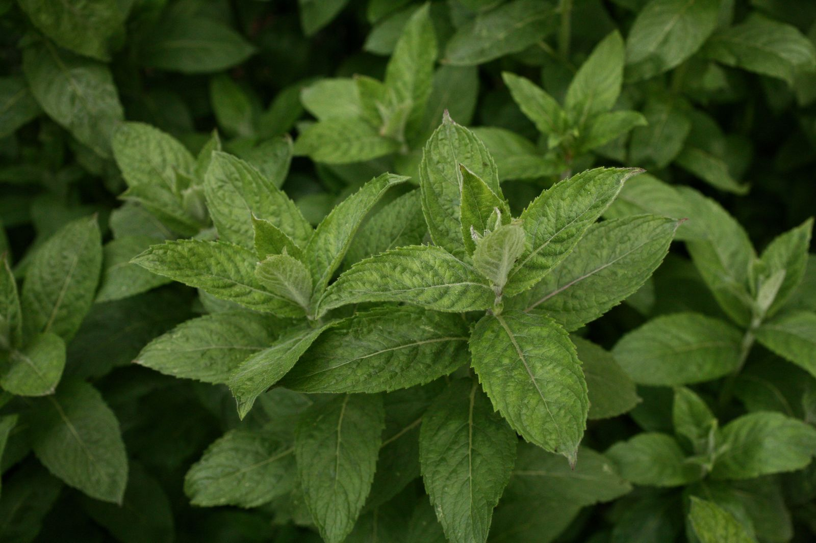
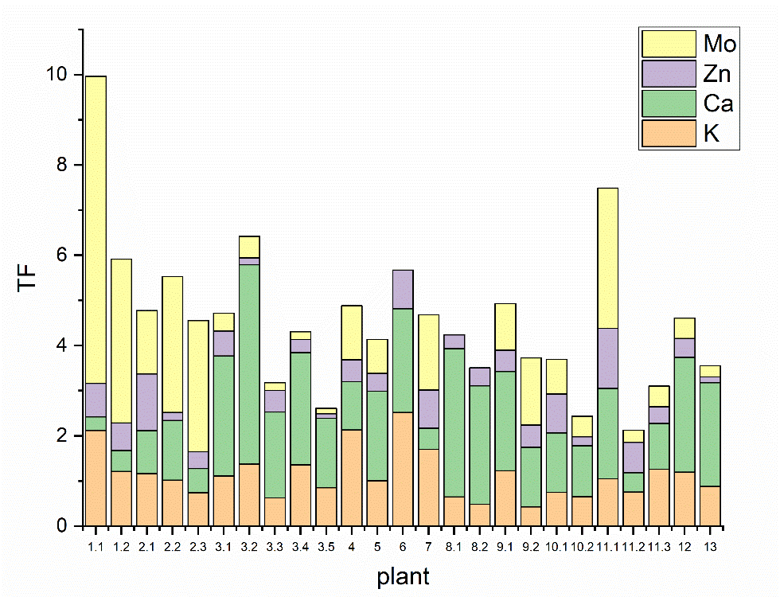
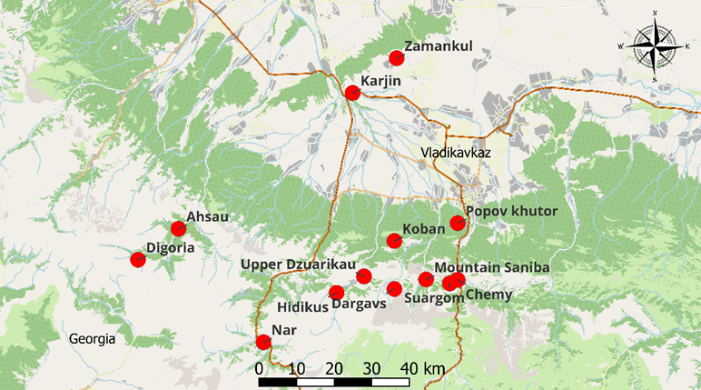
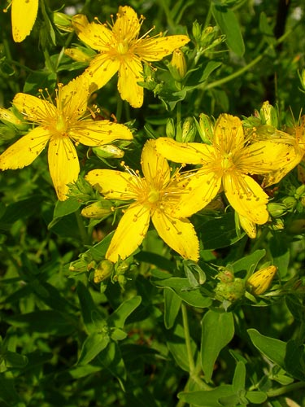
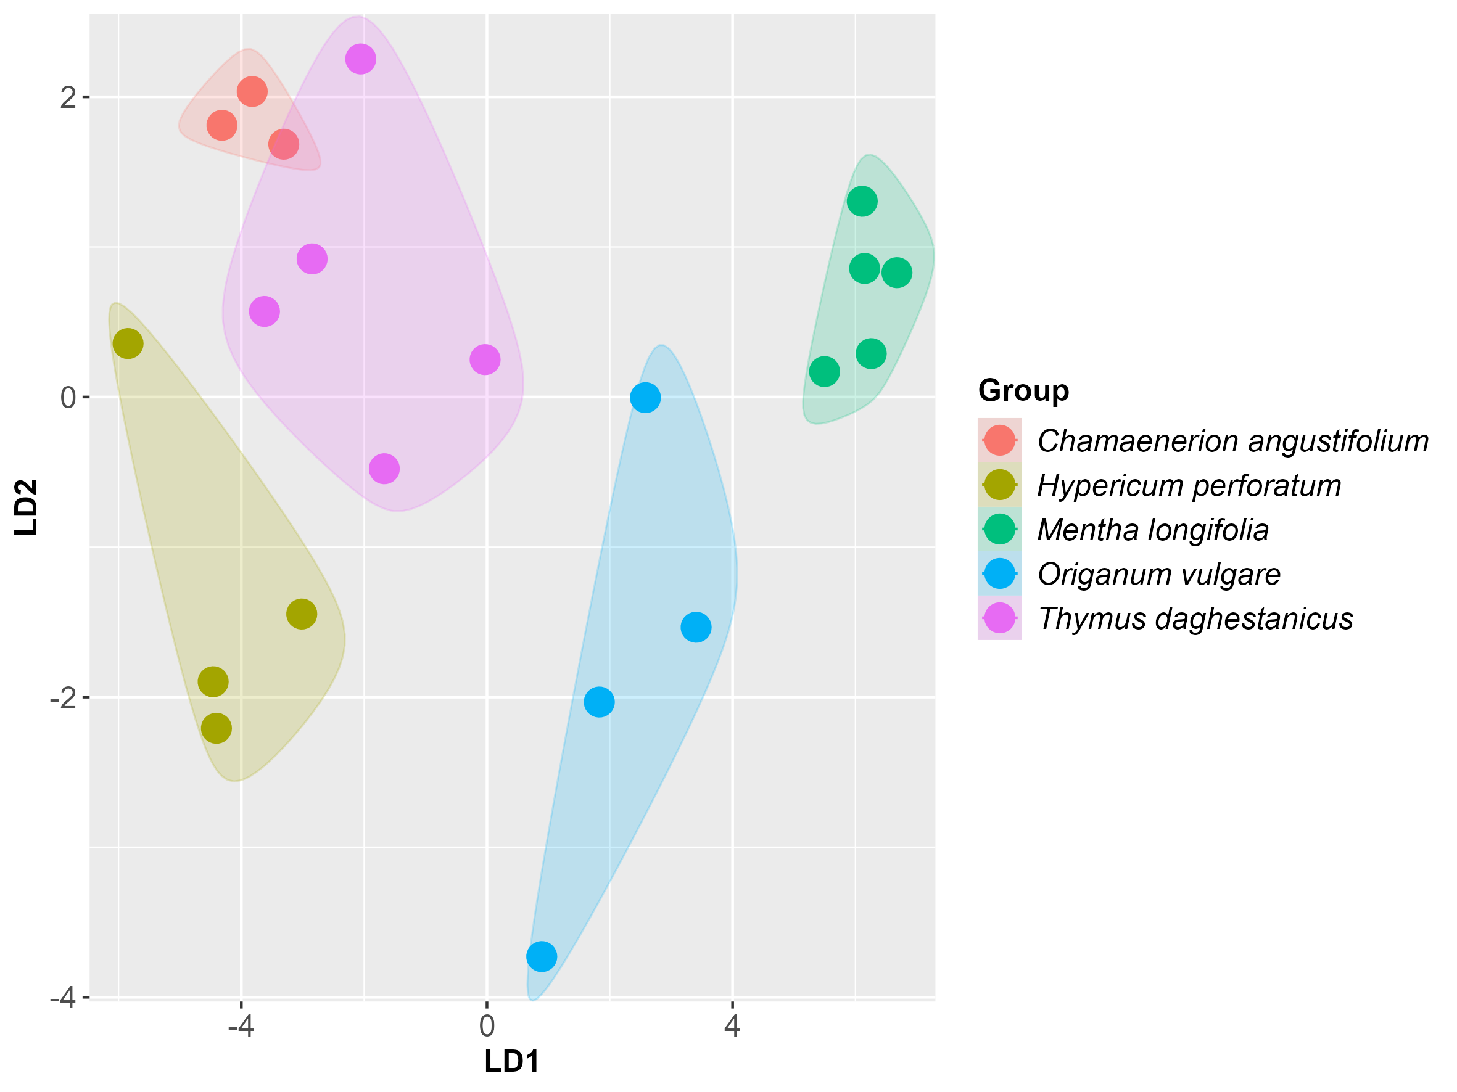
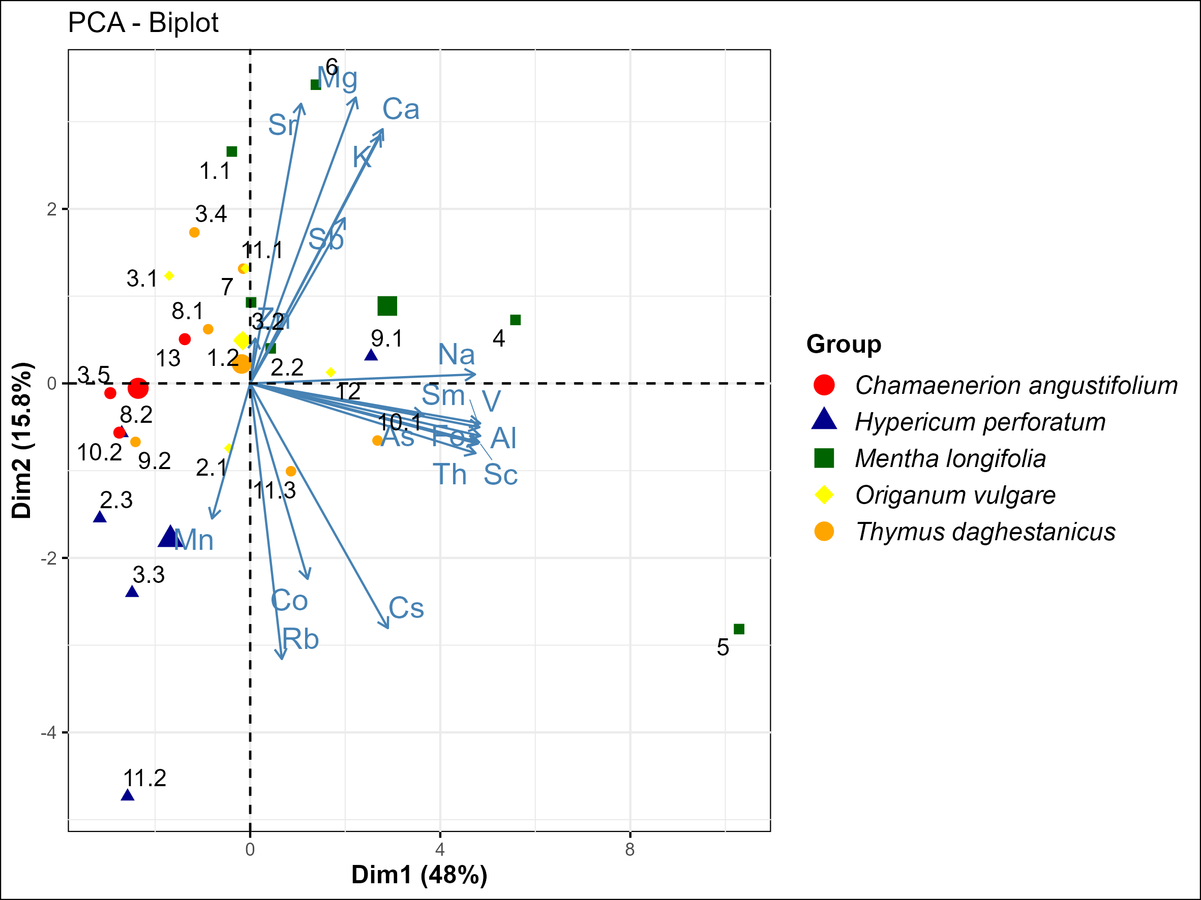
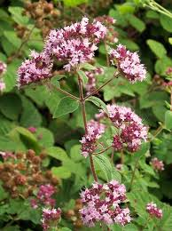
  Medicinal plants
Map of samples collection
TFs for K, Ca, Zn and Mo in medicinal plants
Discriminant Analysis
PCA scores plot for medicinal plants

Slide 25














  Nanotoxicology
1-100 mg/L
AuNPs
Medicinal plants
Animals
Accumulation of silver nanoparticles in mice and their offspring brain
Сereals
Microorganisms
The content of gold in soil samples under root irrigation condition (a) and foliar spraying with AuNPs (b)
Spirulina platensis exposed to 0.05 µM AgNPs

Slide 26

Cultural heritage
(a) St. Nicholas
(b) St. Basil the Great
(c) St. John Baptist
(d) Mater Dolorosa
(e) Christ entering
Jerusalem
The content of major elements and trace elements as determined by NAA in some fragments of Russian icons.
Icon | Elements, mg/kg
 | Na (%) | Mg (%) | Cl (%) | K (%) | Ca (%) | Fe (%) | Zn | As | Sr | Sb | Ba | Au
Christ entering Jerusalem: yellow foil | 0.04 | 0.12 | 0.6 | 0.2 | 42 | 0.2 | 65 | 1 | 1090 | --- | --- | 4
Christ entering Jerusalem: ocher fragment | 0.08 | --- | 0.8 | --- | 39 | 0.1 | 60 | 5 | 950 | 2 | 220 | 1
St. Basil the Great: wood fragment | 0.02 | --- | 0.1 | --- | 0.1 | --- | 10 | --- | 2 | --- |  | 27

Slide 27







Extraterrestrial materials
The content of major (a) and trace elements (b) in Chelyabinsk meteorite
Elemental composition of clean and contaminated fragments of the rolled cotton cloth determined by NAA, in µg/g

Slide 28



Slide 29
May 27
Vladimir Galustov. Dataset preparation software for training a neural network to determine the boundaries of full energy peaks in gamma spectra.
May 29
Marina Frontasyeva. Air pollution studies in Asia and the Pacific based on moss analysis by nuclear and related analytical techniques.
Alexandra Peshkova. Risks assessment of gold nanoparticles exposure for the soil-plant-consumer system.
Margarita Shvetsova. Assessment of the recreational zones in Moscow using neutron activation analysis and atomic absorption spectrometry.
Aleksandra Kravtsova. Copper and nickel accumulation and translocation in leafy vegetables irrigated with metal-containing effluents.
Vladimir Zaichick. Activation by neutrons and related analitical methods as a tool of medical elementology.
Octavian Duliu. INAA and XRD investigation of the Serbian sector of the Danube river and its tributary.

Slide 30
Thank you for attention!

