Slide 1
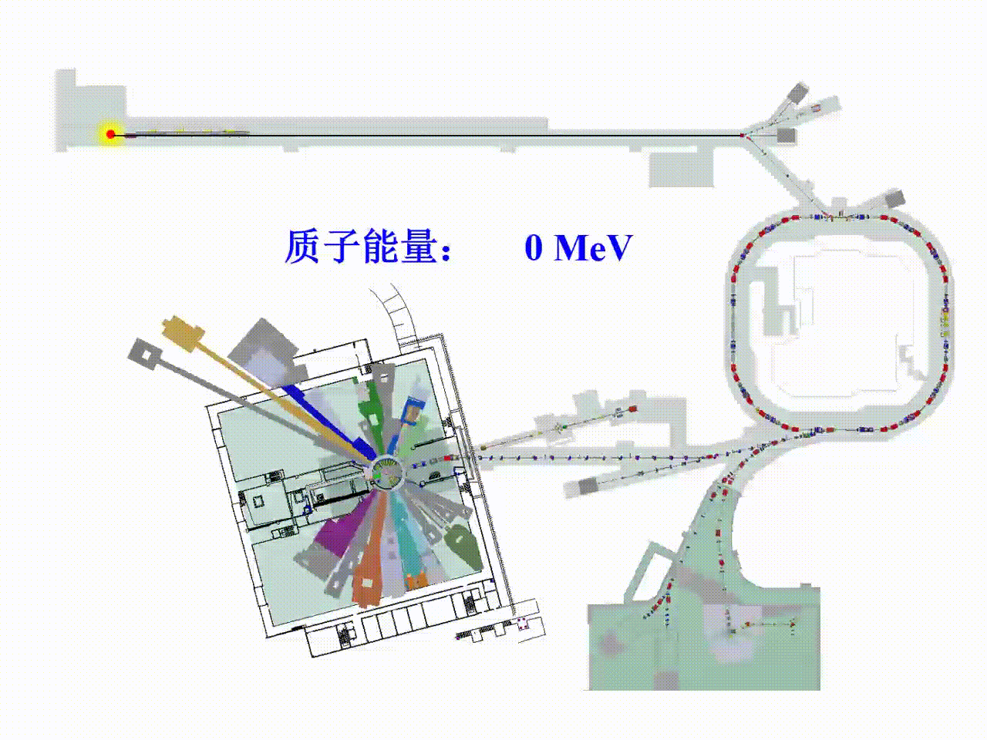
Experimental Study on Differential Cross Section of ¹⁴N($n, p$)¹⁴C Reaction
Qiuyue Luo, Wei Jiang, Kang Sun, et al.
China Spallation Neutron Source (CSNS)
2025-05-27
ISINN-31

Slide 2
Content
Motivation and Background
Experimental Setup
Data Analysis
Data Processing
R-Matrix Fitting
Preliminary Results
Conclusion

Slide 3
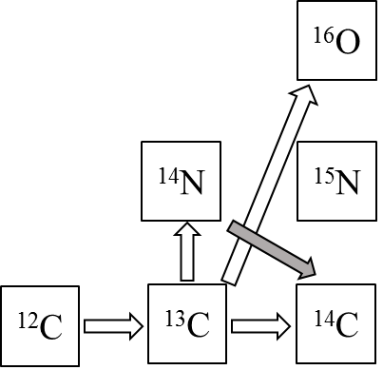
Motivation and Background
1、The ¹⁴N($n, p$)¹⁴C reaction is the most significant poison reaction in the $s$-process nucleosynthesis.
2、It is an important proton feeder for producing ¹⁹F.
¹⁴N(n, p)¹⁴C(α, γ)¹⁸O(p, α)¹⁵N(α, γ)¹⁹F
3、In boron neutron capture therapy (BNCT), it is crucial to determine the delivered neutron dose.
4、The angular distribution of the differential cross section is helpful for testing some nuclear models.
Notes:
¹³C(α, n)¹⁶O反应是s过程中子的主要来源之一，1）¹⁴N(n, p)¹⁴C反应在keV能区的截面相对其他反应道而言比较大，2）¹⁴N又是碳氮氧循环链中的主要产物之一，¹³C(p, γ)¹⁴N。因此，¹⁴N(n, p)¹⁴C反应是s过程主中子源的最主要的毒药反应（消耗中子）
19F对恒星内部物理条件敏感，作为探针研究恒星核合成的图像；19F在渐近巨星支（红巨星发展第二阶段，0.5-7太阳质量，最终白矮星或者行星状星云）中超丰度
10B(n, α)6Li，中子剂量
Angular distribution, relevant to the angular momentum and the parity

Slide 4
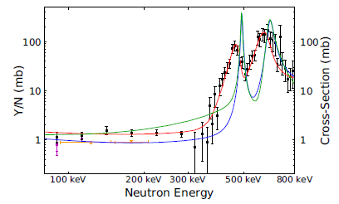
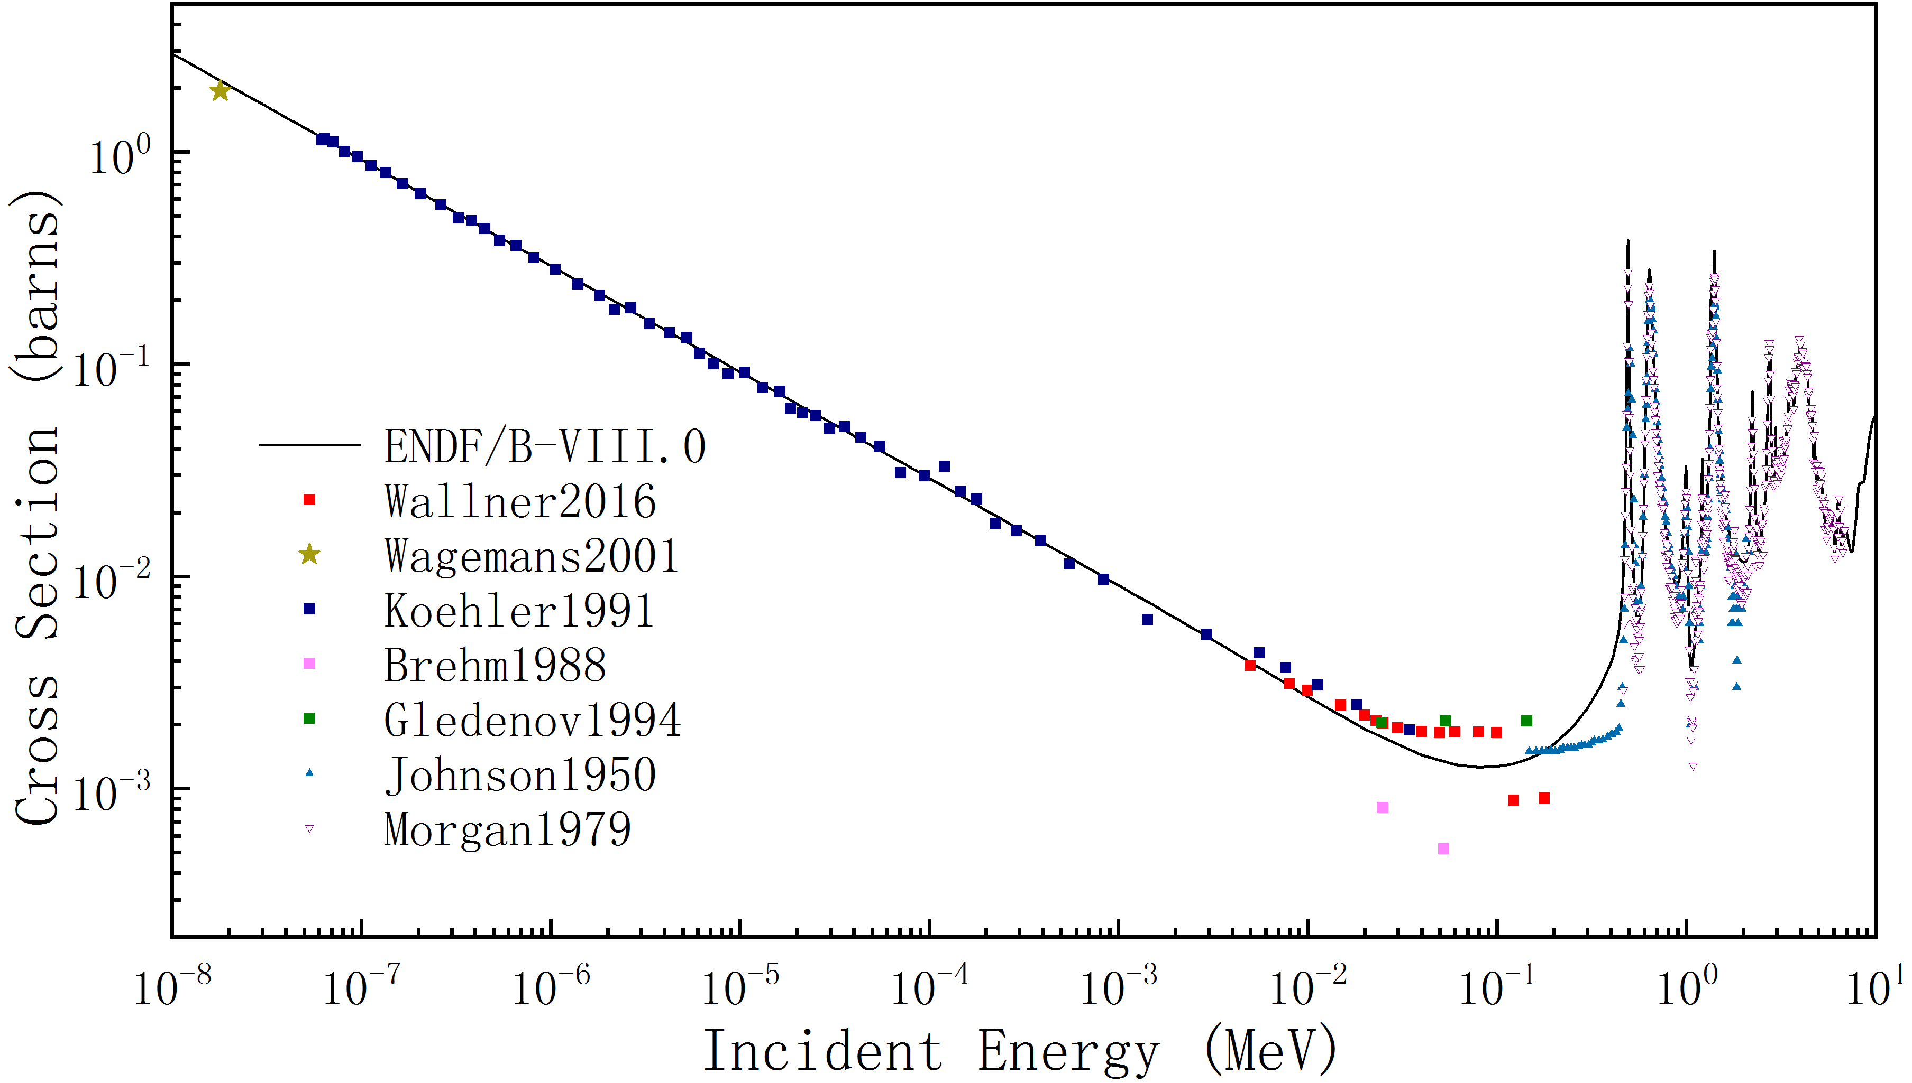
Motivation and Background
Wallner, et al (2016)：Suggesting that the cross section of the resonance at 493 keV should be ~3.3 lower than Morgan's (1979) experimental results.
n-TOF (2023)：The cross section at 493 keV is consistent with the ENDF/B-VIII.1 evaluations.
n-TOF (2023)：The low-energy tail(100-450 keV) of the resonance at ~490 keV is lower than the ENDF/B-VIII.1 evaluation, where there are disagreements among existing experimental results.
From 800keV to 2.5MeV, some resonances are present in the JENDL-5.0 but not in the ENDF/B-VIII.1.
There is a lack of differential cross section for the ¹⁴N(n, p)¹⁴C reaction in the entire energy range.
PHYSICAL REVIEW C 107, 064617 (2023)

Slide 5
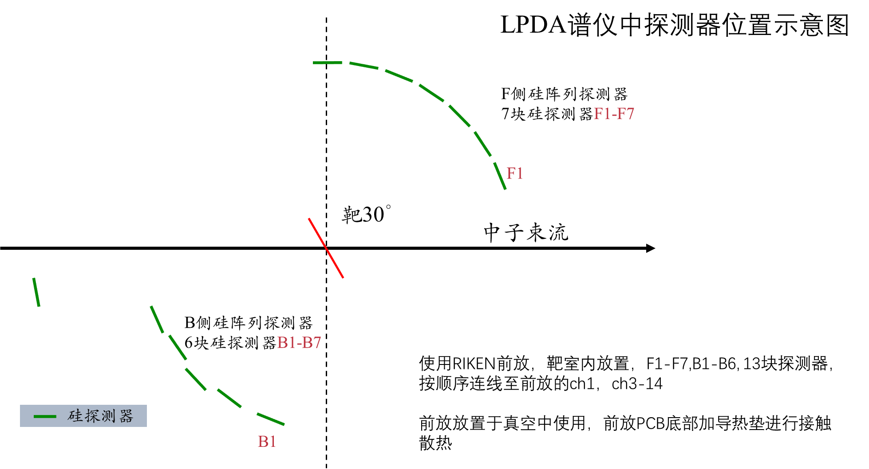
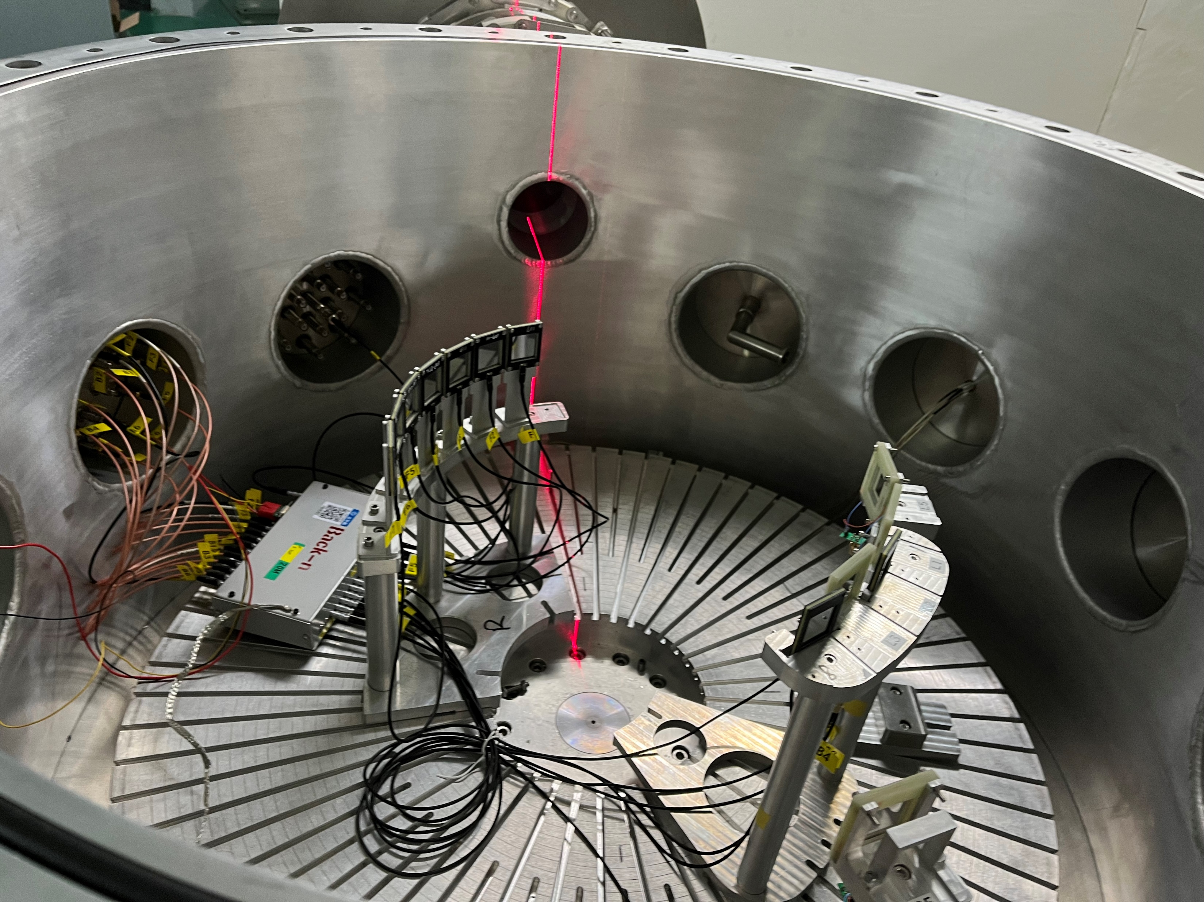
Experimental Setup
13 Si-PIN detectors
F7
B6
B5
Detector | F1 | F2 | F3 | F4 | F5 | F6 | F7
Angle(°) | 21.4 | 32.86 | 44.29 | 55.71 | 67.14 | 78.57 | 90
D(mm) | 189.5 | 189.5 | 189.5 | 189.5 | 189.5 | 189.5 | 189.5
B1 | B2 | B3 | B4 | B5 | B6
105 | 121.32 | 133.88 | 146.41 | 158.74 | 170
193 | 195.61 | 202.73 | 193.75 | 204.64 | 360
Notes:
the target was rotated by 30° to reduce the energy loss of particles emitted at large angels.

Slide 6
Experiemental Setup
1# ²⁴¹Am+²⁴⁴Cm：standard $α$ source for the system stability test
2# Al：control target
3# Al+C₃H₆N₆ ：Double-sided target, with a single side coated at 200 μg/cm², deposited on a 10.8 μm Al substrate。
4# Al+⁶LiF：Single-sided target, 360 μg/cm², deposited on a 10 μm Al substrate。
For measurement and as the reference
2
3
4
Notes:
melamine
lithium6 fluoride

Slide 7
Data Processing
1# 2D histogram of wave peakvalue vs. nTOF
Energy valibration
nTOF calibration
2# Double bunch unfolding
3# Subtracting the background
4# Selecting event
Event count
1D histogram of count vs. neutron energy
5# Relative differential corss-section of ¹⁴N(n,p)
Referring to the standard cross-section of ⁶Li(n,t)
error
6# Fitting with Legendre polynomial
Angular distribution of differential cross-section
Angle-integrated cross-section
7# R-Matrix Fitting

Slide 8
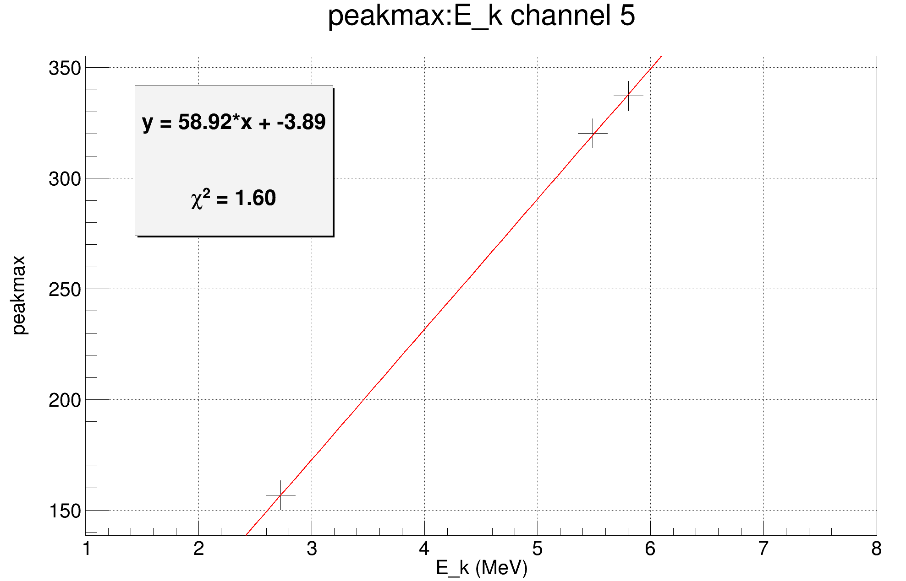
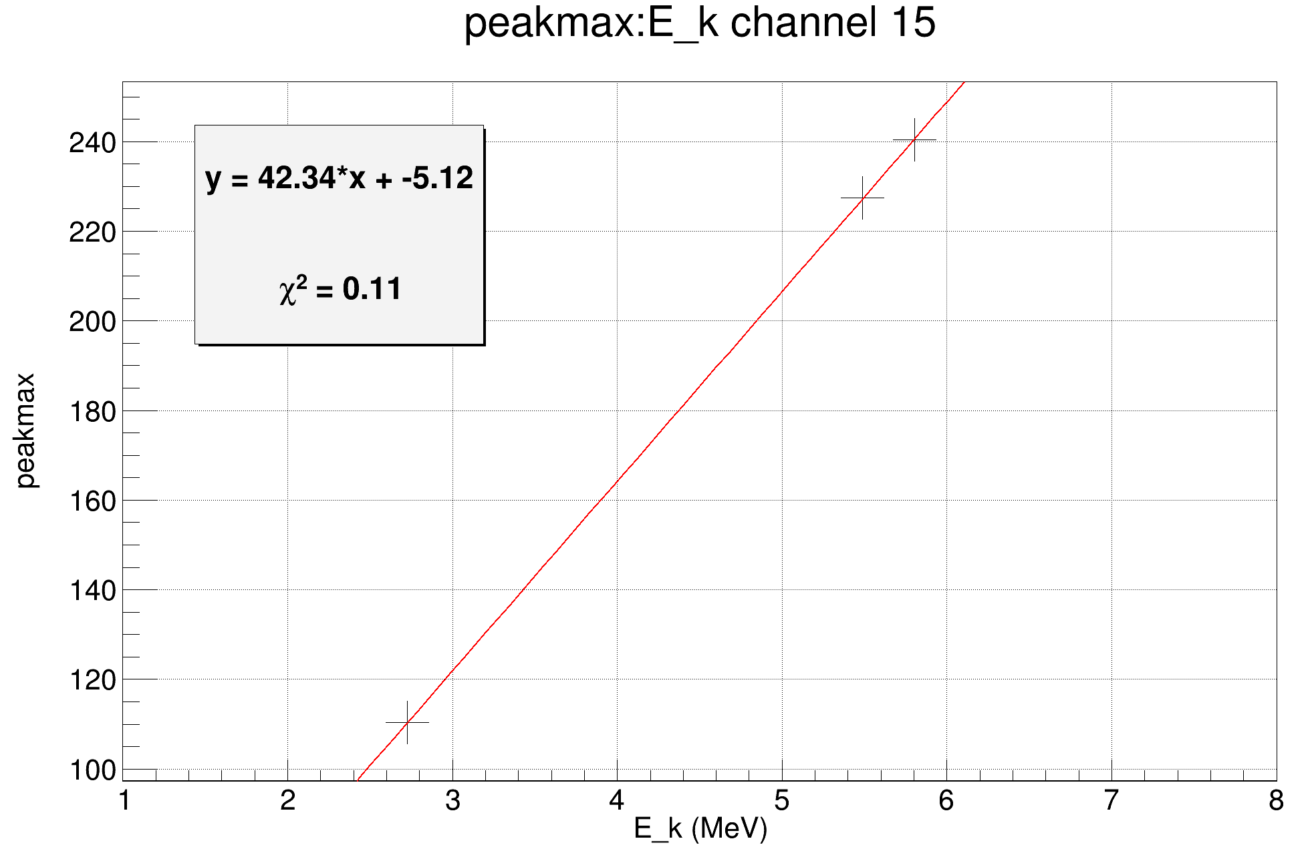
Energy Calibration
During the experiment, the gain of each detector remains essentially unchanged by default
Channel 5 Calibration
Channel 15 Calibration

Slide 9
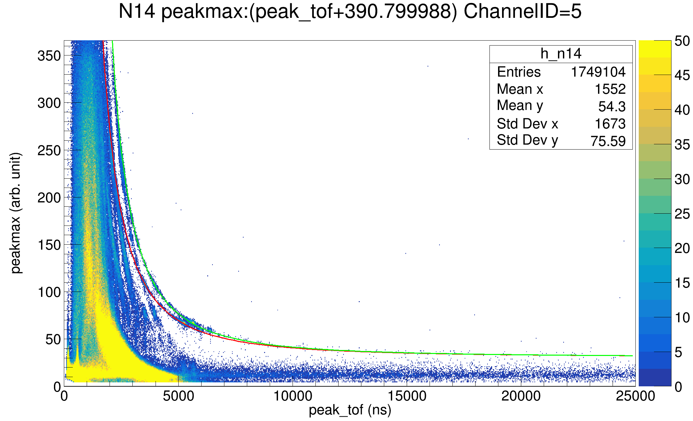
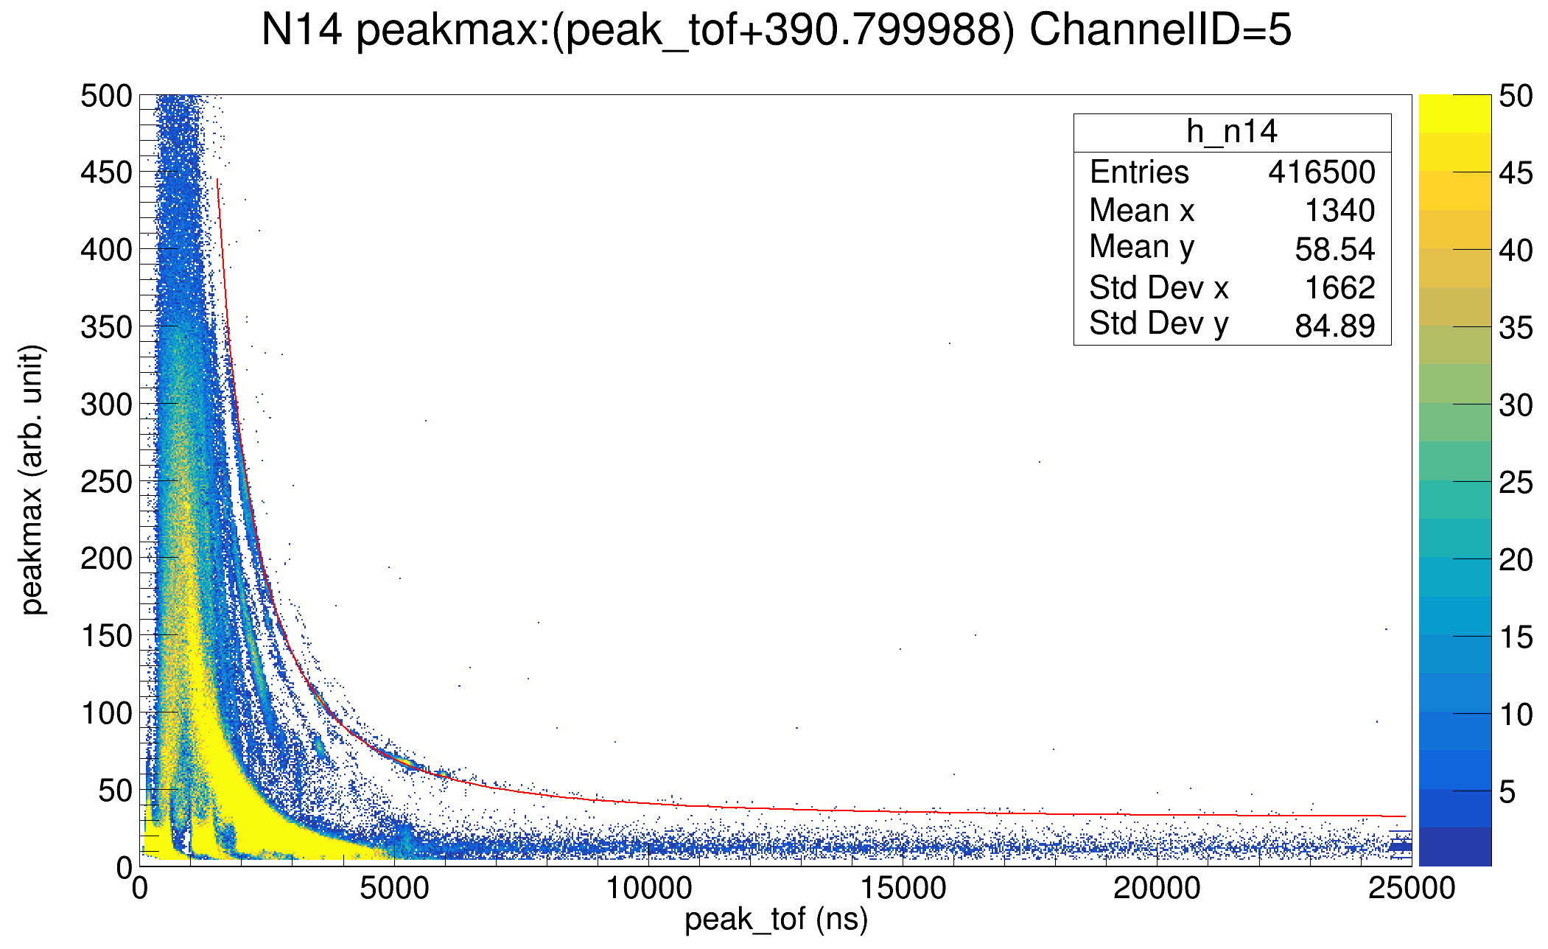
Double Bunch Unfolding
Double bunch: the events outlined in red are produced from the first bunch while the ones in green are from the second bunch.
Al+C₃H₆N₆ ：Double-sided target
* With TOF calibration already done
Preliminary
Preliminary
Before unfolding
After unfolding

Slide 10
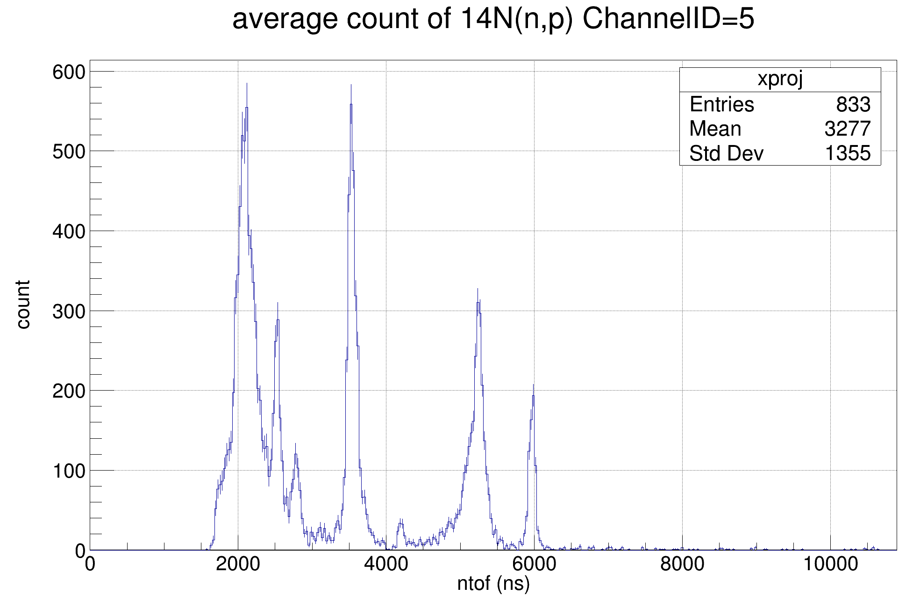
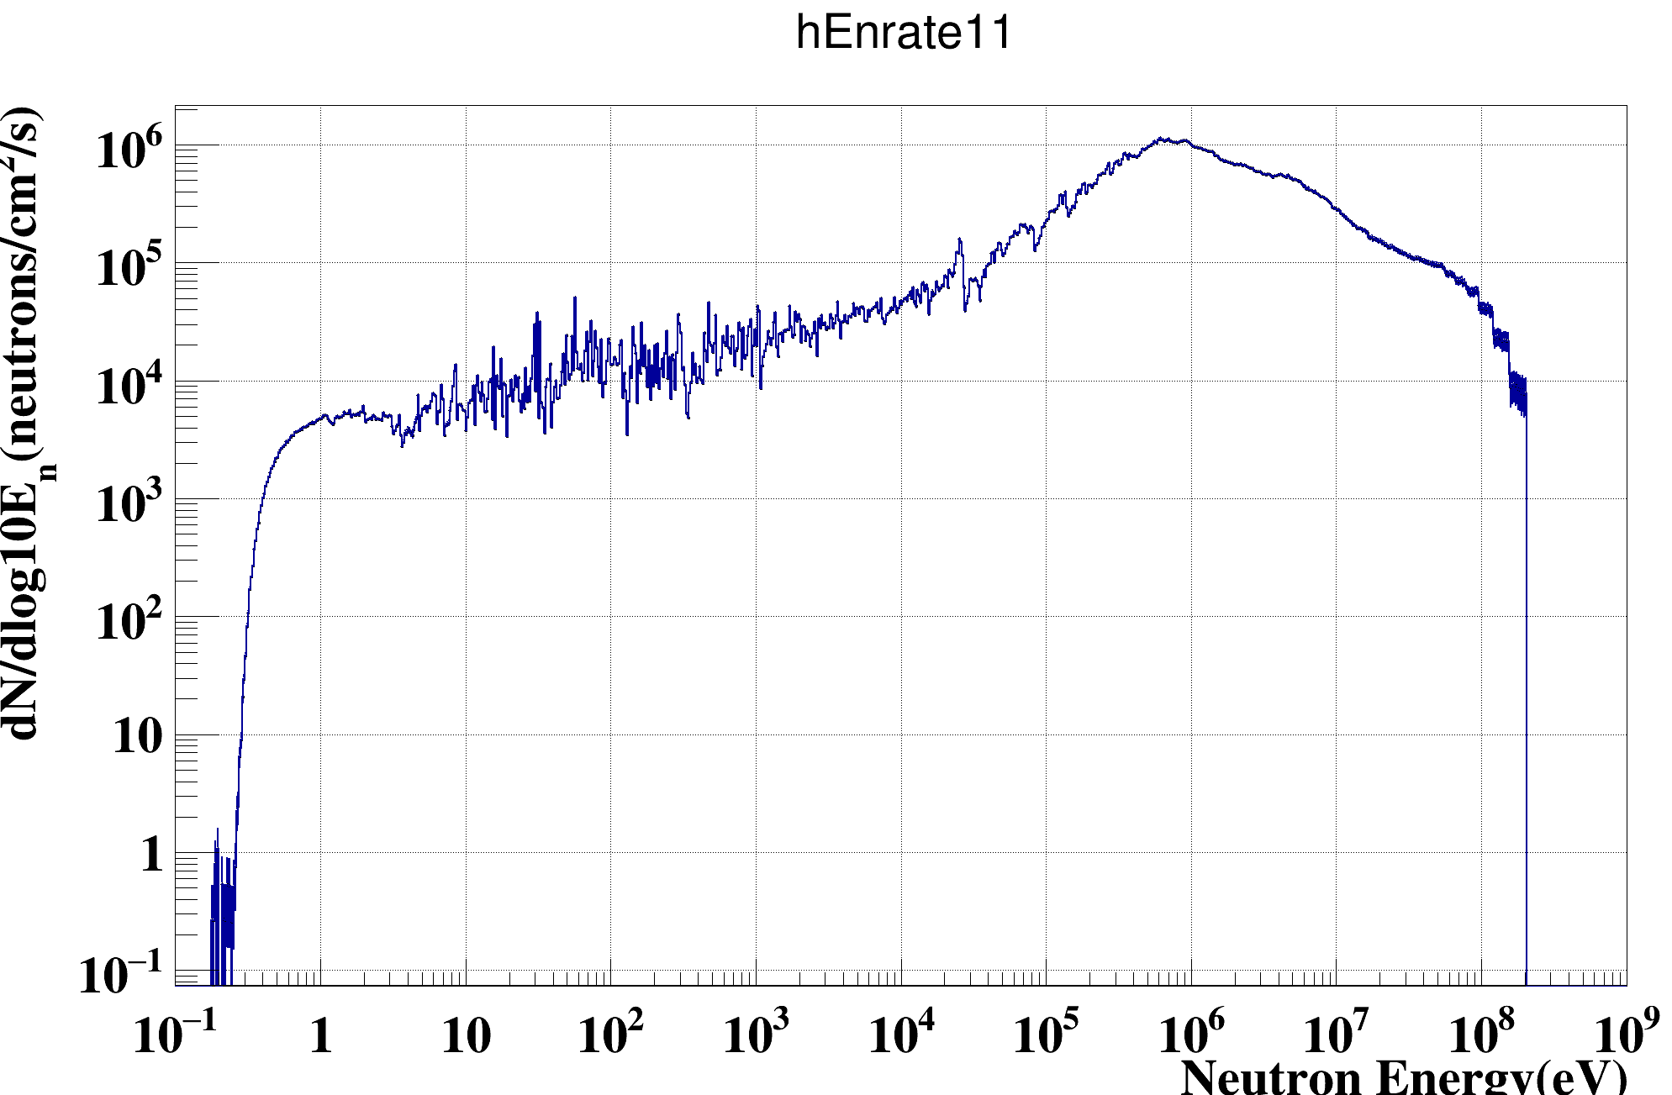
Counts of Selected Events (¹⁴N(n,p)¹⁴C)
Preliminary
(*The background from Al has been subtracted)
The Fluence of Back-n neutron beam
When TOF of neutron is longer than ~3800 ns (the energy of neutron is lower than ~1.3 MeV or so), the protons are only from the side facing forward.

Slide 11
The Differential Cross-Section of ⁶Li(n,t)α
$\frac{dσ}{dΩ}{\left.​\right|}_{E_{n}}=\frac{count(E_{n})}{N_{n}(E_{n})⋅N_{target}⋅Ω_{det}⋅ε_{det}}=k_{det}⋅\frac{count\left(E_{n}\right)}{N_{n}\left(E_{n}\right)⋅N_{target}}$ (1)
$count(E_{n})$: count of proton at E_{n}
$N_{n}(E_{n})$: the number of the incident neutrons whose energy is equal to E_{n}，$∝{flux}_{E_{n}}×proton(t)$
$N_{target}$: the number of target nuclei
$Ω_{det}$, $ε_{det}$: the solid angle and the detecting efficiency of the detectors
The cross-section of ⁶Li(n,t)α is standard and isotropic.
the relative differential cross-section of ¹⁴N(n,p)¹⁴C
$\frac{dσ}{dΩ}\left(n14\right){\left.​\right|}_{E_{n}}=\frac{k_{N14}}{k_{Li6}}⋅\frac{count{\left(n14\right)}_{E_{n}}}{{flux}_{E_{n}}}×\frac{dσ}{dΩ}\left(Li6\right){\left.​\right|}_{E_{i}}$ / $\frac{count{\left(Li\right)}_{E_{i}}}{{flux}_{E_{i}}}$ (2)
$\frac{k_{N14}}{k_{Li6}}=\frac{Nproton\left(6LiF\right)}{Nproton\left(14N\right)}×\frac{Ntarget\left(6Li\right)}{Ntarget\left(14N\right)}$
“normalization coefficient”
from dataset
measurement of ⁶Li(n,t)α

Slide 12
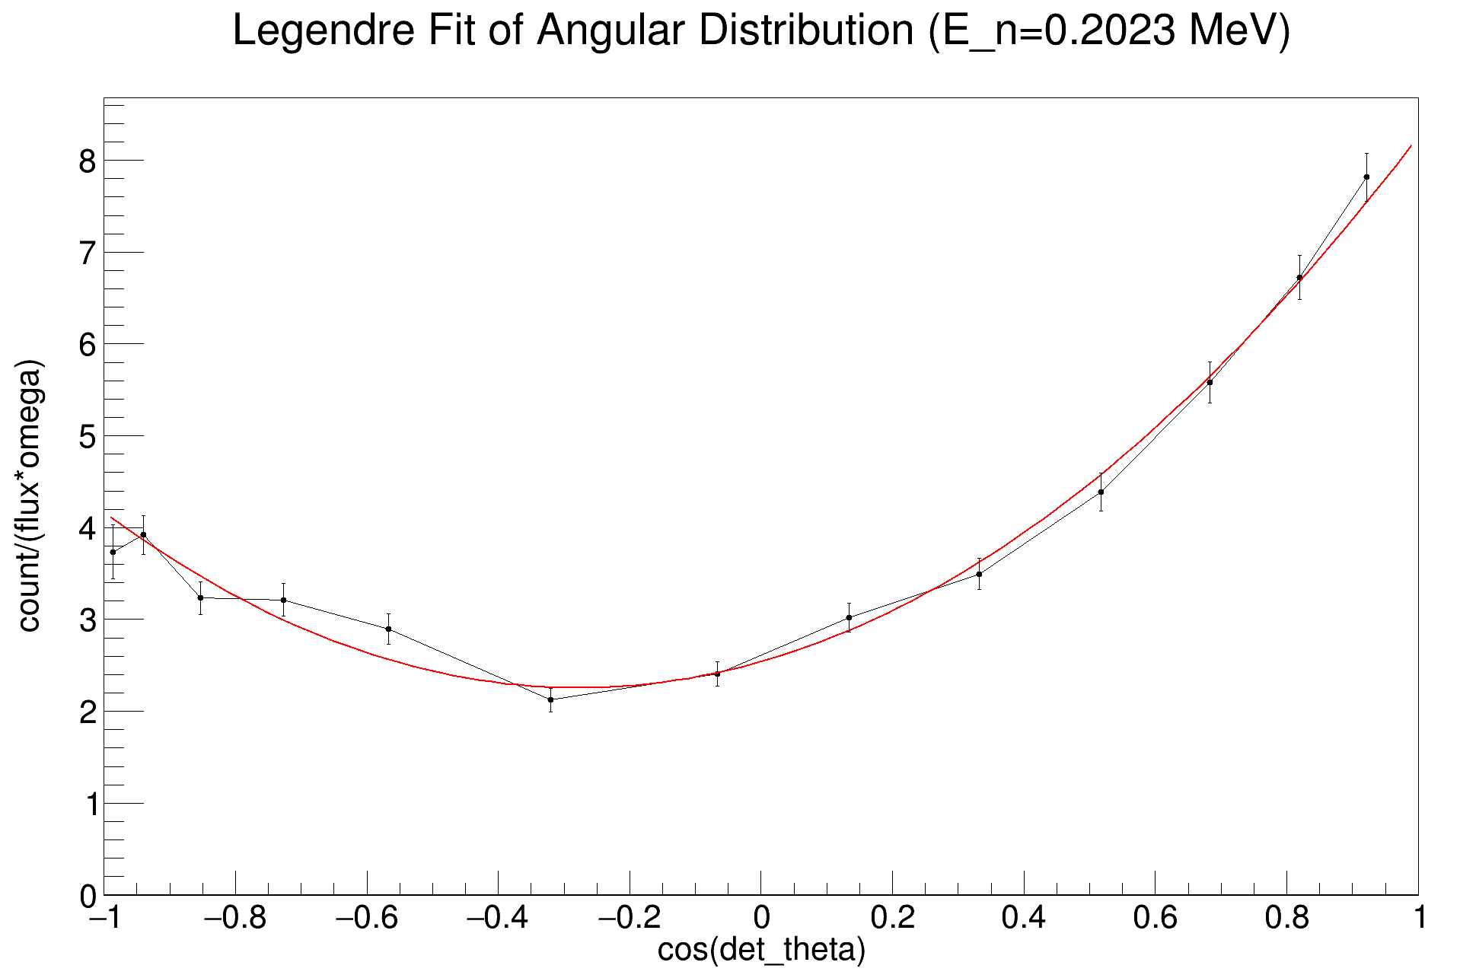
The Cross-Section of ⁶Li(n,t)α
For differential cross-section (measurement):
Fit it with Legendre Polynomials
$$\frac{dσ}{dΩ}\left(E,\cos{θ}\right)$$
$$=\frac{σ_{n,x}\left(E\right)}{4π}\sum_{l=0}^{L}{\left(2l+1\right)f_{l}\left(E\right)P_{l}(\cos{θ})}$$
$=\sum_{l=0}^{L}{A_{l}P_{l}(\cos{θ})}$ (3)
Preliminary
For cross-section (unnormalized)
Integrate the fitting Legendre Polynomials along $cos⁡(det⁡_theta)$
Integral: $σ_{n,x}\left(E\right)=\int_{−1}^{1}{2π\frac{dσ}{dΩ}\left(E,\cos{θ}\right)d\cos{θ}}$ (4)

Slide 13
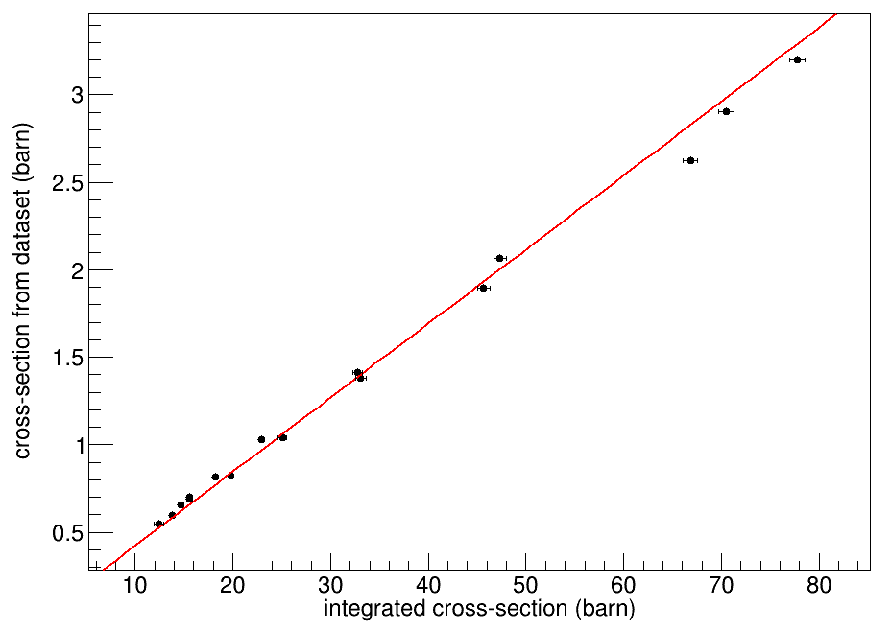
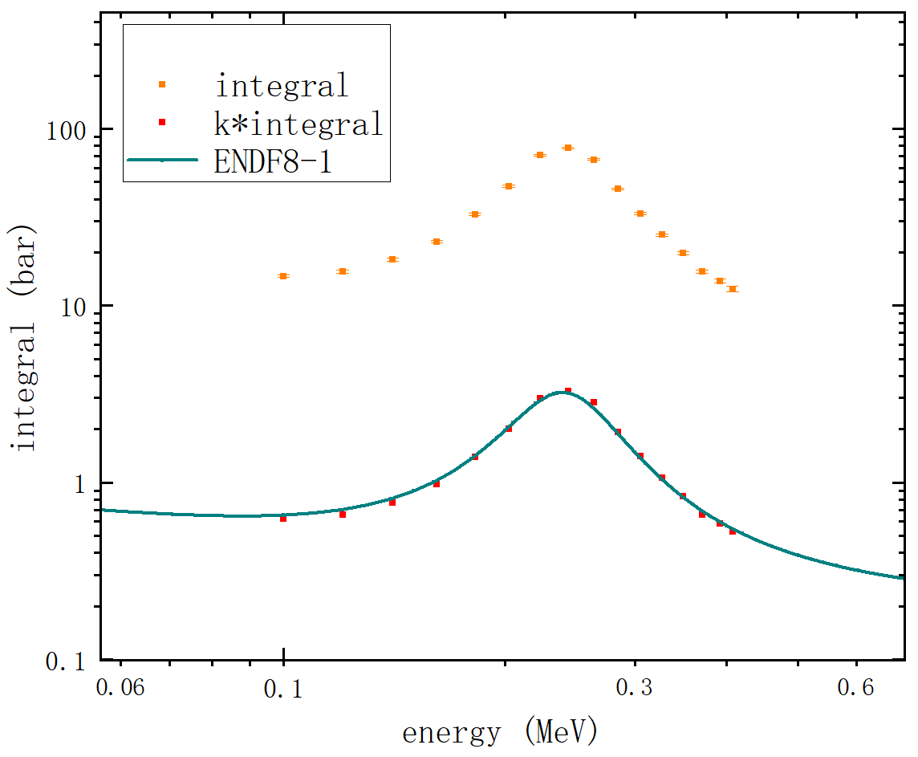
The Cross-Section of ⁶Li(n,t)α
Normalize the measurement to the standard cross-section
$σ_{ENDFB8−1}=k×I_{integral}$
$\frac{dσ}{dΩ}\left(Li6\right){\left.​\right|}_{E_{i}}$ / $\frac{count{\left(Li\right)}_{E_{i}}}{{flux}_{E_{i}}}=k/Ω(detector)$
Preliminary
Preliminary

Slide 14
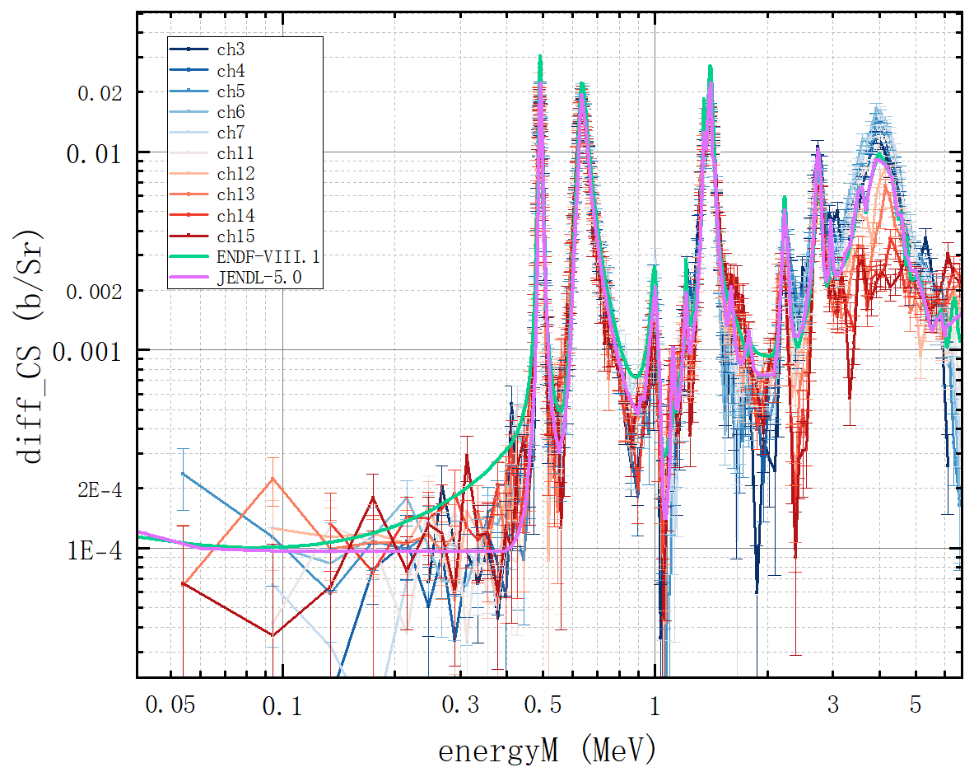
The Differential Cross-Section of ¹⁴N(n, p)¹⁴C
First achieve the measurement of the differential cross-section globally
range of neutron energy:
~50 keV— ~6.8 MeV
resonance at $0.491±0.005$ MeV
JENDL-5.0：0.4927 MeV
ENDF-BVIII.1：0.491 MeV
resonance at $0.6344±0.0075$ MeV
JEDNL-5.0: 0.6351 MeV
ENDF-BVIII.1: 0.635 MeV
Preliminary
* in LAB frame

Slide 15
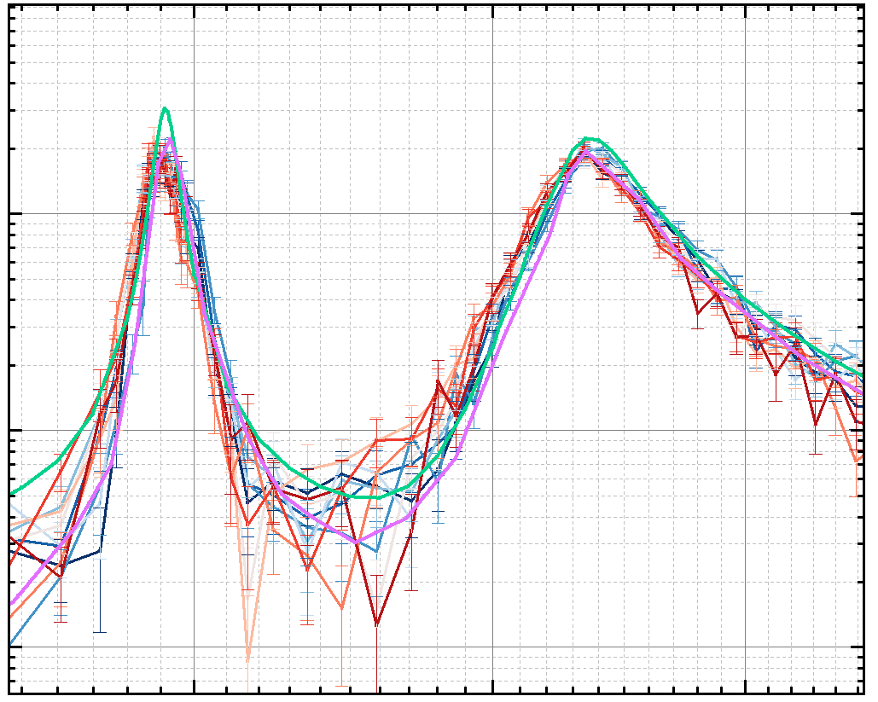
The Differential Cross-Section of ¹⁴N(n, p)¹⁴C
First achieve the measurement of the differential cross-section globally
range of neutron energy:
~50 keV— ~6.8 MeV
resonance at $0.491±0.005$ MeV
JENDL-5.0：0.4927 MeV
ENDF-BVIII.1：0.491 MeV
resonance at $0.6344±0.0075$ MeV
JEDNL-5.0: 0.6351 MeV
ENDF-BVIII.1: 0.635 MeV
Preliminary
* in LAB frame

Slide 16
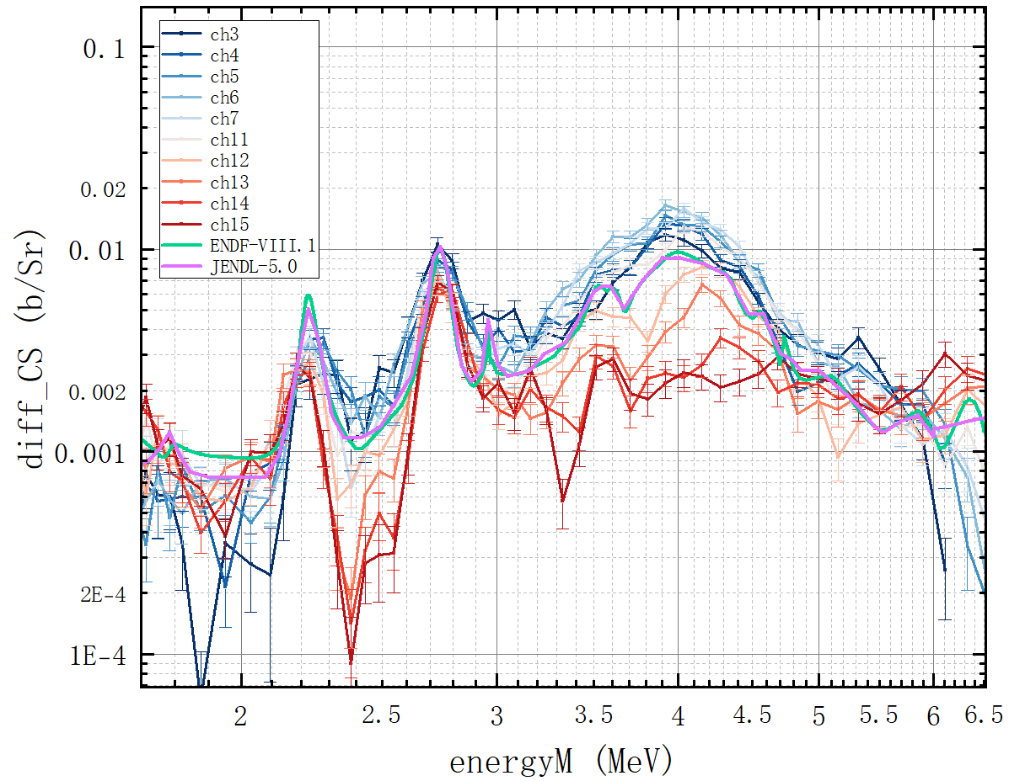
The Differential Cross-Section of ¹⁴N(n, p)¹⁴C
remarkable angular distribution of the measured differential cross-section :
2.2~2.8MeV, 3~5MeV
the total momentum of ¹⁵N excited states: $J>\frac{3}{2}$
contribute to calculating $J$ and the parity
Preliminary
* in LAB frame

Slide 17
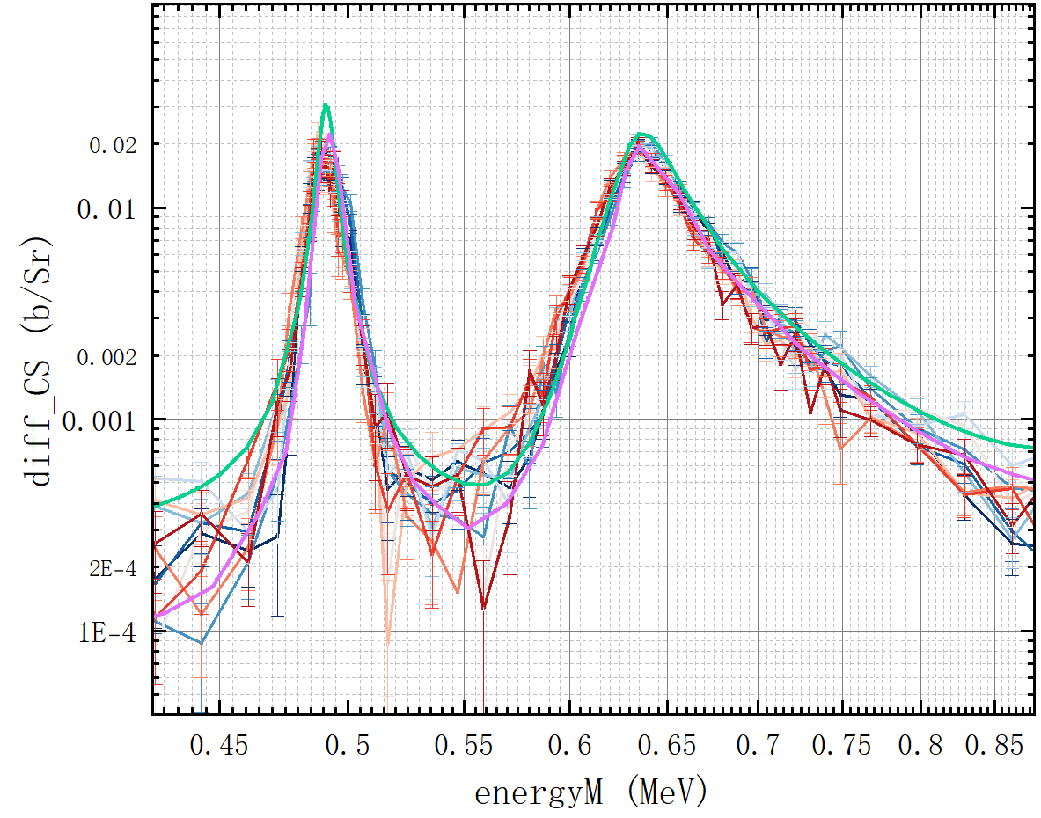
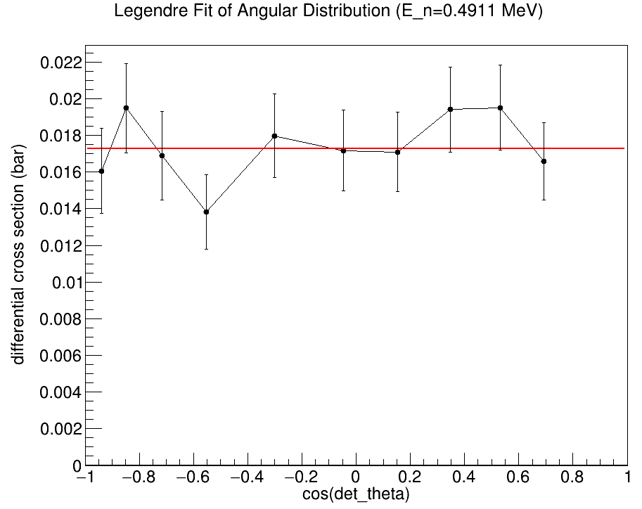
Fitting with Legendre Polynomials——Angular Distribution
Preliminary
Preliminary
differential cross-section of ¹⁴N(n,p)
(0.491MeV)
angular distribution of differential cross-section
(0.491MeV)

Slide 18
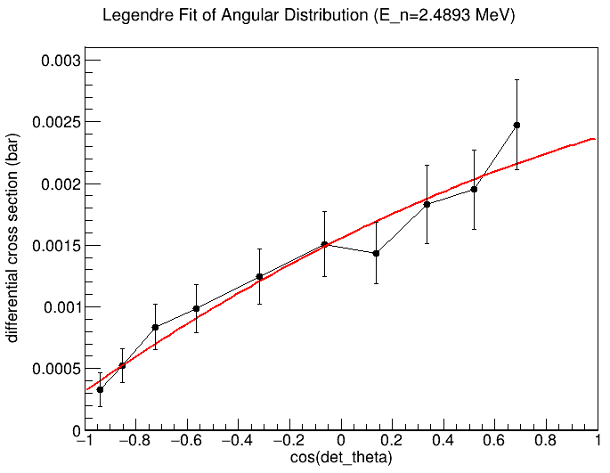
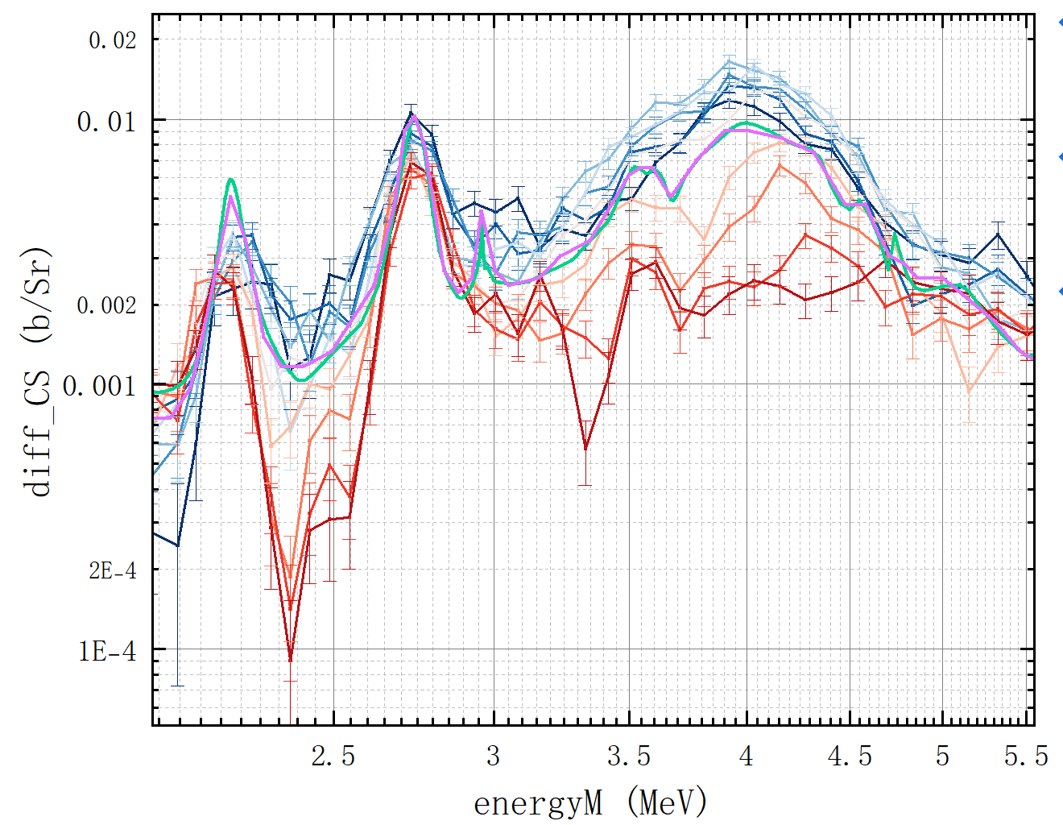
Fitting with Legendre Polynomials——Angular Distribution
Preliminary
Preliminary
differential cross-section of ¹⁴N(n,p)
(2.4893MeV)
angular distribution of differential cross-section
(2.4893MeV)

Slide 19
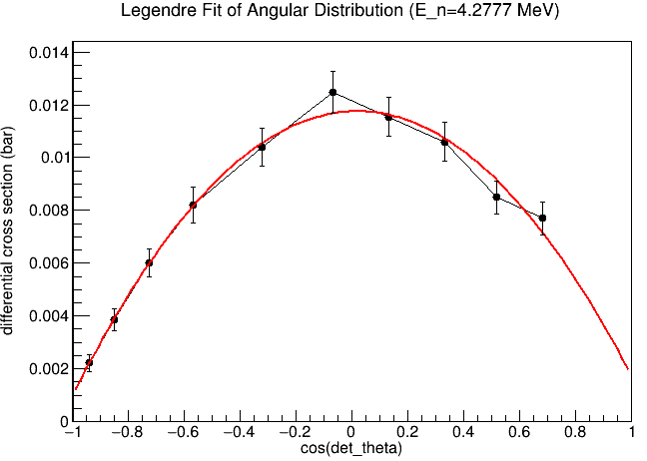
Fitting with Legendre Polynomials——Angular Distribution
Preliminary
Preliminary
differential cross-section of ¹⁴N(n,p)
(4.2777MeV)
angular distribution of differential cross-section
(4.2777MeV)

Slide 20
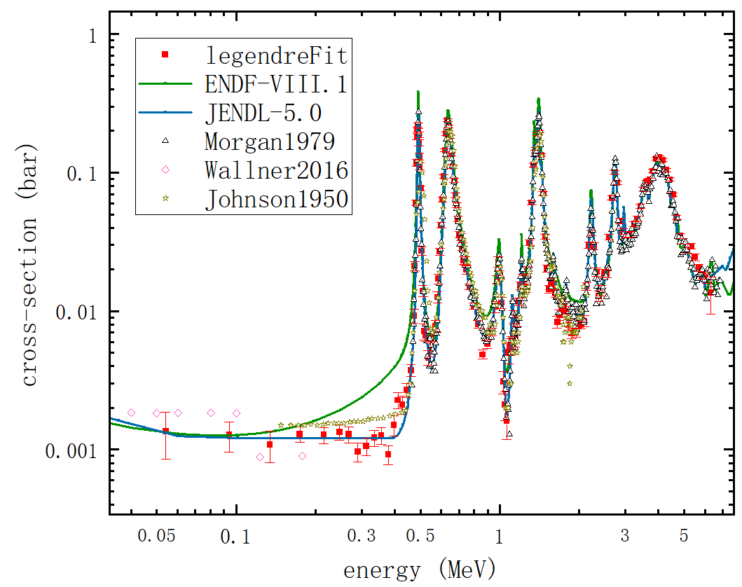
Fitting with Legendre Polynomials——Angle-Integrated Cross-Section
vertical error: <5% at resonance
 | energy (MeV) | cross-section (barn)
This work | $$0.4911±0.0016$$ | $$0.2169±0.0090$$
JENDL-5.0 | 0.4927 | 0.27744
ENDF-BVIII.1 | 0.491 | 0.382958
Preliminary
 | energy (MeV) | cross-section (barn)
This work | $$0.6344±0.0075$$ | $$0.2399±0.0051$$
JENDL-5.0 | 0.6351 | 0.244517
ENDF-BVIII.1 | 0.635 | 0.279083

Slide 21
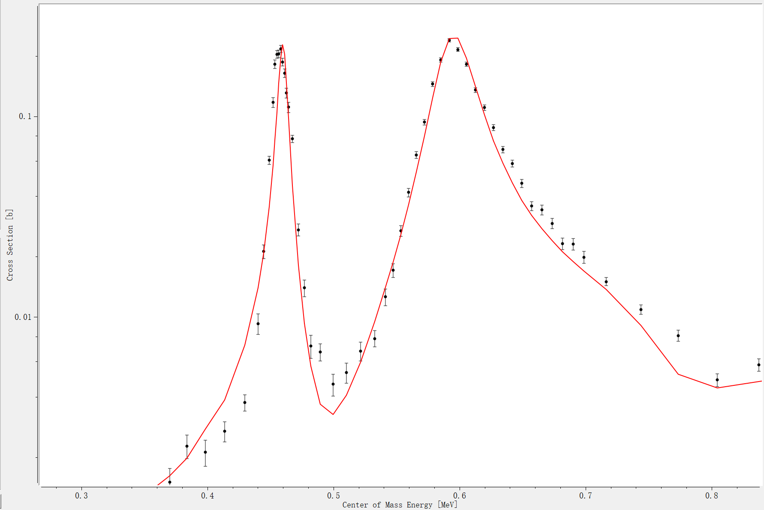
R-Matrix Fitting (0.49~0.9MeV in Lab frame)
: data with only statistical error
—: Azure2 fitting
Preliminary
 | $$E_{r}$$ (MeV) | $$E_{N−15 }$$ (MeV) | level spin | $Γ_{n}$(eV) | $Γ_{p}$(eV) | $Γ_{γ}$(eV)
This work | - | 11.2929 | ½- | 1060.29 | 7125.15 | 0.29
Ref. | 0.4927 | 11.2928 | ½- | 1900 | 6200 | 0.29
cross-section fitted with R-Matrix
Ref. : Atlas of Neutron Resonances, 6th ed. (Elsevier, Amsterdam, 2018), pp. 89–822;
F. Ajzenberg-Selove, Energy levels of light nuclei A = 13–15, Nuclear Physics A 523(1991) 1-196

Slide 22
R-Matrix Fitting (0.49~0.9MeV in Lab frame)
: data with only statistical error
—: Azure2 fitting
 | $$E_{r}$$ (MeV) | $$E_{N−15 }$$ (MeV) | level spin | $Γ_{n}$(eV) | $Γ_{p}$(eV) | $Γ_{γ}$(eV)
This work | - | 11.4277 | ½+ | 28050 | 7140 | 4.2
Ref. | 0.644 | 11.429 | ½+ | 35000 | 9200 | 4.2
Preliminary
 | $$E_{r}$$ (MeV) | $$E_{N−15 }$$ (MeV) | level spin | $Γ_{n}$(eV) | $Γ_{p}$(eV) | $Γ_{γ}$(eV)
This work | - | 11.615 | ½+ | 350.16 | 118904 | 20.92
Ref. | 0.837 | 11.615 | ½+ | 4000 | 400900 | 19.2
cross-section fitted with R-Matrix
Ref. : Atlas of Neutron Resonances, 6th ed. (Elsevier, Amsterdam, 2018), pp. 89–822;
F. Ajzenberg-Selove, Energy levels of light nuclei A = 13–15, Nuclear Physics A 523(1991) 1-196

Slide 23
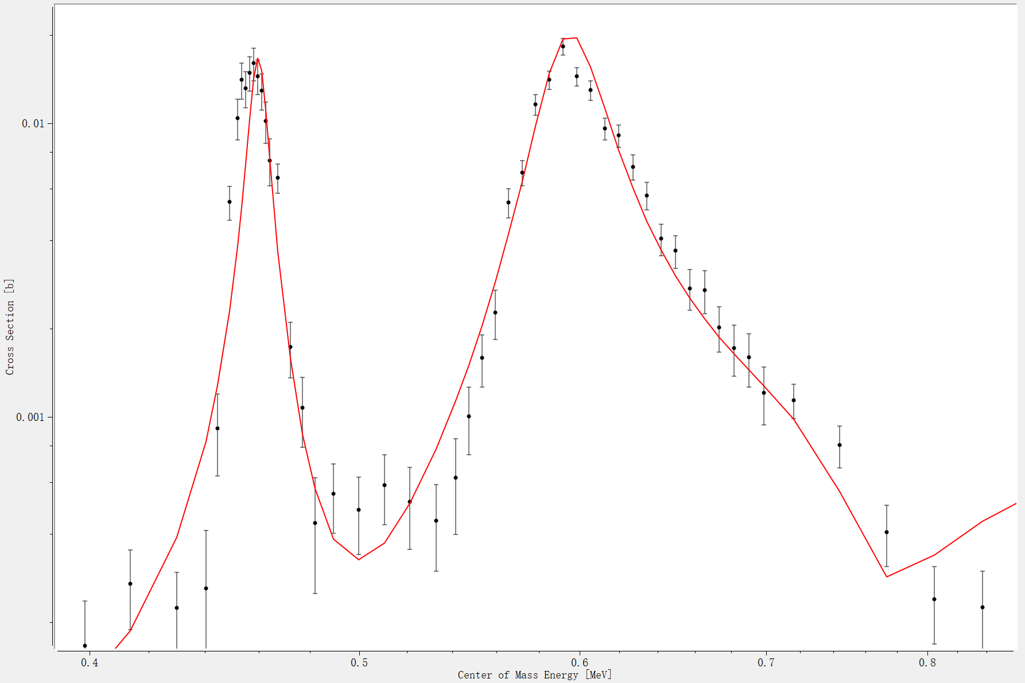
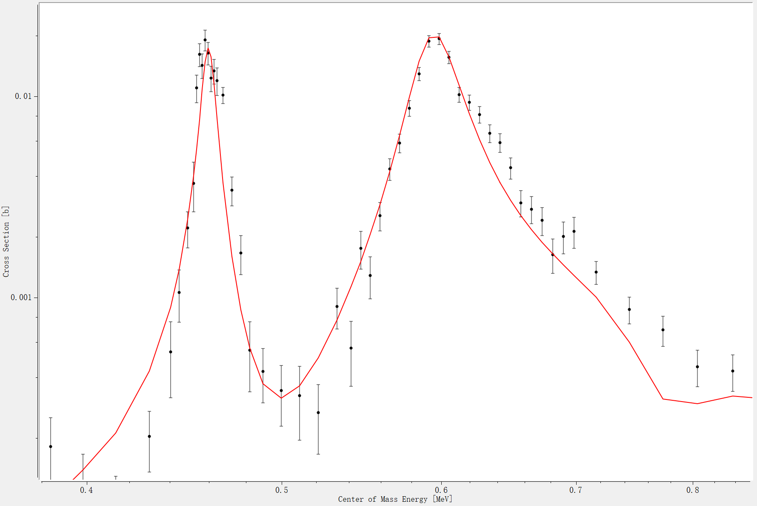
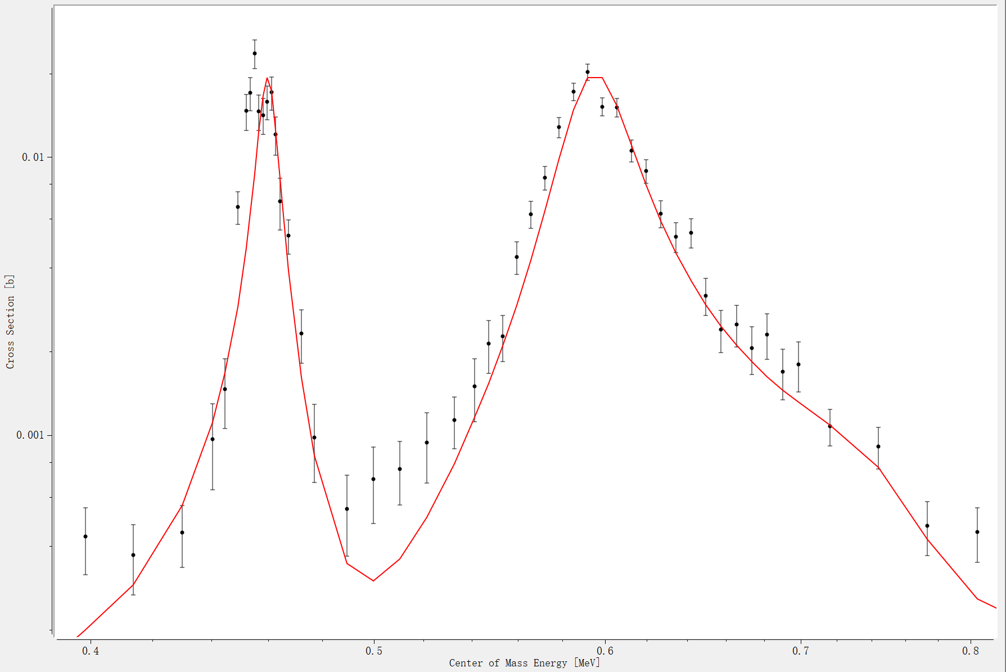
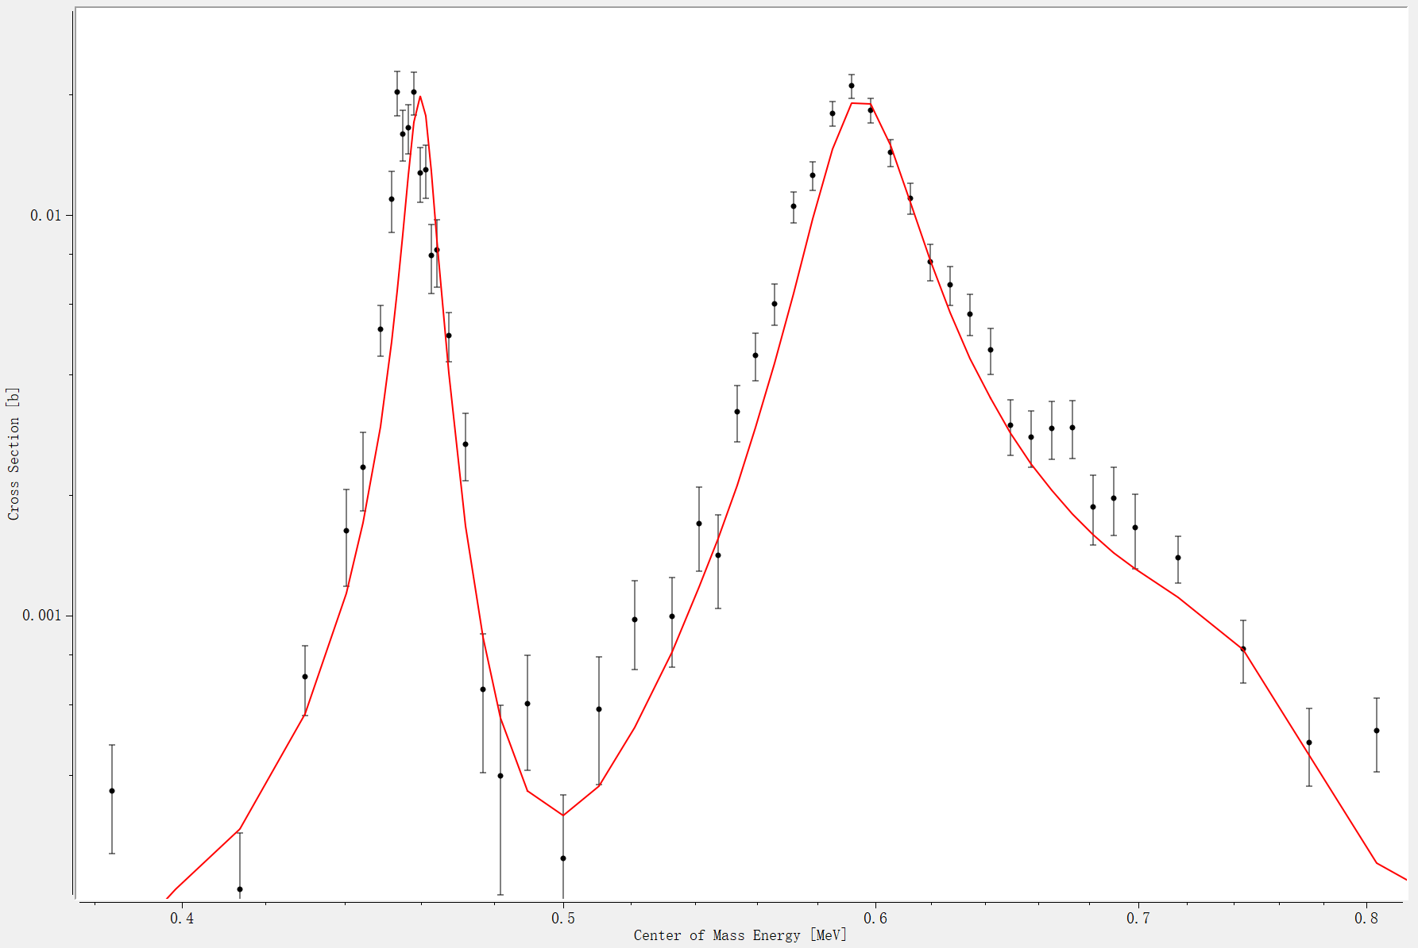
R-Matrix Fitting (0.49~0.9MeV in Lab frame)
44.29°
67.14°
: data with only statistical error
—: Azure2 fitting
 | $$E_{r}$$ (MeV) | $$E_{N−15 }$$ (MeV) | level spin | $Γ_{n}$(eV) | $Γ_{p}$(eV) | $Γ_{γ}$(eV)
This work | - | 11.4277 | ½+ | 28050 | 7140 | 4.2
Ref. | 0.644 | 11.429 | ½+ | 35000 | 9200 | 4.2
Preliminary
121.32°
146.41°
 | $$E_{r}$$ (MeV) | $$E_{N−15 }$$ (MeV) | level spin | $Γ_{n}$(eV) | $Γ_{p}$(eV) | $Γ_{γ}$(eV)
This work | - | 11.615 | ½+ | 350.16 | 118904 | 20.92
Ref. | 0.837 | 11.615 | ½+ | 4000 | 400900 | 19.2
Ref. : Atlas of Neutron Resonances, 6th ed. (Elsevier, Amsterdam, 2018), pp. 89–822;
F. Ajzenberg-Selove, Energy levels of light nuclei A = 13–15, Nuclear Physics A 523(1991) 1-196
differential cross-section fitted with R-Matrix

Slide 24
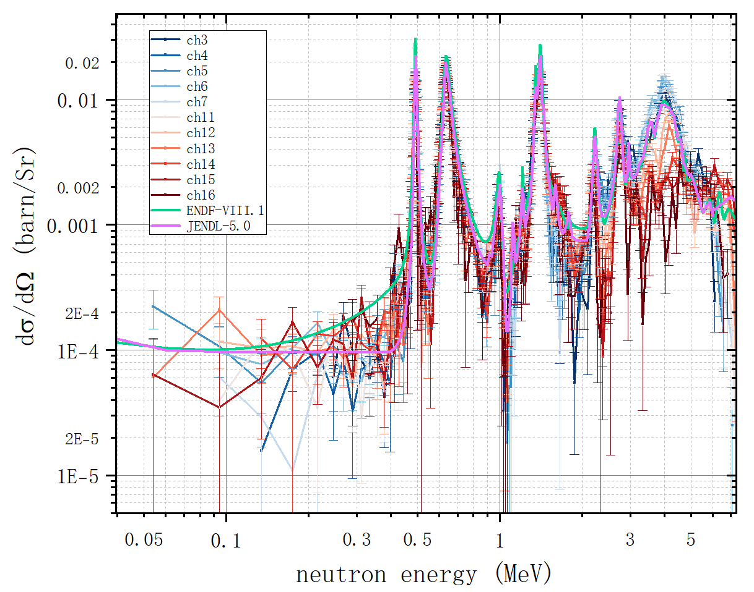
Conclusion
In 0.05~0.4 MeV, the measured result agrees better with the evaluation of JENDL-5.0.
The measured result at ~0.491 MeV is ~0.5 lower than the evaluation of JENDL-5.0 and ~1 lower than that of ENDF-BVIII.1.
The measured result at ~0.634 MeV agrees with the evaluation, within the measurement uncertainty.
Between 2.2~2.8 MeV, 3~6 MeV, the measured differential cross-section shows a distinct angular distribution, and the data fits well with Legendre polynomial.
The angle-integrated cross-section mostly agrees with the evaluations of the databases.
The parameters of resonances at ~0.491 MeV & 0.634 MeV are generally consistent with those in the reference.
Preliminary
Preliminary

Slide 25
Thanks for your attention!
Qiuyue Luo, Wei Jiang, Kang Sun, et al.
China Spallation Neutron Source (CSNS)
2025-05-27
ISINN-31

