Slide 1
Double (n-$γ$) and triple (n-n′$γ$) angular correlations in neutron inelastic scattering on ¹²C
P.G. Filonchik, A.L. Barabanov, D.N. Grozdanov, Yu.N. Kopatch, P.S. Prusachenko, N.A. Fedorov, T.Yu. Tretyakova, I.N. Ruskov, V.R. Skoy, C. Hramco and TANGRA collaboration

Slide 2
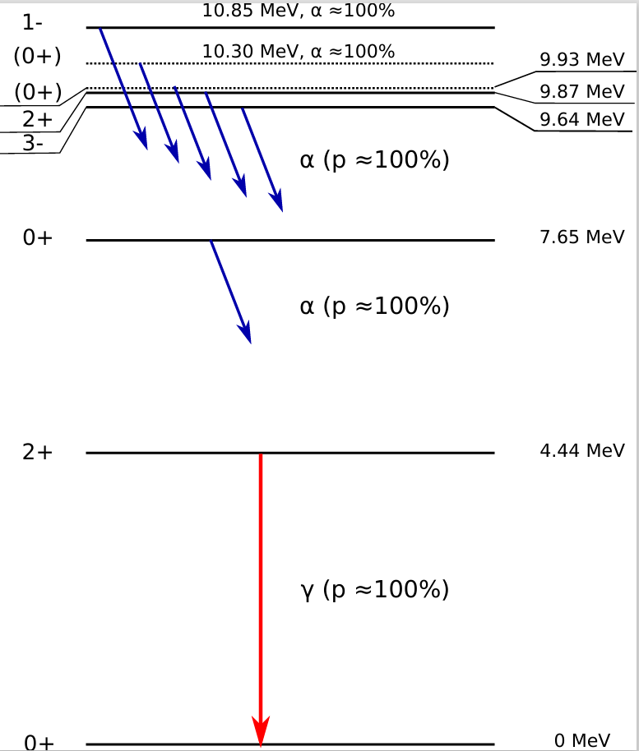
Outline
Considered reaction:
$12C\left(n,n^{′}γ\right)12C$
Motivation
Theory
How to write 500 pages PDF file with formulas?
S-matrix from TALYS
Levels of ¹²C

Slide 3
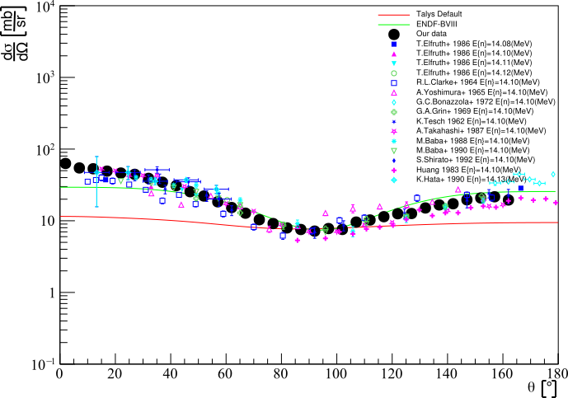
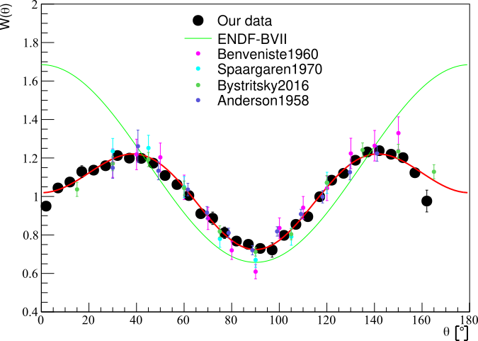
Types of angular correlations
Triple correlations
Double correlations
Differential cross-section of inelastic scattering of neutrons on 1st level of ¹²С
$\left(n−n′\right)$- correlations
Anisotropy of $γ$with energy 4,43 MeV in result of neutron inelastic scattering on ¹²С
Kelly at al. 2021
$\left(n−γ\right)$- correlations
$\left(n−n^{′}γ\right)$- correlations

Slide 4
Inelastic scattering of neutron on 12C
$$E_{α}=0 MeV→E_{β}=4,44 MeV$$
Partial waves
Wave-function of binary system (nucleus+neutron)
Spin-angular functions
S-matrix of transition in channel $λ_{β}$
neutron
total

Slide 5
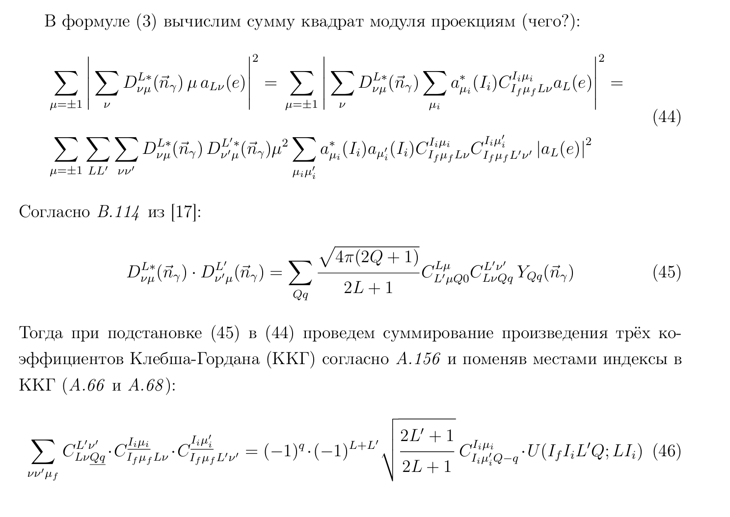
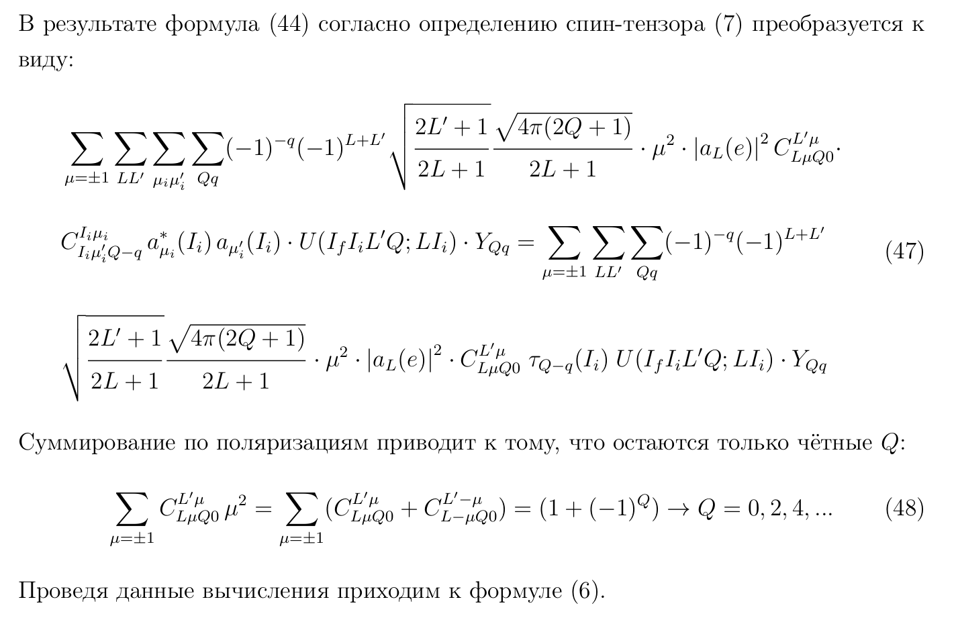
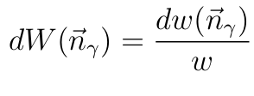
$γ$-emission from the 1st excited state of ¹²C
Total probability of $γ$-emission per time unit
Differential probability of $γ$-emission per time unit
D-functions of SO(3) group
Amplitude of electric transition
Angular distribution of $γ$

Slide 6
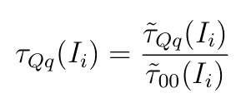
Spin-tensor
Differential probability of $γ$-emission per time unit
Unnormalized spin-tensor
Wave function of binary system (nucleus+neutron)
Normalized spin-tensor

Slide 7
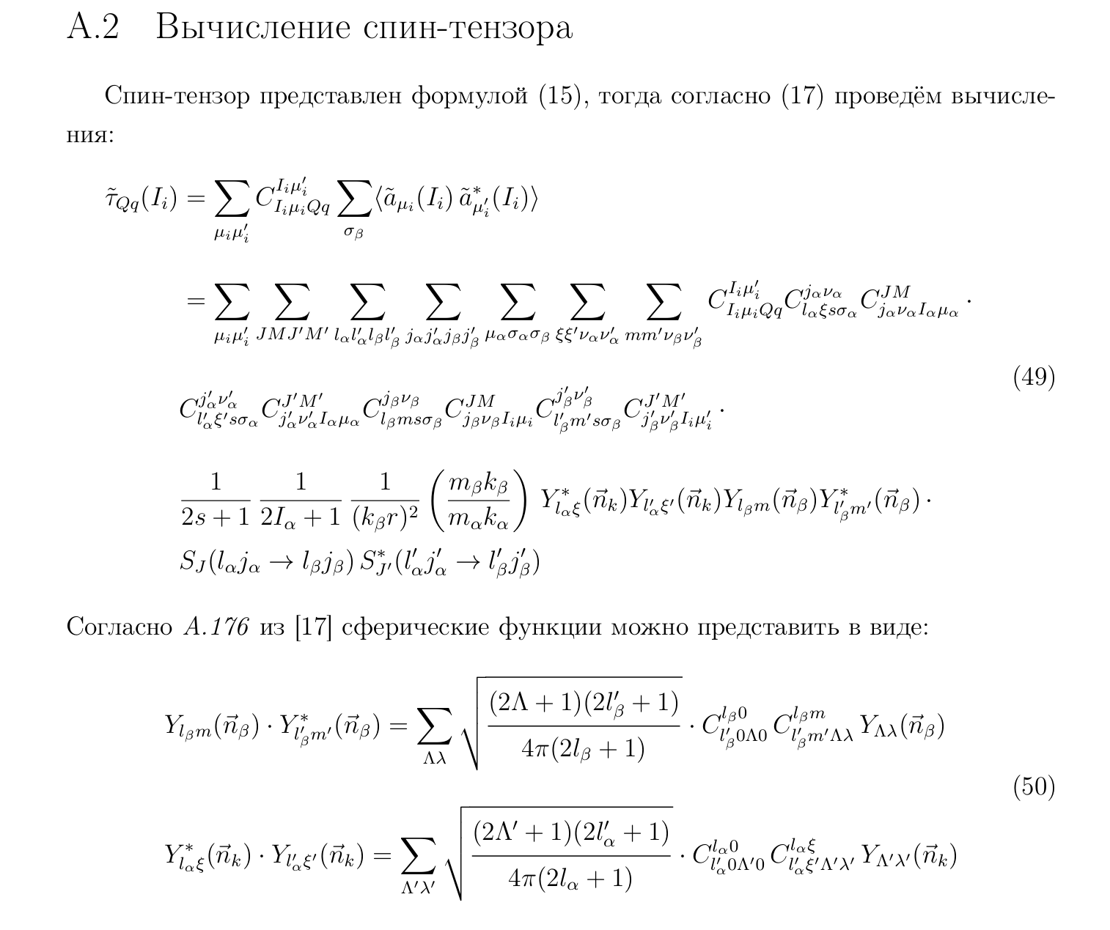
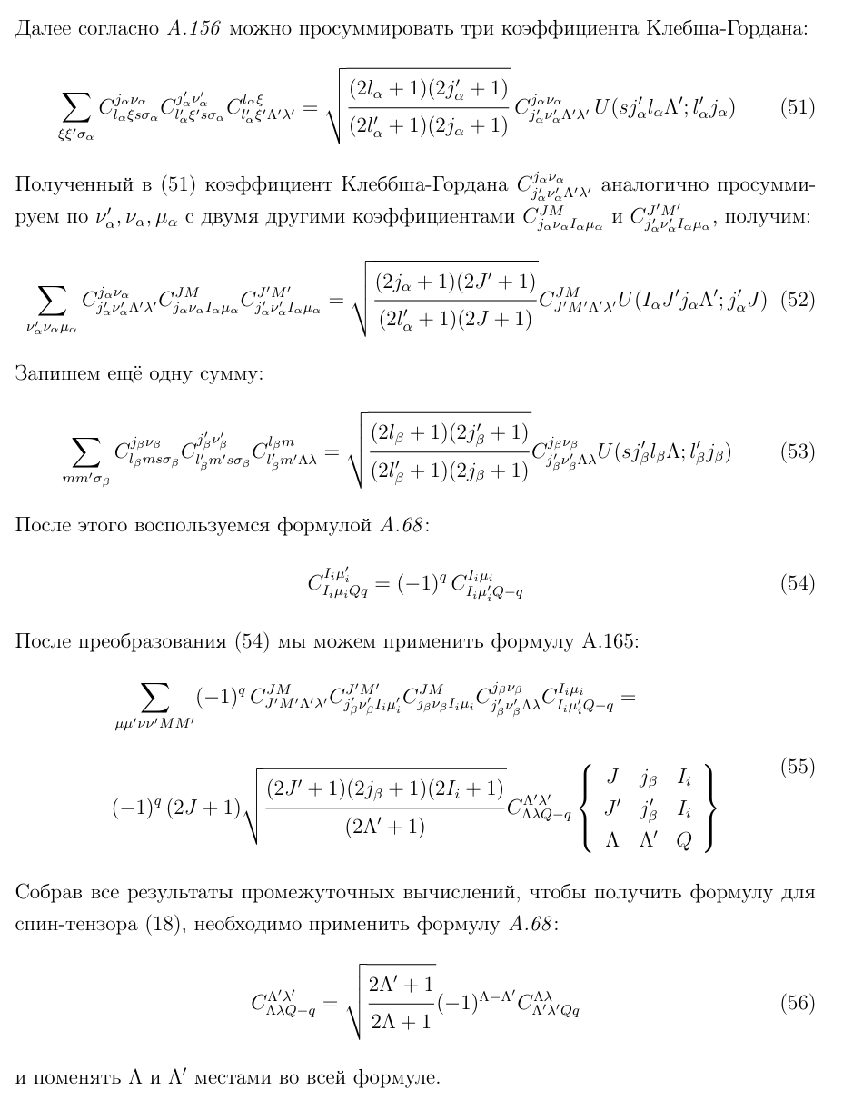

Slide 8
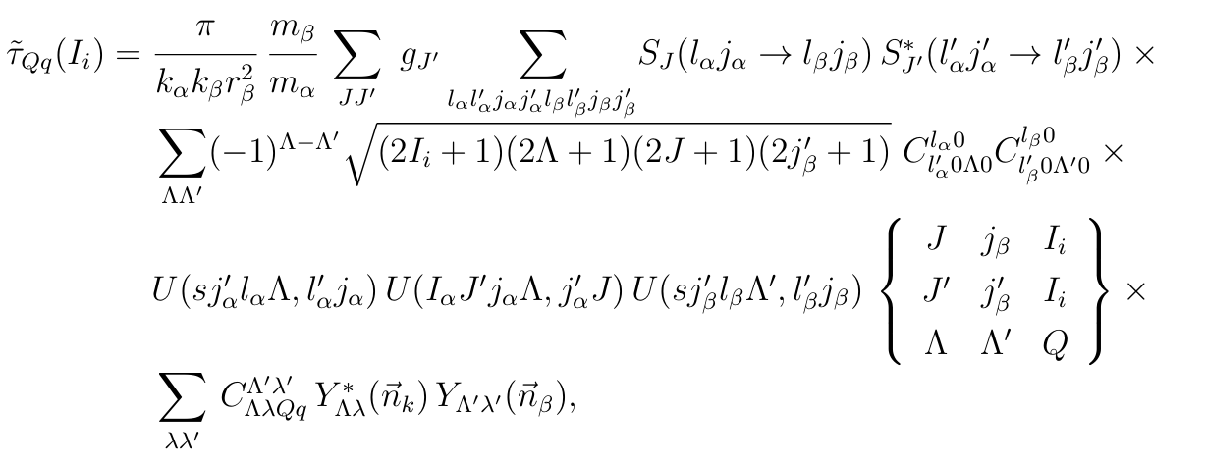
Spin-tensor

Slide 9
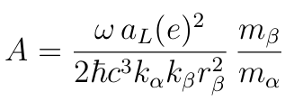
Differential probability of $γ$-emission
Invariant convolution of 3 spherical harmonics

Slide 10
Differential cross-section of neutron inelastic scattering

Slide 11
Double differential cross-section of neutron inelastic scattering
Unnormalized differential probability of $γ$-emission per time unit
Normalized

Slide 12
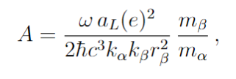
(n-n’$γ$)-angular correlations
Double differential cross-section of neutron inelastic scattering with $γ$-emission
$$φ_{β}$$
$$φ_{γ}$$
S-matrix coefficients from TALYS

Slide 13
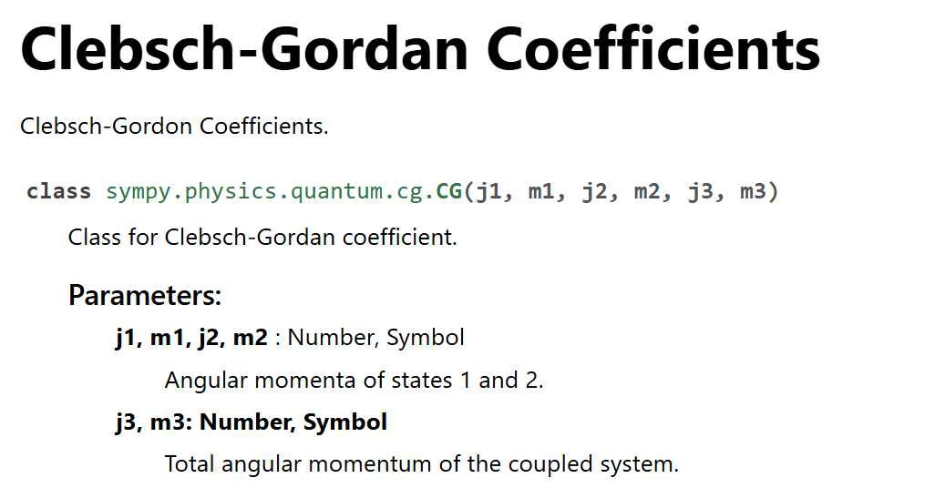
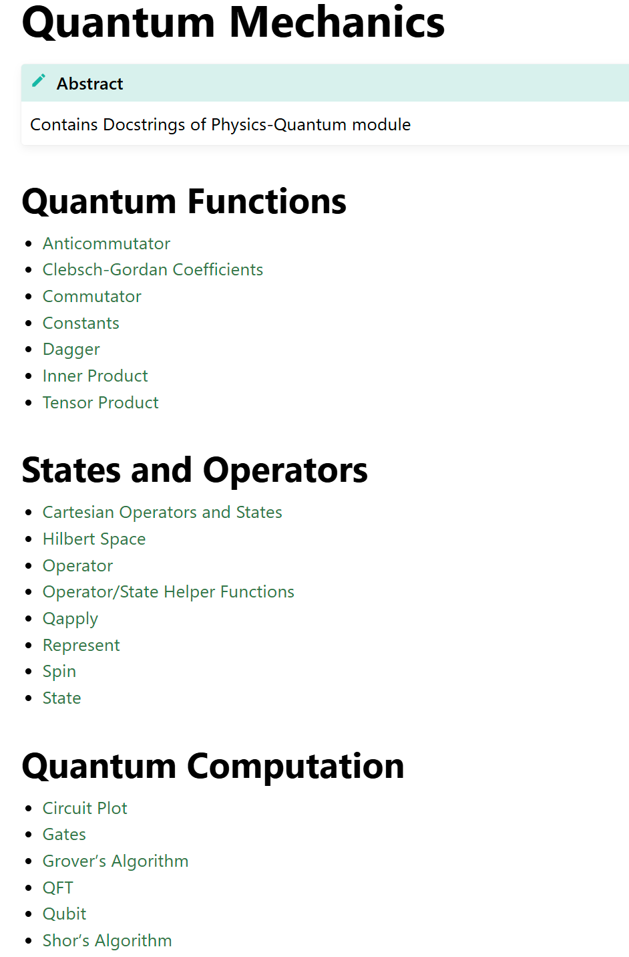
SymPy - Python library for symbolic mathematics

Slide 14
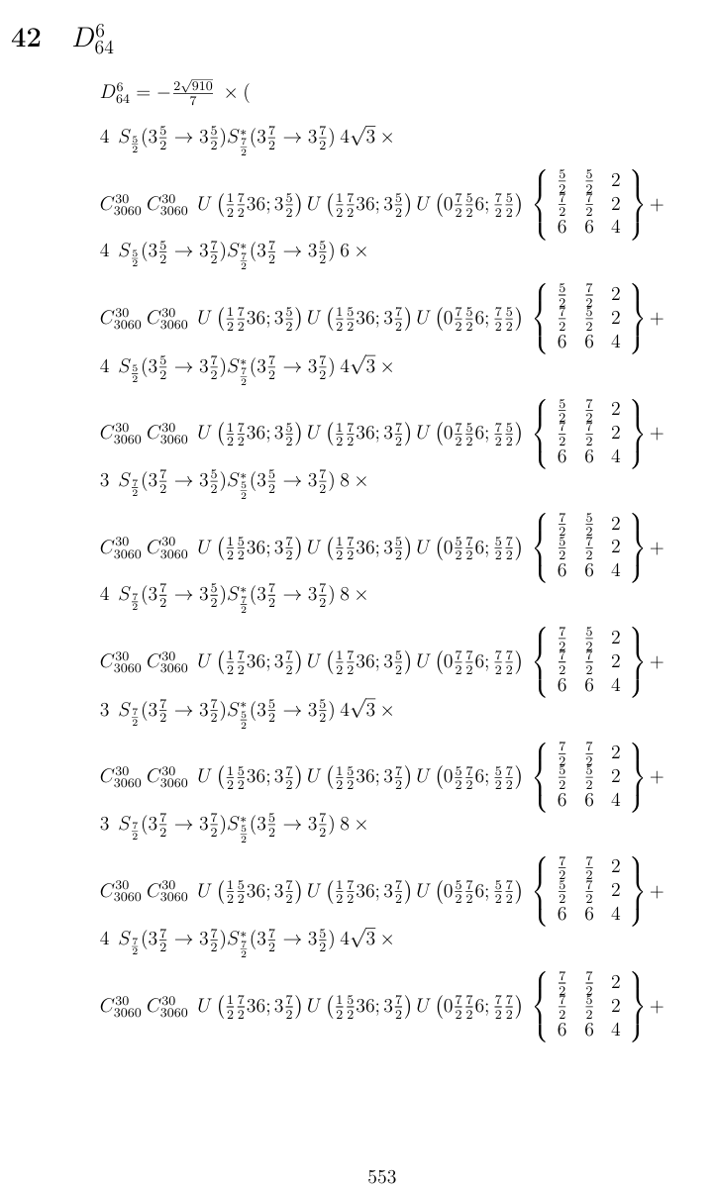
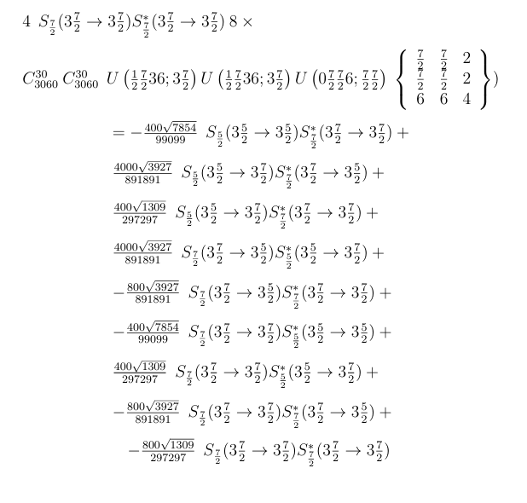

Slide 15
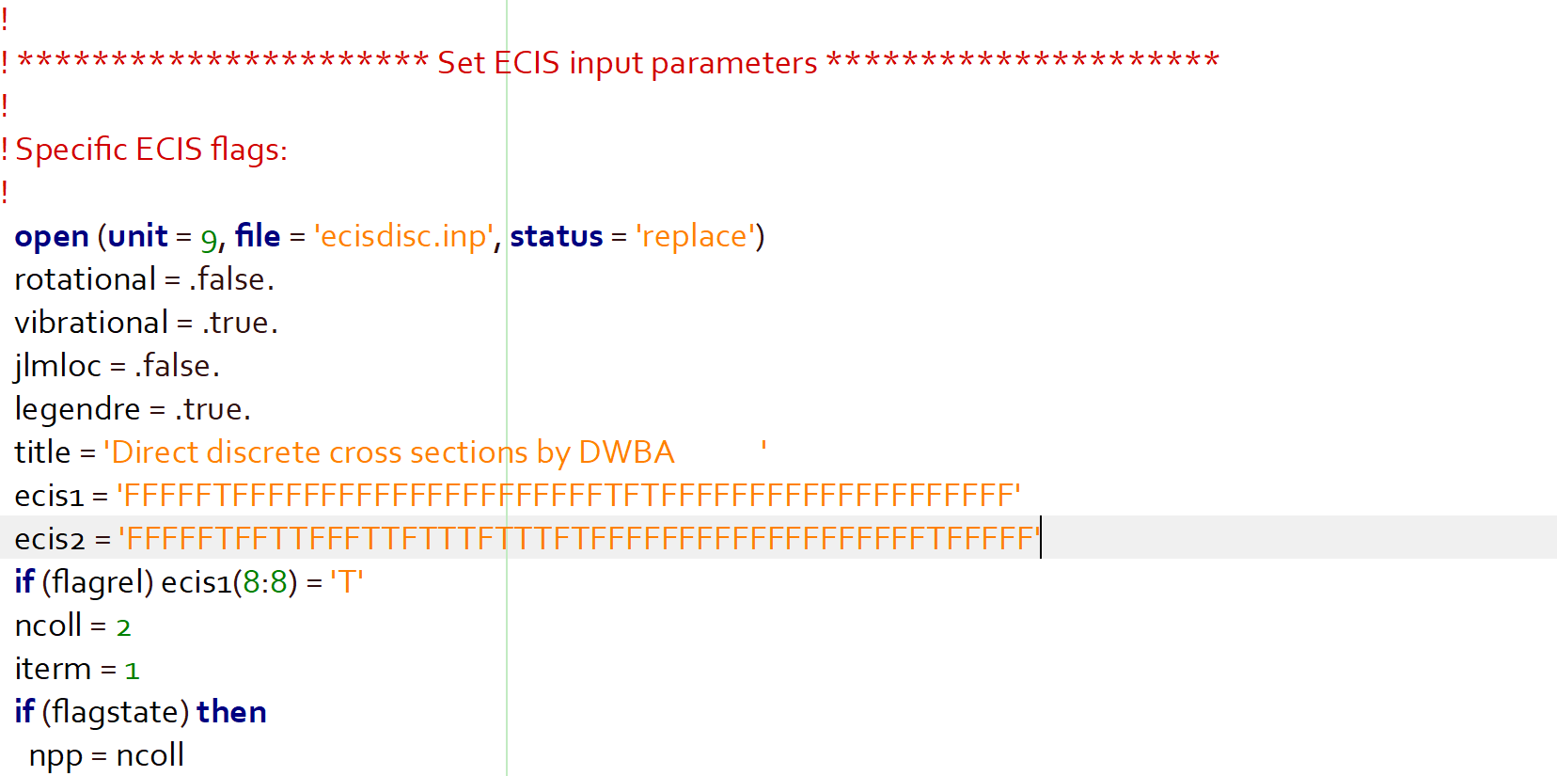
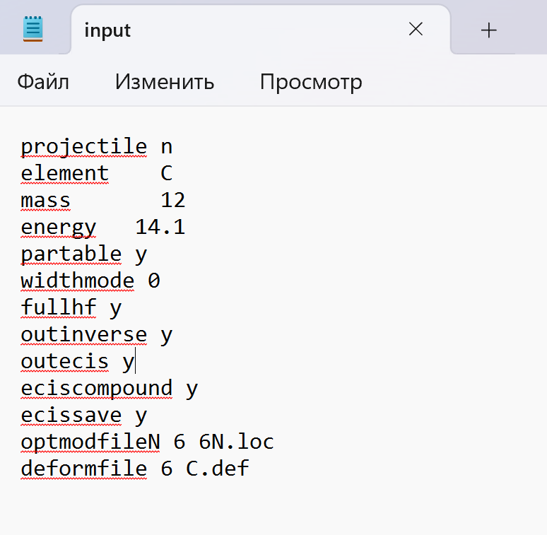
S-matrix from ECIS (TALYS subprogram)
Changes in source file: directecis.f, dwbaecis.f, incidentecis.f
ecist.f
lo – array with logical flags in ecis1 and ecis2
Print S-matrix in file fort.60:
lo(60) = T – 10th place in variable ecis2
Print S-matrix in ecis output files (ex. ecisdisc.out):
lo(56) = T - 6th place in variable ecis2

Slide 16
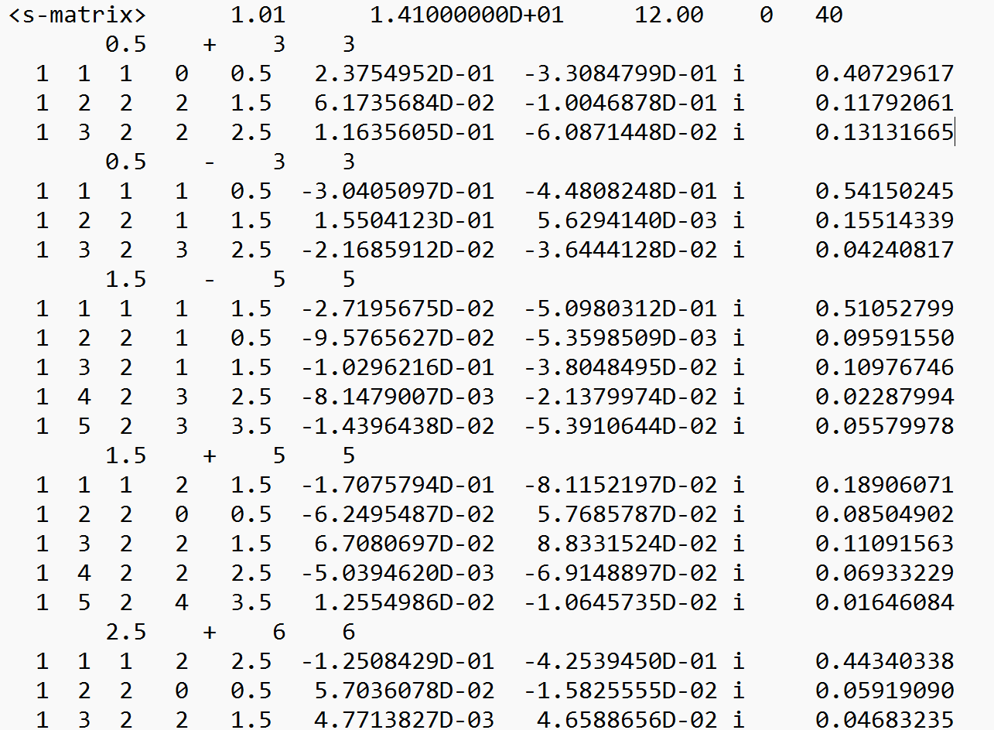
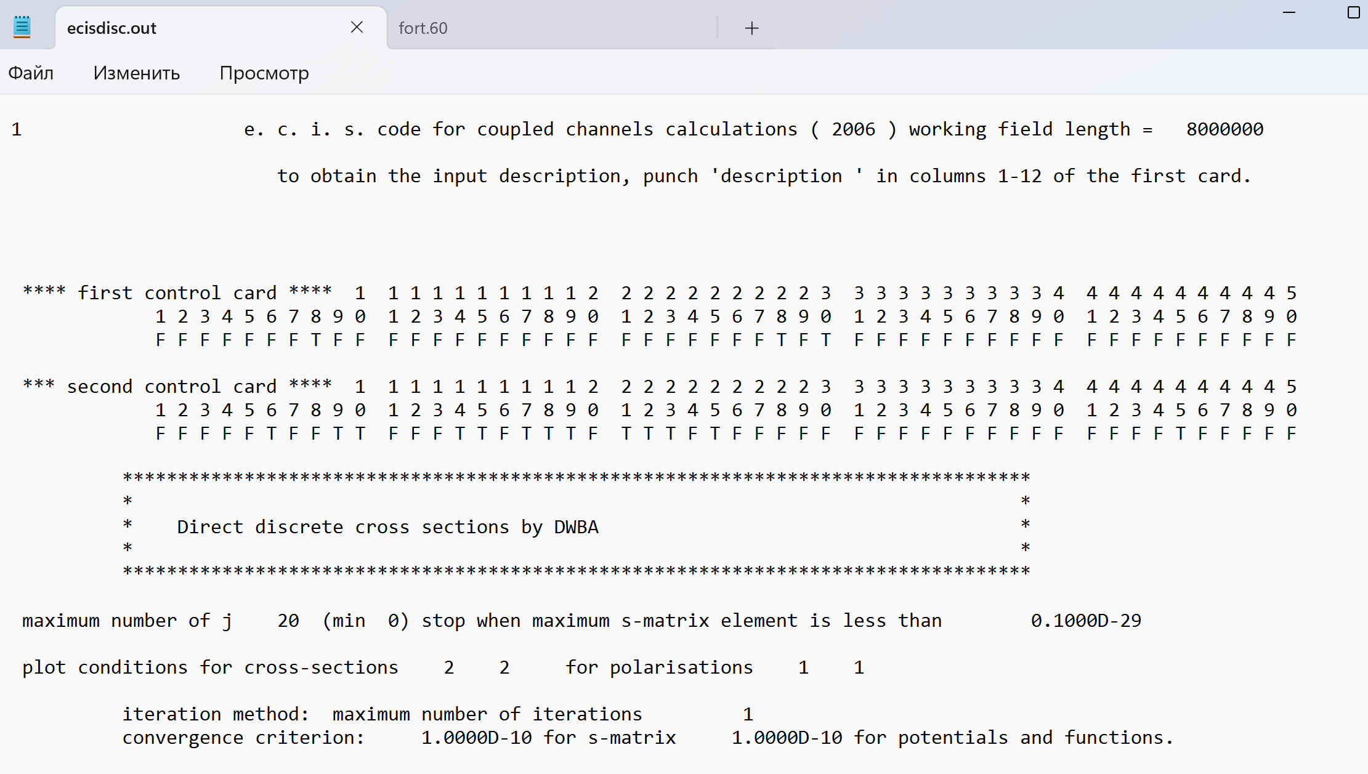
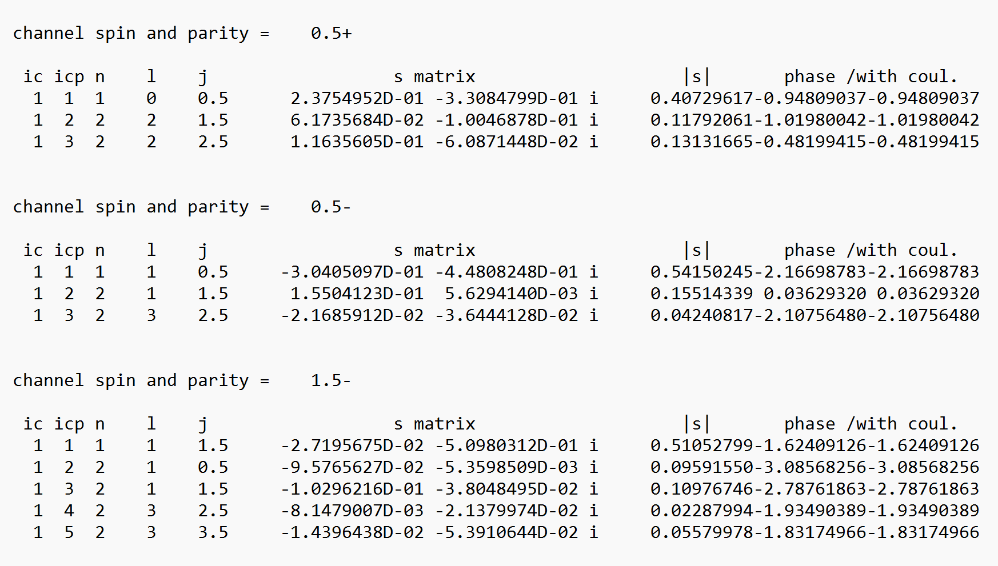
S-matrix – file fort.60
fort.60
ecisdisc.out

Slide 17
Thank you for your attention! 感谢您的关注

