Slide 1
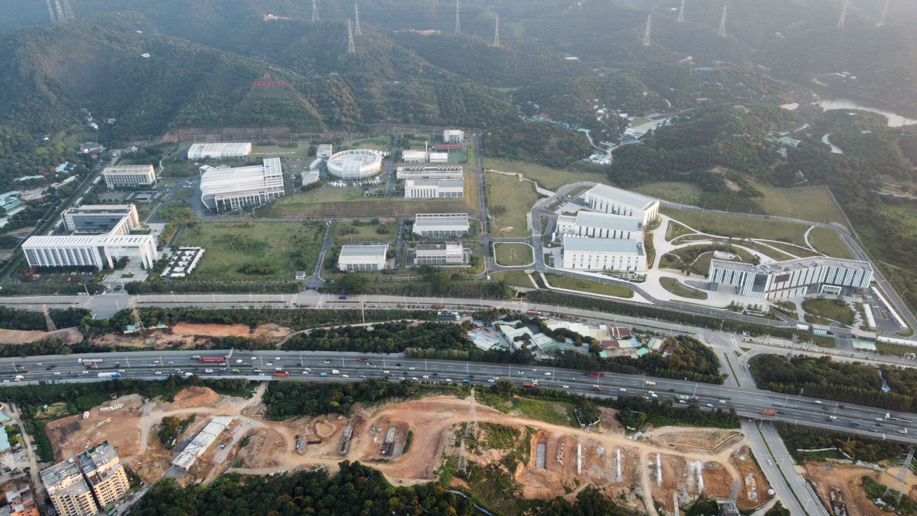
Measurement of relative differential cross sections of the n-p scattering reaction in the neutron energy range from 0.45 MeV to 8.5 MeV
Kang SUN(孙康), Wei JIANG, Ruirui FAN, Wenkai REN, Han YI, Yonghao CHEN, et al.
Back-n Cooperation Group, CSNS
May. 27, 2025

Slide 2
Contents
Recent n-p scattering experiments at Back-n
The n-p scattering experiment in 2024
Experimental setup
Data analysis
Preliminary results
Summary and Outlook

Slide 3
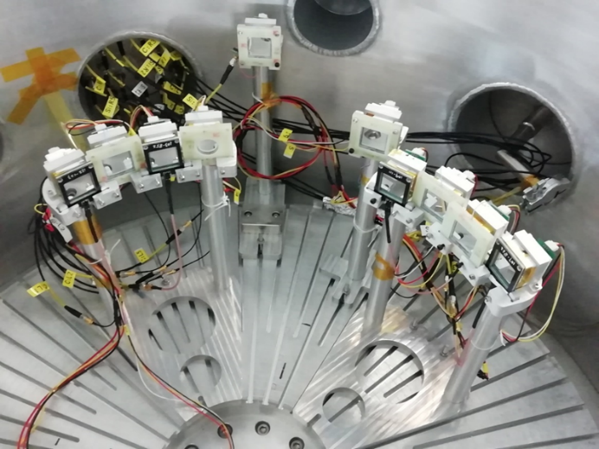
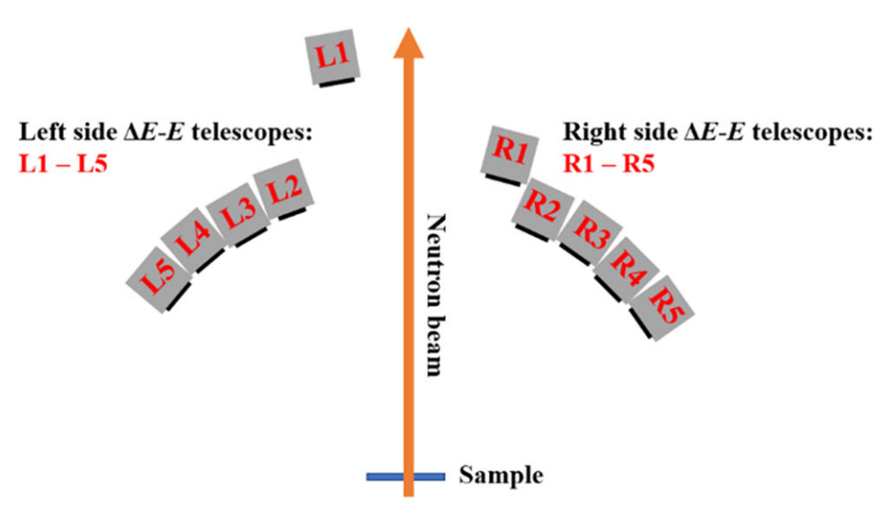
Research background
Importance of this research:
The n-p scattering reaction plays an important role in Fundamental Physics Research, Neutron Cross-Section Standard, Nuclear Data Evaluation and so on.
There are few results for the differential cross sections of n-p scattering reaction in the EXFOR in several MeV neutron energy regions.
The n-p scattering experiment in 2019:
The experimental goal is to measure the differential cross sections of n-p scattering reaction in the neutron energy range of 10-55 MeV.
10 sets of ΔE-E telescopes composed of Si-PIN and CsI(Tl) detectors were used.
The experimental sample is a 100 μm thick polyethylene film.
Detector layout for n-p scattering experiments

Slide 4
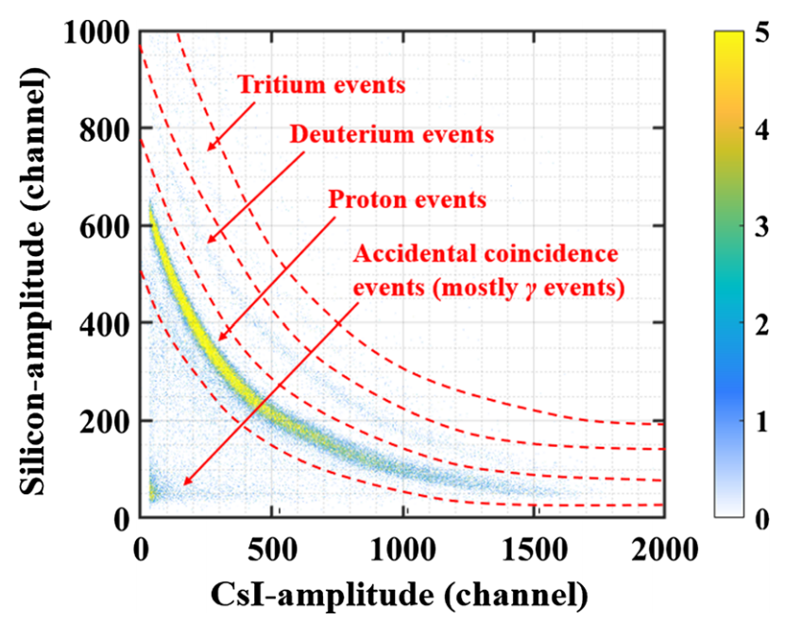
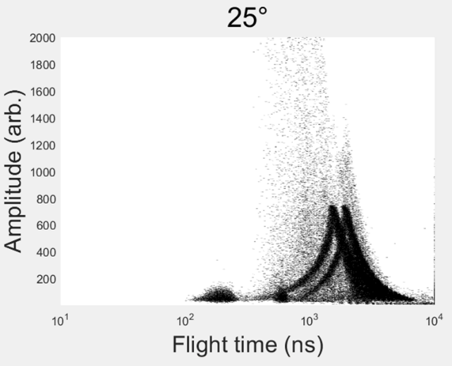
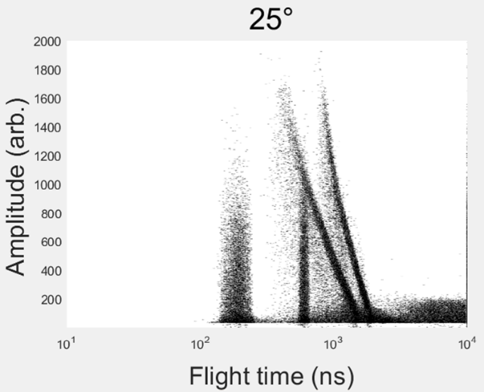
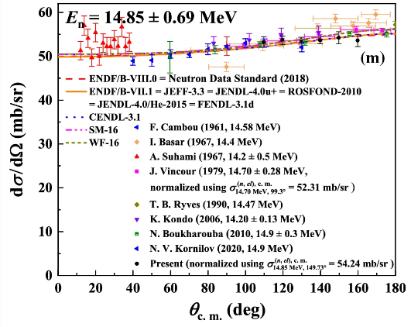
The n-p scattering experiment in 2019
The n-p scattering experiments in 2019:
23 energy points in the neutron energy range of 6.14 MeV – 52.48 MeV
Gave the relative differential cross sections of the n-p scattering reaction in the range of 70° to 160° in the center-of-mass system.
The experimental results：
A wider neutron energy range than previous measurements
The first measurement result in some energy ranges (such as 6.52 - 9.09 MeV)
Good consistency compared with existing measurement results, evaluation results and theoretical calculations.
Amplitude – TOF spectrum in Si-PIN
ΔE-E spectrum (Si + CsI)
Amplitude – TOF spectrum in CsI(Tl)
Relative differential cross sections at 14.85 MeV

Slide 5
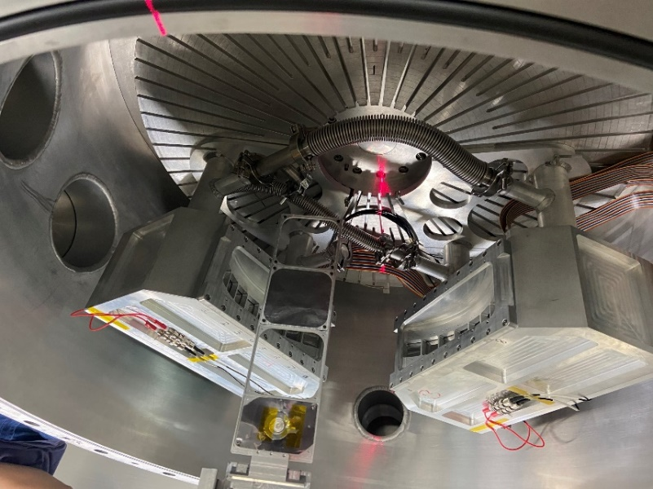
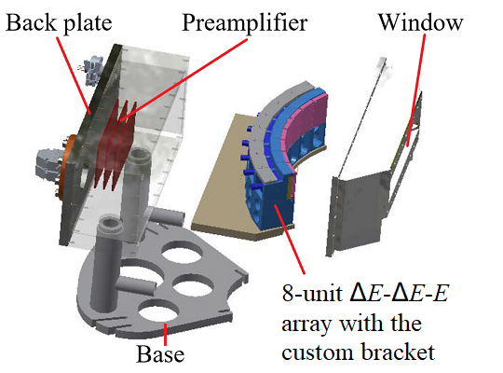
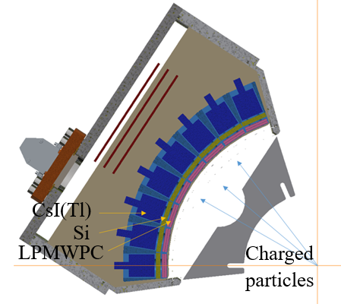
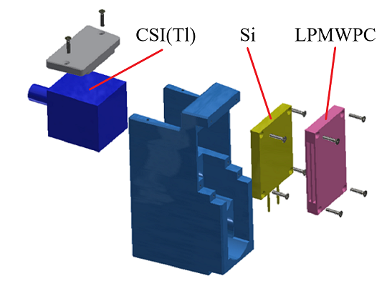
The n-p scattering experiment in 2020-21
The n-p scattering experiments in 2020 and 2021:
The experimental goal is to measure the differential cross sections of n-p scattering reaction in the neutron energy range of 1.5-15 MeV.
The 16-unit ΔE-ΔE-E telescope light-charged particle detector array, composed of low-pressure multi-wire proportional chamber (LPMWPC), Si-PIN and CsI(Tl) detectors were used.
The experimental sample is a 4 μm thick polypropylene film.
Neutron beam spots: Φ50+Φ50(in 2020), Φ50+Φ15(in 2021)
Detector layout for n-p scattering experiments
Structure of the 8-unit ΔE-ΔE-E Telescope Array

Slide 6
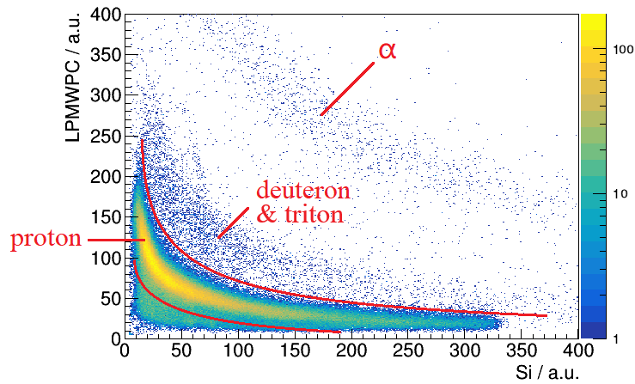
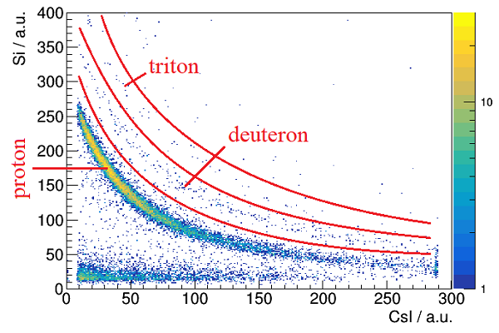
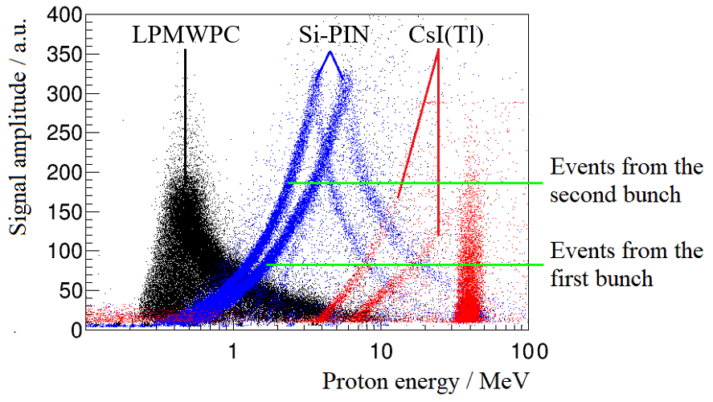
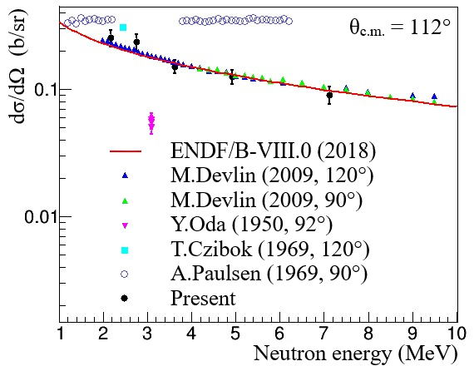
The n-p scattering experiment in 2020-21
Summary of the n-p scattering experiments in 2020 and 2021:
Protons with energies as low as 0.5 MeV can be identified using the ΔE−E method.
The relative differential cross sections at 2-7 MeV is given at 112° in the center-of-mass system.
The experimental accuracy is limited by the resolution and detection efficiency of LPMWPC.
The level-1 and level-2 ΔE−E spectrum of the ΔE-ΔE-E telescope
≈6.2 MeV
≈0.4 MeV
Amplitude – TOF spectrum in LPMWPC, Si-PIN and CsI(Tl)
Preliminary results of the relative differential cross sections

Slide 7
Contents
Recent n-p scattering experiments at Back-n
The n-p scattering experiment in 2024
Experimental setup
Data analysis
Preliminary results
Summary and Outlook

Slide 8
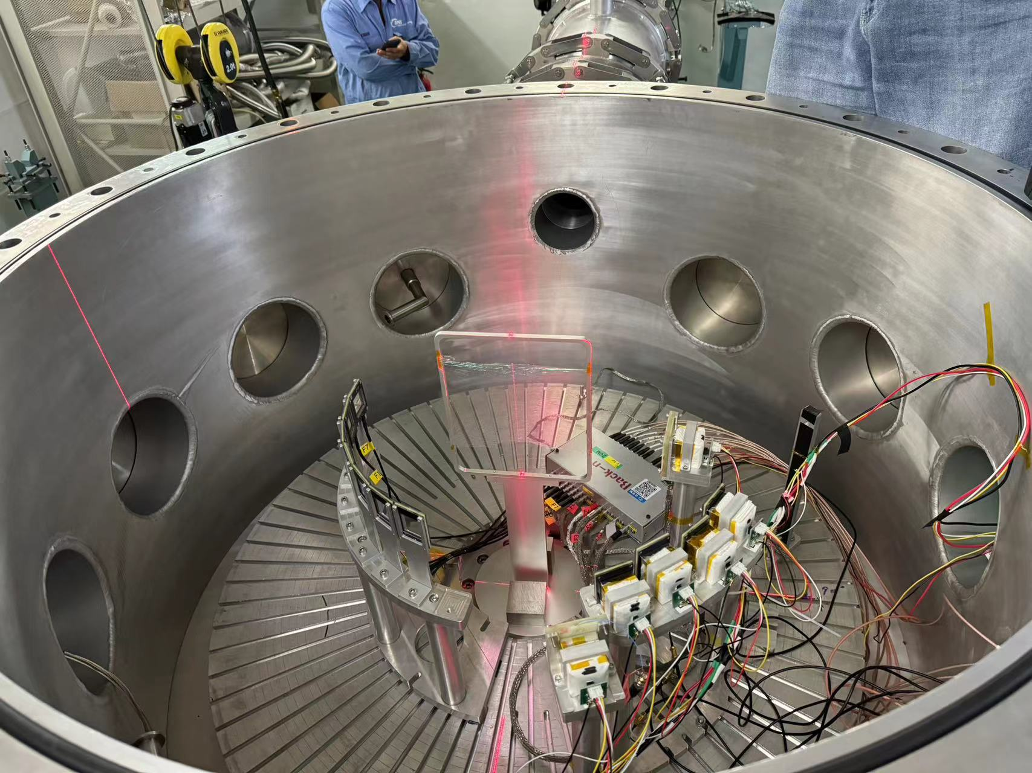
The n-p scattering experiment in 2024
Detector layout of the n-p scattering experiments in 2024
300 μm thick Si-PIN
30 mm thick CsI
Right side
7 Si-PINs
A1-A7
22.4° - 91°
A7
A1
Neutron beam
B1
Sample 0°
Left side
6 sets of ΔE-E telescopes B1-B6
19° - 79°
LPDA vacuum chamber
B6
Detector layout for n-p scattering experiments

Slide 9
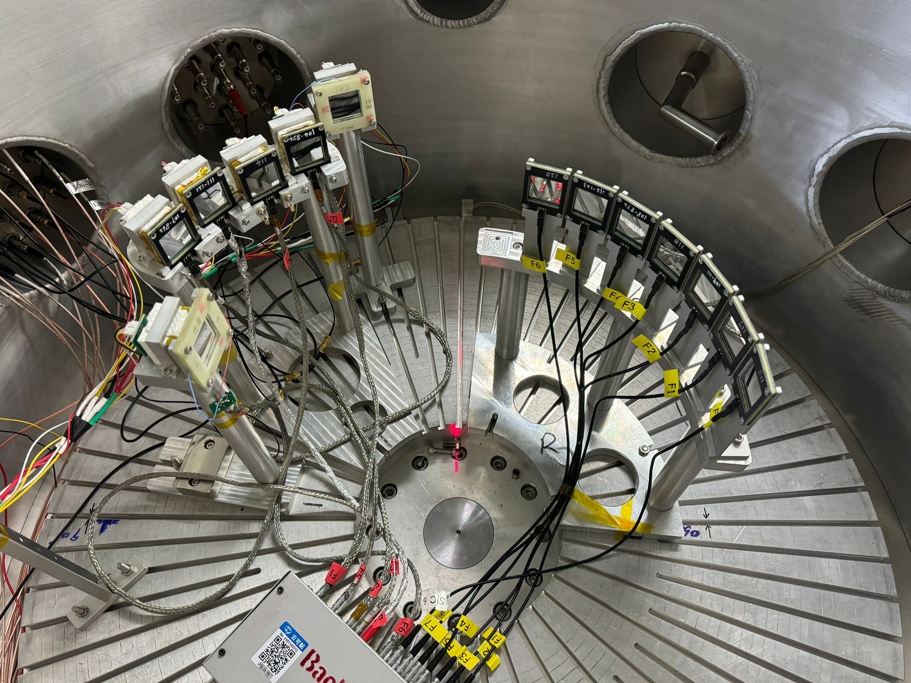
Experimental setup
B1
Detector system setup
A1-A7: Si
Angles: 22.4°, 33.9°, 45.3°, 56.7°, 68.1°, 79.6°, 91°
Distances: 189.5 mm
B1-B6: Si + CsI
Angles: 19°, 29°, 39°, 49°, 59°, 79°
Distances: B1=295 mm, B2=B4=249 mm, B3=B5=240 mm, B6=170 mm
Sample: 500 nm thick Mylar film
Neutron beam spots:
Φ50+Φ50 (big spots,118 h),
Φ50+Φ15 (small spots, 47 h)
A1
B6
A7
Detector layout for n-p scattering experiments

Slide 10
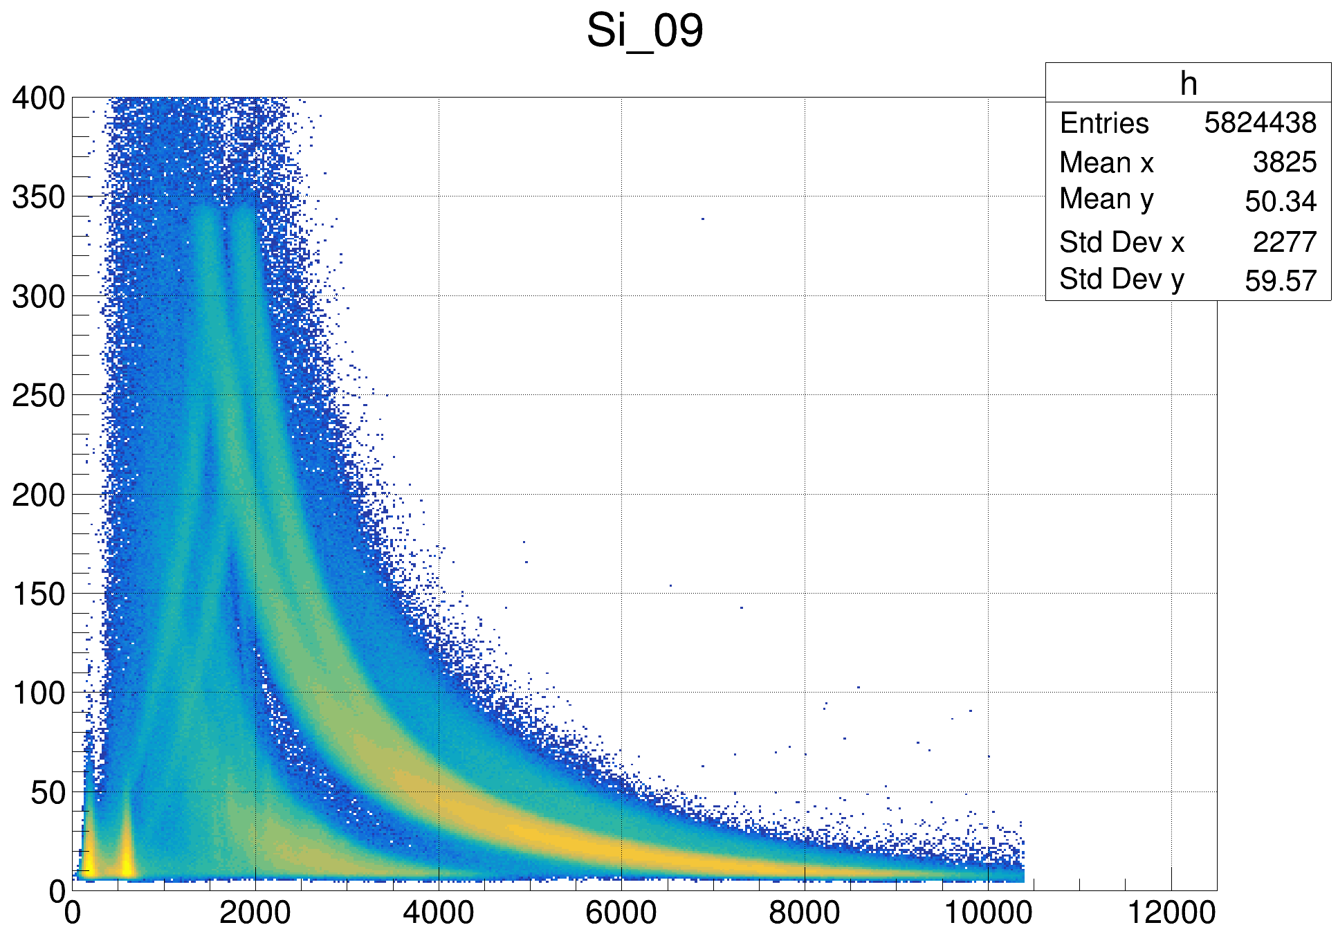
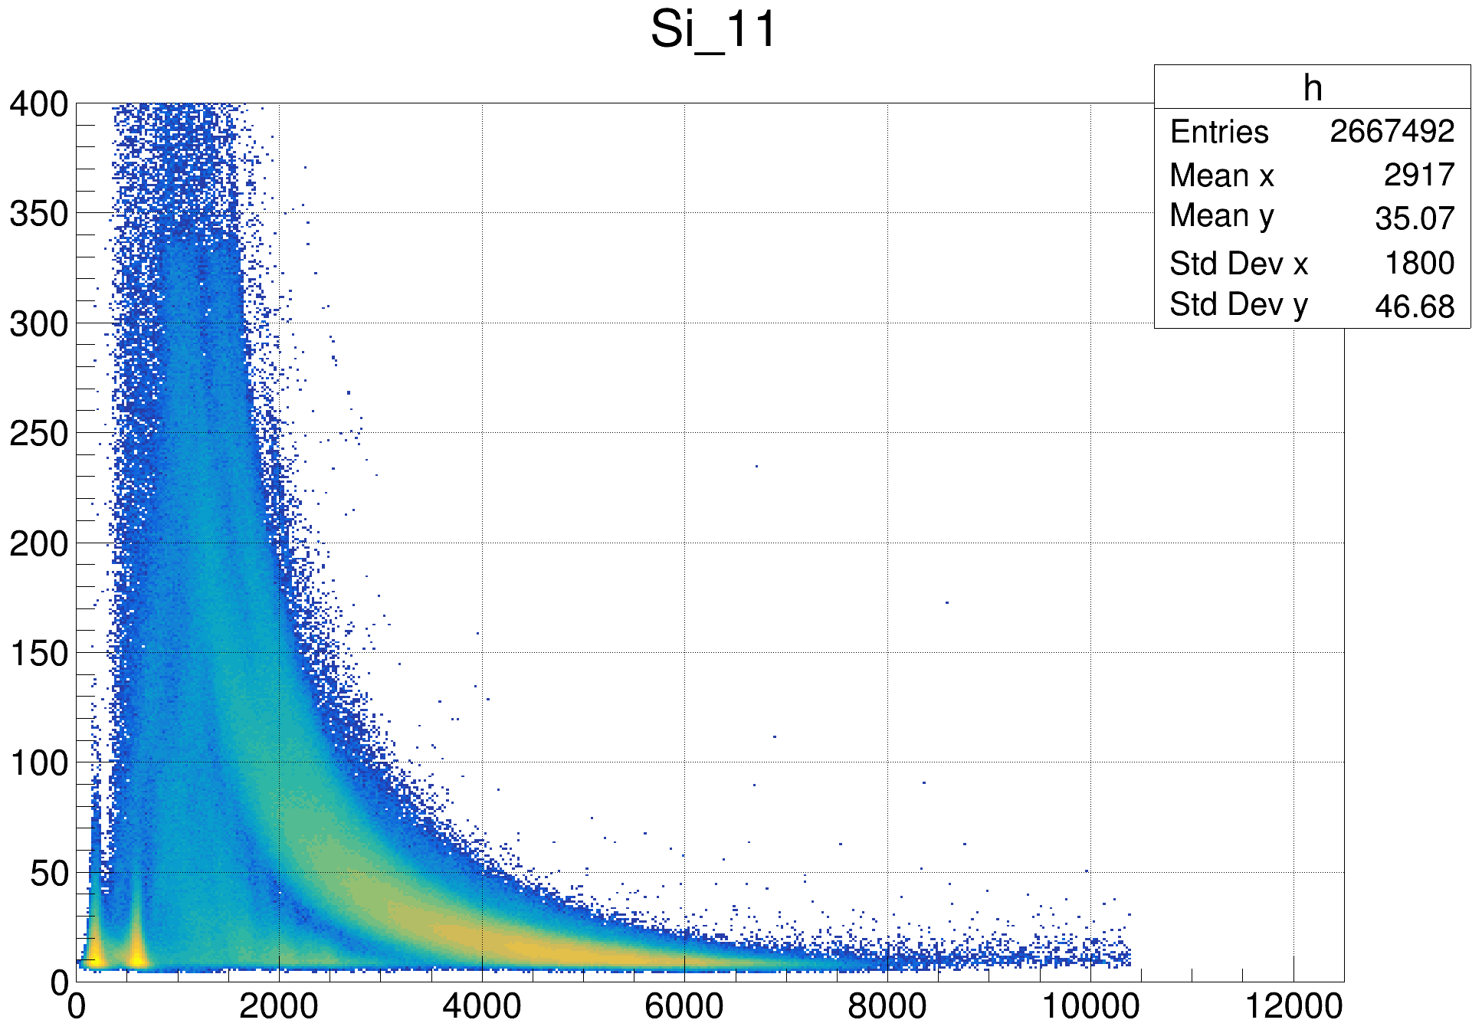
Amplitude – TOF spectrum
Amplitude – TOF spectra at different angles using big spots
A2 33.8° 18.95 cm
A4 56.7° 18.95 cm
protons
¹⁶O(n, α)

Slide 11
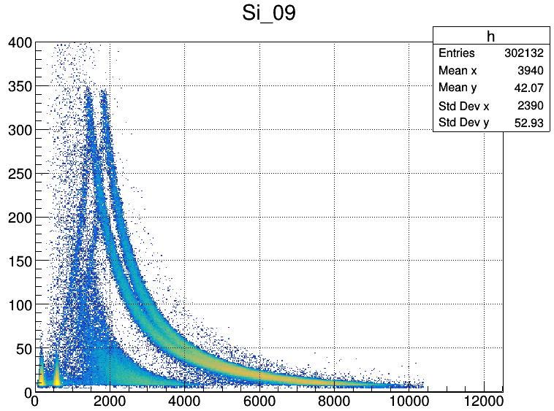
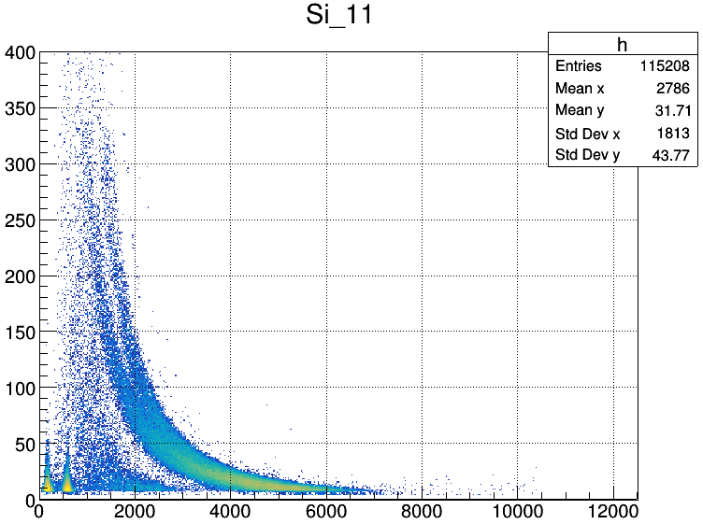
Amplitude – TOF spectrum
Amplitude – TOF spectra at different angles using small spots
A2 33.8° 18.95 cm
A4 56.7° 18.95 cm
protons
¹⁶O(n, α)

Slide 12
Double-bunch unfolding methods
Folded Amplitude – TOF spectrum (A2 33.8°)
Double-bunch unfolding methods
In the normal operation mode of CSNS, there are two proton bunches with a time interval of 410 ns in each pulse which has a repetition frequency of 25 Hz.
To nearly recover the event distribution corresponding to a single proton bunch, the unfolding methods have been developed.
Unfolded Amplitude – TOF spectrum (A2 33.8°)

Slide 13
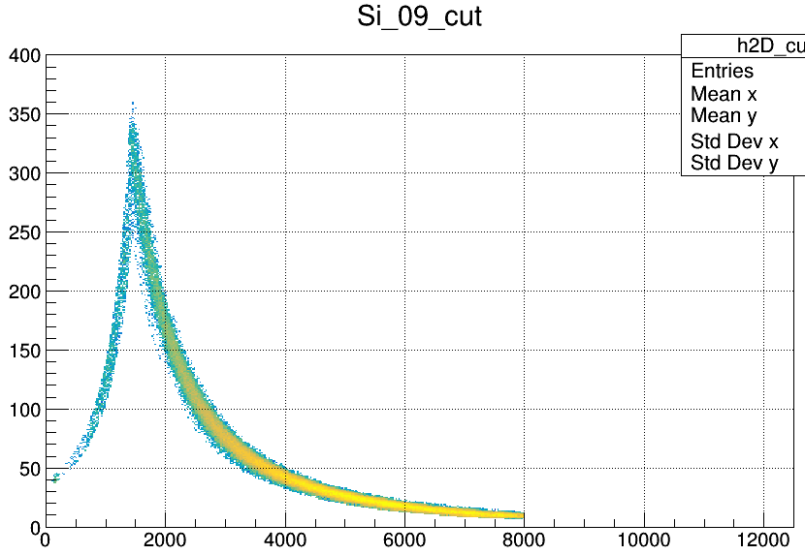
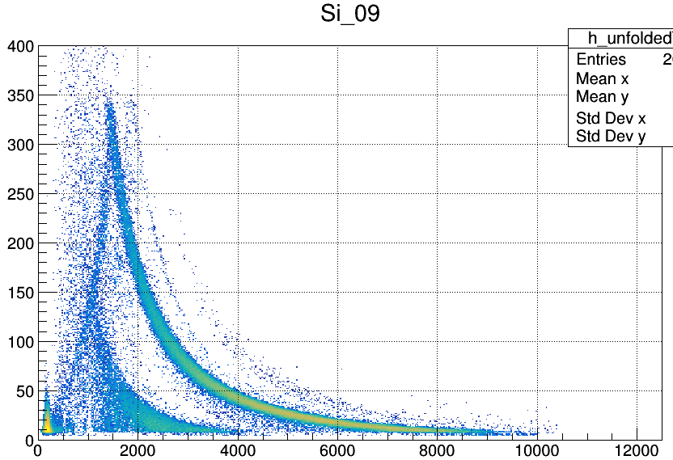
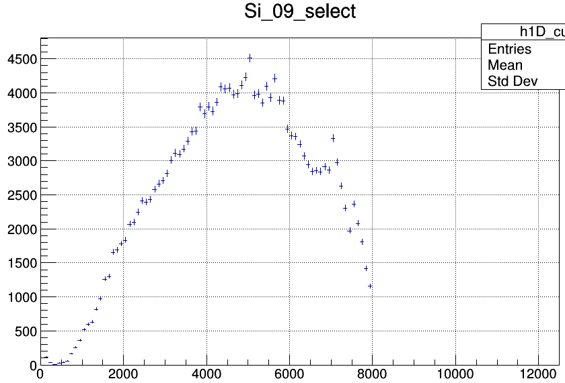
Selection of proton events
Select proton event bands in the unfolded Amplitude – TOF spectrum by two different methods:
Using the Graphical Cut tool in ROOT to manually select the proton event band.
Derive the approximate function of the proton event band, then use this function to select the proton event band.
Using the approximate function method
Project the selected proton event band onto the x-axis and calculate the error for each bin, including statistical errors and unfolding errors.
Using the Graphical Cut tool
The projection of the proton event band onto the x-axis

Slide 14
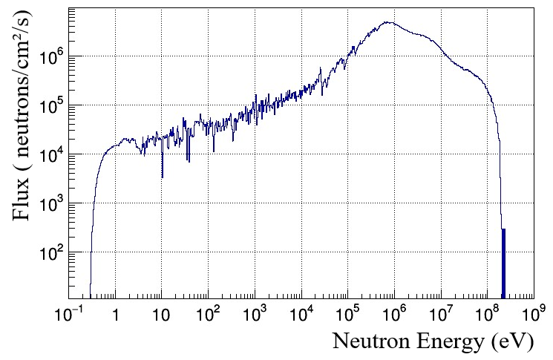
Preliminary results
For the projection of the proton event band, calculate the neutron energy for each bin by the Time-of-Flight (TOF) method.
Normalize the data based on the neutron energy spectrum of Back-n.
Convert the relative differential cross sections in the laboratory system to the relative differential cross sections in the center-of-mass system.
Calculate the normalization coefficient so that the experimental results match the existing results of evaluations of ENDF/B-VIII.0 library.
Angles in lab system：
Red：19°
Orange：22.4°
Yellow：29°
Green：33.9°
Cyan：39°
Blue：45.3°
Violet：49°
Black：56.7°
The neutron energy spectrum of Back-n ES#2 at 100 kW
The preliminary results of the relative differential cross sections of n-p scattering (8 angles, obtained by small spots data)

Slide 15
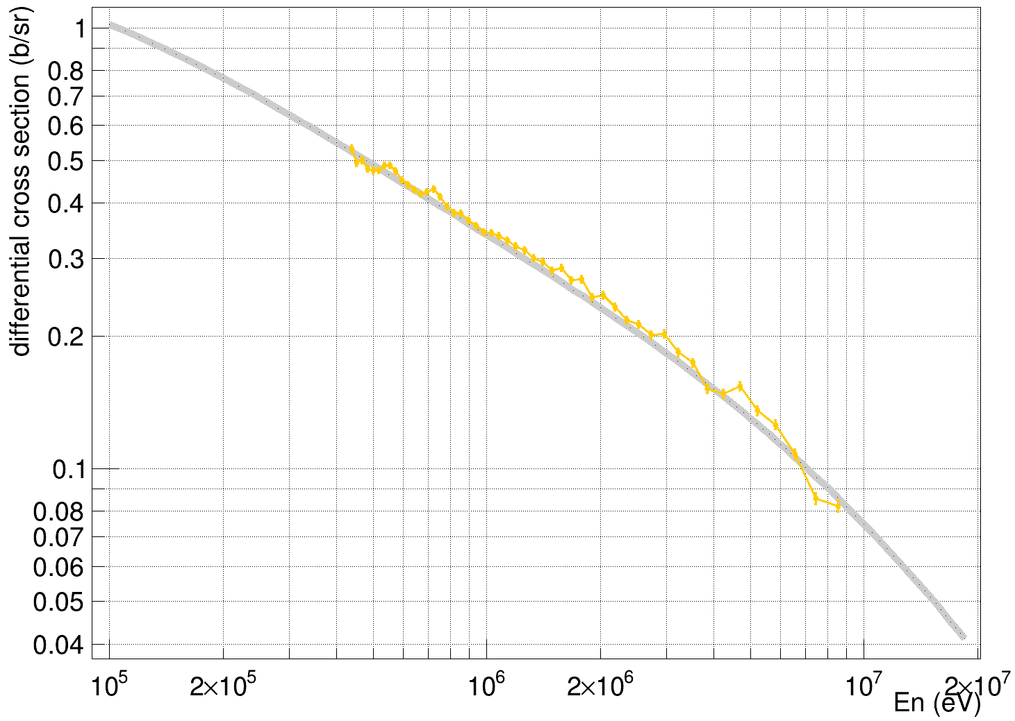
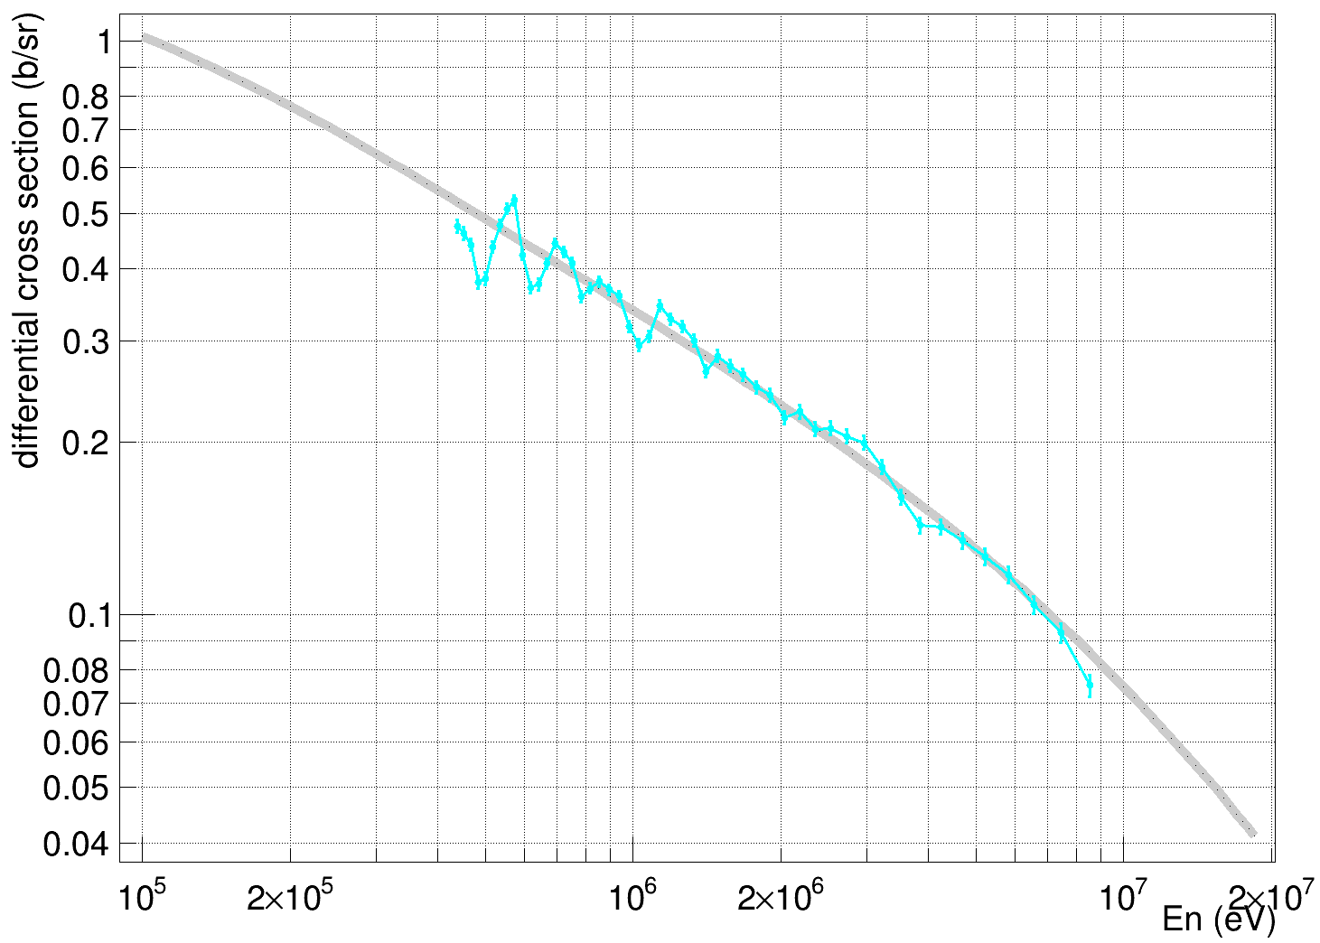
Preliminary results
The preliminary results of the relative differential cross sections of n-p scattering at 22.4° and 39° in the laboratory system as examples, compared with existing results of evaluations of ENDF/B-VIII.0 library.
Affected by noise of the detector system, the effective lower limit of the neutron energy of the differential cross sections of the small-angle detector in the laboratory system is lower than that of the large-angle detector.
Angles in lab system：
Orange：22.4°
Angles in lab system：
Cyan：39°
The preliminary results of the relative differential cross sections of n-p scattering (22.4°, obtained by small spots data)
The preliminary results of the relative differential cross sections of n-p scattering (39°, obtained by small spots data)

Slide 16
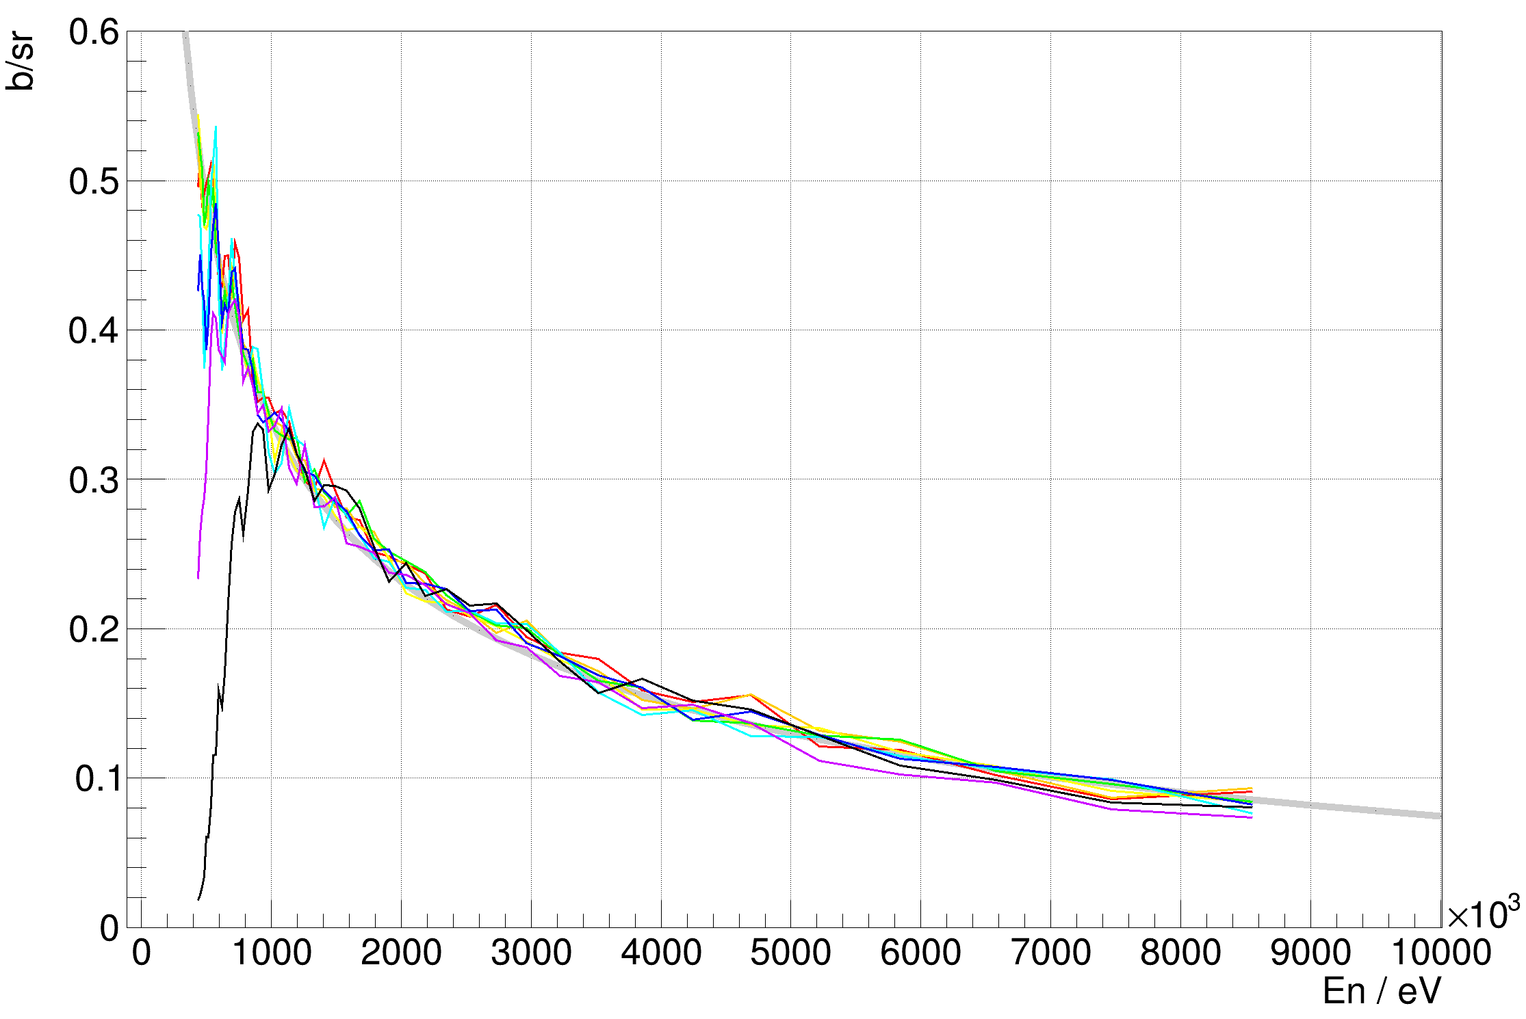
Preliminary results
The preliminary results obtained by the data in different neutron beam spots (small spots and big spots).
The trend of small spots results are in better agreement with evaluation data in low neutron energy region (0.5 – 2.5 MeV).
big spots results show smaller statistical errors in high neutron energy region (3 – 8 MeV).
The preliminary results obtained by small spots data
The preliminary results obtained by big spots data

Slide 17
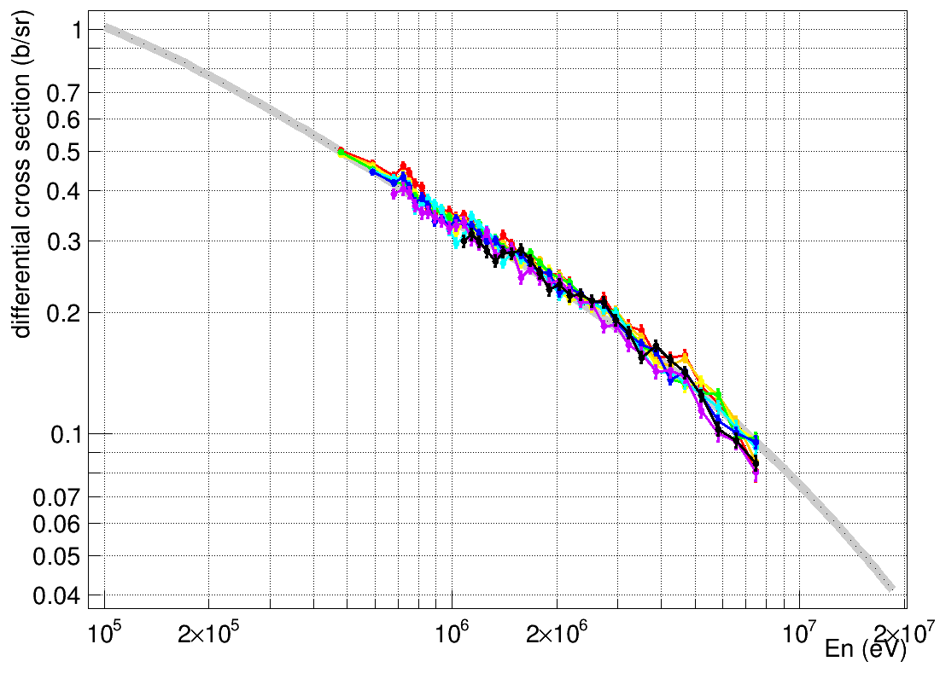
Preliminary results
Using listed methods to improve the oscillation of the differential cross sections in the low-energy region:
Increasing the width of each energy point and in the low-energy region;
Increasing the effective lower limit of the neutron energy of the differential cross sections of the large-angle detector
Angles in lab system：
Red：19°
Orange：22.4°
Yellow：29°
Green：33.9°
Cyan：39°
Blue：45.3°
Violet：49°
Black：56.7°
The preliminary results of the relative differential cross sections of n-p scattering
The corrected results of the relative differential cross sections of n-p scattering

Slide 18
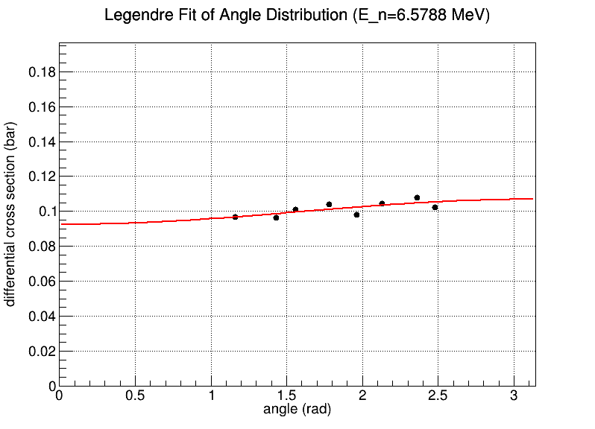
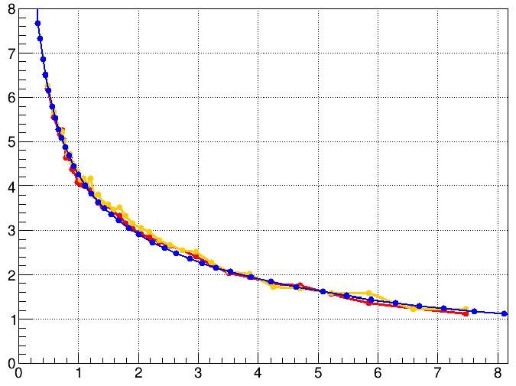
Angular integrated cross sections
For the relative differential cross sections of n-p scattering at different angles, fit the experimental data for each energy point using the Legendre polynomial.
The angular integrated cross sections for n-p scattering can be obtained by integrating.
Cross-section / b
E_{n} / MeV
The angular distribution and fitting results of the n-p scattering differential cross sections at 1.9 MeV.
The angular distribution and fitting results of the n-p scattering differential cross sections at 6.6 MeV.
The angular integrated cross sections vs cross sections data from ENDF

Slide 19
Summary and Outlook
The present results
The relative differential cross sections of the n-p scattering reaction in the center-of-mass system from 66° to 142° in the neutron energy range from 0.45 MeV to 8.5 MeV were obtained from 8 Silicon detectors in the ∆E−E telescope array and the Silicon detector array.
Next steps
Combining the respective advantages of small spots results (better agreement with evaluation data in low neutron energy region) and big spots results (smaller statistical errors in high neutron energy region) to obtain better relative differential cross sections.
Giving the system errors and statistical errors of each energy point.

Slide 20
Thanks for listening!

