Slide 1
Investigate the physical processes occurring during beads production
Formation of a drop
Heat exchange of liquid nitrogen with the surrounding space
Heat exchange of a drop with liquid nitrogen
Cooling and crystallization of a drop
Adhesive properties of balls
.
Notes:
To refine this process, we’re examining:
Drop formation.
Heat exchange between liquid nitrogen and its surroundings.
Heat exchange between the drop and liquid nitrogen.
Cooling and crystallization of the drop.
Adhesive properties of the beads.

Slide 2
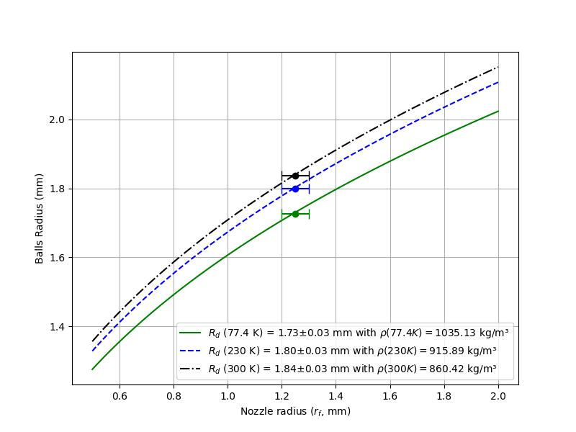
Formation of a drop
Force balance:
Droplet detachment radius:
Correction to the bead radius based on density change:
Notes:
The bead starts as a droplet formed through(тру) a nozzle. The nozzle size dictates the droplet size, and the graph displays these sizes, adjusted for the bead’s density increase during cooling

Slide 3
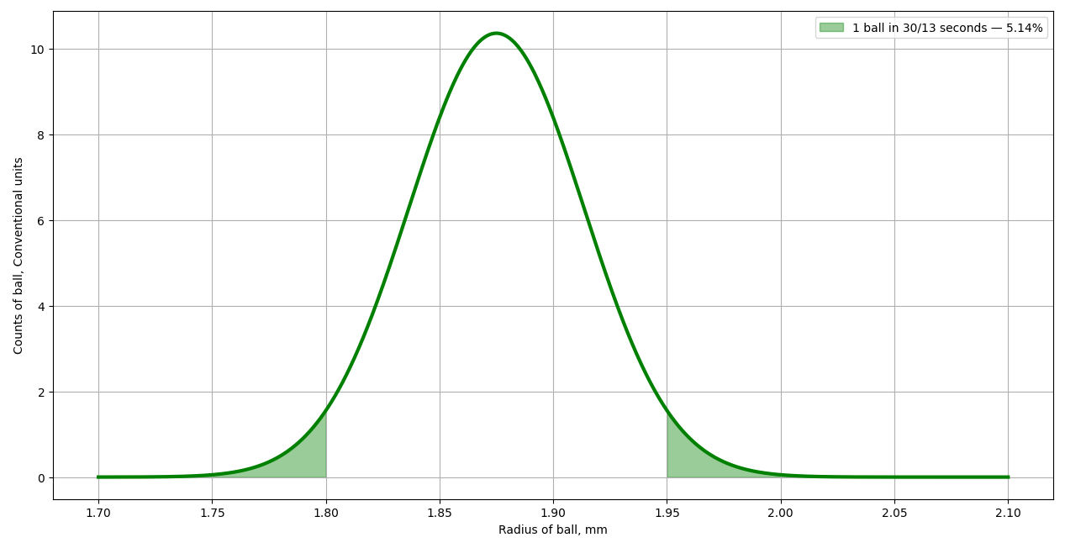
Formation of a drop
Nozzle Radius (mm) | Detachment Mechanism
r_{f} < 2.04 | Rayleigh-Plateau Instability
2.04 < r_{f} < 4.37 | Gravity > Surface Tension
r_{f} > 4.37 | Taylor Instability
Dependence of droplet detachment mechanisms on nozzle radius for a mesitylene and meta-xylene mixture [1]
[1] A. I. Grigoriev, A. A. Zemskov, Detachment of a drop from a capillary under the action of gravity. Nauchnoe Priborostroenie 1, 50–58 (1991).
Therefore, the size distribution of balls can be described using a normal distribution with a mean ball radius of 1.875 mm and a standard deviation of 0.0385 mm
Notes:
In our setup, droplet detachment results from Rayleigh-Plateau (релея-плато) instability, where capillary waves are the source of separation. This makes bead size a distributed quantity due to this stochastic factor

Slide 4
Heat exchange of liquid nitrogen with the surrounding space
Notes:
Liquid nitrogen absorbs energy via external radiation across its surface, mainly from the device walls. However, within the cells, this influence is small, enabling a calm liquid surface—crucial for constructing an accurate analytical model. The video demonstrates this clearly.

Slide 5
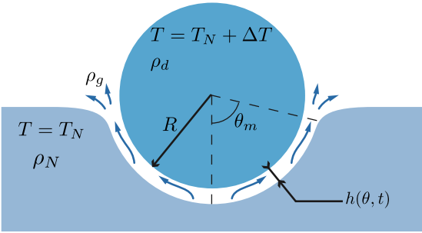
Heat exchange of a drop with liquid nitrogen(Inverse leidenfrost effect)
Therefore
Heat exchange of a steam pillow
Lubrication theory:
ΔT = 0 and quasi-static limit:
A Gauthier, CD R ´emi, D Lohse, D van der Meer, Self-propulsion of inverse leidenfrost drops on a cryogenic bath. Proc. Natl. Acad. Sci. 116, 1174–1179 (2019).
M Adda-Bedia, et al., Inverse leidenfrost effect: Levitating drops on liquid nitrogen. Langmuir (2016).
Notes:
My work builds on research by scientists like Gauthier and Adda-Bedia, who explored the Inverse Leidenfrost Effect—where a hot droplet levitates over a cold liquid on a vapor cushion. This slide includes three formulas: the energy conservation law (describing heat exchange through the vapor cushion), the mass conservation law (describing the cushion’s pressure), and an estimate of the constant vapor cushion when the droplet’s temperature matches that of liquid nitrogen

Slide 6
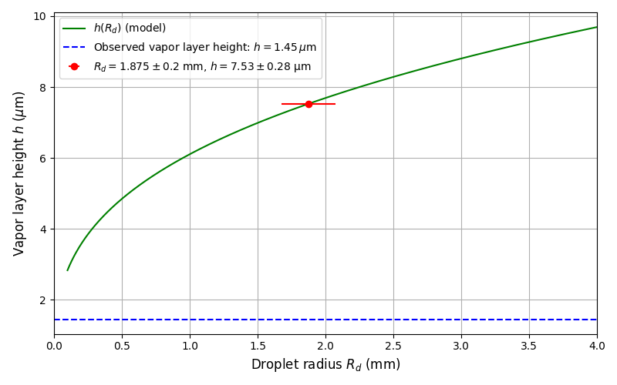
Inverse leidenfrost effect
Thickness of the constant vapor cushion caused by external radiation
Notes:
The vapor cushion supports the droplet’s levitation even after it has fully cooled, keeping it separated from the liquid nitrogen

Slide 7
Theory | Experiment
2.35 s | 3 +- 1 s
17 s | -
10 s | -
13.26 s | 13 +- 1 s
Inverse leidenfrost effect
Duration of cooling of a liquid droplet to its melting temperature:
Duration of droplet crystallization:
Cooling of the beads to the Leidenfrost temperature of liquid nitrogen:
Duration of beads levitation:
Inverse Leidenfrost Effect: Levitating Drops on Liquid Nitrogen / M. Adda-Bedia, S. Kumar, F. Lechenault, S. Moulinet, M. Schillaci, D. Vella // Langmuir 2016, 32, 17, 4179–4188
Notes:
The model we’ve developed aligns well with experimental data for key durations: cooling to melting temperature and levitation time

Slide 8
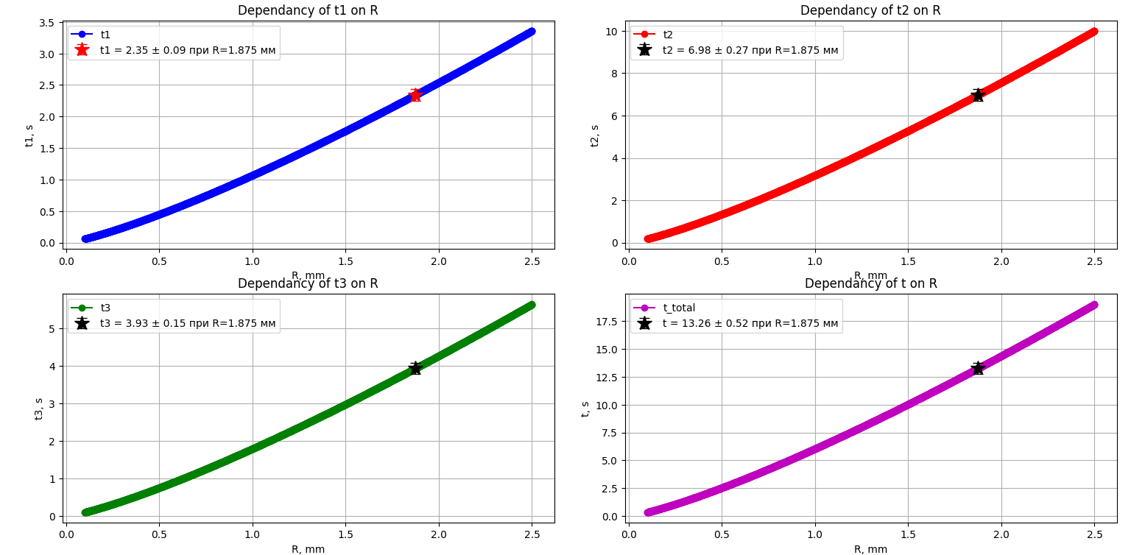
Inverse leidenfrost effect
Notes:
These are graphs obtained from our model, showing how cooling time (t) increases with droplet radius (R)

Slide 9
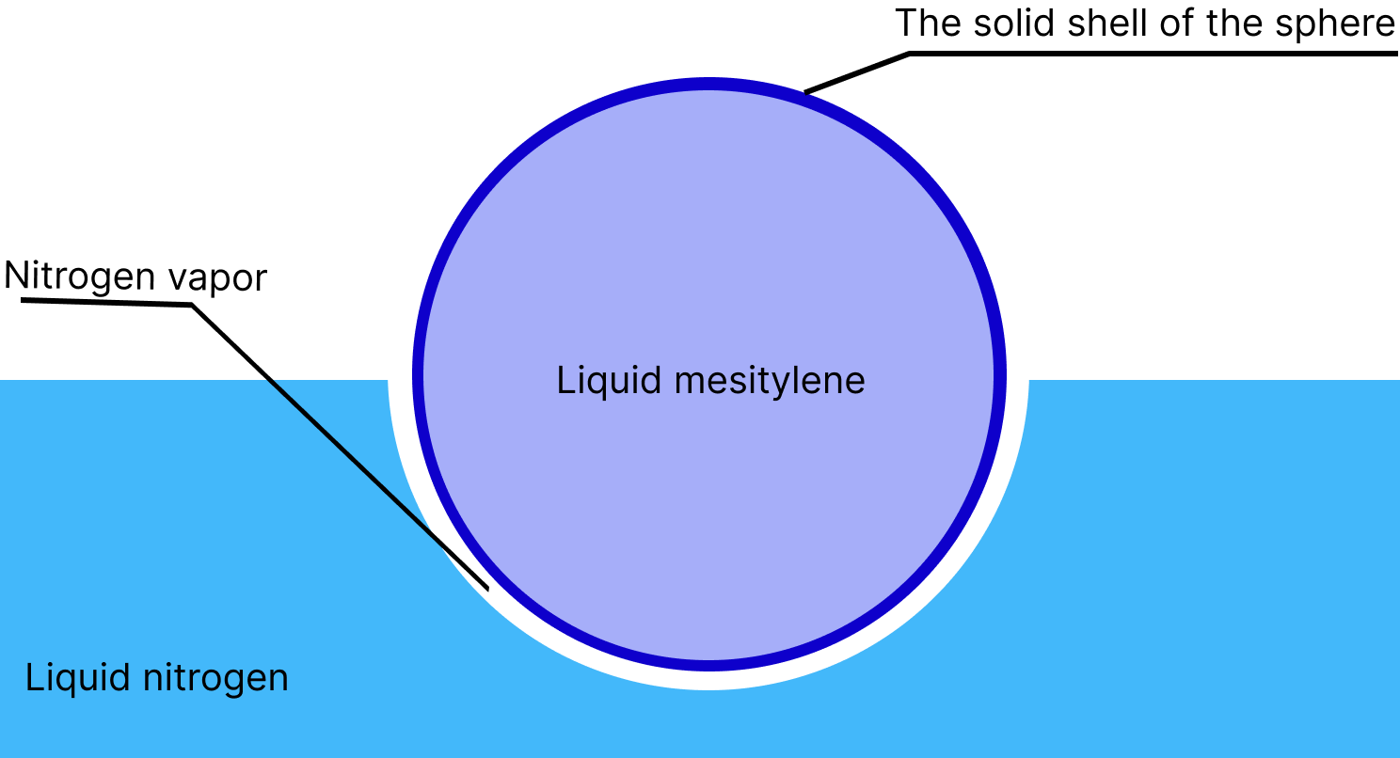
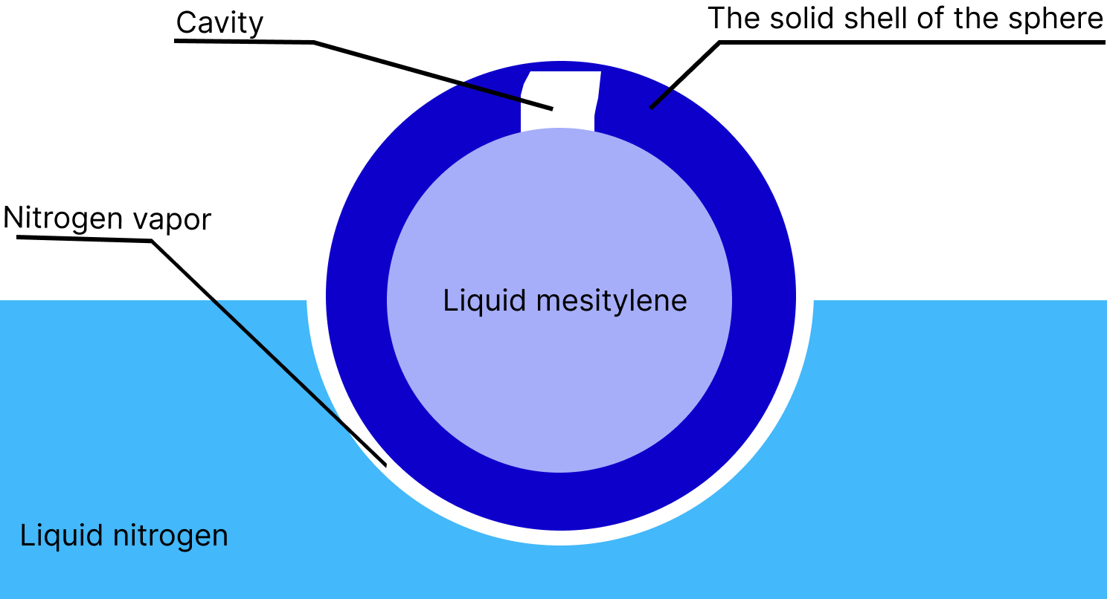
Cooling and crystallization of a drop
Formation of a solid outer shell
Formation of a cavity inside the beads
The shape of the bead, the shape of the cavity, and the size of the bead depend on: the intensity of heat exchange, the initial size of the droplet, and the initial temperature of the droplet The bead will break during production if the heat exchange intensity exceeds the critical value The size of the bead affects its shape, as in the case of the direct Leidenfrost effect [1]
[1] Geometry of the Vapor Layer Under a Leidenfrost Drop / J. C. Burton and etc. // Physical Review Letters, 2012, 109(7), 074301–617
Notes:
As the droplet cools, a solid shell forms, followed by internal crystallization, often leaving a cavity due to contraction. Bead shape and size depend on heat exchange intensity, droplet size, and initial temperature. Cracks are always present and can lead to destruction if heat exchange is too intense

Slide 10
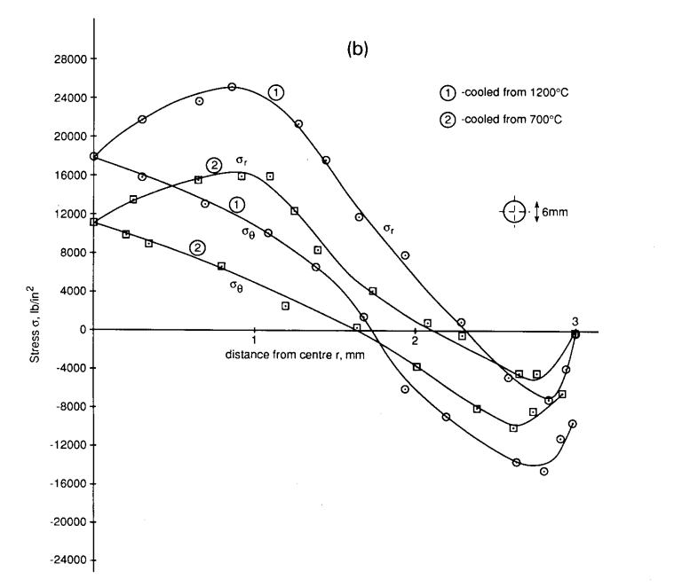
Solidification of the Inner Layer
Longitudinal stresses
The outer layer solidifies without volume change
Molecules tend to increase the material's density
A mechanical stress gradient forms between the core and the shell
A crack forms. Mechanical stress decreases
Transverse stresses
Mechanical stresses in a glass bead after cooling [1]
A cavity forms as the mechanical stress decreases proportionally to the growth [2]
[1] Residual-stress measurements and calculations and hypotheses for explaining disintegrating fracture // W. Johnson, S. Chandrasekar // Journal of Materials Processing Technology, 31 (1992) 413-440
[2] Площадь свободной поверхности как критерий хрупкого разрушения / Ерасов В.С., Орешко Е.И., Луценко А.Н // Авиационные материалы и технологии. 2017. №2 (47). С. 69–79
Notes:
During inner solidification: the outer shell solidifies without volume change, density rises, mechanical stresses develop between the core and shell, and cracks may emerge, relieving stress and leaving a cavity—similar to stress patterns in cooled glass beads. This suggests that the beads are similar to Rupert's drops.

Slide 11
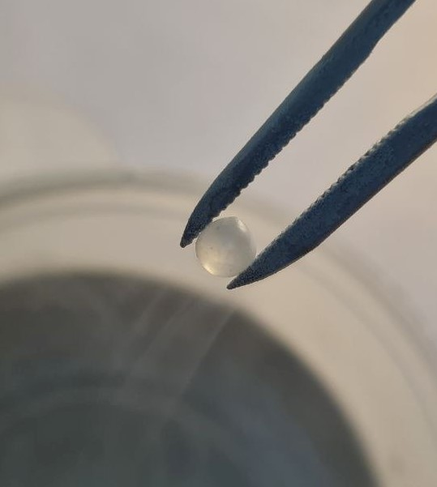
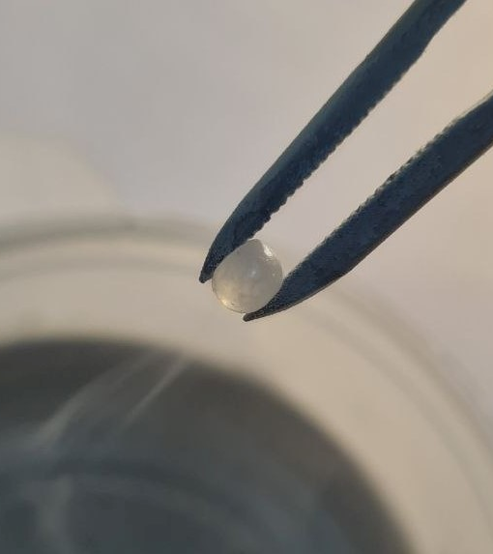
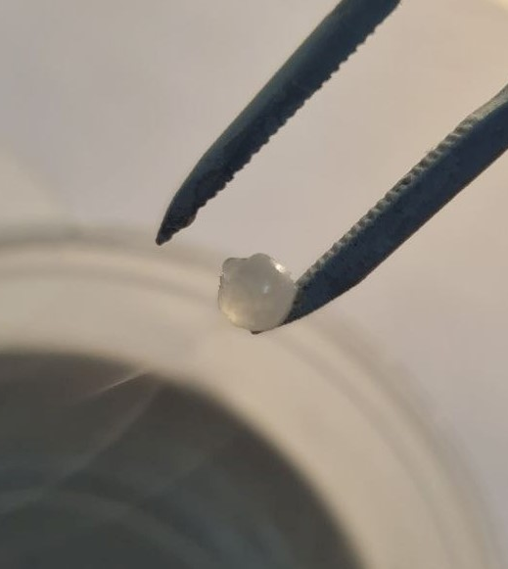
Adhesive properties of the beads
a)
b)
c)
Manifestation of plastic properties and high adhesion upon heating a frozen bead made from a mesitylene-m-xylene mixture: a) bead at 80 K in heated tweezers, b) plastic deformation of the bead under tweezers' pressure during heating, c) adhesion of the bead to the tweezers.
Notes:
Initially, the frozen bead doesn’t stick; then, it deforms under pressure; finally, at one hundred fifty K, it adheres to the tweezers, showing plastic and adhesive traits as it warms

Slide 12
Enhancement of heat exchange between the bead and the vapor cushion
Parameters for the production of balls from a mixture of 280 mL.
Parameter | Value
Duration of production of one ball (s) | 30/13 | 10 | 7
Voltage and current supplied to the nichrome wire (V, A) | 0, 0 | 15.69, 2 | 23.69, 3
Production time (h) | 6 | 3 | 2
Frequency of adding liquid nitro- gen (times/h) | 1 | 3 | 3
Defective balls with a diameter greater than 3.9 mm (%) | 2.5 | 8.5 | 12.5
Defective balls with a diameter less than 3.6 mm (%) | 2.5 | 1.5 | 0.5
Notes:
For a two hundred eighty mL liquid batch, we manufactured beads and obtained these figures: bead production times of 7 to Thirty seconds, nichrome wire power from 0 to twenty three point sixty nine V and 3 A, total production times of 2 to 6 hours, nitrogen refill frequencies, and defect rates as shown. As you can see, the acceleration of production leads to an increase in the number of defective balls. Moreover, there are fewer small balls, and significantly more large ones

Slide 13
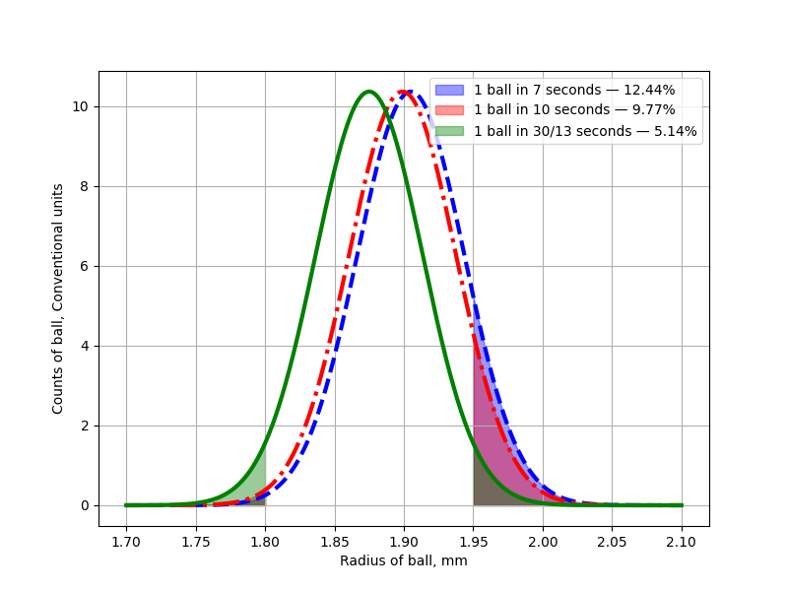
Enhancement of heat exchange between the bead and the vapor cushion
Schematic representation of the size distribution of balls at different levitation
times. The shaded areas denote balls with diameters smaller than 3.6 mm and larger than 3.9 mm.
Notes:
This schematic shows bead size distribution versus levitation time. Adjusting levitation time alters the average bead size, with shaded areas marking defects (<3.6 mm or >3.9 mm). This behavior is expected for the previously announced model

Slide 14
Comparison of Conventional and Automated Devices
 | Conventional Device | Automated Device (Production is nearing completion)
Productivity | 50 mL/h | 1 L/h
Device preparation and shutdown | About 20 minutes | A few minute
Maintenance frequency | After producing a batch (1/3 liter of beads) + refilling liquid nitrogen every hour | Not required
Employee safety | Contact with liquid nitrogen and mesitylene mixture | Button press, remote control
Control of defective beads | After batch production | In real-time
Nitrogen-free storage capability | Not available | Possible
1 person per 4 devices (5 employees)
Variations in bead shape and size = potential issues with the dispenser
18 conventional devices < 1 Automated Device
Emergency bead production possible
Absence of employee contact with liquid nitrogen and the mesitylene mixture, as well as a significant reduction in routine work.
Notes:
Our automated device offers: 1 L/h productivity versus 50 mL/h, minimal setup time, no frequent maintenance, safer remote operation, real-time defect monitoring, and potentional nitrogen-free storage. It also enables emergency bead production when needed and outperforms 18 conventional units

Slide 15
Thanks
Notes:
In summary, by harnessing the Inverse Leidenfrost Effect, we’ve created an automated device that vastly(вастли) improves productivity, safety, and quality for cold neutron source materials. There’s a wealth(велф) of additional information available that I haven’t covered here, and I’ll do my best to answer any questions. Thank you for listening!

