Slide 1
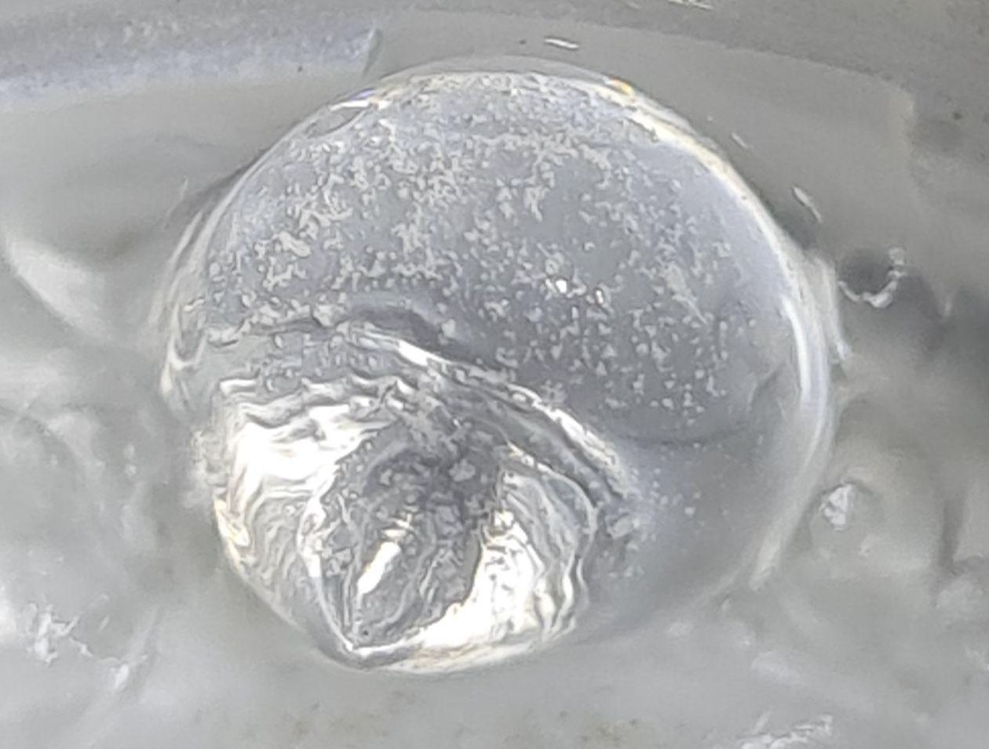
Investigation of the Inverse Leidenfrost Effect in the Production of Moderating Material for Cold Neutron Sources
I. L. Litvak,
M. V. Bulavin,
A. V. Galushko,
R. V. Chepurchenko
Notes:
Good evening, everyone. Before I begin, I’d like to thank our Chinese colleagues for their excellent organization of this event and the delicious food they’ve provided. My name is Ivan, and I’m here to present our research titled "Investigation of the Inverse Leidenfrost Effect in the Production of Moderating Material for Cold Neutron Sources." This work was done together with M. V. Bulavin, A. V. Galushko, and R. V. Chepurchenko. Let’s get started!

Slide 2
Current Challenges
Required |  | Current Capabilities | Issue
Production Needs | Baseline: 6 L in 4 weeks | 6.7 L in 4 weeks | Current device meets only baseline needs; emergency production impossible
 | Optimal: 10 L in 4 weeks
 | Future: 10 L/day for a source with 10x neutron flux
Safety for Employees and Productivity |  | Routine work. Contact with liquid nitrogen and mesitylene mixture | Increased costs and risks with higher productivity
Scalability |  | Requires additional device
Ease of Use |  | 1 employee can manage 4 devices
Defect and Size Control |  | Post-batch (330 ml beads) | One day lost if issues arise
Dry Storage |  | Not possible | Delay required for helium purge before loading
Notes:
At present, the baseline need for the moderating material is 6 liters over 4 weeks, though (тру) ideally, we’d prefer 10 liters in that time. With the potential to develop a neutron source offering 10 times the neutron flux, it’s sensible to prepare now for its future needs—estimated at 10 liters per day. As the table shows, our current device cannot meet these production volumes. Furthermore(фуземоре), it demands routine manual labor and a lengthy (ленти) startup process, making emergency production or scaling unfeasible (анфизибл). It also lacks real-time quality monitoring of the moderating material. This diverts staff from more critical tasks and requires careful handling due to direct contact with liquid nitrogen and hydrocarbons.

Slide 3
Relevance
Solution to the problems described
Brings you closer to use Methane for Solid Frozen Beads
3–4x Increase in Cold Neutron Intensity
Medicine and Biology
Freezing and transporting biological materials without contamination risks [1].
Materials Science
Studying Rupert’s drops from various materials (sizes from mm to cm) [2].
History and Archaeology
Exploring processes similar to lava interacting with cold surfaces during eruptions [3].
Molecular Cuisine
Creating edible beads from liquids (e.g., compote).
[1] Inverse Leidenfrost Effect: Levitating Drops on Liquid Nitrogen / M. Adda-Bedia, S. Kumar, F. Lechenault, S. Moulinet, M. Schillaci, D. Vella // Langmuir 2016, 32, 17, 4179–4188
[2] Rupert's glass drops: Residual-stress measurements and calculations and hypotheses for explaining disintegrating fracture / W. Johnson, S. Chandrasekar // Journal of Materials Processing Technology, 31 (1992) 413-440
[3] Prince Rupert’s Drops: An analysis of fragmentation by thermal stresses and quench granulation of glass and bubbly glass / K. V. Cashman etc. // PNAS, 2022 y. Vol. 119 № 31
Notes:
While we are not using methane in this study, our research brings us closer to its potential use, which could boost cold neutron intensity by 3 to 4 timess. Beyond that, this technology has wider implications: freezing biological materials for medical and biological research, studying phenomena like Rupert’s drops, exploring historical processes such as lava cooling during eruptions, and even producing edible beads for molecular gastronomy

Slide 4
Objectives and Tasks
Objectives:
Develop a high-performance automated device using knowledge of physical processes involved in bead production
Tasks:
Investigate the physical processes occurring during beads production.
Conduct laboratory experiments to validate research findings.
Design a automated device to produce mesitylene beads with a target output of 1 liters in 1 hours, based on the obtained results.
.
Notes:
Our aim is to develop an automated device for efficient bead production by mastering the underlying physics. Our tasks include:
Studying the physics of bead production.
Validating results through lab experiments.
Design a automated device to produce mesitylene beads with a target output of 1 liters in 1 hours, based on the obtained results.

Slide 5
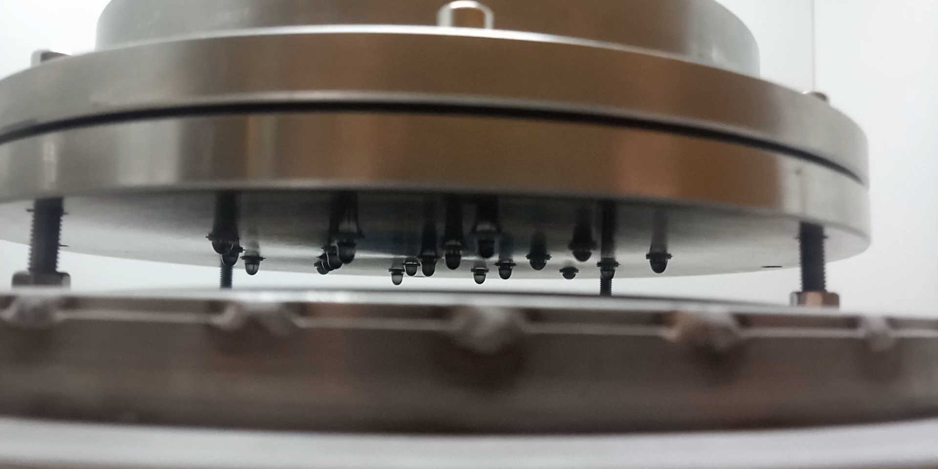
Technology description
Notes:
The technology involves freezing liquid droplets in liquid nitrogen. Droplets with a radius of approximately 1.85 (one point eighty five mm) are produced using a nozzle through which the liquid flows under gravity. Once formed, the droplet detaches and falls into liquid nitrogen, which serves as a cryogen. Due to the significant temperature difference between the droplet and the liquid nitrogen (approximately Three hundred K), a vapor cushion forms, preventing direct contact between the droplet and the nitrogen surface, resulting in levitation. The droplet undergoes complex motion across the nitrogen surface as long as the vapor cushion supports it. The duration of levitation is regulated by inducing vigorous boiling of the liquid nitrogen using a nichrome wire. The droplet’s shape evolves from spherical to a flattened spheroid, depending on its radius and the material properties

