Slide 1
Analysis of chlorine neutron capture experiment for efficiency calculation validation
Constantin Hramco
Researcher, Frank Laboratory of Neutron Physics,
Joint Institute for Nuclear Research
costea.edinets@mail.ru

Slide 2
TANGRA – TAgged Neutron & Gamma RAys
The setup is being developed to investigate neutron-induced reactions on different materials, with primary focus on the investigate the inelastic scattering of 14.1MeV neutrons on atomic nuclei using the Tagged Neutron Method (TNM). Gamma emission is detected using scintillators and high-purity germanium detectors. The neutron source is a PuBe mix and the neutron generator is an ING27.

Slide 3
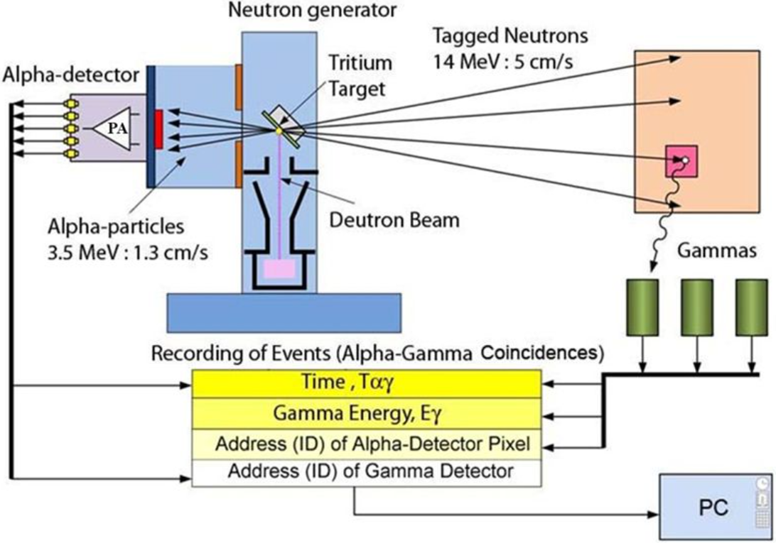
TANGRA – TAgged Neutron & Gamma RAys
Source of 14.1 MeV neutrons:
D + T = α + n
https://flnp.jinr.int/en-us/main/facilities/tangra-project-en

Slide 4
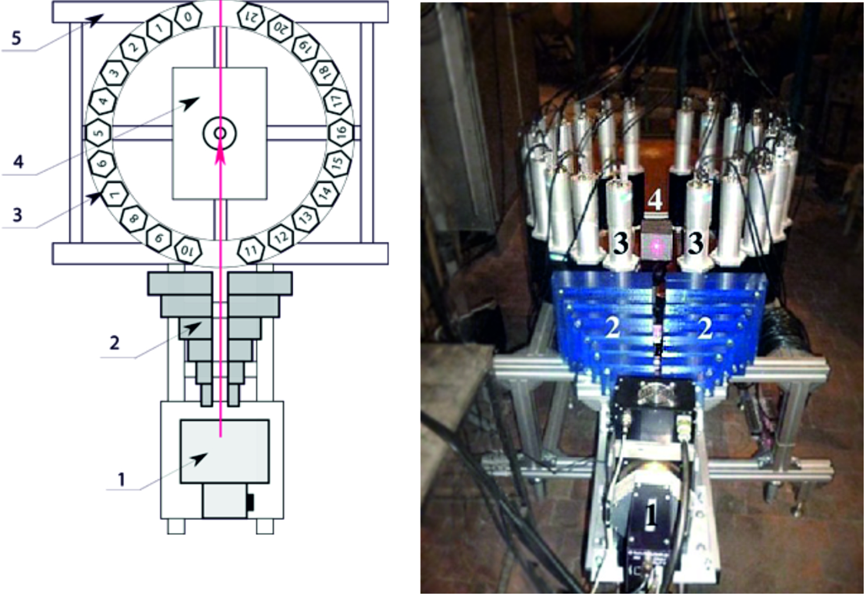
TANGRA – TAgged Neutron & Gamma Rays, beginning
Number of NaI(Tl) detectors: 22
NaI(Tl) crystals: hexagonal prism (78 x 90 x 200 mm)
PMT type: Hamamatsu R1306
Gamma-ray Energy-resolution ~ 7.2% @ 0.662 MeV
Gamma-ray Energy-resolution ~ 3.6% @ 4.437 MeV
Gamma-ray Time-resolution ~ 3.8ns @ 4.437 MeV
https://flnp.jinr.int/en-us/main/facilities/tangra-project-en

Slide 5
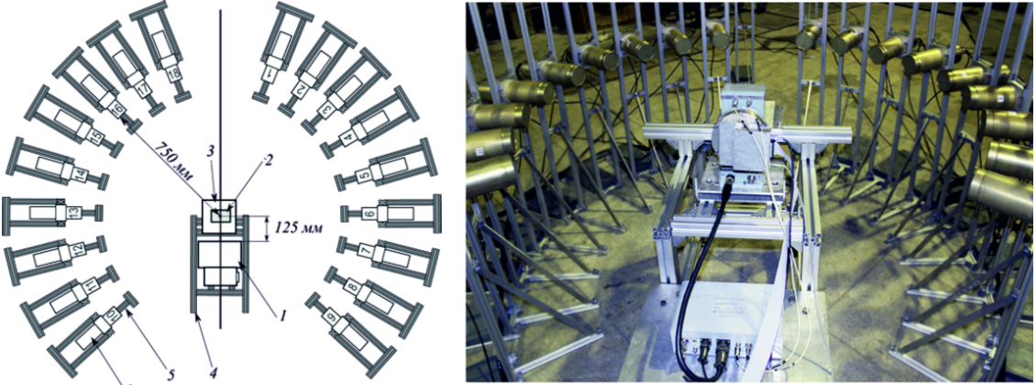
TANGRA – TAgged Neutron & Gamma Rays, modernization
Number of BGO detectors: 18
BGO crystals: cylinder (76 x 65 mm)
PMT type: Hamamatsu R1307
Gamma-ray Energy-resolution ~ 10.4% @ 0.662 MeV
Gamma-ray Energy-resolution ~ 4.0% @ 4.437 MeV
Gamma-ray Time-resolution ~ 4.1ns @ 4.437 MeV
https://flnp.jinr.int/en-us/main/facilities/tangra-project-en

Slide 6
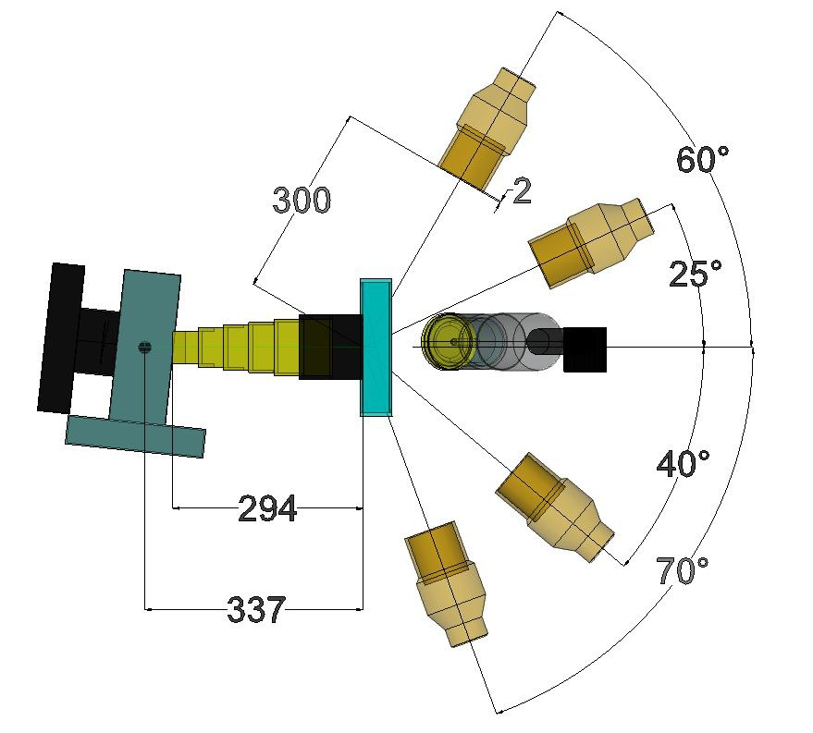
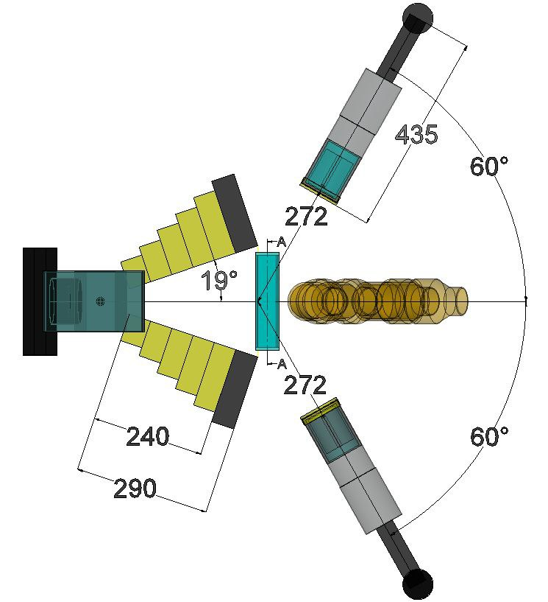
TANGRA – TAgged Neutron & Gamma Rays, more upgrades
LaBr₃
HPGe
LaBr₃
LaBr₃
HPGe
LaBr₃
LaBr₃
HPGe
2D scheme of the recently upgraded TANGRA setup,
left: side view, right: top view

Slide 7
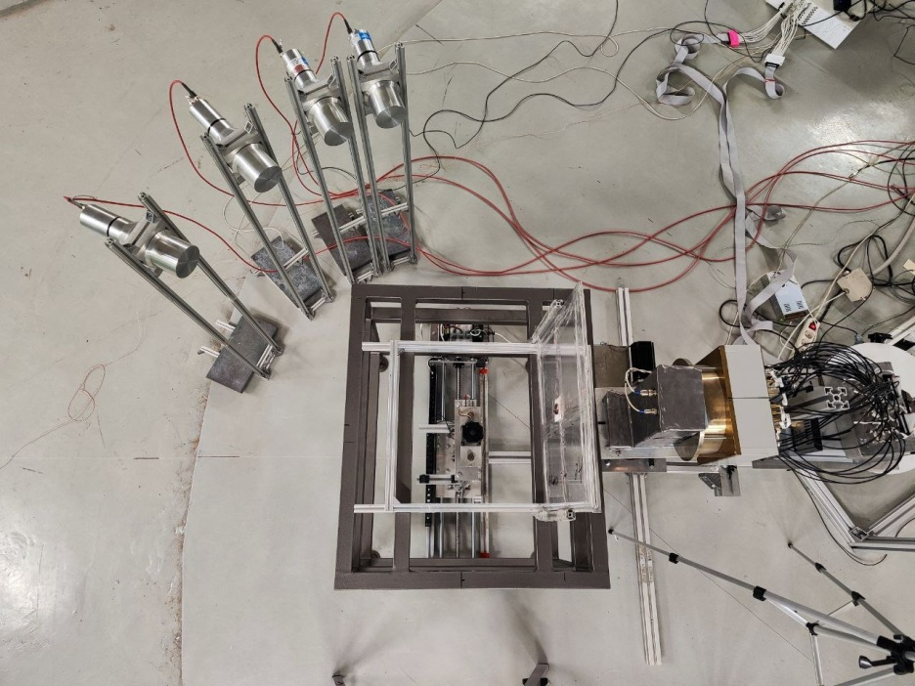
TANGRA – TAgged Neutron & Gamma Rays, more upgrades
Neutron generator ING27
LaBr₃
Sample + point gamma source
LaBr₃
LaBr₃
LaBr₃
LaBr₃
Sample + point gamma source
Picture of the last configuration of the experimental setup

Slide 8
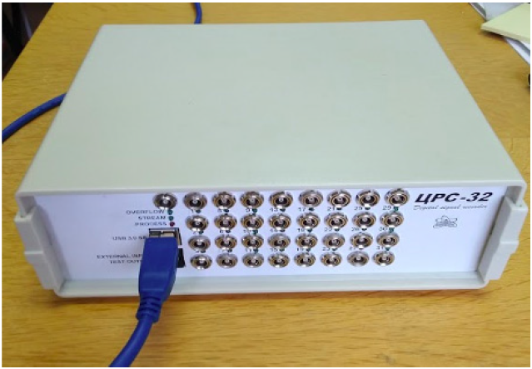
TANGRA – TAgged Neutron & Gamma Rays, DAQ
Fast digitizer CRS-6/32 DAQ (32-channel, 200 MHz, 11-bit, USB-3 connection; approximately 10⁵ events/s/channel)

Slide 9
Photo-peak counting efficiency
$$ε_{γ}= \frac{N_{γ}}{A∙I_{γ}∙t_{meas}}$$
ε – counting efficiency, N – energy peak counts, A – isotope activity at the time of measurement, I – intensity of gamma emission, tmeas – time of measurement,
γ – the interested gamma energy
$$A=A_{0}∙e^{−λ∙t}$$
A₀ – certified activity of the used point gamma source, λ – decay constant, t – elapsed time between the certifying of the point gamma source and time of experimental measurements

Slide 10
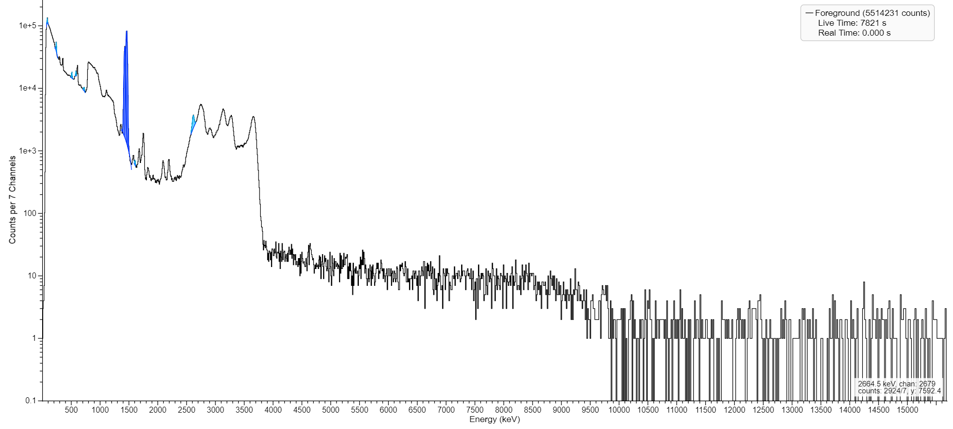
The acquired spectrum from ²²⁸Th point source with LaBr₃

Slide 11
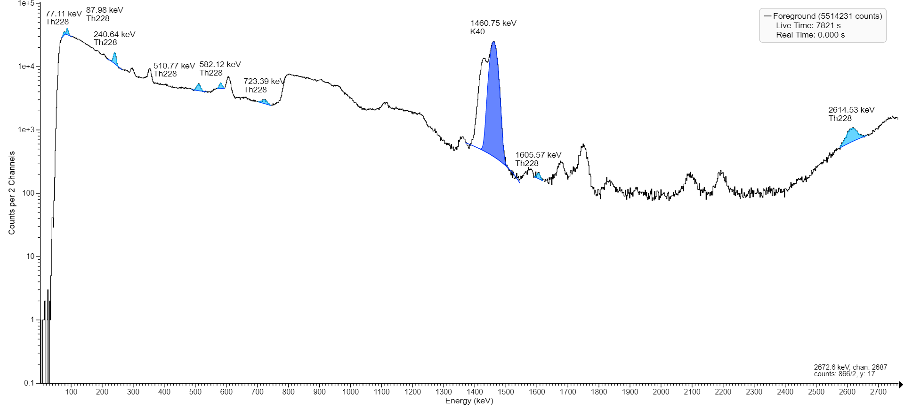
The acquired spectrum from ²²⁸Th point source with LaBr₃

Slide 12
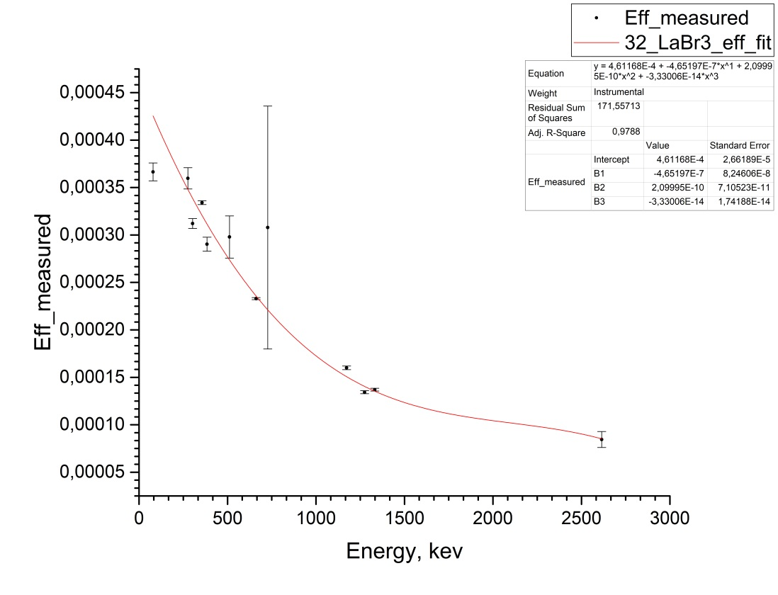
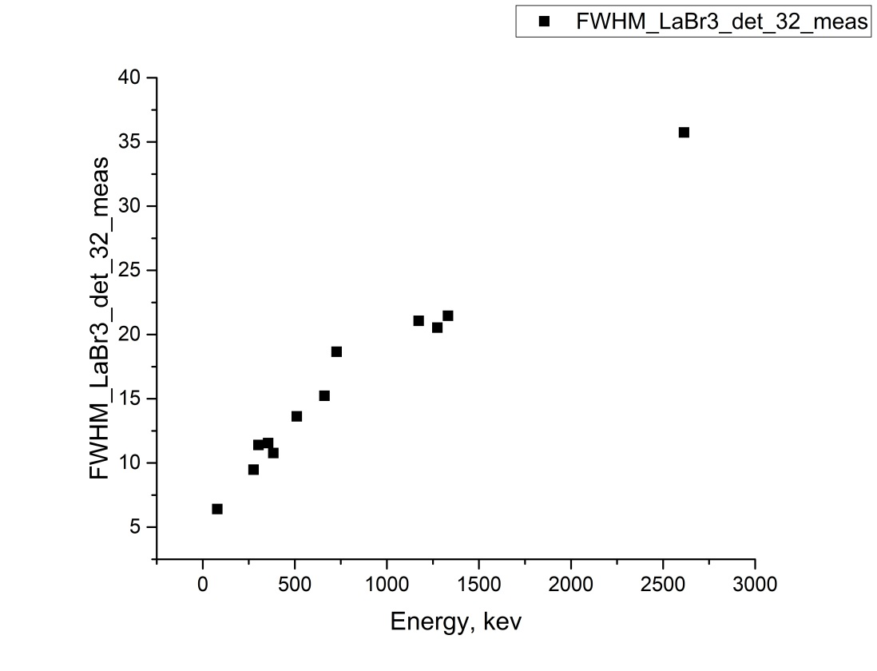
Measured characteristics for the energy range up to 2614 keV for LaBr₃ detectors

Slide 13
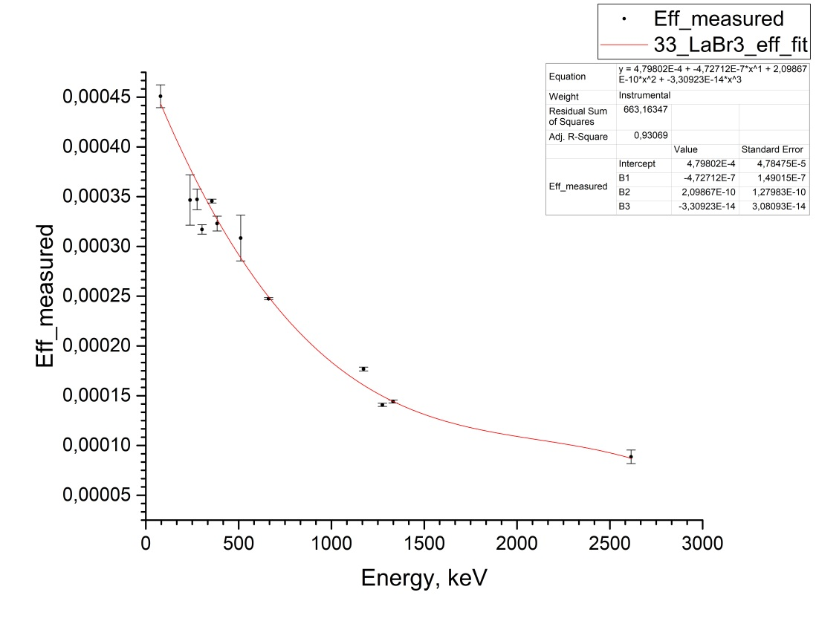
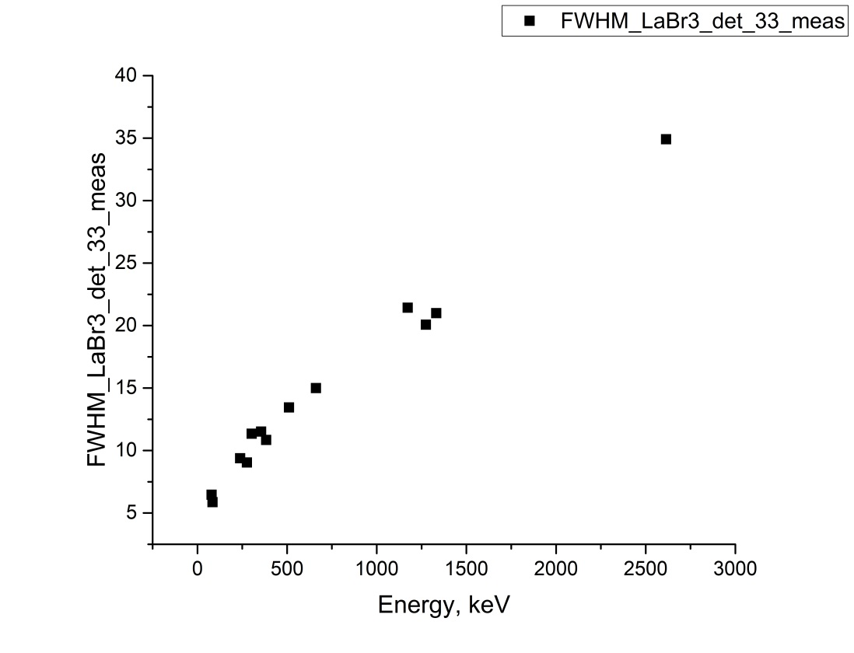
Measured characteristics for the energy range up to 2614 keV for LaBr₃ detectors

Slide 14
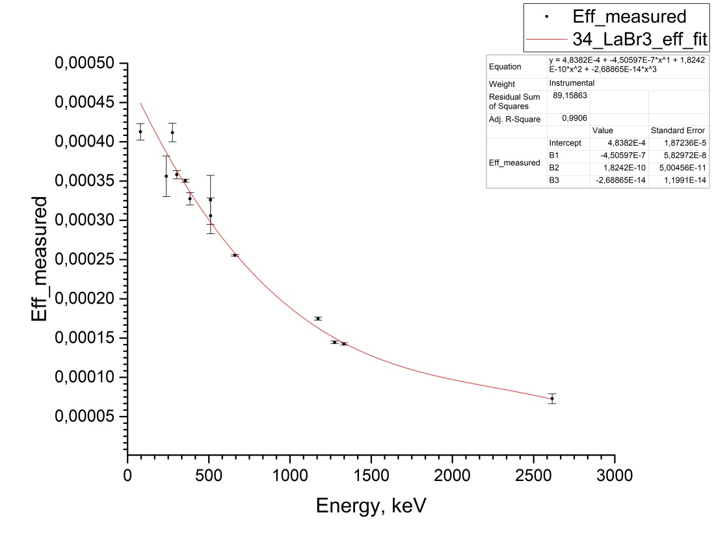
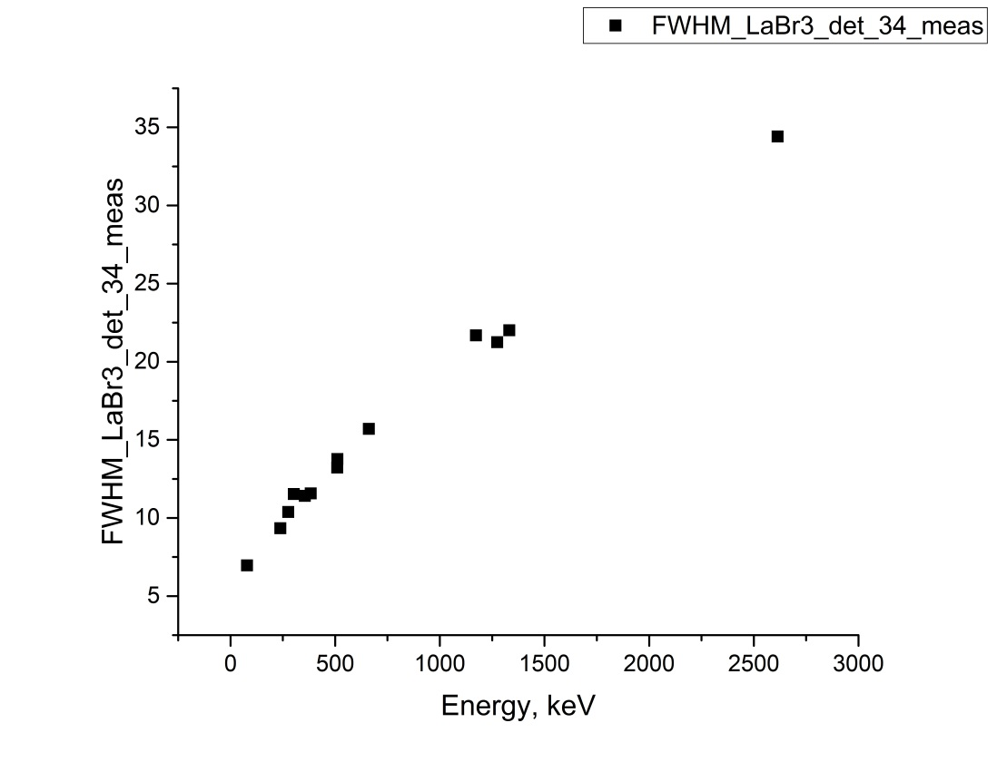
Measured characteristics for the energy range up to 2614 keV for LaBr₃ detectors

Slide 15
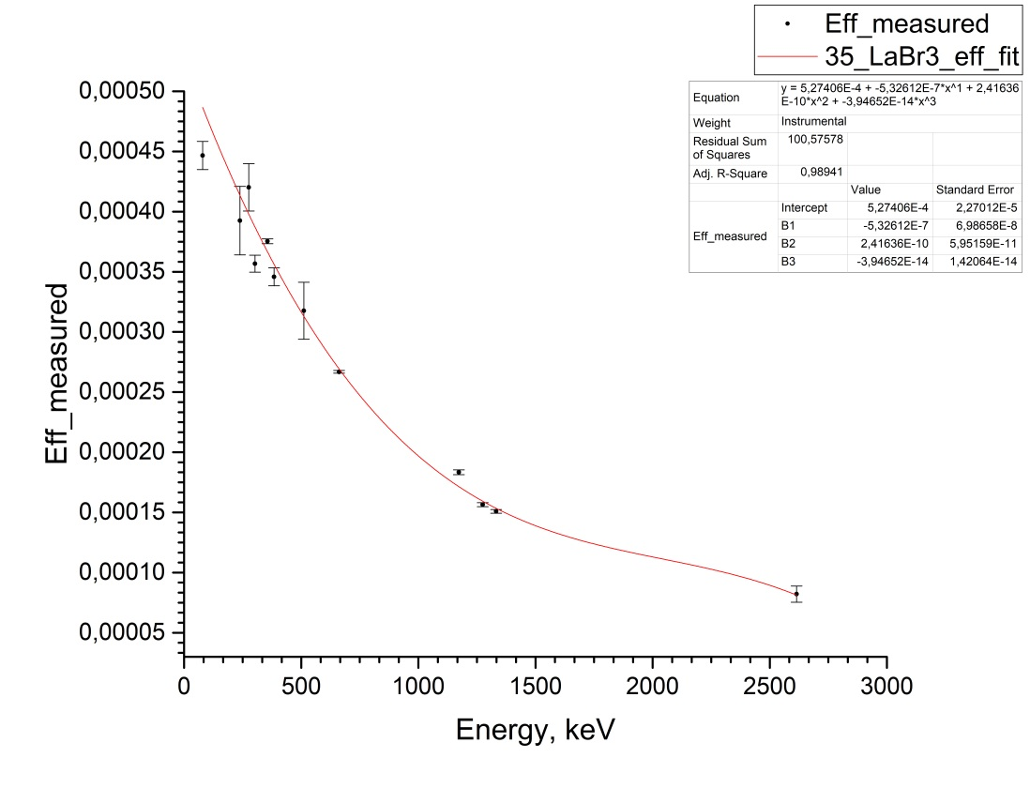
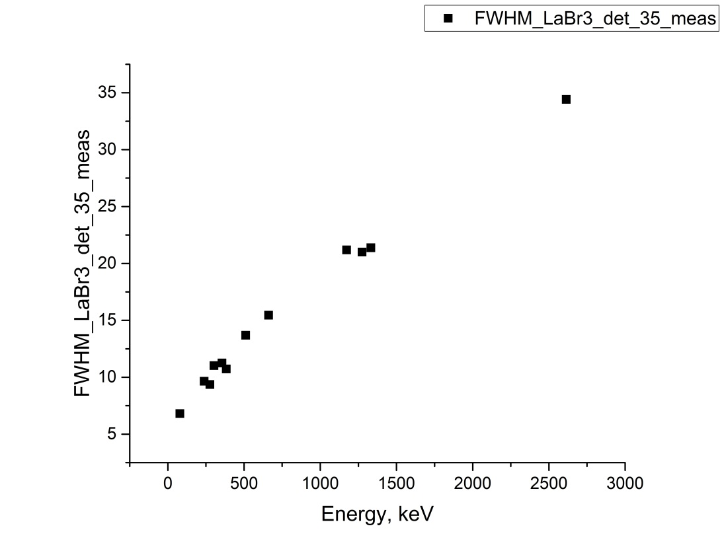
Measured characteristics for the energy range up to 2614 keV for LaBr₃ detectors

Slide 16
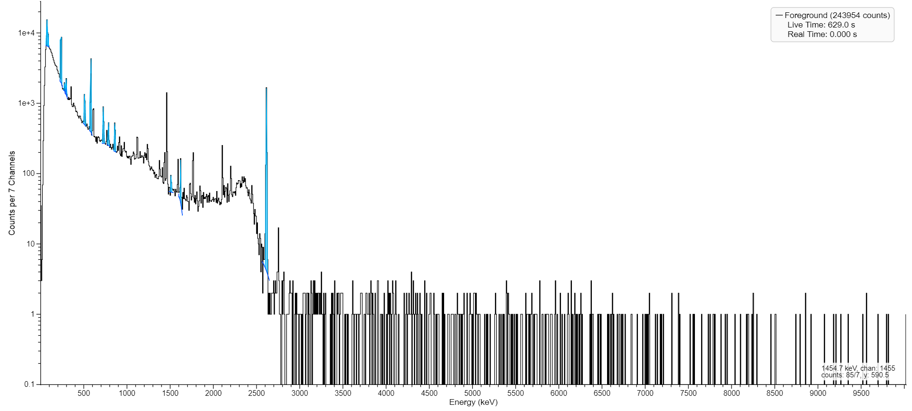
The acquired spectrum from ²²⁸Th point source with HPGe

Slide 17
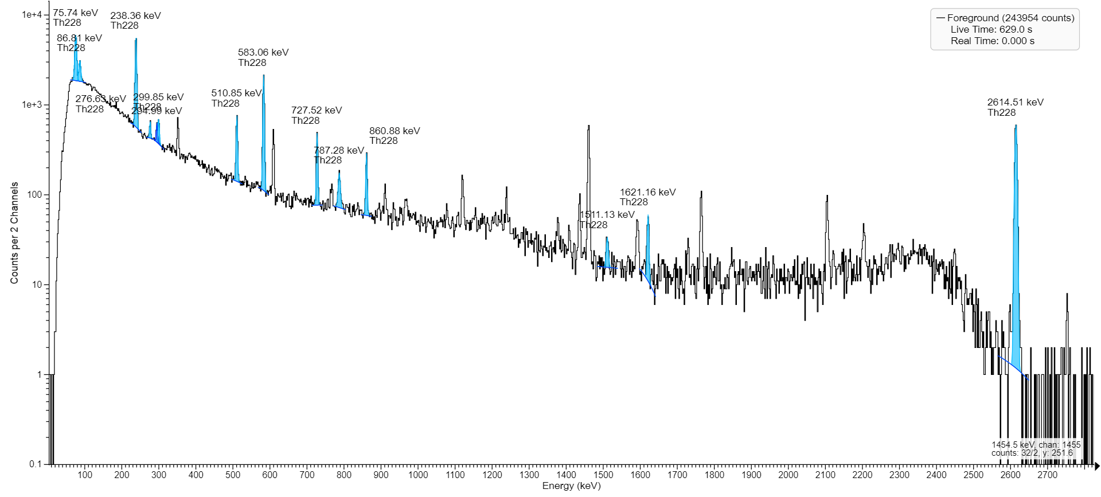
The acquired spectrum from ²²⁸Th point source with HPGe

Slide 18
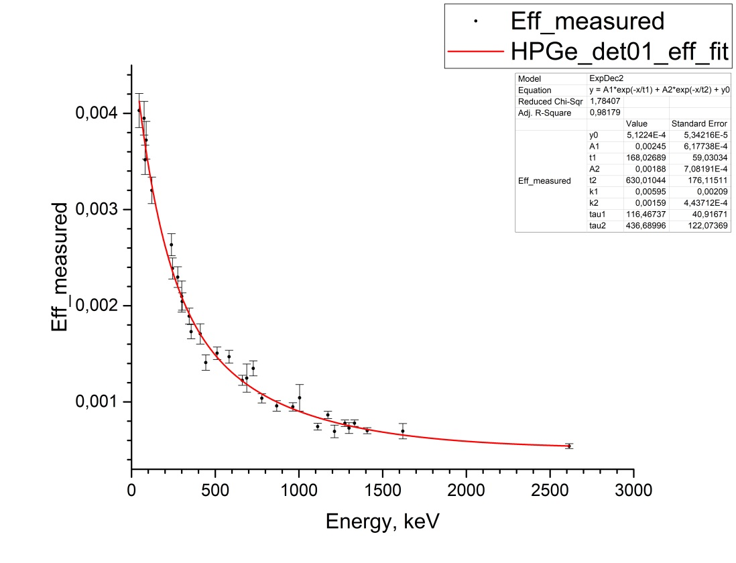
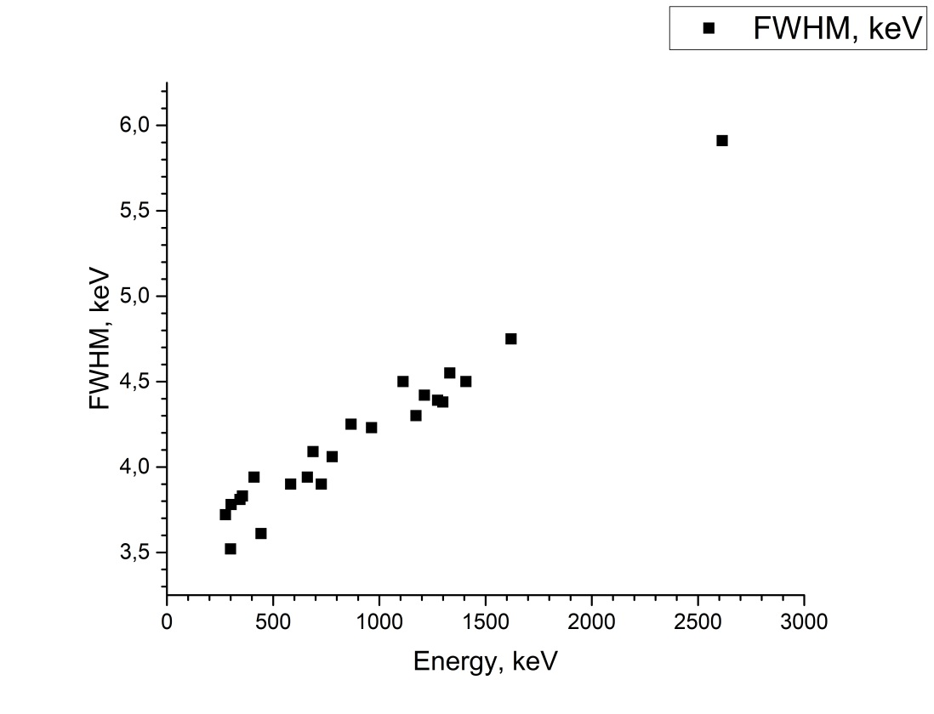
Measured characteristics for the energy range up to 2614 keV for HPGe detectors

Slide 19
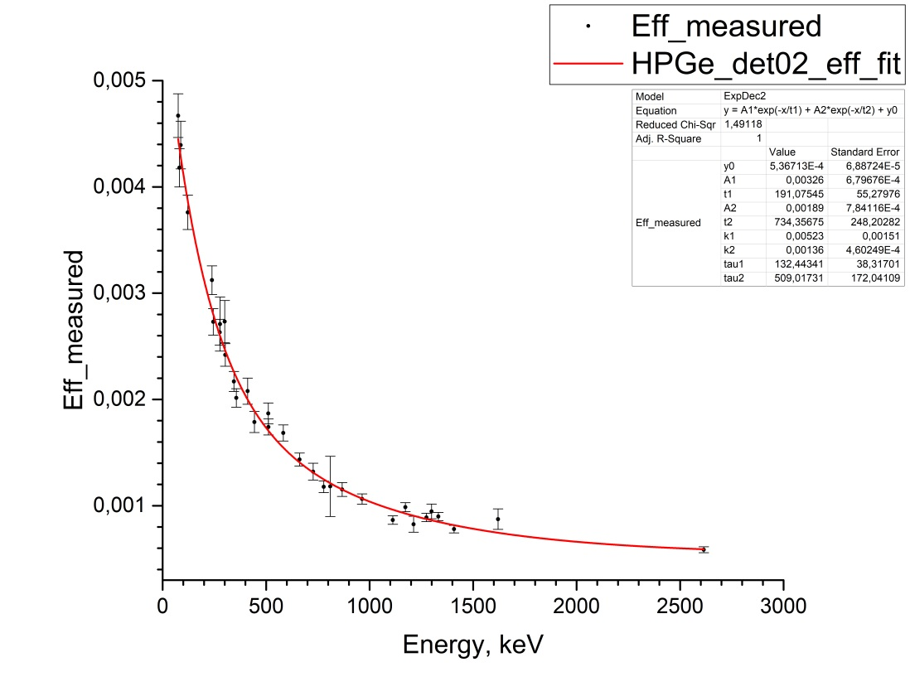
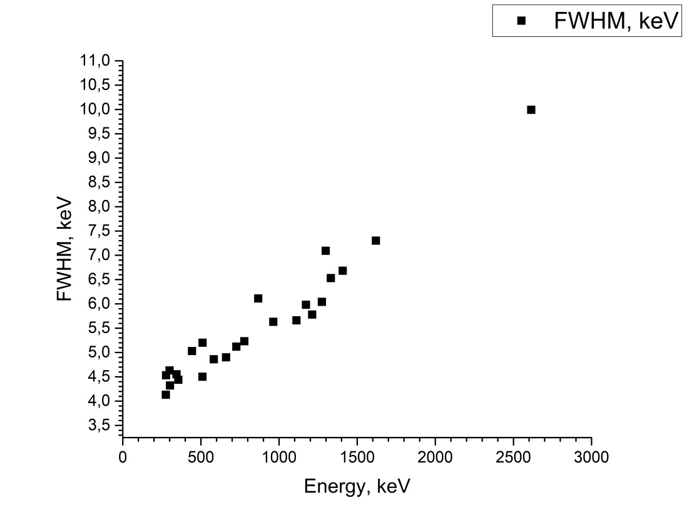
Measured characteristics for the energy range up to 2614 keV for HPGe detectors

Slide 20
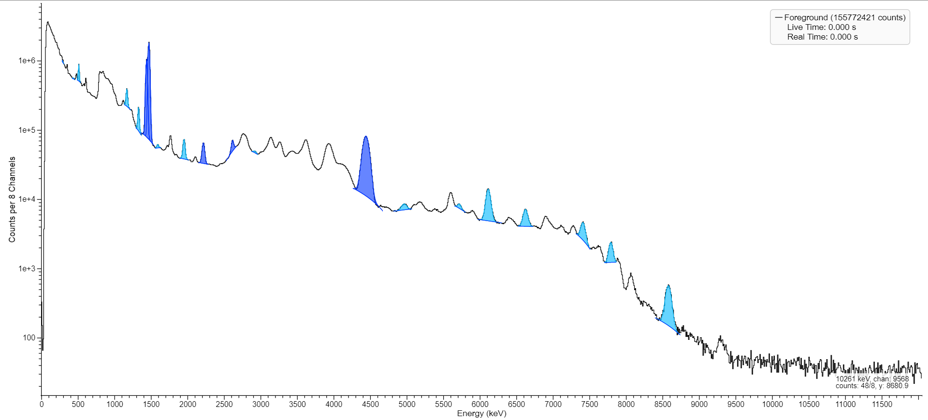
The acquired spectrum from ³⁵Cl (n, γ) ³⁶Cl reaction with LaBr₃

Slide 21
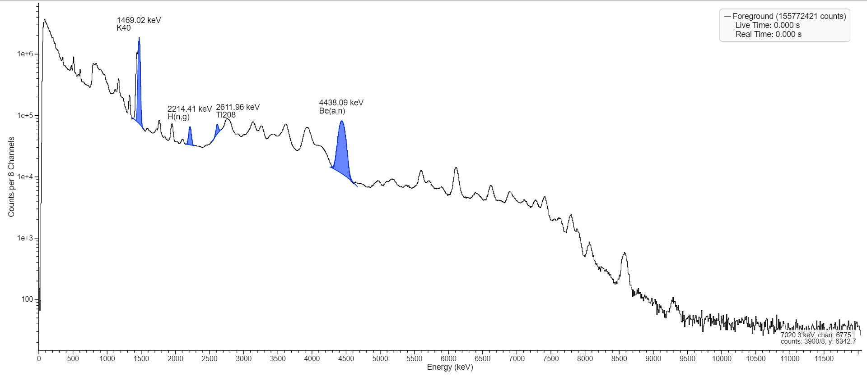
The acquired spectrum from ³⁵Cl (n, γ) ³⁶Cl reaction with LaBr₃

Slide 22
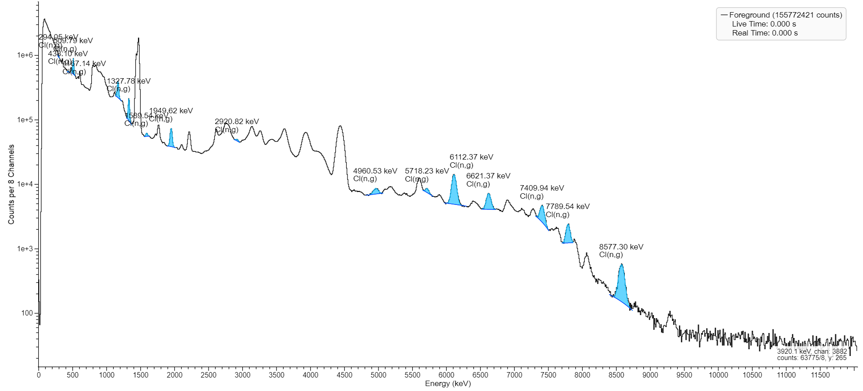
The acquired spectrum from ³⁵Cl (n, γ) ³⁶Cl reaction with LaBr₃

Slide 23
Efficiency calculation for energy range of gamma above 2614 keV
$${ε(E}_{γi})=\frac{N_{γ}(E_{γi})∙I(E_{γ0})}{I(E_{γi})∙N_{γ}(E_{γ0})}∙ε(E_{γ0})$$
ε – counting efficiency, N – energy peak counts, I – intensity of gamma emission,
γi – interested gamma energy, γ0 – reference gamma energy

Slide 24
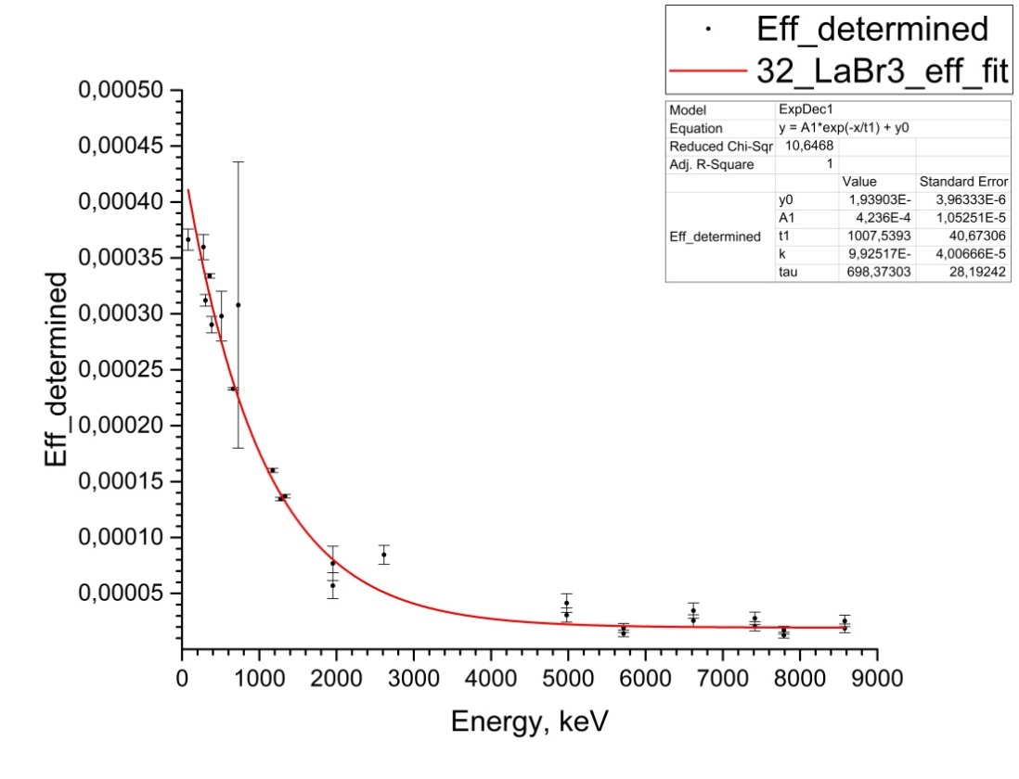
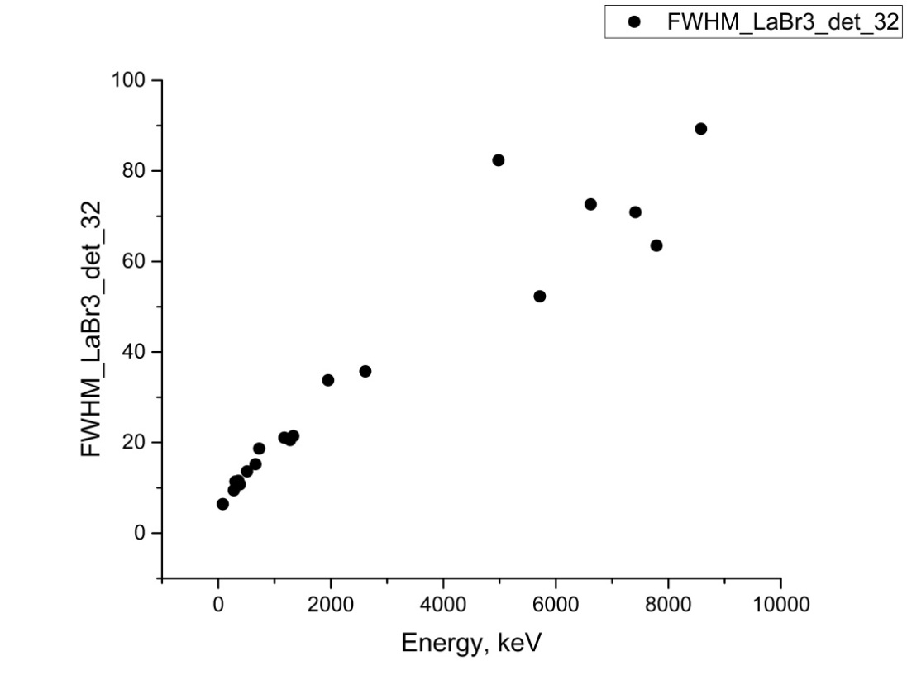
Determined characteristics for wide energy range for LaBr₃ detectors

Slide 25
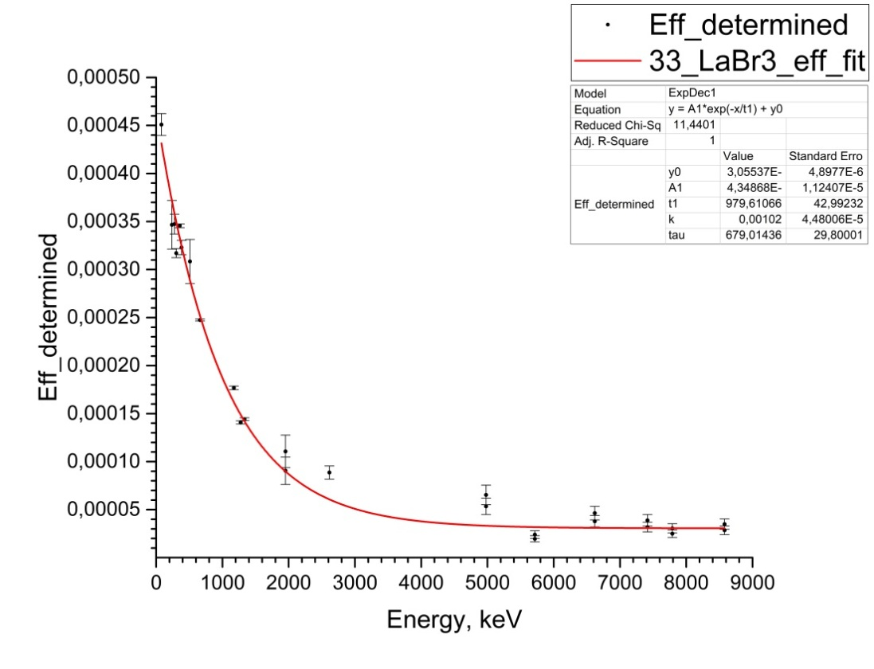
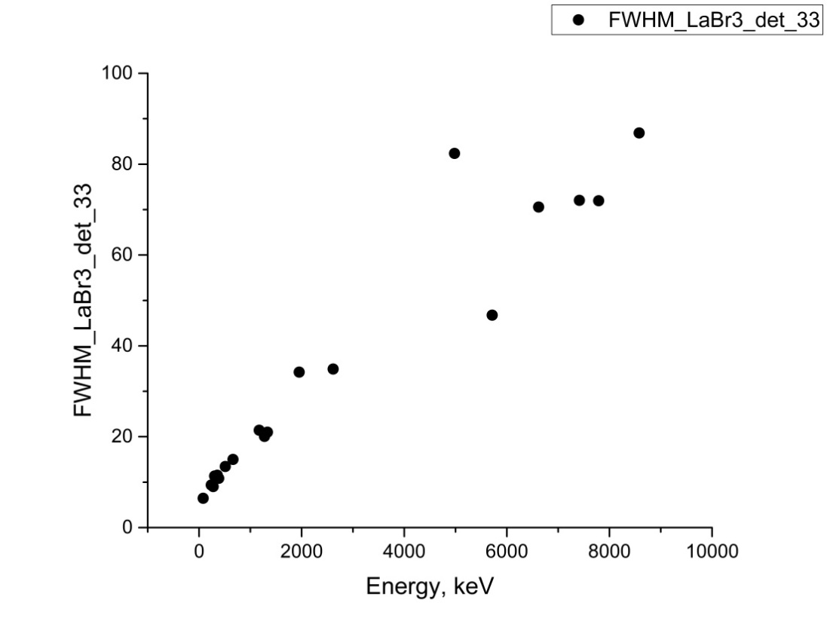
Determined characteristics for wide energy range for LaBr₃ detectors

Slide 26
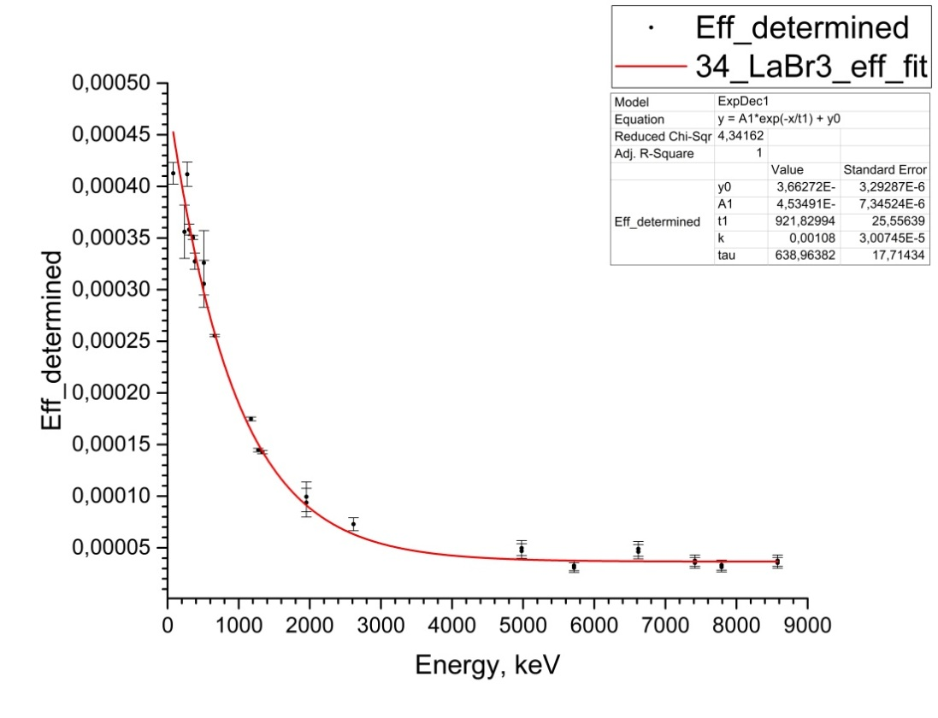
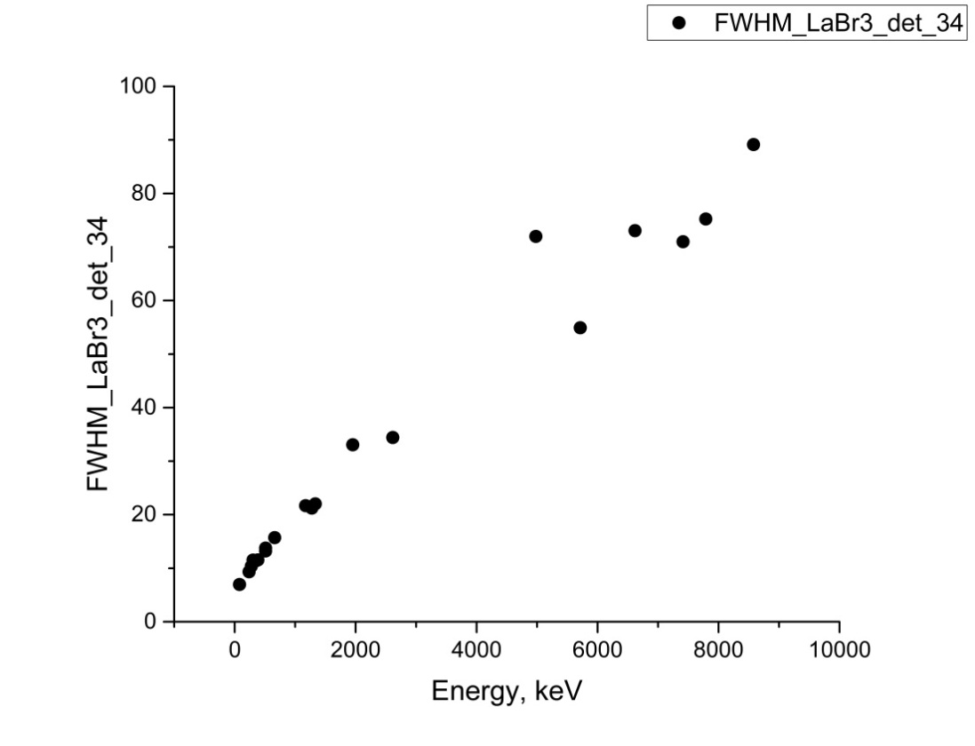
Determined characteristics for wide energy range for LaBr₃ detectors

Slide 27
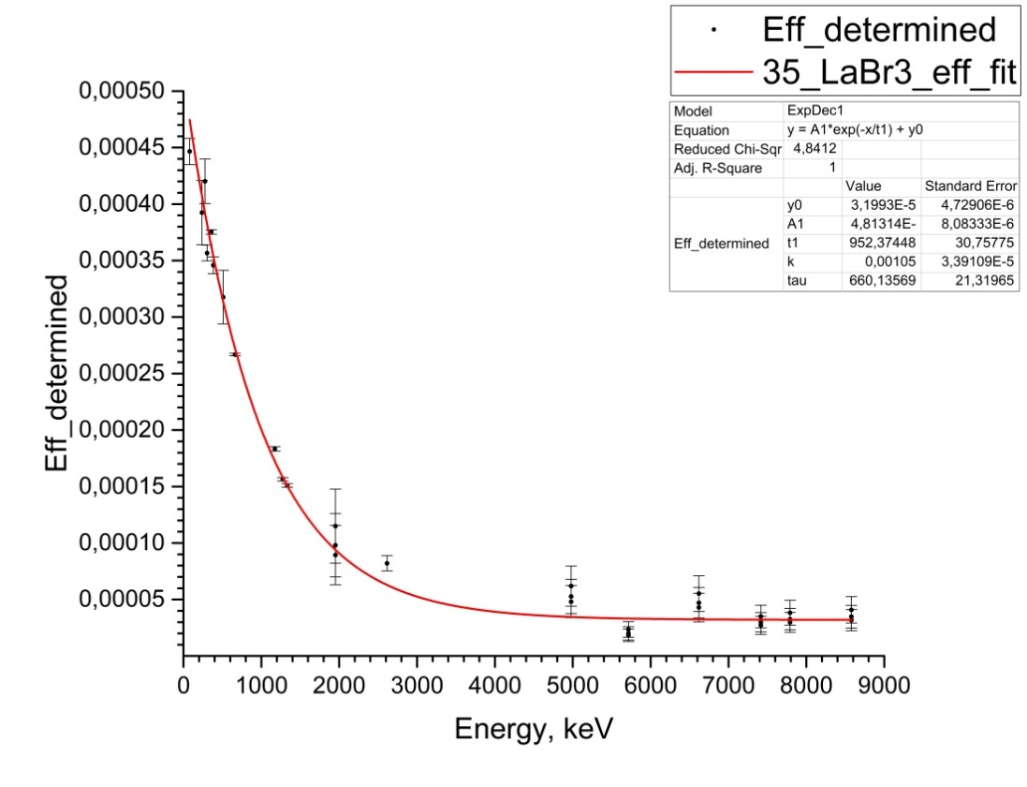
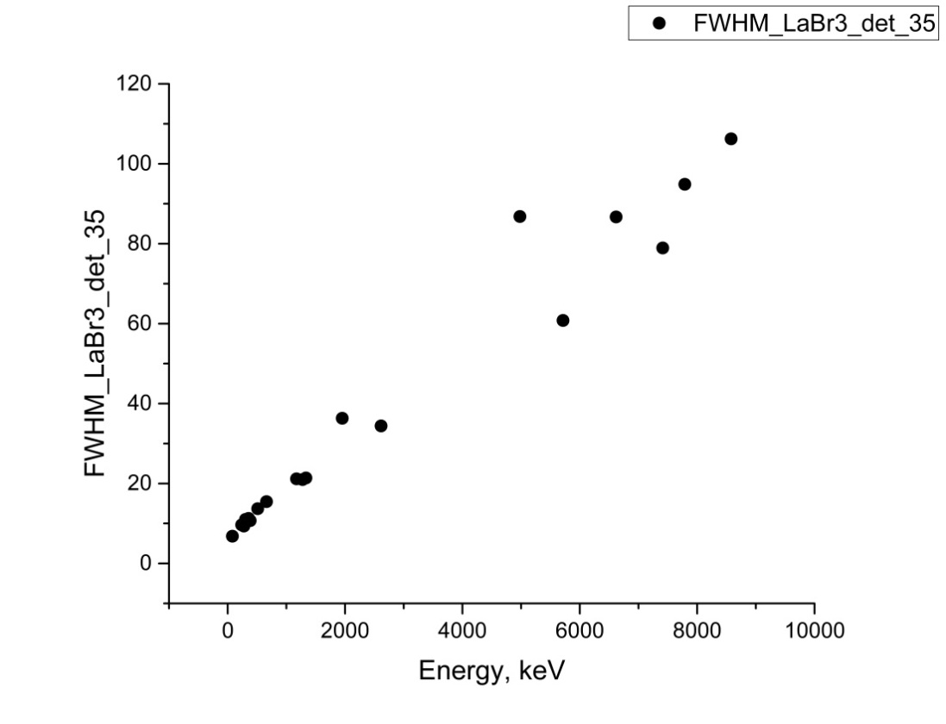
Determined characteristics for wide energy range for LaBr₃ detectors

Slide 28
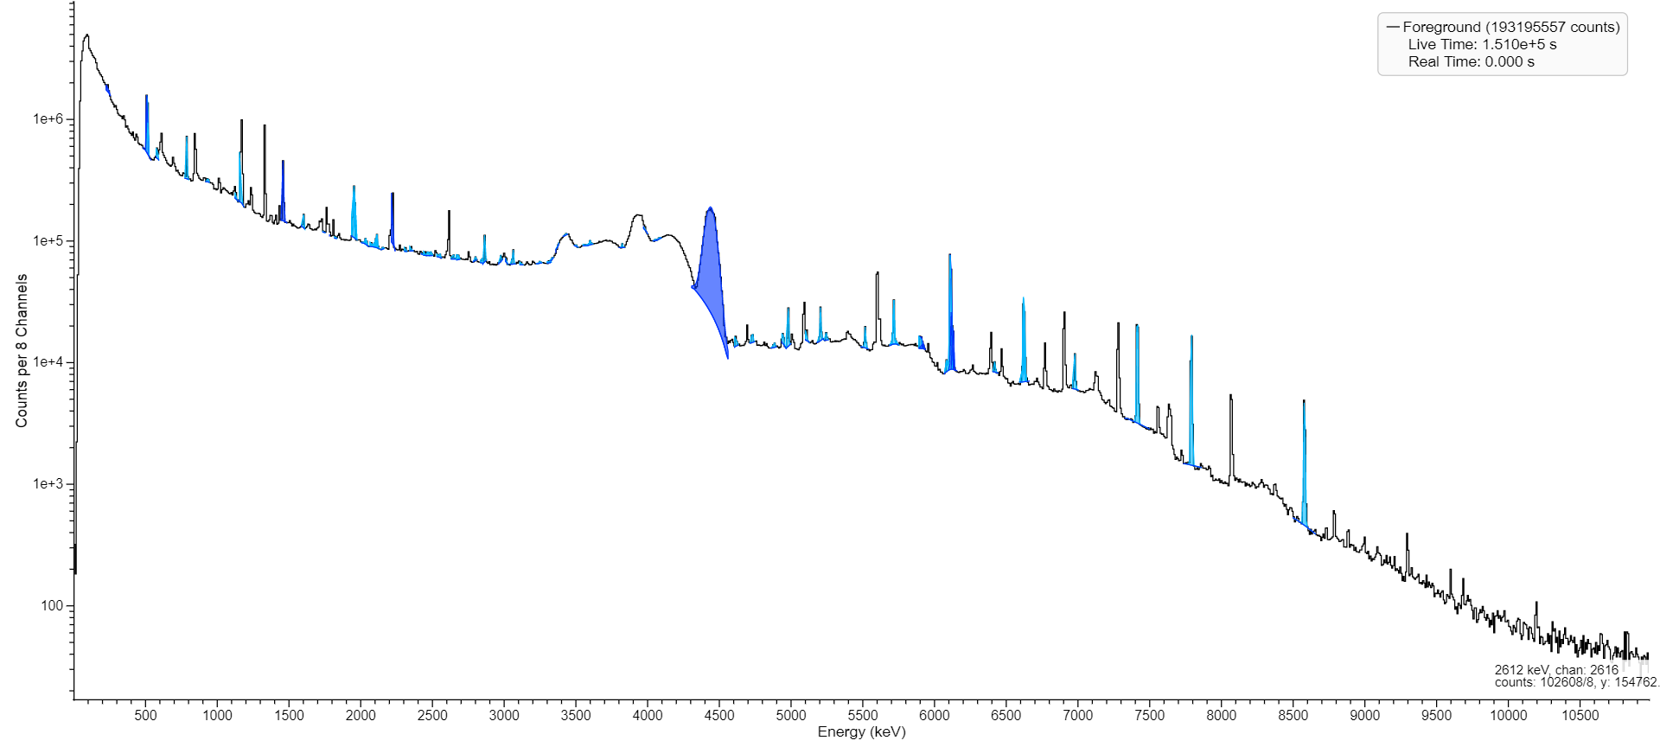
The acquired spectrum from ³⁵Cl (n, γ) ³⁶Cl reaction with HPGe

Slide 29
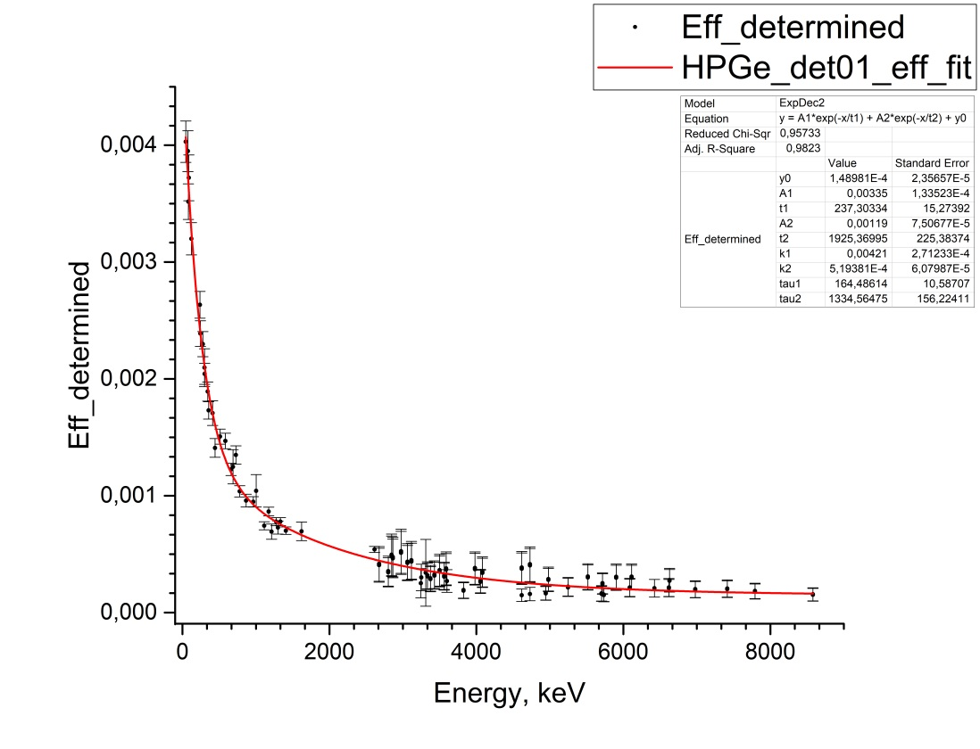
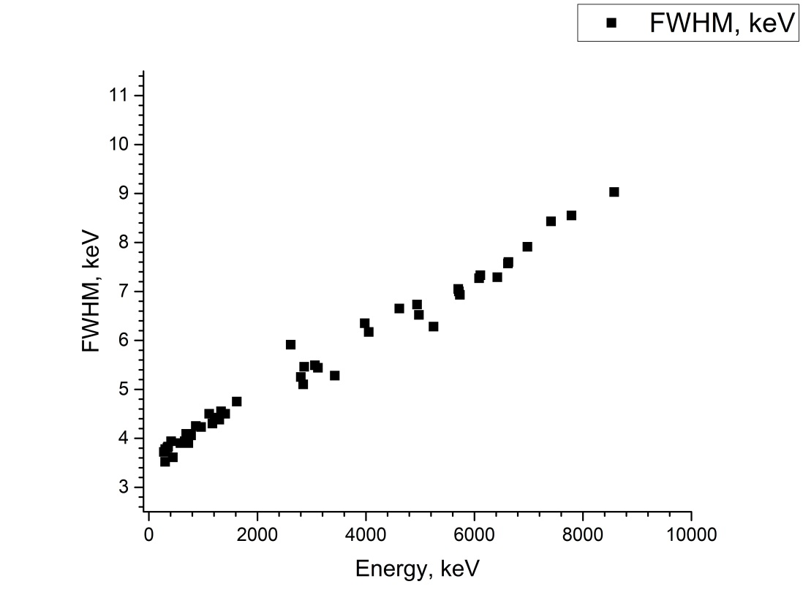
Determined characteristics for wide energy range for HPGe detectors

Slide 30
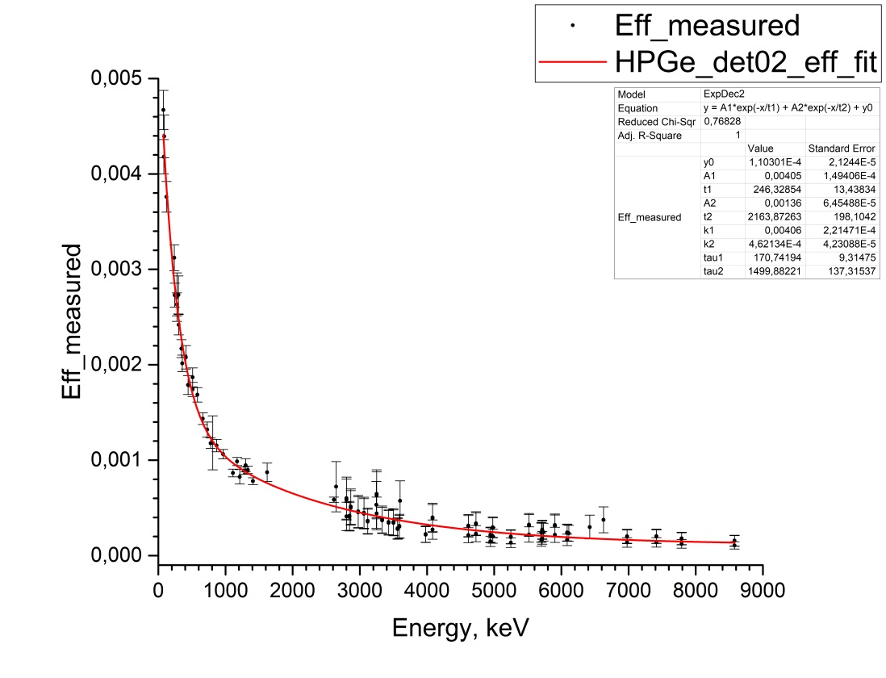
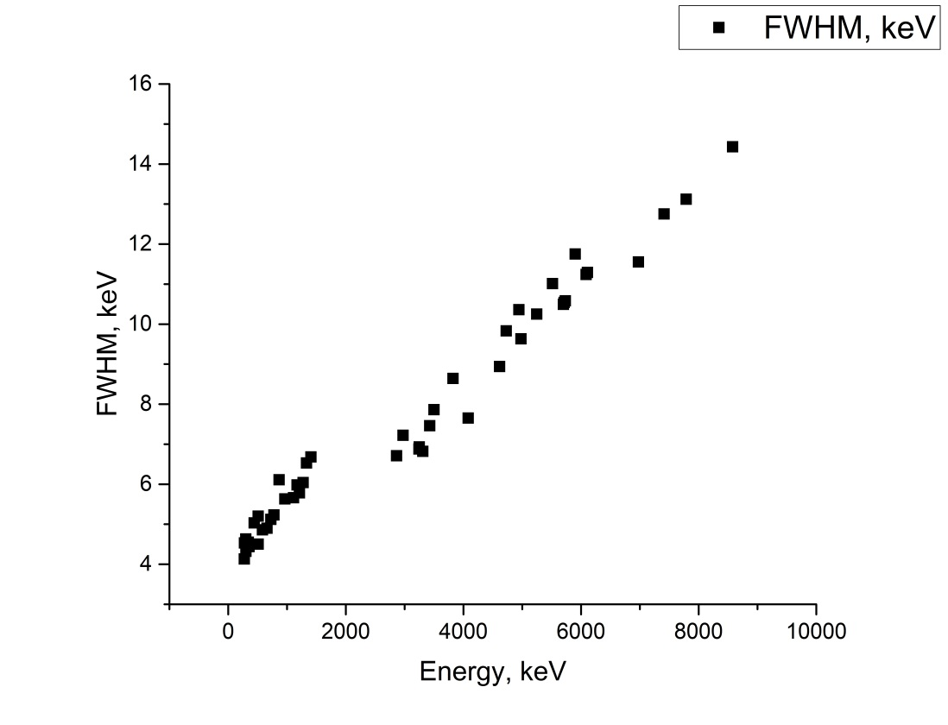
Determined characteristics for wide energy range for HPGe detectors

Slide 31
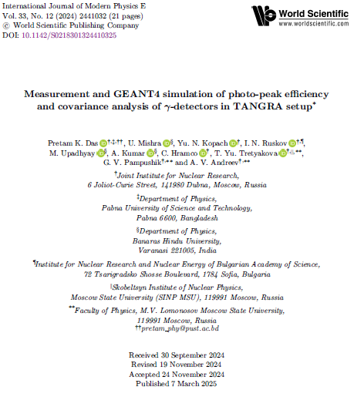
Publications

Slide 32
Summary
Within the TANGRA project at JINR-FLNP, a new experimental setup was built to precisely measure the yields (probabilities, cross-sections) of (n, x n’ γ) nuclear reactions;
The acquired data from the HPGe and LaBr₃ detectors were successfully decoded and processed;
The counting efficiencies in the wide energy range for the HPGe and LaBr₃ detectors were calculated using measurements of a set of standard radioactive point gamma sources (²²Na, ⁶⁰Co, ¹³³Ba, ¹³⁷Cs, ²²⁸Th) and the radioactive capture reaction of the neutrons on the ³⁵Cl nucleus.

