Slide 1
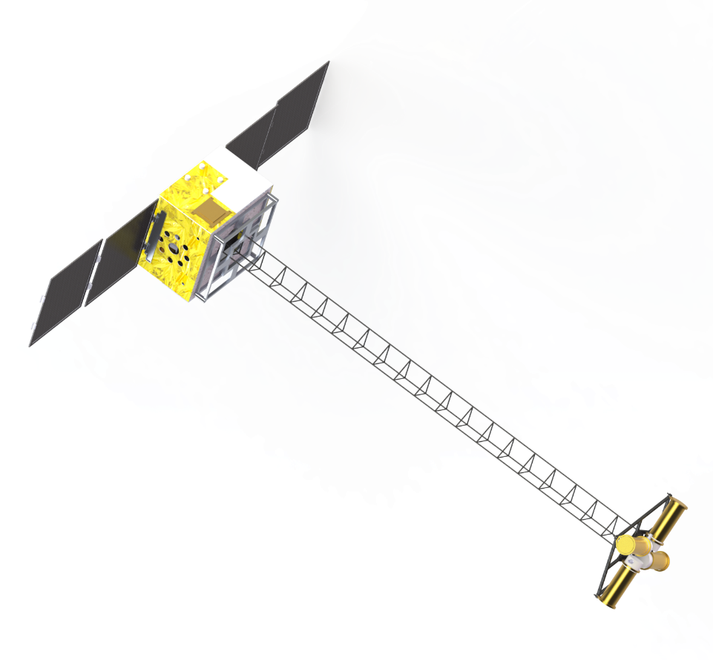
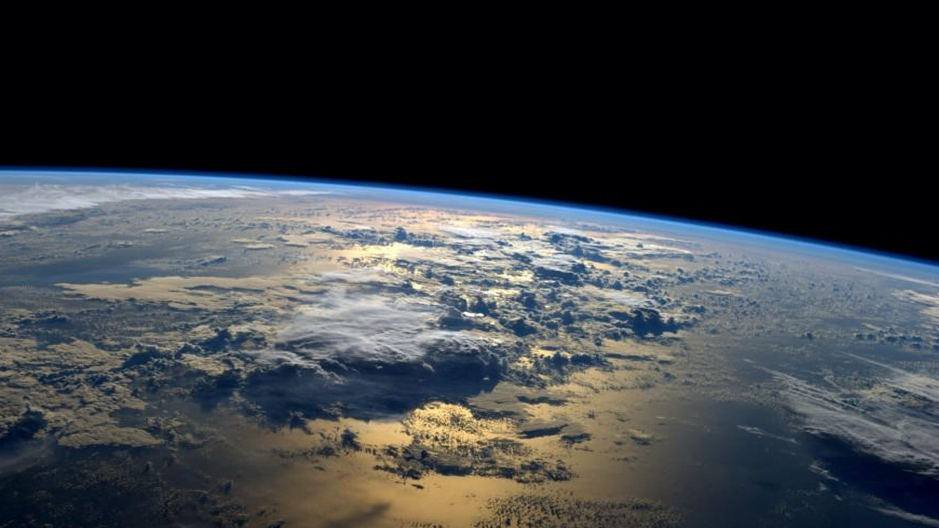
Neutron Lifetime Puzzle
and a new scheme using CubeSats
Xiaopeng ZHOU (周 小朋）
School of physics
Beihang University
on behalf of the StarNeutronix collaboration
Notes:
GSI, Darmstadt, February 24-28, 2025
Thank you, Zsolt，for the introduction.
I would also like to thank Christoph for the invitation.
It is truly an honor to join this special events in this way.
Title: A new scheme of spaced-based measurement of neutron lifetime
How long neutrons survive plays a key role in particle physics and cosmology. However, conflicting results with a deviation of about 9 second have been found over years in neutron lifetime measurements. Different ideas have been proposed to solve such deviations. We proposed a new scheme based on CubeSat to determine neutron lifetime. In this talk, after a short overview on the lifetime puzzle, I will show the principle of our proposed measurement, the challenges and also the progress in payload development.

Slide 2
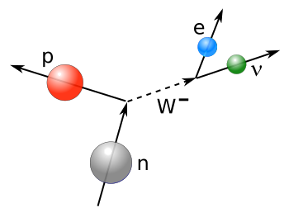
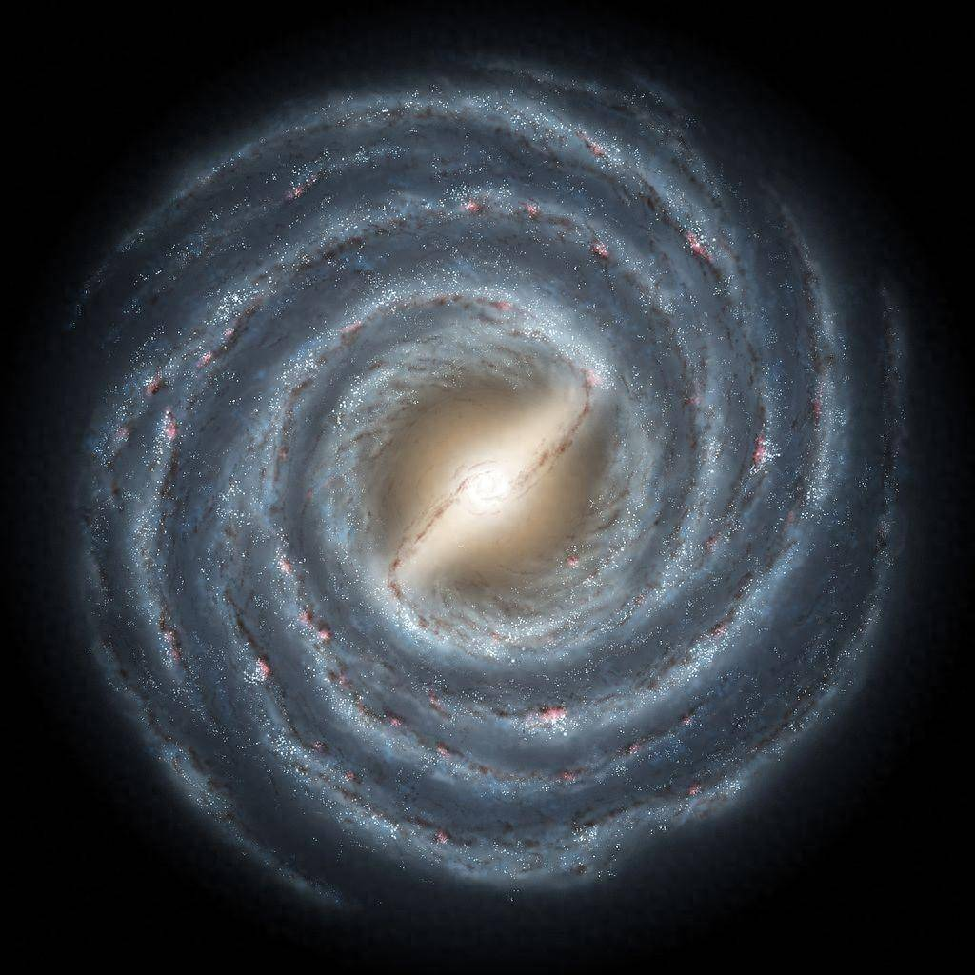
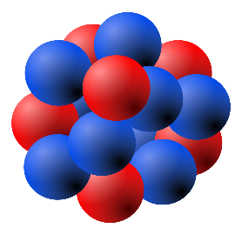
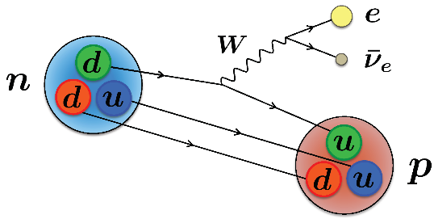
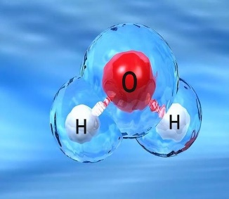
Neutron: one of the building blocks of visible matter
Courtesy：史金阳
1
Even though, there remains mysterious for neutron
Notes:
We know, neutron is one of the building block of our visible universe!
我们知道，我们的世界从浩瀚的星宇到微不可见的分子都是由原子组成。
而原子核则是原子的重要组成部分，根据原子核中质子数目的不同，人们将其分类为多种元素，根据其中子数的不同，分类为多种同位素。
它们统称为核素。

Slide 3
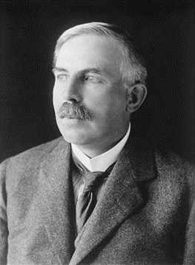
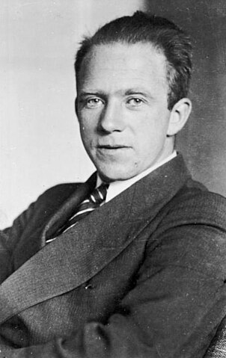
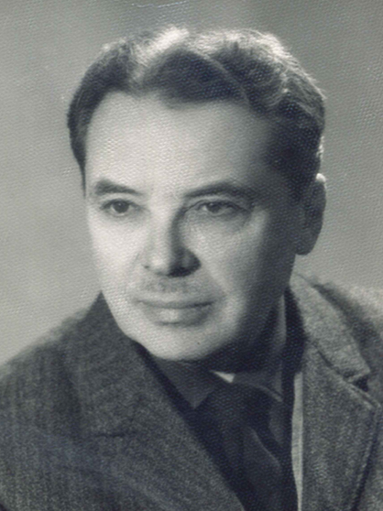
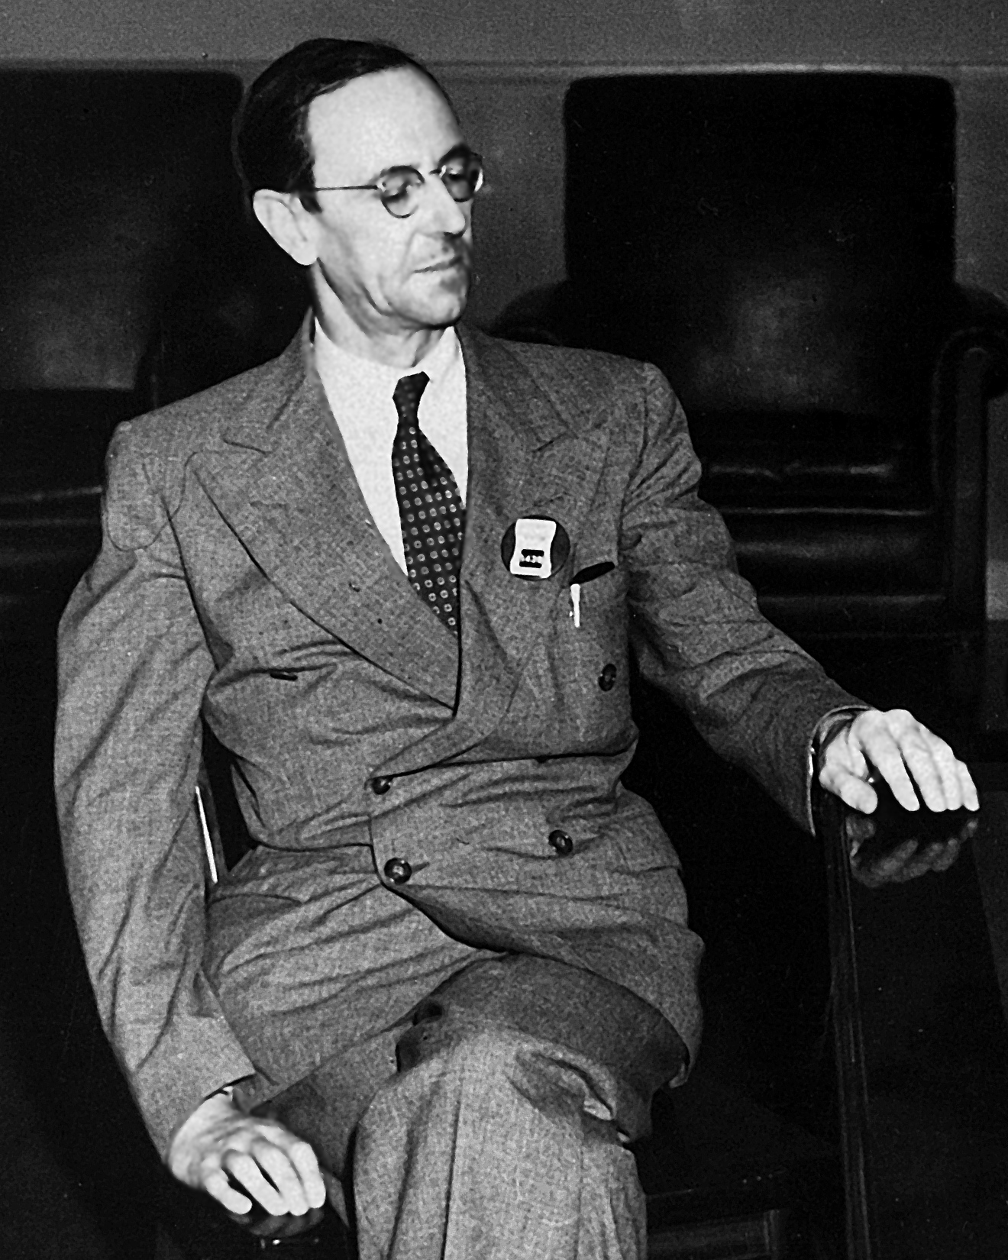
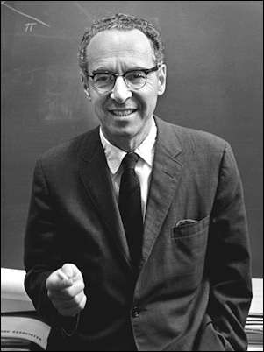
Discovery of neutron
E. Rutherford
Bothe&Becker,
Joliot-Curie, Chadwick
Chadwick
Goldhaber
Heisenberg
Iwanenko
Suggesting a heavy
neutral particle like “neutron”
Discovery of neutron
Neutron: elementary like p
Improved mass determinations
1911-1920
1928-1932
1932
1934-1935
Atomic mass ≠ atomic number
Protons alone cannot bound into an nuclide
First determination of the neutron mass, “probably between 1.005 and 1.008” atomic mass units
Rutherford picture X
Elementary spin ½ particle
M_{n}(1.0090 u) > M_{H}(1.0081 u)
Nuclei made of p and n.
free neutron decays
neutron ~ a bound state of H nucleus with an electron
No decisive conclusion on the mass difference with M_{H}
If the neutron is definitely heavier than the hydrogen atom, then one must conclude that a free neutron is unstable, i.e., it can change spontaneously into a proton + electron + neutrino
Rutherford, Proc. R. Soc. A 97, 374(1920).
Chadwick, Proc. R. Soc.
A136, 692(1932).
Heisenberg, Z. Phys. 77, 1(1932)
Iwanenko, Nature 129,798(1932)
Chadwick, and Goldhaber,
1935, Proc. R. Soc. A 151, 479.
Notes:
1. The suggestion that the atomic nucleus contains a heavy neutral particle and the positively charged proton is generally attributed to Ernest Rutherford (1920). This is largely motivated by the observation that atomic mass differs from atomic number,
And by the fact that an ensemble of positively charged protons alone would not be bound electromagnetically.
Under some circumstances, it may be possible for an electron to combine much more closely with the H nucleus, forming a kind of neutral doublet. Such an atom would have very novel properties. In external field would be practivally zero, and in consequence it should be able to move freely through matter.
However, an important consequence of this picture is that such a neutron, being a bound state, would have a mass less that the sum of the masses of the proton and electron. In such a way, neutron decay is forbidden.
2. 1932， Chadwick 1932, provided the first determination of the neutron mass by noting that it was “probably between 1.005 and 1.008” atomic mass units. This result is reasonably consistent with the current accepted values of about 1.0887 amu. However, the suggested error bar
3. Heisenberg (1932) as well as Iwanenko (1932) anticipated that the Rutherford picture was incorrect by suggesting that neutron was not a bound state,but rather an elementary spin ½ particle, and that nuclei were made of neutrons and protons, rather than protons and electrons. However, they did not appear to consider the possibility of neutron decay.
Microsoft Word - D-Ivanenko.doc， Ivanenko (1904 – 1994) ，an author of the proton-neutron model of atomic nucleus (1932).
In May 1932, Ivanenko published his famous proton-neutron model of the atomic nucleus in “Nature” [18], and two months later Werner Heisenberg (Nobel laureate in 1932) referred to his work.
4. 1934-1935, accurate measurement of neutron mass, by mass spectroscopic measurement, and further data on photo-disassociation of light nuclei (deuteron .
Neutron mass exceeded the mass of the hydrogen atom.
Chadwick and Goldhaber certainly recognized that their result was inconsistent with Rutherford’s conception of the neutron as a bound state and mentioned in their paper “If the neutron is definitely heavier than the hydrogen atom, then one must conclude that a free neutron is unstable, i.e., it can change spontaneously into a proton + electron + neutrino”.
This appears to be the first seirous suggestions that a free neutron would decay.

Slide 4
Discovery of neutron
Chadwick
Chadwick
Goldhaber
Discovery of neutron
Improved mass determinations
1932
1934-1935
No decisive conclusion on the mass difference with M_{H}
M_{n}(1.0090 u) > M_{H}(1.0081 u)
If the neutron is definitely heavier than the hydrogen atom, then one must conclude that a free neutron is unstable, i.e., it can change spontaneously into a proton + electron + neutrino
Chadwick, Proc. R. Soc. A136, 692(1932).
Chadwick, and Goldhaber, 1935, Proc. R. Soc. A 151, 479.
Notes:
1. The suggestion that the atomic nucleus contains a heavy neutral particle and the positively charged proton is generally attributed to Ernest Rutherford (1920). This is largely motivated by the observation that atomic mass differs from atomic number,
And by the fact that an ensemble of positively charged protons alone would not be bound electromagnetically.
Under some circumstances, it may be possible for an electron to combine much more closely with the H nucleus, forming a kind of neutral doublet. Such an atom would have very novel properties. In external field would be practivally zero, and in consequence it should be able to move freely through matter.
However, an important consequence of this picture is that such a neutron, being a bound state, would have a mass less that the sum of the masses of the proton and electron. In such a way, neutron decay is forbidden.
2. 1932， Chadwick 1932, provided the first determination of the neutron mass by noting that it was “probably between 1.005 and 1.008” atomic mass units. This result is reasonably consistent with the current accepted values of about 1.0887 amu. However, the suggested error bar
3. Heisenberg (1932) as well as Iwanenko (1932) anticipated that the Rutherford picture was incorrect by suggesting that neutron was not a bound state,but rather an elementary spin ½ particle, and that nuclei were made of neutrons and protons, rather than protons and electrons. However, they did not appear to consider the possibility of neutron decay.
Microsoft Word - D-Ivanenko.doc， Ivanenko (1904 – 1994) ，an author of the proton-neutron model of atomic nucleus (1932).
In May 1932, Ivanenko published his famous proton-neutron model of the atomic nucleus in “Nature” [18], and two months later Werner Heisenberg (Nobel laureate in 1932) referred to his work.
4. 1934-1935, accurate measurement of neutron mass, by mass spectroscopic measurement, and further data on photo-disassociation of light nuclei (deuteron .
Neutron mass exceeded the mass of the hydrogen atom.
Chadwick and Goldhaber certainly recognized that their result was inconsistent with Rutherford’s conception of the neutron as a bound state and mentioned in their paper “If the neutron is definitely heavier than the hydrogen atom, then one must conclude that a free neutron is unstable, i.e., it can change spontaneously into a proton + electron + neutrino”.
This appears to be the first seirous suggestions that a free neutron would decay.

Slide 5
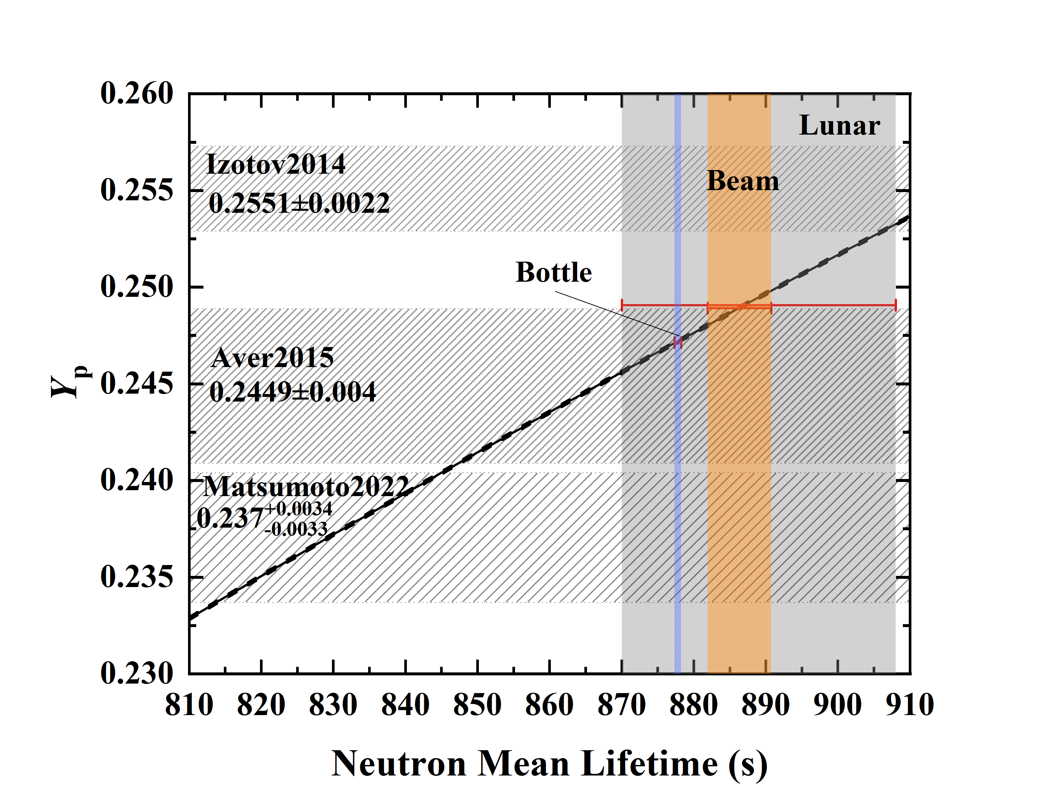
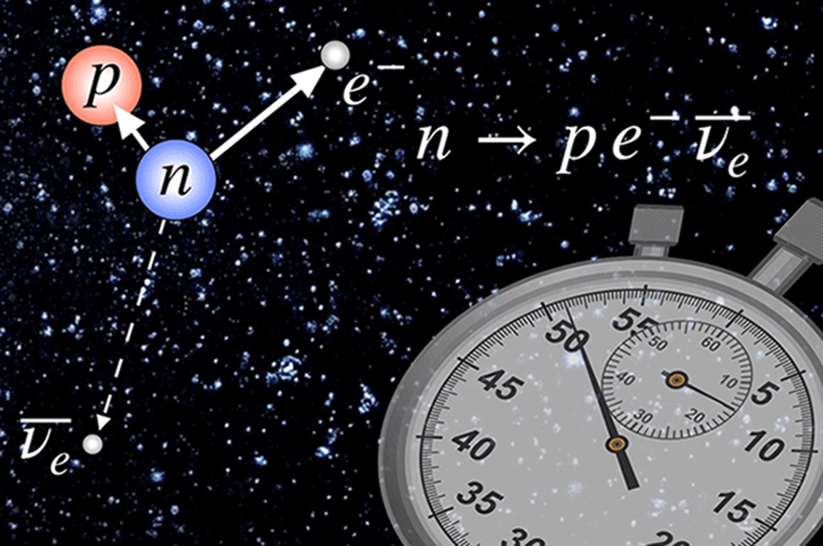
Lifetime of neutron: key role particle physics and Cosmology
Weak coupling constants
Big bang nucleosynethesis
Test of standard model for particle physics
Determine the ratios of n/p in BBN
affect all the following evolution of matter
the simplest example of nuclear beta decay：
1/2 to ½ decay , both Fermi & GT decays allowed
ℳ=[𝐺_𝑉 𝑝 ̅𝛾_𝜇 𝑛−𝐺_𝐴 𝑝 ̅𝛾_5 𝛾_𝜇 𝑛][𝑒 ̅𝛾_𝜇 (1+𝛾_5)𝜈]
标准模型：14 minutes and 48 seconds
𝐺_{𝑉}: strength of the vector force
𝐺_{𝐴}: strength of the axial vector force
t~1s, nucleon freeze-out, Yn/Yp~1/6
t~3m, neutrons all bound into light nuclei
⁴He abundance vs. neutron lifetime
Wietfeldt and Greene, Rev. Mod. Phys. 83,1173 (2011)
Precision neutron lifetime is a frontier.
Notes:
\The lifetime is fundamentally important in many aspect.
In particle physics, it severs as a test of stadard model. Since neutron decay is the simplest example of nuclear beta decay.
It played a key role in the early Universe as it determined the ratio of neutrons to protons during the era of big-bang nucleosynthesis.
/////////////////
Neutron decay is physically related to important processes in solar physics and neutrino detection.
“The neutron lifetime is an important parameter in the Standard Model because it is used as an input for calculating the quark mixing matrix, which describes quark decay rates,” said Gonzalez, who calculated probabilities of neutrons oscillating for the ORNL study. “If the quarks don't mix as we expect them to, that hints at new physics beyond the Standard Model.”
The decay of the free neutron into a proton, electron, and antineutrino is the prototype semileptonic weak decay and is the simplest example of nuclear beta decay. It played a key role in the early Universe as it determined the ratio of neutrons to protons during the era of primordial light element nucleosynthesis. Neutron decay is physically related to important processes in solar physics and neutrino detection.
Neutron decay is a spin-1=2 to spin-1=2 decay, so both Fermi and Gamow-Teller decays are allowed.
The neutron lifetime provides a means to measure the weak coupling constants GA and Gv. GA is best measured by neutron decay, either from the
Neutron lifetime or from a beta decay correlations.
Hardy and Towner (2005) evaluated and combined the results of hundreds of such measurements for 12 different nuclei. From this, the value GV 1⁄4 1:1358ð5Þ 105 GeV2 is obtained.
As the Standard Model of particle physics requires the neutron lifetime to be about 879 seconds, any deviation from this would provoke a fundamental change in our understanding of this model.
GA is best measured by neutron decay, either from the neutron lifetime via Eq. (8) or from a beta decay correlation, such as the beta asymmetry that depends on the ratio GA=GV.
The answer — 877.8 seconds, give or take 0.3 seconds, or a little under 15 minutes — hinted at a crack in the Standard Model of particle physics. That model describes the behavior of subatomic particles, such as the three quarks that make up a neutron. The flipping of quarks initiates neutron decay into protons.
确定中子的寿命对于理解宇宙在138亿年前的大爆炸中诞生后最初几分钟内形成了多少氢、氦和其他轻元素非常重要。科学家们还认为，如果能更好地确定中子的寿命，他们就能寻找到新的物理类型，因为这将有助于限制对其他亚原子粒子的测量。
中子是我们非常熟悉的粒子。大多数存在于自然界的中子是非放射性原子核的一部分，在那里，它们基本上可以永远存在。在宇宙物质的某些原子中，中子已经存在了数十亿年甚至更长时间。 但是，自由的中子（如核裂变过程所产生的中子）是不稳定的，它们的寿命很短，只有大约15分钟的时间。因为这些自由的中子会衰变为质子，在这个过程中，每个衰变的中子会释放一个电子和一个反中微子。 一直以来，物理学家都希望能够完美地了解中子的精确寿命，这对于我们理解物质的基本结构至关重要。通过知晓中子的寿命，物理学家可以推测出是否还存在其他有待发现的基本粒子。可以说，中子寿命之谜是解答宇宙学和粒子物理学中几个大问题的关键，有助于我们理解宇宙的早期状态和基本粒子的行为。 然而，物理学家用了几十年的时间，仍无法就中子寿命问题达成一致。
The neutron lifetime is significant here. First, and most importantly, the reaction rates n $ p prior to tfreeze depend on the strength of the charged weak interaction, and, in particu- lar, they are proportional to the combination of coupling constants G2V þ 3G2A that appear in Eq. (7) for the neutron lifetime. These reaction rates determine tfreeze and hence the neutron to proton ratio at tfreeze via Eq. (9). Second, the neutron lifetime governs the change in the neutron to proton ratio between tfreeze and nucleosynthesis. The precise value of the neutron lifetime is an important input for theoretical BBN calculations of primordial element abundances. In fact, the theoretical uncertainty in the predicted 4He abundance is dominated by the experimental uncertainty in the neutron lifetime (Burles et al., 1999; Lopez and Turner, 1999).

Slide 6
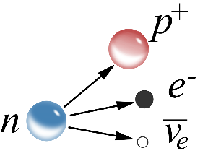
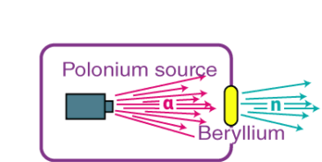
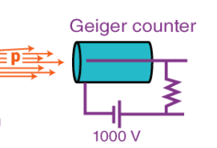
Difficulties in pioneering neutron decay detection
(α,n) reactions
~MeV，
~1cps
Neutron decay
Time of flight~ meter
Chadwick
Impossible for neutron decay measurement
neutron beam flux (~1 n/s), decay probability (10⁻¹⁰), background, detection eff.（v~10⁷m/s)
Solution： 1940’
Increase neutron flux Cyclotron (10⁶ n/s） Large statistic error
Slow down velocity Thermalized（0.025eV~2.2km/s） Random neutron direction
Increase s/n ratio Decay signal Only counting
Notes:
最早设想了中子寿命测量实验的是查德威克，他提出利用 (α, n) 反应作为中子源，使出射的快中子在米量级的距离上发生衰变，并利用G-M管测量衰变放出的中子。但是快中子飞行速度太快，在这样小的空间尺度内只有约10^-10的概率衰变并被G-M管测量到，当时的探测技术远远不能达到这种灵敏度。
等到40年代，假如使用上当时发展起来的回旋加速器，利用α束流轰击铍靶，将中子通量提高到10^6 cps；但这样所能测到的中子衰变事件率也仅仅只有10-4 cps，统计误差非常大。
另一个方法是使中子慢下来，增加单位体积内的中子衰变事例率；这意味着需要使用热中子，但在慢化过程中将损失中子的方向信息。

Slide 7
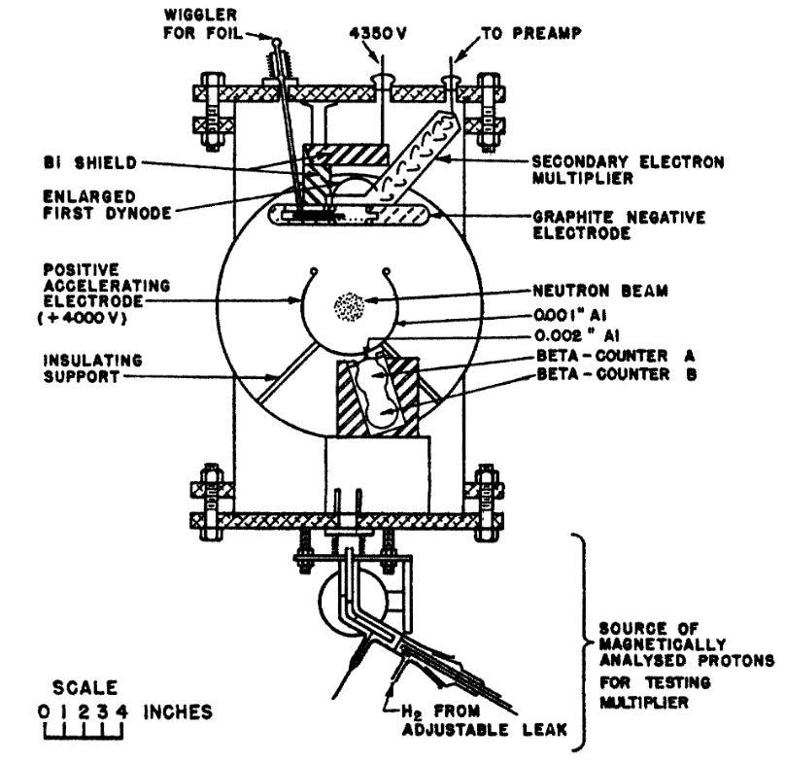
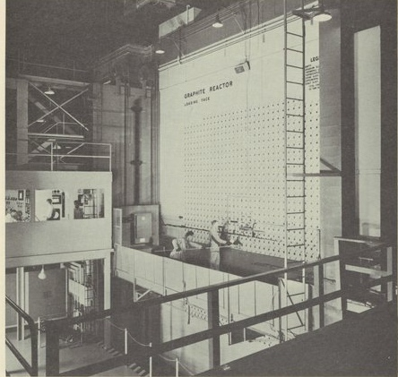
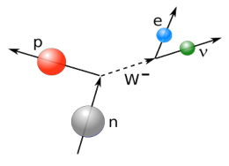
First measurement：1950s’
Background event rejection/reduction
thermal neutron flux
due to neutron detection
Graphite Reactor at Oak Ridge
First dedicated nuclear reactor
(1943)
Collimated thermal n beam
Coincident detection of
Decay protons and electrons:
bg~0.67(5) cpm
Apparatus for the first detection of coincident e⁻ and p from neutron decay
Thermal power of ≈ 3.5MW
Peak thermal n flux at the core
: 10¹² /cm²/s
Beam flux: 10³ n/cm³/s
Snell, Pleasonton, McCord, 1950, Phys. Rev. 78, 310. 10-30 min
titled with“Radioactive decay of neutron”
Robson using Chalk River reactor, 1950, Phys. Rev. 78, 311. 9-25 min
Robson, 1951, Phys. Rev. 83, 349. （T_{1/2}） 12.8±2.5 min
Notes:
The first serious measurement of neutron decay has to wait until the thermal reactor was available in 1943.
The beam flux of thermal neutron is high enough , 10^3 n/cm3/s.
Applying the coincidence method significantly reduce the background event.
So in 1950, in two paper ad·ja·cent [əˈdʒeɪsnt] to one aother were published , with identicial titles, Radioactive decay of the neutron.
This was the first time that decay from free neutron were found. They were not able to give the lifetime due to unknown neutron detection efficiency, but gave an estimation.
The first lifetime values was reported by Robson in 1951.
//////////
The development of fission reactor made the neutron measurement possible for the first time.
Background was a more troubling issue, not only must the measurement be carried out in the close proximity to the core of a nuclear reactor,
But the background generated by the beam itself is considerable.
The probability for a thermal neutron to decay over a light path on the order of 10cm is on the order of a few parts in 10^8.
However, all neutrons that do not decay will eventually be absorbed producing ionizing radiation. Thus, even if the beam related background is significantly reduced, a simple beam-on versus beam-off comparison is not likely to provide complete background suppression.
Sneel and colleagus choos to address the background issue by coincident detection of decay protons and electrons.
The use of two beta detectors (gas detectors A and B) provided rought directional tracking. The protons were more challenging to detect as the end point of the proton energy spectrum is only 752 eV. The proton detector itself was a negatively biased electron multiplier. (The positive electrode was designed to efficiently focus the decay protons onto the first plate of electron multiplier as well as providing sufficient acceleration to allow detection) → decay proton were accelerated and focused onto an electron multiplier.
Extraction of a neutron lifetime from an in-beam decay rate requires two additional quantities: the density of neutrons in the beam and the overall efficiency of the decay detection system.
Because of uncertainties in evaluating the detector efficiencies, Snell et al. were not able to give an accurate value for the neutron lifetime, but rather provided an estimation of 10-30 min for its half-life.
Robson, working at Chalk River Reactor (1950) described the observation of neutron decay and provided an estimate of 9-25 min for its half-life. The papers of Snell (1949) and Robson (1950) appear adjacent to one aother, with identicial titles, Radioactive decay of the neutron.
+++ Both Snell and Robson convincingly demonstrated that free neutrons do beta decay.
The first experiment of neutron lifetime was performed by Robson (1951) at NRX reactor at Chalk River, Canda. Robson concluded that the half-life of the neutron was 12.8 min with a probable eorror of +-2.5min. Robson detected decay electron by a beta spectrometer, making him possible to provide the first direct determination of the end point of the beta spectrum, which he found to be 782±13 keV.
反应堆的出现极大的提高了中子流强，热中子的通量达到了10^12 cps；
在X-10石墨反应堆的中子孔道上，Snell等人利用符合测量技术测量中子衰变产生的质子和电子；通过三重符合技术，他成功的将本底降到了1个每分钟（cpm）的级别；给出了中子半衰期的首个实验结果：10-30分钟。
一周以后，Robson等人也发表了他们利用类似实验测量得结果：9-25分钟；后来他们又将精度提高到12.8±2.5 分钟。
这开创了中子寿命的实验测量，
从此之后，科学家不断地开发新的实验技术，并形成了两类测量方法：
其中一类是通过测量中子衰变的产物数目来测量中子寿命，被称为束方法；
另一类是通过约束中子，并测量一段时间后的中子剩余数目来测量中子寿命。

Slide 8
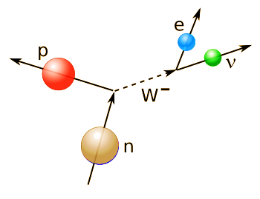
Modern neutron lifetime measurements
Bottle method
Beam method
A beam of slow neutrons pass through a known decay volume, and one counts protons appearing in a beam as neutrons decay
trap neutrons in a “bottle” and
counts their disappearance after some time.
Credit: Daniel Savage/Quanta Magazine
Notes:
Modern methods to determine neutron lifetime have been classified into two, namely, bottle method and beam method.
In the bottle method, one traps neutrons in a bottle and counts their disappearance after some time. This is so far the most precise method.
While in the beam method, one counts protons appearing in a beam as neutrons decay. This is the oldest method, starting from the first experiment in 1951.
So one would expect both methods should give identical neutron lifetime
/////////
Nativelly speaking, bottle method counts how many neutrons survive, and the beam method counts how many neutrons decayed to protons.
///////////
A beam of slow neutrons with density &n passes through a known decay volume V. The instantaneous neutron decay rate N_ in the decay volume is given by the differential equation that governs exponential decay
To measure the lifetime of a free neutron, scientists take two approaches that should arrive at the same answer.
the specific activity (decay rate per
neutron) of a neutron beam is measured
It turns out neutrons appear to live nine seconds longer in a beam than in a bottle.
Over the years, perplexed physicists have considered many reasons for the discrepancy. One theory is that the neutron transforms from one state to another and back again. “Oscillation is a quantum mechanical phenomenon,” Broussard said. “If a neutron can exist as either a regular or a mirror neutron, then you can get this sort of oscillation, a rocking back and forth between the two states, as long as that transition isn’t forbidden.”
Physicists confront the neutron lifetime puzzle
一直以来，物理学家们试图用两种方法来对此进行测量，一种被称为“瓶方法”；另一种被称为“束方法”。用这两种方法得出的测量结果并不一致，瓶方法得出的中子寿命是14分39秒；而束方法得出的结果却是14分48秒。这相差的约9秒的时间对于一个寿命只有15分钟长的粒子来说，是不容忽视的重大差异。
物理学家通常有两种方法来测量中子寿命，一种涉及到瓶子结构的容器，被称为瓶方法；另一种涉及到粒子束，被称为束方法。
现在，一项发表于《物理评论快报》的新研究表明，一个由多个科学家团队组成的合作组利用瓶方法，对中子的寿命进行了迄今为止最精确的测量。新的结果表明，中子寿命为877.75秒（约14.629分）、不确定度为0.039%（约0.005分）。这一结果与理论计算结果一致，精度是同类测量结果的两倍。 这个实验被称为UCNτ（UCN指超冷中子，τ指中子寿命），它始于十多年前，但对于最新公布的结果则是基于2017年和2018年运行的两个实验。 从实验的角度来看，这项研究面临一些艰巨的挑战，比如自由的中子很容易与原子结合，因此，研究人员必须在实验装置内创造一个非常严密的真空，以防止气体进入。此外，他们还必须大幅降低中子的速度，这样中子才能捕获并计数。 在UCNτ团队于2017年和2018年进行的两个瓶方法实验中，研究人员通过不同的步骤来冷却中子，最后的关键步骤是让中子与固态的寒冷的氘相互作用，使中子失去能量，从而将中子减速到超低温度。他们将这些中子置于一个浴缸大小的真空瓶中，瓶子装置配备有约4000块磁铁，强大的磁场可以阻止中子与瓶子表面接触，从而将自由的中子困在瓶中。
浴缸大小的高效超冷中子探测器。｜图片来源：Michael Pierce / LANL在瓶子中，这些中子开始衰变为质子。在每轮实验中，中子会被置于瓶子中一段足够长的时间。研究人员要做的就是通过复杂的数据分析方法，在每个周期结束的时候，清点瓶中的剩余中子。接着，他们会将新的中子再次装入瓶中，重新开始这个过程。在两年多的时间里，研究人员通过这两个实验总共统计了4000万个中子。 为了消除测量过程中可能出现的任何由人为因素导致的偏差，合作组分成三个小组，分别由加州理工学院、印第安纳大学，以及洛斯阿拉莫斯国家实验室（LANL）的研究人员领导，以一种“盲”的工作方式展开研究。 每个小组都配有一个“假”的时钟，这些时钟被故意调节得更慢一些，这一“错误”直到实验的最后才会被纠正。如此一来，研究人员就无法知道实际究竟经过了多长时间，也就无从知道中子的实际寿命。这使得实验更加可靠，因为它避免了研究人员为了使结果符合预期数值，而造成的有意识或无意识的偏差。 在实验完成并收集了所有数据后，三个小组使用了不同的方法来分析数据。令人惊喜的是，三个小组发现，虽然他们采用了不同的数据处理方式，却得出了几乎相同的答案，这是惊人一致的结果。最后，研究人员得出中子衰变的平均时间为877.75秒，计算精度优于百万分之四百，是迄今为止最精确的结果。 然而，新的结果仍然无法解释为什么用瓶方法和束方法得出的结果会出现9秒左右的不一致性。这意味着这两种测量方法之间仍然存在分歧，它表明要么其中一种方法存在系统性错误，要么物理学中存在某些仍有待理解的未知事物。 但新的精确结果为解决中子寿命之谜提供了独立的评估，帮助科学家更接近一个答案。现在，UCNτ团队正在进行新的改进，以求进一步提高精度。在未来的实验规划中，物理学家们也将进一步完善束方法进行的测量，从而最终找出导致中子寿命之谜的，究竟是系统性误差还是新的物理学。

Slide 9
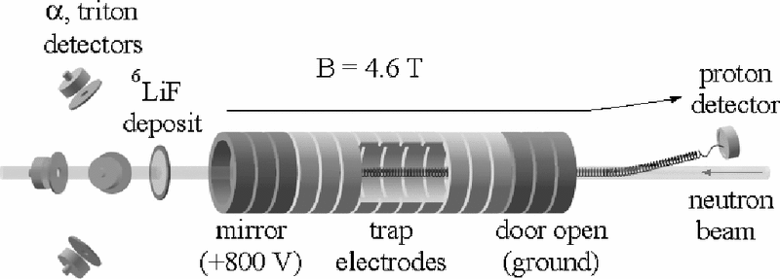
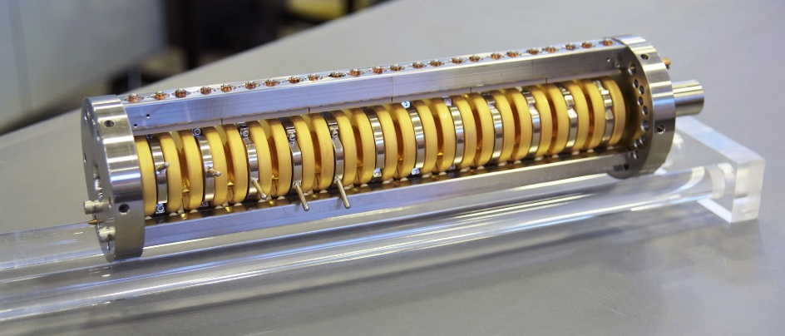
Beam method (absolute meas.)
(systematic uncertainty?)
 | 中子寿命 | 误差
Robson, 1951 | 1110 | 220
Spivak et al., 1956 | 1040 | 130
D’Angelo, 1959 | 1100 | 160
Sosnovsky et al., 1959 | 1013 | 26
Christensen et al., 1972 | 918 | 14
Last et al., 1988 | 876 | 21
Spivak, 1988 | 891 | 9
Kossakowski et al., 1989 | 878 | 30
Byrne et al., 1996 | 889.2 | 4.8
Nico et al., 2005 | 886.3 | 3.4
Yue et al., 2013 | 887.7 | 2.2
NIST实验
Nico, et al., 2005, Phys. Rev. C 71, 055502
Notes:
A bit more information about the method:
Beam method is the oldest method, starting from the first experiment in 1951.
It measures the specific activity (decay rate per
neutron). Here is a collection of this approach.
/////////////
It measures the specific activity (decay rate per
neutron) of a neutron beam is measured
/////////////////
it has been used in the first true measurement of the
neutron lifetime by Robson at the Chalk River pile reactor in
1950 (Robson, 1951). A beam of slow neutrons with density
$\rho_n$ passes through a known decay volume $V$.
The instantaneous neutron decay rate $\dot{N}$ in the decay volume is given by
the differential equation that governs exponential decay.
The neutron beam density is measured based on the 1/v law.
In the figure, Sussex-ILL-NIST seires of experiments.
The NIST beam neutron lifetime experiment.
Top: The neutron beam passes through a 16 segment quasi-Penning trap
where neutron decay protons are trapped and later extracted through
a 9.5 bend in the magnetic field to the proton detector. The neutron beam density is measured by counting 6Li(alpha, n) 3H reactions in a thin 6LiF deposit.
=================
A neutron beam was passed through a segmented quasi-Penning trap
where the decay protons were trapped and counted; see Fig. 4.
The trap consisted of 16 individual electrode segments. In the trapping
state, the first three segments (the ‘‘door’’) were held at
+800 v, a variable number (3–10) of trap segments were
held at ground, and the following three segments (the
‘‘mirror’’) were at +800 v. When a neutron decayed inside
the grounded region, the proton was trapped electrostatically
in the axial direction and by the 4.6 T magnetic field in the
transverse direction.
After some period of time in the trapping state, typically 10 ms, the door electrodes were briefly lowered to the ground and a small ramped potential was
applied to the trap electrodes. Trapped protons were flushed
through the door and transported by a 9.5^degree bend in the
magnetic field to a silicon surface barrier detector where
they were electrostatically accelerated and counted (Byrne
et al., 1986).
The trap was then returned to the trapping state
to repeat. When the neutron beam exited the trap, it passed
through a very thin deposit of 6LiF on a silicon substrate. A
set of four surface barrier detectors with very well characterized detection solid angle and efficiency counted the alpha and triton reaction products from 6Li(alpha,n)3H reactions, thus
giving an in situ measurement of the neutron density.
七十余年来，束实验的精度不断提高。目前最新的实验使用了潘宁阱来保存衰变产生的质子，累积一段时间后将质子引出并计数；与LiF测得的中子总数相比，就能得到寿命。这个实验中的误差主要来自：质子测量效率的误差和中子通量测量效率的误差。
Trapped protons of energy < 0.751 keV move in cyclotron orbits of radii < 1 mm about the local magnetic field lines.

Slide 10
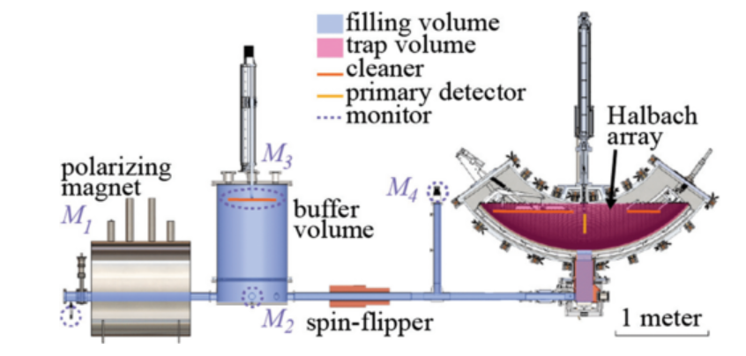
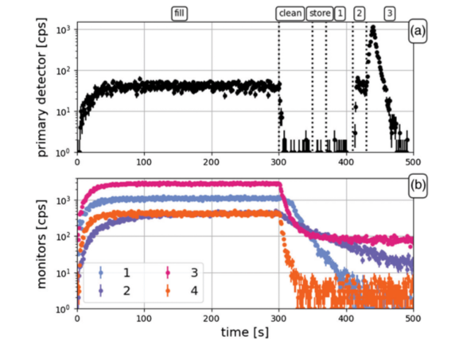
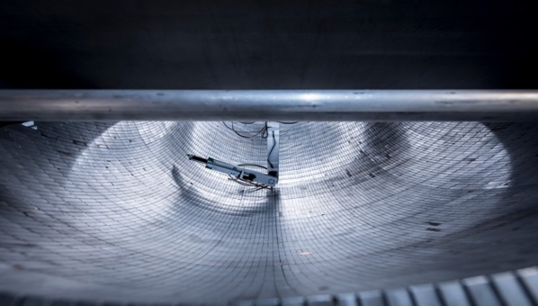
Bottle method (relative meas.)
Ultra cold neutron（<100 neV， 1 mK）
Trapped in magnetic bottom or in a material wall
¹⁰B-coated-ZnS: neutron measurement
 | 中子寿命 | 误差
Kosvintsev et al., 1980 | 875 | 95
Kosvintsev, Morozov, and Terekhov, 1986 | 903 | 13
Morozov, 1989 | 893 | 20
Mampe et al., 1989 | 887.6 | 3
Alfimenkov et al., 1992 | 888.4 | 3.3
Mampe et al., 1993 | 882.6 | 2.7
Arzumanov et al., 2000 | 885.4 | 0.98
Serebrov et al., 2005 | 878.5 | 0.76
Pichlmaier et al., 2010 | 880.7 | 1.8
F. M. Gonzalez et al.，2021 | 877.75 | 0.35
Magnetic field
High vacuum
Loss in the bottle?
14 min 47.75 s
Notes:
The bottle method on the other hand, is so far the most precision method.
In this method, ultracold neutrons are stored in a sort of trap system for a time comparable to the neutron lifetime and the surviving neutrons that did not decay are counted.
The most precise result was reported in 2021, the result is 14 min 47.75s, a value that can be comparable with Standard model predictions.
///////////////////////////
Ultracold neutrons are neutrons whose kinetic energy is less than about 100 neV (temperature less than 1 mK, de Broglie wavelength greater than 100 nm). At this energy, a neutron can be trapped and stored for long periods.
The basic idea of this method is simple. Ultracold neutrons are produced and admitted into a bottle whose walls have high effective potential and therefore are totally reflecting for
neutrons. If the bottle is sufficiently tall, then the neutrons are vertically trapped by gravity. Following some storage time $\Delta t$, the surviving neutrons are extracted and counted.
Two (or more) different storage times are used: $\Delta t_1$ and $\Delta t_2$, with the
longer time comparable to the neutron lifetime. If the only loss mechanism is due to neutron beta decay, the ratio of neutron count rates for the two storage times N1=N2 gives the
neutron lifetime
公式
In practice, there are always competing loss mechanisms that
must be accounted and/or corrected for.
目前精度最高的结果来自瓶实验，它就是通过降低中子速度实现的；最新的实验将极化超冷中子束缚在磁场中，通过测量剩余的中子数目随时间的变化得到中子寿命。
这个实验被称为UCNτ（UCN指超冷中子，τ指中子寿命），它始于十多年前，但对于最新公布的结果则是基于2017年和2018年运行的两个实验。 从实验的角度来看，这项研究面临一些艰巨的挑战，比如自由的中子很容易与原子结合，因此，研究人员必须在实验装置内创造一个非常严密的真空，以防止气体进入。此外，他们还必须大幅降低中子的速度，这样中子才能捕获并计数。 在UCNτ团队于2017年和2018年进行的两个瓶方法实验中，研究人员通过不同的步骤来冷却中子，最后的关键步骤是让中子与固态的寒冷的氘相互作用，使中子失去能量，从而将中子减速到超低温度。他们将这些中子置于一个浴缸大小的真空瓶中，瓶子装置配备有约4000块磁铁，强大的磁场可以阻止中子与瓶子表面接触，从而将自由的中子困在瓶中。
在瓶子中，这些中子开始衰变为质子。在每轮实验中，中子会被置于瓶子中一段足够长的时间。研究人员要做的就是通过复杂的数据分析方法，在每个周期结束的时候，清点瓶中的剩余中子。接着，他们会将新的中子再次装入瓶中，重新开始这个过程。在两年多的时间里，研究人员通过这两个实验总共统计了4000万个中子。 为了消除测量过程中可能出现的任何由人为因素导致的偏差，合作组分成三个小组，分别由加州理工学院、印第安纳大学，以及洛斯阿拉莫斯国家实验室（LANL）的研究人员领导，以一种“盲”的工作方式展开研究。

Slide 11
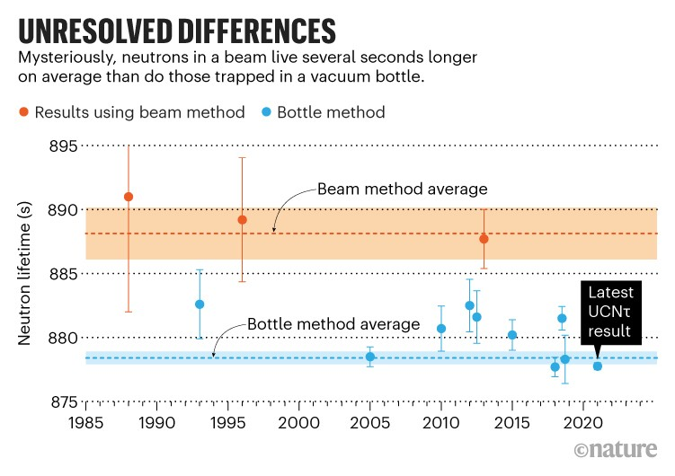
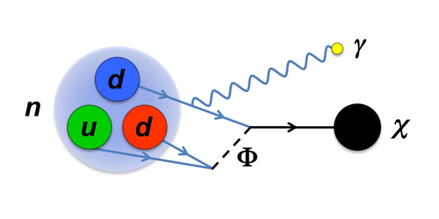
Decades-long mystery of neutron lifetime
Nature 598, 549 (2021)
PRL127,172601(2021)
Science 360,627(2018)
PRL111,222501(2013)
Unknown systematic errors in one or both methods
New physics behind neutron decay
Precisions get better and better, with typical uncertainties being reduced to less than 3 seconds
A gap of about 9 s in neutron lifetime between the most precise measurements in earth (>4σ, 1% deviation)
Notes:
Shown here is A summary of neutron lifetime measurements for about 40 years.
Red circles are beam experiement, and blue circles are bottle experiments.
The shadowed areas are the relevant averages for each method.
You see, although the precisions are continuously improved, two methods tend to give different answers.
The difference is about 9 s, corresponding to 4 standard deviation or 1% in neutron lifetime.
This deviation was summarized as “neutron lifetime puzzle.” in 2021.
The possible solutions have been well documented, to at least two possibilities. The first one is there are unknown…
The second one, supposed both methods are correct, there must be something we have never seen behind neutron decay, namely, new physics may occur behind that…
Despite decades of taking measurements, scientists cannot agree on how long neutrons live.
但过去的实验结果表明，中子束里的中子，比瓶子里的中子多存活了约8秒左右。对于平均寿命不到900秒的自由中子来说，8秒的差异是不容忽视的，它无法仅用测量的不准确性来解释
需要把 中子寿命疑难单独拿出来；如何解释？（1）实验问题；（2）理论探索，可以找出1-2篇文章，简要说明下
一直以来，物理学家们试图用两种方法来对此进行测量，一种被称为“瓶方法”；另一种被称为“束方法”。用这两种方法得出的测量结果并不一致，瓶方法得出的中子寿命是14分39秒；而束方法得出的结果却是14分48秒。这相差的约9秒的时间对于一个寿命只有15分钟长的粒子来说，是不容忽视的重大差异。
经过多年来的实验技术进步，瓶实验与束实验的实验精度不断提升，并都控制在3s以内；但两类实验却分别收敛到不同的结果，束实验的结果约比瓶实验大了9s，大约是4倍的σ。
为什么会有这种差别目前还没有定论。可能的解释是存在一个没有被合理评估的系统误差；还有一种可能是存在新的中子衰变道，比如向暗物质的衰变。
因此亟需开展具有类似精度、但系统误差不同的独立实验。
经过几十年对实验方法的微调，物理学家们“没有找到任何理由怀疑这种差异是来自于不良测量，”Grinstein说，“我们面临着一个非常现实的选择，那就是我们需要考虑从根本上改变物理定律。”
研究人员现在提出，在中子衰变的时间里，大约有1%的时间，随着分解成一些已知的粒子，它们也会产生暗物质粒子。这可能有助于解释科学中最大的谜团之一。
暗物质粒子的存在被用来解释各种各样的宇宙谜题，比如为什么星系可以像人们看到的那样快速旋转而不被撕裂。科学家们已经基本上排除了所有已知的普通材料作为暗物质的候选者——如果它存在的话，目前的共识是它是由新的粒子组成的，而这些粒子只会与普通物质有微弱的相互作用。
由于中子束实验的重点是衰变为质子的中子，所以它们不能解释有可能产生暗物质粒子的衰变方式，因此这一实验得出的中子寿命与瓶子实验的不同。
加州大学圣地亚哥分校的理论物理学家Bartosz Fornal说：“如果能让我们探测到宇宙中暗物质的粒子，那真是太神奇了。”
物理学家们探索了几种不同的中子“暗衰变”的情形，其中中子会同时分解成暗物质粒子和诸如伽马射线或电子之类的普通成分。“我们提出的这种新粒子是微不可见的，就像暗物质一样，它们只会与正常物质发生微弱的相互作用，”Grinstein说到。

Slide 12
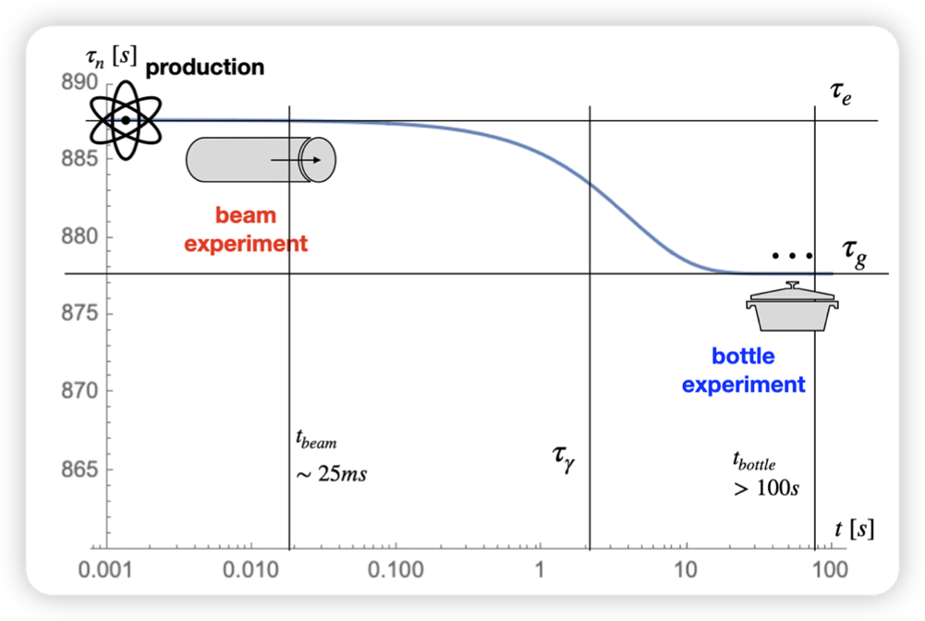
New physics proposed to solve the lifetime puzzle
SM: the branching fraction (Br), dominated by β decay, is 100%.
Ideas to account for the missing 1% in the bottle method !
PRL 120, 191801 (2018)
PRD 110, 073004 (2024)
new dark decay channel
existence of the excited state
Excited state
the existence of a dark decay channel
two different scenarios :
(a) n → invisible + visible;
(b) n → invisible:
Ground state
PRL121,061801(2018)
PRL121,022505(2018)
… …
Notes:
So there were many discussions on possible new physics.
For example, there is 1% branch for neutrons decay to dark matter. Dark matter is invisible to us so far.
Or neutron may have an excited stat besdids ground states.
These new ideas can accounts for the missing 1% in the bottle method.
Over the years, perplexed physicists have considered many reasons for the discrepancy. One theory is that the neutron transforms from one state to another and back again. “Oscillation is a quantum mechanical phenomenon,” Broussard said. “If a neutron can exist as either a regular or a mirror neutron, then you can get this sort of oscillation, a rocking back and forth between the two states, as long as that transition isn’t forbidden.”
The ORNL-led team performed the first search for neutrons oscillating into dark-matter mirror neutrons using a novel disappearance and regeneration technique. The neutrons were made at the Spallation Neutron Source, a DOE Office of Science user facility. A beam of neutrons was guided to SNS’s magnetism reflectometer. Michael Fitzsimmons, a physicist with a joint appointment at ORNL and the University of Tennessee, Knoxville, used the instrument to apply a strong magnetic field to enhance oscillations between neutron states. Then the beam impinged on a “wall” made of boron carbide, which is a strong neutron absorber.
If the neutron does in fact oscillate between regular and mirror states, when the neutron state hits the wall, it will interact with atomic nuclei and get absorbed into the wall. If it is in its theorized mirror neutron state, however, it is dark matter that will not interact.
暗物质粒子 https://baijiahao.baidu.com/s?id=1601425657755649680&wfr=spider&for=pc
https://baijiahao.baidu.com/s?id=1600983267472211513&wfr=spider&for=pc
中子存在未知的激发态 PRD110，073004（2024）
… this difference can be explained by the existence of a dark decay channel for the neutron, which makes Br(n → p + anything) ≈ 99%. There are two qualitatively different scenarios for the new dark decay channel, depending on whether the final state consists entirely of dark particles or contains visible ones: (a) n → invisible + visible; (b) n → invisible:

Slide 13
a third way to determine independently
neutron lifetime
with different systematic errors + fair precisions
Notes:
As for experiment, a third way to determine neutron lifetime independently will be very helpful. It will have totally different systematic errors, but should have similar precisions as the previous two methods.
////////
To help solve the neutron-lifetime dilemma, physicist David Lawrence at Johns Hopkins University in Baltimore, Maryland, and his collaborators have been developing a technique to measure it using neutron detectors on space probes. “It would be really useful to have a third way of doing it,” he says.
The method relies on the fact that most planetary bodies eject neutrons when hit by cosmic rays. Many of the neutrons fail to escape a planet’s gravity and eventually rain back down — but by then, some of those have transformed into protons. Comparing the number of neutrons emit Latest UCNτ result 2020 ted into space with those that come back can provide an estimate of the neutron’s lifetime.
“Some fraction of the neutrons will go up, decay and never come back down,” Lawrence says. He adds that the ideal way to do such an experiment would be with a small, dedicated probe in orbit around Venus, because the planet’s carbon dioxide atmosphere does not absorb neutrons well.
The UCNτ team has been working on several improvements to increase precision further. Hoogerheide and her colleagues at NIST are doing the same with the beam technique; they think that its precision can improve by around a factor of ten, she says.

Slide 14
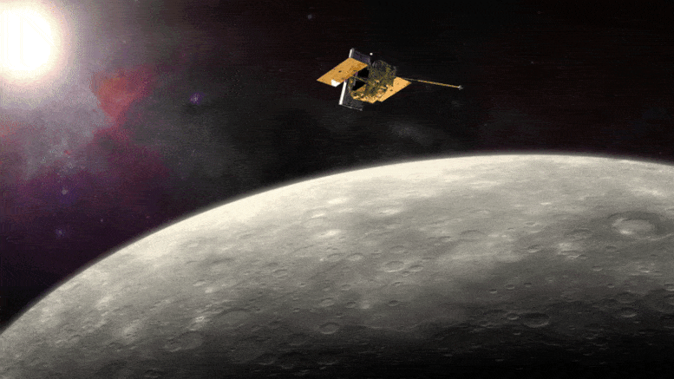
Space-based measurement of neutron lifetime
Feldman, Nucl. Instur. Meth. A 287,595(1990)
 neutrons with energies <0.5 eV undergo
beta decay when escaping from the planet.
Number of neutrons at a certain altitude
reflect how long neutrons can survive
Many neutrons fail to escape a planet’s gravity,
eventually, rain back down — but by then, some of those have already transformed into protons.
Comparing the number of neutrons ted into space with those that
come back can provide an estimate of the neutron lifetime.
planet as a “free” neutron source
large bottle experiment, using the Planet’s gravity to confine thermal neutrons
neutron decay in flight (high vacuum conditions)
 neutrons generated by galactic cosmic ray spallation of planets surfaces and atmospheres
Notes:
In 1990, Feldmann proposed a space-based experiment. The idea is fantastic.
+ In such a method, one makes use of the free neutrons that are naturally produced by interactions between Galactic Cosmic Rays (GCRs) and a planetary body, Such as moon or mercury.
Some neutron may fly away from the planet, slowing down by atomosphere and gravitation.
+ If the neutron energy is very low, say, less than 0.5 eV, these neutron will undergo beta decay during their flight. So one can count the number of neutrons at different altitudes
And deduce the lifetime.
Of course, this rely on the fact that high vacuum is above the sea level.
+ if the neutron energy is not enough to escape a planet’s gravity, eventually, will rain back down, but by then, some of those neutrons have already decayed into protons.
By comparing the number of neutron travelling into space and travelling back, can also provide an estimate of the neutrons’ lifetime.
So if you try to compare this space-based methods with earth-based methods, this method is sort of bottle experiment, it use the planet’s gravity to confine thermal neutrons.
///////////
The lowest energy (< 0.5 eV) of these neutrons have a velocity less than 10 km/s, and can thus undergo beta decay when they escape from the planet.
Of course, Many of the neutrons fail to escape a planet’s gravity and eventually rain back down — but by then, some of those have transformed into protons.
Comparing the number of neutrons ted into space with those that come back can provide an estimate of the neutron’s lifetime.
+ However, there were no space mission designed to measure τn. There were on the other hand many space missions carrying on a neutron detector,
because they provide insight into the surface composition of planetary bodies.
===========================
However, no mission designed to measure τn has flown and no previous successful measurements of τn from space have been reported. We present a measurement of τn using data taken by NASA’s MESSENGER spacecraft [2] during its flybys of Venus and Mercury [3].
These data were taken with the aim of characterizing the compositions of Mercury’s surface, so this measurement technique is not optimized and there are systematics present that could be avoided with a dedicated mission.
However, the measurement’s success demonstrates the possibility of measuring τn from space.
The new technique exploits the fact that τn affects both the relative count rates at Venus and Mercury
and the rate at which the neutron flux decreases with distance from the top of Venus’ atmosphere.
During MESSENGER’sflybyofVenusthemeantimeofflight for a detected neutron varied between 80 and 640 s.
===================
A space-based measurement technique makes use of the free neutrons that are naturally produced by interactions between Galactic Cosmic Rays (GCRs) and a planetary body, such as the Moon.
The lowest energy (< 0.5 eV) of these neutrons have a velocity less than 10 km/s, and can thus undergo beta decay in the distances reasonably sampled by an orbiting satel lite. The neutron lifetime can then be measured based on the disappearance of these neutrons with distance from the planetary body.
These same neutrons have been measured by many planetary science missions because they provide insight into the surface composition of planetary bodies.
Thus while no dedicated space-based neutron lifetime measurement has been performed, initial studies are possible with existing planetary science data. A feasibility study of this method was first done by Wilson et al. (2020), estimating the τn = 780±70 s using flybys of Venus and Mercury by NASA’s MESSENGER space craft. A more recent measurement of τn = 887±14 s has been reported by Wilson et al. (2021) using data from the Lunar Prospector (LP) mission
To help solve the neutron-lifetime dilemma, physicist David Lawrence at Johns Hopkins University in Baltimore, Maryland, and his collaborators have been developing a technique to measure it using neutron detectors on space probes. “It would be really useful to have a third way of doing it,” he says.
“Some fraction of the neutrons will go up, decay and never come back down,” Lawrence says. He adds that the ideal way to do such an experiment would be with a small, dedicated probe in orbit around Venus, because the planet’s carbon dioxide atmosphere does not absorb neutrons well.
Wilson et al. has tWe establish the feasibility of measuring the neutron lifetime via an alternative, space-based class of methods, which use neutrons generated by galactic cosmic ray spallation of planets surfaces and atmospheres.

Slide 15
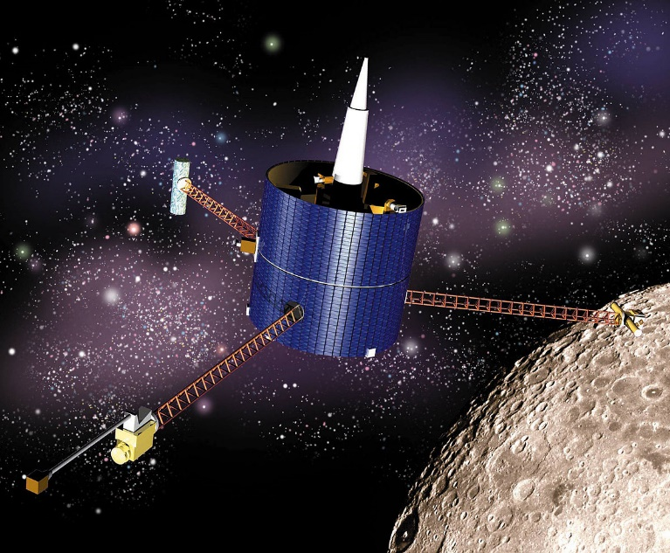
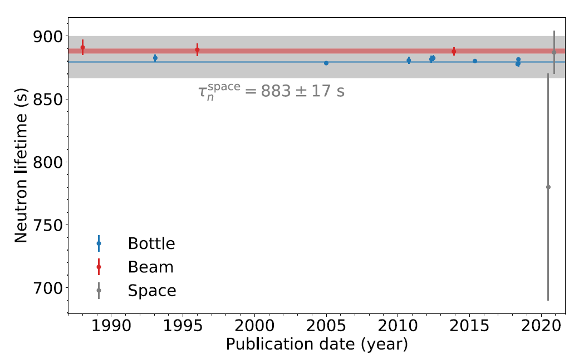
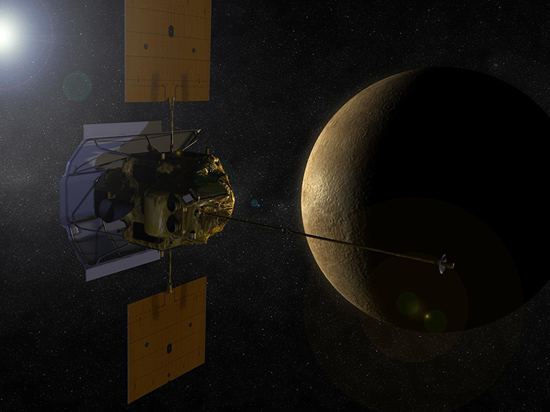
Space-based measurements
Generally consistent with earth-based experiments,
but with larger error bars.
Lunar（1998-1999）
Phys. Rev. C (2021)
887±14±7 s
▪
Mission：water
Phys. Rev. Res. (2020)
780±60±70 s
Message（2004-2015）
Wilson et al., Phys. Rev. Reseach 2, 023316(2020)
Wilson et al., Phys. Rev. C104,045501 (2021)
Vydula et al., arXiv 2501.18831
Using existing data during flybys of planets like Mercury and moon, Wilson et al. examined the feasibility of such space-based measurement.
Data flybys of Mercury
Notes:
Unfortunately, there were no mission designed to measure neutron lifetime.
Instead, in 2020-2021, scientists have used the old data, collecting neutron flux over a large range of heights during a flyby of Mercury by Message and of moon by lunar, to determine neutron lifetime. Both mission carried a neutron detector.
Wilson et al. have attempted to determine the lifetime and the results are summarized here. Although with a large error, it looks promising.
However, recently, Vydula et al. also checked the lunar data, but evaluated carefully the systematic error due to e.g., temperature, local surface compositions, and they gave 754.72 second, which is a bit far away from the earth-based measurements.
////////////////////////////////
In 2020, Wilson published the first result of space-based measurement. with an uncertainty of about 130s. They used data acquired in 2007 and 2008 during flybys of Venus and Mercury by NASA’s MESSENGER spacecraft.
They estimate the neutron lifetime to be 780 ± 60stat ± 70syst s, thereby demonstrating the feasibility of this new approach.
Later they also surveyed the data from Lunar mission, and obtained a result of 887 seconds.
Just recently, Vydula et al. also used the lunar data, and tried to evaluated the systematic error due to e.g., temperature, local surface compositions, and they gave 754.72 second, which is a bit far away from the earth-based measurements.
Anyway, the 3 work show that it is feasible to determine the neutron lifetime from spaced measurement.
=============================
“The spacecraft made observations over a large range of heights above the surfaces of Venus and Mercury, which allowed us to measure how the neutron flux changes with distance from the planets.”
the measurement’s success demonstrates the possibility of measuring τn from space.
MESSENGER carried a neutron spectrometer to detect neutrons set loose into space by cosmic rays colliding with atoms on Mercury’s surface as part of research to determine the existence of water on the planet.
On its way the spacecraft first flew by Venus, where it collected neutron measurements for the first time ever.
Using models, the researchers estimated the number of neutrons MESSENGER should count at its altitude above Venus for neutron lifetimes would be between 600 and 1,020 seconds. For the shorter lifetimes, fewer neutrons survive long enough to reach MESSENGER’s neutron detector.
They found the neutron lifetime to be 780 seconds, with an uncertainty of about 130 seconds from statistical and other uncertainties, like whether the number of neutrons changes during the day and uncertainty about the chemical make-up of Mercury’s surface.

Slide 16
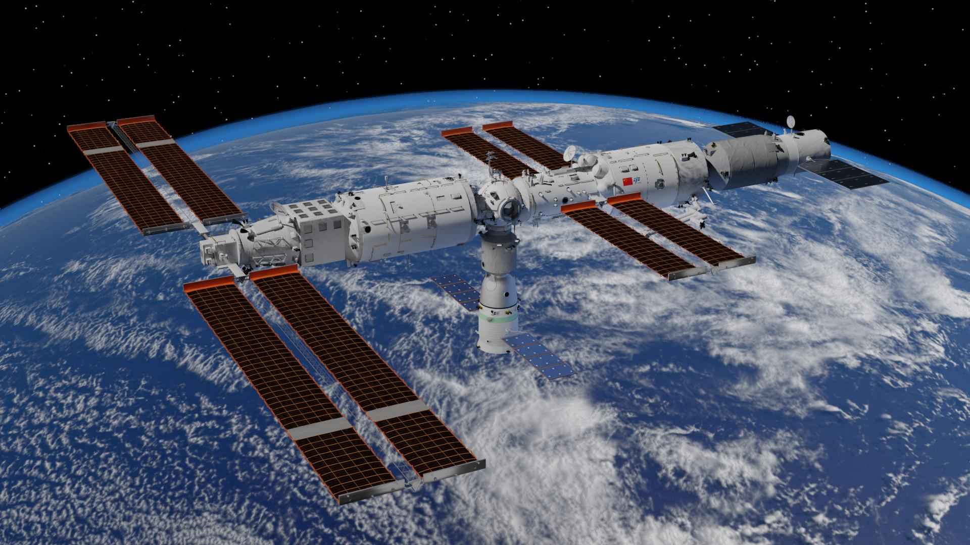
Comments on existing data
Counting of “thermal neutrons”:
Relatively large-scale spacecraft:
Uncertainties in planet surface:
Cosmic rays
Secondary neutrons
Systematic error
dedicated space-based neutron lifetime measurement
Notes:
Anyway, the space-based measurement looks very promising. However, there are defects in the pioneering studies.
Here I list 3 of them:
Only neutron numbers were recorded in the old data. As we know, there will be many backgrounds due to cosmic rays in the space environment. One can solve the problem by developing a system that is only sensitive or selective to thermal neutrons.
Used a large-scale spaceship or satellite, typically several hundred kg or tons. The spacecraft can introduce secondary neutrons, again making the data complicated sources; As a solution, instead of using a large spacecraft, we should use a nano-satellite.
we do not know much about the moon or mercury. This is generally thought to be the most significant uncertainty。
Therefore, a dedicated mission will be exciting. In this way, we can diminish [dəˈminiSH] possible systematics uncertainties as identified here.
This comes to our proposal.

Slide 17
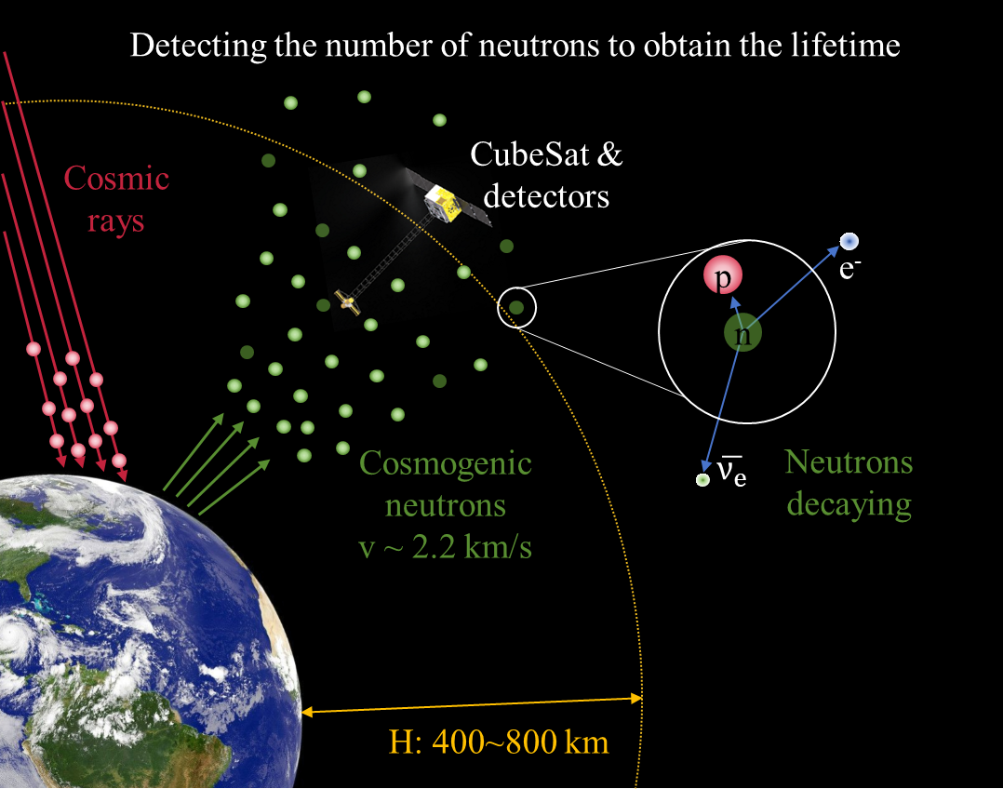
新方案：基于小卫星对近地空间开展中子探测
Thermalized albedo neutron flux at low-earth orbits
Albeto neutrons thermalized in the atmosphere
Neutron decay in flight
(h~800 km & v~2.2 km/s: about 360s)
Detecting the neutron flux at 400-800 km using CubSate
Extraction of neutron lifetime
Neutron thermalized
In orbit operation for 1 year, thermal neutron~4x10⁵, statistic error ~ 3 s
被行星引力俘获的中子形成一个巨大的瓶子+束实验——拥有与地面实验方法截然不同的系统误差
真空环境优势：没有振动产生的噪音
Notes:
We have proposed a project aiming to determine the thermalized alberdo neutron flux at low-earth orbits.
Instead of using the moon or mecury, we stick to our earth system since we know much much better on our earth and its atomosphere, this
Allows us to have a better control on the potential systematic error. Moreover, with the existing data on the several tens km in altitude, we can verify our simimulation code of generating alberno neutrons and their transportation.
This is the first advantage.
Second, we will use a nano-satellite instead of e.g., Chinese Space station, to reduce the secondary neutrons from the spacecraft, i.e., background events.
Of course, utilizing a nano-satellite will challenge us in detector design, which I will talk a few mins later.
Third, we will use a state-of-art tech for detecting thermal neutrons.it will be more sensitive, more selective (e.g., distinguish from the background events from the detector itself, cosmic rays, sparking).
=====================
In this case, neutron produced from the collision of cosmic ray with atomphere, and then thermalized. We are interested only in the Albeto neutrons,
Namely, the secondary neutrons that
fly away from the atmosphere /al’bi:dou/ neutrons.
We already know that majority of neutrons are produced at about 10 km.
One can safely assume the outspace above 100 km is vaccum.
In this case, neutrons would decay in flight. A rough estimation: in a flight of about 800 km, about 1/3 of thermal neutrons would decay.
We are planning to detect the thermal neutrons at various altitutes by nano-statellate. %, meanwhile count the neutrons flying away from earth and rain back.
Nanosatellate or CubeSat are needed to reduce the secondary neutrons produced from statellate itself.
Then we can deduce the lifetime.
If it runs in orbit for 1 year, the total count of neutron cases can reach more than 104, and the statistical error accuracy can reach 1%.
////////////////
在轨运行1年，中子事例的总计数达到4x10⁵以上 → 1% 的统计误差精度
150cps/cm2/s/nv, ~ 1/min

Slide 18
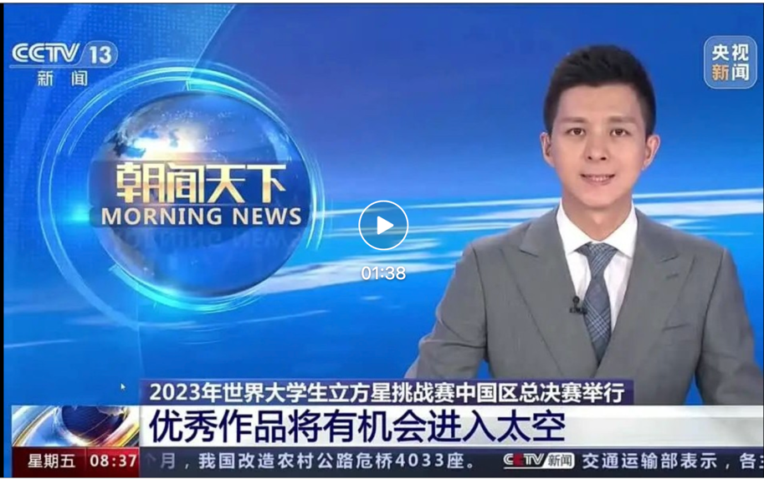
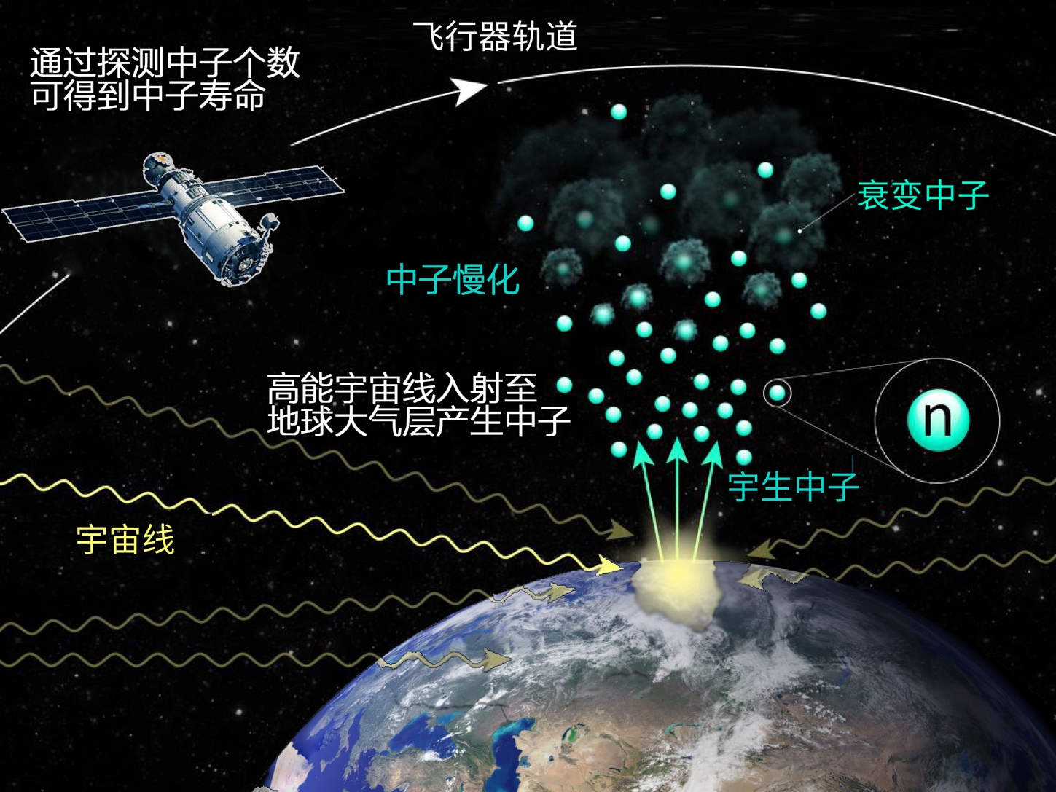
Gold award of China in Space Universities Cubesate Challenge (SUCC)
Notes:
This project initially is a student project in the bachelor and master level. It wons the Gold award of China in Space Unviersities Cubsate challenge (SUCC)
In 2023.
We are happy about that.
Baohua Sun is Lan-Tian distinguished Professor at Beihang university, and deputy dean of School of physics. His research interests include rare isotope physics and particle detector development for space science and medical physics. He published more than 130 journal papers and was invited to present talks at academic conferences for over 60 times. He is now the vice president of China Nuclear Industry Education Society and vice president of radiation beam technology division of China Nuclear Society. He also serves as the editorial board of Chinese Physics C, and a committee member for proposals of nuclear-physics beam time experiments at HIRFL, CIAE, SLEGS, and CSNS in China. Baohua studied at GSI as a joint PhD student in 2005-2008, and then worked at JLU Giessen as a postdoc fellow and visiting scholar in 2008-2012.

Slide 19
Rare event detection in a multi-radiation senario
Rare event（10⁻⁴-10⁻³ cm⁻²s⁻¹）
Thermal neutrons v.s. Van Allen Radiation Belt + cosmic ray
Satellite orbit & detector (particle discrimination)
Platform
Secondary neutron induced by cosmic ray
Detection：eff. v.s. weig., distance betw. payload and platform, ultra low bg.
Signal vs. noise
Statistic error
10⁻⁸ n/cm²/s
Neutron model →< 0.5% systematic error
From Fermi scale (interaction) to semi-earth-scale (transport)
Interaction: magnetic field+solar modulation+graditation+atomsp.
modeling
Syst. error
Data
Calib.
To achieve a similar precision as earth-based experiments
Notes:
As you can imagine, there are many challenges that we have to deal with. We are dealing with a very low neutron flux, of about 10^-3 or ^-4 cm.
This number is not known experimentally.
So, this is a typical rare-event detection measurement in large-scale multi-radiation scenarios.
Fortunately, over the last 2 years, we have solved all these problems, including improving the single-to-noise ratio and reliably modeling neutron transport.
We can now achieve a sensitivity of about 10^-8 n/cm2/s.
We hope to achieve a similar precision as earth-based experiments.

Slide 20
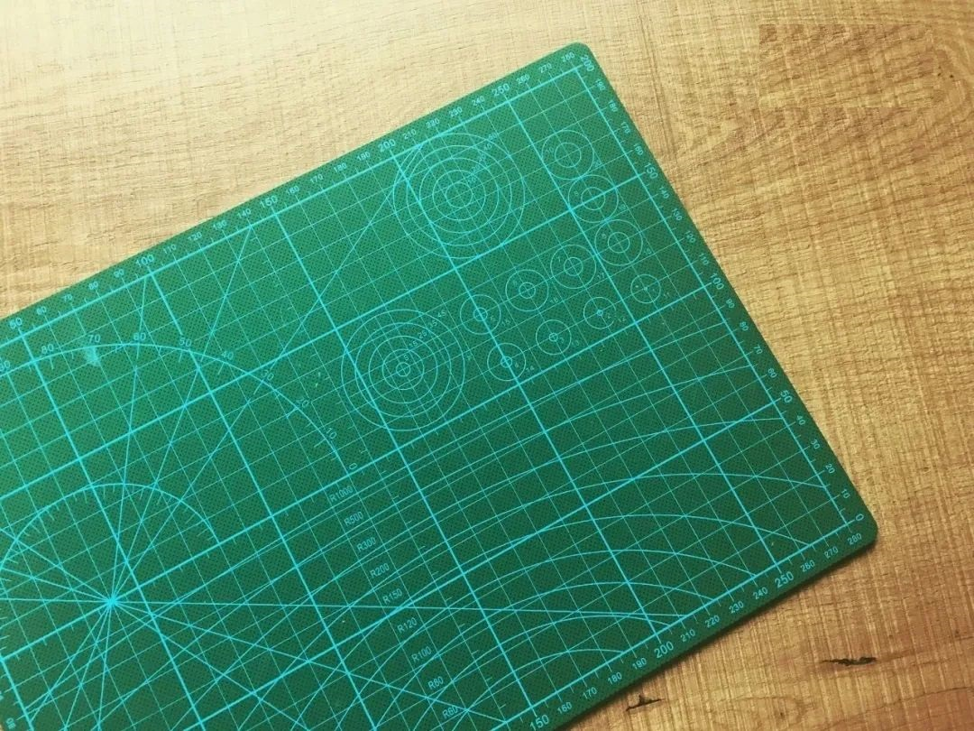
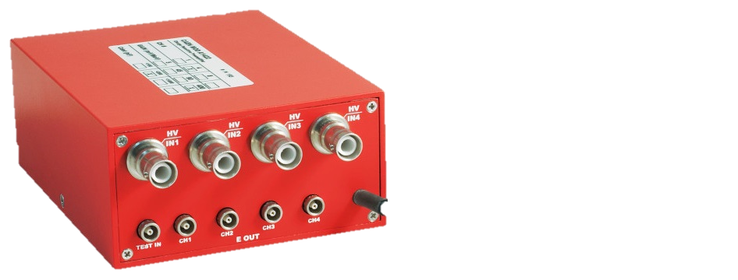
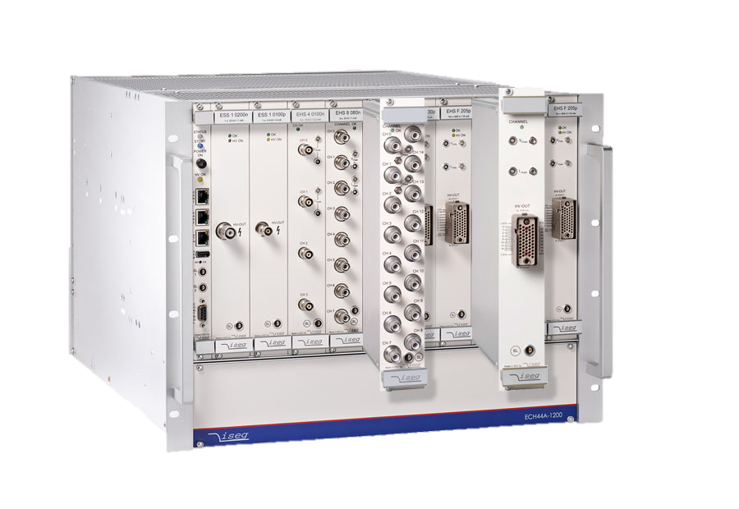
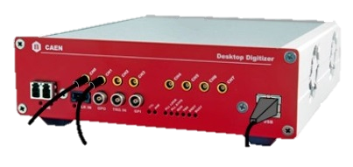
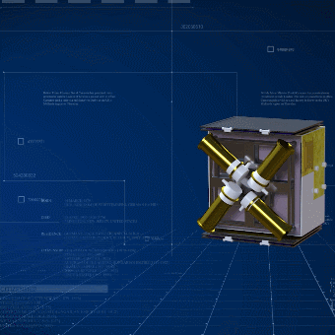
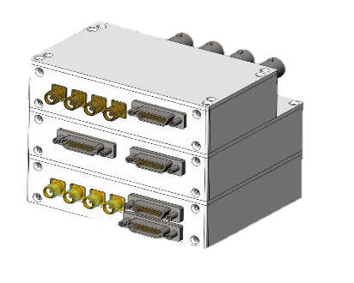
Payload
In Laboratory
In Space
High sensitivity
Portable (< 1U, 10x10x10cm³)
72 mm
Lightweight (< 1 kg)
Low-power consumption (<5 W)
94 mm
74 mm
Anti-radiation
Notes:
Very different from the lab experiments, in which we always have a second chance, if something is wrong.
However, in a spac e-based experiment, there are only two possibilities: succeed or fail. One basically has no chance to make additional modification.
So everything has to be well packed and prepared.
Moreover, the best solution is to use a nano-satellate. This means we have very limited space, it must be light and costs very little power.
For example, the total size is about a few times 10cmx10cm*10cm, the weight is 1 kg. and power less than 5 W in total.
This shows a schematic view, to detect neutrons, which instrucmentation we need in the lab and in the space as a payload.
To further reduce the background induced from the platform, we designe a Telescopic rod to move the payloard further from the platform.
小卫星+伸展臂：次生中子本底低至10⁻⁸ n/cm²/s； S/N ratio is about 10^-5
变轨的可能性：降低中子模型系统误差本底控制在
high-efficiency portable electronic products

Slide 21
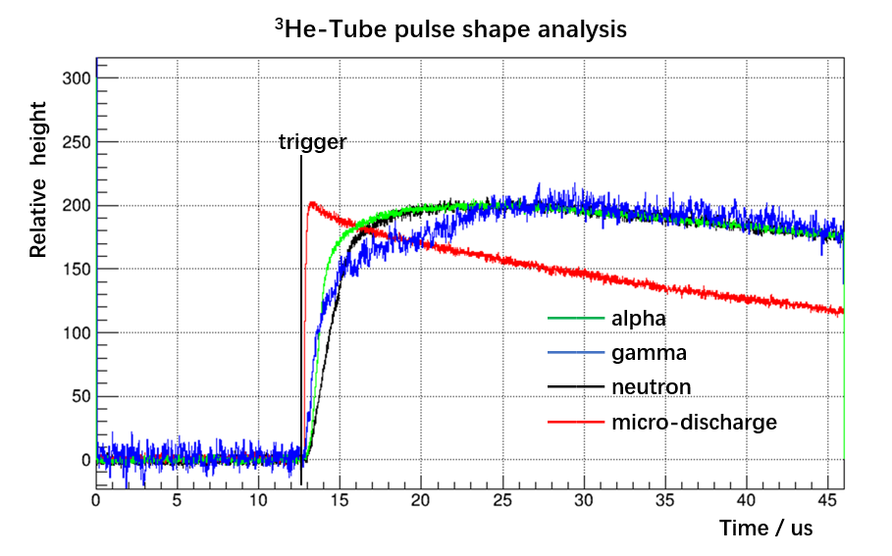
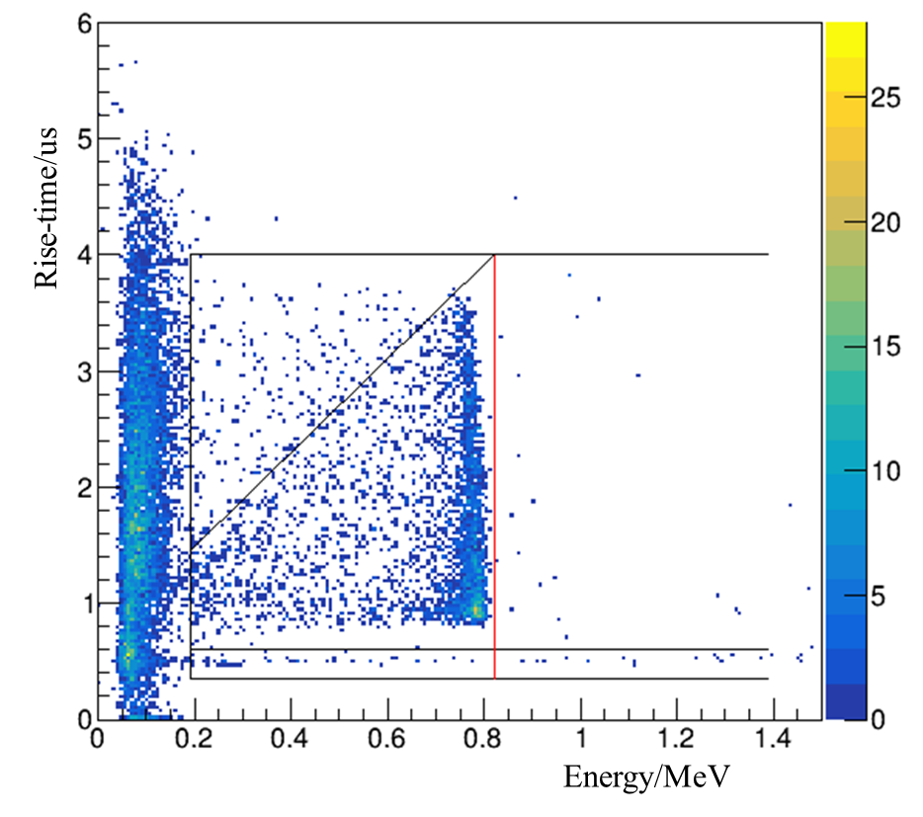
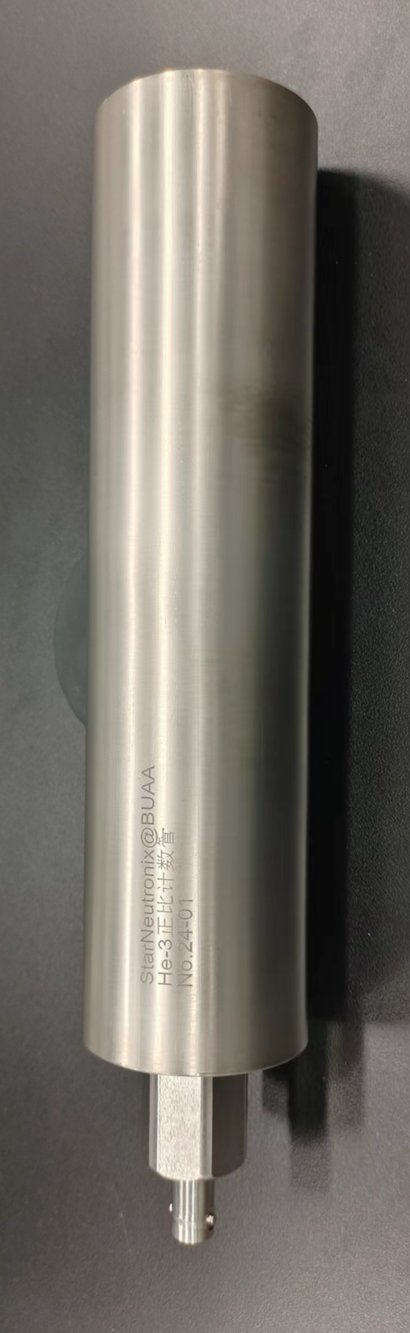
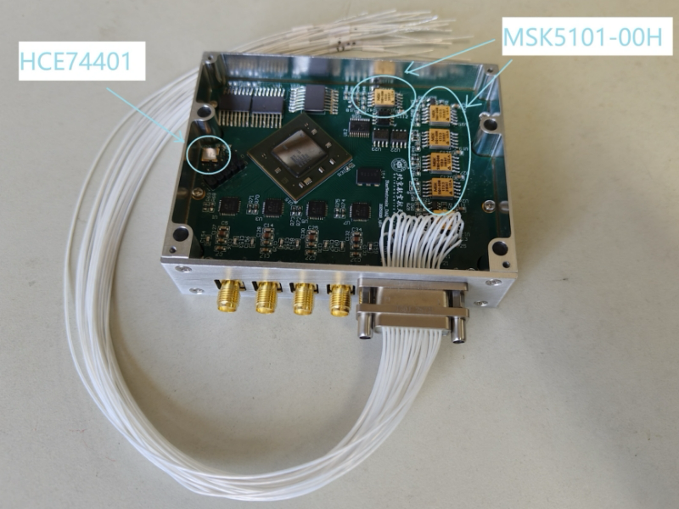
系统误差：
-- GCR通量：AMS2等带电粒子数据、MeVGRO等伽马数据（in-site meas.）
-- 大气层：厚度、湿度、对流层的影响？
精度监测与：
-- 临近空间的中子通量（飞艇@20 km）
He-3 tubes & DAQ board
高能宇宙射线
太阳活动：太阳调制参数 精确
地球磁场：地磁截止刚度 精确
物理过程：簇射，核反应 精确
大气：大气成分 温度 季节性 较为精确
中子输运：重力 精确
极端天文过程，极端天气 时间选择
Ti-made He-3
low mass，structure strength，
low alpha emission
50 cps/nv
100 MSps 4 channel Customized Electronics
初步结果：不同海拔高度下各能区中子的通量分布
Notes:
We need to understand the origin and transport of Albeto neutrons. For that, we developed a full simulation code. In this code, we need to take into account not only the collision of comsic ray with atmosphere but all the magnetic field, gravitation, composition of atmosphere.
Now we have a much better understanding of Albeto neutrons. For example, we know what occur in troposhere /ˈtrɑː.pə.sfɪr/ would not affect the neutron flux in low-earth orbits, that is to see, no matter how extreme the weather is, it has no impact to our measurement. This is very good!
The troposphere extends upward to about 10 km (6.2 miles or about 33,000 feet) above sea level. The height of the top of the troposphere varies with latitude (it is lowest over the poles and highest at the equator) and by season (it is lower in winter and higher in summer). It can be as high as 20 km (12 miles or 65,000 feet) near the equator, and as low as 7 km (4 miles or 23,000 feet) over the poles in w inter.
中子注量率，单位为nv（neutrons per square centimeter per second），即每平方厘米每秒的中子数
The neutron sensitivity of an SUI detector is specified by the number of counts per second per neutron flux (cps/nv)
1、400km处绝大部分是向上的，向下的中子飞行中就衰变完了，2.2km基本要飞到一半的地球半径（3000km）耗时远大于中子寿命，2 引力确实有影响现在还没考虑在模型里 但是百公里级别的引力效应是非常小的。
The troposphere is the lowest layer of Earth's atmosphere. Most of the mass (about 75-80%) of the atmosphere is in the troposphere. Most types of clouds are found in the troposphere, and almost all weather occurs within this layer. The troposphere is by far the wettest layer of the atmosphere (all of the other layers contain very little moisture).
鹊桥二号的轨道参数：周期24h 近月点200 公里[5] 远月点16,000 公里[5] 倾角62.4°[6]
月球实验（更高中子通量）对中子寿命更灵敏

Slide 22
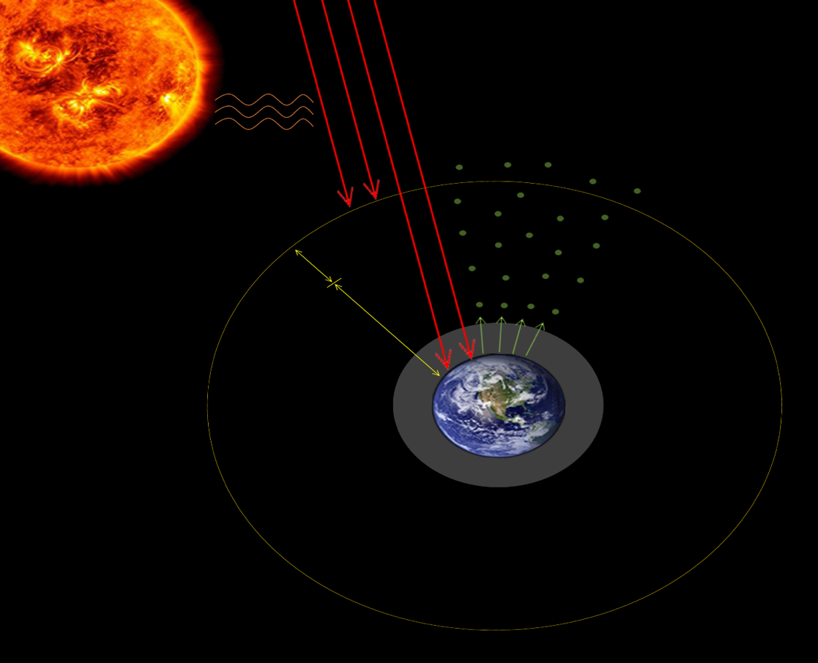
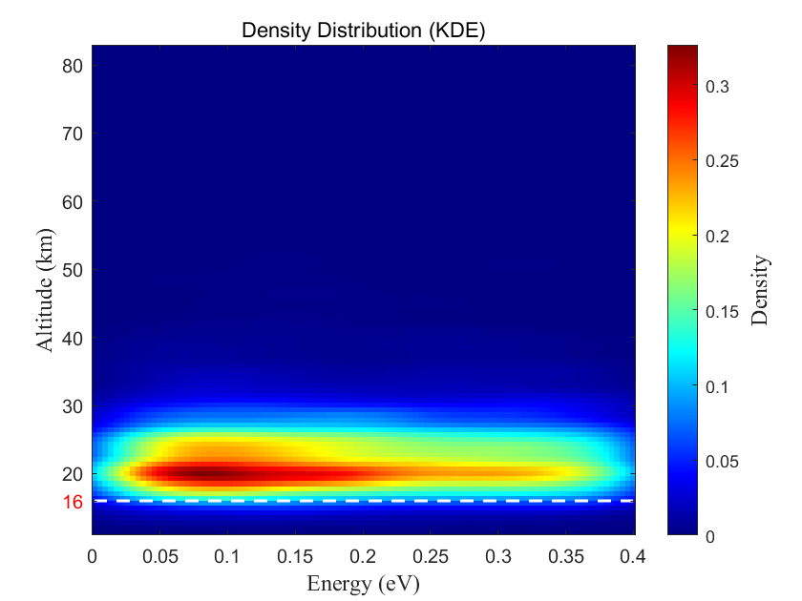
系统误差：
-- GCR通量：AMS2等带电粒子数据、MeVGRO等伽马数据（in-site meas.）
-- 大气层：厚度、湿度、对流层的影响？
精度监测与：
-- 临近空间的中子通量（飞艇@20 km）
Planet-scale neutron model: the “free” neutron source
Albeto neutron flux at various altitudes
Origin of Albedo neutron
detected @ Starneutronix
Solar wind
Cosmic ray
Albedo neutron
Preliminary
高能宇宙射线
太阳活动：太阳调制参数 精确
地球磁场：地磁截止刚度 精确
物理过程：簇射，核反应 精确
大气：大气成分 温度 季节性 较为精确
中子输运：重力 精确
极端天文过程，极端天气 时间选择
600km+
0~600km
Magnetic field
Gravity
Atmosphere
…
Atomsphere
初步结果：不同海拔高度下各能区中子的通量分布
Notes:
We need to understand the origin and transport of Albeto neutrons. For that, we developed a full simulation code. In this code, we need to take into account not only the collision of comsic ray with atmosphere but all the magnetic field, gravitation, composition of atmosphere.
Now we have a much better understanding of Albeto neutrons. For example, we know what occur in troposhere /ˈtrɑː.pə.sfɪr/ would not affect the neutron flux in low-earth orbits, that is to see, no matter how extreme the weather is, it has no impact to our measurement. This is very good!
The troposphere extends upward to about 10 km (6.2 miles or about 33,000 feet) above sea level. The height of the top of the troposphere varies with latitude (it is lowest over the poles and highest at the equator) and by season (it is lower in winter and higher in summer). It can be as high as 20 km (12 miles or 65,000 feet) near the equator, and as low as 7 km (4 miles or 23,000 feet) over the poles in w inter.
中子注量率，单位为nv（neutrons per square centimeter per second），即每平方厘米每秒的中子数
The neutron sensitivity of an SUI detector is specified by the number of counts per second per neutron flux (cps/nv)
1、400km处绝大部分是向上的，向下的中子飞行中就衰变完了，2.2km基本要飞到一半的地球半径（3000km）耗时远大于中子寿命，2 引力确实有影响现在还没考虑在模型里 但是百公里级别的引力效应是非常小的。
The troposphere is the lowest layer of Earth's atmosphere. Most of the mass (about 75-80%) of the atmosphere is in the troposphere. Most types of clouds are found in the troposphere, and almost all weather occurs within this layer. The troposphere is by far the wettest layer of the atmosphere (all of the other layers contain very little moisture).
鹊桥二号的轨道参数：周期24h 近月点200 公里[5] 远月点16,000 公里[5] 倾角62.4°[6]
月球实验（更高中子通量）对中子寿命更灵敏

Slide 23
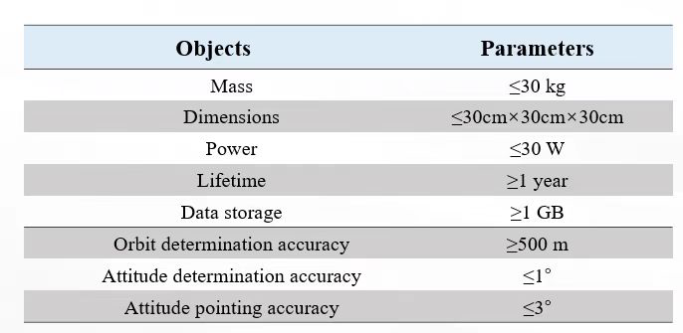
系统误差：
-- GCR通量：AMS2等带电粒子数据、MeVGRO等伽马数据（in-site meas.）
-- 大气层：厚度、湿度、对流层的影响？
精度监测与：
-- 临近空间的中子通量（飞艇@20 km）
Senstivity and key parameters
Errors in 1 year
Statics 0.9s
Sysmetic 1.4s
detection eff 0.8s
CRs 0.2s
temperature. 0.6s
pointing. 0.2s
attitude. 0.2s
humidity. 0.2s
高能宇宙射线
太阳活动：太阳调制参数 精确
地球磁场：地磁截止刚度 精确
物理过程：簇射，核反应 精确
大气：大气成分 温度 季节性 较为精确
中子输运：重力 精确
极端天文过程，极端天气 时间选择
payload senstivity 150cps/nv
初步结果：不同海拔高度下各能区中子的通量分布
Notes:
We need to understand the origin and transport of Albeto neutrons. For that, we developed a full simulation code. In this code, we need to take into account not only the collision of comsic ray with atmosphere but all the magnetic field, gravitation, composition of atmosphere.
Now we have a much better understanding of Albeto neutrons. For example, we know what occur in troposhere /ˈtrɑː.pə.sfɪr/ would not affect the neutron flux in low-earth orbits, that is to see, no matter how extreme the weather is, it has no impact to our measurement. This is very good!
The troposphere extends upward to about 10 km (6.2 miles or about 33,000 feet) above sea level. The height of the top of the troposphere varies with latitude (it is lowest over the poles and highest at the equator) and by season (it is lower in winter and higher in summer). It can be as high as 20 km (12 miles or 65,000 feet) near the equator, and as low as 7 km (4 miles or 23,000 feet) over the poles in w inter.
中子注量率，单位为nv（neutrons per square centimeter per second），即每平方厘米每秒的中子数
The neutron sensitivity of an SUI detector is specified by the number of counts per second per neutron flux (cps/nv)
1、400km处绝大部分是向上的，向下的中子飞行中就衰变完了，2.2km基本要飞到一半的地球半径（3000km）耗时远大于中子寿命，2 引力确实有影响现在还没考虑在模型里 但是百公里级别的引力效应是非常小的。
The troposphere is the lowest layer of Earth's atmosphere. Most of the mass (about 75-80%) of the atmosphere is in the troposphere. Most types of clouds are found in the troposphere, and almost all weather occurs within this layer. The troposphere is by far the wettest layer of the atmosphere (all of the other layers contain very little moisture).
鹊桥二号的轨道参数：周期24h 近月点200 公里[5] 远月点16,000 公里[5] 倾角62.4°[6]
月球实验（更高中子通量）对中子寿命更灵敏

Slide 24
Lunar albedo neutron simulation results
Date：2023/2/1。
Lunar soil configuration from ChangE-6，0.5%H
Reference: Massive Water Production from Lunar Ilmenite through Reaction with Endogenous Hydrogen. The Innovation 5(5), 100690.
Notes:
初步构建了月球的中子输运模型，模拟参数在左上方。因为月球没有磁场和大气，其热中子通量会比地球更明显。月壤采用混合物的形式。模拟次数为500万次
图为月球上产生中子在不同高度的通量分布图。

Slide 25
Lunar albedo neutron simulation results
Large elliptical orbit around the moon
0.06%
1y data collection，1s
Notes:
图是通过模拟鹊桥二号环月轨道不同高度处的热中子通量，根据高度对应的轨道时间，计算出的不同时刻，卫星在轨道对应位置处的热中子通量。并做了800S,880S,960三个寿命设定下的中子通量模拟。
小图为放大环月轨道400km高处的通量数据。根据计算，该处的不同中子寿命的通量偏差为0.06%/s（以880S的中子寿命为标准）。
弧段占比表示通讯弧段占分析时间（1年）的百分比。

Slide 26
Summary
Neutron measurements at low-earth orbits might provide an independent data for neutron lifetime.
Now payload and simulation code are almost ready.
Wait for the opportunity to launch
Notes:
Now, we are waiting for an opportunity to launch our setup. The nearest chance is in August.
If everything goes smoothly, we hope to get the first data on how many neutrons are in the low-earth orbits.
Such measurement can help us not only to study neutron lifetime,
but also to understand how our earth interacts with the cosmic ray.
In a long term, neutron may serve as a new message in the multi-message astronomy.

Slide 27
Physics building, Shahe Campus
Open for collaboration & discussion!
bhsun@buaa.edu.cn
Notes:
We are open to collaboration and discussions. Also, I hope some of you can visit us here, the physics building.
Thank you.
////////////
I believe in space science with particle detectors.

Slide 28
Origin of charged particle in Van Allen Belt
--- Albedo neutron decay and neutron density in near-Earth space
Van Allen Belt
Nature 552, 382–385 (2017)
albedo neutrons are a possible source of geomagnetically trapped protons and electrons.
Around Earth, trapped energetic protons, electrons and other particles circulate at altitudes from about 500 to 40,000 kilometres in the Van Allen radiation belts
If albedo thermal neutron flux 2E-9 n/cm³ VAB origin would be confirmed
Notes:
Around Earth, trapped energetic protons, electrons and other particles circulate at altitudes from about 500 to 40,000 kilometres in the Van Allen radiation belts.
The main source of inner-belt protons (MeV) is cosmic-ray albedo neutron decay (CRAND).
In this process, cosmic rays that reach the upper atmosphere interact with neutral atoms to produce albedo neutrons, which, being prone to β-decay, are a possible source of geomagnetically trapped protons and electrons.
范艾伦辐射带，指在地球附近的近层宇宙空间中包围着地球的高能粒子辐射带，主要由地磁场中捕获的高达几兆电子伏的电子以及高达几百兆电子伏的质子组成，其中只有很少百分比像O+这样的重粒子。范艾伦辐射带分为内外两层，内外层之间存在范艾伦带缝，缝中辐射很少。范艾伦辐射带将地球包围在中间。范艾伦带内的高能粒子对载人空间飞行器、卫星等都有一定危害，其内外带之间的缝隙则是辐射较少的安全地带。由美国物理学家詹姆斯·范艾伦于1958年发现并以他的名字命名。
范艾伦带粒子的主要来源是被地球磁场俘获之太阳风粒子，这些带电粒子在范艾伦带两转折点间来回运动。当太阳发生磁暴时，地球磁层受扰动变形，而局限在范艾伦带的高能带电粒子大量洩出，并随磁力线於地球的极区进入大气层，激发空气分子产生美丽的极光。
目前一般认为范艾伦辐射带的纬度范围是南北纬40°~50°之间；高度范围分两段：内带1500~5000km，外带13000~20000km。

Slide 30
Research interest: Experimental nuclear physics
Charge-changing reaction studies
Key reactions relevant for origin of s-, p-isotopes
`
`
Experimental station, RIBLL2
SLEGS facility
gamma-ray station
back-n facility
white neutron station
Heavy Ion Research Facility in Lanzhou
Shanghai Synchrotron Radiation Facility
China Spallation Neutron Source
`
`
Li et al., PLB 859(2024)139143
Zhao et al., PLB 858(2024)139082
Zhang et al., Sci. Bull. 69 (2024) 1647
Zhao et al., PLB 847 (2023)138269
Wang et al., CPC47(2023) 084001
Li et al., PRC107(2023)024609
Xu et al., PLB833(2022)137333
Zhao et al., NIMA 930(2019)95
BHS et al., Sci. Bull. 63(2018)78
Lin et al., CPC41(2017)066001
Zhao et al., NIMA 823(2016)41
Cheng et al., ApJ975(2024)161；Cheng et al., ApJ951(2021)78；
Cheng et al., NST31(2020)99； He et al., NIMA880(2019)22
Notes:
The Shanghai Laser Electron Gamma Source (SLEGS, located in BL03SSID) beamline at the Shanghai Synchrotron Radiation Facility (SSRF) is a Laser Compton Scattering (LCS) gamma source used for the investigation of nuclear structure, which is in extensive demand in fields such as nuclear astrophysics, nuclear cluster structure, polarization physics, and nuclear energy. The beamline is based on the inverse Compton scattering of 10640 nm photons on 3.5 GeV electrons and a gamma source with variable energy by changing the scattering angle from 20∘ to 160∘. γ rays of 0.25−21.1 MeV can be extracted by the scheme consisting of the interaction chamber, coarse collimator, fine collimator, and attenuator. The maximum photon flux for 180∘ is approximately 107 photons/s at the target at 21.7 MeV, with a 3-mm-diameter beam. The beamline was equipped with four types of spectrometers for experiments in (γ,γ’), (γ,n), (γ,p), and (γ,α). At present, Nuclear Resonance Fluorescence (NRF) spectrometry, Flat-Efficiency neutron Detector (FED) spectrometry, neutron Time-Of-Flight (TOF) spectrometry, and Light-Charged Particle (LCP) spectrometry methods have been developed.
Back-streaming neutrons from the spallation target of the China Spallation Neutron Source (CSNS) that emit through the incoming proton channel were exploited to build a white neutron beam facility (the so-called Back-n white neutron source), which was completed in March 2018. The Back-n neutron beam is very intense, at approximately 2 × 10⁷ n/cm²/s at 55 m from the target, and has a nominal proton beam with a power of 100 kW in the CSNS-I phase and a kinetic energy of 1.6 GeV and a thick tungsten target in multiple slices with modest moderation from the cooling water through the slices. In addition, the excellent energy spectrum spanning from 0.5 eV to 200 MeV, and a good time resolution related to the time-of-flight measurements make it a typical white neutron source for nuclear data measurements; i

Slide 31
关键科学问题：大尺度多辐射物理场下的极稀有信号探测
热中子流强 v.s. 范艾伦辐射带+高能宇宙线 +太阳宇宙线
10⁻³cm⁻²s⁻¹ 100/cm²/s
范艾伦辐射带
银河宇宙射线
太阳宇宙线

Slide 32
方案：规划卫星轨道
范艾伦辐射带，主动轨道避让，或探测器关机
太阳宇宙射线： 地球磁场偏转，避让地球南北级大轨道
低倾角近地轨道，避开SAA及南北极区域
轨道设计 实现100km及变轨
地磁场保护 + 避开范艾伦辐射带 （< 1/cm²/s）
探测器选择进一步压低宇宙线影响
宇宙线模型参考数据多（AMS、Fermi-LAT..）

Slide 33
关键科学问题：大尺度多辐射物理场下的极稀有信号探测
宇宙线轰击卫星平台产生的次生中子，是需要消除的重要本底
次生中子/待测中子 对比
航天器信息
 | 国际空间站 | 月球勘探者 | StarNeutronix
质量/kg | ~4.2×10⁵ | 1523 | 30
尺寸/m（长×宽） | 109×73 | 4.1×2.1 | 0.3×0.3
次生中子/待测中子 | ~10¹ | ~10⁻² | ~10⁻⁵
探测器位置 | 舱内/舱壁 | 2.5 m 伸展臂 | 1.5 m 伸展臂
小卫星+伸展臂：次生中子本底低至10⁻⁸ n/cm²/s
变轨的可能性：降低中子模型系统误差本底控制在
小卫星平台+伸展臂+推进装置（变轨）
稳定可靠卫星平台及数传、传控通道
轨道设计 实现100km及变轨

Slide 34
关键科学问题：大尺度多辐射物理场下的极稀有信号探测
探测器对热中子、带电粒子、伽马射线等的灵敏度
探测器选型的考虑：
探测灵敏度/探测器重量
宇宙线（p，α，γ）不敏感： 闪烁体×
探测器内秉放射性： α放射性
可靠性
³He管的内禀本底分析
射线能量沉积对比
³He-正比管
CLYC + PMT
⁶Li-glass + SiPM
³He正比计数管内信号及特点
类型 | 产生原因 | 能量区间
α | 器壁内表面发射α | 0-5 MeV
γ | 环境γ本底诱发电子 | 0-100 keV
中子 | n + ³He → p + T | 191-764 keV
微放电 | 电极、电路高压放电 | \
在线波形鉴别技术
宇宙线 微放电 达到标准
α将成为重要本底
信噪比：高灵敏、轻质量、低本底、低功耗的热中子探测器
选型：³He探测器， CLYC探测

Slide 35
进展：钛壳体低α本底正比管
钛壳体低α本底正比管
钛金属密度小、强度高，适用于航天需求
筛选低本底钛材料，进行表面处理以降低 α 发射率
有效评估探测器 α 本底
钛壳体正比管
³He充气压力1bar，灵敏面积 85 cm²， > 50 cps/nv
单位灵敏面积重量为不锈钢的47%
α发射率 ~ 4.53 × 10⁻⁴ cm⁻² day⁻¹ keV⁻¹，仍待提升
（无氧铜管 ~ 3.13 × 10⁻⁵ cm⁻² day⁻¹ keV⁻¹）
对管壁材料进行α发射率测量并鉴别母核
管壳本底需继续降低
依托锦屏深地实验室（PandaX，CDEX）开展低本底钛材料筛选
探索钛表面处理技术：金属或有机物镀层、抛光及清洗工艺（与PandaX实验需求一致）
发展基于深度学习的 α 甄别技术······
第一版
钛壳体 ³He-正比管
无氧铜 ³He-正比管，曾昭明. 低本底热中子探测技术研究与应用[D].清华大学,2019.
³He正比管对来自外部的干扰不敏感
宇宙线在探测器内沉积能量产生本底信号，
宇宙线活化探测器及附属结构产生的瞬发、缓发射线，
探测器内生本底：放射性残留及电路引入噪声等，
Notes:
~ 1.73e-5 cps/cm² (0-7MeV)，~3.06e-6 cps /cm² (191-764keV)；不能，原因是：1、铝及铝合金相较于不锈钢及无氧铜具有更高的放射性本底，（有文献支撑）；2、铝及铝合金在太空环境（高真空、震动、温度变化剧烈）下，强度不及不锈钢或者钛，（无氧铜强度也不够）

Slide 36
进展：专用低功耗电子学系统
为在轨进行脉冲波形分析开发了专用电子学：包括波形采样卡、电荷灵敏前放、高压模块和上位机系统
核心：4通道、14bit精度、≥40 MSPS的波形采样卡
低功耗芯片、集成化设计，功耗不高于 5 W
通过环境适应性试验
初步按照飞艇搭载任务完成了探测器样机
参照20~30km高度飞艇舱内环境适应性要求试验
新一代前放有望解决
探测器与电子学
长距离耦合引入的
噪声问题
波形采样卡
多通道前放
电子学
探测器
采集到的中子信号波形

Slide 37
进展：初步构建了地球中子的产生+输运蒙卡模型
宇宙射线：原位测量数据 精确
太阳活动：太阳调制参数 精确
地球磁场：地磁截止刚度 精确
地球引力场：场分布 精确
物理过程：簇射，核反应 足够精确
大气：大气成分 温度 季节性 较为精确
中子输运：理论 精确
极端天文过程，极端天气 时间选择
对流层上限
不同中子寿命的通量图
由于地球大气层的慢化及吸收，LEO处反照中子
产生于20-40km内，天气地貌等影响基本可忽略
初步结果合理自洽
1年在轨时间统计误差～3s
临近空间飞艇测试做模型检验
初步结果：不同海拔高度下各能区中子的通量分布
Notes:
宇宙射线输运到大气这个过程，受三个因素影响：
太阳活动对宇宙射线的影响
地球磁场对特定入射角度的宇宙射线的屏蔽作用
地球大气对宇宙射线的屏蔽作用
蒸发中子：高能粒子与大气原子作用产生的激发核，激发核退激产生
碰撞中子：高能粒子与大气原子核碰撞作用产生

Slide 38
寿命灵敏度
不同中子寿命的通量图

Slide 39
They made the work possible

Slide 40
Properties of neutron
验证粒子物理的标准模型：弱相互作用耦合常数
10⁻¹² cm
10⁻¹³ cm
最简单、最纯粹的弱相互作用例子，Fermi&GT衰变
𝐺_{𝑉}: strength of the vector force
𝐺_{𝐴}: strength of the axial vector force
ℳ=[𝐺_𝑉 𝑝 ̅𝛾_𝜇 𝑛−𝐺_𝐴 𝑝 ̅𝛾_5 𝛾_𝜇 𝑛][𝑒 ̅𝛾_𝜇 (1+𝛾_5)𝜈]
10⁻⁸ cm
m_{n}-m_{p}=1.2933324(5) MeV
标准模型：14 minutes and 48 seconds
Mass：1.67492749804(95)×10⁻²⁷ kg
Charge：(−2±8)×10⁻²² e (limit)
Lifetime：878.4(5) s (free) (PDG2024)
Composition：1 up quark, 2 down quarks
Charge radii：
Determine the ratios of n/p in the primordial nucleosyn.
thus affect all the process afte
Neutron lifetime: key to solving the most fundamental questions in cosmology and particle physics.
t~1s, nucleon freeze-out, Yn/Yp~1/6
t~3m, neutrons all bound into light nuclei
⁴He丰度与中子寿命存在显著关联
Precision neutron lifetime is a frontier.
Notes:
Neutron decay is a spin-1=2 to spin-1=2 decay, so both Fermi and Gamow-Teller decays are allowed. Hardy and Towner (2005) evaluated and combined the results of hundreds of such measurements for 12 different nuclei. From this, the value GV 1⁄4 1:1358ð5Þ 105 GeV2 is obtained.
The decay of the free neutron into a proton, electron, and antineutrino is the prototype semileptonic weak decay and is the simplest example of nuclear beta decay. It played a key role in the early Universe as it determined the ratio of neutrons to protons during the era of primordial light element nucleosynthesis. Neutron decay is physically related to important processes in solar physics and neutrino detection.
GA is best measured by neutron decay, either from the neutron lifetime via Eq. (8) or from a beta decay correlation, such as the beta asymmetry that depends on the ratio GA=GV.
确定中子的寿命对于理解宇宙在138亿年前的大爆炸中诞生后最初几分钟内形成了多少氢、氦和其他轻元素非常重要。科学家们还认为，如果能更好地确定中子的寿命，他们就能寻找到新的物理类型，因为这将有助于限制对其他亚原子粒子的测量。
中子是我们非常熟悉的粒子。大多数存在于自然界的中子是非放射性原子核的一部分，在那里，它们基本上可以永远存在。在宇宙物质的某些原子中，中子已经存在了数十亿年甚至更长时间。 但是，自由的中子（如核裂变过程所产生的中子）是不稳定的，它们的寿命很短，只有大约15分钟的时间。因为这些自由的中子会衰变为质子，在这个过程中，每个衰变的中子会释放一个电子和一个反中微子。 一直以来，物理学家都希望能够完美地了解中子的精确寿命，这对于我们理解物质的基本结构至关重要。通过知晓中子的寿命，物理学家可以推测出是否还存在其他有待发现的基本粒子。可以说，中子寿命之谜是解答宇宙学和粒子物理学中几个大问题的关键，有助于我们理解宇宙的早期状态和基本粒子的行为。 然而，物理学家用了几十年的时间，仍无法就中子寿命问题达成一致。
The neutron lifetime is significant here. First, and most importantly, the reaction rates n $ p prior to tfreeze depend on the strength of the charged weak interaction, and, in particu- lar, they are proportional to the combination of coupling constants G2V þ 3G2A that appear in Eq. (7) for the neutron lifetime. These reaction rates determine tfreeze and hence the neutron to proton ratio at tfreeze via Eq. (9). Second, the neutron lifetime governs the change in the neutron to proton ratio between tfreeze and nucleosynthesis. The precise value of the neutron lifetime is an important input for theoretical BBN calculations of primordial element abundances. In fact, the theoretical uncertainty in the predicted 4He abundance is dominated by the experimental uncertainty in the neutron lifetime (Burles et al., 1999; Lopez and Turner, 1999).

Slide 41
Properties of neutron
The decay of the free neutron into a proton, electron, and antineutrino is the prototype semileptonic weak decay and is the simplest example of nuclear beta decay.
m_{n}-m_{p}=1.2933324(5) MeV
Mass：1.67492749804(95)×10⁻²⁷ kg
Charge：(−2±8)×10⁻²² e (limit)
Lifetime：878.4(5) s (free) (PDG2024)
Composition：1 up quark, 2 down quarks
Charge radii：
Q=0.782 MeV
Neutron lifetime: key to solving the most fundamental questions in cosmology and particle physics.
Notes:
Neutron-proton mass differences originates from isospin breaking caused by the different masses and charges of their consitituent light quarks.

Slide 42
Properties of neutron
验证粒子物理的标准模型：弱相互作用耦合常数
10⁻¹² cm
10⁻¹³ cm
最简单、最纯粹的弱相互作用例子，Fermi&GT衰变
𝐺_{𝑉}: strength of the vector force
𝐺_{𝐴}: strength of the axial vector force
ℳ=[𝐺_𝑉 𝑝 ̅𝛾_𝜇 𝑛−𝐺_𝐴 𝑝 ̅𝛾_5 𝛾_𝜇 𝑛][𝑒 ̅𝛾_𝜇 (1+𝛾_5)𝜈]
10⁻⁸ cm
m_{n}-m_{p}=1.2933324(5) MeV
标准模型：14 minutes and 48 seconds
Mass：1.67492749804(95)×10⁻²⁷ kg
Charge：(−2±8)×10⁻²² e (limit)
Lifetime：878.4(5) s (free) (PDG2024)
Composition：1 up quark, 2 down quarks
Charge radii：
Determine the ratios of n/p in the primordial nucleosyn.
thus affect all the process afte
Neutron lifetime: key to solving the most fundamental questions in cosmology and particle physics.
t~1s, nucleon freeze-out, Yn/Yp~1/6
t~3m, neutrons all bound into light nuclei
⁴He丰度与中子寿命存在显著关联
Precision neutron lifetime is a frontier.
Notes:
Neutron decay is a spin-1=2 to spin-1=2 decay, so both Fermi and Gamow-Teller decays are allowed. Hardy and Towner (2005) evaluated and combined the results of hundreds of such measurements for 12 different nuclei. From this, the value GV 1⁄4 1:1358ð5Þ 105 GeV2 is obtained.
The decay of the free neutron into a proton, electron, and antineutrino is the prototype semileptonic weak decay and is the simplest example of nuclear beta decay. It played a key role in the early Universe as it determined the ratio of neutrons to protons during the era of primordial light element nucleosynthesis. Neutron decay is physically related to important processes in solar physics and neutrino detection.
GA is best measured by neutron decay, either from the neutron lifetime via Eq. (8) or from a beta decay correlation, such as the beta asymmetry that depends on the ratio GA=GV.
确定中子的寿命对于理解宇宙在138亿年前的大爆炸中诞生后最初几分钟内形成了多少氢、氦和其他轻元素非常重要。科学家们还认为，如果能更好地确定中子的寿命，他们就能寻找到新的物理类型，因为这将有助于限制对其他亚原子粒子的测量。
中子是我们非常熟悉的粒子。大多数存在于自然界的中子是非放射性原子核的一部分，在那里，它们基本上可以永远存在。在宇宙物质的某些原子中，中子已经存在了数十亿年甚至更长时间。 但是，自由的中子（如核裂变过程所产生的中子）是不稳定的，它们的寿命很短，只有大约15分钟的时间。因为这些自由的中子会衰变为质子，在这个过程中，每个衰变的中子会释放一个电子和一个反中微子。 一直以来，物理学家都希望能够完美地了解中子的精确寿命，这对于我们理解物质的基本结构至关重要。通过知晓中子的寿命，物理学家可以推测出是否还存在其他有待发现的基本粒子。可以说，中子寿命之谜是解答宇宙学和粒子物理学中几个大问题的关键，有助于我们理解宇宙的早期状态和基本粒子的行为。 然而，物理学家用了几十年的时间，仍无法就中子寿命问题达成一致。
The neutron lifetime is significant here. First, and most importantly, the reaction rates n $ p prior to tfreeze depend on the strength of the charged weak interaction, and, in particu- lar, they are proportional to the combination of coupling constants G2V þ 3G2A that appear in Eq. (7) for the neutron lifetime. These reaction rates determine tfreeze and hence the neutron to proton ratio at tfreeze via Eq. (9). Second, the neutron lifetime governs the change in the neutron to proton ratio between tfreeze and nucleosynthesis. The precise value of the neutron lifetime is an important input for theoretical BBN calculations of primordial element abundances. In fact, the theoretical uncertainty in the predicted 4He abundance is dominated by the experimental uncertainty in the neutron lifetime (Burles et al., 1999; Lopez and Turner, 1999).

Slide 43
Lifetime measurement
(α,n) reactions
~MeV， ~1cps
Neutron decay
Time of flight~ meter
Chadwick
难点：
1、neutron beam flux（~1 n/s），2、Decay rate衰变比例低(10⁻¹⁰)，3、探测器本底高 4、中子探测效率（能量高~10⁷m/s)
解决途径： 40年代
提高中子流强 回旋加速器 10⁶ n/s 统计误差巨大
降低中子速度 成功慢化（0.025eV~2.2km/s） 损失方向信息
提高信噪比 → 瓶方法 如何确定中子的衰变信号 简单的计数功能
Notes:
最早设想了中子寿命测量实验的是查德威克，他提出利用 (α, n) 反应作为中子源，使出射的快中子在米量级的距离上发生衰变，并利用G-M管测量衰变放出的中子。但是快中子飞行速度太快，在这样小的空间尺度内只有约10^-10的概率衰变并被G-M管测量到，当时的探测技术远远不能达到这种灵敏度。
等到40年代，假如使用上当时发展起来的回旋加速器，利用α束流轰击铍靶，将中子通量提高到10^6 cps；但这样所能测到的中子衰变事件率也仅仅只有10-4 cps，统计误差非常大。
另一个方法是使中子慢下来，增加单位体积内的中子衰变事例率；这意味着需要使用热中子，但在慢化过程中将损失中子的方向信息。

Slide 44
Despite decades of taking measurements, scientists cannot agree on how long neutrons live.
v_{n}~1 m/s
v_{n}~1000 m/s
束方法：测量慢中子束通过一个限定空间衰变的总次数，对中子和衰变粒子（p）进行绝对测量。
瓶方法：把超冷中子束缚在一个瓶子结构的容器中，分别统计刚束缚时以及一段时间（~中子半衰期）之后的中子数，对中子进行相对测量。
Notes:
To measure the lifetime of a free neutron, scientists take two approaches that should arrive at the same answer.
One traps neutrons in a magnetic bottle and counts their disappearance.
The other counts protons appearing in a beam as neutrons decay.
It turns out neutrons appear to live nine seconds longer in a beam than in a bottle.
Over the years, perplexed physicists have considered many reasons for the discrepancy. One theory is that the neutron transforms from one state to another and back again. “Oscillation is a quantum mechanical phenomenon,” Broussard said. “If a neutron can exist as either a regular or a mirror neutron, then you can get this sort of oscillation, a rocking back and forth between the two states, as long as that transition isn’t forbidden.”
Physicists confront the neutron lifetime puzzle
A beam of slow neutrons with density &n passes through a known decay volume V. The instanta- neous neutron decay rate N_ in the decay volume is given by the differential equation that governs exponential decay
一直以来，物理学家们试图用两种方法来对此进行测量，一种被称为“瓶方法”；另一种被称为“束方法”。用这两种方法得出的测量结果并不一致，瓶方法得出的中子寿命是14分39秒；而束方法得出的结果却是14分48秒。这相差的约9秒的时间对于一个寿命只有15分钟长的粒子来说，是不容忽视的重大差异。
物理学家通常有两种方法来测量中子寿命，一种涉及到瓶子结构的容器，被称为瓶方法；另一种涉及到粒子束，被称为束方法。
现在，一项发表于《物理评论快报》的新研究表明，一个由多个科学家团队组成的合作组利用瓶方法，对中子的寿命进行了迄今为止最精确的测量。新的结果表明，中子寿命为877.75秒（约14.629分）、不确定度为0.039%（约0.005分）。这一结果与理论计算结果一致，精度是同类测量结果的两倍。 这个实验被称为UCNτ（UCN指超冷中子，τ指中子寿命），它始于十多年前，但对于最新公布的结果则是基于2017年和2018年运行的两个实验。 从实验的角度来看，这项研究面临一些艰巨的挑战，比如自由的中子很容易与原子结合，因此，研究人员必须在实验装置内创造一个非常严密的真空，以防止气体进入。此外，他们还必须大幅降低中子的速度，这样中子才能捕获并计数。 在UCNτ团队于2017年和2018年进行的两个瓶方法实验中，研究人员通过不同的步骤来冷却中子，最后的关键步骤是让中子与固态的寒冷的氘相互作用，使中子失去能量，从而将中子减速到超低温度。他们将这些中子置于一个浴缸大小的真空瓶中，瓶子装置配备有约4000块磁铁，强大的磁场可以阻止中子与瓶子表面接触，从而将自由的中子困在瓶中。
浴缸大小的高效超冷中子探测器。｜图片来源：Michael Pierce / LANL在瓶子中，这些中子开始衰变为质子。在每轮实验中，中子会被置于瓶子中一段足够长的时间。研究人员要做的就是通过复杂的数据分析方法，在每个周期结束的时候，清点瓶中的剩余中子。接着，他们会将新的中子再次装入瓶中，重新开始这个过程。在两年多的时间里，研究人员通过这两个实验总共统计了4000万个中子。 为了消除测量过程中可能出现的任何由人为因素导致的偏差，合作组分成三个小组，分别由加州理工学院、印第安纳大学，以及洛斯阿拉莫斯国家实验室（LANL）的研究人员领导，以一种“盲”的工作方式展开研究。 每个小组都配有一个“假”的时钟，这些时钟被故意调节得更慢一些，这一“错误”直到实验的最后才会被纠正。如此一来，研究人员就无法知道实际究竟经过了多长时间，也就无从知道中子的实际寿命。这使得实验更加可靠，因为它避免了研究人员为了使结果符合预期数值，而造成的有意识或无意识的偏差。 在实验完成并收集了所有数据后，三个小组使用了不同的方法来分析数据。令人惊喜的是，三个小组发现，虽然他们采用了不同的数据处理方式，却得出了几乎相同的答案，这是惊人一致的结果。最后，研究人员得出中子衰变的平均时间为877.75秒，计算精度优于百万分之四百，是迄今为止最精确的结果。 然而，新的结果仍然无法解释为什么用瓶方法和束方法得出的结果会出现9秒左右的不一致性。这意味着这两种测量方法之间仍然存在分歧，它表明要么其中一种方法存在系统性错误，要么物理学中存在某些仍有待理解的未知事物。 但新的精确结果为解决中子寿命之谜提供了独立的评估，帮助科学家更接近一个答案。现在，UCNτ团队正在进行新的改进，以求进一步提高精度。在未来的实验规划中，物理学家们也将进一步完善束方法进行的测量，从而最终找出导致中子寿命之谜的，究竟是系统性误差还是新的物理学。

Slide 45
https://www.quantamagazine.org/neutron-lifetime-puzzle-deepens-but-no-dark-matter-seen-20180213/
https://www.wired.com/story/how-long-can-a-neutron-live-depends-on-who-you-ask/
Wired.com

Slide 46
Decades-long mystery of neutron lifetime
Precision gets better and better, but deviations
remains 每种方法的精度逐步提升，误差<3s
束方法
Nature 598, 549 (2021)
PRL127,172601(2021)
Science 360,627(2018)
PRL111,222501(2013)
测量衰变后的
质子、电子
瓶方法
测量中子
A gap of about 9 s (4sigma, 1% deviation) in neutron lifetime between the most precise measurements in earth !
对此疑难的可能解释：
两种实验方法其一或者均存在系统性错误：实验方法改进
存在尚未发现的新物理：暗物质粒子
中子存在未知的激发态：PRD110,073004（2024）
PRL128,212503(2022)
PRL120,191801(2018)
PRL121,061801(2018)
PRL121,022505(2018)
… …
亟需开展具有类似精度、但系统误差不同的独立实验。
Notes:
Despite decades of taking measurements, scientists cannot agree on how long neutrons live.
但过去的实验结果表明，中子束里的中子，比瓶子里的中子多存活了约8秒左右。对于平均寿命不到900秒的自由中子来说，8秒的差异是不容忽视的，它无法仅用测量的不准确性来解释
需要把 中子寿命疑难单独拿出来；如何解释？（1）实验问题；（2）理论探索，可以找出1-2篇文章，简要说明下
一直以来，物理学家们试图用两种方法来对此进行测量，一种被称为“瓶方法”；另一种被称为“束方法”。用这两种方法得出的测量结果并不一致，瓶方法得出的中子寿命是14分39秒；而束方法得出的结果却是14分48秒。这相差的约9秒的时间对于一个寿命只有15分钟长的粒子来说，是不容忽视的重大差异。
经过多年来的实验技术进步，瓶实验与束实验的实验精度不断提升，并都控制在3s以内；但两类实验却分别收敛到不同的结果，束实验的结果约比瓶实验大了9s，大约是4倍的σ。
为什么会有这种差别目前还没有定论。可能的解释是存在一个没有被合理评估的系统误差；还有一种可能是存在新的中子衰变道，比如向暗物质的衰变。
因此亟需开展具有类似精度、但系统误差不同的独立实验。
经过几十年对实验方法的微调，物理学家们“没有找到任何理由怀疑这种差异是来自于不良测量，”Grinstein说，“我们面临着一个非常现实的选择，那就是我们需要考虑从根本上改变物理定律。”
研究人员现在提出，在中子衰变的时间里，大约有1%的时间，随着分解成一些已知的粒子，它们也会产生暗物质粒子。这可能有助于解释科学中最大的谜团之一。
暗物质粒子的存在被用来解释各种各样的宇宙谜题，比如为什么星系可以像人们看到的那样快速旋转而不被撕裂。科学家们已经基本上排除了所有已知的普通材料作为暗物质的候选者——如果它存在的话，目前的共识是它是由新的粒子组成的，而这些粒子只会与普通物质有微弱的相互作用。
由于中子束实验的重点是衰变为质子的中子，所以它们不能解释有可能产生暗物质粒子的衰变方式，因此这一实验得出的中子寿命与瓶子实验的不同。
加州大学圣地亚哥分校的理论物理学家Bartosz Fornal说：“如果能让我们探测到宇宙中暗物质的粒子，那真是太神奇了。”
物理学家们探索了几种不同的中子“暗衰变”的情形，其中中子会同时分解成暗物质粒子和诸如伽马射线或电子之类的普通成分。“我们提出的这种新粒子是微不可见的，就像暗物质一样，它们只会与正常物质发生微弱的相互作用，”Grinstein说到。

Slide 47
新的中子寿命测量的新尝试
Lunar Prospector：
首次发现月球两极存在水的迹象
JOURNAL OF GEOPHYSICAL RESEARCH, VOL. 106, NO. El0, PAGES 23,231-23,251, OCTOBER 25, 200
总重：300kg
任务时间：Jan. 8, 1998-July 31, 1999
远拱点 101.2 km
近拱点 99.45 km
周期 117.9 分钟
中子能谱仪：
质量: 3.9 kg
功率: 2.5 W
伸展臂：2.5m
数据带宽 : 0.05 kbps
探头：³He (10 bar，20cm)
探测灵敏度：10 ppm H
多道数：32ch
月球探险者（1998-1999）
任务：月球表面成分、水等
Phys. Rev. C 104, 045501 (2021)
Notes:
这个需要把背景交代下：xx飞跃xx的数据，月球、水星？这里的问题：大探测器、--》
图1(a)初始椭圆轨道期间的LP高度。(b)在Cd和sn覆盖的NS探测器中测量到的计数率。
(c)第三节中描述的镉和锡覆盖探测器的模拟计数率。(d)由计数统计的不确定性归一化的热中子计数的残差(即镀锡和镀镉探测器之间的差值)。灰色区域显示的是根据第四节中描述的切割量产生最终结果的数据。x轴上的时间是从1998年1月1日开始测量的。
图2
(a)中子计数率模型中包含了5个成分不同的区域:procellarum KREEP terrane (PKT)、south pole Aitken terrane (SPAT)、Feldspathic highland terrane (FHT)、 pure anorthosite terrane (PAN)和non-PKT maria (nPKT)。(b)30km高度。模型热中子计数，即镀锡和镀镉探测器之间的差异。(c)测得的热探测器计数。(b)和(c)中的灰色轮廓表示(a)中定义的区域。

Slide 48
Notes:
Strangely enough, however, scientists have observed conflicting results when measuring the lifetime of free neutrons. The results vary depending on whether the neutrons are studied in a neutron beam or confined in a “bottle” using magnetic fields. A research team at TU Wien has suggested a possible explanation: neutrons may have previously unknown excited states. In these states, neutrons could have slightly more energy and a different lifetime, which would account for the discrepancies. The team is already exploring methods to detect these excited neutron states.
Two Measurement Methods, Two Results
By pure chance, without any reason at all, neutrons can spontaneously decay according to the laws of quantum theory – turning into a proton, an electron, and an antineutrino. This is particularly likely if it is a free neutron. If the neutron combines with other particles to form an atomic nucleus, it can be stable.
The average lifetime of free neutrons is surprisingly difficult to measure. “For almost thirty years, physicists have been puzzled by contradictory results on this topic,” says Benjamin Koch from the Institute of Theoretical Physics at TU Wien. He analyzed this puzzle together with his colleague Felix Hummel. The two are also working closely with the neutron research team led by Hartmut Abele from the Atomic Institute at TU Wien.
“For such measurements, a nuclear reactor is often used as the neutron source,” explains Benjamin Koch. “Free neutrons are produced during radioactive decay in the reactor. These free neutrons can then be channeled into a neutron beam where they can be precisely measured.” One can measure how many neutrons are present at the beginning of the neutron beam and how many protons are produced by the decay process. If these values are determined very precisely, the average lifetime of the neutrons in the beam can be calculated.
However, it is also possible to take a different approach and try to store neutrons in a kind of ‘bottle’, for example with the help of magnetic fields. “This shows that neutrons from the neutron beam live around eight seconds longer than neutrons in a bottle,” says Benjamin Koch. “With an average lifespan of just under 900 seconds, this is a significant difference – far too big to be explained by mere measurement inaccuracy.”
https://scitechdaily.com/solving-the-mystery-neutron-lifetimes-and-the-new-quantum-puzzle/
How long do neutrons live? Different measurement results contradict each other.
Researchers at TU Wien propose that free neutrons might exist in previously unknown excited states, potentially resolving discrepancies in measured lifetimes between neutron beams and magnetic ‘bottles’. The hypothesis suggests these states could significantly alter decay rates, prompting a need for new experiments to validate this theory, with international interest already peaking.
The Neutron Decay Dilemma
Neutrons are fundamental particles that make up matter. When they are part of a stable atomic nucleus, they can remain there indefinitely. However, free neutrons—those not bound within a nucleus—decay on average after about fifteen minutes.
The Neutron Decay Dilemma
Neutrons are fundamental particles that make up matter. When they are part of a stable atomic nucleus, they can remain there indefinitely. However, free neutrons—those not bound within a nucleus—decay on average after about fifteen minutes.
Exploring Excited Neutron States
Benjamin Koch and Felix Hummel have now been able to show: This discrepancy can be explained if one assumes that neutrons can have excited states – previously undiscovered states with a slightly higher energy. Such states are well known for atoms and are the basis for lasers, for example. “With neutrons, it is much more difficult to calculate such states precisely,” says Benjamin Koch. “However, we can estimate what properties they should have in order to explain the different results of the neutron lifetime measurements.”
The researchers’ hypothesis is that when the free neutrons emerge from radioactive decay, they are initially in a mixture of different states: Some of them are ordinary neutrons in the so-called ground state, but some of them are in an excited state, with a little more energy. Over time, however, these excited neutrons gradually change to the ground state. “You can think of it like a bubble bath,” says Felix Hummel. “If I add energy and bubble it up, a lot of foam is created – you could say I’ve put the bubble bath into an excited state. But if I wait, the bubbles burst and the bath returns to its original state all by itself.”
If the theory about excited neutron states is correct, that would mean that in a neutron beam, several different neutron states are present in significant numbers. The neutrons in the bottle, on the other hand, would be almost exclusively ground-state neutrons. After all, it takes time for neutrons to cool and be captured in a bottle — by which point, the vast majority will have already returned to their ground state.
“According to our model, the decay probability of a neutron strongly depends on its state,” says Felix Hummel. Logically, this also results in different average lifetimes for neutrons in the neutron beam and neutrons in the neutron bottle.
Further Experiments Needed
“Our calculation model shows the parameter range in which we need to search,” says Benjamin Koch. “The lifetime of the excited state must be shorter than 300 seconds, otherwise you can’t explain the difference. But it also has to be longer than 5 milliseconds, otherwise the neutrons would already be back in the ground state before they reach the beam experiment.”
The hypothesis of previously undiscovered neutron states can be tested using data from past experiments. However, this data has to be re-evaluated. However, further experiments will be necessary for a convincing proof. Such experiments are now being planned. To this end, the researchers are liaising closely with teams at TU Wien’s Institute for Atomic and Subatomic physics, whose PERC and PERKEO experiments are well-suited for this task. Research groups from Switzerland and Los Alamos in the USA have also already shown interest in using their measurement methods to test the new hypothesis. Technically and conceptually, nothing stands in the way of the necessary measurements. So we can hope to learn soon, whether the new thesis really has solved a decades-old problem in physics.
Reference: “Exciting hint toward the solution of the neutron lifetime puzzle” by Benjamin Koch and Felix Hummel, 10 October 2024, Physical Review D.

Slide 49
美国人之前就提出有可能用反照中子做这件事
探测器的张角，不同的角度不一样
尽可能去压低其他因素的效应，
（1）宇宙线等、地球磁场效应减小带电粒子
（2）探测器灵敏度
(3) 近地轨道：地球磁场、寿命~距离 400-800 km (变轨？）
Another message for cosmic ray: maybe a new window?
Other physics related to earth: thunder storm,
Data can be filetered
极端天气、宇宙射线等，可以去除
大多数中子：~20 km；方向
平流层
First step: how many neutrons in low-earth orbit? → transportation model,
Largest uncertainty:
Alberto Neutron

Slide 50
几个数字：预期中子数、本底数(, 信噪比
Payload with weight<5kg (300g*4 3He+ 1kg elec + <1kg 杆子), power (<5w）
We hope to give the first measurement of alberto neutron in low earth orbit. ---》 数量级
Give a discrimination of both method.
Cali: 20km origin of neutron
数据量：600 MB/s, -→ 我们的通量
Key: reliable, one-time job

Slide 51
新方案：基于小卫星对近地空间开展中子探测
Thermalized albedo neutron flux at specific orbits as observables
(2021-)
Albeto neutrons thermalized in the atmosphere
Neutron decay in flight.
(h~800 km & v~2.2 km/s: about 360s)
Detecting the neutron flux at 400-800 km using CubSate
Extraction of neutron lifetime
Neutron decay
Neutron thermalized
Cosmic ray
Secondary neutron
(Albeto neutron)
In orbit operation for 1 year, thermal neutron~10⁴, statistic error ~ 3 s
被行星引力俘获的中子形成一个巨大的瓶子+束实验——拥有与地面实验方法截然不同的系统误差
真空环境优势：没有振动产生的噪音
Notes:
The secondary neutrons that are directed back towards space, away from the atmosphere, are referred to as albedo /al’bi:dou/ neutrons. In this case, the neutron albedo will add to the dose received by humans in low-Earth orbit.
If it runs in orbit for 1 year, the total count of neutron cases can reach more than 104, and the statistical error accuracy can reach 1%.
在轨运行1年，中子事例的总计数达到10⁴以上 → 1% 的统计误差精度

Slide 52
新方案：基于小卫星开展近地轨道中子探测
把地球当做天然热中子源，在近地轨道利用小卫星开展热中子的直接探测
近地轨道：300-800km，对应~1/3Τ_{n}
反照热中子：速度～2.2km/s
近地轨道精确反照热中子通量测量（绝对 or 相对）
反推中子寿命
多星组网+月球轨道
在轨运行1年，中子事例的总计数达到10⁴以上 → 1% 的统计误差精度
Notes:
中子注量率，单位为nv（neutrons per square centimeter per second），即每平方厘米每秒的中子数
The neutron sensitivity of an SUI detector is specified by the number of counts per second per neutron flux (cps/nv)
1、400km处绝大部分是向上的，向下的中子飞行中就衰变完了，2.2km基本要飞到一半的地球半径（3000km）耗时远大于中子寿命，2 引力确实有影响现在还没考虑在模型里 但是百公里级别的引力效应是非常小的。
鹊桥二号的轨道参数：周期24h 近月点200 公里[5] 远月点16,000 公里[5] 倾角62.4°[6]
月球实验（更高中子通量）对中子寿命更灵敏

