Slide 1
Progress in mechanical design
of CEPC detector TDR
Ji Quan
September 10, 2024

Slide 2
Content:
1. Progress of the overall drawing
2. Pre-installation point installation scheme design

Slide 3
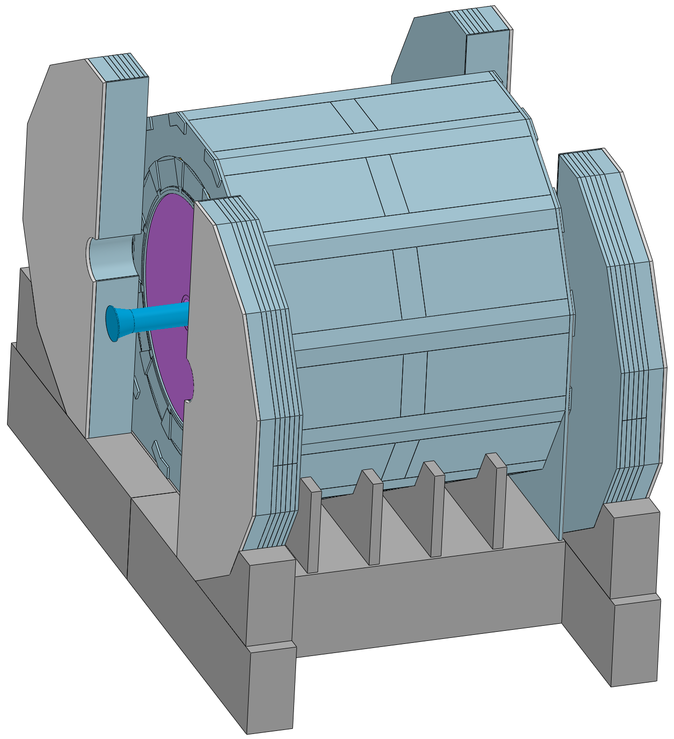
1. Progress of the overall drawing
1) Adding 100mm thick paraffin wax on the outer surface of the end yoke
Axial ：Length increases

Slide 4
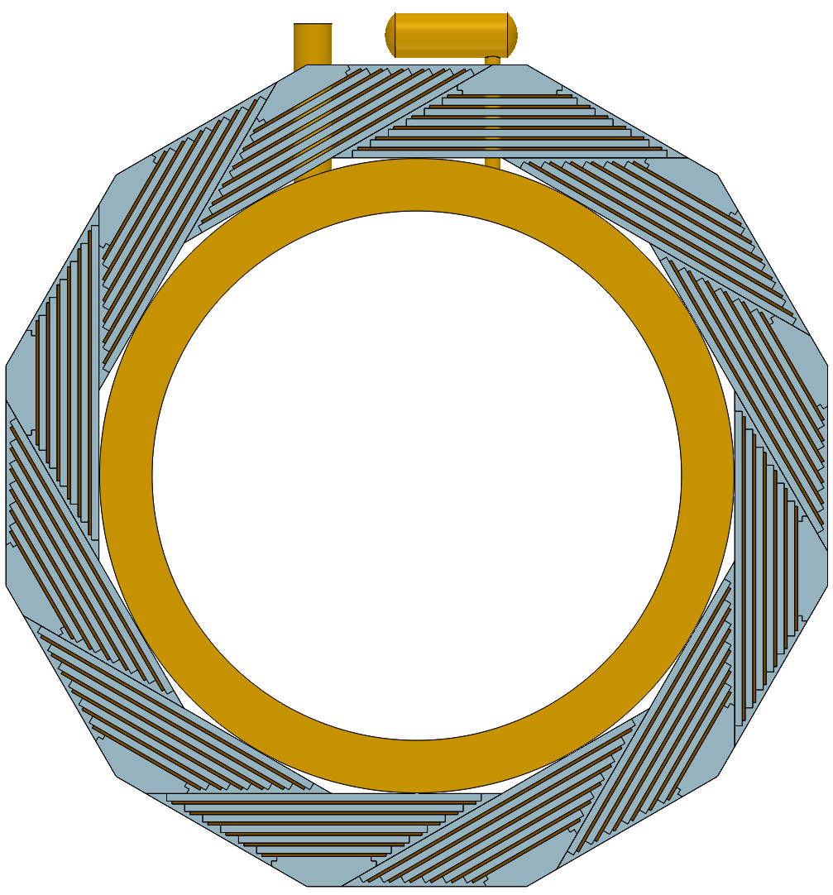
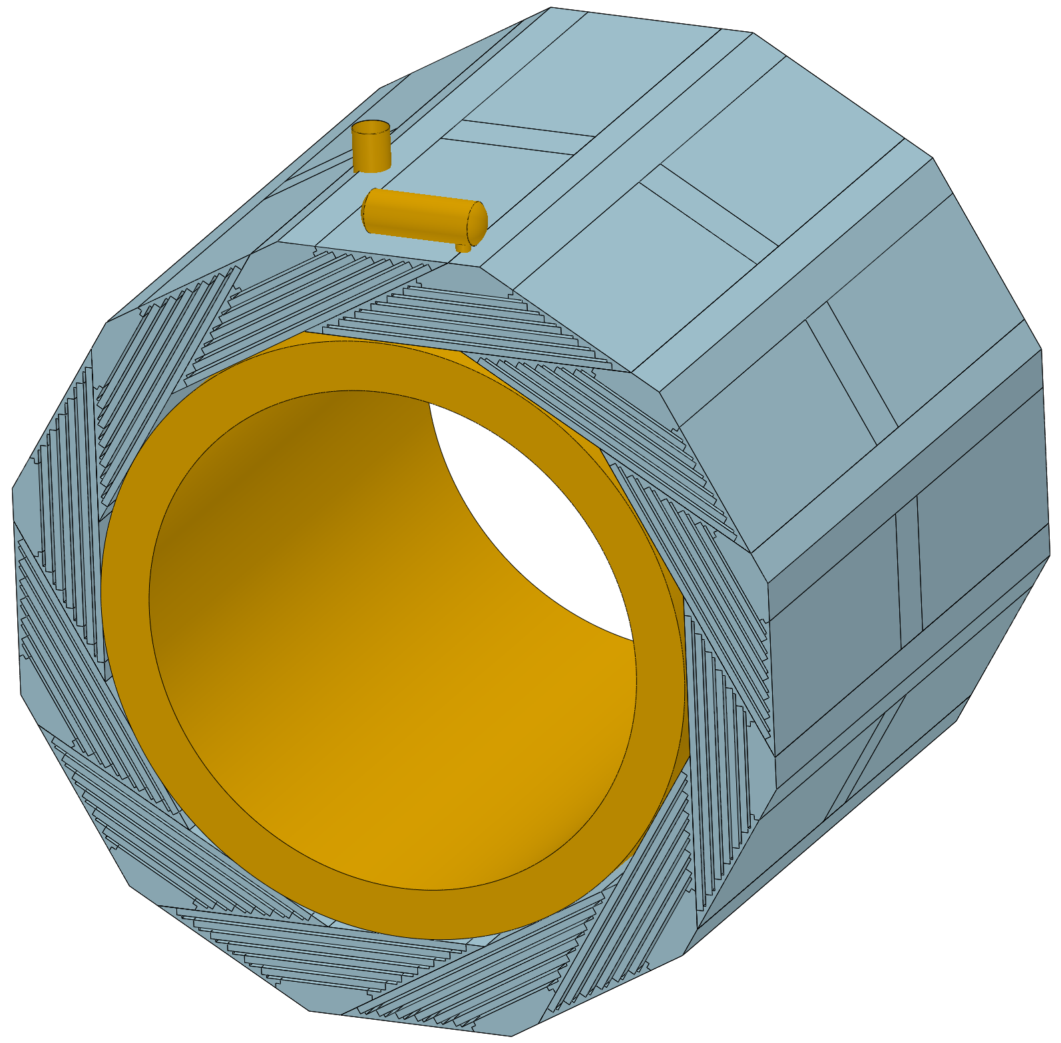
1. Progress of the overall drawing
2) Optimization design of yoke and magnet chimney
Next plan :
Mixed installation design
Optimization :
a. Chimney channel only affects one yoke module
b. The yoke is divided into two sections along the axial direction

Slide 5
1. Progress of the overall drawing
3) OTK, VERTEX and ECAL
OTK, VERTEX :
Start discussing with the overall drawing……
ECAL :
侯少静单独汇报

Slide 6
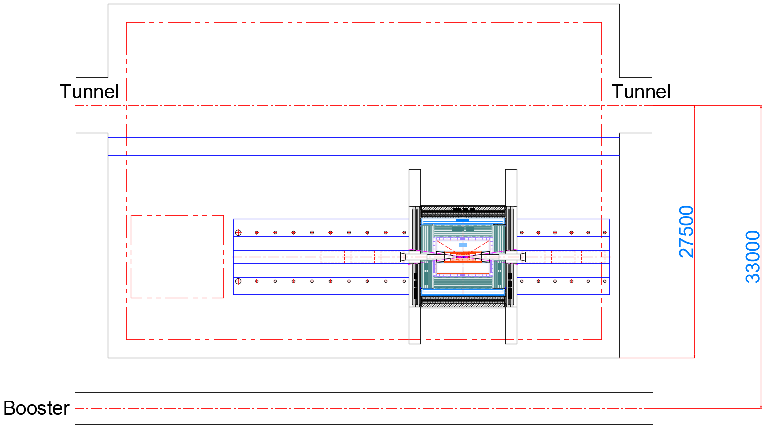
2. Pre-installation point installation scheme design
Scheme 1
Length :
50000 to 55500
33000 to 38500
Collision point
Question :
Distance 33 m
(>25 m)

Slide 7
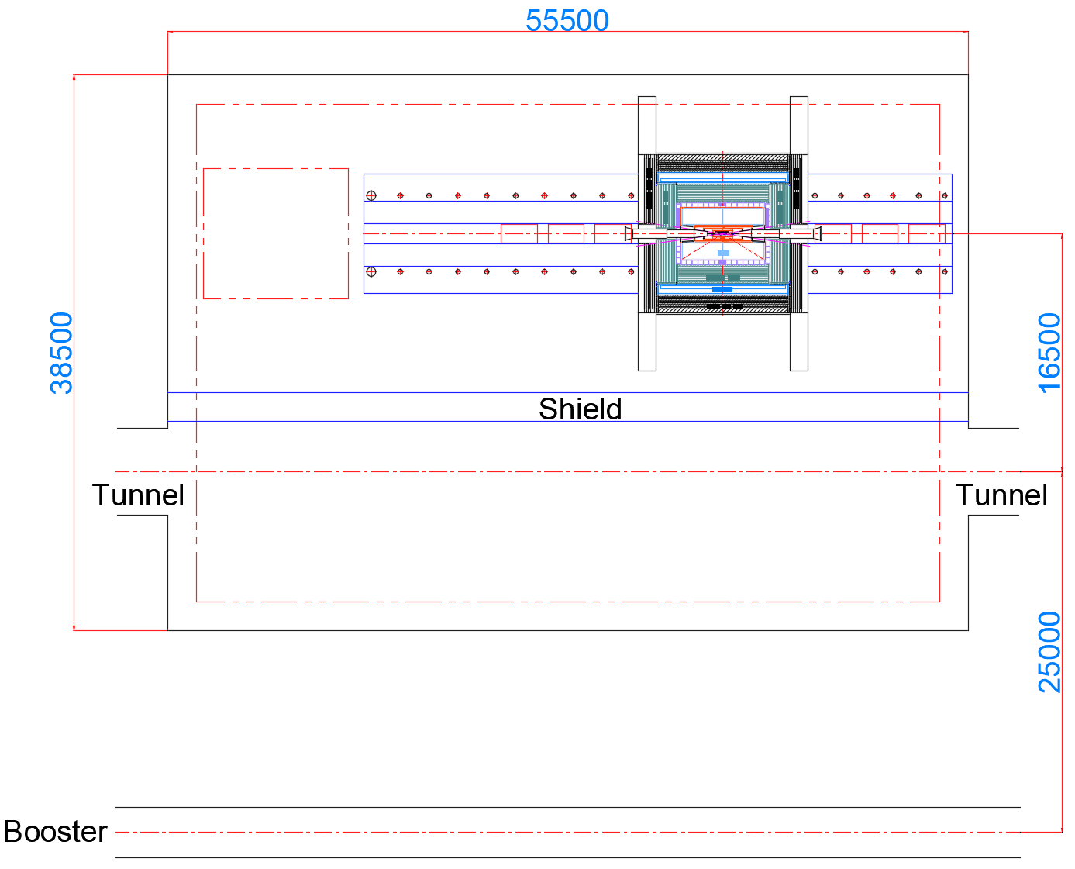
2. Pre-installation point installation scheme design
Scheme 2
Length :
50000 to 55500
33000 to 38500
Collision point
Question :
Distance 16.5 m
(Increased the distance to the service room)

