Slide 1
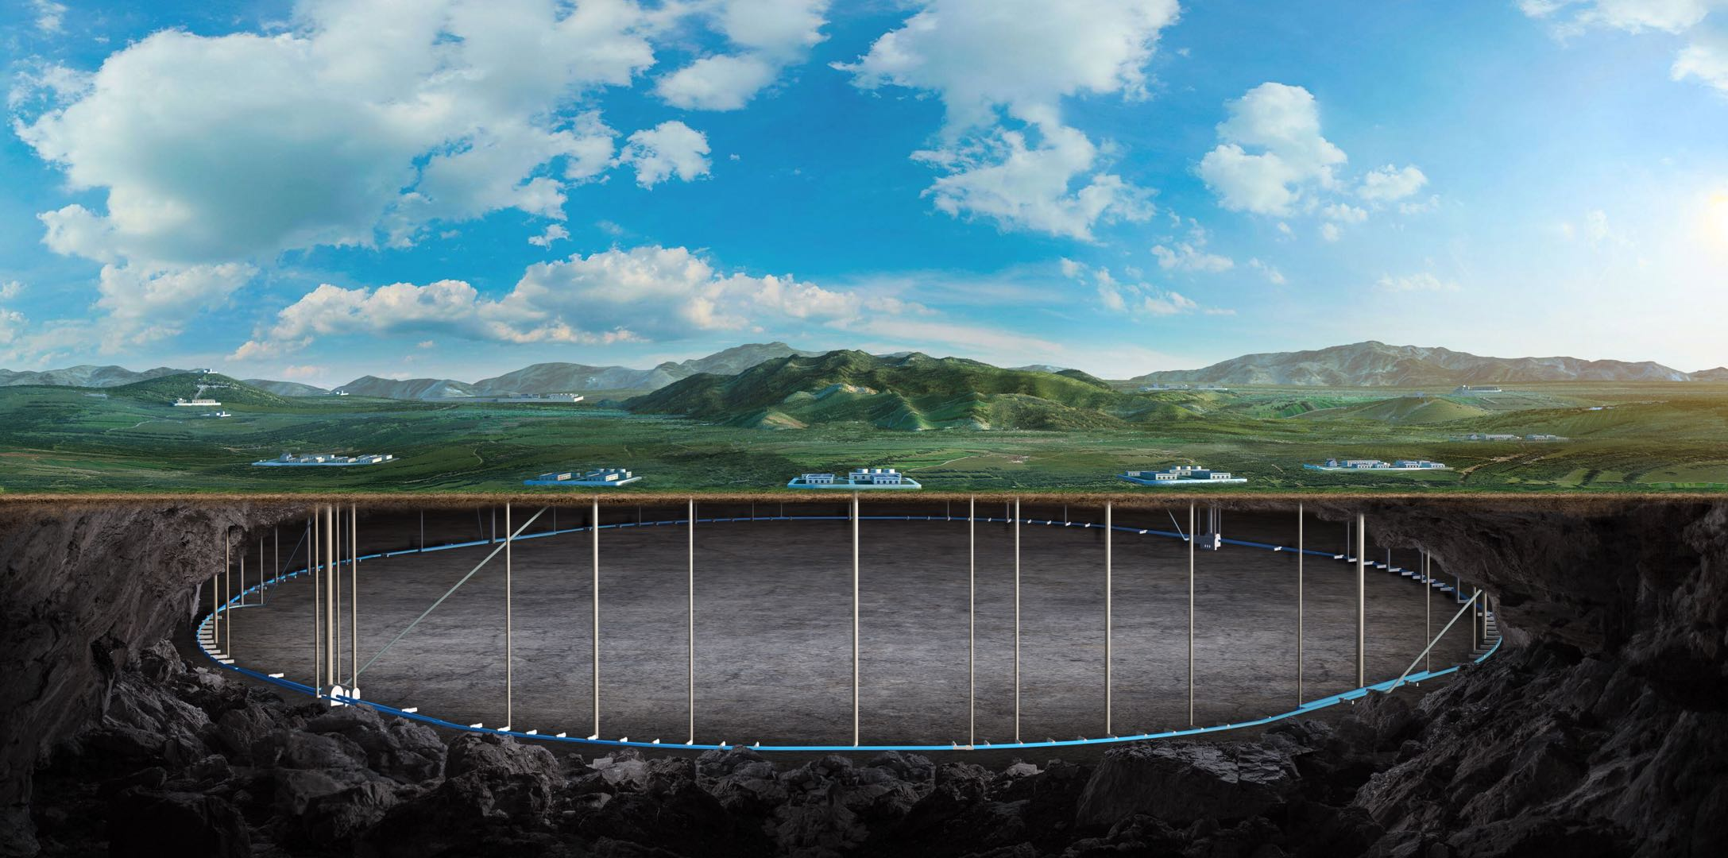
CEPC Detector Magnet
Feipeng Ning
On behalf of SC magnet Team

Slide 2
Outline
The chimneys of the magnet
Physical design work is still ongoing
Superconducting cable LTS and HTS, summary of the latest work and the next work arrangement

Slide 3
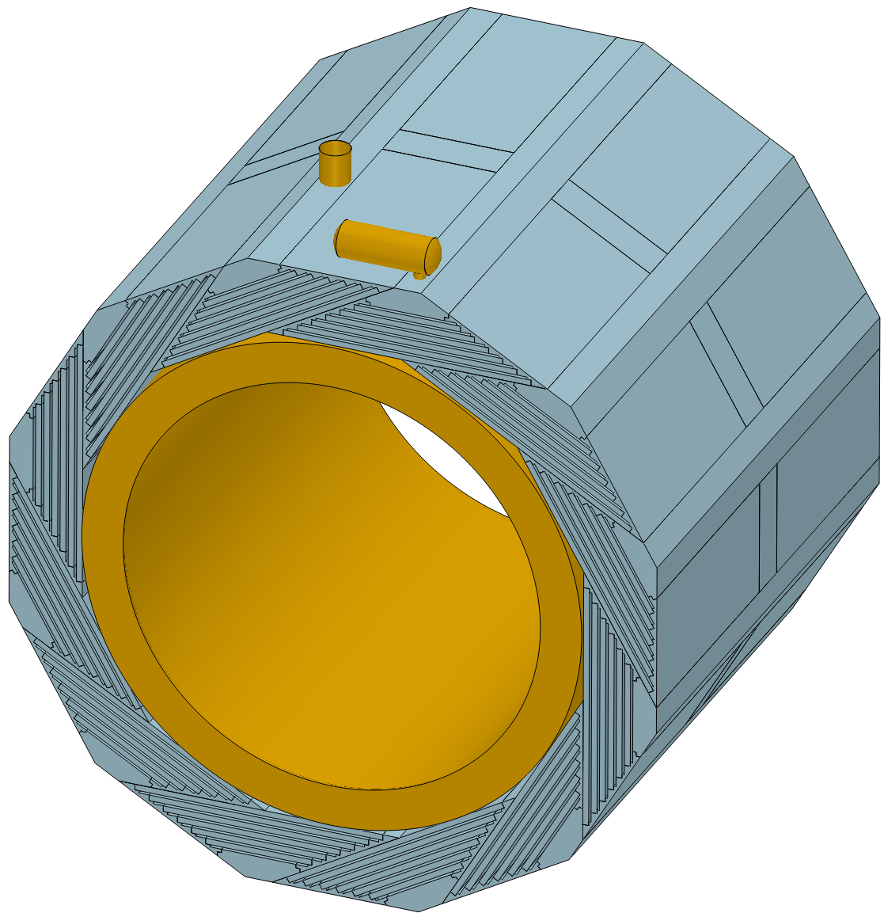
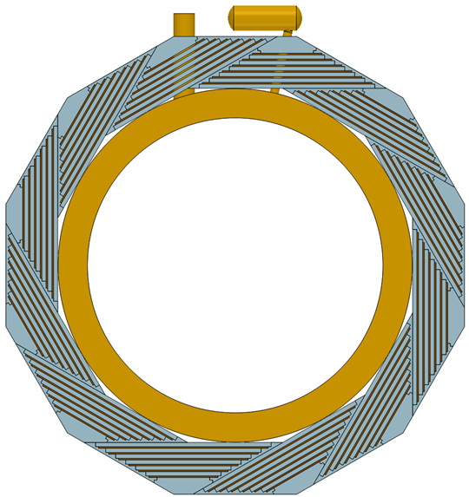
The chimneys of the magnet
Location and structure of the chimneys.
Cryogenic chimney：
at the end of the coil. On the top.
Current leads chimney:
at the center part of the coil.

Slide 4
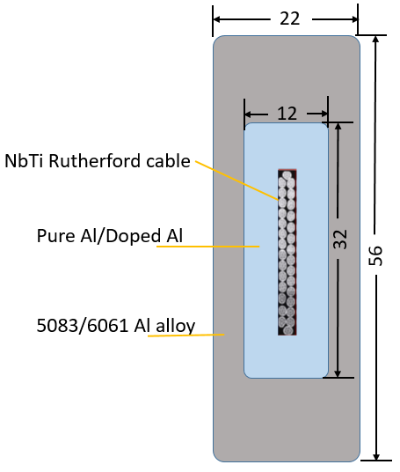
Physical design of the magnet
Optimize the physical design of the magnet
Cable structure:
Summary of the Superconducting Detector Magnet Workshop, 23/09/2023
Present
CEPC LTS cable

Slide 5
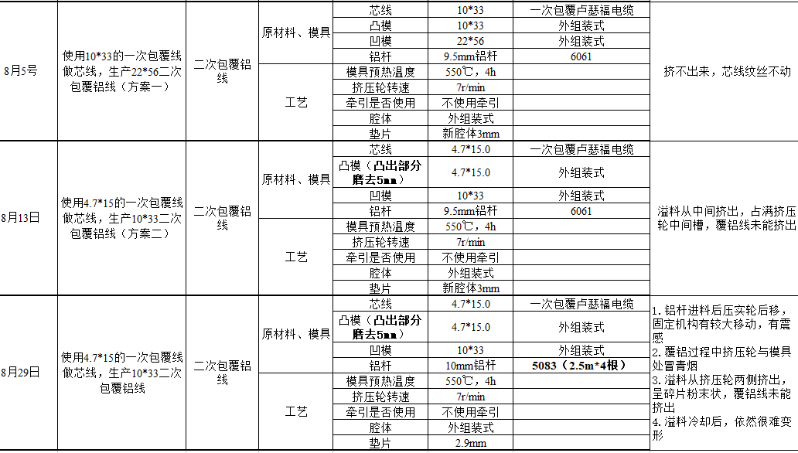
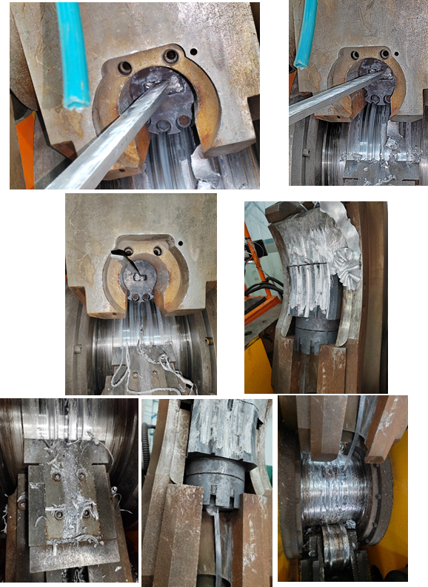
Superconducting cables: LTS and HTS
Aluminum stabilized LTS cable:

Slide 6
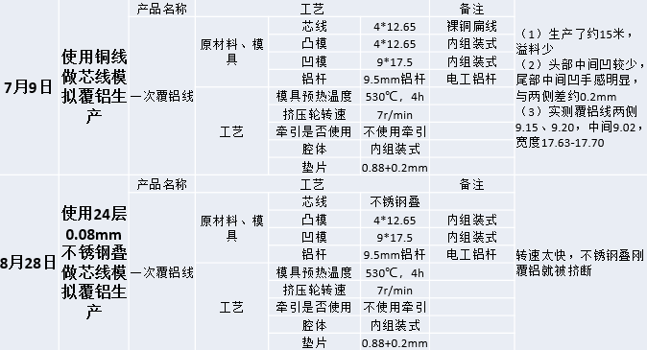
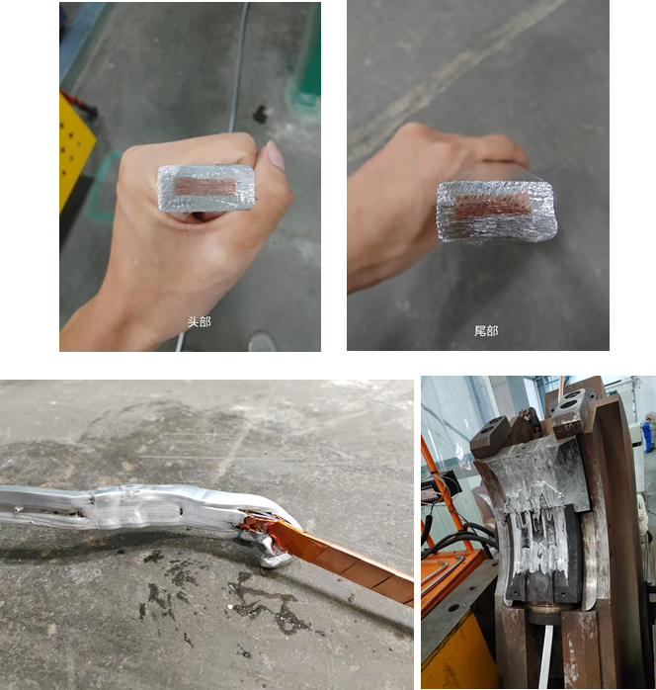
Superconducting cables: LTS and HTS
Aluminum stabilized HTS cable:
问题集中在芯线加工不紧密导致芯线尺寸太大，与凸模摩擦引起绕包铜带断裂，堵塞模具

Slide 7
Thank you for your attention!

