Slide 1

LHCb实验重子CP破坏进展
张艳席
第七届全国重味物理与量子色动力学研讨会
南京师范大学，2025/04/18-22

Slide 2
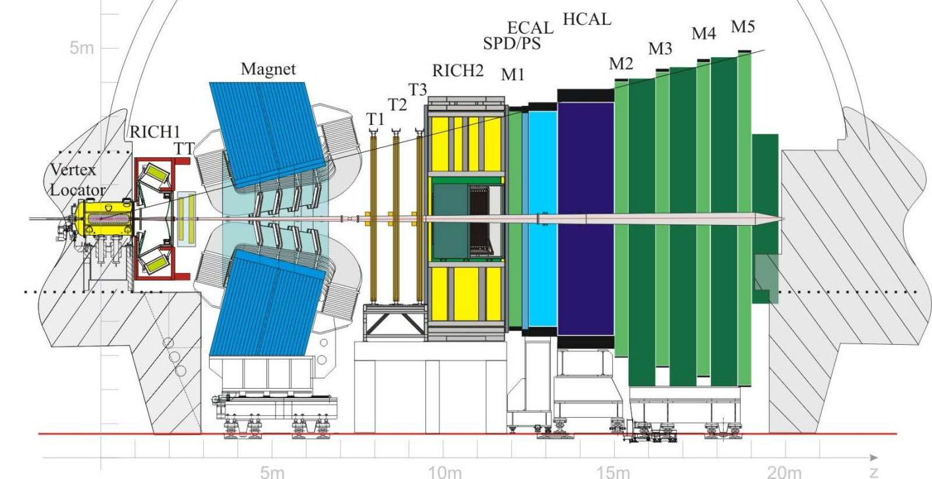
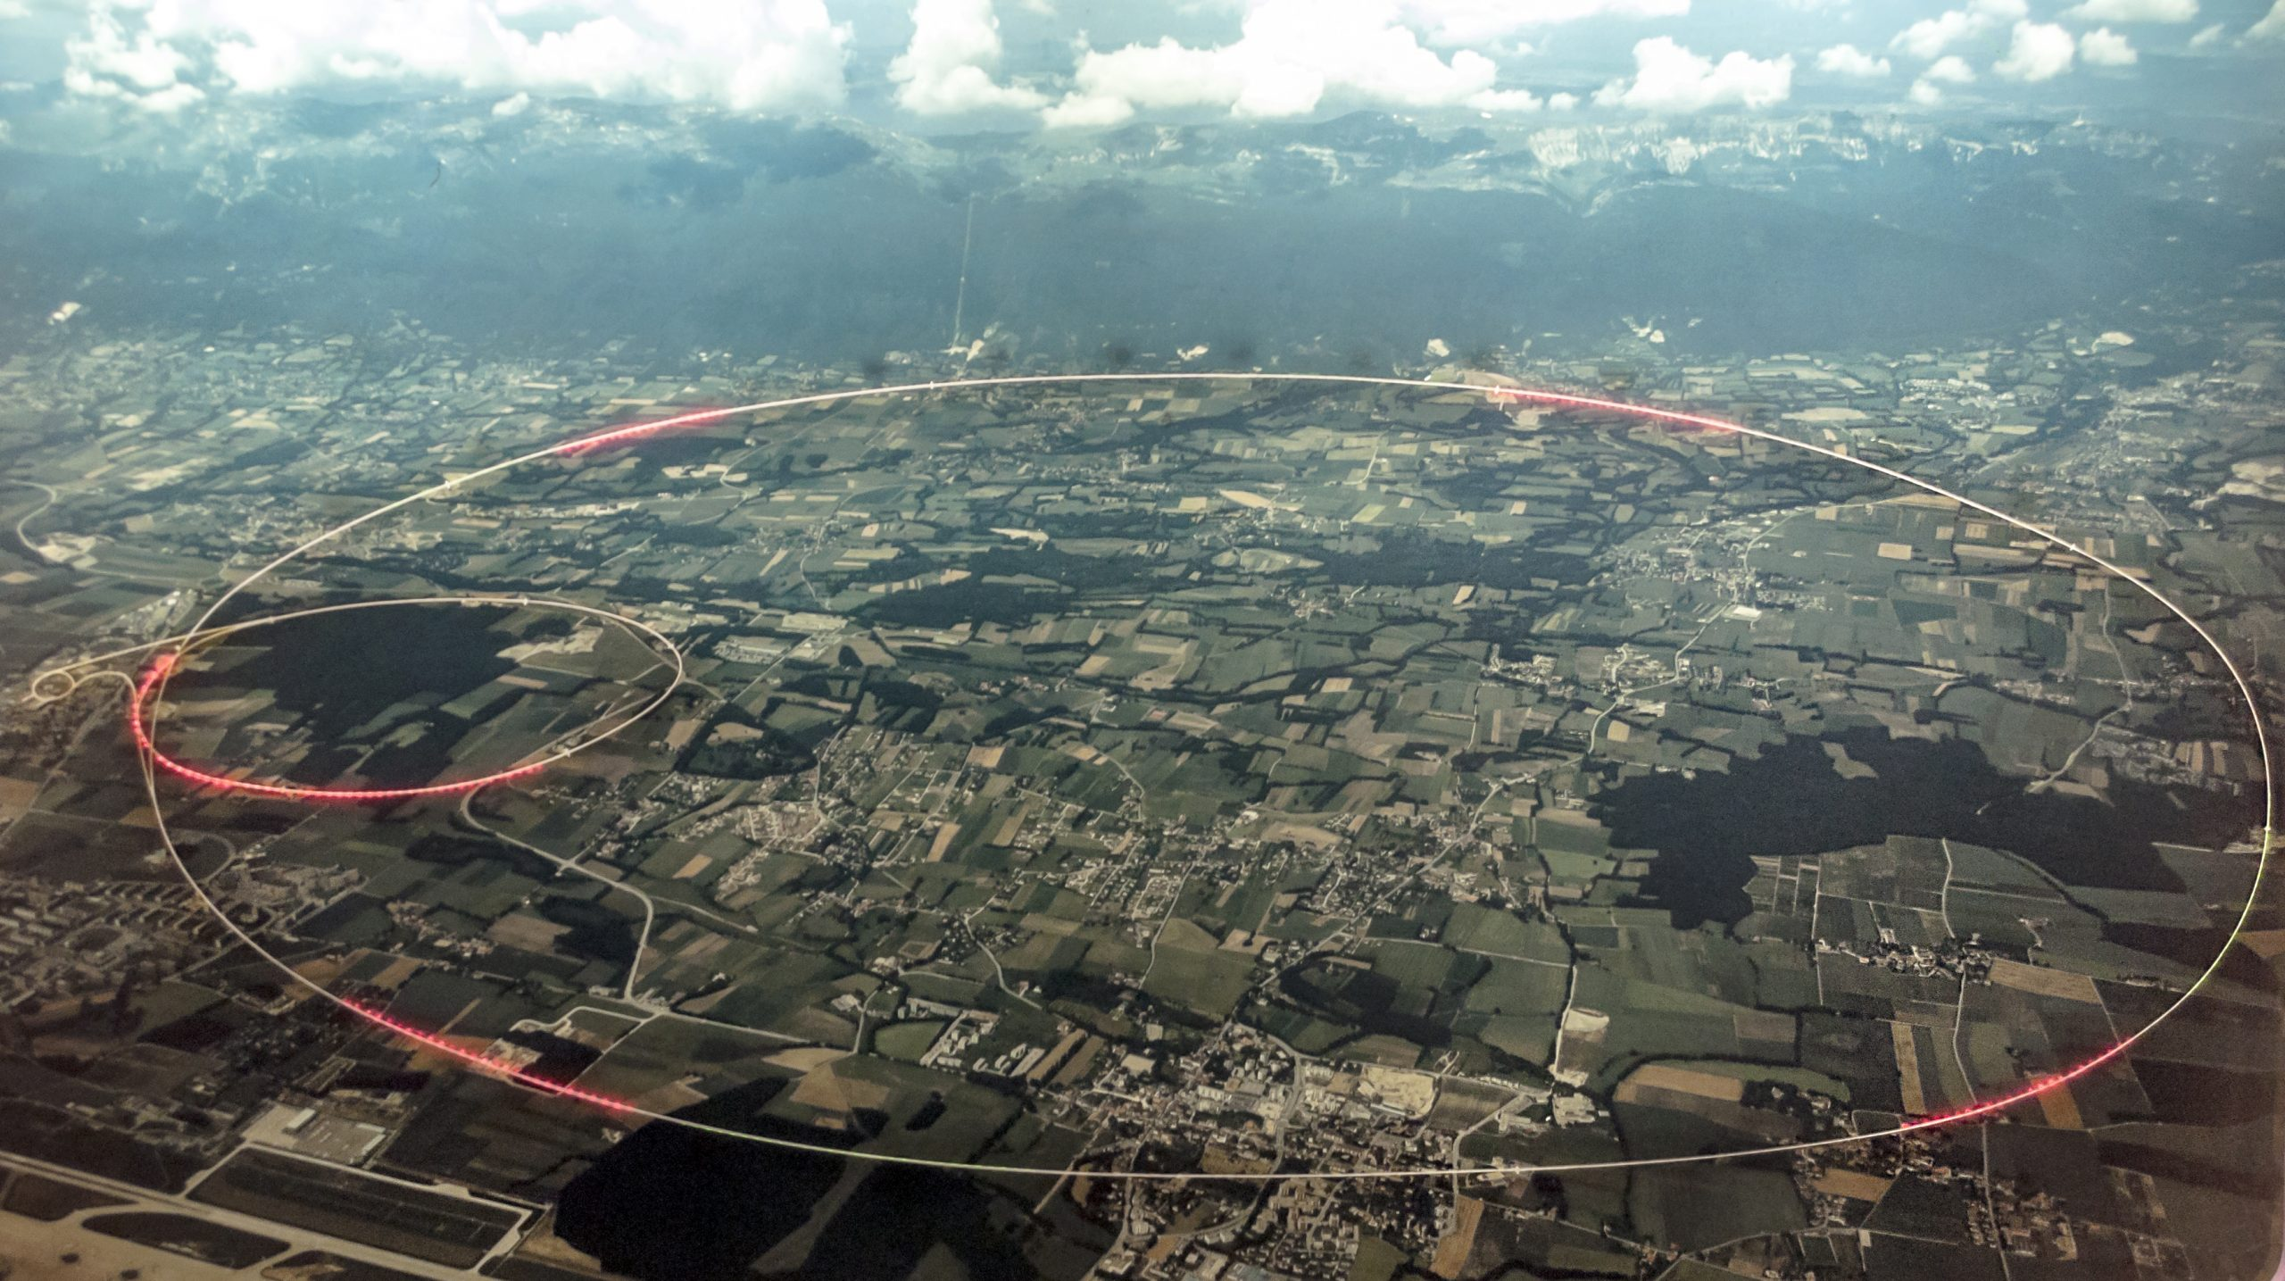




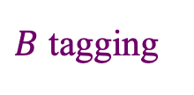
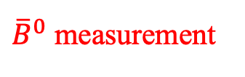
LHCb experiment
JINST 3 (2008) S08005
IJMPA 30 (2015) 1530022
Dedicated experiment at CERN to measure 𝑏, 𝑐 hadrons
Excellent vertexing, hadron PID, momentum; flexible trigger …
Main topics
Heavy flavor and CP violation
Rare decay
QCD: production, spectroscopy
EW and Higgs
Heavy ion
${\overline{B}}^{0}$ measurement
$B$ tagging
LHCb中国组：清华大学、华中师范大学、高能物理研究所、中国科学院大学、武汉大学、湖南大学、华南师范大学、北京大学、兰州大学、中国科学技术大学、西北工业大学、河南师范大学

Slide 3
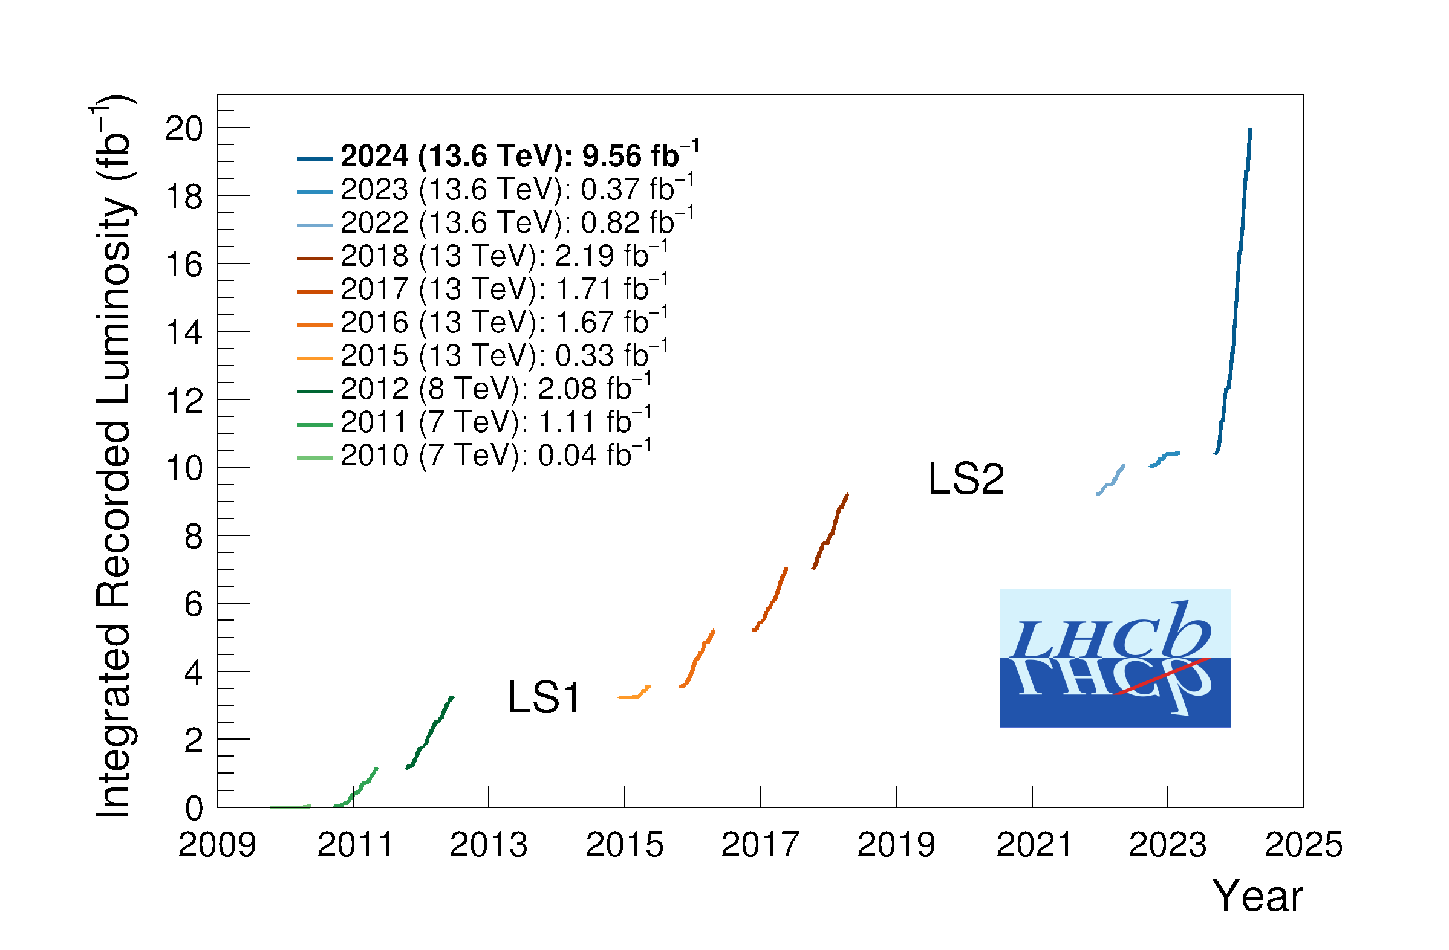
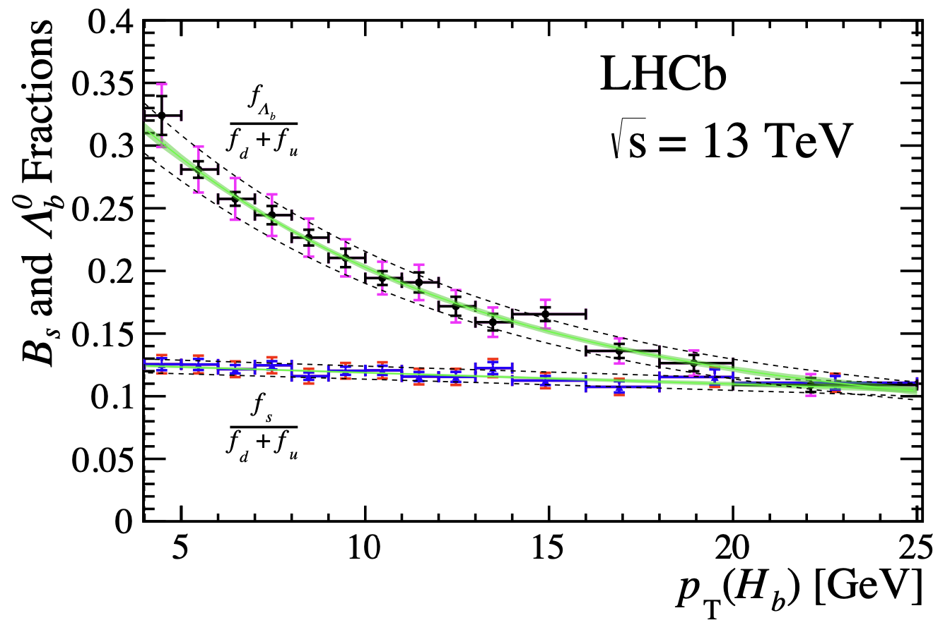
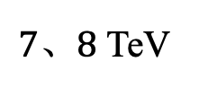
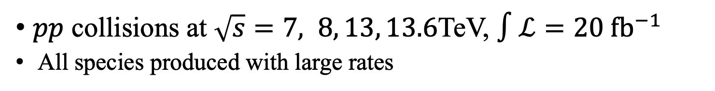

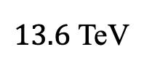

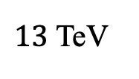
LHCb data
$pp$ collisions at $\sqrt{s}=7, 8, 13, 13.6$TeV, $∫ℒ=20 {fb}^{−1}$
All species produced with large rates
JHEP 05 (2017) 074
PRL 118 (2017) 052002
PRD 100 (2019) 031102(R)
$σ\left(pp→b\overline{b}X, 13 TeV\right)≈0.5 mb$
$B^{+}:B^{0}:B_{s}^{0}:Λ_{b}^{0}≈4:4:1:2$
Run 3…
$13.6$ TeV
Run 1
Run 2
$7、8$ TeV
$13$ TeV
PRD 100 (2019) 031102(R)

Slide 4
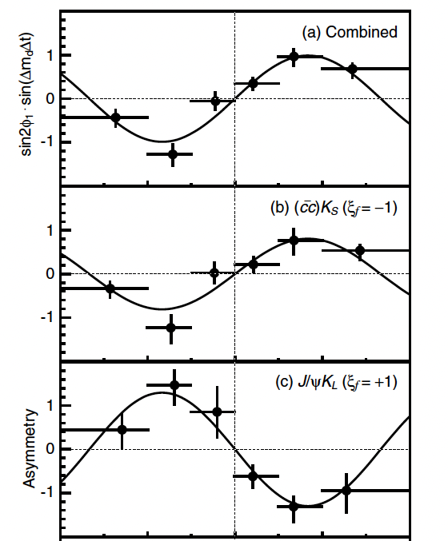
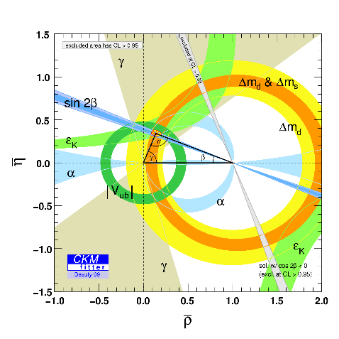
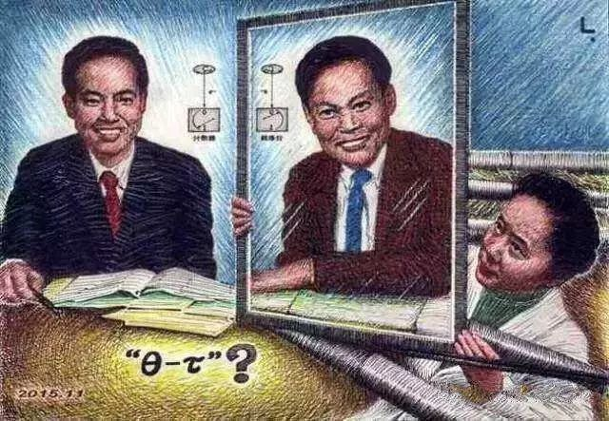
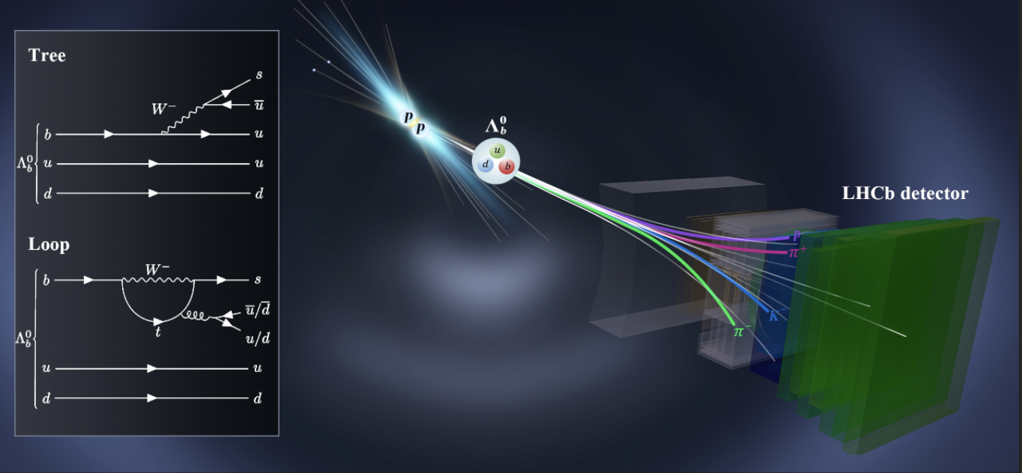
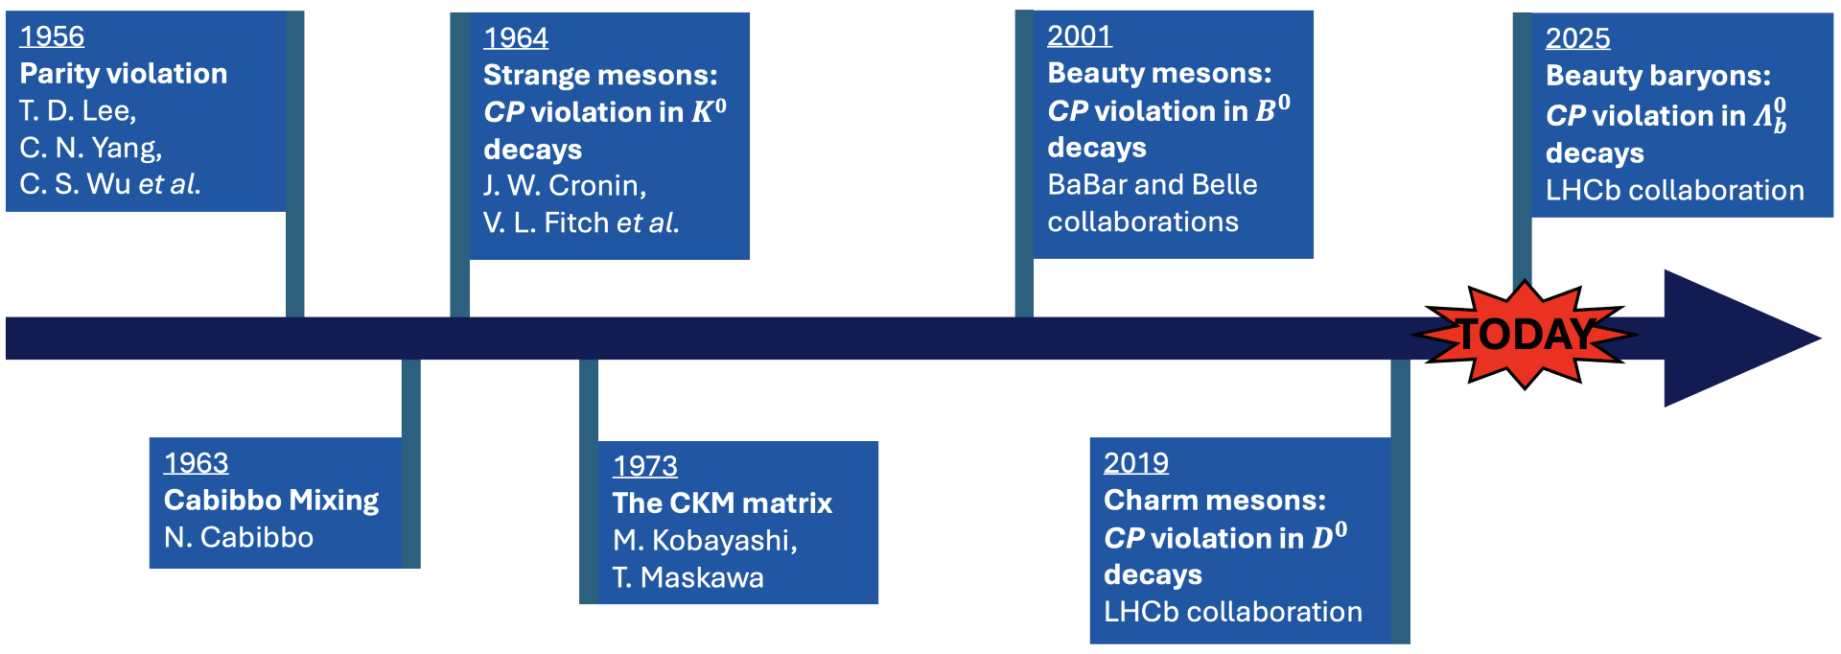
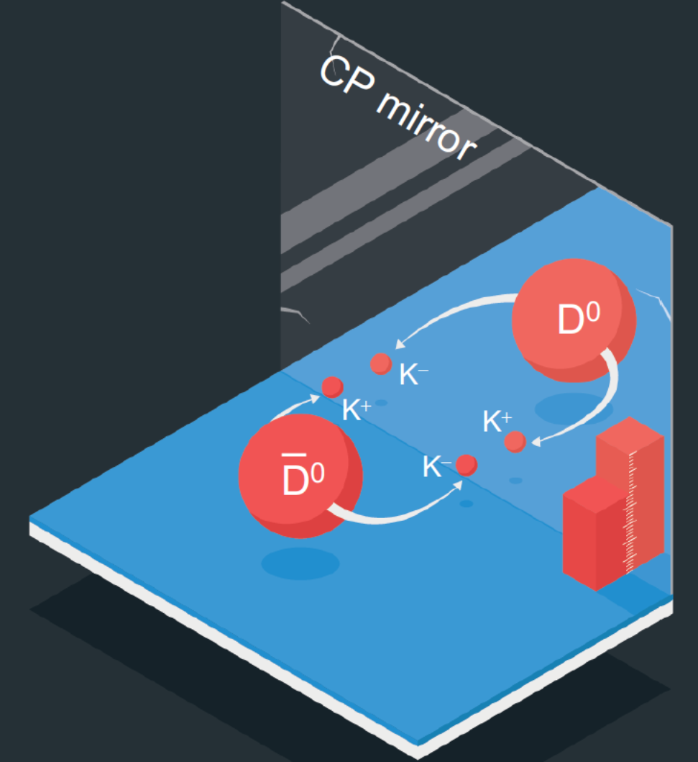
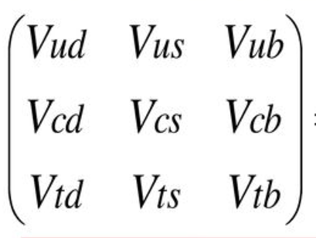

Brief history of CP violation
$K_{L}^{0}→π^{+}π^{−}$

Slide 5
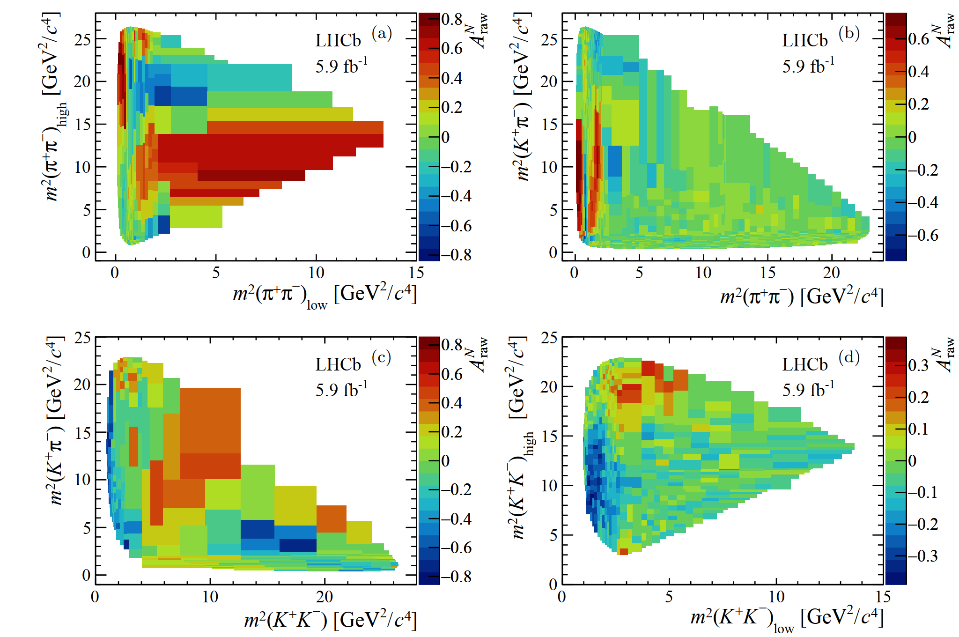
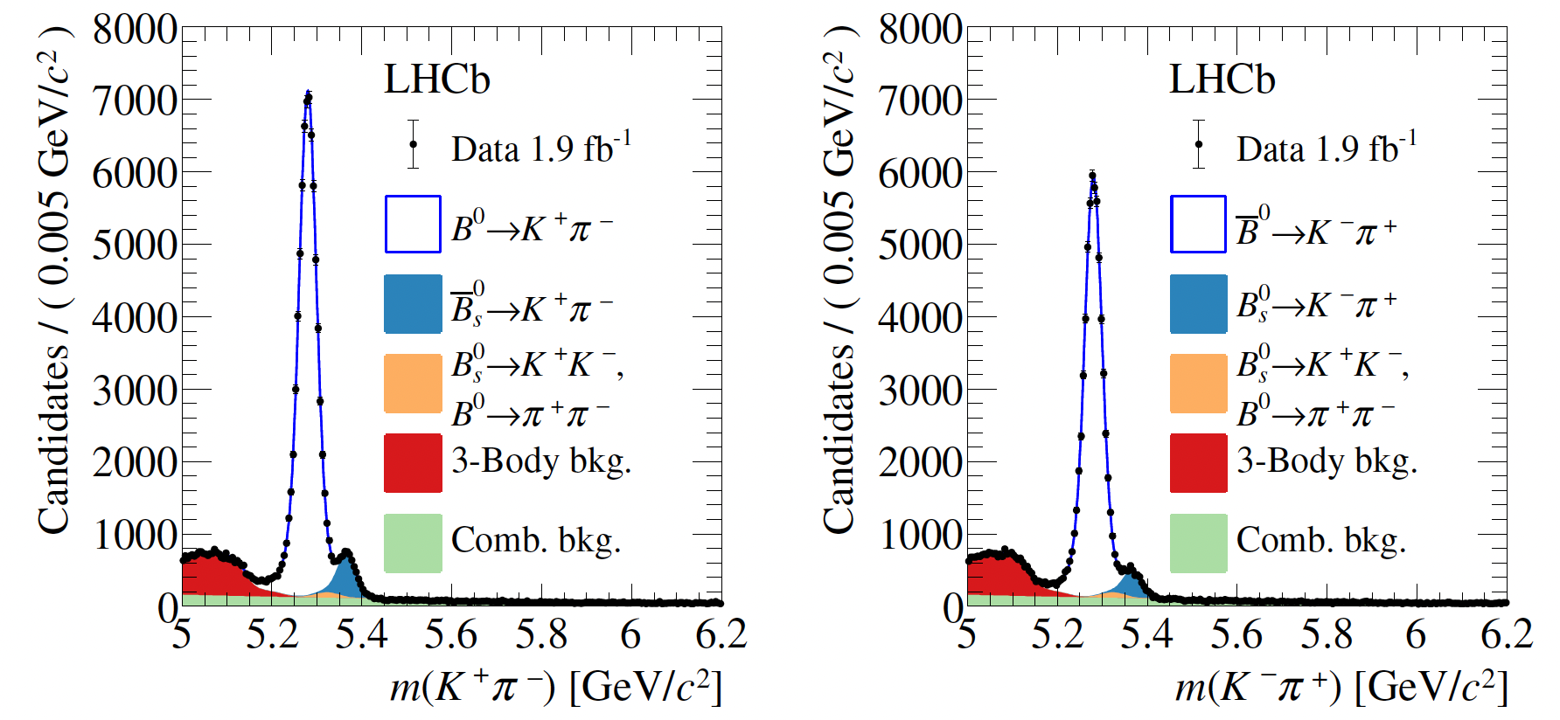








Direct CP violation for beauty mesons
Two body decays
Three body decays
$$A_{CP}^{B^{0}→K^{+}π^{−}}=−0.083±0.005$$
$$B^{±}→π^{±}π^{+}π^{−}$$
$$B^{±}→K^{±}π^{+}π^{−}$$
$$A_{CP}^{B_{s}^{0}→K^{−}π^{+}}=+0.236±0.017$$
$$B_{(s)}→K^{+}π^{−}$$
$$B_{(s)}→K^{−}π^{+}$$
PRD98 (2018) 032004
$$B^{±}→π^{±}K^{+}K^{−}$$
$$B^{±}→K^{±}K^{+}K^{−}$$

Slide 6
Recent LHCb baryonic CP violation measurements

Slide 7
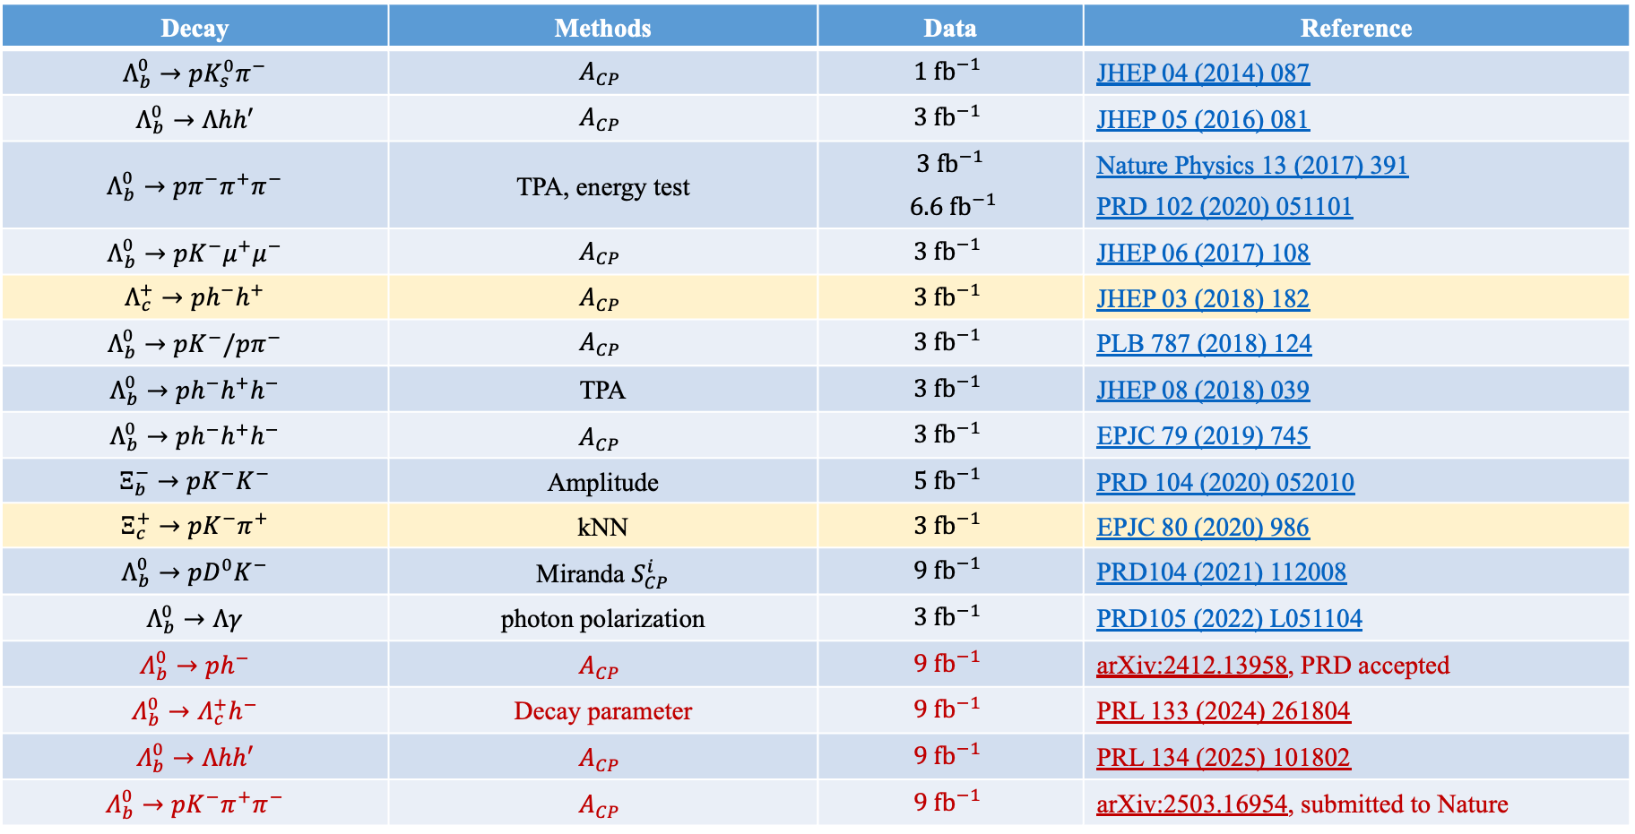
Long list of efforts by LHCb
Decay | Methods | Data | Reference
$$Λ_{b}^{0}→pK_{s}^{0}π^{−}$$ | $$A_{CP}$$ | $$1{ fb}^{−1}$$ | JHEP 04 (2014) 087
$$Λ_{b}^{0}→Λhh′$$ | $$A_{CP}$$ | $$3 {fb}^{−1}$$ | JHEP 05 (2016) 081
$$Λ_{b}^{0}→pπ^{−}π^{+}π^{−}$$ | TPA, energy test | $$3{ fb}^{−1}$$ $6.6 {fb}^{−1}$ | Nature Physics 13 (2017) 391 PRD 102 (2020) 051101
$$Λ_{b}^{0}→pK^{−}μ^{+}μ^{−}$$ | $$A_{CP}$$ | $$3 {fb}^{−1}$$ | JHEP 06 (2017) 108
$$Λ_{c}^{+}→ph^{−}h^{+}$$ | $$A_{CP}$$ | $$3 {fb}^{−1}$$ | JHEP 03 (2018) 182
$$Λ_{b}^{0}→pK^{−}/pπ^{−}$$ | $$A_{CP}$$ | $$3{ fb}^{−1}$$ | PLB 787 (2018) 124
$$Λ_{b}^{0}→ph^{−}h^{+}h^{−}$$ | TPA | $$3{ fb}^{−1}$$ | JHEP 08 (2018) 039
$$Λ_{b}^{0}→ph^{−}h^{+}h^{−}$$ | $$A_{CP}$$ | $$3{ fb}^{−1}$$ | EPJC 79 (2019) 745
$$Ξ_{b}^{−}→pK^{−}K^{−}$$ | Amplitude | $$5{ fb}^{−1}$$ | PRD 104 (2020) 052010
$$Ξ_{c}^{+}→pK^{−}π^{+}$$ | kNN | $$3{ fb}^{−1}$$ | EPJC 80 (2020) 986
$$Λ_{b}^{0}→pD^{0}K^{−}$$ | Miranda $S_{CP}^{i}$ | $$9{ fb}^{−1}$$ | PRD104 (2021) 112008
$$Λ_{b}^{0}→Λγ$$ | photon polarization | $$3{ fb}^{−1}$$ | PRD105 (2022) L051104
$$Λ_{b}^{0}→ph^{−}$$ | $$A_{CP}$$ | $$9{ fb}^{−1}$$ | arXiv:2412.13958, PRD accepted
$$Λ_{b}^{0}→Λ_{c}^{+}h^{−}$$ | Decay parameter | $$9{ fb}^{−1}$$ | PRL 133 (2024) 261804
$$Λ_{b}^{0}→Λhh′$$ | $$A_{CP}$$ | $$9{ fb}^{−1}$$ | PRL 134 (2025) 101802
$$Λ_{b}^{0}→pK^{−}π^{+}π^{−}$$ | $$A_{CP}$$ | $$9{ fb}^{−1}$$ | arXiv:2503.16954, submitted to Nature

Slide 8
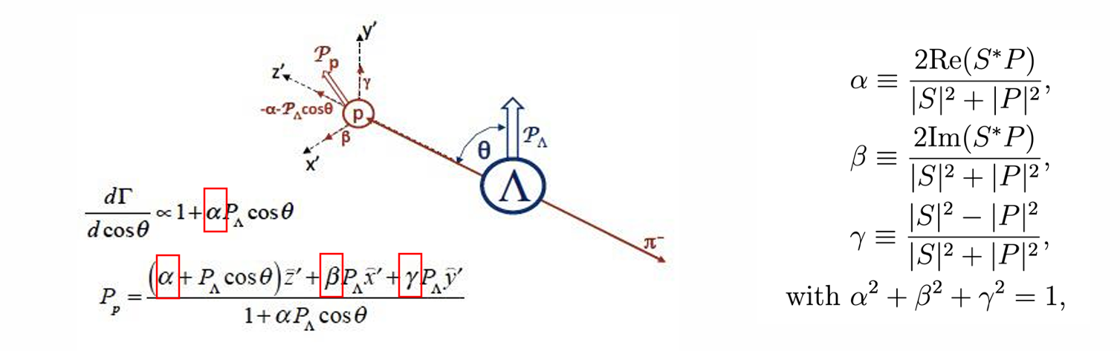
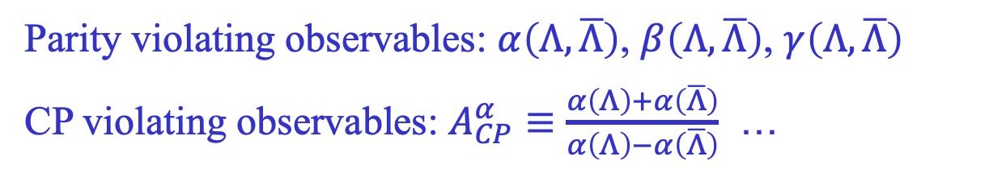
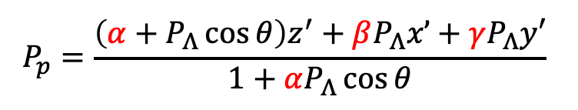
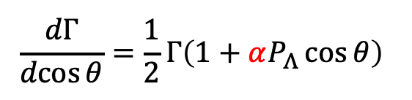
CP violation with decay parameters
Decay parameters proposed by Lee & Yang to study P violation in hyperon decay
S and P waves
$$\frac{dΓ}{\operatorname{dcos}{θ}}=\frac{1}{2}Γ\left(1+αP_{Λ}\cos{θ}\right)$$
$$P_{p}=\frac{\left(α+P_{Λ}\cos{θ}\right)z^{′}+βP_{Λ}x’+γP_{Λ}y′}{1+αP_{Λ}\cos{θ}}$$
Parity violating observables: $α\left(Λ,\overline{Λ}\right)$, $β\left(Λ,\overline{Λ}\right)$, $γ\left(Λ,\overline{Λ}\right)$
CP violating observables: $A_{CP}^{α}≡\frac{α\left(Λ\right)+α\left(\overline{Λ}\right)}{α\left(Λ\right)−α\left(\overline{Λ}\right)}$ …
Complementary to decay rate asymmetry
Clean observables, less polluted by experimental effects

Slide 9
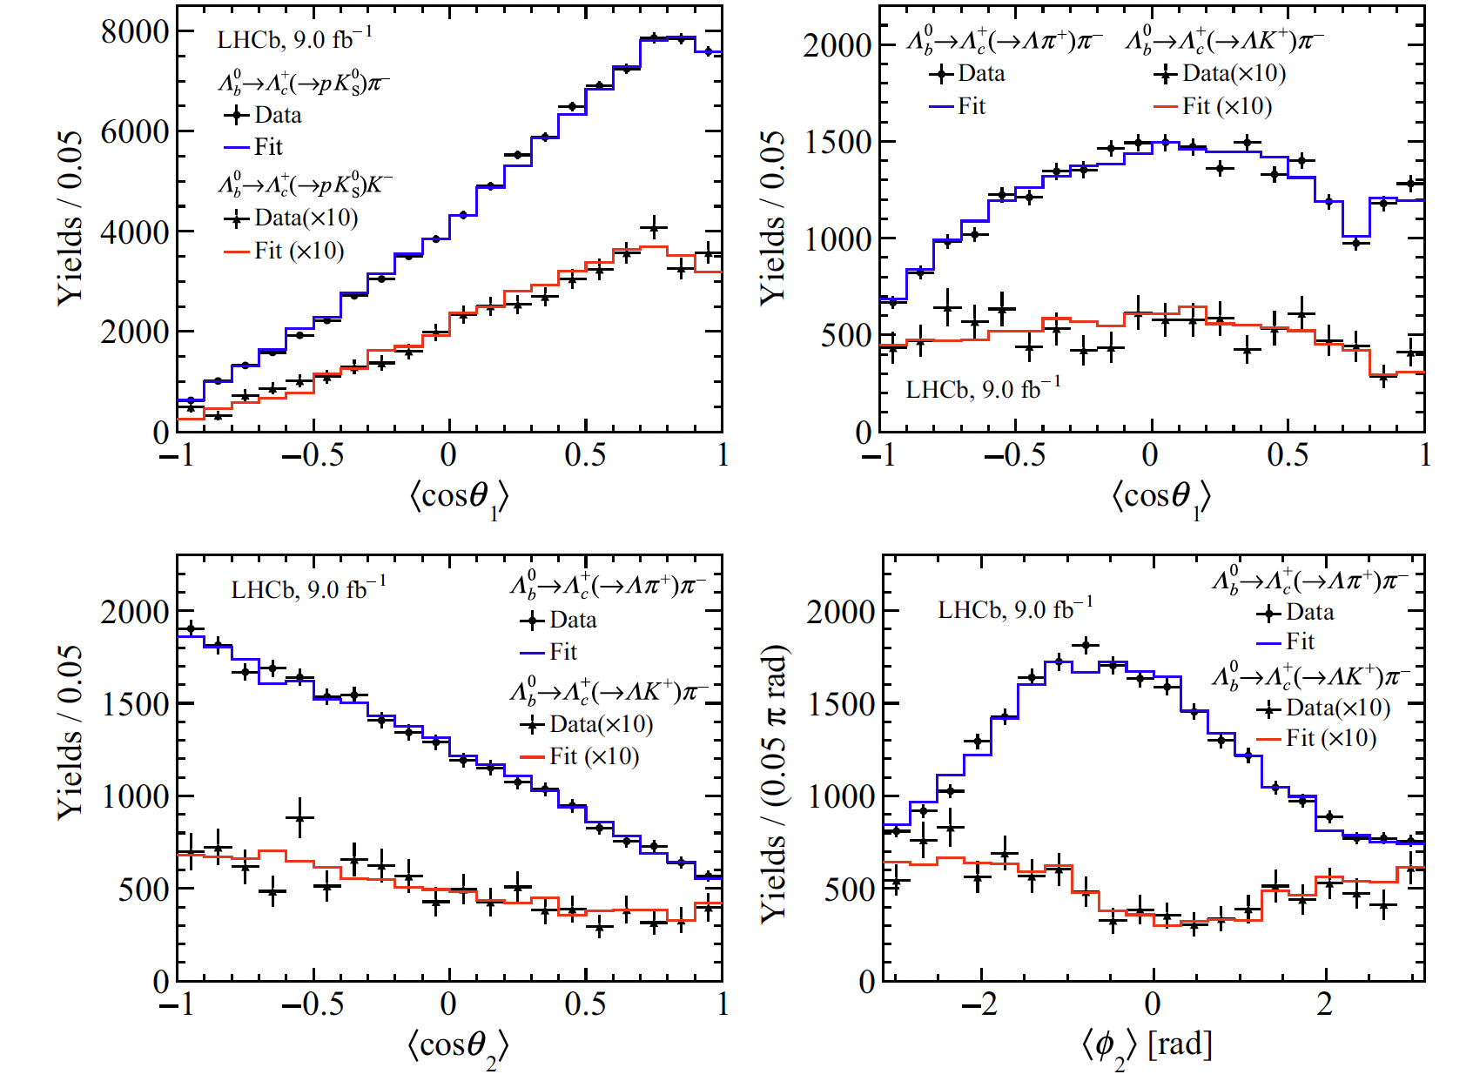
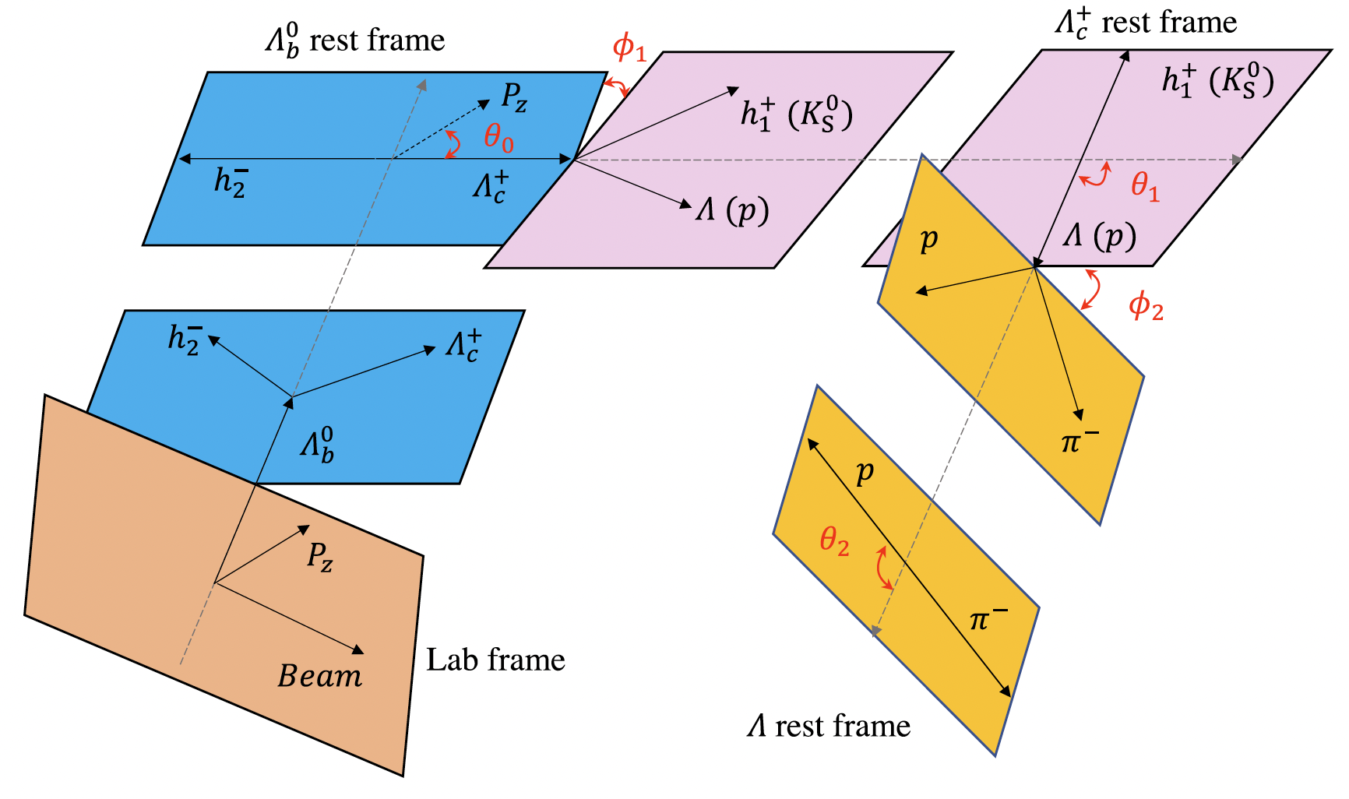
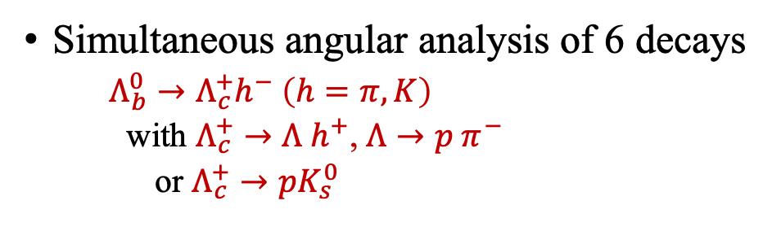
Beauty and charm baryon decay parameters
Simultaneous angular analysis of 6 decays
  $Λ_{b}^{0}→Λ_{c}^{+}h^{−} \left(h=π, K\right)$
  with $Λ_{c}^{+}→Λ h^{+}$, $Λ→p π^{−}$
  or $Λ_{c}^{+}→pK_{s}^{0}$
PRL 133 (2024) 261804

Slide 10
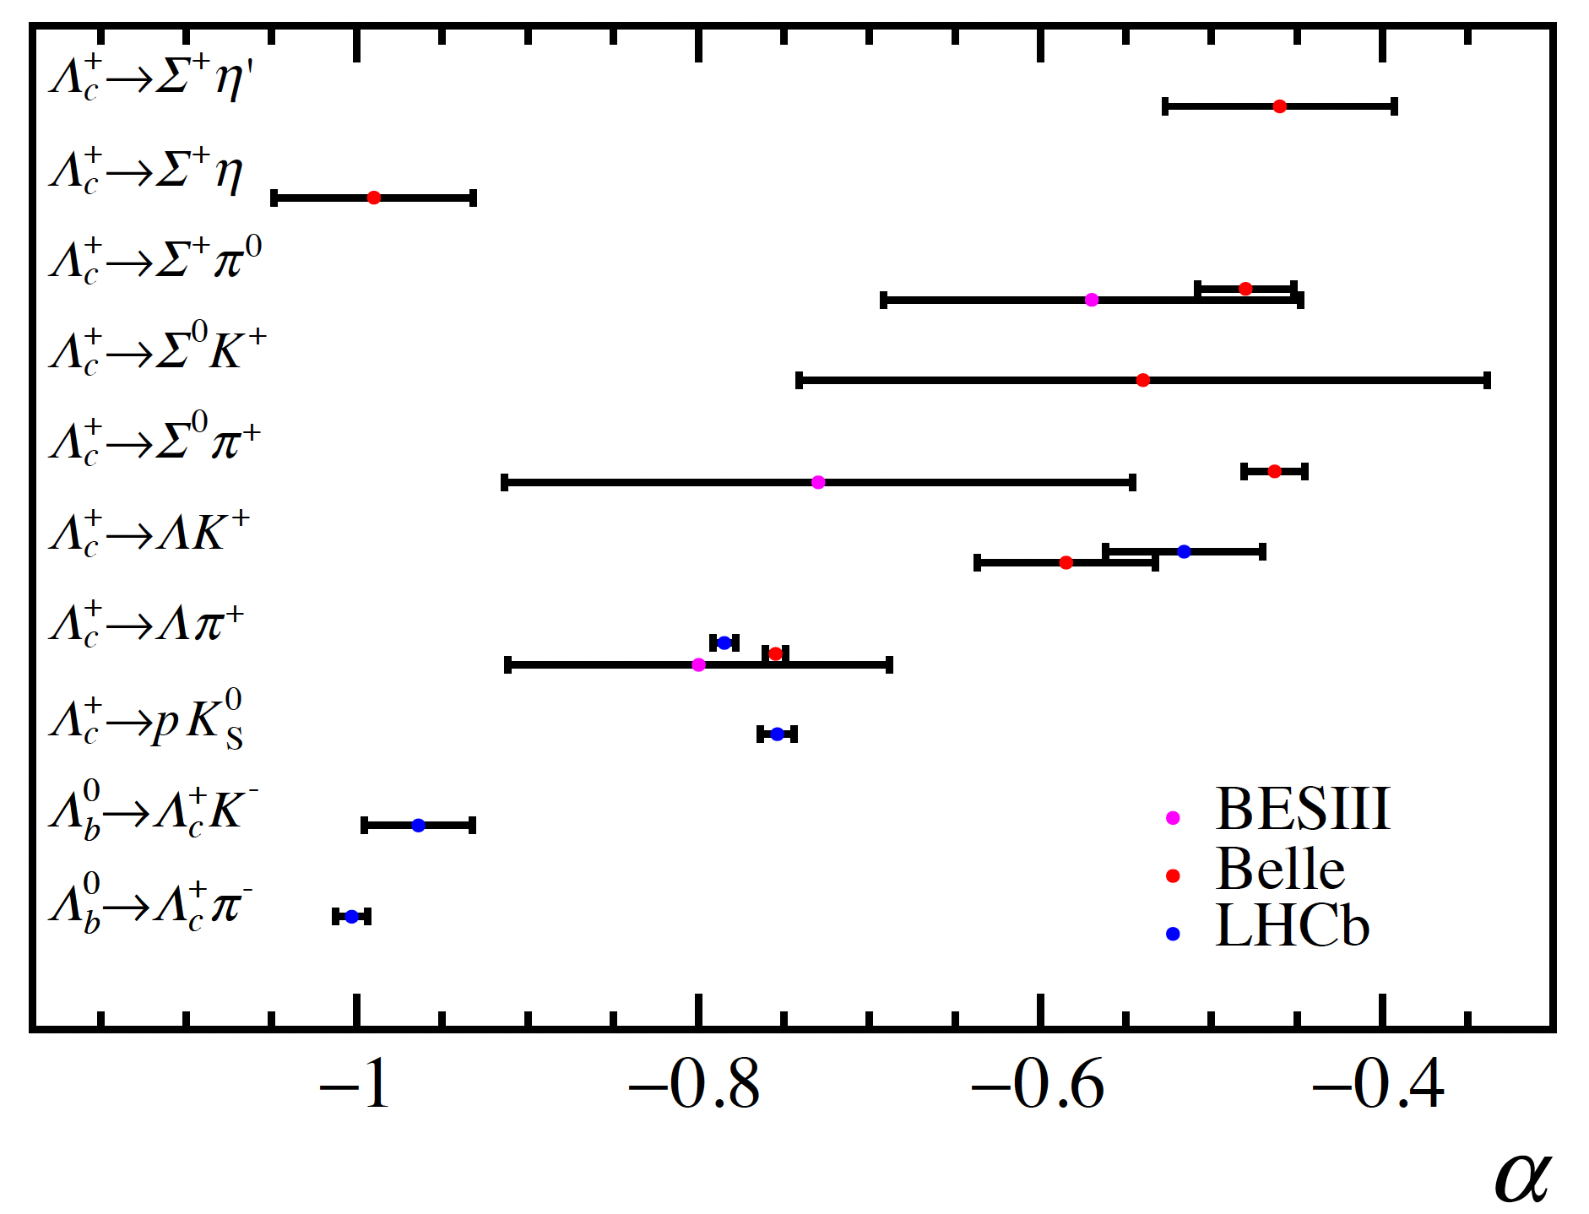
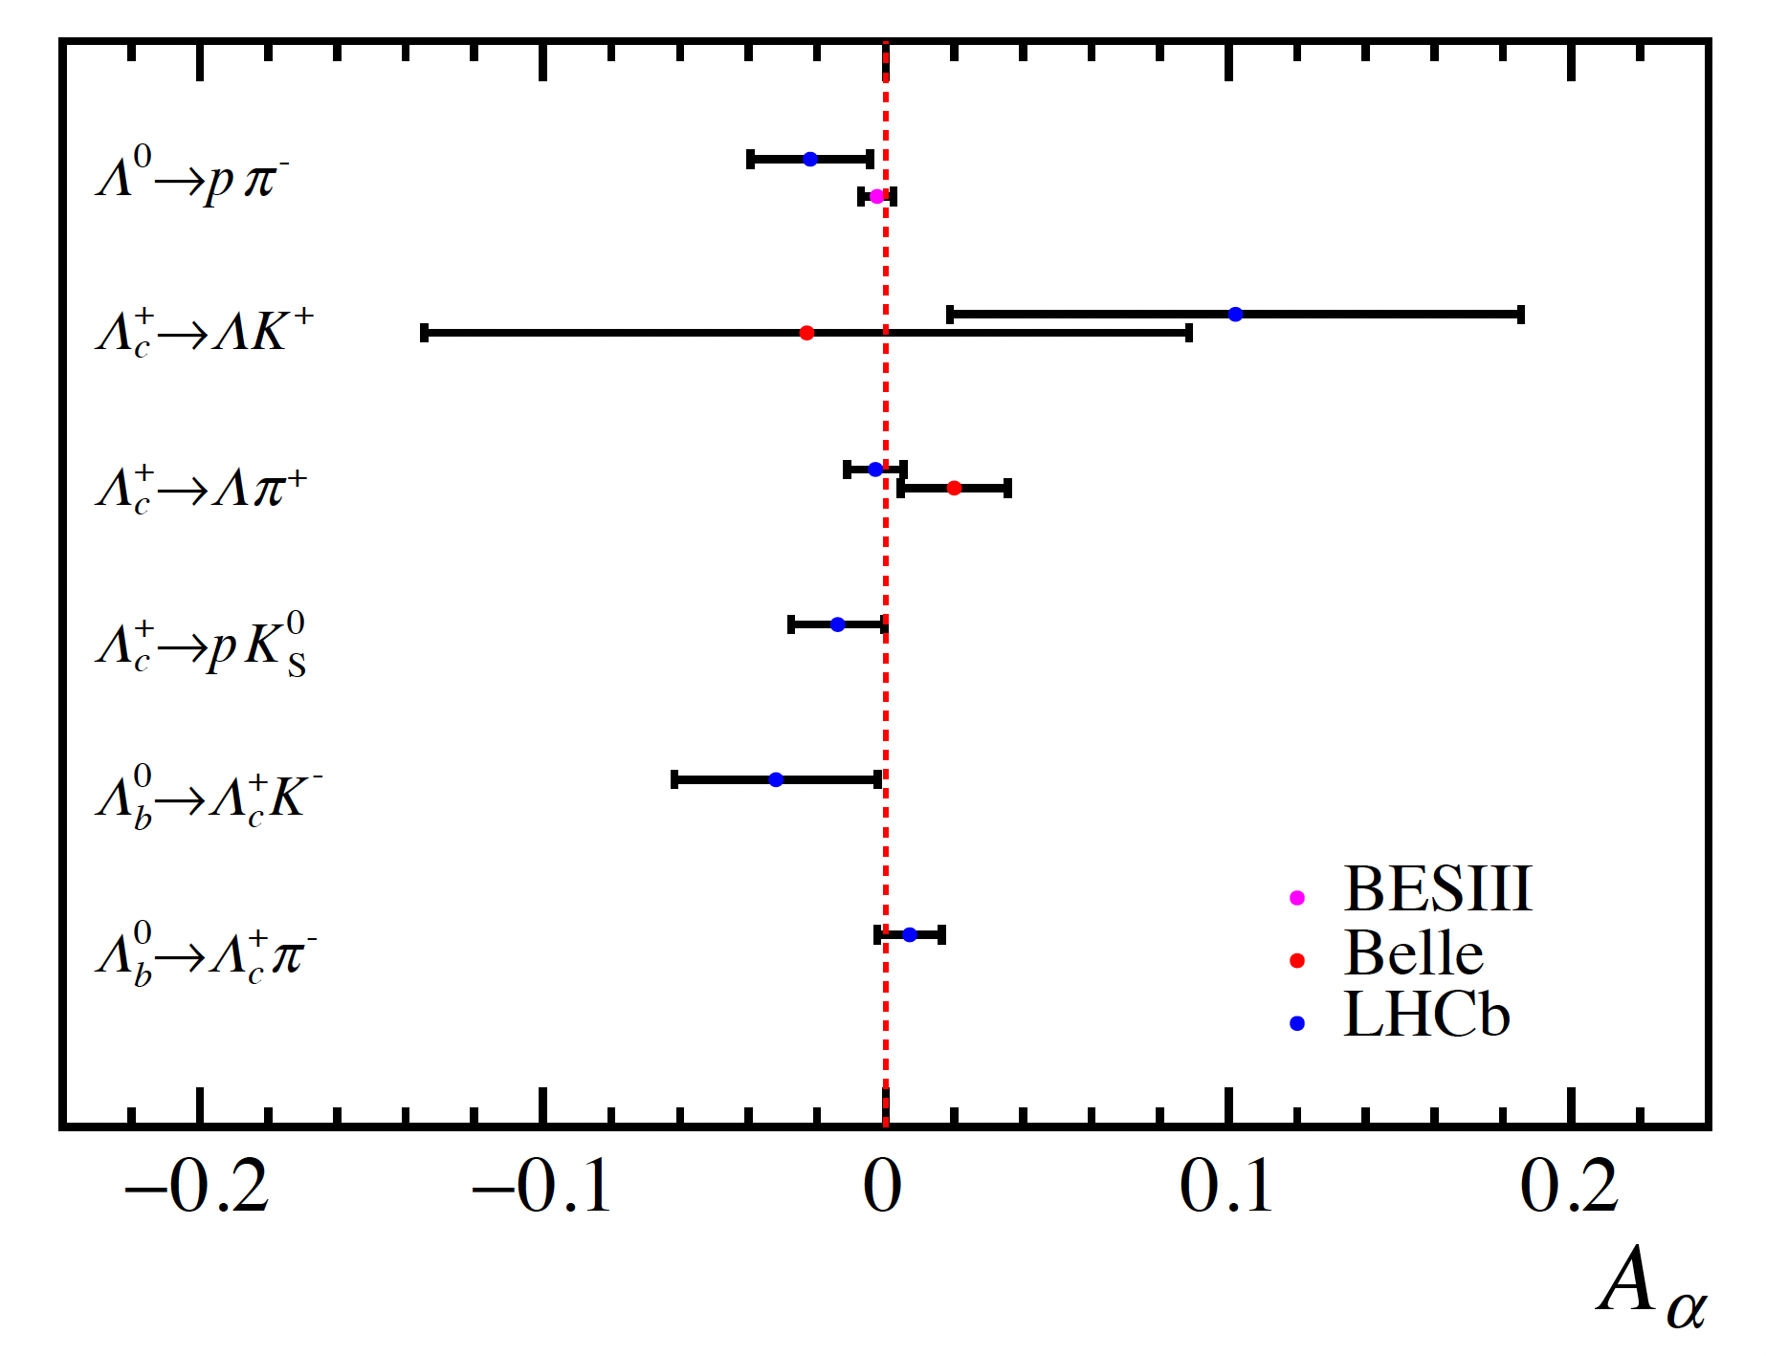
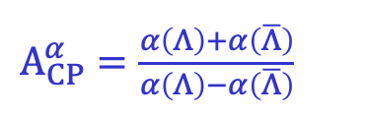
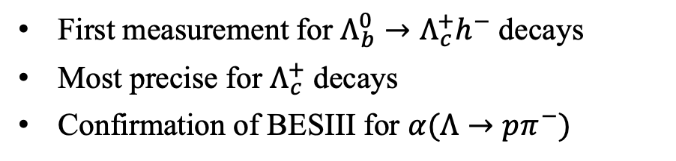
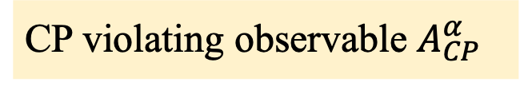
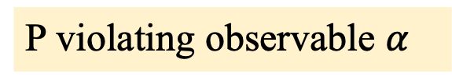
P and CP violation
PRL 133 (2024) 261804
P violating observable $α$
First measurement for $Λ_{b}^{0}→Λ_{c}^{+}h^{−}$ decays
Most precise for $Λ_{c}^{+}$ decays
Confirmation of BESIII for $α(Λ→pπ^{−})$
CP violating observable $A_{CP}^{α}$
$A_{CP}^{α}=\frac{α\left(Λ\right)+α\left(\overline{Λ}\right)}{α\left(Λ\right)−α\left(\overline{Λ}\right)}$
Consistent with CP symmetry
Consistent with Belle and BESIII

Slide 11
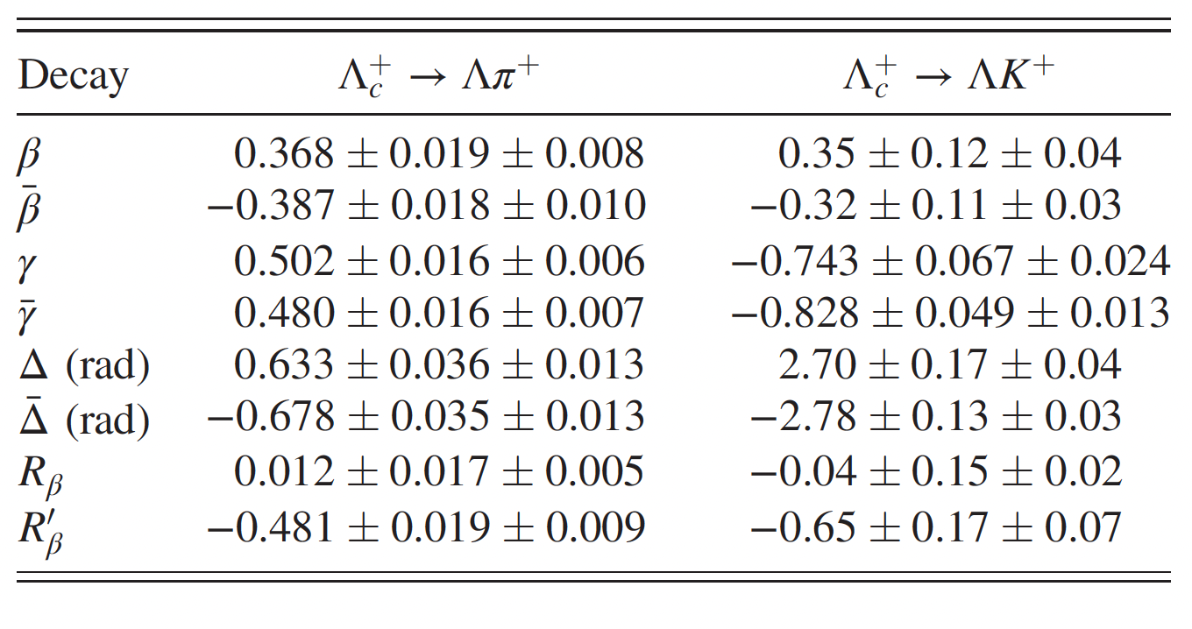
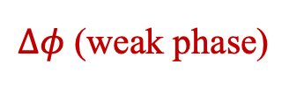

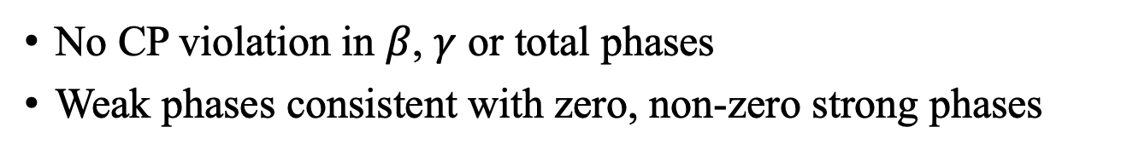

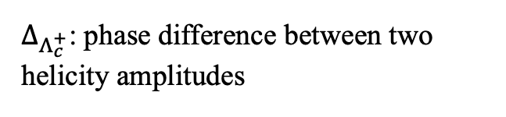
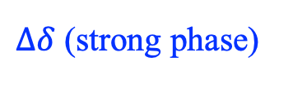


More parameters for $Λ_{c}^{+}→Λh^{+}$ decays
PRL 133 (2024) 261804
No CP violation in $β$, $γ$ or total phases
Weak phases consistent with zero, non-zero strong phases
$Δφ$ (weak phase)
$$0.01±0.02$$
$$−0.03±0.14$$
$Δδ$ (strong phase)
$$2.69±0.02$$
$$2.57±0.19$$
$Δ_{Λ_{c}^{+}}$: phase difference between two helicity amplitudes
Inputs for global fit: H.-Y. Cheng, F. Xu, H. Zhong, PRD111 (2025) 034011

Slide 12
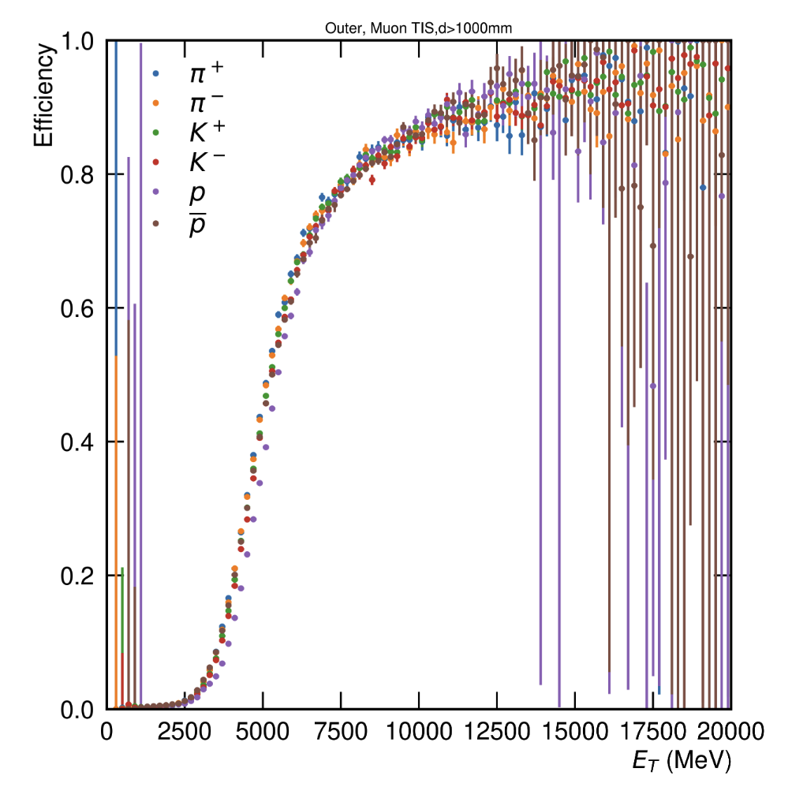
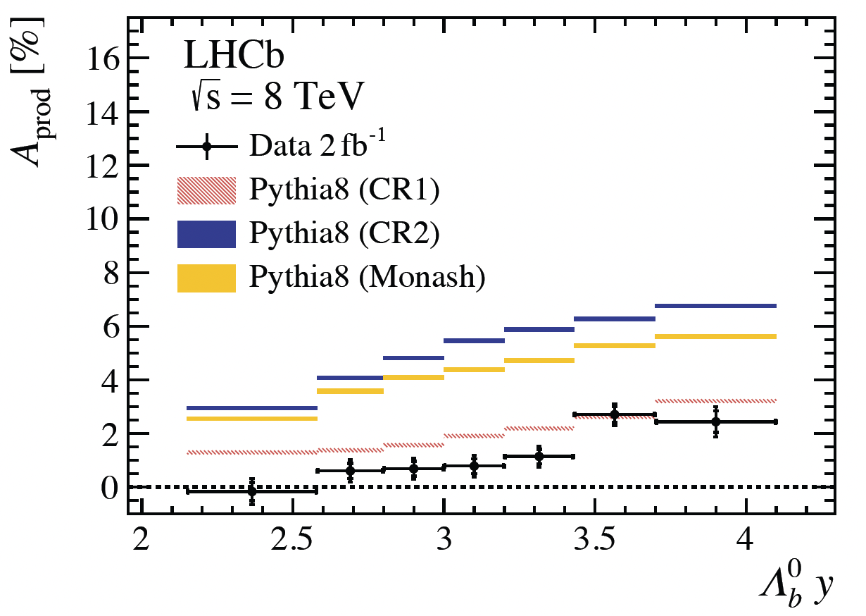
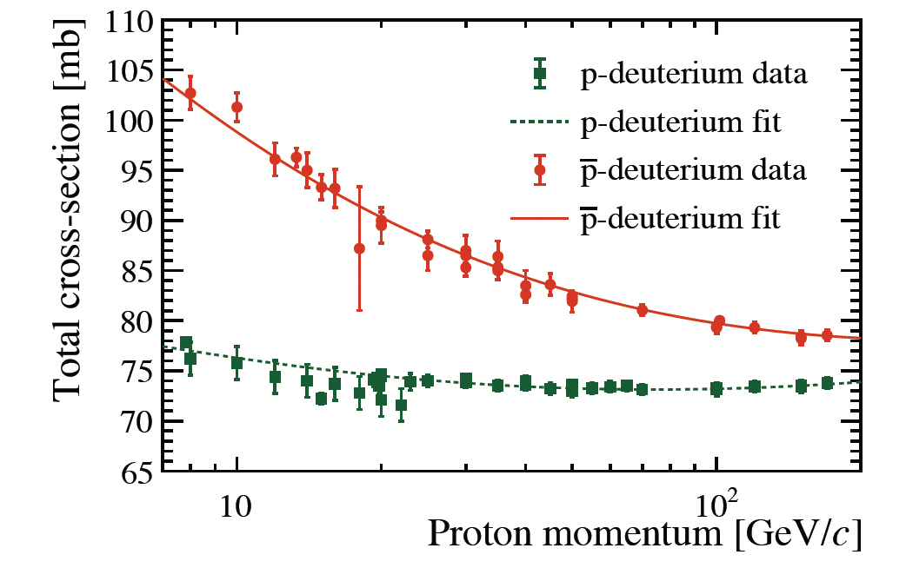
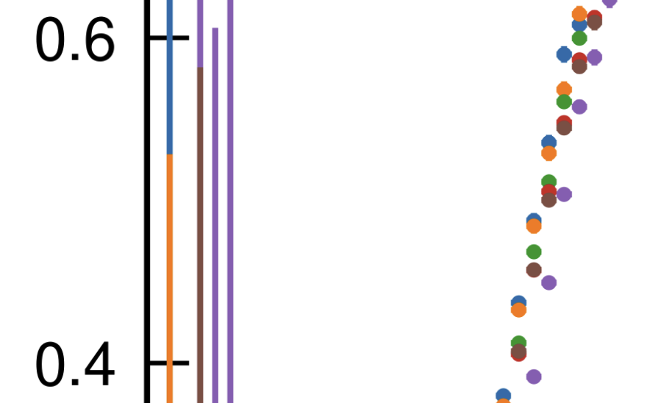
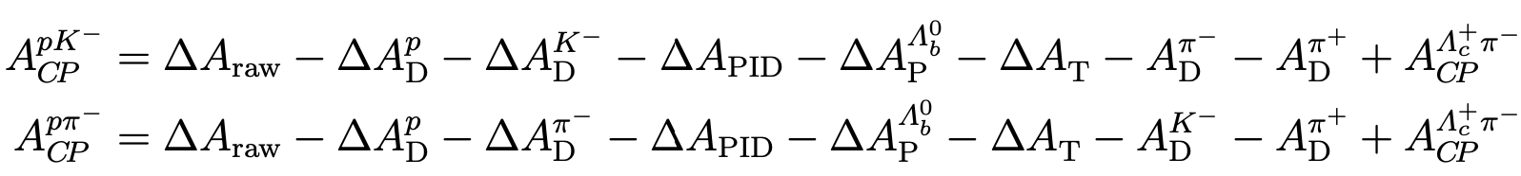
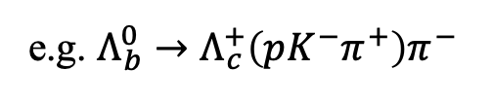
Crucial to control systematics
Subtraction of experiment induced asymmetries ($∼1\%$, similar to/larger than CPV itself)
$A_{yield}=A_{CP}+A_{prod}+A_{detection}+A_{PID}+A_{trigger}$
JHEP 10 (2021) 060
Data driven corrections, use control mode to reduce/remove systematics
e.g. $Λ_{b}^{0}→Λ_{c}^{+}\left(pK^{−}π^{+}\right)π^{−}$
Usually good cancellation, slightly limited by control sample size

Slide 13
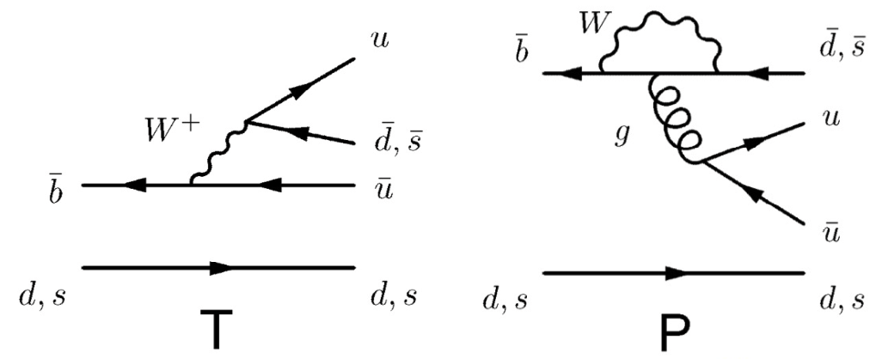
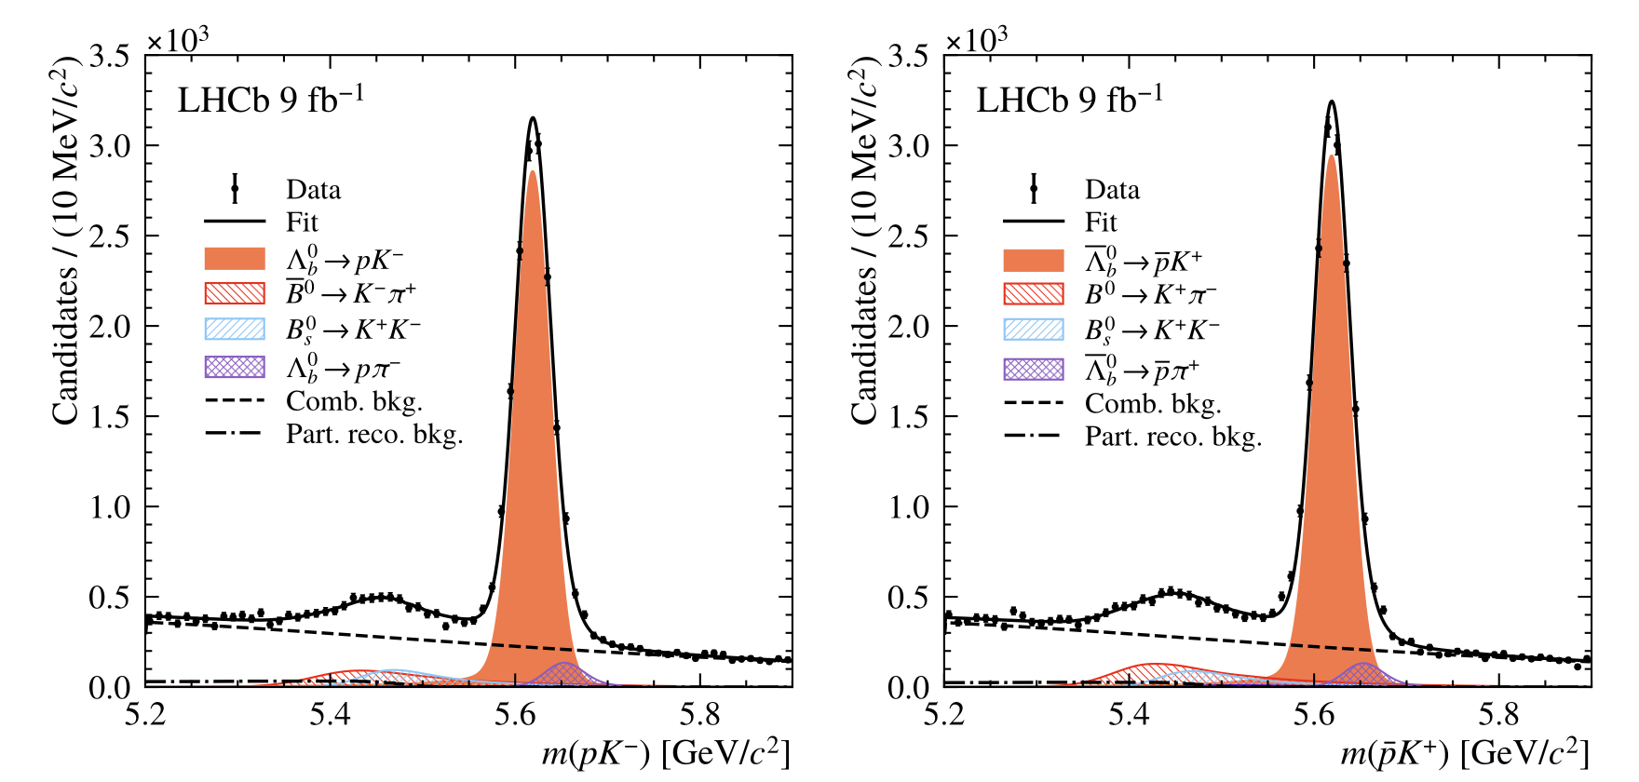
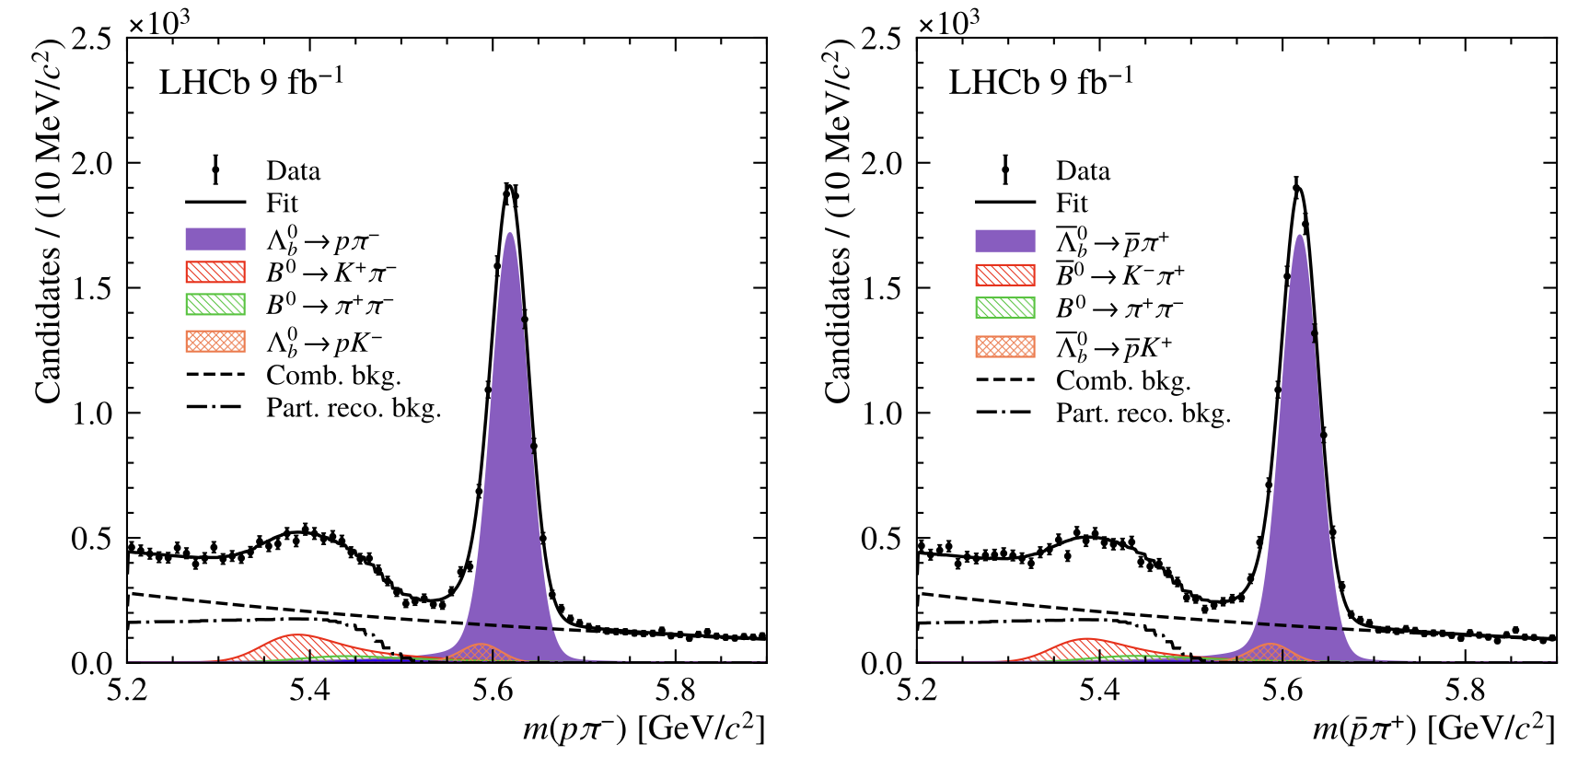





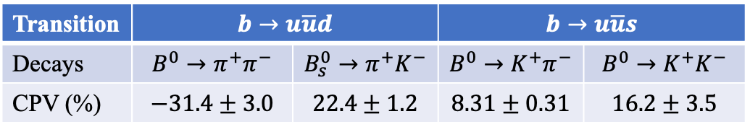



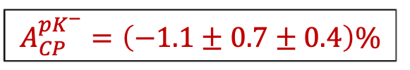

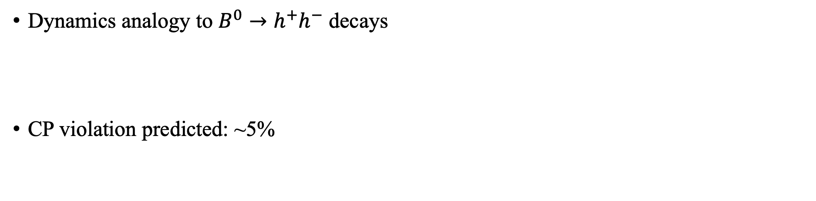
CP violation in $Λ_{b}^{0}→ph^{−}$ decays
arXiv:2412.13958
Dynamics analogy to $B^{0}→h^{+}h^{−}$ decays
CP violation predicted: ~5%
Transition | $$b→u\overline{u}d$$ |  | $$b→u\overline{u}s$$
Decays | $$B^{0}→π^{+}π^{−}$$ | $$B_{s}^{0}→π^{+}K^{−}$$ | $$B^{0}→K^{+}π^{−}$$ | $$B^{0}→K^{+}K^{−}$$
CPV (%) | $$−31.4±3.0$$ | $$22.4±1.2$$ | $$8.31±0.31$$ | $$16.2±3.5$$
( )
$$B^{0}/{\overline{Λ}}_{b}^{0}$$
$$K^{+}π^{−}/{\overline{p}}^{−}$$
PRD 102 (2012) 034033
PRD 95 (2017) 093001
$$\overline{u}\overline{d}$$
$$\overline{u}\overline{d}$$
Sizable CP violation ruled out
$$A_{CP}^{pK^{−}}=\left(−1.1±0.7±0.4\right)\%$$
$$A_{CP}^{pπ^{−}}=\left(+0.2±0.8±0.4\right)\%$$
$pK^{−}$
$\overline{p}K^{+}$
$pπ^{−}$
$\overline{p}π^{+}$

Slide 14







CP asymmetry in $Λ_{b}^{0}→Λh_{1}^{+}h_{2}^{−}$ decays
PRL 134 (2025) 101802
Three $Λ_{b}^{0}$ decays $Λπ^{+}π^{−}$、 $ΛK^{+}π^{−}$、 $ΛK^{+}K^{−}$, and $Ξ_{b}^{0}→ΛK^{−}π^{+}$decay
$Λ_{b}^{0}→Λ_{c}^{+}\left(→Λπ^{+}\right)π^{−}$ as control channel
3.1$σ$, evidence for CPV in baryons
$Λ_{b}^{0}→ΛK^{+}K^{−}$
$$Λ_{b}^{0}$$
$${\overline{Λ}}_{b}^{0}$$

Slide 15










Local CP asymmetry for $Λ_{b}^{0}→ΛK^{+}K^{−}$
PRL 134 (2025) 101802
In analogy to $B^{+}→K^{+}K^{+}K^{−}$ decay
Two resonance-dominated regions
$$B^{±}→K^{±}K^{+}K^{−}$$
raw asymmetry
$m_{K^{+}K^{−}}<1.1$ GeV
$Λ_{b}^{0}→Λφ(→K^{+}K^{−})$ or non-resonant:
$ΔA_{CP}\left(Λφ\right)=0.150±0.055±0.021$
$m_{ΛK^{+}}<2.9$ GeV
${Λ_{b}^{0}→N}^{∗+}\left(→ΛK^{+}\right)K^{−}$: possibly via $b→u\overline{u}s$
$ΔA_{CP}\left(N^{∗+}K^{−}\right)=0.165±0.048±0.017$
(local 3.2$σ$)
Many $N^{∗+}$ contributing to $Λ_{b}^{0}→N^{∗+}K^{−}$
Several related $N^{∗+}$channels to cross-check
${ N}^{∗+}→ΛK^{+} ⇒$ ${Λ_{b}^{0}→N}^{∗+}\left(ΛK^{+}\right)K^{−}$
$N^{∗+}→pπ^{+}π^{−} ⇒$ ${Λ_{b}^{0}→N}^{∗+}\left(pπ^{+}π^{−}\right)K^{−}$
$N^{∗+}→pπ^{0} ⇒$ ${Λ_{b}^{0}→N}^{∗+}\left(→pπ^{0}\right)K^{−}$
J.P. Wang, F.S. Yu, CPC 48 (2024) 101002

Slide 16






More local CP asymmetries
PRL 134 (2025) 101802
$m_{ΛK^{+}}<2.3$ GeV
$m_{π^{+}π^{−}}<1.7$ GeV
$Λ_{b}^{0}→N^{∗+}\left(→ΛK^{+}\right)π^{−}$
$ΔA_{CP}\left(N^{∗+}π^{−}\right)=−0.078±0.051±0.027$
$Λ_{b}^{0}→Λf(π^{+}π^{−})$
$ΔA_{CP}\left(Λf\right)=0.088±0.069±0.021$

Slide 17











Study of $Λ_{b}^{0}→pK^{−}π^{+}π^{−}$ decays with Run 1+2
arXiv:2503.14954
Contributed by tree and loop diagrams
Rich resonances
$Λ_{b}^{0}→N^{∗∗+}\left({pπ}^{+}π^{−}\right)K^{−}$,
$$pK^{∗∗}(K^{−}π^{+}π^{−})$$
$Λ_{b}^{0}→Λ^{∗∗}\left(pK^{−}\right)f(π^{+}π^{−})$,
$$N^{∗∗0}\left(pπ^{−}\right)K^{∗∗}(π^{+}K^{−})$$
Cancelling production and detection asymmetries
$$Λ_{b}^{0}→Λ_{c}^{+}π^{−}$$
$${\overline{Λ}}_{b}^{0}→{\overline{Λ}}_{c}^{−}π^{+}$$
Control channel: $Λ_{b}^{0}→Λ_{c}^{+}(pK^{−}π^{+})π^{−}$
same final state, no CP violation expected
$A_{CP}=ΔA_{yield}−ΔA_{prod}−ΔA_{exp }$
$$A_{yield}\left(Λ_{b}^{0}→Λ_{c}^{+}π^{−}\right)=\left(1.25±0.23\right)\%$$

Slide 18






Raw yield asymmetry of $Λ_{b}^{0}→pK^{−}π^{+}π^{−}$
arXiv:2503.14954
Maximum-likelihood fits to mass spectra to extract signal yield
$Λ_{b}^{0}$
${\overline{Λ}}_{b}^{0}$
$A_{yield }=\left(3.71±0.39\right)\%$
$$N_{yield}^{Λ_{b}^{0}} \text{=}$$
$$\left(4.184 ± 0.025\right)×{10}^{4}$$
$$N_{yield}^{{\overline{Λ}}_{b}^{0}} \text{=}$$
$$\left(3.885 ± 0.023\right)×{10}^{4}$$

Slide 19








Corrections for experimental bias
$A_{CP}=ΔA_{yield}−ΔA_{prod}−ΔA_{exp }$
Production asymmetry: cancelled by matching $Λ_{b}^{0}$ kinematics of control to signal mode
Detection asymmetry: candidate by candidate correction depending on final state kinematics
$ΔA_{prod}=0$
$ΔA_{exp}=0.01\%$

Slide 20



Systematic uncertainties
arXiv:2503.14954
From experimental bias
From signal extraction
$0.10\%$

Slide 21



First observation of CP violation
arXiv:2503.14954
$A_{CP}=(2.45±0.46±0.10)\%$
Rule out CP symmetry at $5.2σ$, and large CP violation

Slide 22






CP asymmetry in resonance regions 1
arXiv:2503.14954
$$>3σ$$
$Λ_{b}^{0}$
${\overline{Λ}}_{b}^{0}$

Slide 23




CP asymmetry in resonance regions 2
arXiv:2503.14954
$Λ_{b}^{0}$
${\overline{Λ}}_{b}^{0}$

Slide 24




CP asymmetry in resonance regions 3
arXiv:2503.14954
$Λ_{b}^{0}$
${\overline{Λ}}_{b}^{0}$

Slide 25





CP asymmetry in resonance regions 4
arXiv:2503.14954
$$6.0σ$$
$Λ_{b}^{0}$
${\overline{Λ}}_{b}^{0}$

Slide 26


What does it tell us
CP violation do exist in baryons, a milestone in study of CP violation
CP violation in baryons unexpectedly small, dynamics more complex than mesons
Is it SM or new physics? Likely SM, but more studies needed to quantify
J.P. Wang, F.S. Yu,
CPC 48 (2024) 101002
Can it explain BAU? CKM itself insufficient
${10}^{−18}\left(CKM\right)≪{10}^{−10}$ (observation)
New physics needed

Slide 27



CP violation in future
Many more data by LHCb: more measurements and more precise
Opportunities in future
Confirmation
CPV in new decays, charm baryon?
Differential measurements
Unexpected observations ?
…
CPV sources
Lepton
Higgs
EDM
…
谢谢！
Ultimate goal

Slide 28
Backup slides

Slide 29


CERN采访
Moriond会议现场
Source：CERN/LHCb

Slide 30







Global analysis of CKM mechanism (4 parameters)
When LHC started
Current status
$$A={0.826}_{−0.015}^{+0.018}$$
$$λ=0.22500±0.00067$$
$$\overline{ρ}=0.159±0.010$$
$$\overline{η}=0.348±0.010$$
$$α+β+γ={\left(173±6\right)}^{∘}$$

Slide 31





Identification of charged hadrons
Required to separate each hadronic decay mode, (semi)leptonic mode
Essential to distinguish $p$、 $K$、 $π$、$μ\text{、}e$
Core flavor physics at LHCb
$$H_{b}→h_{1}^{+}h_{2}^{−}$$
$$H_{b}→ph_{1}^{+}h_{2}^{−}h_{3}^{−}$$
Simulation
Without PID
Data
With PID
Notes:
One decay mode can be a source of background for the other decay

Slide 32





Predictions?
CP violation in $Λ_{b}^{0}→N^{∗+}\left(→pπ^{+}π^{−}\right)K^{−}$ similar to $Λ_{b}^{0}→N^{∗+}\left(→ΛK^{+}\right)K^{−}$
Generally difficult to calculate for multiple body decays
Complicated by many resonances
Predictions exploiting $Nπ$ scattering data compatible with LHCb
$$A_{CP}=\left(5.4±0.9\right)\%$$
$A_{CP}=\left(16.5±5.1\right)\%$
J.P. Wang, F.S. Yu,
CPC 48 (2024) 101002

Slide 33





Why CP violation so small
$A_{CP}∝\left|\frac{P}{T}\right|\sin\left(δ_{T}−δ_{P}\right)\sin\left(φ_{T}−φ_{P}\right)$
One diagram overwhelming? small strong phase difference?
T
P
Dynamics more complex than mesons
Possible cancellation of S and P amplitudes
韩佳杰、余纪新、李亚等，arXiv:2409.02821
Tree amplitude dominating
$$Λ_{b}^{0}→pπ^{−}$$
Favoring multiple body decays
S
P

Slide 34






Decay parameters and CPV in hyperons
Pioneering work to probe CPV in $J/ψ→Λ\overline{Λ}$
Nat. Phys. 15 (2019) 631
PRL129(2022) 131801
Entangled $Λ$ and $\overline{Λ}$
Many other $ψ$ to hyperon channels explored, no sign of CP violation
Decay | $$Λ\overline{Λ}$$ | $$Σ^{+}{\overline{Σ}}^{−}$$ | $$Ξ^{−}{\overline{Ξ}}^{+}$$ | $$Ξ^{0}{\overline{Ξ}}^{0}$$
$$A_{CP}$$ | $$−0.0025$$ $$±{0.0046}_{ }$$ $$±{0.0012}_{ }$$ | $$−0.004$$ $$±{0.037}_{ }$$ $$±{0.010}_{ }$$ | $$−0.006±{0.013}_{ }±{0.006}_{ }$$ | $$−0.0054$$ $$±{0.0065}_{ }±{0.0031}_{ }$$
 | PRL129 (2022) 131801 | PRL125 (2020) 052004 | Nature 606 (2022) 64 | PRD108 (2023) 3

Slide 35



Decay parameters and CPV in charm baryons
No sign of CP violation
S.S. Tang, L.-K. Li, X.-Y. Zhou and C.-P. Shen,
Symmetry 15 (2023) 91

Slide 36

CKM matrix up to $λ^{6}$

Slide 37


LHCb Upgrade II sensitivities
CERN Yellow Rep.Monogr. 7 (2019) 867
$δ<1\%$
Uncertainty
reduced by factor ~10
1% level precision
High precision charm physics

Slide 38






More information for decay paramerters

Slide 39


First observation of CP violation in baryons by LHCb
25/Mar/2025

