Slide 1
Grant no. 12135007
Craig Roberts … http://inp.nju.edu.cn/
Perspective on Hadron Gravitational Form Factors
Notes:
25+5

Slide 2
Quantum Chromodynamics
$$L= \frac{1}{4}G_{μν}^{a}\left(x\right)G_{μν}^{a}\left(x\right)+\overline{ψ}\left[γ⋅∂_{x}+m+ig \frac{λ^{a}}{2}γ⋅A^{a}\left(x\right)\right]ψ\left(x\right)$$
$$G_{μν}^{a}\left(x\right)=∂_{μ}A_{ν}^{a}(x)−∂_{ν}A_{μ}^{a}(x)−f^{abc}A_{μ}^{b}{(x)A}_{ν}^{c}(x)$$
One-line Lagrangian – expressed in terms of gluon and quark partons
Which are NOT the degrees-of-freedom measured in detectors
Questions
What are the (asymptotic) detectable degrees-of-freedom?
How are they built from the Lagrangian degrees-of-freedom?
Is QCD really the theory of strong interactions?
Is QCD really a theory … or just another EFT?
$⇒$ Implications far beyond Standard Model
Gluon and Quark Confinement

Slide 3
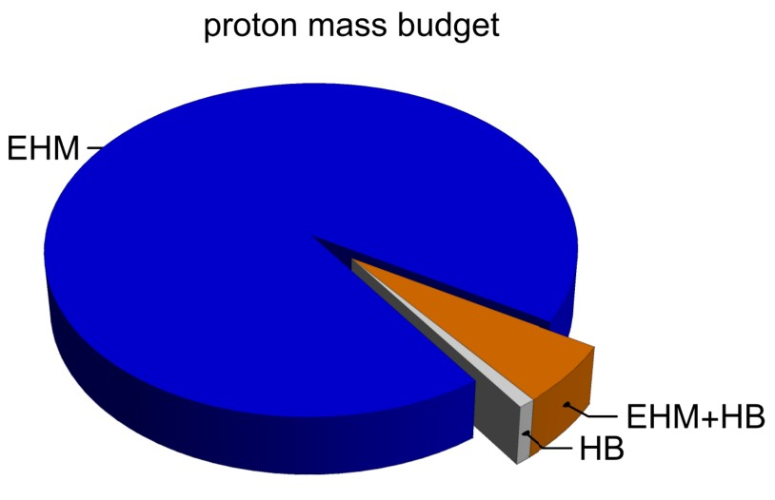
Emergence of Hadron Mass
Standard Model of Particle Physics has one obvious mass-generating mechanism
= Higgs Boson … impacts are critical to evolution of Universe as we know it
However, Higgs boson alone is responsible for just ∼ 1% of the visible mass in the Universe
Proton mass budget … only 9 MeV/939 MeV is directly from Higgs
Decomposition is
gauge invariant
Poincaré invariant
scale invariant
Evidently, Nature has another very effective mechanism for producing mass:
Emergent Hadron Mass (EHM)
Alone, it produces 94% of the proton’s mass
Remaining 5% is generated by constructive interference between EHM and Higgs-boson
What is the origin of EHM?

Slide 4
In the Beginning…

Slide 5
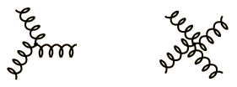
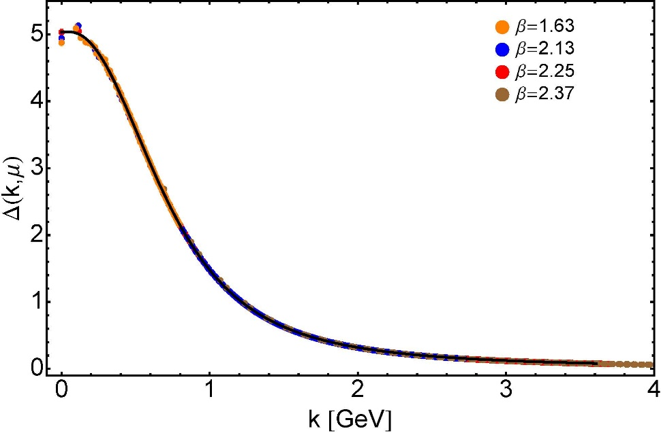
Ancient History
Cornwall’s estimate: $m_{g}=0.5\left(2\right)GeV≈\frac{1}{2}m_{p}$
$≈$ 45 years ago
Dynamical mass generation in continuum quantum chromodynamics,
J.M. Cornwall, Phys. Rev. D 26 (1981) 1453 … $>1100$ citations
Owing to strong self-interactions, gluon partons $⇒$ gluon quasiparticles,
described by a mass function that is large at infrared momenta
3-gluon vertex
4-gluon vertex
$$\frac{1}{m_{g}^{2}}$$
Truly mass from nothing
An interacting theory, written in terms of massless gluon fields, produces dressed gluon fields that are characterised by a mass function that is large at infrared momenta
Gluon propagator … continuum and lattice QCD agree
QCD fact
Continuum theory and lattice simulations agree
Empirical verification?

Slide 6
Ancient History
D. Binosi, Emergent Hadron Mass in Strong Dynamics, Few Body Syst. 63 (2022) 42.
M. N. Ferreira, J. Papavassiliou, Gauge Sector Dynamics in QCD, Particles 6 (1) (2023) 312–363.
Today’s best estimate: $m_{g}^{RGI}=0.43\left(1\right)GeV$
Gauge Invariance and Mass,
J. S. Schwinger
Phys. Rev. 125 (1962) 397-398
It is argued that the gauge invariance of a vector field does not necessarily imply zero mass for an associated particle if the current vector coupling is sufficiently strong.
EHM means
Gluons are massive via Schwinger Mechanism
More than 40 years ago
Dynamical mass generation in continuum quantum chromodynamics,
J.M. Cornwall, Phys. Rev. D 26 (1981) 1453 … $∼1050$ citations
Owing to strong self-interactions, gluon partons $⇒$ gluon quasiparticles,
described by a mass function that is large at infrared momenta
3-gluon vertex
4-gluon vertex
$$\frac{1}{m_{g}^{2}}$$
Truly mass from nothing
An interacting theory, written in terms of massless gluon fields, produces dressed gluon fields that are characterised by a mass function that is large at infrared momenta
Gluon propagator … continuum and lattice QCD agree
QCD fact
Continuum theory and lattice simulations agree
Empirical verification?

Slide 7
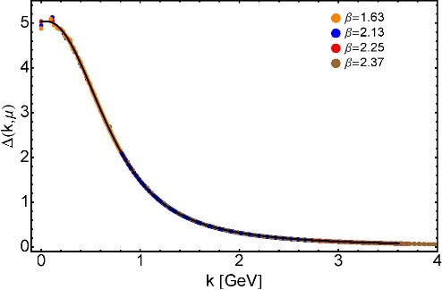
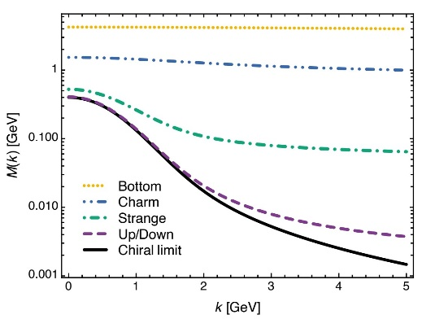
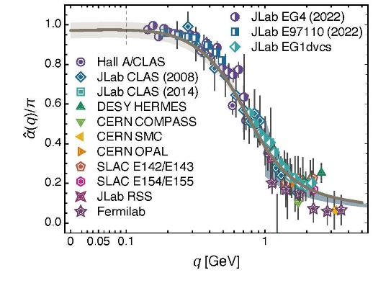
EHM Basics
Absent Higgs boson couplings,
QCD Lagrangian is scale invariant … yet …
Massless gluons become massive
A momentum-dependent, IR saturating charge is produced
Massless quarks become massive
Three pillars of EHM
$3×M\left(0\right)$ sets the scale of the proton mass.
Meson-loops provide $20$% quantum corrections

Slide 8
EHM Basics
Can’t build a Theory of Everything
before status of QCD is decided
Three pillars of EHM
EHM is expressed in
EVERY strong interaction observable
Challenge to Theory =
Elucidate all observable consequences of these phenomena
and highlight the paths to measuring them
Challenge to Experiment =
Test the theory predictions so that
the boundaries of the Standard Model can finally be drawn
$3×M\left(0\right)$ sets the scale of the proton mass.
Meson-loops provide $20$% quantum corrections

Slide 9
Charting EHM using High Intensity, High Luminosity Facilities

Slide 10
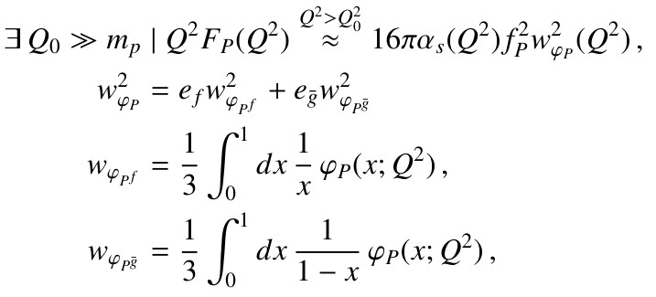
Pseudoscalar Meson Electromagnetic Form Factors Hard QCD Prediction
G. P. Lepage, S. J. Brodsky, Phys. Lett. B 87 (1979) 359–365.
A. V. Efremov, A. V. Radyushkin, Phys. Lett. B 94 (1980) 245–250.
G. P. Lepage, S. J. Brodsky, Exclusive Processes
in Perturbative Quantum Chromodynamics, Phys. Rev. D 22 (1980) 2157–2198.
Delivered $≈45$ years ago … positive-charge pseudoscalar meson $P$, constituted from valence $f, \overline{g}$ quarks:
$α_{s}(Q^{2})$ is QCD running coupling
$f_{P}$ is pseudoscalar meson's leptonic decay constant
$φ_{P}(x;Q^{2})$ is meson’s leading parton distribution amplitude (DA) – like a quantum field theory wave function – evaluated at the hard scale of the interaction

Slide 11
Hard QCD Prediction
Hard QCD prediction is remarkable.
beyond some momentum scale, the meson form factor is precisely known
magnitude (normalisation) is set by meson leptonic decay constant, which is an order parameter for dynamical chiral symmetry breaking (DCSB) – a corollary of EHM
and scaling violations are apparent, with $Q^{2}$ dependence determined by that of the running coupling and evolution of the DA
Analogous proton equation – magnitude (normalization) is not known
On domain ${m_{p}^{2}}/{Q^{2}}≃0⇒φ_{P=π,K}\left(x\right)=6 x(1−x)$ and right-hand side $⇒16πα_{s}\left(Q^{2}\right)f_{P}^{2}$
Two outstanding issues:
what is value of $Q_{0}$for which scaling violations become apparent?
and what is pointwise form of $φ_{P}(x;Q^{2})$at scales for which terrestrial experiments are possible?
These questions can only be answered using a nonperturbative approach to QCD.

Slide 12
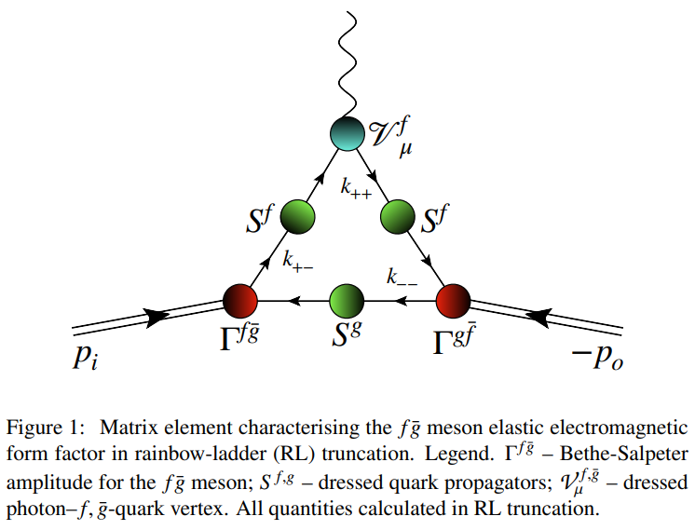
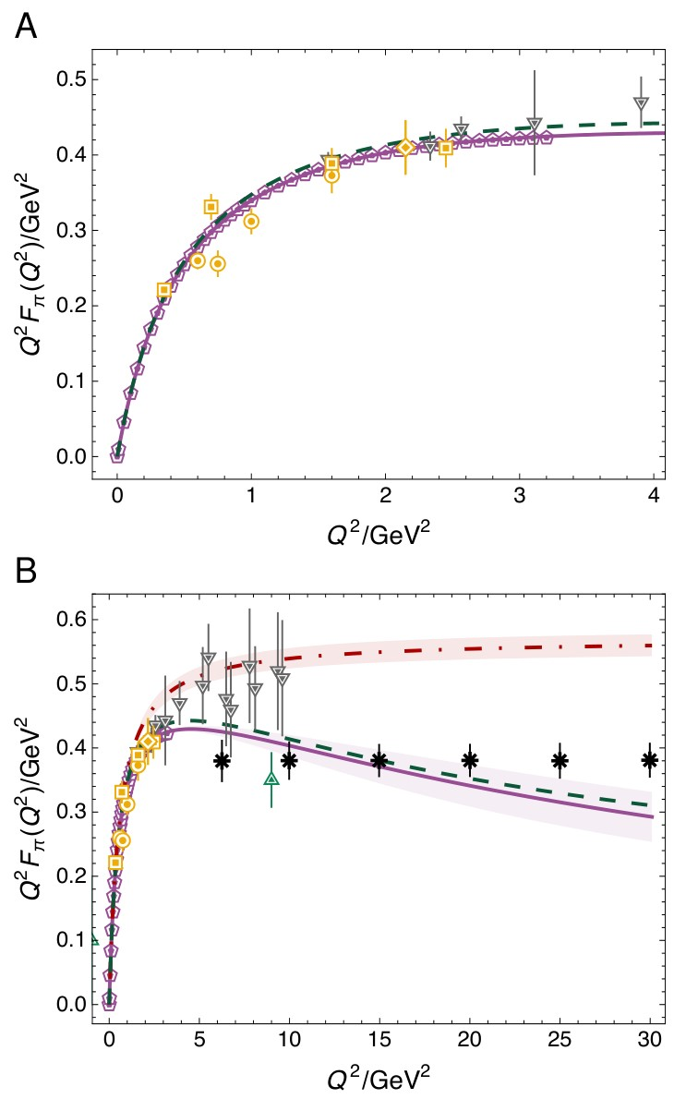
Pion Form Factor
dressed photon-
quark vertex
dressed (quasiparticle)
quark
QCD continuum Schwinger function method predictions for $Q^{2}F_{π}\left(Q^{2}\right)$ – purple curve
Charge radius agrees with experiment: $0.67$ fm
$Q^{2}$dependence matches that suggested by JLab precision measurements [Horn:2007ug, Huber:2008id] (gold symbols)
Meson Bethe-Salpeter
amplitude
meson in
meson out
$Q^{2}>4GeV^{2}$
cf. phenomenological – much loved, much used – vector meson dominance (VMD) result = dot-dashed red
this curve begins to deviate significantly from data and CSM prediction at upper bound of available JLab measurements
precision of lQCD (grey triangles) is insufficient to distinguish between VMD estimate and CSM prediction

Slide 13
Pion Form Factor
Salient feature of CSM predictions is existence of maximum in $Q^{2}F_{π}\left(Q^{2}\right)$, which occurs on $Q^{2}≃4.6\left(5\right)GeV^{2}$
Thereafter, scaling violation apparent,
$Q^{2}F_{π}\left(Q^{2}\right)$ falls steadily toward zero as $≈{\left(1/ln⁡Q^{2}\right)}^{γ_{F}}$, $γ_{F}≈1.1$
consistent with hard QCD prediction
Any model that expresses VMD must exhibit opposite trend, viz. result for $Q^{2}F_{π}\left(Q^{2}\right)$ which rises steadily with increasing $Q^{2}$, without inflection, toward finite ultraviolet limit.
Today: lattice-QCD (grey triangles) reach and precision are inadequate to see breakaway from VMD and scaling violation
green point farthest reach of anticipated JLab data
JLab is potentially capable of seeing breakaway from VMD
black asterisks – with anticipated reach and precision,
EIC will see scaling violation

Slide 14
Hadron Gravitational Form Factors
Forces inside hadrons: pressure, surface tension, mechanical radius, and all that,
M. V. Polyakov, P. Schweitzer, Int. J. Mod. Phys. A 33 (2018) 26
“The physics related to the form factors of the energy momentum tensor spans a wide spectrum of problems, and includes
gravitational physics,
hard exclusive reactions,
hadronic decays of heavy quarkonia,
and the physics of exotic hadrons described as hadroquarkonia.
It also provides access to the “last global unknown property:” the D (pressure) term.

Slide 15
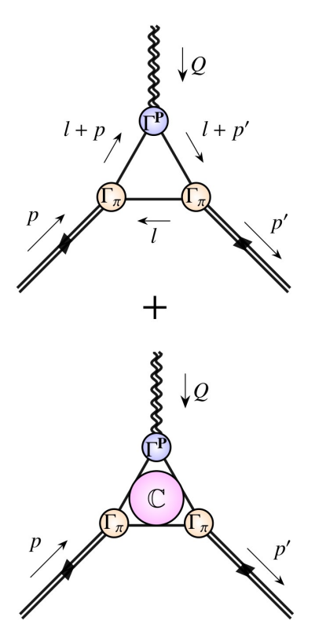
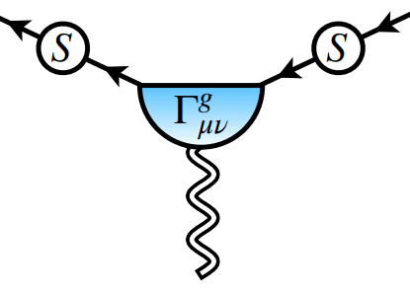
Pion and kaon gravitational form factors
Precisely same framework as used for electromagnetic form factors of these mesons
Prediction and Unification
Need graviton-quark vertex … made available by analysis in Pion and kaon electromagnetic and gravitational form factors, Yin-Zhen Xu (徐胤禛) et al., e-Print: 2311.14832 [hep-ph], Eur. Phys. J. C 84 (2024) 2, 191/1-13
In-meson expectation value of EM tensor – gravitational current: 2 objective (measurable) form factors …
Vanishes owing to energy-momentum conservation: $Q_{μ}Λ_{μν}^{g}\left(P,Q\right)≡0$
mass
pressure

Slide 16
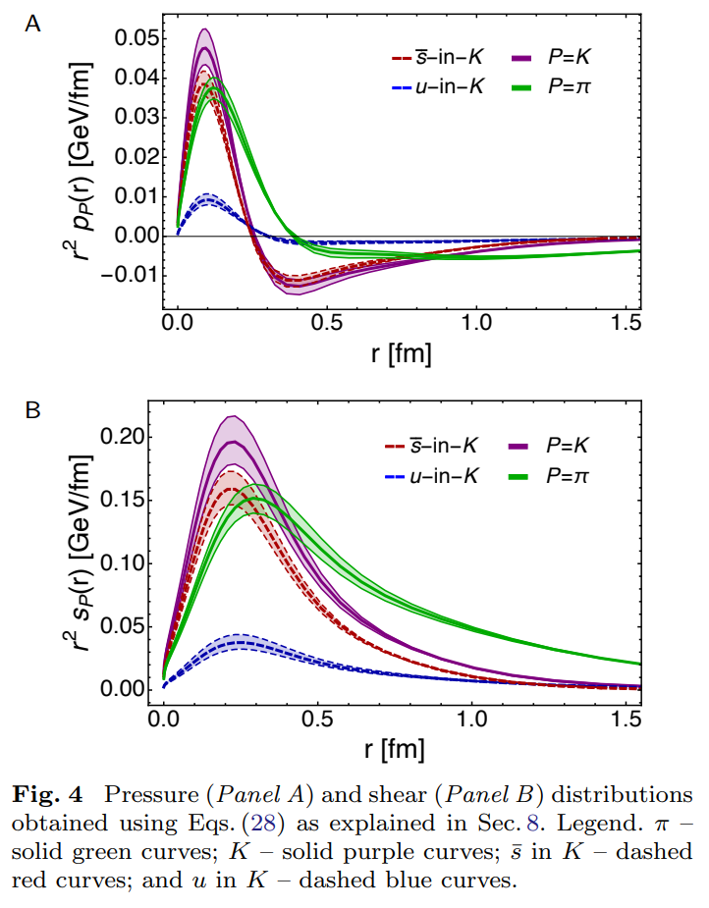
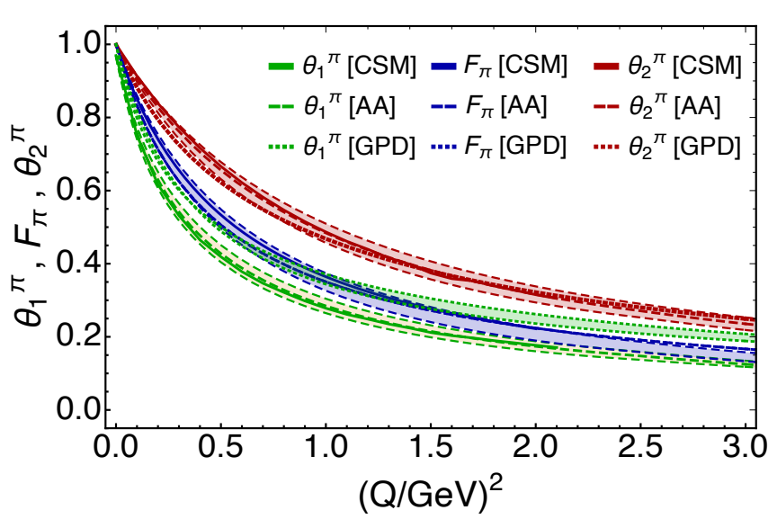
Meson Gravitational Form Factors
$θ_{1}\left(Q^{2}\right)$ is the pressure form factor
Provides access to pressure and shear-force distributions within the meson
Meson core pressures are more than an order of magnitude greater than those in neutron stars.
Calculations reveal that each meson’s mass radius is smaller than its charge radius, matching available empirical inferences
Empirical Determination of the Pion Mass Distribution,
Y-Z. Xu (徐胤禛) et al., e-Print: 2302.07361 [hep-ph], Chin. Phys. Lett. Express 40 (2023) 041201/1-7. Express Letter.
Bound states; so, pressure integrates to zero (von Laue, 1911)
Zero in pressure near maximum in shear force
Kaon more compact; so, pressure higher

Slide 17
Nucleon as a Bound State
Nucleon charge and magnetisation distributions: flavour separation and zeroes,
Zhao-Qian Yao (姚照千), e-Print: 2403.08088 [hep-ph], Fund. Res. (2025) in press.
Nucleon bound-state problem can be addressed
in any approach that provides access to the three-quark six-point Schwinger function
Using CSMs, one begins with the Poincaré-invariant Faddeev equation
Today, there are 3 people in the world who can solve this problem
Only one (姚照千) can handle systems with non-degenerate valence quark flavours
The analysis to be described used precisely the same approach (approximation and interaction) as that employed for pion and kaon electromagnetic form factors
Thus, one arrives at unifying set of parameter-free predictions for all pion and kaon and nucleon elastic electromagnetic and gravitational form factors and their species separations to large values of momentum transfer
All predictions link observables directly with fundamental QCD Schwinger functions and thereby expose novel expressions of emergent phenomena in QCD.

Slide 18
Nucleon Gravitational Form Factors
Current … complementing solution of Faddeev equation, then all elements are known
Current …
$A(Q^{2})$ mass distribution form factor
$$A\left(Q^{2}=0\right)=1$$
$J(Q^{2})$ spin distribution form factor
$$J\left(Q^{2}=0\right)=1/2$$
$D(Q^{2})$ pressure distribution form factor
$$D\left(Q^{2}=0\right)=?$$
Last unknown/unmeasured global property of nucleon

Slide 19
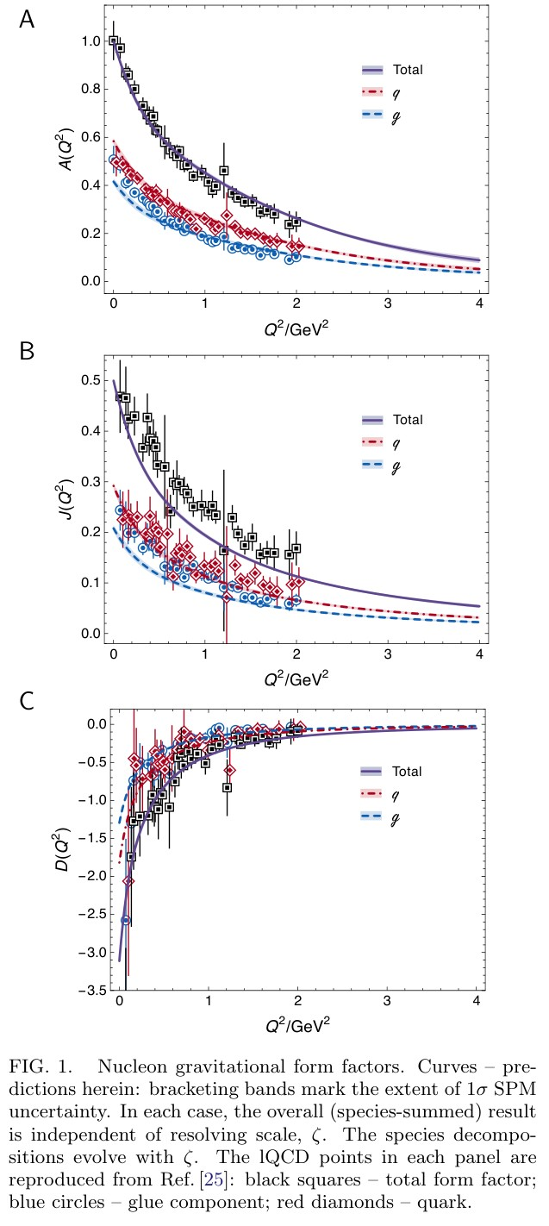
Predicted GFFs
Solid curves … CSM predicitions
Points lQCD results [Hackett:2023rif]
Agreement within (large) lattice uncertainties
Symmetry-preserving character of CSM analysis is evident in values of
$A\left(0\right)=1$
$J\left(0\right)=1/2$
With $J\left(0\right)=1/2$, confirm that the anomalous gravitomagnetic moment of a spin-$1/2$ system is zero [Kobzarev:1962wt, Teryaev:1999su, Brodsky:2000ii].
nucleon “D-term” … prediction $D\left(0\right)=−3.11(1)$

Slide 20
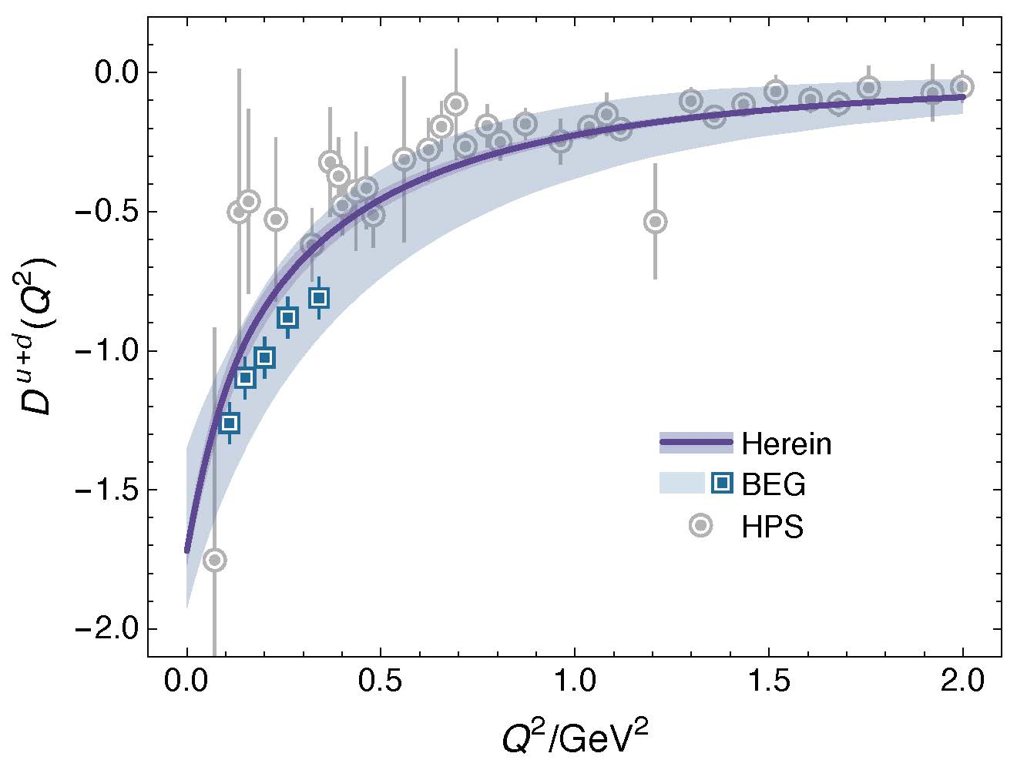
GFF Species Decomposition (scale dependent, $ζ_{2}=2GeV$)
Considering light quarks alone:
$$D^{u+d}\left(0;ζ_{2}\right)=−1.73(5)$$
Inference from available DVCS data
$$D_{DVCS}^{u+d}\left(0;ζ_{2}\right)=−1.63(29)$$
CSM prediction is also in pointwise agreement with curve inferred from that data … see figure
BEG: Inference from existing DVCS data
V. D. Burkert, L. Elouadrhiri, F.-X. Girod, The pressure
distribution inside the proton, Nature 557 (7705) (2018) pp. 396–399.

Slide 21
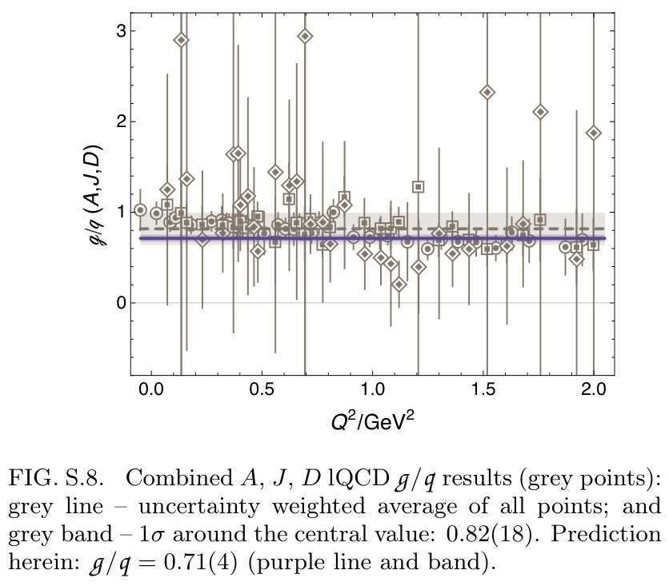
GFF Species Decomposition (scale dependent, $ζ_{2}=2GeV$)
CSM prediction – species decomposition,
for each form factor:
$$\frac{F^{glue}\left(Q^{2};ζ\right)}{F^{quark}\left(Q^{2};ζ\right)}=constant(ζ)$$
$constant\left(ζ_{2}\right)=0.71(4)$
namely, the ratio of glue:quark contributions is the same
$Q^{2}$-independent number for each form factor
Important to test this prediction
lQCD results … see figure
Consistent with prediction
${constant}_{lQCD}\left(ζ_{2}\right)=0.82(18)$

Slide 22
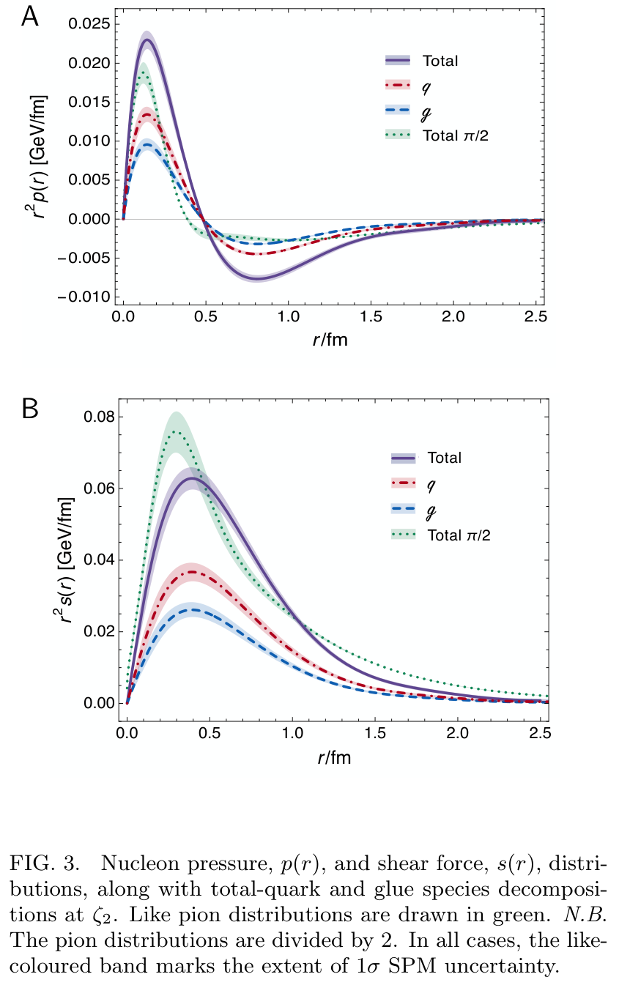
Proton Pressure Profiles
Pressure and shear-force density profiles: determined by $D\left(Q^{2}\right)$ for proton and $θ_{1}\left(Q^{2}\right)$ for pion
Pion (green) peak values are roughly twice those in the proton
Expected because
pressures $∼Ψ^{2}$
similar interior QCD dynamics + more compact object
$⇒\frac{p_{π}}{r_{π}^{2}}≈p_{p}/r_{p}^{2}$ & $r_{p}^{2}≈2{ r}_{π}^{2}$
Scale is order-of-magnitude greater than neutron star core
$r_{mass}=0.81\left(5\right)r_{ch}$ $>$ $r_{mech}=0.72\left(2\right)r_{ch}$
Species decomposition ($ζ_{2}$)
$r_{mass}^{q}=0.62\left(4\right)r_{ch}$ $>$ $r_{mass}^{g}=0.52\left(3\right)r_{ch}$
$r_{mech}^{q}=0.55\left(4\right)r_{ch}$ $>$ $r_{mech}^{g}=0.47\left(3\right)r_{ch}$
No existing experiment provides objective information on glue contributions to proton GFFs
J/ψ photoproduction: threshold to very high energy, Lin Tang (唐淋) et al.,
e-Print: 2405.17675 [hep-ph], Phys. Lett. B 856 (2024) 138904/1-7

Slide 23
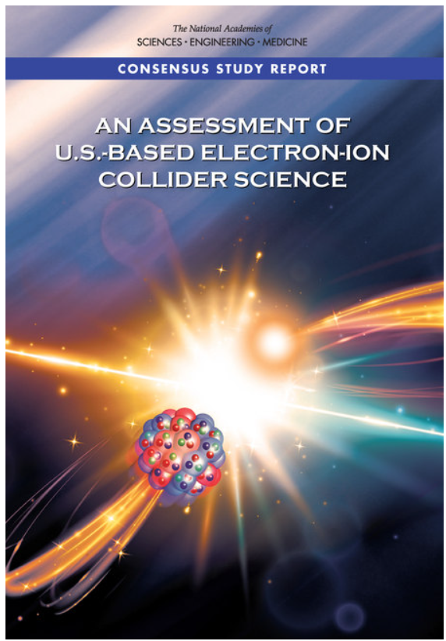
Electron Ion Collider
Now available:unified set of empirically benchmarked, parameter-free predictions for …
pion, kaon, proton, neutron elastic electromagnetic and gravitational form factors
and their species decompositions
with direct connections to three pillars of emergent hadron mass
Also … ab initio predictions for pion and kaon structure functions
Next step … nucleon structure function predictions with equal QCD fidelity

Slide 24
Synergy of Experiment, Phenomenology, Theory
Gather all pieces of the puzzle … Reveal the source of Nature’s basic mass-scale
Continuum strong interaction theory is maturing
Expanding array of parameter-free predictions for the nucleon – yes
And all the other hadrons whose properties express the full meaning of QCD
Structure of Nature’s most fundamental Nambu-Goldstone bosons
Structure of baryons, e.g.,
$Q^{2}$-dependence of nucleon resonance transition form factors
Spectrum is insufficient – many models give same spectrum, but transition form factors discriminate between pictures.
Understanding how QCD’s simplicity explains the emergence of hadron mass and structure requires investment in facilities that can deliver precision data on much more than one of Nature’s hadrons.
AMBER@CERN, EIC, EicC, STCF, CEPC, JLab22, LHeC, QCD@FAIR could …
Deliver precise structure data on a wide range of hadrons with distinctly different quantum numbers
Thereby move Science into a new realm of understanding.

Slide 25
Emergent Hadron Mass
Grant no. 12135007
QCD is unique amongst known fundamental theories of natural phenomena
The degrees-of-freedom used to express the scale-free Lagrangian are not directly observable
Massless gauge bosons become massive, with no “human” interference
Gluon mass ensures a stable, infrared completion of the theory through the appearance of a running coupling that saturates at infrared momenta, being everywhere finite
Massless fermions become massive, producing
Massive baryons and simultaneously Massless mesons
These emergent features of QCD are expressed in every strong interaction observable
They can also be revealed via
EHM interference with Nature’s other known source of mass = Higgs
We are capable of building facilities that can validate these concepts, proving QCD to be
the 1st well-defined four-dimensional quantum field theory ever contemplated
This may open doors that lead far beyond the Standard Model

Slide 26
Can’t build a Theory of Everything
before status of QCD is decided
$${\text{L}}_{Nature}= ?$$
There are theories of many things,
But is there a theory of everything?
Thankyou

Slide 28
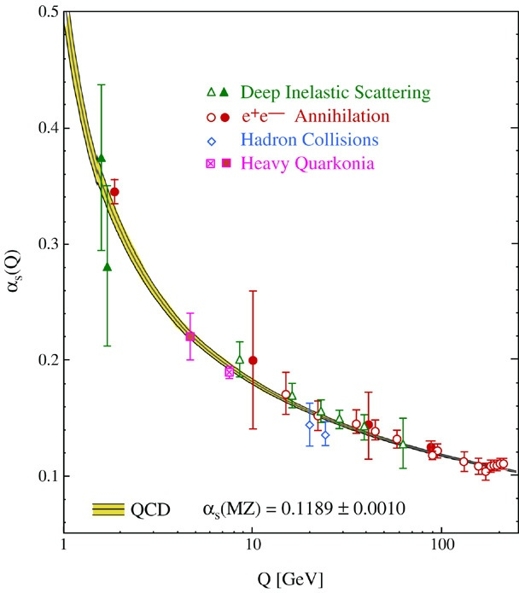
QCD’s Running Coupling
This is where we live
Asymptotic Freedom
Interaction becomes weaker
as energy grows
(as charges get closer together)
⇐
What’s happening
out here?!

Slide 29
Process independent effective charge = running coupling
W orkshop on Dyson-Schwinger Equations in Modern Mathematics
and Physics (DSEMP2014) Trento, Italy, September 22-26, 2014
Effective charge from lattice QCD, Zhu-Fang Cui, Jin-Li Zhang et al.,
NJU-INP 014/19, arXiv:1912.08232 [hep-ph], Chin. Phys. C 44 (2020) 083102/1-10
$2624$ total downloads
Modern theory – exploiting pinch technique and background field method – enables unique QCD analogue of
“Gell-Mann – Low”
running charge to be
rigorously defined and calculated
Analysis of QCD’s gauge sector
yields a parameter-free prediction
N.B. Qualitative change in α̂_{PI}(k) at k ≈ ½ m_{p}
No Landau Pole
Below $k∼{{\hat{m}}_{0}}_{ },$interactions become scale independent, just as they were in the Lagrangian; so, QCD becomes practically conformal again
Process independent strong running coupling
Daniele Binosi et al., arXiv:1612.04835 [nucl-th], Phys. Rev. D 96 (2017) 054026/1-7
Experimental determination of the QCD effective charge α_{g1}(Q).
A. Deur; V. Burkert; J.-P. Chen; W. Korsch, Particles 5 (2022) 171
QCD Running Couplings and Effective Charges, Alexandre Deur, Stanley J. Brodsky and Craig Roberts, e-Print: 2303.00723 [hep-ph], Prog. Part. Nucl. Phys. 134 (2024) 104081

Slide 30
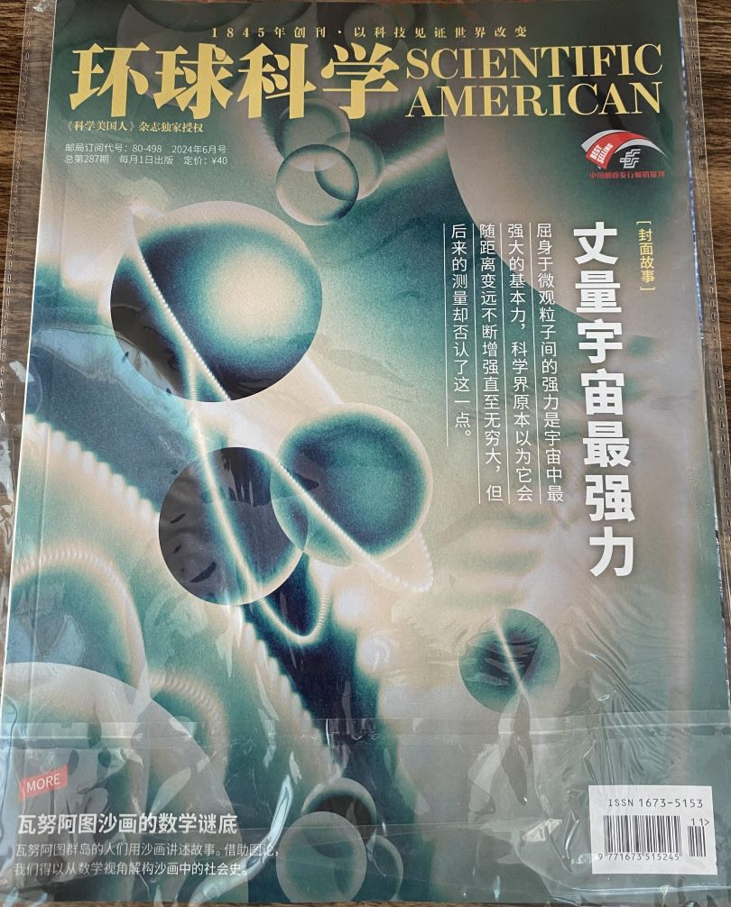
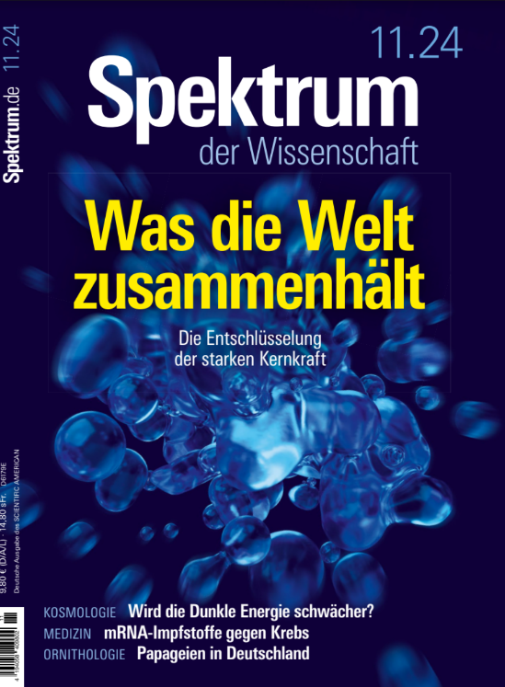
Process-independent Effective Charge
https://1drv.ms/b/s%21Apbnb6VLY1RplPRdL0J4Wm-tlzQd-Q?e=hdZxHH
May 2024
Most-read article in the May issue of SciAm
Translated into Chinese, French, German, Italian
Cover story on Chinese and German editions
SciAm is one of the Top-5 popular science magazines in the world.
International circulation that exceeds 10,000,000 readers per month in subscriptions and millions more via social media etc.

Slide 31
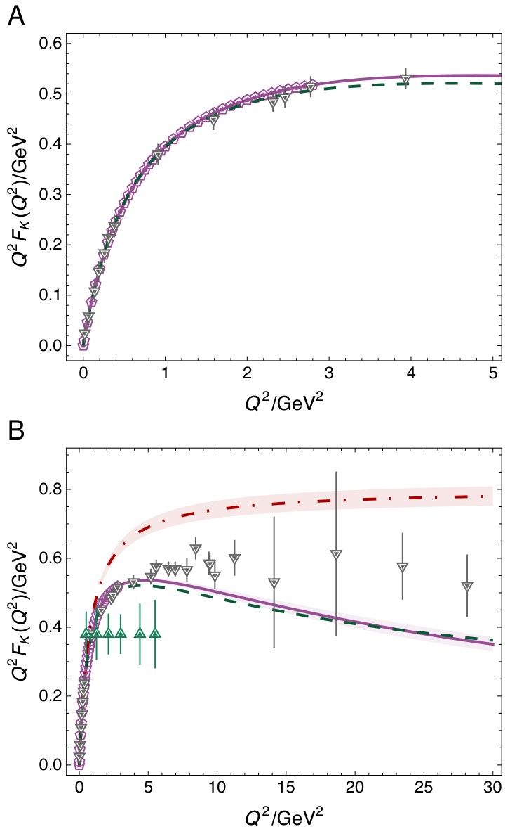
Charged kaon form factor
CSM predictions for $Q^{2}F_{K}\left(Q^{2}\right)$ – purple curve
Precise $F_{K}\left(Q^{2}\right)$data are lacking, so no comparison with experiment is made
Predicted charge radius is commensurate with available empirical estimates: $r_{K}=0.6$fm
$Q^{2}F_{K}\left(Q^{2}\right)$exhibits maximum on $Q^{2}≃4.8\left(5\right)GeV^{2}$
$Q^{2}F_{K}\left(Q^{2}\right)$ falls steadily toward zero as
$≈{\left(1/ln⁡Q^{2}\right)}^{γ_{F}}$, $γ_{F}≈1.1$
consistent with hard QCD prediction

Slide 32
Charged kaon form factor
VMD result = dot-dashed red
Comparing $F_{π,K}$, notable that, with increasing mass of the meson involved, position at which VMD curve separates from CSM prediction moves to smaller $Q^{2}$
Considering anticipated $Q^{2}$ reach (green points), JLab experiments [E12-09-011] may be expected to confirm this breakaway
On the other hand, discovery of scaling violation in charged kaon form factor may require a machine with EIC capabilities
Existing lattice-QCD results (grey triangles) are insensitive to scaling violation in $F_{K}\left(Q^{2}\right)$: on $Q^{2}>5 GeV^{2}$, lQCD results are consistent with $Q^{2}F_{K}\left(Q^{2}\right)=$constant.

Slide 33
Summary $F_{π}\left(Q^{2}\right)$ & $F_{K}\left(Q^{2}\right)$
Onset of scaling violation in pion and kaon elastic electromagnetic form factors
Zhao-Qian Yao (姚照千), Daniele Binosi and Craig D. Roberts, NJU-INP 087/24
e-Print: 2405.04681 [hep-ph], Phys. Lett. B 855 (2024) 138823/1-7
Predictions also for flavour separation and neutral kaon form factors
Possibly accessible at EIC and EicC
CSM analysis
$Q^{2}F_{P}\left(Q^{2}\right)$ has maximum at $Q^{2 }≈5GeV^{2}$
So …
proposed experiments are capable of locating the peak
can, potentially, provide quantitative information on value of $γ_{F}$
Crucial steps toward ultimate verification of hard QCD prediction
(perhaps seen in $γ^{∗}π→γ$, but this is controversial – Phys. Rev. D93 (2016) 074017/1-9)
Connecting hard scattering of leptons from mesons to expressions of emergent hadron mass, via QCD effective charge and meson leptonic decay constant

Slide 34
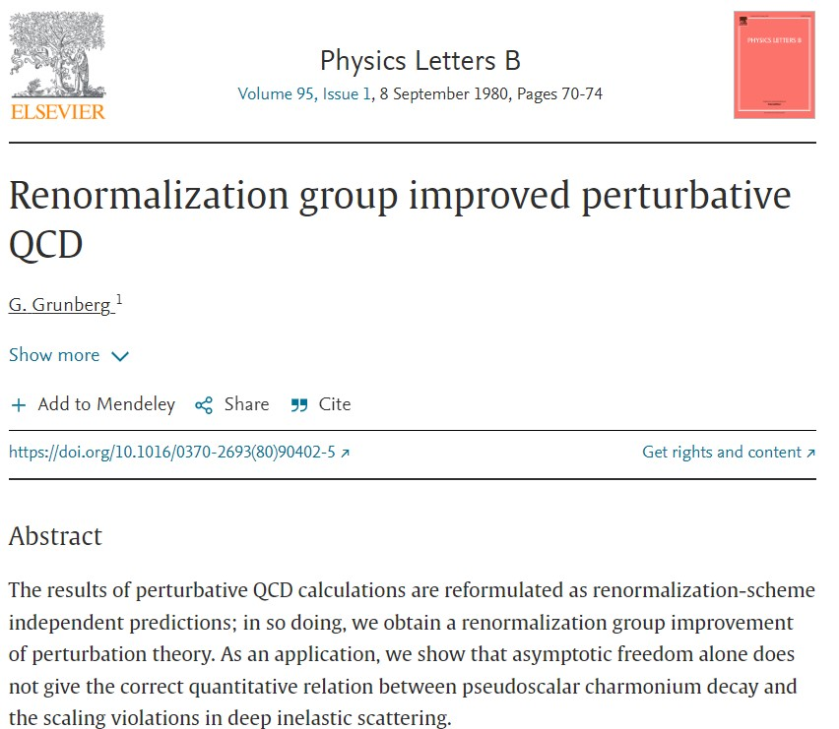
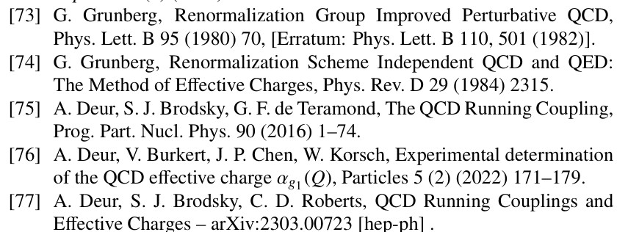
All-orders evolution
All-Orders Evolution of Parton Distributions: Principle, Practice, and Predictions
Pei-Lin Yin (尹佩林), NJU-INP 075/23, e-Print: 2306.03274 [hep-ph]
P1 – In the context of Refs. [73, 74], there exists at least one effective charge, $α_{1ℓ}(k^{2})$, which, when used to integrate the leading-order perturbative DGLAP equations, defines an evolution scheme for parton DFs that is all-orders exact.
CSM Process-Independent charge serves this purpose
Hadron scale, $ζ_{H}$
Scale at which all properties of a given hadron are carried by valence degrees-of-freedom

Slide 35
AO Evolution
Principle
Hadron scale, $ζ_{H}$, is rigorously defined in connection with a Grunberg charge, in terms of which leading-order DGLAP evolution is promoted to the status of an all-orders exact procedure.
The AO scheme is not a model, and neither is $ζ_{H}$.
Instead, the AO approach, involving and defining $ζ_{H}$, is complete by definition.
As explained by Grunberg, there is always an effective (process-dependent) effective charge for which the AO propositions are true.
Consequently, there is no room for doubt about the existence of $ζ_{H}$.
Crucially, such a Grunberg effective charge is
consistent with the renormalization group;
renormalization scheme independent;
everywhere analytic and finite;
and supplies an infrared completion of any standard running coupling.

Slide 36
AO Evolution
Crucially, such a Grunberg effective charge is
consistent with the renormalization group;
renormalization scheme independent;
everywhere analytic and finite;
and supplies an infrared completion of any standard running coupling.
These features entail that all calculations of a DF at a scale within a domain of pQCD applicability are compatible with this effective charge.
Moreover, and especially important, is the fact that one does not need to know the pointwise form of the effective charge
Its existence alone is sufficient to deliver
the definition of $ζ_{H}$ and all attendant consequences
N.B. glue and sea DFs are identically zero at $ζ_{H}$

Slide 37
AO Evolution
The potential issue with a Grunberg effective charge is
that reference to a specific process may make it globally useless
We know that is not the case
The class of process-dependent (Grunberg) charges,
defined in connection with the AO scheme,
may be characterized by our unique, predicted process-independent effective charge
Thus far, the AO class of charges – in particular, our PI charge – has served in the same form for all known parton DFs
Namely, for a large array of structure functions and fragmentation processes.
This is a very broad domain of applicability for one single Grunberg charge.

Slide 38
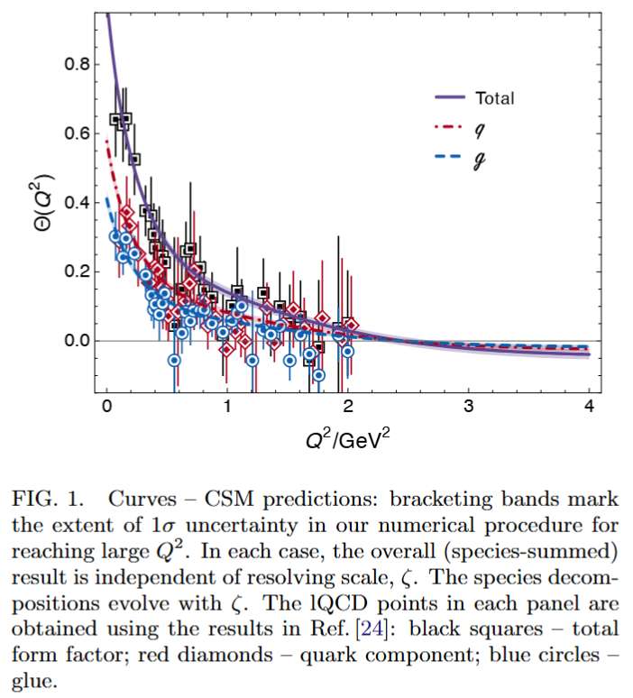
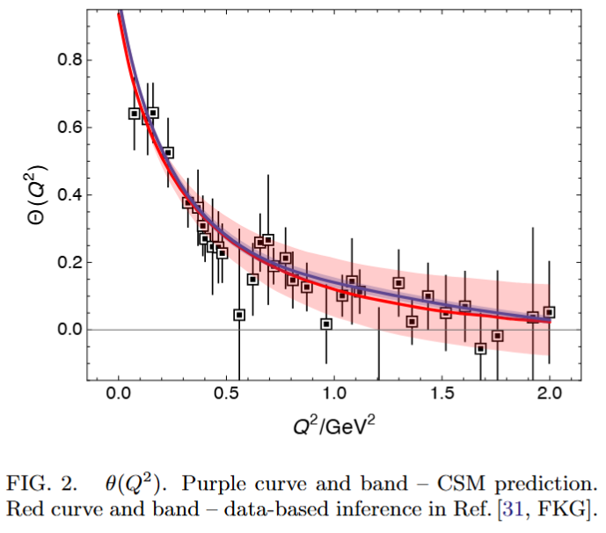
Gravitational Form Factors Mass, Spin, Pressure Distributions
Prediction built from
Zhao-Qian’s results
Lattice results in left panel from [Hackett:2023rif]
Authors acknowledge these are first results.
Statistical errors are very large.
Results on only one lattice spacing & one lattice volume are available.
Only one unphysical pion mass is used.
Renormalisation scheme is not gauge invariant and renormalisataion constants were calculated on a different lattice from the one used to compute the GFFs.
No other computed observable is available on the lattice setup the authors used.
Follows, inter alia, that the systematic errors on [Hackett:2023rif] are completely unknown and therefore uncontrolled.
Hence, no one can know whether it is better to agree or disagree with the lQCD results – Nevertheless, authors claimed “benchmark for future”
CSM prediction (parameter-free) in precise agreement with inference from $ππ, K\overline{K}$ scattering data [Cao:2024zlf]

Slide 39
Gravitational Form Factors Mass, Spin, Pressure Distributions
Prediction built from
Zhao-Qian’s results
CSM prediction (parameter-free) in precise agreement with inference from $ππ, K\overline{K}$ scattering data [Cao:2024zlf]
CSM results
Systematic errors considered and controlled
Statistical errors associated with numerical algorithms small
Parameter-free unification of nucleon gravitational form factors with data-consistent predictions for pion, kaon, and nucleon electromagnetic form factors [Yao:2024drm, Yao:2024uej]
CSM predictions are fully benchmarked

Slide 40
Gravitational Form Factors Mass, Spin, Pressure Distributions
Prediction built from
Zhao-Qian’s results
CSM prediction (parameter-free) in precise agreement with inference from $ππ, K\overline{K}$ scattering data [Cao:2024zlf]
My position
Breadths of application & success of the parameter-free framework employed suggest that predictions delivered should serve as benchmarks for future phenomenology and theory.
No improvement on CSM study can be anticipated before lattice-QCD analyses have simultaneously delivered infinite-volume, continuum-limit, carefully renormalised, physical pion mass studies of all physical properties discussed, viz. pion, kaon, nucleon electromagnetic and gravitational FFs.
CSM predictions are truly setting the standard against which future calculations/inferences should be judged

Slide 41
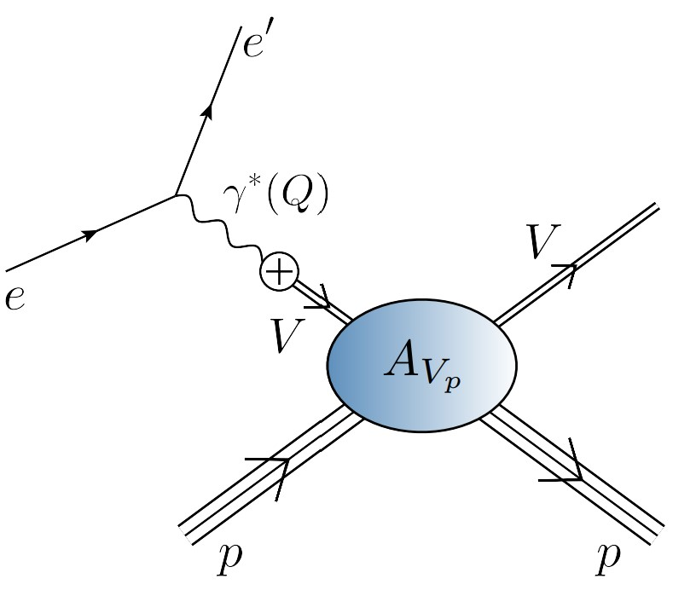
Photoproduction of heavy vector mesons

Slide 42
EHM Measurements How does the mass of the nucleon arise?
Once considered viable …
Electromagnetic process ($V=J/ψ, Υ$) … $e+p→e^{′}+V+p$
to access purely hadronic process … $V+p→V+p$
But …
Deciphering the mechanism of near-threshold J/ψ photoproduction, M.-L. Du, V. Baru, F.-K. Guo et al., Eur. Phys. J. C 80, 1053 (2020)
Vector-meson production and vector meson dominance, Yin-Zhen Xu, Si-Yang Chen, Zhao-Qian Yao et al., Eur. Phys. J. C 81 (2021) 895/1-11
Near threshold heavy quarkonium photoproduction at large momentum transfer, P. Sun, X.-B. Tong, F. Yuan, Phys. Rev. D 105 (2022) 5, 054032
There is no objective, model-independent means by which to connect $e+p→e^{′}+V+p$ with $V+p→V+p$
Hence, vector meson photoproduction
does not provide a path to the QCD trace anomaly
(or anything else)

Slide 43
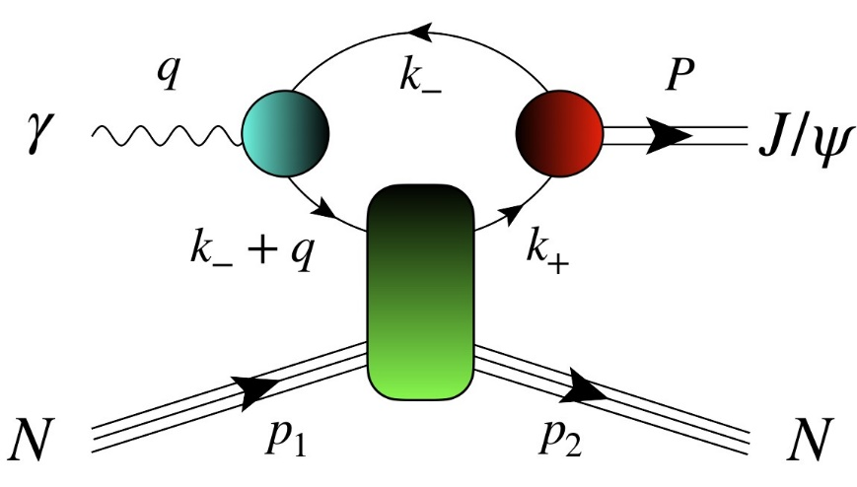
$J/ψ$ photoproduction: from threshold to very high energies
J/ψ photoproduction: threshold to very high energy, Lin Tang (唐淋), Yi-Xuan Yang (杨逸轩), Zhu-Fang Cui (崔著钫) and Craig D. Roberts, NJU-INP 089/24, e-Print: 2405.17675 [hep-ph], Phys. Lett. B 856 (2024) 138904/1-7
If GPD scheme valid at all, then only very near threshold.
All $W$ unification impossible
Some modern proposals for reaction model:
GPD treatment – gain access to in-proton gluon gravitational form factors
Coupled channels treatment – $P+ J/ψ p rescattering$
S. Sakinah, T. S. H. Lee, H.-M. Choi, Dynamical Model of J/Ψ photoproduction on the nucleon – arXiv:2403.01958 [nucl-th] Phys. Rev. C 109 (2024) 6, 065204
Suggestion = Final state interactions dominate cross-section near-threshold, so obscuring any connection with in-proton gluon distributions and/or gluon gravitational form factors.
$γ+p→c+\overline{c}+P+p→J/ψ+p$
Lin Tang (唐淋) et al. NJU-INP 089/24
Exposes $c+\overline{c}$ content of the dressed photon
Couples the intermediate $c+\overline{c}$system to
proton’s valence quarks via Pomeron exchange

Slide 44
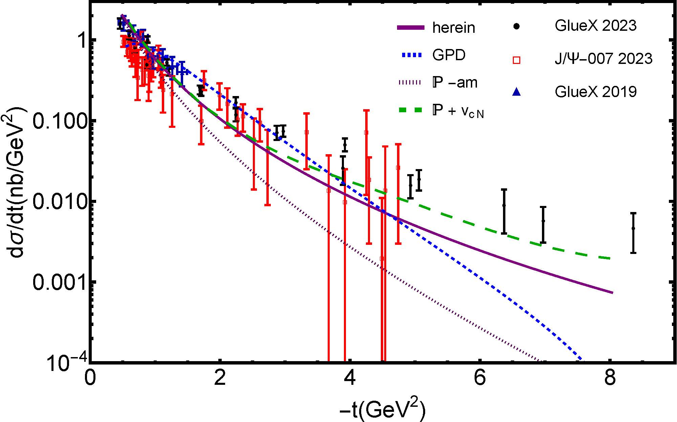
$J/ψ$ photoproduction: threshold differential cross-section
GPD model (dotted blue)
overfitting issue
concave differential cross-section with max. at low $\left|t\right|$
trying to reconcile GlueX and $J/ψ$-007 data (some tension)
all other reaction models produce convex $\frac{dσ}{dt}$
$P+J/ψp$ rescattering
dashed green – $χ_{dof}^{2}=8$
$P+quark loop$
solid purple – $χ_{dof}^{2}=7$

Slide 45
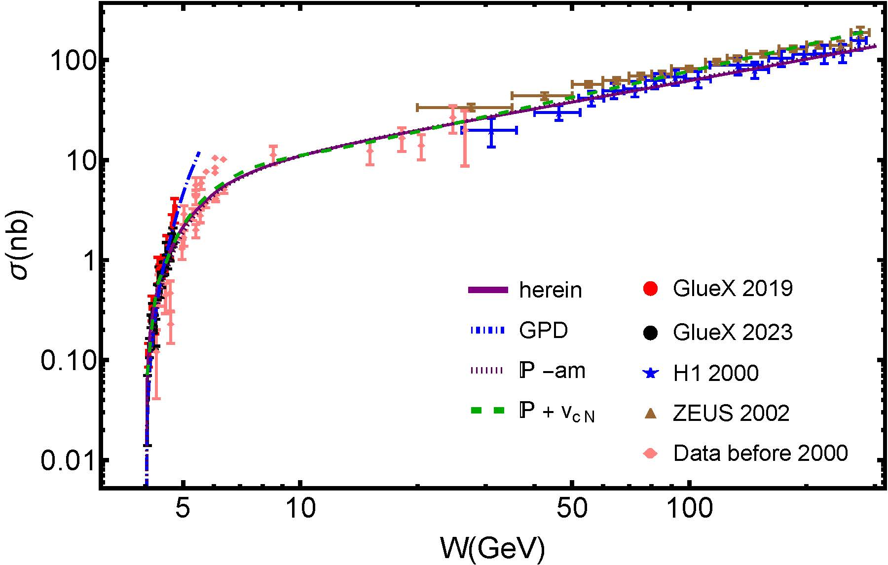
$J/ψ$ photoproduction: total cross-section, threshold to high-$W$
Reported ZEUS uncertainty in W is large, but uncertainty in $σ$ is small
Distorts $χ^{2}$
GPD model (dotted blue)
Inapplicable on $W>5$ GeV
$χ_{dof}^{2}$ undefined
$P+J/ψp$ rescattering
dashed green
ZEUS+H1 $χ_{dof}^{2}=2.1$
H1 $χ_{dof}^{2}=1.6$
$P+quark loop$
solid purple
ZEUS +H1 $χ_{dof}^{2}=3.5$
H1 $χ_{dof}^{2}=1.0$

Slide 46
$J/ψ$ photoproduction: from threshold to very high energies
Two reaction models provide viable unification
differential and total cross-section data
GPD model does NOT
Premature to connect γ + p → J/ψ + p photoproduction data with anything derived from/connected with GPDs
Theory predicts that proton mass radius < proton charge radius – see Empirical Determination of the Pion Mass Distribution, Y-Z. Xu (徐胤禛) et al., NJU-INP 070/23, e-Print: 2302.07361 [hep-ph], Chin. Phys. Lett. Express 40 (2023) 041201/1-7.
Best description of data is provided by CSM reaction model
$(W,t)$ dependence of quark loop is important to differential cross-section near threshold
Photoproduction probes quark structure of $γ→J/ψ$ not glue in proton

