Slide 1
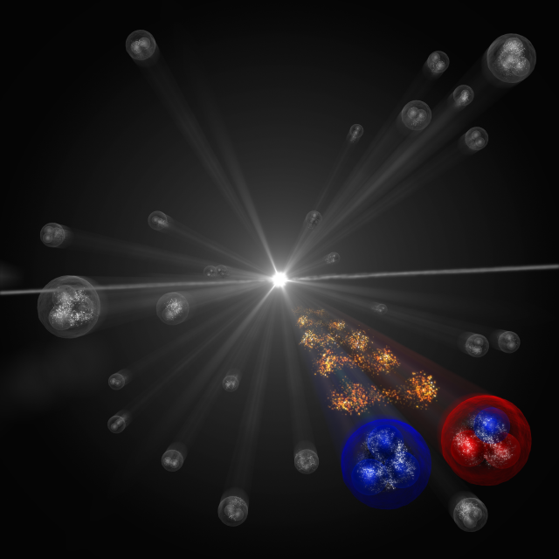
第七届全国重味物理和量子色动力学研讨会 2025年4月18—22日 中国·南京
Recent progress in Femtoscopic studies
Li-Sheng Geng（耿立升）@ Beihang U.
(Image: CERN)

Slide 2
Contents
Femtoscopic correlation functions (CFs)—general features
Recent applications
$J/Ψ$- $J/Ψ$ correlation functions with EFT potentials
$J/Ψ$-$N$ and $η_{c}$-$N$ correlation functions with lQCD phaseshifts
Summary and outlook

Slide 3
Many more exotic hadrons discovered
$$X_{0}(2866)$$
$$X_{1}(2904)$$
$D_{s1}$(2460)
$$\text{X}\text{(4160)}$$
$$\text{Y}\text{(4220)}$$
$Z_{c}$(4100)
$$\text{Y}\text{(4660)}$$
$Z_{c}$(4020)
$$P_{c}(4380)$$
$Ξ$(1620)
$$X(6900)$$
X(6900)
X(7200)
$D_{s0}$(2317)
$$\text{Y}\text{(4260)}$$
$$\text{X}\text{(3915)}$$
$$\text{X}\text{(4274)}$$
$Z_{c}$(3900)
$$P_{c}(4450)$$
$$\text{Y}\text{(4390)}$$
$$P_{cs}(4459)$$
$$\text{Y}\text{(4500)}$$
$$\text{Y}\text{(4360)}$$
$Ω$(2012)
$$P_{c}(4337)$$
2003
2005
2006
2007
2009
2011
2013
2014
2015
2016
2018
2019
2020
2021
2022
2023
$$\text{X}\text{(3960)}$$
$$\text{X}\text{(3872)}$$
$Z_{c}$(4430)
$X$(4140)
$Z_{c}$(4200)
$$P_{c}(4457)$$
$$P_{cs}(4338)$$
X(6900)
X(6600)
X(7100)
$$\text{X}\text{(5568)}$$
$$P_{c}(4440)$$
$Z_{cs}$(3985)
$$T_{cs}(2900)$$
$Y$(3940)
$$P_{c}(4312)$$
$T_{cc}$(3875)
$Z_{b}$(10610)
$Z_{b}$(10650)
$Λ_{c}$(2940)

Slide 4
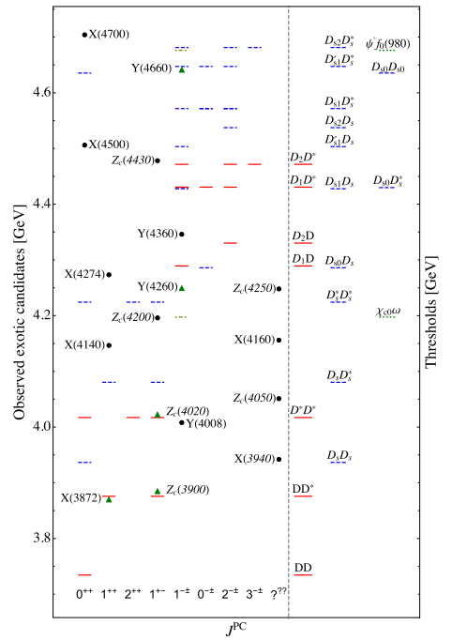
Most of them close to thresholds— hadronic molecules
Feng-Kun Guo, Christoph Hanhart,
Ulf-G. Meißner, Qian Wang,
Qiang Zhao, Bing-Song Zou. Rev.Mod.Phys. 90 (2018) 015004
Richard F. Lebed, Ryan E. Mitchell,
Eric S. Swanson,
Prog.Part.Nucl.Phys. 93 (2017) 143
Atsushi Hosaka, Toru Iijima, Kenkichi Miyabayashi, Yoshihide Sakai , Shigehiro Yasui,
PTEP 2016 (2016) 062C01
Hua-Xing Chen, Wei Chen, Xiang Liu
Shi-Lin Zhu,
Phys. Rept.639 (2016) 1
……

Slide 5
How to check the molecular picture?
Directly measure two-hadron interactions.
Check whether they can form molecules.

Slide 6
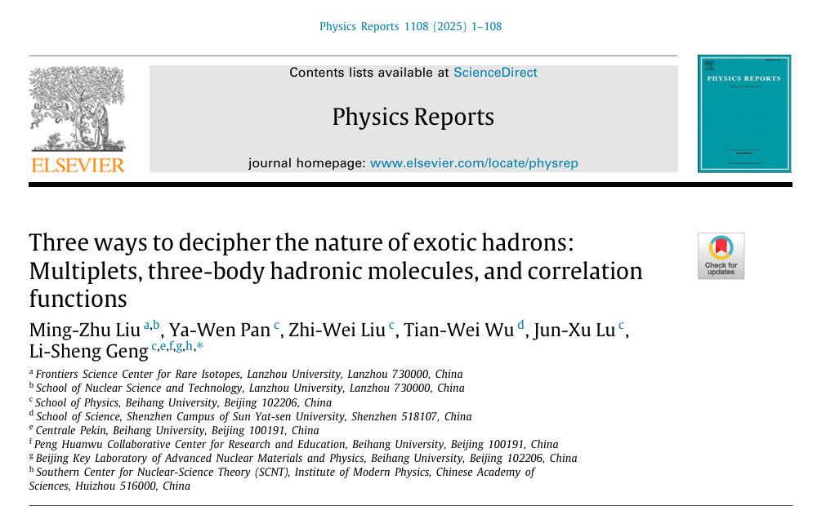

Slide 7
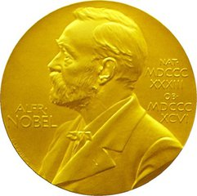
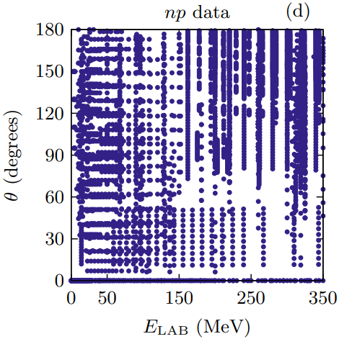
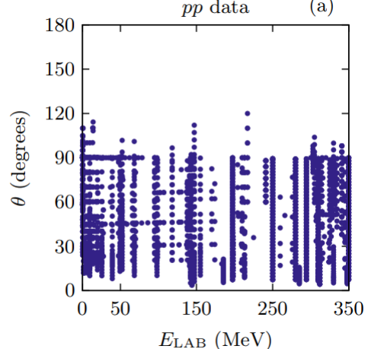
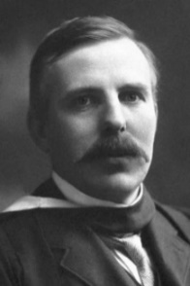
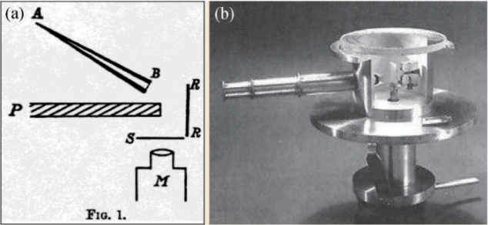
立项依据—传统散射实验
New probe—femtoscopic correlation functions
For stable hadrons, scattering experiments are extremely valuable in extracting their interactions
NN scattering，8125 data
Foundation of high-precision nuclear force
Ernest Rutherford
Rutherford Scattering Experiment
For unstable particles, direct scattering experiments are impossible!
Difficult to get large quantity of beam particles
No fixed targets available
$$Λp→Λp$$ | $$Σ^{−}p→Λn$$ | $$Σ^{+}p→Σ^{+}p$$ | $$Σ^{−}p→Σ^{−}p$$ | $$Σ^{−}p→Σ^{0}n$$
12 | 6 | 4 | 7 | 6
Hyperon-nucleon low energy scattering, 35 data
Hindering hyper-nuclear physics and neutron star studies
Notes:
传统上，散射实验是研究相互作用的主要实验方法
最成功的例子是卢瑟福散射实验，其揭示原子的核式结构模型，至今仍然是研究强相互作用的基本手段
例如核子散射实验，8000多个NN散射数据是开展高精度核力研究的坚实基础。
然而，对于不稳定了强子，传统的散射实验非常困难。短寿命的强子，很难产生大量炮弹粒子，也无法制作固定靶。
例如，超子-核子的散射数据只有35个，这也进一步制约了核物理、天体物理领域的发展。

Slide 8
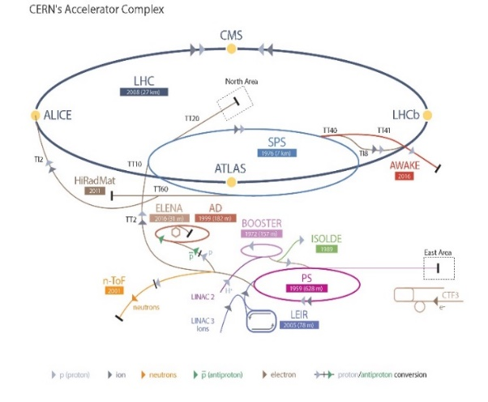
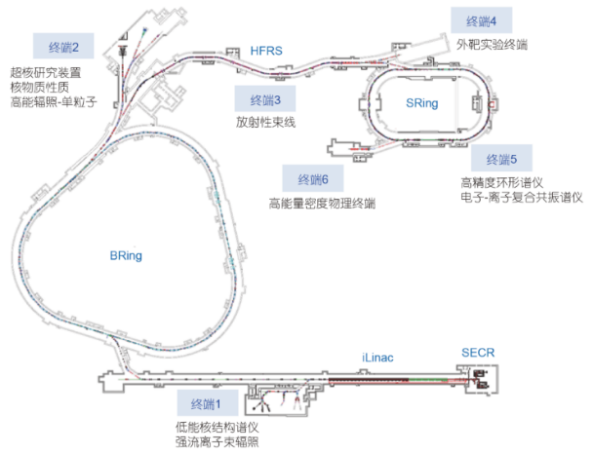
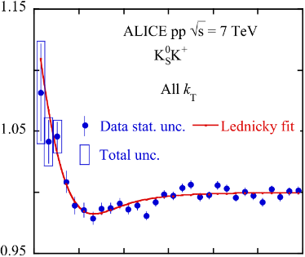
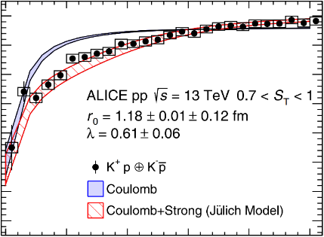
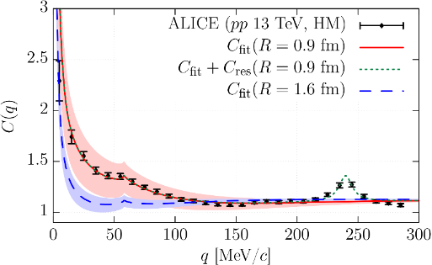
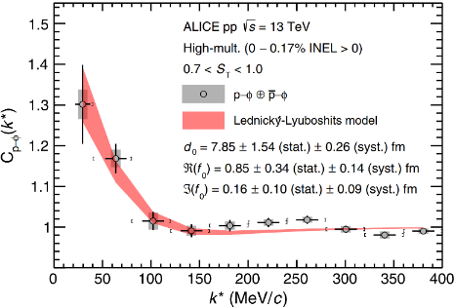
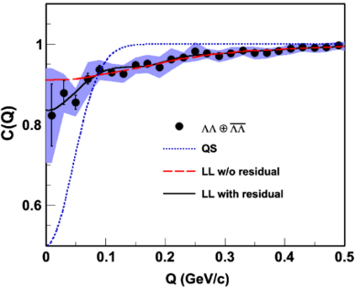
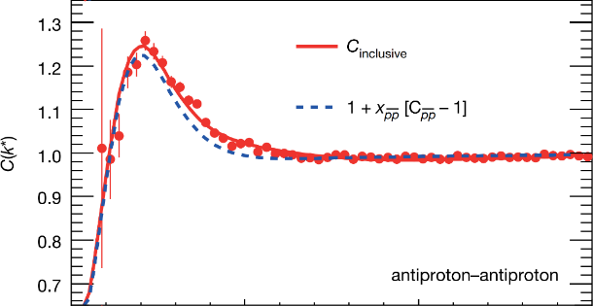
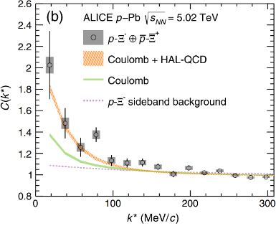
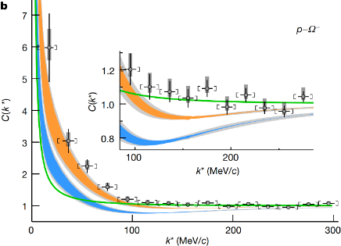
New probe—femtoscopic correlation functions
$$K_{S}^{0}K^{±}$$
$$K^{±}p$$
$$K^{−}p$$
$$ϕp$$
$$\overline{p}\overline{p}$$
$\text{Λ} \text{Λ}$
$${\text{X}}^{−}p$$
$$^{−}p$$
$$K^{−}d$$
$$Σ^{0}p$$
$$ΛΞ$$
$$ΞΞ$$
$$ΩΩ$$
$$pD$$
$$ppp$$
PLB 2019
PRL 2020
PRL 2020
PRL 2021
Nature 2015
PRL 2015
PRL 2019
Nature 2020
$$ppΛ$$

Slide 9
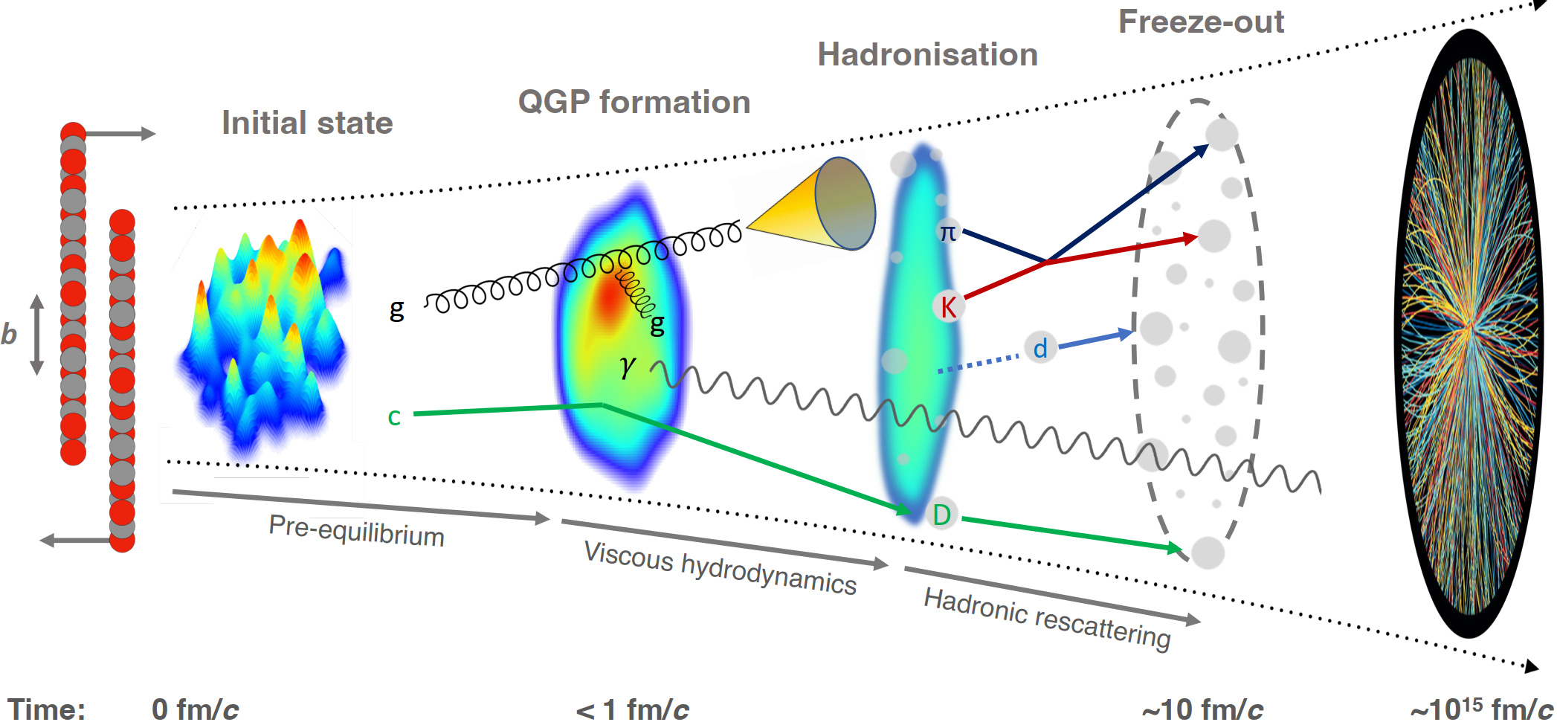
Abundant particles produced in AA, pA, and pp collisions
Final-State Interaction

Slide 10
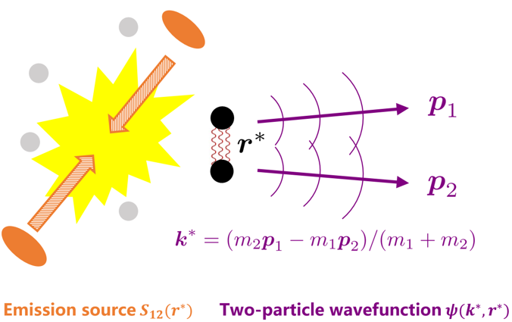
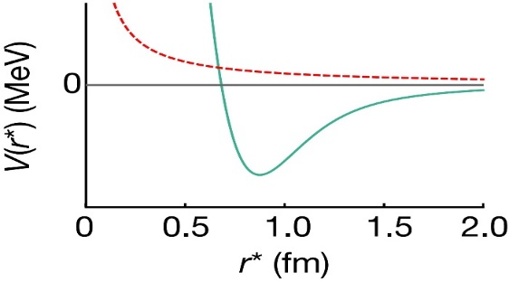
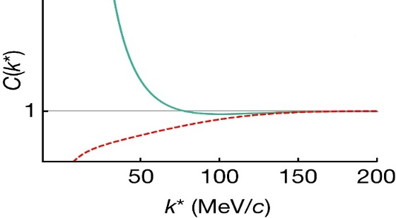
Femtoscopic correlation functions (CFs)
Interacting potential
Correlation function
repulsive
attractive
attractive
repulsive
Schrödinger equation
Two-particle wavefunction$ψ(k^{∗}, r^{∗})$
Exp. measurement
mixed-event technique
Theo. description
Koonin–Pratt formula
S. E. Koonin, Phys. Lett. B 70 (1) (1977) 43
A. Ohnishi, Nucl. Phys. A 954 (2016) 294
Basic Properties
>1 if the interaction is attractive
=1 if there is no interaction
<1 if the interaction is repulsive
$N_{same}$: the same event distributions
$N_{mixed}$: the mixed event distributions $ξ$: the corrections for experimental effects
final-state interactions
quantum statistics effects
coupled-channel effects
spacial structure

Slide 11
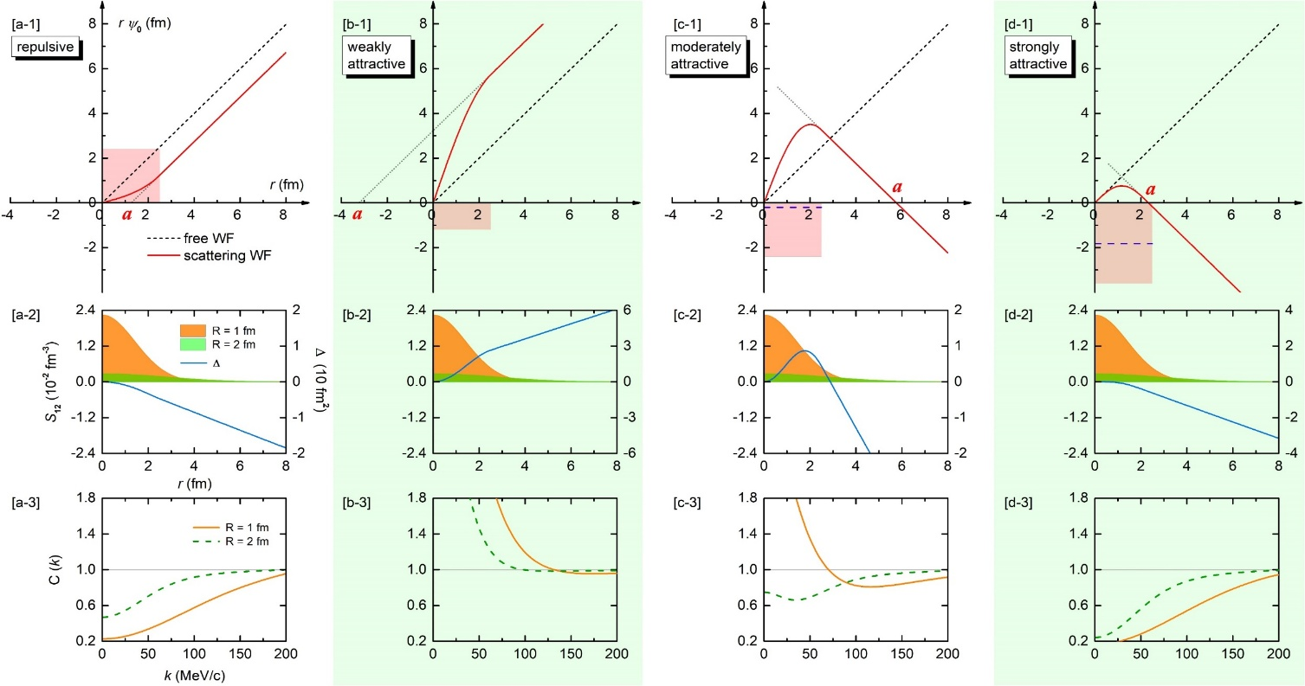
Reality is bit more complicated but understood
Repulsive, attractive, weakly bound, deeply bound
Narrow resonance, broad resonance, virtual
Zhi-Wei Liu, Jun-Xu Lu and LSG*, PRD107(2023)074019
Zhi-Wei Liu, Ming-Zhu Liu, Jun-Xu Lu and LSG*, 2404.18607

Slide 12
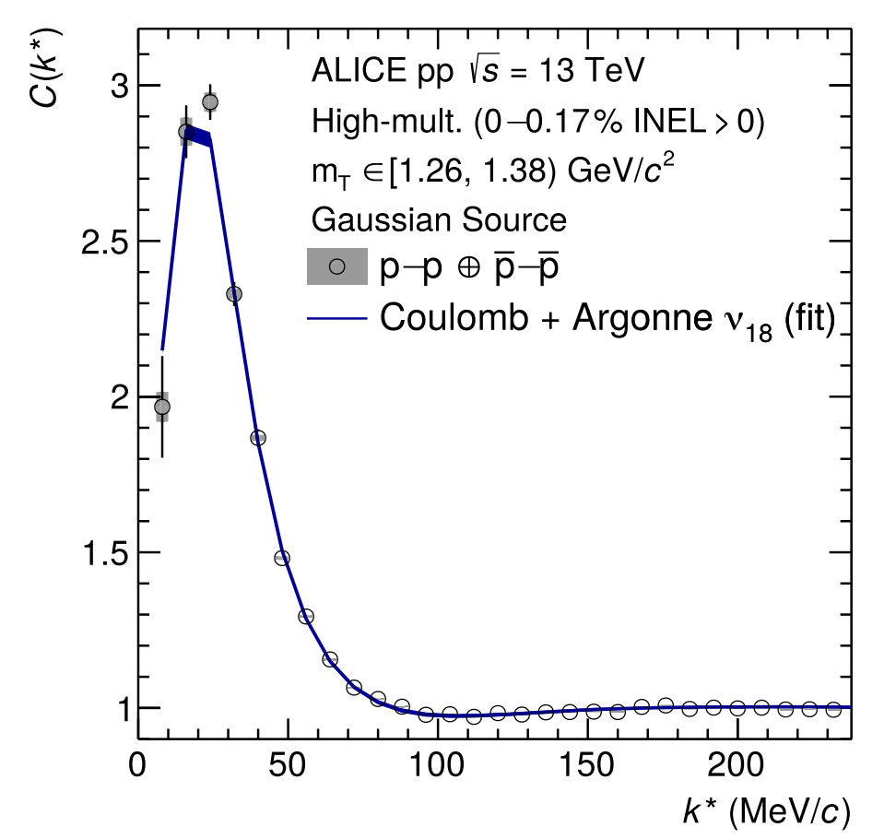
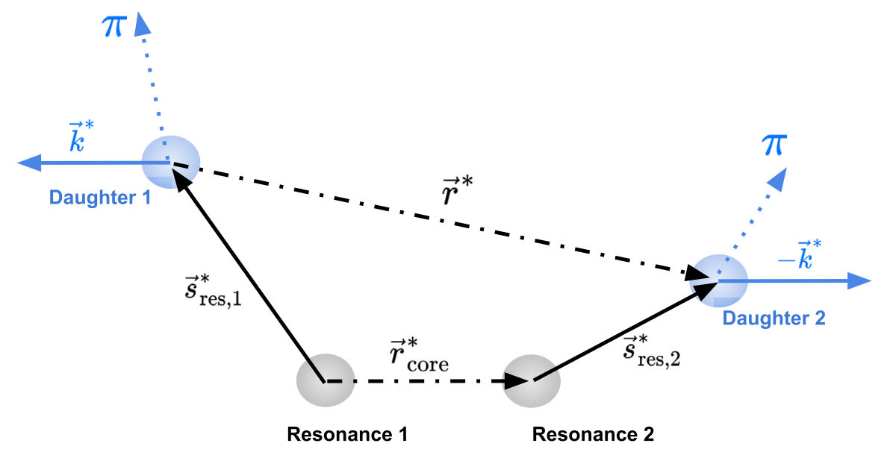
Constraining the source function
Using the well-known proton-proton interaction to calibrate the source
$$C\left(k^{∗}\right)=\int{S}\left({\vec{r}}^{∗}\right){\left|ψ\left({\vec{k}}^{∗},{\vec{r}}^{∗}\right)\right|}^{2}d^{3}{\vec{r}}^{∗}$$
For CFs involving short-lived resonances ($cτ∼1fm$ )—Resonance Source Model
$$S\left(r^{∗}\right)=\frac{1}{{\left(4πr_{\text{core} }^{2}\right)}^{3/2}}exp⁡\left(−\frac{r^{∗2}}{4r_{\text{core} }^{2}}\right)×SLR$$
ALICE, PLB, 811 (2020) 135849

Slide 13
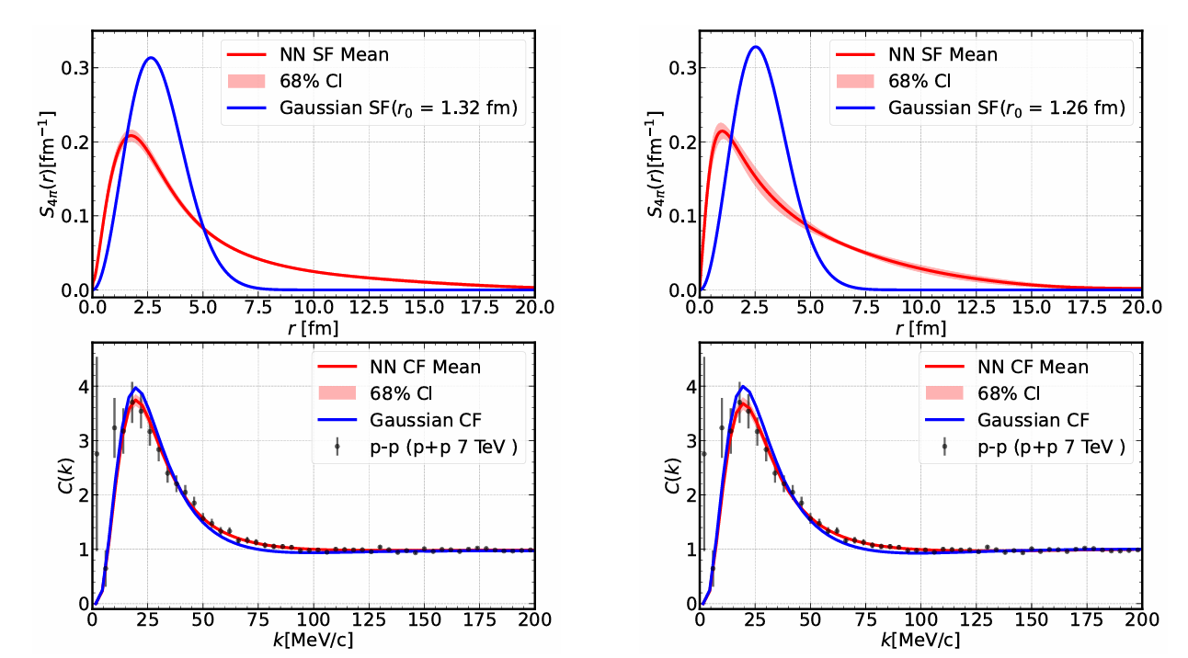
Constraining the source function
Lingxiao Wang1 and Jiaxing Zhao, 2411.16343

Slide 14
Other domestic works
K-Lambda and N*(1535): Si-Wei Liu, Ju-Jun Xie, 2503.22453
Sigma*(1430): Hai-Peng Li, Chu-Wen Xiao, Wei-Hong Liang, Jia-Jun Wu, En Wang et al, 2409.05787
P-Omega: Ye Yan, Qi Huang, Youchang Yang, Hongxia Huang, Jialun, 2408.15493
N*(1535): Hai-Peng Li, Jing Song, Wei-Hong Liang, R. Molina, E. Oset, 2311.14365

Slide 15
Contents
Femtoscopic correlation functions (CFs)—general features
Recent applications
$J/Ψ$- $J/Ψ$ correlation functions with EFT potentials
$J/Ψ$-$N$ and $η_{c}$-$N$ correlation functions with lQCD phaseshifts
Summary and outlook

Slide 16
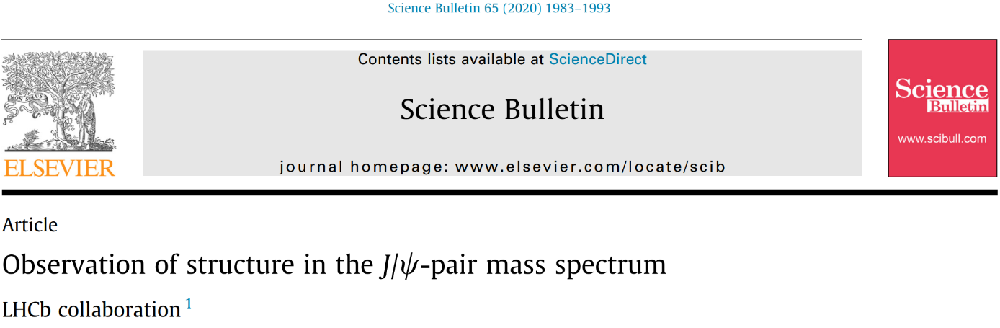
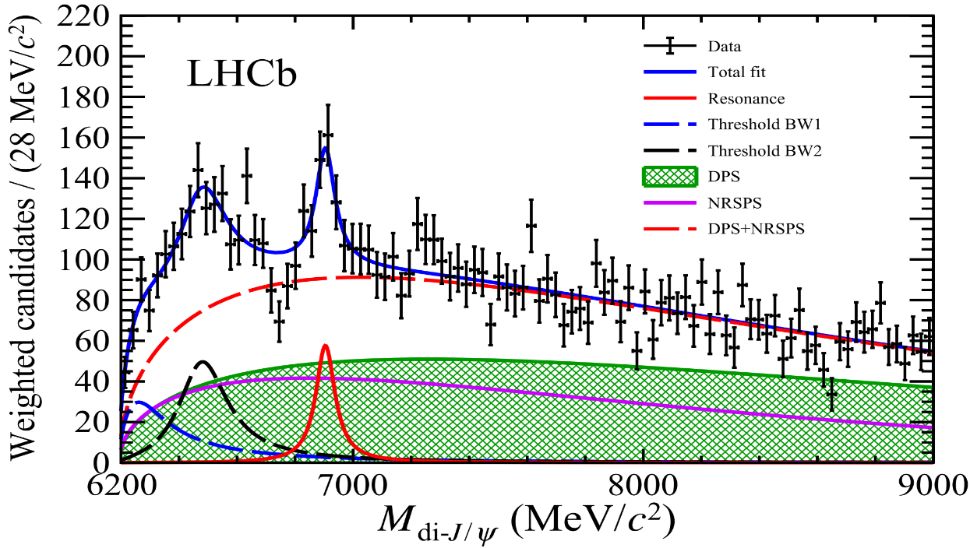
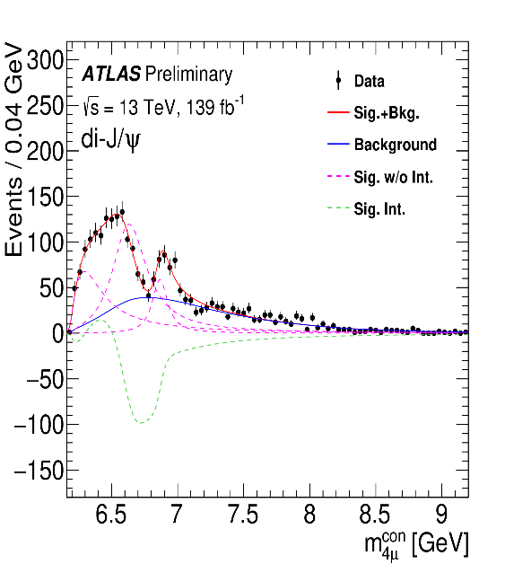
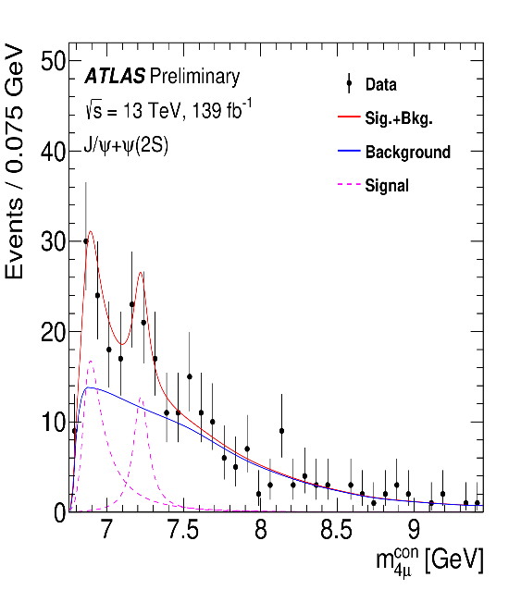
Tetracharm states — LHCb & ATLAS
A narrow structure around 6.9 GeV — X(6900)
A broad structure just above twice the $J/Ψ$ mass
Di- $J/Ψ$
$J/Ψ$ + $Ψ$(2S)
X(6900) and a broad structure at threshold
A resonance structure at about 7.2 GeV

Slide 17
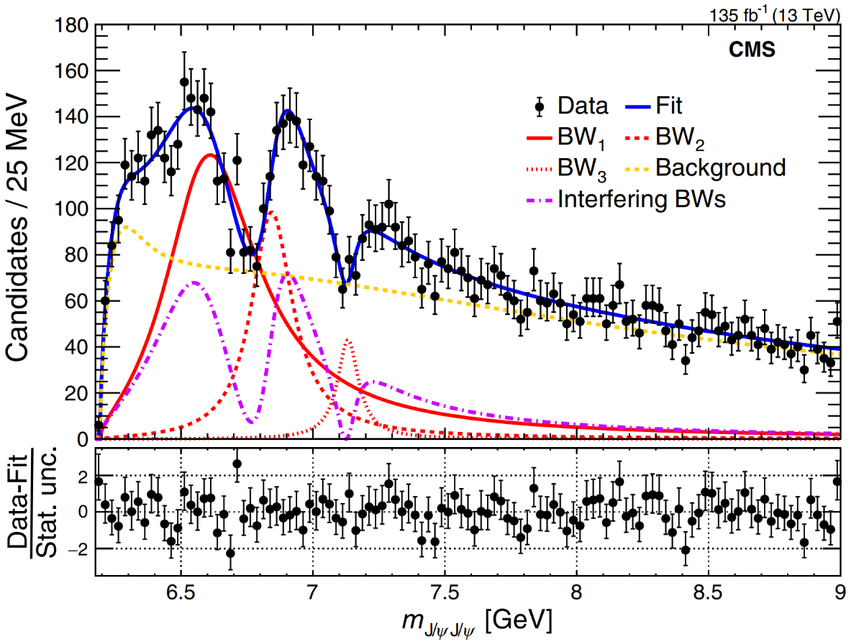
Tetracharm states — CMS
X(6900) structure
Two new structure X(6600) and X(7100)
broad structure

Slide 18
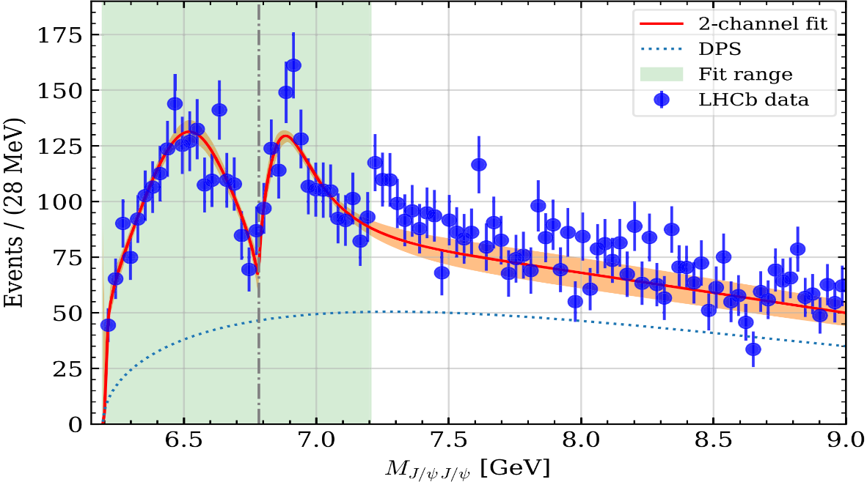
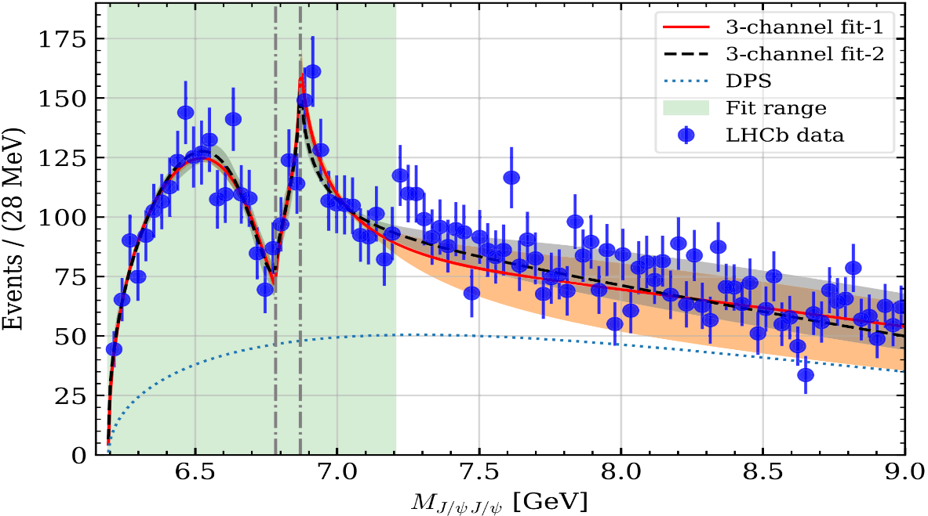
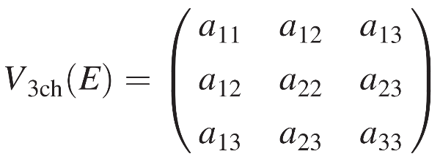
Tetracharm states — near $J/ΨJ/Ψ$ threshold
Two coupled-channel: $J/ΨJ/Ψ$, $J/ΨΨ(2S)$
near $J/ΨJ/Ψ$ threshold:
virtual state
resonance
bound state
Three coupled-channel: $J/ΨJ/Ψ$, $J/ΨΨ(2S)$, $J/ΨΨ(3770)$
near $J/ΨJ/Ψ$ threshold:
virtual state
bound state
How to decipher the nature of possible state near the $J/Ψ$-pair threshold ?

Slide 19
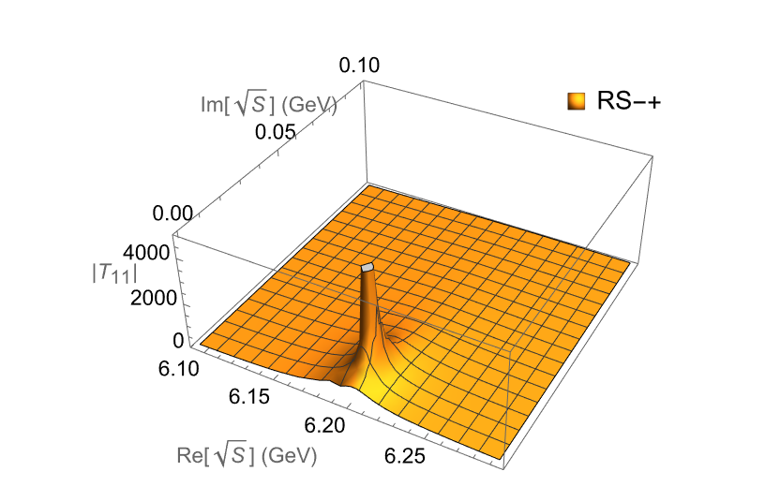
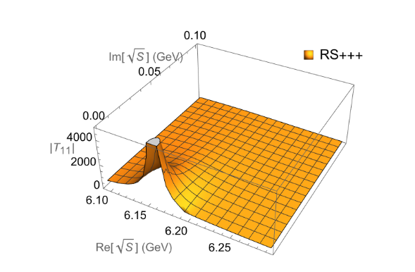
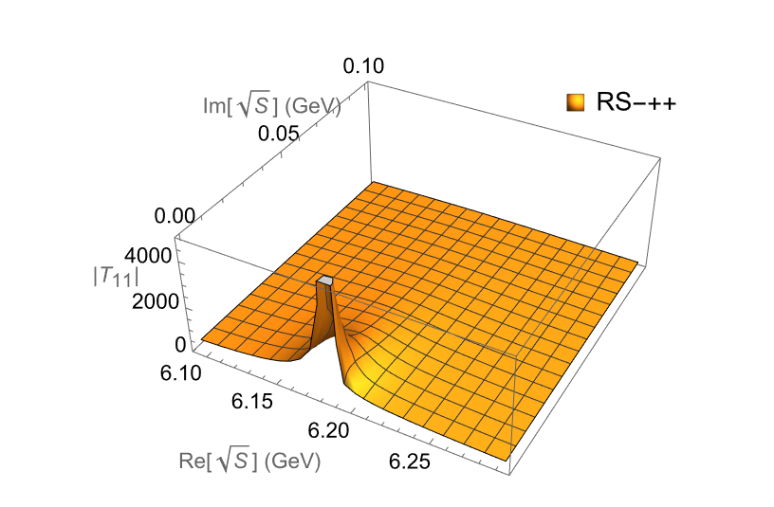
X(6200)
General potential from EFTs
Strength of potential from double J/$Ψ$ spectrum
Resonant
Bound
Virtual
Taken from X.-K. Dong, V. Baru, F.-K. Guo, C. Hanhart, and A. Nefediev, Phys. Rev. Lett. 126, 132001 (2021)
Identical neutral mesons (J=1) correlation function
Spatial part of wave function
Symmetric (for 1S0, 5S2)
Anti-symmetric (for 3S1)
Quantum Statistic (QS) effect
Final State Interaction (FSI) effect

Slide 20
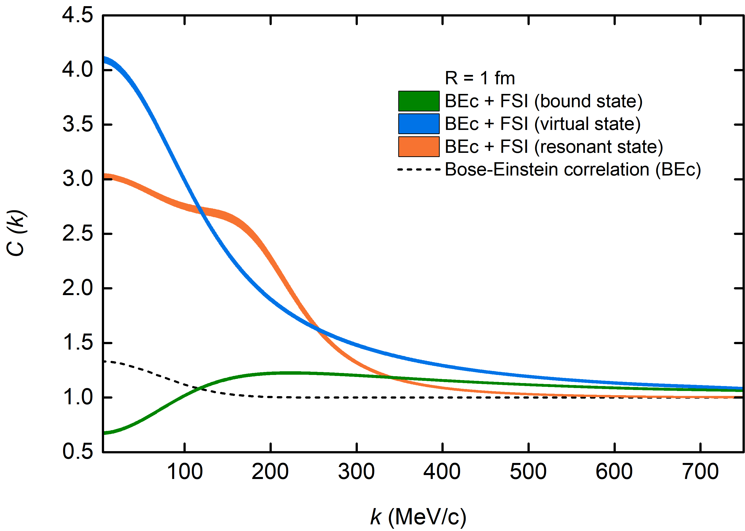
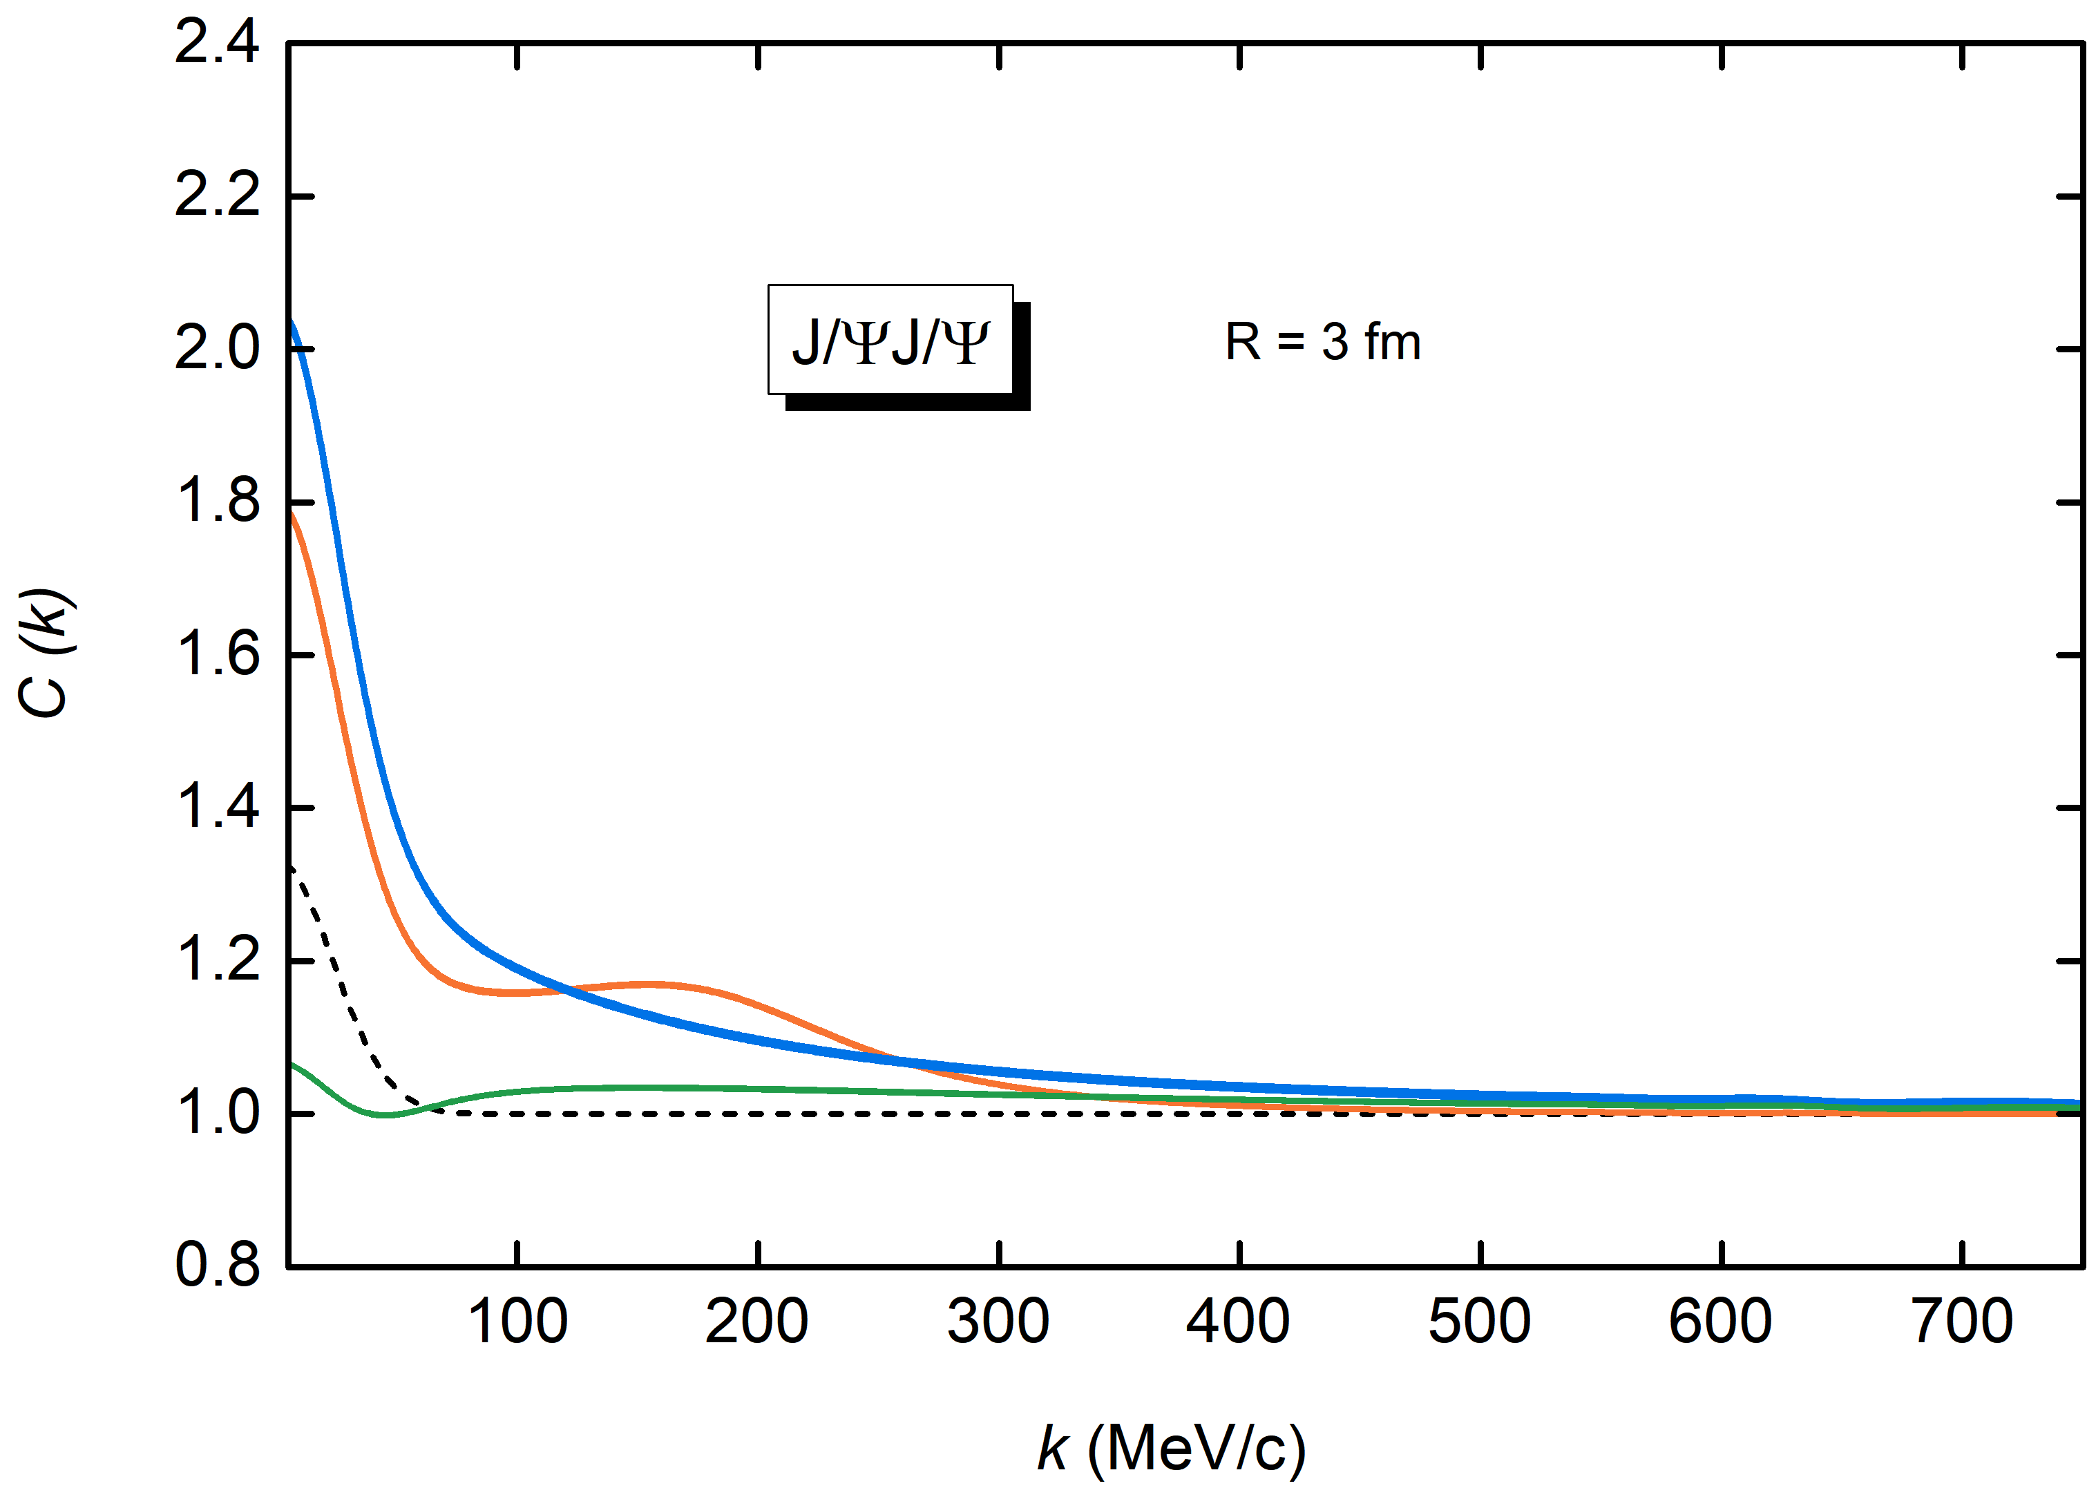
Preliminary $J/Ψ$-pair CFs
Attraction:
resonant < virtual < bound state
Typical low-momentum features of different pole positions
BEc + bound state < BEc
BEc + resonant state > BEc
BEc + virtual state > BEc

Slide 21
Contents
Femtoscopic correlation functions (CFs)—general features
Recent applications
$J/Ψ$- $J/Ψ$ correlation functions with EFT potentials
$J/Ψ$-$N$ and $η_{c}$-$N$ correlation functions with lQCD phaseshifts
Summary and outlook

Slide 22
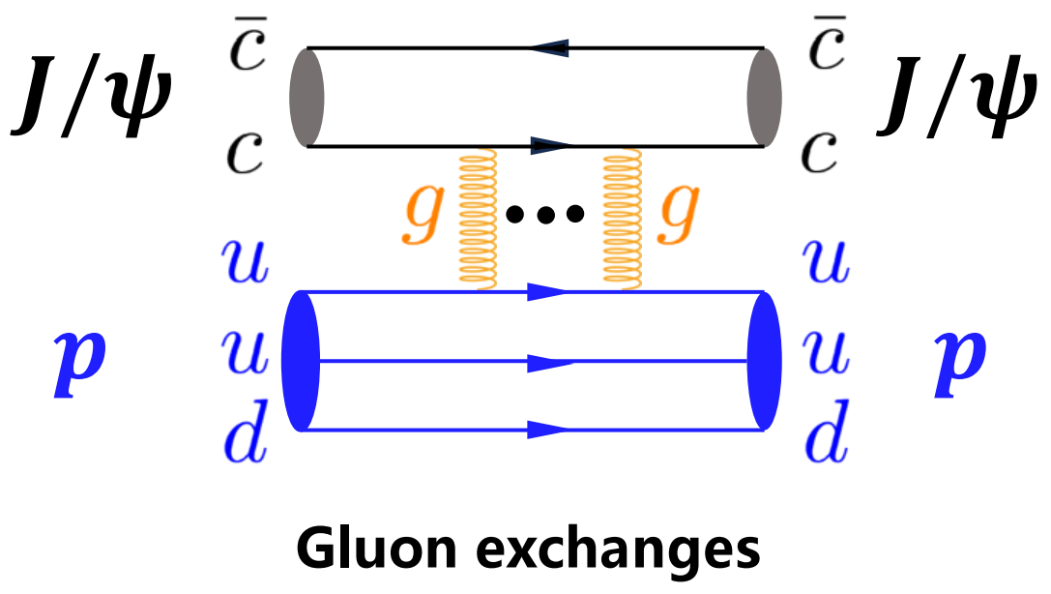
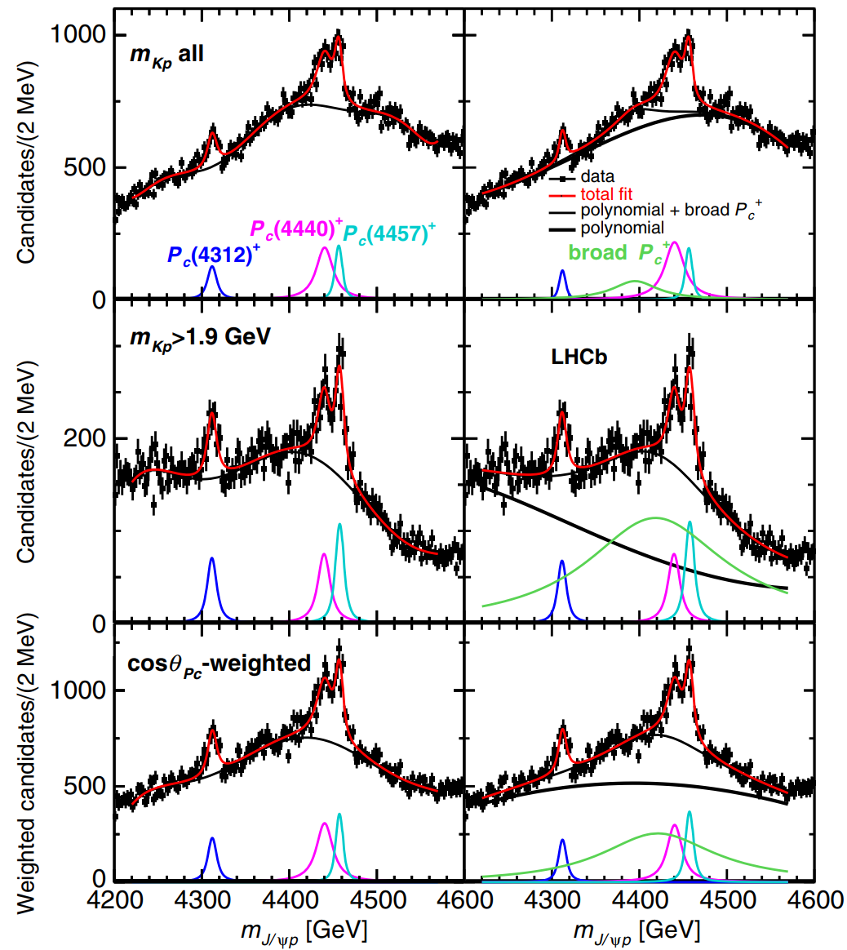
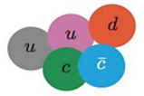
Charmonium-nucleon Interaction
OZI suppression
Predominant multiple-gluon exchanges at low energies
S. Okubo, Phys. Lett. 5, 165 (1963)
G. Zweig, “An SU(3) model for strong interaction symmetry and its breaking. Version 2,”
DEVELOPMENTS IN THE QUARK THEORY OF HADRONS. VOL. 1. 1964 - 1978
J. Iizuka, Prog. Theor. Phys. Suppl. 37, 21 (1966)
Nucleon mass origin
Gluon trace anomaly contribution to the nucleon mass
Taken from Bing Wu’s report on “East Asian Workshop on Exotic Hadrons 2024”
Y. Hatta et al., JHEP 12 (2018) 008
X.-D. Ji, Phys. Rev. Lett. 74, 1071 (1995)
Hidden-charm pentaquark states
$P_{c}$ states observed by LHCb
— $P_{c}$(4312), $P_{c}$(4440) and $P_{c}$(4457)
LHCb Collaboration, PRL 115 (2015) 072001 LHCb Collaboration, PRL 122 (2019) 222001
In-medium properties of charmonia
A. Sibirtsev and M. B. Voloshin,
Phys. Rev. D 71, 076005 (2005)
N. Brambilla et al.,
Eur. Phys. J. C 74, 2981 (2014)

Slide 23
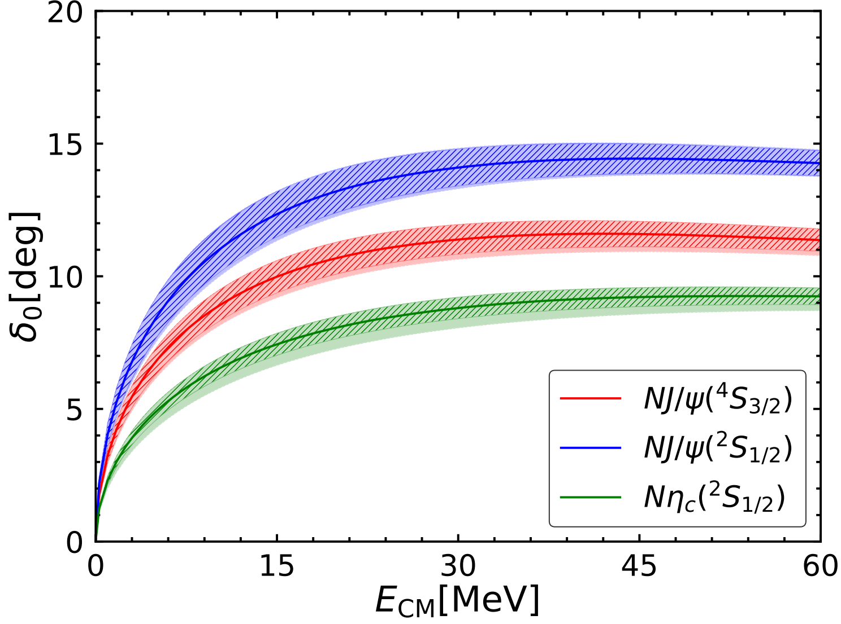
Charmonium-nucleon phase shifts from HAL QCD
Phase shifts for J/$Ψ$-$N$ and $η_{c}$-$N$
Lyu, Takumi Doi , Tetsuo Hatsuda, and Takuya Sugiura,
Phys. Lett. B 860 (2025) 139178
Phase shifts to correlation functions
evaluated with
gaussian source

Slide 24
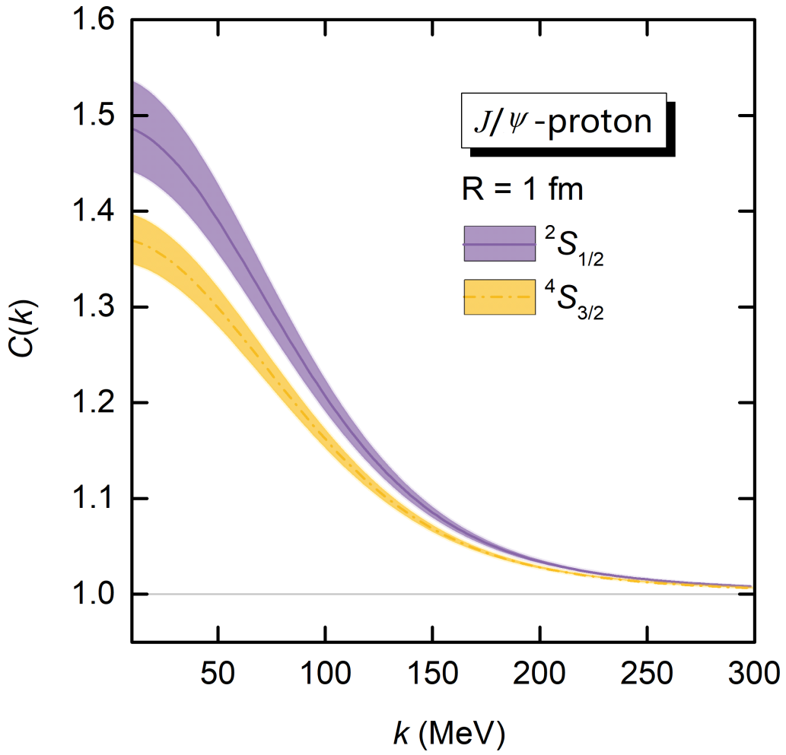
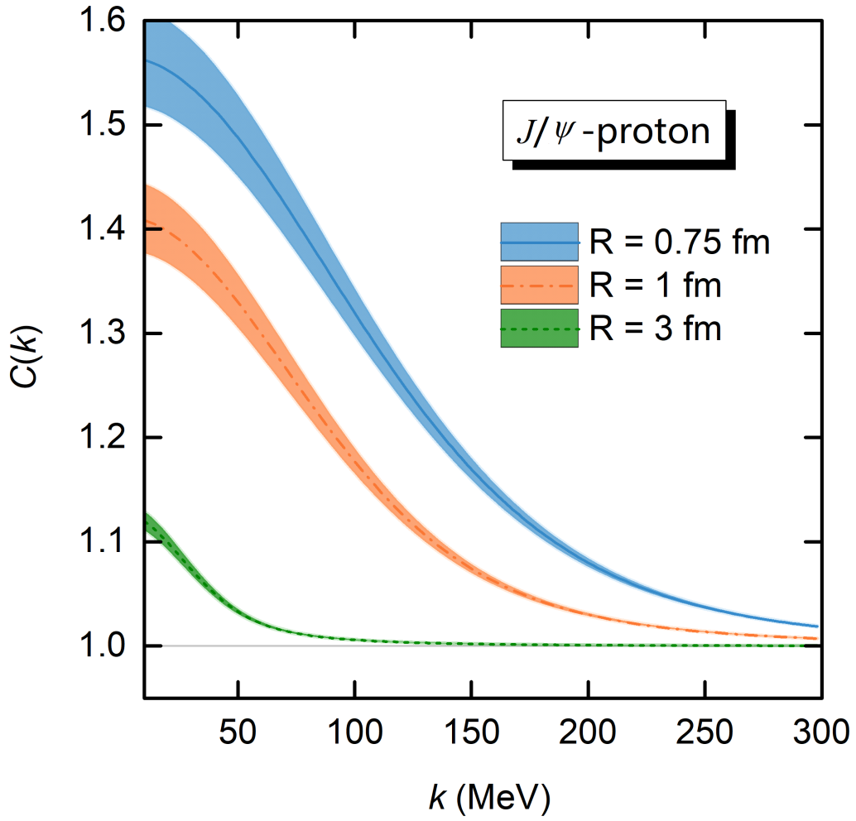
J/𝚿-proton CFs
Zhi-Wei Liu, Duo-Lun Ge, Jun-Xu Lu, Ming-Zhu Liu and LSG*, 2504.04853
Attraction: ${}_{}^{4}{S_{3/2}}$< ${}_{}^{2}{S_{1/2}}$

Slide 25
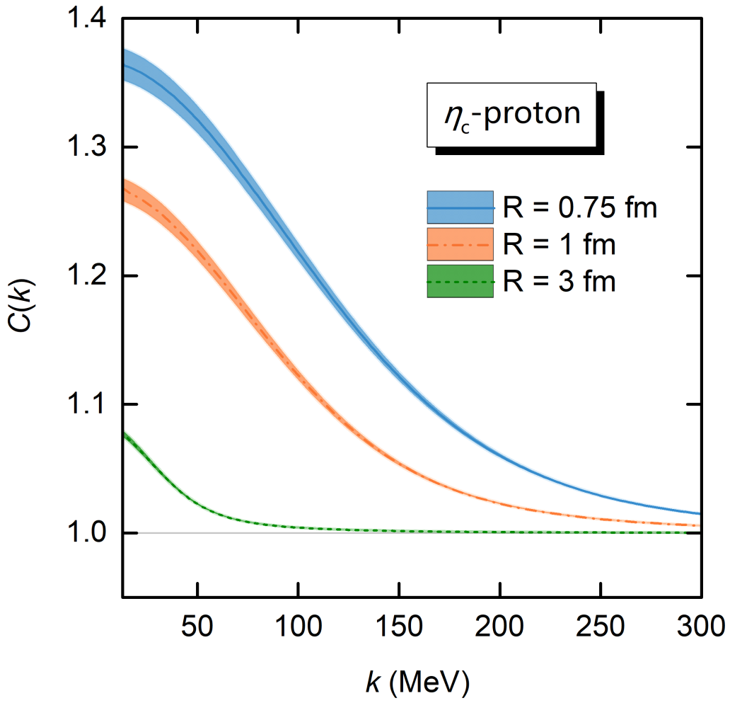
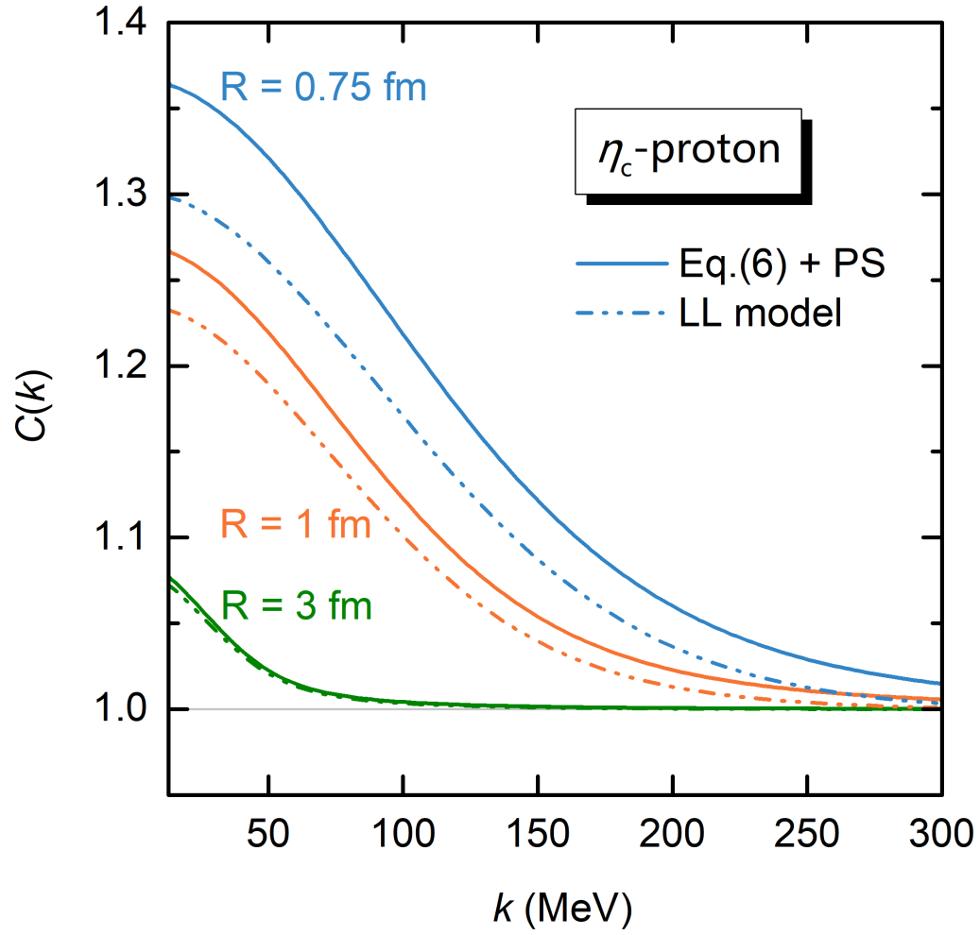
$η_{c}$-$N$ CFs
Attraction: $η_{c}$-$N$ < J/𝚿-$N$
LL model: not suitable for small source

Slide 26
Summary and outlook
Femtoscopy offers high-precision tests of the strong interaction between pairs of (un)stable particles and can be valuable to decipher the nature of the many exotic hadrons discovered so far.
$J/Ψ$- $J/Ψ$ correlation functions can be used to decipher the nature of possible $X(6200)$
$J/Ψ$-proton and $η_{c}$-proton correlation functions can unveil valuable insights into charmonium-nucleon interaction
Many two-hadron correlations involving s, c, b quarks studied
$DD^{∗}$, I. Vidana, A. Feijoo, M. Albaladejo, J. Nieves, and E. Oset, PLB 846 (2023) 138201
$DD^{∗}$, Y. Kamiya, T. Hyodo, and A. Ohnishi, EPJA 58 (2022) 131 ${BB}^{∗}$, A. Feijoo, L. R. Dai, L. M. Abreu, and E. Oset, PRD 109 (2024) 016014
$\text{B}D,$ H.P. Li, J.Y. Yi, C.W. Xiao, D.L. Yao, W.H. Liang, and E. Oset, CPC (2024)
……
$$Σ_{c}{\overline{D}}^{∗}$$
$$BD$$
$$ΞN$$
$$N\overline{D}$$
$$ΛN$$
$$ΛΛ$$
$$D{\overline{D}}^{∗}$$
$$NN$$
$$DK$$

Slide 27
Summary and outlook
Precise measurement of many two-body correlation functions relevant to understanding the nature of many exotic hadrons
Measurement of three-particle correlations — genuine three-body effects
ppp, pp$Λ$, ALICE Collaboration, Eur. Phys. J. A 59 (2023) 145
pp$K^{±}$, ALICE Collaboration, Eur. Phys. J. A 59 (2023) 298
ppp, A. Kievsky and et al., Phys. Rev. C 109 (2024) 034006

Slide 28
Thanks a lot for your attention!
(Image: CERN)

Slide 29
Classification of hadron-hadron interactions
repulsive
attractive
nonexistent
weaker attraction
resonant
state
stronger attraction
weak attraction
deeply bound state
shallow bound state
virtual
state

Slide 30
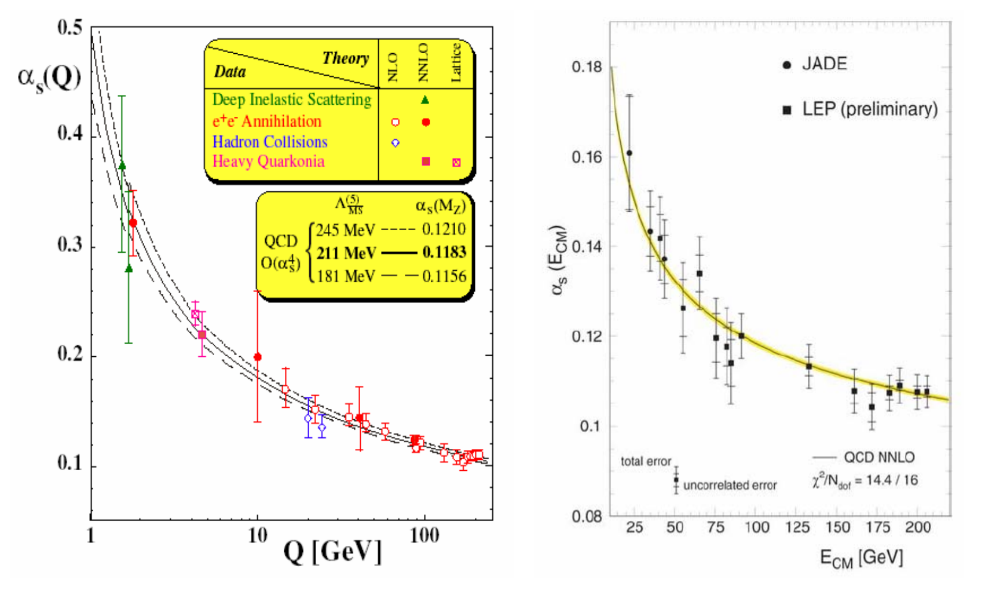
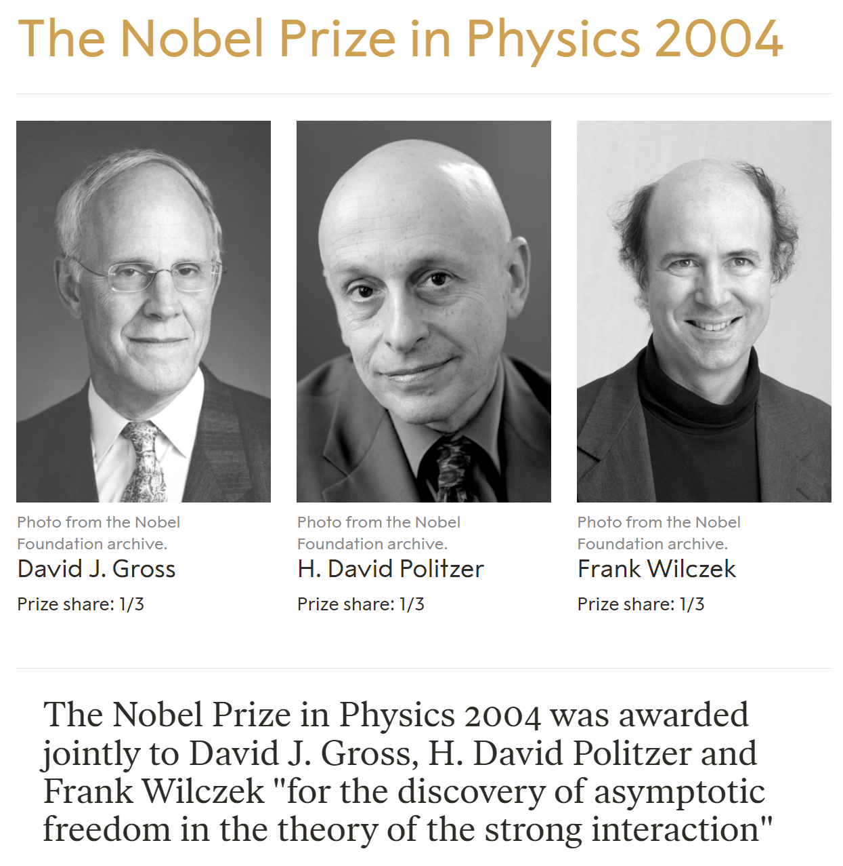
Better understanding of the nonperturbative strong interaction
Asymptotic Freedom
Color Confinement
Millennium Problems
Yang–Mills and Mass Gap
Experiment and computer simulations suggest the existence of a "mass gap" in the solution to the quantum versions of the Yang-Mills equations. But no proof of this property is known.

Slide 31
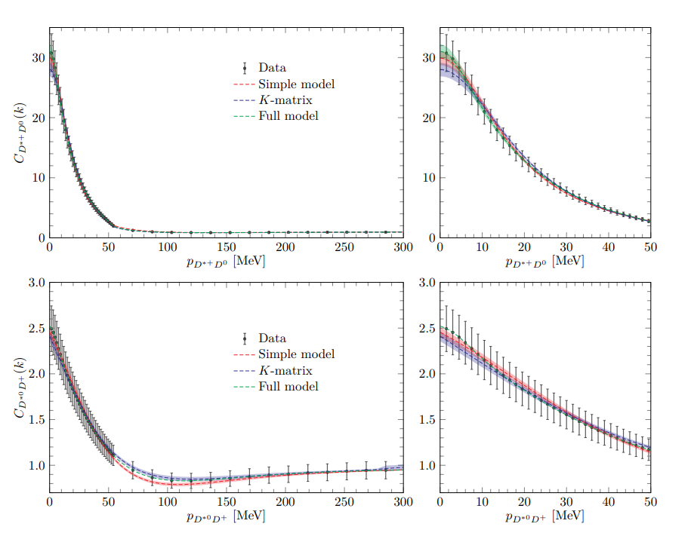
Summary and outlook
One can also perform inverse studies and extract hadron-hadron interaction from the exp. CF data
Inverse problem in femtoscopic correlation functions: The Tcc(3875)+ state,
Albaladejo , Feijoo , Vidaña , Nieves , and Oset, 2307.09873

Slide 32
Femtoscopic correlation functions (CFs)
S. E. Koonin, Phys. Lett. B 70 (1) (1977) 43
A. Ohnishi, Nucl. Phys. A 954 (2016) 294
Koonin–Pratt (KP) formula
Only S-waves
Common static and spherical Gaussian source
Scattering wave function
the Schrödinger equation
the Lippmann-Schwinger equation

Slide 33
Constraining the source function
2311.14527v1.
… “providing compelling evidence for the presence of a common emission source for all hadrons in small collision systems at the LHC …”
Convention dependent, see, Ref.[ 2504.08631 ]

Slide 34
CFs in the presence of bound states
Zhi-Wei Liu, Jun-Xu Lu and LSG*, PRD 107, 074019 (2023)
Notes:
In the same plot, the difference between the free and scattering wave functions squared ∆ ≡ r 2 (|ψl=0| 2 − |jl=0| 2 ) in Eq. (7) is also shown as the blue solid line. Panels (a3–d3): Correlation function as a function of the relative momentum k.

Slide 35
CFs in the presence of resonant and virtual states
Zhi-Wei Liu, Ming-Zhu Liu, Jun-Xu Lu and LSG*, 2404.18607
vs

