Slide 1
Analytic Calculation for QCD Corrections to Hard Exclusive Processes
第七届全国重味物理与量子色动力学研讨会
arXiv:2407.21120
arXiv:2406.19994
Long-Bin Chen
In collaboration with：Wen Chen, Feng Feng ,Yu Jia, Siwei Hu
2025/4/20

Slide 2
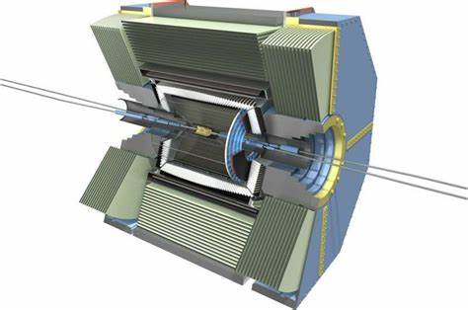
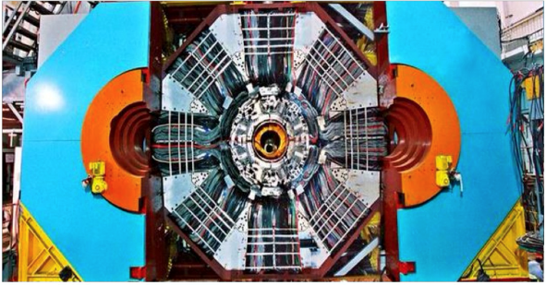
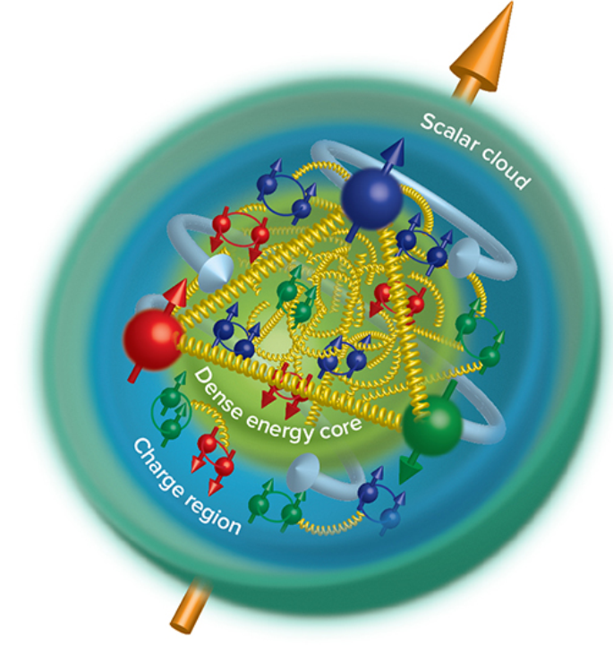
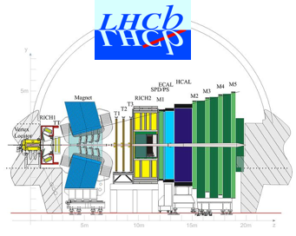
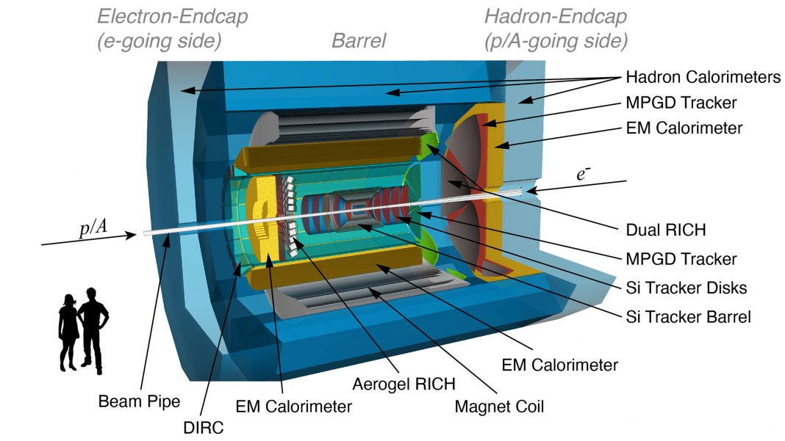
Unveiling the inner structure of hadron
Motivation
Understanding the internal structure of nucleons from quantum chromodynamics (QCD), the underlying theory of strong interaction, is the fundamental challenge faced by the contemporary hadron and nuclear physics.--Eur. Phys. J. C83, 1125 (2023 )

Slide 3
EM FFs: Probing the internal structure of hadrons
EM Form Factors for mesons and baryons:
Dirac FF
Pauli FF
EM FFs describe the distributions of electric charge and magnetization inside the hadron, key roles to probes the internal structure of hadron.

Slide 4
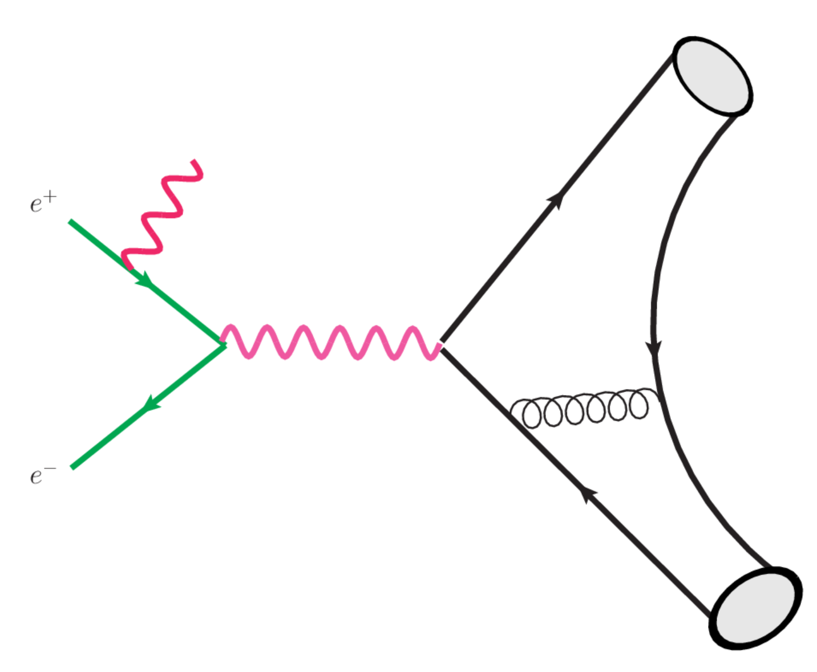
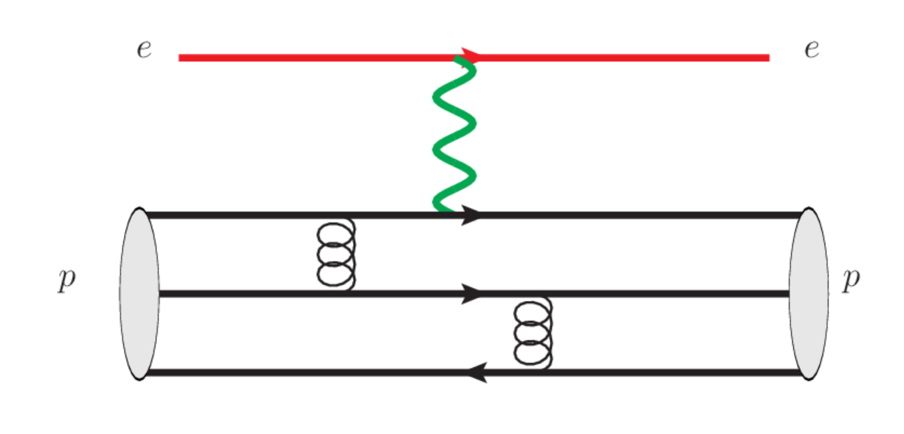
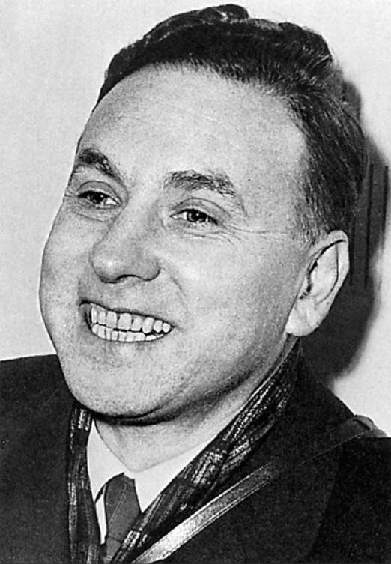
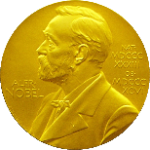
Probing baryon and meson EM Form Factors
Space Like
R. Hofstaders’ pioneering work in mid-50s
SLAC, Q^2 up to 30GeV^2 in early 90
Phys. Rev. D 48 , 29 (1993)
EIC：Q^2 up to 40-50 GeV^2
arXiv:2208.14575
Time Like
BESIII, BarBar, Belle II, STCF
1961
王雅迪4.19 黄光顺4.19
Babar, Q^2 up to 40GeV^2 in 2013
Phys. Rev. D88 , 072009 (2013)

Slide 5
Theoretical side on EMFFs
vector meson dominance model
PLB43,191 (1973); PRD69,054022 (2004); NCA109, 241 (1996); CPL41, 021302 (2024); ……
constitute quark model
PRD44, 229 (1991); PRD73, 114021 (2006); PLB671, 153 (2009); ……
cloudy bag model
PRD24, 216 (1981); PRD28, 2848 (1983); PRC46, 1077 (1992); ……
Dyson-Schwinger equation
CTP58, 79 (2012); PRL111, 101803 (2013); FBS55, 1185(2014); ……
light-front Hamiltonian
PRD102, 016008 (2020); ……
chiral perturbation theory
EPJA26, 1 (2005); PRC86, 065206 (2012); ……
light-cone sum rule
PRD65, 074011 (2002); PRD78, 033009 (2008); PRD88, 114021 (2013); ……
lattice QCD
PRD84, 074507 (2011); PRD83, 094502 (2011); PRD96, 114509 (2017);
PRD92, 054511 (2015); PRD100, 014509 (2019); PRD101, 014507 (2020); ……
dispersive analysis
NPA596, 367 (1996); PRC75, 035202 (2007); ……

Slide 6
Factorization:
Large Q^2, Collinear Factorization
(Lepage, Brodsky, Efremov, Radyushkin, Duncan, Mueller)
Operator definition of Tiwst-3 LCDA for baryon
Phys. Rev. D
22 , 2157 (1980)
Phys. Rev. D
78 , 033009 (2008)
ERBL evolution equations

Slide 7
Hard Kernel
Pertubative Expansion
Leading Order EMFFs
G. P. Lepage and S. J. Brodsky, Phys. Rev. Lett. 43, 545 - 549 (1979)
G. P. Lepage and S. J. Brodsky, Phys. Rev. D22, 2157 (1980)
V. L. Chernyak, A. R. Zhitnitsky and V. G. Serbo, JETP Lett. 26, 594 (1977)
V. L. Chernyak and A. R. Zhitnitsky, Phys. Rept. 112, 173 (1984)

Slide 8
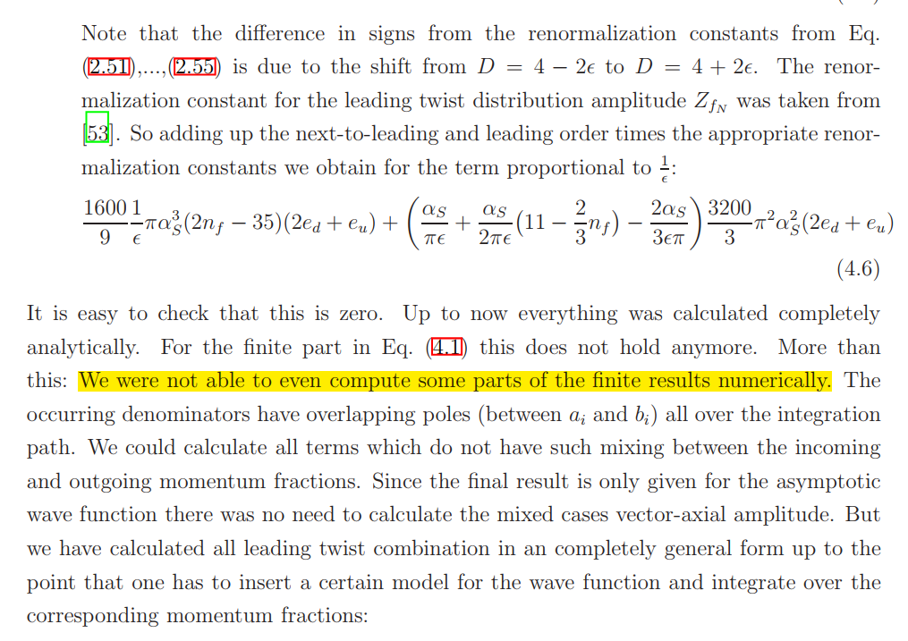
Status of EMFF in pQCD for baryon FFs
Promotionsgesuch eingereicht am: 18.06.2014
Die Arbeit wurde angeleitet von: Prof. Dr. V. Braun

Slide 9
Perturbative matching in KM scheme
S. Krankl and A. Manashov, Phys. Lett. B 703,519-523 (2011)

Slide 10
Matching

Slide 11
Renormalization Factor

Slide 12
Feynman Diagrams(about 2000)

Slide 13
Convolution:

Slide 14
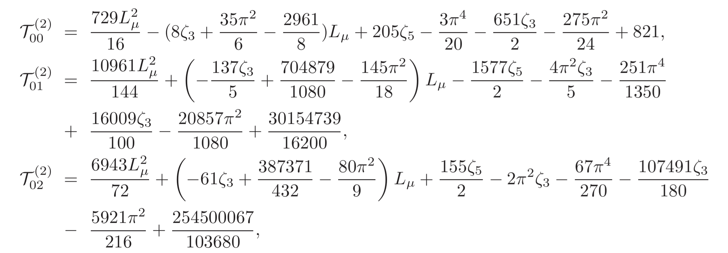
Kaon FFs
The short distance coefficients:

Slide 15
Proton FFs
Analytic short-distance coefficients
Agreed with
Huang, Shi, Wang and Zhao
[arXiv: 2407.18724]
Only Zeta function and rational number appear.
Validated numerically by cubature

Slide 16
Calculation Methods
Diagrams and amplitudes : HepLibFeng 2021, FeynArts
Partial Fraction: Apart
Integrals Reduction: FIRE (Integration-By-Parts)
Master Integrals Calculation: Differential Equations
Validations of analytic results for MIs: AMFLOW, AmpRed
Two-fold and Four-fold convolutions: Cubature, PolylogTool
Feng 2012
Liu, Ma 2022
Chen 2024

Slide 17
Phenomenological Exploration

Slide 18
Leading-twist LCDA
Kaon
Twist-2
Nucleon
Twist-3
$a_{n},a_{ij}$can be calculated by Lattice QCD
华俊4.20

Slide 19
Charge Kaon FFs
Space like FFs, data taken form Ding et.al. Phys. Rev. Lett. 18, 181902 (2024)
Time like FFs, data taken from BESIII and BarBar

Slide 20
Neutral Kaon FFs
Time like FFs for neutral Kaon,
data take from BESIII[Phys. Rev. Lett. 132,131901 (2024)]

Slide 21
SU(3) Flavor Breaking Effects
Kaon FFs
Data take from BESIII [Phys. Rev. Lett. 132,131901 (2024)]

Slide 22
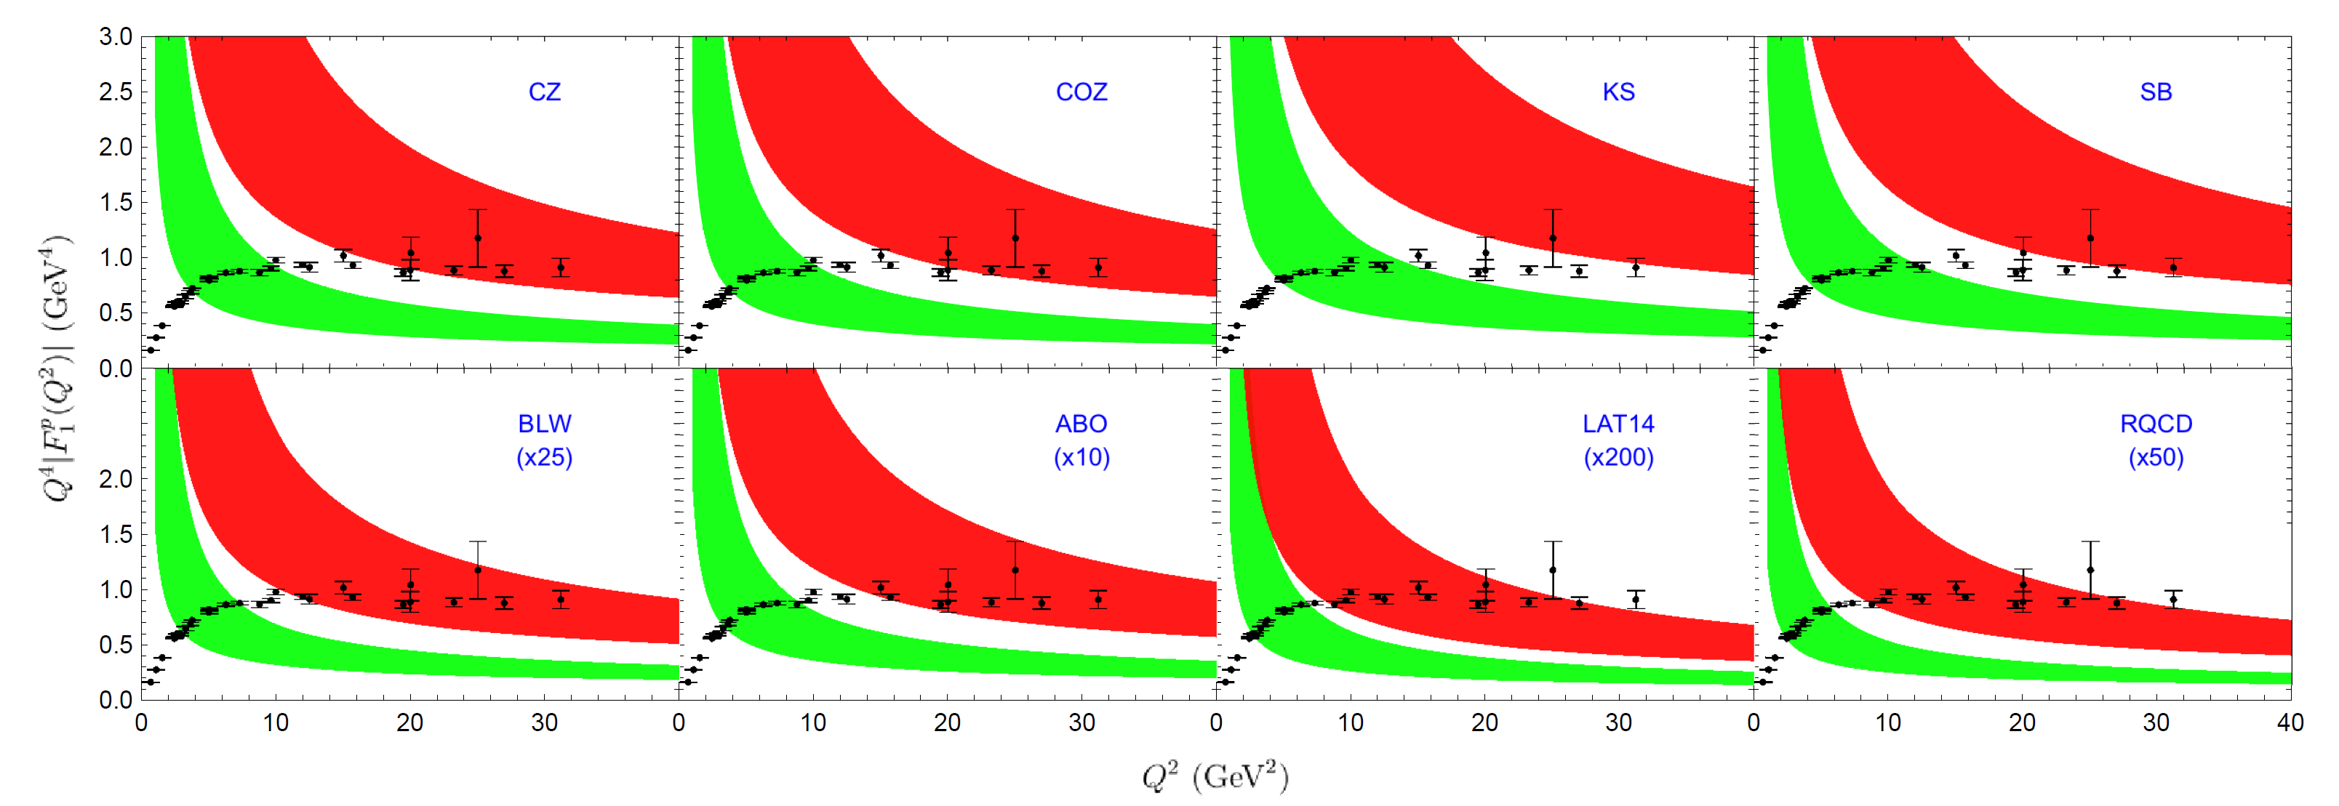
Space like FFs
$Q^{4}F_{1}^{p}(Q^{2})$-Proton

Slide 23
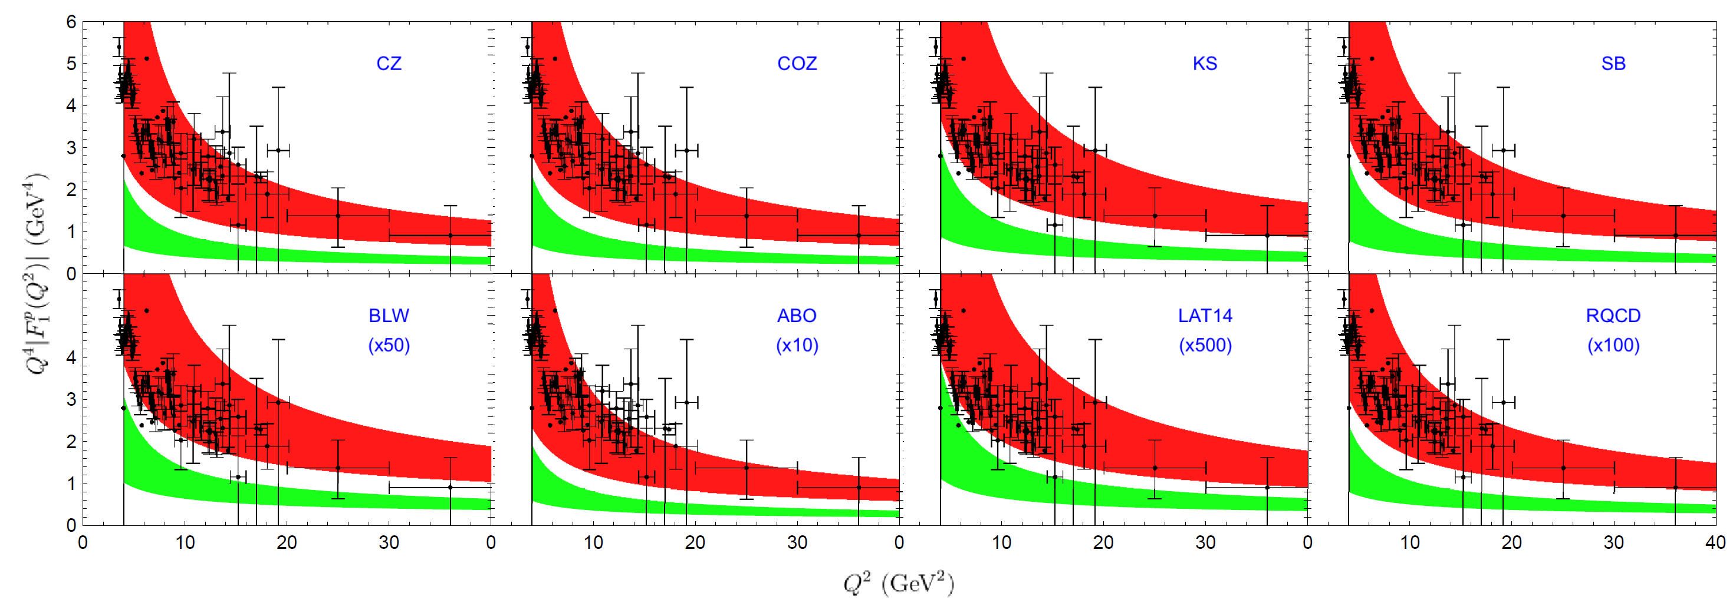
$Q^{4}F_{1}^{p}(Q^{2})$-Proton
Time like FFs

Slide 24
$Q^{4}F_{1}^{n}(Q^{2})$-Neutron
Space like FFs

Slide 25
$Q^{4}F_{1}^{n}(Q^{2})$-Neutron
Time like FFs

Slide 26
Conclusion
The EM form factors for kaon have been calculated up to NNLO QCD corrections.
The EM form factors for baryon have been calculated up to NLO QCD corrections after 50 years.
The matching kernel have been obtained analytically.
The QCD corrections turn out to be positive and significant.
Extend to more exclusive processes…
Combined with PMC [ Rep. Prog. Phys. 78 (2015) 126201] …

Slide 27
Thanks！

Slide 28
Relate to Experimental mesurement

