Slide 1
QCD corrections of $e^{+}e^{−}→J/ψ+c+\overline{c}$ using the principle of maximum conformality
黄旭东
重庆师范大学
Based on : PRD 110, 114010 (2024)
In collaboration with Xing-Gang Wu, Xu-Chang Zheng, Bin Gong and Jian-Xiong Wang
第七届全国重味物理与量子色动力学研讨会
21th Apr., 2025, 江苏.南京

Slide 2
Contents
1. Introduction and Motivation
2. Calculation of the NLO SDCs
3. Phenomenological results
4. Summary

Slide 3
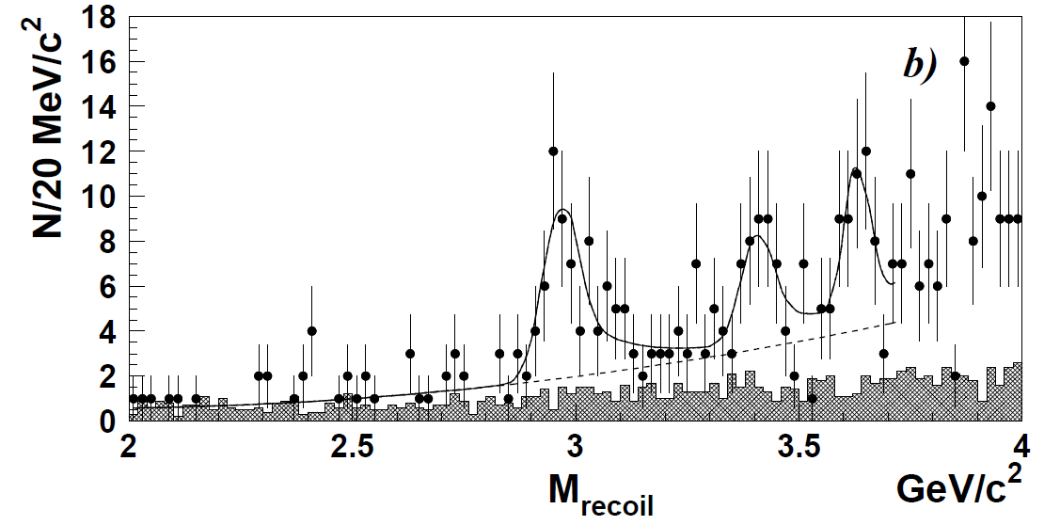
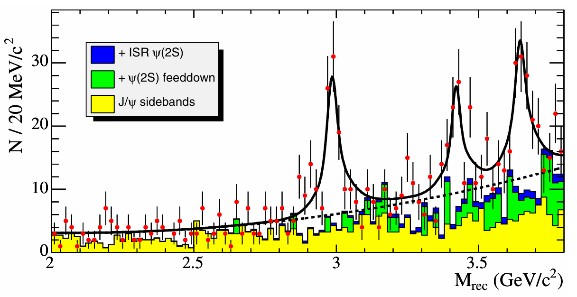
Background
For a long time, double $c\overline{c}$ production in $e^{+}e^{−}$ annihilation has been a focus of theoretical and experimental researches.
c
c
Experiment
Charmonium
Belle, PRL 89, 142001(2002)
BARBAR, PRD 72, 031101(R) (2005)
$σ(e^{+}e^{−}→J/ψ+c+\overline{c})$=$0.74±{\text{0.08 }}_{−0.08}^{+0.09}$ pb Belle, PRD 79, 071101(R) (2009)

Slide 4
Background
Theoretical Calculation
The Belle result is about a factor of 5 higher than the LO theoretical predictions.
V. V. Kiselev, A. K. Likhoded and M. V. Shevlyagin, Phys. Lett. B 332, 411 (1994)
P. Cho and A. K. Leibovich, Phys. Rev. D 54, 6690 (1996)
S. Baek, P. Ko, J. Lee and H. S. Song, J. Korean Phys. Soc. 33, 97 (1998)
F. Yuan, C. F. Qiao and K. T. Chao, Phys. Rev. D 56, 1663 (1997)
K. Y. Liu, Z. G. He, and K. T. Chao, Phys. Lett. B 557, 45 (2003).
Some theoretical studies were attempted in order to resolve the large discrepancy. Such as the color-octet contribution and the two-photon contribution.
K. Y. Liu, Z. G. He and K. T. Chao, Phys. Rev. D 68, 031501(R) (2003)
K. Y. Liu, Z. G. He and K. T. Chao, Phys. Rev. D 69, 094027 (2004)
The NLO NRQCD predictions is very significant, reduce the large discrepancy.
Y. J. Zhang and K. T. Chao, Phys. Rev. Lett. 98, 092003 (2007).
The momentum and production angular distribution for $J/ψ$ production at NLO.
B. Gong and J. X. Wang, Phys. Rev. D 80, 054015 (2009).

Slide 5
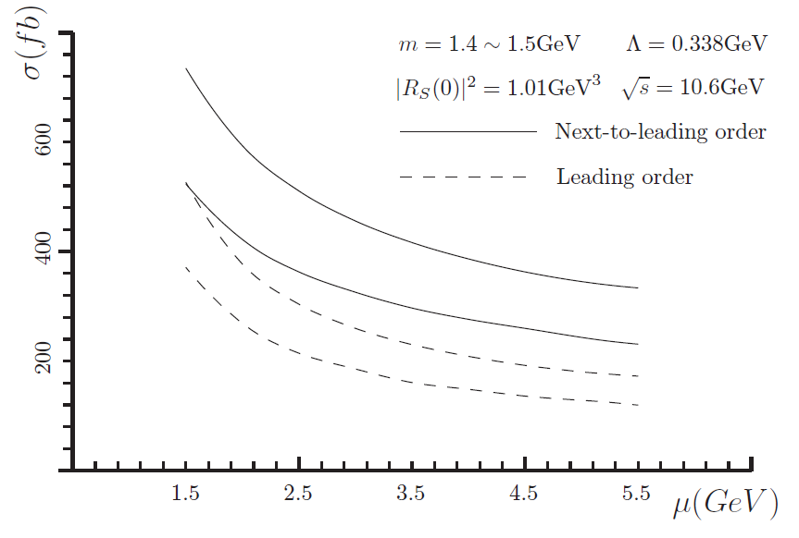
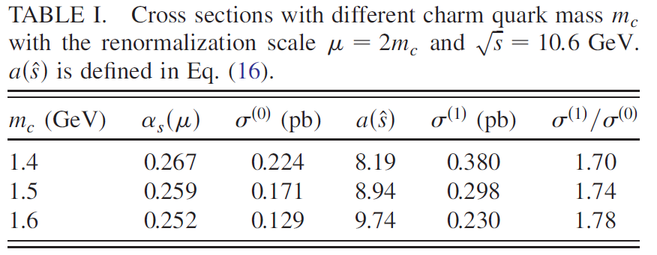
Motivation
1、The NLO corrections exist a large theoretical uncertainty. Sensitive to the renormalization scale and charm quark mass.
Reduce theoretical uncertainty
Y. J. Zhang and K. T. Chao, PRL. 98, 092003 (2007).
2、The NLO corrections are comparable with the LO corrections.
K factor$\sim$1.8
Improve its convenience
B. Gong and J. X. Wang, PRD 80, 054015 (2009).

Slide 6
Cross Sections
G.T. Bodwin, E. Braaten and G.P. Lepage, PRD 51, 1125 (1995)
Under the NRQCD factorization, the cross section for $e^{+}e^{−}→J/ψ+c+\overline{c}$ can be written as
$$σ{(e}^{+}e^{−}→J/ψ+c+\overline{c})$$
$=\hat{σ}(e^{+}e^{−}→\left(c\overline{c}\right)[ ^{3}S_{1}^{[1]}]+c+\overline{c}$)$×\left\langle 𝒪^{J/ψ}\right\rangle$
Short-distance coefficients (SDCs)
perturbative calculable
Long-distance matrix elements (LDMEs)
nonperturbative, universal
Separate the short-distance effect and long-distance dynamics
The LO cross section for $e^{+}e^{−}→J/ψ+c+\overline{c}$ is
$${σ_{LO}(e}^{+}e^{−}→J/ψ+c+\overline{c})=\frac{1}{4}\frac{1}{2s}\sum{{\left|A_{LO}\right|}^{2}}dΦ_{3}$$

Slide 7
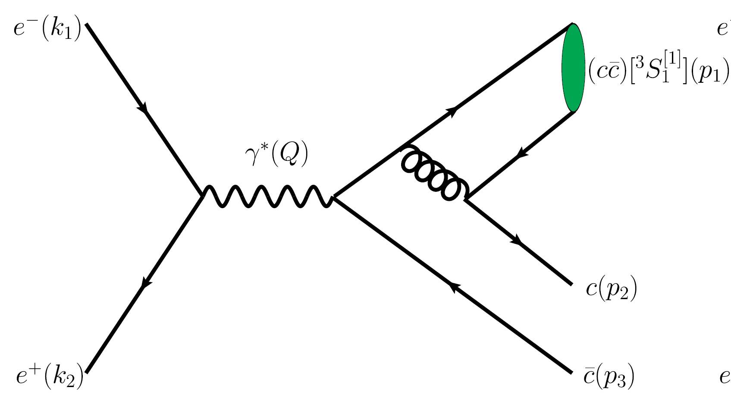
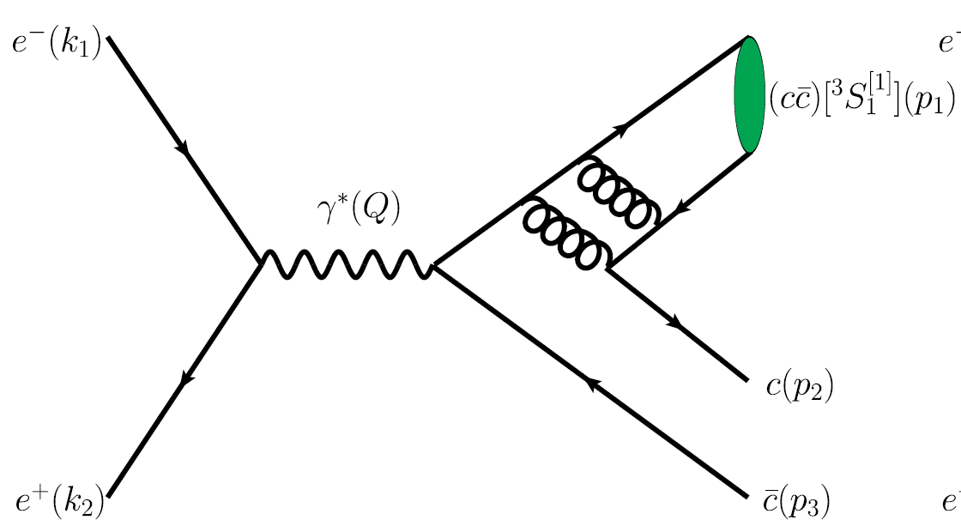
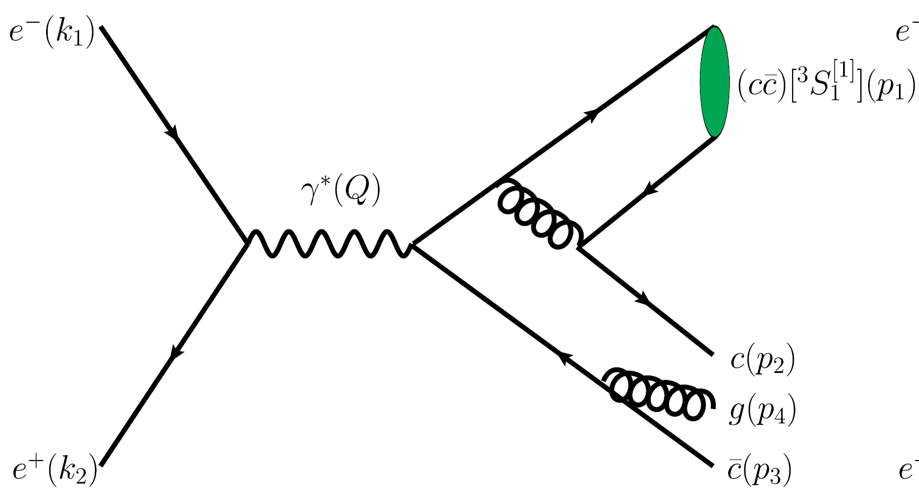
Calculation of the NLO SDCs
Nearly 100 one-loop diagrams for the process $e^{+}e^{−}→J/ψ+c+\overline{c}$
(FeynArts)
Handle the Lorentz index contraction and Dirac/SU(Nc) traces
(FeynCalc)
Perform partial fraction and IBP reduction
(Apart、FIRE)
Calculate the Feynman master integrals
(LoopTools)
Finish the phase-space integrations
(VEGAS)
T. Hahn, CPC. 140, 418 (2001)
LO
NLO-Virtual
NLO-Real
V. Shtabovenko, R. Mertig, and F. Orellana, CPC 207, 432 (2016)
F. Feng, CPC 183, 2158 (2012)
A. V. Smirnov, JHEP 10, 107 (2008)
T. Hahn and M. Perez-Victoria, CPC 118, 153 (1999).
G. P. Lepage, J. Comput. Phys. 27, 192 (1978).

Slide 8
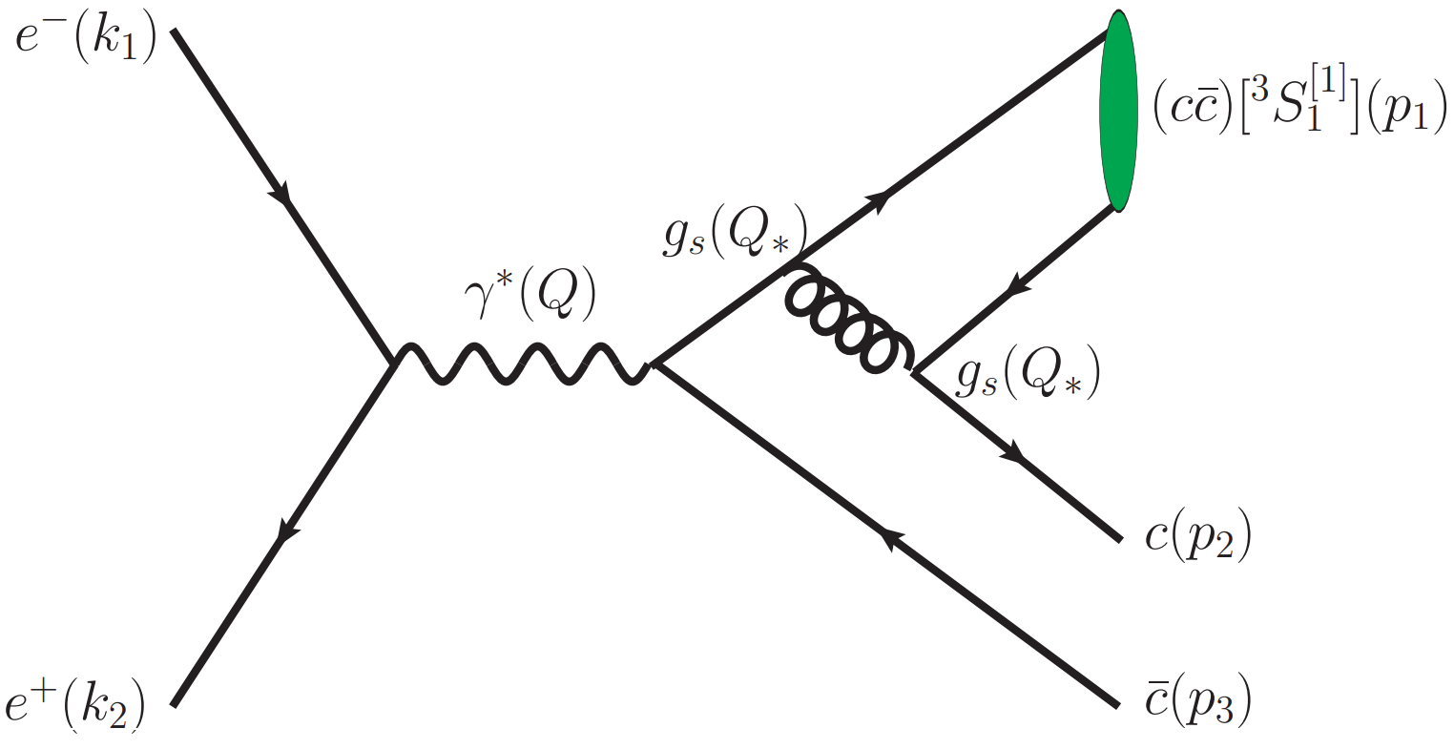
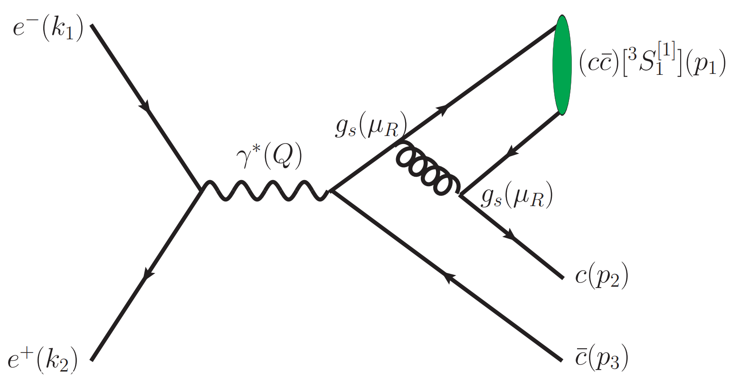
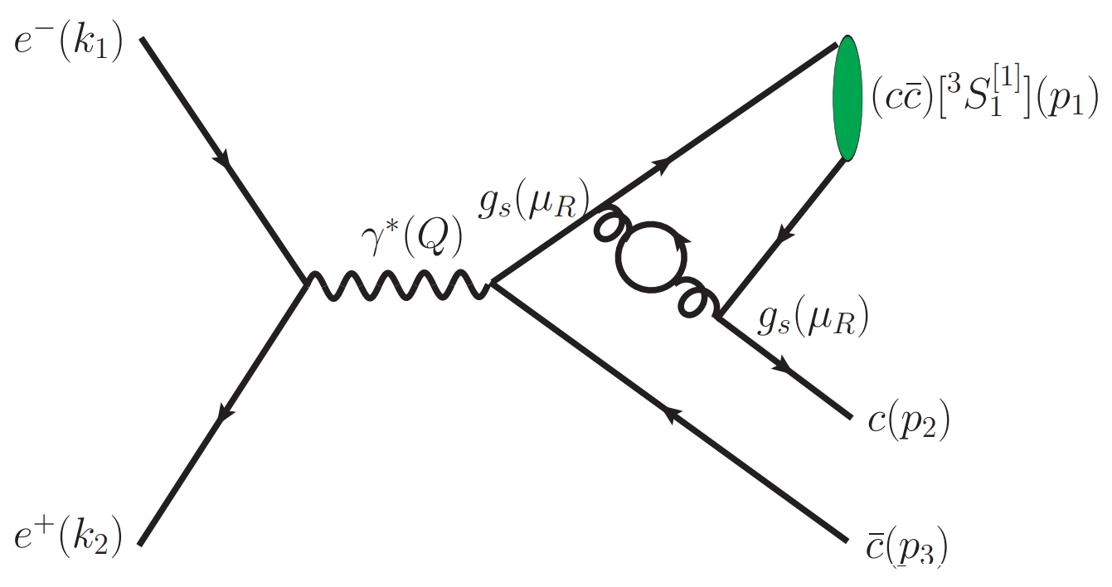
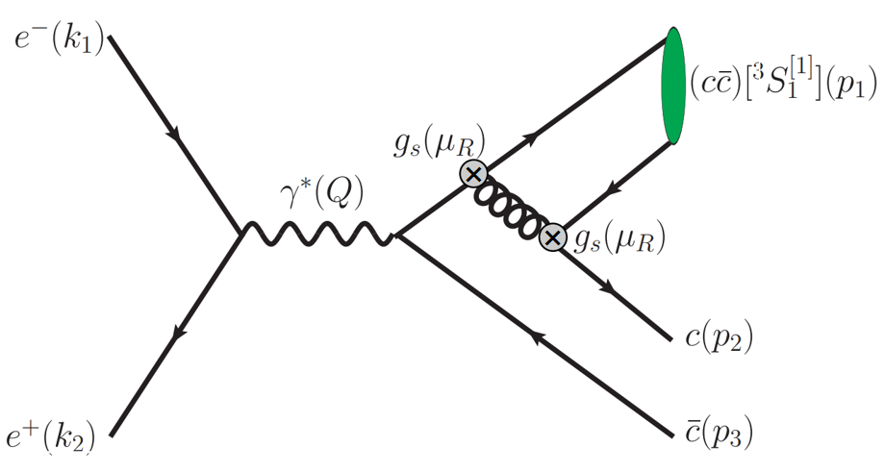
PMC
S. J. Brodsky and X. G. Wu, PRD 85, 034038 (2012)
S. J. Brodsky, M. Mojaza, and X. G. Wu, PRD 89, 014027 (2014).
The NLO cross section for $e^{+}e^{−}→J/ψ+c+\overline{c}$ is
$$σ_{NLO}=c_{1}a_{s}^{2}(μ_{R})+[c_{2,0}+c_{2,1}n_{f}]a_{s}^{3}(μ_{R})$$
$=r_{1,0}a_{s}^{2}(μ_{R})+[r_{2,0}+2r_{2,1}β_{0}]a_{s}^{3}(μ_{R})$
Resum all the known type of $β$-terms with the help of RGE
$$β(a_{s})=\frac{da_{s}(μ_{R})}{dlnμ_{R}^{2}}=−a_{s}^{2}(μ_{R})\sum_{i=0}^{∞}{β_{i}a_{s}^{i}(μ_{R})}$$
RGE:
The displacement relation:
$$a_{s}^{k}(μ_{1})=a_{s}^{k}(μ_{2})[1+kβ_{0}ln\frac{μ_{2}^{2}}{μ_{1}^{2}}a_{s}(μ_{2})+...]$$
Then the effective strong coupling $a_{s}(Q_{∗})$:
$$a_{s}^{2}(Q_{∗})←a_{s}^{2}(μ_{R})[1+2β_{0}\frac{r_{2,1}}{r_{1,0}}a_{s}(μ_{R})+...]$$
$$←$$
$$+$$
$$+$$
$$+...$$
$$σ_{NLO}^{PMC}=r_{1,0}a_{s}^{2}(Q_{∗})+r_{2,0}a_{s}^{3}(Q_{∗})$$

Slide 9
Phenomenological results
Input parameters:
PDG, PTEP 2022, 083C01 (2022).
B. Gong and J. X. Wang, PRD 80, 054015 (2009)
$\sqrt{s}=10.6GeV， m_{c}=1.5GeV$，$α=1/137，α_{s}\left(M_{z}\right)=0.1179$, ${\left|R_{s}^{J/ψ}(0)\right|}^{2}$=$0.918{GeV}^{3}$，
The NLO cross section (in pb) of $e^{+}e^{−}→J/ψ+c+\overline{c}$
$$\frac{ α_{s}^{3}\text{−}\text{order} }{α_{s}^{2}\text{−}\text{order}}$$
0.71
0.43
Central values are for $μ_{r}={2M}_{c}$ and their errors are for ${μ_{r}∈[M}_{c},4M_{c}]$
Renormalization scale uncertainties: 123% 15% 74%
PMC salce $Q_{∗}=1.72GeV$

Slide 10
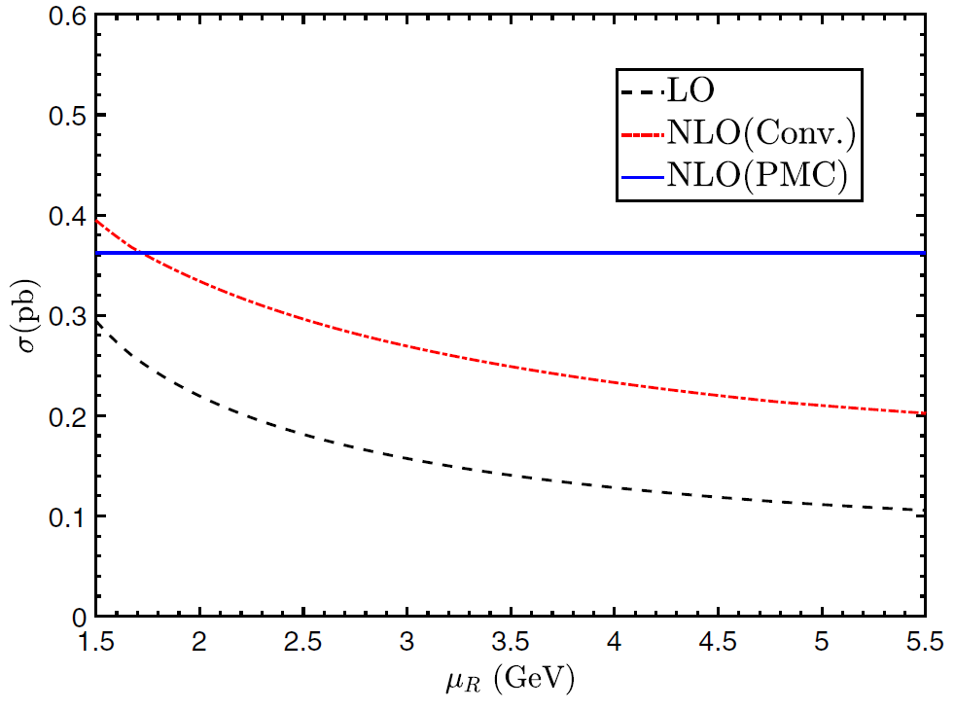
Renormalization scales $μ_{R}$ dependence
The $μ_{R}$ dependence of the cross section at LO and NLO.

Slide 11
Estimation of the uncalculated higher-order
Pad$\acute{e}$ Approximation Approach (PAA)
M. A. Samuel et al., Phys. Rev. Lett. 74, 4380 (1995).
B. L. Du, X. G. Wu, J.M. Shen, and S. J. Brodsky, EPJC 79, 182 (2019).

Slide 12
Theoretical uncertainties
Uncertainties caused by$α_{s} (Mz)$=0.1179$±$0.0010
Uncertainties caused by$M_{c}$=${1.5}_{−\text{0.1}}^{+\text{0.1}}$GeV
Final predictions
The net uncertainty from changes down from 108% of the conventional series to 54% of the PMC series.

Slide 13
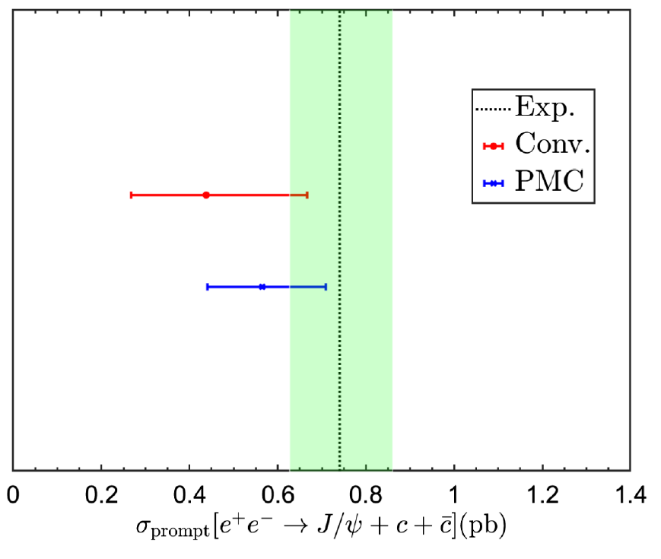
NLO cross section
The prompt NLO cross section of $e^{+}e^{−}→J/ψ+c+\overline{c}$
Exp.
$0.74±{0.08}_{−0.08}^{+0.09}$pb
Conv.
$${0.437}_{−0.170}^{+0.228} pb$$
PMC
$${0.564}_{−0.125}^{+0.144} pb$$

Slide 14
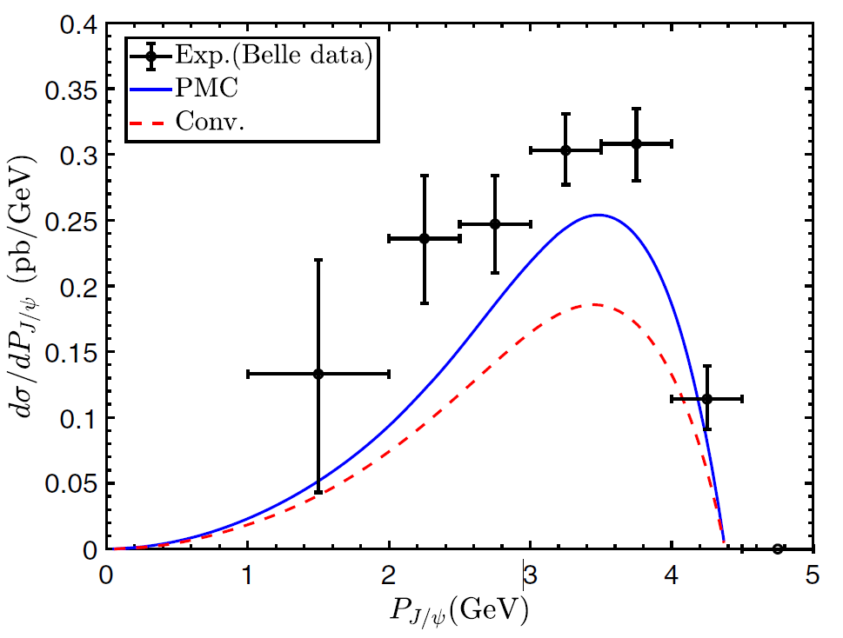
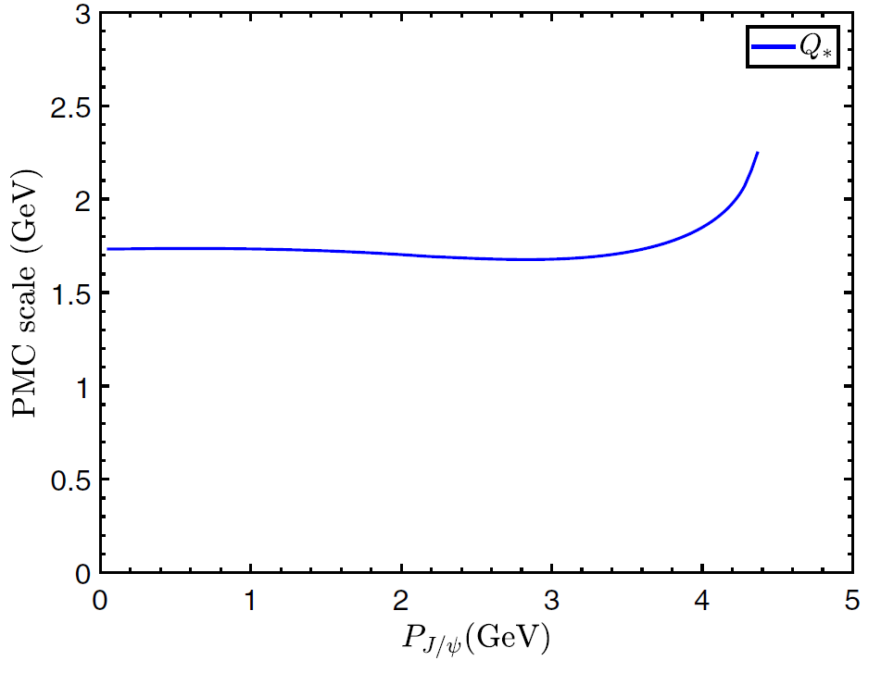
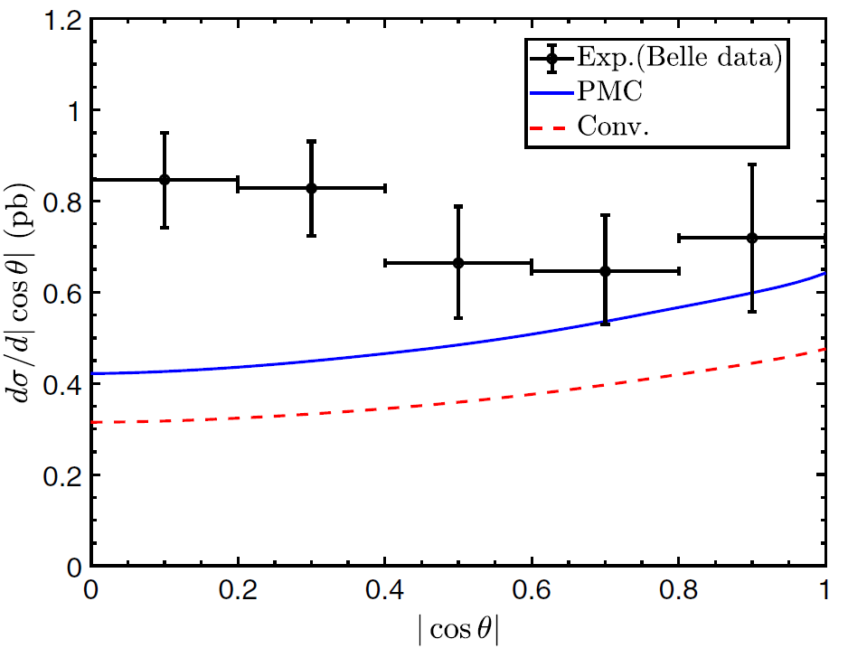
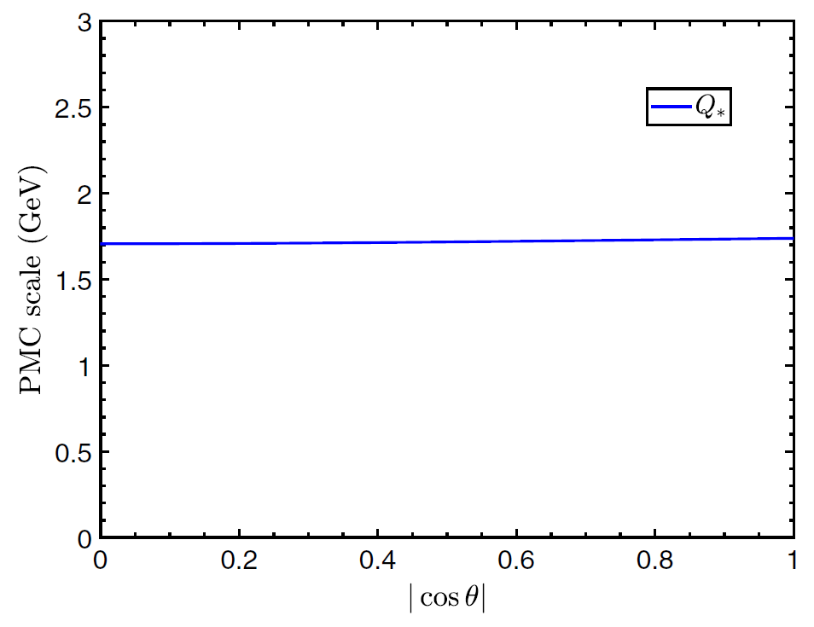
NLO differential cross section

Slide 15
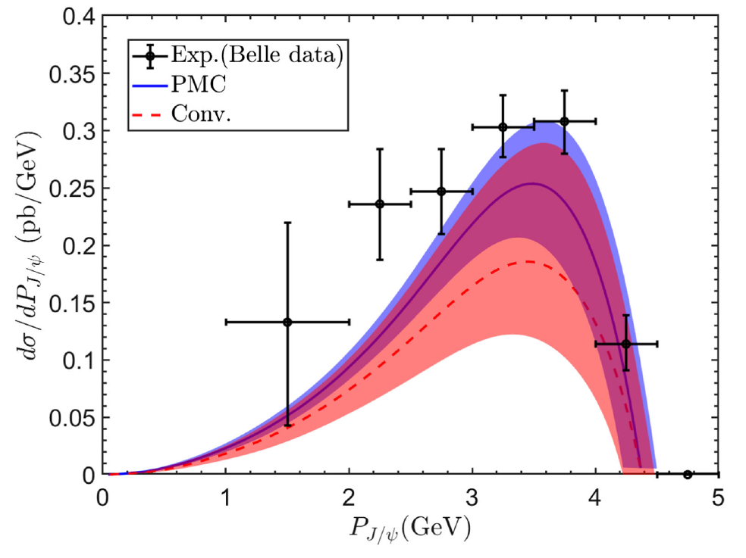
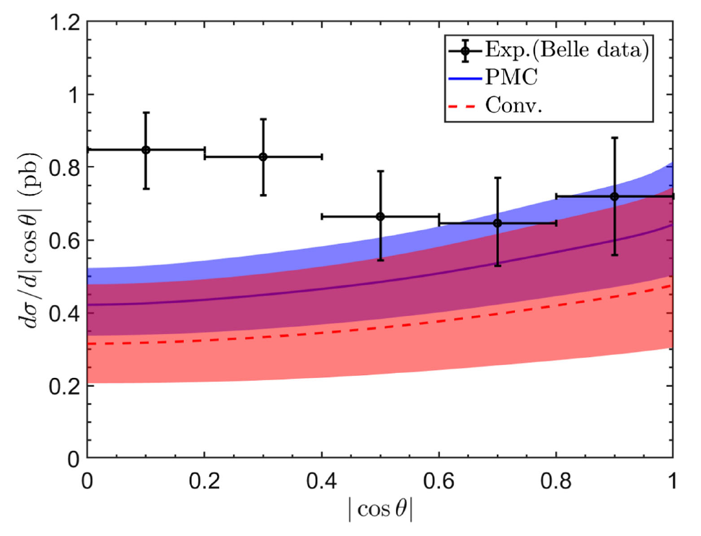
NLO differential cross section
Agree well
Exist discrepancy
The Self-consistency of PMC to integrated and differential cross sections

Slide 16
Summary
The perturbative convergence behavior of the cross section for $e^{+}e^{−}→J/ψ+c+\overline{c}$ is improved.
The $μ_{R}$ dependence of the cross section for $e^{+}e^{−}→J/ψ+c+\overline{c}$ is reduced.
The total and momentum differential cross section can agree well with the Belle measurements.
The self-consistency of PMC to integrated and differential cross sections
Thanks！

