Slide 1


正负电子对撞机上重味多夸克态产生机制的研究
马鸿浩
广西师范大学
In collaboration with 牛娟娟、陶正奎、石斌斌
Based on: Phys.Rev.D 111, 014019 (2025)
Eur.Phys.J.C 85, 397 (2025)
第七届全国重味物理和量子色动力学研讨会
April 18th -22th 2025,南京师范大学

Slide 2
Contents
Background and motivation
Production of doubly charmed tetraquark
Production of fully charmed tetraquark
Summary

Slide 3
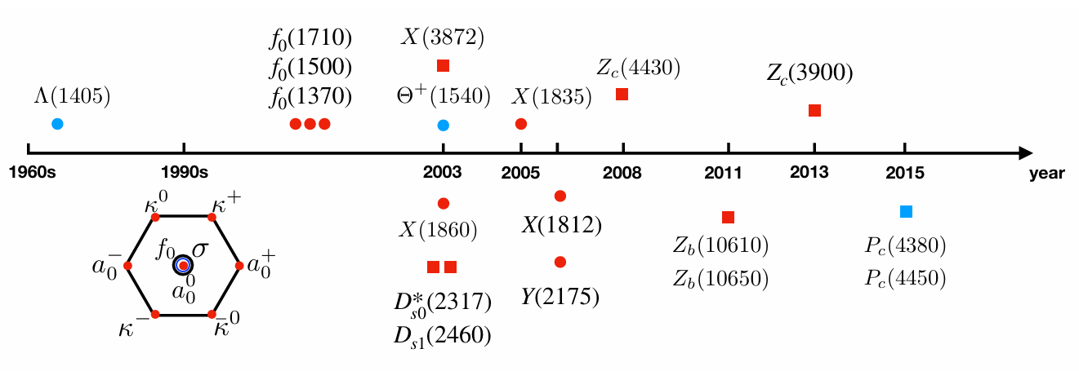
Motivation
Motivation
Doubly charmed tetraquark
Fully charmed tetraquark
Summary
粲奇异介子D_{S0}*(2317) by BABAR (2003)
类粲偶素 X(3872) by Belle (2003)
Z_{C}(3900) by BESIII and Belle (2013)
五夸克态P_{C} states by LHCb (2015)
, X (6900)
Y. R. Liu, H. X. Chen, W. Chen, X. Liu and S. L. Zhu,
Prog. Part. Nucl. Phys. 107, 237 (2019)

Slide 4
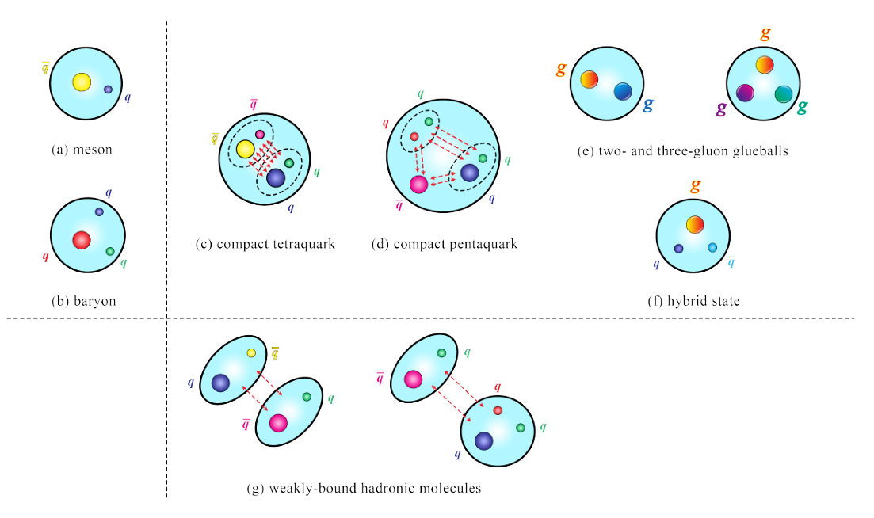
Motivation
Doubly charmed tetraquark
Fully charmed tetraquark
Summary
这些奇特强子态是近年来强子物理研
究的焦点之一，它们的发现为我们理解
低能强相互作用提供了新的平台和
机遇，同时也带来了很大的挑战。
Sum Rule、HQEFT和BOEFT等
H.X. Chen, W. Chen, X. Liu, Y.R. Liu, S.L. Zhu, Rep. Prog. Phys. 86, 026201 (2023).

Slide 5
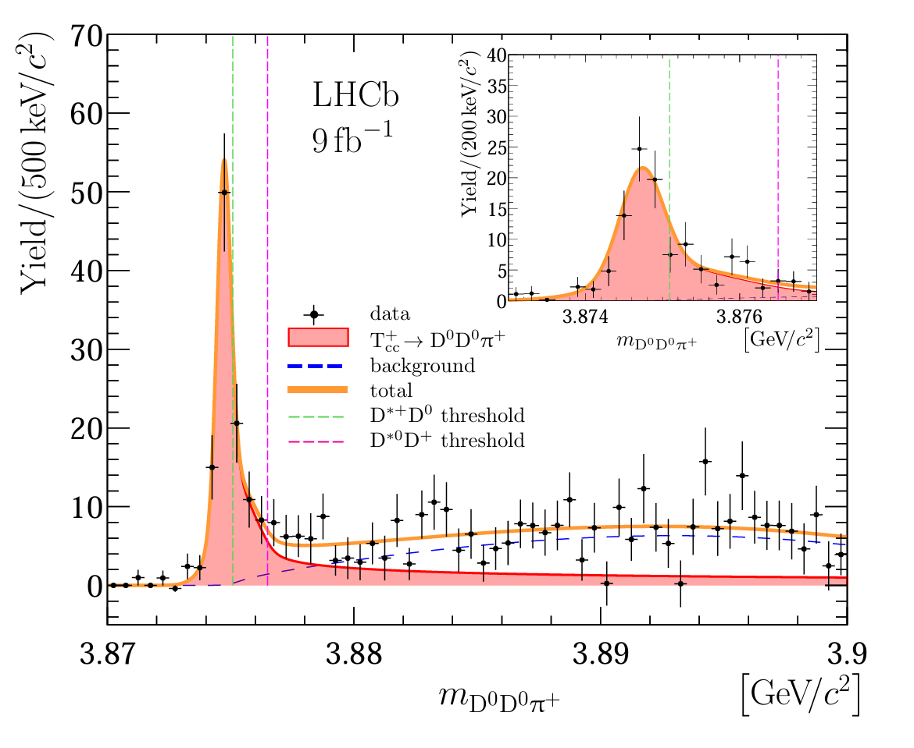
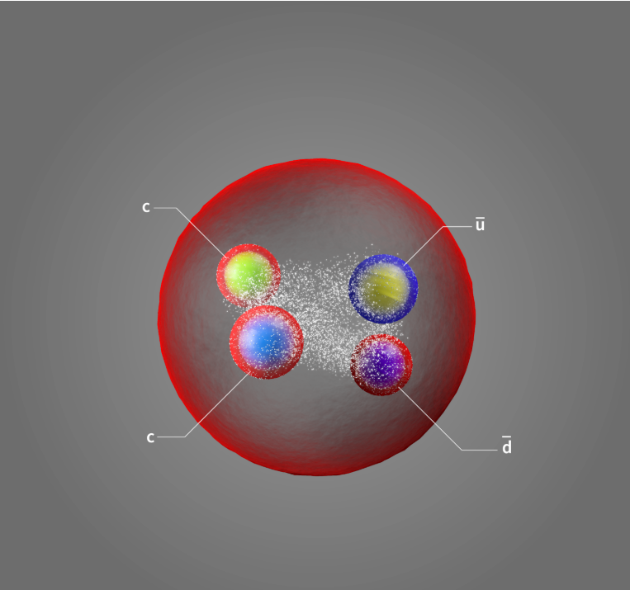
Motivation
Doubly charmed tetraquark
Fully charmed tetraquark
Summary
N. Li, Z. F. Sun, X. Liu and S. L. Zhu,
Phys. Rev. D 88, 114008 (2013) (理论预言)
R. Aaij et al. [LHCb], Nature Phys. 18, 751-754 (2022)
R. Aaij et al. [LHCb], Nature Commun. 13, 3351 (2022)

Slide 6
Motivation
Doubly charmed tetraquark
Fully charmed tetraquark
Summary
Meson molecule ?
Z. G. Wang and T. Huang, Eur. Phys. J. C 74, 2891 (2014).
F. K. Guo, C. Hanhart, U. G. Meißner, Q. Wang, Q. Zhao,
and B. S. Zou, Rev. Mod. Phys. 90, 015004 (2018); 94, 029901(E) (2022).
Hadroquarkonium ?
J. Ferretti and E. Santopinto, , J. High Energy Phys. 04 (2020) 119.

Slide 7
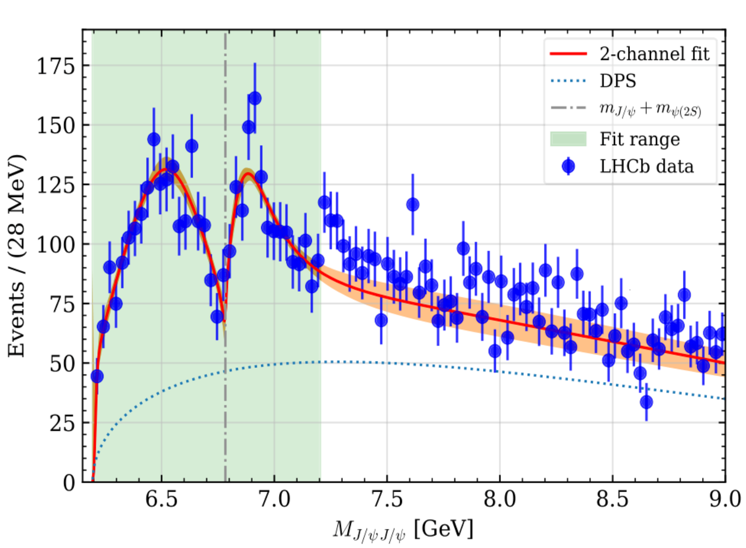
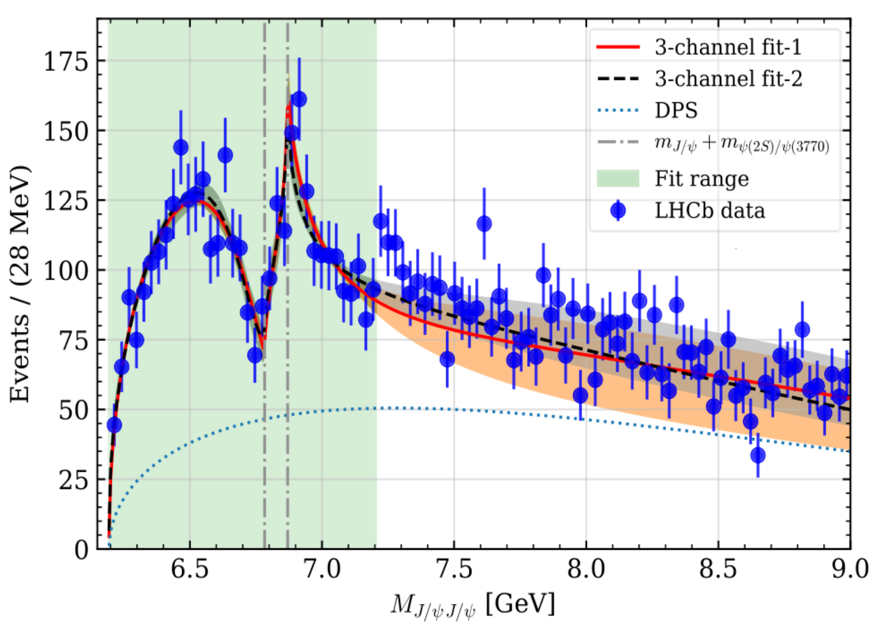
Motivation
Doubly charmed tetraquark
Fully charmed tetraquark
Summary
X (6900)
R. Aaij et al. [LHCb]Sci. Bull.65, 1983-1993 (2020).
X. K. Dong, V. Baru, F. K. Guo, C. Hanhart and A. Nefediev,
Phys. Rev. Lett. 126, 132001(2021)
[erratum: Phys. Rev. Lett. 127, 119901 (2021)]

Slide 8
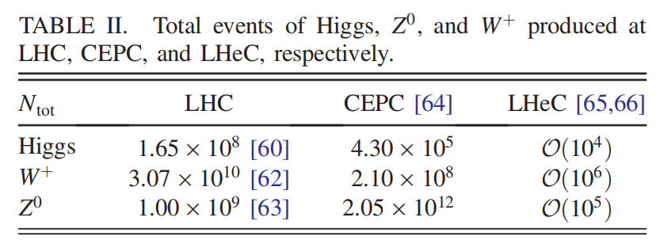
Motivation
Doubly charmed tetraquark
Fully charmed tetraquark
Summary
中国环形正负电子对撞机（CEPC）
Relatively clean background
High resolution and detection ability
Super factory of Higgs, W⁺ and Z⁰

Slide 9
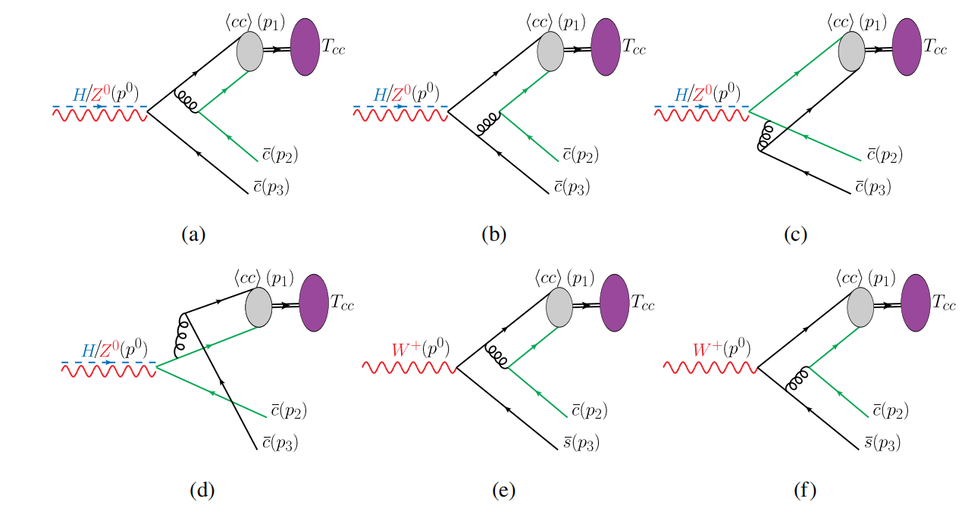
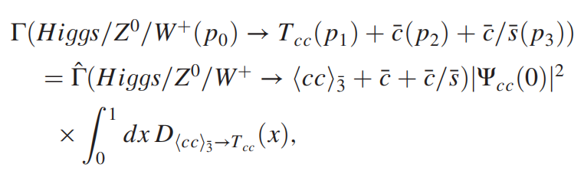
Production of doubly charmed tetraquark
Motivation
Doubly charmed tetraquark
Fully charmed tetraquark
Summary
J. J. Niu, B. B. Shi, Z. K. Tao and H. H. Ma, PRD 111, 014019 (2025)
NRQCD因子化
perturbative region
nonperturbative region
G. T. Bodwin, E. Braaten and G. P. Lepage, Phys. Rev. D 51, 1125 (1995).
A. F. Falk, M. E. Luke, M. J. Savage and M. B. Wise, Phys. Rev. D 49, 555-558 (1994).

Slide 10
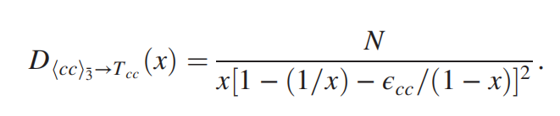
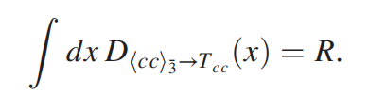
Motivation
Doubly charmed tetraquark
Fully charmed tetraquark
Summary
NRQCD因子化
Peterson model
=?
C. Peterson, D. Schlatter, I. Schmitt, and P. M. Zerwas, Phys. Rev. D 27, 105 (1983).
Y. q. Chen and S. z. Wu, Phys. Lett. B 705, 93 (2011).

Slide 11
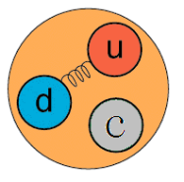
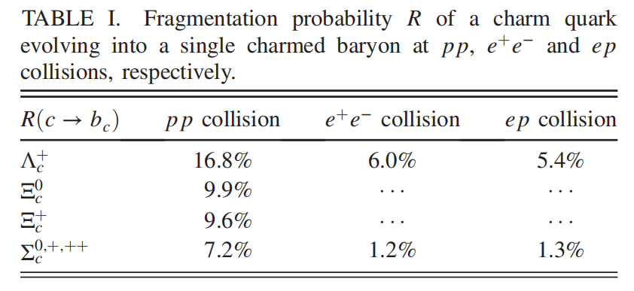

Motivation
Doubly charmed tetraquark
Fully charmed tetraquark
Summary
Figure from BEPC
(cc) diquark in color antitriplet acting as an antiquark has a heavy diquark-antiquark symmetry (HDAS)
Y. q. Chen and S. z. Wu, Phys. Lett. B 705, 93 (2011).

Slide 12
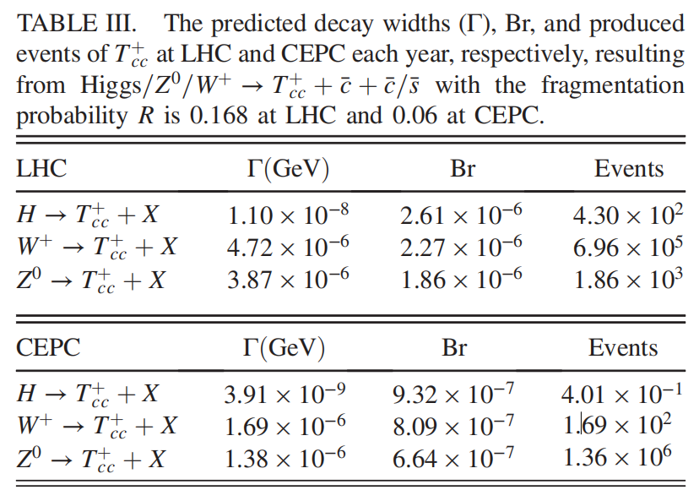

Motivation
Doubly charmed tetraquark
Fully charmed tetraquark
Summary
Branching ratio, events, and distributions
Consistent with the prediction made by
Qin Qin et al CPC 45,103106(2021 )!
Instead of HDAS model, one can also use the harmonic oscillator potential (HOP) to obtain the long distance matrix elements (LDMEs).
不确定性较大！
J. Jiang, S. Y. Li, X. Liang, Y. R. Liu, Z. G. Si and Z. J. Yang, [arXiv:2412.08045]
T. Hyodo, Y. R. Liu, M. Oka, K. Sudoh and S. Yasui, Phys. Lett. B 721, 56-60 (2013)

Slide 13
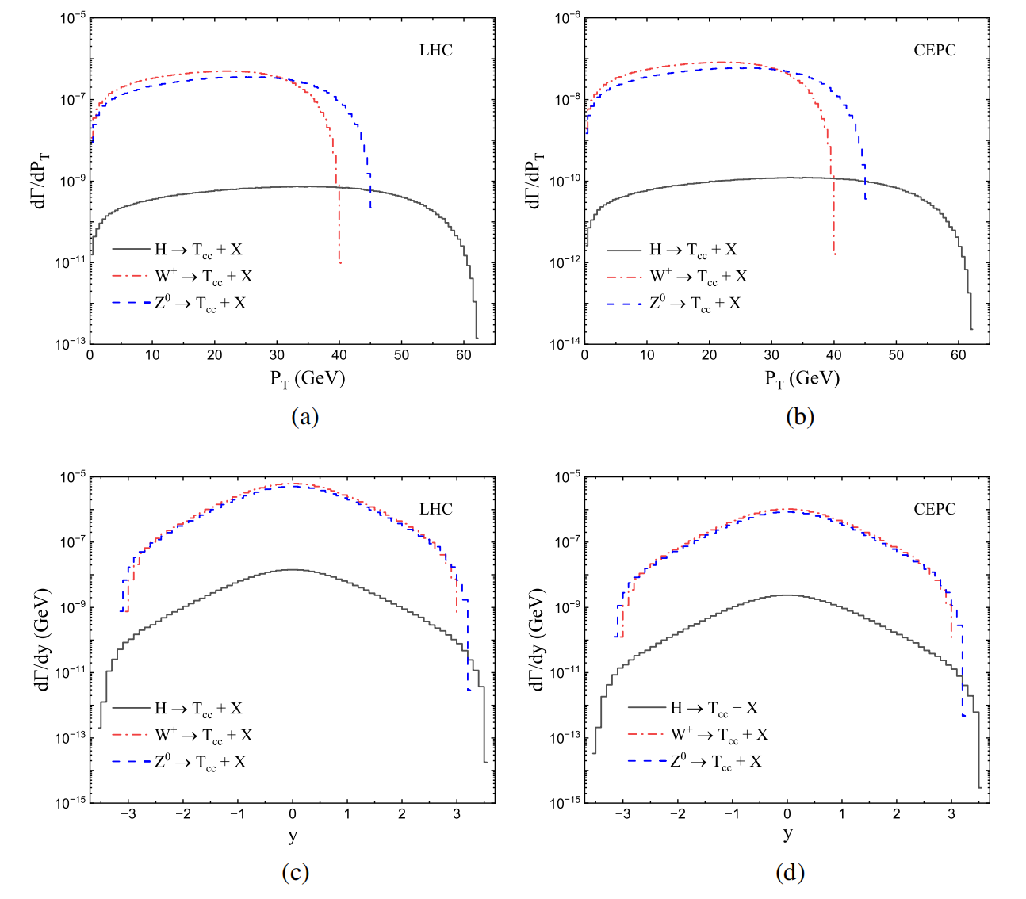
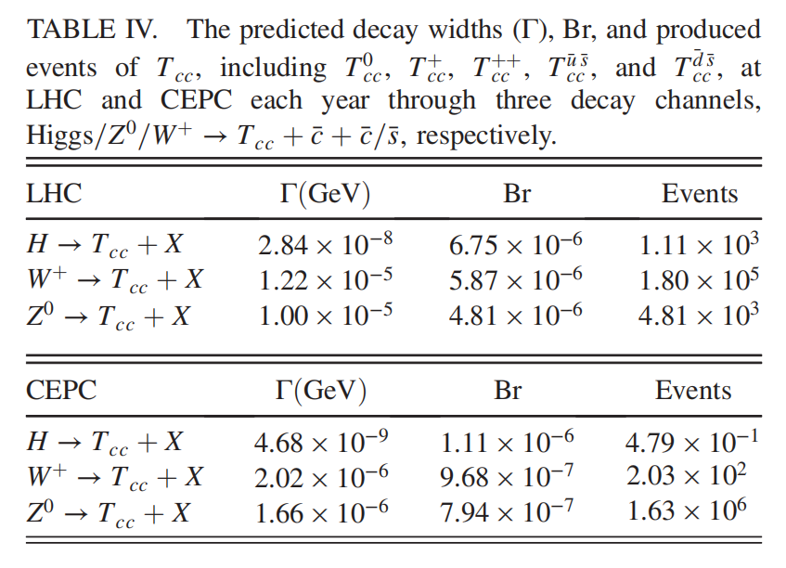
Motivation
Doubly charmed tetraquark
Fully charmed tetraquark
Summary
Branching ratio, events, and distributions

Slide 14
Motivation
Doubly charmed tetraquark
Fully charmed tetraquark
Summary
小结
CEPC provides a good experimental platform for study doubly charmed tetraquark.
LHC is very likely to find other components of .

Slide 15
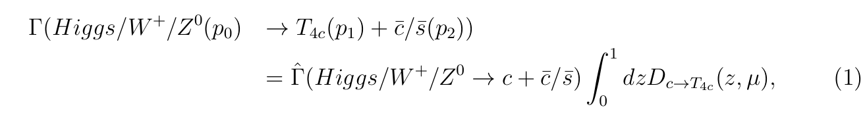
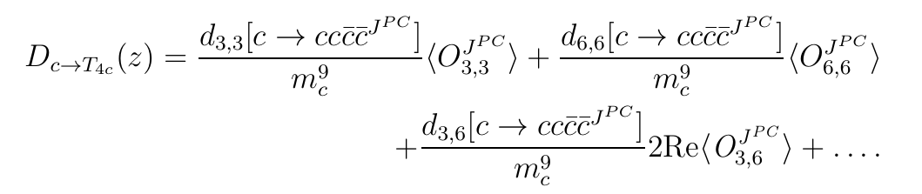
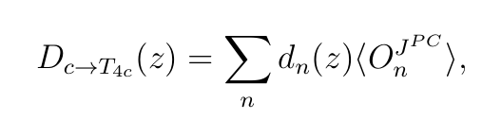
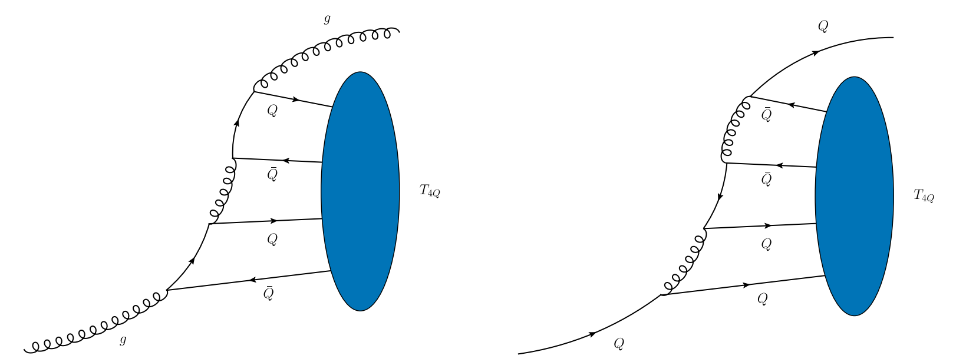
Production of fully charmed tetraquark
Motivation
Doubly charmed tetraquark
Fully charmed tetraquark
Summary
H. H. Ma, Z. K. Tao and J. J. Niu,[arXiv:2502.20891].
F. Feng, Y. Huang, Y. Jia, W. L. Sang, X. Xiong and J. Y. Zhang, Phys. Rev. D 106, 114029 (2022).
X. W. Bai, F. Feng, C. M. Gan, Y. Huang, W. L. Sang and H. F. Zhang, JHEP 09, 002 (2024)

Slide 16
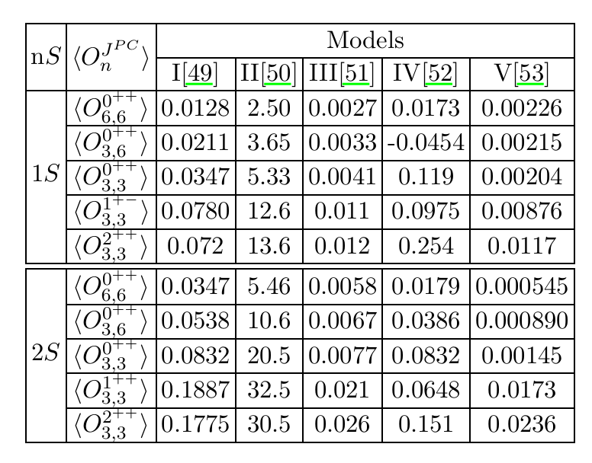
Motivation
Doubly charmed tetraquark
Fully charmed tetraquark
Summary
[49] Q. F. Lu, D. Y. Chen and Y. B. Dong, Eur. Phys. J. C 80, 871 (2020).
[50] J. Zhao, S. Shi and P. Zhuang, Phys. Rev. D 102, 114001 (2020).
[51] M. S. liu, F. X. Liu, X. H. Zhong and Q. Zhao, Phys. Rev. D 109, 076017 (2024).
[52] G. L. Yu, Z. Y. Li, Z. G. Wang, J. Lu and M. Yan, Eur. Phys. J. C 83, 416 (2023).
[53] G. J. Wang, L. Meng and S. L. Zhu, Phys. Rev. D 100, 096013 (2019).

Slide 17

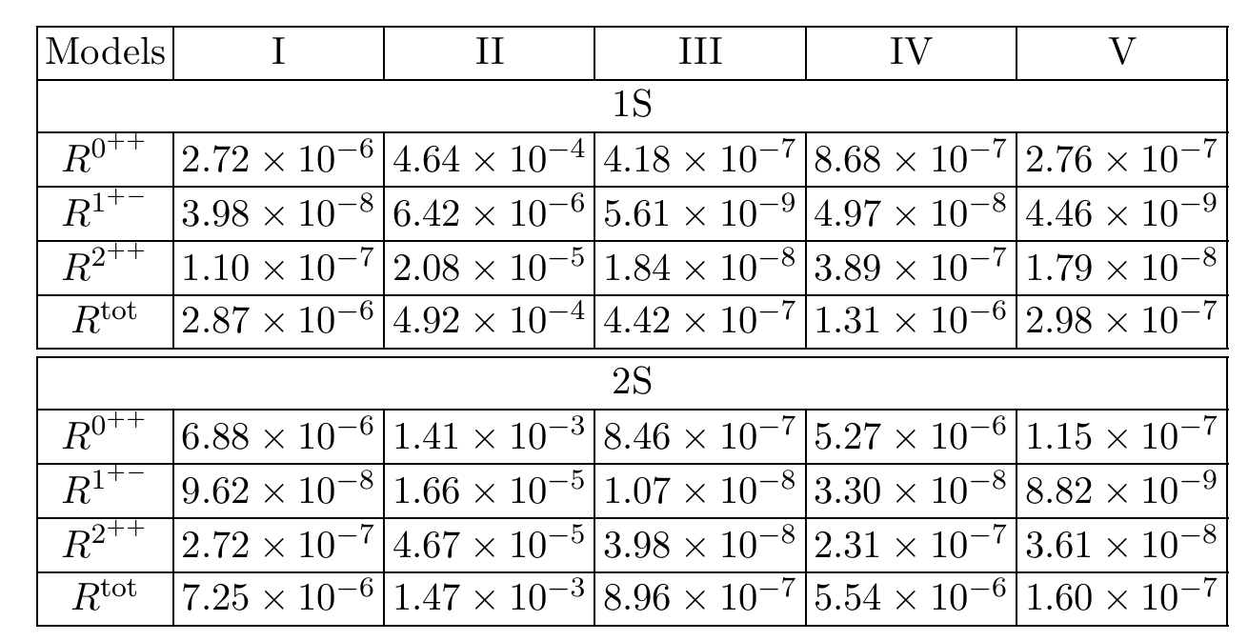
Motivation
Doubly charmed tetraquark
Fully charmed tetraquark
Summary
Fragmentation probability R of a charm quark c evolving into Fully charmed tetraquark

Slide 18
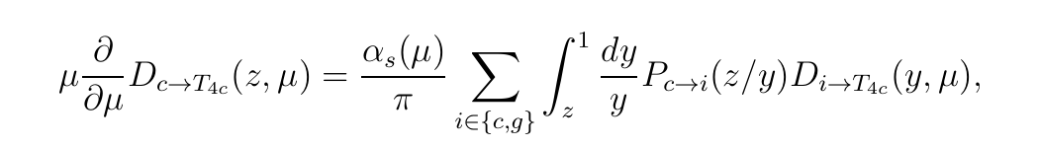
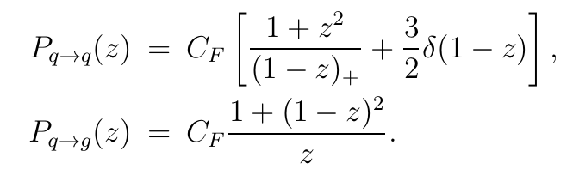
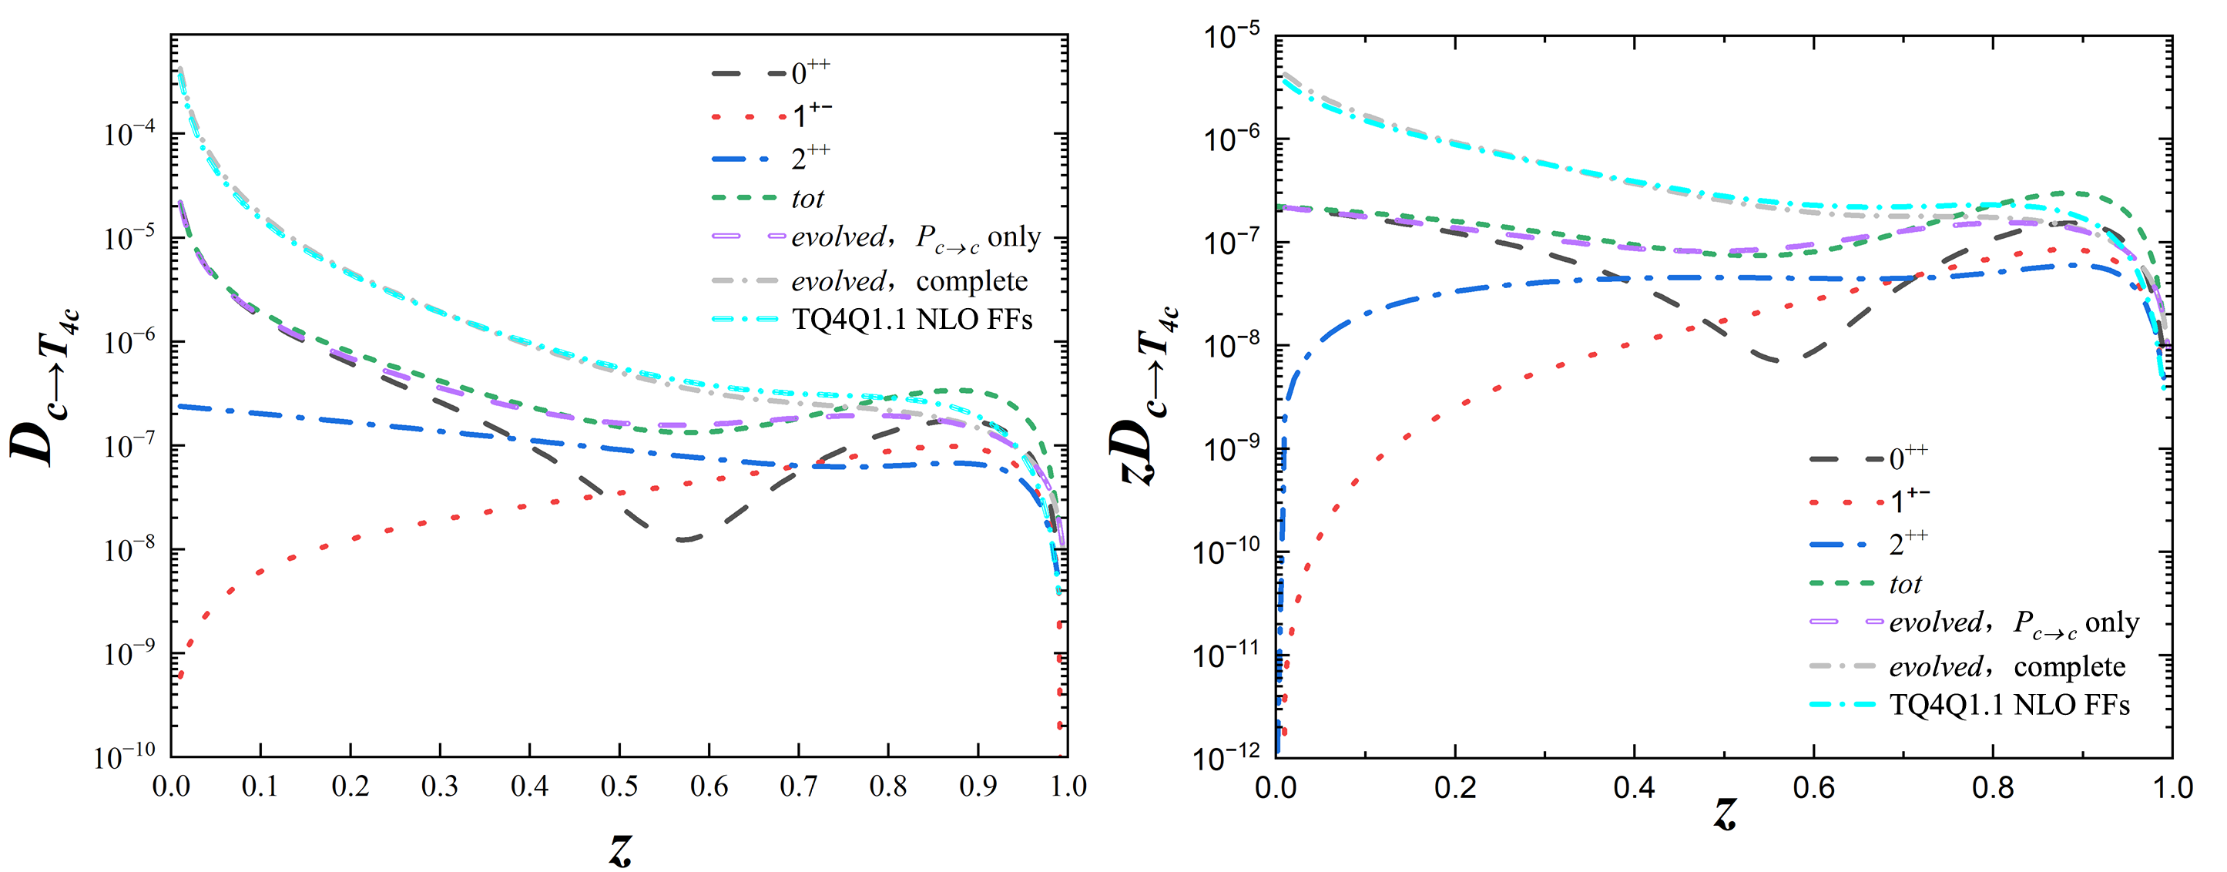
DGLAP evolvuation
Motivation
Doubly charmed tetraquark
Fully charmed tetraquark
Summary
TQ4Q1.1: F. G. Celiberto, G. Gatto and A. Papa, Eur. Phys. J. C 84, 1071 (2024)
FFEVOL:M. Hirai and S. Kumano, Comput. Phys. Commun. 183, 1002-1013 (2012)
近似解析或数值求解：APFEL(++) , EKO, FFEVOL or LHAPDF grids TQ4Q1.1

Slide 19
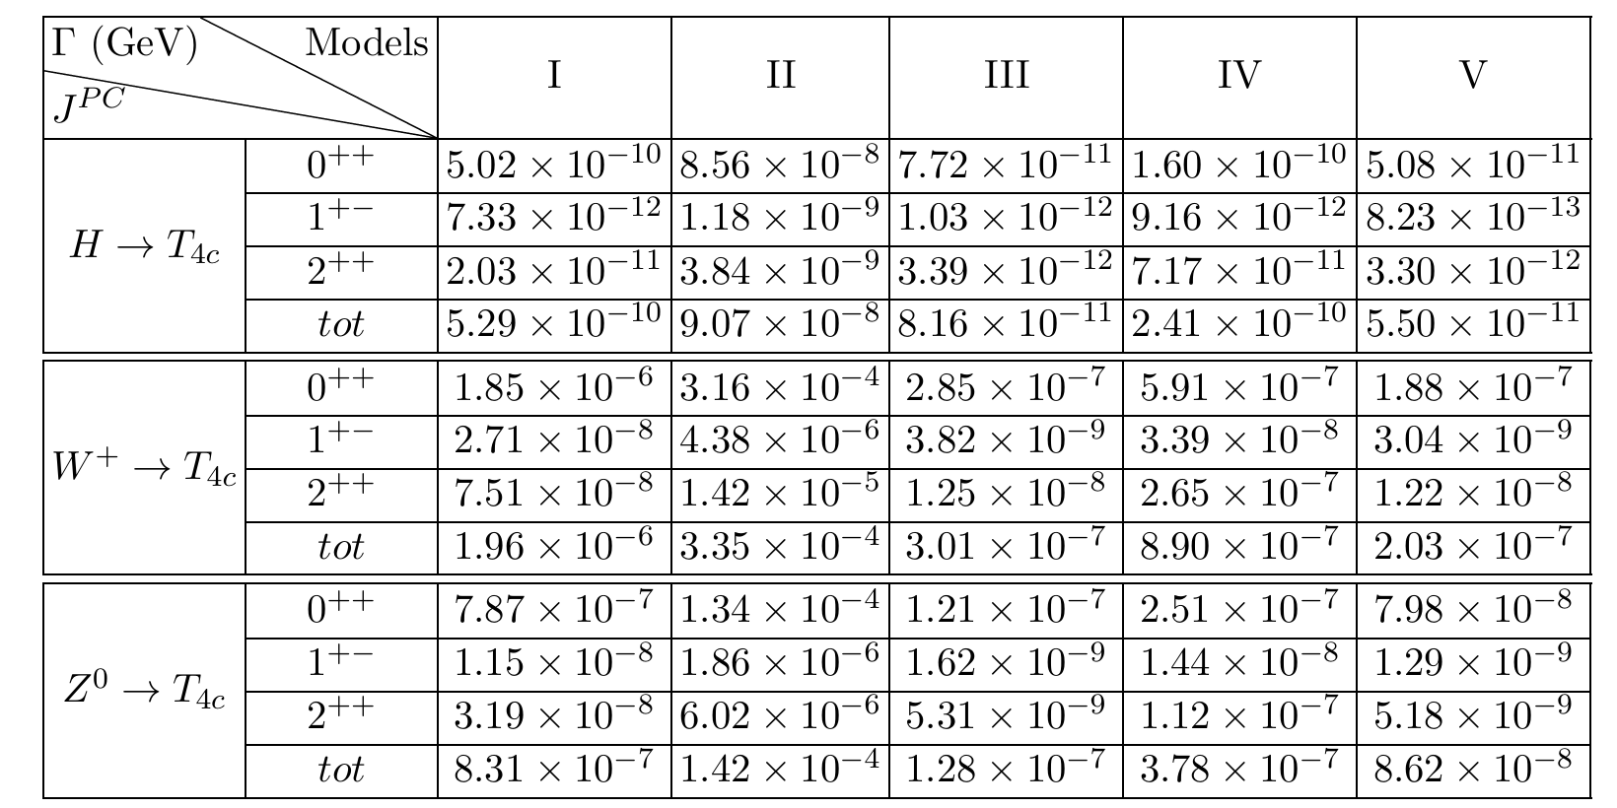
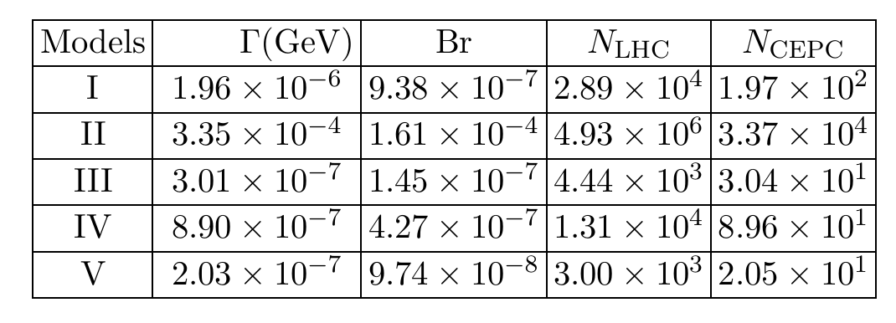
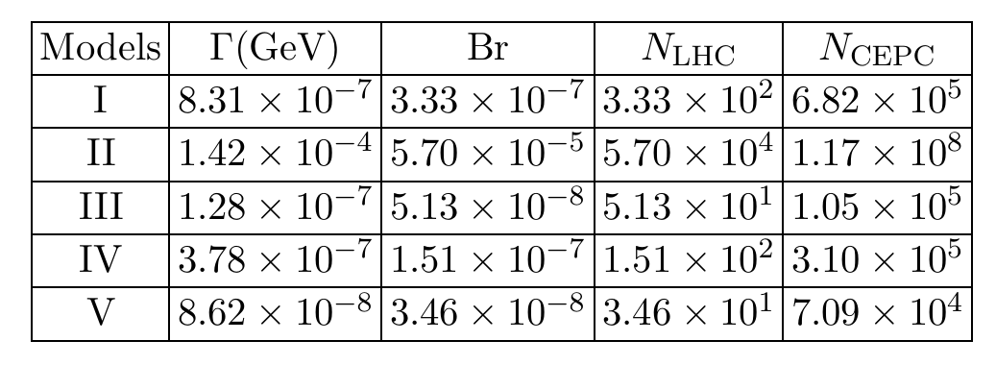
Motivation
Doubly charmed tetraquark
Fully charmed tetraquark
Summary
Decay width，branching ratio，and events
decays
decays
Higgs decays channel is too small to be negligible!

Slide 20
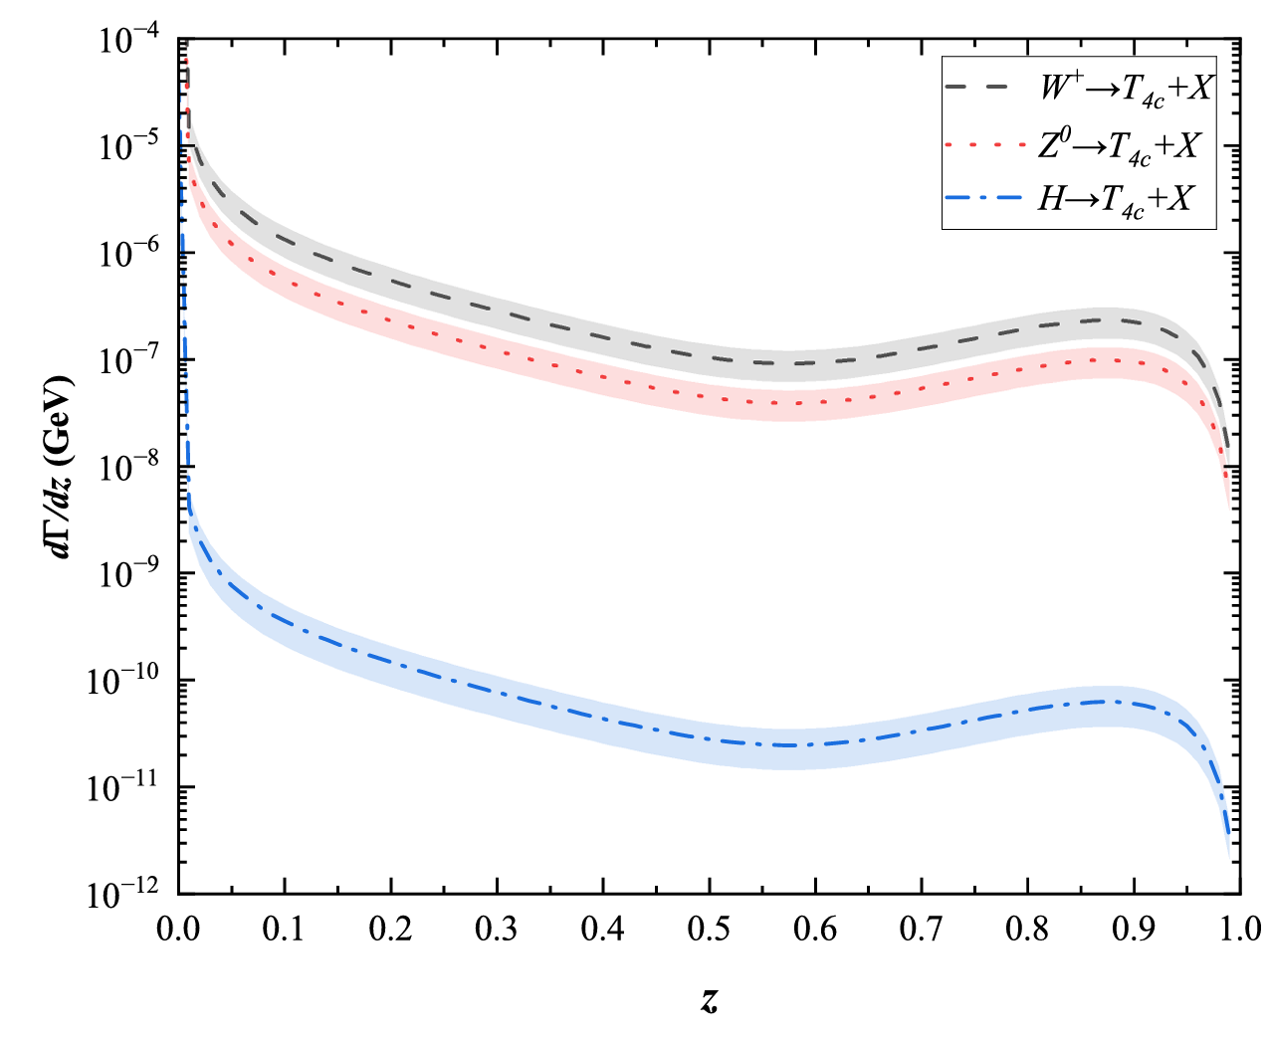
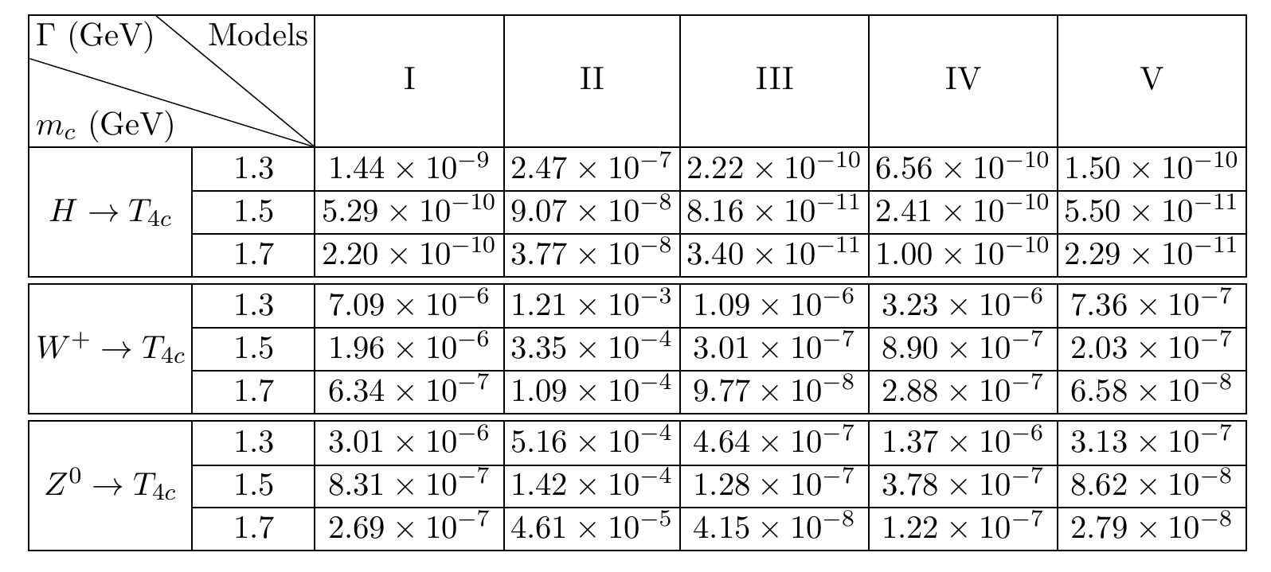

Motivation
Doubly charmed tetraquark
Fully charmed tetraquark
Summary
Theoretical uncertainty

Slide 21
Summary
Motivation
Doubly charmed tetraquark
Fully charmed tetraquark
Summary
CEPC provides a good experimental platform for study doubly charmed and fully charmed tetraquarks.
LHC is very likely to find other components of .
The production of tetraquarks is very model-dependent and requires stronger theoretical and experimental constraints.

Slide 22
Thanks for your attention!

Slide 23
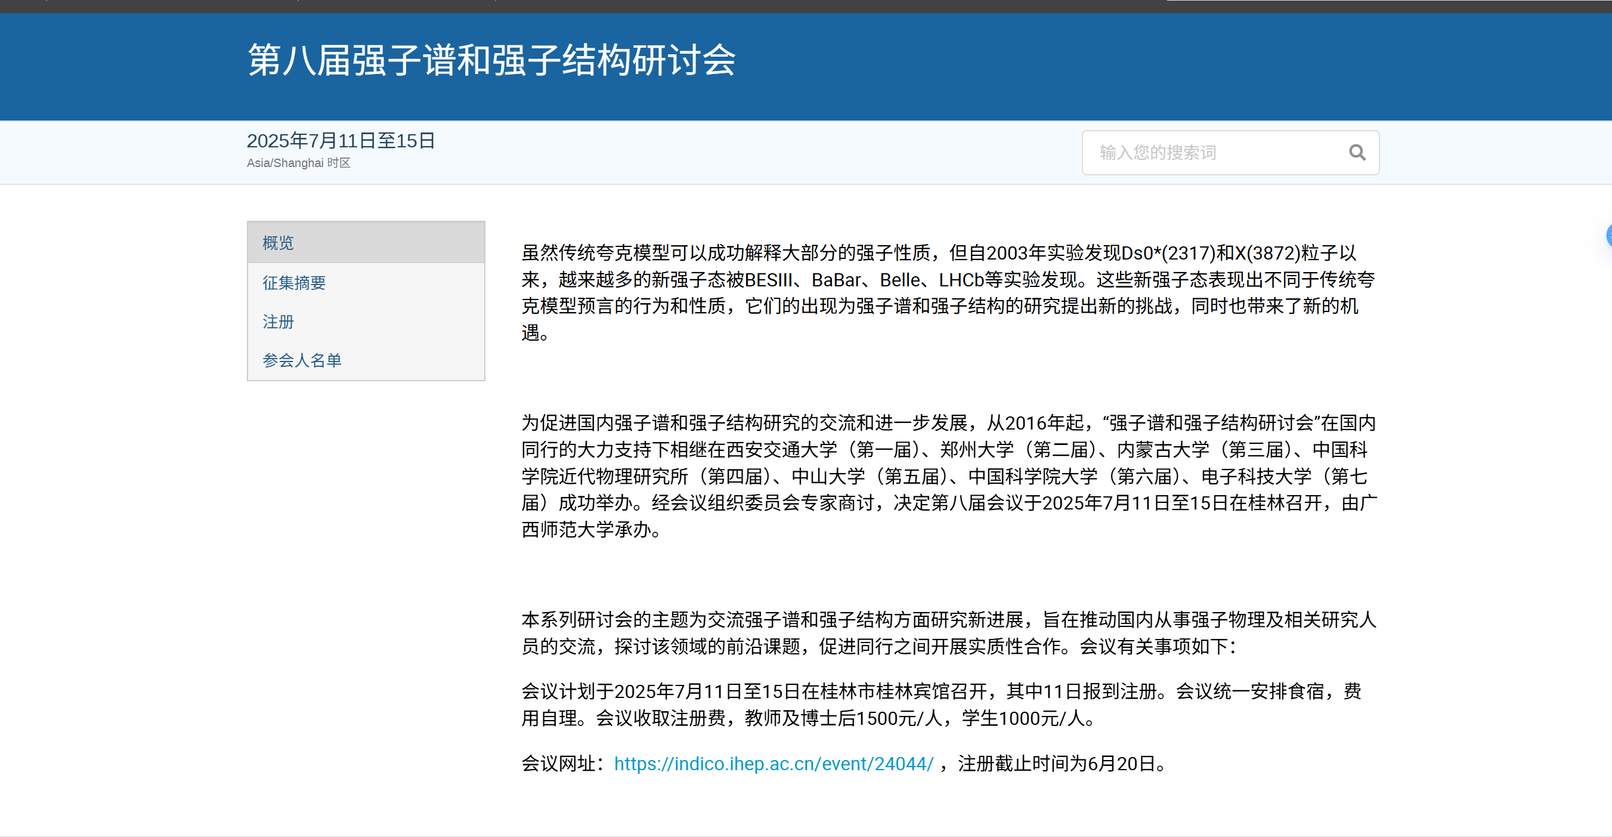
第八届强子谱和强子结构研讨会，7月11-15日，桂林。 https://indico.ihep.ac.cn/event/24044/

Slide 24

第十六届QCD相变与相对论重离子物理研讨会
10月24-28日，桂林。 https://indico.ihep.ac.cn/event/25521/

Slide 25
Backup

Slide 26
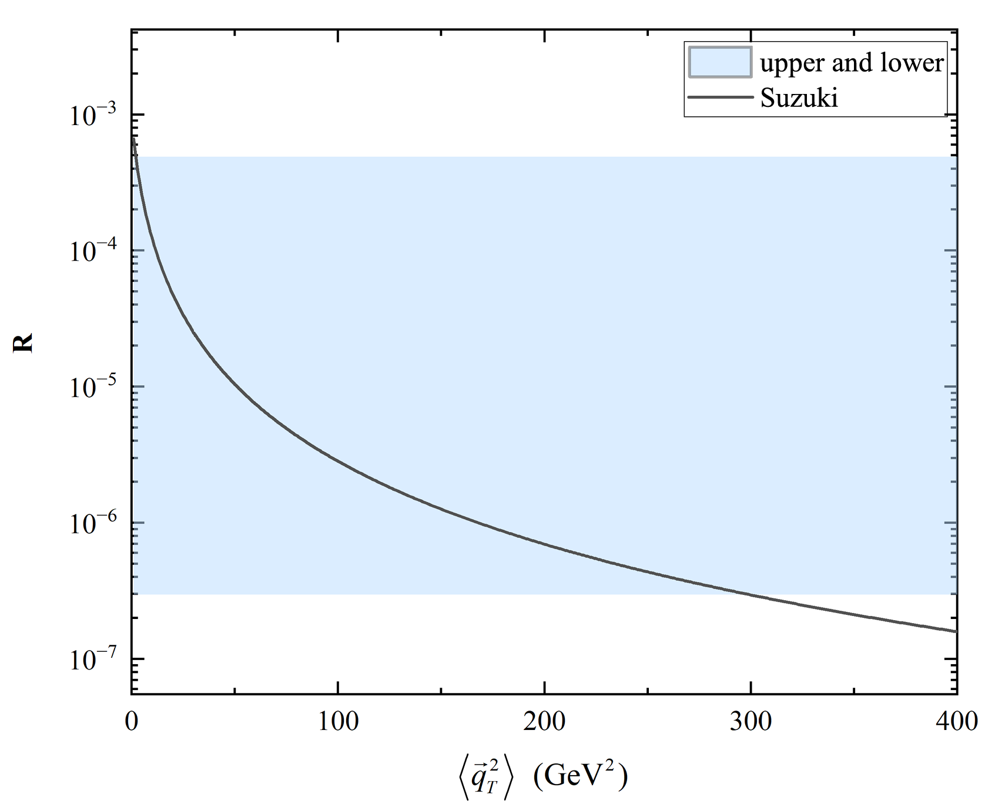
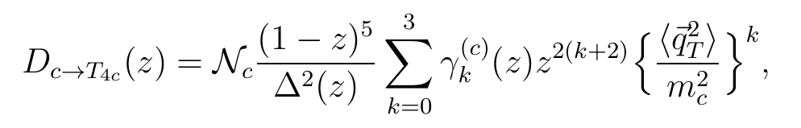
Motivation
Doubly charmed tetraquark
Fully charmed tetraquark
Summary
Suzuki
M. Suzuki, Phys. Lett. B 71, 139 (1977).
M. Suzuki, Phys. Rev. D 33, 676 (1986).
F. Amiri and C.-R. Ji, Phys. Lett. B 195, 593 (1987).
F. G. Celiberto, G. Gatto and A. Papa, Eur. Phys. J. C 84, 1071 (2024)

