Slide 1
New version of NeatIBP
A novel tool for Feynman integral computation
Zihao Wu
Based on:
NeatIBP 1.1: ZW, Janko Boehm, Rourou Ma, Johann Usovitsch, Yingxuan Xu, Yang Zhang, arXiv: 2502.20778
NeatIBP 1.0: ZW, Janko Boehm, Rourou Ma, Hefeng Xu, Yang Zhang, Comput.Phys.Commun. 295 (2024) 108999

Slide 2
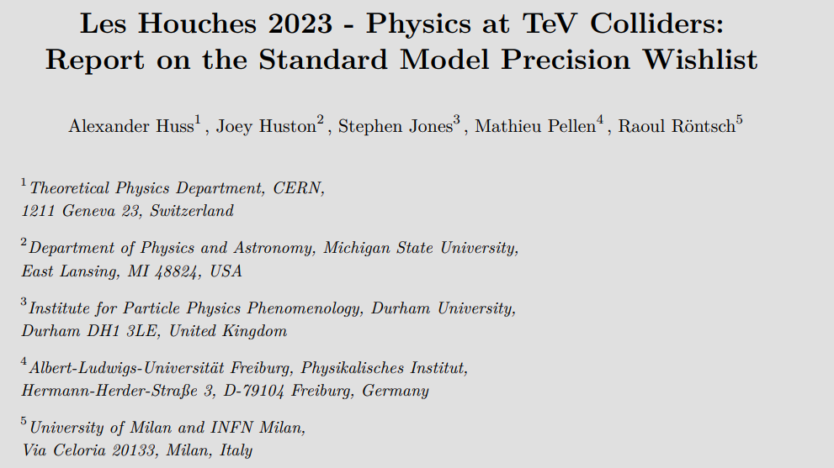
What is NeatIBP for?
Computing fixed-order amplitudes for scattering processes remains a key obstacle to producing precise predictions for the LHC and HL-LHC. (…) we divide the computation of multi-loop amplitudes into two broad categories:1. (…) 2. Calculating the integrals which appear in the amplitudes.
…
The use of integration-by-parts (IBP) identities (…) remains a critically important technique in modern loop calculations, but also presents a major bottleneck.
…
The NeatIBP tool uses syzygy and module intersection techniques to provide IBP systems in which the propagator degrees are limited.

Slide 3




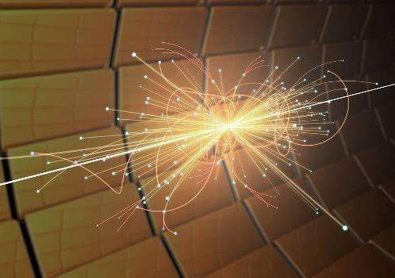
Multi-loop Feynman integrals in particle physics
Multi-loop Feynman integrals
Action of the theory in QFT
…
High-order scattering amplitudes
Multi-loop Feynman diagrams
High-precision experiments
(picture from the internet)

Slide 4
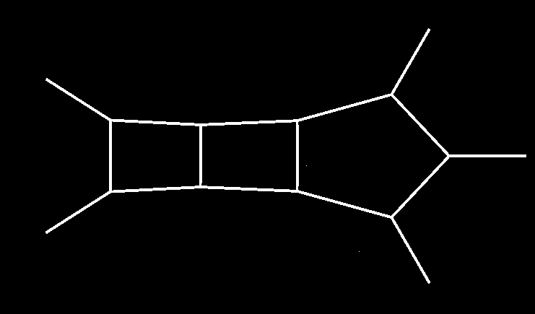

Multi-loop Feynman integrals, frontiers
More loops:
2411.18697
Phys.Rev.D 109 (2024) 7,
L071503
More legs:
JHEP 08 (2024) 027
More masses:
JHEP 07 (2023) 089
JHEP 06 (2023) 144

Slide 5
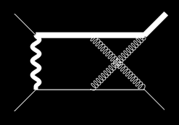


Workflow of analytic computation of Feynman integrals
Feynman diagrams
Feynman rules
Feynman integrals
Tensor reduction
Scalar integrals keep only the information of propagators
Scalar integrals
Integration-by-parts (IBP) reduction
Master Integrals
Analytic functions
Analytic evaluation methods
A linear independent basis of the scalar integrals

Slide 6
Traditional IBP algorithm
Linear system of IBP relations (large)
Linear solver
Traditional IBP generators
IBP reduction results
Computational expensive
NeatIBP:
Linear solver
IBP generators from syzygy
Linear system of IBP relations (small)
IBP reduction results
Computational less expensive

Slide 7

Performance of NeatIBP
Target integrals:
Max numerator degree: 5
Max denominator power: 1
Quantity: 2483
# of IBP (FIRE6): 11207942
# of IBP (NeatIBP): 14120
Time used: 27m at
2L5P Example
3
4
2
5
1
CPU threads: 20
RAM: 128GB

Slide 8
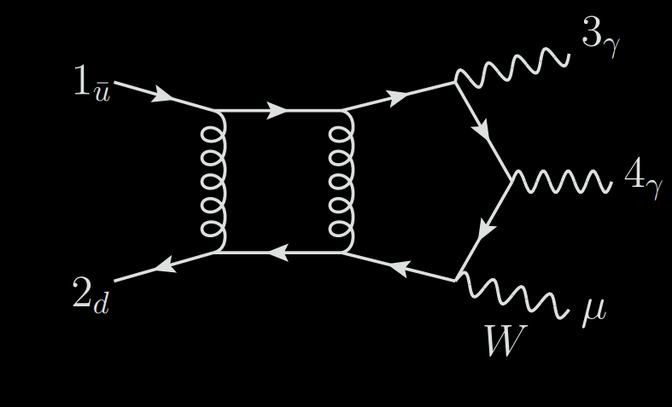
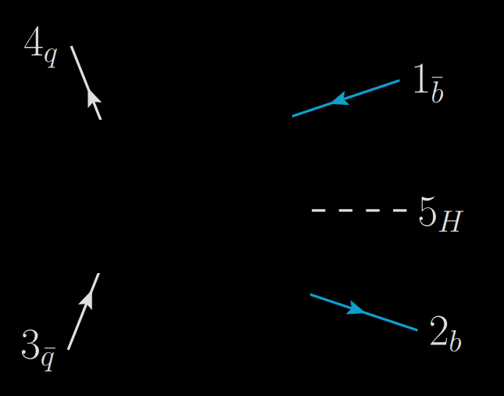
Application of NeatIBP:
Two-loop-five-point amplitudes
Simon Badger, Heribertus Bayu Hartanto, ZW, Yang Zhang and Simone Zoia, JHEP 03 (2025) 066
Simon Badger, Heribertus Bayu Hartanto, Rene Poncelet, ZW, Yang Zhang and Simone Zoia, JHEP 12 (2025) 221

Slide 9
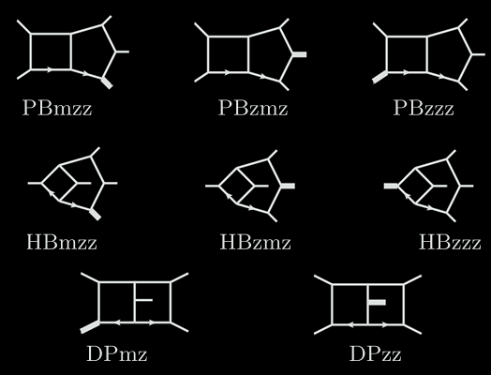
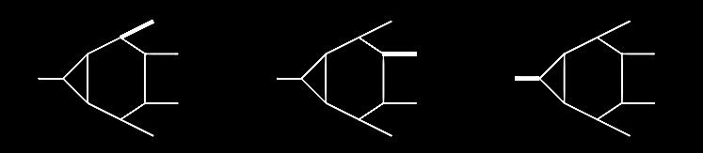
Relevant Feynman diagrams
NeatIBP generated IBP relations within hours for each diagram
JHEP 03 (2025) 066:
“This (using NeatIBP) improves the evaluation of the solution to the IBP relations, resulting in both a speed up in the finite-field sampling of the rational coefficients of the amplitudes and in a reduction of its memory footprint (by around 8 times and 3 times, respectively, for the leading colour two-loop five-particle amplitudes).”

Slide 10
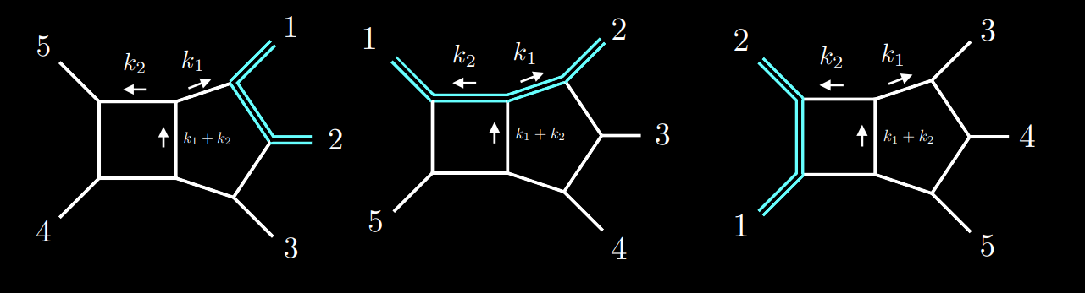
Application of NeatIBP:
Two-loop-five-point amplitudes for $p p→t \overline{t} j$ at leading color
Simon Badger, Matteo Becchetti, Nicolò Giraudo, Simone Zoia, JHEP 07 (2024) 073
( diagrams from JHEP 07 (2024) 073 )
“The latter package (NeatIBP), in particular, allows us to obtain optimized systems of IBP relations through the solution of syzygy equations, this way making their solution substantially simpler.”

Slide 11
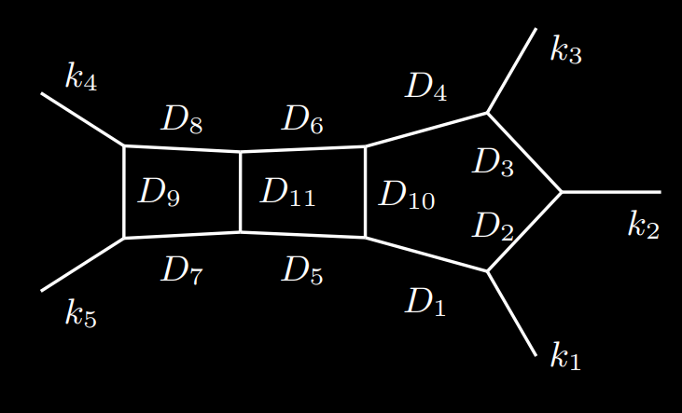
Application of NeatIBP:
Three-loop-five-point diagrams
Yuanche Liu, Antonela Matijašić, Julian Miczajka, Yingxuan Xu, Yongqun Xu, Yang Zhang, arXiv:2411.18697
Analytic evaluation of the master integrals for the Pentagon-box-box diagram via differential equations
Target integrals: integrals needed for DE of master integrals
( diagram from arXiv:2411.18697 )
“On a laptop, NeatIBP finds about 85000 IBP identities in full kinematics dependence within several hours. These relations are sufficient to derive the differential equation. As a comparison, standard IBP tools would generate three orders of magnitude more IBP relations, which make the reduction computation impossible.”

Slide 12
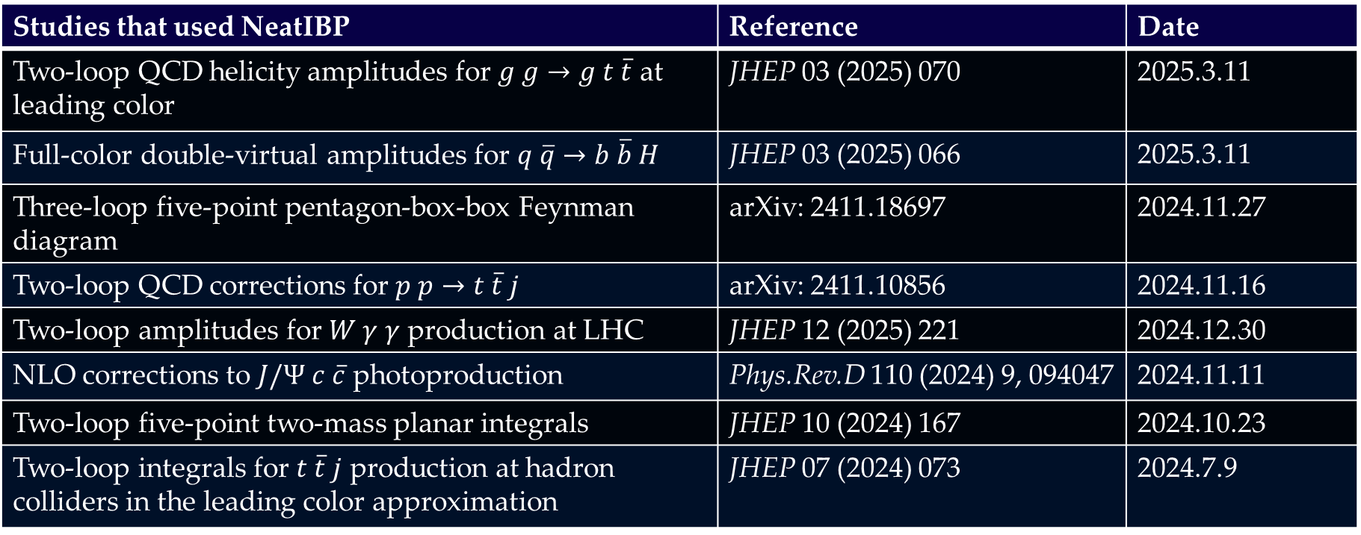
Applications of NeatIBP:
Studies that used NeatIBP | Reference | Date
Two-loop QCD helicity amplitudes for $g g→g t \overline{t}$ at leading color | JHEP 03 (2025) 070 | 2025.3.11
Full-color double-virtual amplitudes for $q \overline{q}→b \overline{b} H$ | JHEP 03 (2025) 066 | 2025.3.11
Three-loop five-point pentagon-box-box Feynman diagram | arXiv: 2411.18697 | 2024.11.27
Two-loop QCD corrections for $p p→t \overline{t} j$ | arXiv: 2411.10856 | 2024.11.16
Two-loop amplitudes for $W γ γ$ production at LHC | JHEP 12 (2025) 221 | 2024.12.30
NLO corrections to $J/Ψ$ $c \overline{c}$ photoproduction | Phys.Rev.D 110 (2024) 9, 094047 | 2024.11.11
Two-loop five-point two-mass planar integrals | JHEP 10 (2024) 167 | 2024.10.23
Two-loop integrals for $t \overline{t} j$ production at hadron colliders in the leading color approximation | JHEP 07 (2024) 073 | 2024.7.9
You may also try NeatIBP in your projects
https://github.com/yzhphy/NeatIBP

Slide 13
Contents
Algorithms and features in NeatIBP 1.0
Main new features in the NeatIBP 1.1
2025.02
1. The Kira+NeatIBP interface
2. The spanning cuts method
3. Algorithm of syzygy vector simplification

Slide 14




Integration by parts reduction
Feynman integral family
IBP relations
IBP reduction
Master integrals
Gaussian
Elimination
Linear system of IBP relations
Coefficients

Slide 15











IBP relations in with multiple propagators
IBP-Related integrals
Target integrals
Master integrals
…
…
…
Contains redundant integrals with denominator indices lifted
Introducing multiple propagators

Slide 16
IBP relations from syzygy method
Introducing multiple propagators
Janusz Gluza, Krzysztof Kajda, David A. Kosower, Phys.Rev.D 83 (2011) 045012
What if we find a good combination of v such that the additional Di cancels?
3
4
Syzygy equations
2
(top sector)
5
Indeed decreases the number of equations a lot
1

Slide 17

NeatIBP: syzygy method in Baikov representation
Feynman integrals in momentum space:
Variable transformation
Baikov representation: integrates directly over propagators zi

Slide 18





IBP relations in Baikov representation
dimension shift
multiple propagators
Without multiple propagators

Slide 19



Polynomial equations in Baikov IBP relations
Syzygy Equations
Generators of the solution module

Slide 20


Syzygy generator
Symbolic IBP relation
Seeding
Specific IBP relation
(# generators) × (# seeds) = (# IBP relations)

Slide 21



IBP relation selection
An enough IBP system
Column reduction (numeric + finite field)
Linearly independent system
Row reduction (numeric + finite field)
Remove the unneeded relations for reducing the targets
Small-size IBP system minimally needed

Slide 22
The work flow and program package
config
kinematics
target
integrals
IBP
relations
master
integrals
other
outputs
Derive the Baikov representations
Select independent, necessary and simple IBP relations
NeatIBP
Solve the polynomial equations using module intersection methods
Generate IBP relations

Slide 23

Parallelization between sectors
Tail mask strategy
current sector:
sub sectors:

Slide 24
Contents
Algorithms and features in NeatIBP 1.0
Main new features in the NeatIBP 1.1
1. The Kira+NeatIBP interface
2. The spanning cuts method
3. Algorithm of syzygy vector simplification

Slide 25
Currently, NeatIBP itself dose not perform IBP reduction
NeatIBP
Small-size IBP system
IBP solver?
IBP reduction results
IBP reduction inputs
KIRA
as a popular integral reduction software, is a very nice IBP solver for NeatIBP output.
Comput.Phys.Commun. 230 (2018) 99-112, Comput.Phys.Commun. 266 (2021) 108024, etc.
Kira allows user to feed in linear systems of IBP relations (called user defined system) and then reduce them .
The Kira+NeatIBP interface is included in NeatIBP 1.1

Slide 26
The Kira+NeatIBP interface (normal mode)
NeatIBP
IBPs generated by NeatIBP
Input files of KIRA format (.yaml)
Inputs for NeatIBP
Converter
Converter
Optional
Kira
KIRA user defined system ( solvable using KIRA)
Reduced IBP system
In NeatIBP 1.1, to use Kira to reduce the IBP generated by NeatIBP, add the following commands into NeatIBP “config.txt”
PerformIBPReduction=True;
IBPReductionMethod=“Kira”;
KiraCommand=“/some/path/kira”
FermatPath=“/some/path/fer64”

Slide 27
Contents
Algorithms and features in NeatIBP 1.0
Main new features in the NeatIBP 1.1
1. The Kira+NeatIBP interface
2. The spanning cuts method
3. Algorithm of syzygy vector simplification

Slide 28



Generalized unitarity cuts in Baikov representation
Cuts change the integrals but preserve IBP relations
Cuts increases the number of zero sectors in a family

Slide 29







Spanning cuts method
{1,3} - cut
{2,4} - cut
A spanning cuts is defined so that for all nonzero sector in a family, , such that
Step 1: Run NeatIBP on each cut
Current version of NeatIBP avoids cutting multiple propagators. Thus, for integrals such that , means
Benefit：
1. Split a difficult problem into simpler pieces
2. Parallelizable
Step 2: Reduce the IBP system on each cut
Kira
Step 3: Merge the reduced IBP system of all cuts

Slide 30




Merging the spanning cut systems
{1,3} - cut
{2,4} - cut
merge
Currently, NeatIBP uses a “direct” merging strategy:
Consistency condition
NeatIBP checks consistency conditions before merging the spanning cut systems. This step cannot be omitted because the condition is NOT always guaranteed according to our observation.
Inconsistency often observed in integrals with massive propagators.

Slide 31



The Kira+NeatIBP interface (spanning cuts mode)
Parallelized by default
IBPs generated by NeatIBP on each cut
KIRA user defined systems on each cut
Reduced IBP system on each cut
NeatIBP
Inputs for NeatIBP
If consistency check passed
Kira
Config settings
PerformIBPReduction = True;
IBPReductionMethod = “Kira”;
KiraCommand = “/some/path/kira”;
FermatPath = “/some/path/fer64”;
SpanningCutsMode = True;
Merged reduced IBP system

Slide 32
A baby example of Kira+NeatIBP performance (with spanning cuts)
Two-loop five-point, with numerator degree 4
CPU threads: 20
RAM: 128GB
Running NeatIBP + Kira in spanning cuts mode:
1. NeatIBP: Generates equations on 10 spanning cuts, time used: 8m
2. Number of equations: vary from 310 ~ 1583, on different cuts
3. Kira reduction time used: 5h
Running NeatIBP + Kira in normal mode:
1. NeatIBP: Generates 3708 equations spanning cuts, using 18m
2. Kira reduction time used: 24h

Slide 33
Another example of Kira+NeatIBP performance (with spanning cuts)
Three-loop four-point, with numerator degree 5
CPU threads: 20
RAM: 128GB
Running NeatIBP + Kira in spanning cuts mode:
1. NeatIBP: Generates equations on 22 spanning cuts, time used: 1h22m
2. Number of equations: 2k ~ 10k+ or so, at most 35k, on different cuts
3. Kira reduction time used : 35m
Running NeatIBP + Kira in normal mode:
1. NeatIBP: Generates 113k equations spanning cuts, using 13h
2. Kira reduction time used: 2h30m

Slide 34
Contents
Algorithms and features in NeatIBP 1.0
Main new features in the NeatIBP 1.1
1. The Kira+NeatIBP interface
2. The spanning cuts method
3. Algorithm of syzygy vector simplification

Slide 35
Generator vector of the solution module of the syzygy equations
Symbolic IBP relation
Seeding
Specific IBP relation
(# generators) × (# seeds) = (# IBP relations)

Slide 36
Generator vector of the solution module of the syzygy equations
Symbolic IBP relation
Seeding
Specific IBP relation
(# generators) × (# seeds) = (# IBP relations)
~ hundreds large combinatorial numbers
Seeding cost ↑

Slide 37


Idea of the algorithm (taking no-dot integrals as example)
current sector:
sub sectors:
Treating tail integrals as zeros:
IBP relations containing only sub sector integrals will be discarded
This is equivalent to maximal cut (mc):
,

Slide 38








Simplification of syzygy generators via maximal cut
Delete generators that dose not change the “maximal cut” module defined as
for
Step 1: Using “maximal cut” Groebner basis
lifting
Delete in generators of M if
Because this means does not contribute to
Step 2: Scanning
After step 1, sort the remaining generators from complex to simple
Scanning i from 1 to n, if deleting does not change the GB of maximal cut module, then delete it.

Slide 39
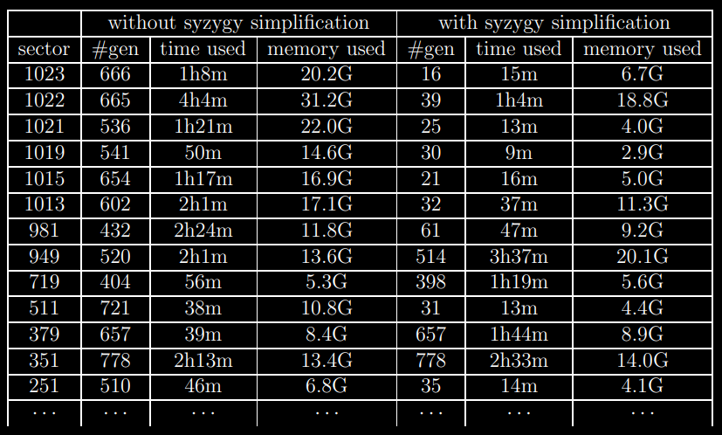
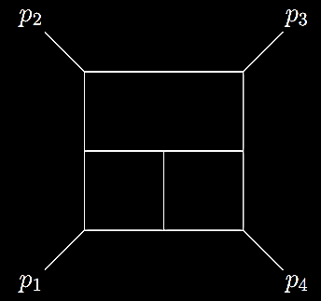
Example
Degree-5 targets

Slide 40
Summary
Feynman integrals are important objects in particle physics.
The integration-by-parts (IBP) reduction is one of the bottle-neck steps in the evaluation of multi-loop Feynman integrals.
NeatIBP is an automated program generating small-size IBP system. It helps to reduce the computation cost of IBP reduction.
NeatIBP has been successfully applied to frontier problems, including two-loop amplitude computation in phenomenology and three-loop five-point Feynman diagrams.
We have displayed some new features of NeatIBP of the new version. They include:
1. The spanning cuts method：
Splitting the hard problem into simpler pieces.
2. The Kira interface:
Providing automated IBP solver.
3. Simplification algorithm of syzygy generators
https://github.com/yzhphy/NeatIBP

