Slide 1
Implications of recent LHCb data on CPV in b-baryon four body decays
Authors : Qi Chen, Xin Wu, Zhi-Peng Xing and Ruilin Zhu
Presenter : Qi Chen
arXiv: 2504.01853
@HFQCD 2025 南京

Slide 2
Contents
Background
U-spin matrices in decays of bottom baryon
U-spin amplitudes and CPV relations in bottom baryon decay
Simple dynamic analysis under u-spin analysis
Conclusion

Slide 3
BACKGROUND
The experimental measurement in the baryon system.
[LHCb],Nature Phys. 13, 391-396 (2017)
[LHCb],JHEP 06, 108 (2017)
[LHCb],JHEP 03, 182 (2018)
[LHCb],Phys. Lett. B 787, 124-133 (2018)
[LHCb],JHEP 08, 039 (2018)
[LHCb],Eur. Phys. J. C 79, no.9, 745 (2019)
[LHCb],Eur. Phys. J. C 80, no.10, 986 (2020)
[BESIII],Phys. Rev. Lett. 125, no.5, 052004 (2020)
[LHCb],Phys. Rev. D 102, no.5, 051101 (2020)
[LHCb],PoS ICHEP2020, 362 (2021)
[BESIII],Phys. Rev. D 108, no.3, L031106 (2023)
[BESIII],Phys. Rev. Lett. 133, no.10, 101902 (2024)
......
More work in theoretical side
R. Aaij et al. [LHCb], [arXiv:2503.16954]

Slide 4
BACKGROUND
In the context of CPV, U-spin symmetry is a powerful tool.
The symmetry between d and s quarks does not affect the mechanisms of CP Violation
$$d,s$$
B. n. Zhang and D. Wang, [arXiv:2503.21885 ]
X. G. He, C. W. Liu and J. Tandean, [arXiv:2503.24350 ].

Slide 5
Contents
Background
U-spin matrices in decays of bottom baryon
U-spin amplitudes and CPV relations in bottom baryon decay
Simple dynamic analysis under u-spin analysis
Conclusion

Slide 6
U-spin matrices
A representation in U-spin symmetry.
The anti-triplet bottom baryons
$$2⊗2=1⊕3$$
$$B_{b}^{1}=(Ξ_{b}^{−}(dsb))$$
$$B_{b\overline{3}}$$
$$B_{b}^{2}=(Λ_{b}^{0}(udb),Ξ_{b}^{0}(usb))$$
The light messon octet
$$M_{}^{2}= (π^{−},K^{−})$$
doublet
$$M_{8}$$
$$M_{}^{\overline{2}}= (π^{+},K^{+})$$
doublet
$${ M}_{}^{3} =\left(\begin{matrix}−\frac{π^{0}}{2\sqrt{2}}−\frac{\sqrt{3}η_{8}}{2\sqrt{2}} & K^{0} \\ {\overline{K}}^{0} & \frac{π^{0}}{2\sqrt{2}}−\frac{\sqrt{3}η_{8}}{2\sqrt{2}}\end{matrix}\right)$$
triplet

Slide 7
U-spin matrices
A representation in U-spin symmetry.
The light baryon octet
$$B_{1}^{2}= (p,Σ^{+})$$
doublet
$$B_{2}^{2}= (Σ^{−},Ξ^{−})$$
doublet
$$B_{8}$$
$$\left(\begin{matrix}−\frac{Σ^{0}}{2\sqrt{2}}−\frac{{\sqrt{3}Λ}^{0}}{2\sqrt{2}} & n \\ Ξ^{0} & \frac{Σ^{0}}{2\sqrt{2}}+\frac{{\sqrt{3}Λ}^{0}}{2\sqrt{2}}\end{matrix}\right)$$
$${ B}_{}^{3}=$$
triplet
$$B_{}^{1}= \frac{{\sqrt{3}Σ}^{0}}{2}−\frac{Λ^{0}}{2}$$
singlet

Slide 8
U-spin matrices
The low-energy effective weak Hamiltonian：
Tree：
Penguin：

Slide 9
U-spin matrices
Tree：
Penguin：
$${H_{u}}^{`}=(V_{ub}^{∗}V_{ud}^{},V_{ub}^{∗}V_{us}^{})$$
$$H(4)=0$$
$${H_{c}}^{`}=(V_{cb}^{∗}V_{cd}^{},V_{cb}^{∗}V_{cs}^{})$$
$${H(2)}_{u}=(V_{ub}^{∗}V_{ud}^{},V_{ub}^{∗}V_{us}^{})$$
doublet
$${H(2)}_{c}=(V_{cb}^{∗}V_{cd}^{},V_{cb}^{∗}V_{cs}^{})$$
$$H_{u}={H_{u}}^{`}+{H(2)}_{u}\sim (V_{ub}^{∗}V_{ud}^{},V_{ub}^{∗}V_{us}^{})$$
$$H_{c}={H_{c}}^{`}+{H(2)}_{c}\sim (V_{cb}^{∗}V_{cd}^{},V_{cb}^{∗}V_{cs}^{})$$

Slide 10
Contents
Background
U-spin matrices in decays of bottom baryon
U-spin amplitudes and CPV relations in bottom baryon decay
Simple dynamic analysis under U-spin analysis
Conclusion

Slide 11
U-spin amplitudes
$$H_{u}=(V_{ub}^{∗}V_{ud}^{},V_{ub}^{∗}V_{us}^{})$$
$$B_{8}=(B_{1}^{2},B_{2}^{2},{ B}_{}^{3},B_{}^{1})$$
$$B_{b\overline{3}}=(B_{b}^{1},B_{b}^{2})$$
$$M_{8}=(M_{}^{2},M_{}^{\overline{2}}{,M}_{}^{3})$$
$$H_{c}=(V_{cb}^{∗}V_{cd}^{},V_{cb}^{∗}V_{cs}^{})$$
11

Slide 12
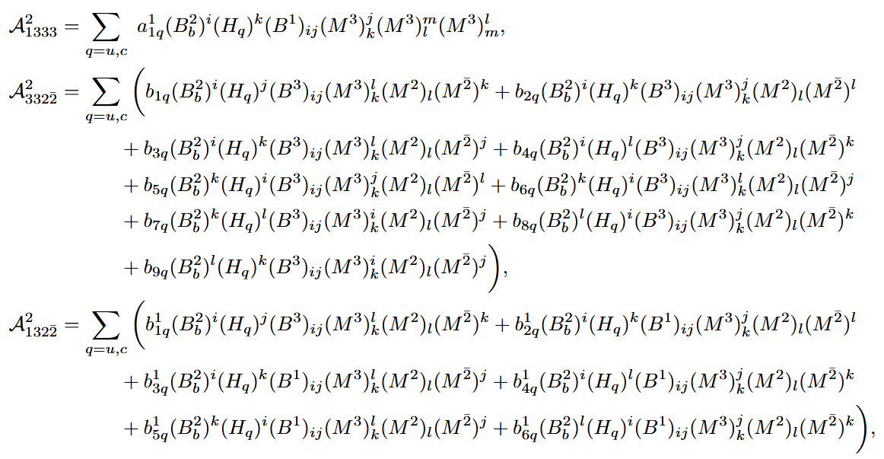
U-spin amplitudes

Slide 13
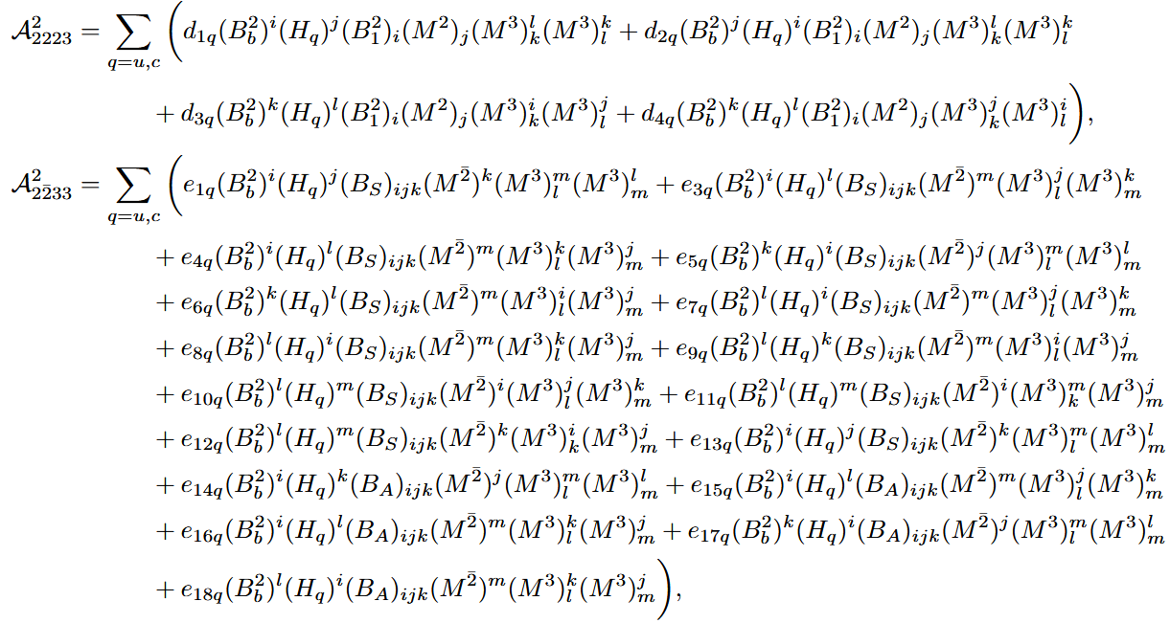
U-spin amplitudes

Slide 14
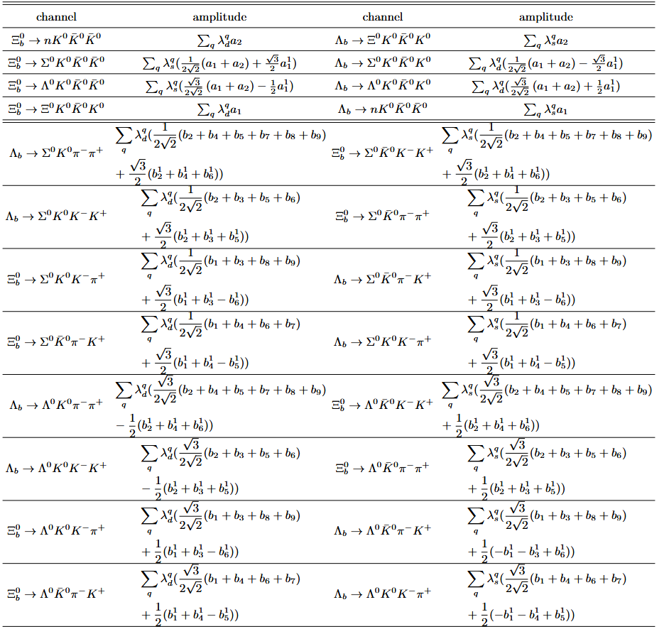
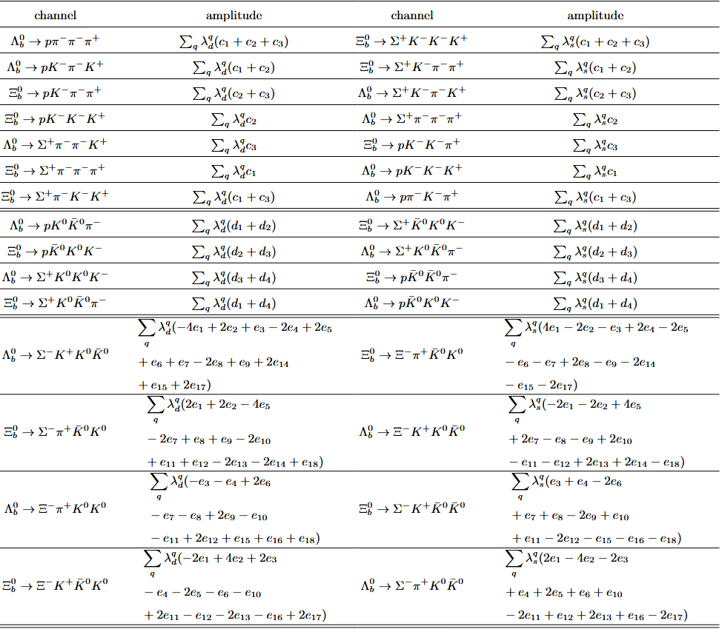
U-spin amplitudes
The U-spin amplitude:

Slide 15
CPV relations
The directly CP violation can be expressed as
treated as a complex number.
The CKM matrix unitarity relation:

Slide 16
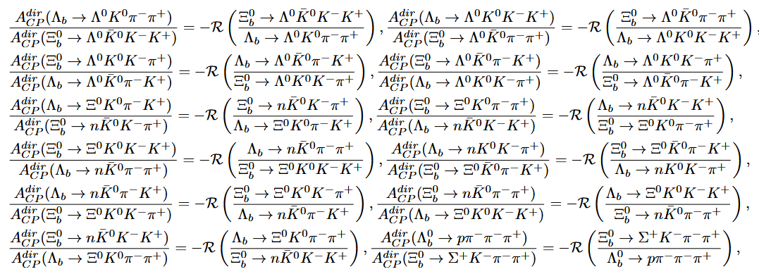
CPV relations
CPV relations for bottom doublet decays

Slide 17
CPV relations
[LHCb], arXiv:2504.01853
Heavy Flavor Averaging Group (HFLAV)

Slide 18
Contents
Background
U-spin matrices in decays of bottom baryon
U-spin amplitudes and CPV relations in bottom baryon decay
Simple dynamic analysis under U-spin analysis
Conclusion

Slide 19
CPV relations
Topological diagrams
Simple dynamic analysis
simplify the U-spin amplitude

Slide 20
CPV relations
The momentum in the final state can be divided into three types:
hard-collinear mode：
collinear mode：
soft mode：

Slide 21
CPV relations
The light quark in b-baryon should be soft.
The quark-antiquark pairs produced from the vacuum should be soft.
For the Hamiltonian, the momentum of the light quark in the final state should be hard-collinear.
The meson and baryon octet can be hard-collinear or soft, all the quarks should be either soft or hard-collinear (but not mixed).
Assume that the power of h in different topological diagrams is identical.

Slide 22
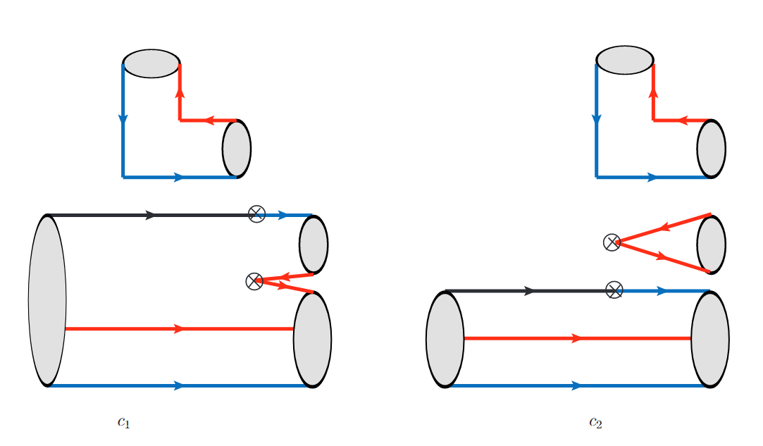
CPV relations
soft
The blue line: the d and s quark/anti-quark
The black line: the b quark.
The red line: the u quark and u anti-quark.

Slide 23
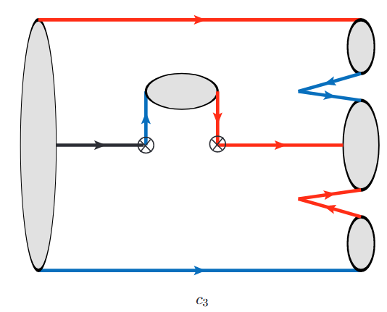
CPV relations
The blue line: the d and s quark/anti-quark
The black line: the b quark.
The red line: the u quark and u anti-quark.

Slide 24
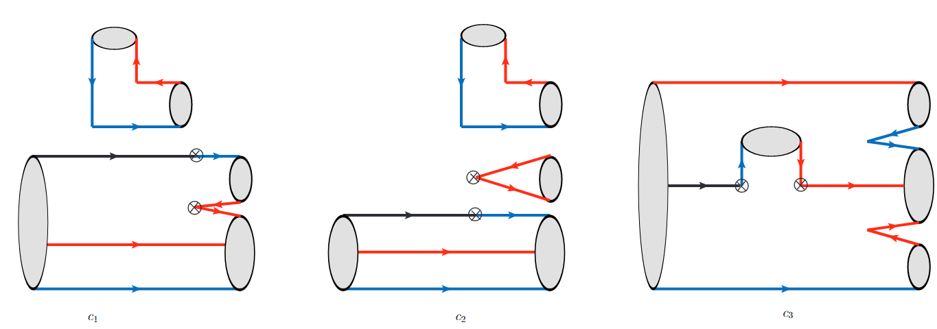
CPV relations
R. Aaij et al. [LHCb], [arXiv:2503.16954]
c3

Slide 25
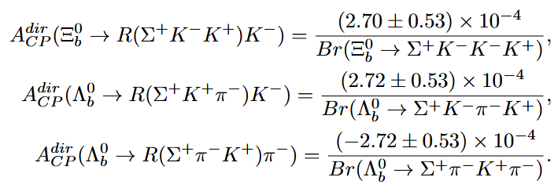
CPV relations

Slide 26
Contents
Background
U-spin matrices in decays of bottom baryon
U-spin amplitudes and CPV relations in bottom baryon decay
Simple dynamic analysis under u-spin analysis
Conclusion

Slide 27
CONCLUSION
By constructing the U-spin matrices, the U-spin symmetry amplitudes for each category were derived.
Establishing U-spin symmetry relations among the decay channels and deriving a universal CPV relation.
Utilizing LHCb data, the CPV in the decay channel $Ξ_{b}^{0}→Σ^{+}{ π}^{−}{ K}^{−}{ K}^{+}$ is predicted.
Through a dynamic analysis, parameters were simplified, yielding more predictions, particularly $A_{CP}(Λ_{b}^{0}→R(p{ π}^{−}{ π}^{+}){ π}^{−})=(−12.98±2.85)\%$.

