Slide 1
Semileptonic decay of heavy
flavor mesons
Xian-Wei Kang
Beijing Normal University
Based on：EPJC2017, EPJC2018, PRD2020, JHEP2021, PRD2022
第七届重味物理和QCD会议，南京，2025年4月18-22日

Slide 2
Introduction
Theoretical tool: the relativistic quark model
physical observables

Slide 3
Introduction
■ Extraction of CKM matrix element
compared to pure hadronic decay, clean
compared to pure leptonic decay, larger Br
e.g. $B→e{ ν}_{e}$ helicity suppression
■ Experimental side, huge data sample
Belle, LHCb, BES, STCF!
■ Form factor is crucial, related to understanding of QCD

Slide 4
Experimental status
Eur. Phys. J. C 78 (2018) 11, 909

Slide 5
Form factor: general Lorentz structure
Parity conservation

Slide 6
• all the dynamic information is contained in the form
factor. Calculation of form factor is a central task of
theorists.
• No full description in QCD theory: various models,
typically a limited range of applicability, and a
combination of them give a better picture of
underline physics

Slide 7
Heavy meson ChPT, large q² region, due to soft pion;
2. QCD light cone sum rule for small q² region for B->$π$;
3. Covariant light-front quark model is often used in the space-like region, and then extrapolate to time-like region.
But there exits models that enable predicting the form factor in the whole kinematic region: relativistic quark model (RQM) introduced below.

Slide 8
Relativistic Quark Model (RQM)
Ebet, Faustov, Galkin, e.g., refers to 1705.07741
1. Based on quasipotential approach, 4 dimension reduced to 3 dimension
2. Wave function is solvable, not just assume a Gaussian type function

Slide 9
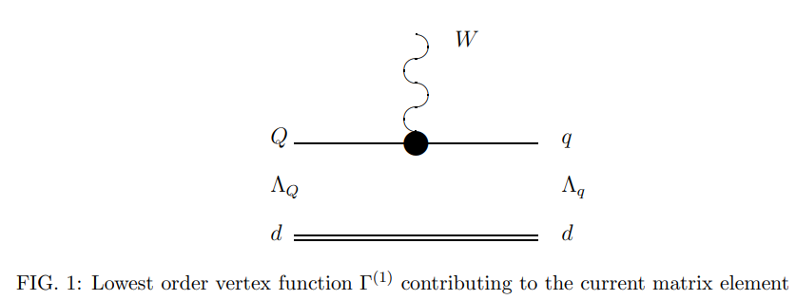
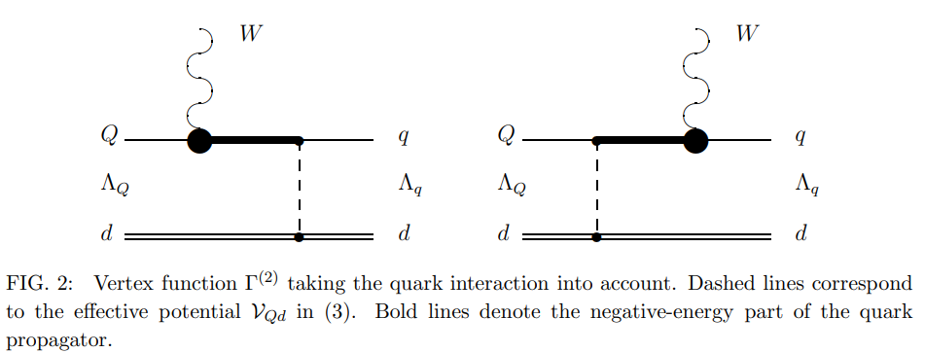
Relativistic effects: (1) negative-energy part of the propagator

Slide 10
Relativistic effects: (2) wave functions boosted

Slide 11
Expression for form factor: overlap between initial
and final state wave functions
ꢔ , ꢔ mass of initial and final meson
ꢕ
ꢖ
in the rest frame of mother particle
As it should be, the form factor depends only on q²

Slide 12
Features of RQM
1. form factor are calculated in the framework of quasipotential
approach
2. systematic account of the relativistic effects including
transformation of the meson wave function from the rest to the moving frame and contributions of the intermediate negative-
energy states.
3. meson wave functions are taken from previous studies of meson
spectroscopy. Parameters have been fixed. Make a prediction for the decay.
4. work in the whole range of the transferred momentum q²

Slide 13
A full calculation without the heavy quark approximation.

Slide 14
double-pole form:

Slide 15
Predictions from covariant light-front quark model.
D->K case not so good, but within 1.5 sigma certainly.

Slide 16
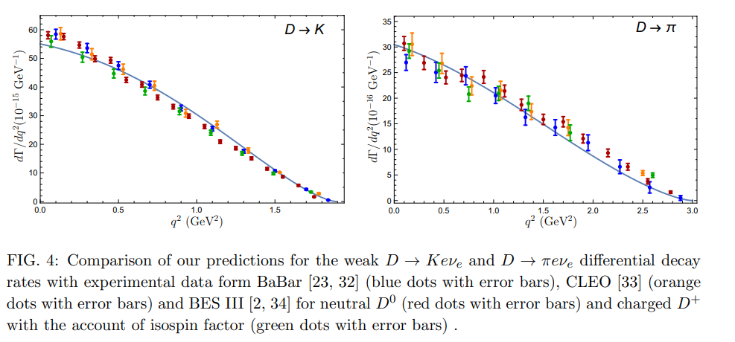
Predictions from the relativistic quark model.
All are in agreement nicely.

Slide 17
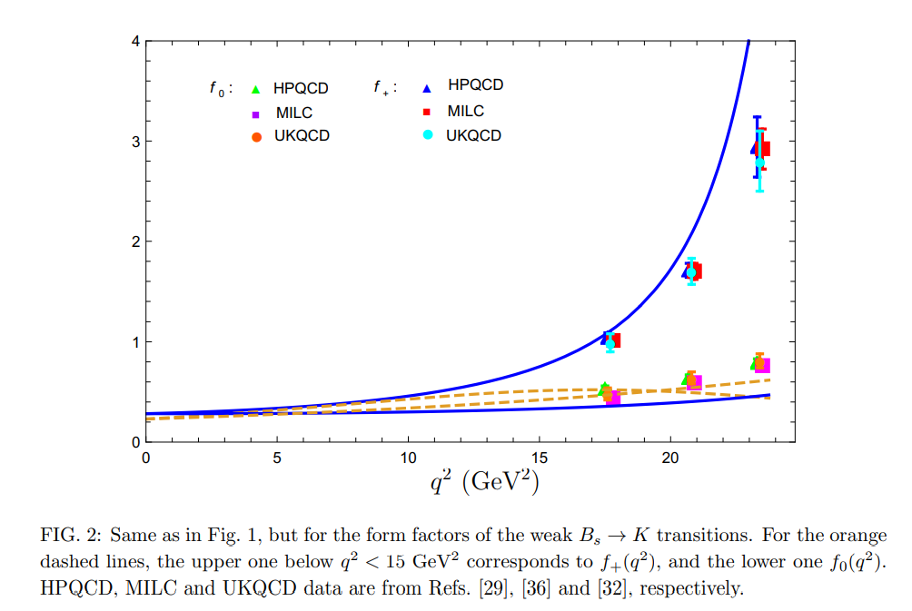
Comparison between covariant light-front quark model (CLFQM) and RQM: work in the same way for heavy to heavy transition, but differ for heavy to light transition, which should be due to the different treatment of relativistic effects.

Slide 18
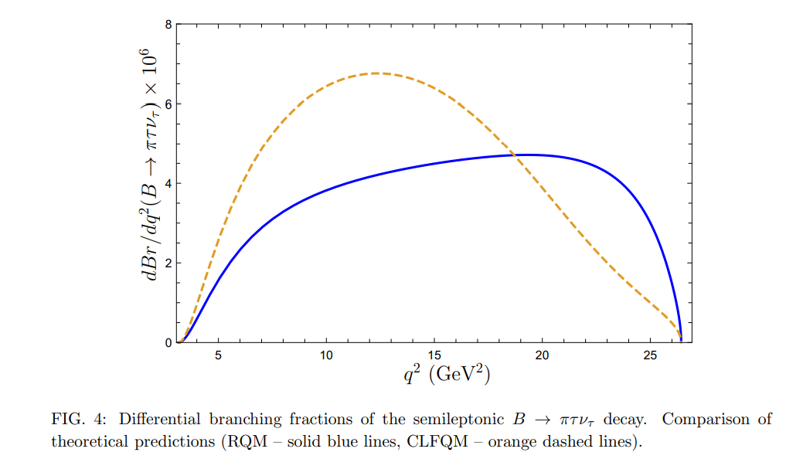

Slide 19
To calculate more observables,
we exploit the helicity formalism
• conveniently express observables, otherwise
may be cumbersome.
• Conveniently work in the partial-wave basis, often used in the experimental analysis
• The polarization observables are clearly defined.

Slide 20
Virtual W boson has 4 polarization components
Calculations of hadronic current and leptonic current are
performed in their respective frames!

Slide 22
Branching fraction, as only a number, is not the whole story. Concerning this quantity, all the following model results agree with each other and with experimental numbers.
We need to investigate more observables.
Differential decay rates

Slide 23
Forward-backward asymmetry
There exists only one measurement for the tau longitudinal polarization from Belle. Phys. Rev. Lett. 118 (2017) 211801, with the result of $P_{L}^{τ}$ for $\overline{B}→D^{∗}τυ_{τ}$ as $−0.38±{0.51}_{−0.10}^{+0.21}$.

Slide 24
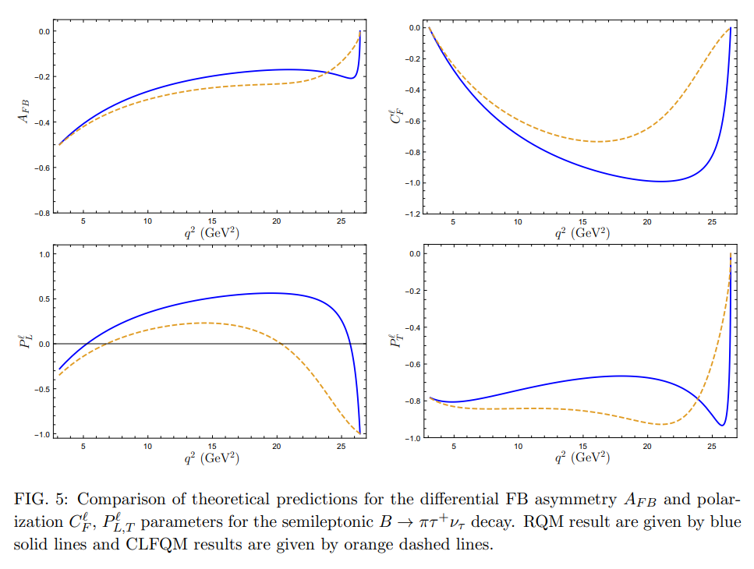
Polarization observables are very sensitive to different models.
Also used to discriminate the New Physics scenario.

Slide 25
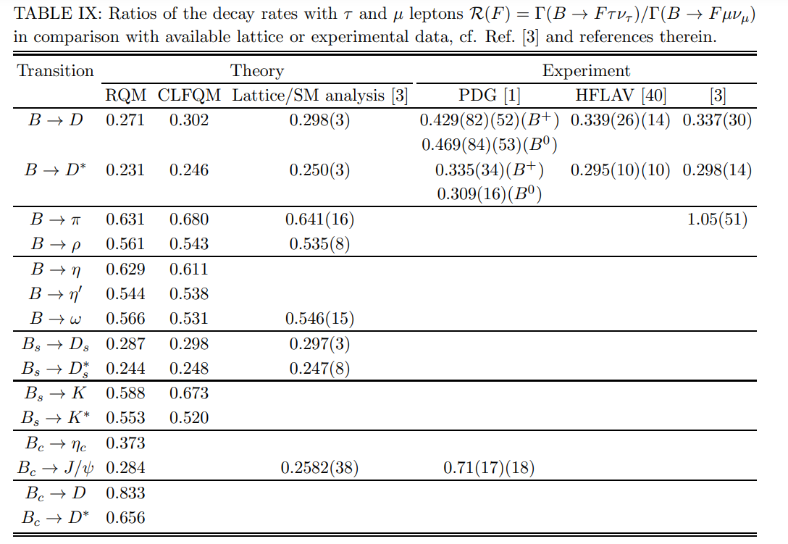
Consistency between theories, but may be lower than exp by 1-3 $σ$

Slide 26
decays to higher excited states
Confirmed by BESIII measurement, refers to PRL 123 (2019) 231801, 1907.11370

Slide 27
Thanks for your attention.

