Slide 1
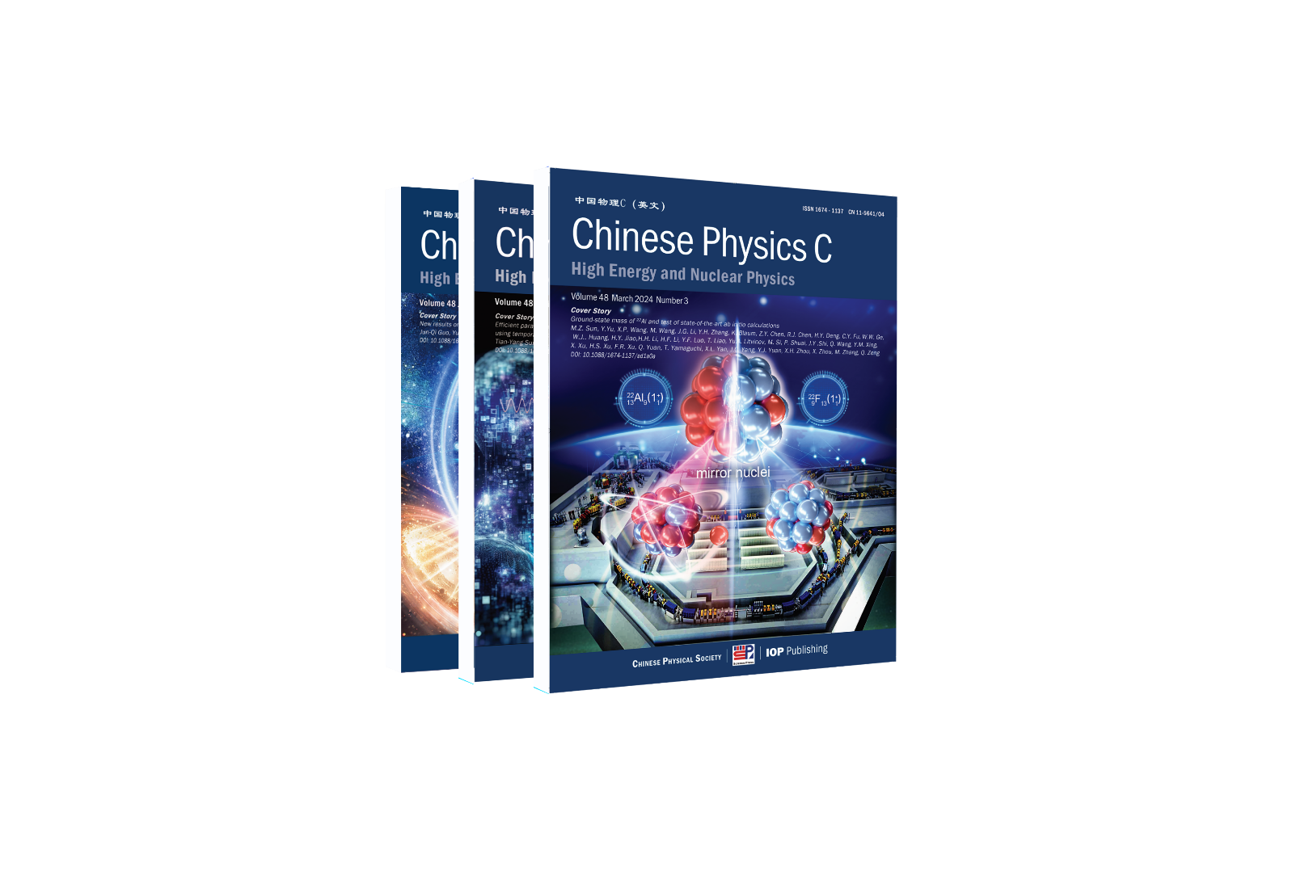
Chinese Physics C
中国物理C
主管编辑：董海荣
邮件：donghr@ihep.ac.cn
2025-4-21 南京
推动学术交流 助力科研创新

Slide 2
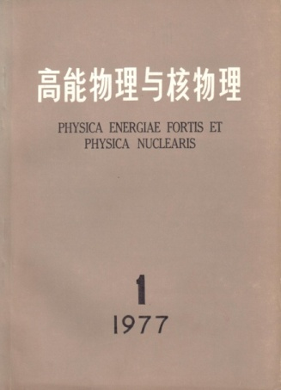
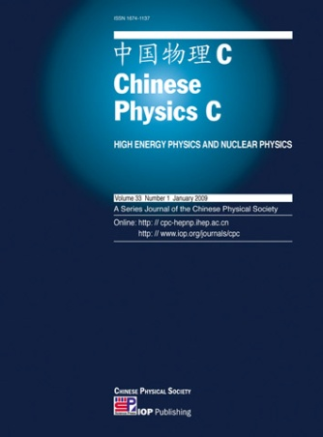
期刊简介
An international, peer-reviewed, English-language journal focusing on the latest developments and achievements in high energy and nuclear physics.
1977/01
《高能物理与核物理》
数据库收录
主办单位
国际及国内发行
SCI-E, Scopus, CSCD, CNKI et.al.
中国科学院高能物理研究所（IHEP）
中国科学院近代物理研究所（IMP）
中国物理学会（CPS）
2008/01
Chinese Physics C
IOP Publishing (国际)
科学出版社(国内)

Slide 3
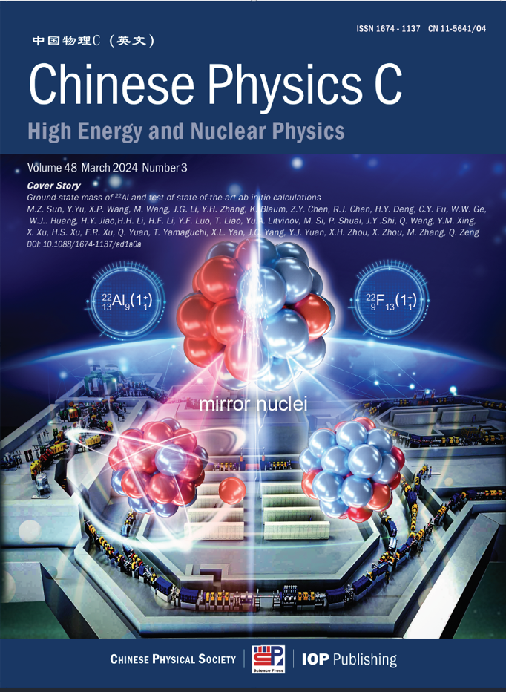
发文领域
Chinese Physics C
An international journal for high energy and nuclear physics
Original research articles, letters and reviews in the fields of:
Particle physics
Nuclear physics
Particle and nuclear astrophysics
Cosmology

Slide 4
影响因子
2009JIF 2023JIF 期刊影响因子分区 2021&2022发文 国家 1st JCR year
Chinese Physics C
Journal of Physics G
Journal of High Energy Physics
Physical Review D
European Physical Journal C
Nuclear Physics B
Physics Letter B
Physical Review C
European Physical Journal A
0.251
2.124
6.019
4.922
2.746
4.341
5.083
3.477
1.968
3.6
3.4
5.0
4.6
4.2
2.5
4.4
3.2
2.6
10/30 P Q2, 5/22 N Q1
12/30 P Q2, 6/22 N Q2
5/30 P Q1
6/30 P Q1, 17/84 A Q1
7/30 P Q2
14/30 P Q2
7/30 P Q1, 3/22 N Q1, 18/84 A Q1
7/22 Q2
13/30 P Q2, 10/22 N Q2
572
277
5135
8040
2242
610
1417
1895
571
China
England
Italy
USA
Germany
Netherlands
Netherlands
USA
Germany
2008
1997
2000
1997
1998
1997
1997
1997
1998
P: Particle & Field N: Nuclear A: Astronomy & Astrophysics

Slide 5
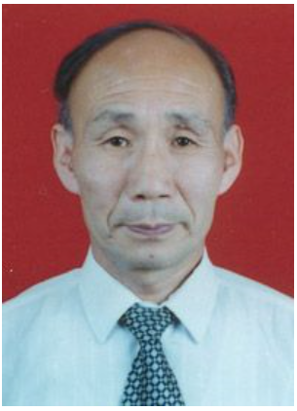
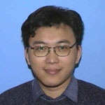
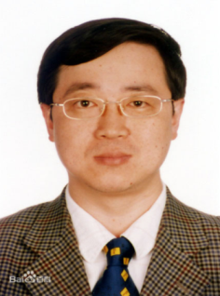
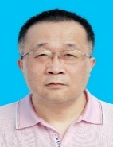
专业国际化的编委团队
Hokkaido University
编委会
Institute of Theoretical physics,CAS
Fudan University
Shandong University
Peking University
王贻芳
Yifang Wang Editor-in-Chief
IHEP
University of Chinese Academy of Sciences
Institute of Modern Physics,CAS
Uppsala University
Osaka University
Indiana University
吕才典
Caidian Lv
Associate EIC
IHEP
左维
Wei Zuo
Associate EIC
IMP
Beihang University
INFN
Durham University
Universita di Pisa
Grand Accélérateur National d'Ions Lourd
Institute of High Energy Physics, CAS
Queen Mary University of London
Nanjing University
Particles Theory
Nuclear Theory
University of Arizona
Northeastern University
Tokyo University
University of Wisconsin
Nankai University
李海波
Haibo Li
Associate EIC
IHEP
周小红
Xiaohong Zhou
Associate EIC
IMP
Univertita di Bari
Shanghai Jiao Tong University
NCTU
Tsinghua University
Iowa State University
University of Science and Technology of China
Ruhr-Universitat Bochum
Particle Experiment
Nuclear Experiment
China Institute of Atomic Energy
The University of Hong Kong
From more than30 institutes

Slide 6
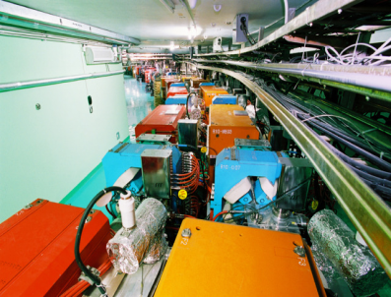
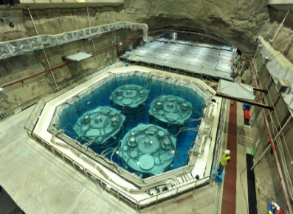
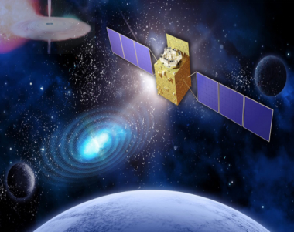
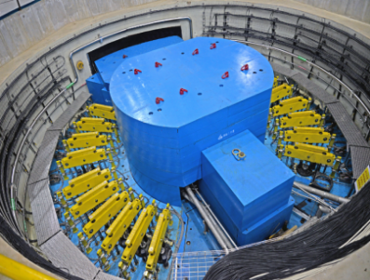
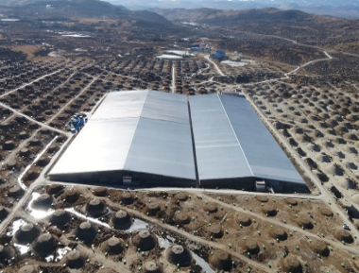
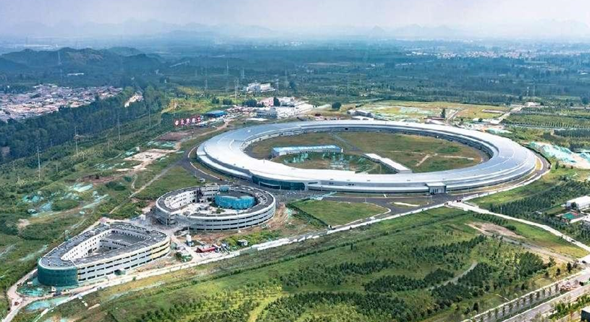
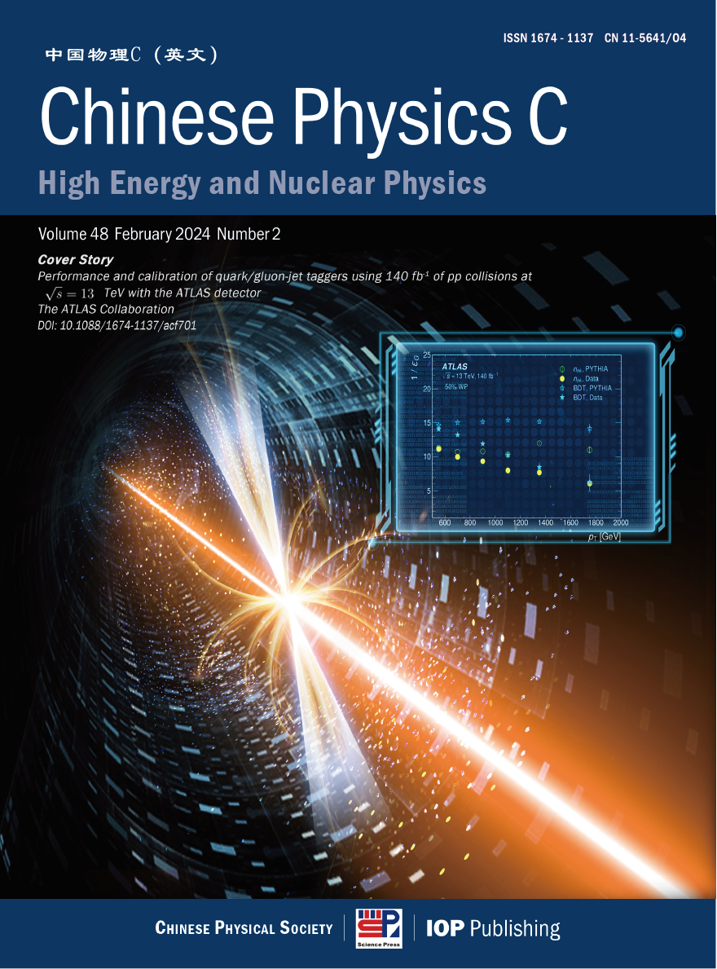
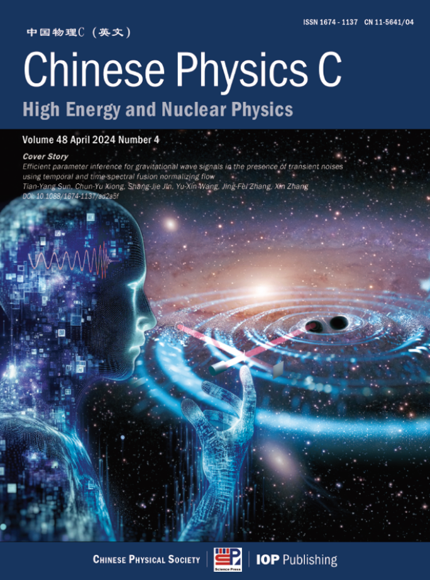
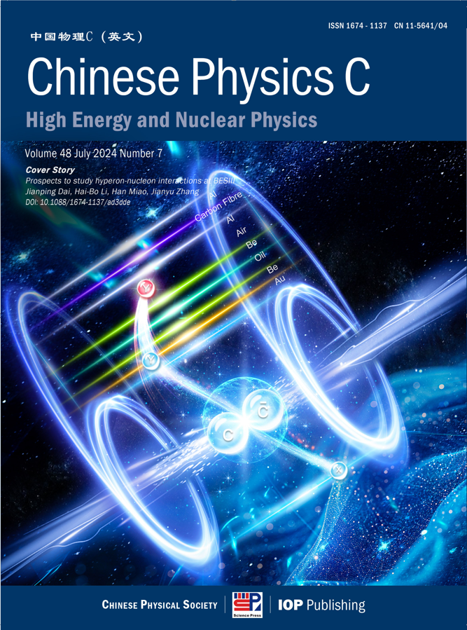
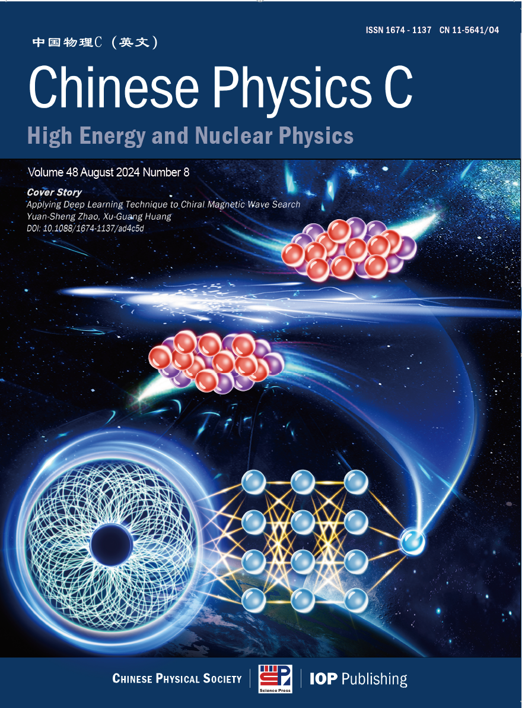
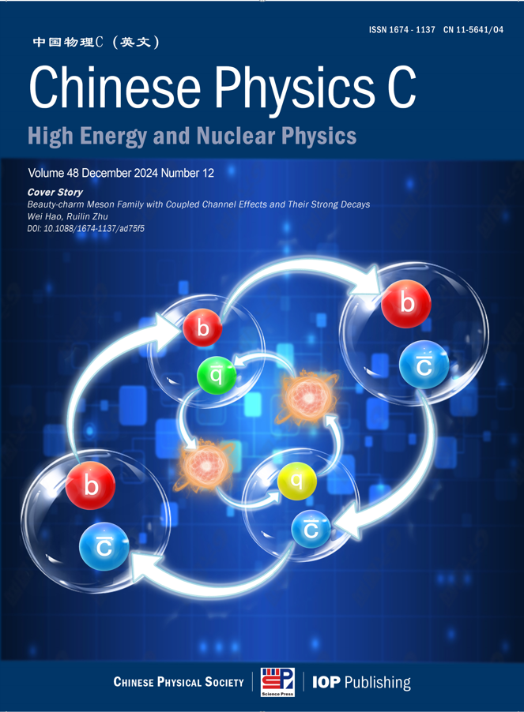
发挥学科特点 刊发重要研究成果

Slide 7
发表合作组文章
BESIII Collaboration | 2024 issue 8 | Amplitude Analysis of D⁰→π⁺π⁻π⁺π⁻ and π⁺π⁻π⁰π⁰
LHAASO Collaboration | 2024 issue 6 | Optimization of performance of the KM2A full array using the Crab Nebula
BESIII Collaboration | 2024 issue 9 | Determination of the number of $\psi$(3686) events taken at BESIII
ATLAS Collaboration | 2024 issue 3 | Performance and calibration of quark/gluon-jet taggers using 140 fb$^{-1}$ of $pp$ collisions at $\sqrt{s} = 13$ TeV with the ATLAS detector
CDEX Collaboration | 2024 issue 10 | Searching for 76Ge neutrinoless double beta decay with the CDEX-1B experiment
CSNS Collaboration | 2024 issue 8 | Measurement of the neutron total cross section of 9Be at the Back-n white neutron source of CSNS
PandaX Collaboration | 2024 issue 7 | Detecting Neutrinos from Supernova Bursts in PandaX-4T
JUNO Collaboration | 2025 issue 1 | Prediction of Energy Resolution in the JUNO Experiment
BESIII Collaboration | 2024 issue 12 | Measurement of the integrated luminosity of the data collected at 3.773 GeV by BESIII from 2021 to 2024
PandaX Collaboration | 2024 issue 9 | Measurement of Solar $pp$ Neutrino Flux using Electron Recoil Data from PandaX-4T Commissioning Run
BelleII Collaboration | 2025 issue 1 | Measurement of the integrated luminosity of data samples collected during 2019-2022 by the Belle II experiment
ᵡQCD Collaboration | 2024 issue 12 | Charm physics with overlap fermions on 2+1-flavor domain wall fermion configurations
BESIII Collaboration | 2025 issue 4 | Search for the lepton number violation decay $\phi \to \pi^+ \pi^+ e^- e^-$ via $J/\psi\to \phi\eta$
νGeN Collaboration | 2025 issue 5 | New constraints on coherent elastic neutrino–nucleus scattering by the νGeN experiment

Slide 8
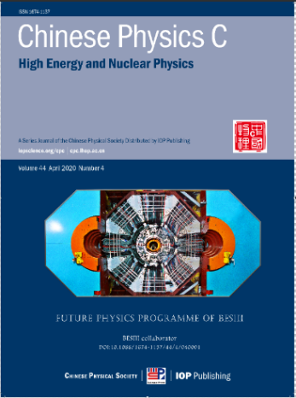
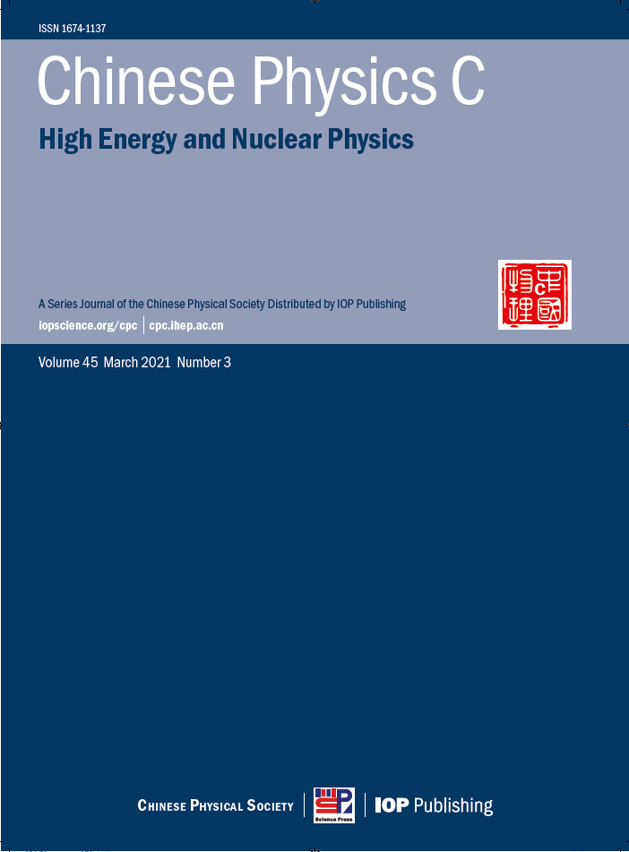
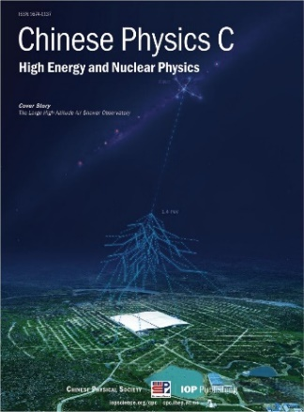
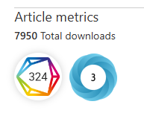
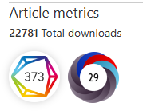
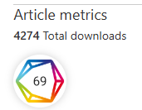
出版具有国际影响力的学科领域重要专刊
2020 No 4
Future Physics
Programme of BESIII Citation：378
2021 No 3
The AME 2020 Atomic
Mass evaluation Citation：1190
2022 No 3
The Large High Altitude
Air Shower Observatory Citation：84

Slide 9
国际一流的评审出版流程
平均审稿时间
平均生产时间
24天
24小时
投稿到第一轮审稿意见返回
正式接收到上网分配DOI
54天
35天
投稿到接收平均时间
正式接收到正式发表
审稿专家库超过4000人，来自57个国家和地区，国际审稿人占比49%。
国际出版道德伦理委员会（COPE）正式成员，严格按照国际标准完善学术诚信制度，营造良好学术秩序，打造国际一流的学术诚信体系。

Slide 10
完善的作者服务与支持
SCOAP³
高能物理领域文章免费开放获取
绿色通道
英文润色
重大科研成果快速审稿快速发表
接收文章由专业人员免费英文润色
投稿支持
封面设计
提供投稿咨询及时解答投审稿过程中问题
为高影响力文章提供定制封面设计服务

Slide 11
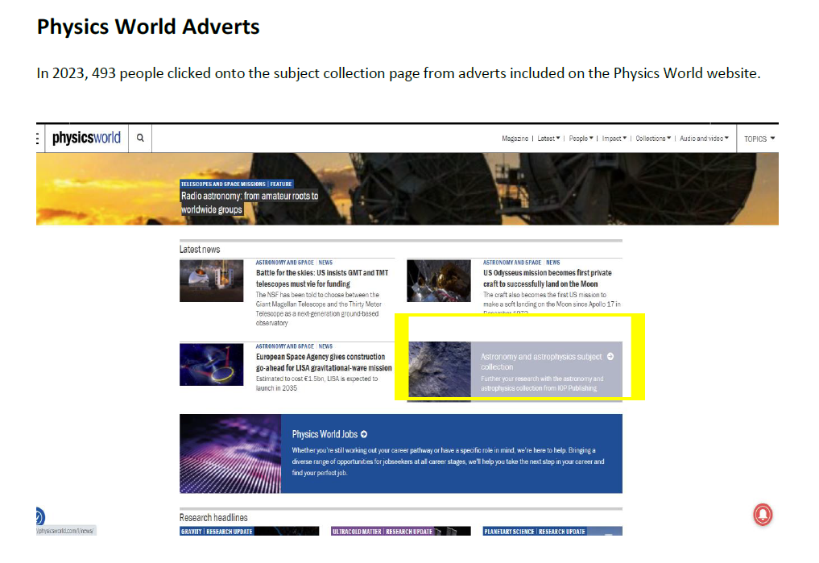
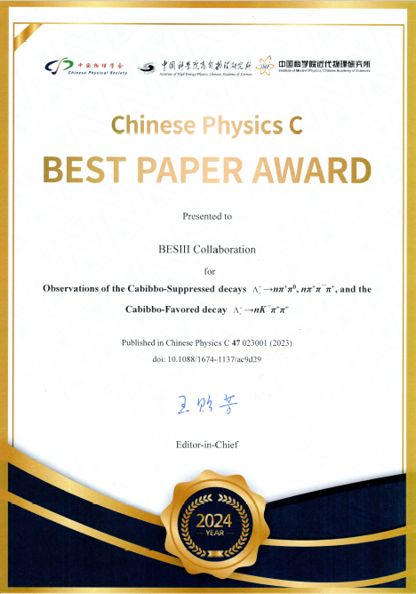
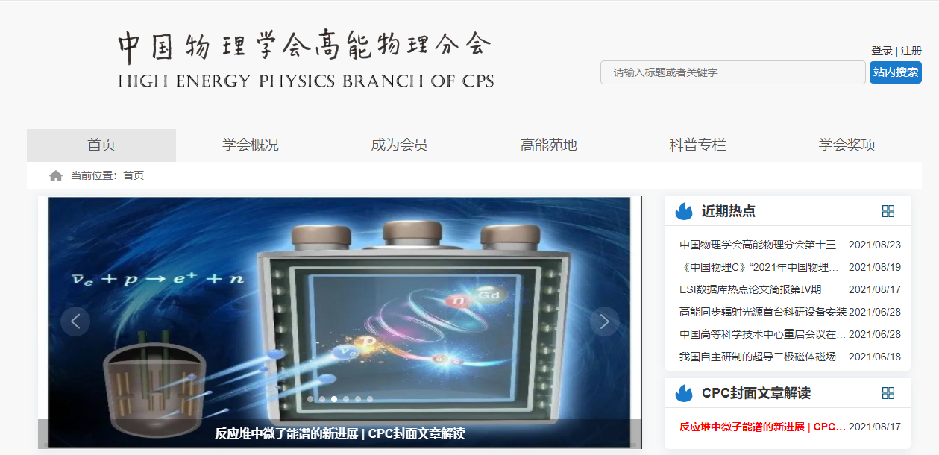
宣传推广
为优秀论文成果打造全方位的宣传阵地
WeChat/Twitter/Email
Physics World/《现代物理知识》高能物理学会/Researcher APP
CPC
供应商的选择
The total number of full-text downloads for CPC on IOP science was over 170,000

Slide 12
在国际范围内具有较高学术影响力
CPC论文的国际引用占比处于较高水平，除中国外引用前五的国家分别是美国、德国、印度、意大利和英国
引用CPC前五的期刊分别是Physical Review D， European Physics Journal C，Physical Review C，CPC，和Journal of High Energy Physics
CPC发表国际合作论文占比40%左右
下载CPC论文的国际科研机构前四位分别是CERN、TelAviv University，Brookhaven National Laboratory和Michigan State University

Slide 13
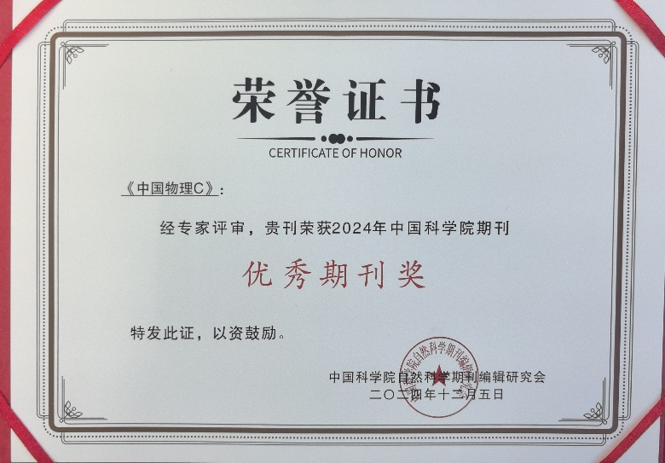
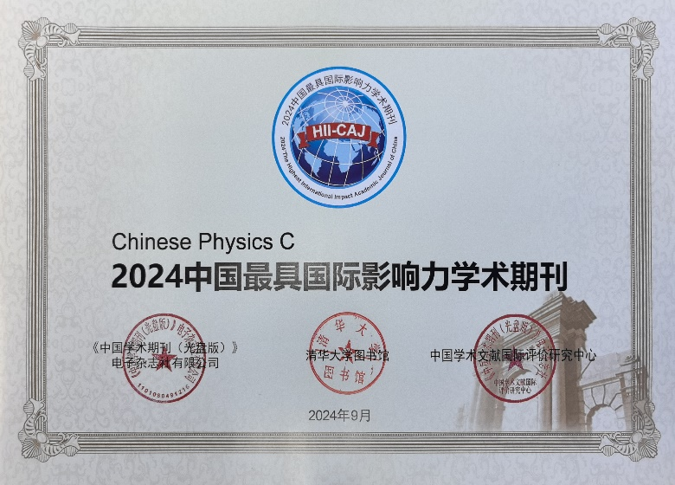
期刊影响力
中国科技期刊卓越行动计划CPC-Tier 2 (2.5 million) 2024-2028
核学会期刊分级
Tier 1 (2024)
2023 CiteScore: 6.5
Nuclear & High Energy physics: Q1
中国科学院期刊分级
Physics and Astronomy Q2
- Particles & Fields: Q2
- Nuclear: Q2
中国科学院优秀期刊
15 out of more than 400 journals supervised by Chinese Academy of Science
中国最具国际影响力学术期刊
Top 5% of 3500 journal in China
Received the award for 13 consecutive years

Slide 14
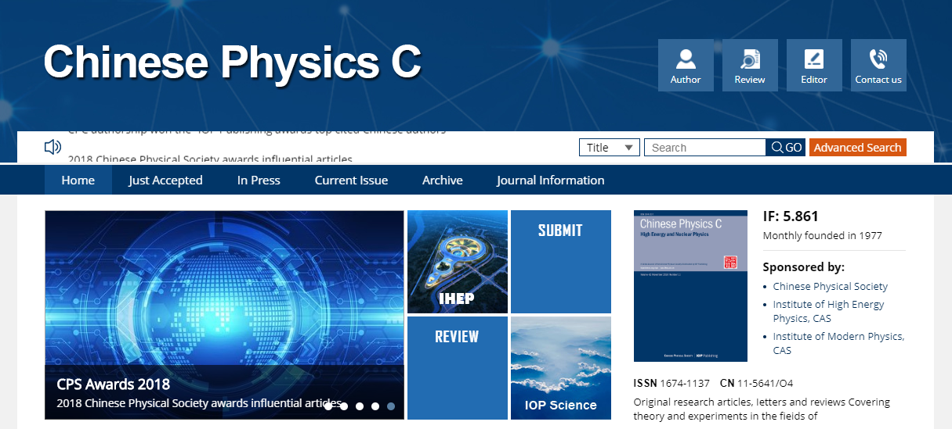
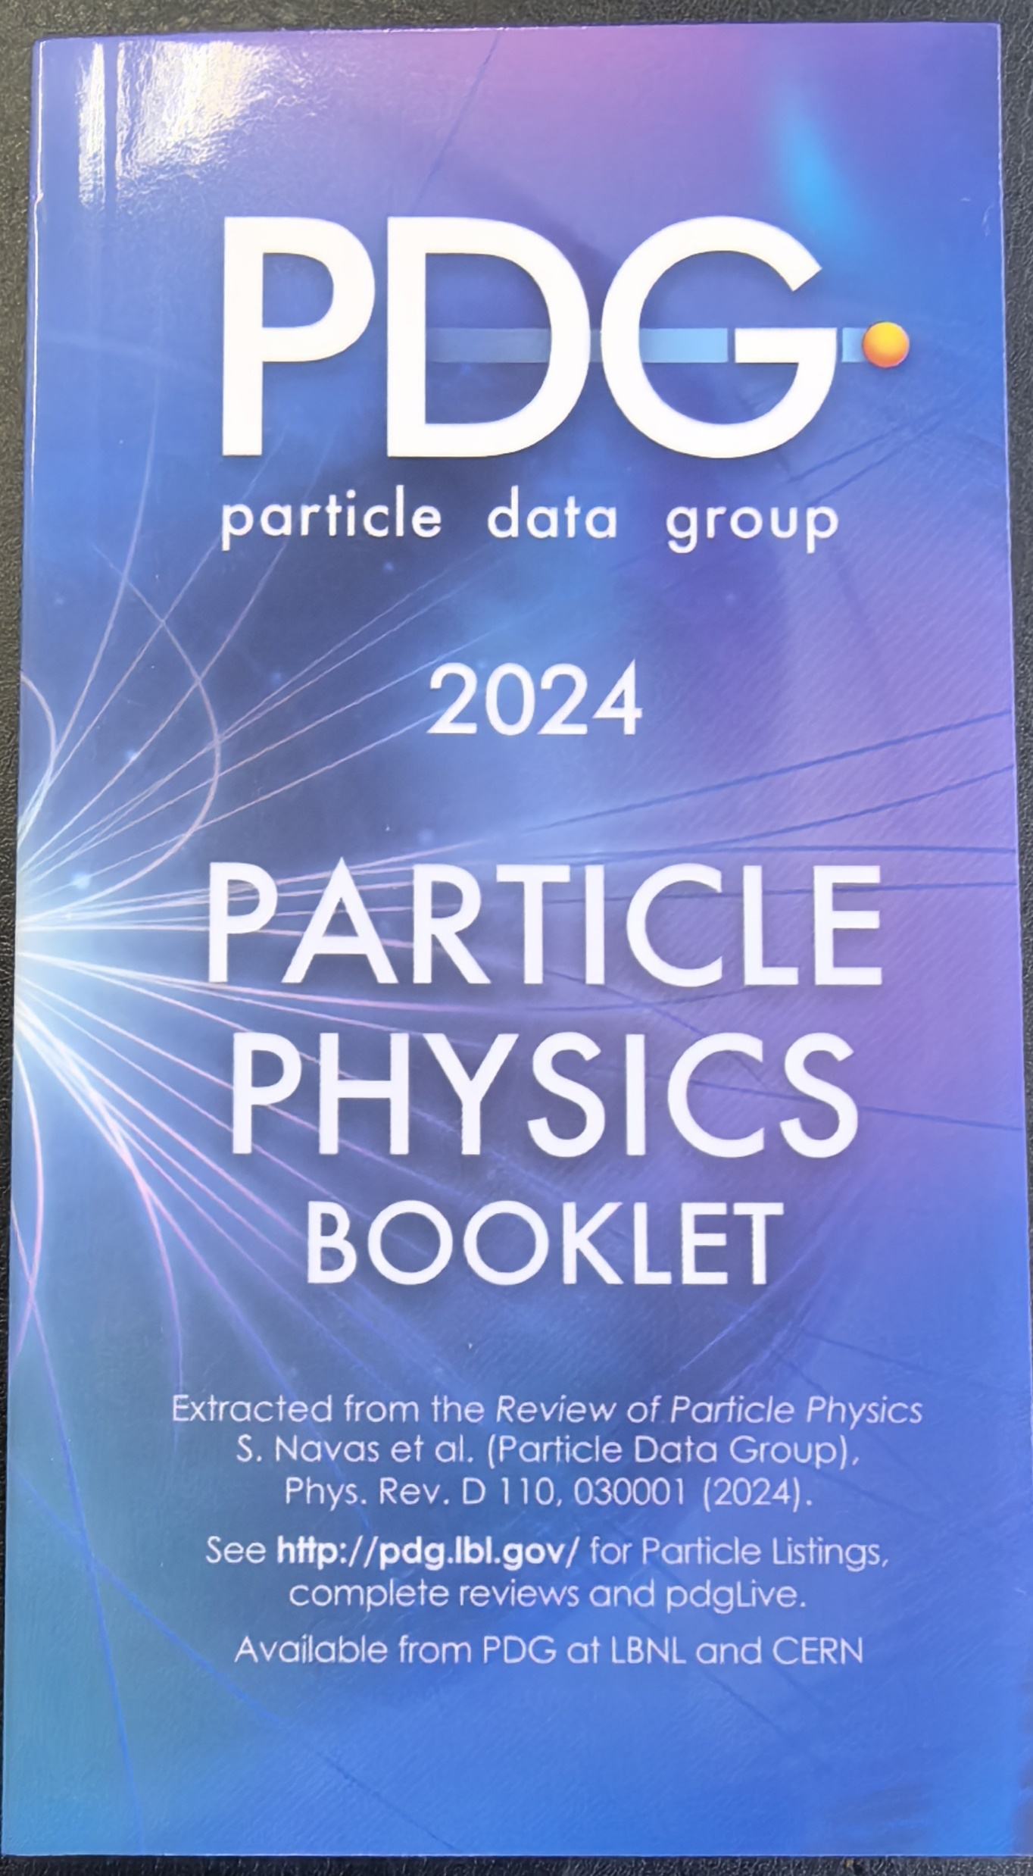
投稿指南与联系方式
FEATURED
| PROJECT’S
Conveniently iterate top-line alignments for wireless metrics.
How to submit
INSURANCE
BUSINESS PLAN
Conveniently iterate top-line alignments for wireless metrics.
Register / log in at http://mc03.manuscriptcentral.com/cpc
仅支持投稿系统投稿
cpc.ihep.ac.cn
cpc@ihep.ac.cn

Slide 15
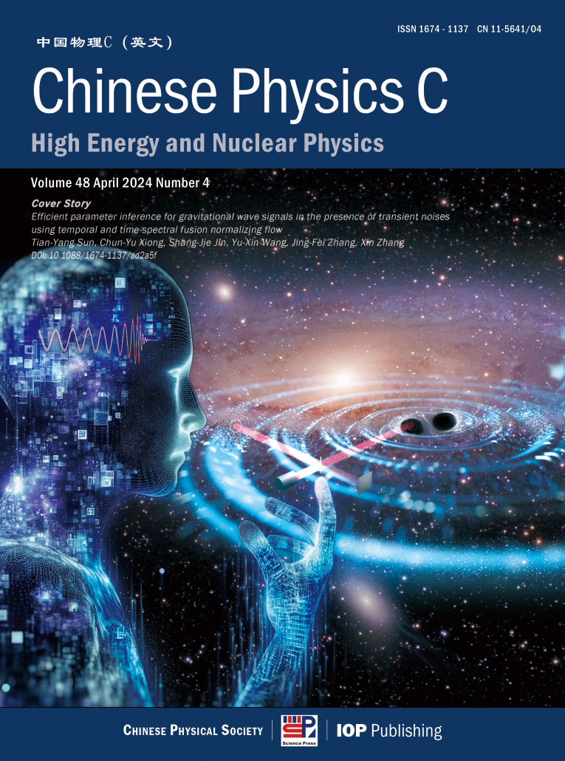
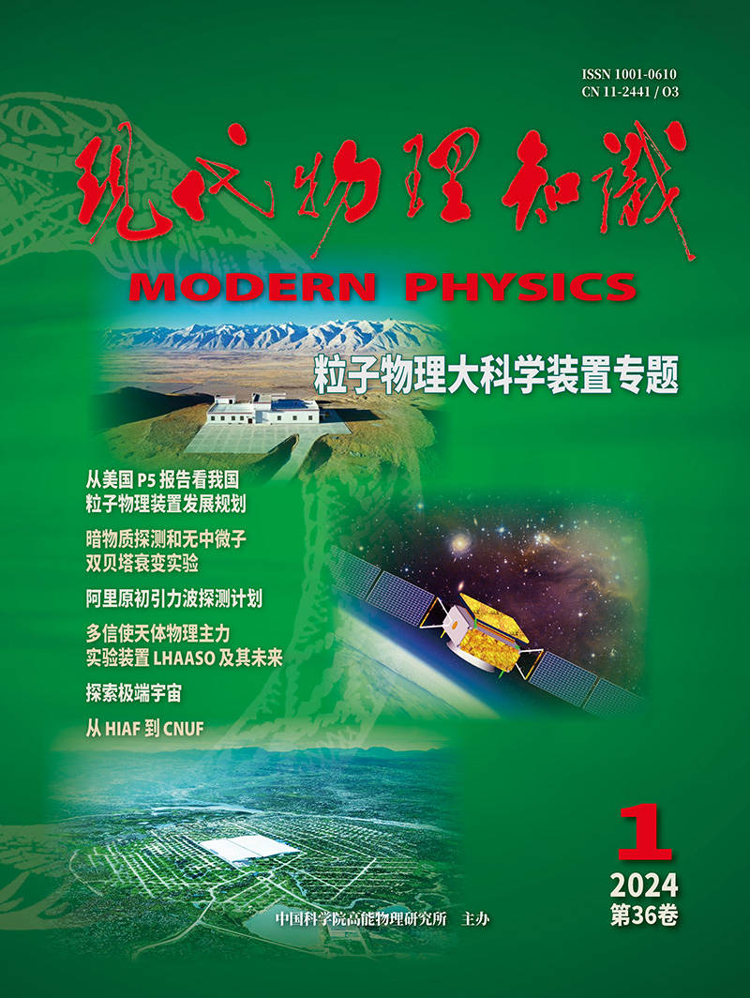
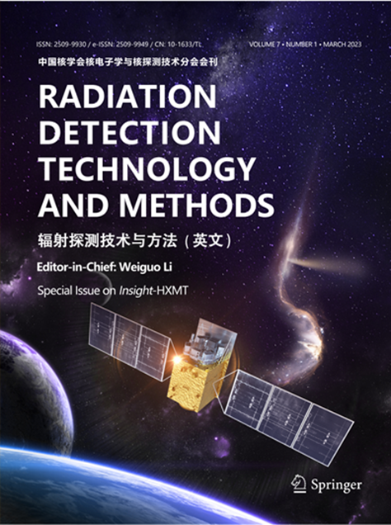
加入我们，共同推动学科发展！
Chinese Physics C
《现代物理知识》
Radiation Detection
Technology and Methods

