Slide 1
3’rd Round SCD BT Calibration
Sep-9-2024
Zhaoyi Qu/SDIAT

Slide 2
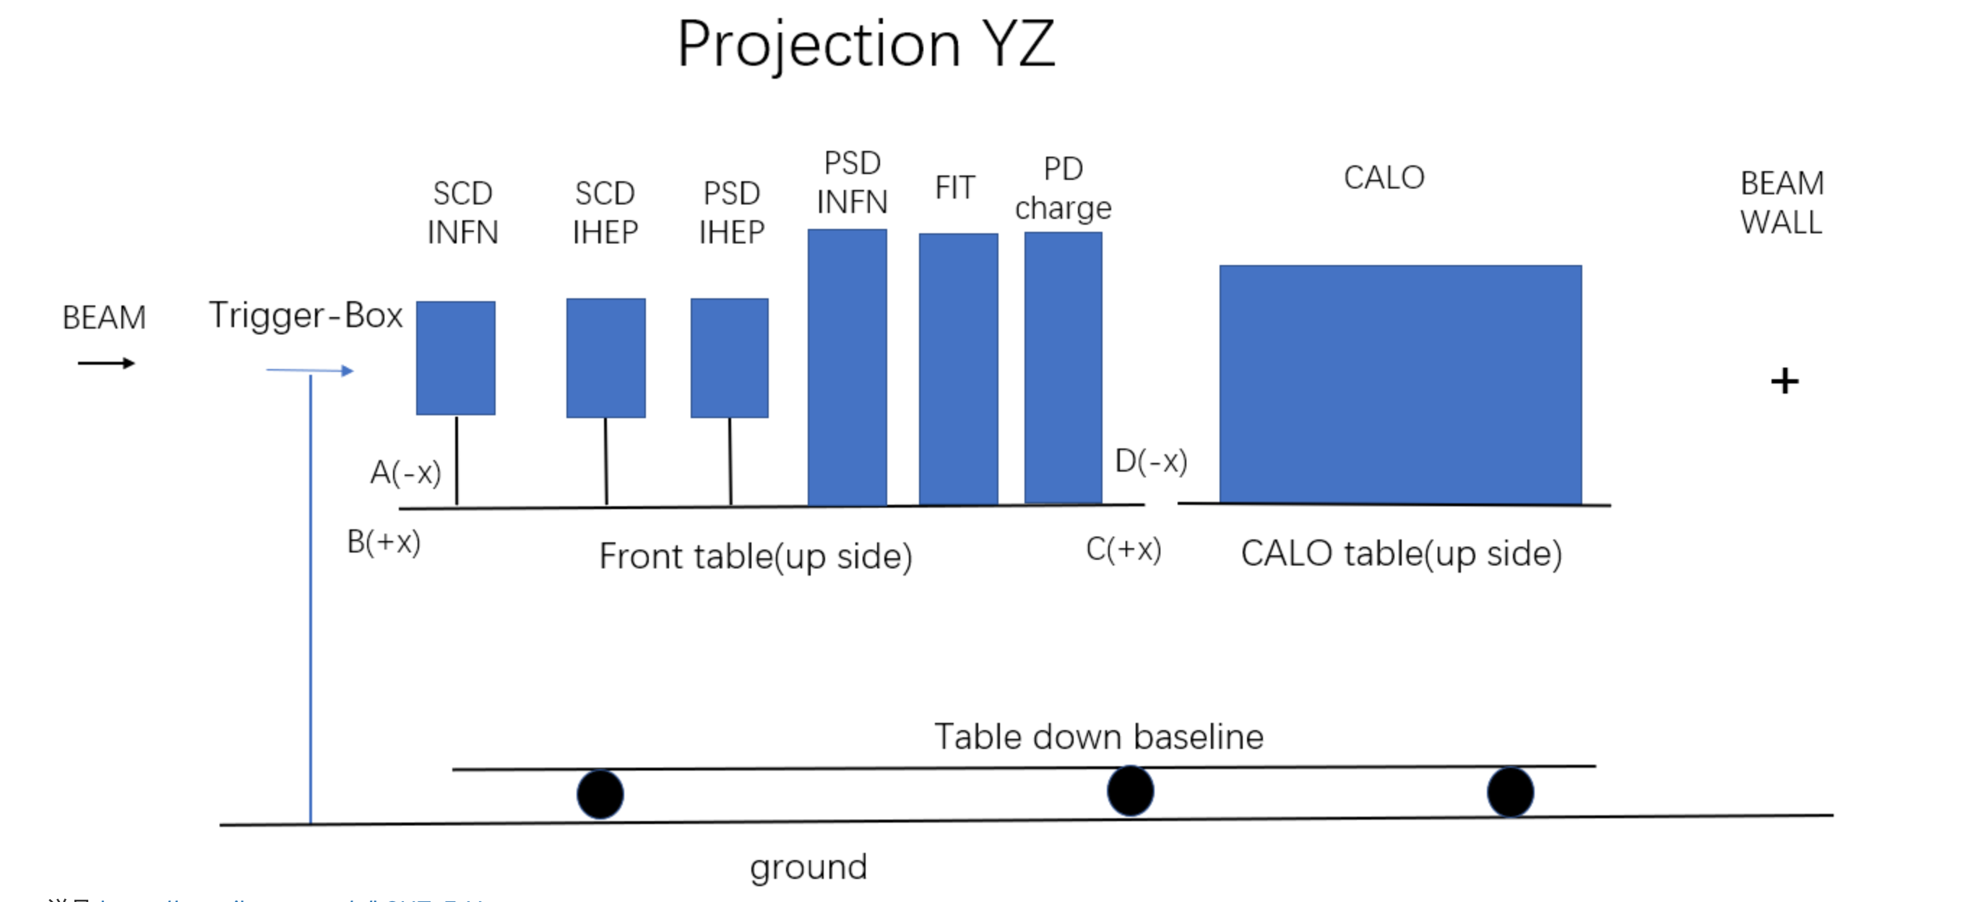
3’rd round of calibration
Data used:
SPS-Ion: Apr 18
PD Charge
INFN SCD Cluster
INFN SCD Track
IHEP SCD Digi (160um)
IHEP SCD Digi (150um)
INFN Track->IHEP
Residual < 300um
2 layers of SCD used:
Micron
Zaozhuang(RT)

Slide 3
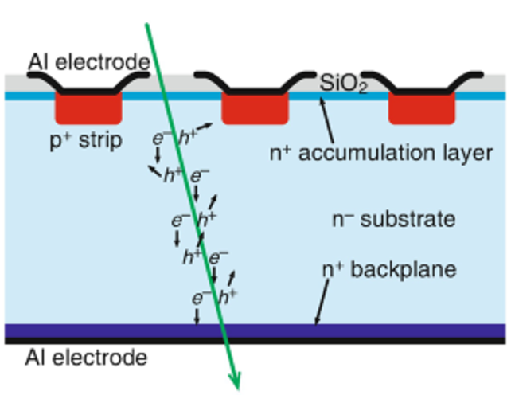
3’rd round of calibration
seed
second
$$r_{s}=\frac{{ADC}_{second}}{{ADC}_{seed}}×sign$$
sign is determined by ChannelID
secondID < seedID : -1
secondID > seedID : +1

Slide 4
Sensor Strip Layout
160 μm
160 μm
60 μm
25 μm
Micron
va0
va1
va2
va3
150 μm
150 μm
RT(枣庄)
va0
va1
va2
d = ?um
va3
va4
va5

Slide 5
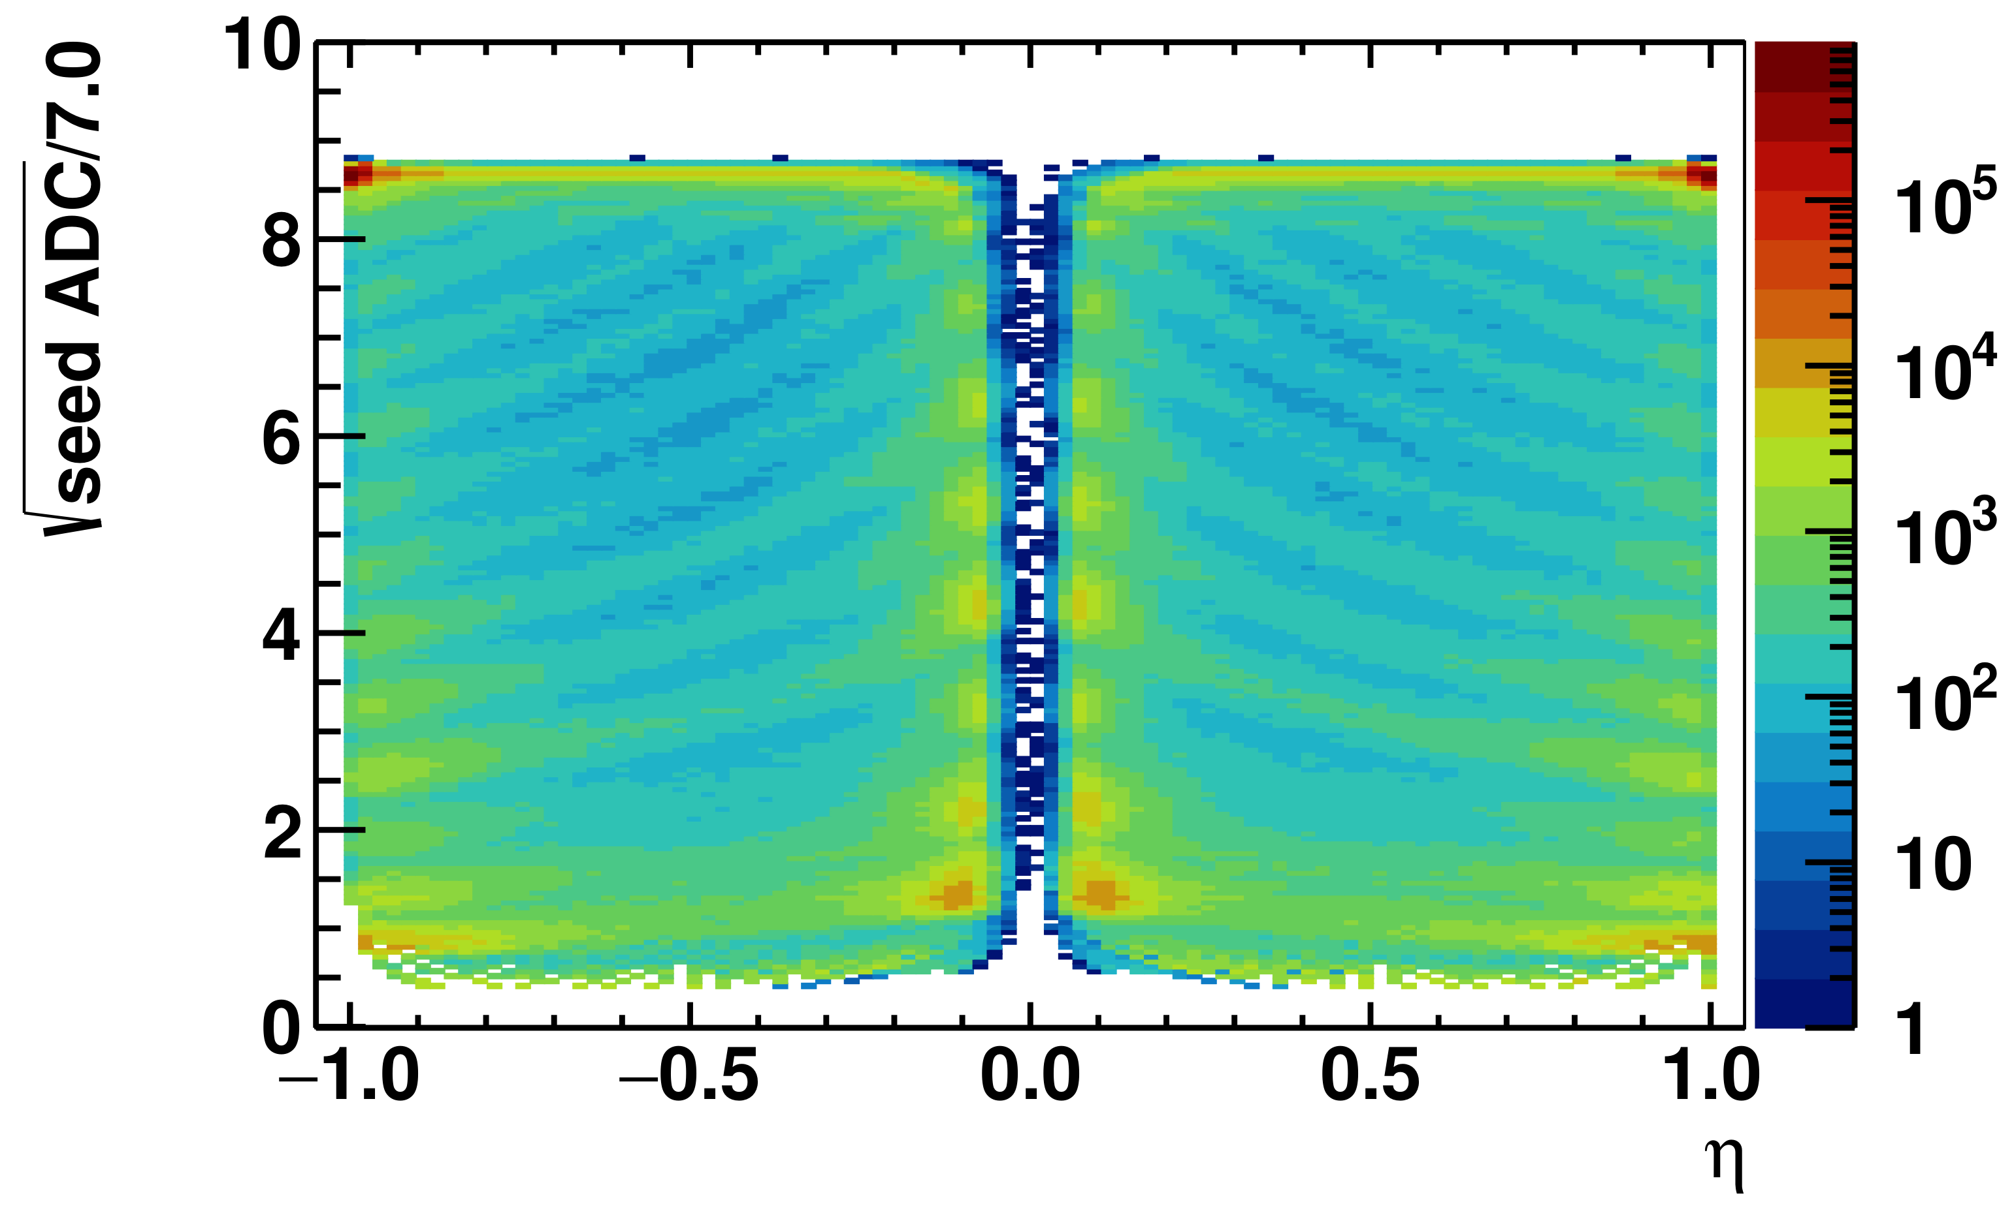
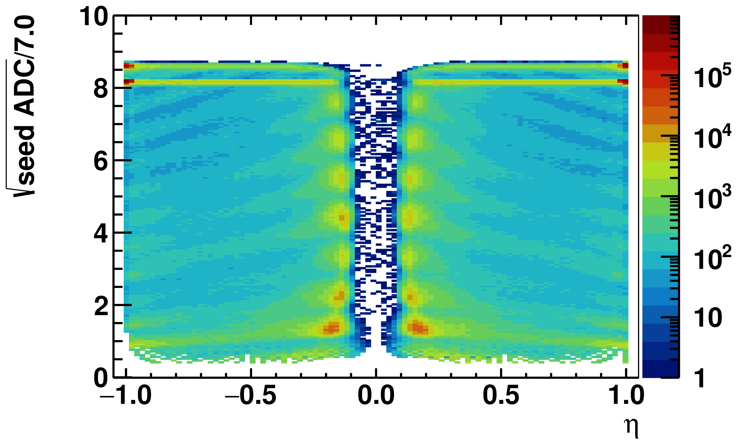
Calibration Principle
$$r_{s}=\frac{{ADC}_{second}}{{ADC}_{seed}}×sign$$
Micron
枣庄
$$r_{s}$$
$$r_{s}$$
Obtain equalization parameters,
by equalize seed ADC of all Q for all strips, @r_{s}≌0 .
Reaches Q <= 8.

Slide 6
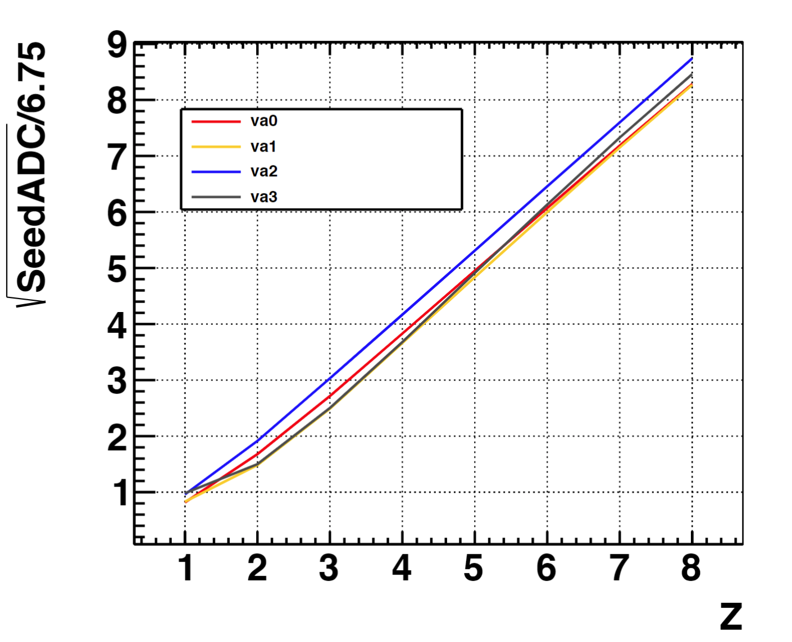
ADC Response
Y-Axis: MPV of each Charge Category.
X-Axis: Integral value of Charge.
Flaws:
Small statistics of Q=1
x-axis is related with r_{s}, which is not accurately integral.
old method

Slide 7
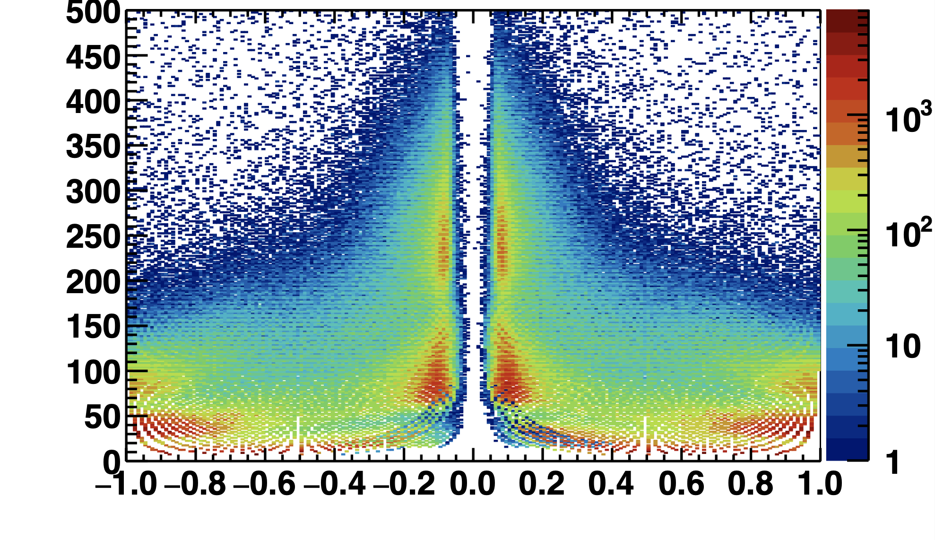
Flaws of 1’st 2’nd round calibration
Statistics on Q=1 events is too small
If Calibration for ADC<50 is wrong, r_{s}
for Q=2~7 is wrong.
ADC
Q=3
Q=2
Q=?1
𝝶
$$r_{s}$$

Slide 8
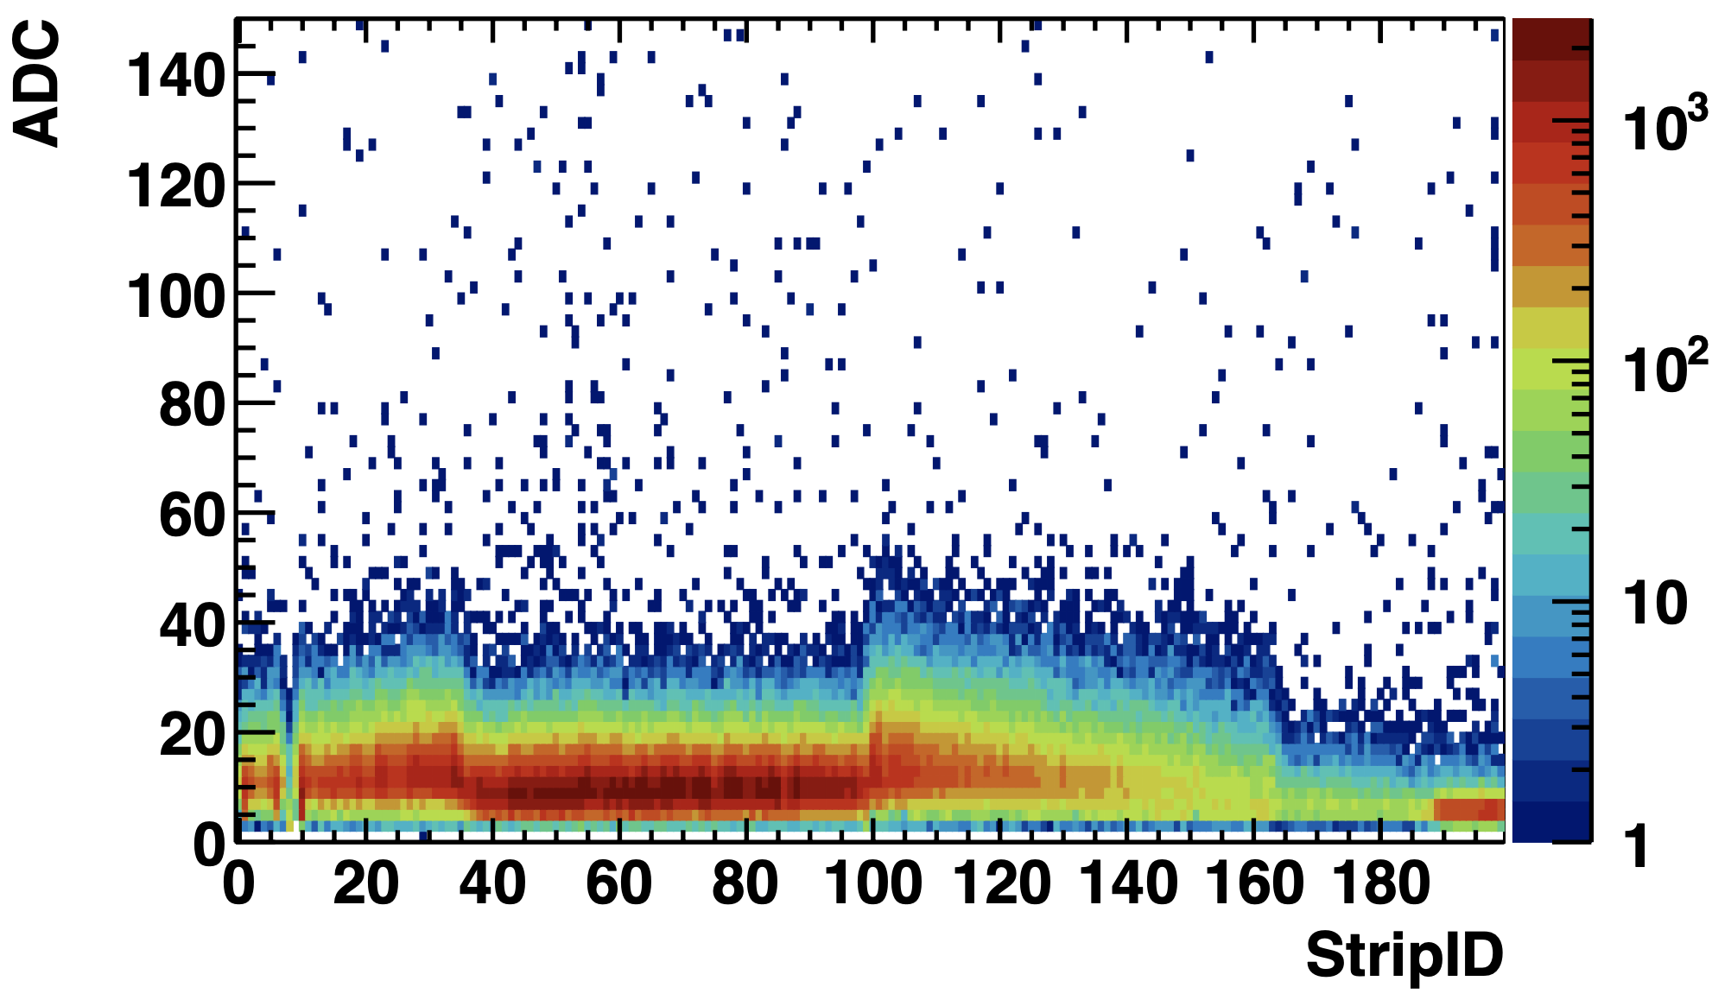
Approach Second Strip
For Q=2, r_{s} <0.2, second strip ADC is below 50.
If Q=2 second strip calibrated well, Q=1 seed strip is covered.
Micron

Slide 9
More Accurate Approach
Y-Axis
MPV of each categories
Categories:
Seed strip of Z = 2-8
Second strip of Z = 2,3,4
X-Axis
Z reweighted by r_{s}
Weights:
Seed strip of Z = 2-8 : $W_{seed} =Mean(1−r_{s})/r_{s0}$
Second strip of Z = 2,3,4 : $W_{second}=Mean(r_{s})/r_{s0}$
$$r_{s}=\frac{{ADC}_{second}}{{ADC}_{seed}}×sign$$
$$Z_{weighed}=Z∗W$$
$$r_{s} \sim 0.11$$
$$r_{s0}=0.89$$

Slide 10
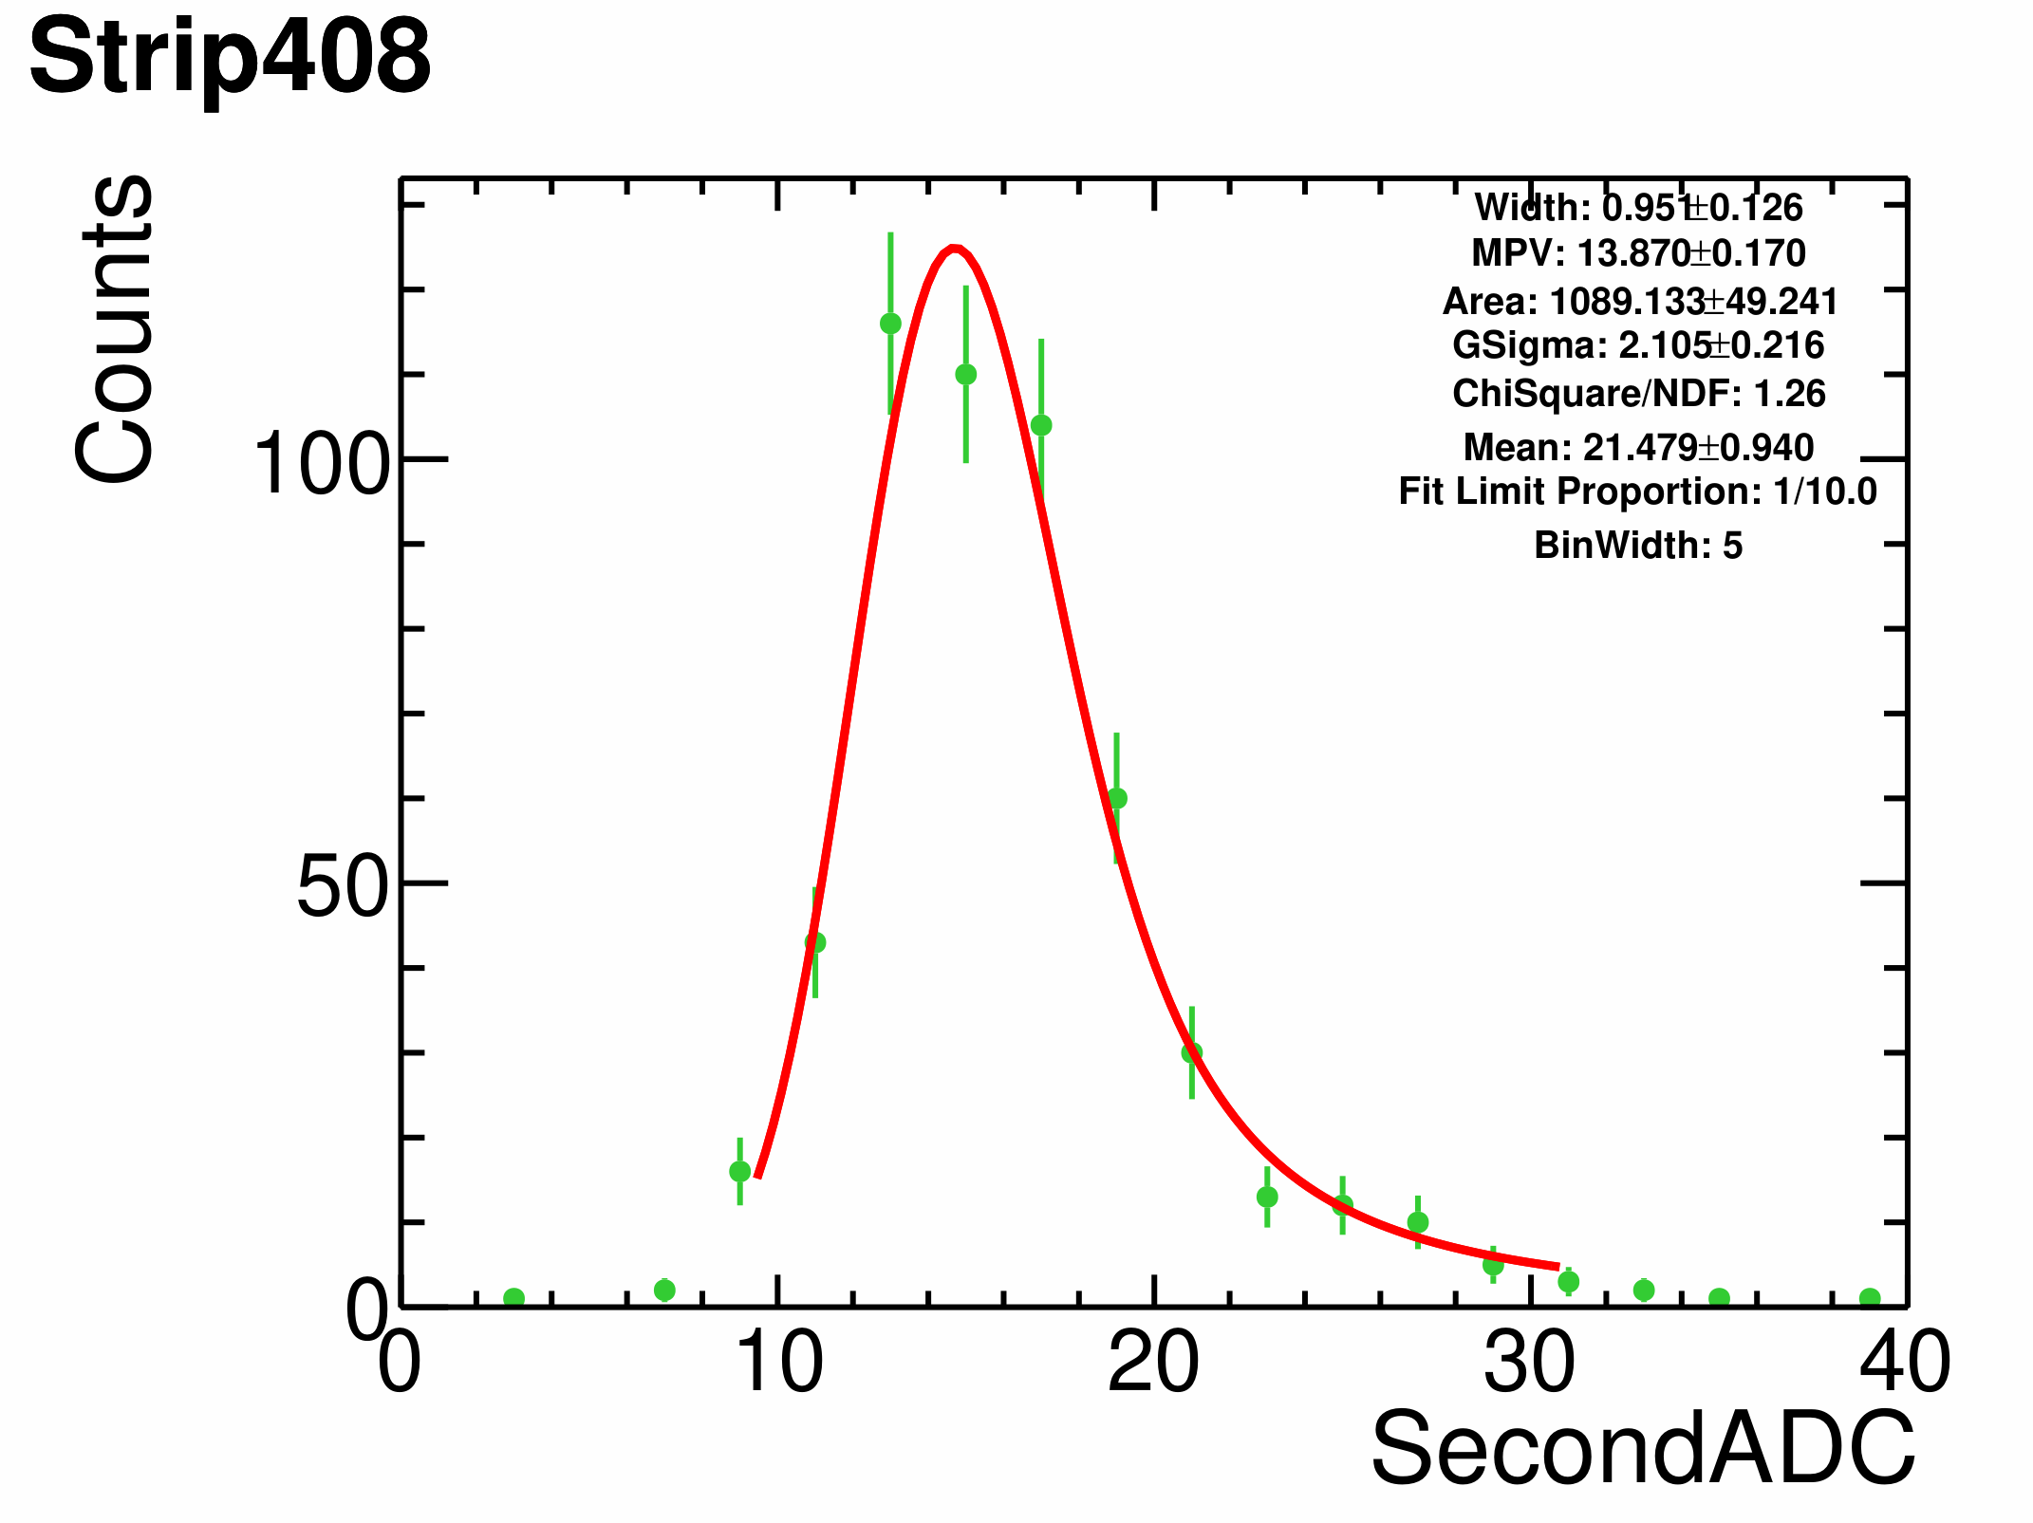
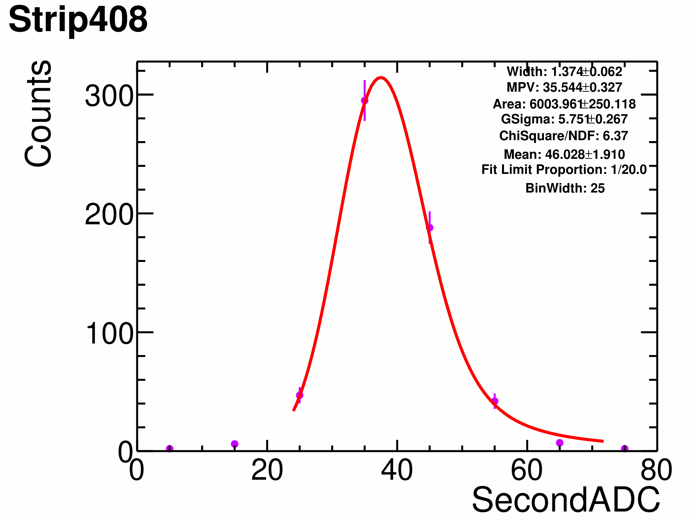
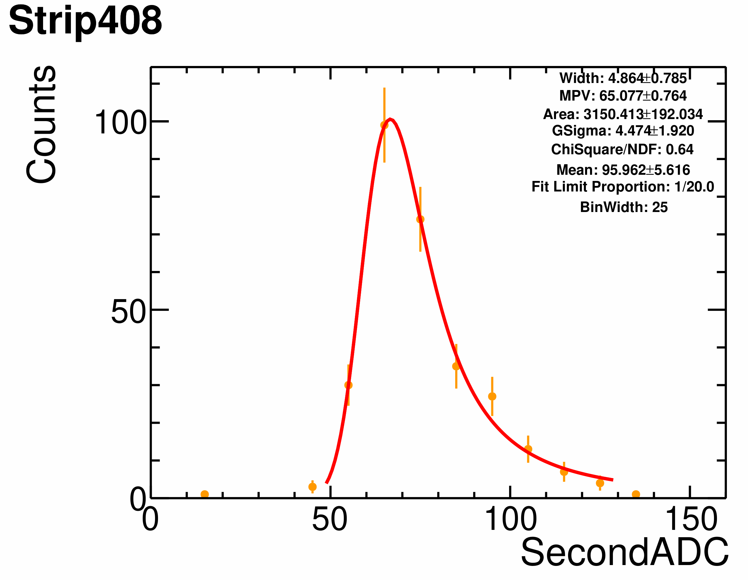
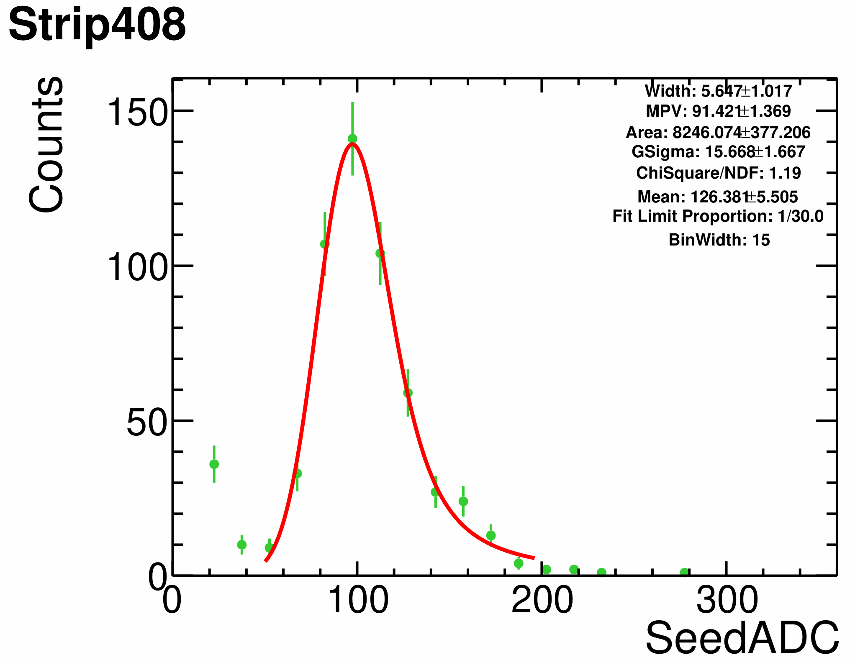
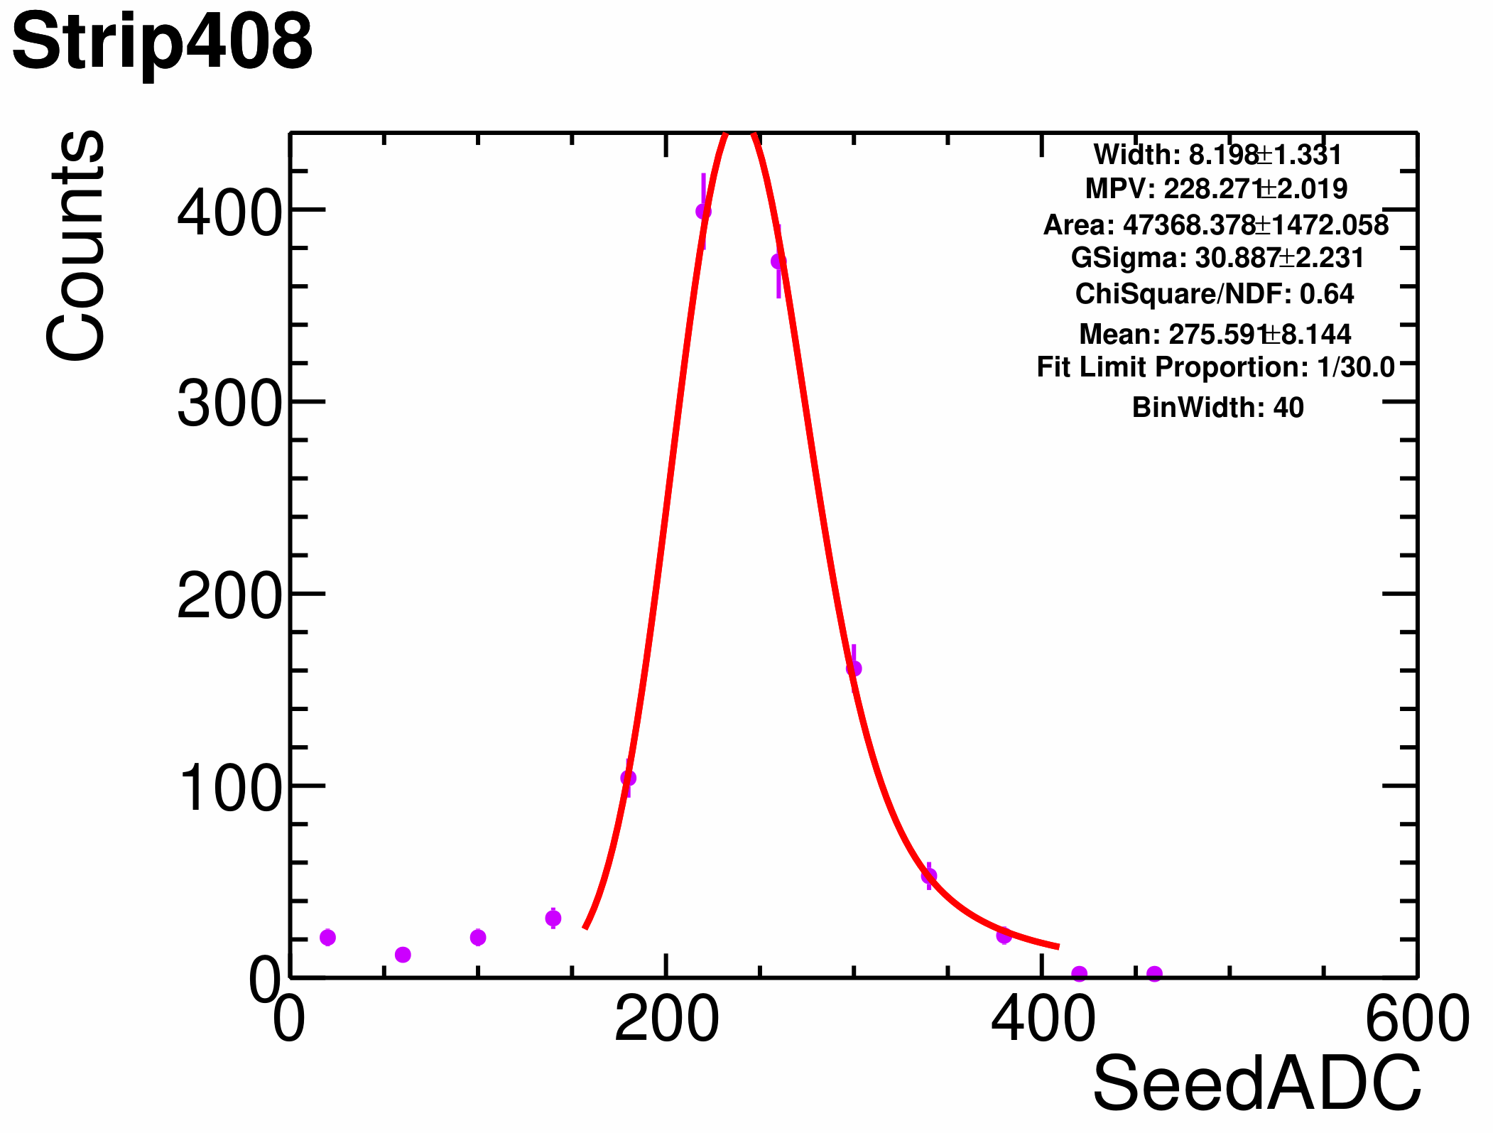
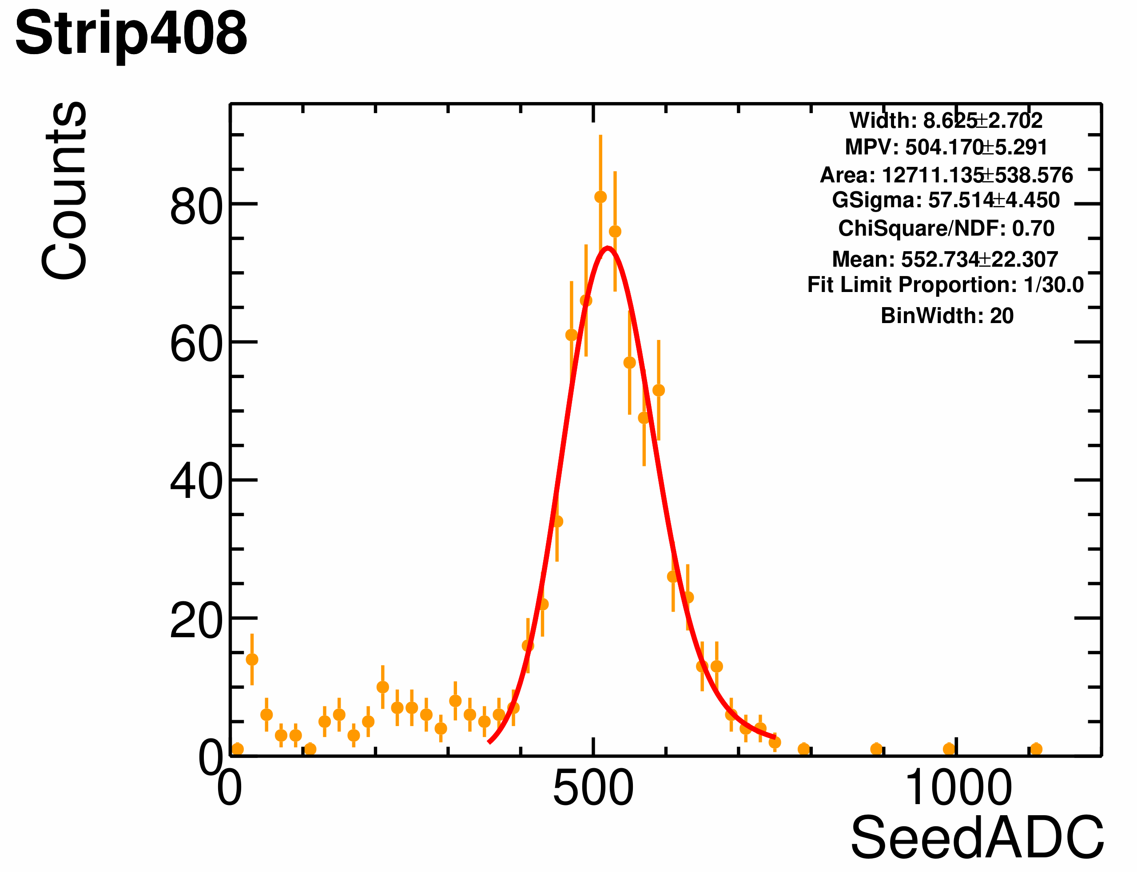
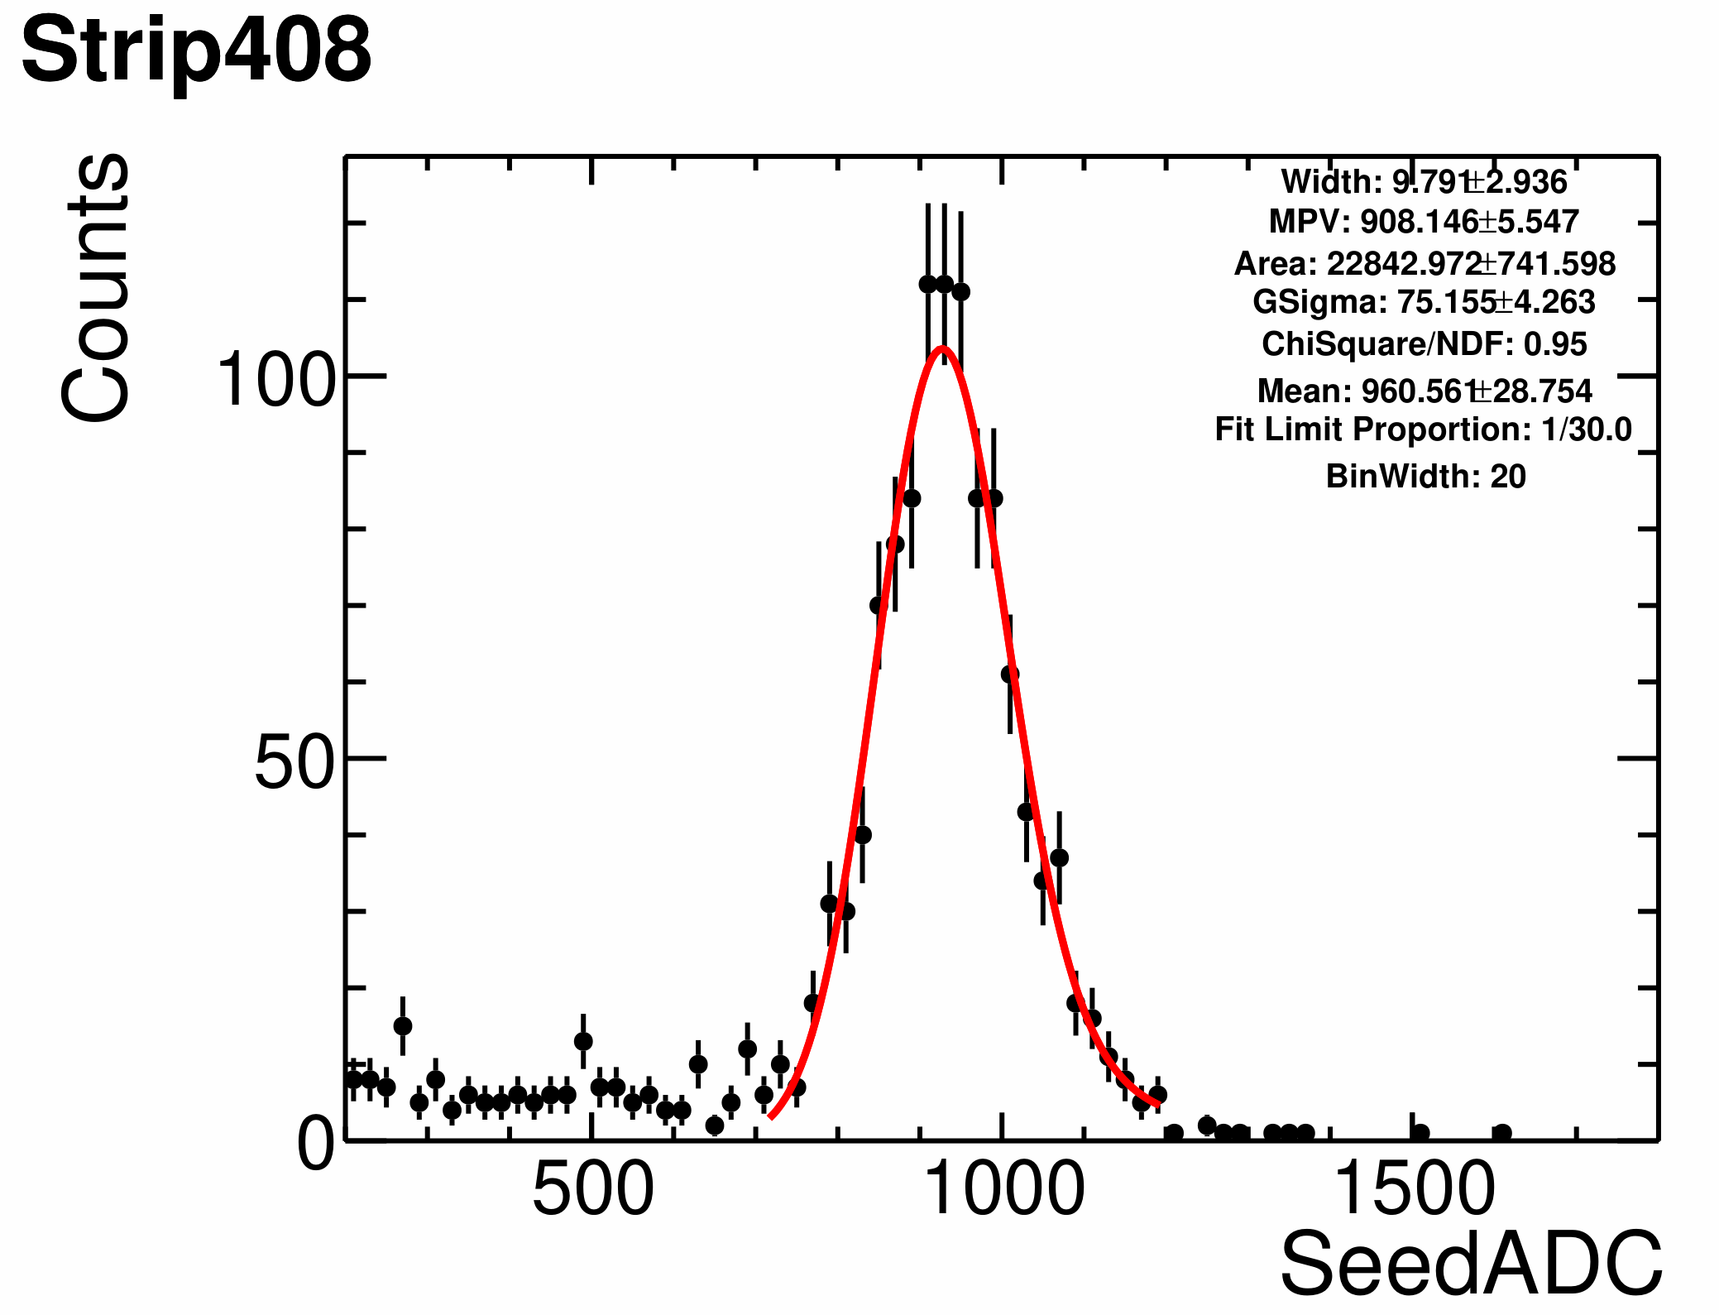
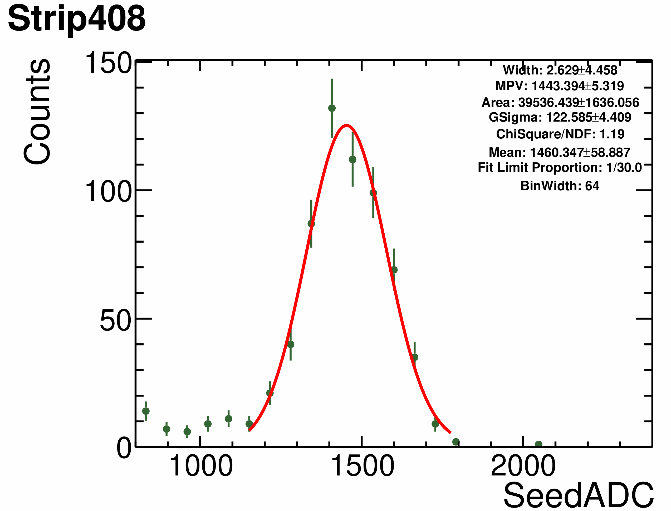
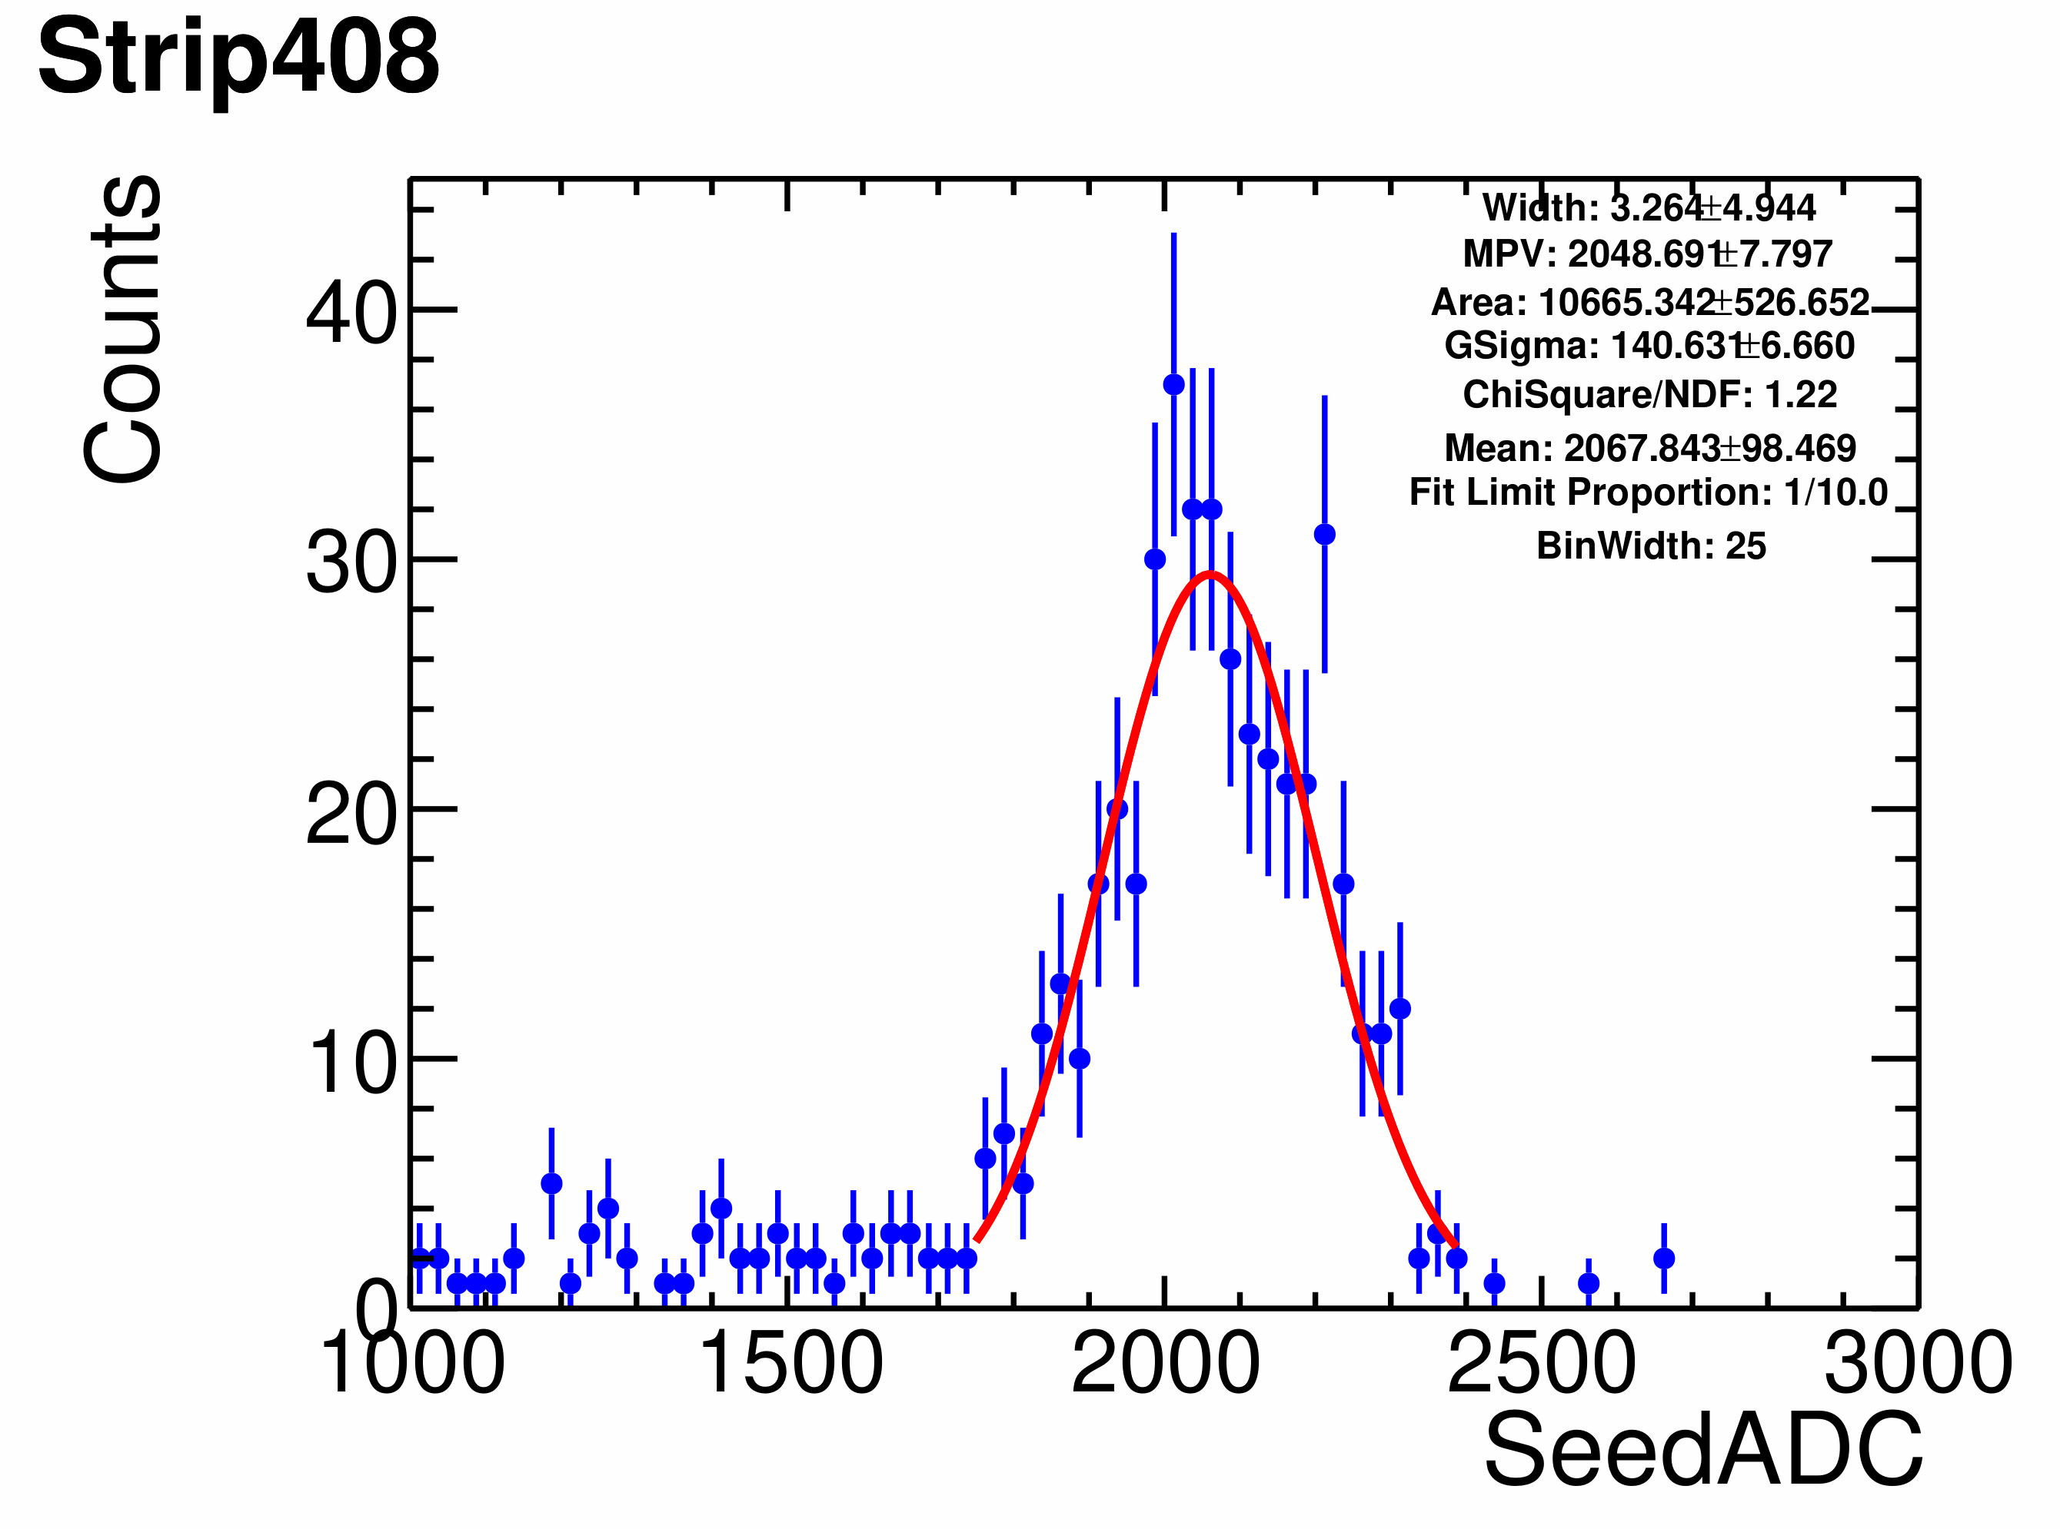
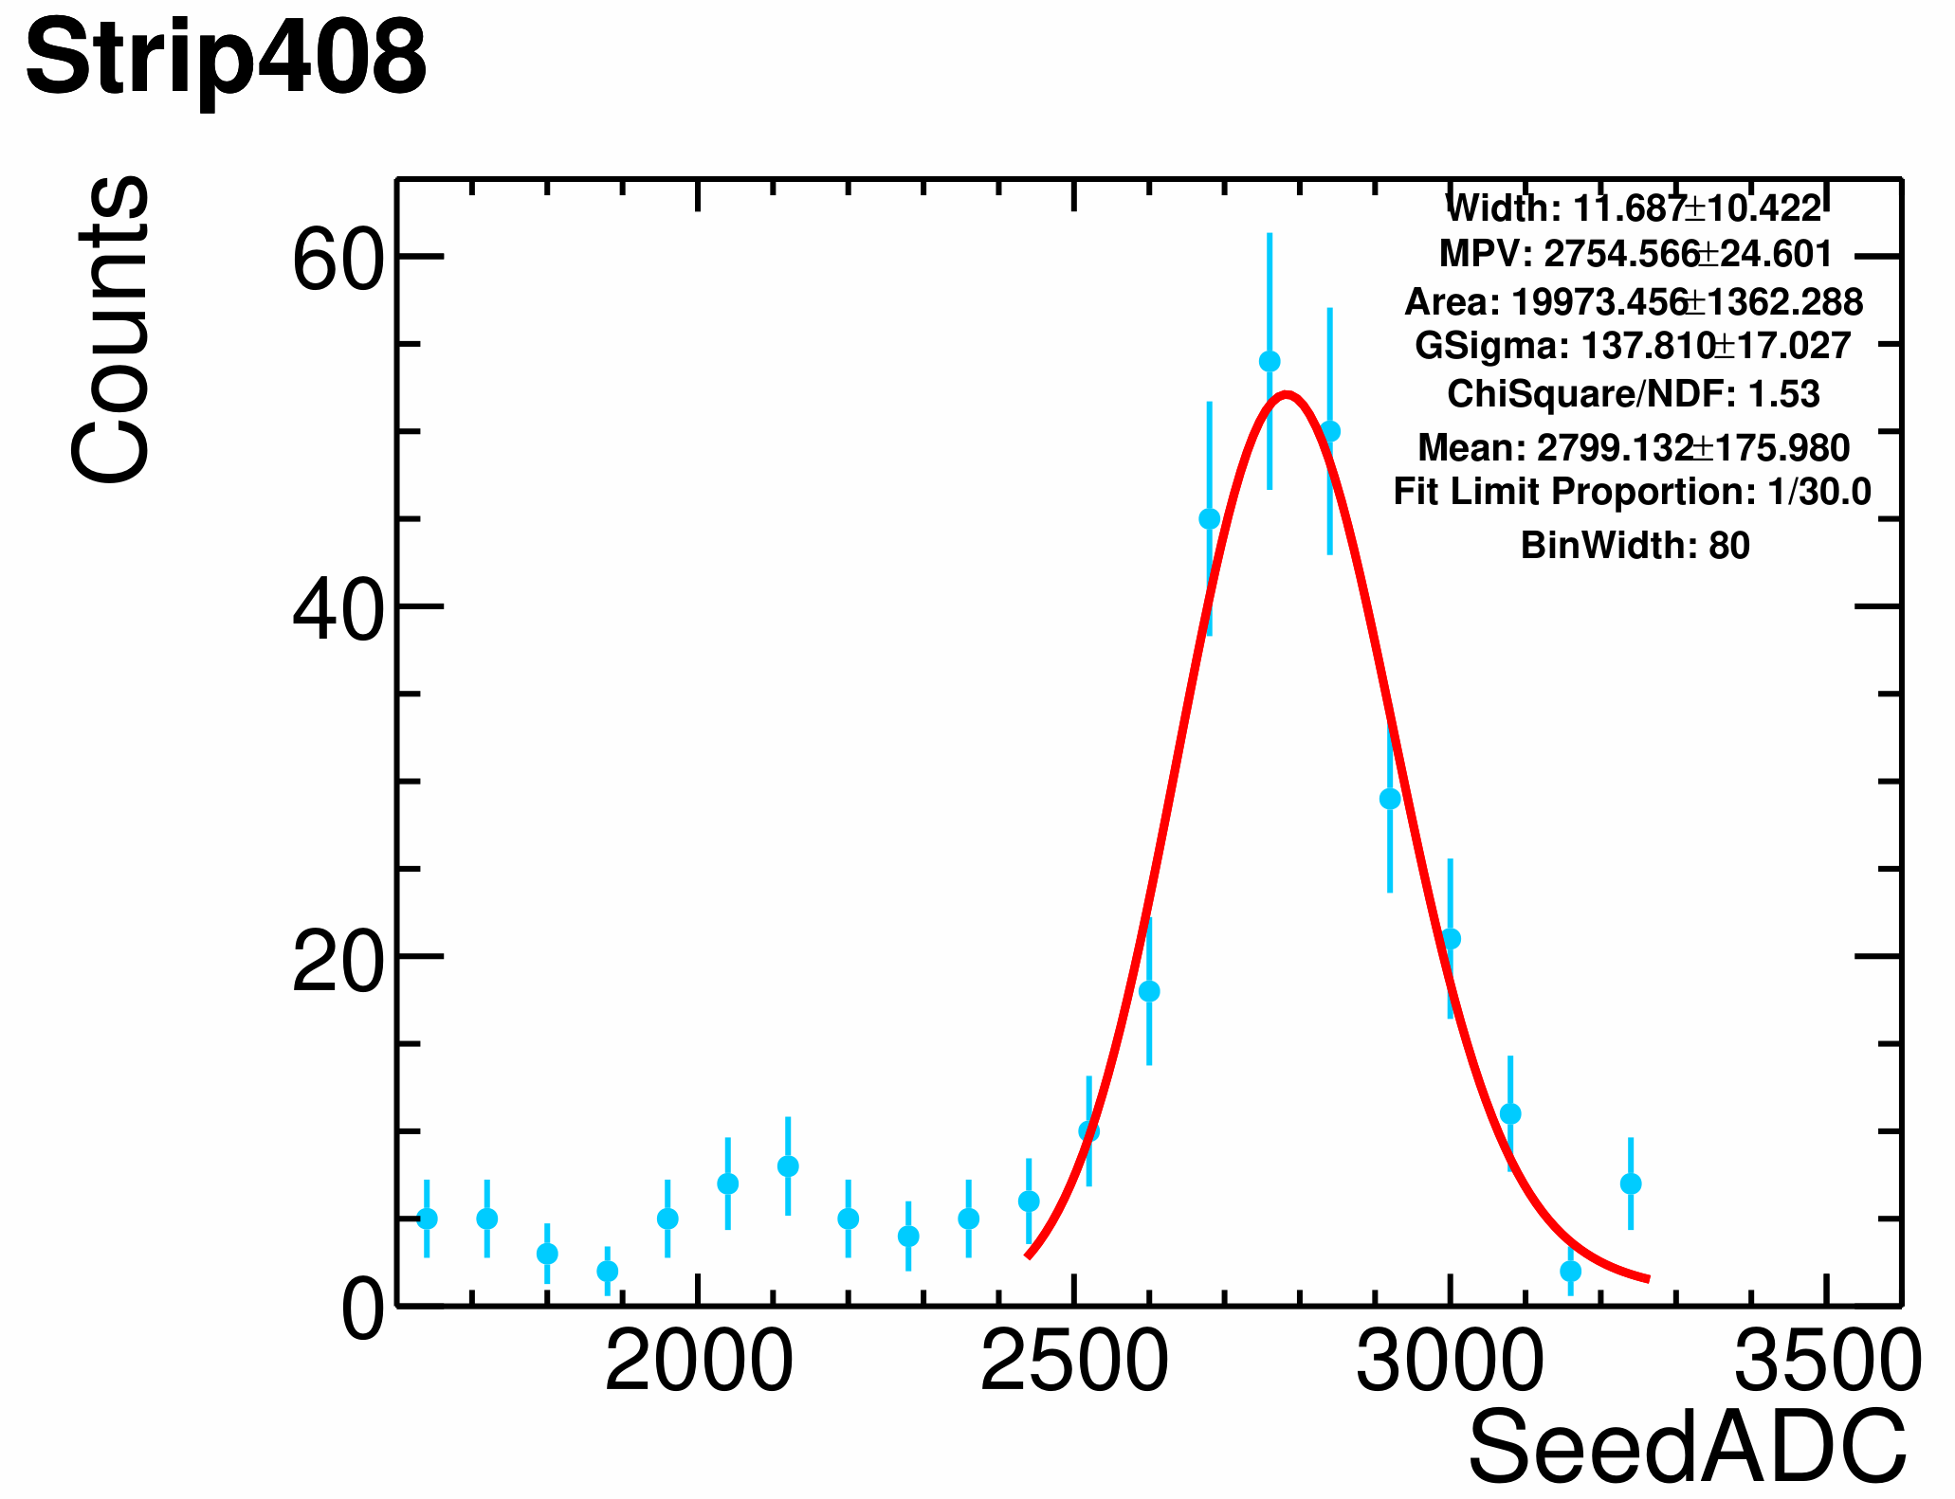
ADC MPV Fitting example
By Yan.Z.X
Second strip z=2
Second strip z=3
Second strip z=4
Seed strip z=2
Seed strip z=3
Seed strip z=4
Seed strip z=5
Seed strip z=6
Seed strip z=7
Seed strip z=8

Slide 11
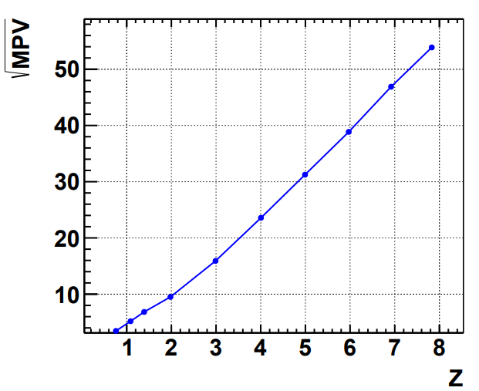
New ADC Response for Strip 408 Micron
Features:
Replace Q=1 region with 2’nd strip ADC
Replace integral Z with floating Z
Linear extrapolation for
ADC < helium 2’nd strip
ADC > Oxygen 1’st strip

Slide 12
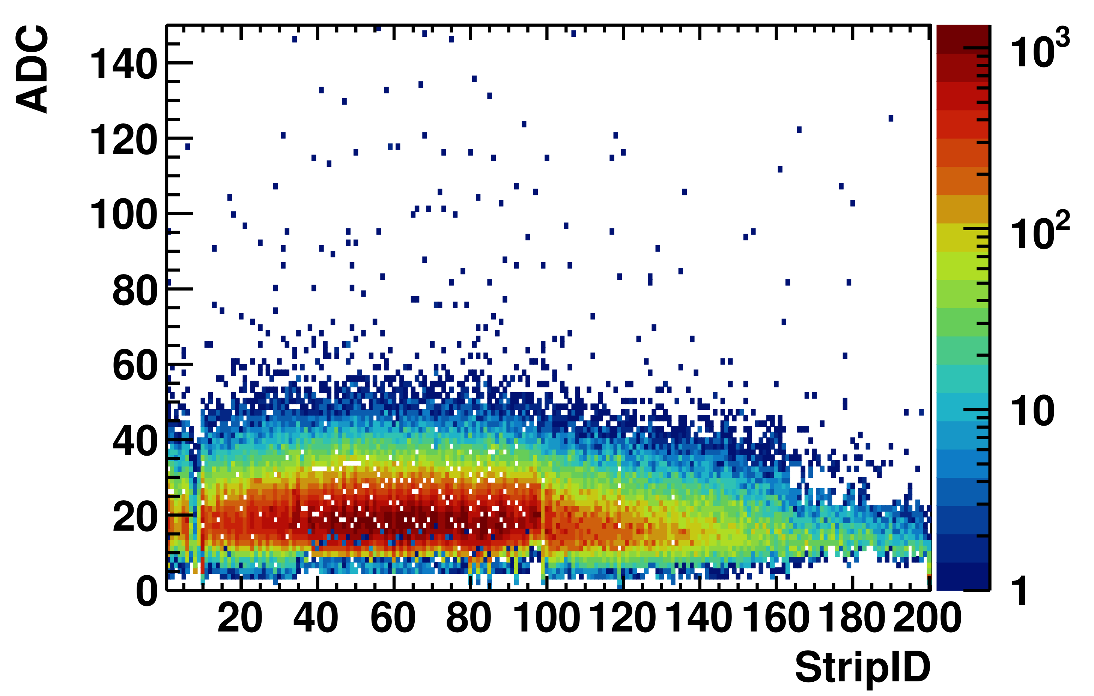
Comparison After Bottom Reconstruction
Before
After
Q=2, r_{s} <0.2,Micron, Second Strip
Q=2, r_{s} <0.2,Micron, Second Strip

Slide 13
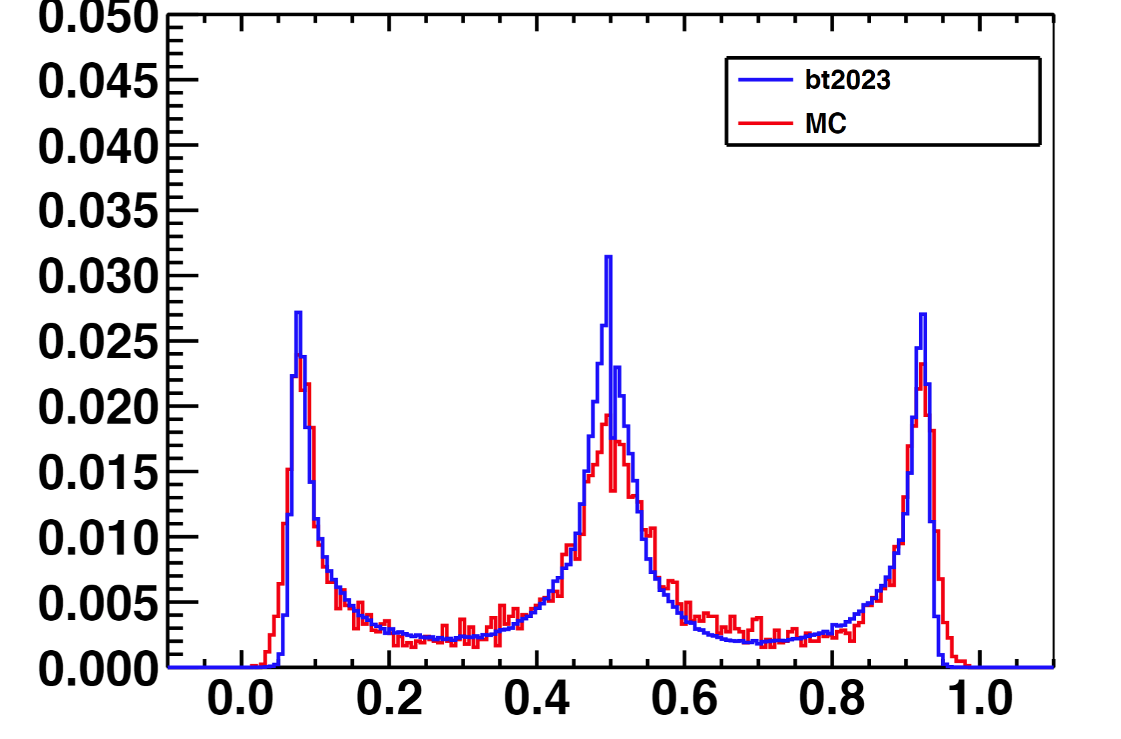
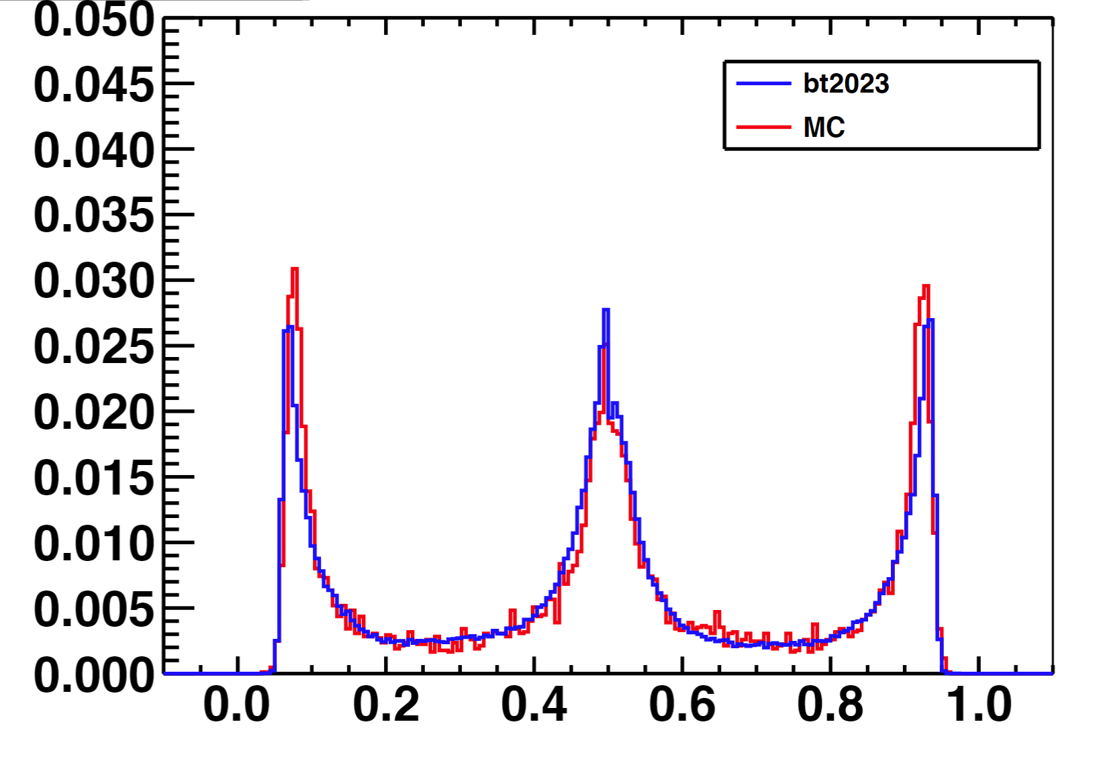
$η$ Comparison of Data (bt2023) and MC
Qiao Rui
$$η$$
$$η$$
Q=3, Micron
Q=4, Micron

Slide 14
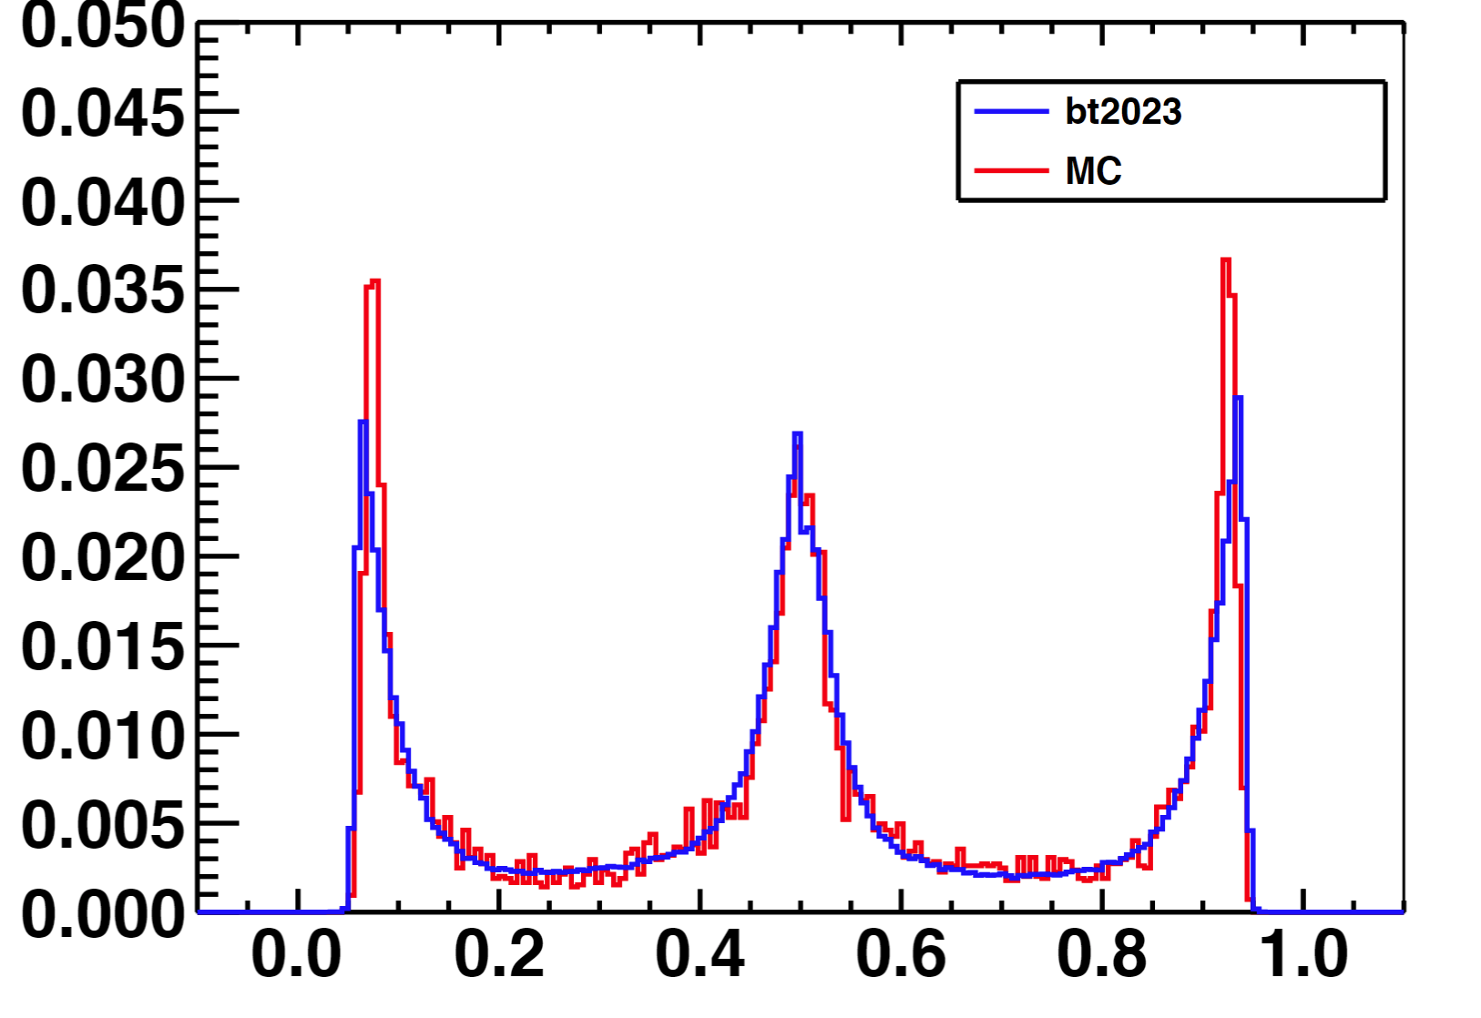
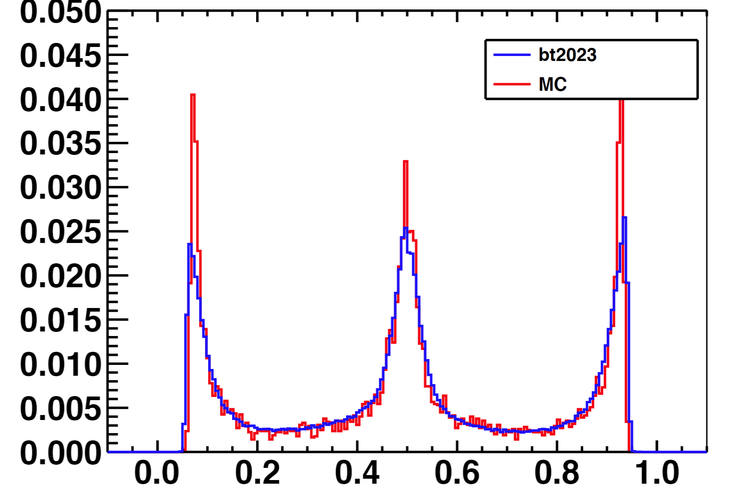
$η$ Comparison of Data (bt2023) and MC
Qiao Rui
Need additional ADC related smearing
$$η$$
$$η$$
Q=5, Micron
Q=6, Micron

Slide 15
HERDOS Progress
Calibration
Finished and tested
Base Reconstruction validated for:
BT2023 base reconstruction
MC data
MC/Data match
Some progress on Micron
Not ready for RT
Testing/Plots scripts/algorithm
Done

