Slide 1
Residual distribution of σpt at different Pt with fast simulation 9.13耿青林

Slide 2
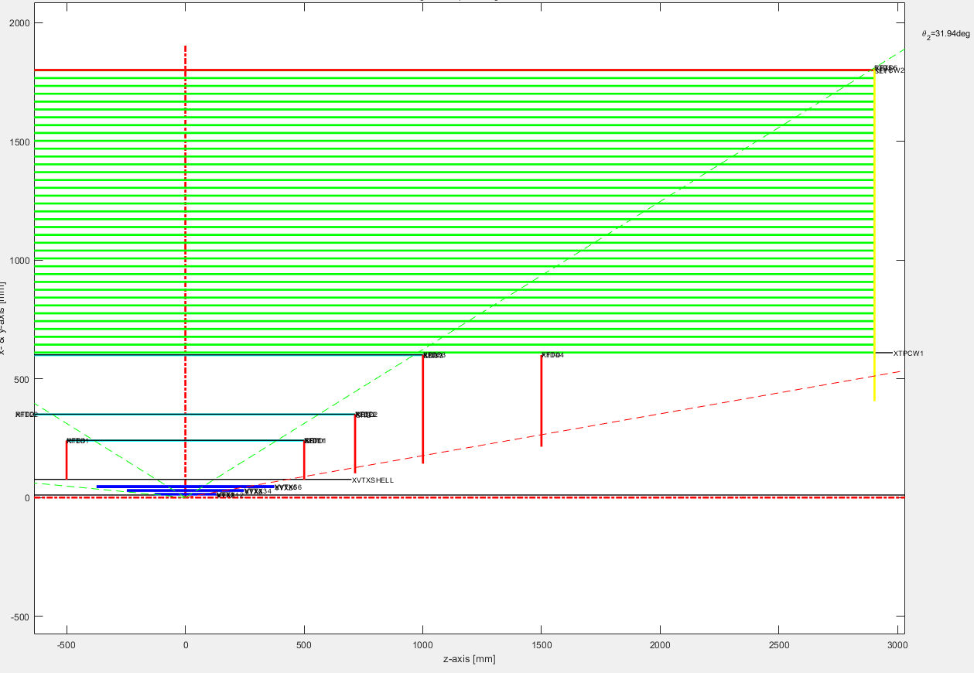
Global layout of tracking system
VXD |  |  | ITKE & OTKE |  |  |  | ITKB & OTKB |  |  | TPC
layer | Half-Z | R | layer | Inner-R | Outer-R | Z | layer | Half-Z | R | Inner-R | Half-Z | Outer-R
L11 | 130 | 12.459 | ITKE1 | 75 | 240 | 500.5 | ITKB1 | 500.5 | 240 | 600 | 2900 | 1800
L12 | 130 |  | ITKE2 | 101.9 | 350 | 715 | ITKB2 | 715 | 350
L21 | 247 | 27.892 | ITKE3 | 142.6 | 600 | 1001 | ITKB3 | 1001 | 600
L22 | 247 |  | ITKE4 | 214 | 600 | 1500 | OTKB | 2900 | 1800
L31 | 374.5 | 43.792 | OTKE | 405.7 | 1810 | 2903
L32 | 374.5
模拟中入射的角度选为10°，即只穿过VTX和端盖部分。把ITKE和OTKE的hit效率分别设为1.00，0.95，0.90三个不同的值，观察在不同动量下，动量分辨的残差分布。

Slide 3
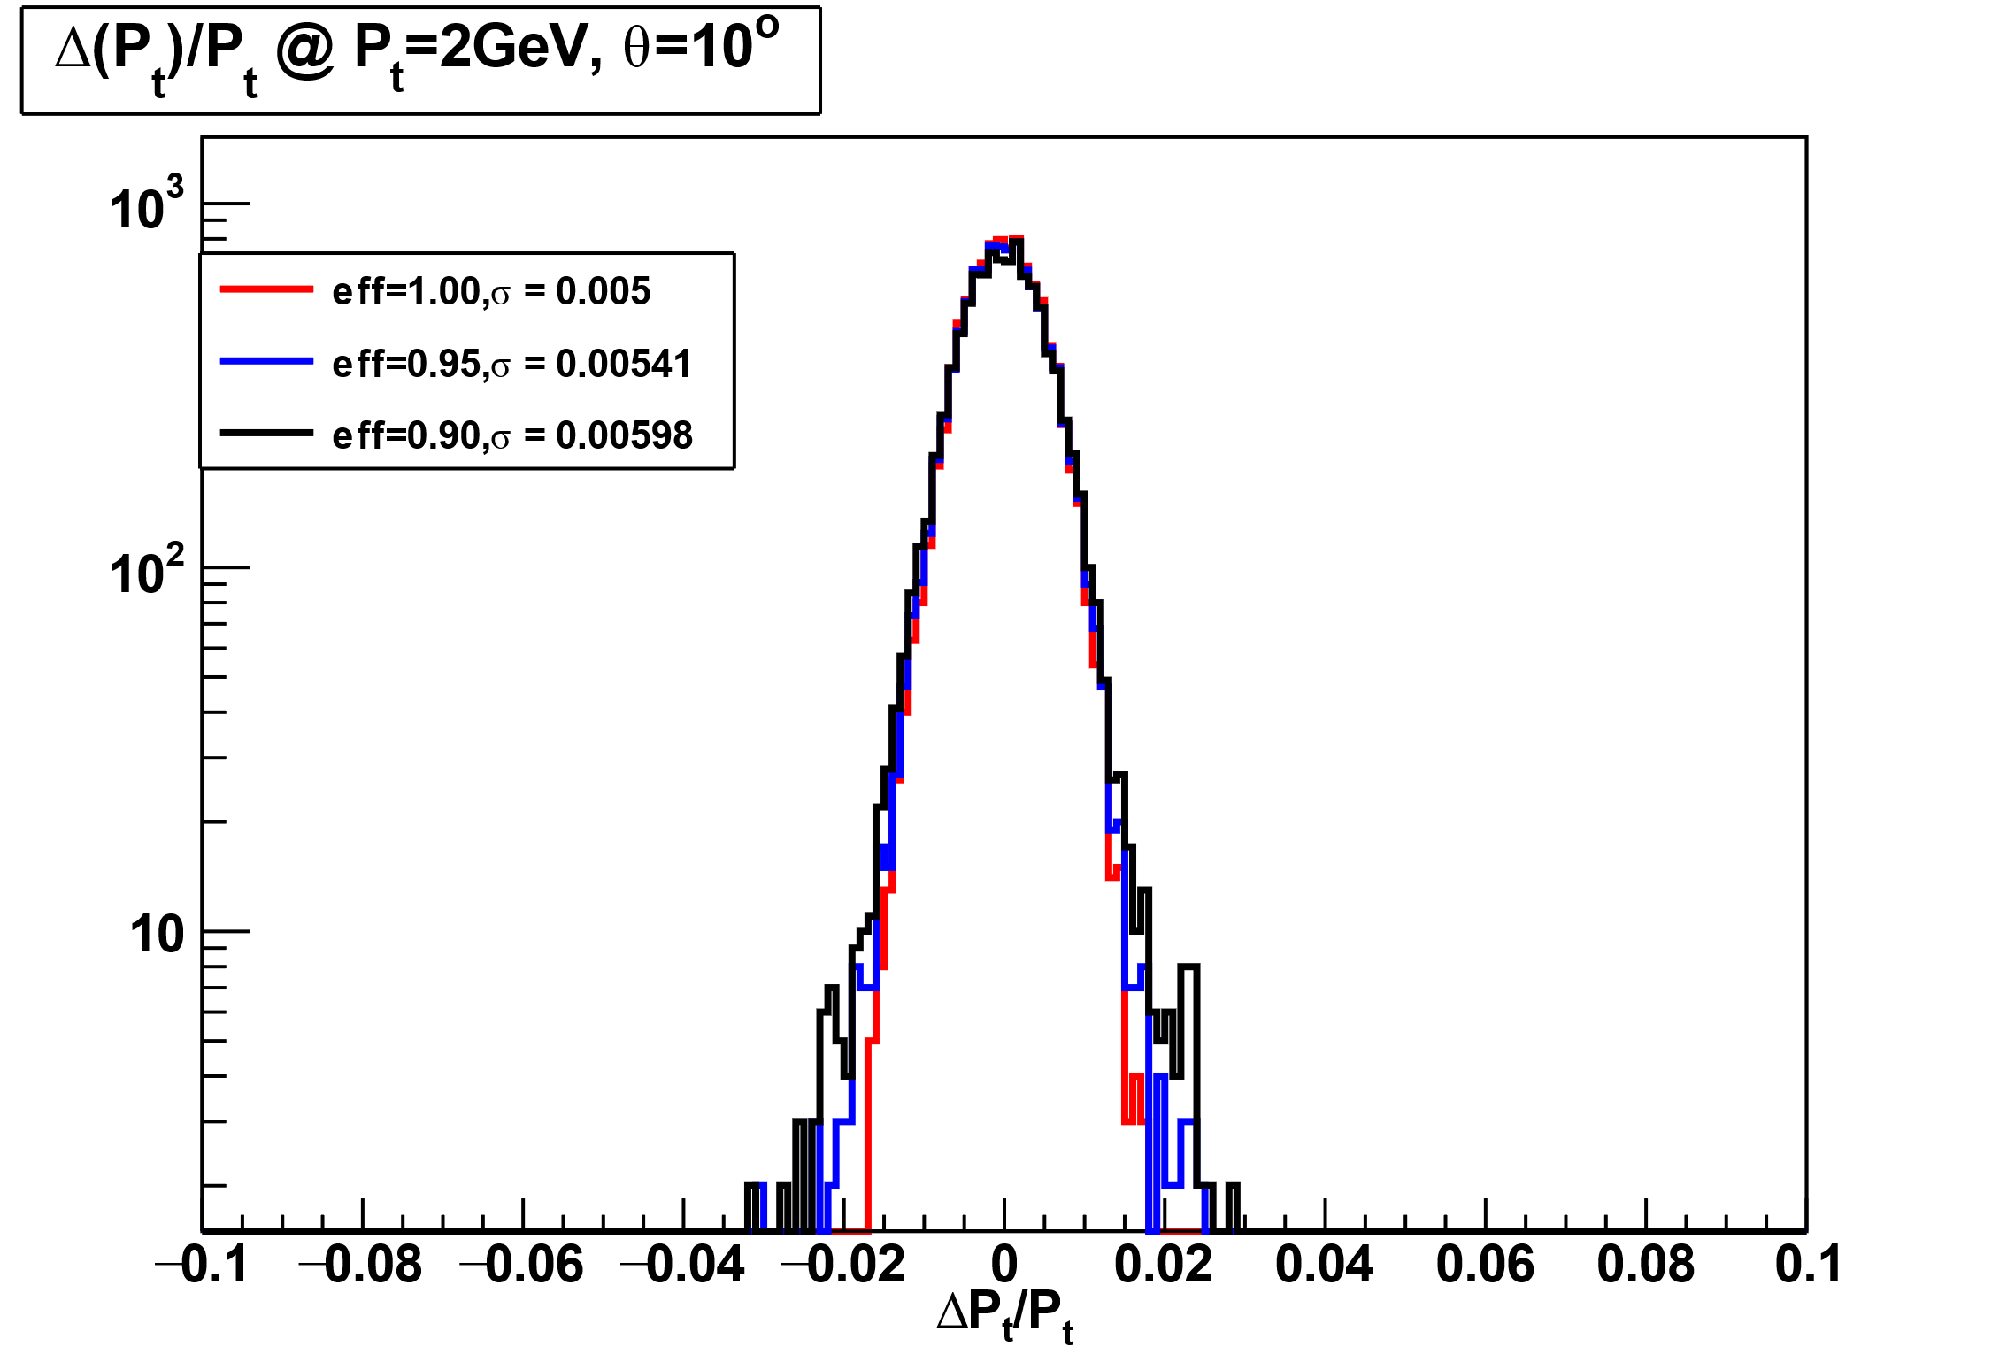
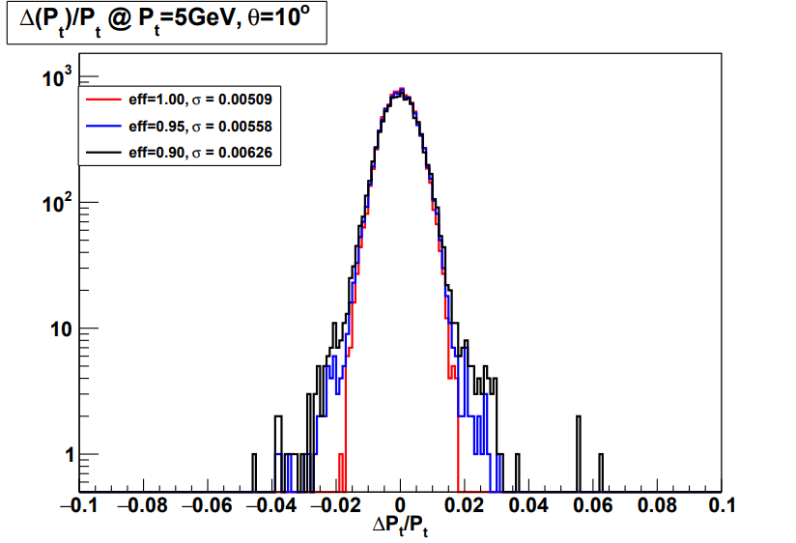
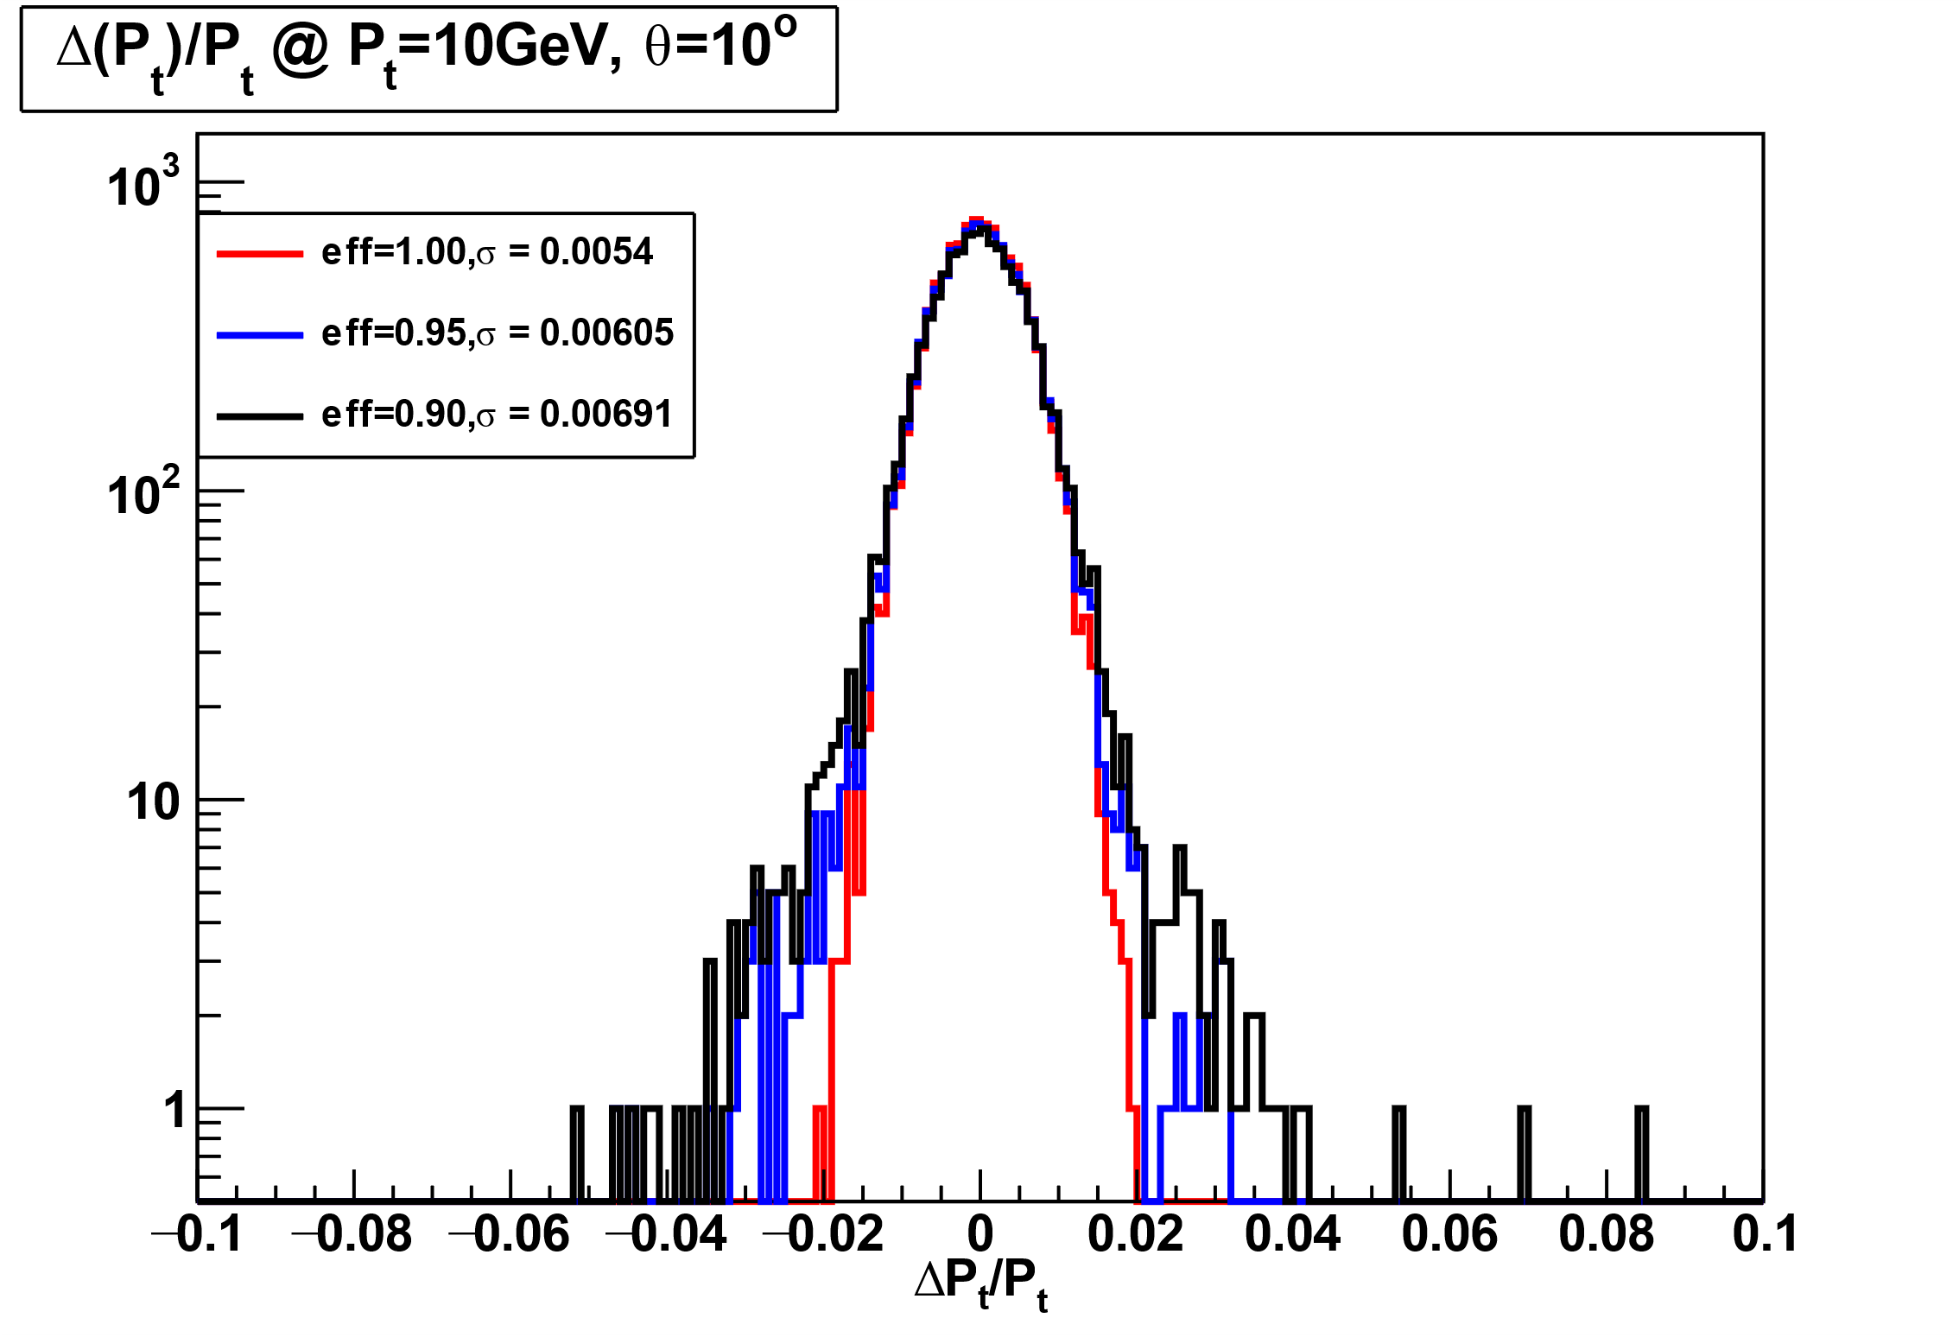
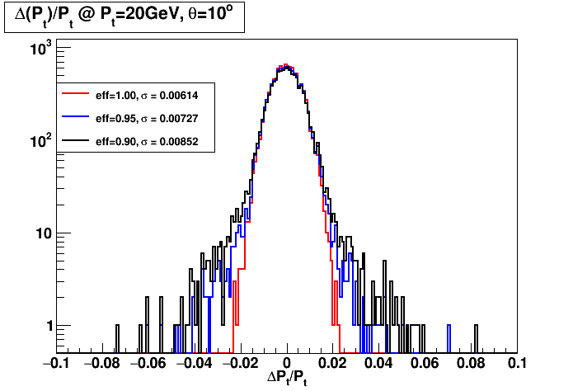
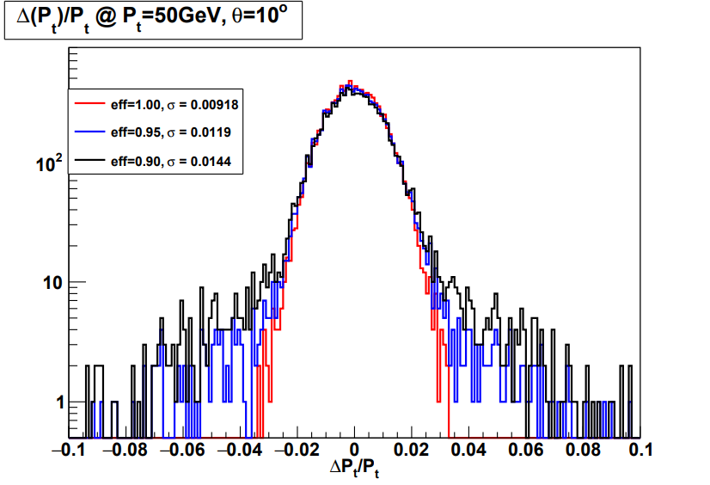
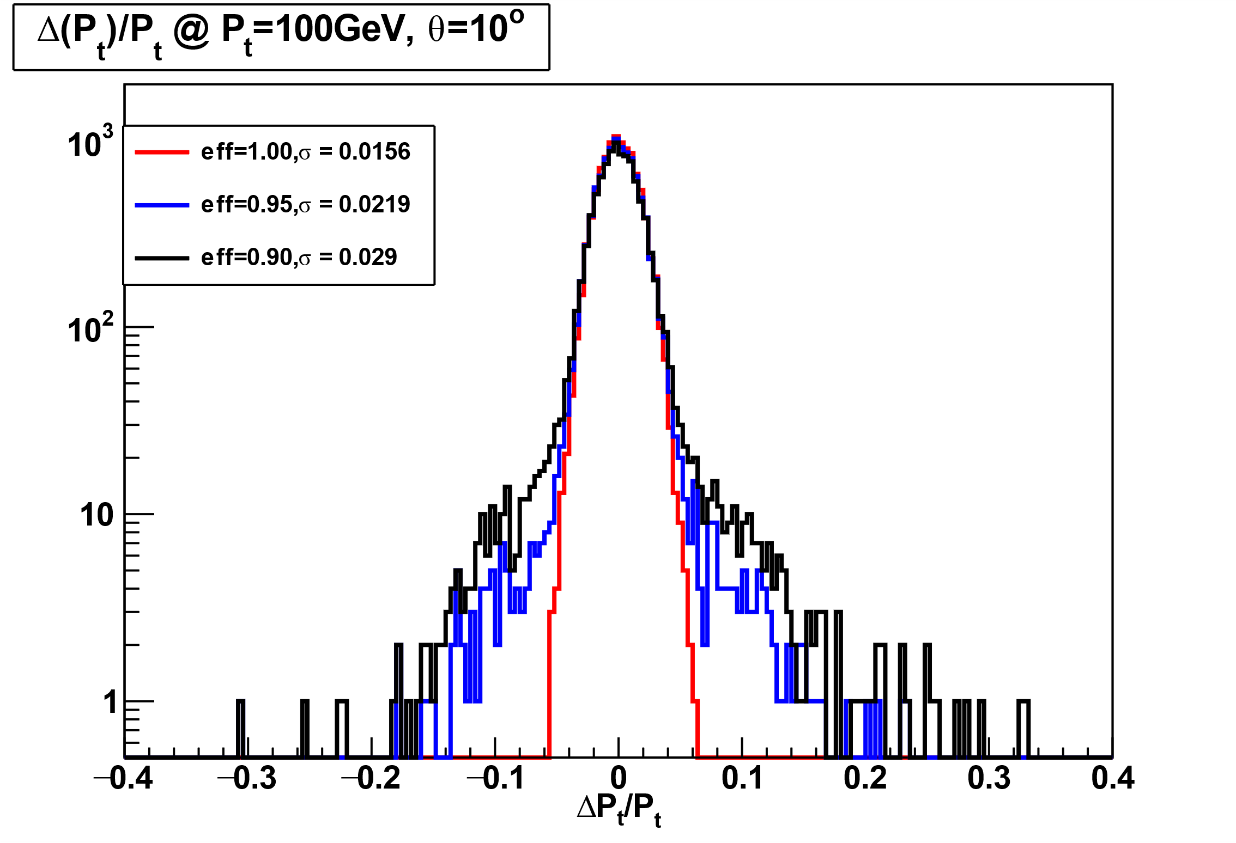
residual distribution of σPt

Slide 4
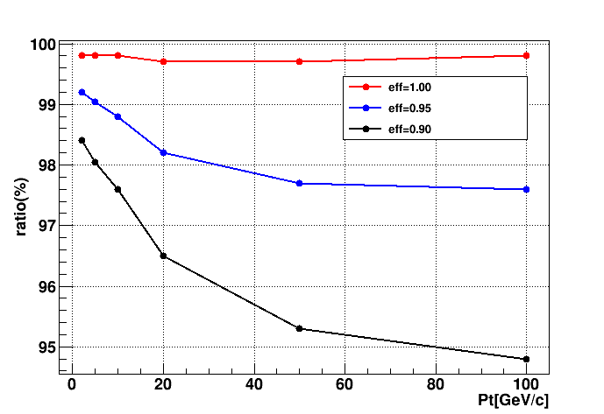
events ratio within 3σ
events_{(between ±3σ)} / events_{(total)}
Pt eff | 2 | 5 | 10 | 20 | 50 | 100
100% | 99.8% | 99.8% | 99.8% | 99.7% | 99.7% | 99.8%
95% | 99.2% | 99.04 | 98.8% | 98.2% | 97.7% | 97.6%
90% | 98.4% | 98.04 | 97.6% | 96.5% | 95.3% | 94.8%
pt分辨的残差分布未观察到明显拖尾现象，3σ范围内事例数占比随效率和动量增加而降低。

Slide 5
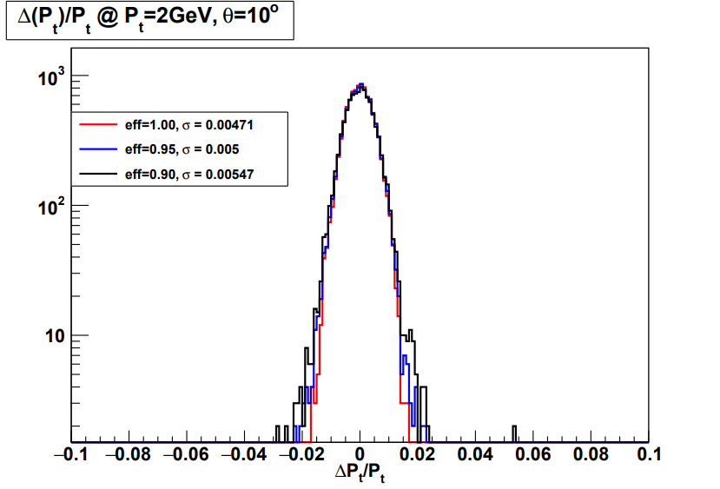
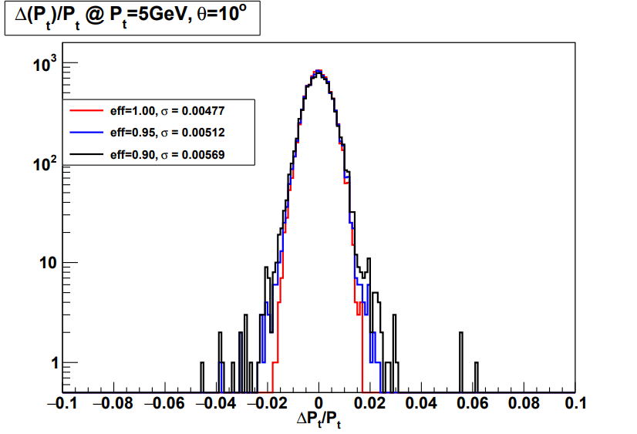
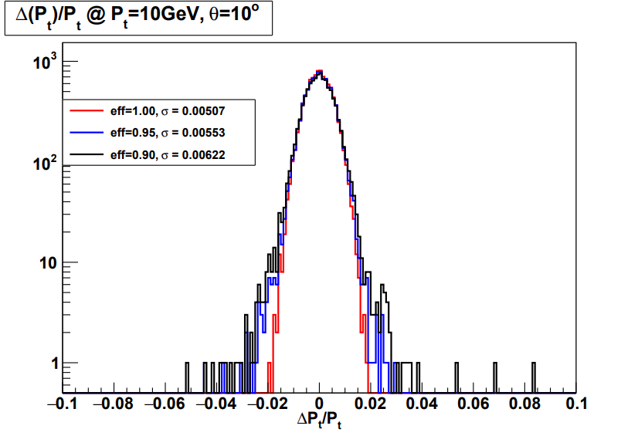
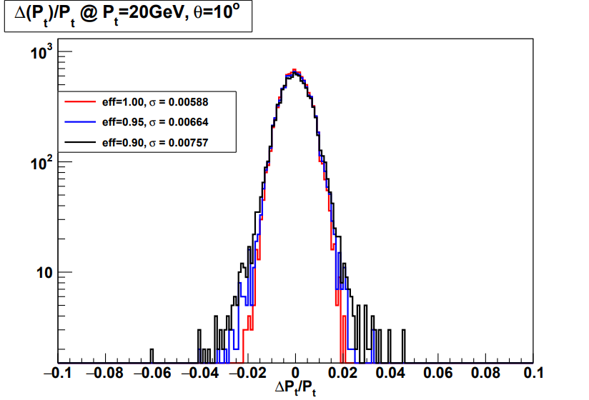
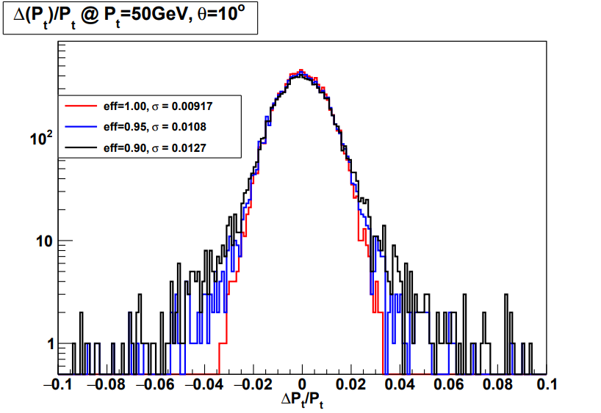
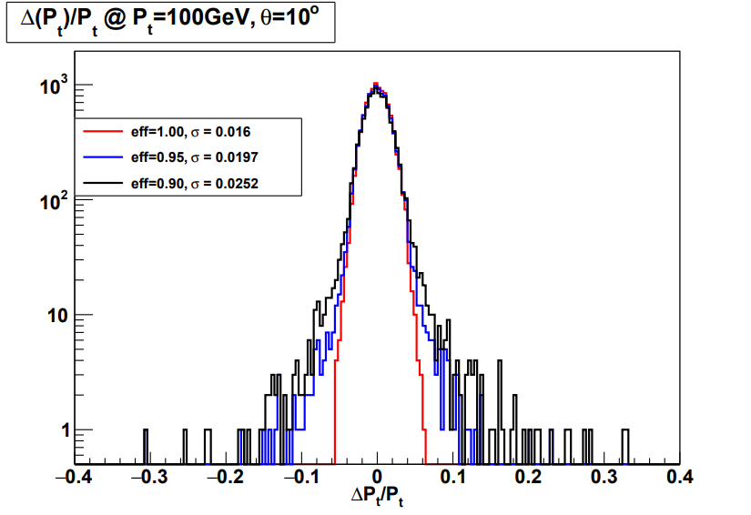
z of ITKE4: 1500mm→1800mm

Slide 6
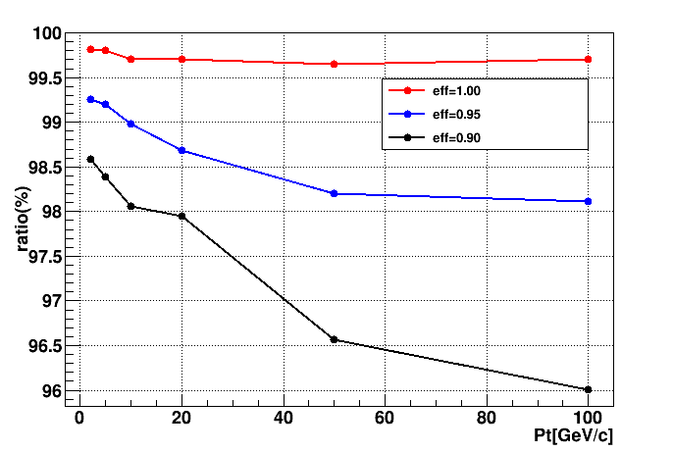
events ratio within 3σ for 4 endcaps
z of ITKE4: 1500mm→1800mm
events_{(between ±3σ)} / events_{(total)}
Pt eff | 2 | 5 | 10 | 20 | 50 | 100
100% | 99.81% | 99.80% | 99.71% | 99.70% | 99.65% | 99.71%
95% | 99.25% | 99.20% | 98.98% | 98.68% | 98.20% | 98.11%
90% | 98.58% | 98.39% | 98.06% | 97.95% | 96.56% | 96.01%

Slide 7
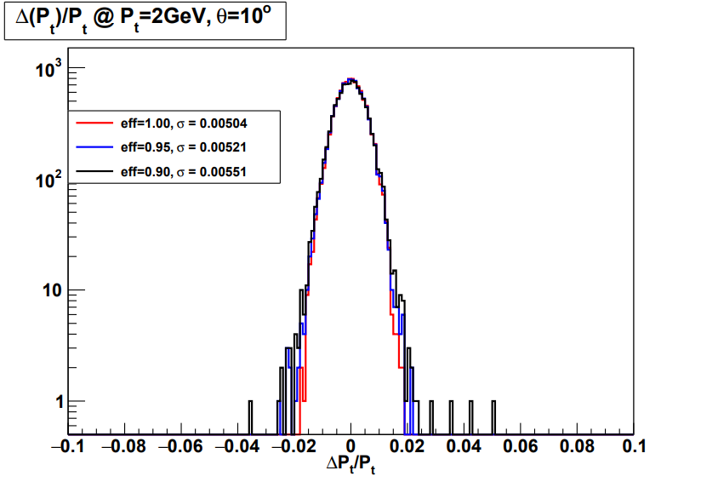
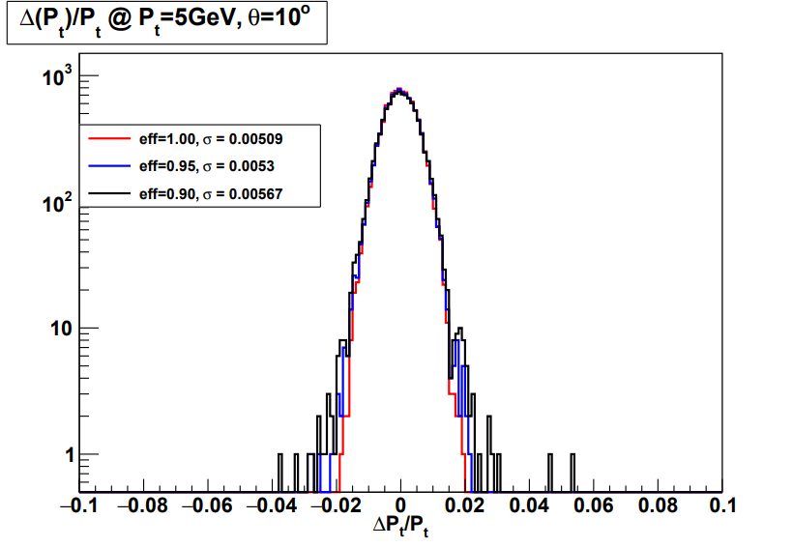
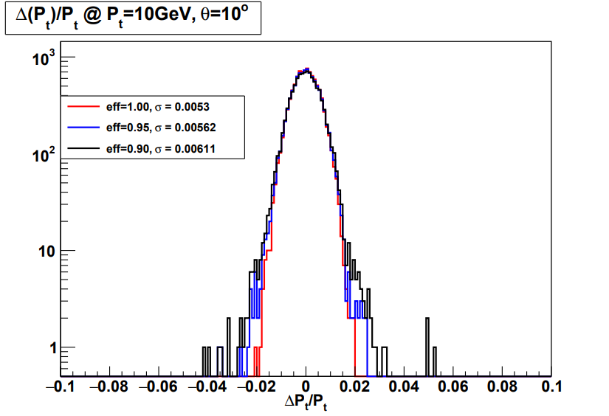
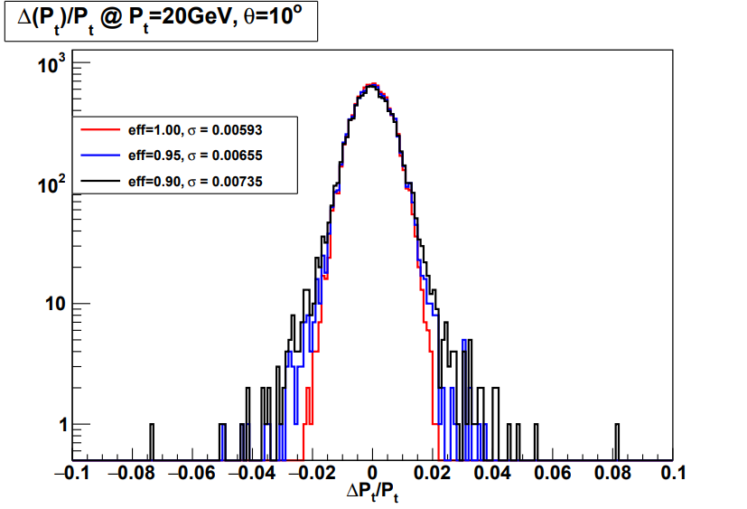
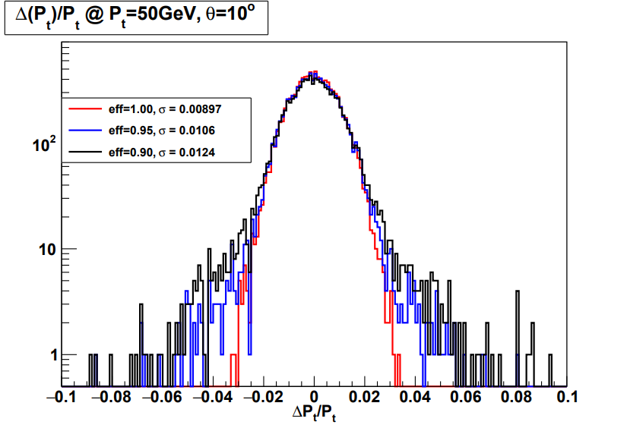
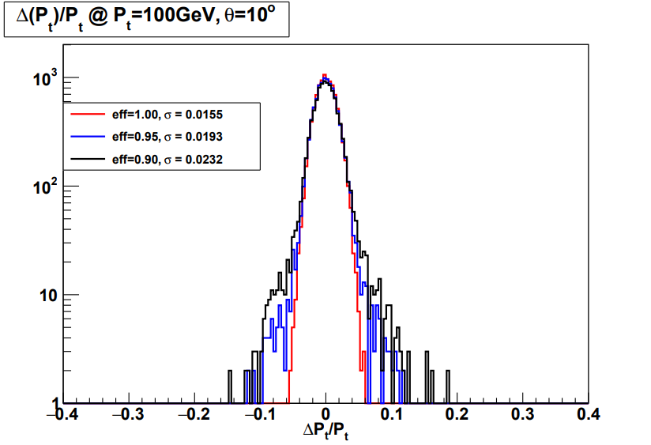
z of ITKE3、ITKE4: 1001mm、1500mm→1301mm、1800mm

Slide 8
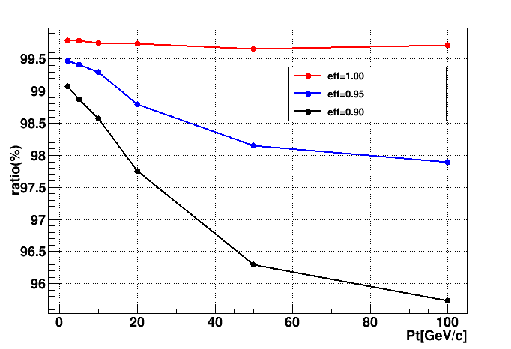
events ratio within 3σ for 4 endcaps
z of ITKE3、ITKE4: 1001mm、1500mm→1301mm、1800mm
events_{(between ±3σ)} / events_{(total)}
Pt eff | 2 | 5 | 10 | 20 | 50 | 100
100% | 99.78% | 99.78% | 99.75% | 99.74% | 99.66% | 99.71%
95% | 99.47% | 99.41% | 99.29% | 98.79% | 98.15% | 97.90%
90% | 99.07% | 98.87% | 98.57% | 97.76% | 96.29% | 95.74%

Slide 9
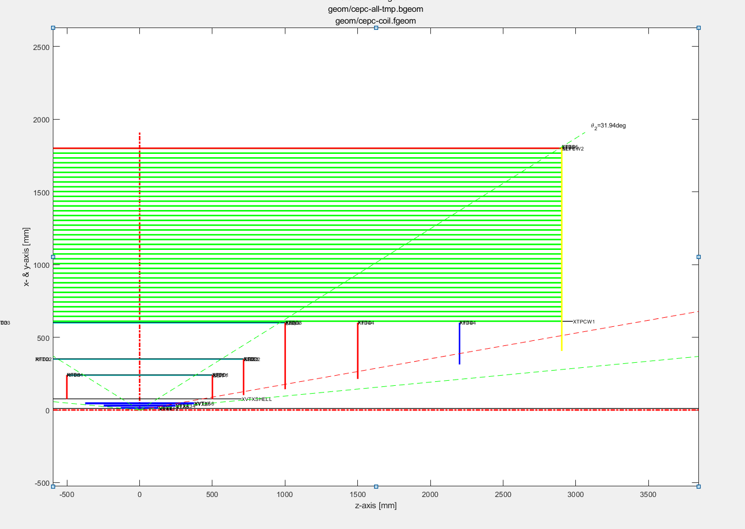
Global layout of tracking system
VXD |  |  | ITKE & OTKE |  |  |  | ITKB & OTKB |  |  | TPC
layer | Half-Z | R | layer | Inner-R | Outer-R | Z | layer | Half-Z | R | Inner-R | Half-Z | Outer-R
L11 | 130 | 12.459 | ITKE1 | 75 | 240 | 500.5 | ITKB1 | 500.5 | 240 | 600 | 2900 | 1800
L12 | 130 |  | ITKE2 | 101.9 | 350 | 715 | ITKB2 | 715 | 350
L21 | 247 | 27.892 | ITKE3 | 142.6 | 600 | 1001 | ITKB3 | 1001 | 600
L22 | 247 |  | ITKE4 | 214 | 600 | 1500 | OTKB | 2900 | 1800
L31 | 374.5 | 43.792 | OTKE | 405.7 | 1810 | 2903
L32 | 374.5
添加了第5层
模拟中入射的角度选为10°，即只穿过VTX和端盖部分。把ITKE和OTKE的hit效率分别设为1.00，0.95，0.90三个不同的值，观察在不同动量下，动量分辨的残差分布。

Slide 10
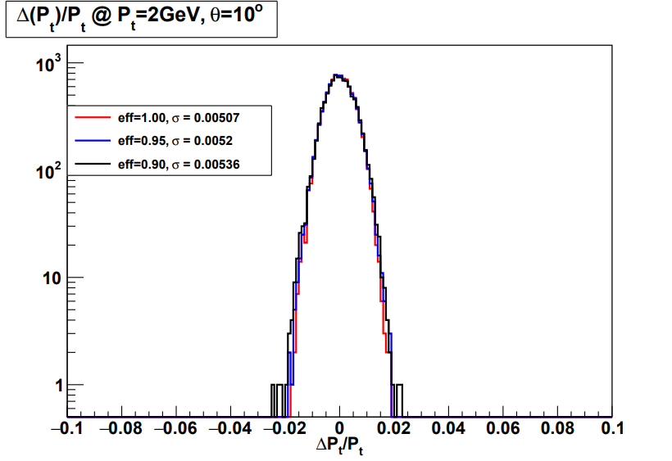
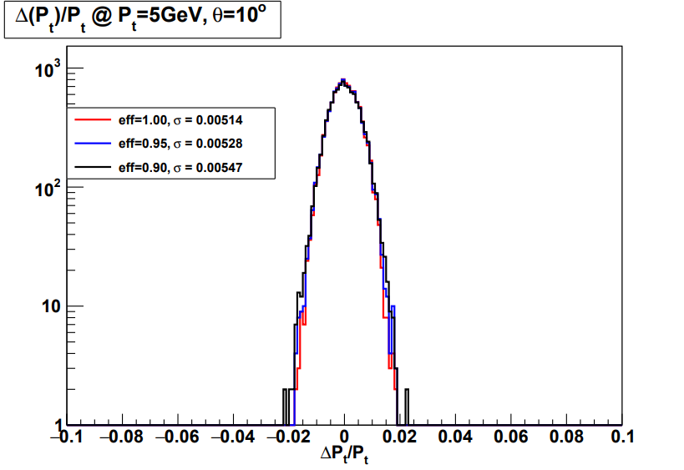
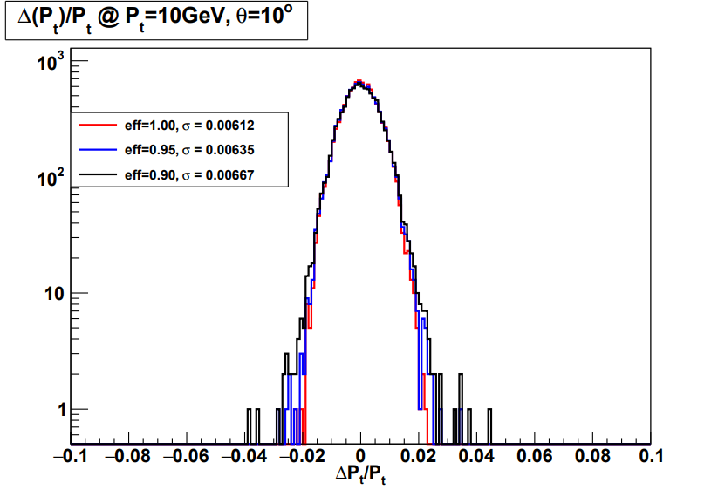
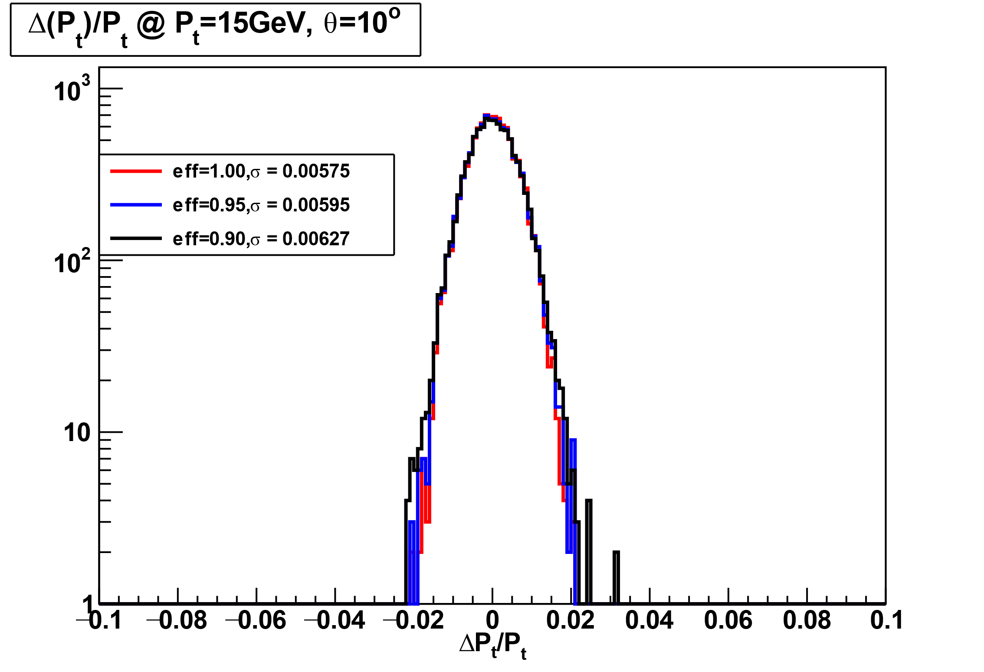
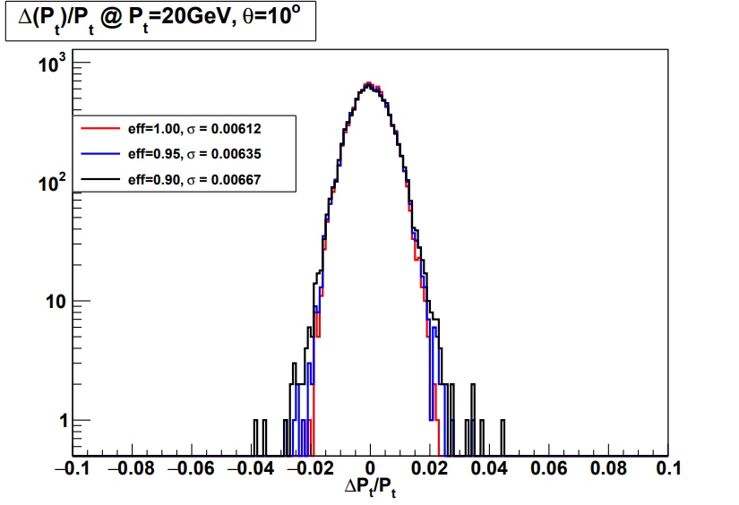
residual distribution of σPt for 5 endcaps
add endcap at z = 2200mm

Slide 11
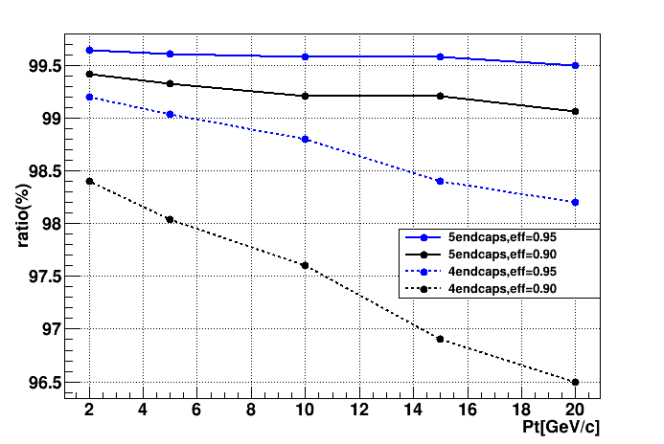
events ratio within 3σ for 5 endcaps
add endcap at z = 2200mm
events_{(between ±3σ)} / events_{(total)}
Pt eff | 2 | 5 | 10 | 15 | 20
100% | 99.81% | 99.81% | 99.80% | 99.80% | 99.79%
95% | 99.64% | 99.61% | 99.58% | 99.54% | 99.50%
90% | 99.42% | 99.33% | 99.21% | 99.12% | 99.06%
5层端盖情况下，3σ内事例数占比相比4层在不同动量下有~2%提升

Slide 12
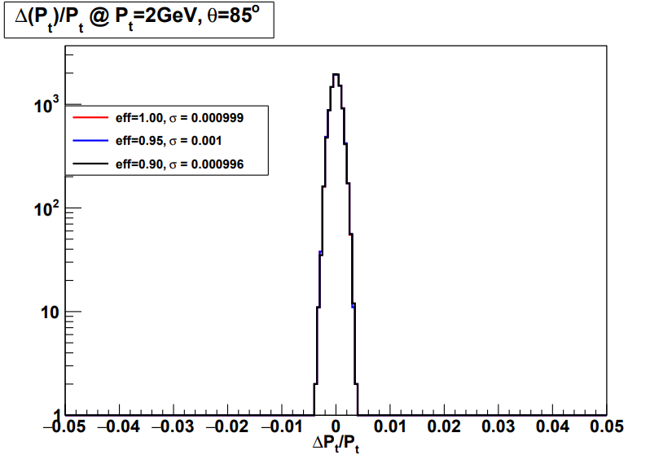
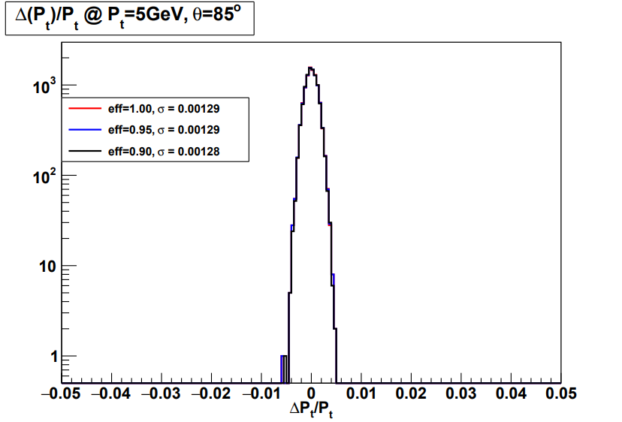
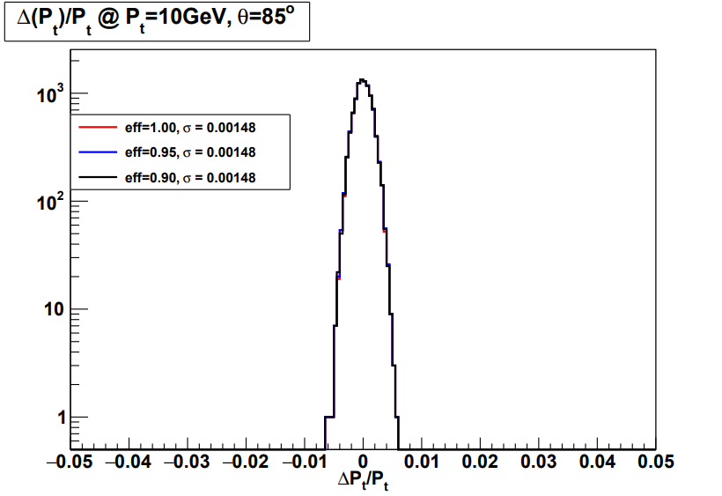
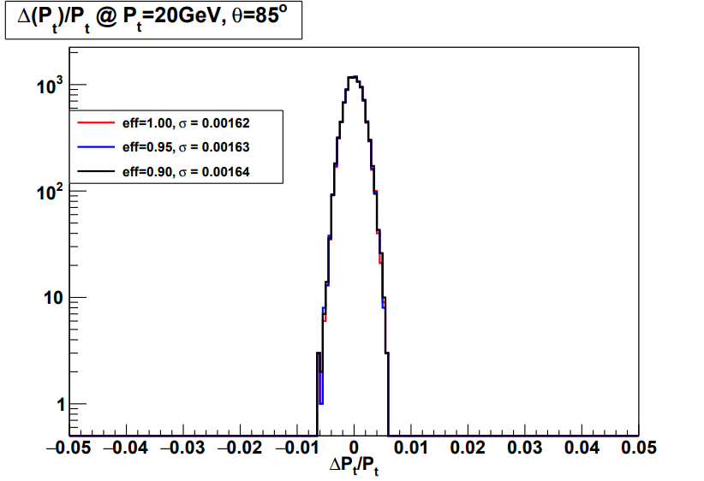
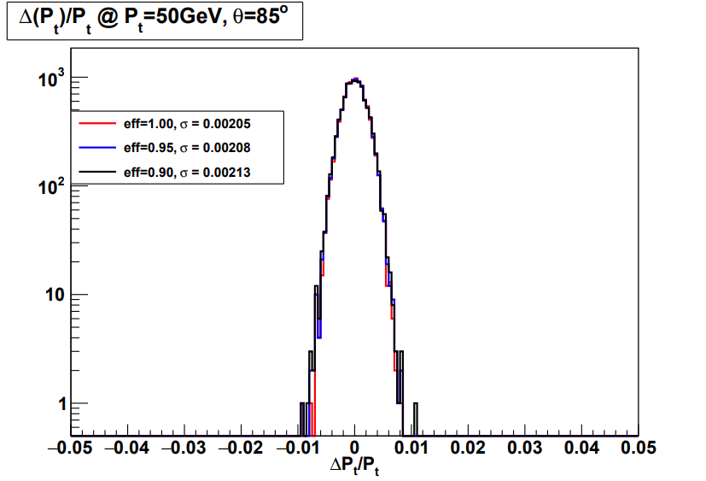
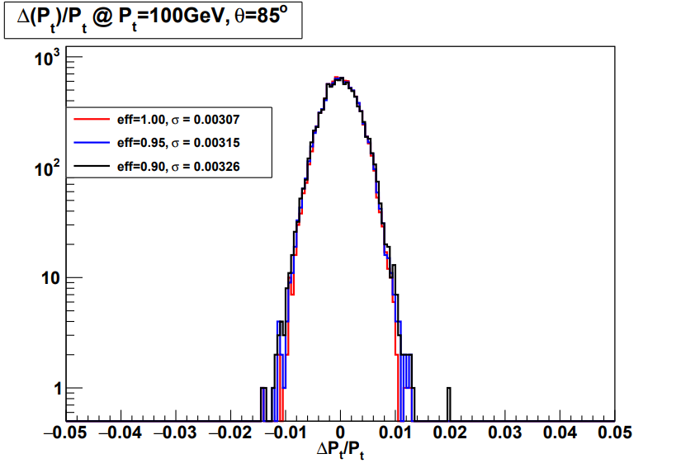
residual distribution of σPt for barrel

Slide 13
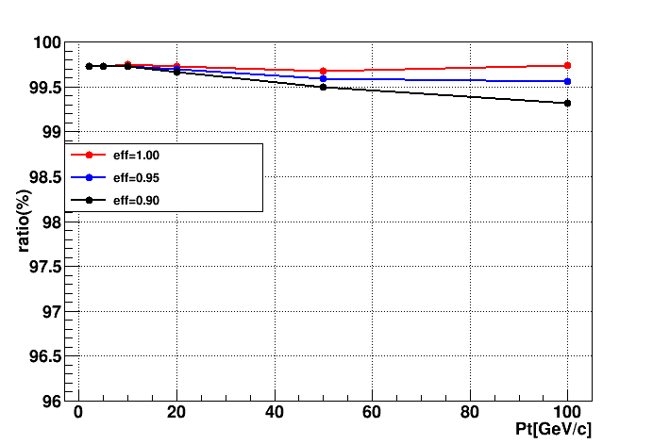
events ratio within 3σ for barrel
events_{(between ±3σ)} / events_{(total)}
Pt eff | 2 | 5 | 10 | 20 | 50 | 100
100% | 99.73% | 99.73% | 99.75% | 99.73% | 99.68% | 99.74%
95% | 99.73% | 99.73% | 99.73% | 99.70% | 99.59% | 99.56%
90% | 99.73% | 99.73% | 99.73% | 99.66% | 99.50% | 99.32%
不同效率的差别，对桶部的影响较小。3σ内事例数占比在各个动量下差别均小于1%

Slide 14
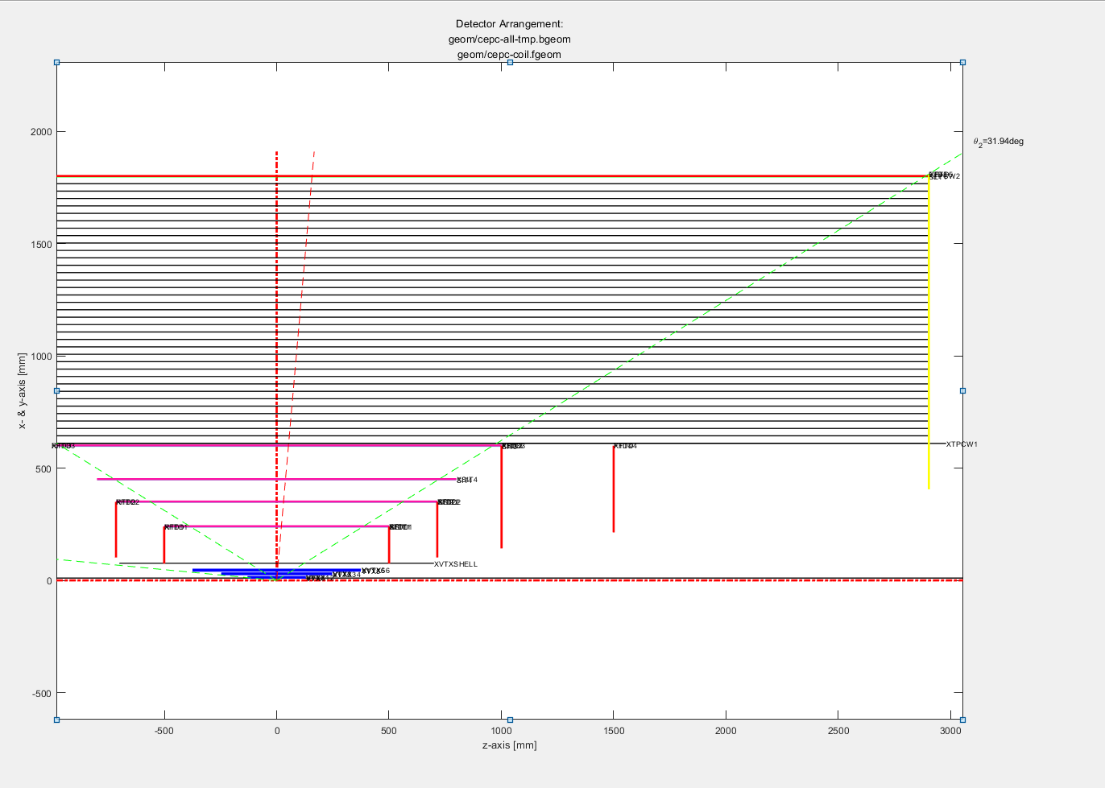
Global layout of tracking system
VXD |  |  | ITKE & OTKE |  |  |  | ITKB & OTKB |  |  | TPC
layer | Half-Z | R | layer | Inner-R | Outer-R | Z | layer | Half-Z | R | Inner-R | Half-Z | Outer-R
L11 | 130 | 12.459 | ITKE1 | 75 | 240 | 500.5 | ITKB1 | 500.5 | 240 | 600 | 2900 | 1800
L12 | 130 |  | ITKE2 | 101.9 | 350 | 715 | ITKB2 | 715 | 350
L21 | 247 | 27.892 | ITKE3 | 142.6 | 600 | 1001 | ITKB3 | 1001 | 600
L22 | 247 |  | ITKE4 | 214 | 600 | 1500 | OTKB | 2900 | 1800
L31 | 374.5 | 43.792 | OTKE | 405.7 | 1810 | 2903
L32 | 374.5
在2，3层ITKB之间添加了一层
模拟中入射的角度选为85°，同时把TPC效率设置为０。把ITKB的hit效率分别设为1.00，0.95，0.90三个不同的值，观察在不同动量下，动量分辨的残差分布。

Slide 15
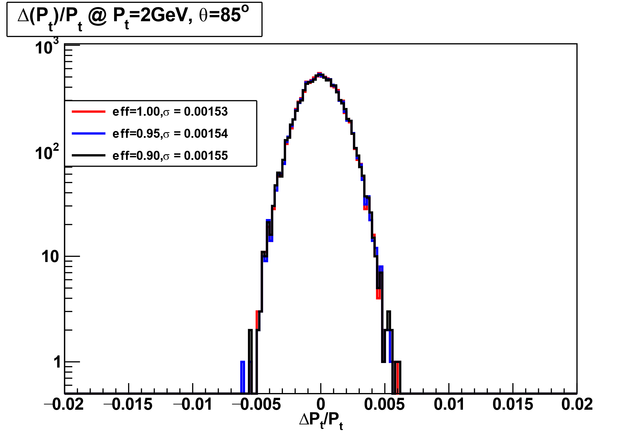
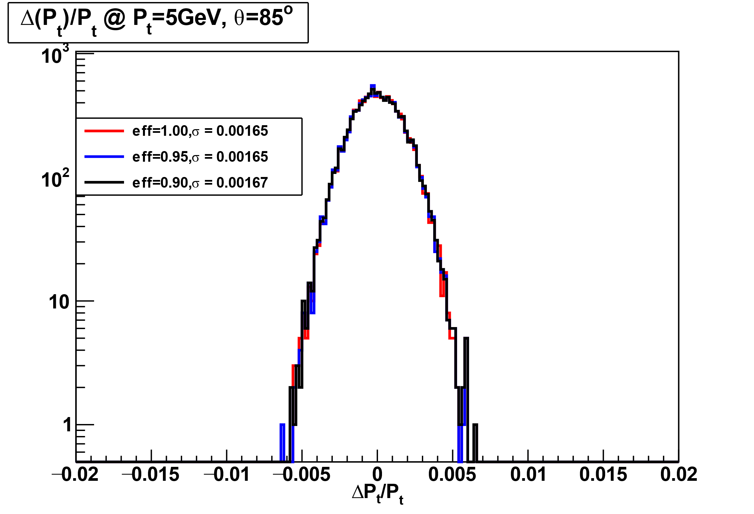
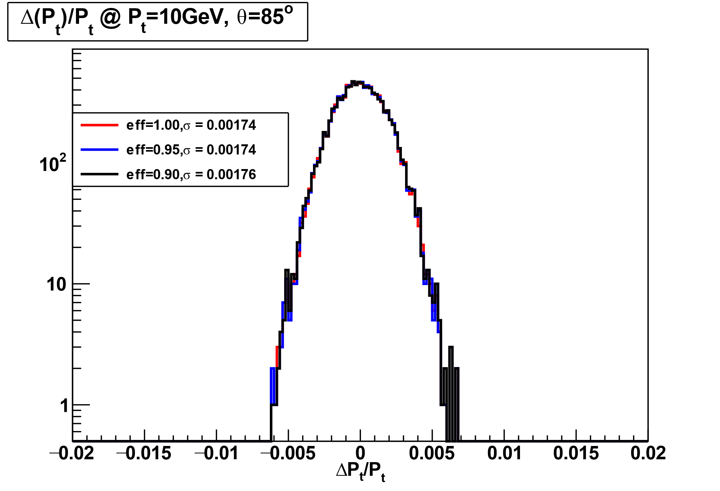
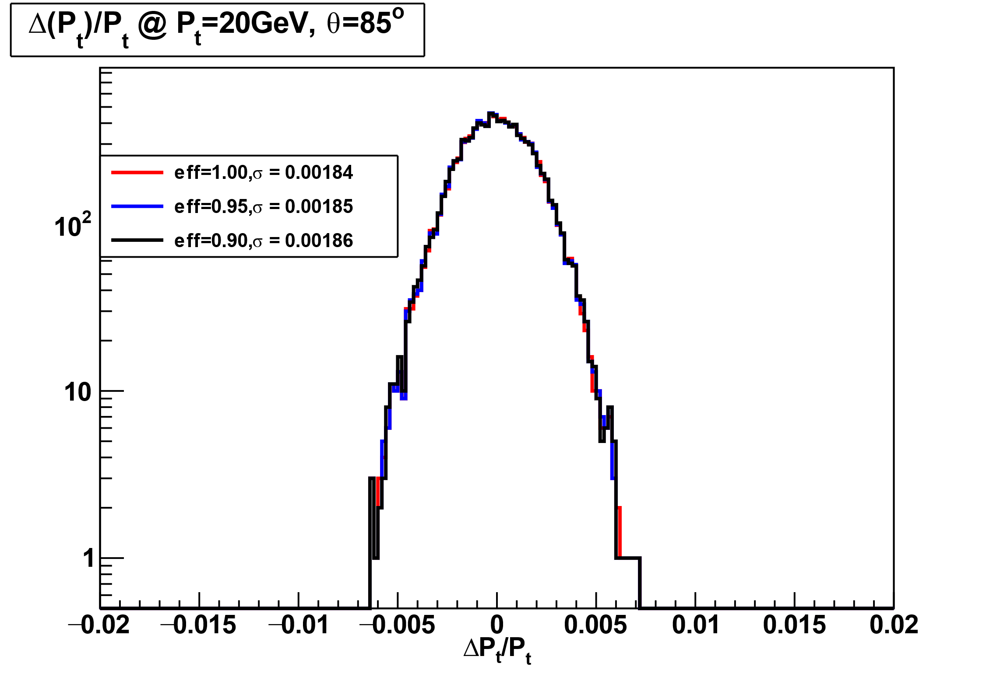
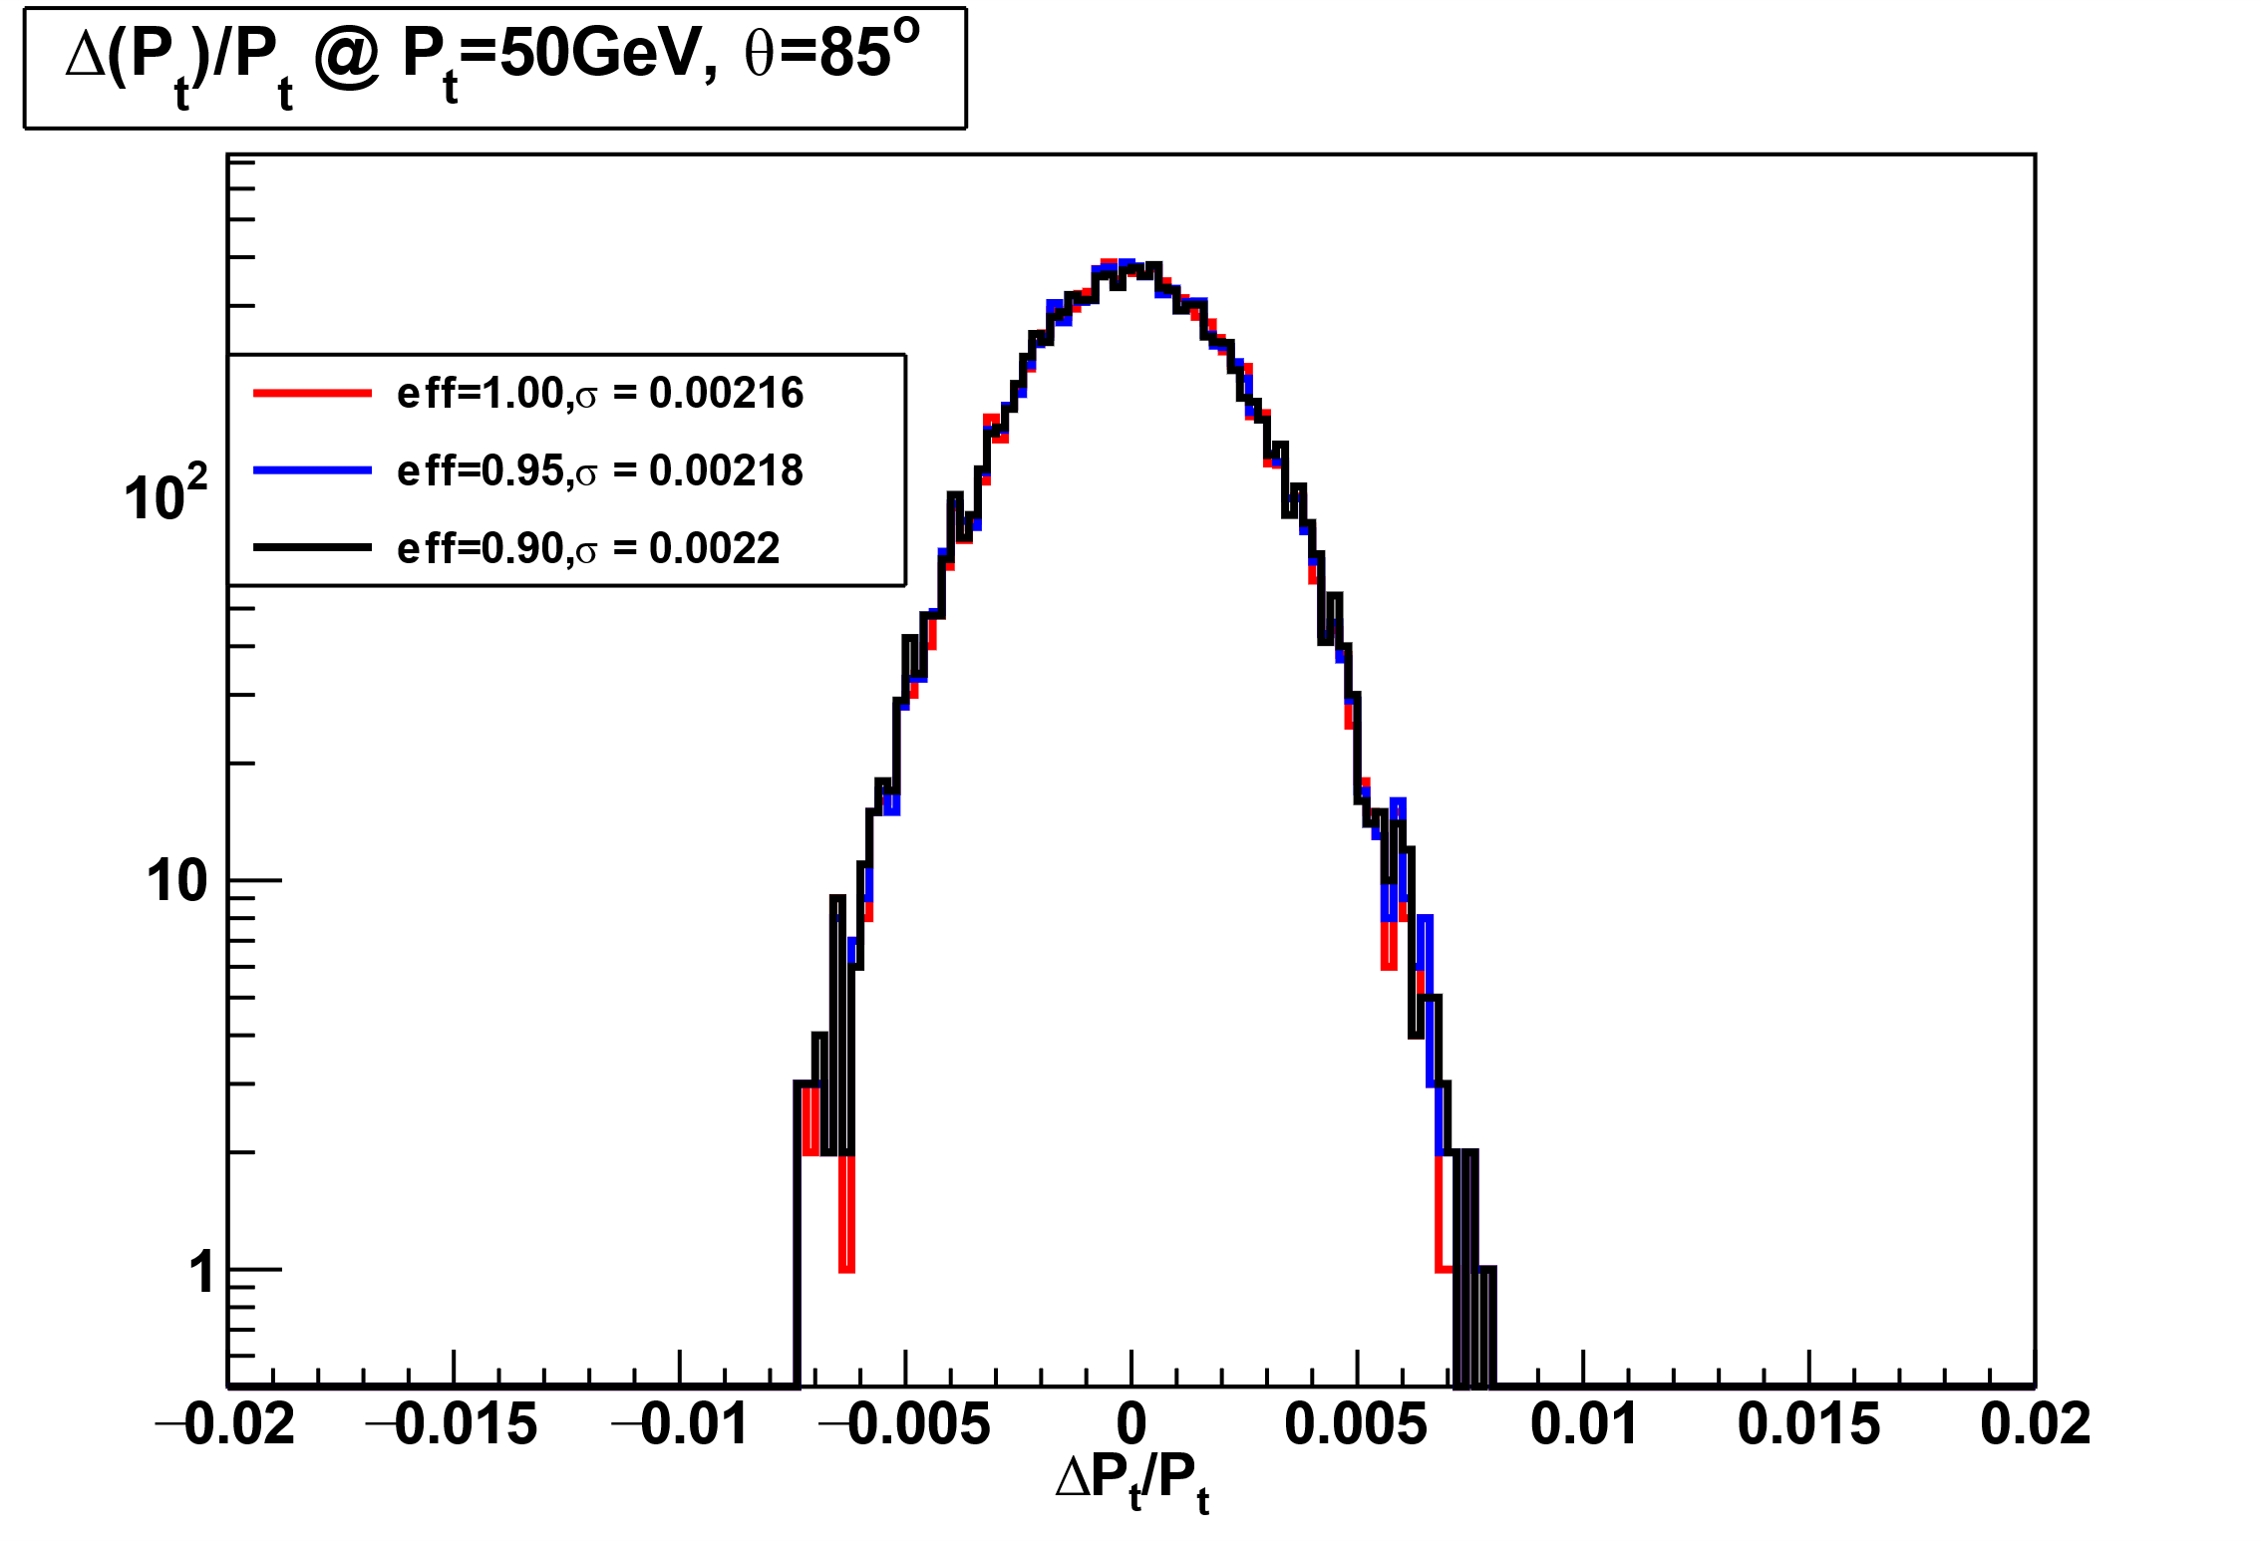
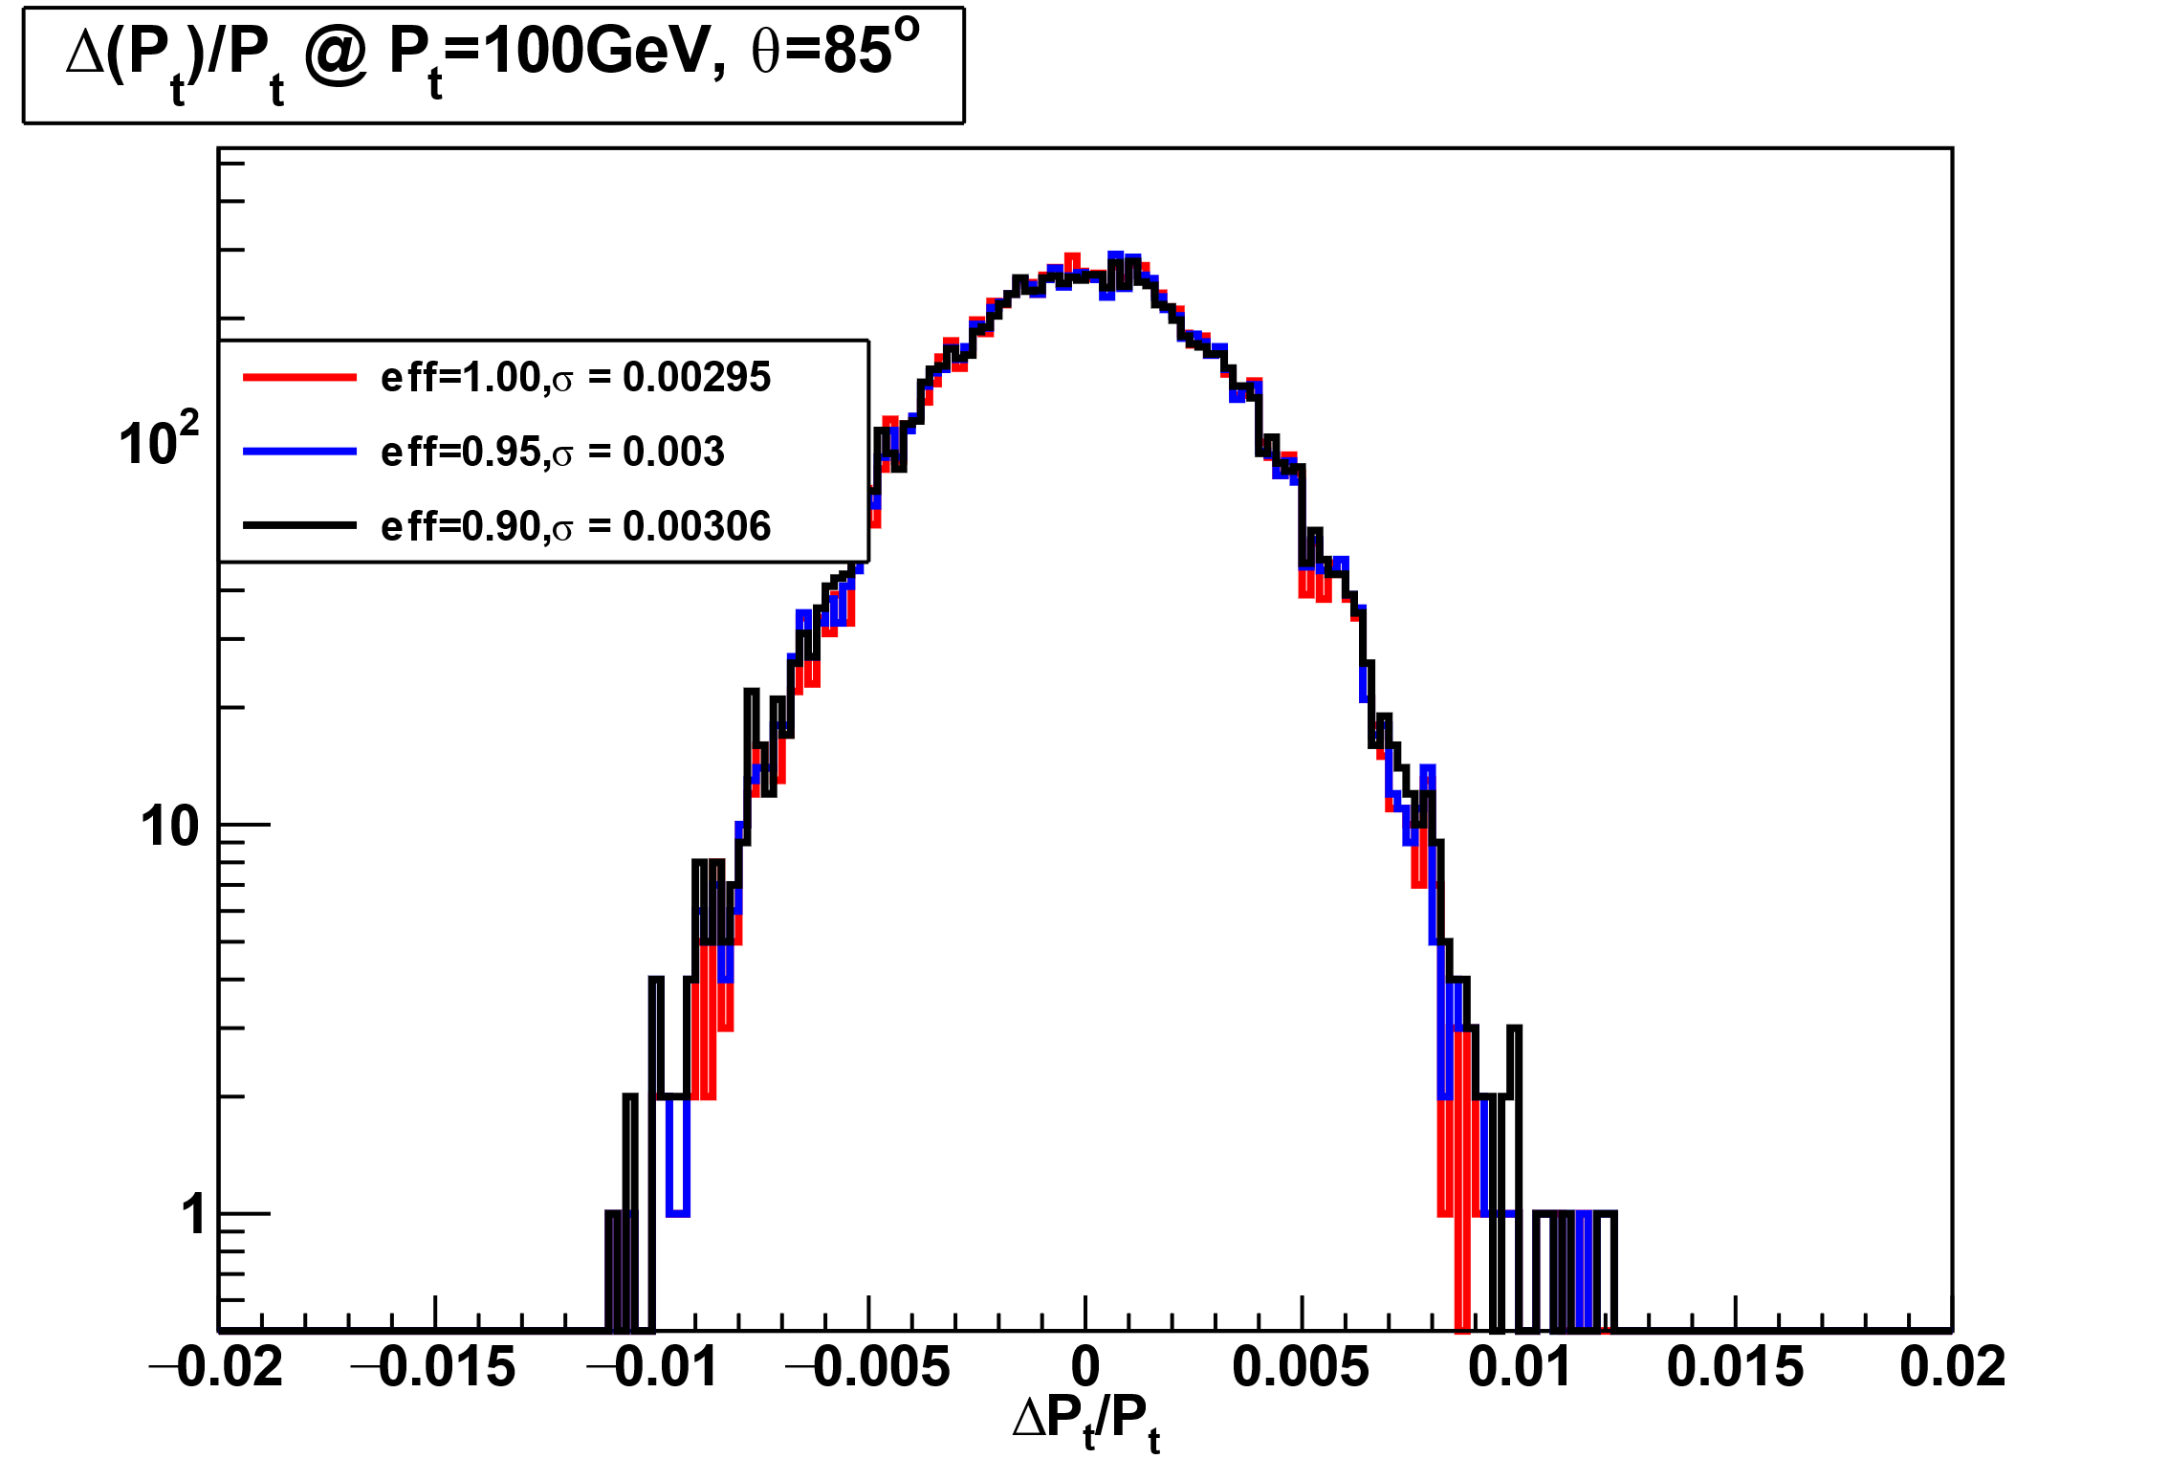
residual distribution of σPt for barrel
add ITKB at R = 450mm

Slide 16
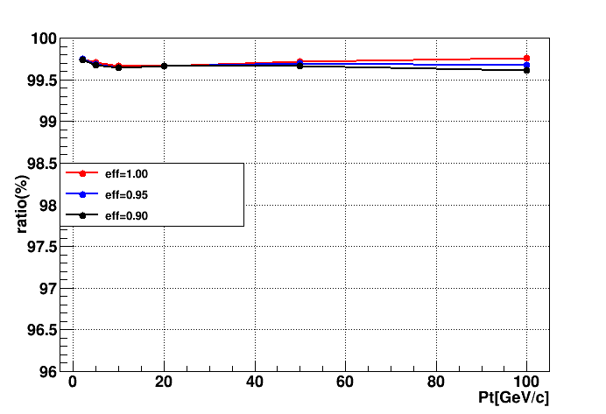
events ratio within 3σ for ITKB
add ITKB at R = 450mm
３层ITKB的结果
Pt eff | 2 | 5 | 10 | 20 | 50 | 100
100% | 99.75% | 99.71% | 99.66% | 99.67% | 99.72% | 99.76%
95% | 99.75% | 99.69% | 99.64% | 99.67% | 99.70% | 99.68%
90% | 99.74% | 99.68% | 99.64% | 99.66% | 99.67% | 99.61%
添加一层ITKB对3σ内事例比率影响较小

Slide 17
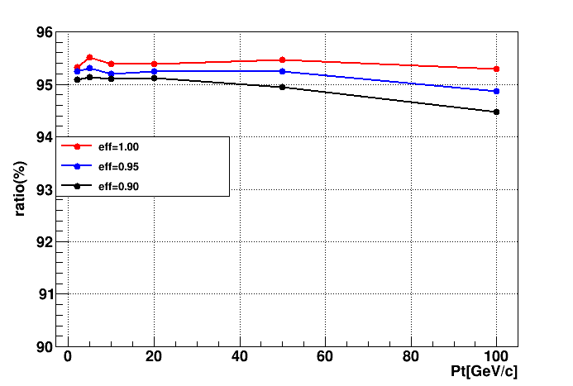
events ratio within 2σ for ITKB
add ITKB at R = 450mm
Pt eff | 2 | 5 | 10 | 20 | 50 | 100
100% | 95.32 | 95.52 | 95.38 | 95.38 | 95.47 | 95.29
95% | 95.24 | 95.31 | 95.20 | 95.24 | 95.24 | 94.86
90% | 95.08 | 95.13 | 95.10 | 95.12 | 94.95 | 94.48
选用２σ作为cut条件，整体比率均下降，但差别也是不明显。

Slide 18
summary
对于桶部，在２，３层之间添加一层，对３σ内事例数比例的影响较小。去掉TPC的贡献，影响主要在分辨上，对比例影响也不大。
将cut条件设为２σ，不同的ｈｉｔ效率下比例差别也不明显。
相关的full simulation正在进行。

