Slide 1
Revealing the Origin of Neutrino Masses through
Displaced Shower Searches in the CMS Muon System
Wei Liu（刘威）
Nanjing University of Science and Technology
2407.20676
In collaboration with
Frank Deppisch, Suchita Kulkarni

Slide 2
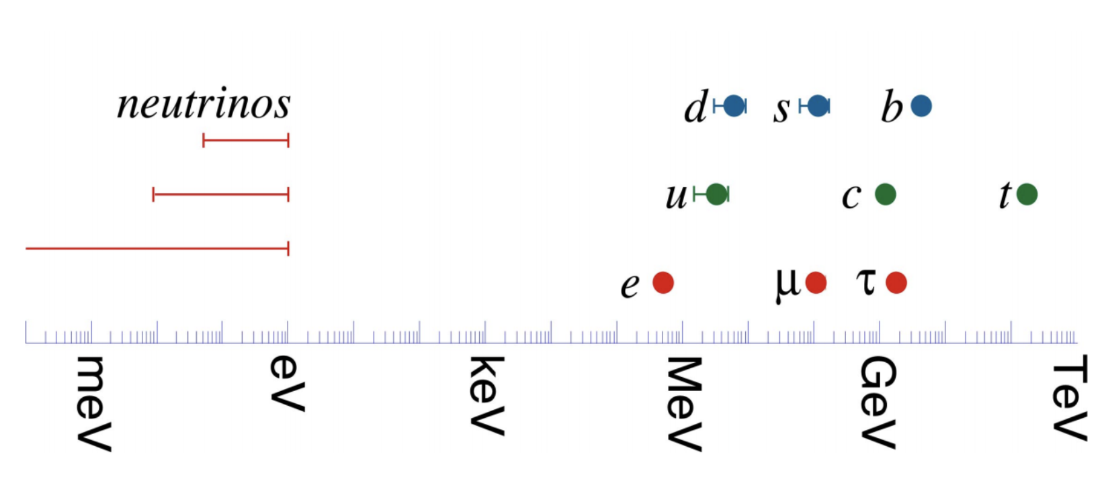
Neutrino Mass
The masses of the neutrinos are much smaller than the other fermions!
Neutrinos are the only neutral fermions.
The nature of the neutrino masses can be different!
Figure from Hitoshi Murayama

Slide 3
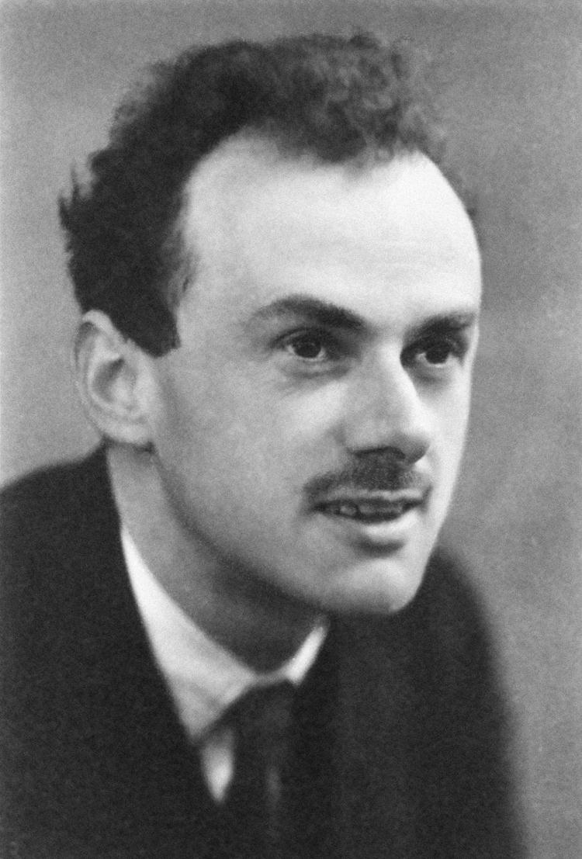
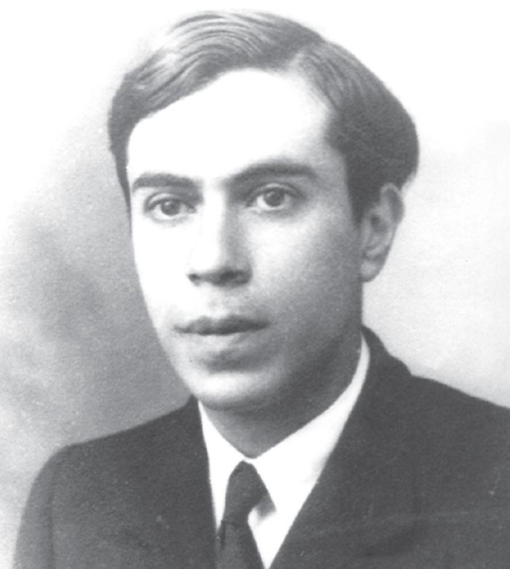
$L_{Dirac}=−y\overline{l_{L}}\tilde{H}ν_{R}$ ${ L}_{Majorana}=−M\overline{{ν_{R}}^{c}}ν_{R}$
Tiny Yukawa coupling ${\sim 10}^{−12}$ for pure Dirac mass!
Can the neutrino masses induced by both?
Type-I Seesaw Mechanisms
Artwork by Sandbox Studio, Chicago with Ana Kova
$L_{Dirac}=−y\overline{l_{L}}\tilde{H}ν_{R}$ ${ L}_{Majorana}=−M\overline{{ν_{R}}^{c}}ν_{R}$
Tiny Yukawa coupling ${\sim 10}^{−12}$ for pure Dirac mass!
Can the neutrino masses induced by both?
$$\left(\begin{matrix}0 & M_{D} \\ M_{D} & M_{R}\end{matrix}\right)$$
$$m_{1}≈−\frac{{M_{D}}^{2}}{M_{R}}\sim eV$$
$$m_{2}≈M_{R}≫GeV$$
Seesaw Mechanism by hand? $υMSM$

Slide 4
Heavy Neutrino Searches
GUT points out $M_{N}≈\frac{M_{D}^{2}}{m_{ν}}\sim {10}^{14}$GeV
$$y_{D}\sim 1$$
Leptogenesis favors $M_{N}\sim {10}^{9}$ GeV
Can we still probe heavy neutrinos at colliders?
Such heavy degree of freedom leads to non-stable Higgs masses, $M_{N}<{10}^{7}$ GeV.
Larger CP violation can be produced if heavy neutrinos are degenerate, or the PMNS has CP violations, i.e. resonant leptogenesis or leptogenesis via oscillations. $M_{N}\sim$ ${10}^{3}(1)$GeV.
The Yukawa couplings can be electron like,
$y_{D}\sim {10}^{−6}$, $M_{N}\sim$ 100 GeV
Inverse seesaw can yield natural Yukawa couplings.
Colliders probes of heavy neutrinos are resonable!

Slide 5
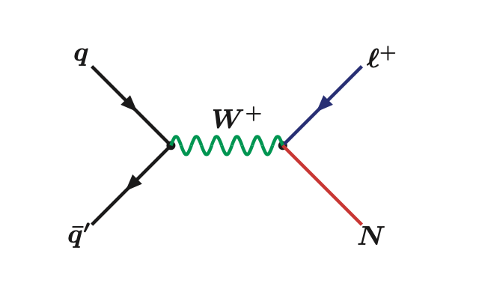
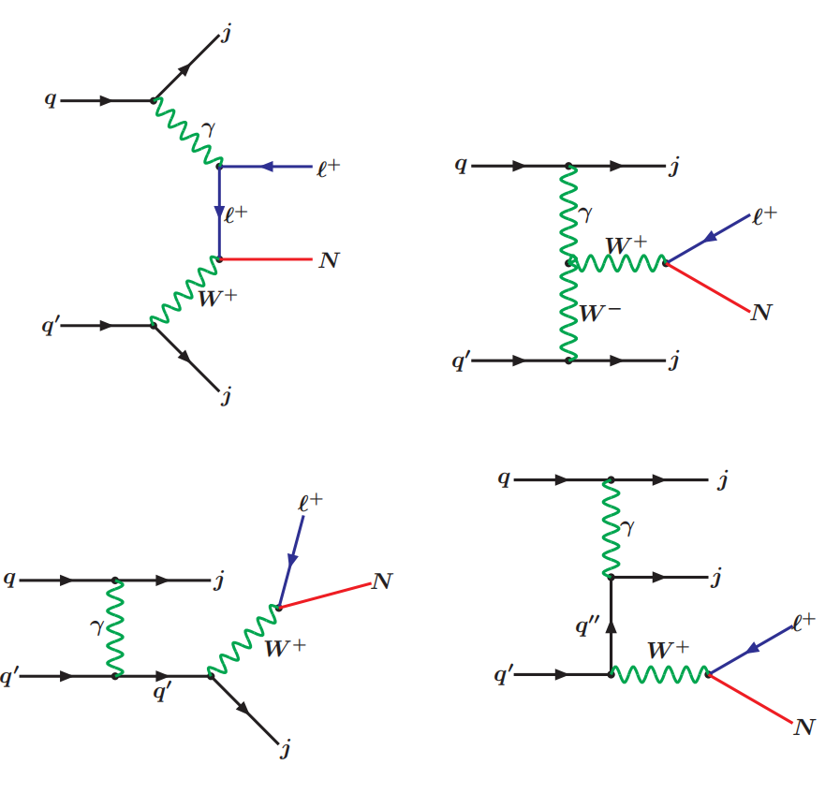
Heavy Neutrino Searches
Our goal is to search the heavy neutrinos colliders!
Within the $υMSM$ model, the heavy neutrinos can be produced either via the $s$ and $t$ channel.
The $s$ channel production from the Drell-Yan processes are the dominant processes for $m_{N}≤$ 1 TeV, otherwise by the $t$ channel.
Both cannot reach low $V_{lN}$!
$$∝ V_{lN}^{−2}$$
${10}^{7}pb × V_{lN}^{2}<$fb
The main production processes of the heavy neutrinos at the LHC. Figures from P.S.Bhupal Dev, Apostolos Pilaftsis, Un-ki Yang, Phys.Rev.Lett. 112 (2014) 8, 081801.

Slide 6
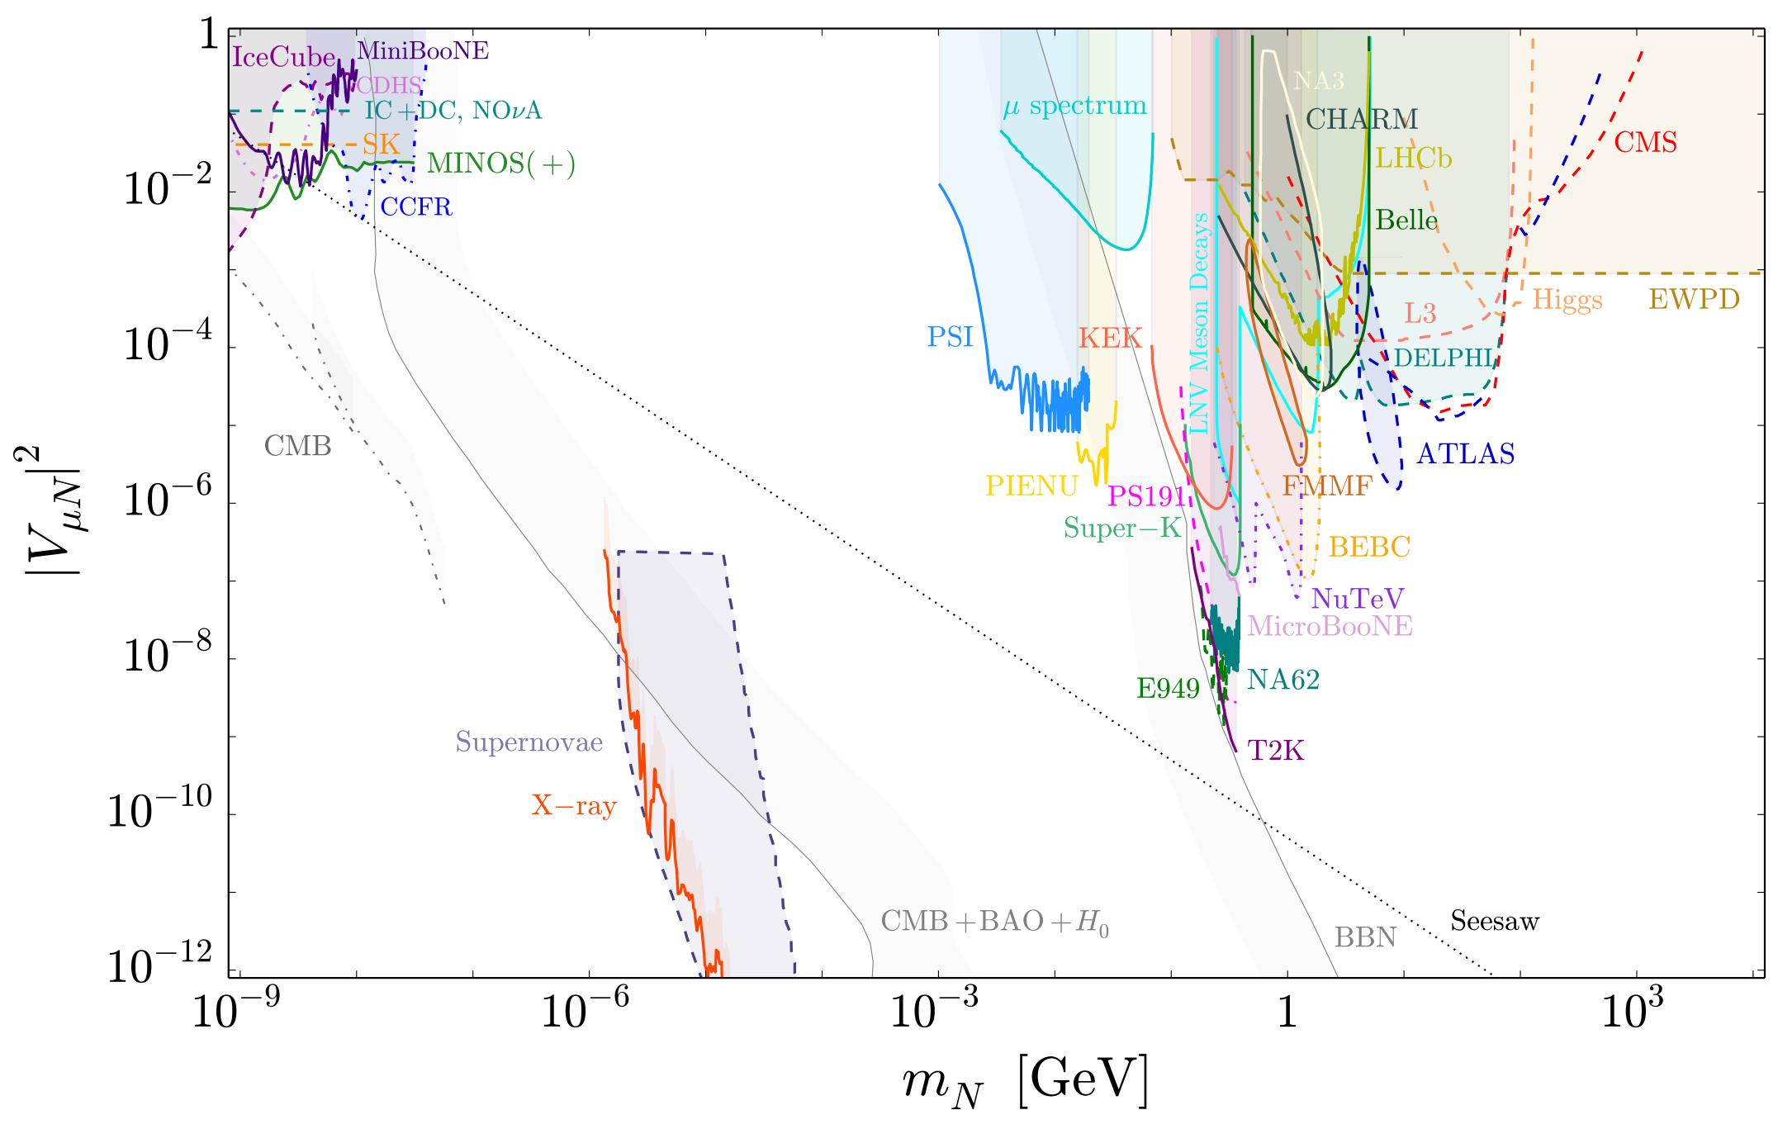
Heavy Neutrino Searches
Our goal is to search the heavy neutrinos and test the type-I seesaw, the origin of the neutrino masses!
However, direct probes of the heavy neutrinos within the $υMSM$ model cannot reach the type-I seesaw due to the low mixing at the EW scale
$$\left[\begin{aligned}ν_{L} \\ ν_{R}\end{aligned}\right]=\left[\begin{matrix}V_{LL} & V_{RL} \\ V_{LR} & V_{RR}\end{matrix}\right]\left[\begin{aligned}ν \\ N\end{aligned}\right]$$
$$V_{lN}^{2}≈\frac{m_{ν}}{mN}<\frac{eV}{GeV}<{10}^{−10}$$
Limits on the seesaw parameters $(m_{N},V_{lN})$ from the collider searches for heavy neutrinos and other probes. Figure from Patrick D. Bolton, Frank F. Deppisch, P.S. Bhupal Dev, JHEP 03 (2020), 170.
We need to look for other production channels!

Slide 7
Natural Type-I Seesaw
The Majorana mass terms can be generated more naturally by the spontaneous breaking of a $U(1)$ gauge.
$ℒ⊃$ $−y_{D}\overline{l_{L}}\tilde{H}ν_{R}$ $−y_{M}\overline{{ν_{R}}^{c}}{χν}_{R}$.
Therefore, $m_{N}≈$ $y_{M}v_{χ}\sim$TeV.
One of the simplest model UV complete and anomaly free model is the ${U(1)}_{B−L}$ model, other $U(1)$ models such as ${U(1)}_{L_{μ}−L_{τ}}$ is also possible.
Baryon and Lepton numbers Accidental symmetries in the SM, can be broken by anomalies
B-L number Anomaly free

Slide 8
${U(1)}_{B−L}$ model
$${SU(3)}_{C} ×SU{\left(2\right)}_{L}×U{\left(1\right)}_{Y}×U{\left(1\right)}_{B−L}$$ R. N. Mohapatra and R. E. Marshak
Phys. Rev. Lett. 44 (1980) 1316
Additional scalar singlet $χ$ with the scalar potential $$V\left(H,χ\right)=m^{2}H^{+}H + μ^{2}{\left|χ\right|}^{2}+λ_{1}{\left(H^{+}H\right)}^{2}+ λ_{2}{\left|χ\right|}^{4}$$
Additional $B−L$ gauge boson $Z^{′}$ with interactions
$$ℒ⊃\sum{{ig}_{B−L}Y_{B−L}Z^{′}f\overline{f}}$$
The $B−L$ gauge interactions can have suppressed kinetic mixings to the hypercharge in the loop level.

Slide 9
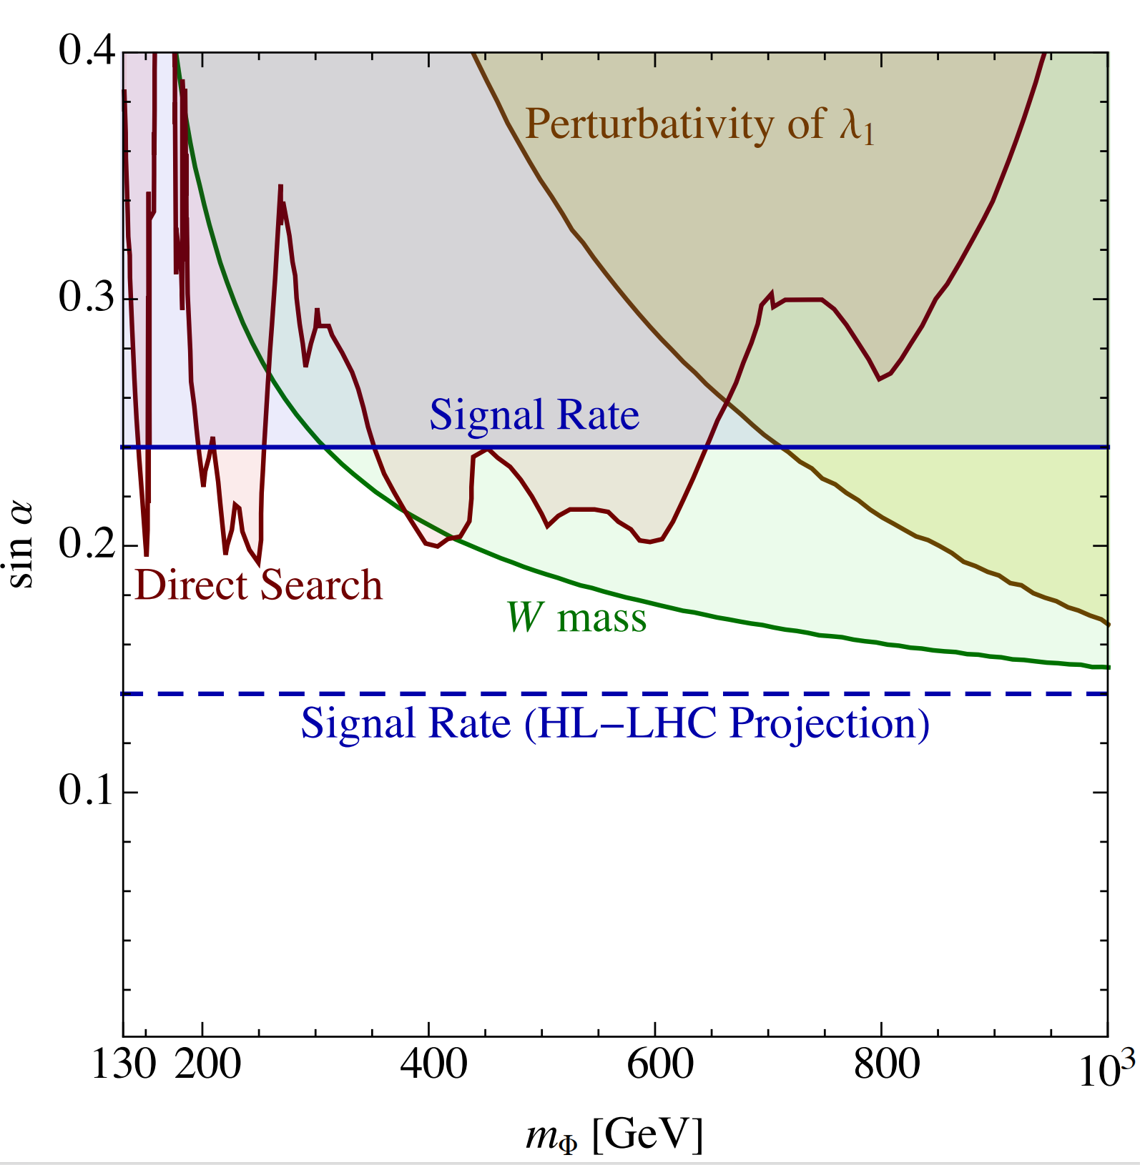
Experimental limits on Higgs mixing
Higgs mixing $$\left[\begin{aligned}h_{1} \\ h_{2}\end{aligned}\right]=\left[\begin{matrix}cos α & −sin α \\ sin α & cos α\end{matrix}\right]\left[\begin{aligned}H \\ χ\end{aligned}\right]$$
$$λ_{h_{x}XX}=sinθ{(cosθ)λ}_{HXX}$$
$$σ_{h_{x}=}\sin^{2}θ(\cos^{2}θ)σ_{h_{SM}}$$
The most stringent limits on heavy scalar is the W boson mass measurement.
Still have room for production of the additional scalars at colliders!

Slide 10
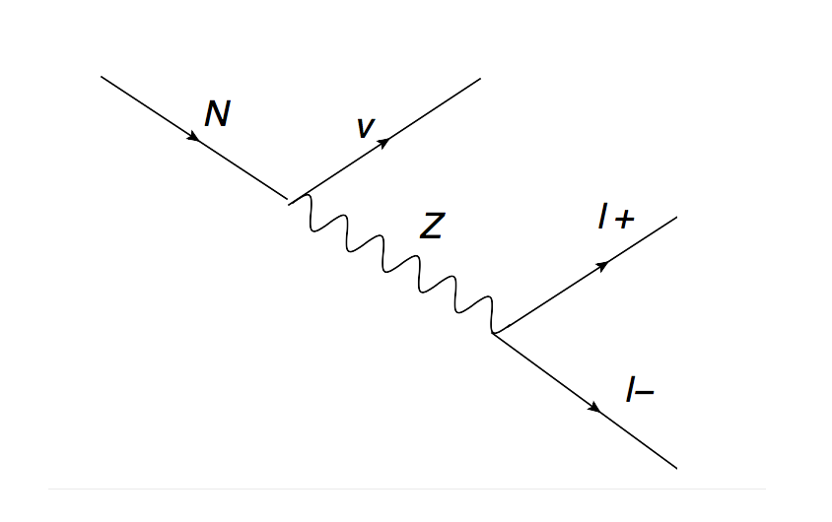
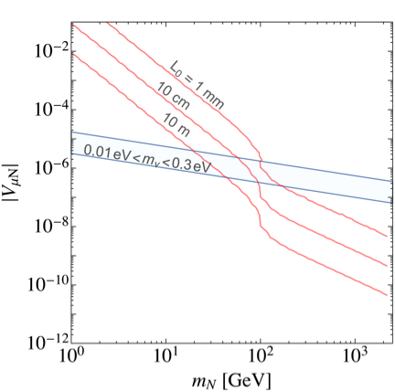
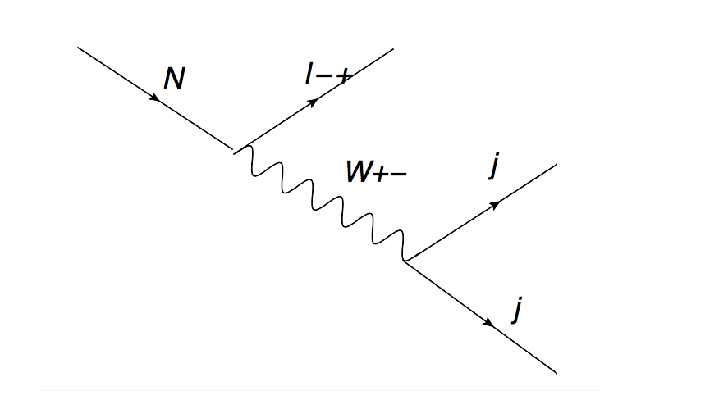
Heavy Neutrino, a Natural LLP
$L≈3 cm×{\left(\frac{{10}^{−6}}{V_{μN}}\right)}^{2}×{\left(\frac{100 GeV}{M_{N}}\right)}^{5}$.
$V_{lN}^{2}≈\frac{m_{ν}}{mN}<\frac{eV}{GeV}<{10}^{−10}$.
At the EW scale, the heavy neutrinos are natural LLPs predicted by the type-I seesaw.

Slide 11
LLP detectors at the LHC
LLP detectors include CODEX-b, FASER, FACET, SHiP, MoEDAL-MAPP and MATHUSLA, etc.
FASER, MoEDAL-MAPP collecting data since Run3,
SHiP approved, run from 2031

Slide 12
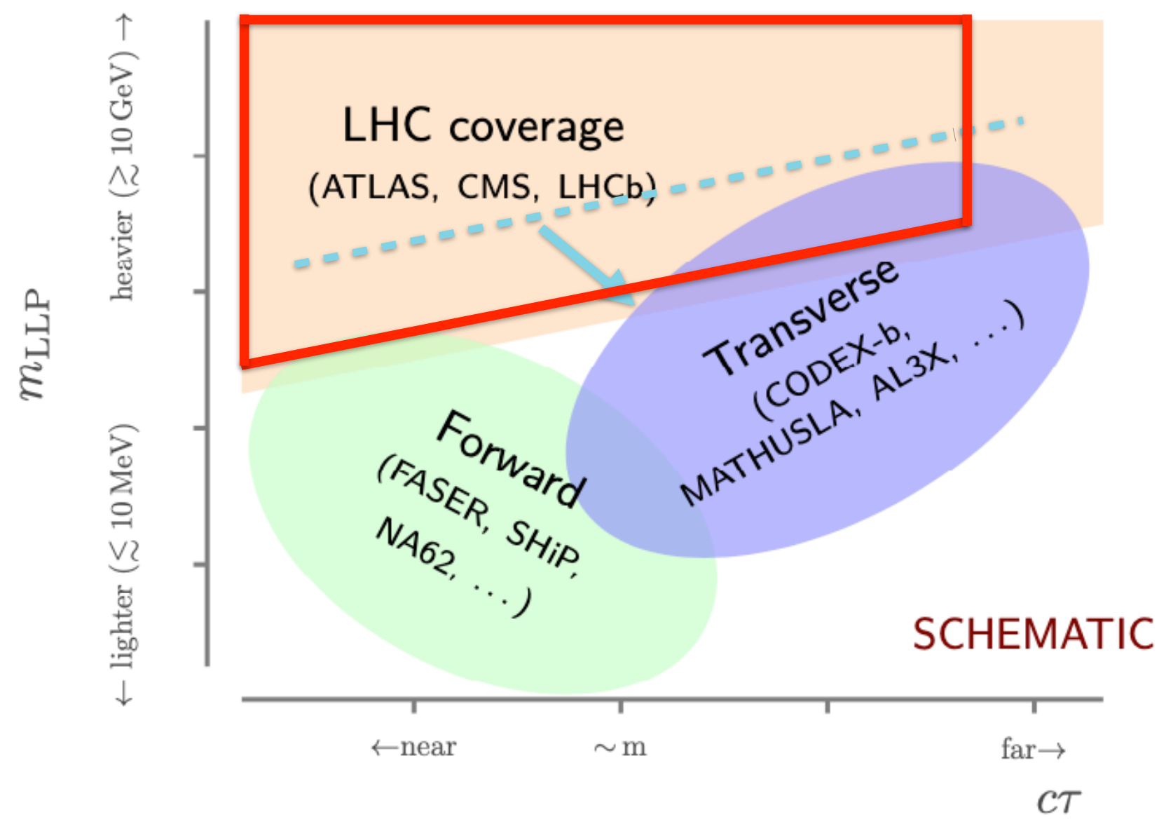
LLP Search at the LHC
CMS/ATLAS, LHCb can probe heavy LLPs, with high coverage, high background
Forward LLP detectors for light LLPs, high events from meson decay
Transverse LLP detectors can suffer in low coverage, low background

Slide 13
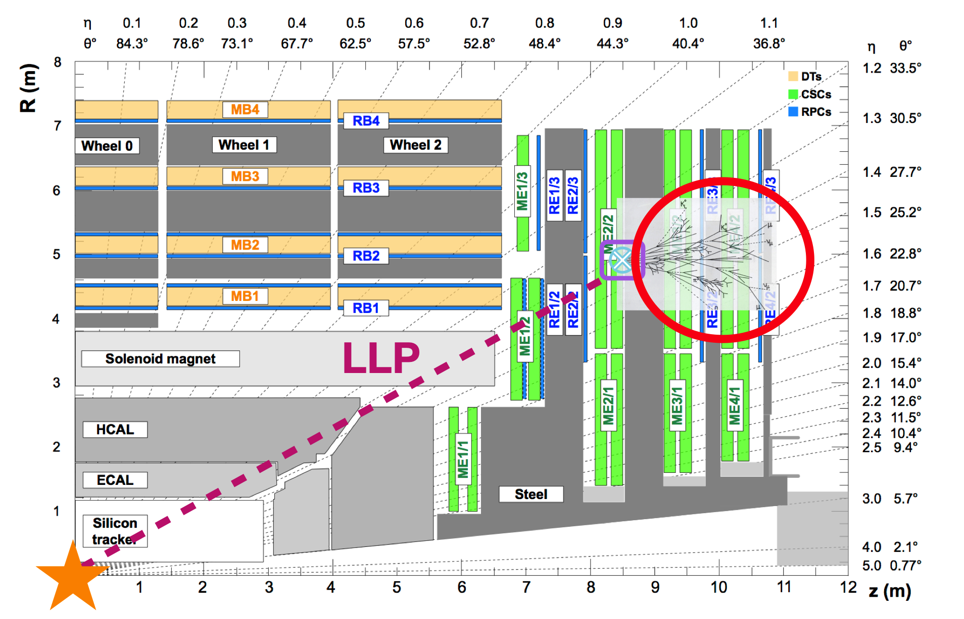
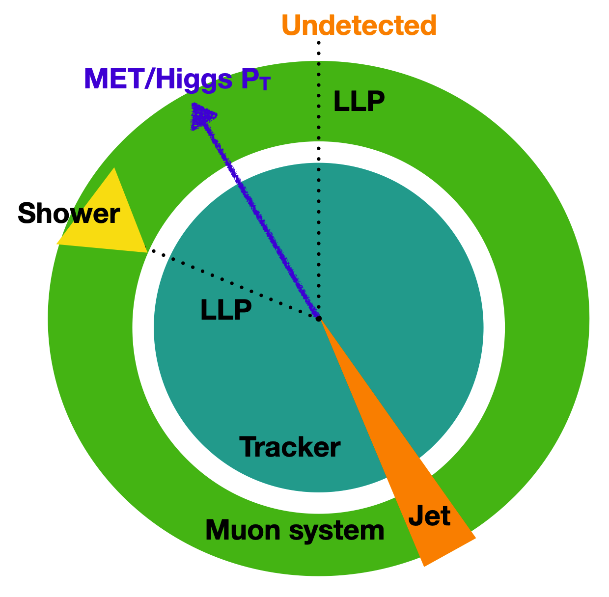
CMS Muon System for LLP
We focus on heavy N as LLP
LLP can also be searched with CMS muon system since Run2.
No Dedicated trigger, require high MET to trigger, MET > 200 GeV
New trigger since Run3, higher efficiency.

Slide 14
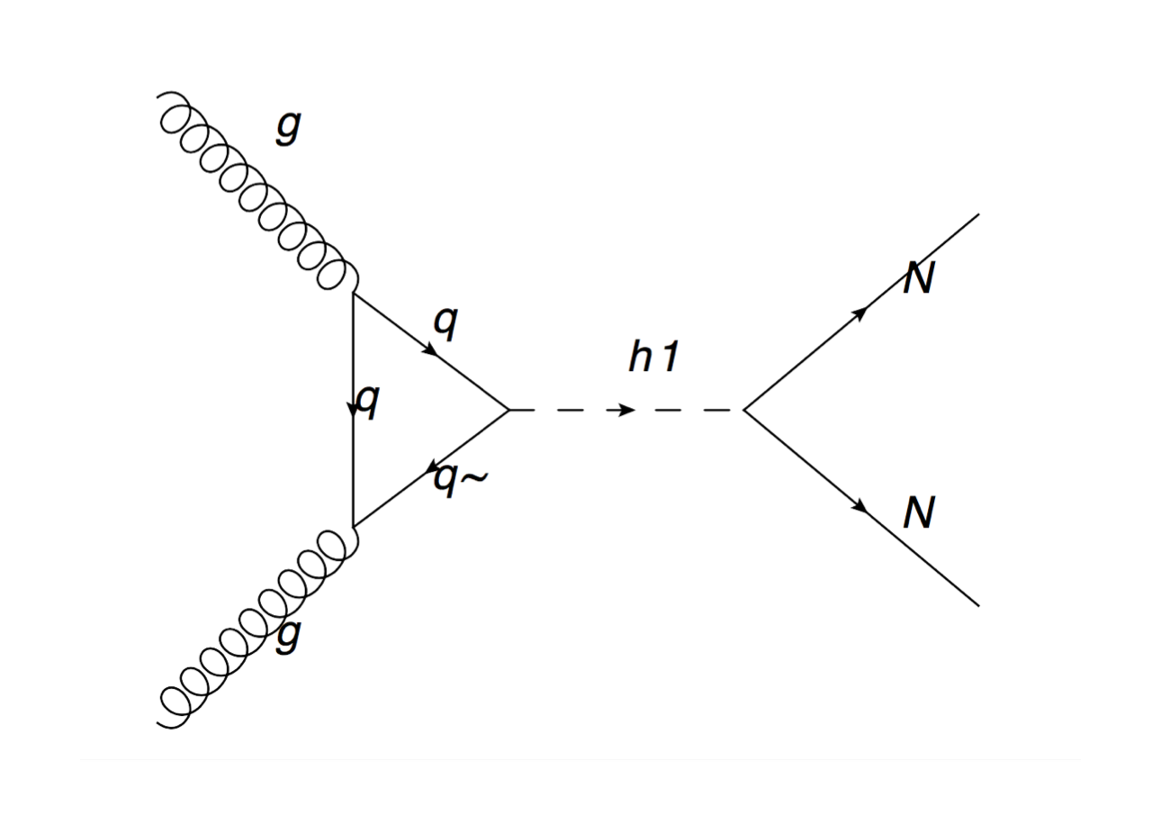
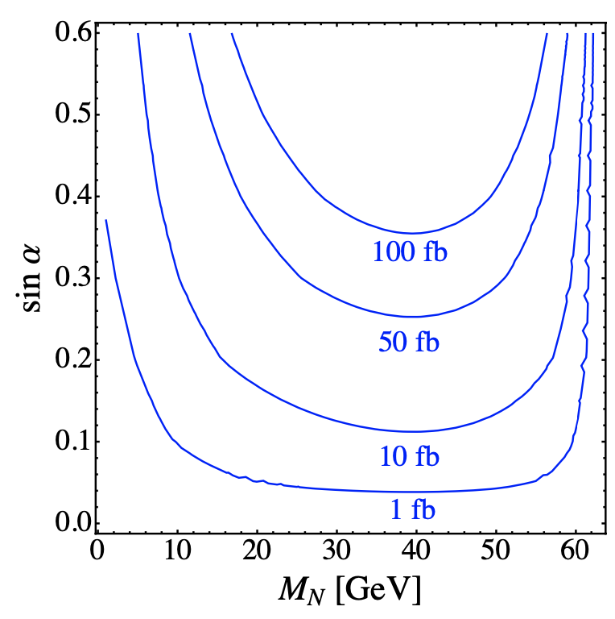
Higgs to pairs of 𝑵 at the LHC
Higgs mixing to $χ$ = $sinα$
This channel can still have 10s fb of cross section.
Higgs mixing to $H$ = $cosα$
Heavy neutrinos can be pair-produced as exotic Higgs decays if the mixing is appreciable.

Slide 15
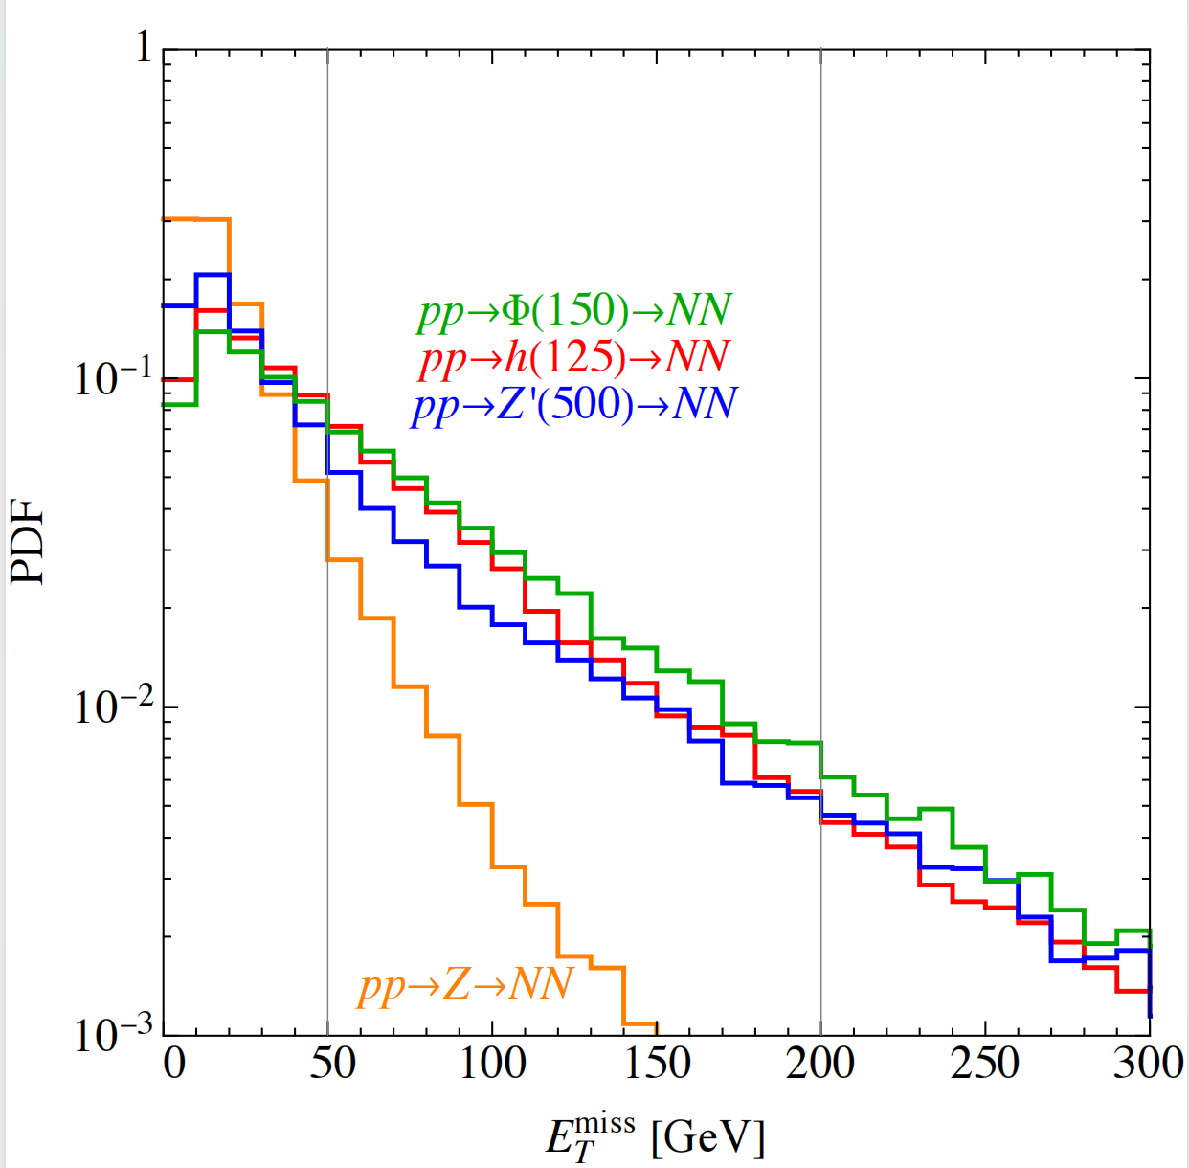
Higgs to pairs of 𝑵 at the LHC
LLPs to displaced shower
ISR jets to trigger MET
ISR jets from gluon fusion to trigger MET
Low efficiency from W/Z decays.
RHNs as LLPs to displaced shower signals at CMS muon system.

Slide 16
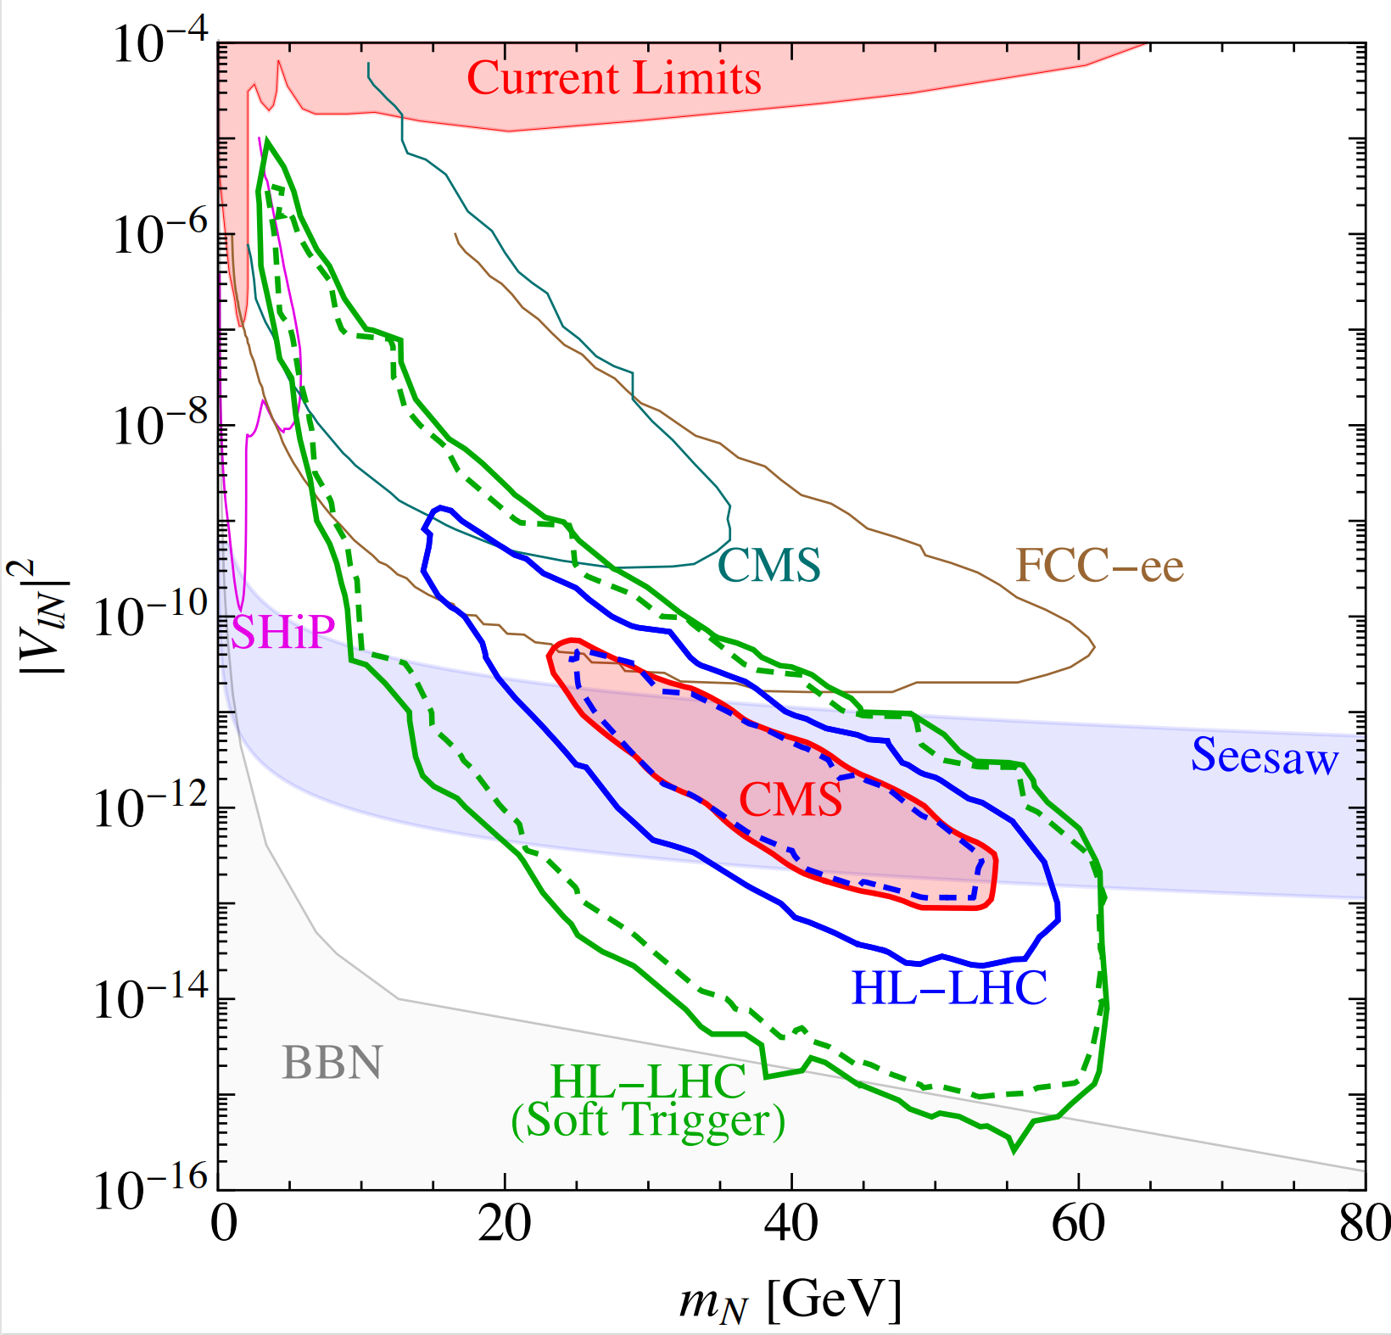
Sensitivity
Current
CMS Search
HNN
Interation
Origin
Neutrino Mass
Higgs mixing at current limits, only require sin $α$ > 0.02 (HL-LHC)
Existing CMS Search can test Seesaw!
Dedicated trigger since Run3, better sensitivity expected
$Br(H→NN)≈{10}^{−5}$ is required to test seesaw.

Slide 17
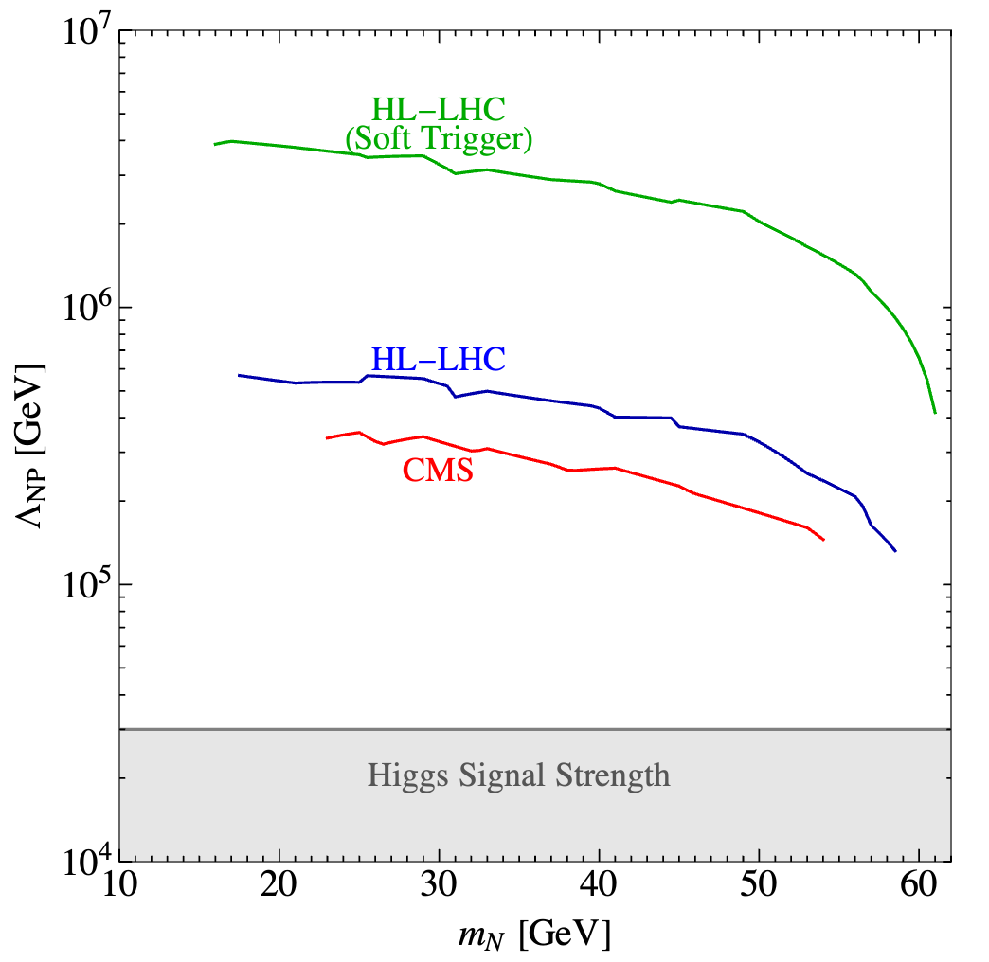
EFT
More General Description in $N_{R}$SMEFT(0806.0876).
Only three in Dim-5
Weinberg Operator for Neutrino Mass, Dipole for W/Z decay to N
Anisimov-Graesser Operator for HNN
Current limits from Higgs signal strength (2210.16279, 2304.06772)
$$Λ≥30 TeV$$
Large parameter space in EFTs to probe seesaw
Limits from this work surpass current limits by more than 10 times

Slide 18
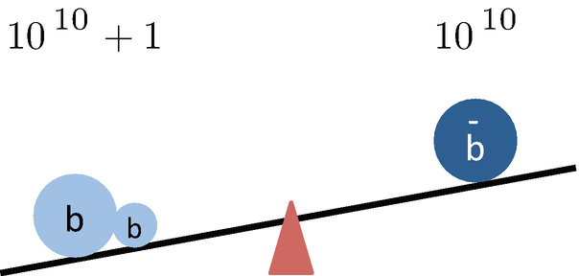
Leptogenesis to explain the BAU
$$\frac{n_{∆B}}{s}≈(8.59±0.11)×{10}^{−11}$$
from Planck satellite and the CMB.
Sakhorov’s criteria
1. Baryon number violating process,
2. C and CP violations,
$Γ(X→Y+b)≠Γ(\overline{X}→\overline{Y}+\overline{b})$, L and R.
3. Out of equilibrium.
$Γ(X→Y+b)≠Γ(Y+b→X).$
Figure from Kaori Fuyuto
Way too small to explain the observed BAU within the SM. We need new physics!

Slide 19
Leptogenesis to explain the BAU
BAU from neutrino!
1. Lepton number is violated within the neutrino masses terms.
2. Additional CP violations can exists in the neutrino mass matrix.
3. Right-handed neutrinos decay out of equilibrium potentially.
And EW sphaleron to transfer $n_{∆L}$into $n_{∆B}$ during EW phase transition,
$$Y_{B}=\frac{28}{79}Y_{B−L}$$
$$Y_{B}≃{10}^{−2}×ε×η$$
CP Asymmetry
Thermal efficiency
Consider $B−L$ gauge boson

Slide 20
Resonant Leptogenesis
$ε_{αα}$ is the CP asymmetry in $N_{1}$ decay,
comes from the interference between the tree-level and one loop amplitude.
Hierarchical RH neutrinos,
$ε≲{10}^{−15}M_{N_{1}}$, $Y_{∆B}≃{10}^{−2}×ε×η≃{10}^{−10}.$
As $η\sim 0.1,ε≃{10}^{−7},$ so $M_{N_{1}}≥{10}^{9}$GeV.
Davidson-Ibarra Bound, no possible collider signatures.
Resonant leptogenesis (what we focus on)
if at least two of the RH neutrinos masses are degenerate, as $∆M≲Γ$.
$ε≲ \frac{1}{2}$, only needs $M_{N_{1}}≥T_{sph}≈130$GeV.
.

Slide 21
CP Asymmetry
$ε_{αα}$ is the CP asymmetry in $N_{1}$ decay, without quantum effect
Yukawa can be expressed by Casas-Ibarra paramterasation.
.

Slide 22
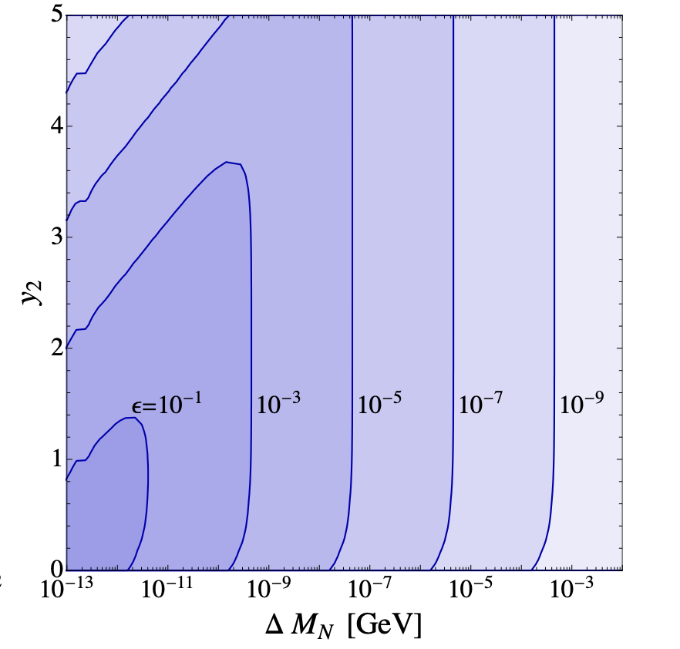
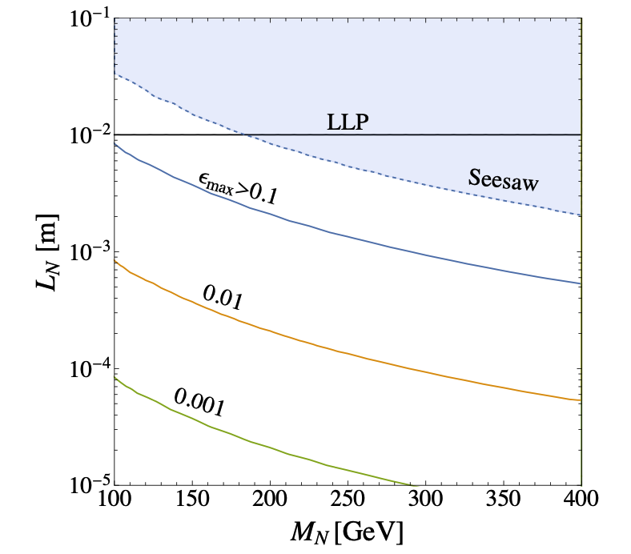
CP Asymmetry
Connection to seesaw
$V^{2}$ is tiny from seesaw$→$LLPs
Tiny $V^{2}→$tiny $y_{2}$
Large $ε_{αα}$ require tiny $y_{2}$
Both Leptogenesis and Seesaw prefer N as LLPs

Slide 23
Free Parameters
Consider neutrino oscillation data, -5 parameters
Take the massless lightest neutrino, decouple the heaviest N, -6 parameters
$ω_{1,3}$ =$π/2$, $ω_{2}$=$x_{2}+iy_{2}$
One free parameter rotate away, -1
Consider couplings with $B−L$ gauge boson $Z^{’}$
add two free parameters
$m_{Z^{’}}$,$g_{B−L}$
Free parameters,
$3x3x2−5−6−1+2$=8

Slide 24
Free Parameters
Benchmark for free parameters

Slide 25
Thermal Efficiency
Corrections on the Boltzmann equations,
Large washout from $Z^{’}$ scattering
Thermal efficiency can be analytically expressed

Slide 26
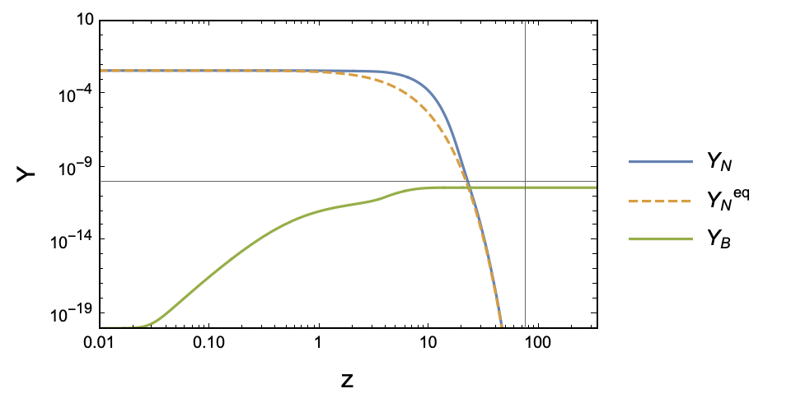
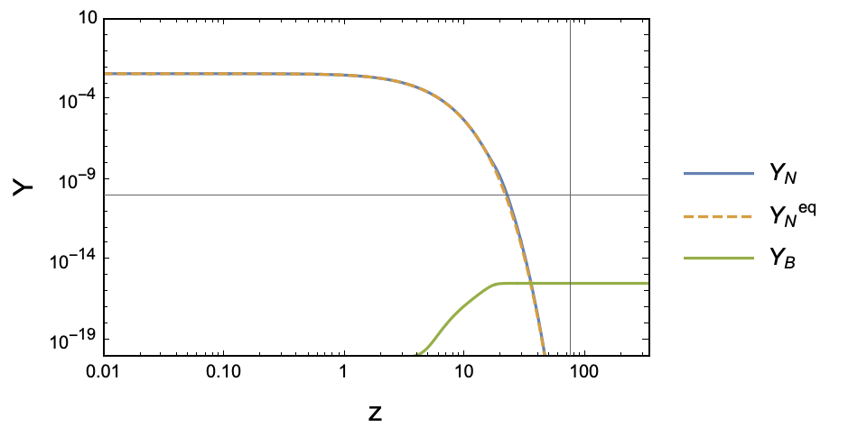
Wash-out from Pair-production
The scattering mediated via $Z^{′}$
makes the N closer to the equilibrium.
The BAU is diluted due to the scatterings.

Slide 27
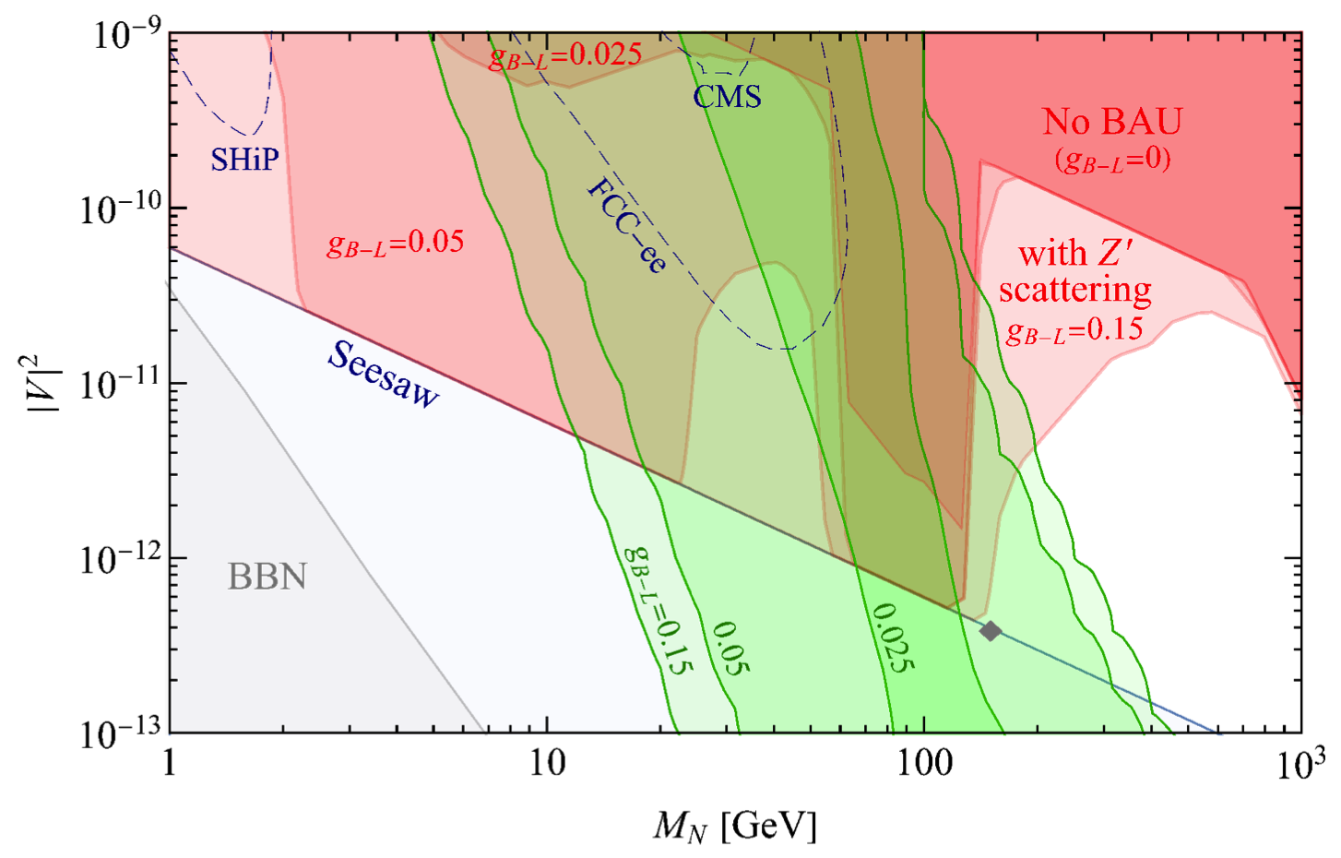
Test Leptogenesis by LLP searches
Large LLP events
Large $Z^{’}→NN$
LLP test Seesaw and Leptogenesis
Smaller $Y_{B}$

Slide 28
Conclusion
There are still a lot unknown in the neutrino physics. The origin of the neutrino masses are one of the most interesting.
Right-handed neutrinos can explain the neutrino masses via the type-I seesaw, and the BAU via the leptogenesis.
By adding a B-L gauge, the pair-production of right-handed neutrinos can be probed at colliders
We show current CMS displaced shower search can test seesaw whenever there is tiny HNN interaction
We show future LLP searches might test both leptogenesis and seesaw with B-L gauge interactions.

